Slide 1


IPPOG and spin-offs
from
nuclear physics
https://indico.cern.ch/e/PTMC
Yiota Foka (GSI/CERN)
28th IPPOG meeting
25-27 November 2024, CERN
https://ippog.org/for-ippogers/outreach-application-society

Slide 2
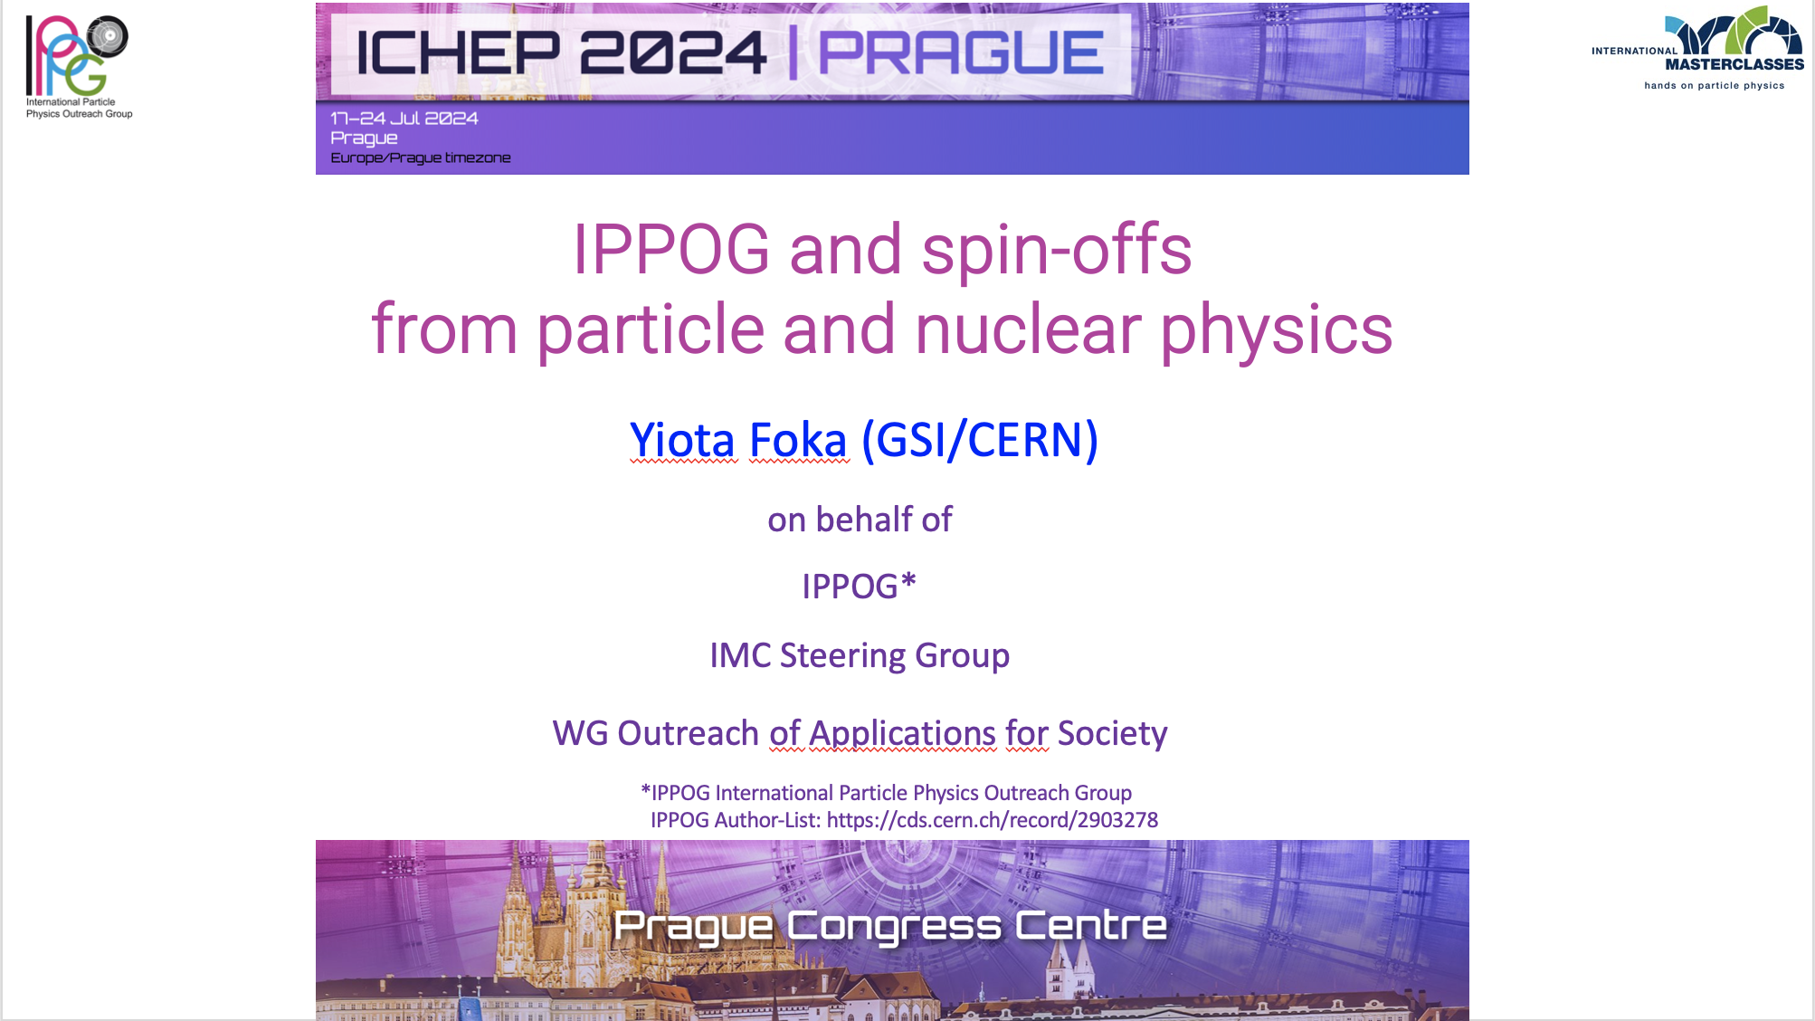
Motivation
Adding “nuclear” in the title
of ICHEP presentation

Slide 3
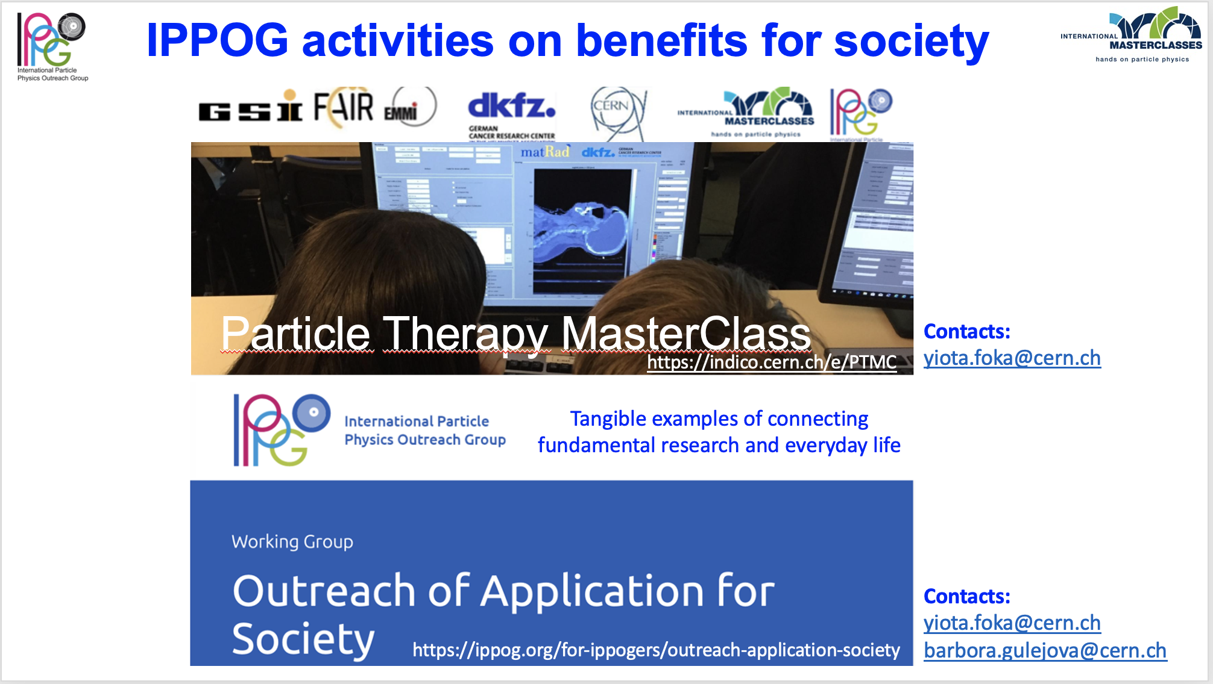
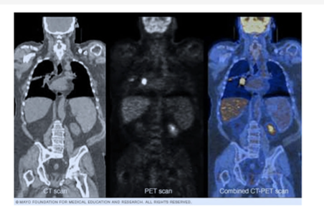
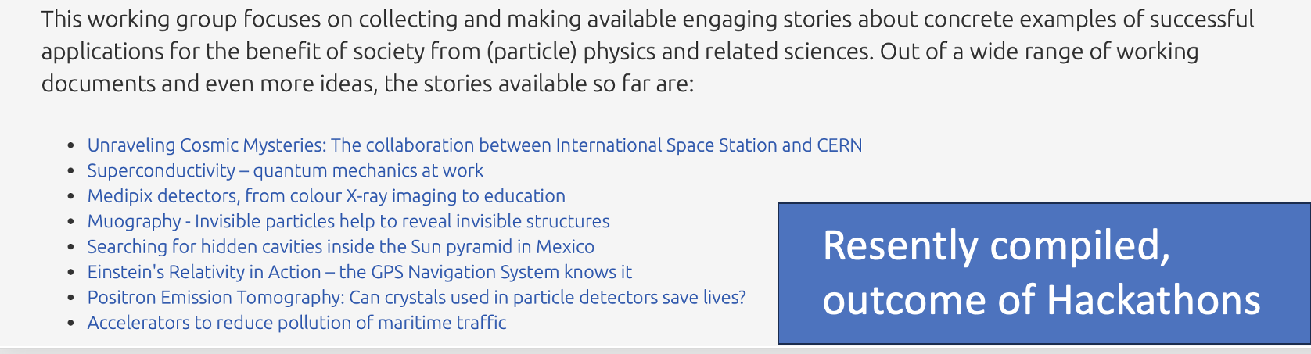
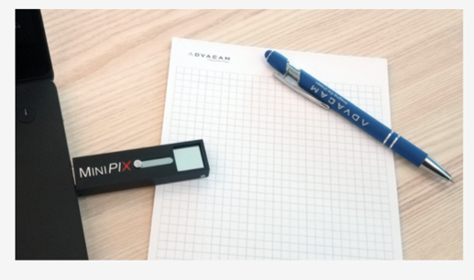
Focus on
medical applications
PTMC
25% of stories
Particle interactions with matter
in the real-world QCD matter at low energies
PET
MEDIPIX

Slide 4
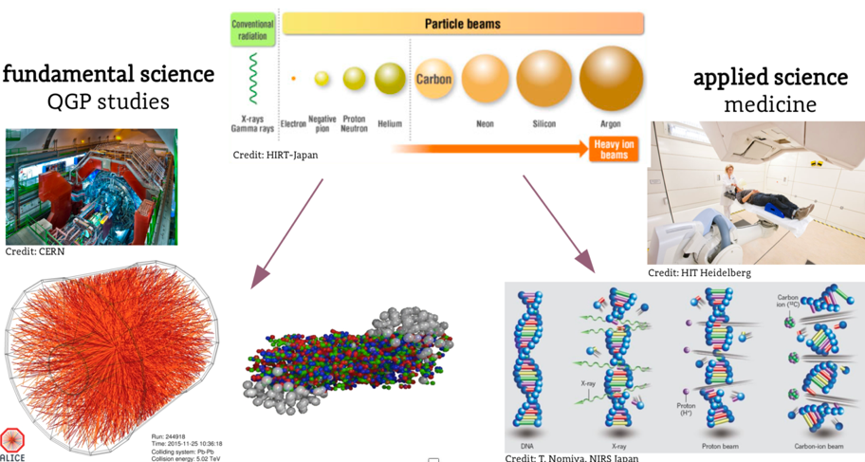

Heavy-ion research and heavy-ion therapy
Pb-Pb at 5.5 TeV
pp at 14 TeV
88-430 MeV/u carbon
50-221 MeV/u protons
An example of applications of fundamental research for the benefit of society

Slide 5
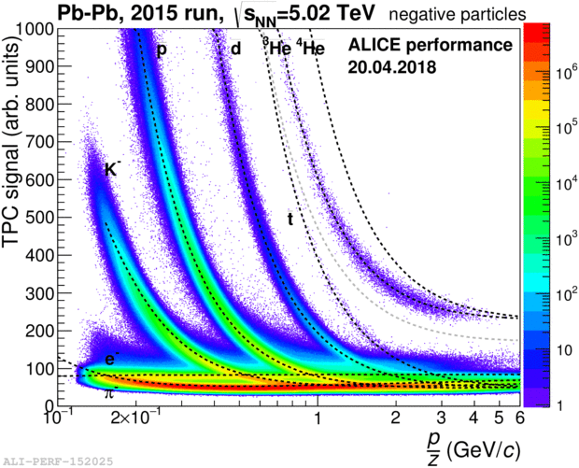
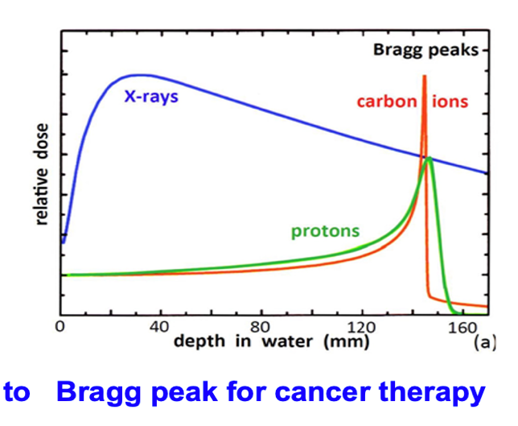
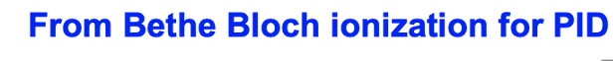
Heavy-ion research and heavy-ion therapy
Pb-Pb at 5.5 TeV
pp at 14 TeV
88-430 MeV/u carbon
50-221 MeV/u protons
fundamental properties
of particles
and their interaction with matter
in the service of society

Slide 6
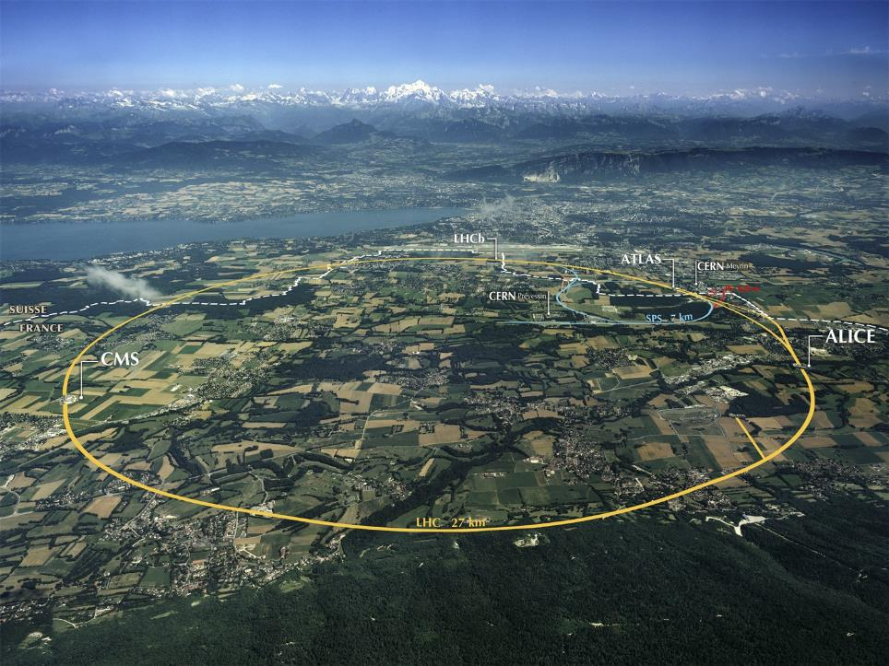
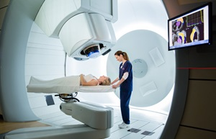
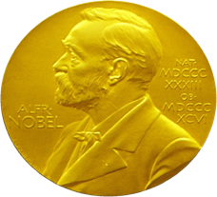
From Fundamental Physics Research….
What are
the benefits
for society?
…..to Medical Applications
Mission and mandate of research institutes: fundamental research
Developed technologies and acquired knowledge find applications for society
The developed accelerator technology is used for cancer research and therapy
Innovative technologies developed for future CERN projects find already applications in medicine
Accelerators for Health

Slide 7
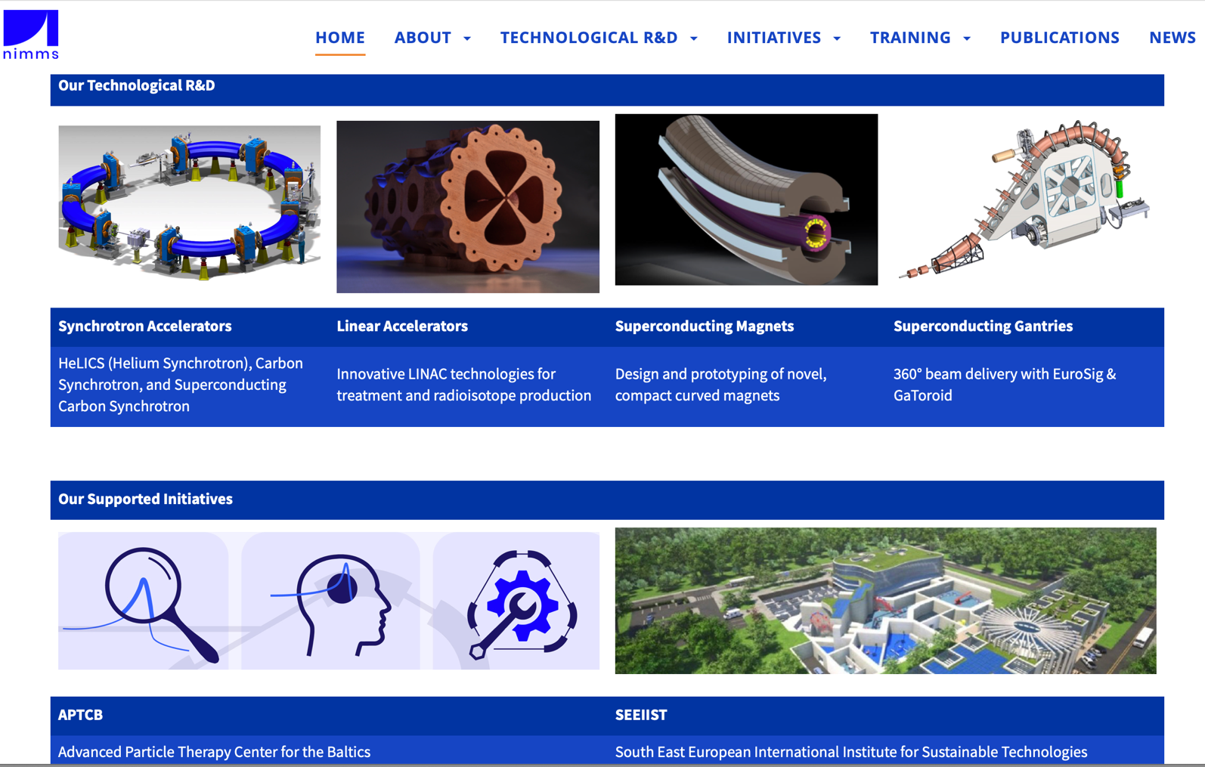
Next Ion Medical Machine Study Group Developments

Slide 8
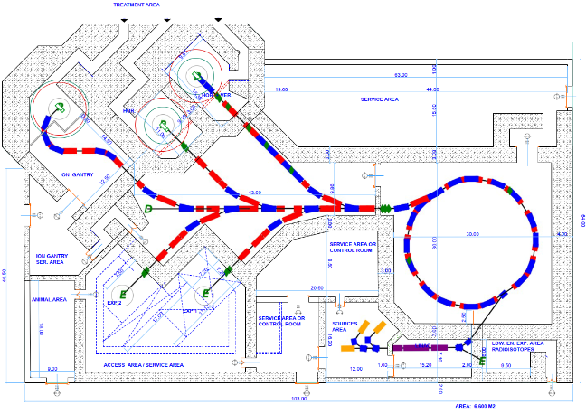
NIMMS supported designs:
1. SEEIIST C-ion therapy and research facility
Design to be presented in a CERN Yellow Report in preparation
Access for therapy
Total 5,400 m² (including shielding)
The synchrotron can be replaced by an SC version if R&D successful
Equipment room and access to synchrotron
Area for future expansion
Target for isotope production
Access for animal testing
Architectural design, Kaprinis Architects
Reconfigurable experimental room
Access to experimental room and linac
complete modern facility for research and therapy with ions up to Oxygen

Slide 9
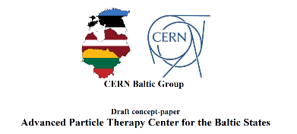
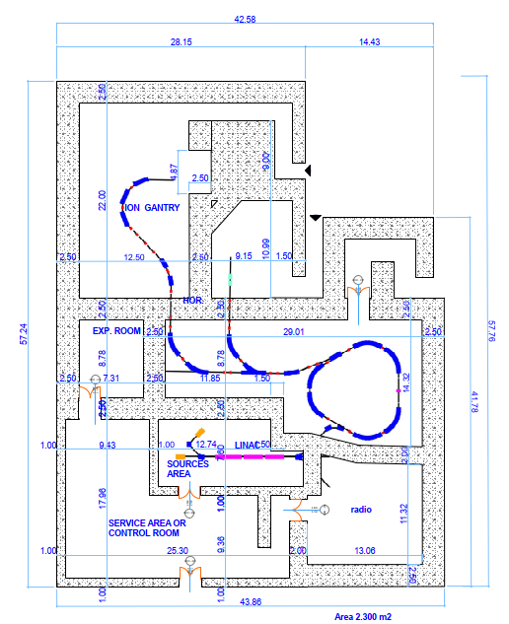
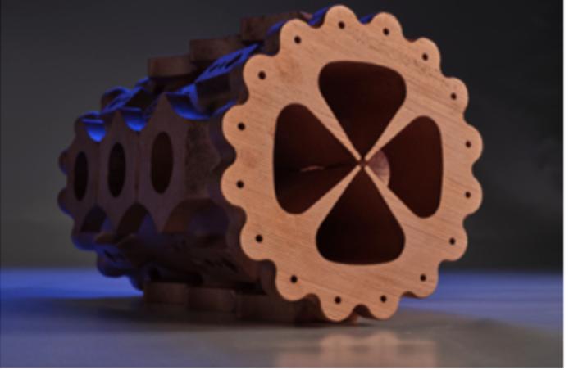
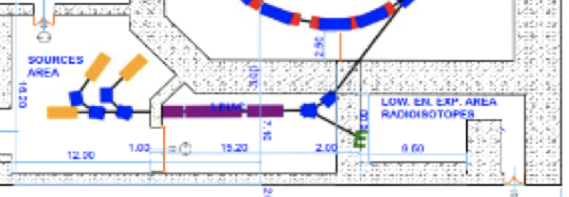
NIMMS supported designs:
2. Compact research and therapy facility with p and He beams
Advanced particle therapy facility for the Baltic states
Both facility layouts include RI production:
- in the same facility
- production close to where it will be used
IPAC22: Vretenar, M., Mamaras, A., Bisoffi, G., Foka, P. (2022).
"Production of radioisotopes for cancer imaging and treatment with compact linear accelerators."
Architectural design, Kaprinis Architects

Slide 10
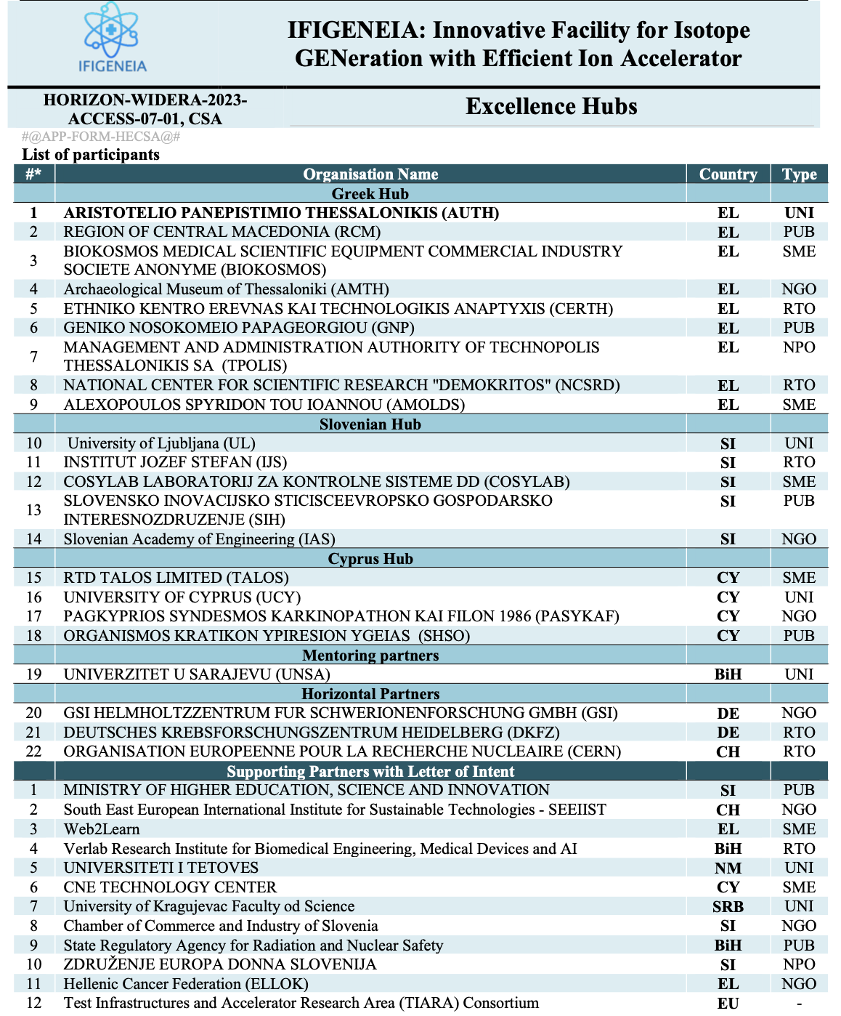

NIMMS supported designs:
Success !
IFIGENEIA: Excellence Hub, Widening Era
Innovative Facility for Isotope GENeration with Efficient Ion Accelerator
Both facility layouts include RI production:
- in the same facility
- production close to where it will be used
IPAC22: Vretenar, M., Mamaras, A., Bisoffi, G., Foka, P. (2022).
"Production of radioisotopes for cancer imaging and treatment with compact linear accelerators."

Slide 11
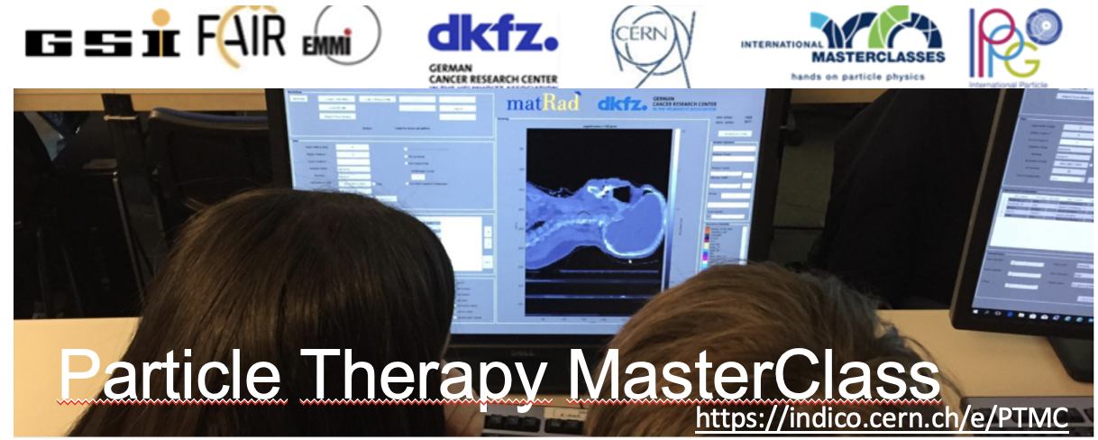
Particle Therapy MasterClasses
as tool for capacity building
in a Work Package dedicated to mentorship

Slide 12
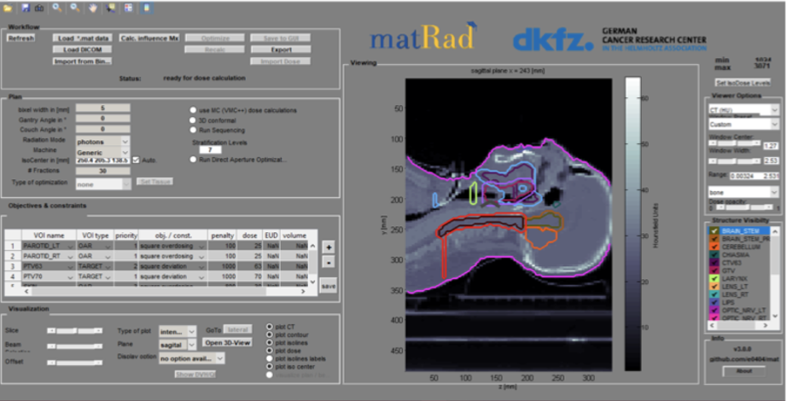
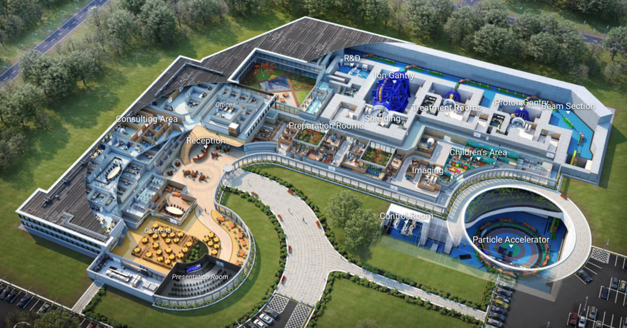
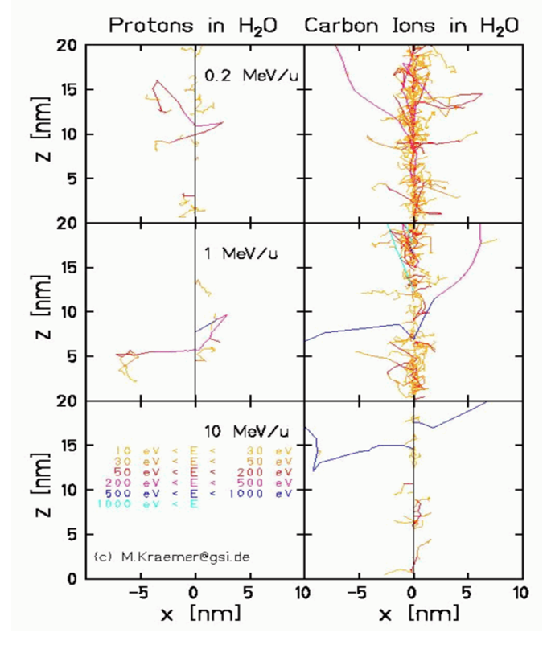

Particle Therapy Multidisciplinary Field
A broad multi-disciplinary field:
the accuracy of ion beams has to be matched by properly locating the target
INCLUSIVITY
MATTERS !
https://indico.cern.ch/event/840212/
Lectures adapted to the expertise of institutes

Slide 13
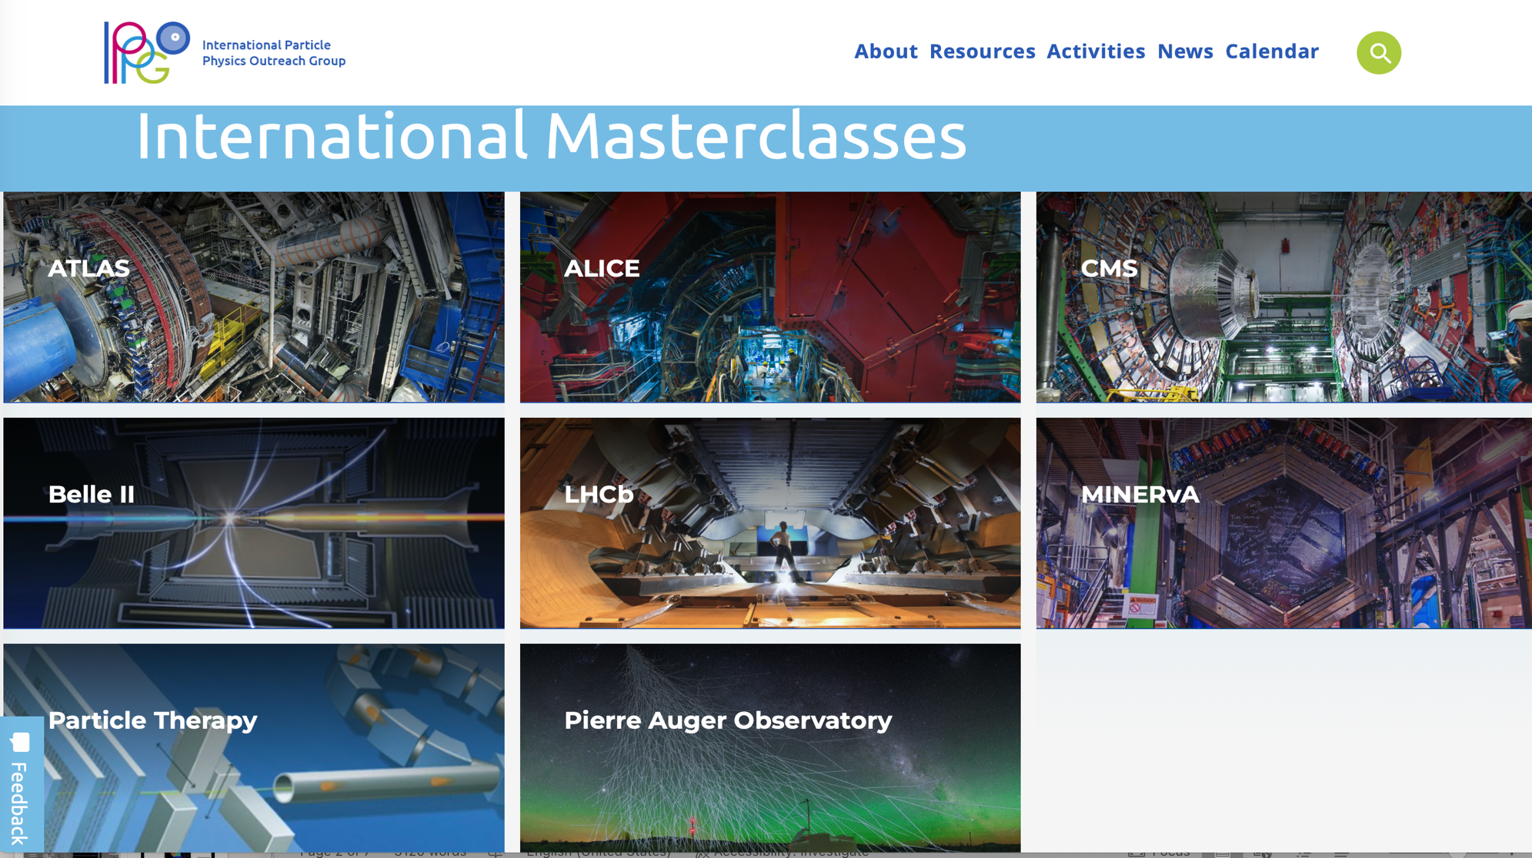

INCLUSIVITY
MATTERS !
Coordinated and moderated by GSI

Slide 14
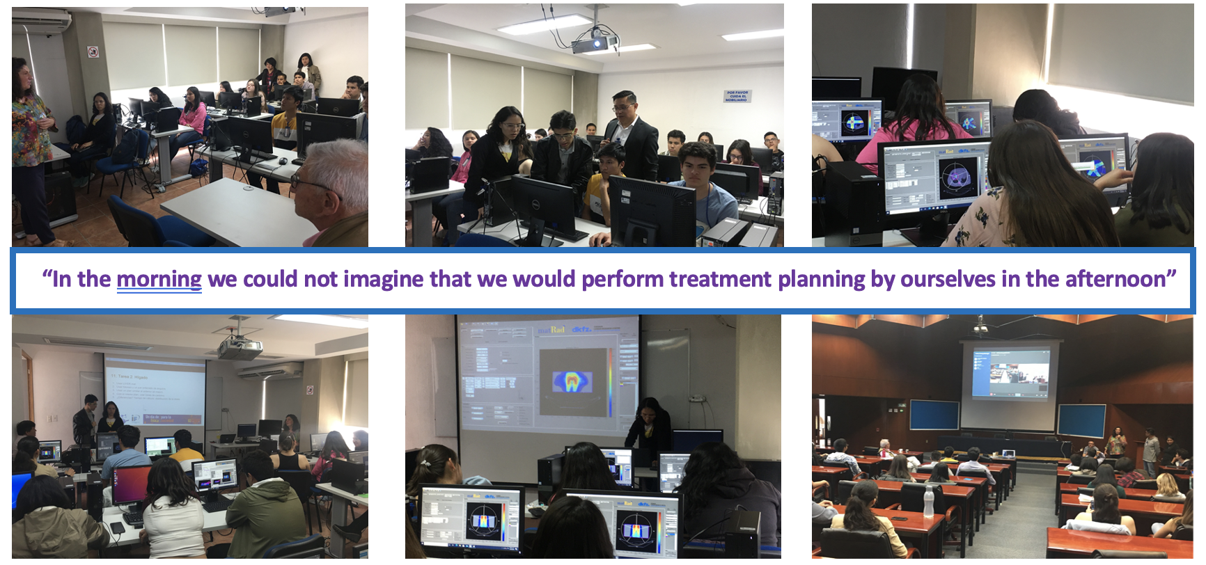
Participants Response
Studying Physics: possibility to do something “applied” and “useful to society”
We could not imagine what physics has to do with medicine,
that research institutes such as CERN can contribute to medical applications

Slide 15
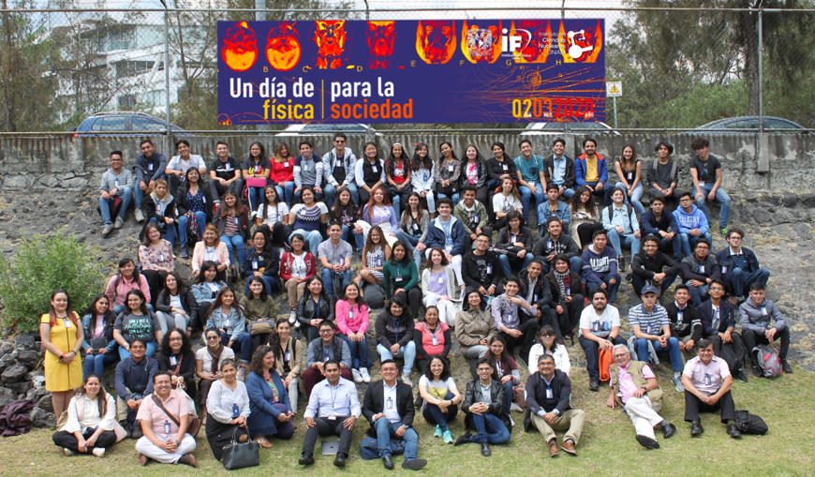
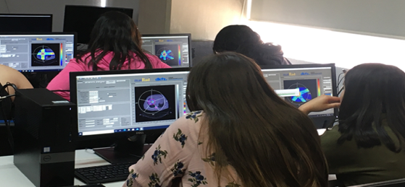
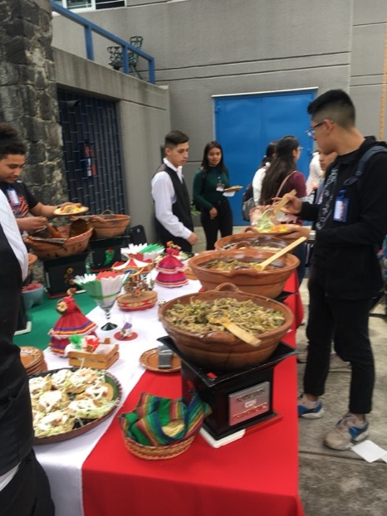
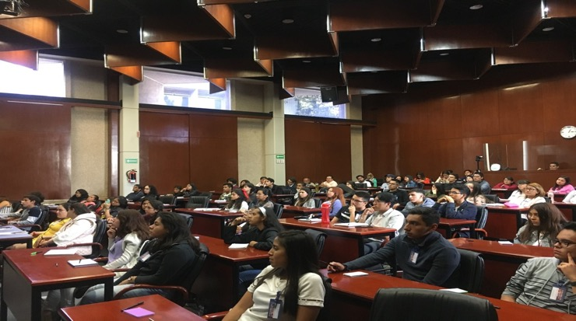

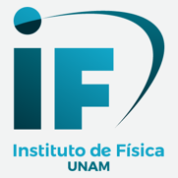
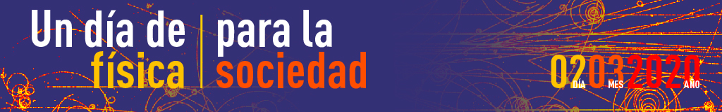
First PTMC in IMC2020
Mexico 2nd March 2020, then online due to covid

Slide 16

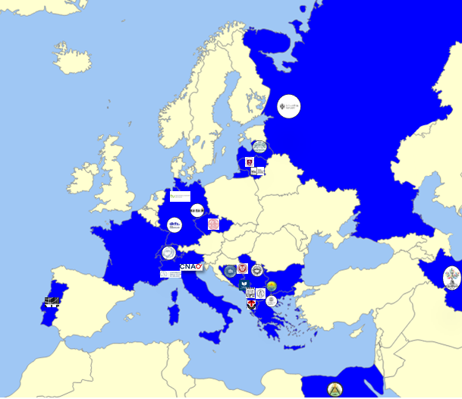
Participants of online PTMC in IMC2021
https://indico.cern.ch/e/PTMC
PTMC2021 online:
6 sessions, 1500 students
from 20 countries and 37 institutes

Slide 17
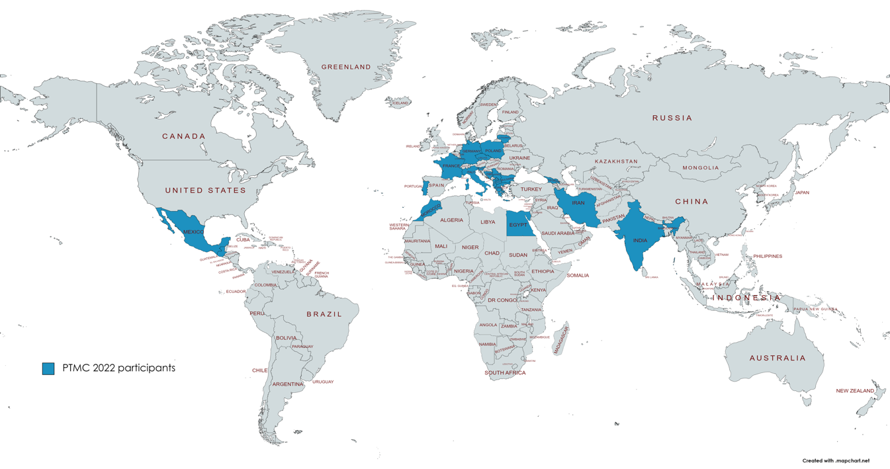
Participants of online PTMC in IMC2022
https://indico.cern.ch/e/PTMC
PTMC2022 online/hybrid:
6 sessions, 1500 students
from 22 countries and 37 institutes
web pages with agendas of every institute with material
in different languages, publicly available for future events
Interest of students, motivation of tutors (voluntary work), potential impact

Slide 18
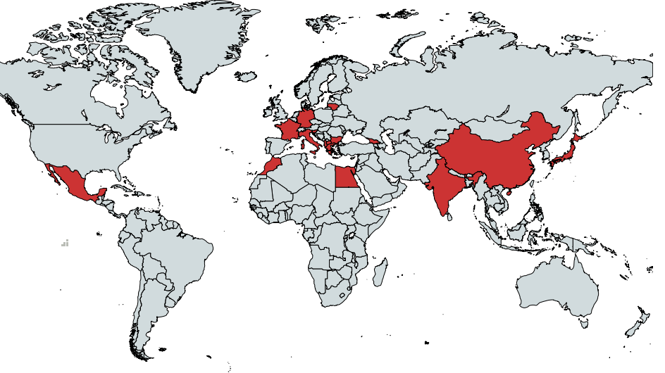
Participants of hybrid PTMC in IMC2023
https://indico.cern.ch/e/PTMC
PTMC2023 in person/online/hybrid:
9 sessions
from 22 countries and 38 institutes
From Japan to Latinoamerica
web pages with agendas of every institute with material
in different languages, publicly available for future events
Interest of students, motivation of tutors (voluntary work), potential impact

Slide 19
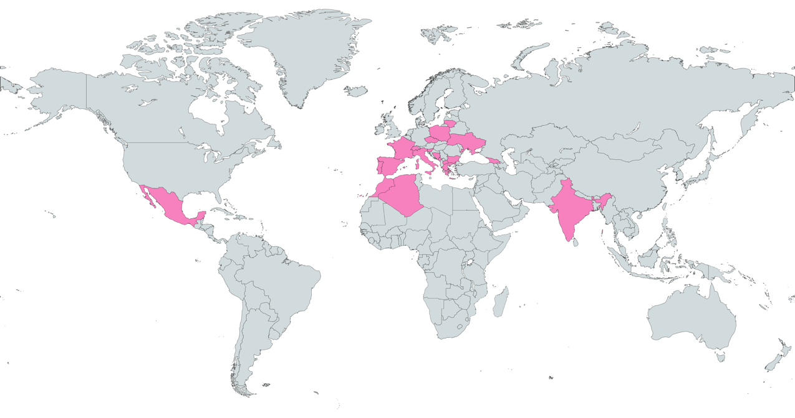
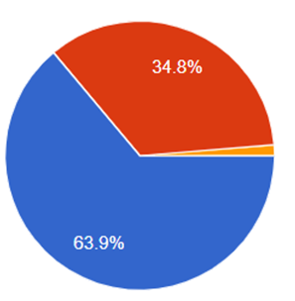
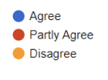
Participants of hybrid PTMC in IMC2024
https://indico.cern.ch/e/PTMC
Statistics of 22 out of 47 institutes:
Total: 1567
428 female, 430 male
17 in person, 5 hybrid
Italy Uni Piemonte Orientale
Italy Bologna
Italy Pavia Uni AND INFN
Italy Torino
Italy Cosenza. Uni AND INFN
Italy Milano UNIMI AND INFN
PTMC2024 in person/online/hybrid:
8 sessions, more than 1500 students
from 22 countries and 47 institutes
Some institutes had 2 sessions
in-person and online
web pages with agendas of every institute with material
in different languages, publicly available for future events
Interest of students, motivation of tutors (voluntary work), potential impact

Slide 20
Took it a step further !
A full week MasterClass school
inspired by the PTMC format
within the HITRIplus EU funded project
Advanced material
for uni students and up to professionals
https://indico.cern.ch/e/HeavyIonTherapyMasterClass

Slide 21
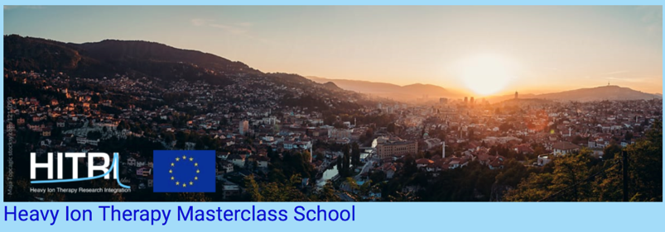
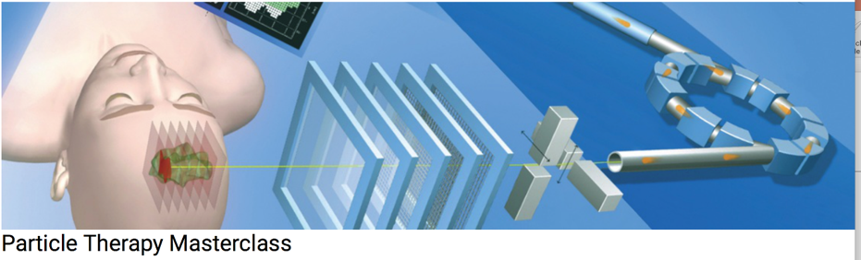
https://indico.cern.ch/e/HeavyIonTherapyMasterClass
https://indico.cern.ch/e/PTMC
Full week course
One day activity
The HITM school is aimed at university students,
and up to early stage researchers.
The Particle Therapy MasterClass,
is aimed at high-school students (16-18)
Future tutors
Different options studying physics, for example accelerator physics, medical physics, bio-physics…
that can provide interesting career paths in upcoming fields where there is lack of specialised personnel
Future Tutors
Information about upcoming modern techniques for cancer tumour therapy and new research avenues,
where clearly the development of technology and the expertise of research laboratories is crucial

Slide 22

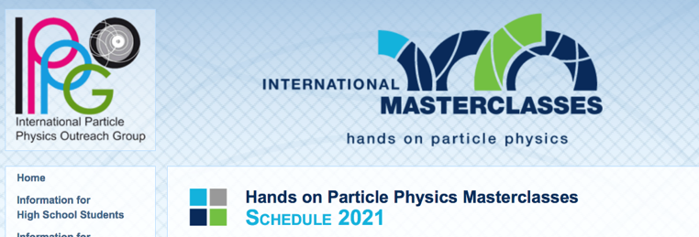
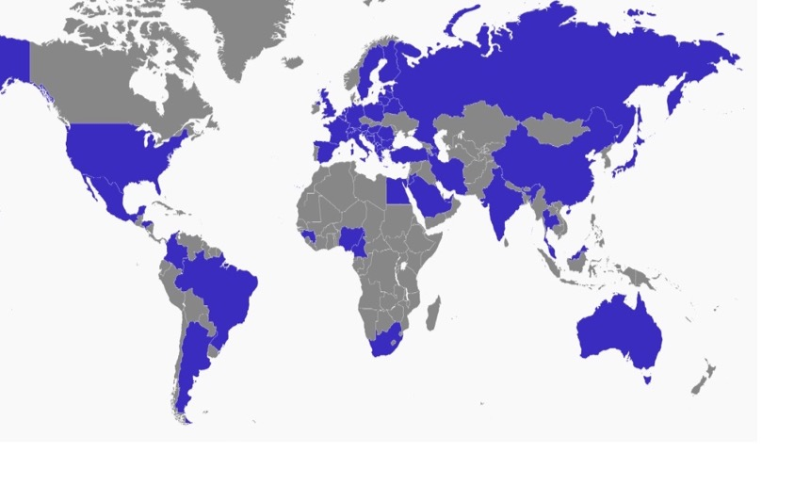
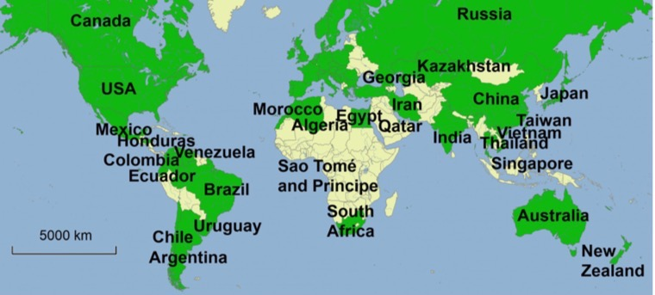
HITRIplus full week heavy-ion therapy masterclass school
World-wide reach motivating next generation of scientists
International MasterClasses one day activity
1050 registrants,
600 connections
at any given time
Power of Networks !

Slide 23
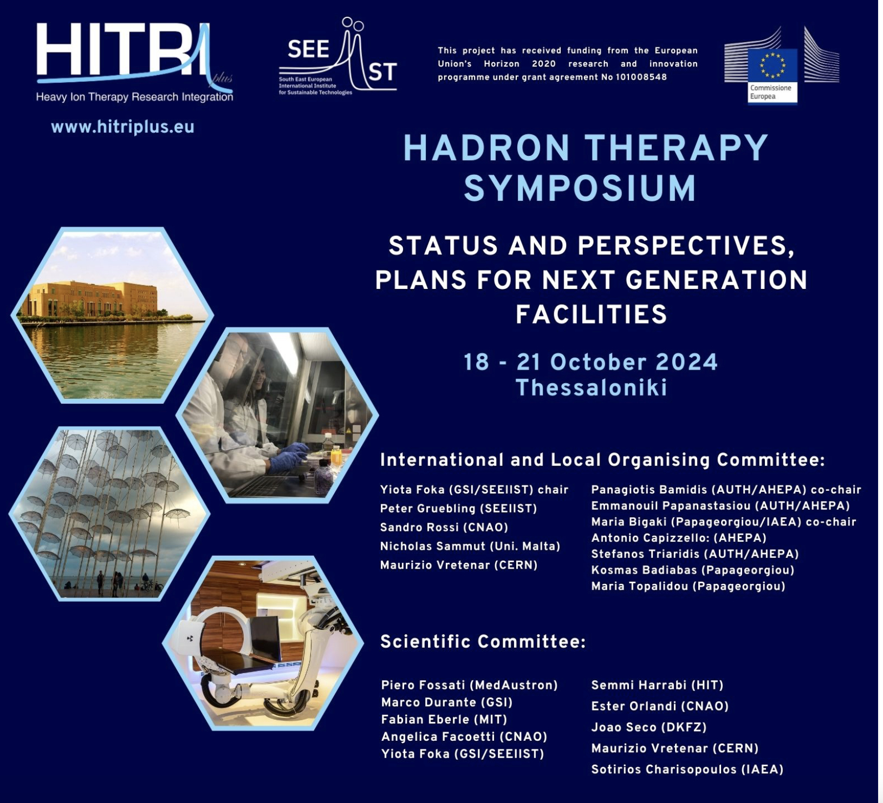
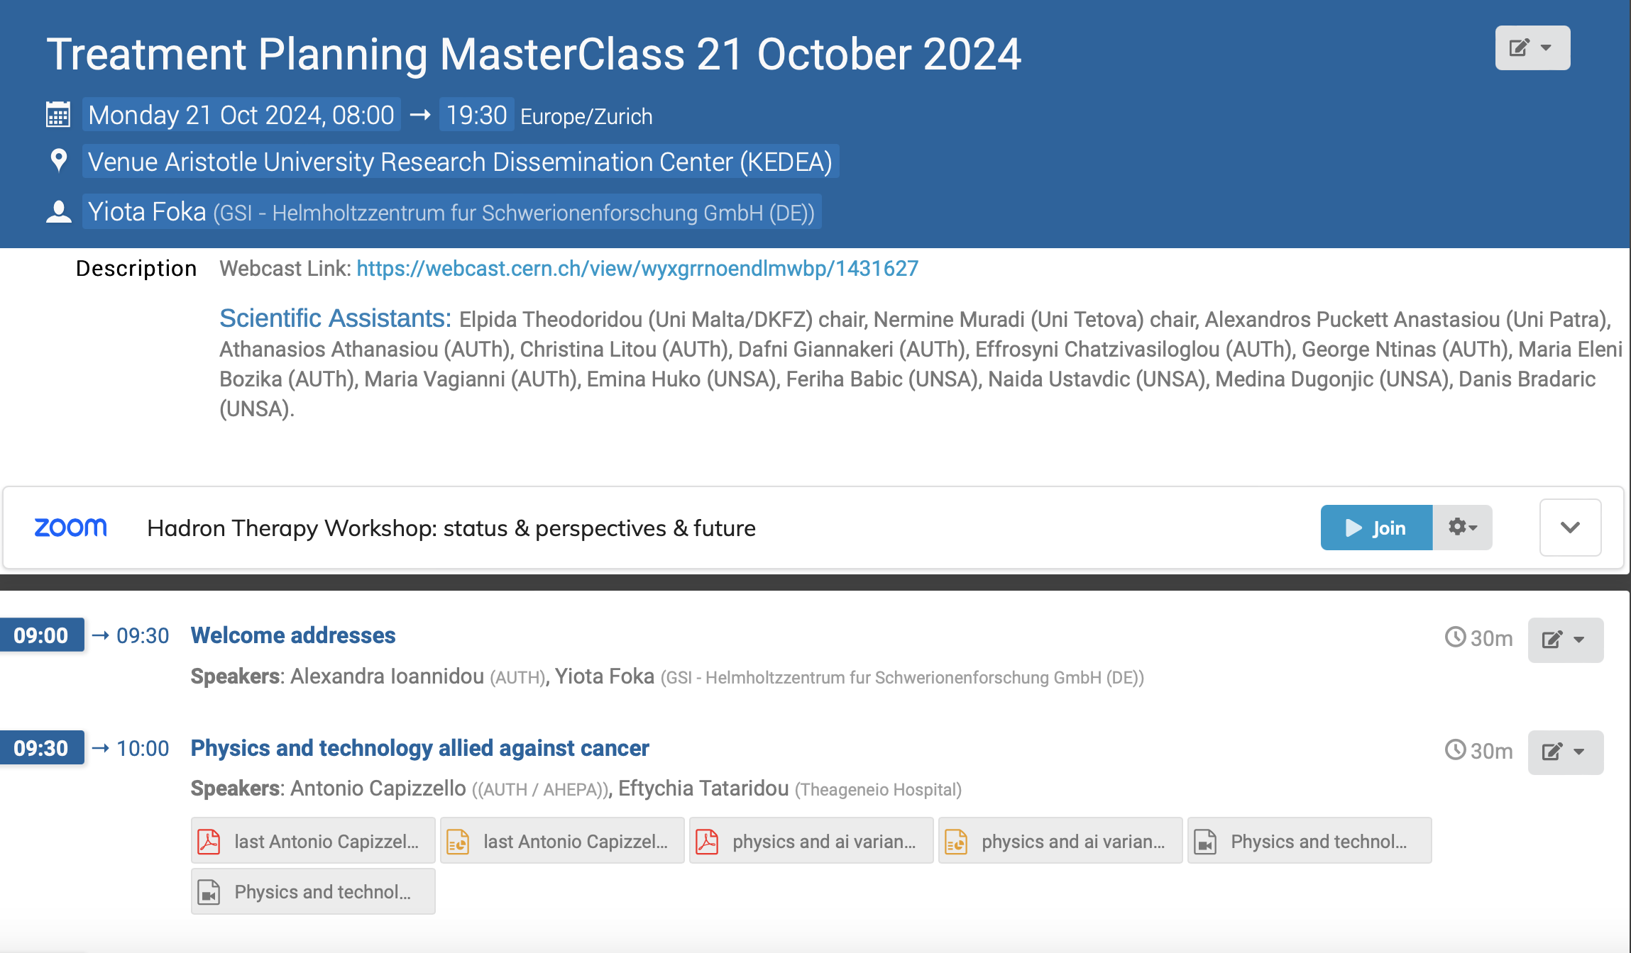
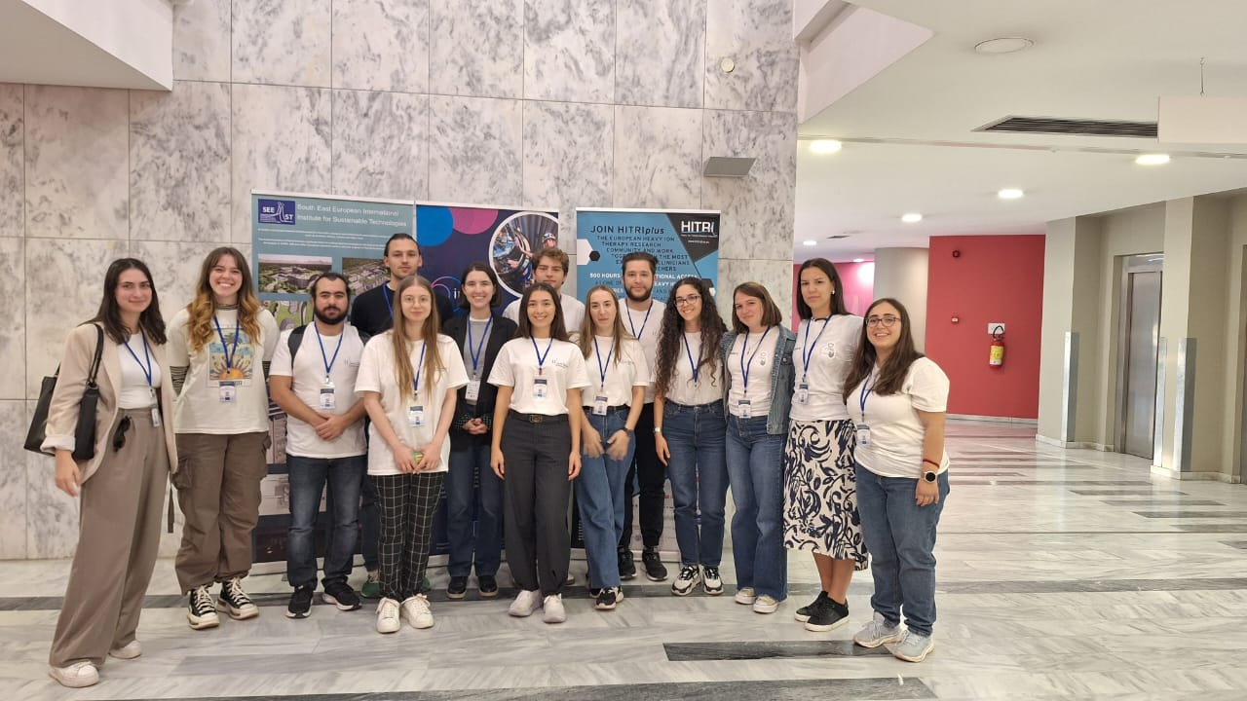
Train the Trainer

Slide 24
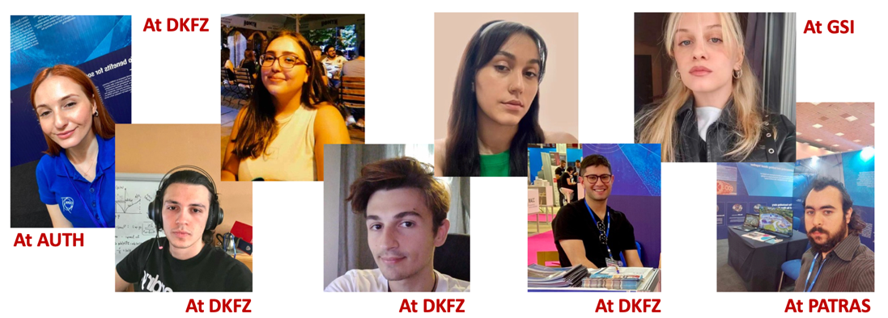
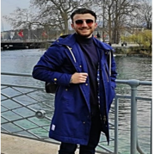
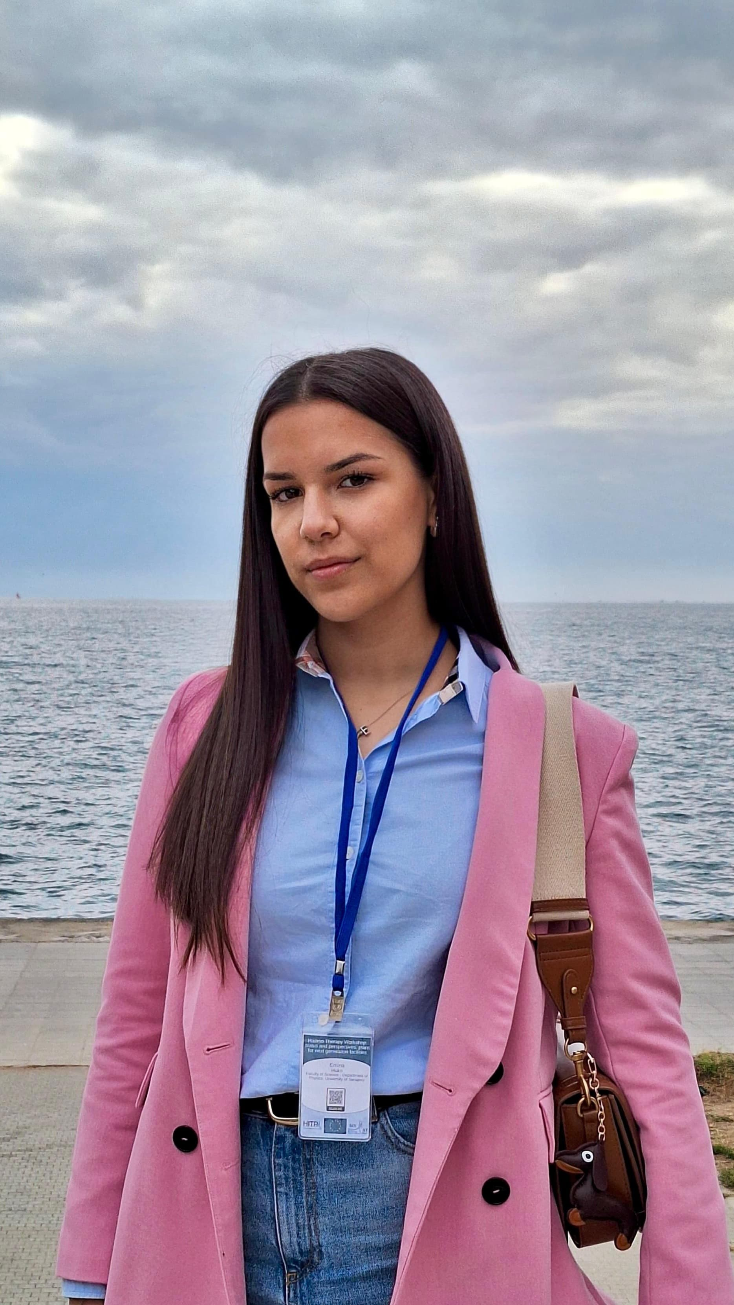
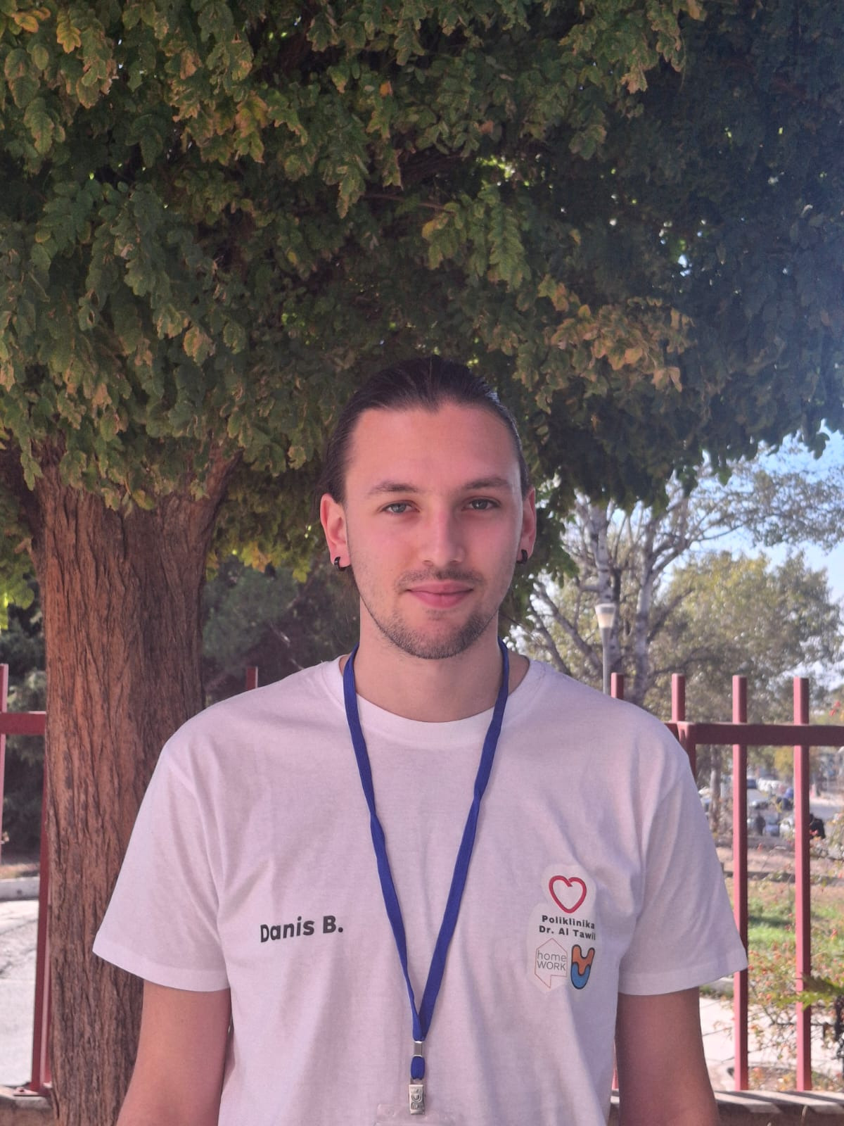
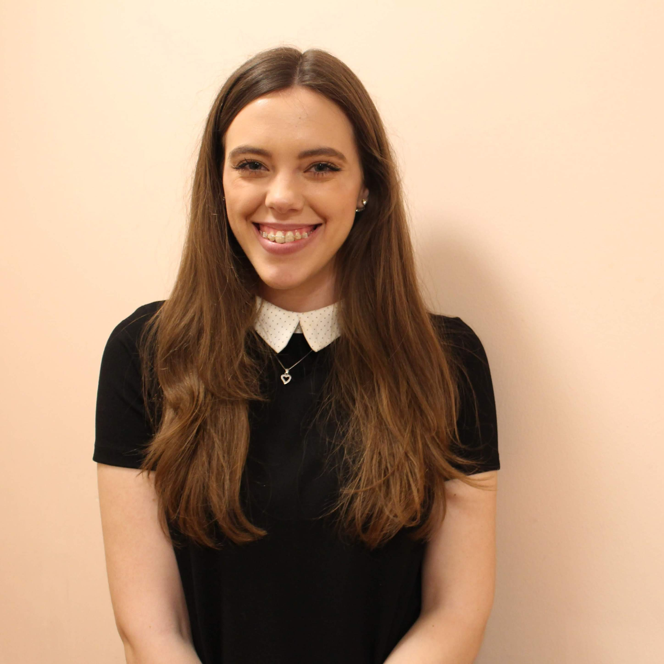










PTMC and HITRIplus school assistants
Greece
Sarajevo
At AUTH
Dafni Giannakeri
Iliana Mitsiou
Aristeidis Mamaras
Elpida Theodoridou
At CERN
Emina Huko
Danis Bradaric
Medina Dugonjic
Eirini Xanthopoulou
Tetova
Marios Dallas
Kostakis Konstantinos
Alexandros Puckett Anastasiou
Kostis Koritsidis
Feriha Babic
Naida Ustavdic
Nermine Muradi
Thanos Athanasiou
Giorgos Ntinas

Slide 25








Virtual visits and video-conferences
Virtual visits during video-conference: GSI research institute, CNAO, MedAustron therapy centers
GSI moderators
CNAO moderator
medAustron moder.
U. Amaldi: HI therapy pioneer
HITRIplus EU-funded project

Slide 26










PTMC supporting females in STEM
11 Feb and 8 March sessions
encouraging female participation
and providing role models
El Houria Algeria
PTMC quiz: a fun way to finish
What have we learnt?

Slide 27

Main Message: need for fundamental research
To get the fruit you need the tree with its roots, trunk, branches….
Attract high-school students to STEM
Cultivate confidence through the hands-on
Support female participation
Create groups of Uni assistants that learn better in order to teach
Enhance public awareness on benefits from fundamental research
Prepare future generations aware of importance of fundamental research
a science educated future generation is crucial for shaping the future of any country,
based on rational scientific thinking and decision-making processes
Demonstrate a return to society from investment in fundamental research
Our reward: the enthusiasm and appreciation of the students

Slide 28
Summary of Activities
PTMC in Zurich and EPFL: PTMC and new material for school curricula
ICHEP Prague: PTMC and stories on applications for society
CONF Australia : Plenary plus MasterClass plus other activities
ANP Thessaloniki : Plenary
Hadron Therapy Symposium: 2 days lectures, 1 day PTMC hands-on
CERN 70th including LIT LHC Interactive Tunnel, with particle therapy
Greek Physics Association 13-14 December, PTMC MasterClass

Slide 29




PTMC and new materials for school curricula
Swiss schools curricula: invited to participate to projects exploring the possibilities to enhance the schools curricula by creating digital tools for STEM teachers in Switzerland and abroad see attached presentation for details
Swiss pilot and proof of concept: YF and Luca Garolfi
  - PTMC at International School, Zurich, 19 june 2024
  SEFI 2024 Workshop EPFL Lausanne, 2-5 sep 2024:
  PTMC contribution “Inspiring next STEM generation by Innovation”

Slide 30


PTMC and stories on applications for society
From plans to reality !
Dedicated web page
Collection of stories

Slide 31

Participation to outreach activities
in Australia in a nutshell
Tuesday 20 august 2024, Cairns
  10:00 Plenary presentation on PTMC and WG “Outreach of Applications for Society” (similar to the one in ICHEP)
  11:00 ALICE MC
  Conference web page: https://confinement24.org.au
  Timetable: https://indico.cern.ch/event/1293041/timetable/#20240818
Saturday 17 august 2024, Townsville
  Outreach Workshops in Townsville focusing on Dark Matter by IPPOG Australian representative Jackie Bondel
  as part of full day event organized by a college for the region’s schools
Wednesday 14 august 2024, Melbourne
  Outreach Workshops in Melbourne by IPPOG Australian representative Jackie Bondel and colleagues
  as part of a half day event of “science week” organized by university
  https://us21.campaign-archive.com/?e=__test_email__&u=47467255c3c5953fcc07ccd51&id=cd8c870d04
  Youtube: https://www.youtube.com/watch?v=2ByOfkXZGaM

Slide 32

ALICE Masterclass
Tuesday 20 august 2024, Cairns
  Attended by about 65 high-school students from 5 schools accompanied by their teachers
  Presented by: Jon-Ivar Skullerud jonivar@thphys.nuim.ie from Maynooth, Wioleta Rzesa wioleta.rzesa@cern.ch from WUT
  Assisted by 6 “local” PhD students and Francesca Ercolessi from Bologna
Group Photos in: https://cernbox.cern.ch/index.php/s/2We9DoacU4qd8UK

Slide 33




ANP Applied Nuclear Physics in Thessaloniki
Importance of imaging
Raster scanning Method
Haberer et al., NIM A , 1993
EPS Awards
relying on scanning of focussed ion beams in fast dipole magnets
active variation of the energy, focus and intensity in the accelerator and beam lines
Notes:
33

Slide 34


Workshop: 392 indico + 23 on-site registrants, 130 in person
MastrClass: 60 in person + 50 online
World experts and sizeable local paricipation
Many young participants
Hadron Therapy Symposium Thessaloniki

Slide 35

Hadron Therapy Symposium Thessaloniki

Slide 36

CERN 70th at Thessaloniki International Fair TIF

Slide 37


Attract childern: protons for resrearch and cancer therapy
CERN 70th at TIF

Slide 38

Technology development for research and cancer therapy
CERN 70th at TIF

Slide 39

CERN 70th at TIF

Slide 40


End of event party and 70th anniversary cake
CERN 70th at TIF

Slide 41


Attendees of IMC were attracted by Science, Technology, Engineering and Math careers.
It was definitely our case
From participants to collaborators
Thank you !
It is inspiring to young students.
This could mean more professionals in STEM topics
Noteworthy fact:
now we collaborate in UNAM with our IMC tutors
.

Slide 42
BACKUP

Slide 43

Proposal for a facility in South East Europe: SEEIIST
50% research and 50% therapy
with multiple ions
Optimisation of linac injector
for radio-isotope production
CERN Yellow Report
in publication process
Architectural design, Kaprinis Architects

Slide 44
PTMC Important Links
https://indico.cern.ch/e/PTMC
Information about the PTMC, in a different languages, can be found through the PTMC web page and the “PTMC in a kit” Google Drive links:
  PTMC web page: https://indico.cern.ch/event/840212/overview
  Google Drive: https://drive.google.com/drive/folders/1jRnLf49N_yRoOGg8V8vwq3DIpnetWdF0?usp=sharing
Material for the matRad installation can be found through the word document in the link below, together with a video describing the procedure:
  Installation: https://drive.google.com/file/d/1vT9tQ9ft1C7AwUSbU18pftC9H-ep4BPC/view
  Video: https://drive.google.com/file/d/1BdkjN63StX-1kFEqR_FgTgj_pgZ2-PhL/view?usp=sharing
Additional instructions for the use of matRad are provided through the workflow, which is available in many languages through the PTMC web page A video describing the workflow of different cases is provided via the google drive:
  Workflow: https://indico.cern.ch/event/840212/page/17991-workflow
  Video: https://drive.google.com/file/d/1jyCzJFfS7I_-0e45ZEcyb4fnXTaRJmpK/view?usp=sharing
Units and terminology of matRad can be found here:
  Link: https://indico.cern.ch/event/840212/page/18006-definitions

Slide 45






Acknowledgements PTMC
matRad Developers
Wahl, Niklas
Bangert, Mark
Hans-Peter Wieser
DKFZ Heidelberg
LoC: Wahl, Niklas
Katrin Platzer, Malte Ellerbrock
Noa Homolka Amit Ben Antony Bennan
GSI
LoC: Yiota Foka
GSI Biophysics:
Christian Graeff, Radek Pleskac
GSI ALICE, EMMI :
Ralf Averbeck, Malzacher, Peter
GSI IT :
Thorsten Kollegger, Behnert, Katharina
Osdoba, Sascha
CERN (staff and users)
CERN: tutors
Loc Org: Nikolaos Charitonidis
Alexander Gerbershagen
Evangelia Dimovasili
Elena Benedetto
CERN/ARIES: Maurizio Vretenar, Valerie Brunner
CERN/ENLIGHT: Manjit Dosanjh Petya Georgieva
CERN/KT: Manuela Cirilli Anais Rassat Rita Ferreira Giovanni Porcellana
CERN: Visits Service Erwan Harrouch Francois Butin
CERN: Training Centre: Eric Bonnefoy M-L LECOQ
Uni Sarajevo: web pages
Amila Avdic
Amra Ibrahimovic
Mirsad Tunja
Damir Skrijelj
Online mode, web pages, training
Sponsors : Edmond Offermann
Aris Mamaras (AUTH), Damir Skrijelj (UNSA), Elpida Theodoridou et al (AUTH)
Nermine Muradi (Uni of Tetovo)
General Coordination :
p.foka@gsi.de yiota.foka@cern.ch

Slide 46
More than 1500 students participated from 22 countries and 47 institutes during 8 sessions
Participants of hybrid PTMC in IMC2024
Including 11 Feb and 8 March women days
CERN
Slovenia
Lithuania Vilnious, Uni AND Cancer institute
Lithuania Kaunas Health uni AND Uni of Technology
Germany DKFZ
Georgia
France
Slovenia Uni Ljubljana
N. Macedonia Uni Tetovo
Morocco
Bulgaria Varna Astronomical observatory AND Uni
Bulgaria Sofia Uni
Spain Uni AND Hospital
Portugal Uni Lisbon
BiH Sarajevo AND Tuzla
Czech republic, Prague, Proton Therapy centre AND Charles UNI
Mexico Puebla
Mexico Hermosillo Uni of Sonora
Mexico, Mexico city, UNAM
Algeria
Poland
Greece
India
Montenegro
Ukraine
Italy Uni Piemonte Orientale
Italy Bologna
Italy Pavia Uni AND INFN
Italy Torino
Italy Cosenza. Uni AND INFN
Italy Milano UNIMI AND INFN

Slide 47


Particle Therapy MasterClass
Particle Therapy MasterClass
https://indico.cern.ch/e/PTMC
Material in different languages
including animations and demos
“PTMC in a kit”
in different languages
with introduction by DKFZ
including recordings
https://drive.google.com/drive/folders/1L94yhos6L7k3FQlMzD9Ql7kpk_c_ABD7
Training sessions: 4-5 per year
Importance of training teachers:
Sofia, Madrid, and Sarajevo
Example of UNSA/Sarajevo:
in-person at university
in-person at schools
common lectures online

Slide 48



PTMC in Greece
PTMC2021 online: through Library of Veroia
PTMC2022 online: more than 150 participants, PTMC2024: 275 participants
AUTH uni, Dimokritos research centre, Papageorgiou Hospital, Technopolis.
Publicity: Library of Veroia extended networks and national press
Total of 366 live views
from at least 20 major regions of Greece
Press Release published in nation-wide media
Post on Facebook resonated with 3,600 people
Announcement viewed 941 times on website

Slide 49



PTMC and matRad Treatment Planning
First Local Test: GSI Feb 2019
International Pilot: CERN, GSI, DKFZ April 2019
Web page: UNSA students
CERN Open Days, Aug 2019
IMC Steering Group Approval: GSI May 2019
We could not imagine
what physics has to do with medicine,
that research institutes such as CERN
can contribute to medical applications

Slide 50



Publications as CERN Yellow Reports
Proposal for a multi-ion accelerator based facility
Conceptual (pre-TRD) design report
CERN Yellow Reports by Ugo Amaldi and international collaborators
https://e-publishing.cern.ch/index.php/CYRM/issue/view/88
https://cernbox.cern.ch/s/AqytzIPSL2kZoA3,
DRAFT

