Slide 1




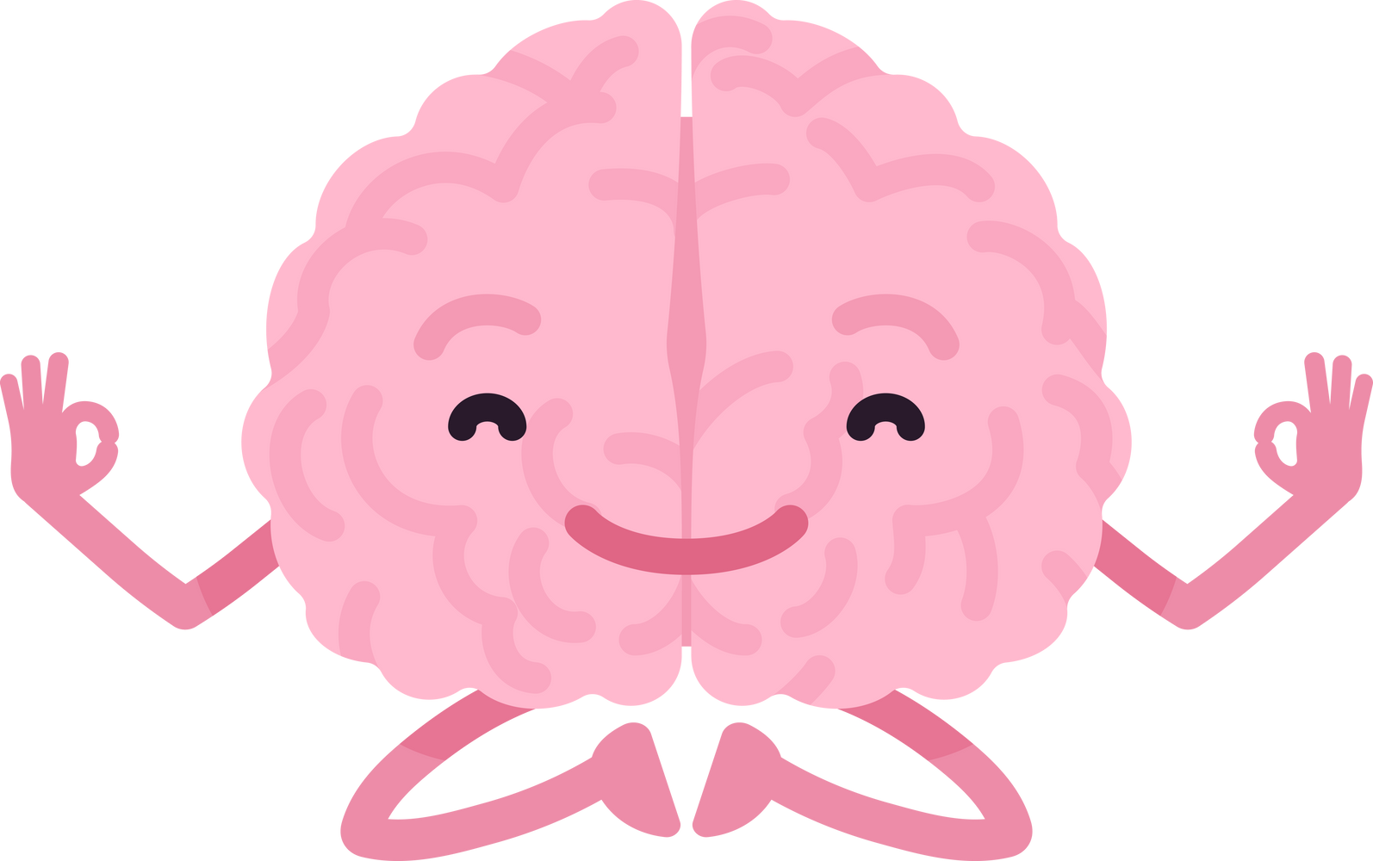


STROKE PREVENTION
How to take care for your brain?
Elsa Fuchs, Clinical nurse specialist MScSI, Department of clinical neurosciences, Geneva University Hospital
Visual by Braderlayout Studio, Canva
Notes:
"Welcome everyone! Today, we’re going to explore a crucial yet often overlooked topic: stroke prevention and how to take proactive steps to care for our brains.
I’m… In this presentation, you will see a motivational approach. It’s a technique I use with my patients during consultations to help them achieve their health-related goals.

Slide 2

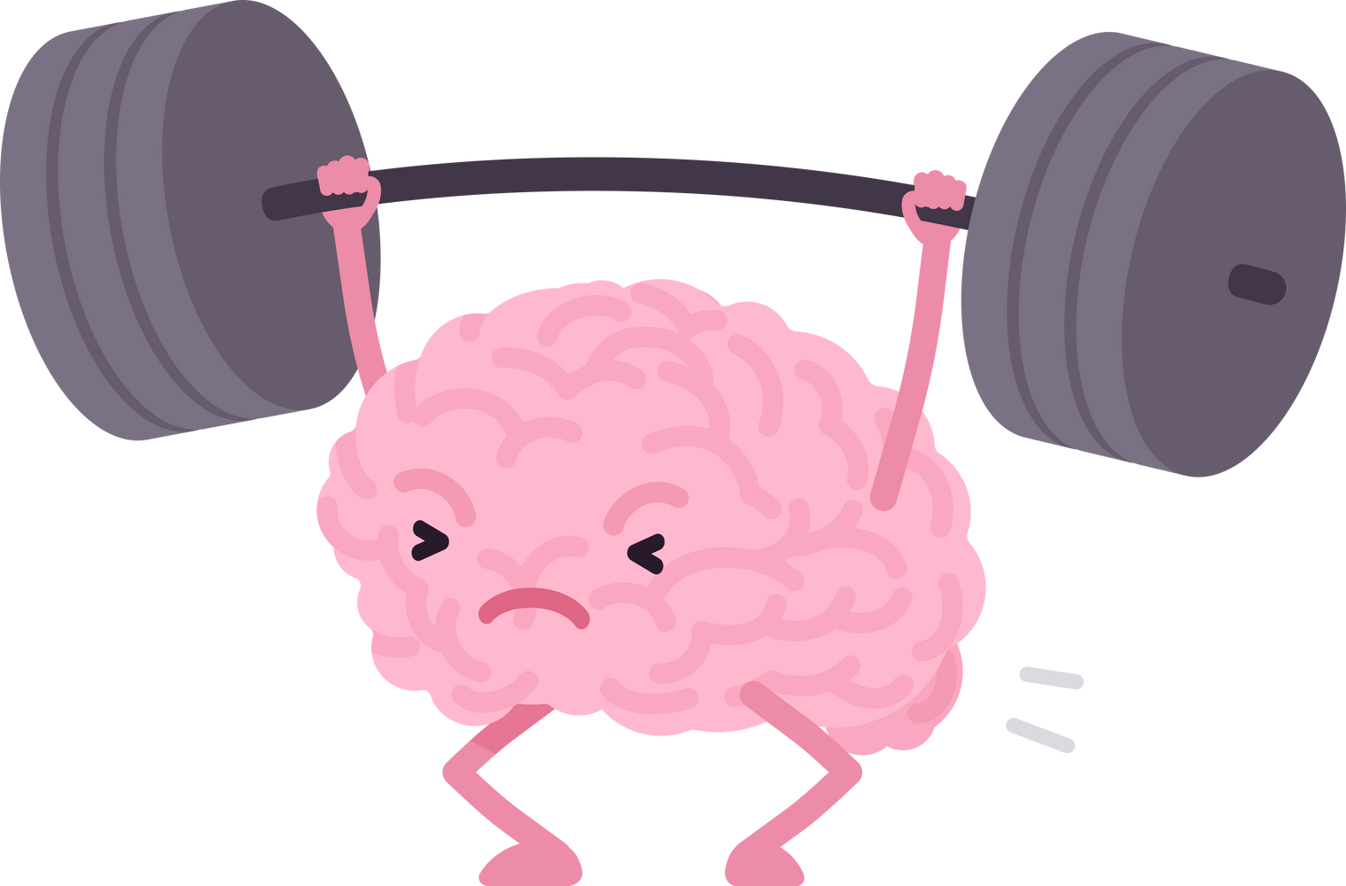

PLAN
  What is a stroke ?
    Atherosclerosis
    Risks factors
  Take action
  Why is it so hard to change ?
    Online tools
  Take home messages
Notes:
Today’s presentation will cover several key topics:
What is a Stroke? - We’ll start with an overview of what a stroke is and its implications for health.
Atherosclerosis - We will discuss the role of atherosclerosis in stroke occurrence.
Risk Factors - Next, we’ll explore the various risk factors that can contribute to strokes.
Take Action - We’ll look at actionable steps you can take to reduce your risk.
Why is it so Hard to Change? - We’ll examine the psychological and social barriers to making lifestyle changes.
Online Tools - I will introduce some online resources that can assist you in your journey toward better health.
Take Home Messages - Finally, we’ll summarize the key takeaways from today’s session."

Slide 3
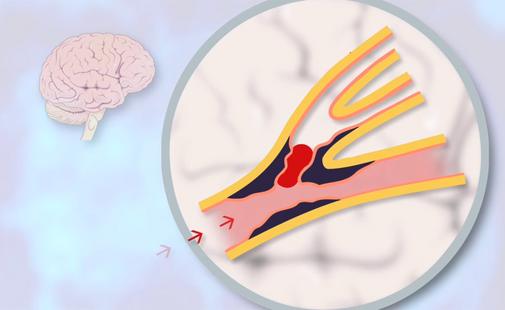
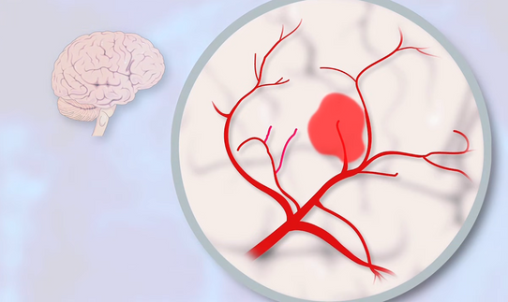
WHAT IS A STROKE ?
Hemorrhagic stroke
Hemorrhage
20%
Ischemic stroke
Non irrigated area
80%
Figure 1 and 2 : Taken from “L’accident vasculaire cérébral”, HUG 2012
Notes:
Ischemic Stroke:
Description: "Occurs when a blood vessel is blocked, preventing blood flow to the brain."
Consequences: "Leads to areas of the brain that become non-irrigated, resulting in cell death.“
Ischemic strokes account for 80% of all stroke cases.
Hemorrhagic Stroke:
Description: "Occurs when a blood vessel ruptures, causing bleeding in or around the brain."
Causes: "Often linked to high blood pressure or aneurysms."
Consequences: "Results in hemorrhage, which increases pressure on brain tissue and can cause damage.“
TIA : “A Transient Ischemic Attack (TIA) is caused, in the same way as an ischemic stroke, by the presence of a blood clot that temporarily obstructs the cerebral blood flow. In the case of a TIA, the symptoms usually last less than an hour and no brain injury is visible upon the radiological examinations.” (HUG, 2018)
TIAs are serious warning signs and should be treated as medical emergencies. They often precede full-blown strokes.
Because Our Brain is Our Orchestra Conductor, During a Stroke the Symptoms Can Be:
sudden numbness, confusion, difficulty speaking. Remember the 'Stroke 112' mnemonic for recognizing stroke signs. Have you seen our poster?
TIME IS BRAIN

Slide 4
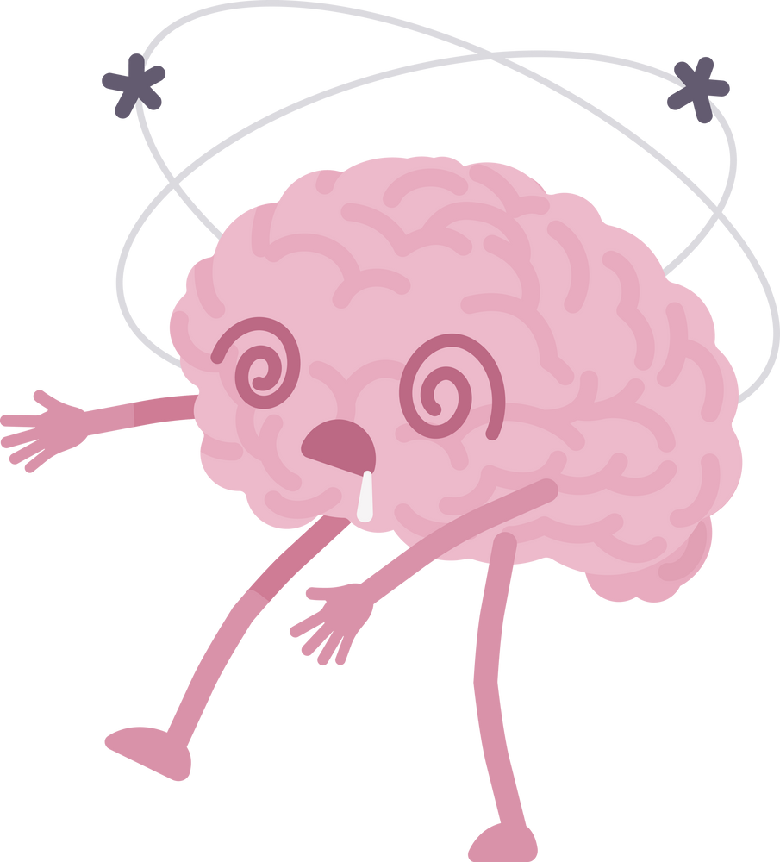

ATHEROSCLEROSIS
> 50% of strokes are due to atherosclerosis
    Big and small arteries
HUG, 2019
What is atherosclerosis ?
Notes:
- More than 50% of strokes are caused by atherosclerosis, which affects all arteries.
Video
Coronary artery disease is well-known because it impacts the arteries supplying blood to the heart, leading to heart attacks.
However, atherosclerosis can also affect other arteries, resulting in stroke

Slide 5
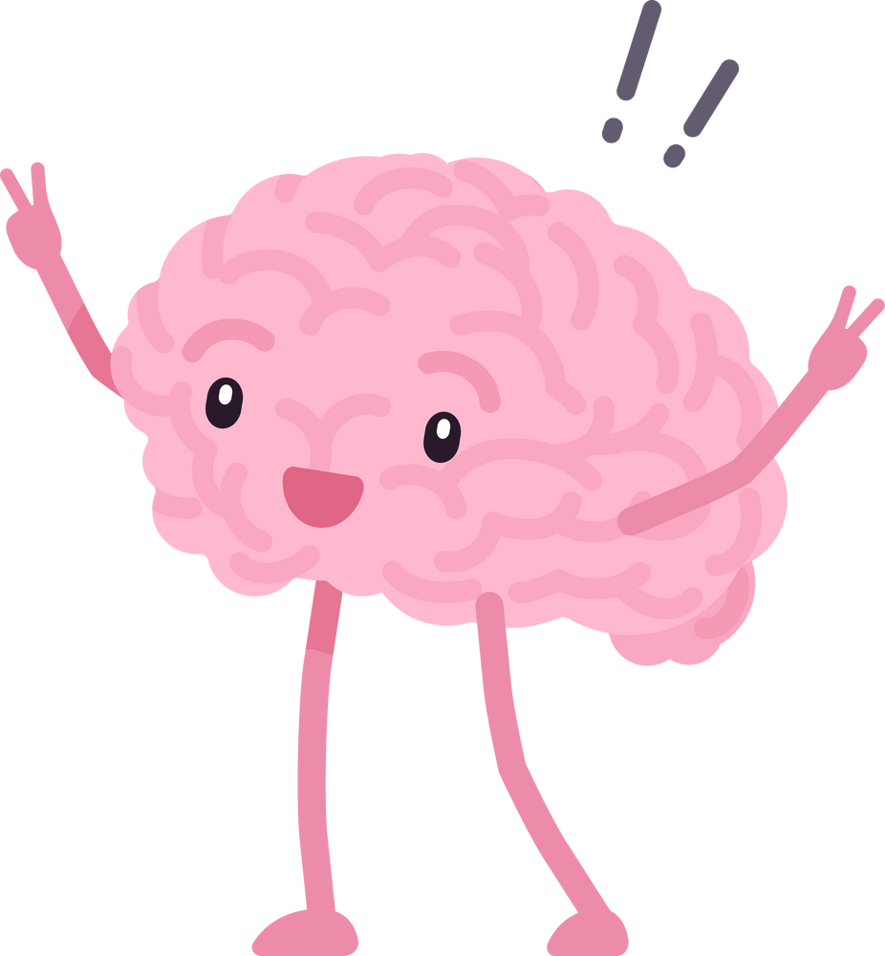

WHAT WE KNOW
>90% of strokes are attributable to things we can control
= modifiable risk factors
O’Donnell et al, 2016
Notes:
More than 90% of strokes are attributable to factors that we can control. This means that the vast majority of strokes are preventable by addressing lifestyle choices and managing health conditions,
By taking action to modify these risk factors, individuals can significantly reduce their chances of experiencing a stroke.

Slide 6
WHAT WE KNOW
Stroke risks increase by :
  Things beyond our control
    Age
    Sex
    Hereditary predisposition
  Things we can control
    Blood pressure
    Smoking
    Cholesterol
    Diabetes
    Alcohol consumption
    Physical activity
    ...
HUG, 2019
Notes:
Life itself is a huge risk, right ?
Stroke risk factors can be divided into non-modifiable (those beyond our control) and modifiable (those that can be controlled or treated)
Things beyond our control include :
Age: The risk increases as we age, especially after 55, due to blood vessels becoming more rigid and narrowing (atherosclerosis).
Sex: Men are at higher risk for strokes earlier in life, but women face a greater lifetime risk because they tend to live longer.
Hereditary Predisposition: A family history of stroke, heart disease, or genetic conditions like hypertension, high cholesterol, or diabetes can increase your risk.
While these factors cannot be changed, recognizing them helps individuals focus on modifiable risks—factors we can control to reduce stroke risk.
As you can see, there are many controllable factors, which we’ll explore next.

Slide 7
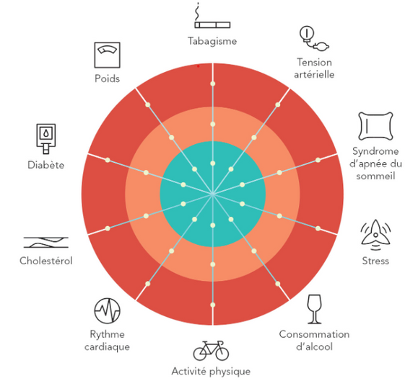

sleep duration is important
TAKE ACTION ON
Choose 1 modifiable
risk factor you would
like to work on :
Smoking
Blood pressure
Weight
Sleep
Diabetes
Cholesterol
Mental health and wellbeing
Heart
conditions
Alcohol consumption and other substances
Physical activity
Figure 3 : Adapted from “Facteurs de risque cardiovasculaire”, HUG, 2023
Notes:
This is the wheel of modifiable cardiovascular risk factors, a helpful tool for understanding how lifestyle changes can help reduce the risk of cardiovascular disease. It highlights key factors such as high blood pressure, cholesterol levels, diabetes, smoking, obesity, lack of exercise…—showing that with the right steps, many of these risks can be controlled.
I won’t go into detail about each risk factor today, but I’m happy to answer any questions after the presentation!
The idea here is that you Choose one modifiable risk factor you would like to take action on : Let me give you an example that might motivate you: After just 2 to 5 years of quitting smoking, your body can largely recover from the harmful effects, greatly reducing your risk of serious diseases."
--------
1. Blood Pressure: High blood pressure (hypertension) is the most important modifiable risk factor for stroke. Keeping your blood pressure under control (below 120/70 mm Hg) can significantly reduce your risk. This can be managed through medication, a healthy diet (low in sodium), and regular exercise.
2. Smoking: Smoking damages the blood vessels, increases blood pressure, and doubles stroke’s risk. After 2 to 5 years of quitting smoking, stroke risks for your health almost disappear
3. Maintaining a healthy weight helps reduce the risk of high blood pressure, diabetes, and heart disease, all of which are linked to strokes. Managing weight isn't just about eating less and moving more. It’s important to consider various factors, such as metabolism, lifestyle, and mental health. Seeking guidance from a healthcare professional can make a significant difference in achieving long-term, healthy weight management.
A heart-healthy diet can reduce stroke risk. TheMediterranean diets, which emphasize fruits, vegetables, whole grains, lean proteins, and healthy fats, are particularly beneficial. Limiting salt (sodium), added sugars, and unhealthy fats is key.
4. Diabetes: Managing diabetes is critical since high blood sugar levels can damage blood vessels and make strokes more likely. Keeping blood sugar levels within a healthy range through medication, diet, and physical activity reduces this risk.
5. Cholesterol: High levels of LDL ("bad") cholesterol lead to plaque buildup in the arteries, increasing the risk of blockages and strokes. Keeping cholesterol levels in check through diet (low in saturated fats), medication (like statins if needed), and physical activity can reduce your stroke risk.
6. Controlling Heart Conditions:
If you have heart conditions like atrial fibrillation (AFib) or other heart diseases, managing these with medication and lifestyle changes reduces the risk of stroke caused by blood clots forming in the heart and traveling to the brain.
7. Physical Activity:Regular exercise helps lower blood pressure, improves heart health, reduces cholesterol levels, and maintains a healthy weight, all of which reduce stroke risk. Aim for at least 150 minutes of moderate aerobic exercise per week, such as brisk walking, cycling, or swimming. Any opportunity is a good one to get moving: for example, take the stairs, get off 1 bus stop earlier...
8. Alcohol Consumption and other substances: Limiting alcohol intake helps reduce stroke risk. Moderation is key: women should have no more than one drink per day, and men should have no more than two. Heavy drinking can raise blood pressure and increase the risk of stroke.
Cannabis, cocaine, ecstasy, psychostimulants and many other substances increase risk
9. Mental health and wellbeing : Managing stress and mental health can lower blood pressure and prevent unhealthy coping mechanisms like overeating or smoking, which increase stroke risk. Practices such as mindfulness, relaxation techniques, and therapy can help.
10. Sleep : sleep duration and quality are important. Consistent sleep duration is important, as an increased need for sleep raises the risk.“Obstructive sleep apnea syndrome raises the cardiovascularisk

Slide 8
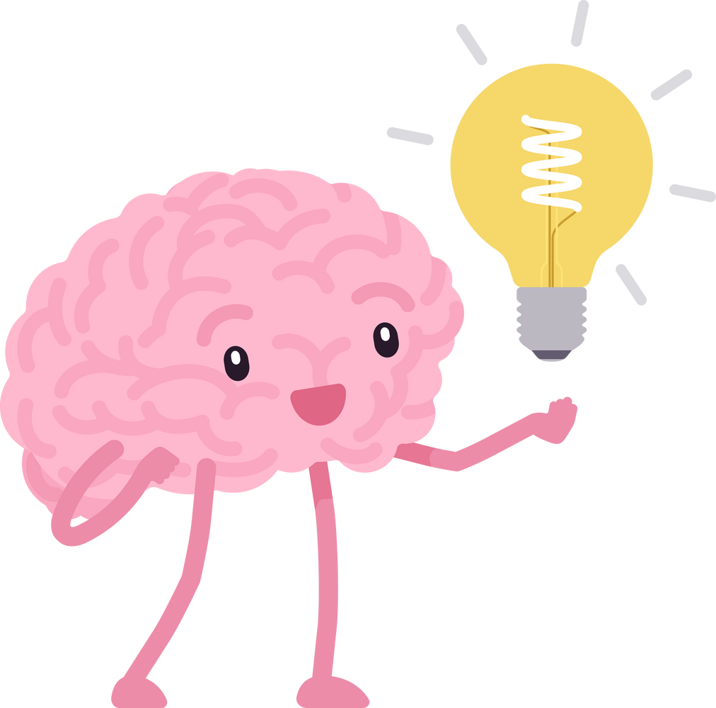
WHY IS IT SO HARD TO CHANGE ?
Many of us have valid reasons for not prioritizing our health
S
M
A
R
T
Specific
Measurable
Achievable
Realistic
Timely
Set 1 “SMART” goal
Evaluate your motivation
Seek professionnal support
Notes:
To bridge the gap between what we know we should change for our health and what we actually do, it’s essential to listen to ourselves, reflect on our needs, and take actionable steps towards our goals
Creating SMART goals can boost your chances of success:
Specific: Make your goal clear. Instead of "I want to get fit," say "I want to exercise for 30 minutes a day."
Measurable: Track your progress. For example, "I want to eat plant based food 3x a week" allows you to measure your success.
Achievable: Your goal should be realistic and attainable. Setting a goal to run a marathon next month when you haven't run in years may not be achievable.
Realistic: Ensure your goal is relevant to your life and aligns with your values. It should be something you genuinely want to achieve. For ex : At the hospital, we need to be efficient, but let's be honest: we’re not trying to reach the speed of light here! After all, if we did, we'd end up creating a black hole in the waiting room!
Timely: Set a deadline for your goal. For example, "I will complete my goal by the end of this year" gives you a clear timeframe to work within.
Evaluating your motivation helps you clarify why you want to make a change. When you understand your underlying reasons, you're more likely to stay committed, even when challenges arise. Assessing your motivation allows you to recognize what's holding you back. Are you afraid of failure? Do you feel overwhelmed? Understanding these barriers can help you develop strategies to overcome them.
Seeking professional support it’s a proactive step towards achieving your goals. With the right guidance, you can make lasting changes and improve your overall well-being.

Slide 9

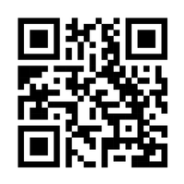
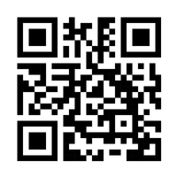
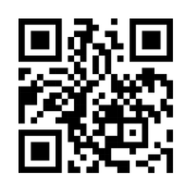

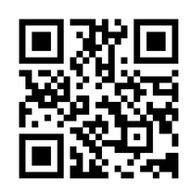
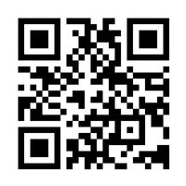

ONLINE TOOLS
To help you to take action and evaluate your risks
“Know your risk and prevent a stroke”
“Healthy Lifestyle”
“My action plan”
“Evaluate your cardiovascular risks”
“Prevent Stroke”
ALSO SEEK PROFESSIONAL SUPPORT
Notes:
Explore a variety of online tools designed to support your health journey by scanning the QR codes below. These resources can help you assess your current risk factors and provide actionable steps towards improvement.
"Types of Tools Available,
first column : Risk Assessment Tools: Evaluate your individual health risks.
Educational Resources: Learn about stroke prevention and healthy habits.
Goal-Setting Platforms: Create and track your SMART goals.
And remember : Working with health professionals is essential for personalized guidance, accountability, and overcoming obstacles on our journey to better health.

Slide 10
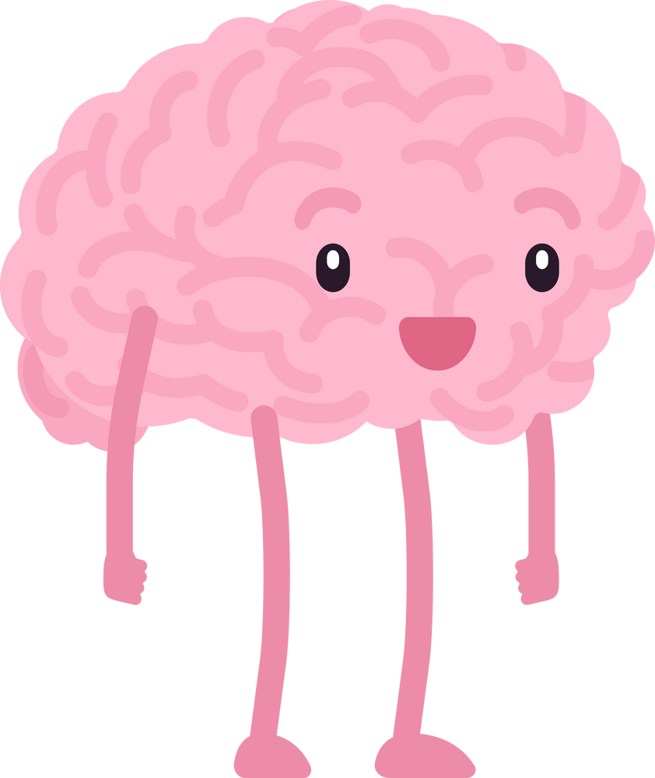
CONCLUSION
  Most strokes may be prevented by taking action
  Ambivalence to change is normal: let’s set SMART goals
  Together we are stronger
  Lifelong learning
  Celebrate progress
  A fail is an opportunity to try differently and to grow
Notes:
Empower Yourself: You have the power to make informed choices that benefit your brain health. Every decision counts, whether it’s following a Mediterranean diet, staying active, or managing stress
Feeling ambivalent about change is normal—let’s set SMART goals to overcome it!” By doing so, you can create a clear roadmap towards better health.
Together…: Don’t hesitate to reach out for help—whether from professionals, friends, or family. Together, we can encourage one another and share our journeys towards healthier lives.
We can always learn new things and adopt healthier habits.
Celebrate Progress: Take time to recognize and celebrate your achievements, no matter how small. Every positive change you make contributes to your overall health and well-being.
If we encounter setbacks, let’s view them as opportunities to try again and grow.

Slide 11

THANK YOU
elsa.fuchs@hug.ch
Notes:
In conclusion, let’s commit to prioritizing our brain health and supporting one another in this journey. Together, we can build a healthier future for ourselves and our communities. Thank you!

Slide 12
REFERENCES (1)
  Aigner A, Grittner U, Rolfs A, et al. Contribution of established stroke risk factors to the burden of stroke in young adults. Stroke 2017;48(7):1744–1751. doi:10.1161/STROKEAHA.117.016599
  AHRQ. Agency for Healthcare Research and Quality [En ligne]. My action plan [cité le 31 juillet 2024]. Disponible: https://www.ahrq.gov/health-literacy/improve/precautions/tool15a.html
  Boehme AK, Esenwa C, Elkind MS. Stroke Risk Factors, Genetics, and Prevention. Circ Res. 2017 ;120(3):472-495. DOI: 10.1161/CIRCRESAHA.116.308398
  Cheng YC, Ryan KA, Qadwai SA, et al. Cocaine use and risk of ischemic stroke in young adults. Stroke 2016;47(4):918–922. doi:10.1161/STROKEAHA.115.011417
  Chiu YC, Bai YM, Su TP, et al. Ischemic stroke in young adults and preexisting psychiatric disorders: a nationwide case–control study. Medicine (Baltimore) 2015;94(38):e1520. doi:10.1097/MD.0000000000001520
  Chobanian AV, Bakris GL, Black HR, Cushman WC, Green LA, Izzo JL Jr, Jones DW, Materson BJ, Oparil S, Wright JT Jr, Roccella EJ; National Heart, Lung, and Blood Institute Joint National Committee on Prevention, Detection, Evaluation, and Treatment of High Blood Pressure; National High Blood Pressure Education Program Coordinating Committee. The Seventh Report of the Joint National Committee on Prevention, Detection, Evaluation, and Treatment of High Blood Pressure: the JNC 7 report. JAMA. 2003;289:2560–2572. DOI: 10.1001/jama.289.19.2560

Slide 13
REFERENCES (2)
  Deschasaux-Tanguy M, Huybrechts I, Julia C, Hercberg S, Sarda B, Fialon M et al. Nutritional quality of diet characterized by the Nutri-Score profiling system and cardiovascular disease risk: a prospective study in 7 European countries. The Lancet Reg Health. 2024; 0(0):1-13. DOI:10.1016/j.lanepe.2024.101006
  Elser H, Vijayaraghavan M, Kasner SE. E-Cigarettes and Stroke Risk-Present Uncertainties and Future Directions. JAMA Neurol. 2023 Sep 1;80(9):883-884. doi: 10.1001/jamaneurol.2023.2050
  Estruch R, Ros E, Salas-Salvadó J, et al; PREDIMED Study Investigators. Primary prevention of cardiovascular disease with a Mediterranean diet. N Engl J Med. 2013;368:1279–1290. DOI:: 10.1056/NEJMoa1200303
  Fonseca AC, Ferro JM. Drug abuse and stroke. Curr Neurol Neurosci Rep 2013;13(2):325. doi: 10.1007/s11910-012-0325-0
  HUG. L’essentiel c’est vous ! [En ligne]. Syndrome métabolique [cité le 23 juillet 2024]. Disponible: https://www.hug.ch/elips/syndrome-metabolique
  HUG. What is atherosclerosis ? [En ligne]. Geneva: Elips program; 2016 [cité le 23 juillet 2024]. Vidéo: 0,25 min. Disponible: https://www.youtube.com/watch?v=JNPD4dX0VcU

Slide 14
REFERENCES (3)
  O'Donnell MJ, Chin SL, Rangarajan S, Xavier D, Liu L, Zhang H, Rao-Melacini P, Zhang X, Pais P, Agapay S, Lopez-Jaramillo P, Damasceno A, Langhorne P, McQueen MJ, Rosengren A, Dehghan M, Hankey GJ, Dans AL, Elsayed A, Avezum A, Mondo C, Diener HC, Ryglewicz D, Czlonkowska A, Pogosova N, Weimar C, Iqbal R, Diaz R, Yusoff K, Yusufali A, Oguz A, Wang X, Penaherrera E, Lanas F, Ogah OS, Ogunniyi A, Iversen HK, Malaga G, Rumboldt Z, Oveisgharan S, Al Hussain F, Magazi D, Nilanont Y, Ferguson J, Pare G, Yusuf S; INTERSTROKE investigators. Global and regional effects of potentially modifiable risk factors associated with acute stroke in 32 countries (INTERSTROKE): a case-control study. Lancet. 2016 Aug 20;388(10046):761-75. DOI: 10.1016/S0140-6736(16)30506-2
  PAHO and WHO. Bringing health to every corner of the Americas [En ligne]. Cardiovascular risk calculator app [cité le 14 août 2024]. Disponible: https://www.paho.org/en/hearts-americas/cardiovascular-risk-calculator-app
  Sztajzel R, Jonniaux S, Schneider F. L’accident vasculaire cérébral [En ligne]. Genève: Service communication HUG; 2012 [cité le 23 juillet 2024]. Vidéo: 18 min. Disponible: https://www.youtube.com/watch?v=ZoHOw2bK6tY&t=246s

Slide 15
REFERENCES (4)
  Swiss Atherosclerosis Association. Groupe de travail Lipides et athérosclérose [En ligne]. Calculateur de risque du GSLA [cité le 23 juillet 2024]. Disponible: https://agla.ch/fr/calculateurs-outils/calculateur-de-risque-du-gsla
  Tsai YT, Li R, Jao T, Fang CW, Hsiao YJ, Tsai CH, Chang KC. Comparison of FAST and Stroke-112: A randomized study in Taiwan. J Formos Med Assoc. 2022 Jan;121(1 Pt 1):187-192. DOI: 10.1016/j.jfma.2021.02.018
  Young T, Finn L, Peppard PE, Szklo-Coxe M, Austin D, Nieto FJ et al. Sleep disordered breathing and mortality: eighteen-year follow-up of the Wisconsin Sleep Cohort. Sleep [En ligne]. 2008[cité le 14 octobre 2024]; 31: 1071-8. Disponible: https://www.ncbi.nlm.nih.gov/pmc/articles/PMC2542952/
  World Stroke Organization. For a life free from stroke [En ligne]. Prevent stroke [cité le 14 août 2024]. Disponible: https://www.world-stroke.org/world-stroke-day-campaign/prevent-stroke
  World Stroke Organization. For a life free from stroke [En ligne]. Stroke Riskometer [cité le 14 août 2024]. Disponible: https://www.world-stroke.org/world-stroke-day-campaign/prevent-stroke/stroke-riskometer
  Zhao J, Eckenhoff MF, Sun WZ, Liu R. Stroke 112: A Universal Stroke Awareness Program to Reduce Language and Response Barriers. Stroke. 2018 Jul;49(7):1766-1769. DOI : 10.1161/STROKEAHA.118.021729

