Slide 1
Muon Collider
Civil Engineering Studies
John Osborne, Tamara Bud SCE-SAM-FS
31/05/2024

Slide 2
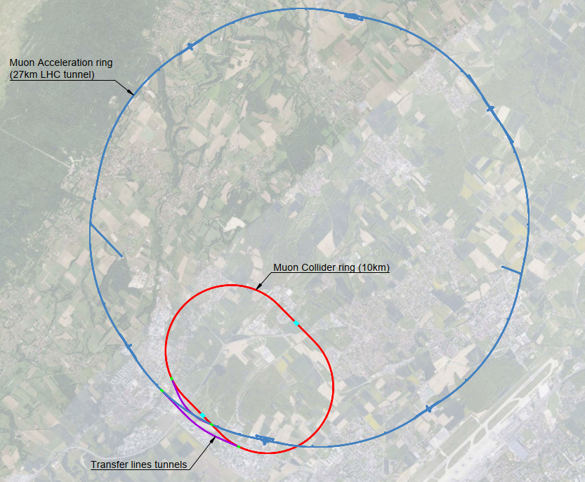
Overview

Slide 3
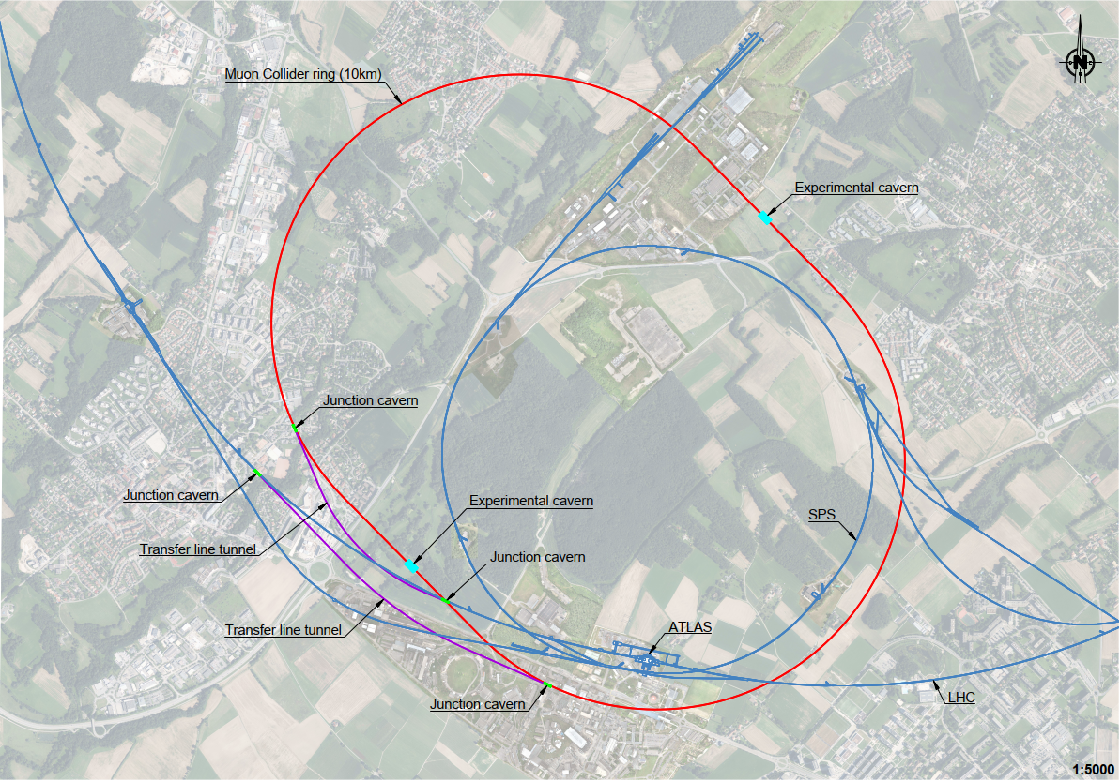
Collider Ring
Detail

Slide 4
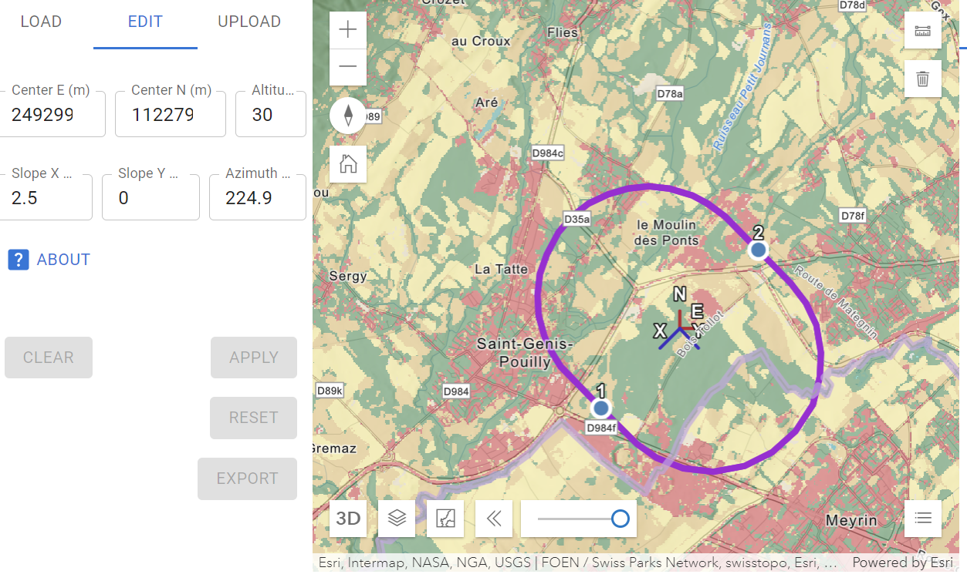
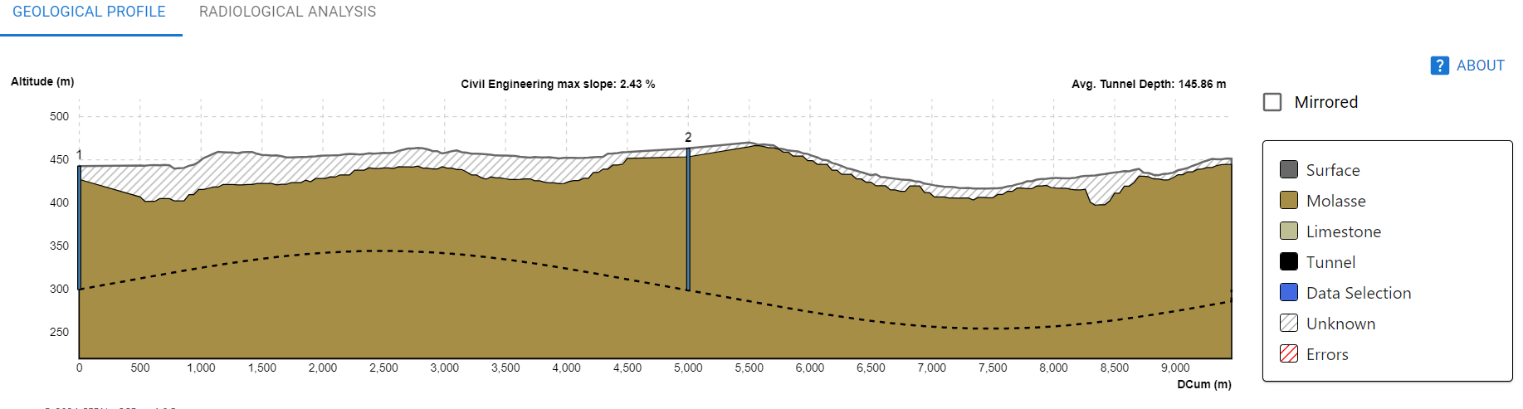
Placement of Collider Ring
Placement of collider such that no interference with existing/future infrastructure (e.g. tunnels) and shafts within CERN (non-fenced) domain

Slide 5
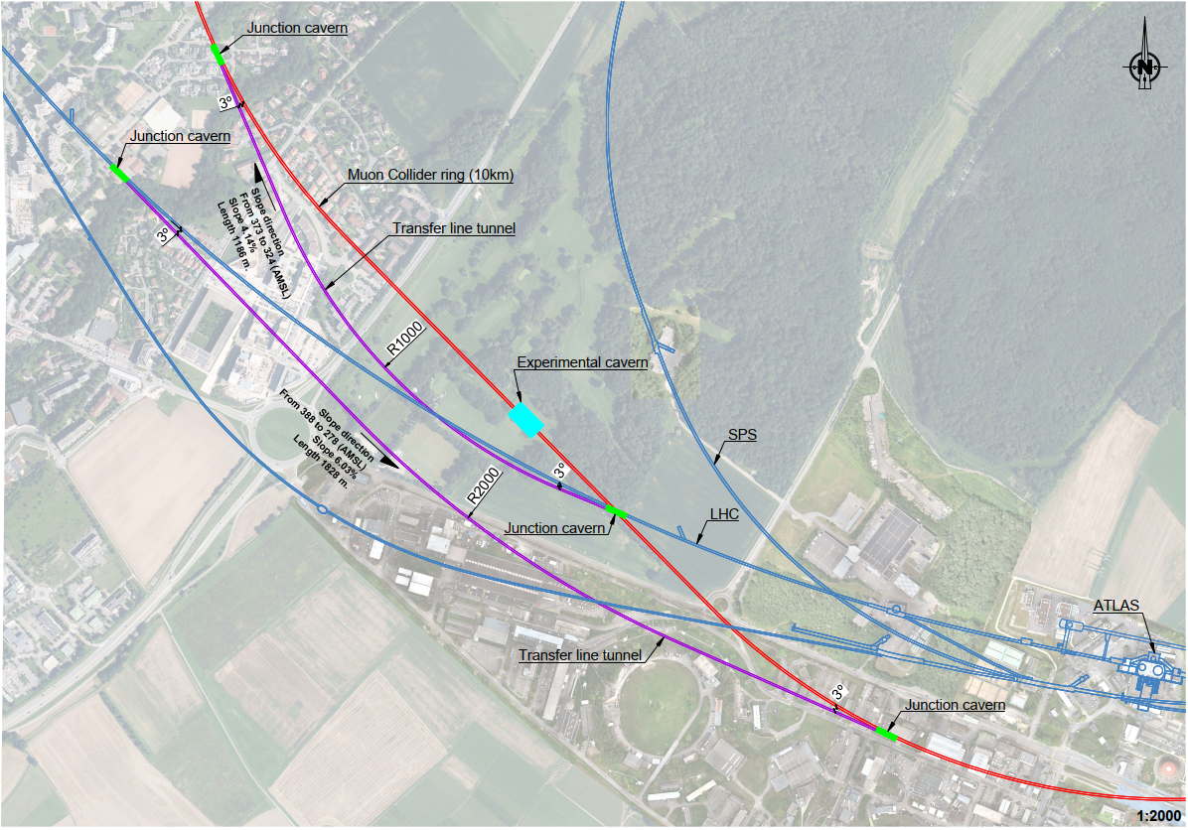
Transfer Lines
Detail

Slide 6
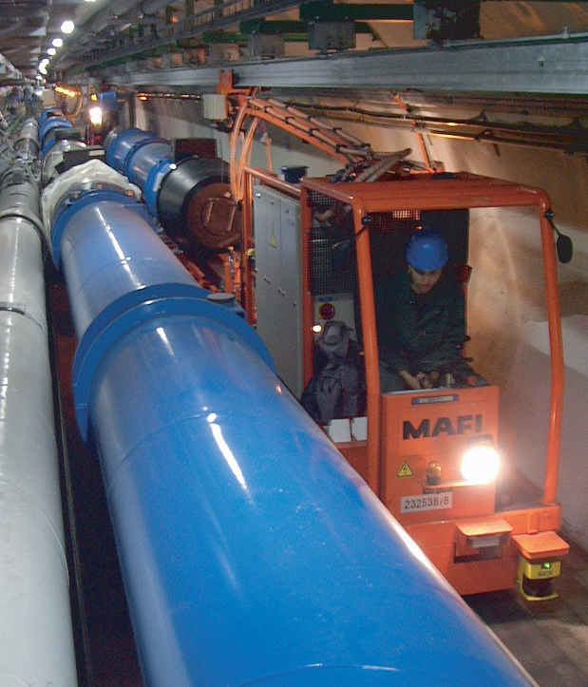
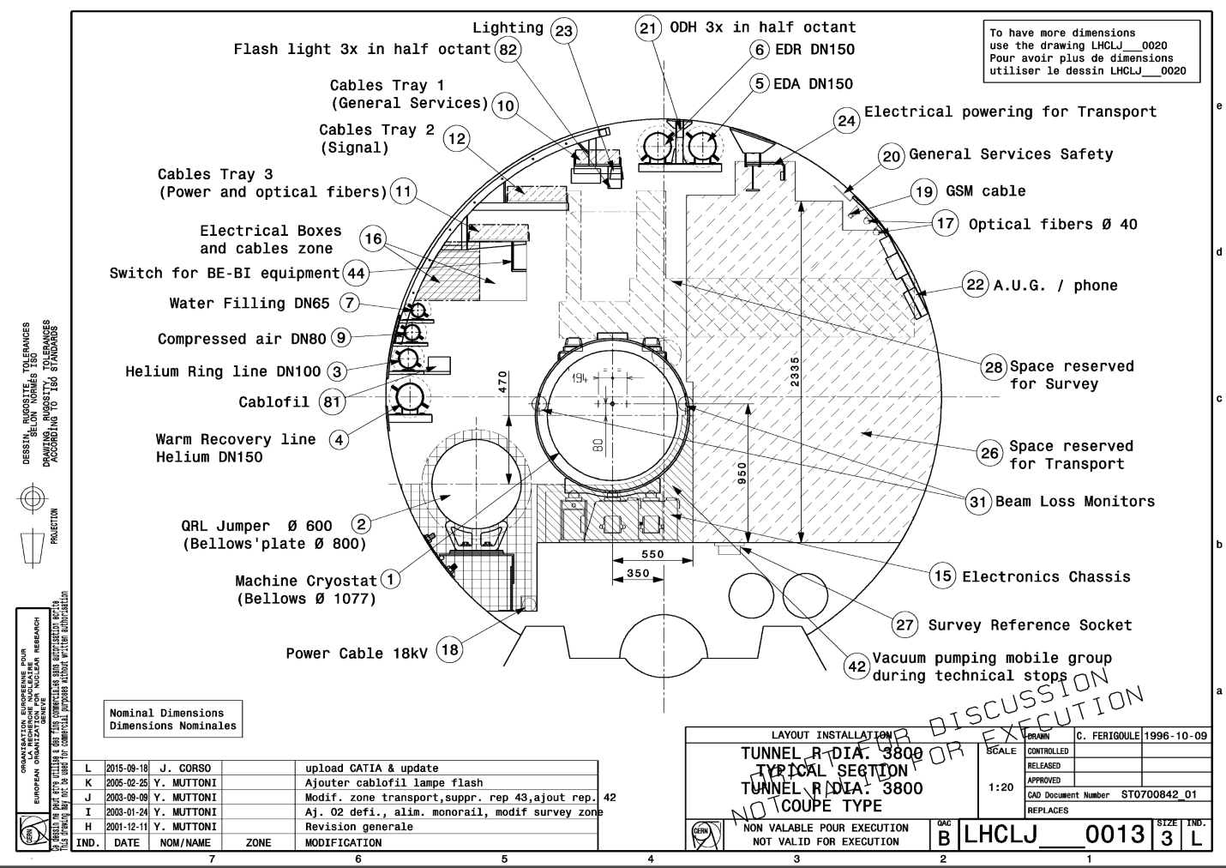
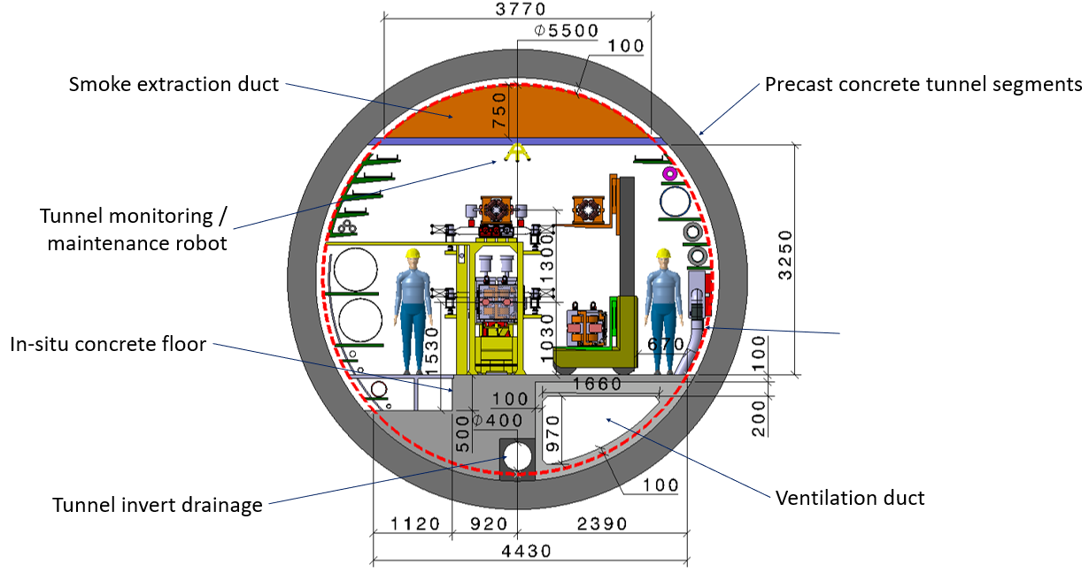
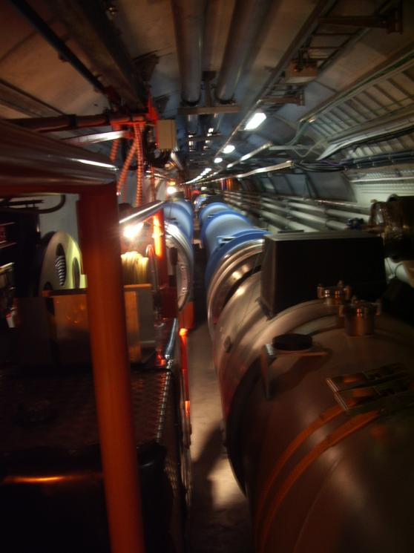
LHC cross section
3.8m
What size tunnel for Moun Collider ?
FCC cross section
5.5m

Slide 7
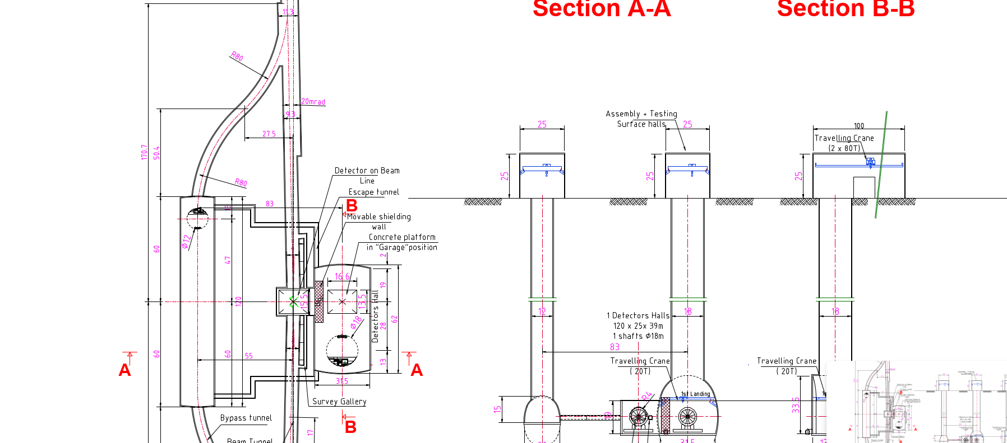
CLIC Experimental Caverns

Slide 8
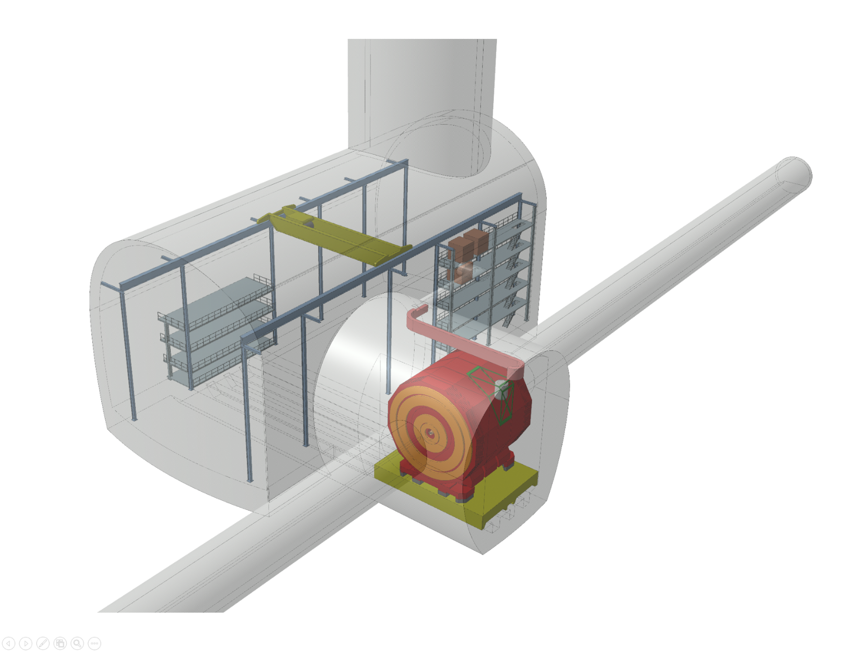
CLIC Experimental Cavern

