Slide 1

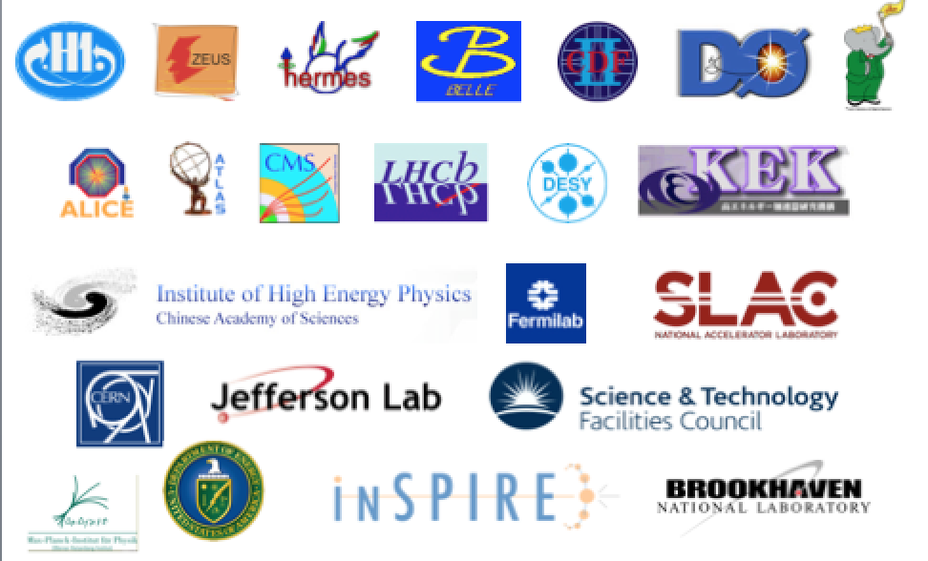


Data Preservation in High Energy Physics: report and perspectives
Cristinel DIACONU
CPPM/CNRS-IN2P3/Aix-Marseille University
http://dphep.org

Slide 2
Data Preservation in High Energy Physics
What is “data”?
  not (only) : “files”
  but : “every digitally encoded information that was created as a result of planning, running and exploiting an experiment”
What is “preservation”?
  not: a freezer, a herbarium, a museum, an album, a cellar….
  but: the process of transforming a "high intensity/ rapidly changing " computing system into a "low intensity / slowly evolving" computing system with conserving the capacity of extracting new science from the "data”.
  Requires clear plans and a long term organization
    Within each collaboration and at international level (DPHEP)

Slide 3
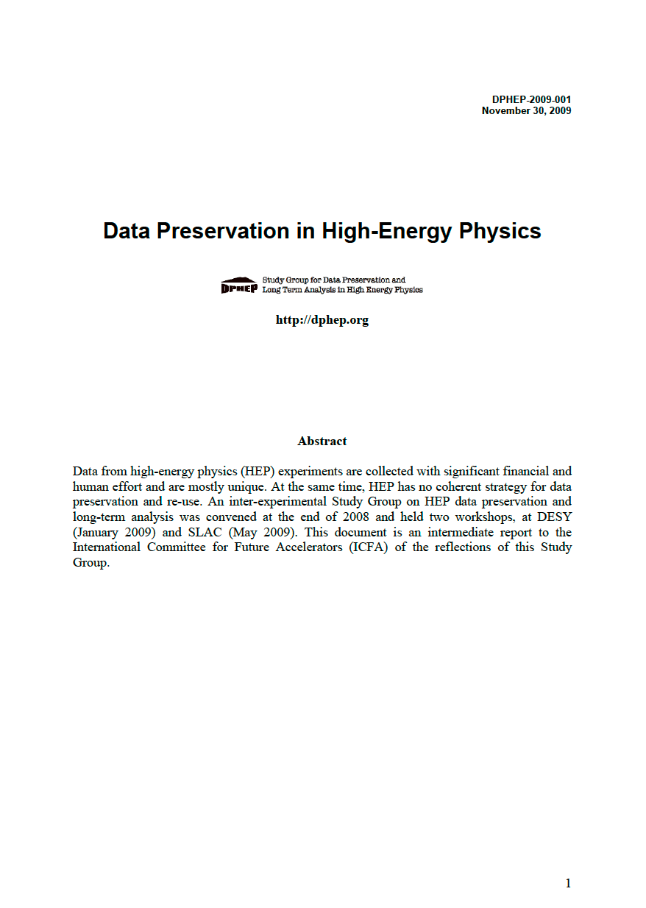
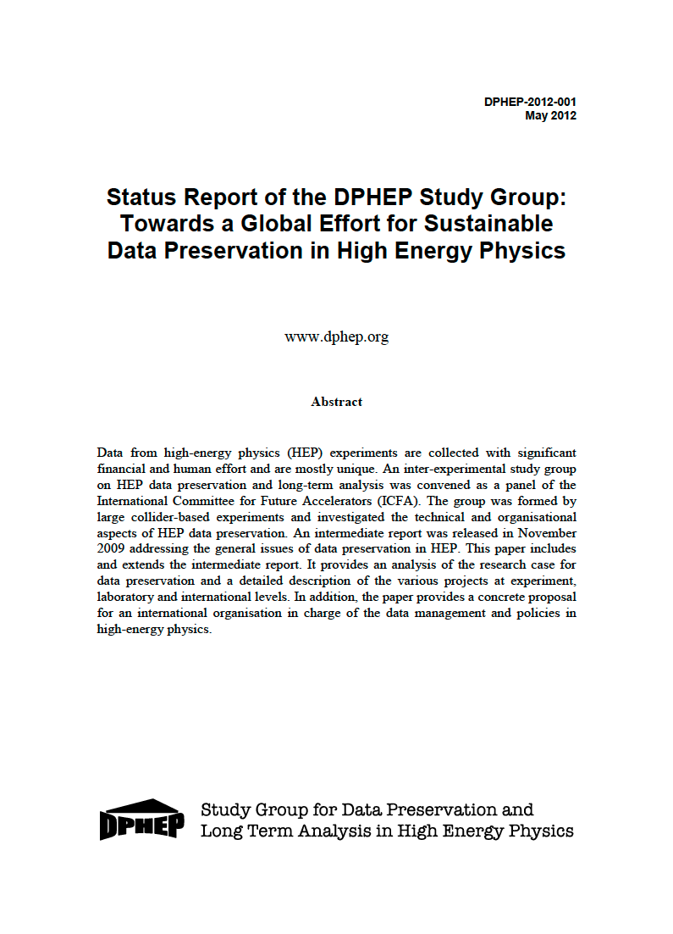
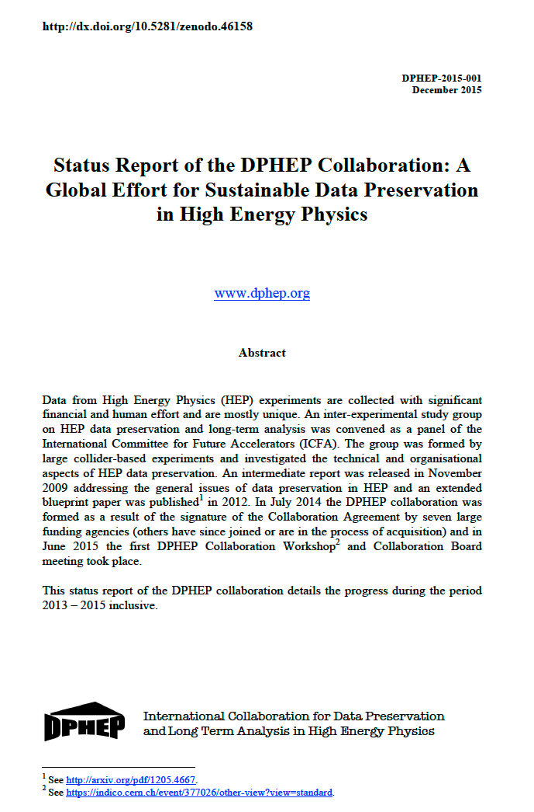
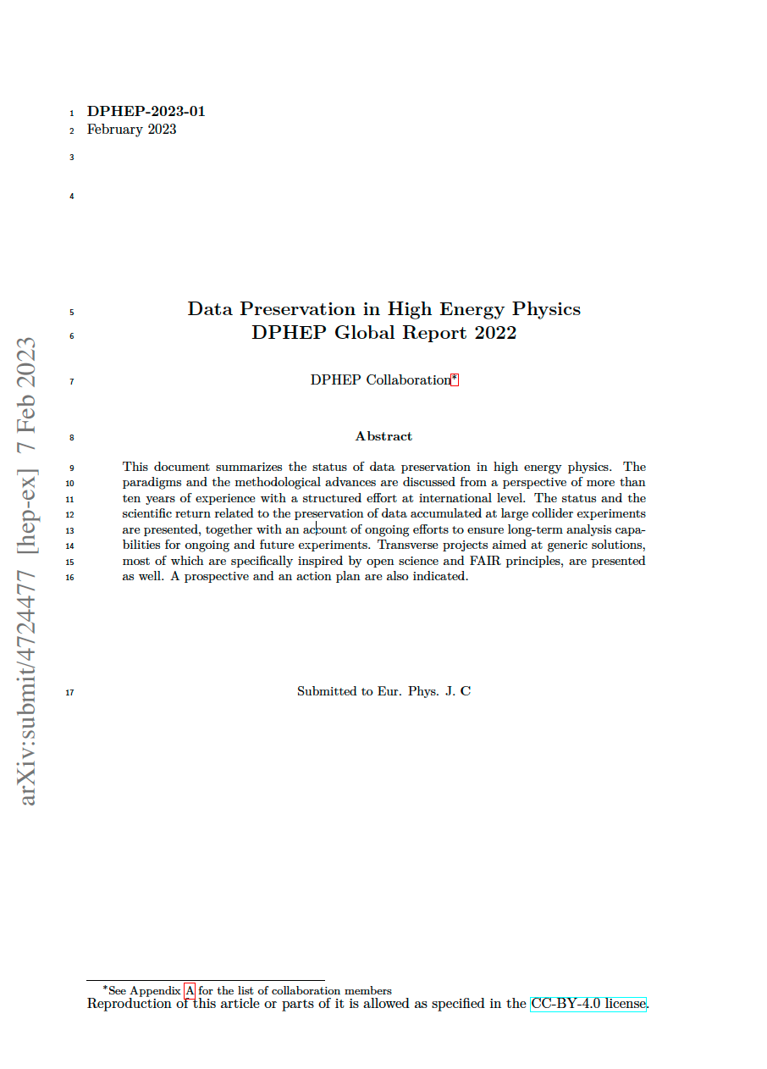
DPHEP Collaboration/ICFA Panel
2009
LoI
2012
Blueprint
2015
Collaboration MoU
2023
Decade report
arXiv:0912.0255
arXiv:1205.4667
arXiv: 1512.02019
arXiv: 2302.03583
http://dphep.org
Eur. Phys. J. C 83, 795 (2023)

Slide 4
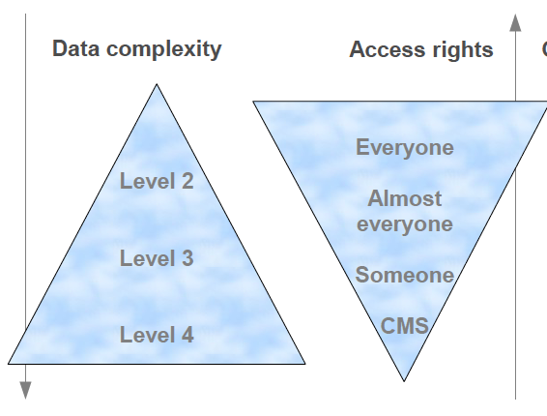
Guidance into data complexity
Preservation Model |  | Use Case
1 | Provide additional documentation | Publication related info search | Documentation
2 | Preserve the data in a simplified format | Outreach, simple analyses | Outreach, reanalysis
3 | Preserve the analysis level software and data format | Full scientific analysis, based on the existing reconstruction | Technical Preservation Projects
4 | Preserve the reconstruction and simulation software as well as the basic level data | Retain the full potential of the experimental data
CMS 2012

Slide 5
A matter of collaboration as well
The supervision and knowledge transfer/capture is essential at long term
Need to clarify the status and the rules
Various stages of organisation can be defined:
0: Organisation during experiment proposal.
1: Organisation during data taking.
2: Organisation after data taking
3: Organisation after the collaboration funding scheme.
4: Rescue organisational scheme. This organisation scheme is to be activated when:
  the host laboratory stops support and announce no long-term commitment.
  the official collaboration/data stewardship is stopped with no further plans (no step 3 is clearly defined).
Remarks:
Taking no action necessarily implies decommissioning (deleting) the data.
  “Securely” storing/freezing the files and the latest version of the software is certainly not a substitute for a preservation project.

Slide 6
Costs and Benefits
C1. Host laboratories allocate person power and computing resources.
in % to the construction/operation costs
C2. Collaborating laboratories participate in the effort: replicate or take over data and computing systems and provide technical assistance.
C3. Researchers and engineers participate outside their main research area.
C4. Innovative computing projects, including pluri-disciplinary open science initiatives, may
offer attractive opportunities for data preservation and are therefore an indirect source of support.
C5. The proximity of a follow-up experiment clearly helps in structuring and supporting a data preservation project.
B1. New publications – counting here those executed with a strong involvement of the dedicated DP systems.
B2. Publications made by other groups/people using the new publications produced at B1.
B3. Preserving the scientific expertise and the leadership in the field of the experiment, possibly
boosting the transition to a new experiment
B4. Technology expertise in robust data preservation. Improved ability to plan for new experiments
and preserve their scientific potential at long term.
FoM = B1/C1

Slide 7

2023: Experiments Data Preservation Status
Colaboration in rescue mode
Laboratory/ Collider | Experiment | Data taking period | Preservation Level | Data Volume | Present status | Coll
DESY/PETRA | JADE | 1979–1986 | 4 | 1 TB | Analysis running on preserved data; migrated from DESY to MPP | 4
CERN/LEP | ALEPH, DELPHI, L3, OPAL | 1989-2000 | 4 | 0.5 PB | Analysis running on preserved data | 4
DESY/HERA | H1 ZEUS | 1992 – 2007 | 4 3/4 | 0.5 PB 0.2 PB | Analysis running on preserved data | 3
SLAC/PEP II | BABAR | 1999–2008 | 4 | 2 PB | Analysis running on preserved data; migrated from home lab to different centers | 4
KEK/KEKB | Belle I | 1999-2010 | 4 | 4 PB | Analysis running on preserved data; Compatible with Belle II computing | 2
FNAL/TeVatron | DØ CDF | 1983–2011 | 4 4 | 8.5 PB 9 PB | Archived on tapes | 4
BNL/RHIC | PHENIX | 2000–2016 | 3 | 25 PB | Analysis running on preserved data | 3
FNAL/ν-beam | Minerva | 2010–2019 | 3 | 10 TB | Analysis running | 2
IHEP/BEPCII | BESIII | 2009–2030 | 4 | 6 PB | Collecting and analyzing data | 1
CERN/LHC | ALICE, ATLAS, CMS, LHCb | 2010-2040 | 4 | O(1EB) | Collecting and analyzing data | 1

Slide 8
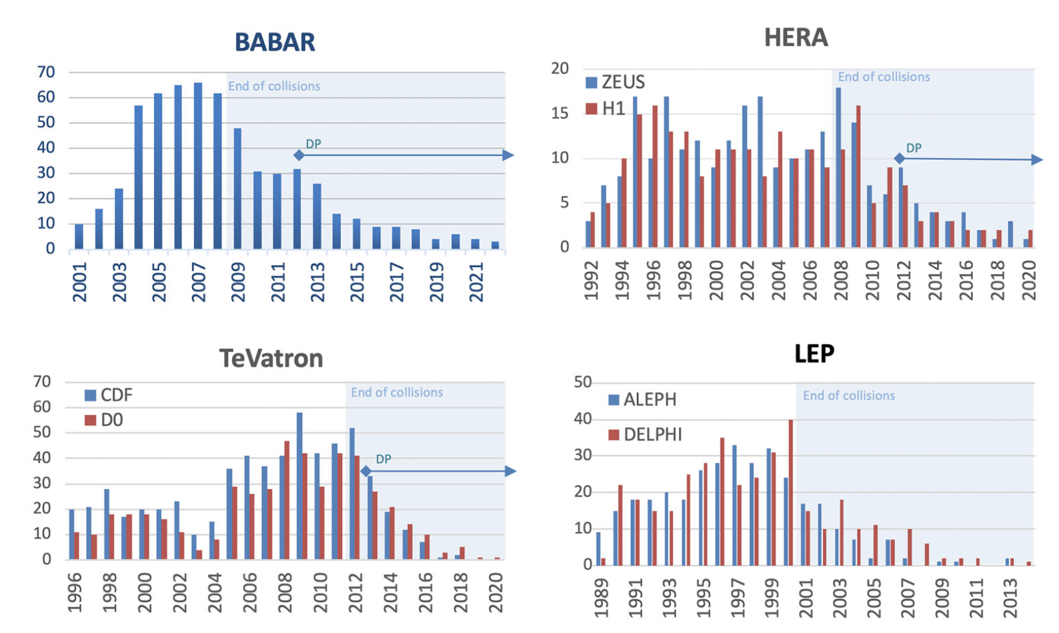
Conclusions after 10 years: the scientific output
DP is a cost-effective way of doing fundamental research by exploiting unique data sets in the light of the increasing theoretical understanding.
DP leads to
  a significant increase in the scientific output (10% typically)
  for a minimal investment overhead (0.1%).
  …. As predicted in 2013
 | Data taking stopped | Publications before 2012 | Publications after 2012 | Scientific return increase %
Babar | 2008 | 471 | 154 | 33%
H1+ZEUS | 2007 | 436 | 62 | 14%

Slide 9
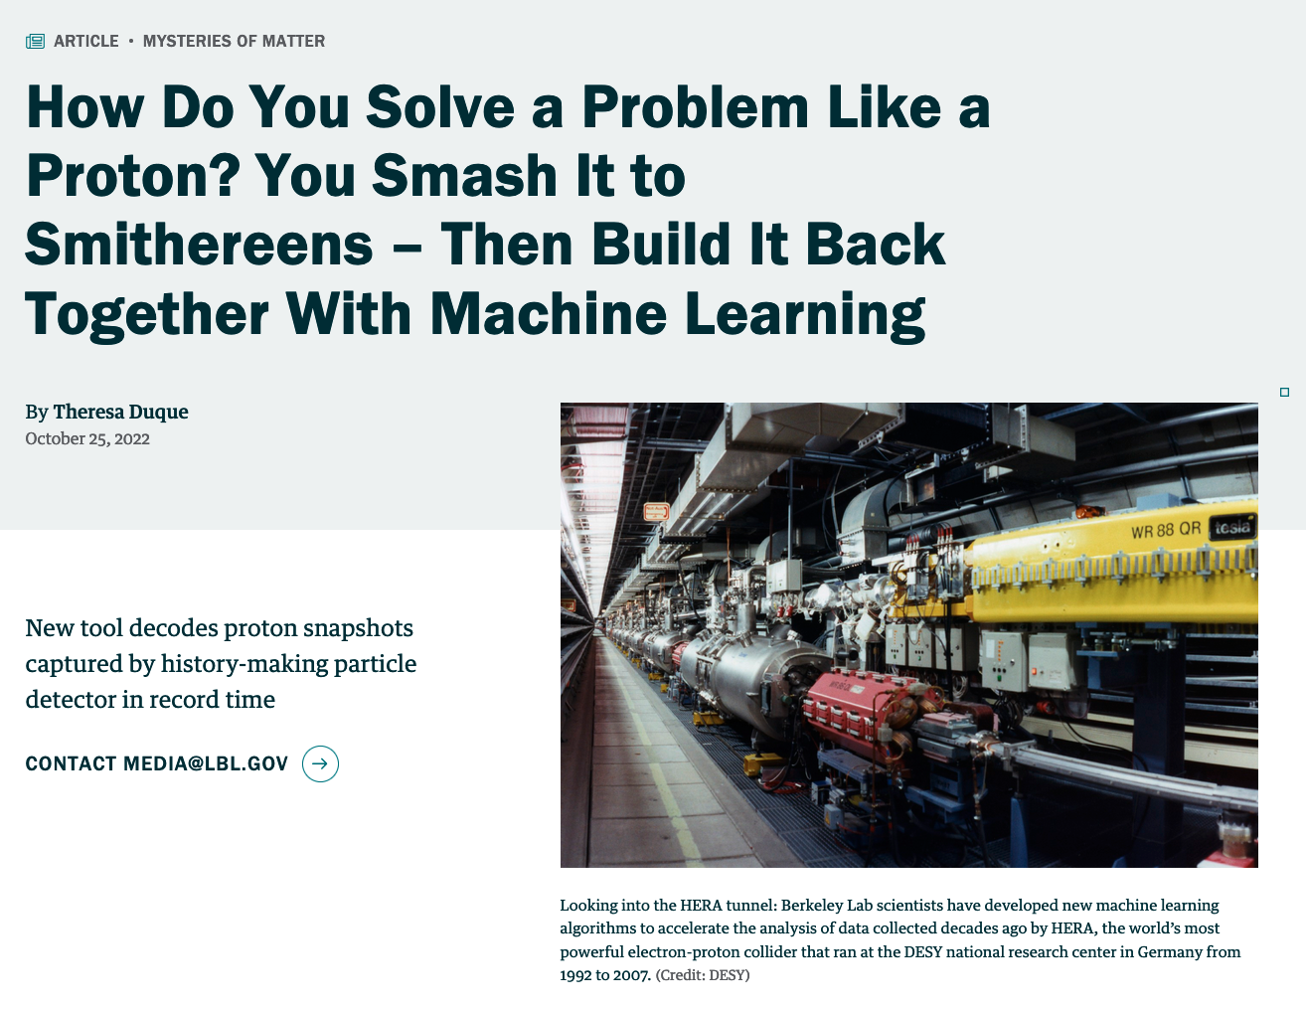
Boosting the future experiments
Preserved data can be used to transfer knowledge, training/teaching, outreach or boosting new research programs
HERA ➔ EIC
  “Scientists today have a renewed interest in HERA’s particle experiments, as they hope to use the data – and more precise computer simulations informed by tools like OmniFold – to aid in the analysis of results from future electron-proton experiments, such as at the Department of Energy’s next-generation Electron-Ion Collider (EIC). “
Possibly
  LHC ➔ FCChh
  LEP ➔ FCCee
https://newscenter.lbl.gov/2022/10/25/solving-the-proton-puzzle/

Slide 10
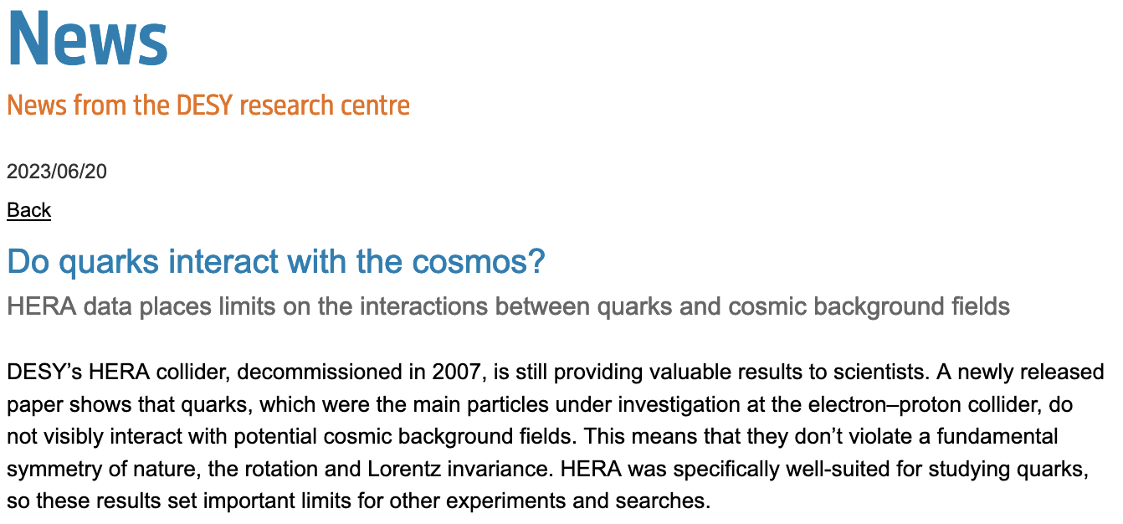
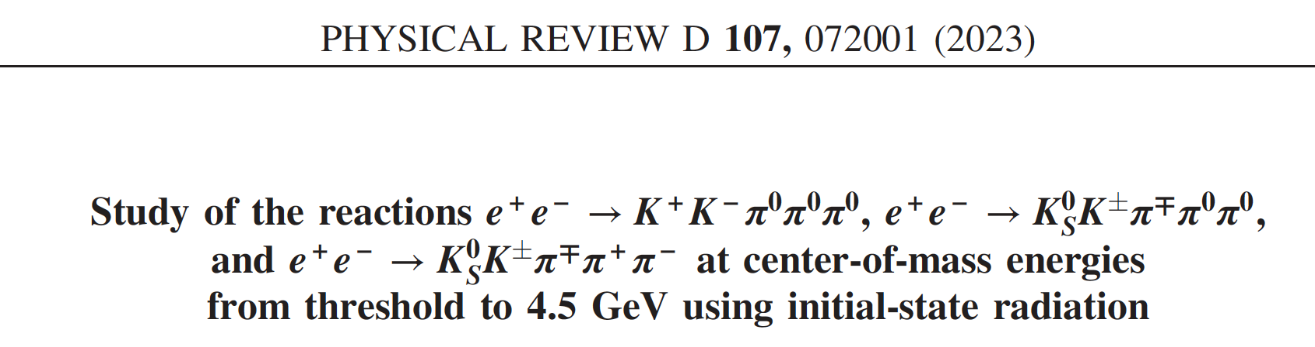
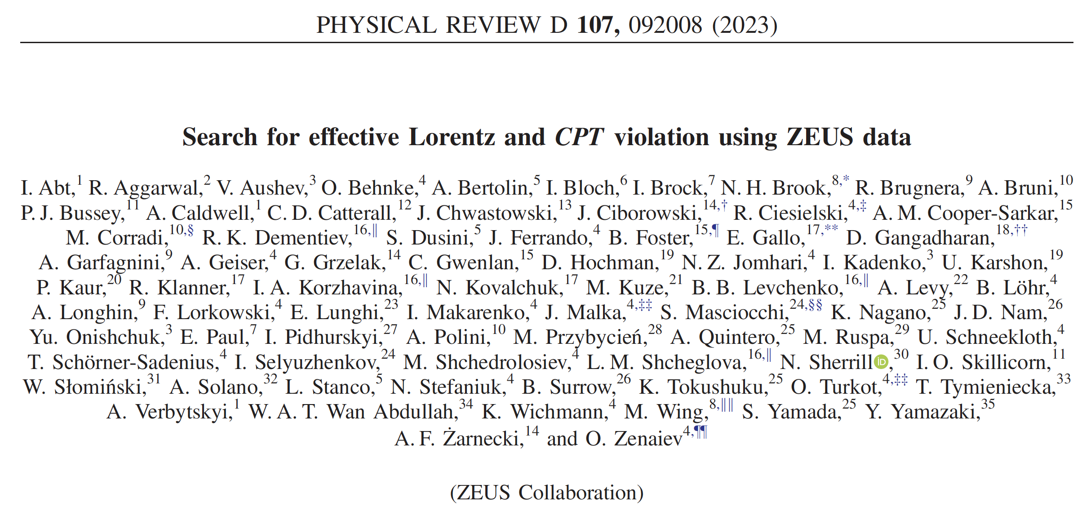
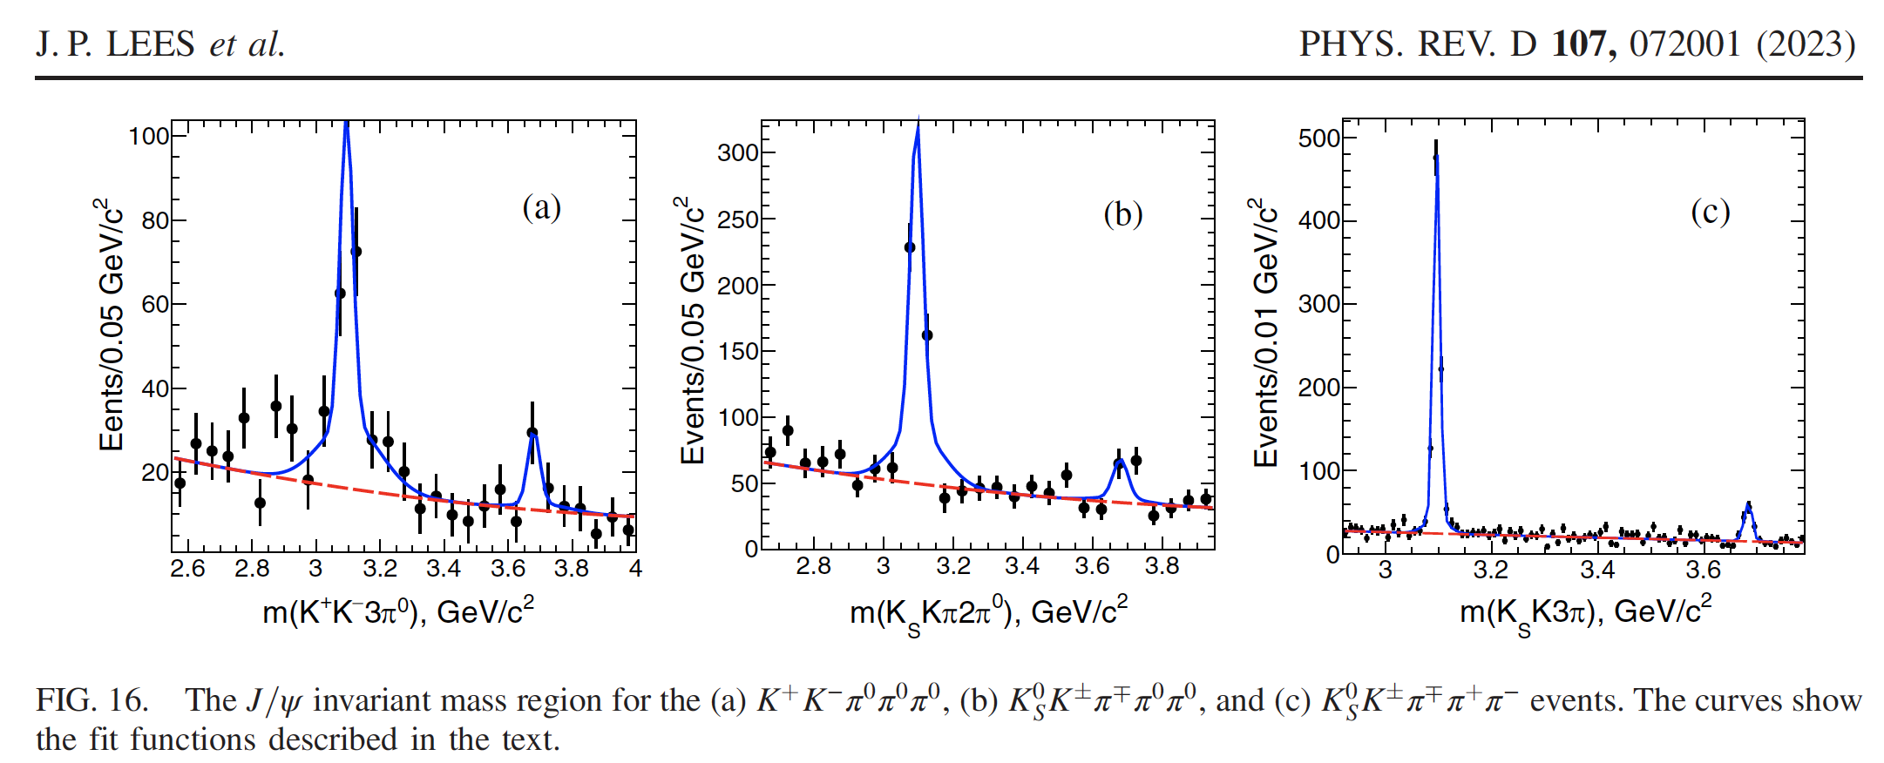
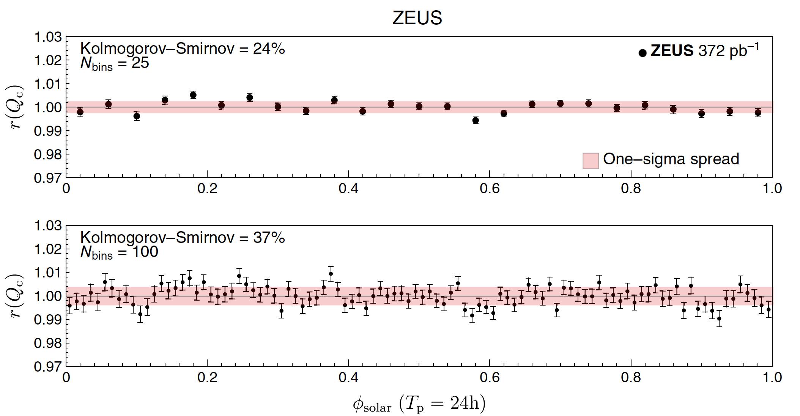
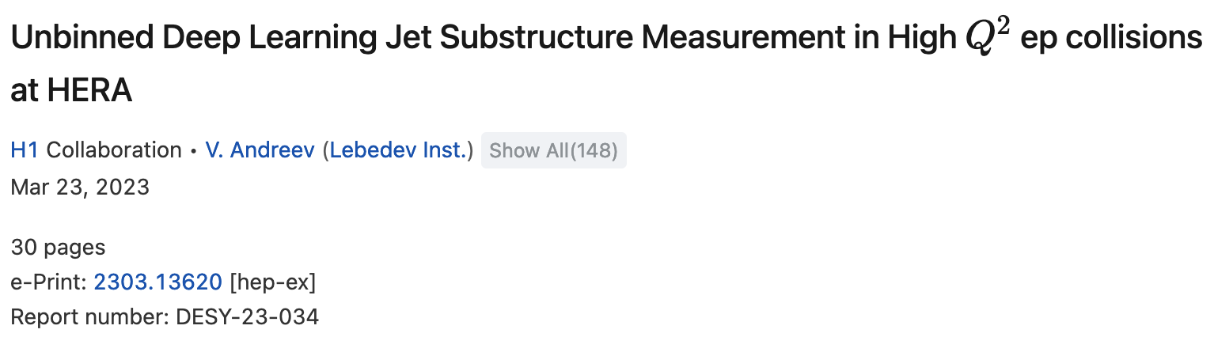
…and ongoing
BaBar April 2023
The 600th paper
ZEUS June 2023
H1 Mars 2023

Slide 11
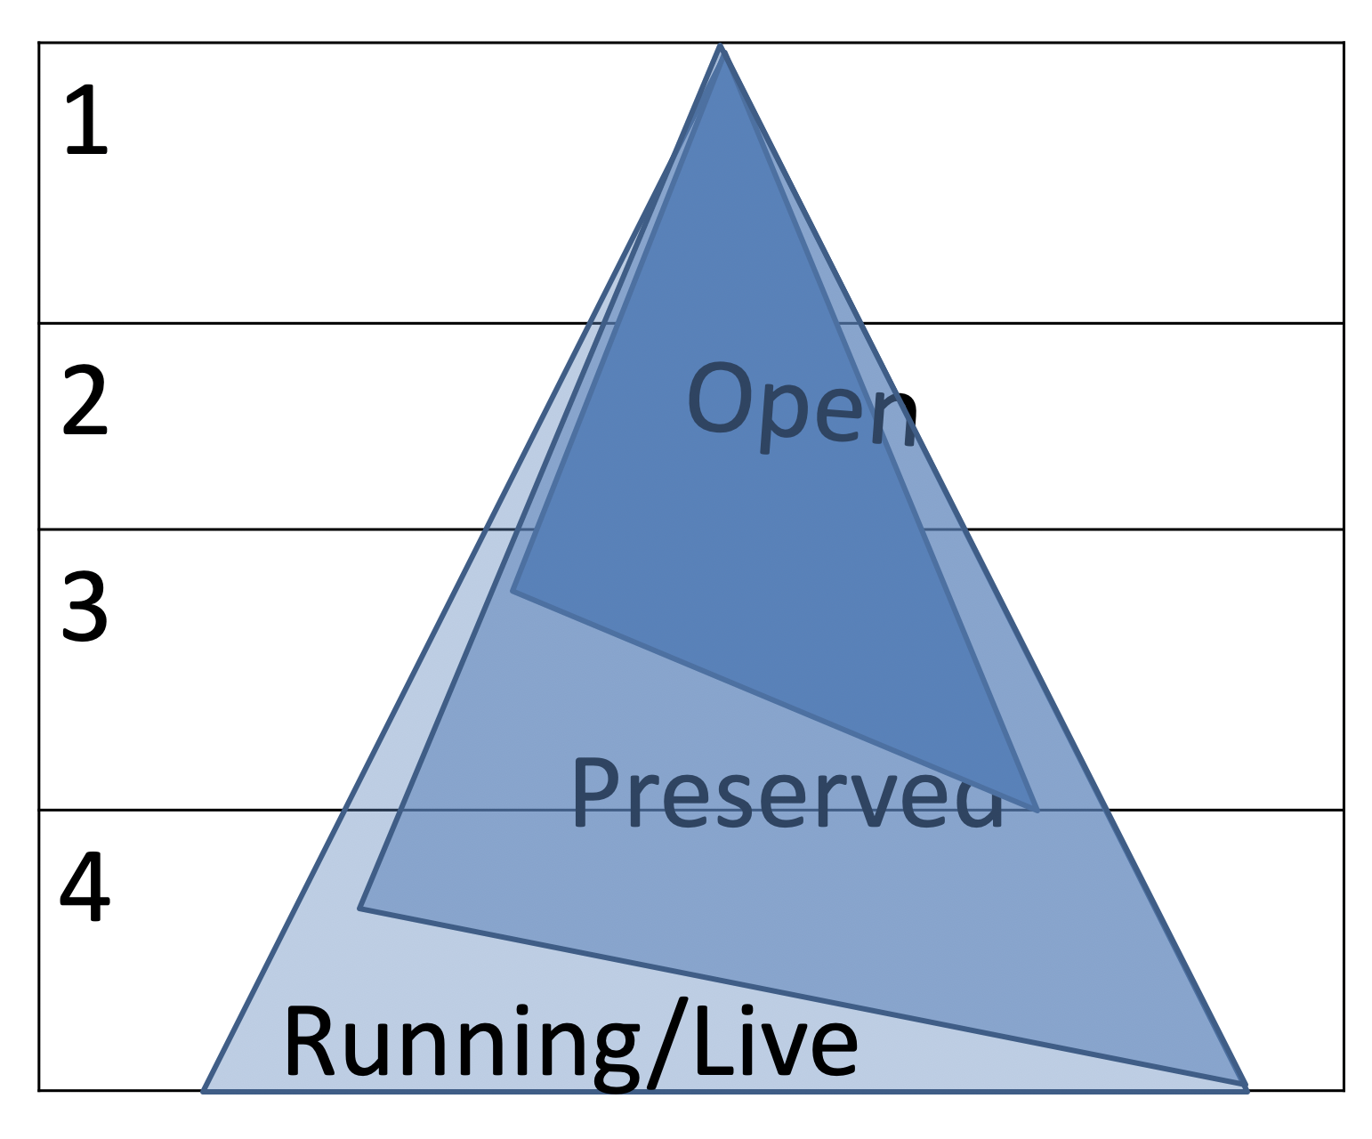
Preserved (time-like) and Open (space-like) Data
Planning for preserved data improves the design of running and future experiments
DP relies on and stimulates cutting-edge technology developments
DP is strongly linked to Open Science and FAIR data paradigms
  F findable A accessible R reproducible
  Most difficult to obtain is “I” : interoperability
Examples:
  CERN Open Data Portal, Analysis Preservation (CAP), Reusable Analyses (ReAna), cernvm, key4hep etc.
  Experiments with long DP practice intend to join open data projects
    Lack of person power

Slide 12
Open Questions (homework)
1. Why the systems did not collapse after the data taking? The “common sense: “publish your last paper and leave”.
  Still, a small but motivated community voluntarily kept data alive for many years and extracted unique science from it, beyond the “local ntuples” philosophy that eventually perpetuates only very specialised analyses.
2. How are the human resources accounted for by the funding agencies or labs?
  Is doing analysis on preserved data subversive, tolerated or highly valued?
3. How are the publications valued in the “long-term” analysis mode of a collaboration?
  What is the impact of those publications? Are the authors able to claim visibility and recognition?
4. How is the value of this (new) science displayed?
  What is the full cost (and who is supporting it) to promote this 10% of additional science?
5 How is HEP data contributing to the human culture as a whole (like in arts, e.g. a painting, or a piece of music, which cannot be valued just in terms of of investment, resources and financial transactions)
6. What global resources were used 5 and 10 years past the end of the experiment to keep systems alive and publish?
7. Are the DP requirements compatible with the running experiments conditions? How much extra investments are needed to make ”fresh” data suitable for a long term preservation and how those investments can be optimised further when considering open data and open science aspects?
8. How are future projects supporting, stimulating and shaping data preservation projects and how are the cost and benefits of this transfer of knowledge accounted for?
9 Outreach and education done using real data sets?

Slide 13
Conclusions 1/2
Significant/measurable impact of dedicated DP projects @expts./labs
  Production of high quality and unique scientific results at very low (non-zero) cost
    10% output for less than 1% investment: ✓
    Long term organisation proves to be productive
  Signs of re-vigorating collaborations in the context of new projects
    HERA-EIC; LEP-FCCee
  Case for longer term preservation: data sets parking
    CDF, D0, Babar, LEP, Jade : carefully follow the usability in time
There is full coherence (but not total overlap) between DP and Open Data/Science
  LHC experiments consider both, looking forward to 2045
The (DP)HEP future is also considered
  FCC, EIC : transfer of knowledge in DP from LHC/oldies
And more is possible on:
  Education, training, outreach….(via open data)

Slide 14
Conclusions 2/2
Although the general awareness of DP in HEP has largely increased in the past decade, and lots of activities and successes are reported, there is still a lack of coherence between the different experiments and projects.
  Lessons for DL panel?
Transverse activities are still exceptions and cover only a minority of the existing data sets.
Moreover explicit support of DP by some labs and funding agencies should be at least maintained and probably increase.
Data preservation is one of the building blocks of the HEP scientific outcome and the DPHEP Collaboration intends to stimulate and support it.
In practice:
  DPHEP abstract accepted at CHEP ➔ talk in track 8
  DPHEP Workshop in autumn (before CHEP) 1.5 days remote+CERN
    Table tour and global report
    Possible topics: make “old” data open; value/outreach preservation (and open?)

Slide 15
If a system has a continuous symmetry property, then there are corresponding quantities whose values are preserved in time.
E. Noether

Slide 16
bckp

Slide 17
DPHEP (Hi)story

Slide 18
In 2013: HEP experiments in ± 10 ans : a change of phase was ongoing
2000
2010
today
2020
LHC LEP HERA Tevatron BaBar Belle CLEO C BES III KLOE RHIC SPS | pp / ions ee ep pp ee ee ee ee ee pp / ions Fixed target | fb⁻¹ ++ 0.9 fb⁻¹ 0.5 fb⁻¹ 10 fb⁻¹ 600 fb⁻¹ 1 ab⁻¹ ++ 0.9 fb⁻¹ fb⁻¹ ++ 1 fb⁻¹ ++ Multi-exp Multi-exp
Unique data here and everywhere
[not all programmes, dates are approximate, just to give the picture]

Slide 19
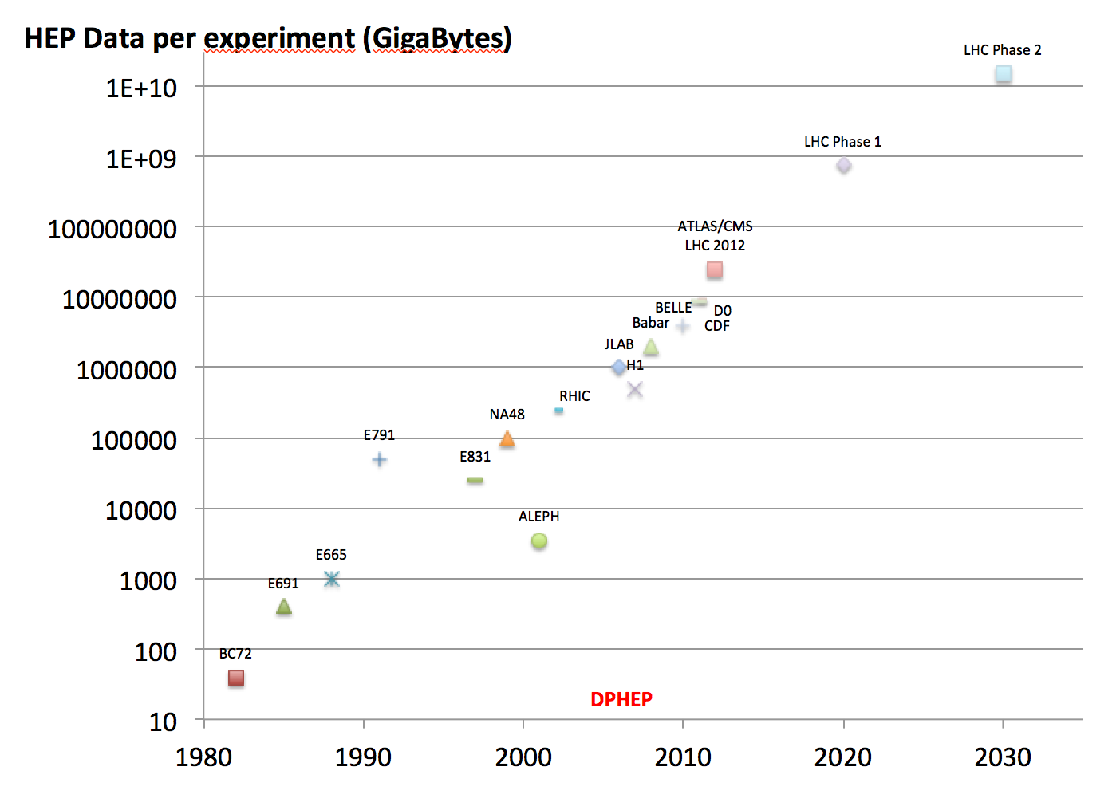
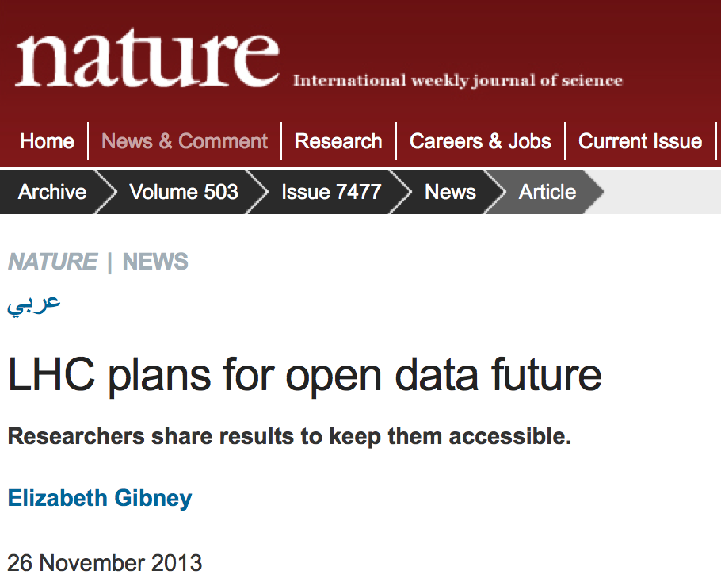
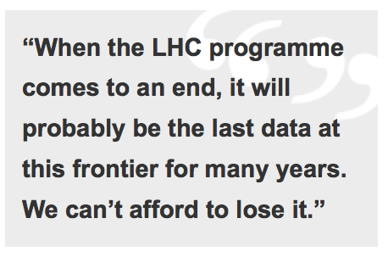
HEP Data
Scientific potential
Outreach, Training, Education
Arxiv: 1205.4667

Slide 20
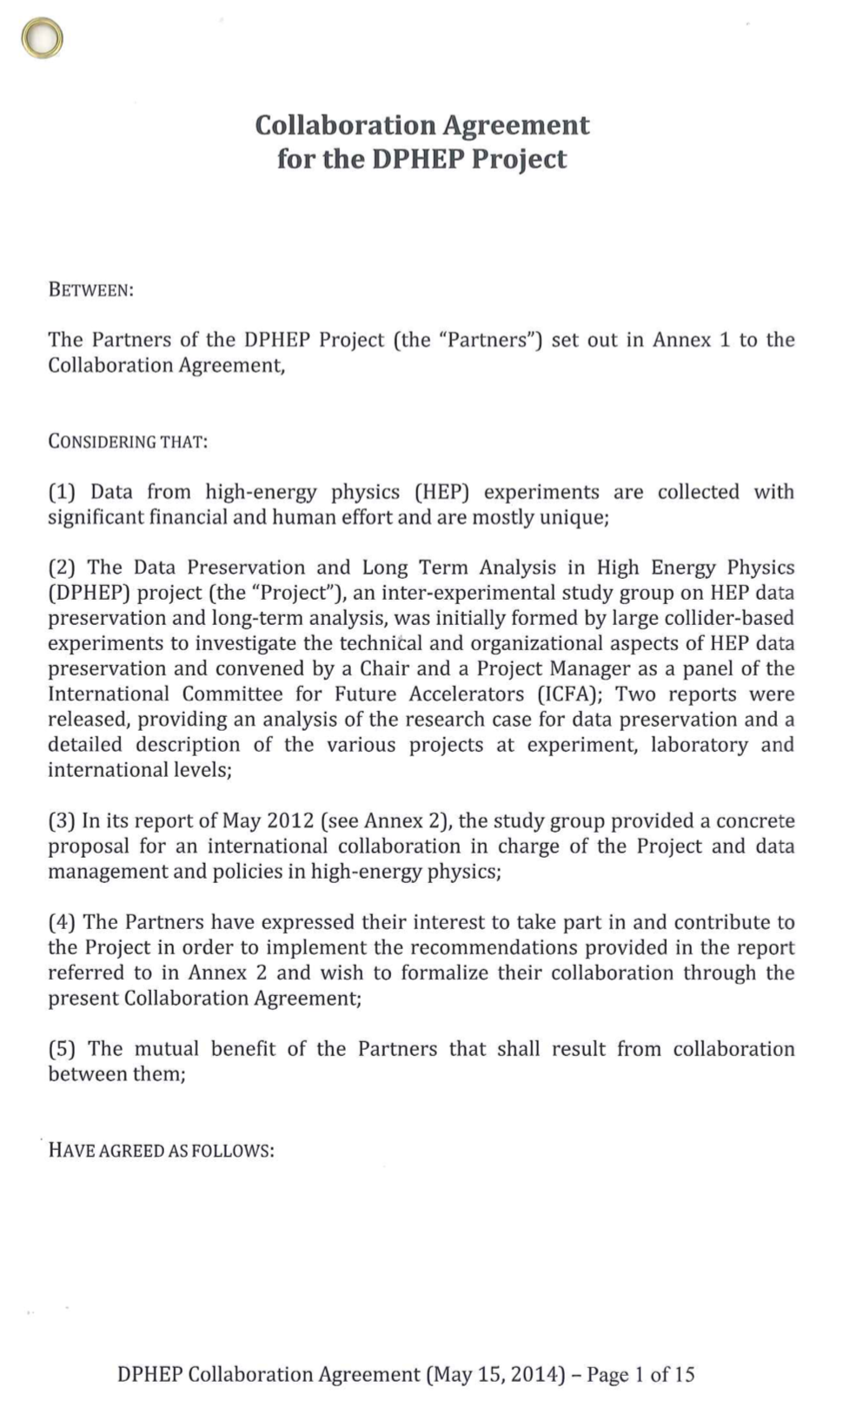
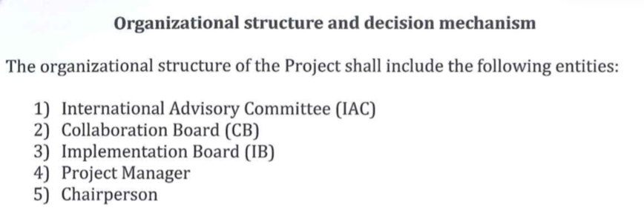
The DPHEP Collaboration
Collaboration Agreement was signed in 2014
  Give a clear sign of the will of labs to collaborate in this common challenge
Members:
  2014: CERN, DESY, HIP, IHEP, IN2P3, KEK, MPP
    2015 IPP/Canada , 2017 UK/STFC
  Active labs from US, Italy
    have not formally joined, but are represented in the Collaboration Board.
The DPHEP collaboration continue to act as an ICFA panel, as indicated in the Collaboration Agreement
  About 60 contact persons FA, Labs, experiments
  Mandate prolonged to 2024

Slide 21
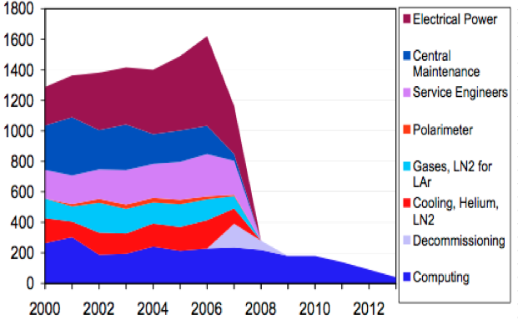
When it stops taking data
H1 budget previsions in 2007
(LHC 2042?)

Slide 22
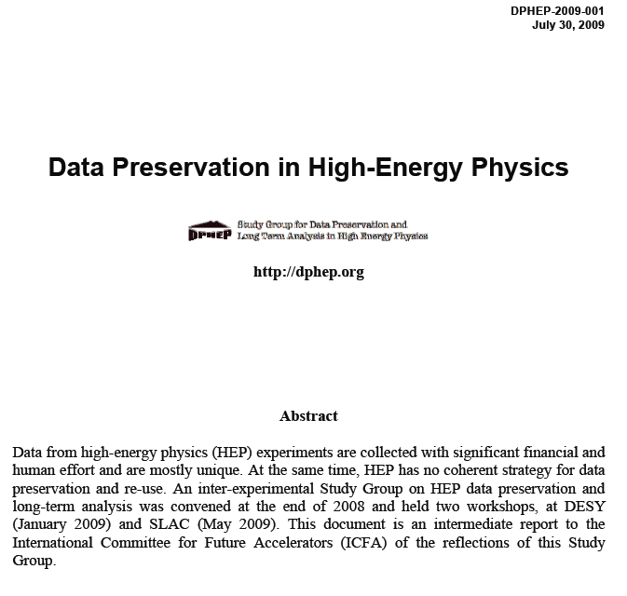
DPHEP Study Group (2009)
arXiv:0912.0255
An urgent and vigorous action is needed to ensure data preservation in HEP
  Examples for the physics case explored
  Data is rich and can be further exploited in most cases beyond the collaboration lifetime
The preservation of the full analysis capability of experiments is recommended, including the preservation of reconstruction and simulation software
An interface to the experiment know-how should be introduced: data archivist position in the computing centres
The preservation of HEP data requires a synergic action: collaborations, laboratories and funding agencies
An International Data Preservation Forum is proposed as a reference organisation. The Forum should represent experimental collaborations, laboratories and computing centres

Slide 23
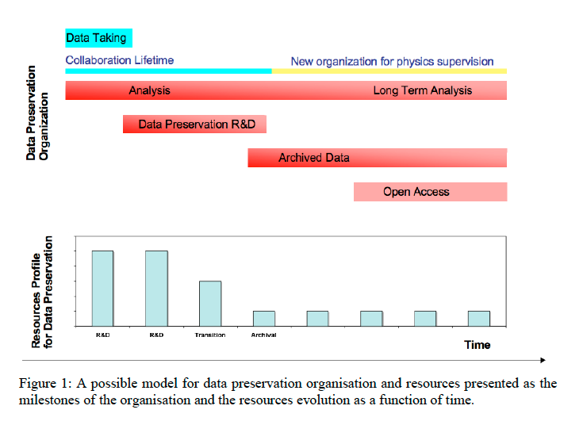
2009 Report

Slide 24
Recent developments
New ICFA panel, enlarging the scope:
  “ICFA Panel on the Data Lifecycle”
  Mission:
    ….enhance global coordination on all aspects of the data lifecycle including acquisition, processing, distribution, storage, access, analysis, simulation, preservation, management, software, workflows, computing and networking in particle physics, with a focus on open science and FAIR practices.[…]
  Mandate:
    Address the data lifecycle within a structured and integrated systems approach in HEP[…]
    Support the ongoing projects and collaborations started within the “Data Preservation in High Energy Physics” collaboration (DPHEP) and the “Standing Committee on Interregional Connectivity” (SCIC).

Slide 25
Experiments Status

Slide 26
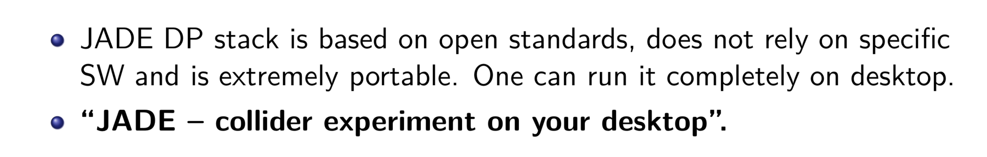
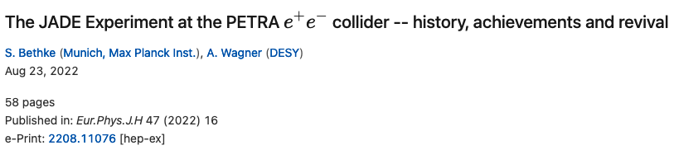
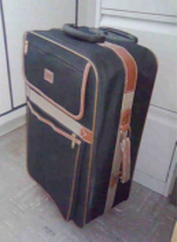
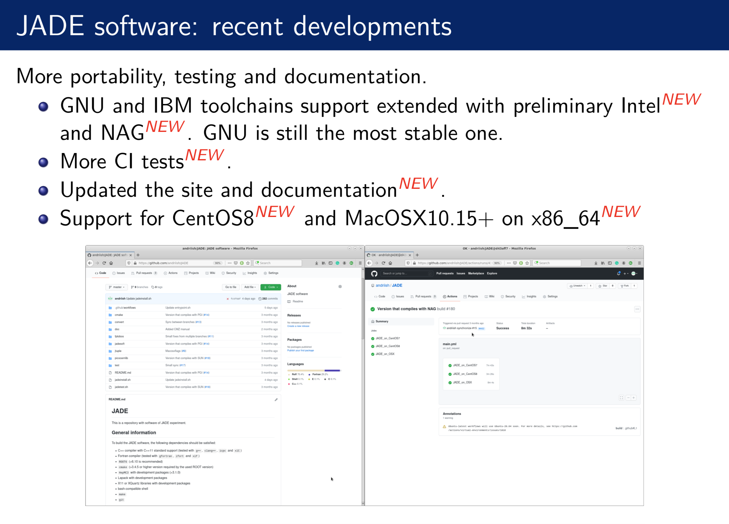
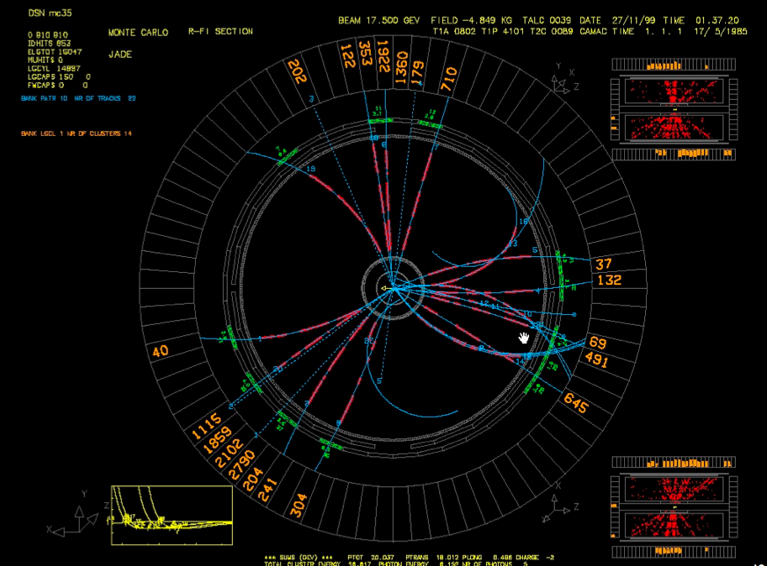
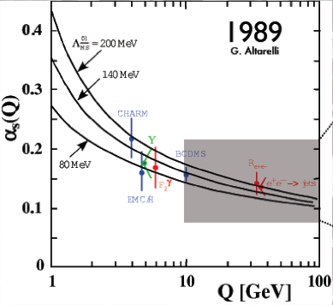
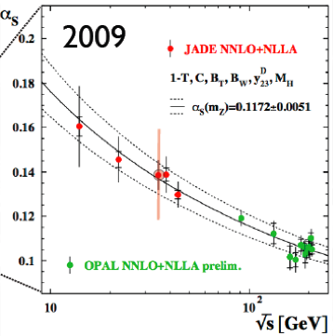
JADE
Data Preservation
model circa 1980-ies
2021

Slide 27
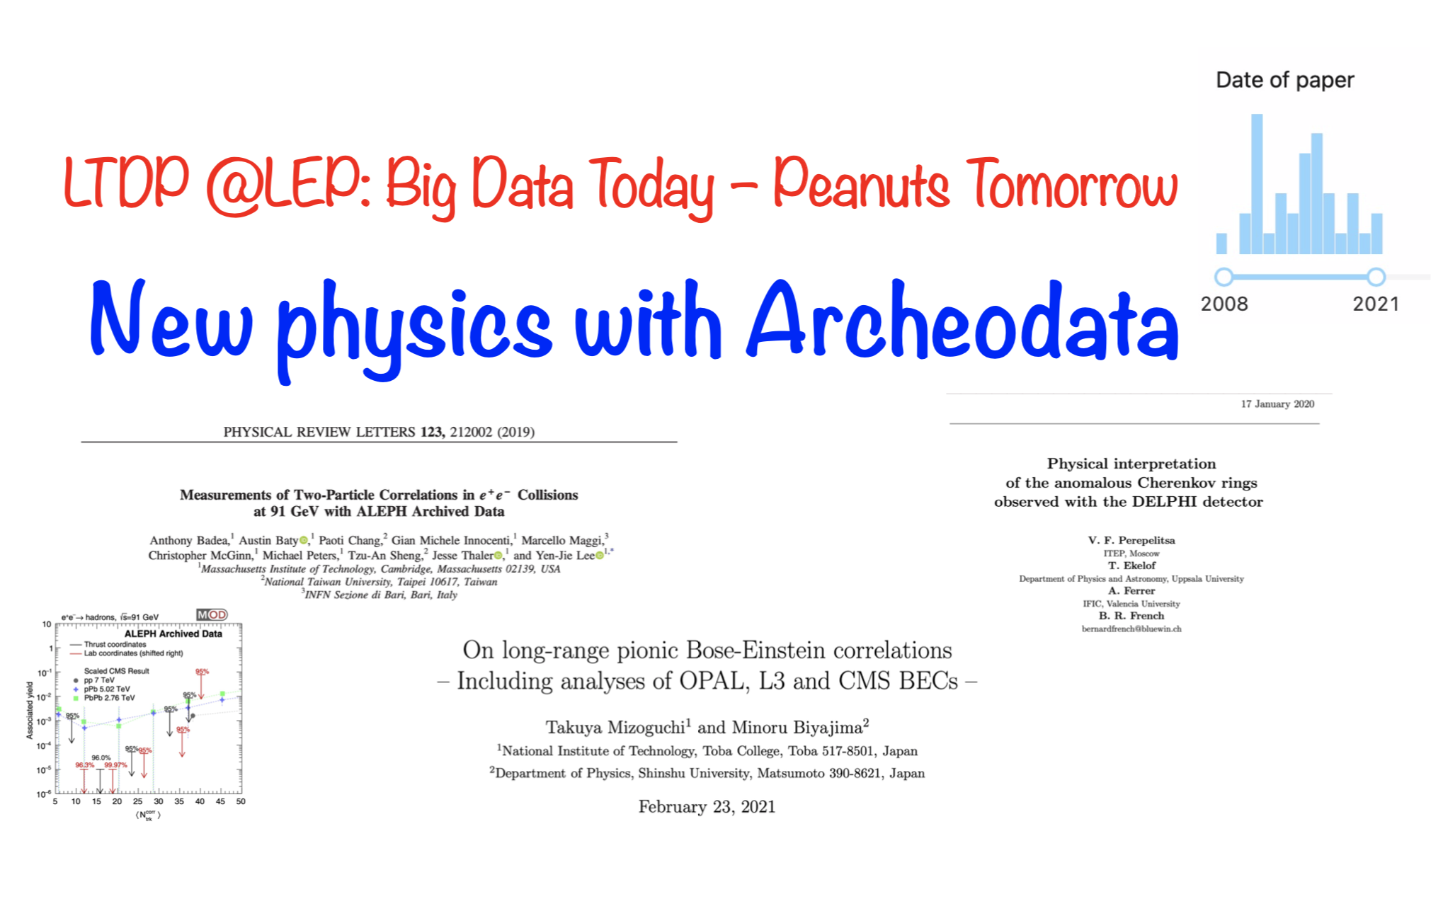
LEP
Papers using archived data
2019
2020
FCCee
  With real data from LEP
2021

Slide 28
DELPHI event display
with revised software

Slide 29
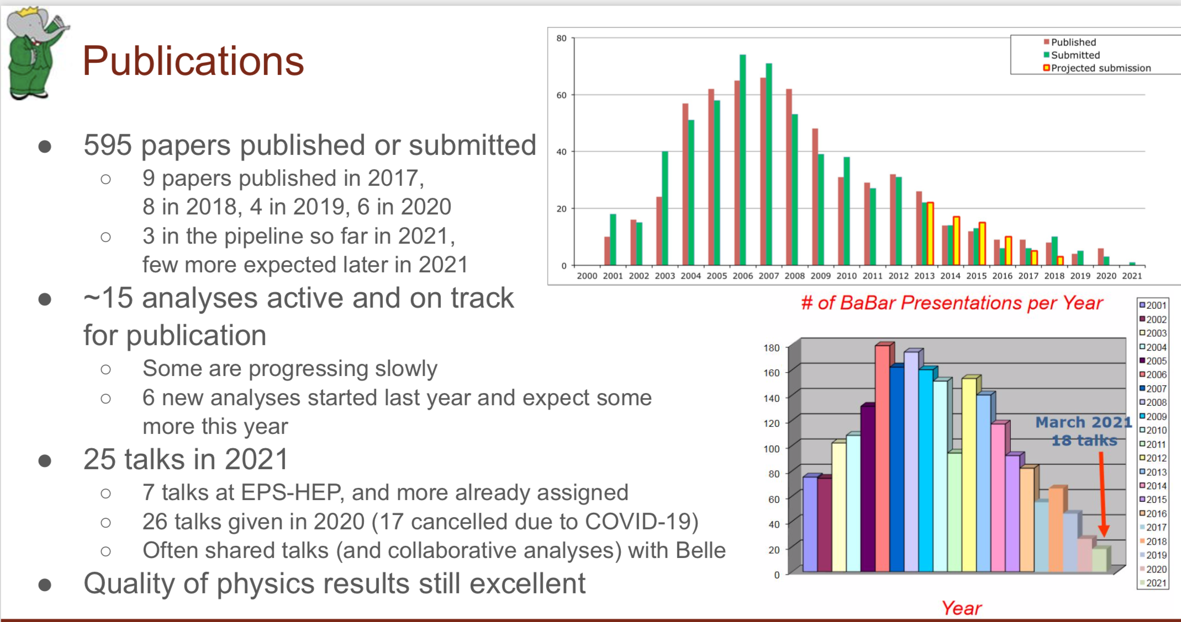
Babar (03/2021)
T. Cartaro
But: SLAC LTDA decommissioned, moving to U. Victoria/CERN/CC-IN2P3/Grid-Ka
Open Data decided

Slide 30
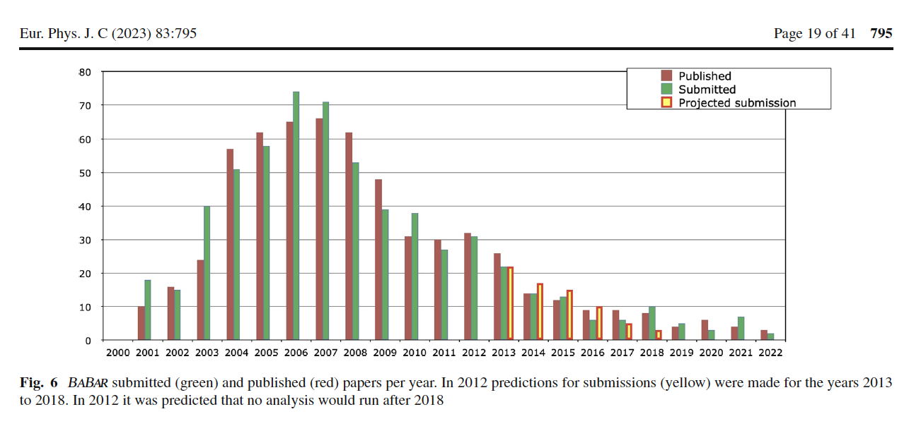
Update of the BaBar publication skyline
Unexpected
10 years ago

Slide 31
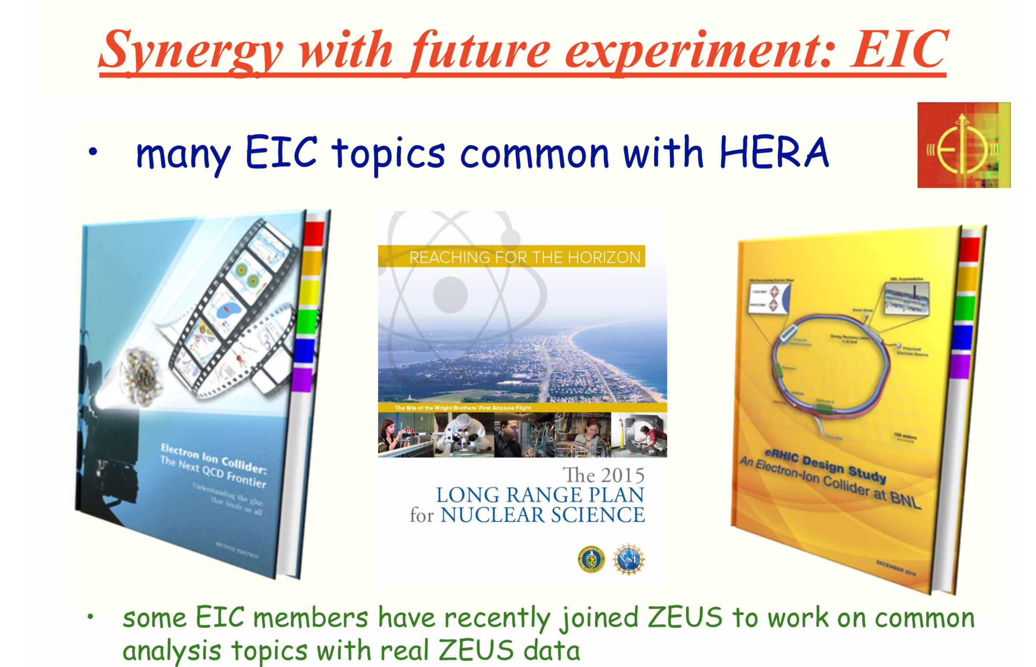
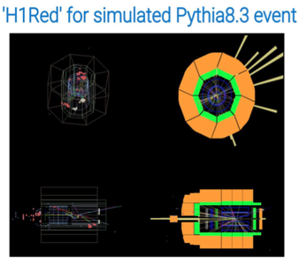
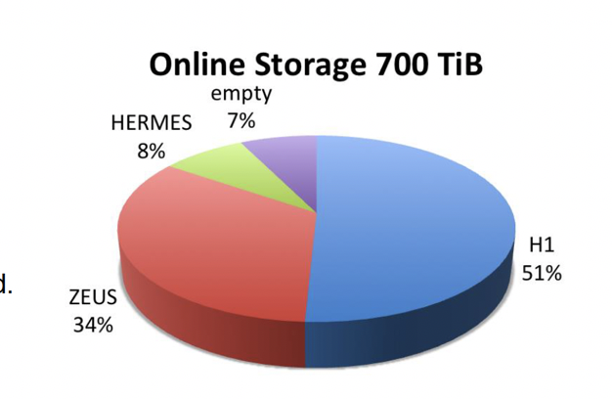
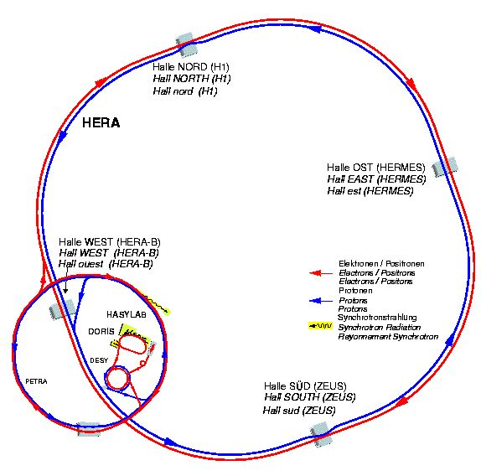
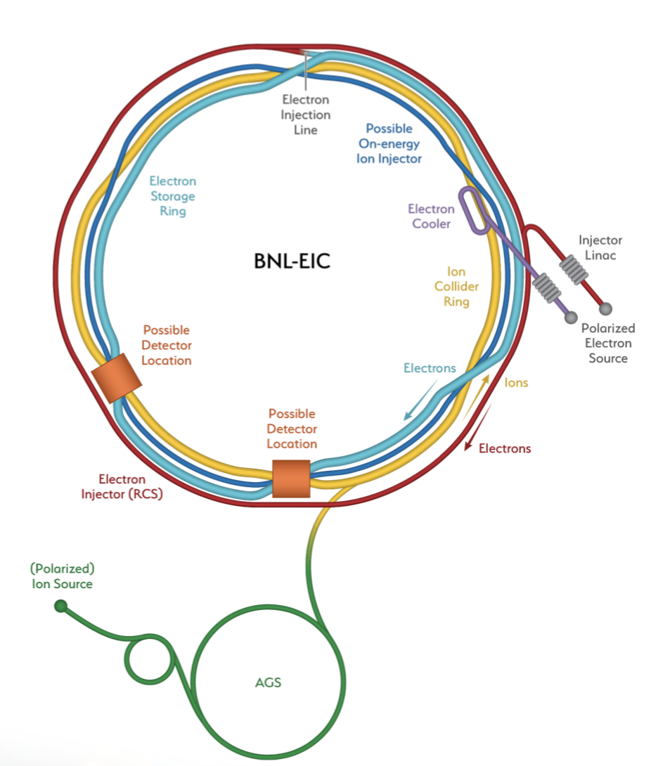
HERA: succesful DP, towards open data
H1: “Level 4” DPHEP strategy
  All data, full migration, including regular recompilation/validation
  Recent “technology jump” succesfull : in line with modern tools
    “LHC”-like tools, ready for opendata
ZEUS : “Level 3/4” DPHEP strategy
  Root ntuples produced in the preparatory phase
  easy to maintain/use/test/open
HERA
EIC
  New topics/collaborators (EIC)

Slide 32
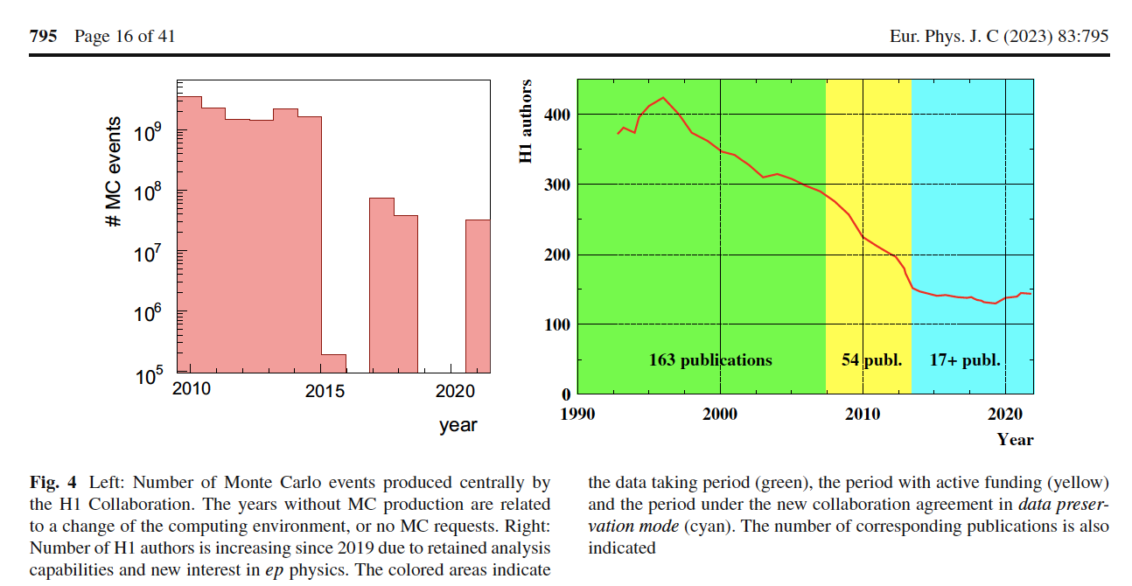

Slide 33
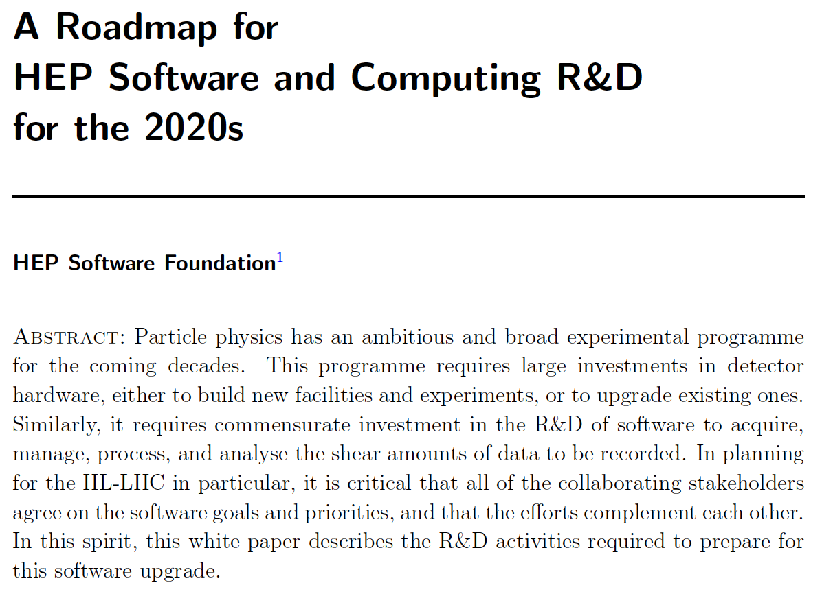
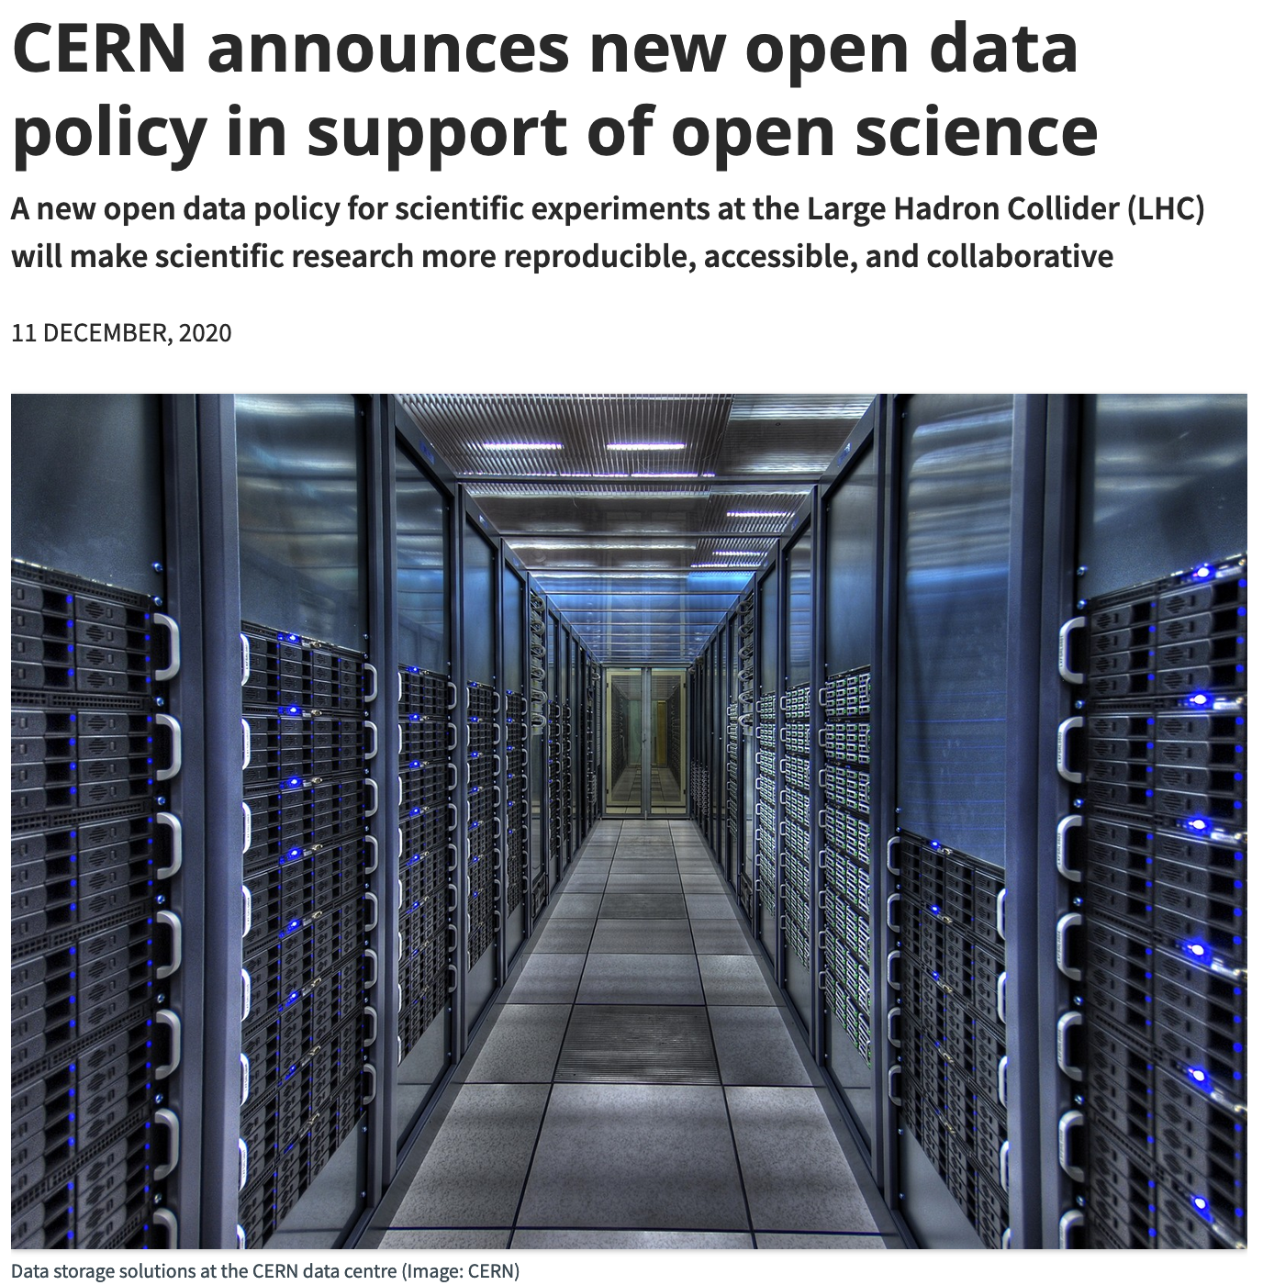
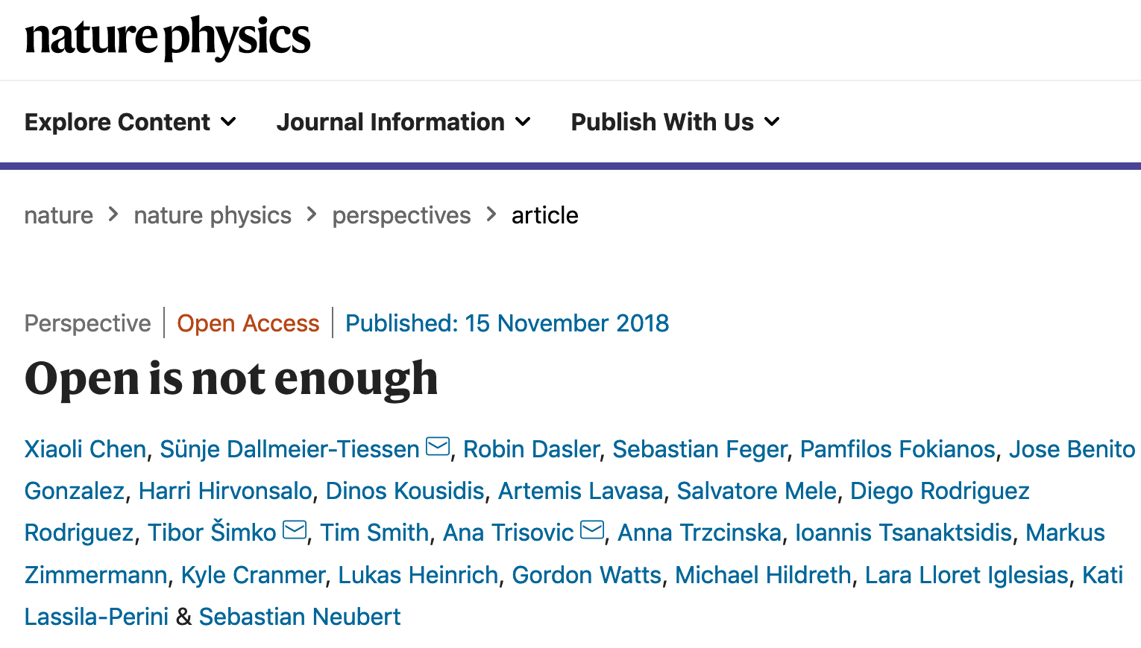
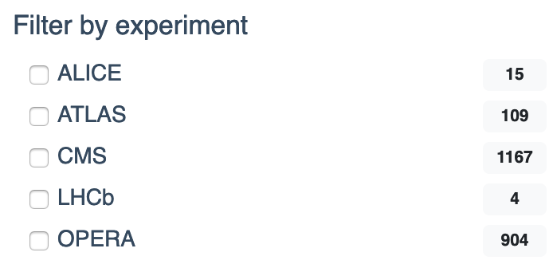
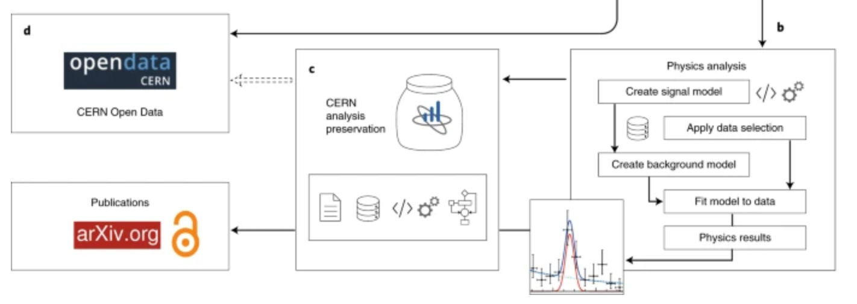
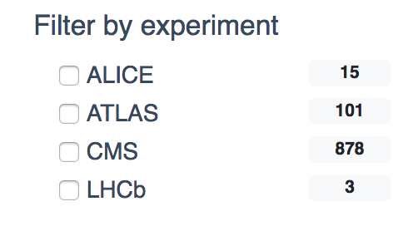

LHC Data Preservation
Data Preservation and Open Access policies (already since 2012-2014)
  DP is a « specification » included in the computing models and plans for upgrades
  HEP Software Foundation Roadmap
Strong initiative on Open Data and Open Science policy
Concrete implementation and technology-oriented survey
  Very active multi-experiment projects
  data re-use, réanalysis, réinterpretation, outreach etc.
    OpenData, Analysis Preservation, REANA…
arXiv:1712.06982
https://www.nature.com/articles/s41567-018-0342-2
2017
2021
Other experiments expressed clear intention to join : LEP, JADE, H1/ZEUS, BaBar (HR is an issue)

Slide 34
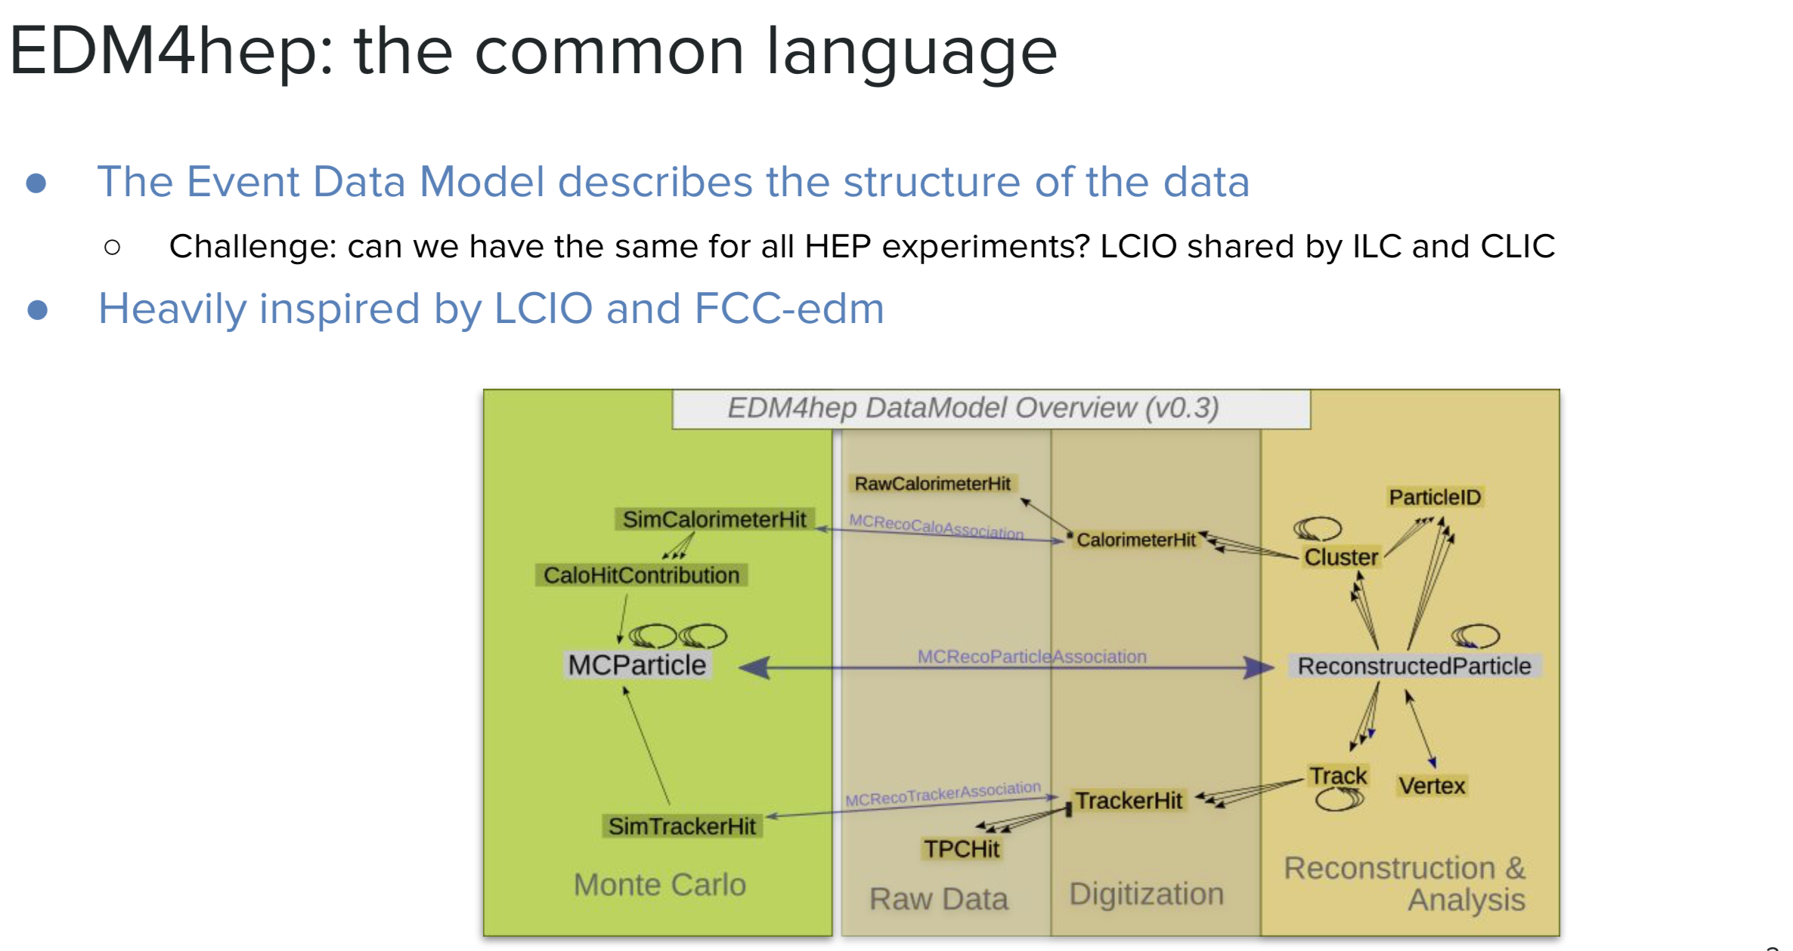
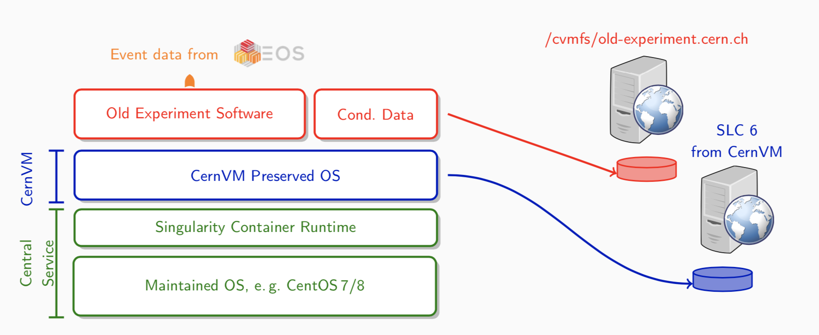
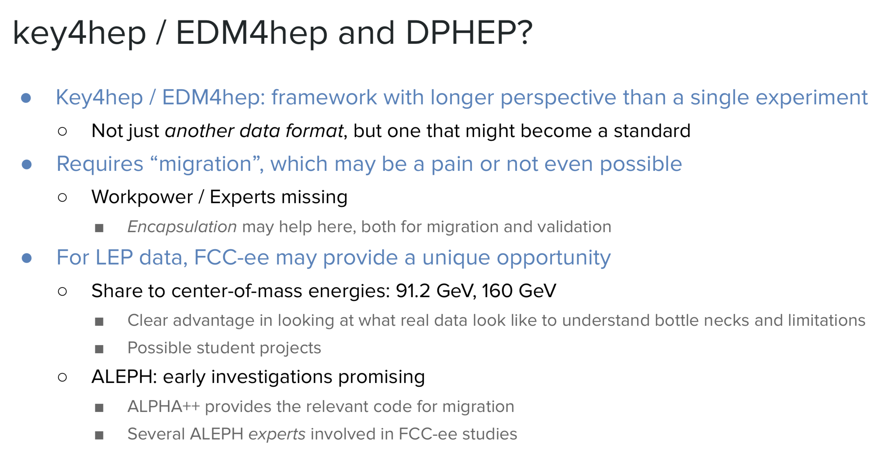
Towards more standards
CERNVM: the “freezer”

Slide 35
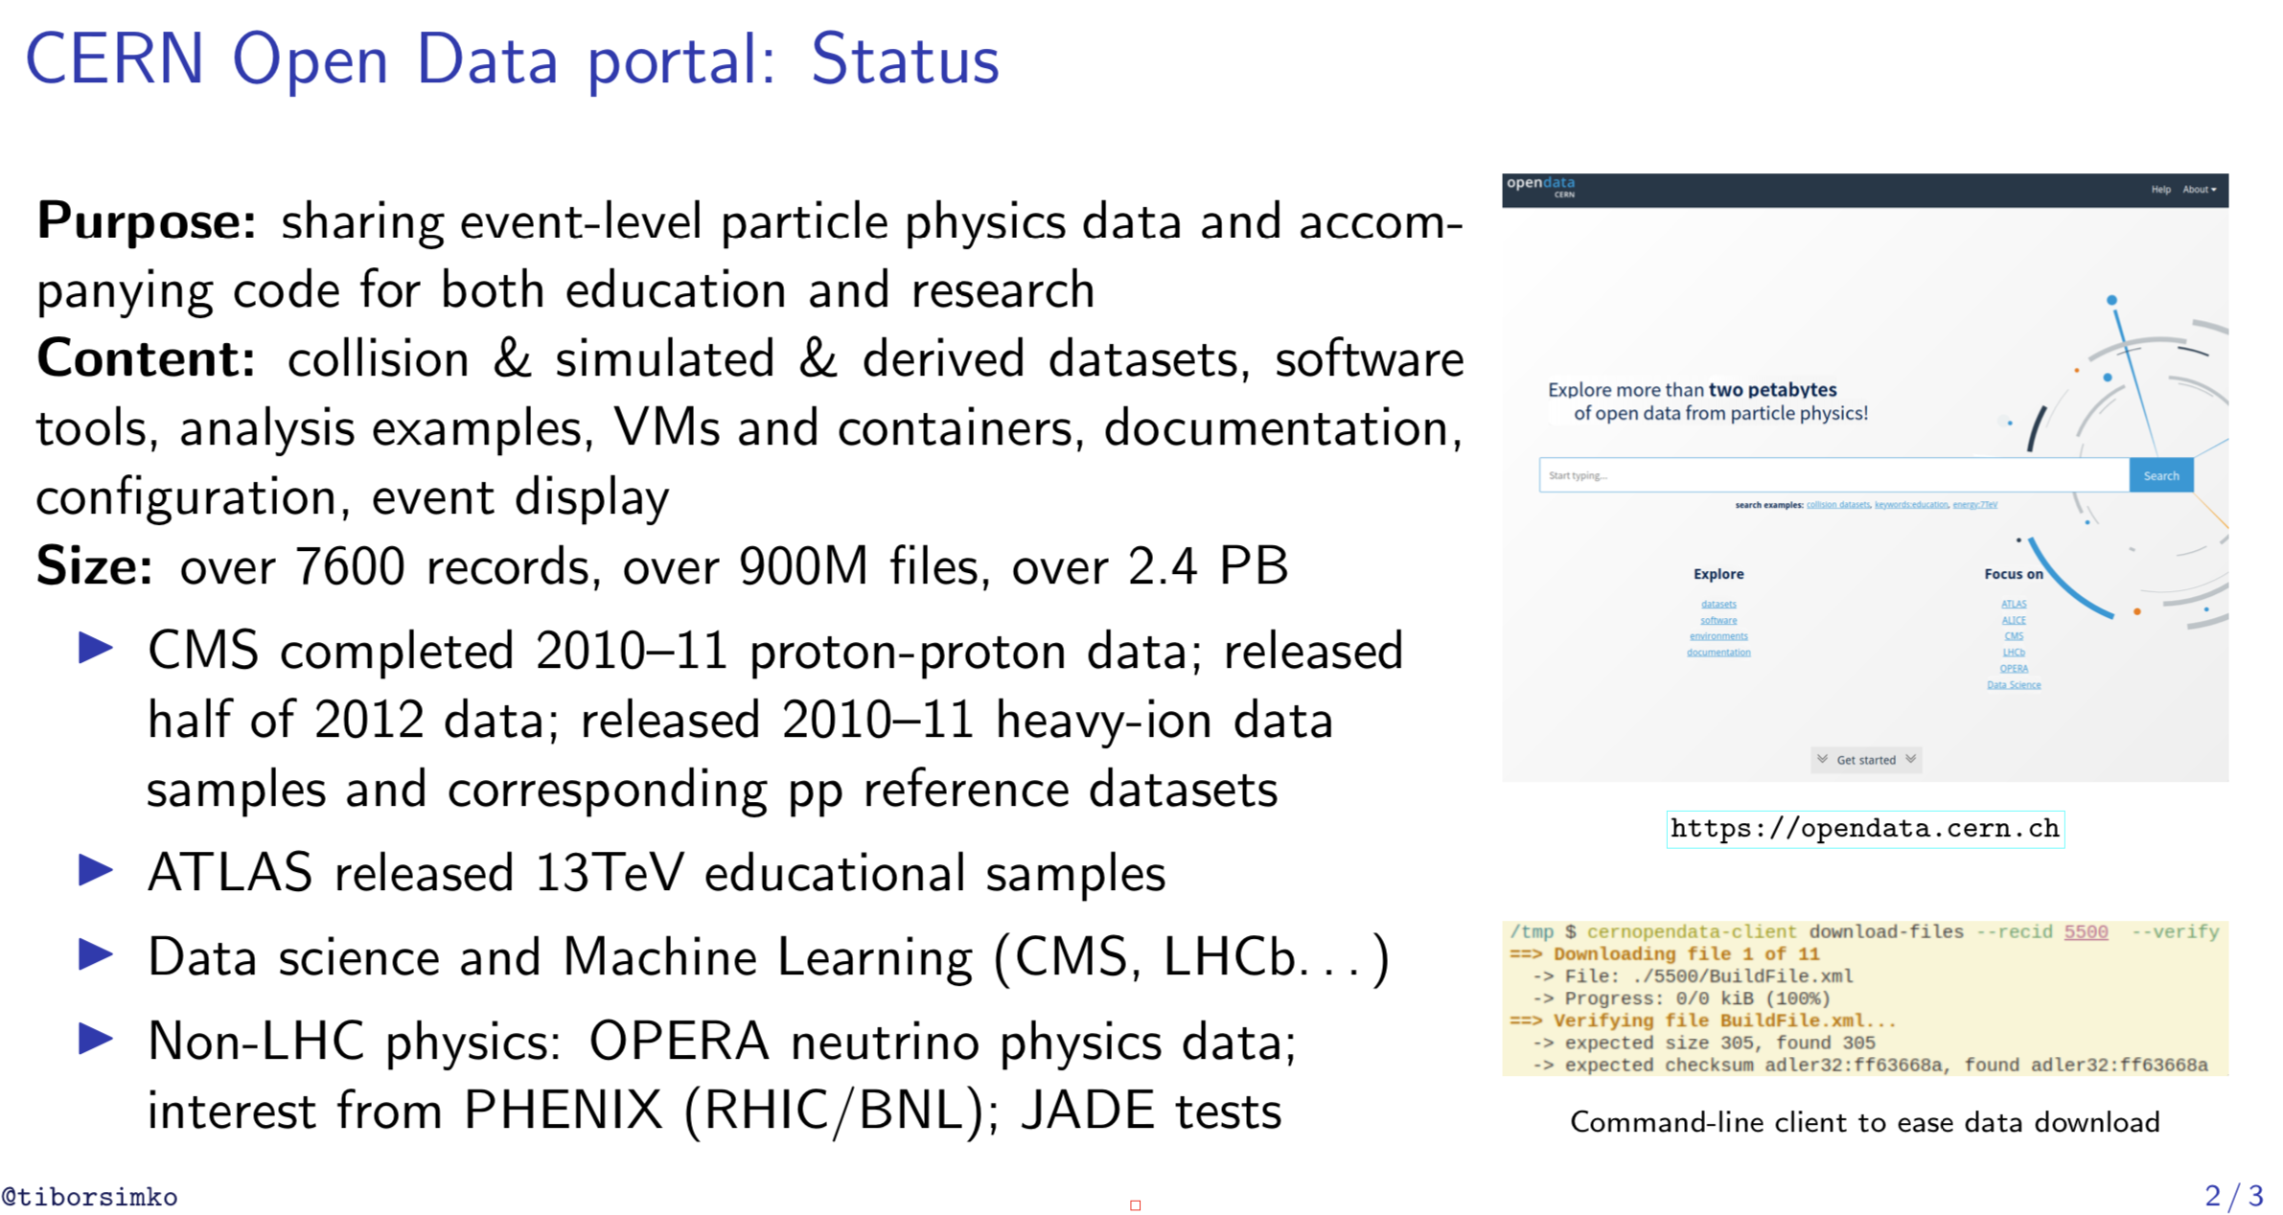
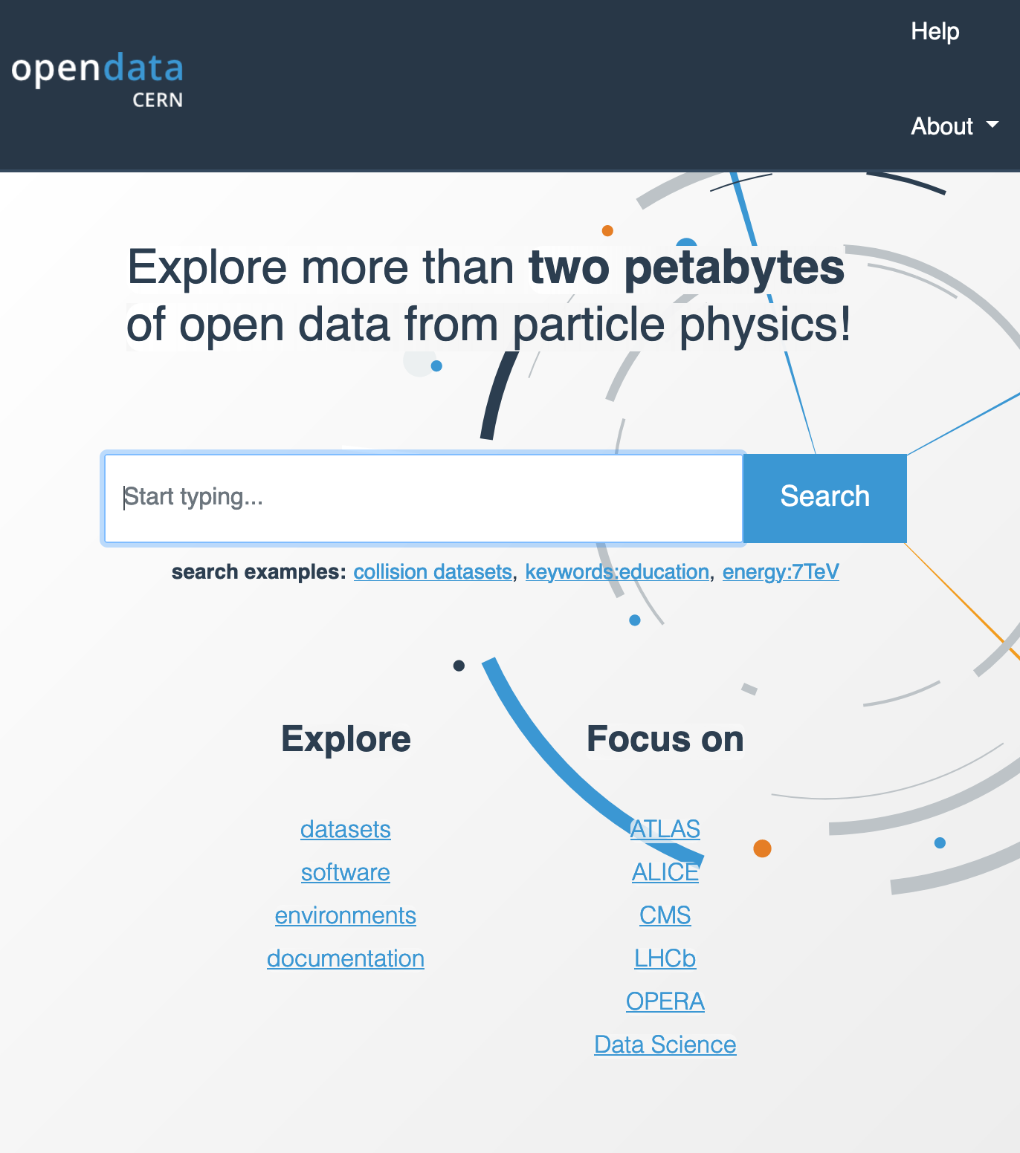


Slide 36


CERN Analysis Preservation and Reusable Analyses
CAP : preserve analysis
  http://analysispreservation.cern.ch/
REANA : improve workflow
  Run research data analyses on containerised compute clouds
  http://reana.io/

Slide 37
The DPHEP 2020 Vision
The “vision” for DPHEP – first presented to ICFA in February 2013 – a consists of the following key points:
  By 2020, all archived data – e.g. that described in DPHEP Blueprint, including LHC data – should be easily findable and fully usable by the designated communities with clear (Open) access policies and possibilities to annotate further
  Best practices, tools and services should be well run-in, fully documented and sustainable; built in common with other disciplines, based on standards
  There should be a DPHEP portal, through which data / tools accessed
  Clear targets & metrics to measure the above should be agreed between Funding Agencies, Service Providers and the Experiments (Collaborations).
  Although there is clearly much work still to be done, this vision looks both achievable and the timescale for realizing it has been significantly reduced through interactions with other (non-HEP) projects and communities.

Slide 38
According to the previsions from DPHEP initial documents and in agreement with the few projects observed in the past years, the direct investments in dedicated DP projects correspond to O(10) FTE-years with a very marginal investment in material
The C1 item can be compared with the total experimental costs that are, for the kind of collaborations considered here (HERA, BABAR etc.) of a few O(10³) FTE-years (plus the constructions costs, usually corresponding to multi-hundred millions).
With this perspective, one can very approximately estimate that the investment in a DP project corresponds to at most a few per mille from the total cost of the experiment.
  C1= O(0,1%)
  B1= O(10%)
C1/B1 ➔ cost effective science
Refinements possible
  make the exercise for Open data as well
2012 (blueprint)
Priority 1: Local Action in experiments, laboratories | Data preparation:1-3 FTE/expt/2-3 years Data archivists: 0.5-1 FTE /lab
Priority 2: International organization | Project Manager: 1 FTE Technical support: 0.2 FTE Contributions from Labs: 0.2/lab (data archivists)
Priority 3: Transverse Projects (examples considered) | Project leaders: 1-2 FTE’s/projects + contributions from involved experiments 0.2 FTEs/expt.

Slide 39
Preserved and Open Data
Planning for preserved data improves the design of running and future experiments
DP relies on and stimulates cutting-edge technology developments
DP is strongly linked to Open Science and FAIR data paradigms
Examples:
  CERN Open Data Portal, Analysis Preservation (CAP), Reusable Analyses (ReAna), cernvm, key4hep etc.

Slide 40

A word on FAIR
The DPHEP objectives (2012) intrinsically comply with what has became to be known as FAIR principles (2016)
Indeed, the data has to be
  easy to find (F)
  accessible (A)
  and therefore -in a HEP collaborative context- (re)usable (R).
  The interoperability (I), identified as one of the long term goals ten years ago, is becoming a built-in specification of the recent computing systems as well.
    Concrete steps have been achieved, with a few examples given, with a strong incentive originating from the open science policy or within structural projects such as WLCG.
However, a clear strategy for a FAIR approach over the entire HEP field (including past, present and future experiments) is still to be defined.
  DPHEP can certainly contribute to such a global approach

Slide 41
Discussion incentives
Preservation and sharing/open:
  Let data escape into unknown/unsual world
    “In time” (long term) ➔ Preserved
    “In space” (released to others) ➔ Open
Why would you do that?
    Data contains more than planned for ➔ more science
    New audience, new ideas ➔ more science
    More technology, interdisciplinarity, skills, teaching, policy …..
The motivation is shared by both P&O
  How are those related?
  DPHEP: P & O are complementary and rather strongly related aspects of a continous output enhancement action around unique frontier science data
DPHEP report 2022:
  a strong interest to translate healthy and functional analysis sytems into open data hosts , HERA, BaBar, RHIC
    main pb: Person power
There is room to think and act in common and global

Slide 42

DPHEP ressources for DP
2012 Blueprint

Slide 44
CERN Analysis Preservation and Reusable Analyses
CAP : preserve analysis
  http://analysispreservation.cern.ch/
REANA : improve workflow
  Run research data analyses on containerised compute clouds
  http://reana.io/

Slide 45




HERA: succesful DP, towards open data

Slide 46
HEP Data
Scientific potential
Outreach, Training, Education
Arxiv: 1205.4667

Slide 47
DPHEP timelines
2018 status
Year | 2007 | 2008 | 2009 | 2010 | 2011 | 2012 | 2013 | 2014 | 2015 | 2016 | 2017
HEP | HERA stops | Babar stops | LHC starts | Belle I stops | Tevatron stops |  |  |  | LHC Run 2
DPHEP Group |  |  | ICFA Panel |  | LHC exp. joined | DPHEP Manger appointed at CERN |  | DPHEP Collaboration Agreements signed | 1st DPHEP Collaboration Meeting |  | 2nd DPHEP Collaboration Meeting
DPHEP Docs |  |  | DPHEP White Paper |  |  | Blueprint Report |  |  | DPHEP Status Report 2020 Vision |  | DPHEP 2017 Status Report
DP Projects within expts. |  | Babar DP starts |  | HERA DP starts | BELLE DP starts | CMS DP Policy CDF/D0 DP starts Babar LTDAP operational | ALICE, LHCb, DP Policies | ATLAS DP Policy H1/ZEUS DP systems operational | CERN/LHC Open Data | CERN/LHC Analysis Preservation Tevatron DP operational
Start-up
Consolidation
DPHEP Collaboration

Slide 48

Scientific output: status 2017
Still supporting few tens of analyses ~10papers/year.
~5 papers/year.
For 2-3 years
Source: web site
Source: web site
DP system
DP system
Source: web site
~10-20 papers/year.
For 2-3 years
Source: inspirehep.net
R2DP/CDFDP

Slide 49











BaBar Highlights and Press Releases
2018 status
November 2017
Dataset:
Y(4S): 433/fb
Y(3S): 30/fb
Y(2S): 14/fb
Off resonance: 10%
Y(1S) accessed via
Y(2S,3S) → Y(1S) π⁺π–
June 2017

Slide 50
BaBar needs Help! BaBar in Numbers
2018 status
BaBar data actively being analyzed and high impact papers published (see slide 2). Expect this to continue to at least through 2021.
SLAC management plans to stop hosting BaBar computing in February 2020 at which time the tapes with data will be ejected.
DOE support ended in 2017, now running on international common funds (OCF).
Looking for possibility of support and long term data preservation at
  CERN,
  GridKa (BaBar site for analysis and XRootD federated dataset main redirector),
  University of Victoria (BABAR site for analysis, documentation, and tools support).
BaBar lightweight VMs come with the latest software release and xrootd client included, running under the most common virtual machine players. Just add the data via the GridKa main XRootD redirector.
2PB of data on T10k-D tapes
  raw, processed, Monte Carlo
  Unique dataset at the Y(3S) resonance (no plan at the moment to run at the Y(3S) @ Belle II)
Full environment enclosed in VMs (SL5,SL6)
~1TB of documentation, repositories, and dataset information (DBs, cvs, wiki, html)
  Internal documents archived on INSPIRE
574 papers, ~10 papers/year past 3 years
231 members (semi-frozen author list)
  Including PhD students in Canada, Germany, Israel, Italy, Russia, US
  Associated theorists mine data to test new ideas
~20 analyses on track, ~10 more in the pipeline
  Continue to have new analyses every year including joint BaBar -Belle analyses
Students analyze BaBar data while working on Belle II and other experiments in construction/commissioning phase

