Slide 1
LHC Vertical Dispersion and MQ powering
LNO Section Meeting
24/05/2024
Yannis Angelis

Slide 2
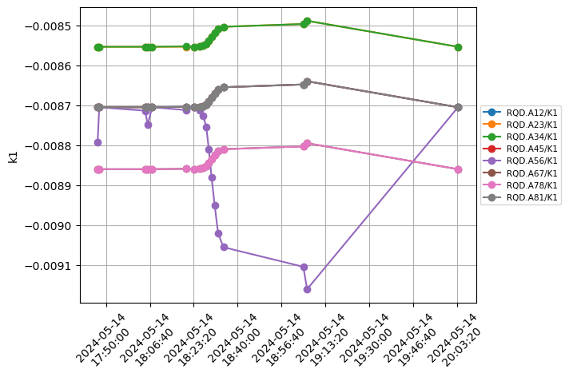
The plan
The measurement
Reduce by 5% MQ strength at ARC 56 (specifically the knob connected with MQ.29R5.B2 -> KQD.A56)
Compensate with all the other arcs
Fill 9627
Data:
/user/slops/data/LHC_DATA/OP_DATA/Betabeat/2024-05-14/LHCB1/Measurements/
Reduce by 10% MQ strength at ARC 56 (specifically the knob connected with MQ.29R5.B2 -> KQD.A56)
Compensate with MQT
Not well matched knob
-> dump + tune of 59

Slide 3
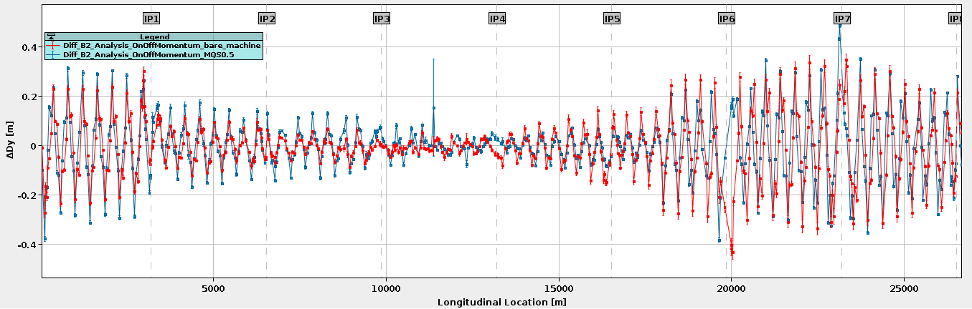
Global Dispersion

Slide 4
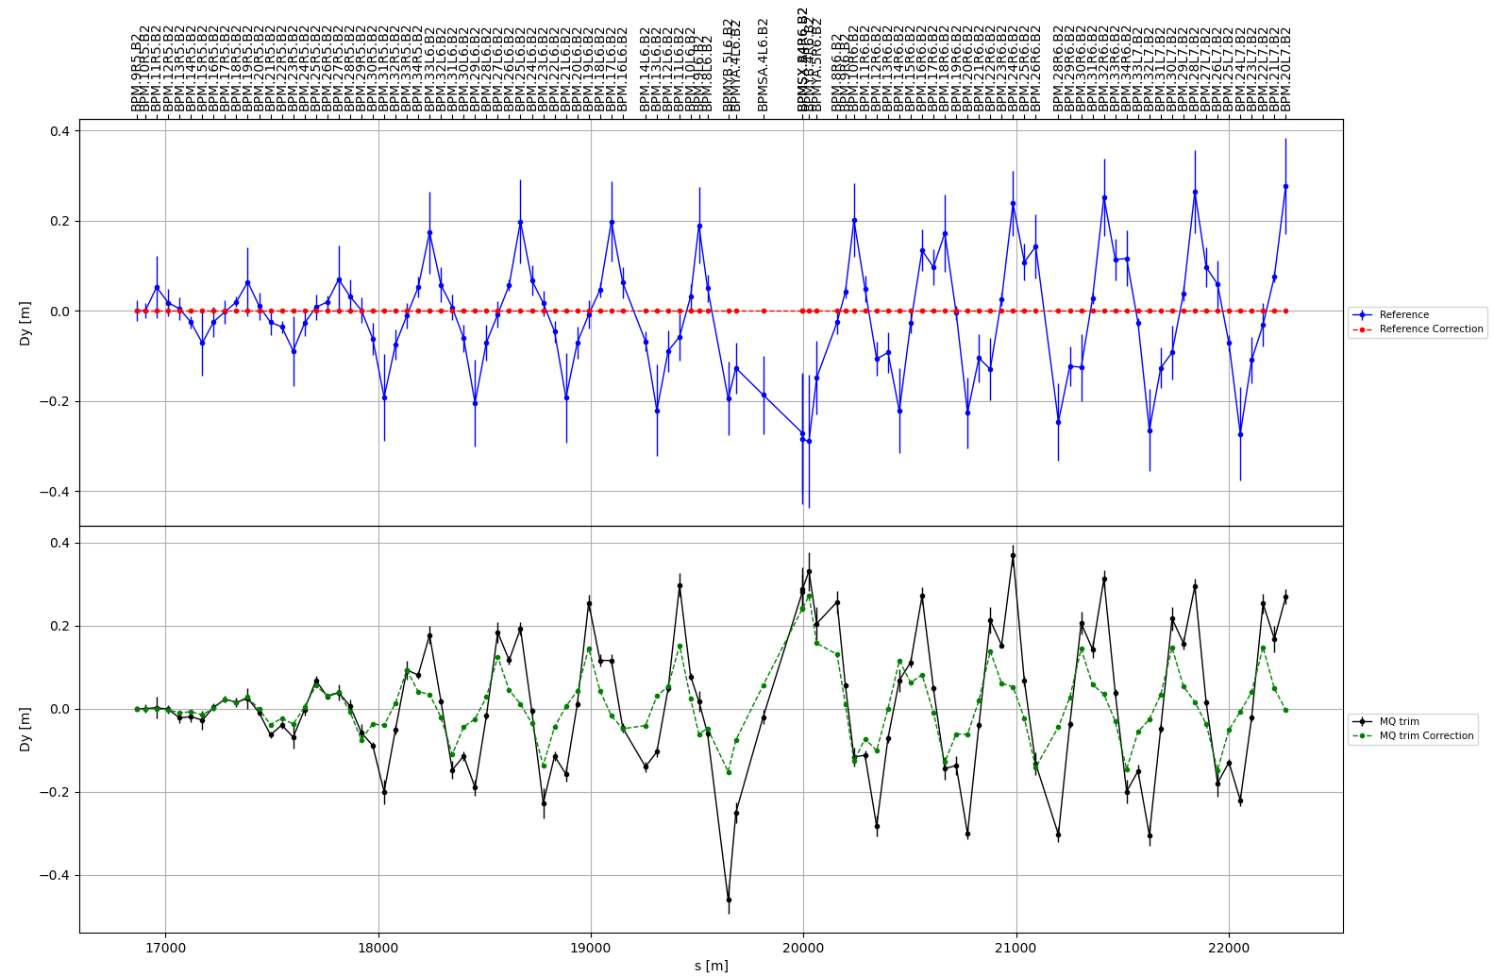
Extracted from BetaBeat SBS
For completeness we should also use a model with the MQ trims applied
‘Correction’: kdq trims applied

Slide 5
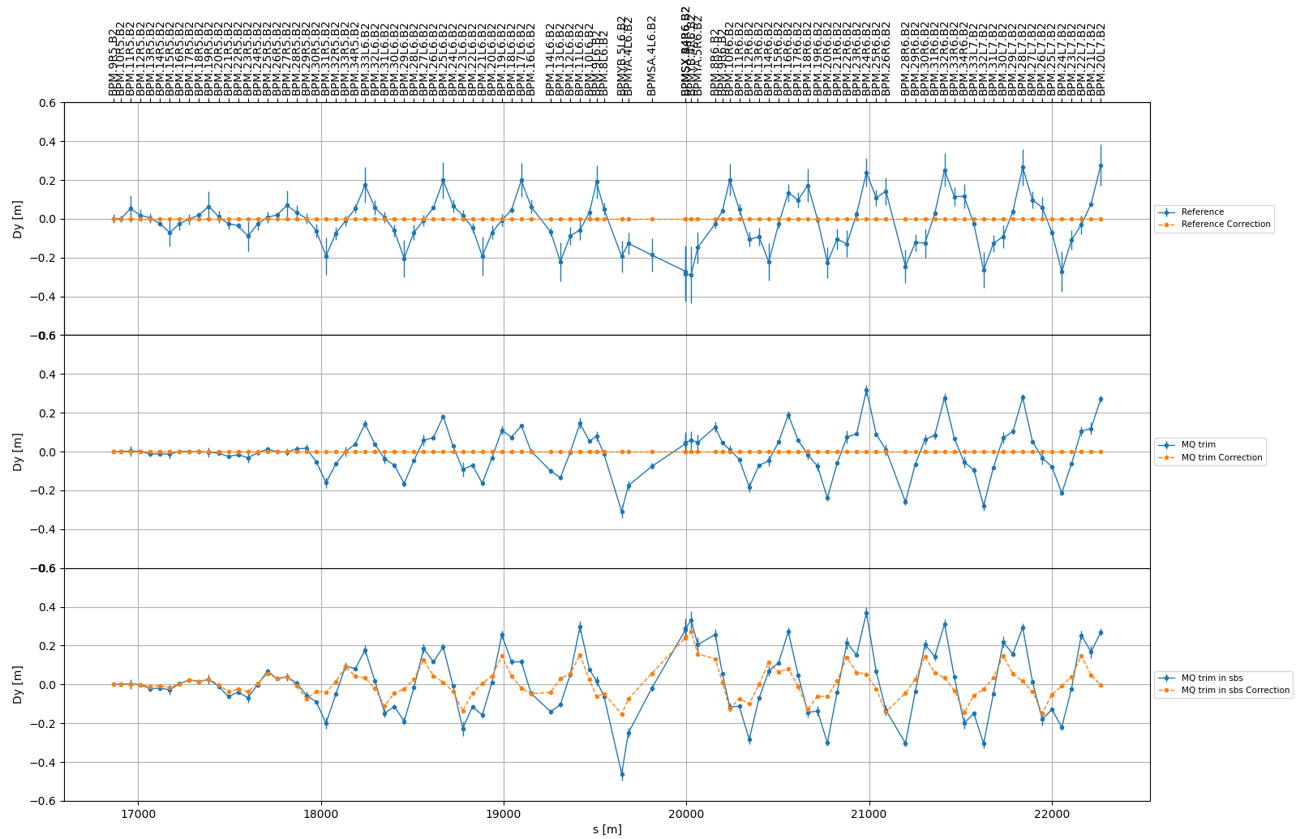
Extracted from BetaBeat SBS
Reference model
Model with trims
MQ trims in sbs ‘corrections’

Slide 6
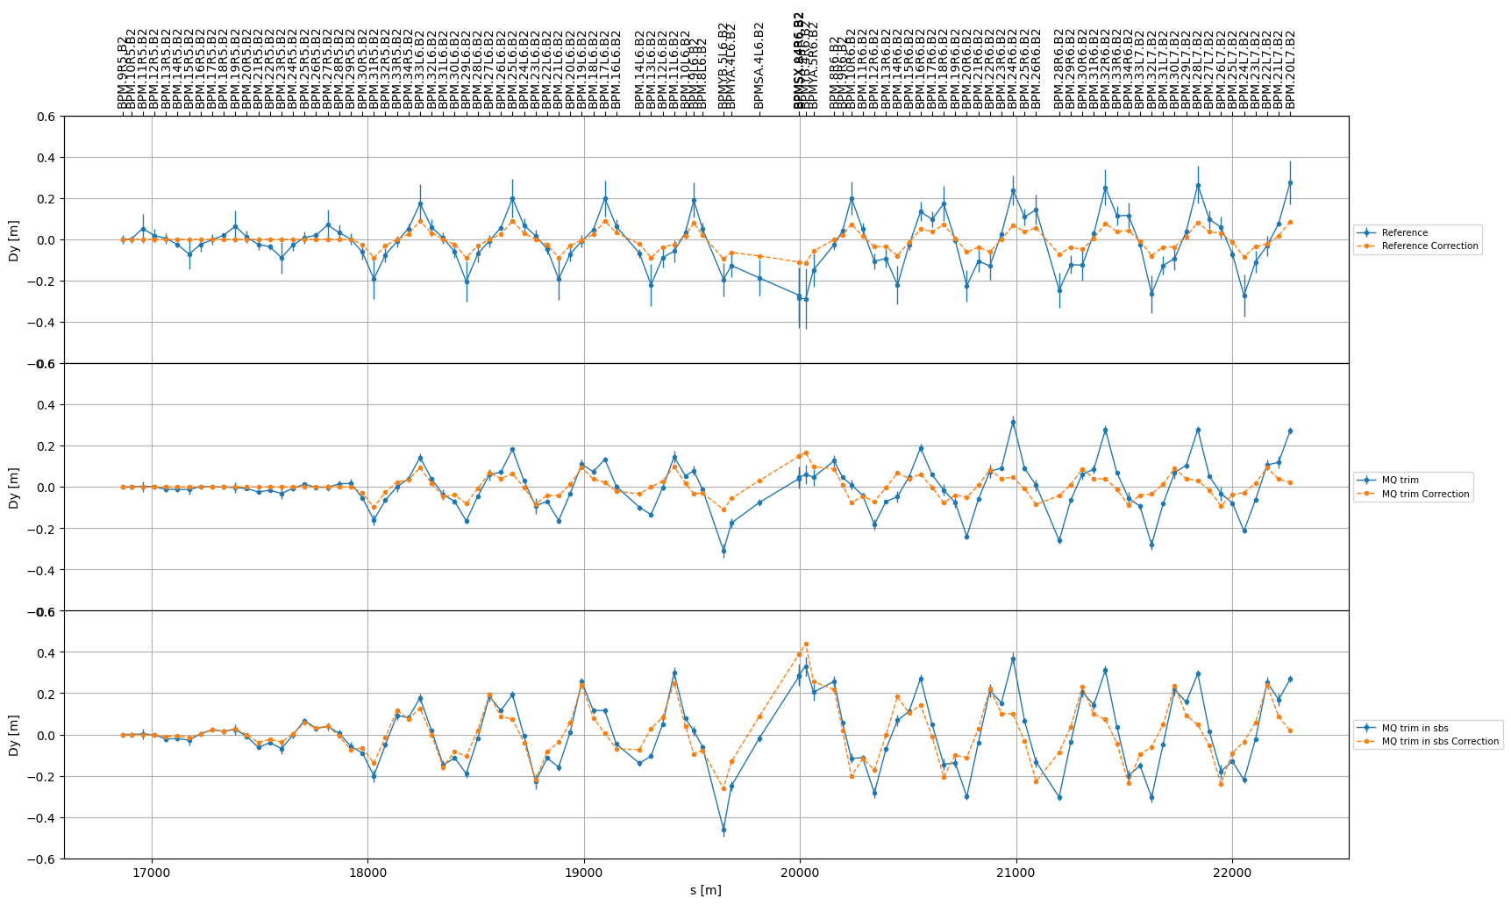
Extracted from BetaBeat SBS
MQ.29R5.B2: 9 mrad tilt
Reference model
Model with trims
MQ trims in sbs ‘corrections’

Slide 7
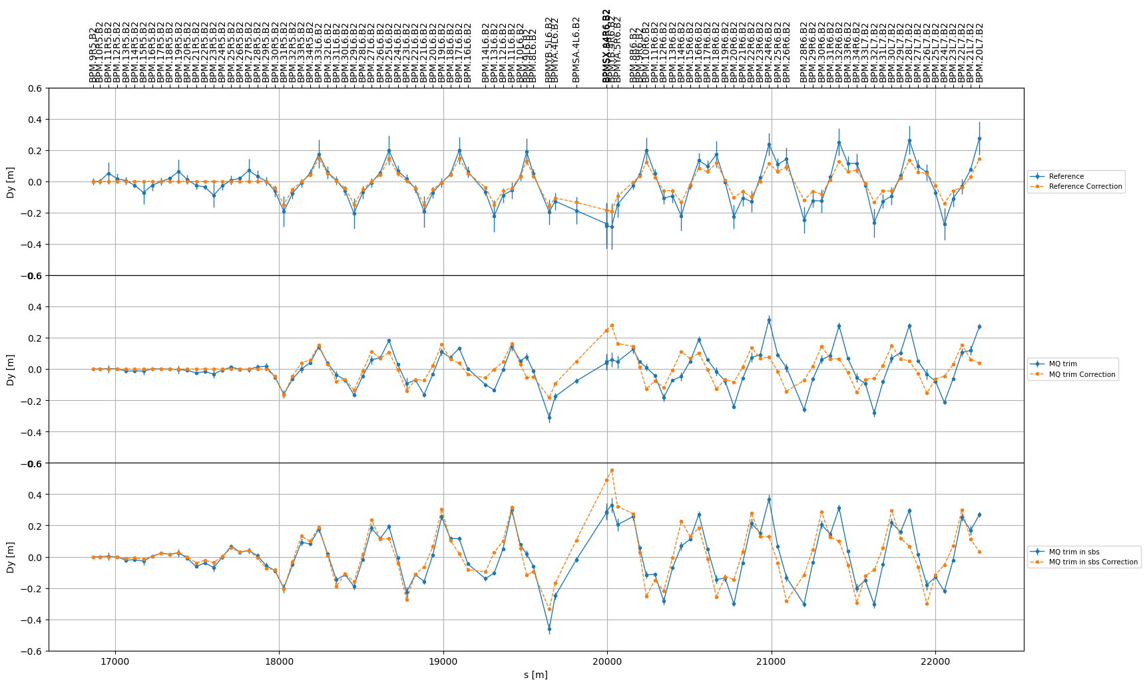
Extracted from BetaBeat SBS
MQ.29R5.B2: 15 mrad tilt
Reference model
Model with trims
MQ trims in sbs ‘corrections’

