Slide 1
Sextupolar RDTs in the ramp analysis
S. Horney
Thanks to E. Maclean and the rest of the OMC team
LNO Meeting, 24 May 2024

Slide 2
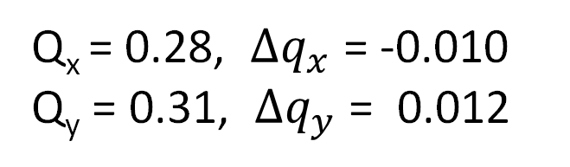
Key settings during the ramp (2023&24)
See details in:
OMC logbook 24/03/24
OMC logbook 06/04/23
Time [s] | Energy [TeV] | Phase-knob [%] | ATS | Betas [m] |  |  |  | Kick [%]
30 | 0.46 | 100 | 1 | 11 | 11 | 10 | 10 | 3
240 | 1.0 | 50 | 1 | 11 | 11 | 10 | 10 | 7
405 | 1.9 | 0 | 1 | 10 | 10 | 10 | 10 | 13
500 | 2.9 | 0 | 1 | 7 | 7 | 10 | 7 | 19
720 | 3.7 | 0 | 1 | 3.7 | 3.7 | 10 | 3.7 | 24
860 | 4.5 | 0 | 1 | 2 | 2 | 10 | 2 | 30
1010 | 5.5 | 0 | 0.72 | 2 | 2 | 10 | 2 | 36
1160 | 6.2 | 0 | 0.57 | 2 | 2 | 10 | 2 | 41
1247 | 6.6 | 0 | 0.5 | 2 | 2 | 10 | 2 | 45
Q_{x} = 0.28, $Δq_{x}$ = -0.010
Q_{y} = 0.31, $Δq_{y}$ = 0.012
3 bunches
For more information on
2023 see: 04/08/23 OMC Meeting

Slide 3
Linear Optics

Slide 4
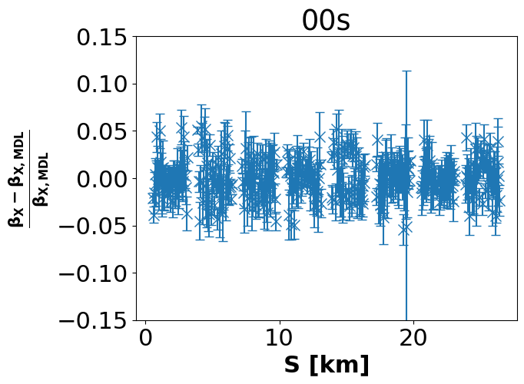
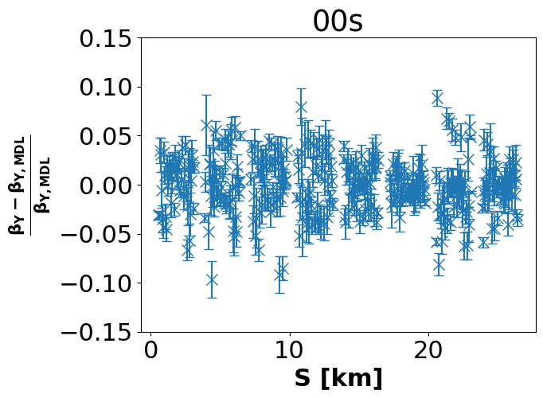
B1 beta-beating in the ramp
x
y

Slide 5
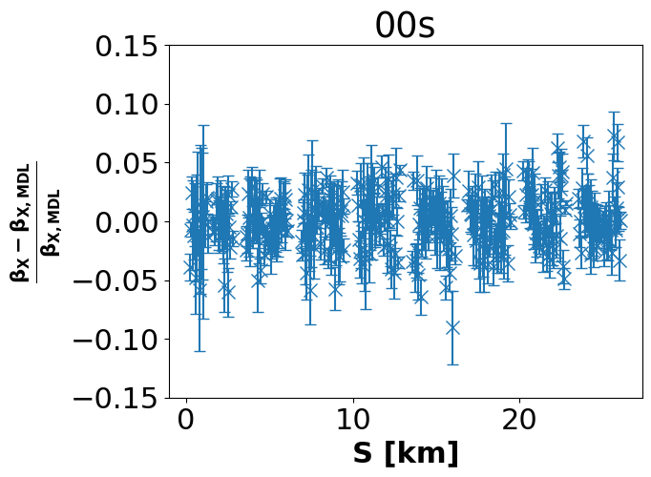
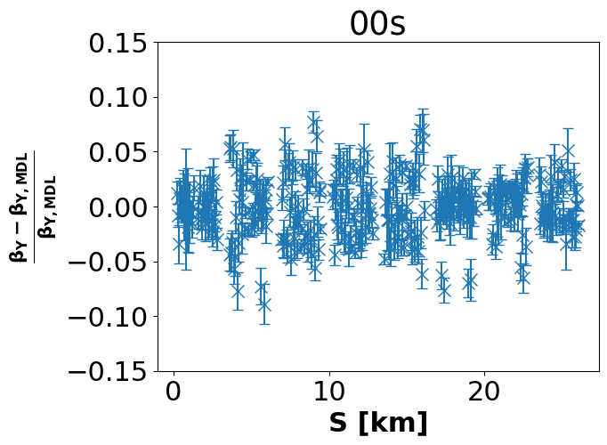
B2 beta-beating in the ramp
x
y

Slide 6
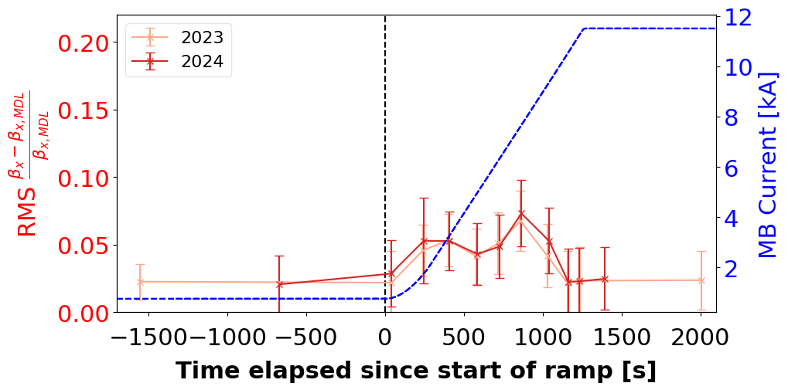
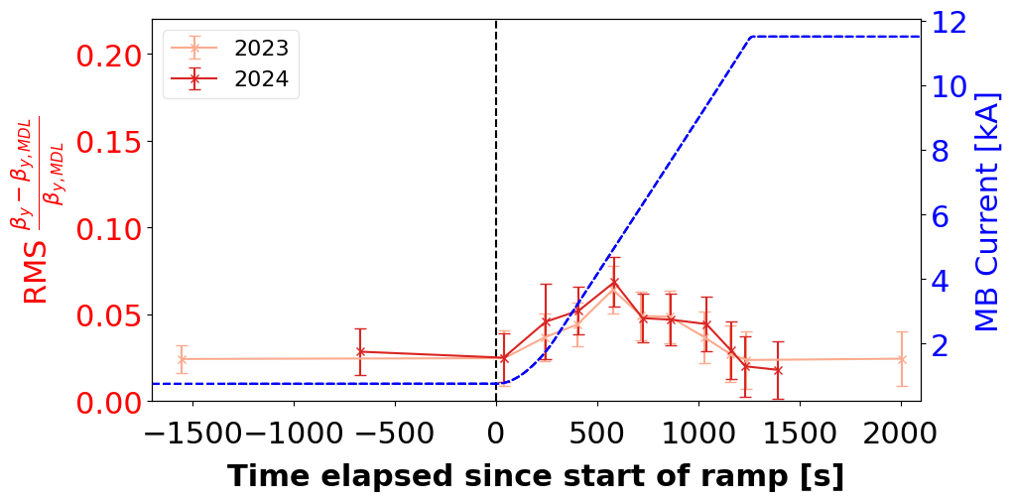
RMS beta-beat B1 comparison
x
y

Slide 7

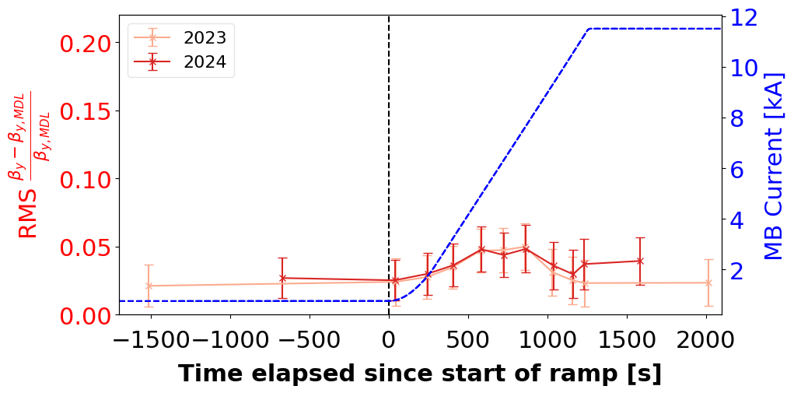
RMS beta-beat B2 comparison
x
y

Slide 8
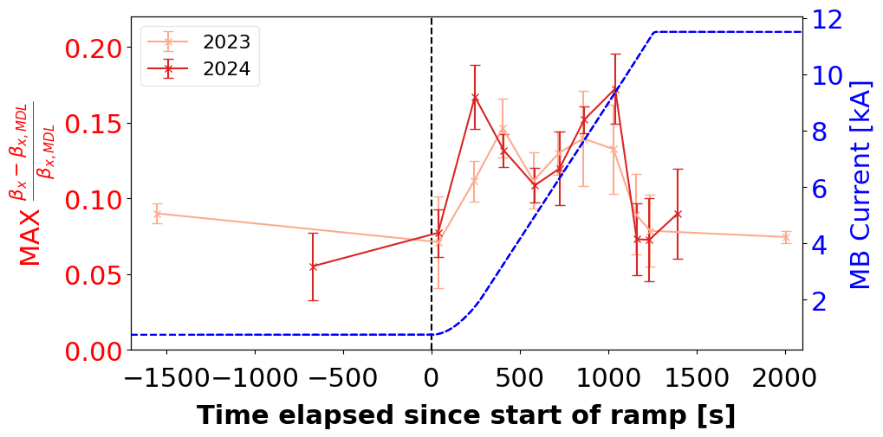
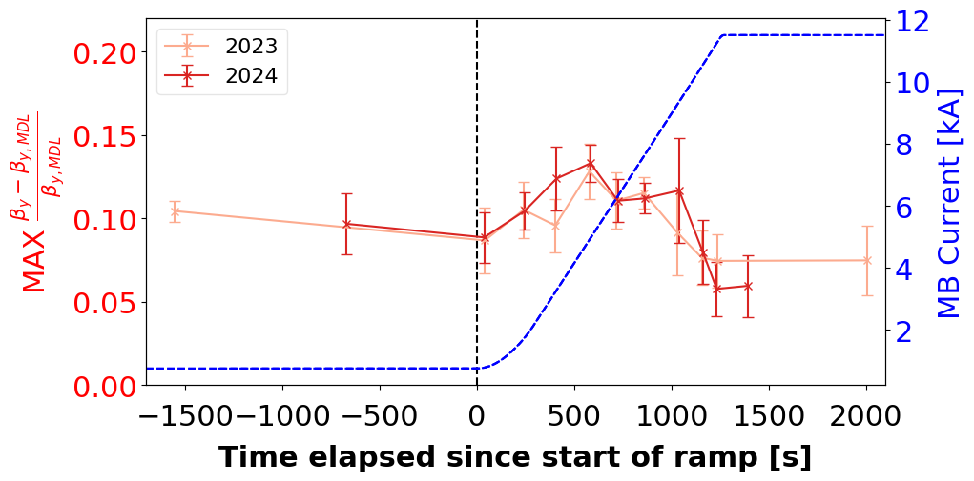
Max beta-beat B1 comparison
x
y

Slide 9
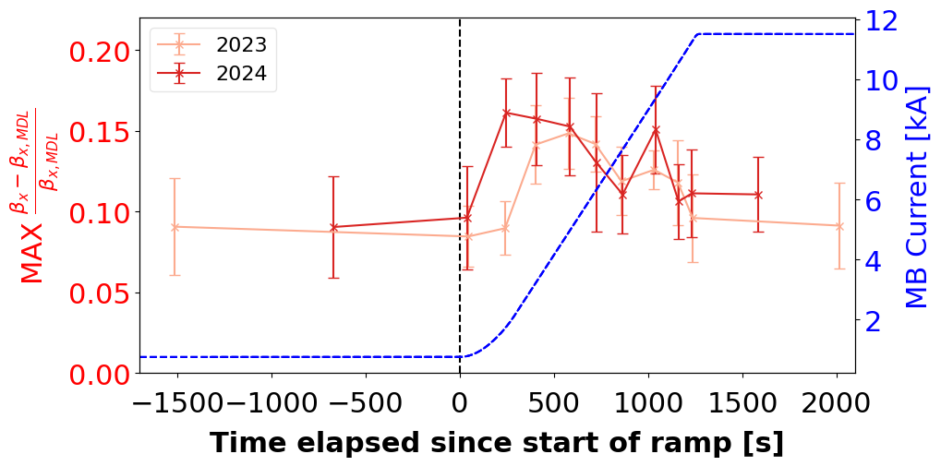
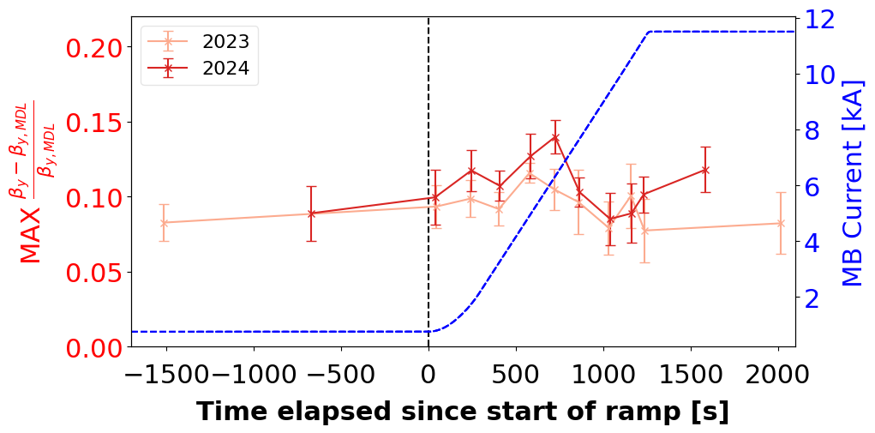
Max beta-beat B2 comparison
x
y

Slide 10
Non-linear optics

Slide 11
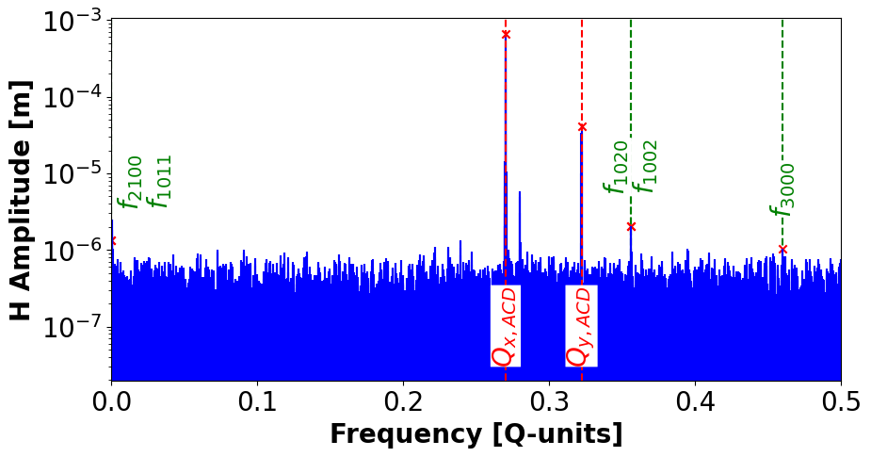
Example horizontal spectrum
Notes:
-Qx + Qy = 0.052, 2Qy = 0.356, 2Qy = 0.46

Slide 12
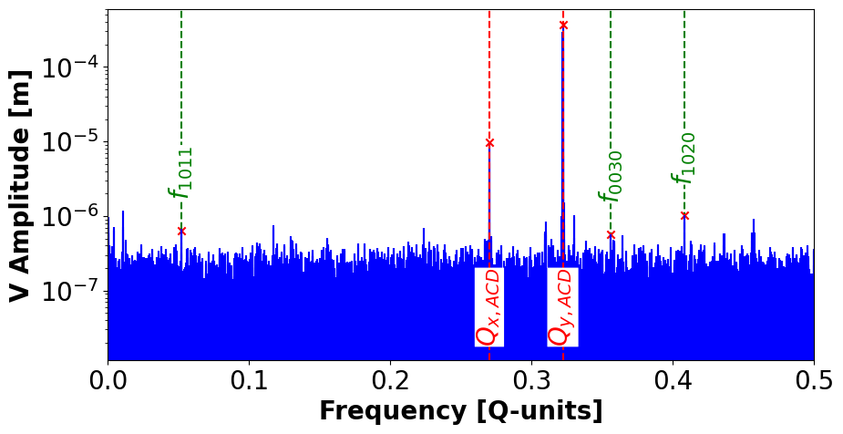
Example vertical spectrum
Notes:
Qx + Qy 0.408
Qx = 0.27 Qy = 0.322

Slide 13
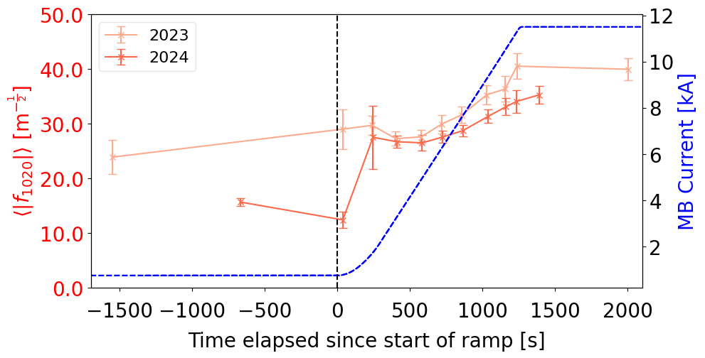
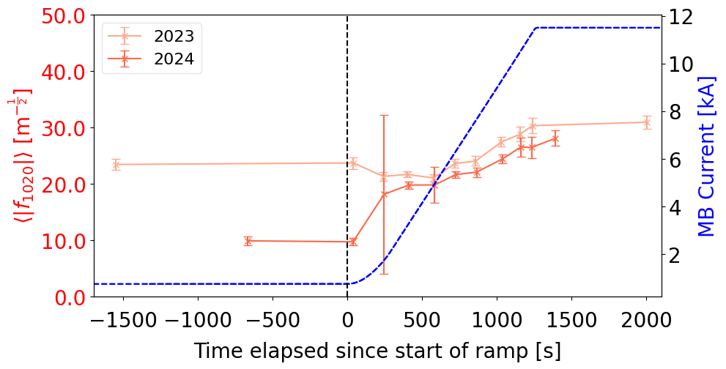
f₁₀₂₀ vs time for B1 comparison
N.B. For 2nd kick during 2024 ramp the amplitude was wrong
x
y

Slide 14
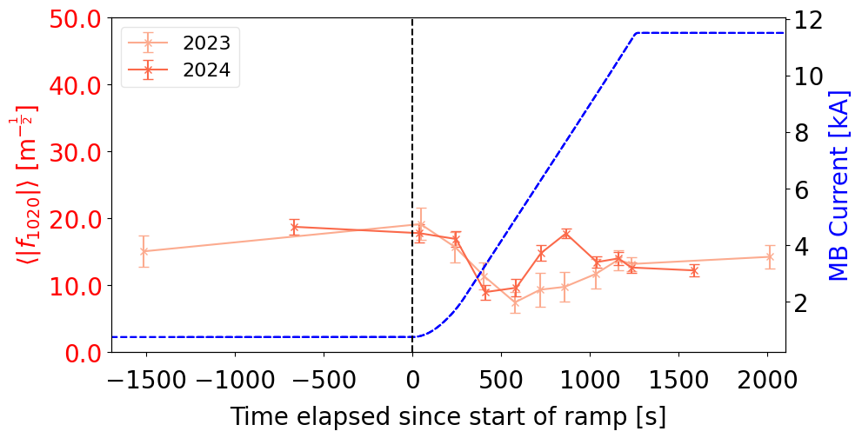
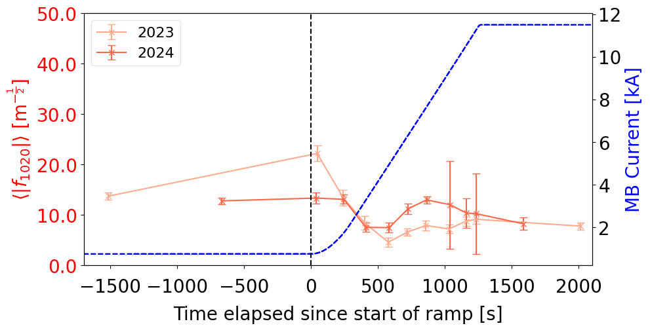
f₁₀₂₀ vs time for B2 comparison
x
y

Slide 15
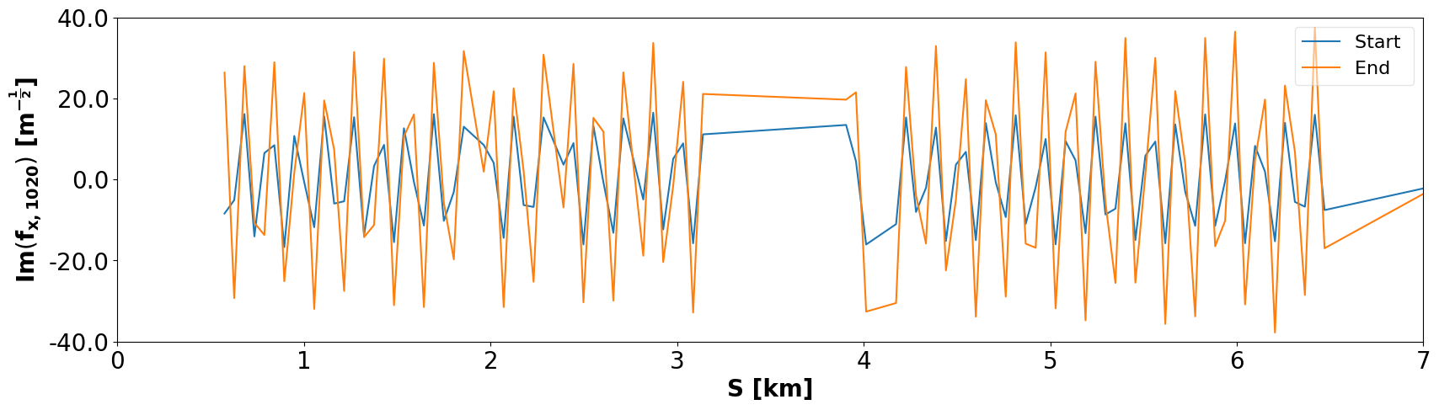
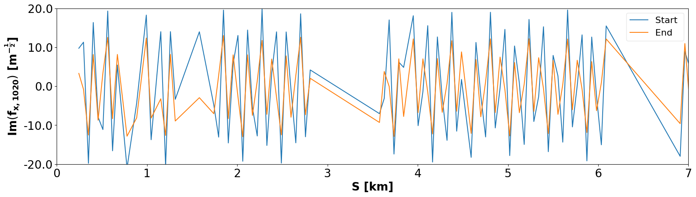
Im(f_{x,1020})
LHCB1
LHCB2

Slide 16
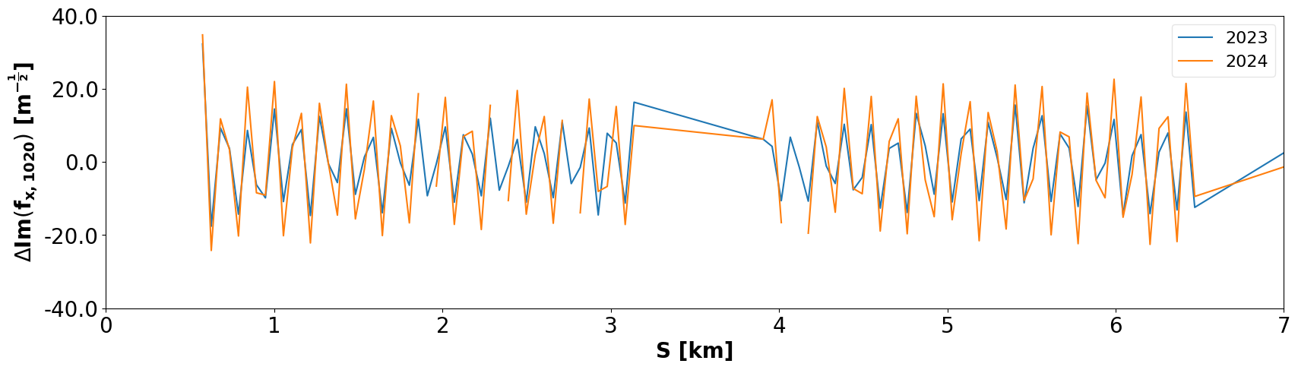
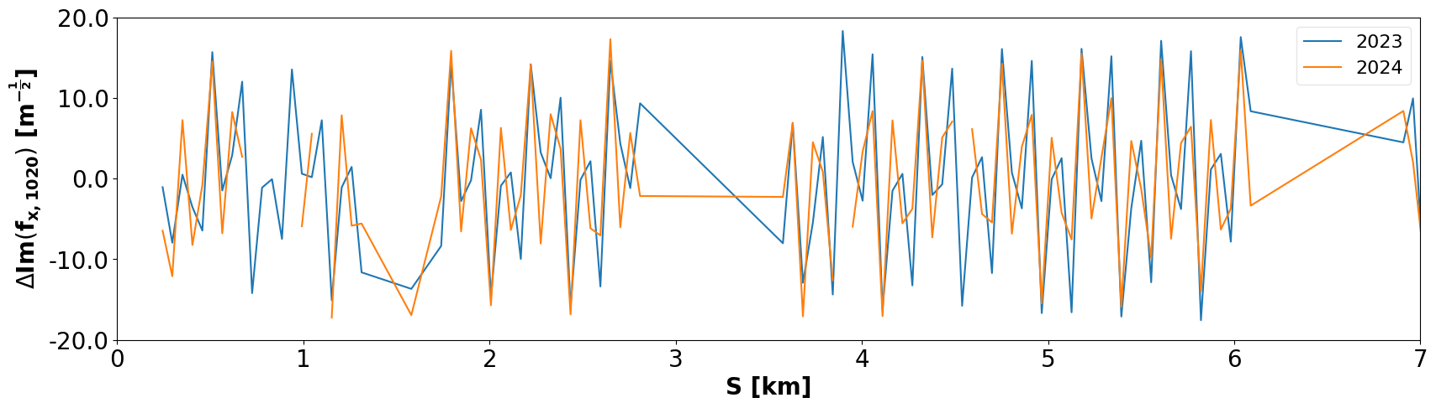
ΔIm(f_{x,1020})
LHCB1
LHCB2

Slide 17
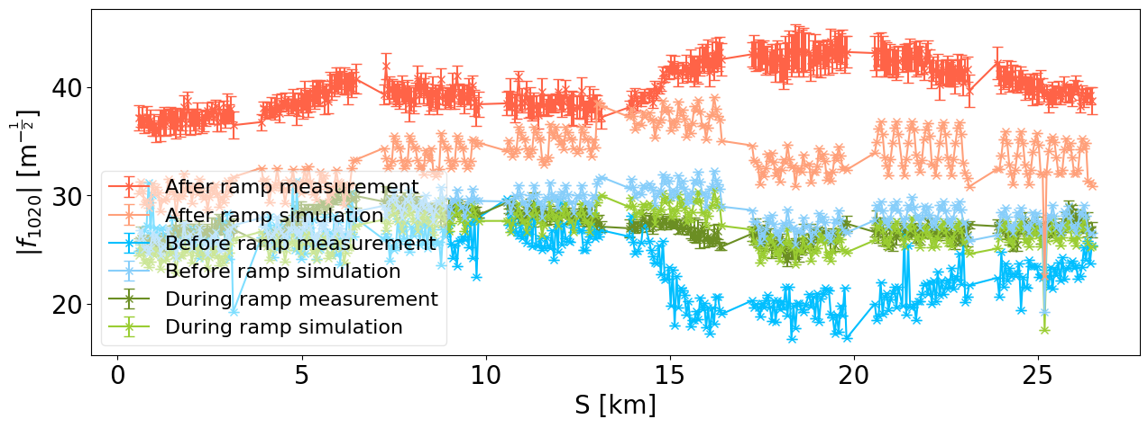
Comparison to simulation (2023 LHCB1)
N.B. No error model included

Slide 18
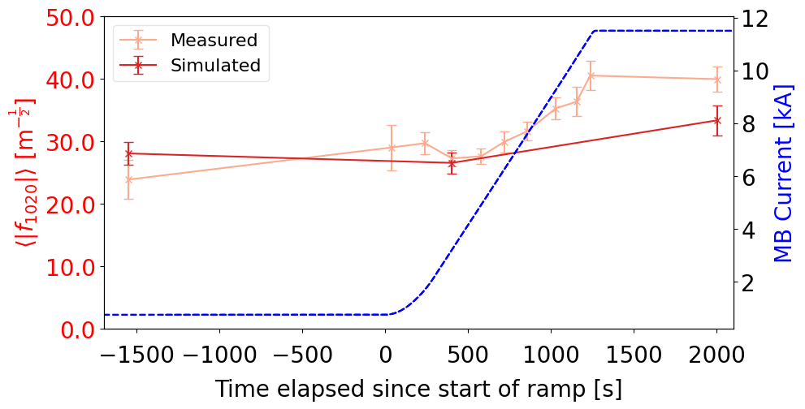
Comparison to simulation (2023)

Slide 19
Conclusion
Beta-beat during ramp remained below the threshold of 15s%
Can see the effect of the correction again at injection
Otherwise, same trends seen in both 2023 and 2024
  Implies that the IR1 polarity reversal had no impact on f₁₀₂₀

