Slide 1
Status of the LHC
Matteo Solfaroli
13th Large Hadron Collider Physics Conference
May 05th, 2025

Slide 2
Outline
2024 run highlights
2025 configuration and key aspects
Beam intensity limitations and plans
2025 schedule and projections
  + considerations on IONS run

Slide 3

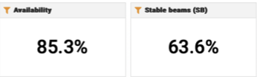
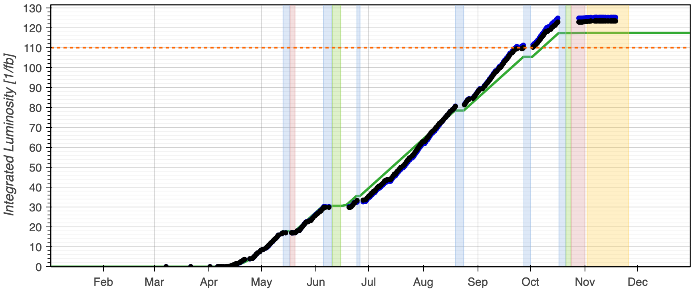
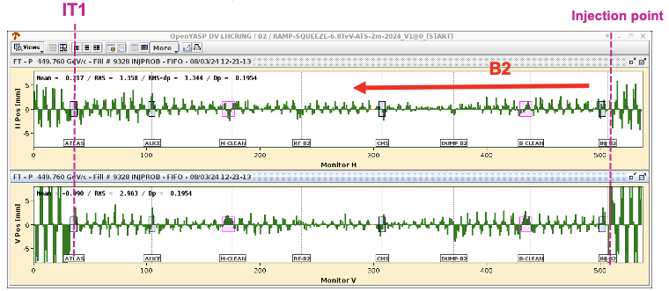
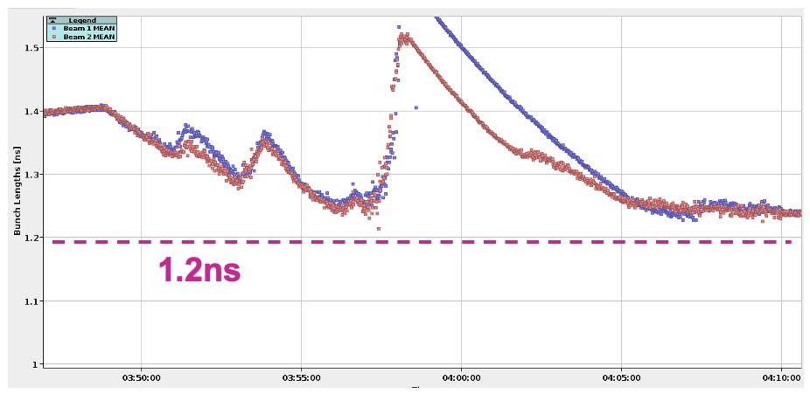
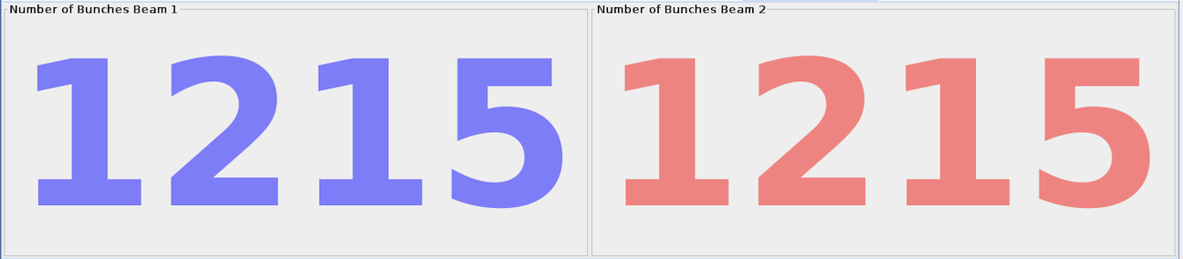
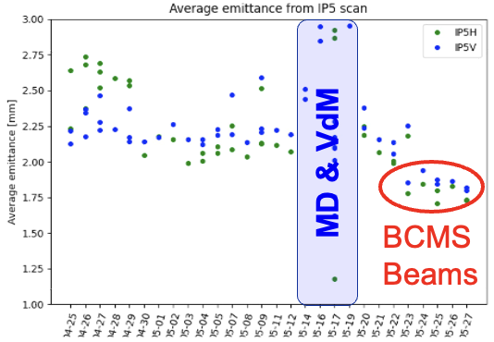
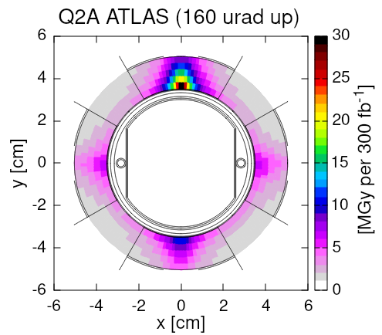
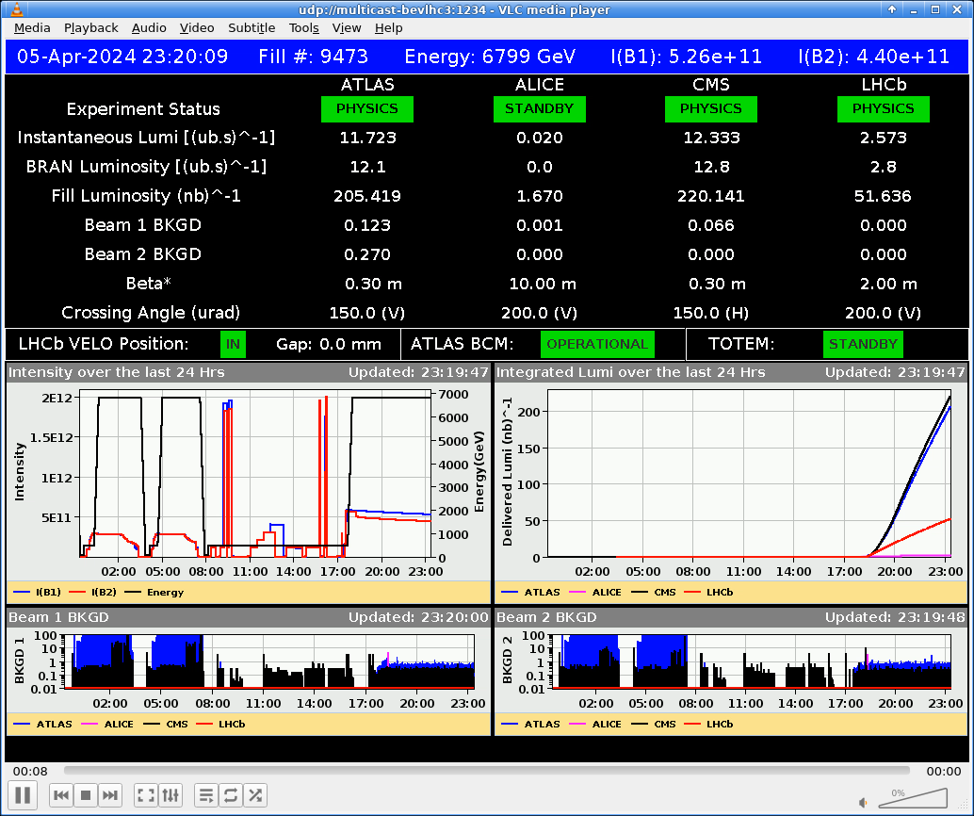
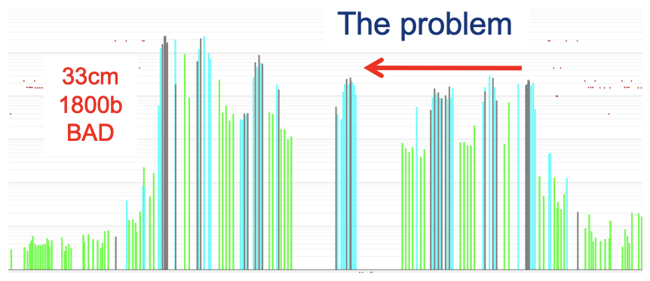
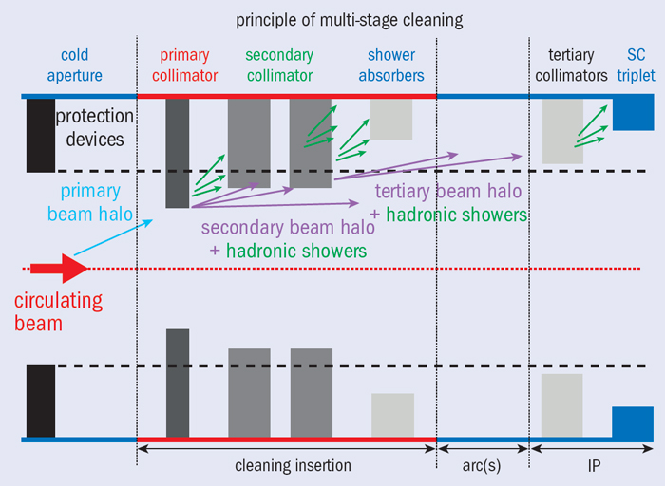
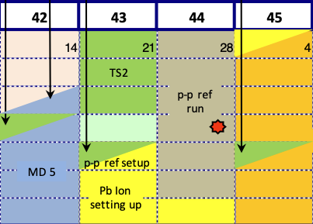
LHC in 2024
VdM & Calibration
Runs, 16th – 20th May
Stable Lumi
Production
Summer period
First injection: 8th March (3 days early)
Bunch length control/target
Limit RF module heating risk
IONS run
(YETS started on 25th November)
1200 bunches on 14th April (10 days early)
BCMS beams
May
Beyond 110 fb⁻¹
1.9 nb⁻¹ in IP1/2/5
(same as 2023 in 50% of the time)
pp run
ref run
IONS run
March
Q1
April
May
June
July
August
September
October
Q4
November
Reverse Polarity optics
commissioned (~ +1 week)
First Stable Beams @6.8 TeV 5th April (3 days early)
β* limited to 36 cm 17th April
β* back to 30 cm 17th June
pp reference run 28th Oct – 2nd Nov
90% availability
LHCb VELO closed for the 1st time

Slide 4
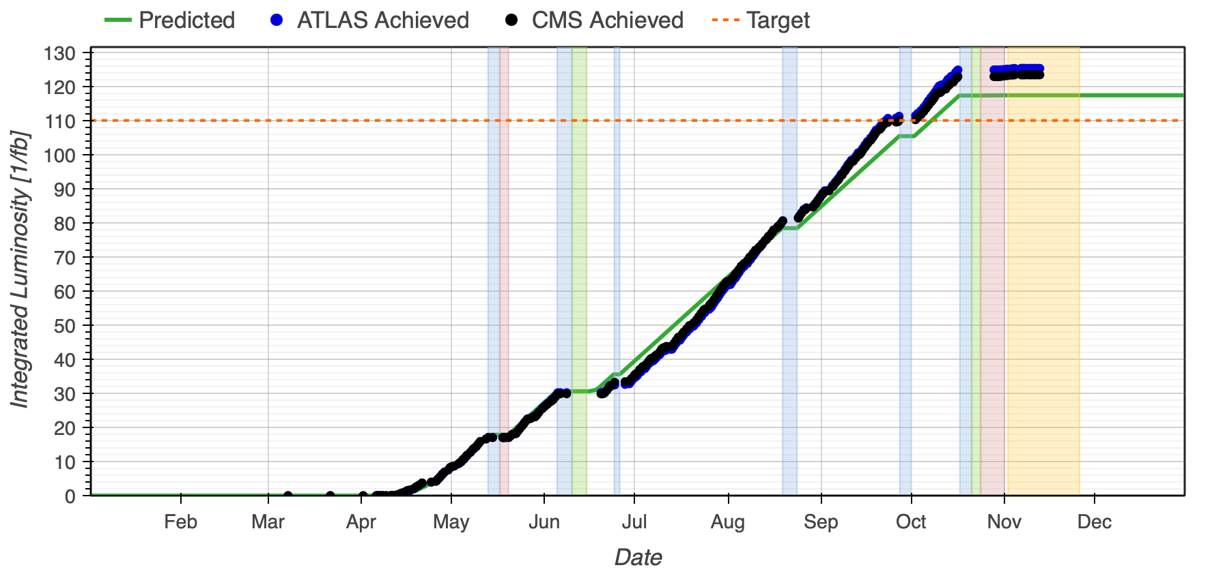
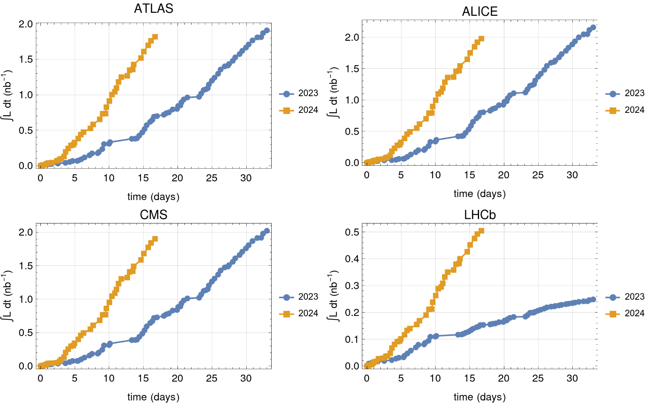
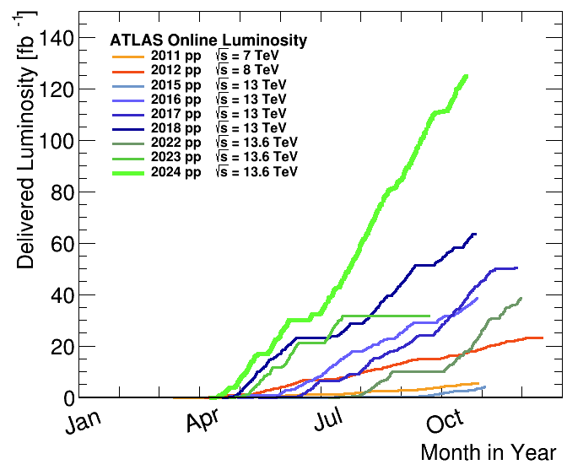
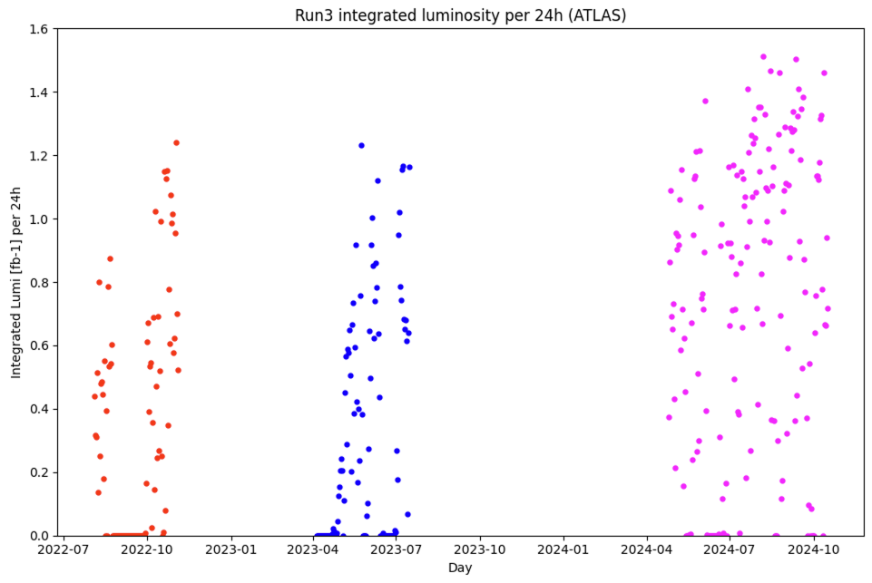
2024 production
IONS
124 fb⁻¹ in ATLAS/CMS
11 fb⁻¹ in LHCb
67.5 pb⁻¹ in ALICE
Highest production rate ever
Single most productive year in LHC history so far!
2024 AVG rate = 0.83 fb⁻¹/24h
2024 highest rate = 1.5 fb⁻¹/24h
(midnight to midnight)
IP1/2/5: Almost same luminosity as 2023, in about half the time, achieving the (ambitious) target of 1.9 nb⁻¹
IP8: About double the 2023 luminosity in about half the time
~30% higher intensity with
performance beyond HL-LHC projection
~2h of levelling at 6.4x10²⁷ cm⁻² s⁻¹
LS1
LS2

Slide 5
Outline
2024 run highlights
2025 configuration and key aspects
Beam intensity limitations and plans
2025 schedule and projections
  + considerations on IONS run

Slide 6
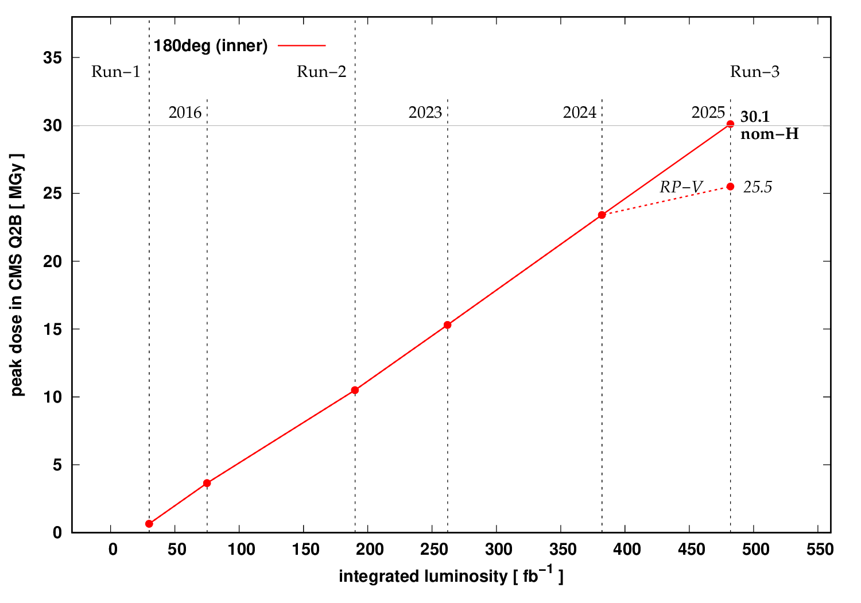
Triplet radiation – the problem
Radiation dose on inner triplet magnets located next to the high-luminosity interaction points, is approaching levels close to the estimated damage thresholds
  though they carry significant uncertainties
A failure of one of these magnets could lead to substantial downtime for the LHC or even compromise the results of the nearby physics experiments
To address this risk a taskforce was established in 2022 to study the impact of radiation on equipment lifetime in the inner triplet regions and to propose possible mitigations
Limiting quadrupole in Interaction Region (IR) 5

Slide 7
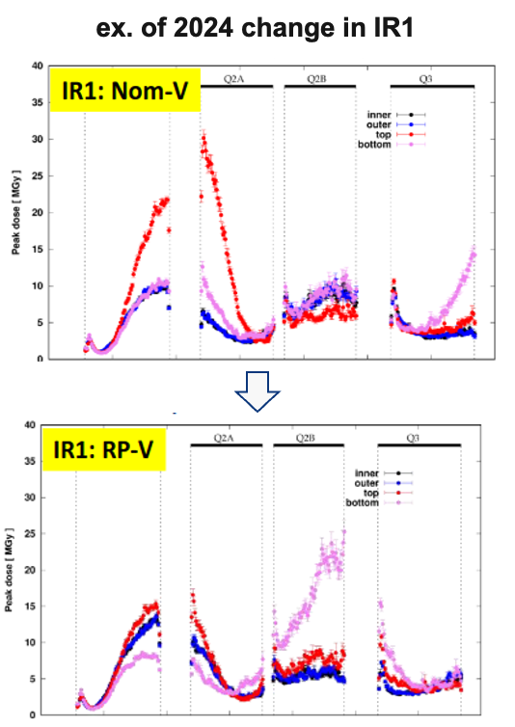
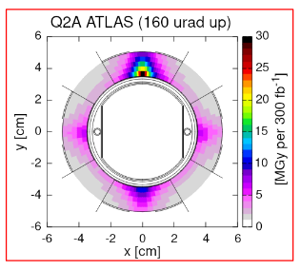
Triplet radiation – the solution
Longitudinal distribution of radiation
The dose can be spread over different azimuths by:
  Inverting quadrupole polarities (Reversed Polarity optics)
  Change crossing angles sign and/or plane
There are in principle 8 configurations, however only 4 are possible, due to stability requirements
  Alternate H-V or V-H crossing angle plane in IR1 and IR5
ex. of 2024 change in IR1
2024: RP optics in Interaction Region (IR)1
  Significant reduction of radiation dose on IR1 magnets
  Increased background for Forward physics detectors
2025: RP optics in IR5 & restored “nominal” optics in IR1 + crossing plane inversion
  Significant reduction of radiation dose on IR5 magnets
  Situation restored for Forward physics detectors

Slide 8
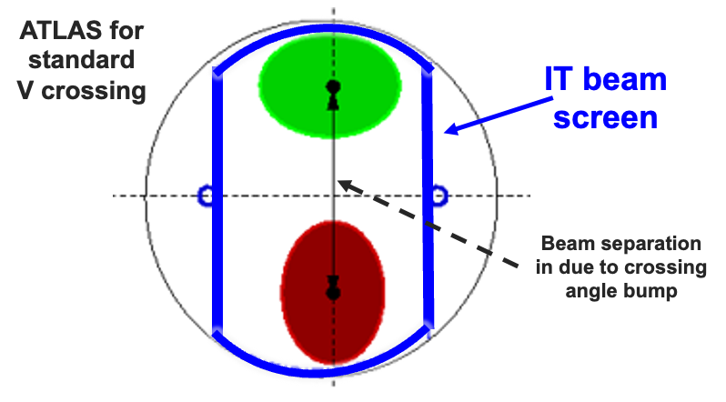
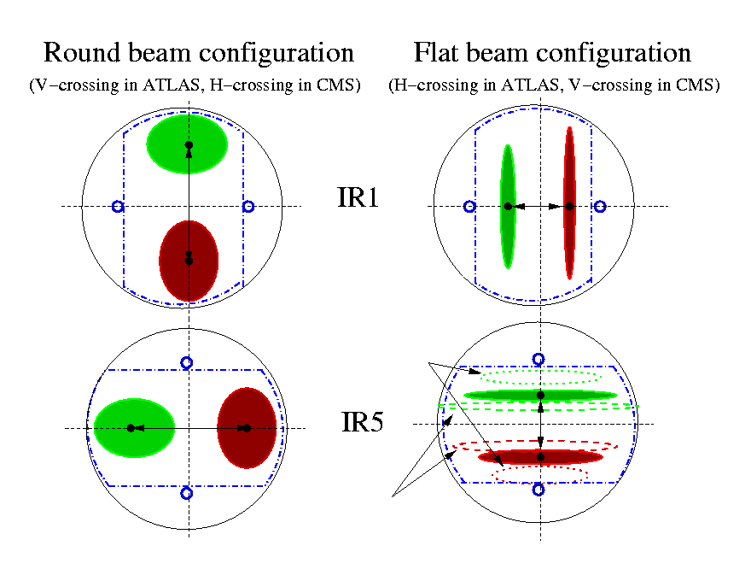
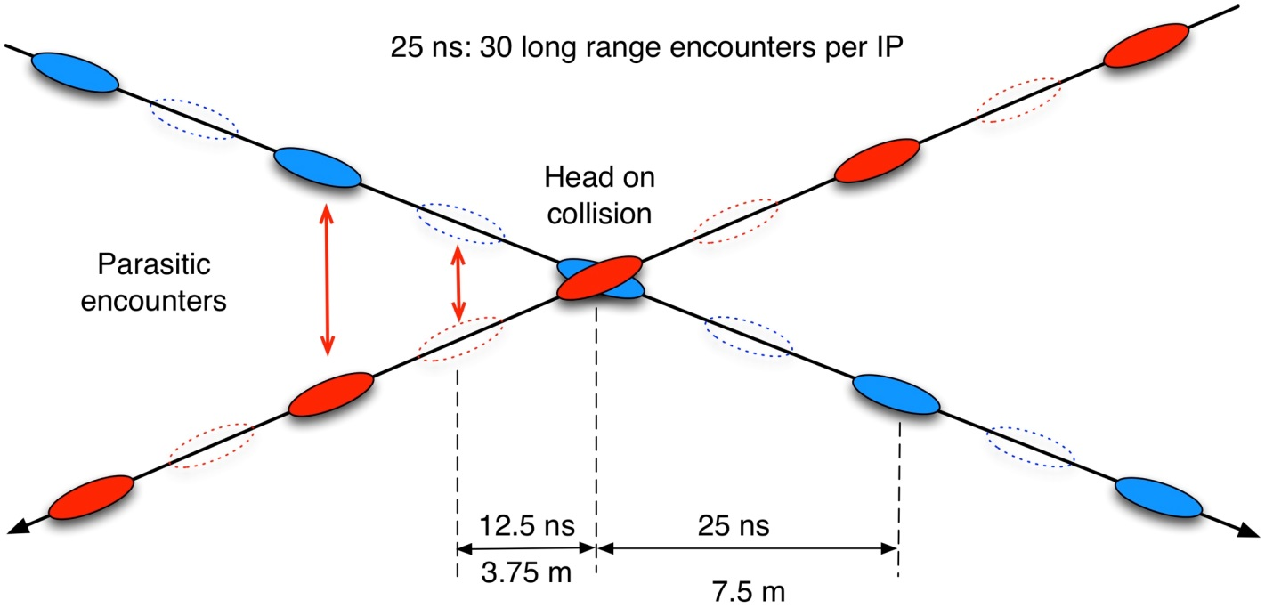


Triplet radiation – consequence
The Inner Triplet beam screen shape is asymmetric, arranged for larger aperture in the “standard” crossing plane (beam size in IT quadrupoles is ∝ 1/√β):
With inversion of planes, the aperture in the crossing angle plane is significantly reduced
  Less aperture in the rotated crossing plane: minimum β* increases from 30 cm (2024 value) to 60 cm
  More aperture in the rotated separation plane: minimum β* decreases from 30 cm to 18 cm
Flat optics: luminosity ~equivalent

Slide 9
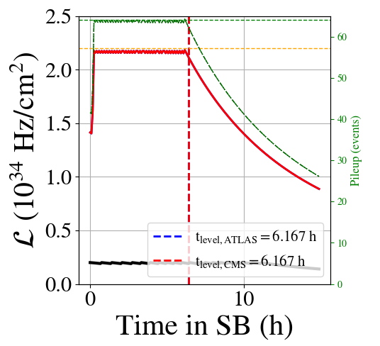
Levelling in physics – why?
The LHC can operate at more than twice its nominal peak luminosity of 1x10³⁴ cm⁻² s⁻¹
However, the instantaneous luminosity needs to be kept under control, due to:
  heat load to the cryogenic system of the superconducting magnets close to the interaction points
  event pile-up in the experiments
For this reason, the instantaneous luminosity during a physics fill is limited to ~2.1x10³⁴ cm⁻² s⁻¹, until the point of natural decay is reached

Slide 10
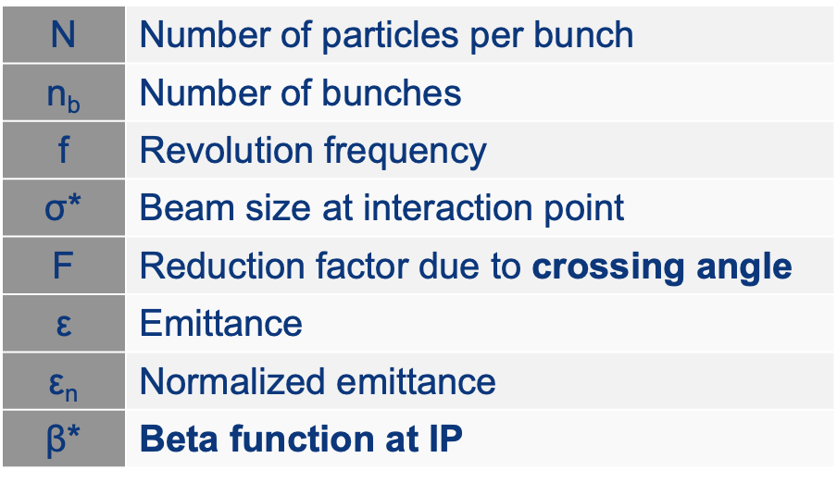
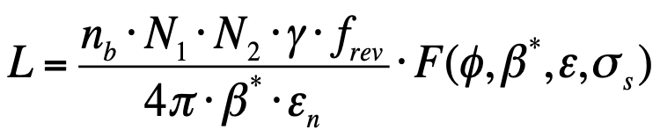
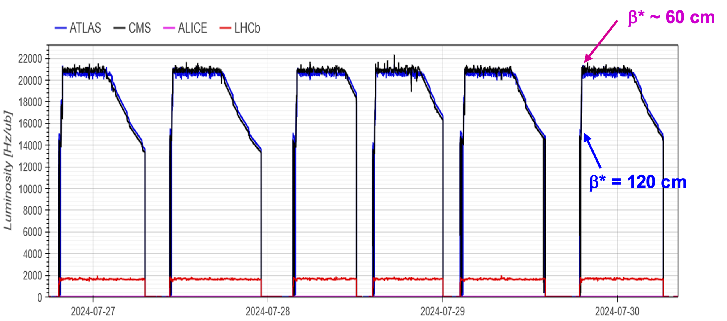
Levelling in physics
There are different ways to control instantaneous luminosity:
Beams separation offset
Crossing angle
Beam dimension at interaction point (β*)
2024 and 2025
Combined (β* + offset) levelling
  6-7 hours constant luminosity
  Well balanced luminosity between CMS and ATLAS
LHCb levelled through the entire fill
Luminosity control ~1.5% (5% is Run3 request)
Fast increase to levelling start point (few % gain)

Slide 11
Outline
2024 run highlights
2025 configuration and key aspects
Beam intensity limitations and plans
2025 schedule and projections
  + considerations on IONS run

Slide 12
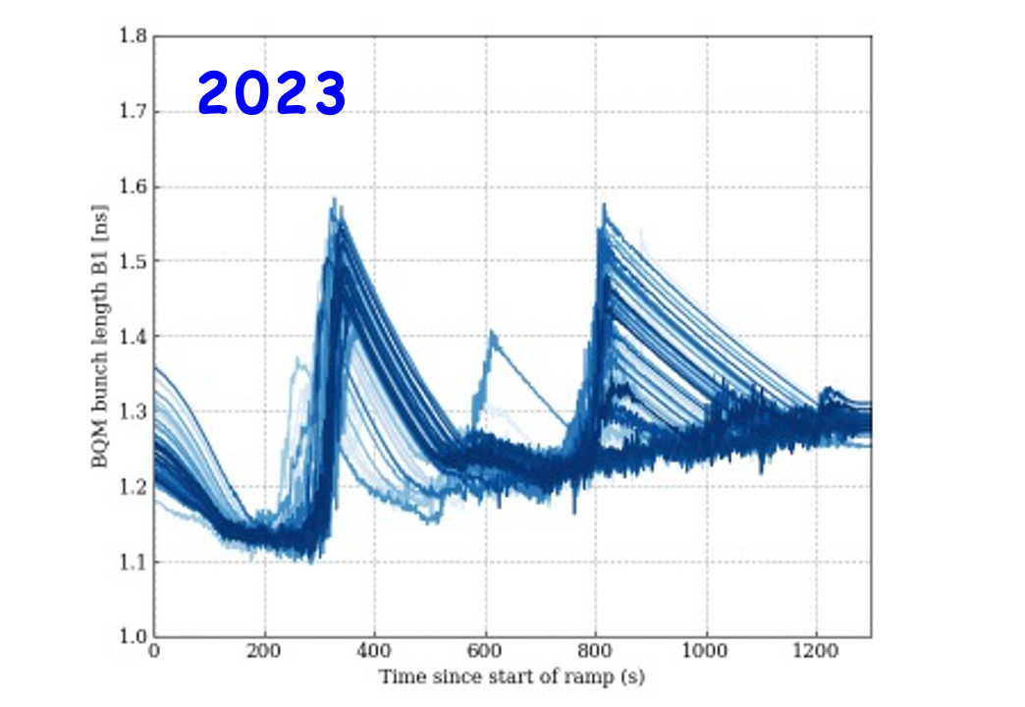
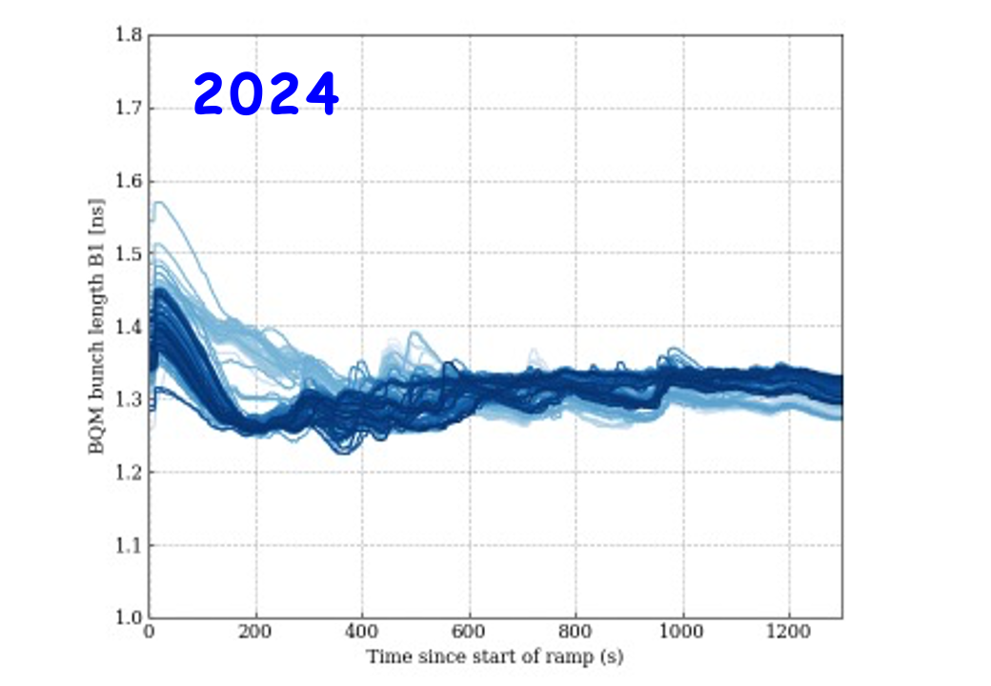
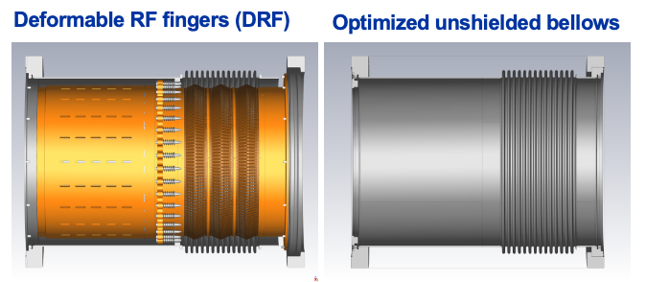
Intensity limitation – warm vacuum modules
IMPACT in 2023
~5 days lost
Bunch intensity limited to 1.6x10¹¹ protons per bunch (ppb)
IMPACT in 2024
Bunch intensity limited to 1.6x10¹¹ ppb, while maximizing the bunch length through the cycle
  Difficult to identify intensity limitation (strong dependence on contact quality)
Improved control of bunch length provides safety factor in power deposition
Bunch length during the energy ramp
NO more intensity limitations in 2025
This operational improvement, together with the completion of the warm vacuum modules consolidation can open a window for higher intensity tests/operation, with very low risk of impact on availability
Consolidation: 71 modules replaced

Slide 13
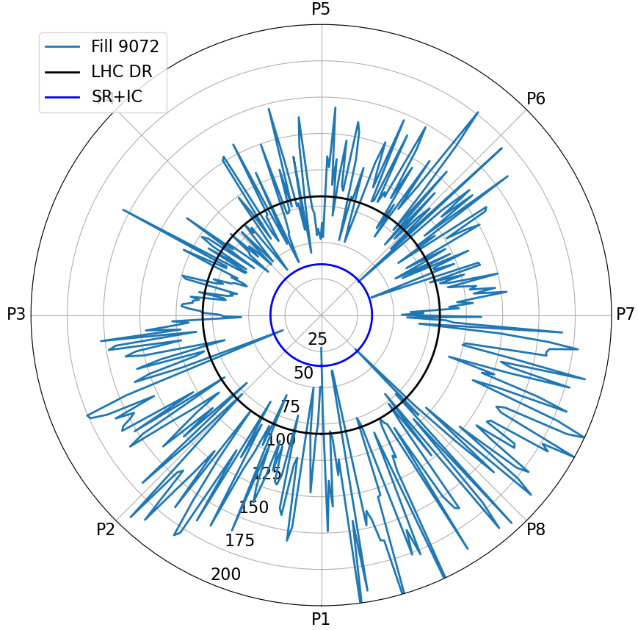
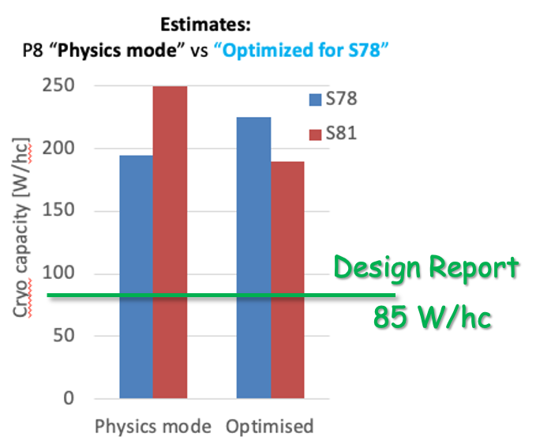
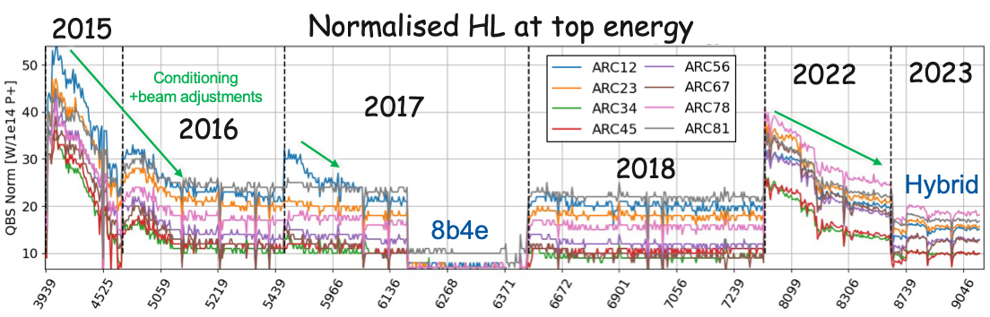
Intensity limitation – heat load
Geographical HL distribution
Heat load (HL) deposited by the beams can become a limitation when cryo capacity is not enough
  Electron cloud generated
  Presently well beyond the Design Report value
Degradation observed when sectors are vented to air
Heat load is not homogeneously distributed
  Sector 78 is the highest sector in Run3

Slide 14
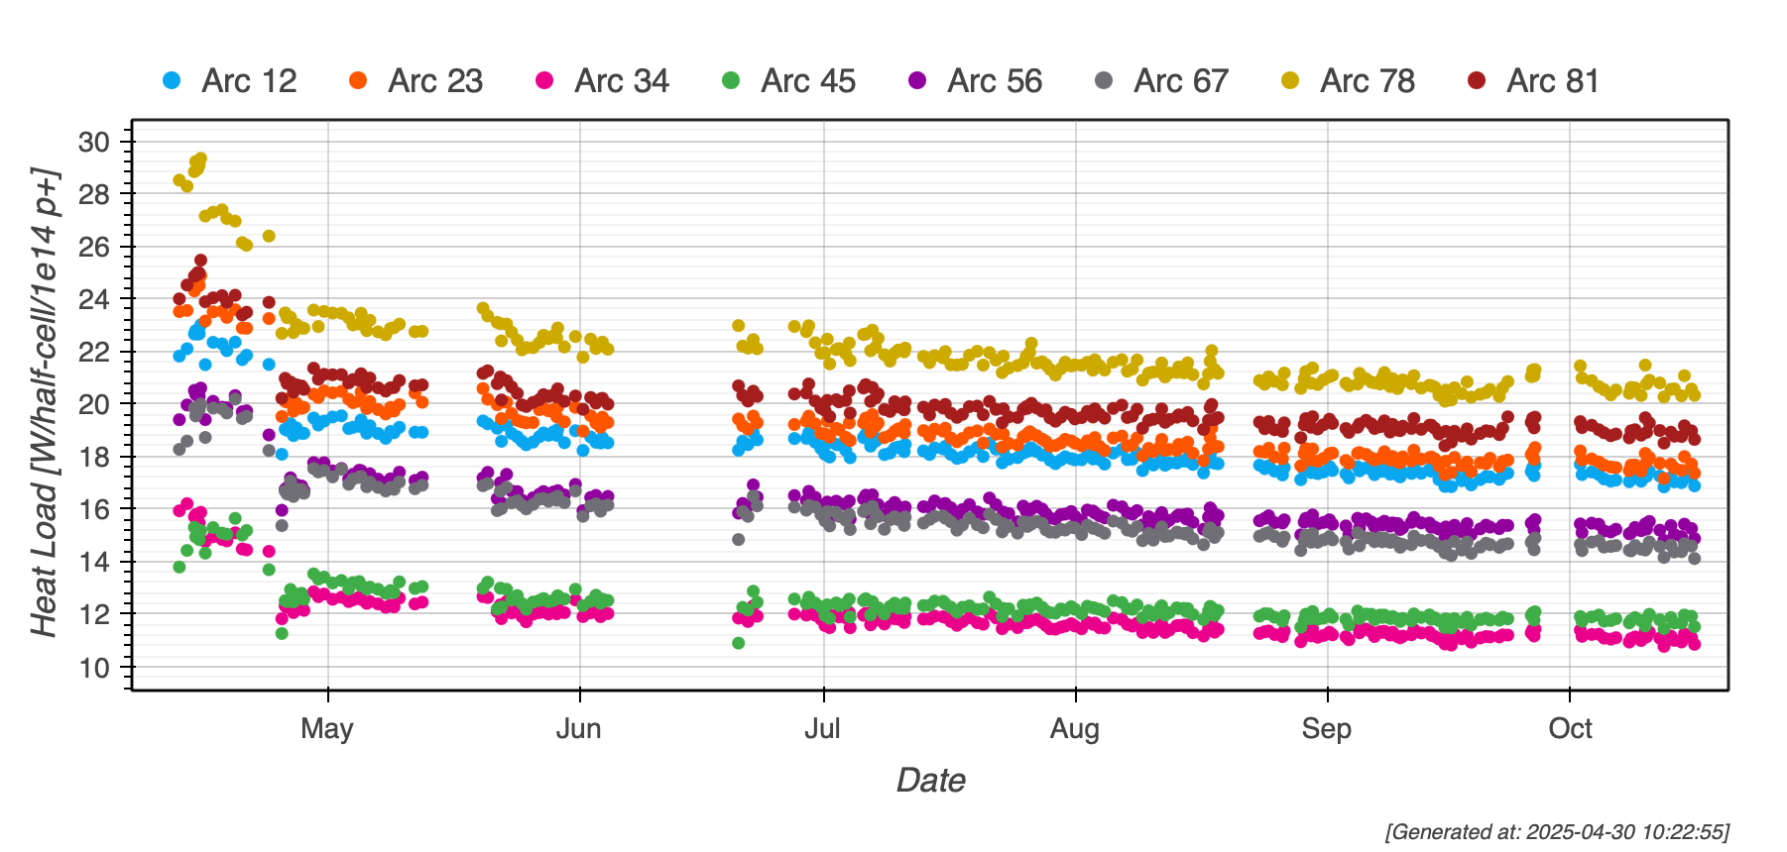
Intensity limitation – heat load
HL brings limitations on total number of bunches and bunch intensity
Gradual conditioning helps to increase beam intensity
  Dedicated sessions (so-called scrubbing) are regularly carried out
  Conditioning by operation over 2024 allowed to gain ~5-10% margin
Scrubbing
conditioning by operation

Slide 15
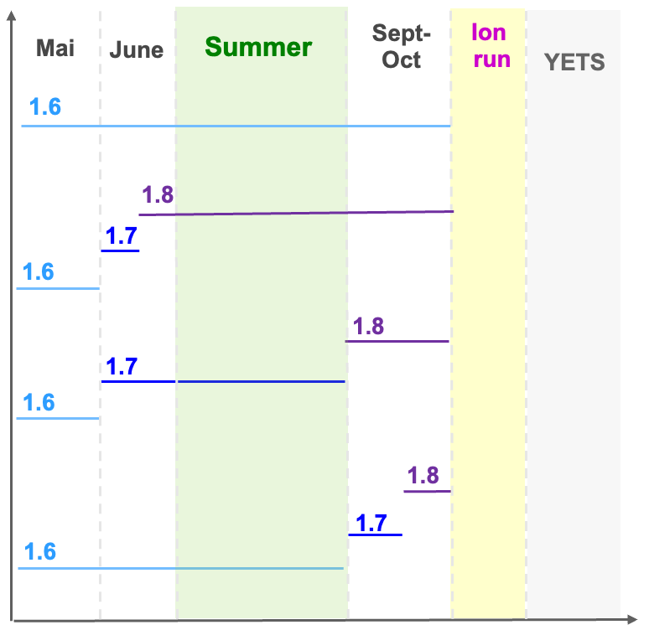
2025 proton-proton operation
In Run3 LHC has been so far operated with train of 1.6×10¹¹ proton per bunch (ppb):
  Run3 target (1.8×10¹¹ ppb) was not (yet) achieved
The injector chain achieved target parameters for LHC Injectors Upgrade (LIU) project
  4x72 bunches @2.3×10¹¹ ppb at SPS flat top
Different scenarios for 2025 run
  No risk pp production - NOT more knowledge at end of 2025 than today!
  Early, distributed, late intensity steps towards 1.8x10¹¹ ppb
Agreed scenario
Stable run at 1.6x10¹¹ ppb until september THEN increase bunch intensity until 1.8x10¹¹ ppb, before ION run

Slide 16

Towards HL-LHC intensity
Q1-Q2 2026
End of Run 3: last window to probe HL-LHC beam intensities
Critical investment into the success of HL-LHC!
Increasing intensity can reveal “unexpected limitations”
  BSRT mirror, (old) TDIs, vacuum modules, roman pots
Once operation at 1.8x10¹¹ ppb (Run3 goal) demonstrated, test to explore intensity range up to 2.3x10¹¹ ppb
  Beam dynamics tests: compatible with intensity limits (lower number of bunches)
    Started: RF capture, electron cloud, beam in(stability), beam-beam…
  Heating test (≥ 2000 bunches)
    Heating power will exceed the peak values achievable in operation with 1.8×10¹¹ ppb
    Potential risk to components and to machine availability from “unexpected limitations”
Heating test proposed for 2026:
Advance the ion run by 2 weeks
No risk to physics program in case of equipment failures

Slide 17
Outline
2024 run highlights
2025 configuration and key aspects
Beam intensity limitations and plans
2025 schedule and projections
  + considerations on IONS run

Slide 18

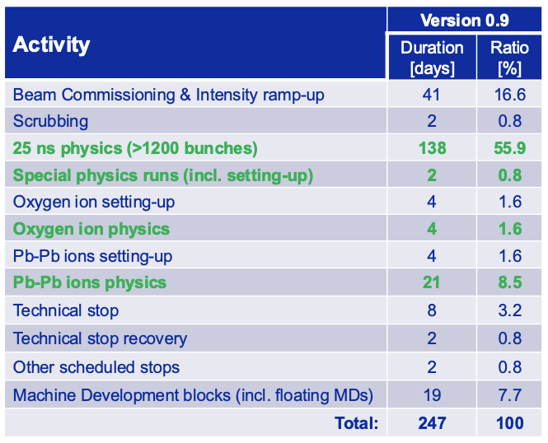
2025 schedule
Q3-Q4
Q1-Q2
First stable beams at 6.8 TeV on May 5th
Intensity ramp up (number of bunches) at 1.6×10¹¹ ppb → full machine around mid-May, followed by long production period
Oxygen run during 1st week of July

Slide 19
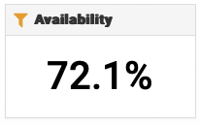
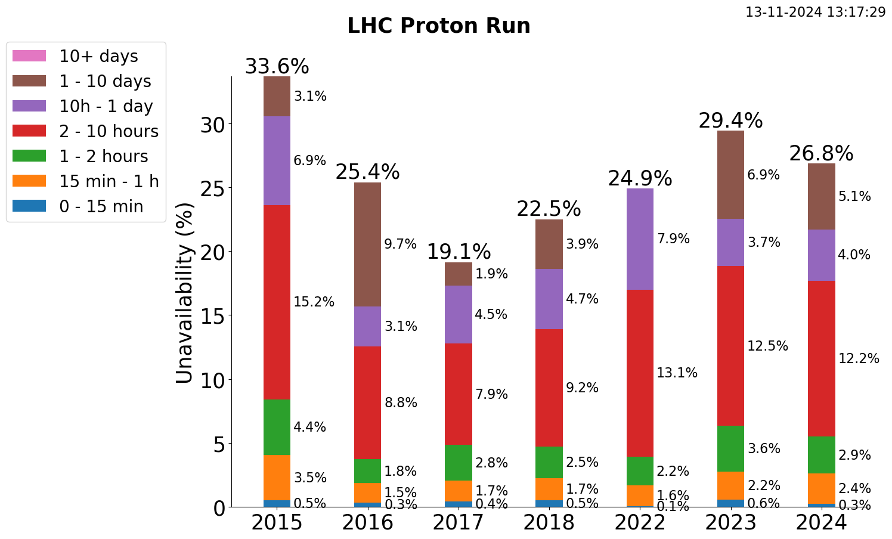
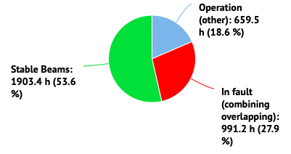
Availability
2024 pp run
Availability is THE key factor for accelerator performance
Availability factor is ~constant through Run2 and Run3 for small (<24h) faults
Minor differences in numbers are due to slightly different choices in term of dates (including or not scrubbing run, TS recovery etc)
NOTE: the availability of the proton run is calculated on the effective time from the retrospetctively calculated schedule (long faults are not included)

Slide 20
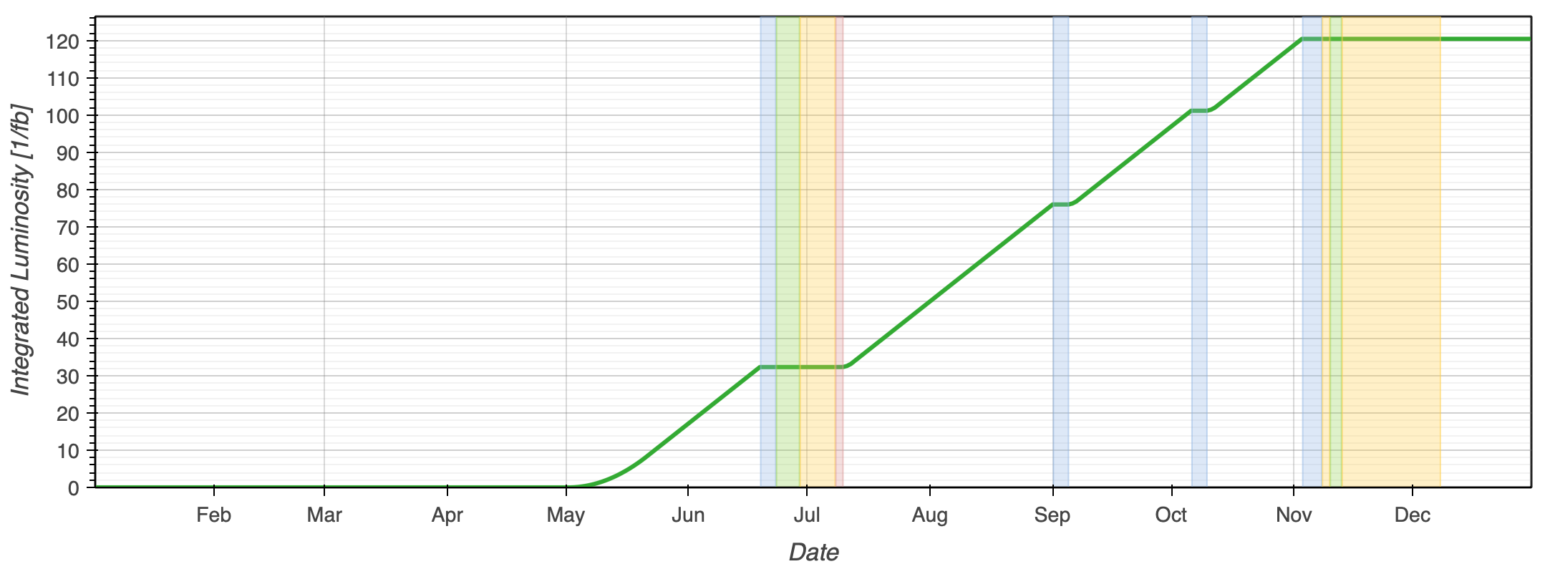
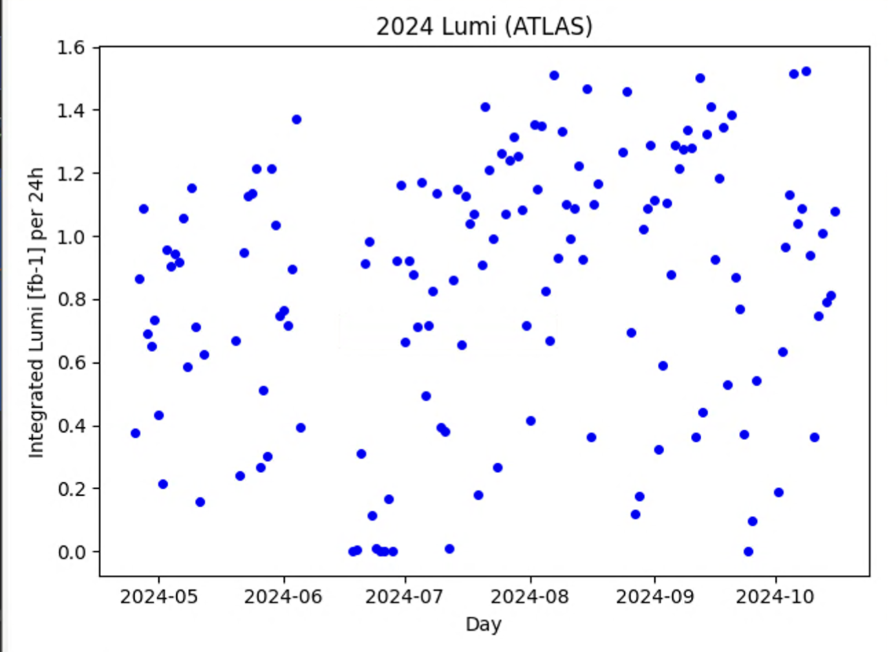
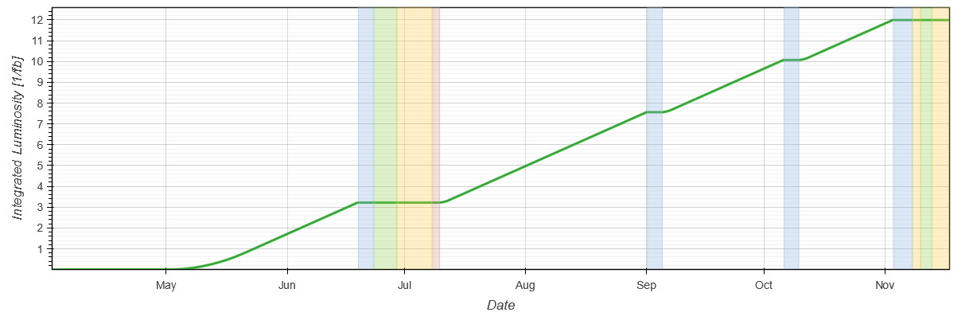
pp run performance estimate
Performance estimate depends on many operational parameters, but above all availability!
Assuming conditions 2024-like:
  ATLAS/CMS: ~120 fb⁻¹
  LHCb: ~11 fb⁻¹
  ALICE: ~65 pb⁻¹
ATLAS/CMS prediction
~120 fb⁻¹
LHCb prediction (driven by hours in stable beams and levelling target)
~11 fb⁻¹
2024 AVG production rate
0.83 fb⁻¹/24h

Slide 21
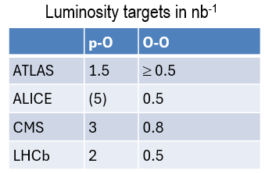
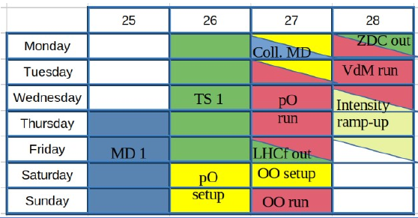
Oxygen run
Pb-Pb
p-O
O-O
Injection
Injection
Injection
8 days allocated for Oxygen - setup and physics
Requests from the experiments require 3 distinct machine configurations (LHCf β* ≥ 1m, OO at 5.36 TeV)
Estimates indicate that some targets are difficult to reach. Time estimates range between 7 days (perfect availability) and 9 days
Short runs are very sensitive to availability
Ramp to 6.8 Z TeV, β*=1m/
1.5m
Ramp to 6.8 Z TeV, β*=1m/
1.5m
Ramp to 5.36 Z TeV, β*=1m/
1.5m
Squeeze β*=0.5m
1m
Physics
Squeeze β*=0.5m
1m
Luminosity targets in nb⁻¹
Physics
Physics
Preferred by experiments

Slide 22
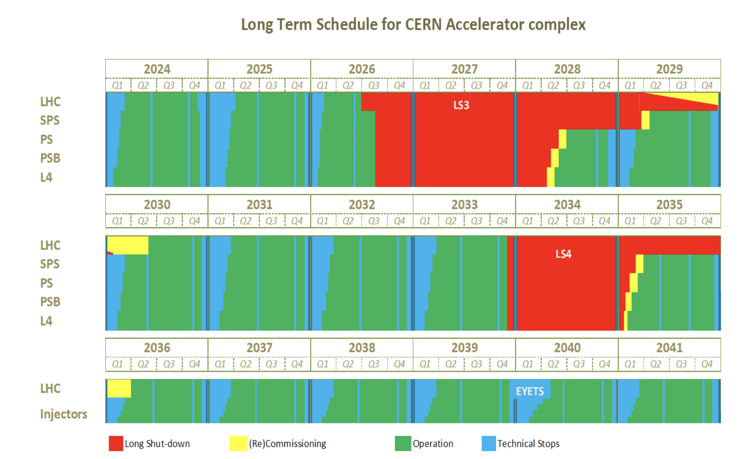
LS3 planning
LS3 start delayed to 29th June 2026
LS3 goal: 47 months beam to beam
  Still ~1.5 month to optimize, promising options being discussed, expected to converge by June 2025
Early June 2030: beam back in the LHC
  Experiments caverns closure mid-May ‘30
  Beam vacuum valves opening end-May ‘30

Slide 23

Conclusions
2025 run has started and the LHC is ready for 2025 goals
  Stable operation with 1.6x10¹¹ ppb until the end of summer
  Increase bunch intensity to reach 1.8x10¹¹ ppb before the ION run
  ~120 fb⁻¹, ~11 fb⁻¹, ~65 pb⁻¹ can be in reach in 2025, assuming 2024-like availability
Pushing bunch intensity during Run3 is key to unveil potential limitations before LS3 and prepare the road to High Luminosity LHC
It looks easy, but the fact that we can operate the LHC at such a high level is a tremendous achievement and a true reflection of the incredible dedication of everyone involved!

Slide 24
SPARE

Slide 25
2026 draft schedule

Slide 26
Heat-load – the problem
*Beam screen values are given as example, as e-cloud varies along the machine
Beam screen*
285 W/hc
☹
Cryogenic operation margin
for daily operation
(handle transients during
injection and magnet ramping)
+ facing disturbances
Operational margin
Operational margin
Operational margin
Beam screen
84 W/h
Beam screen*
170 W/hc
Beam screen*
160 W/hc
Inner Triplet
BASE
(2 K loops, thermal shields, DFB, SAM, RF, etc.)
1 cryoplant capacity
~18 kW @4.5 K
Inner Triplet
BASE
(2 K loops, thermal shields, DFB, SAM, RF, etc.)
BASE
(2 K loops, thermal shields, DFB, SAM, RF, etc.)
BASE
(2 K loops, thermal shields, DFB, SAM, RF, etc.)
LHC
Design Report
LHC
Today
HL-LHC
(without BST)
HL-LHC
(with BST)
NB: The graphics are not scaled, they are only illustrative

Slide 27
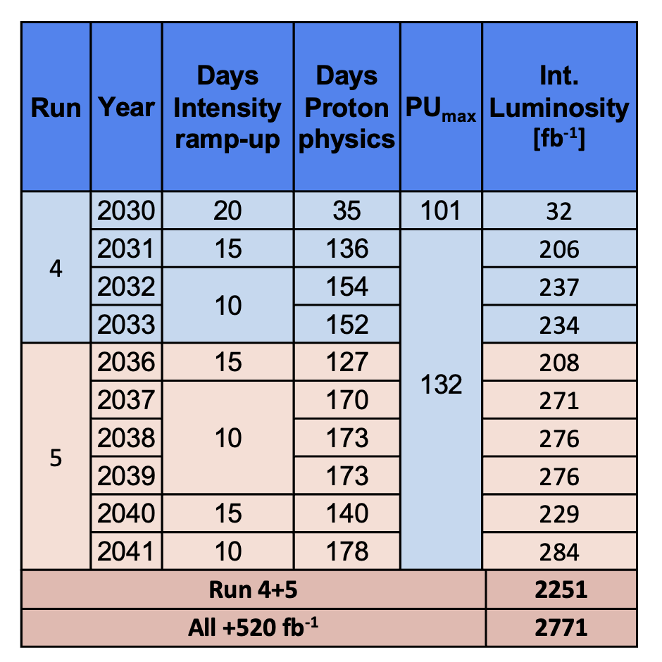
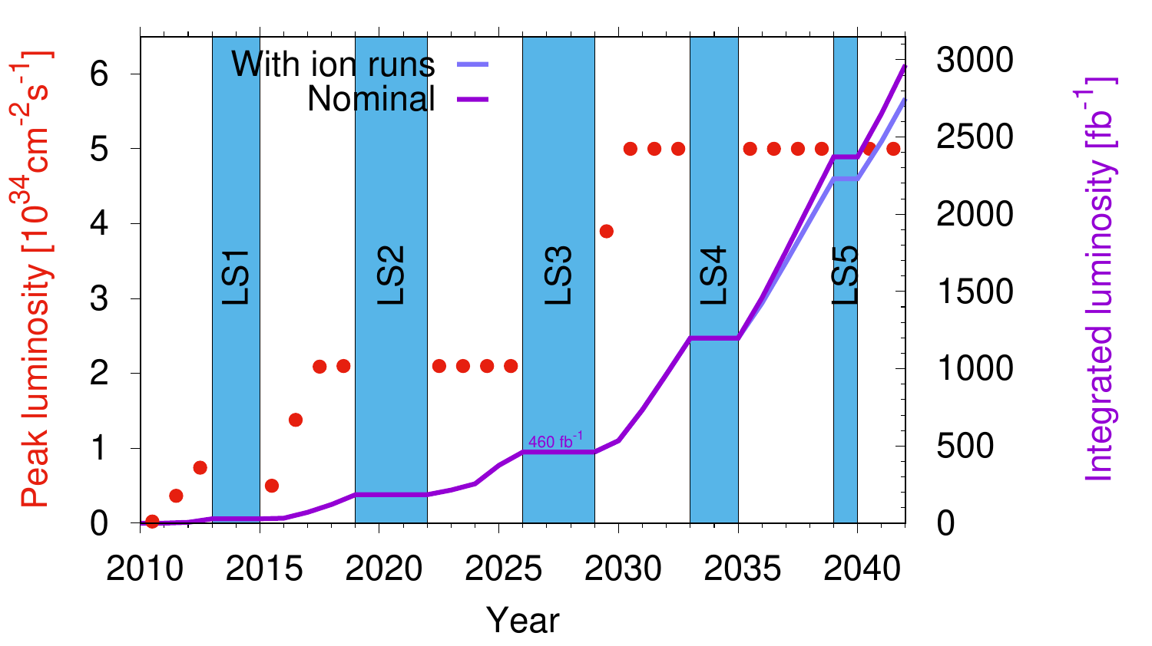
HL-LHC operation
Recent update: IONS operation in 2031-2041

