Slide 1

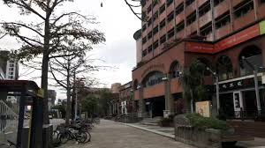



A Flavor Model of EW Baryogenesis
testable @ the LHC
May 9th @ LHCP2025, NTU

Slide 2
Flavor → EWBG
I. Intro: Glashow-Weinberg NFC ad hoc
II. t → ch example: mysterious alignment
III. λ_{t} Im ρ_{tt} robust for EWBG: O (1) quartics / eEDM cancel.
1st order EWPh.Tr.
IV. cg → tH/tA → ttc(bar)
V. cg → bH⁺ → btb(bar)
LHC Search
VI. Conclusion
What hides H, A, H⁺ effects so well from our view ?

Slide 3
0. Intro: tensions; t → ch
PLB’92
h(125) ✔ New Physics ✘
Where is SUSY/WIMP ?
Beyond CKM CPV (Large)
EW BaryoGenesis (EWBG)
- more testable -
tension
LHC
- N o N ew P hysics -
EWBG ought to be pursued
while LHC is still running!
NNP
tension
competition
J I L A 22
e EDM: ACME14 → ACME18
- L.E. Precision Frontier -
0.41
|d_{e}| < 1.1 x 10^{‒29} e cm
Cutting edge of CPV & B.A.U.

Slide 4
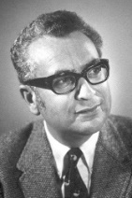
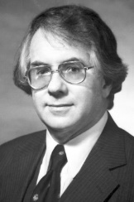

I. Intro: Glashow-Weinberg NFC ad hoc
Natural
Gell-Mann (1969 sole Laureate)
“Everything not forbidden is compulsory.”
the “Totalitarian Principle ofTruth” (wiki)
∃ Weak Higgs Doublet
υ ≈ 246 GeV
Φ =
φ⁺
φ⁰
⟨φ⁰⟩ ≠ 0
G⁺
υ + h⁰ + G⁰
Observed.
S.S.B.
Higgs Mechanism
h(125) ✔
ad hoc
No Reason to forbid
a Second Higgs,
so ∃ Second Higgs Doublet
(1979 Laureates)
Φ' =
Glashow-Weinberg’77 sought to
forbid Second Set of Yukawa’s,
φ' ⁺
φ' ⁰
⟨φ' ⁰⟩ = 0
H⁺
H + i A
usually implemented by a Z₂,
general
refuted by my PLB’92 & EPL’18 (next pages).
2HDM w/o Z₂ → g2HDM
- Still Minority View -

Slide 5
II. t → ch example: mysterious alignment
c
g2HDM
param.
t
ρ_{tc}c_{γ}
c_{γ} small: h-H don’t seem to mix!?
h(125)
H⁺
H + i A
h(125) is so close to SM Higgs! [Higgs properties] Why ?
t → ch still Not Seen to date!

Slide 6
III. λ_{t} Im ρ_{tt} robust for EWBG: O (1) quartics
1st order EWPh. Tr.
S. Kanemura, Y. Okada, E. Senaha, PLB’05
λ_{t} has to be real, ρ_{tt} provides imaginary part !
K. Fuyuto, W.S. Hou, E. Senaha, PLB’18 [1705.05034]
ρ_{tc}, ρ_{tt} satisfy
B_{d, s} mixing, b → sγ
scan over
for illustration (t_{β} = 1)
no obvious diff.
⇒ ρ_{tt} driven !
ρ_{tc} as backup
the charm of EWBG
small ρ_{tt}

Slide 7

Baryogenesis & electron EDM
complex
exquisite cancellation
by flavor hierarchies
complex
Fuyuto, WSH, Senaha, PLB’18
ρ_{tt}
Fuyuto, WSH, Senaha, PRD-RC’20
ρ_{tt}
t
ACME’14
ACME’18
x
ρ_{ee}
JILA’22
eN scattering
CPV
EWBG
λ_{t} Im ρ_{tt} robust driver
ρ_{ee}
λ_{e}
O(λ_{t}) ≈ 1
simplified
“Ansatz”
“Know” SM Hierarchy !
[ρ_{tc} as backup
N.B. r depend on loop functions

Slide 8
Why g2HDM hiding so well ?
extra Yukawas reflect SM Yukawa pattern
seen in eEDM
IV./V. H/A/H⁺ Search & Flavor Frontier
LHC

Slide 9
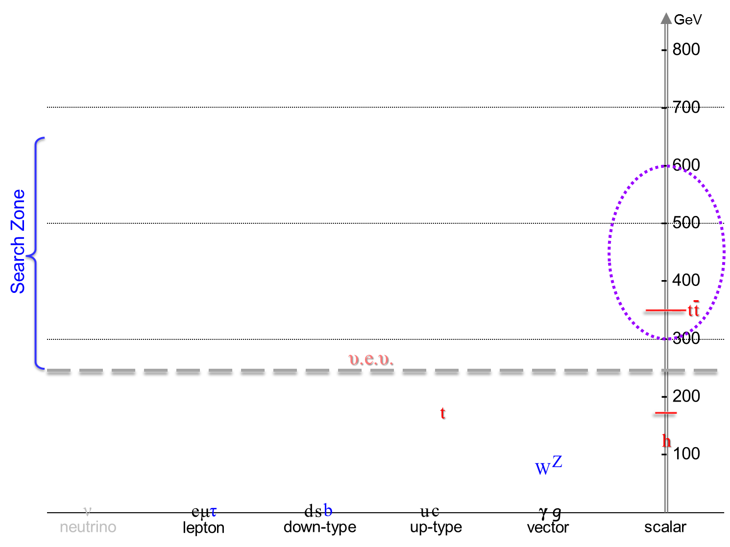

IV./V. Leading Search Modes at the LHC
g 2HDM
sub-TeV Spectrum
H/A/H⁺ Search
Not c_{γ} suppressed
Search at ATLAS/CMS started
ρ_{tc}
JHEP’23/PLB’24
ρ_{tc}
Kohda, Modak, WSH, PLB’18
cg → tH/A → ttc(bar) Same-Sign Top + jet
→ ttt(bar) Triple-Top (High Lumi LHC);
higher mass, more exquisite, tiny SM
ρ_{tt}
H, A, H⁺
Search since 2/2020 @ NTUCMS
cg → bH⁺ → btb(bar) Top w/ two p_{T} b-jets (H⁺)
√
Ghosh, WSH, Modak, 1912.10613 (PRL’20)
KHM, PLB’18
CKM enhanced
ρ_{tc}V_{tb}
Ongoing

Slide 10
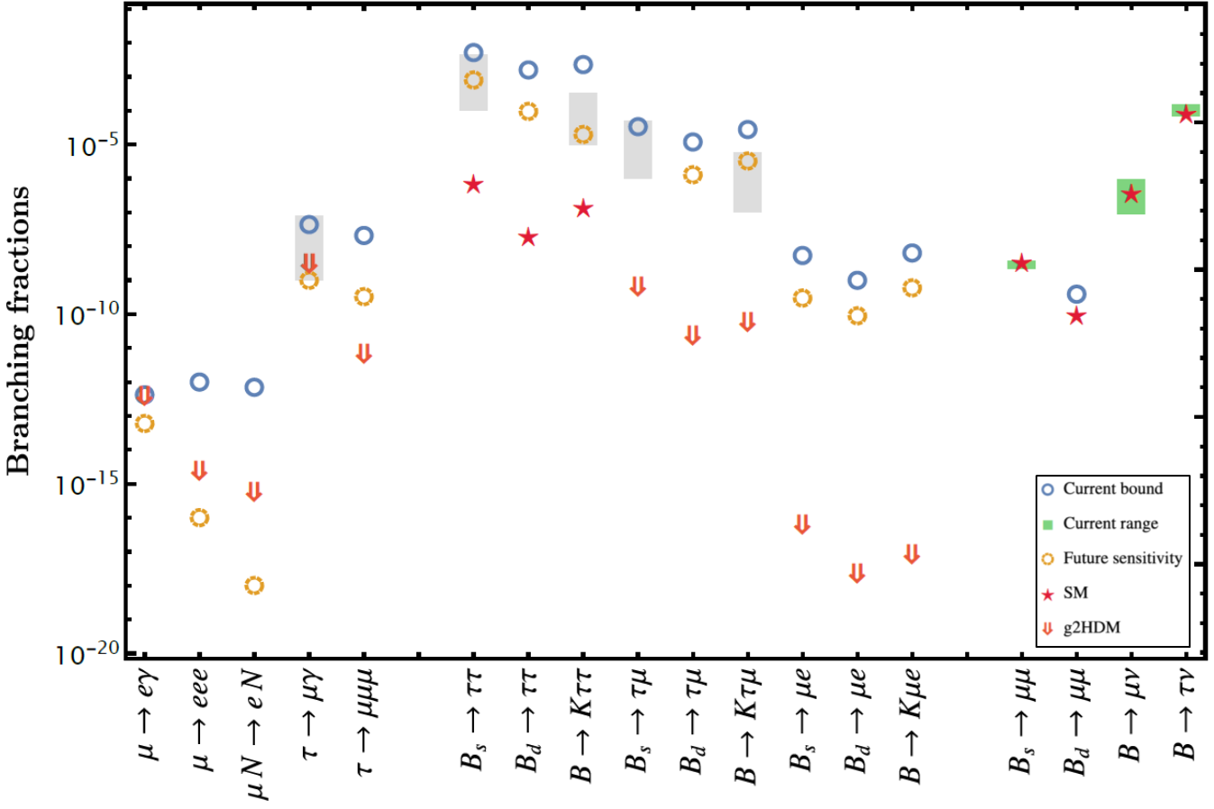
Glimpse of coming New Flavor Era in g2HDM
μ & τFV (Flav.Viol.)
in B decay
~ eEDM diagrams
5 Grey boxes: Astounding BSM via
“LQ ” from B-Anom.
R_{K}, R_{K*} nullified
g2HDM-SM interference
ρ_{μe}
LHCb
LHCb
What hides H, A, H⁺ effects so well from our view ?
PRD’20
“Know” SM Hierarchy !
eEDM
cancel.
b → sγ
2302.08847
Much more promising if
muon g-2 is harbinger
general 2HDM
WSH&Kumar, PRD’20
Belle II
EPJC’21
Belle II
LHCb
Belle/II
CMS

Slide 11
VI. Conclusion
lpha
the Α and the Ω
Still my goal & hope.
I could have told you up front:
H ⁰, A ⁰, H ± ~ 500 GeV
CAN
Verify at LHC.
can generate B.A.U.
⬅
Fantastic !!
accommodates e EDM
and F P C P Probes !
Many Flavor Probes; however
b → sγ: a traditional powerful probe of H⁺ in 2HDM II, but for g2HDM
Probe ρ_{tt}-EWBG & ρ_{bb}-EWBG thru chiral enhancement
Currently b → sγ inclusive rate is best measured.
Belle II can measure ΔA_{CP} in future, crosscheck w/ eEDM – EWBG !
inclusive B⁺ vs. B⁰
emerge?

Slide 12
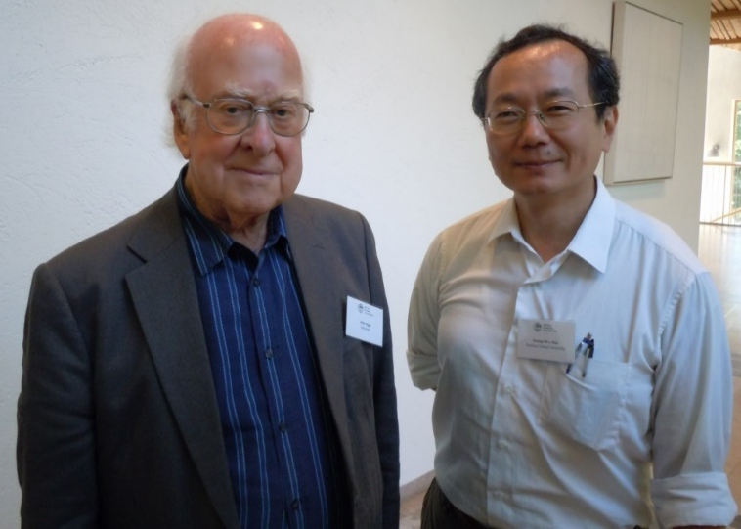
Thank you !
Join the Mission
Caution: Good reasoning does not mean Nature has to oblige …
a Higgs; and a 2nd Higgs ...

