Slide 1
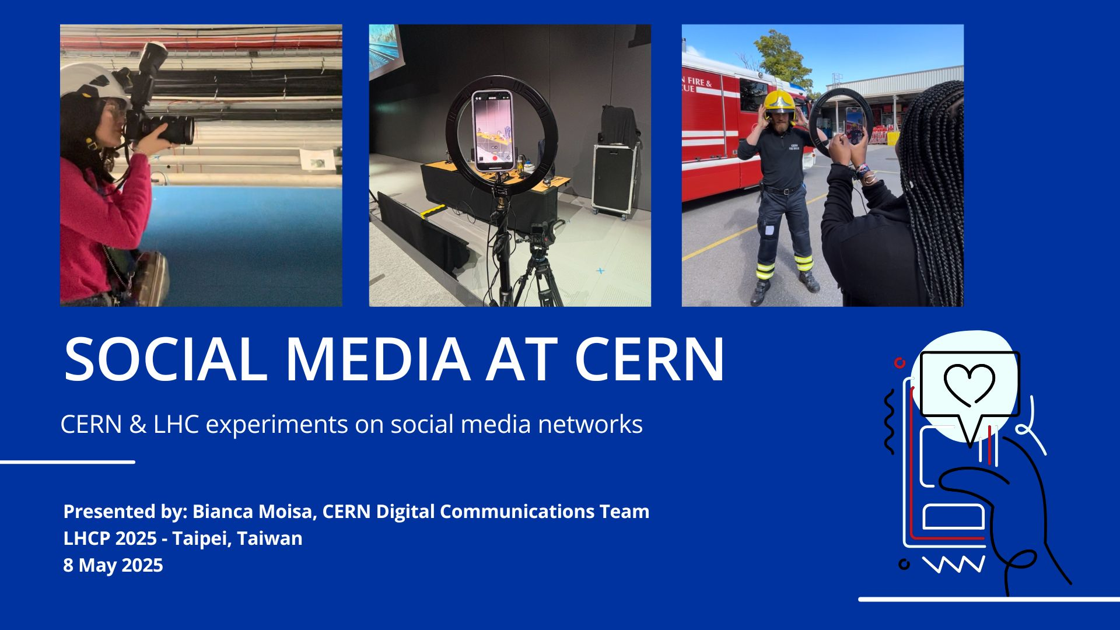

Slide 2
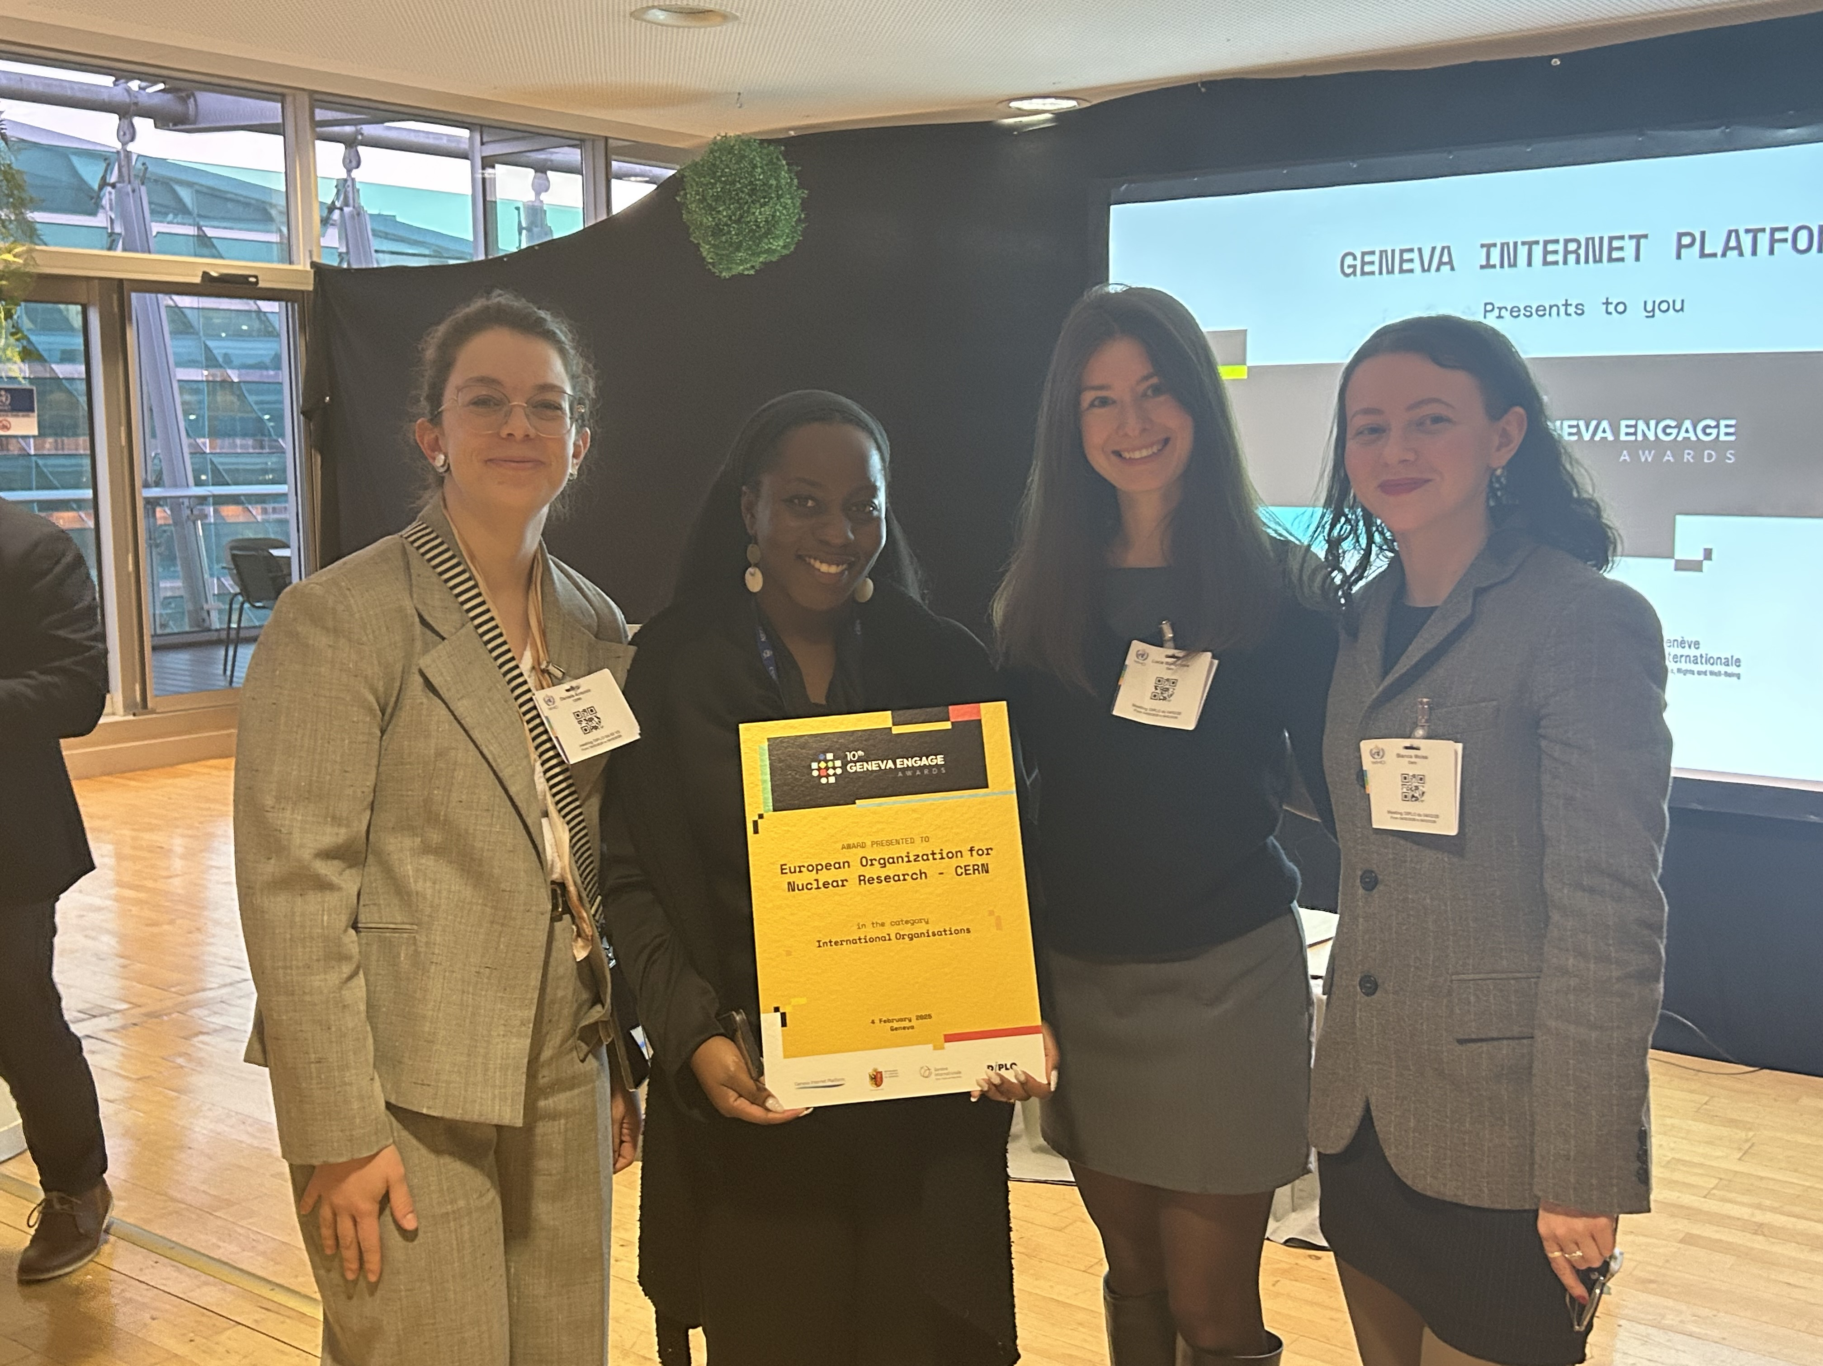
Behind @CERN there is…

Slide 3
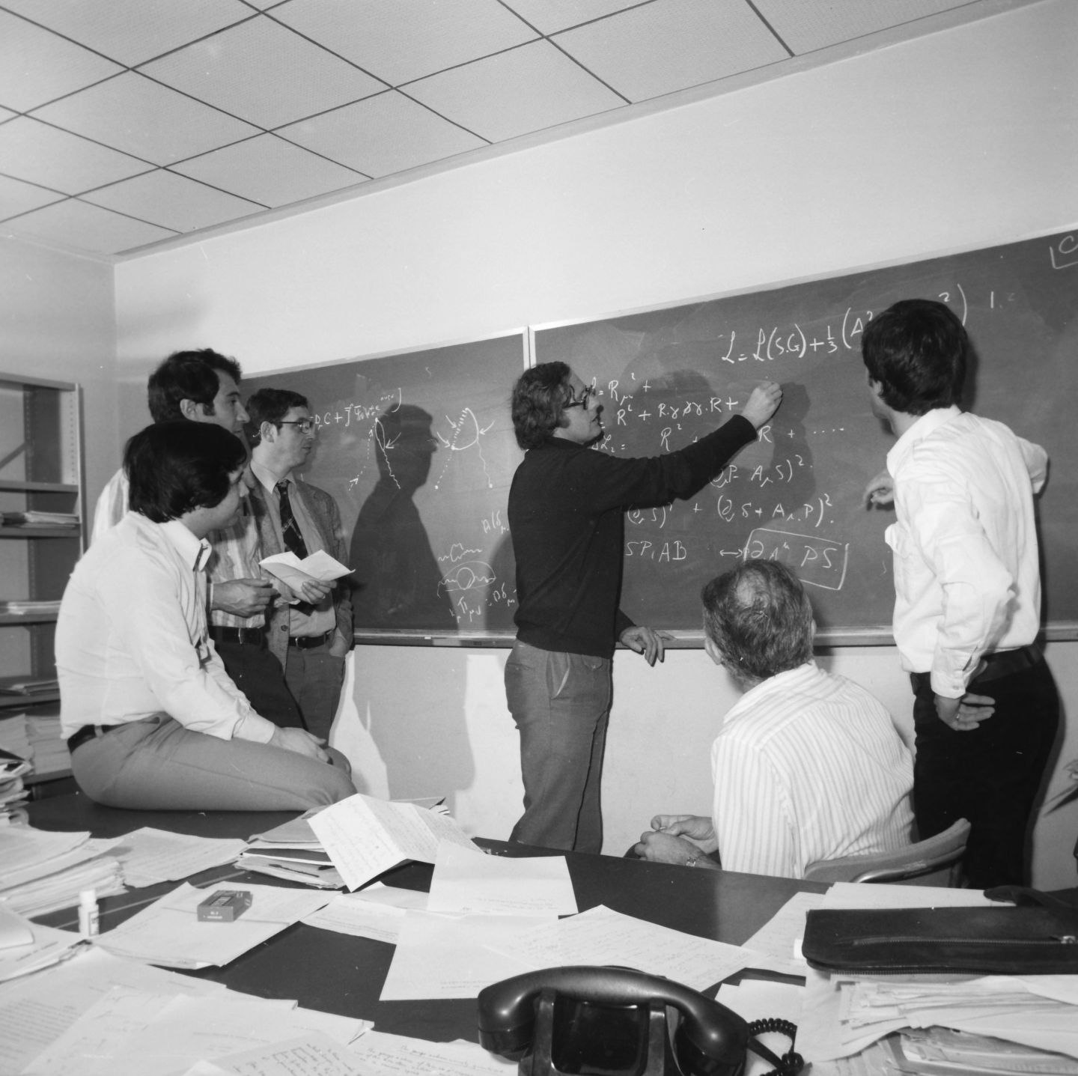
Today’s agenda
CERN’s e-reputation: where are we today?
CERN’s Social Media strategy
Collaboration with the LHC experiments on social media
Q&A
Image: A group of theoretical physicists having a discussion, 1978

Slide 4
I. Overview of CERN’s e-reputation
Digital landscape, evaluation & monitoring

Slide 5
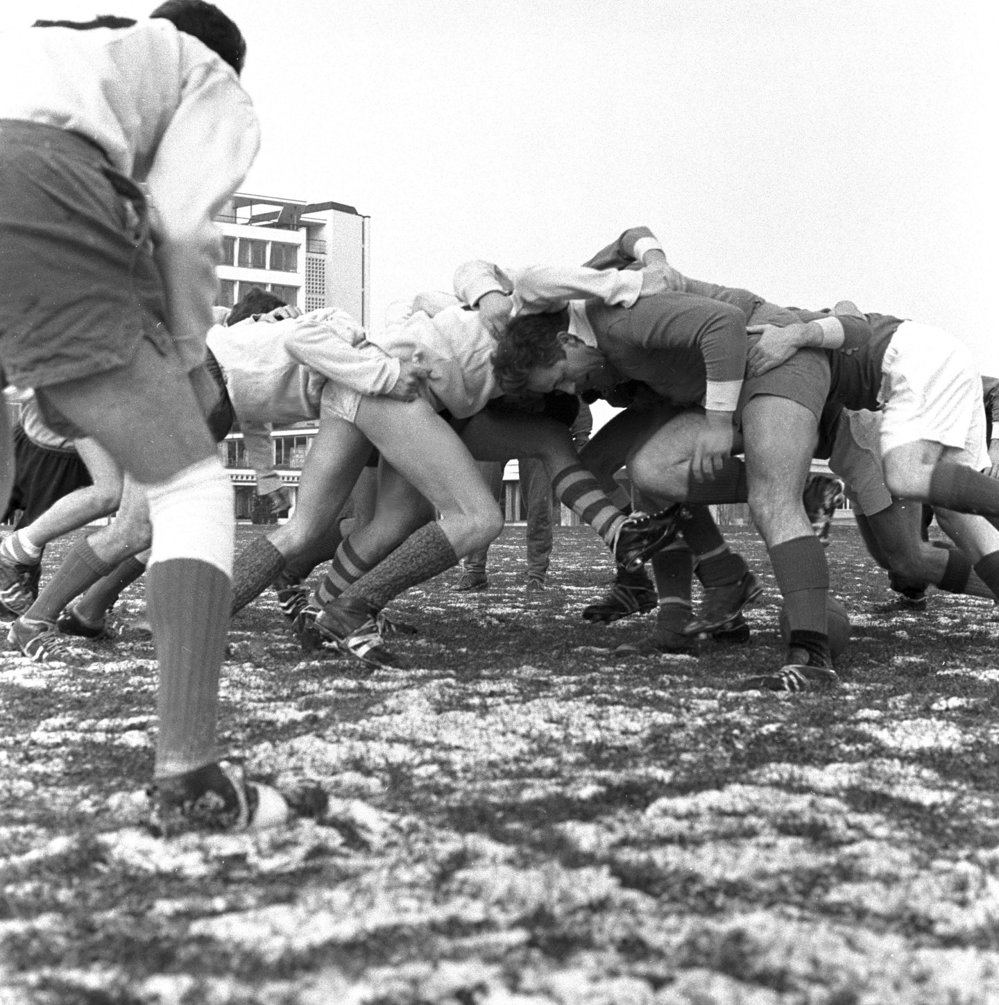
The current digital environment
YES
Social media = a modern public space to…
Source information
Express your opinion freely
Connect, engage & grow a community
BUT…
Ever-changing landscape -> necessary content customisation
Highly competitive environment
Emergence of TikTok as the main source of information for young audiences
Conspiracy theories
Result :
“With scientists publicly debating in real time through Twitter and blogs, and citizens being able to access new research in real time, science communication (as well as the distinction between experts and non-experts) has never been so fluid and porous.” (Bucchi, 2017)
Bucchi, M. (2017). Credibility, expertise and the challenges of science communication 2.0. Public understanding of science, 26(8), 890-893.
Image: Rugby match in front of CERN’s main building, 1977
Notes:
The “public space” = key component of modern democracy (Habermas, 1991) -> Digital Environment = modern public space to source information and exercise freedom of expression (Visentin and Di Domenico, 2021)
Ever-changing landscape: platforms, formats, trends, audiences,

Slide 6
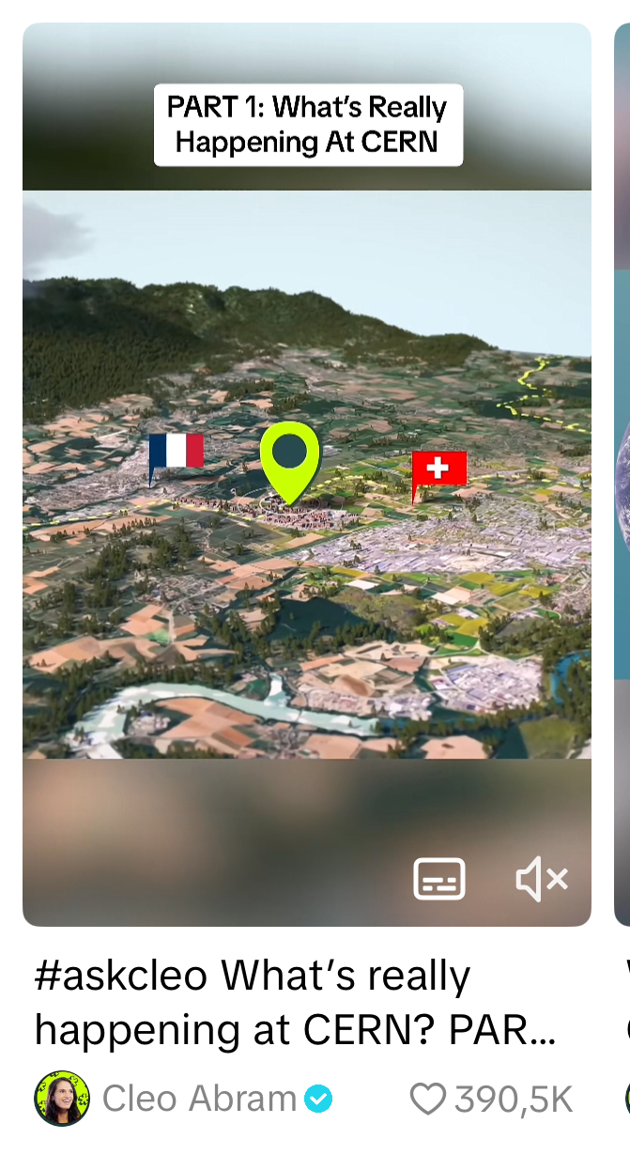
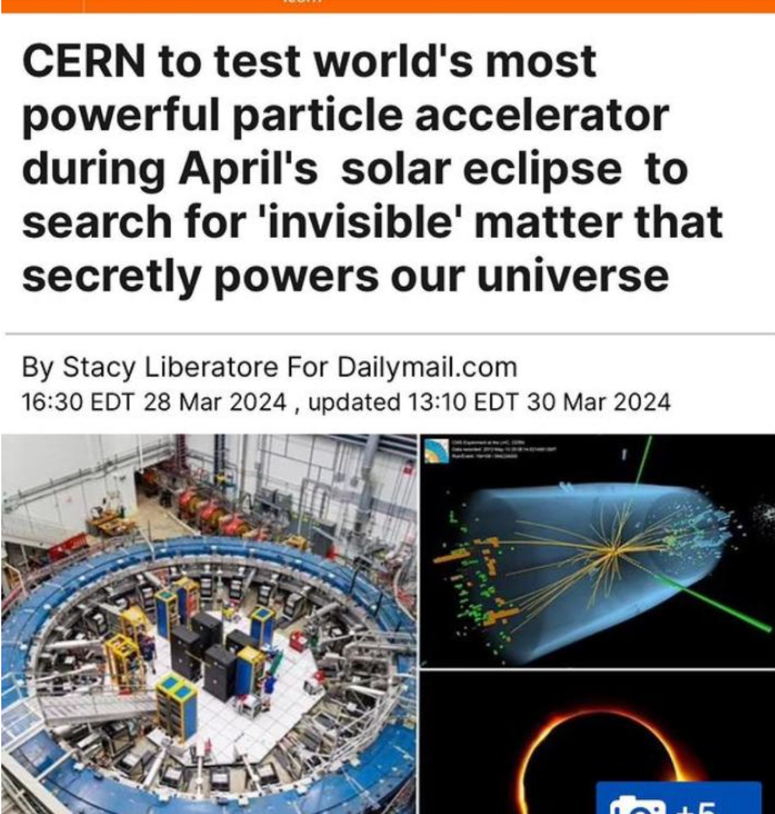
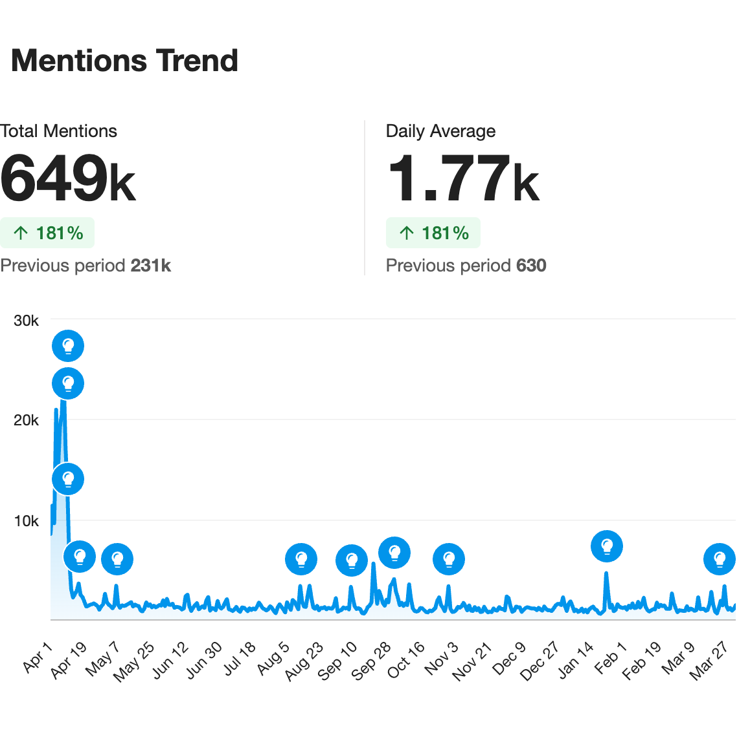
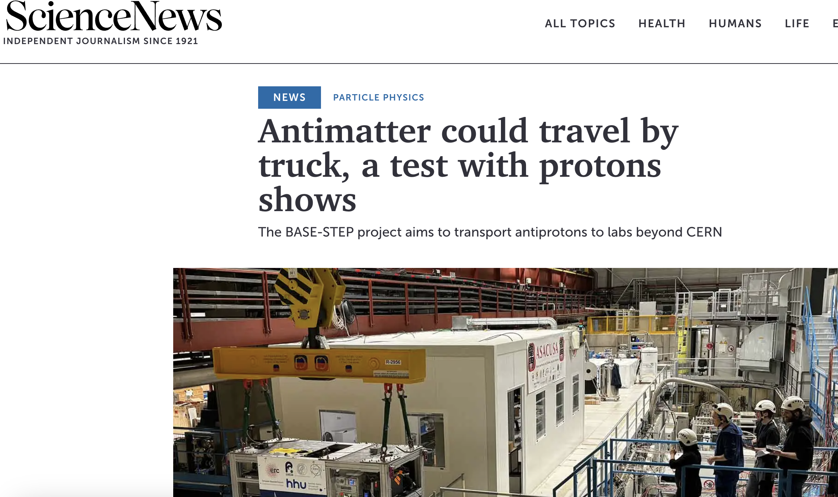
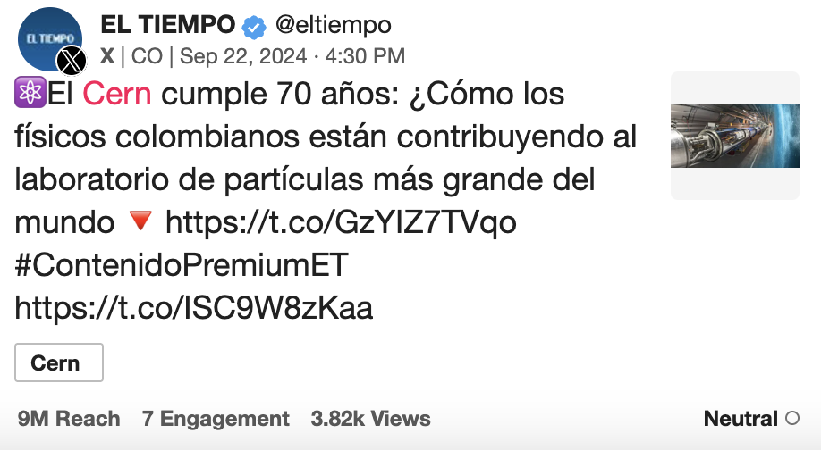
Our online reputation – what do others say about CERN?
Analysis period: 1 April 2024 – 1 April 2025 (Data collected on: 30 April 2025)
Key numbers: 657k mentions; 4.68M engagements; (4.42B reach)
April: #BeamTime (LHC restart)
summer: #CERNScienceGateway
September: #CERN70
February: #WomenInScience
Mentions trend
= aggregate trend of mention activity across sources
Notes:
Meltwater search for the past year
8 April: solar eclipse, Peter Higgs passed away

Slide 7
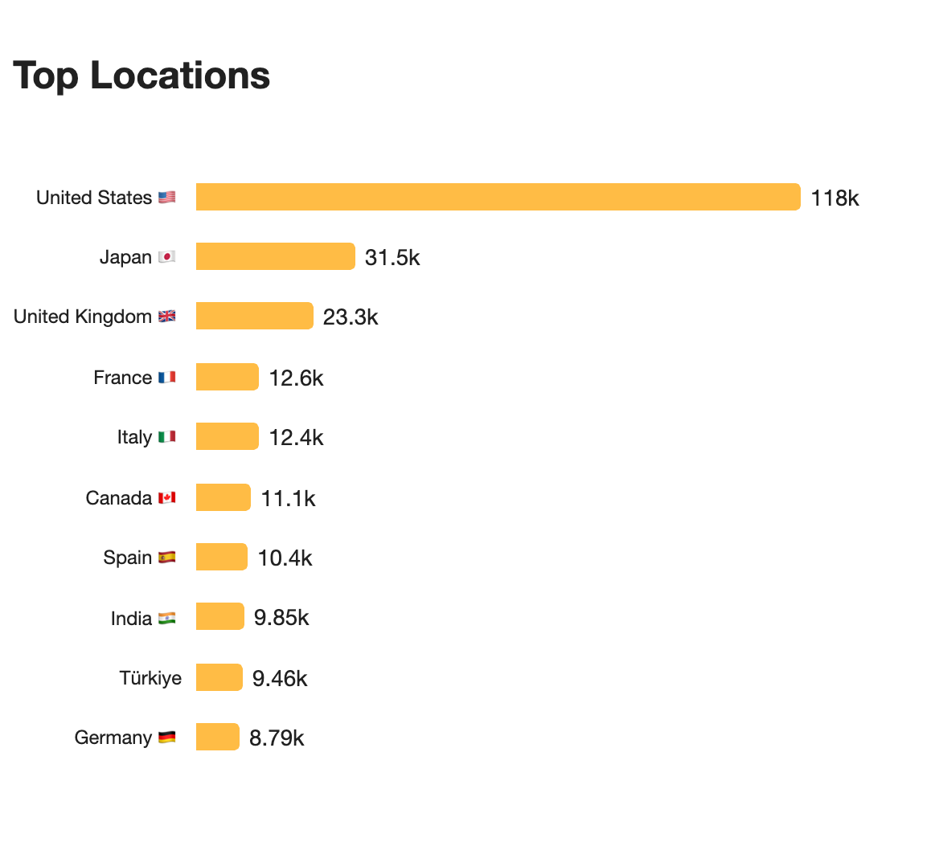
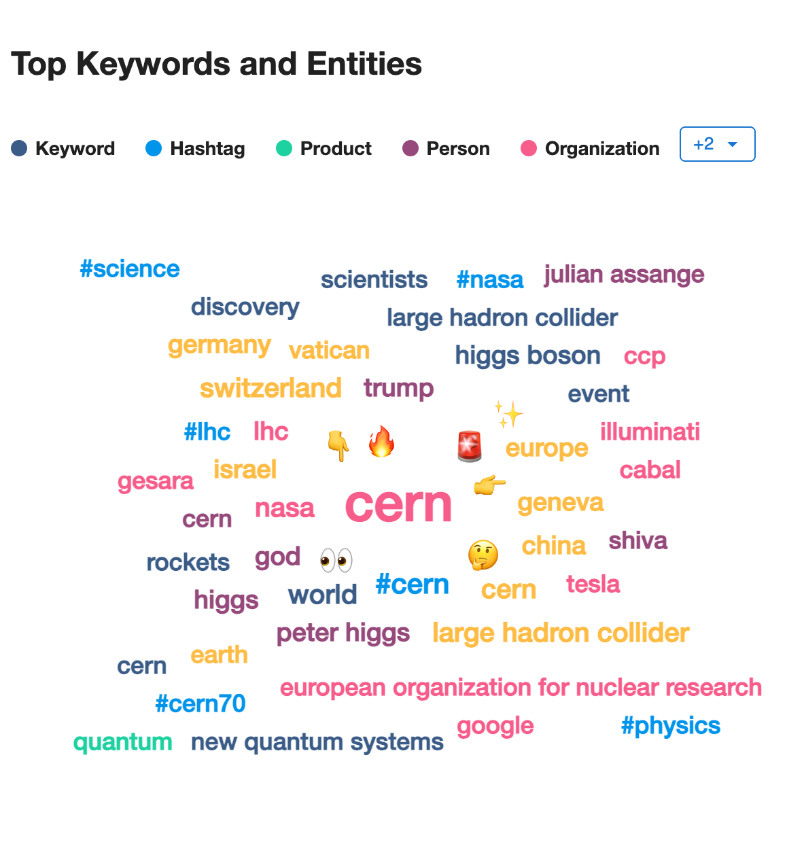
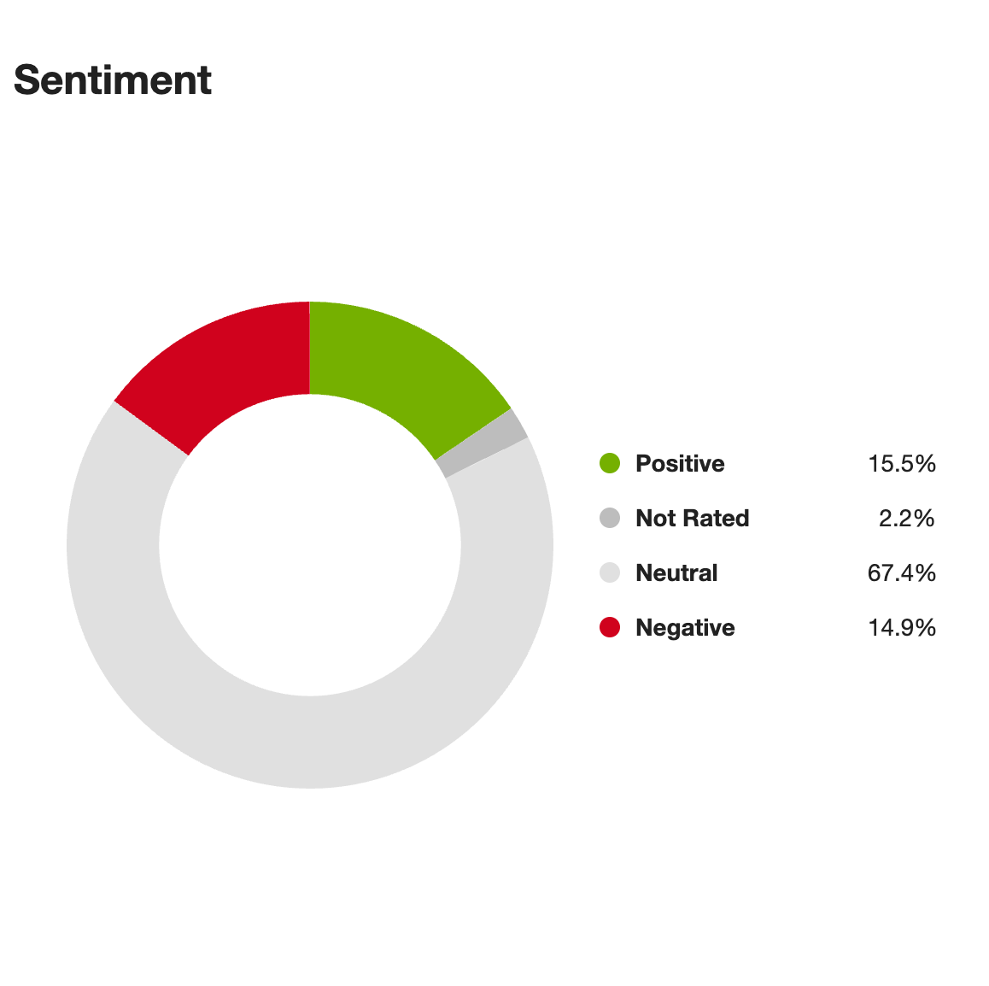

Slide 8
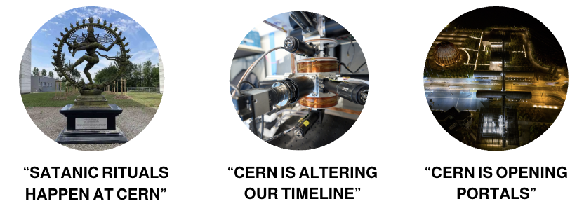
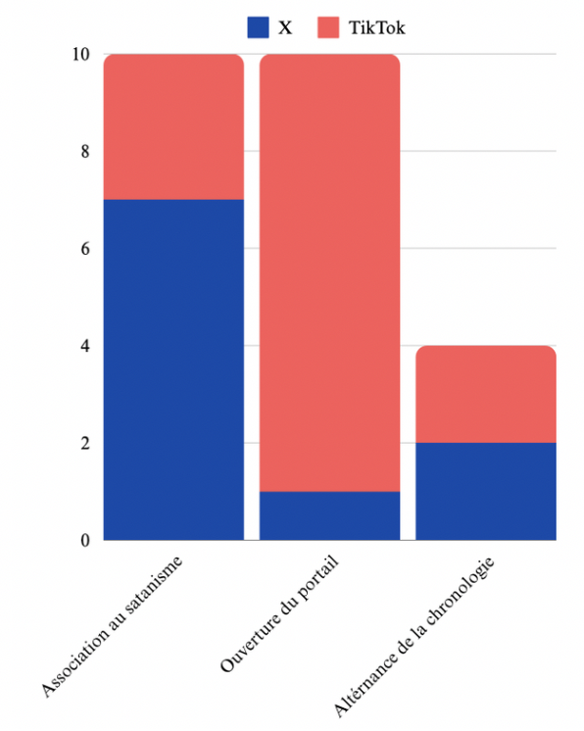
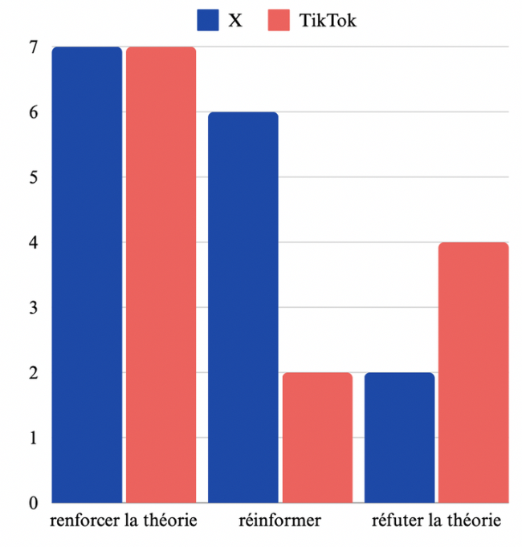
What about CERN conspiracy theories?
Where & who spreads them:
X (Twitter): conspiracy accounts & content creators
TikTok: conspiracy accounts, content creators, personal accounts
3 main theories:
Distribution
How other users react to this type of content
Moisa, B. (2024). Dans quelle mesure les théories du complot diffusées sur les réseaux sociaux affectent l’e-réputation d’une organisation internationale ? Étude de cas des discours complotistes autour du CERN sur X et TikTok.
Notes:
Graphs: give us some insight on what we should act on but not a fully accurate picture

Slide 9

How do we evaluate & monitor?
Data collected on XXXX, analysis period: XXXX
4 main KPIs:
  Impressions: number of times a piece of content was seen – it’s a measure of reach and overestimation of the number of people who have seen that same piece of content.
  Engagements: all actions taken on a piece of content – like, reactions, comment, shares.
  Engagement rate: actions/impressions, it’s a measure of how engaging a piece of content was.
  Mentions: number of times our hashtags/keywords appeared on other profiles across all platforms
Raw data saved; data collected in a collaborative spreadsheet for analysis
Data collected using Meltwater + analytics provided by the different platforms
Questions or comments, please reach out to: social.media@cern.ch

Slide 10
II. A glimpse into CERN’s
Social Media strategy

Slide 11
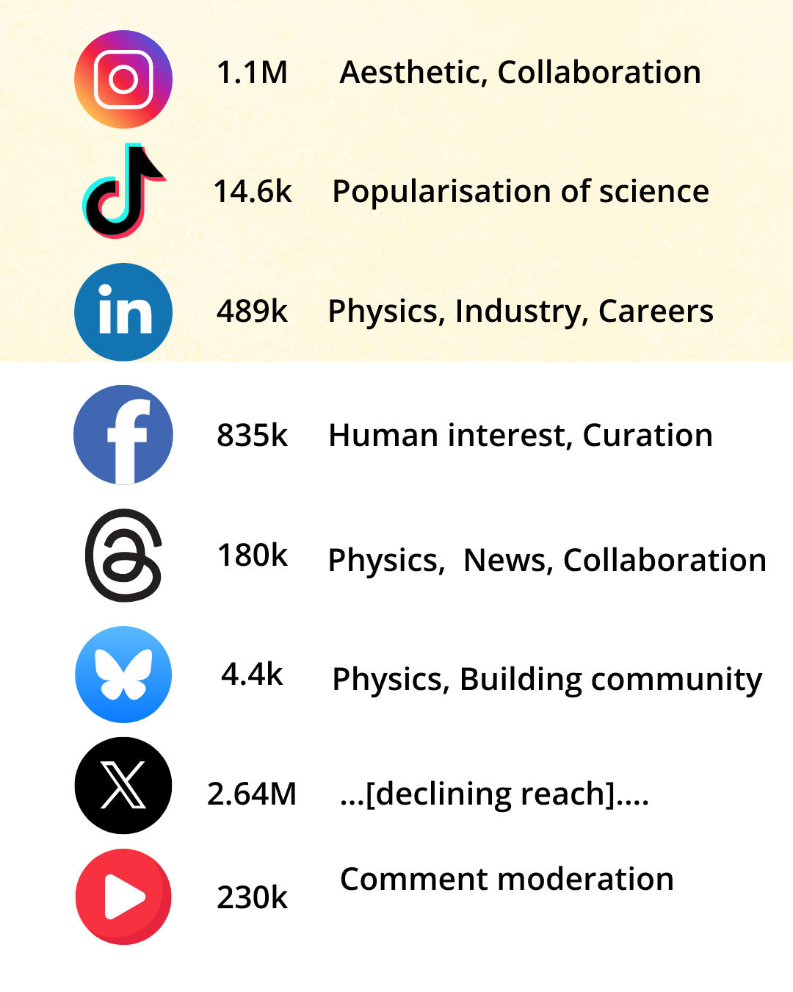
Overview of CERN’s social media presence
Our mandate:
Safeguard CERN’s e-reputation
Deliver key messages to key audiences (reach)
Grow and engage our digital communities (eng. rate)
Earn support for CERN’s mission (sentiment)
Our goals 2021—2025:
Create high-quality, channel-specific content
Build stronger collaboration with
  the CERN ecosystem,
  peer organisations,
  internal/external ambassadors
Proactively engage CERN’s digital community

Slide 12
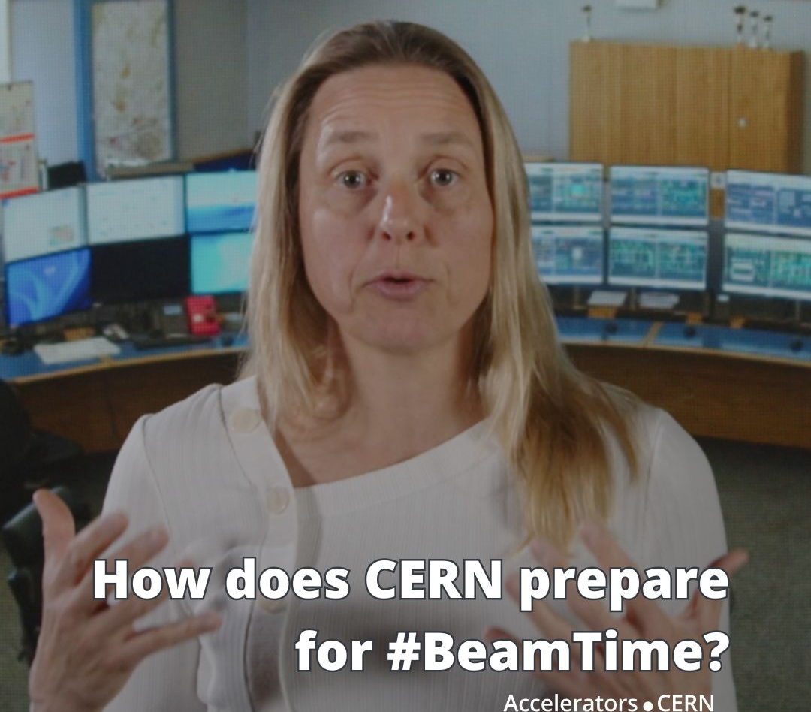
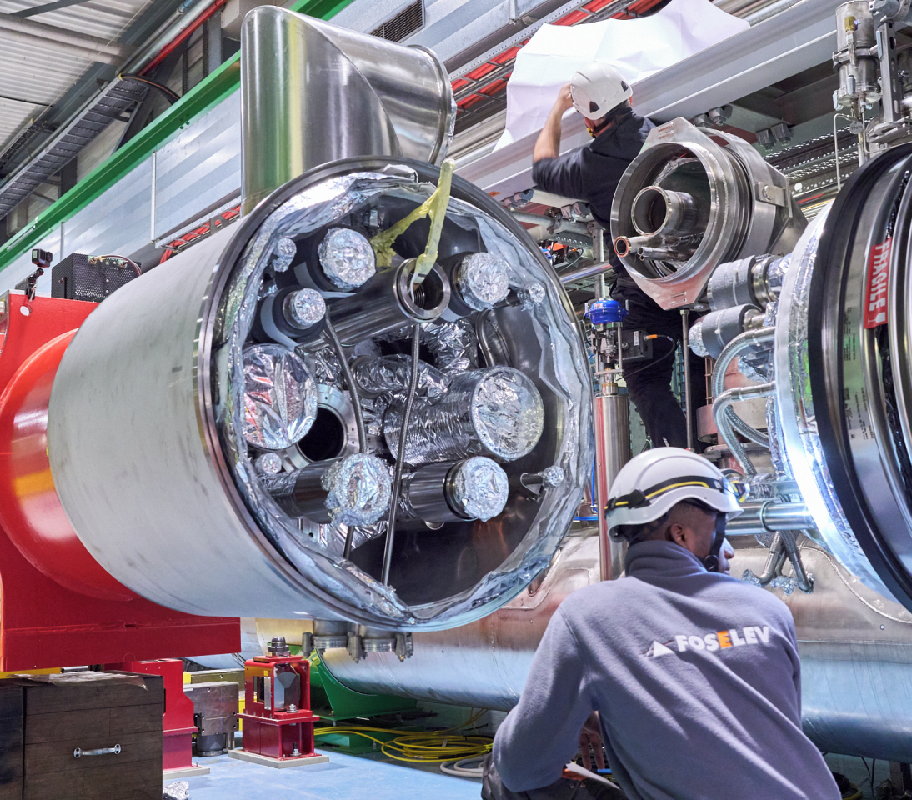
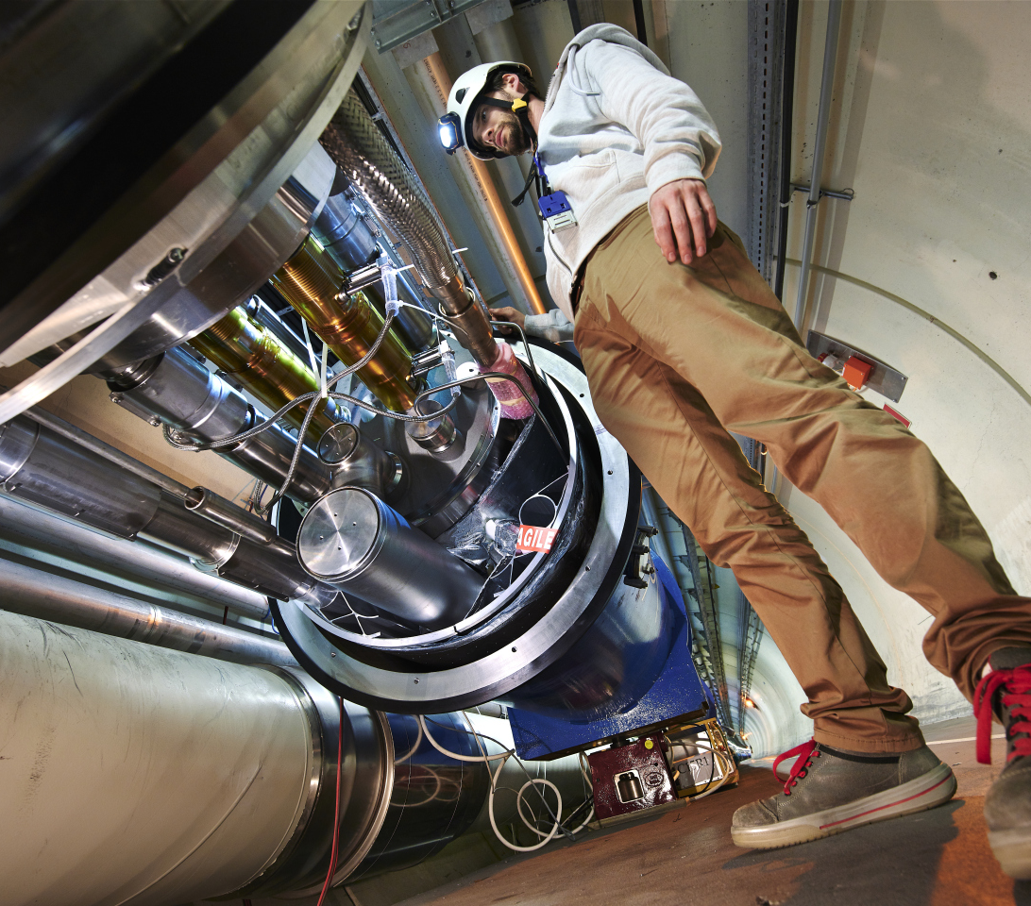
CERN’s content – what makes us special?
Machines
& technology
Experts
Innovation, preparing
for the future
Notes:
Images:
https://cds.cern.ch/record/2927571?ln=fr
https://cds.cern.ch/record/2673004?ln=fr
https://www.instagram.com/reel/DIx_1pRopVH/

Slide 13
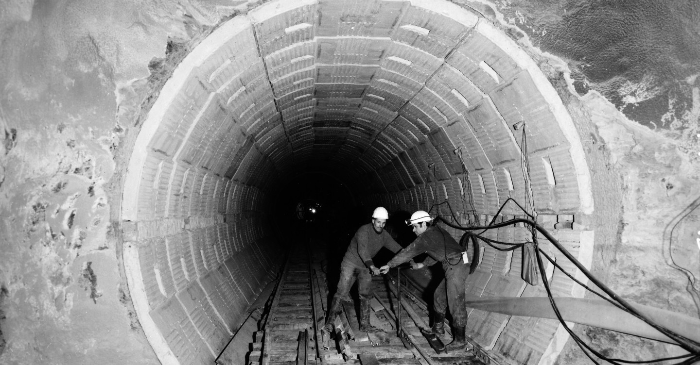
… as well as our (contribution to) history
Image: SPS tunnel construction, 1974
Notes:
https://cds.cern.ch/record/1763615

Slide 14
III. How we collaborate with our community
CERN & LHC experiments on Social Media

Slide 15
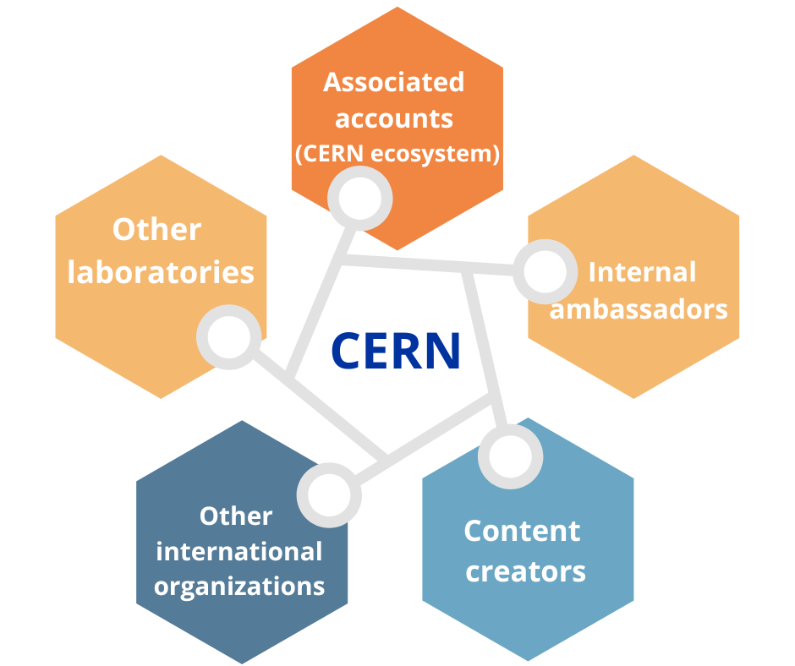
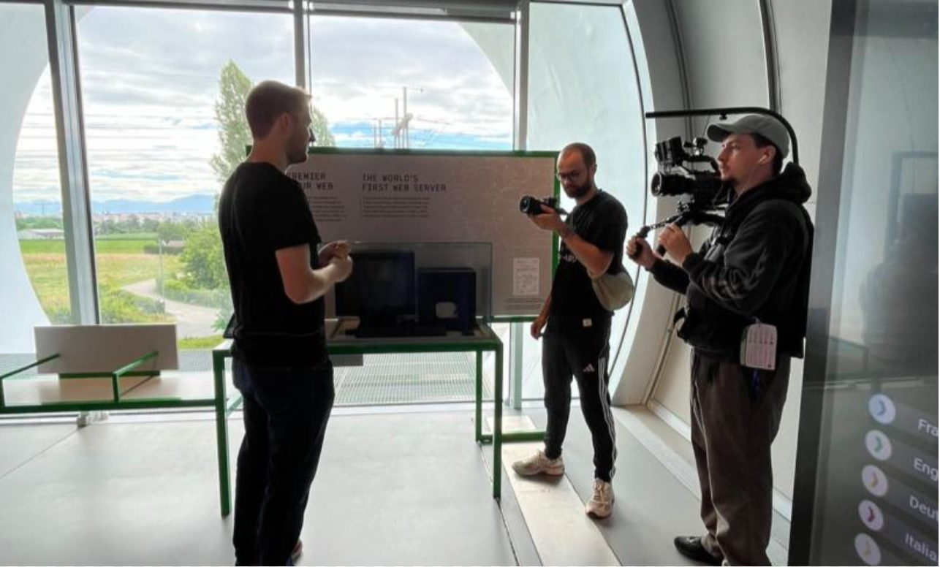
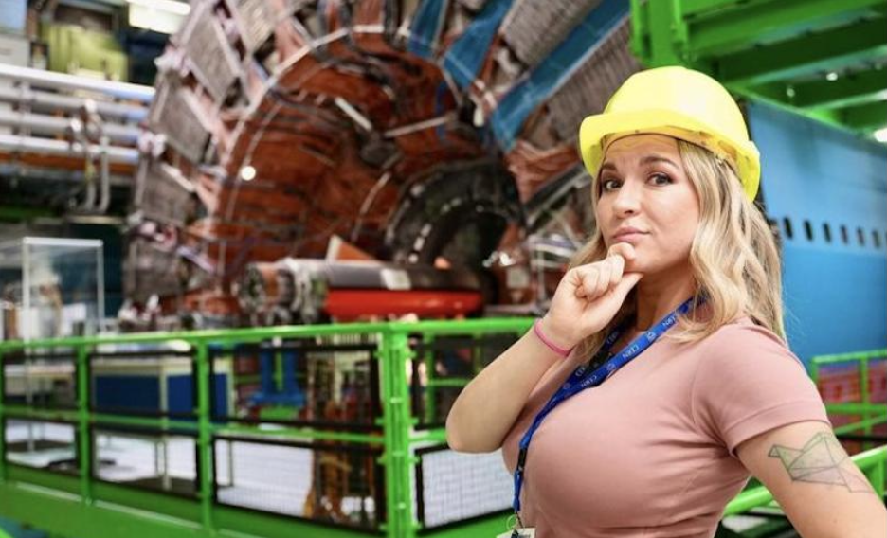
But first… who do we collaborate with?
Notes:
23 influencers visits since 2023 including the 2 locals – allowing us to reach networks where we are not usually present in

Slide 16
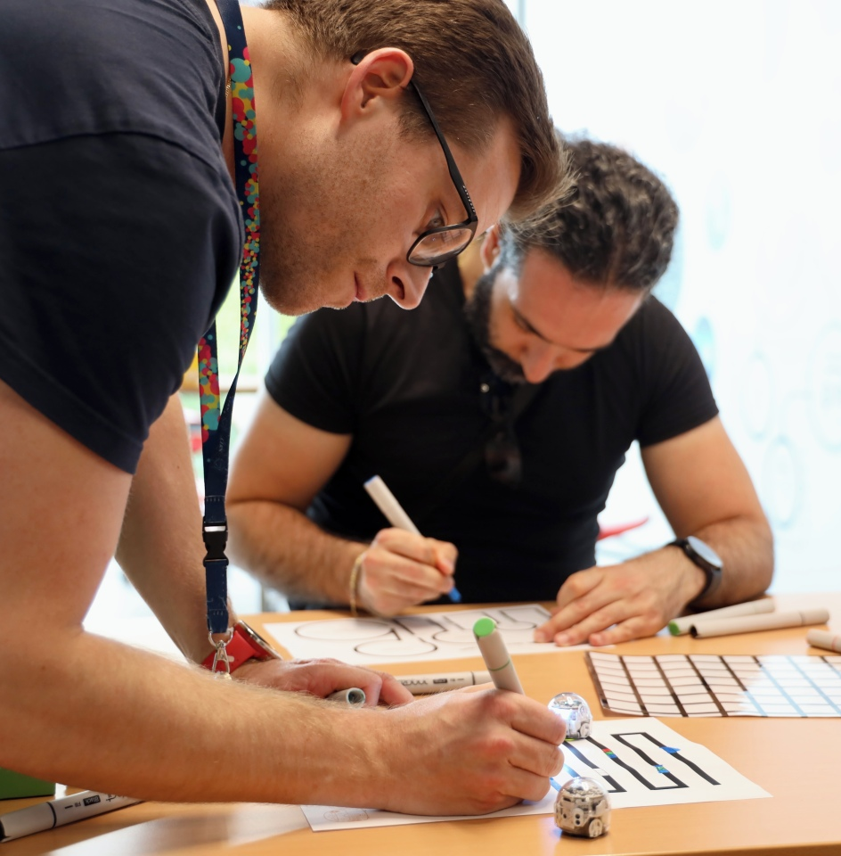
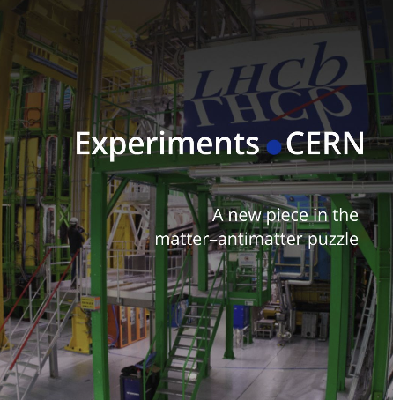
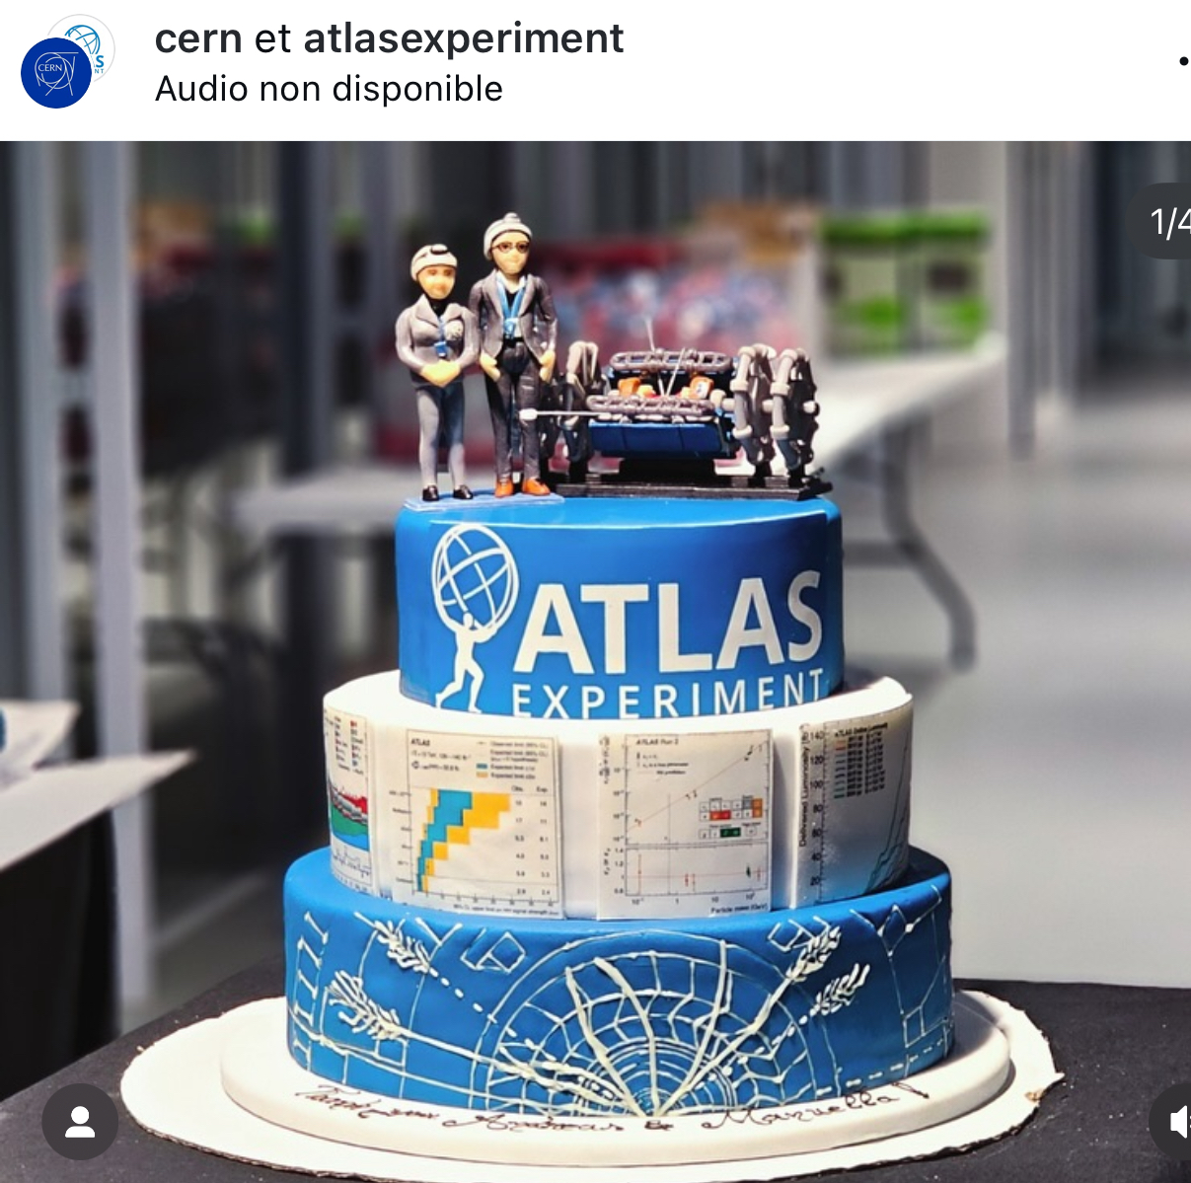
Collaboration with LHC experiments
Monthly meetings with outreach teams
Coordination during milestones
Collaborative posts
Notes:
What we want to do better: co-creative with the experiments
Coordination during milestones (i.e. campaigns, press releases, prizes, results)

Slide 17
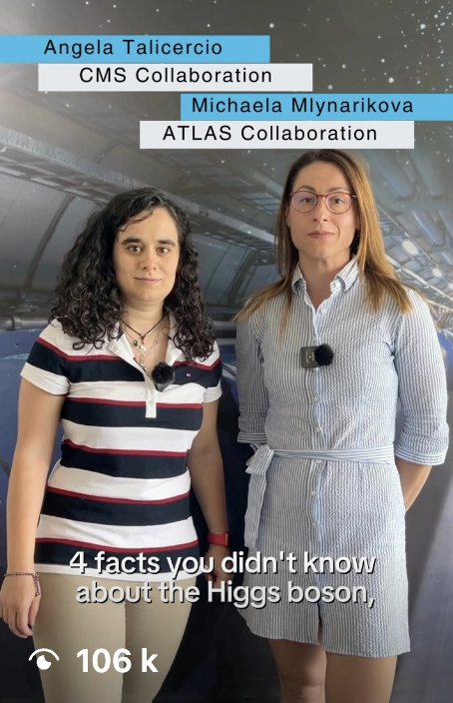
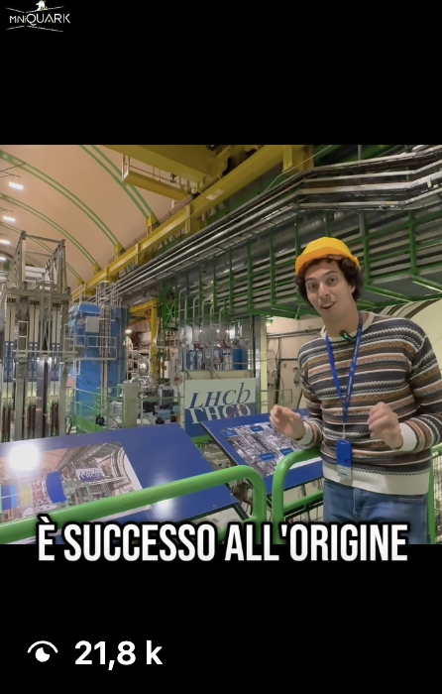
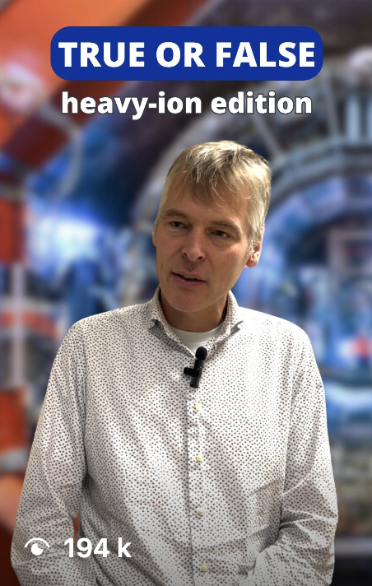
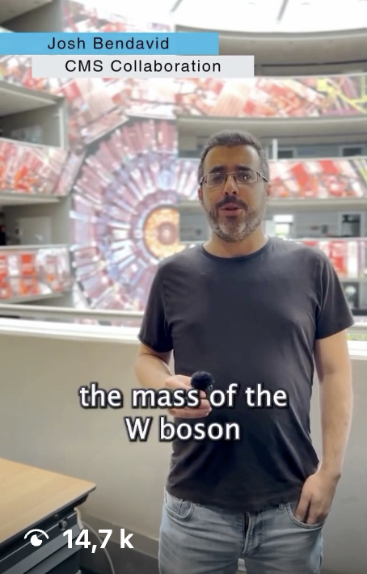
Physics AND the people behind it

Slide 18
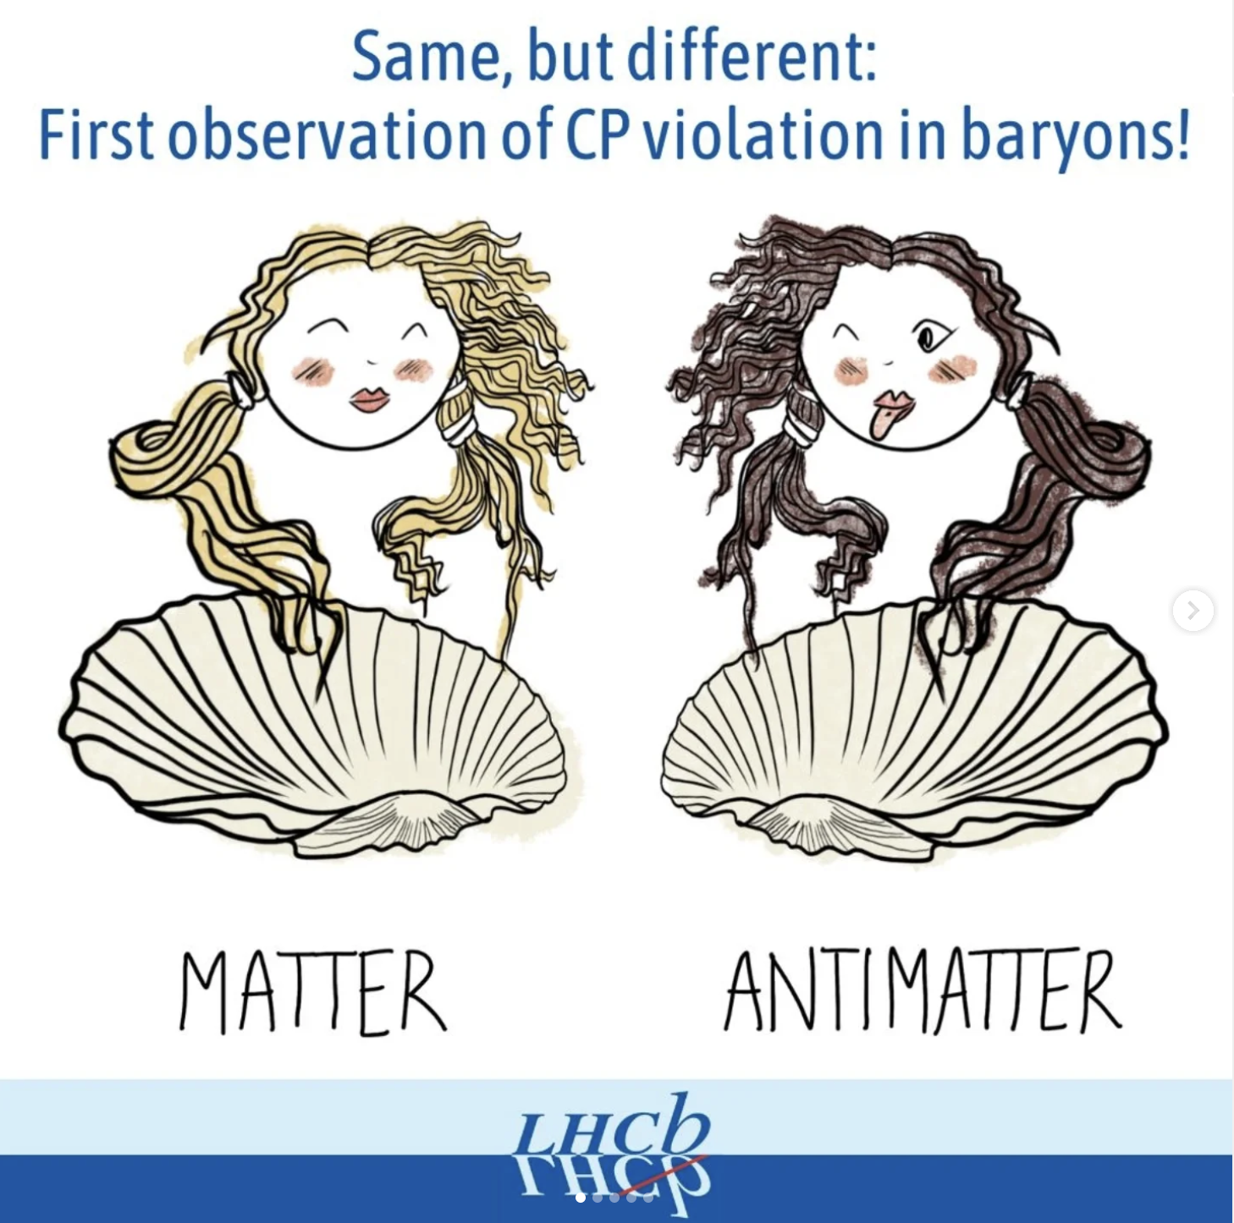
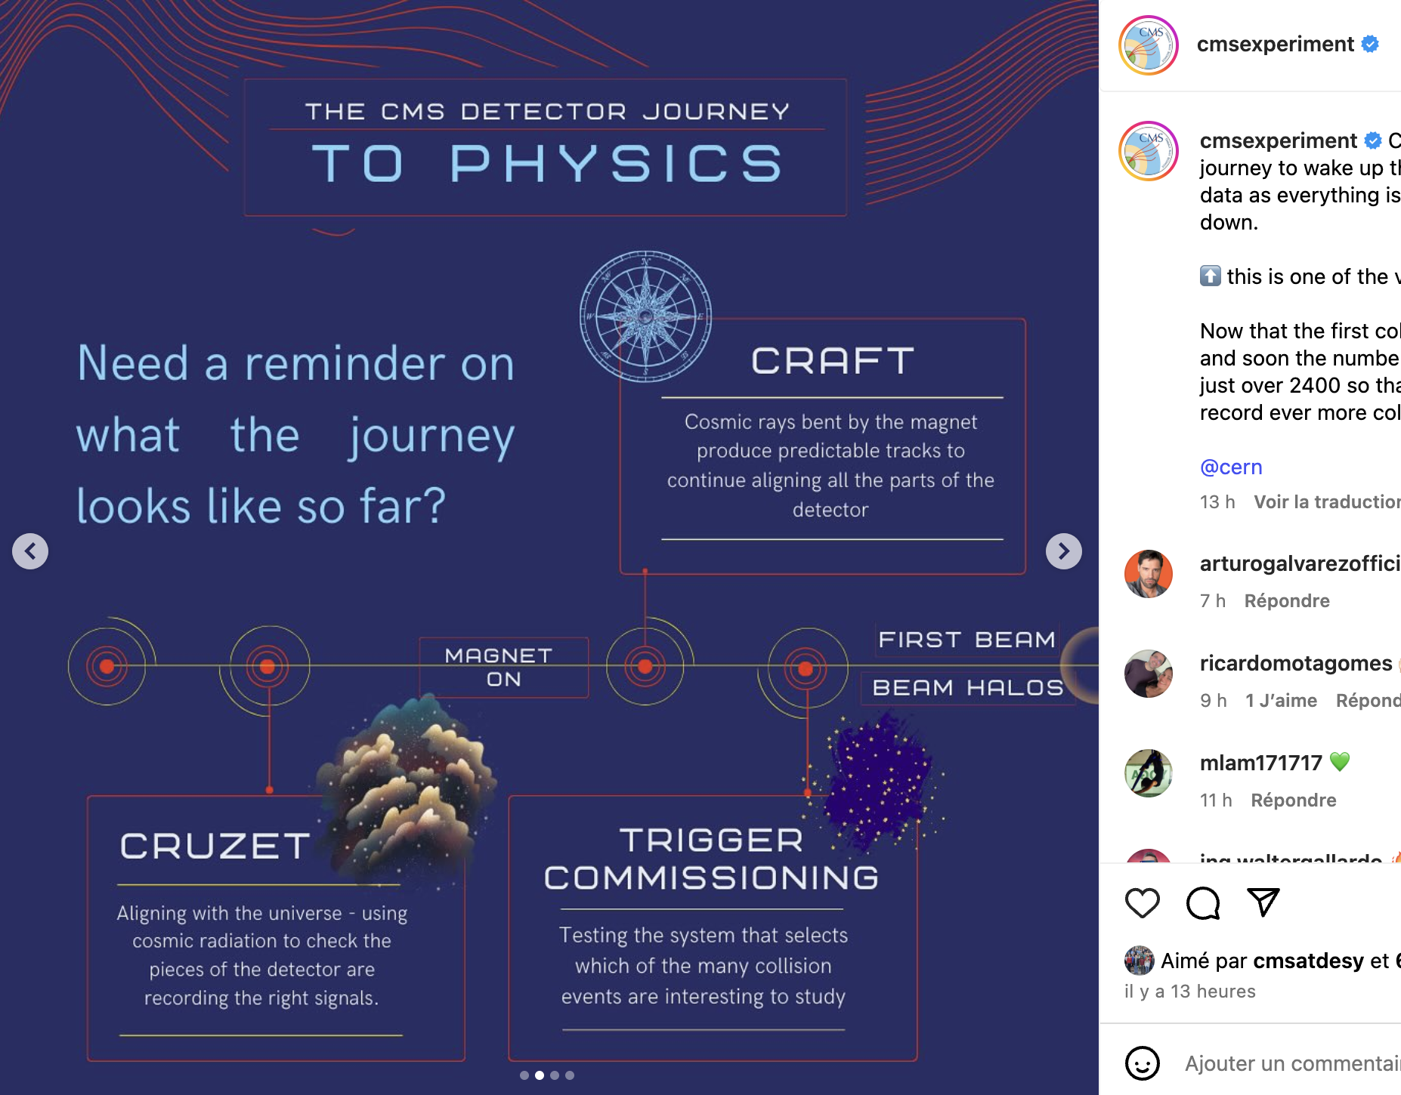
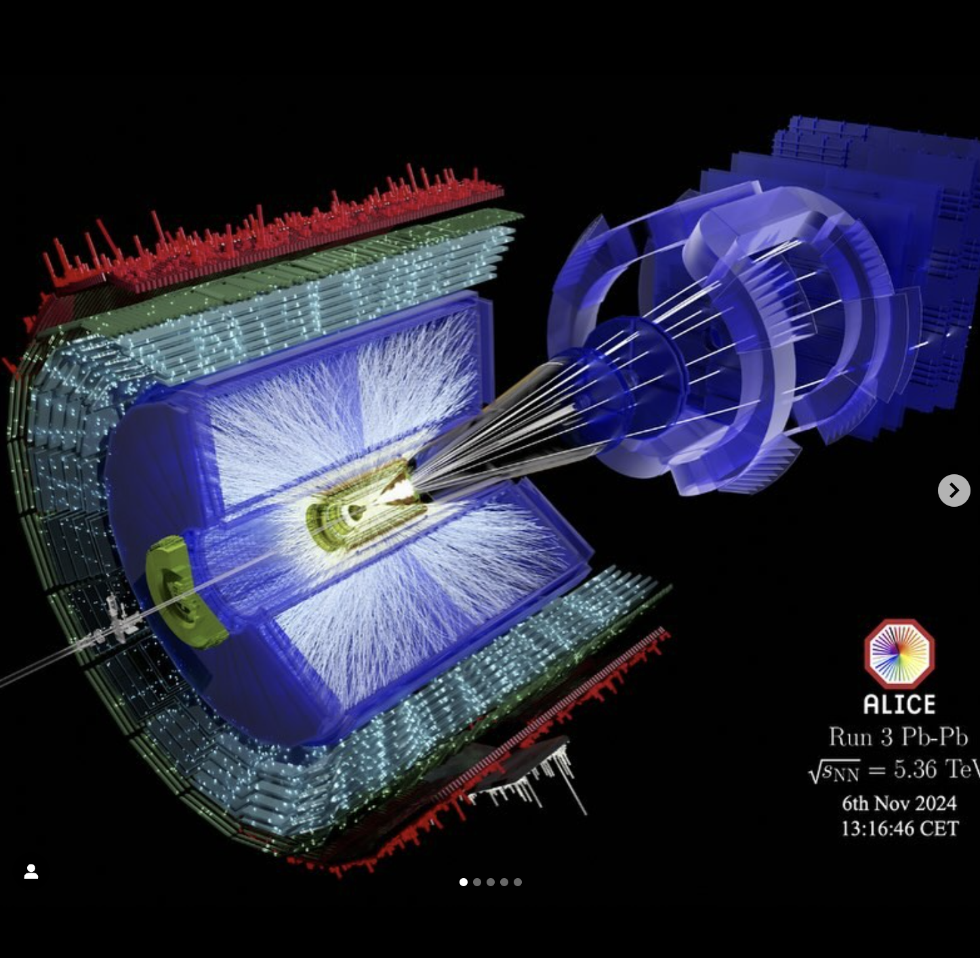
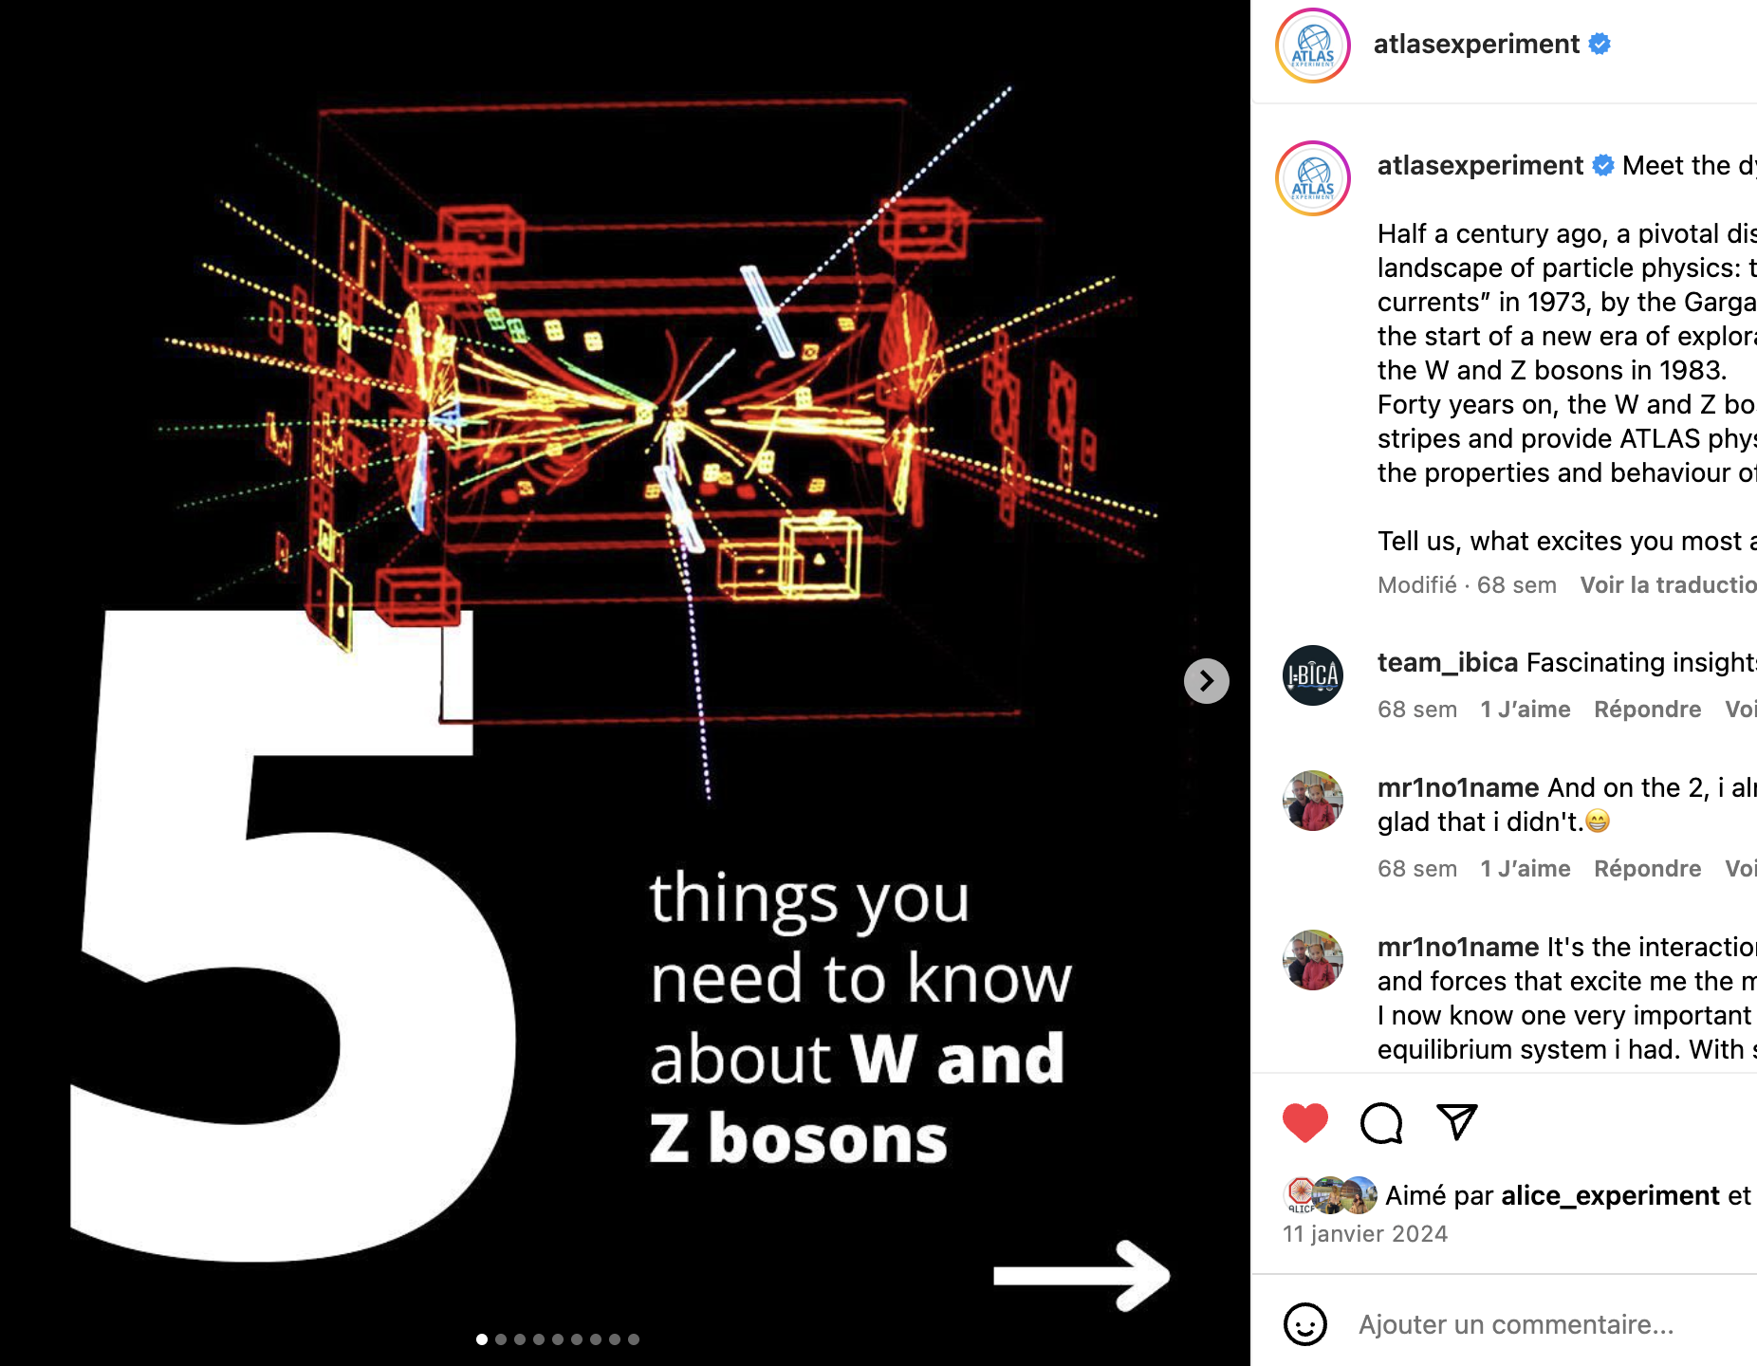
Featuring great work for a greater audience to see

Slide 19
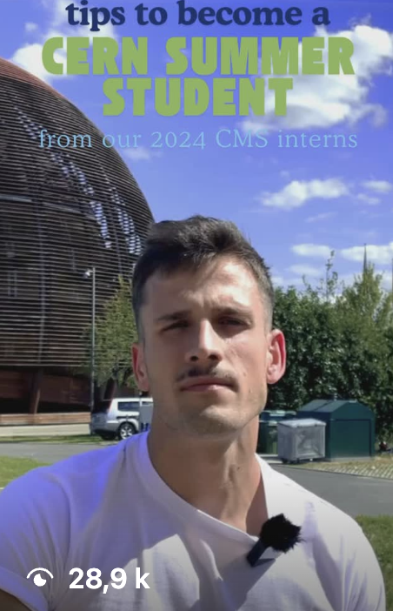
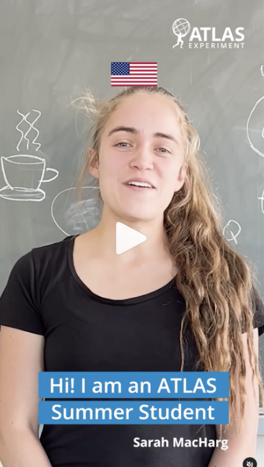
Inspiring the next generations

Slide 20
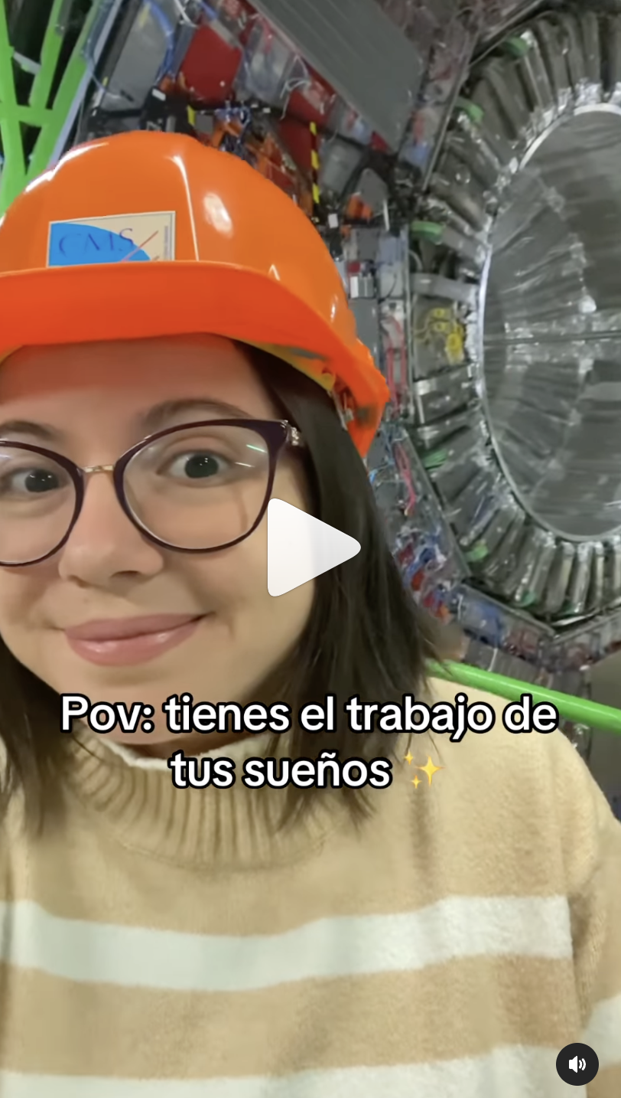
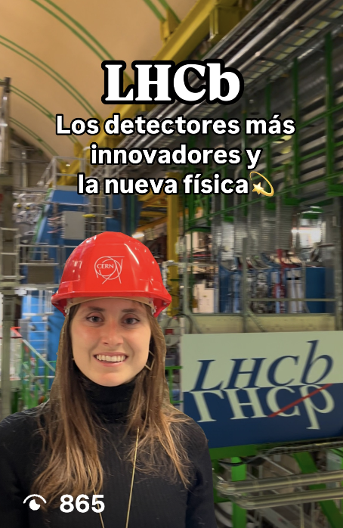
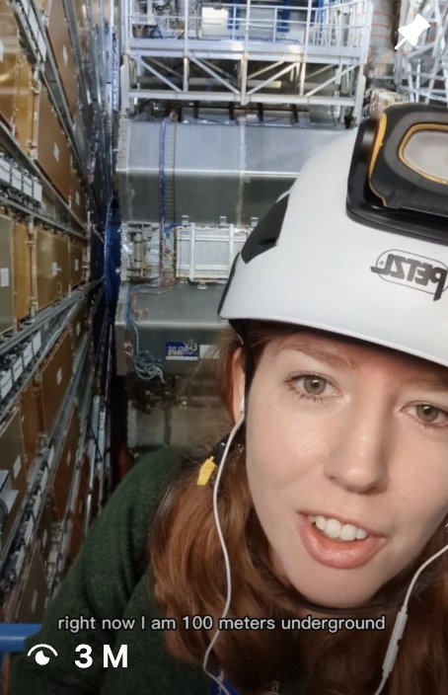
CERN champions – you could be the next one…
@neutralina.lu
CMS Experiment
@pauladesire
Beams department
@particleclara
ATLAS Experiment

Slide 21
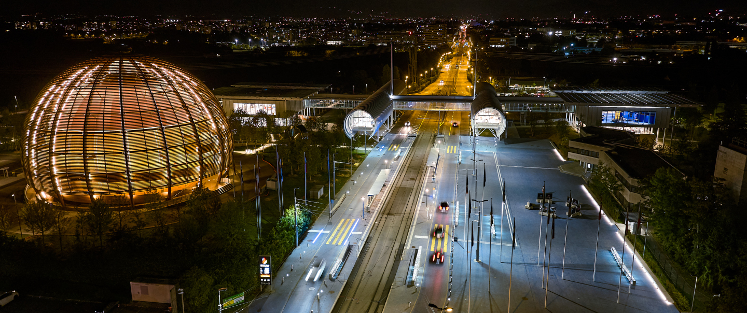
Any questions/comments?
Ideas, questions or stories: social.media@cern.ch

Slide 22

Follow @CERN:

