Slide 1
Materials Studies of Processes in
Internal Oxidation Nb₃Sn wires:
TU Bergakademie Freiberg Collaboration
Simon C. Hopkins, T. Boutboul (TE-MSC-LSC)
G. Rosaz (TE-VSC-SCC)
211th TE-TM Meeting, 3 June 2024
With thanks to A. Leineweber, J. Lachmann and S. Waschull (TU Bergakademie Freiberg)

Slide 2

Introduction
Magnet designs for proposed future energy-frontier hadron colliders impose challenging performance targets for Nb₃Sn wire, including:
  non-Cu J_{c} ≥ 1500 A/mm² (16 T and 4.2 K)
  d_{eff} ≤ 20 µm
Internal oxidation methods show considerable potential to achieve these targets
Collaborations in the context of the High Field Magnets (HFM) programme are developing the understanding needed to establish a scalable wire technology, and optimise wire designs and heat treatments
  UNIGE (KE4663) is working towards a rod-in-tube internal oxidation wire design, producing and characterising trial wires
  This presentation concerns a new collaboration agreement with TU Bergakademie Freiberg (KE5963) addressing the mechanisms of this process with fundamental materials studies
A. Ballarino et al., IEEE Trans. Appl. Supercond. 29 (5) 6001709, 10.1109/TASC.2019.2896469

Slide 3


TU Bergakademie Freiberg
Prof. Andreas Leineweber, Institute of Materials Science (IWW)
  Particular expertise in phase equilibria and crystallographic analysis; intermetallics (e.g. solder systems, Nb₃Sn superconductors); XRD and Rietveld analysis
  Equipment for alloy production, sintering, PVD and galvanic deposition
  Characterisation by XRD, TEM and SEM (with EBSD), thermal analysis
Also access to relevant methods in other departments:
  Institute of Experimental Physics: semiconductor deposition
  Materials Technology: Institute of Metal Forming

Slide 4

Nb₃Sn Wire Technology
2024 marks the 70th anniversary both of CERN and Nb₃Sn, now finally being united for HL-LHC in accelerator magnets
  Key challenge: Nb₃Sn is brittle, and multifilamentary wires with a large fraction of stoichiometric, fine-grained Nb₃Sn are needed
Our present baseline wire type is a variant of the internal tin process (1974):
  Nb filaments are distributed in a Cu matrix containing a Sn core
  Nb₃Sn grows by solid state reaction-diffusion
The Restacked Rod Process (RRP®, ~2001) was developed by Oxford in Carteret (NJ, USA), now Bruker OST
  Subelements are produced from an assembly of Nb rods in Cu contained within a Nb diffusion barrier, stacked, and drawn to produce the wire
  Wires are now Ti-doped (increases B_{c2})
  Flexible configuration to customise Cu/non-Cu and effective filament size, and optimise J_{c} and RRR for the application
.
Selected RRP® wire designs (schematic)
RRP® assembly sequence
C. Sanabria, A new understanding of the heat treatment of Nb-Sn superconducting wires, PhD thesis, FSU 2017
108/127
120/127
132/169
150/169
162/169

Slide 5
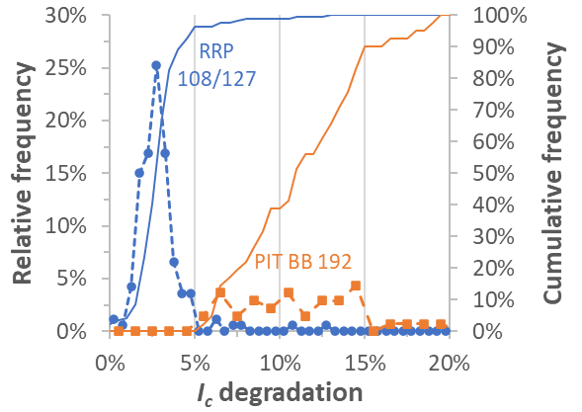
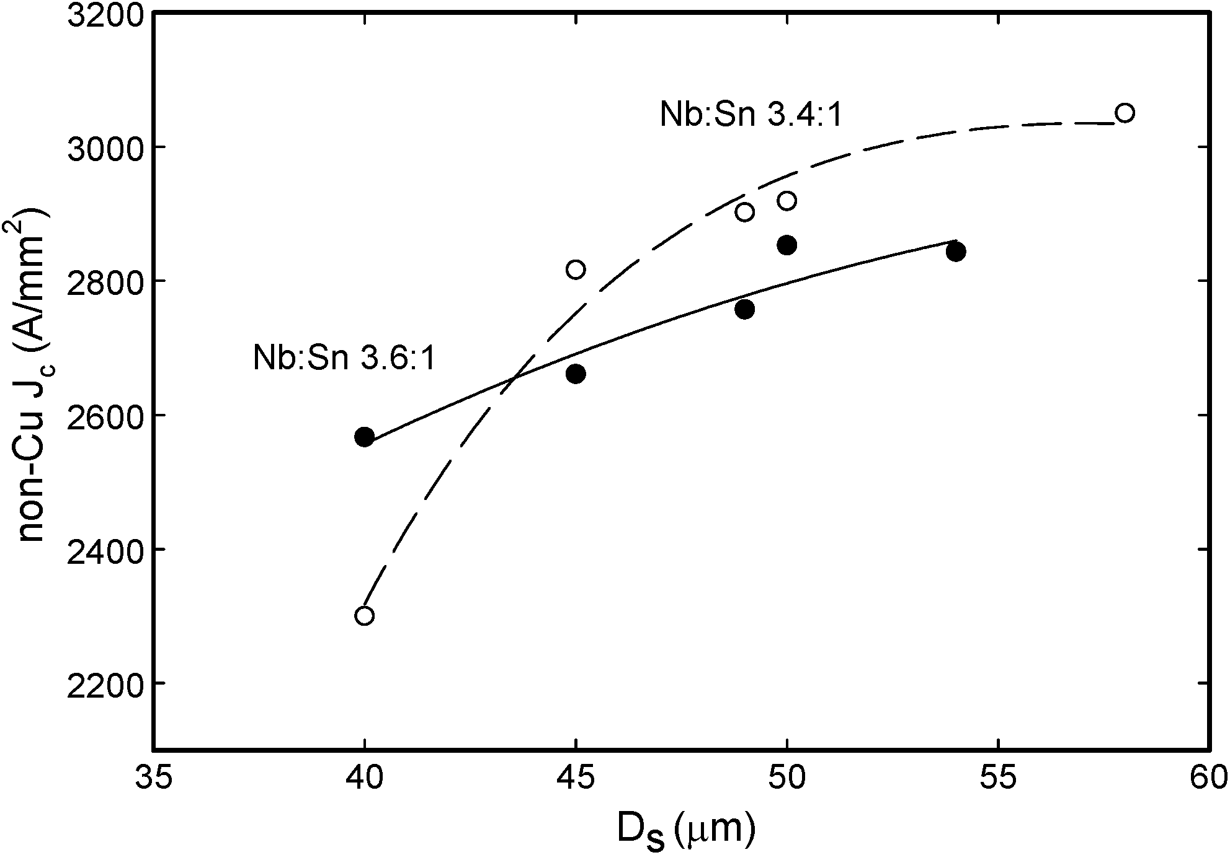
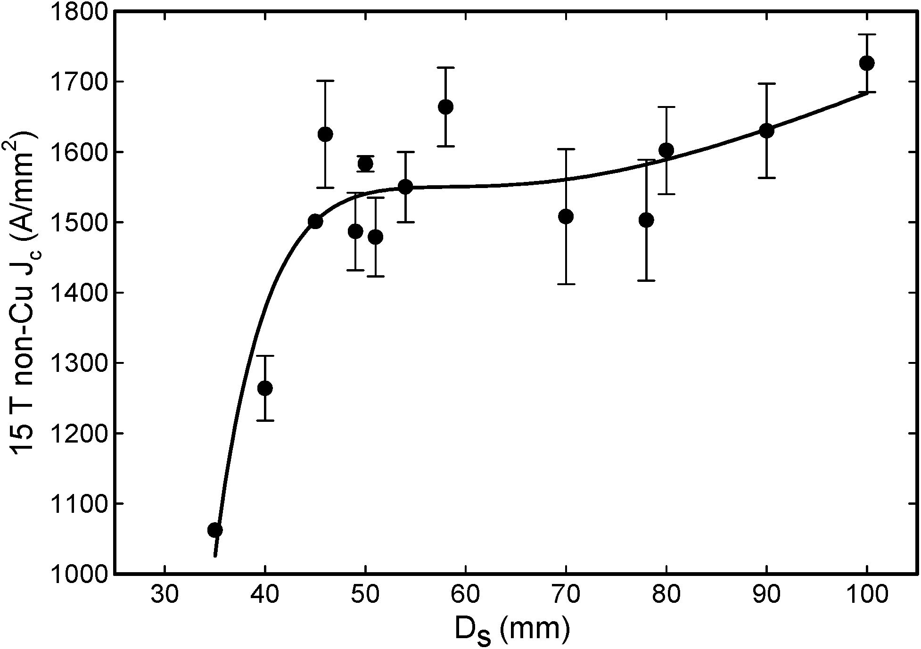
Limits on Nb₃Sn Wire Performance
RRP® has been extremely successful as a magnet conductor:
  High J_{c} and RRR
  Long piece length production
  Low degradation on Rutherford cabling
…but J_{c} performance has not advanced in recent years:
  J_{c} decreases with smaller subelements (d_{s} < ~50 µm)
  Flux pinning is mostly by grain boundaries, so layer J_{c}(B) is limited by grain size (~100 nm) and B_{c2}
  Influenced by Sn stoichiometry and heat treatment – but a compromise between many parameters
    (grain size, B_{c2}, RRR, stability, mechanical properties)
Non-Cu J_{c} at 4.3 K for several RRP® wires (no corrections)
Degradation on cabling for two RRP® and PIT wires
S. C. Hopkins et al., IEEE Trans. Appl. Supercond. 33 (5) 6000609 (2023), 10.1109/TASC.2023.3254497
S. C. Hopkins et al., IEEE Trans. Appl. Supercond. 34 (3) 6001308 (2024), 10.1109/TASC.2024.3375274
ERMC-1
HL-LHC 108/127
12 T 4.2 K
15 T 4.2 K
Non-Cu J_{c} vs. d_{s} for RRP® wires of different Nb:Sn stoichiometry
M. Field et al., IEEE Trans. Appl. Supercond. 24 (3) 6001105 (2014), 10.1109/TASC.2013.2285314

Slide 6
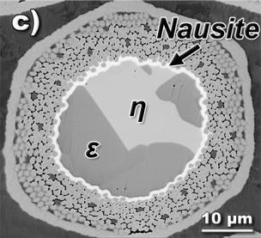




Advancing Nb₃Sn: Nausite (1)
During heat treatment, Nb₃Sn grows at the surface of Nb filaments – basic approximation:
  Sn diffuses through Cu-Sn and the Nb₃Sn layer to the Nb interface, where Nb₃Sn is formed
  For internal tin wires, we pass through all phases of the complex binary Cu-Sn phase diagram, but interactions with Nb (and Ti…) not explicitly considered
…but far from the full picture
  Rely on Cu favouring the formation of stoichiometric Nb₃Sn
  Early reports of inward Cu diffusion and of Nb dissolution
  Extensive intragranular Cu found in high resolution microscopy
A ternary Cu-Nb-Sn phase was eventually identified (‘nausite’) (M. Naus et al., 2001)
  Forms a ‘membrane’ at the interface between the Nb filament bundle and the Sn-rich core, influencing Cu/Sn transport
  Associated with Nb dissolution and formation of coarse/disconnected Nb₃Sn at CERN (I. Pong et al., 2011)
Cu-Sn phase diagram and (dashed) plateau temperatures in Nb₃Sn wire heat treatments
RRP® subelement after the 400 °C heat treatment step
C. Sanabria, PhD thesis, FSU 2017
M. T. Naus et al., IEEE Trans. Appl. Supercond. 11 (1) 3569–3572 (2001), 10.1109/77.919835
I. Pong et al., IEEE Trans. Appl. Supercond. 21 (3) 2537-2540 (2011), 10.1109/TASC.2011.2106473

Slide 7
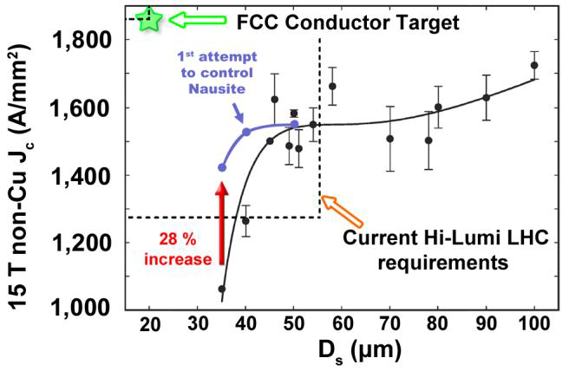
Advancing Nb₃Sn: Nausite (2)
Work between CERN and TUBAF began following an internship of their student Alexander Walnsch (2015)
TUBAF identified the crystal structure of nausite (Nb_{0.75}Cu_{0.25})Sn₂ in 2016
Meanwhile, Sanabria (at FSU) had found that optimisation of the heat treatment step at 350–400 °C could regulate nausite thickness (‘nausite control’) and improve J_{c} for small d_{s} wires
The observations that:
  Heat treatment optimisation – even before Nb₃Sn forms – could achieve progress towards performance targets defined for FCC
  Knowledge of the ternary Cu-Nb-Sn diagram was remarkably incomplete, but necessary for optimisation
  motivated the formulation of a collaboration agreement in 2017 (KE3985)
(a) Kikuchi pattern and (b) distribution of nausite in a PIT wire sample
S. Martin et al., Intermetallics 80 16-21 (2017)
10.1016/J.INTERMET.2016.09.008
Improvements in J_{c}(d_{s}) dependence for nausite control heat treatments
C. Sanabria, PhD thesis, FSU 2017

Slide 8
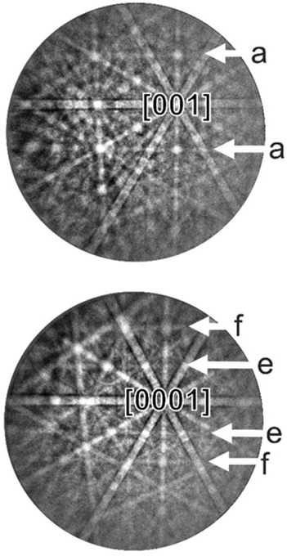
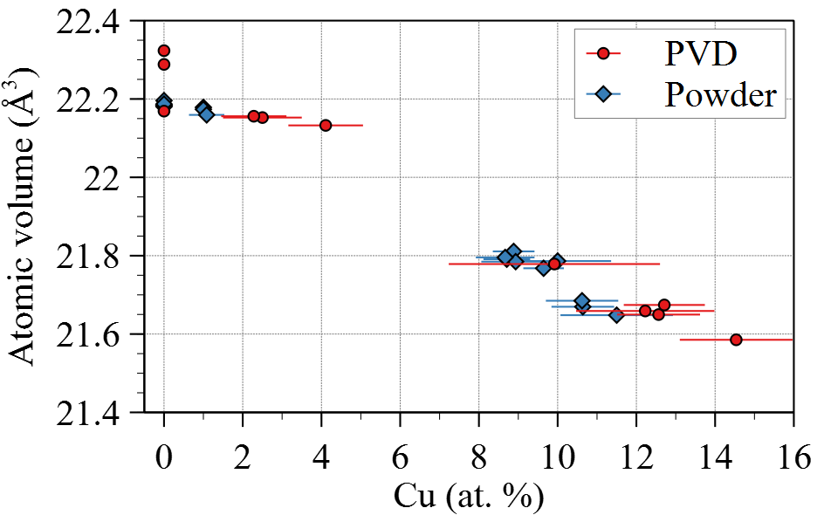
NbSn₂ and Nausite
NbSn₂
TUBAF optimised techniques (EBSD etc.) to distinguish NbSn₂ and Nausite, and clarified their structural relationships
  Nausite is derived from NbSn₂ by partial substitution of Nb for Cu
  Similar layered structures along [001]: lattice parameters are within ~1%, and the phase transition can be described by a change in stacking sequence
  Both phases form with {001} faceted interfaces to a Sn-rich melt, and grow perpendicular to [001], but with differences in morphology vs. temperature
J. Lachmann et al., Mater. Charact. 168 110563 (2020), 10.1016/j.matchar.2020.110563
Examples of experimental Kikuchi patterns around [001] showing the characteristic bands with which the phases can be distinguished
NbSn₂ – a {022}; nausite – e {111}, f {112}
NbSn₂
Nausite
Nausite
Atomic volume over the Cu solubility range of NbSn₂ and nausite obtained from EDX and XRD of powder mixtures and diffusion couples

Slide 9
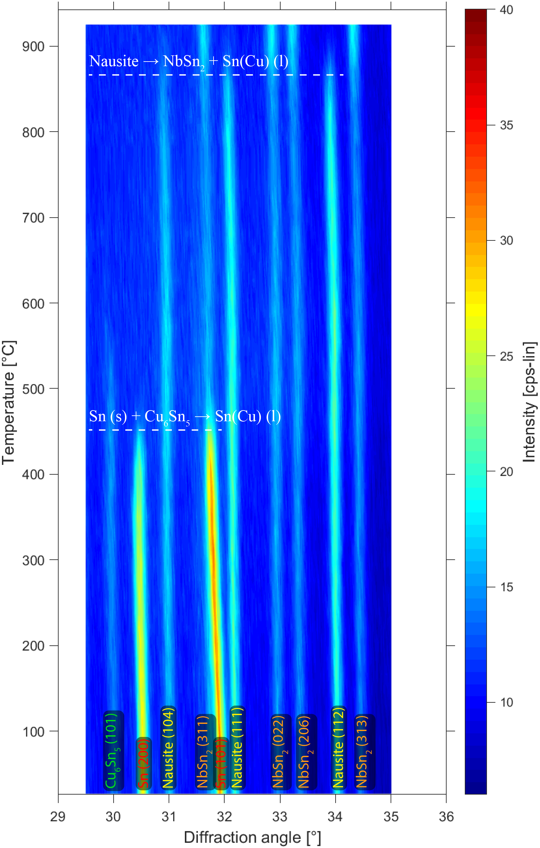
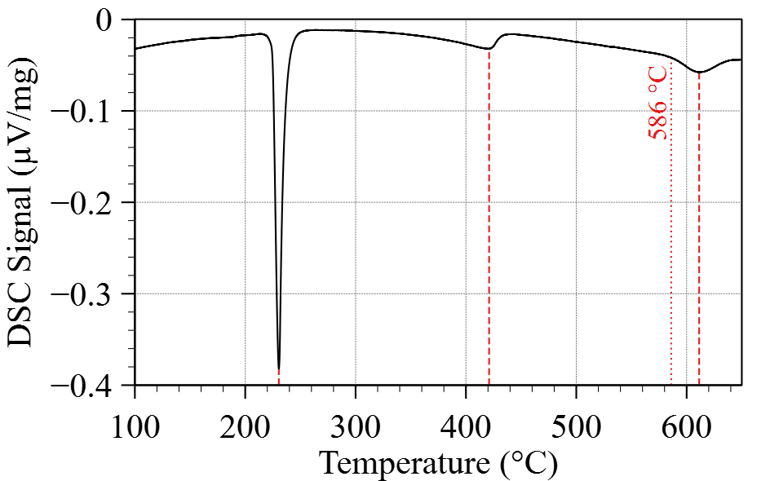
Nausite Decomposition
NbSn₂
~586 °C
Nausite
Thermal analysis of powder samples was used to analyse the decomposition of nausite
Corrected sample
temperatures
from DSC
S. C. Hopkins et al., IEEE Trans. Appl. Supercond. 31 (5) 6000706 (2021), 10.1109/TASC.2021.3063675
~230 °C
nausite decomposition
Analysis of phase transformations during heating of a nausite-containing powder sample
η decomposition
Sn melting
← Left
DSC
Right →
In situ XRD (Cu-Kα)

Slide 10
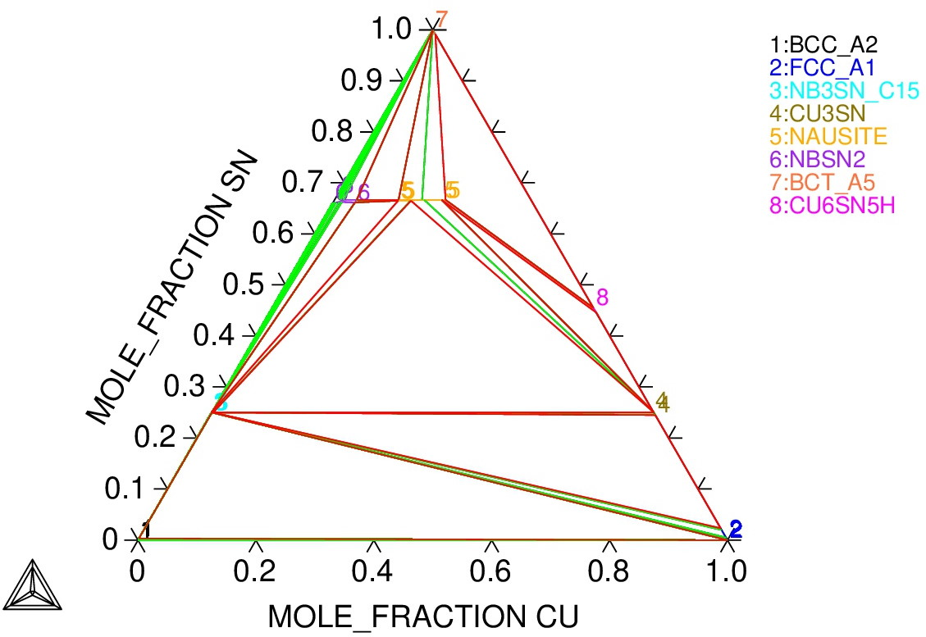
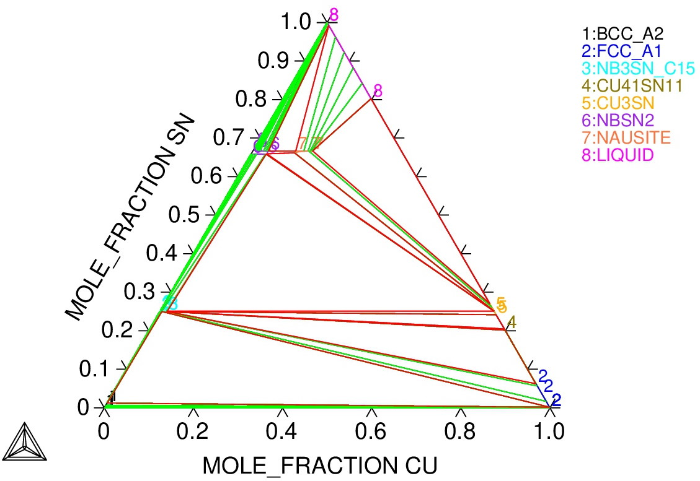
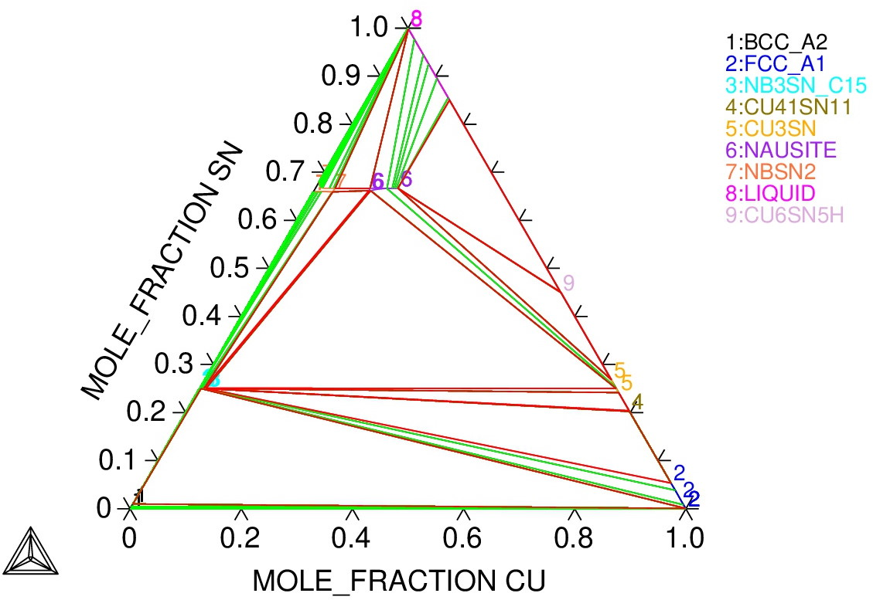
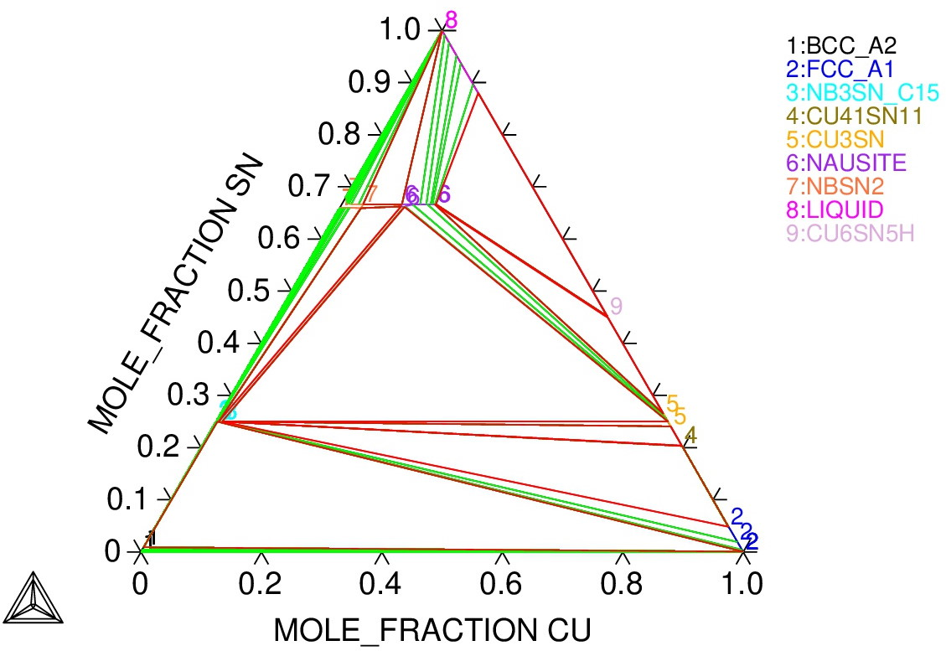
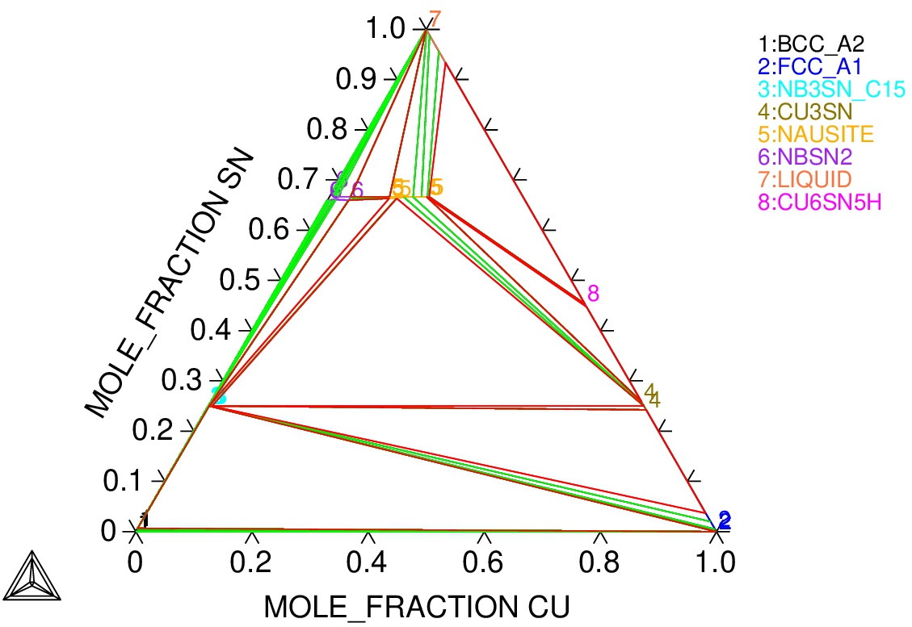

Cu-Nb-Sn Phase Diagram
Phase equilibria were studied by microscopy and thermal analysis of Nb-Sn and Cu-Nb-Sn samples:
  Powder pellets
  Diffusion couples: Cu and Sn sputtered on Nb
CALPHAD re-evaluation of Cu-Nb-Sn phase diagram, including nausite
Later collaboration (KE5074) extended this to consider the effects of Ta and O
  (Ta,Cu)Sn₂ identified
  First steps towards analysing
  internal oxidation
450 °C
210 °C
400 °C
370 °C
Sn
300 °C
NbSn₂/
nausite
η (Cu₆Sn₅)
Nb₃Sn
ε (Cu₃Sn)
α Cu(Sn)
Nb
J. Lachmann et al., Thermodynamic re-modelling of the Cu–Nb–Sn system: Integrating the nausite phase, CALPHAD 77 102409 (2022), 10.1016/J.CALPHAD.2022.102409

Slide 11
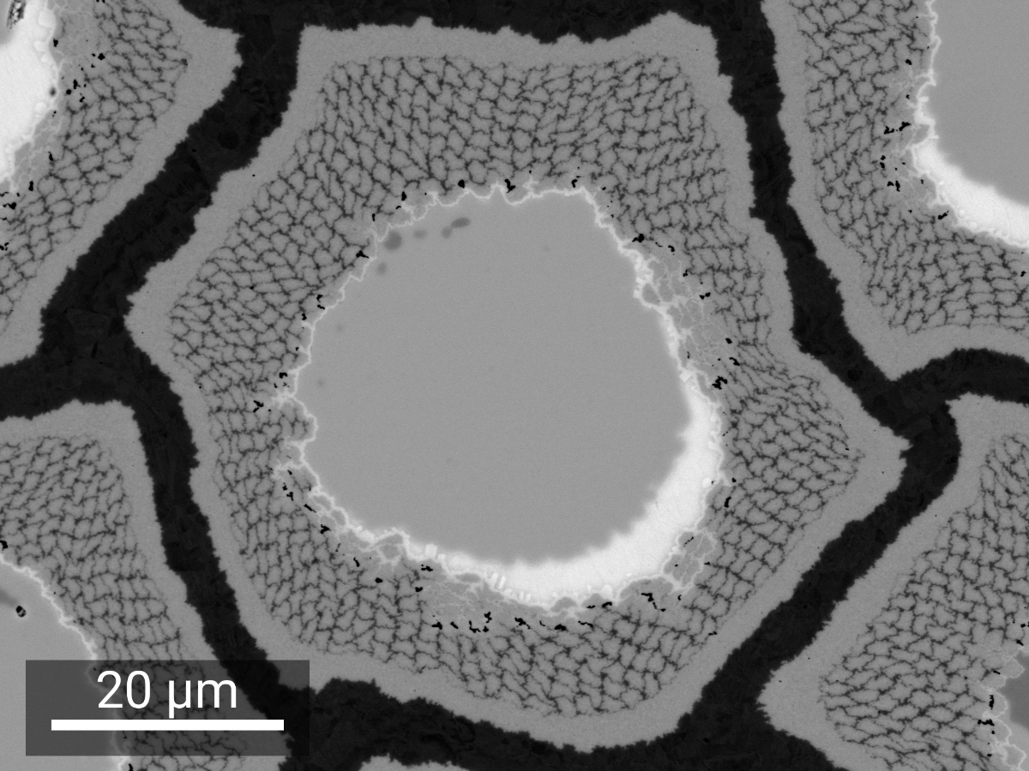
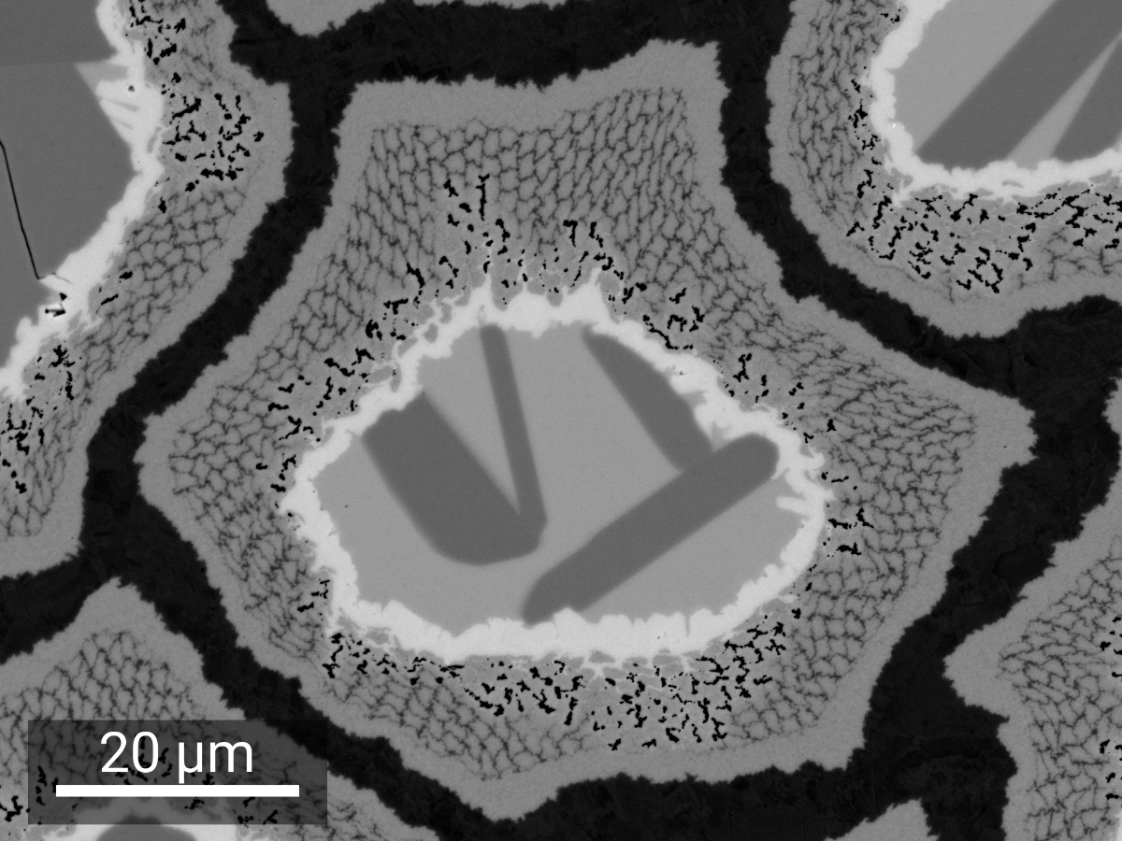
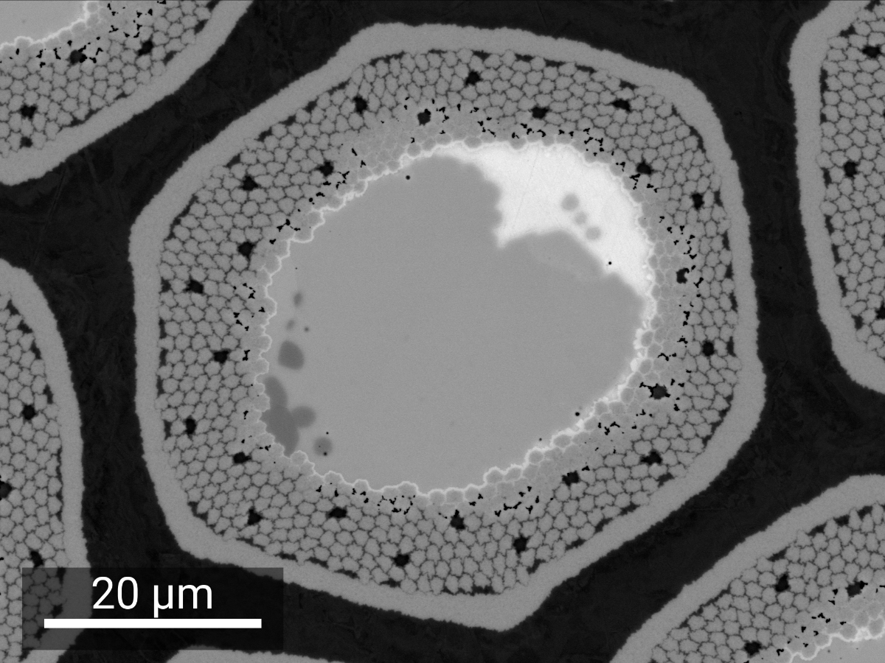
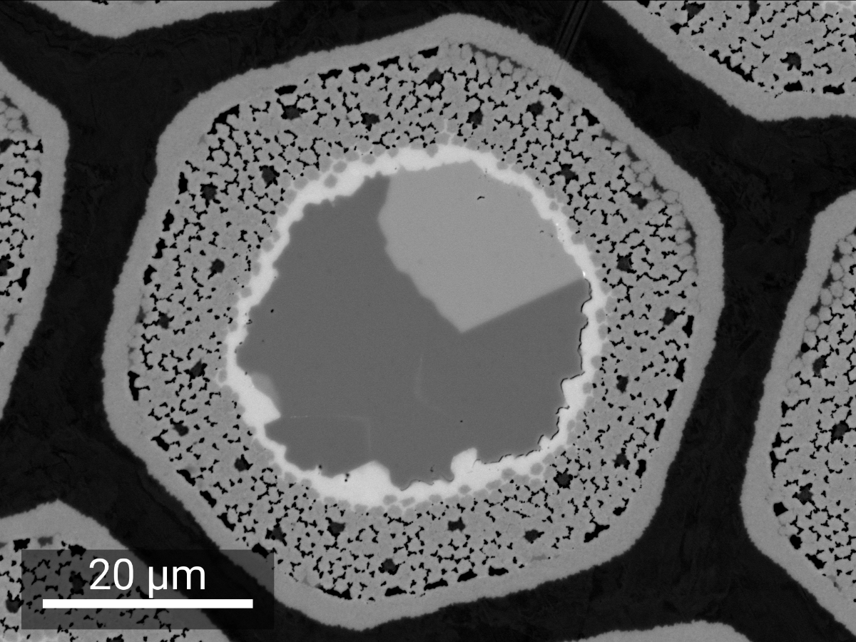
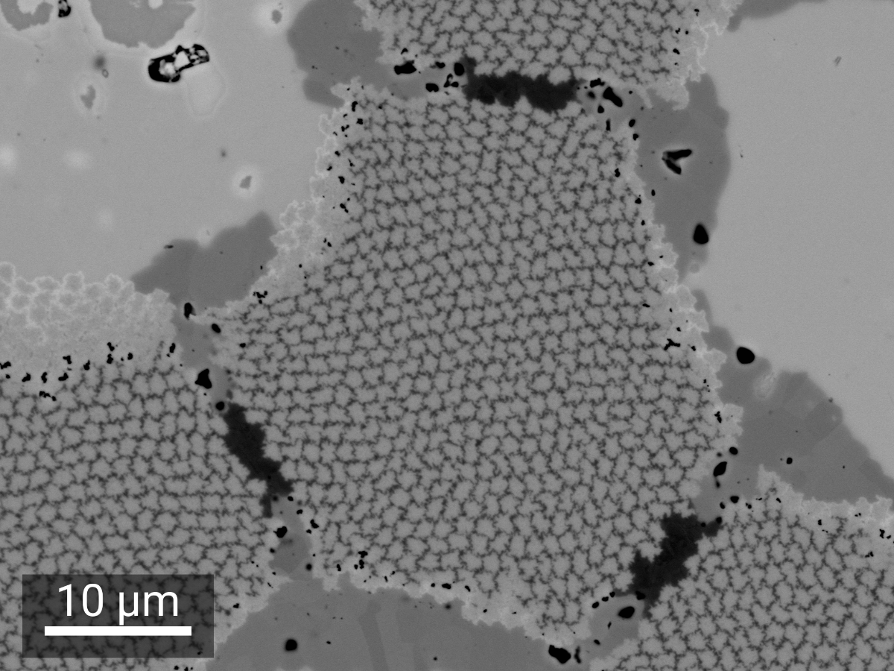
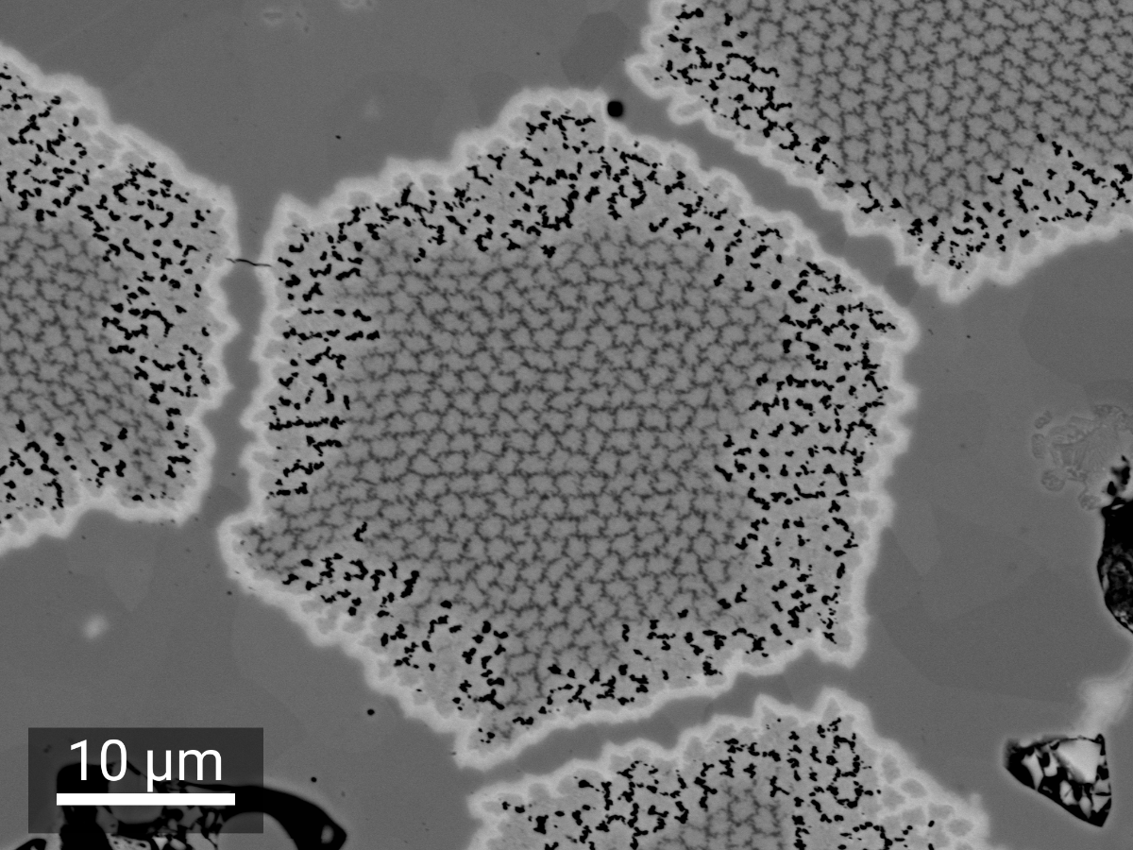
Phase Transformations in Wires
0 h
Nausite
48 h
CERN and TUBAF also conducted a joint study of phase transformations in wire samples
  Tested generality of Sanabria’s observations of RRP® for other RRP® designs, and for R&D distributed barrier and distributed tin wires
TVEL
η
S. C. Hopkins et al., Phase Evolution During Heat Treatment of Nb₃Sn Wires Under Development for the FCC Study,
IEEE Trans. Appl. Supercond. 31 (5) 6000706 (2021), 10.1109/TASC.2021.3063675
RRP® 1 mm
η
ε
JASTEC
BEI of samples quenched from 400 °C

Slide 12
Advancing Nb₃Sn: Internal Oxidation
Flux pinning in conventional Nb₃Sn wires is mostly on grain boundaries:
  Enhancing grain boundary pinning → refining grain size
  (compromise with Nb₃Sn area, B_{c2}, heat treatment duration)
  Adding point pinning → adding or growing precipitates
  (strengthening may impede wire drawing)
‘Internal oxidation’ has been proposed by Xu et al. (2014) as the solution:
  Add a readily oxidised solute element (Hf or Zr) to the Nb alloy (e.g. Nb-Ta-Hf)
  Embed a source of oxygen (e.g. SnO₂)
  Precipitates (e.g. HfO₂) form only on heat treatment, in Nb₃Sn, and:
    Impede Nb₃Sn grain growth and/or
    Provide point pinning
X. Xu et al., Appl. Phys. Lett. 104 082602 (2014), 10.1063/1.4866865

Slide 13
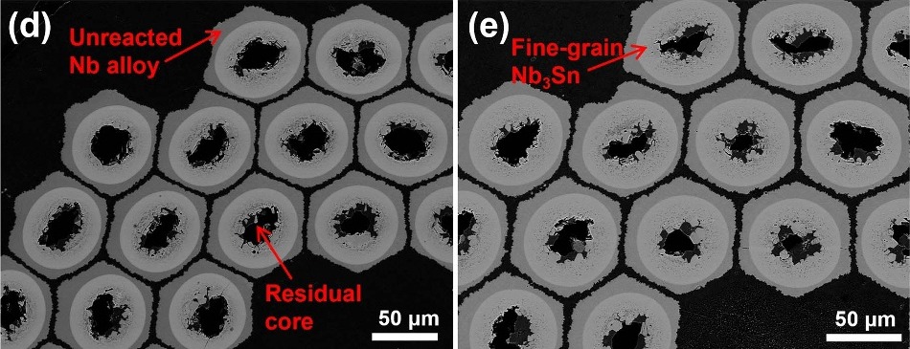
Advancing Nb₃Sn: Internal Oxidation
Implemented in Hyper Tech Research (Columbus, USA) in collaboration with Ohio State University and Fermilab
  Nb₃Sn grain sizes reduced to < 50 nm
  Non-Cu J_{c} exceeds FCC-hh target of 1500 A/cm² at 4.2 K, 16 T
  Shifts pinning peak towards higher reduced field (B / B_{irr})
Hf
Zr
SEM cross-sections of reacted Hyper Tech Hf- and Zr- alloyed internal oxidation PIT wires
X. Xu et al., Supercond. Sci. Technol. 36 035012 (2023),
10.1088/1361-6668/ACB17A
Grain boundary and point pinning contributions in APC wire
Non-Cu J_{c} (4.2 K) of internal oxidised wires compared to HL-LHC wire and FCC target
J. Rochester et al., IEEE Trans. Appl. Supercond. 31 (5) 8000205 (2021),
10.1109/TASC.2021.3057560
Very promising, but not yet an industrialised wire technology validated for accelerator magnet applications
  Still to be demonstrated: long length production, degradation on cabling, magnetothermal stability…

Slide 14
Internal Oxidation: Next Steps
Considerable progress with building understanding – e.g. at UNIGE (KE4663):
  Alternative oxygen source configurations have been evaluated
  Established by XANES that HfO₂ precipitates form at the Nb₃Sn growth front
but significant questions remain, e.g.:
  Detailed understanding of oxide decomposition, oxygen transport, and interactions with Cu/Cu-Sn
  Effects of Zr/Hf alloying on Cu-Nb-Sn thermodynamics and diffusion kinetics
  Effects of Nb alloy microstructure on Nb₃Sn growth
Addressing fundamental questions is challenging in wire studies:
  Long lag between wire trials
  Complex geometry
  All processes coupled – e.g. Cu-Sn phase transformations, Nb₃Sn growth, oxygen transport
Key motivation for new TUBAF collaboration:
  Use diffusion couples to decouple processes and better understand their mechanisms
  (SnO₂ decomposition, O transport, HfO₂ precipitation, influence of Hf/Ta/O on Cu-Nb-Sn, Nb₃Sn formation and grain coarsening)
  Analyse wire samples to identify relevant model systems and validate applicability of conclusions
3-year collaboration (KE5963) signed in March 2024

Slide 15
Methods: Lessons Learnt
Diffusion couple design
  Sn dewetting: use higher-melting Cu-Sn alloys and structured films
  Tune thicknesses and compositions to achieve representative Hf and O atomic fractions
Purity
  Characterisation of substrate materials and purity control during deposition to avoid the influence of other oxygen sources
    cf. wire studies with Hf alloying and without an oxygen source in which HfO₂ precipitates were found
Superconducting characterisation of diffusion couple samples to close the loop with wire samples
  Prepare some samples in a form suitable for VSM at CERN
Grain size determination of very fine-grained regions challenging: multiple methods needed
C. Tarantini et al., Sci. Rep. 11 17845 (2021), 10.1038/s41598-021-97353-w
Dewetting of Sn plated on Nb

Slide 16
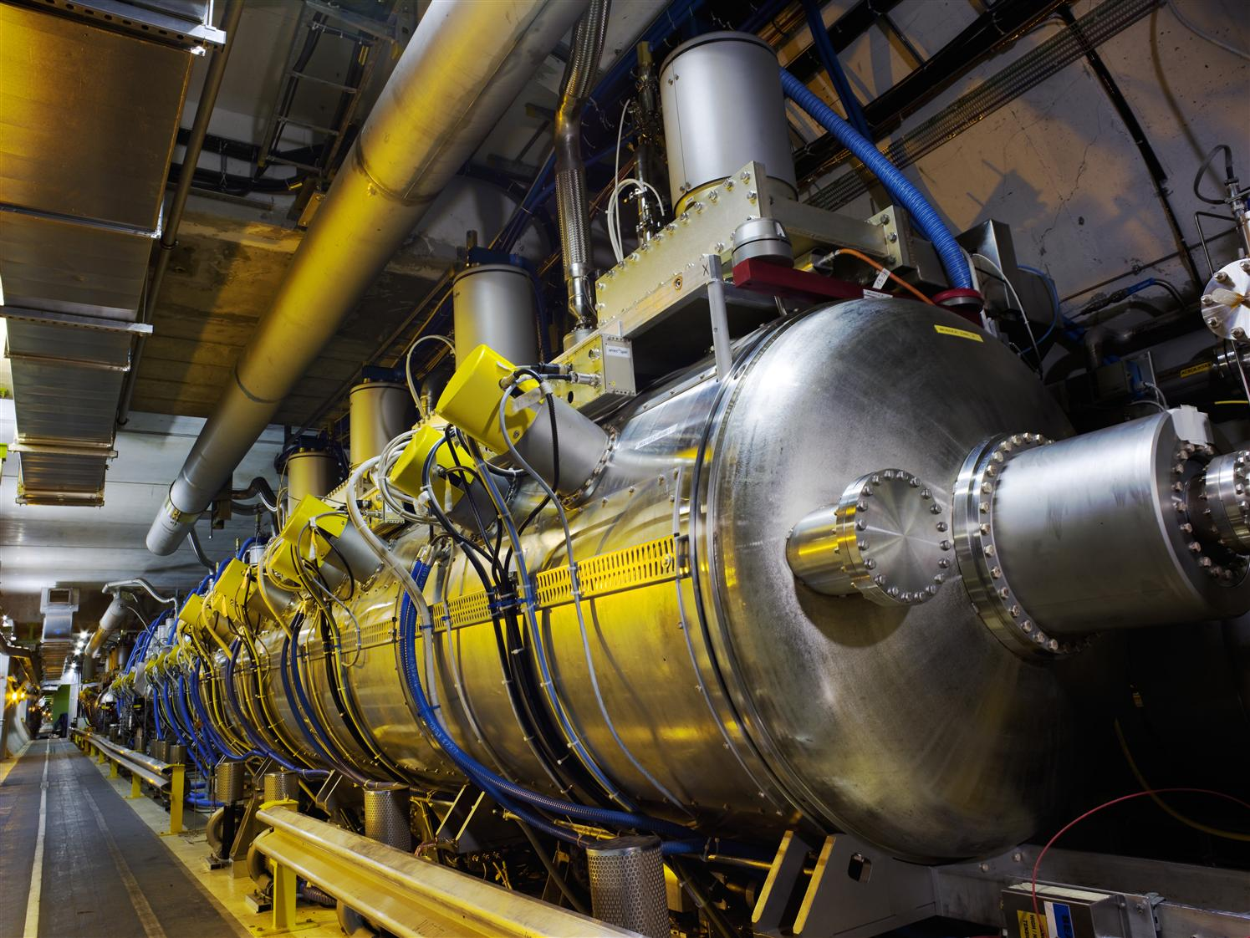
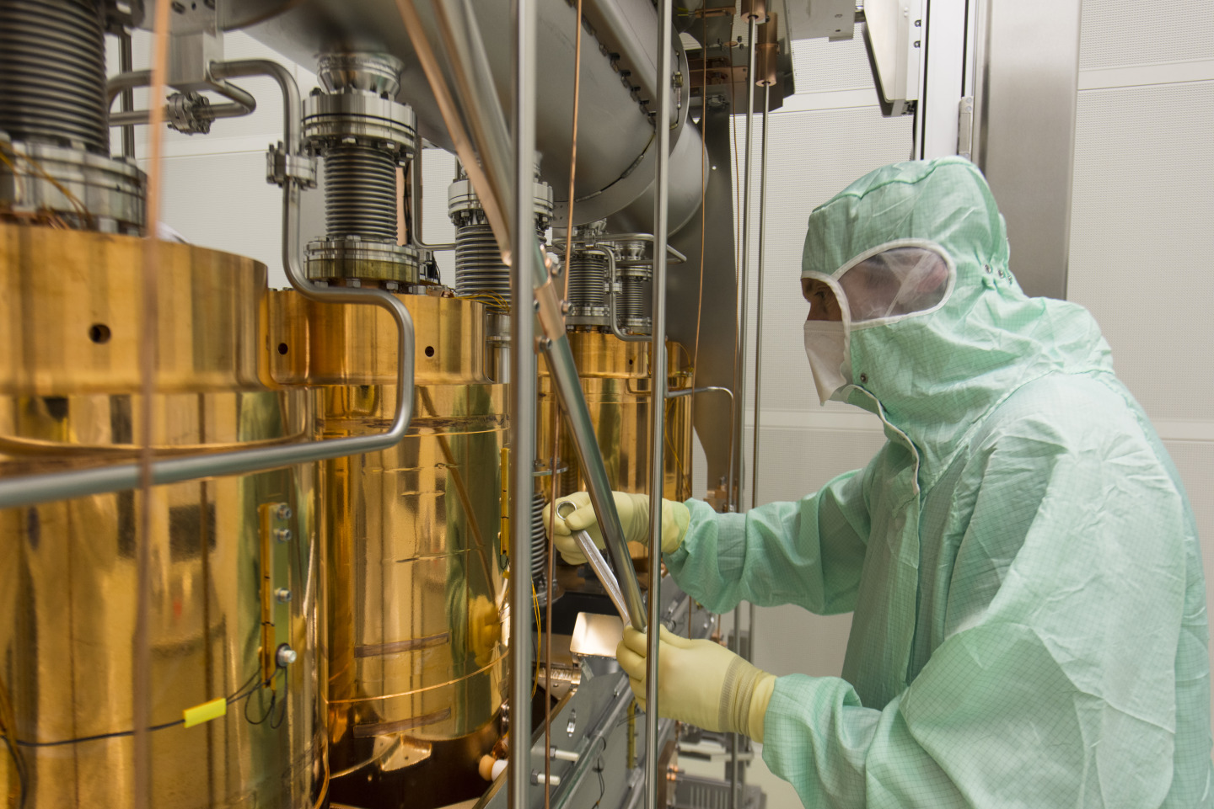
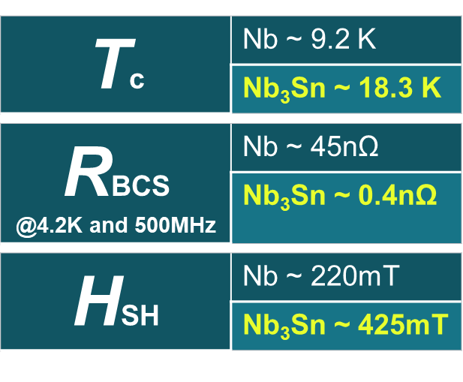
Nb₃Sn SRF Cavities
Cavities: transfer energy from an EM wave to the beam
Current technology at CERN: Nb/Cu (LHC, HIE-ISOLDE)
Objective: decrease by 10× the surface resistance at 4.5 K
Proposal: Replace Nb by Nb₃Sn
Material validated on bulk Nb cavities (expensive, high flux sensitivity)
FCC mid-term report, cds.cern.ch/record/2887249/

Slide 17
Nb₃Sn SRF Cavities: A Comparison
Targets:
  High E_{acc} → high peak field
  High quality factor → low surface resistance (~0.4 nΩ), high T_{c} (~18.3 K)
Compared to wires:
  Many of the same parameters are influential, but the desired condition is different
  Operation in full Meissner state – flux penetration to be avoided at all costs!
  Detailed knowledge and control required of phase diagram, interdiffusion, purity/alloying, microstructure
  Temperature budget: Max 800 °C (cavity material integrity/flange brazing)
 | Wire | Cavity
Key Aim | Maximise flux pinning, optimise F_{p}(B) | Minimise resistance, avoid defects
Defects | Point pinning increases J_{c} at high field | Increase residual resistance
Refined microstructure | Fine grains (<100 nm) increase F_{p} and J_{c} | Typically ~1 µm (gb losses possible)
Alloying | Ti/Ta increase B_{c2} → increase J_{c} at high field | Increase residual resistance
Presence of Cu | Favours Nb₃Sn growth | Surface Cu contamination
Stoichiometry | Optimise T_{c} and B_{c2} | Maximise T_{c}, avoid secondary phases

Slide 18
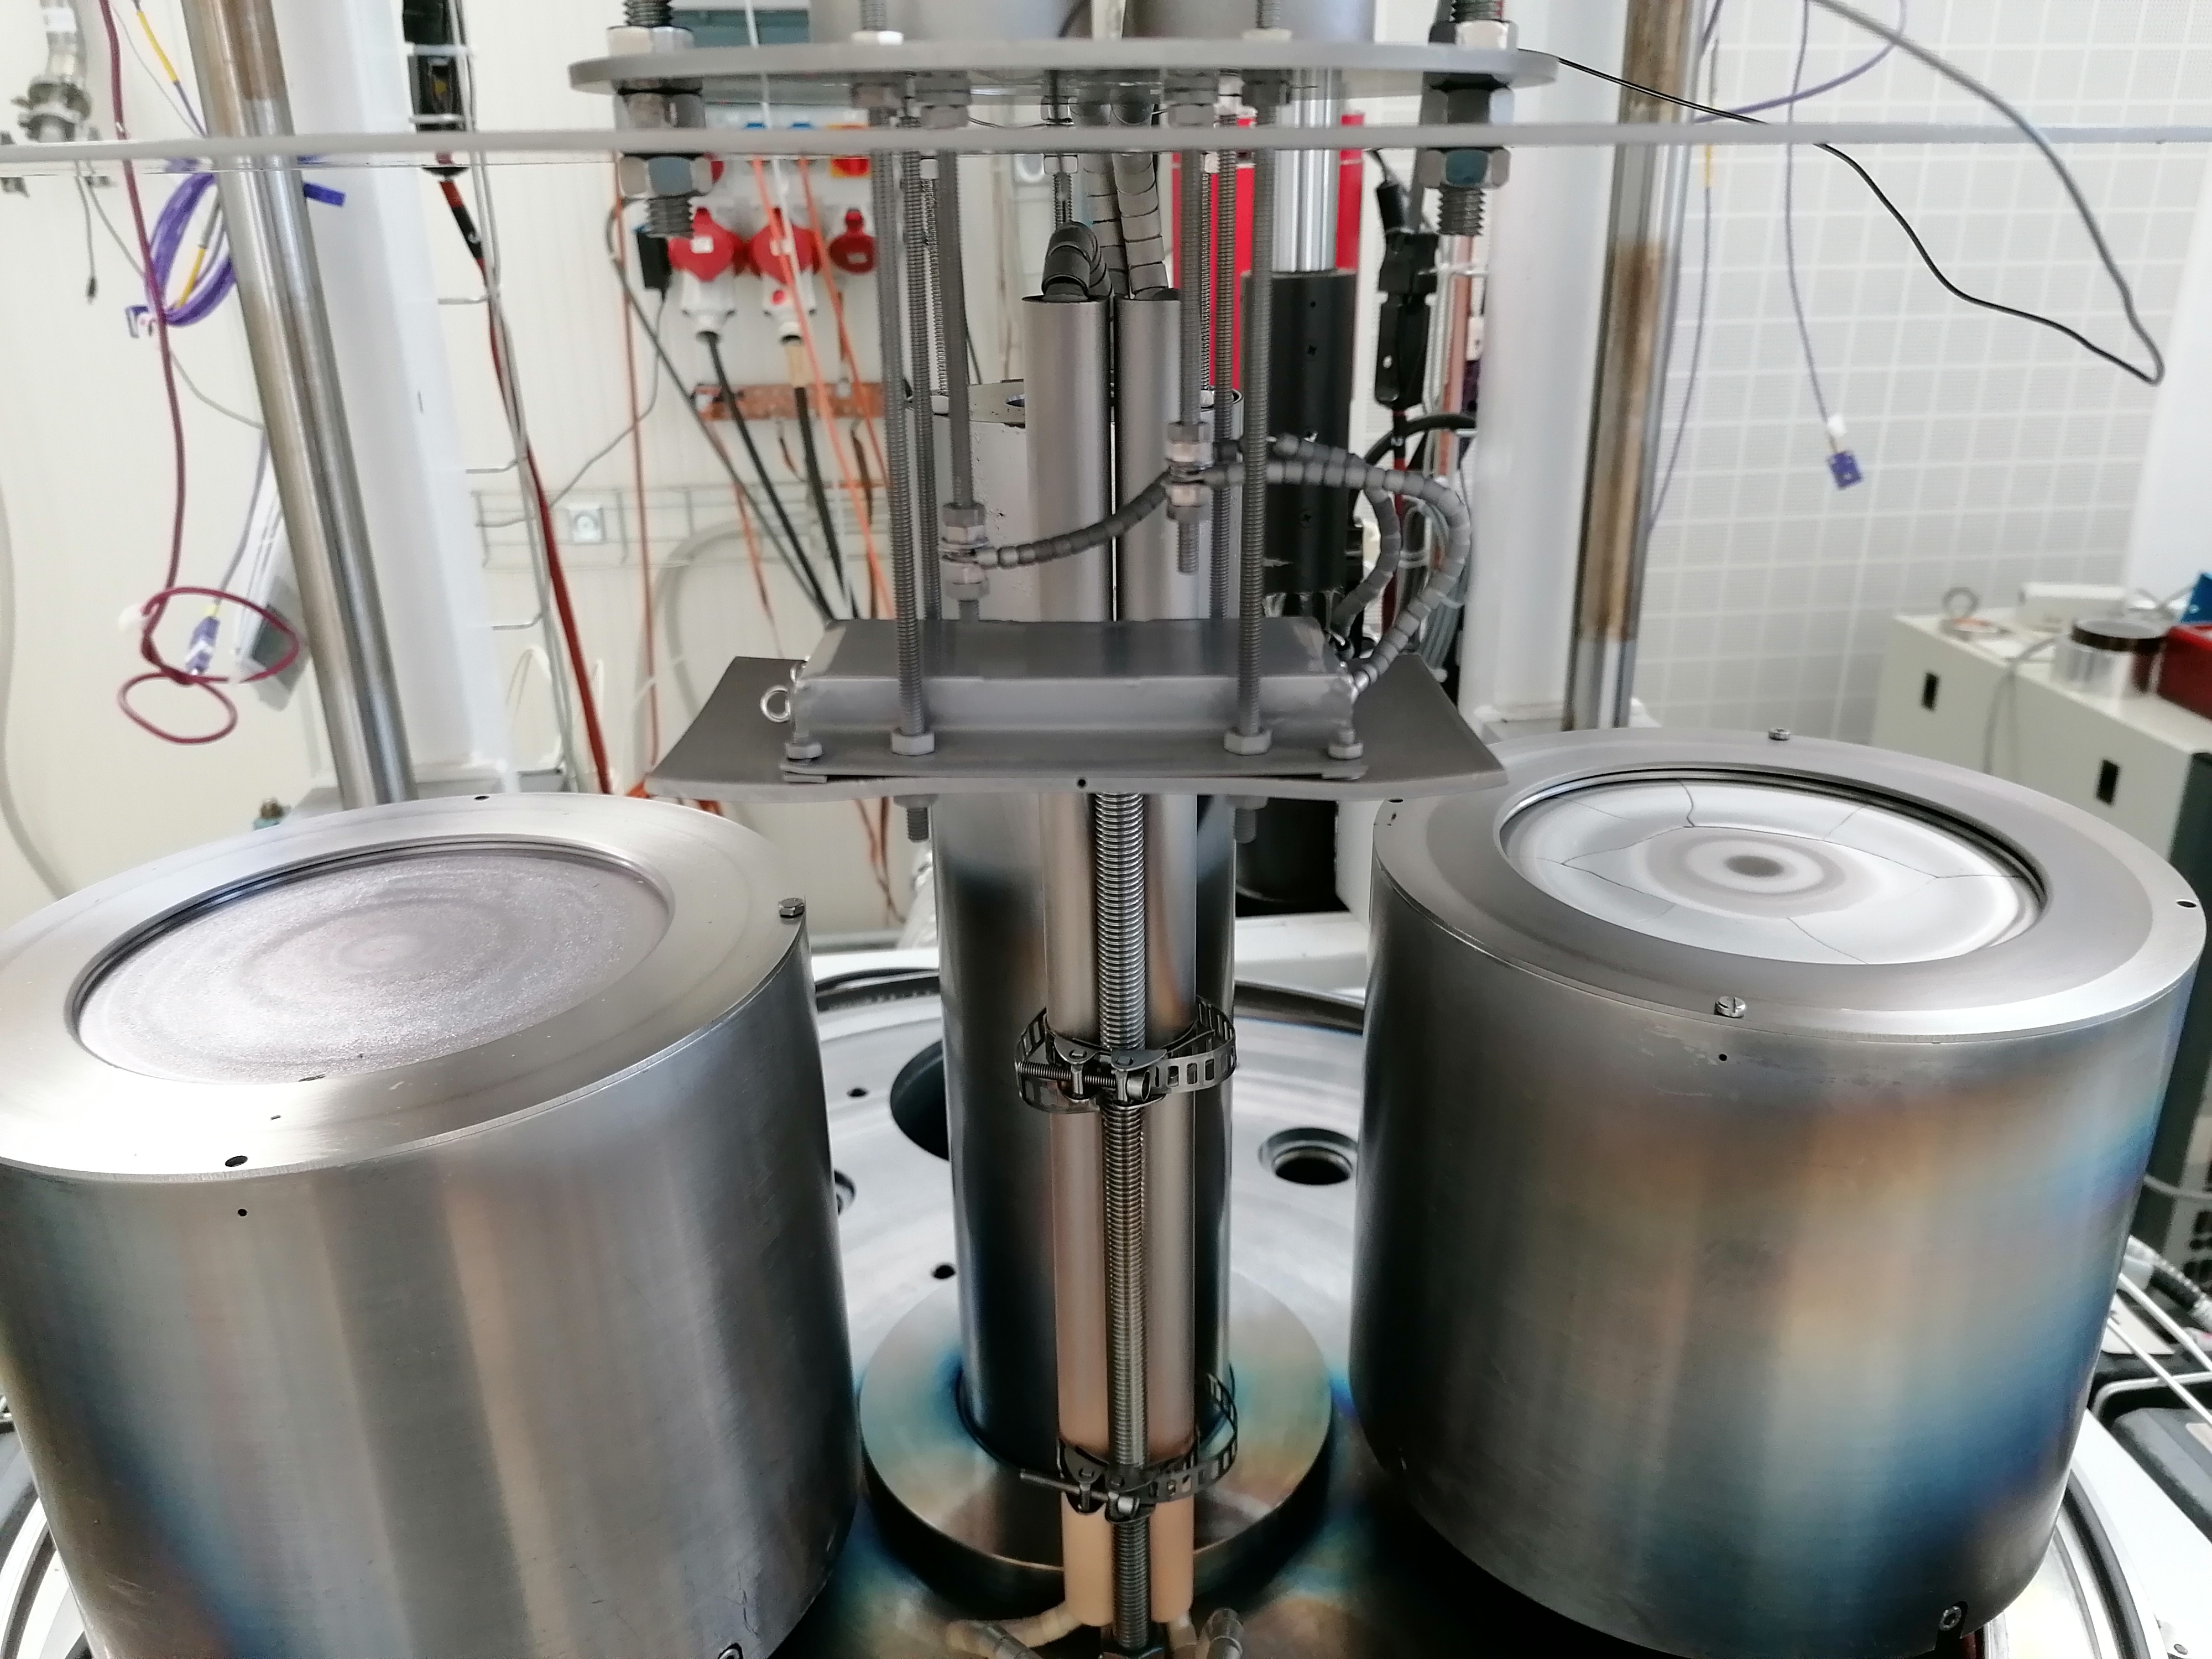
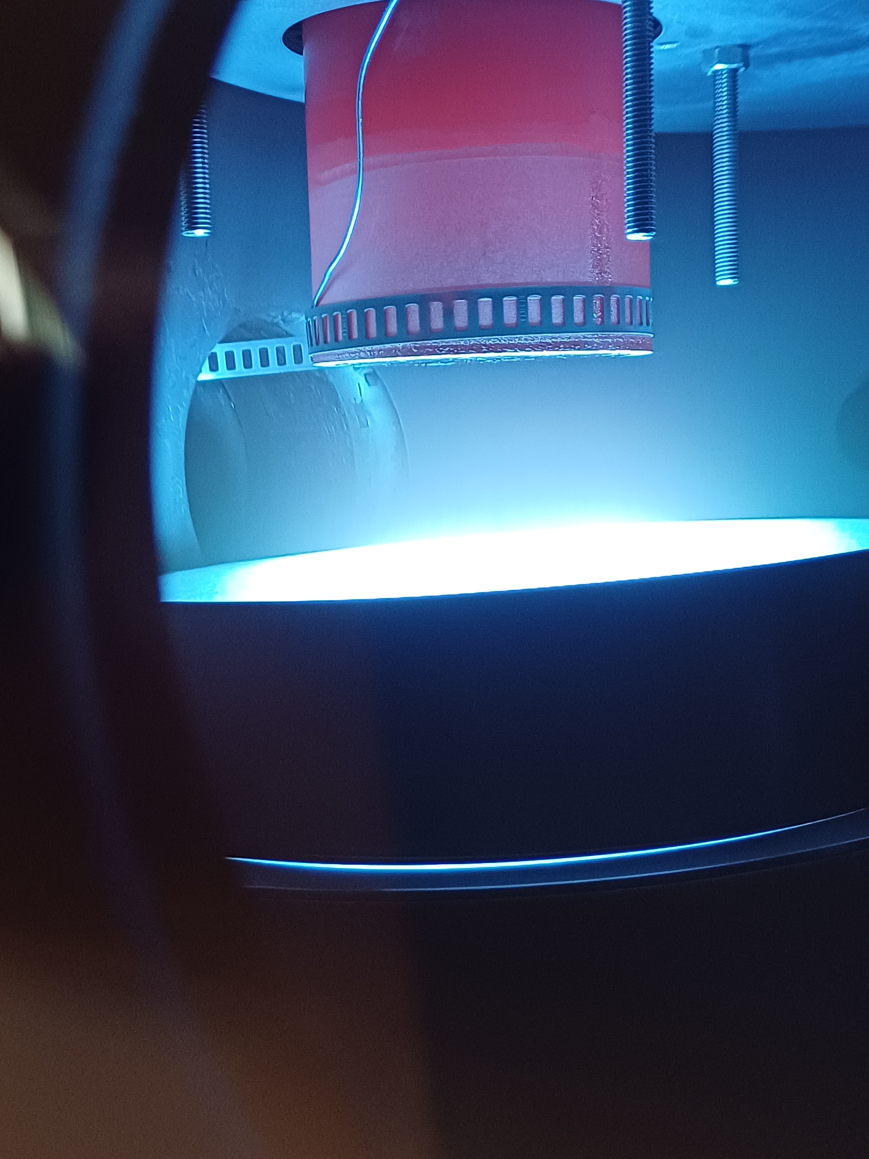


Methods Transferrable from SRF
High Power Impulse Magnetron Sputtering (HiPIMS)
  Nb and Nb alloy/composite targets (e.g. for Nb₃Sn)
  Purity, cleanliness, UHV good practices (control O₂ sources)
  Macrostructure control: porosity
  Microstructure control e.g. by ion bombardment energy
  Nb surface preparation (electropolishing, Buffered Chemical Polish, etc.)
Thin film characterisation:
  XPS profiling
  XRD (EN-MME)
  SHPM, VSM etc.
Materials
  RRR 300 Nb
  Microstructural control by cold work – rolling studies (EN-MME)
UHV coating setup
HiPIMS glow discharge during a quadrupolar sample coating

Slide 19
Diffusion Couples: Basic Approach
Produce layered structures of:
  Nb and its alloys (‘Nb-X’: Nb, Nb-1Hf, Nb-4Ta-1Hf)
  Cu-Sn
  SnO₂ (oxygen source)
  ‘Inert’ substrates (e.g. Y₂O₃, sapphire)
  using Nb-X sheets and sputtered films
Perform heat treatments for different temperatures and durations, and analyse the resulting microstructures by:
  Optical microscopy
  Scanning Electron Microscopy (SEM; cross-section and top-view)
  X-ray diffraction
  Analyse grain sizes by Electron Backscatter Diffraction (EBSD) and/or Transmission Kikuchi Diffraction (TKD)
  For selected samples:
    Transmission Electron Microscopy (TEM) – e.g. for precipitate analysis
    Vibrating Sample Magnetometry (VSM) at CERN – comparative study of J_{c}, T_{c}

Slide 20
New Approaches: Cu-Sn and SnO₂
High-melting Cu-Sn substrates:
  Prepare < 25 at.% Sn substrates by arc melting for heat treatments above 400 °C without melting
  Intermetallics (e.g. Cu₃Sn) and Cu(Sn) solid solutions
SnO₂ patterned films:
  Optimise sputter deposition of SnO₂
  Create laterally structured SnO₂ coatings, e.g. by photolithography:
    Mitigate dewetting (additional metal interfaces)
    Provide internal reference away from without oxygen source
Nb-X
SnO₂
Reference
Cu-Sn
Internal oxidation

Slide 21
New Approaches: Nb-X
Nb-X sheets
  Plates/foils ~1 mm thick
  Assess effect of microstructure with annealing and different degrees of cold work
  Tests with RRR 300 Nb (certified purity) and different rolling reductions
Nb-X sputtered films
  Coatings ~10 µm thick on ‘inert’ substrates (e.g. Y₂O₃ or sapphire)
  Produced at TUBAF
  Produced at CERN by HiPIMS:
    Benchmarking for purity and defect populations
    Control of microstructure

Slide 22
Diffusion Couple Configurations
Expected configurations are shown schematically below
Designs will be finalised after trials in the first year
Nb-X
These configurations are flexible enough to allow:
  Cu-rich (Cu-Sn substrate) and Sn-rich (Cu/Sn coatings) compositions
  SnO₂ decomposition and O transport with (Nb-Ta-Hf) and without (Nb) Hf oxide precipitation
  Behaviour with and without an intentionally added oxygen source:
    As shown – internal reference between SnO₂ patterned strips
    Samples produced with and without SnO₂ layer
All with control of starting Nb alloy microstructure
SnO₂
Cu-Sn
Sn
W
Cu
SnO₂
Nb-X
Cu-Sn
W
Nb-X
SnO₂
Inert

Slide 23
Wire Studies
Analysis of wire samples provided by CERN:
  Consistent comparison of microstructures (e.g. Nb₃Sn grain sizes) in wires from different sources
  Comparison with diffusion couples to identify inconsistencies or interesting cases for further study
  Correlations with I_{c} measured at CERN → understanding of microstructural effects and heat treatment optimisation
Supported by complementary studies in TE-MSC-LSC:
  Ejection furnace: microscopy, VSM and RRR measurements of samples at different stages of the heat treatment
  Studies of rolled wire samples and cables when sufficient internal oxidation wire is available
Supports development of wire activities e.g. in UNIGE

Slide 24
Work Plan
Activity |  |  | 24 |  |  |  | 25 |  |  |  | 26 |  |  |  | 27
 |  |  | Q1 | Q2 | Q3 | Q4 | Q1 | Q2 | Q3 | Q4 | Q1 | Q2 | Q3 | Q4 | Q1
D1 | M1.1 | Cu-Sn substrate preparation
D2 | M2.1 | Patterning of SnO₂ layers
 | M2.2 | Interaction of SnO₂ with Nb/Nb alloys
D3 | M3.1 | Definition of diffusion couple designs
 | M3.2 | Trial samples for magnetisation measurement
 | M3.3 | Interim report: diffusion couple preparation and analysis
 | M3.4 | Samples for CERN characterisation (e.g. VSM)
 | M3.5 | Final report: diffusion couple preparation and analysis
D4 | M4.1 | Analysis of wire samples (batch 1)
 | M4.2 | Analysis of wire samples (batch 2)

Slide 25
Current Status
Visit to TUBAF in January 2024 to visit experimental facilities and discuss the planned work
Agreement signature completed 18 March 2024
Kick-off meeting by Zoom in April 2024
TUBAF hired a PhD student, Simon Waschull, who visited CERN (22-31 May) for:
  UHV system training in TE-VSC
    Sample preparation and handling
    Materials compatibility (UHV)
    Bakeout procedure
    He leak testing
    Residual Gas Analysis
  Familiarisation with superconducting wire and magnet technologies in TE-MSC
    Nb₃Sn wire metallography and microscopy (103, 288)
    Nb₃Sn cabling (103)
    Superconducting tests (I_{c}, RRR, VSM, magnetothermal stability in 163)
    Visit to UNIGE for TEM of internal oxidation sample produced for KE4663 (FIB lamella prepared by EN-MME)
    Visits to LMF (180) and the polymer lab
  Discussions with EN-MME
    Visit of microscopy facilities (112)
    Discussion of cold worked microstructures in RRR Nb

Slide 27
Additional Slides

Slide 28



Nb-Sn Phase Diagram
Reports of the binary Nb-Sn (and Cu-Sn) phase diagrams have not always been consistent
  The Nb-Sn phase diagram of Charlesworth was commonly used (1970), with the established stoichiometries of the Nb-Sn binary intermetallics
  …but solubility and composition ranges were wildly inconsistent between studies and evaluations
Comparison of Nb₃Sn phase fields between different published phase diagrams (1969–2002)
J.P. Charlesworth et al., J. Mater. Sci. 5 580-603 (1970), 10.1007/BF00554367

Slide 29
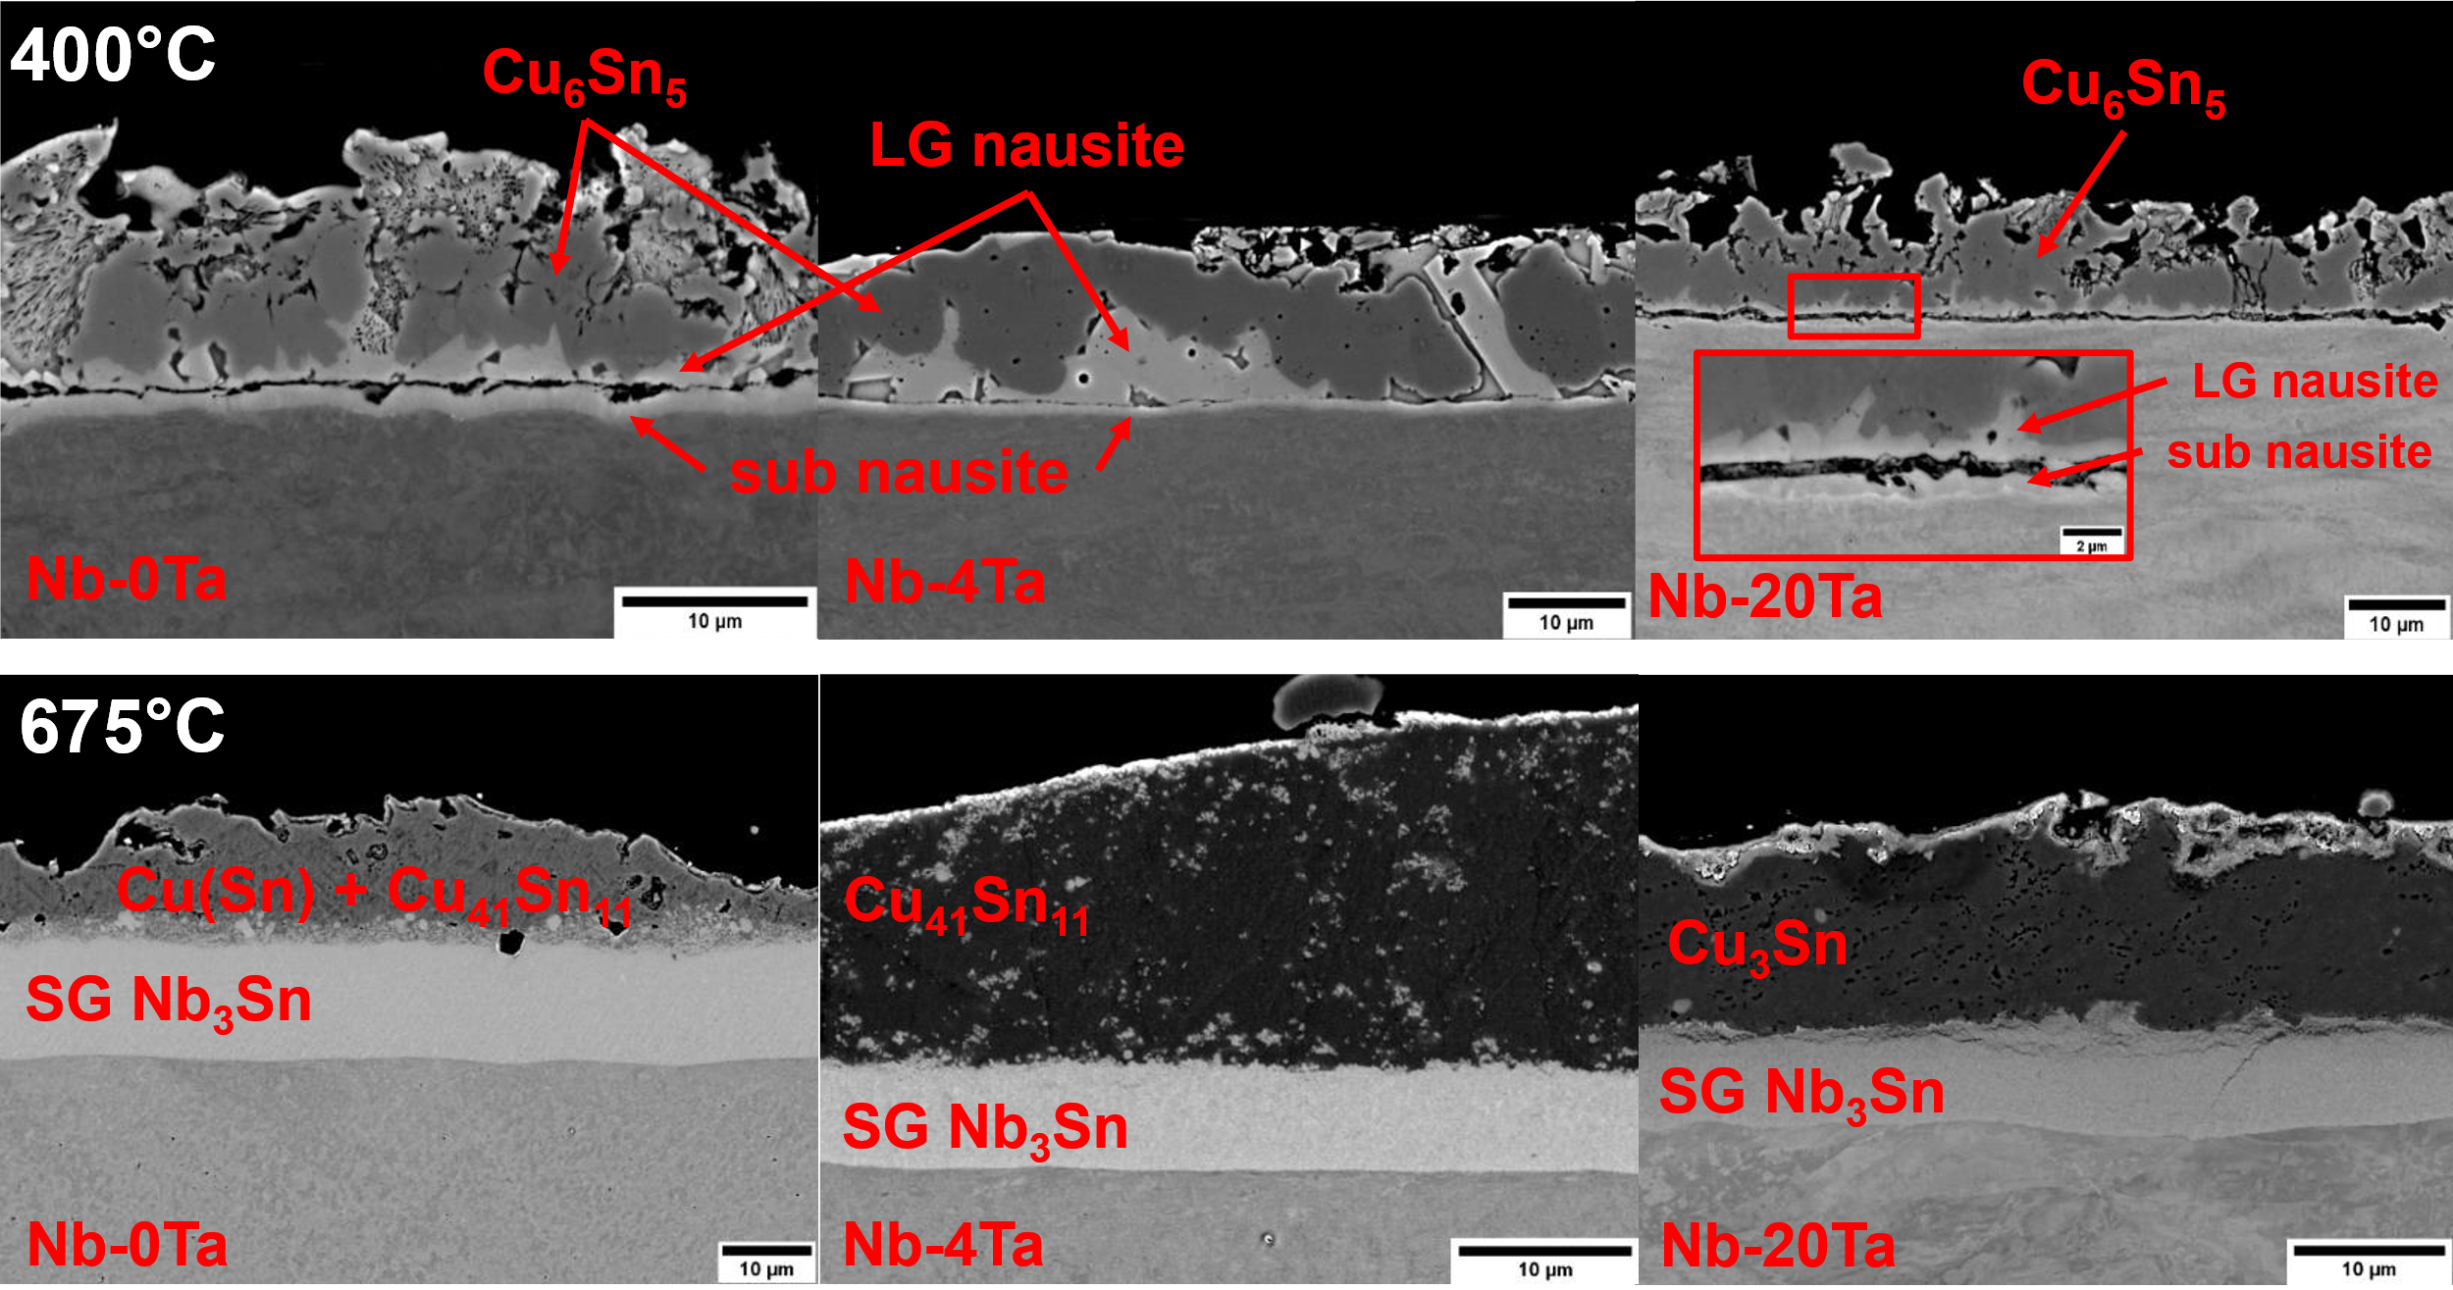

The Influence of Ta
Ta decreases nausite and (modestly) Nb₃Sn layer growth
Note Nb-4Ta is typical for Nb3Sn wire doping
Courtesy of A. Leineweber

Slide 30
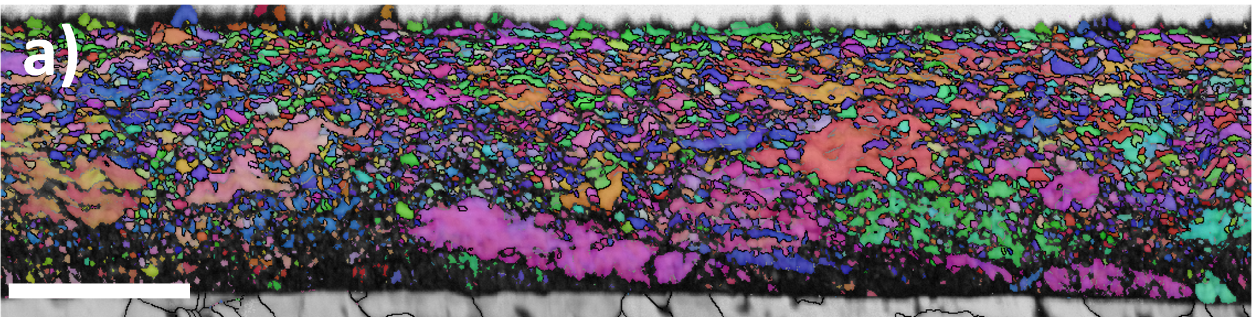
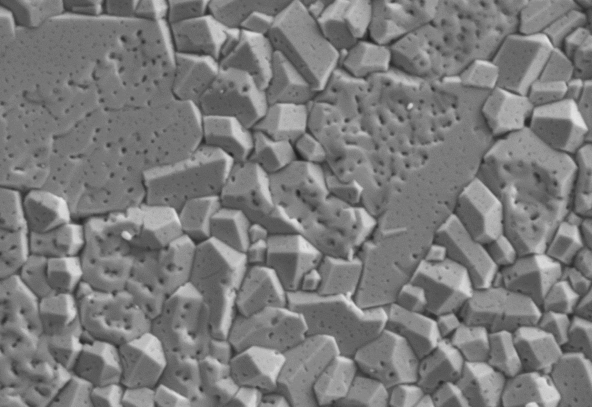
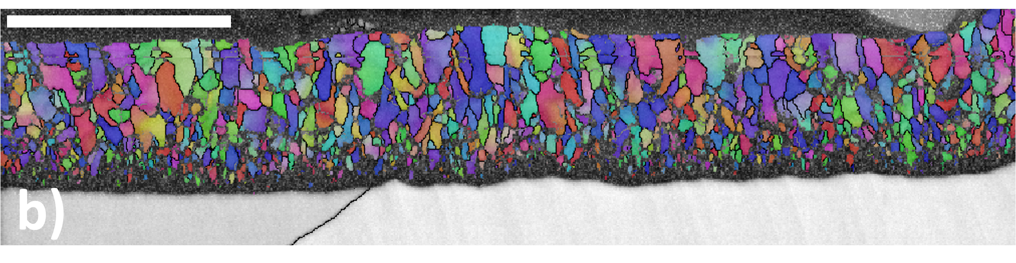
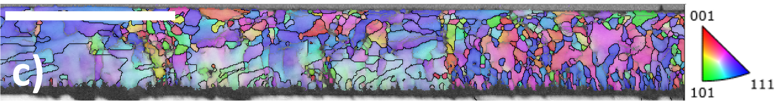
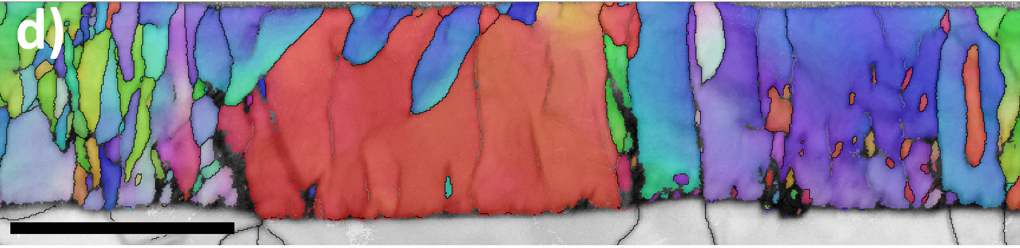
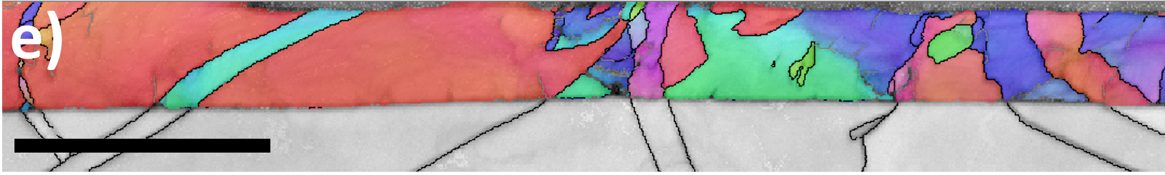
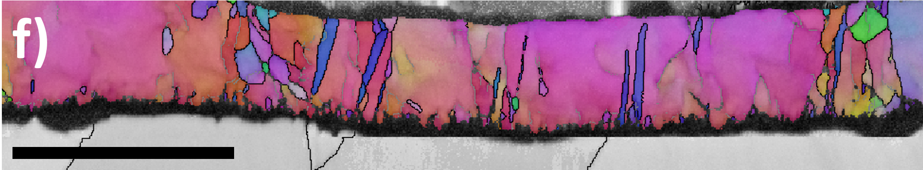


HiPIMS Microstructural Control
0 eV
7×10⁻⁴ mbar
2.5×10⁻³ mbar
50 eV
1μm
1μm
8×10⁻³ mbar
Nb₃Sn morphology in Cu/Ta/Nb₃Sn coatings vs. pressure
75 eV
85 eV
1μm
100 eV
125 eV
Tuning of dislocations in Nb/Cu thin films by ion bombardment energy
C. P. A. Carlos et al., CERN SRF Workshop, 2-3 Feb 2023, https://indico.cern.ch/event/1235920/

