Slide 1
Status of the Neutrino Platform Project
Johan Bremer for the NP project
TE/TM 03/06/2024

Slide 2
Agenda
Introduction Neutrino Platform (NP)
Introduction neutrinos
DUNE Experiment
Developments: Membrane Cryostat
NP installations at Fermilab
NP02 and NP04 at CERN
Conclusion

Slide 3
Introduction Neutrino Platform (NP)

Slide 4
Neutrino Platform
The CERN Neutrino Platform (NP) is CERN’s undertaking to foster and contribute to fundamental research in neutrino physics at particle accelerators worldwide, as recommended by the 2013 European Strategy for Particle Physics. It includes the provision of a facility at CERN (E.g. proto-DUNE) to allow the global community of neutrino experts to develop and prototype the next generation of neutrino detectors, and also the installation of Icarus and the Short Baseline Near Detector at Fermilab and the DUNE detector (Lead, South Dakota, USA).
These are all large argon volume TPC detectors.
The TE department contributes to this research via the involvement of the CRG group. The material budget covering the CRG activities is covered by the NP, while the department participates with an average of about 1.7 FTE over the duration of the NP activities (this participations varies depending on the activities developed by the platform, manpower can also be supplied by NP budget).

Slide 5
Requirement to neutrino oscillation experiment (seen by non-expert)
Neutrinos are non-charged particles. How to measure their energy, momentum etc.? Let’s neutrinos interact with argon atoms and free electrons will be created (secondary particles): now we have measurable particles
How to measure these electrons: put high voltage over argon volume (500 V/cm, E.g. 300 kV over detector) and accelerate these electrons to detection planes (TPC). Electrons shall be “free” for a sufficiently long time (10^{s} ms): extremely pure argon is needed
Neutrinos are only weakly interacting with matter: use high intensity beam and large volumes of liquid argon (dense liquid) to increase number of interactions
Cosmic particles could also interact with the argon bath: put detector in underground cavern for shielding
Cosmic neutrinos will still enter the argon detector volume: use the signal from the accelerator where the neutrinos are created as trigger for the detector system.
neutrinos:
10¹¹ neutrinos pass the surface of the earth per cm² per second. Only 0.001% of these neutrinos has an interaction when they pass through the earth
Three different families of neutrinos have been identified (ϑ_{μ}, ϑ_{τ}, ϑ_{e}). Are they oscillating between families? Do other families exist…

Slide 6
DUNE experiment

Slide 7
DUNE experiment
Over 20 years a worldwide collaboration has been working on the development (and now implementation) of a particle beam driven long baseline neutrino oscillation experiment. Several propositions have been studied (for example Laguna, cavern in Finland with beam from CERN, and LBNE in South Dakota with beam from Fermilab).
Experiment: create a neutrino beam in an accelerator complex and measure the (muon) neutrinos directly after their creation, and after the particles have travelled a distance of about 1300 km (study of neutrino oscillations).
To increase the number of interactions (esspecially for the far detector) between the neutrinos and the detection matter, large volume detectors using a dense material had to be developed. Water and liquid argon were both studied since suitable detection media.
In January 2015 the international DUNE collaboration is founded: development of a neutrino experiment at Lead (South Dakota, US) in a former gold mine (caverns to be excavated 1.5 km underground), based on liquid argon as detection medium (liquid argon TPC) and a neutrino beam facility at Fermilab (PIP2 proton beam). In total 4 liquid argon detectors are foreseen with a volume of about 13.500 m³ each (total of 70 kT of liquid argon, or about 1000 road trucks per cryostat).

Slide 8
DUNE experiment
The implementation of extremely large volumes of cryogenic liquids in underground caverns asks for a development of cryostats and cryogenic systems which can assure the correct operational conditions of such a detector:
Assure that the large volume of liquid argon stays, under all conditions, contained in cryostats
Assure a low temperature gradient (< 1 K) and high temperature stability over the sensitive volume
Assure stable pressure conditions (< 1 mbar)
Assure O₂ equivalent pollution level in argon bath to an equivalent of a 30 ms electron free lifetime (< 10 ppt O₂ equivalent)
The NP has taken the responsibility for the development and design of the cryostat and the proximity cryogenic systems fulfilling the demands of the DUNE requirements, and for the design and installation of the ICARUS and SBND experiments at Fermilab and the proto-DUNES test area at CERN.

Slide 9
Development example: Membrane Cryostat

Slide 10
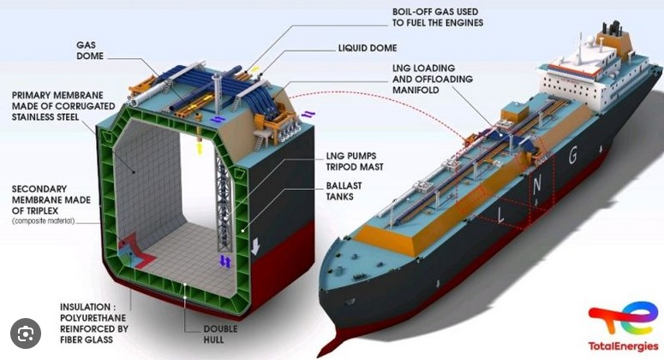
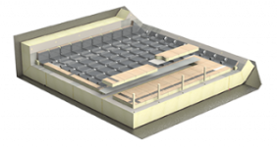
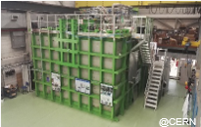
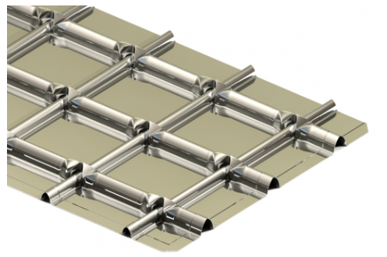
Membrane cryostat for DUNE
Design large volume (13.500 m³) liquid argon detectors cryostats to be placed in underground caverns
GTT MARK III thermal insulation and primary membrane
First test station (B182): 17 m³
No vacuum: System is always in same condition, situation cannot get worse (but high heat load: 7.5 W/m²)
External detectors need to be installed: cryostat needs external support system cannot directly be mounted against cavern wall;
Welding procedures / leak check to be adapted to the use of ultrapure argon
Purging of insulation volume with gaseous nitrogen (no humidity entering in insulation)
First test in B182 made clear: many more improvements needed, work by NP in collaboration with GTT
Other development examples: liquid argon purification system, small temperature gradients over detector (15 m high) over cooldown and standard operational period, pre-argon loss alarms,..

Slide 11
NP installations at Fermilab

Slide 12
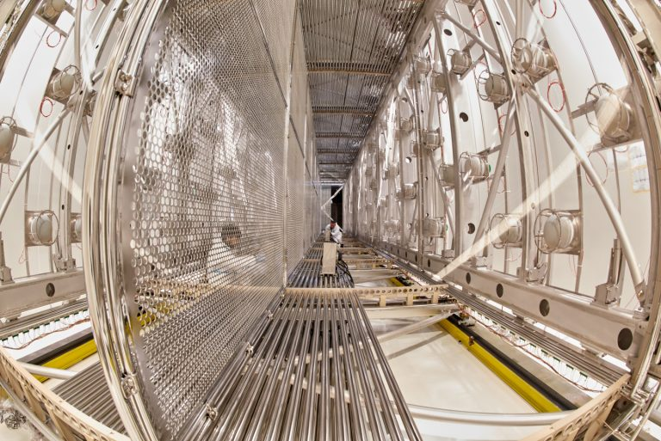
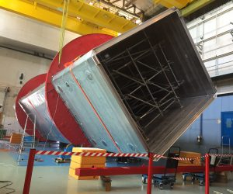
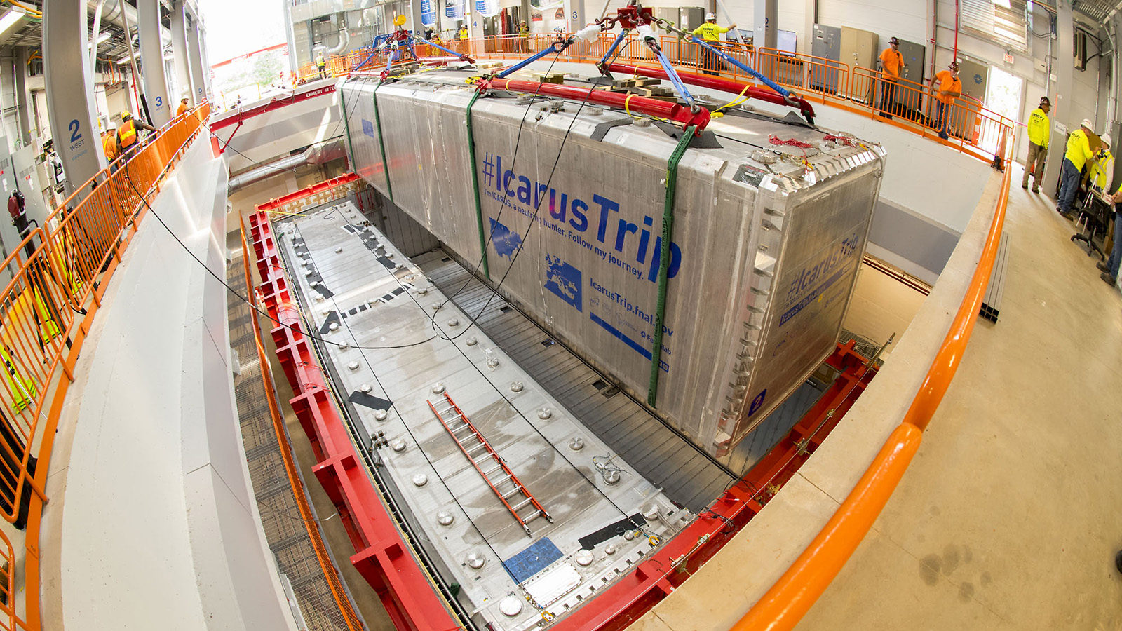
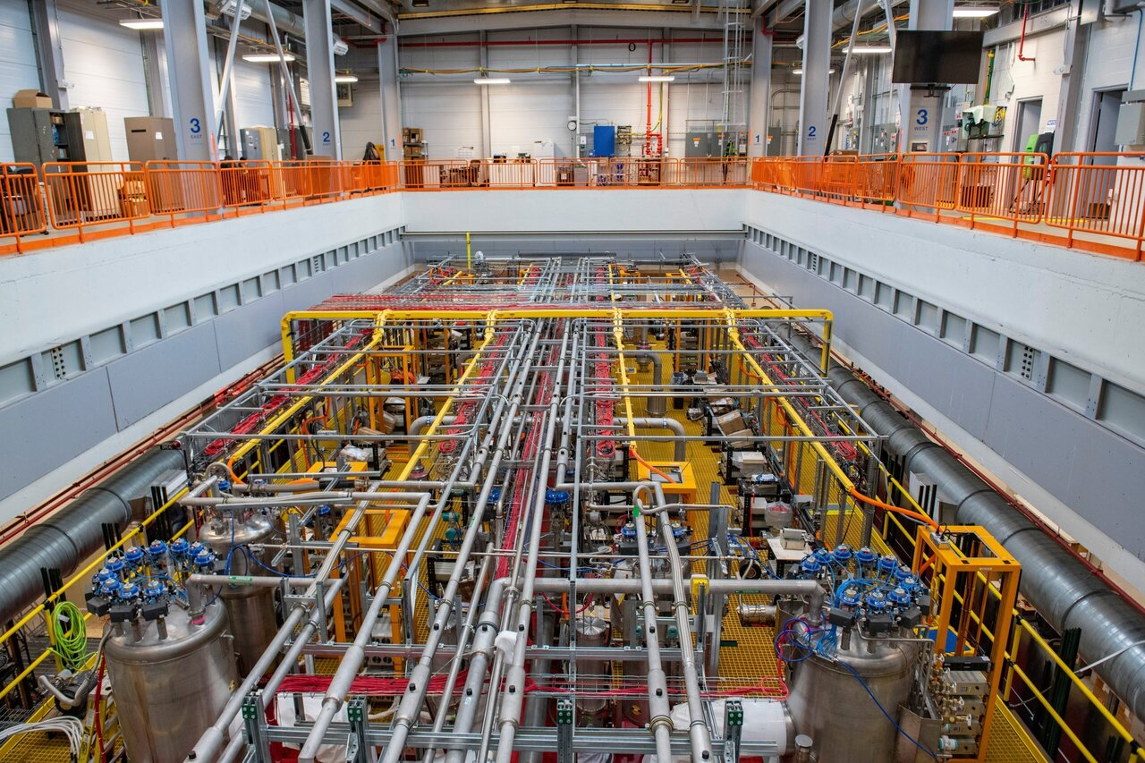
Facilities designed and constructed by NP
NP01 / ICARUS at Fermilab / SBFD
Icarus detector had been in operation in Gran Sasso with a neutrino beam from CERN
Icarus detector transported from Gran Sasso to CERN in original liquid argon cold vessels;
Liquid argon cold vessels have been exchanged for upgraded model at CERN by EN/MME (20mx4mx4m)
Detector system transported to Fermilab and installed in NP cryostat enclosure;
New cryogenic system completely designed, specified, produced, transported, installed and commissioned by CRG
Cryogenic control system specified by C`RG, implemented by Fermilab
System in continuous operation for 4 years, temperature gradient < 0.1 K, pressure stability < 2 mbar, free electron lifetime 8 ms (about 40 ppt)

Slide 13
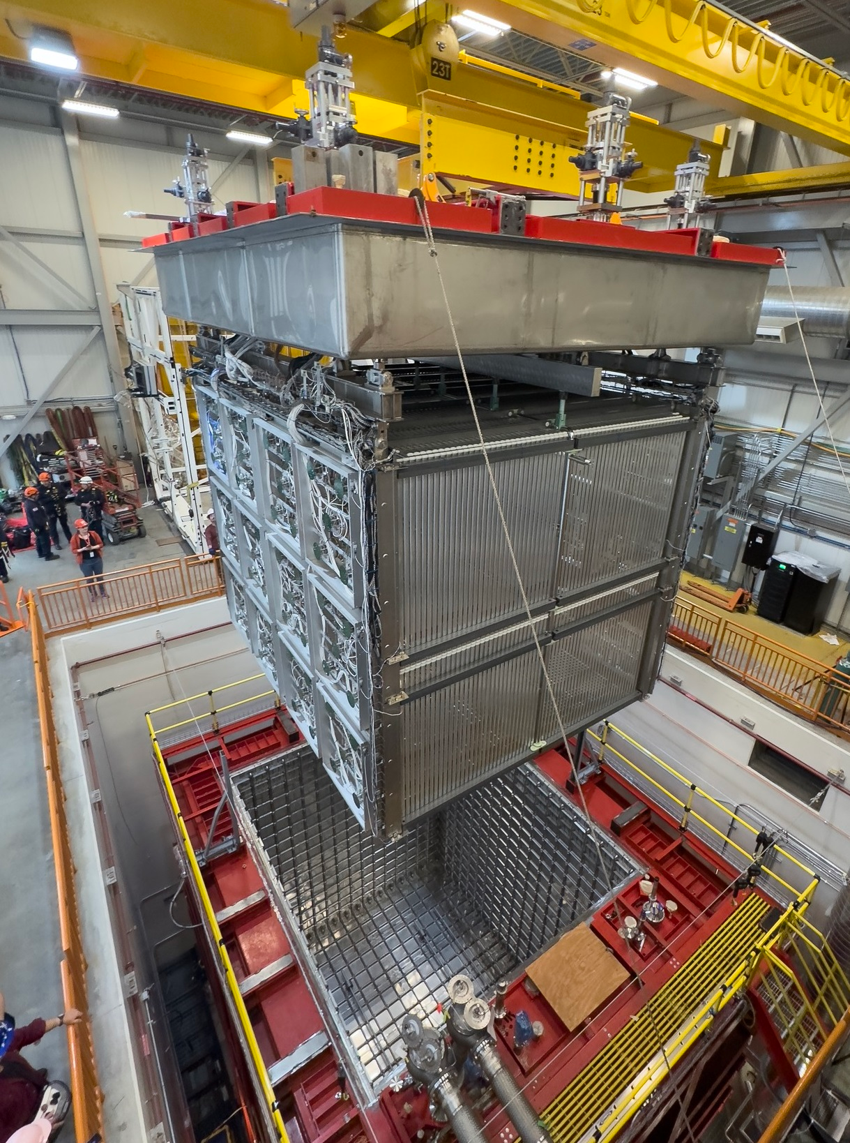
Facilities designed and constructed by NP
NP03 / SBND at Fermilab
Complete cryostat and cryogenic system delivered by NP to Fermilab just before COVID……..
Detector has been introduced end 2023, cooldown started 2024, now stable for about 4 months: System well within the specifications, but…..some problems with the detector read-out.

Slide 14
NP02 and NP04 at CERN

Slide 15
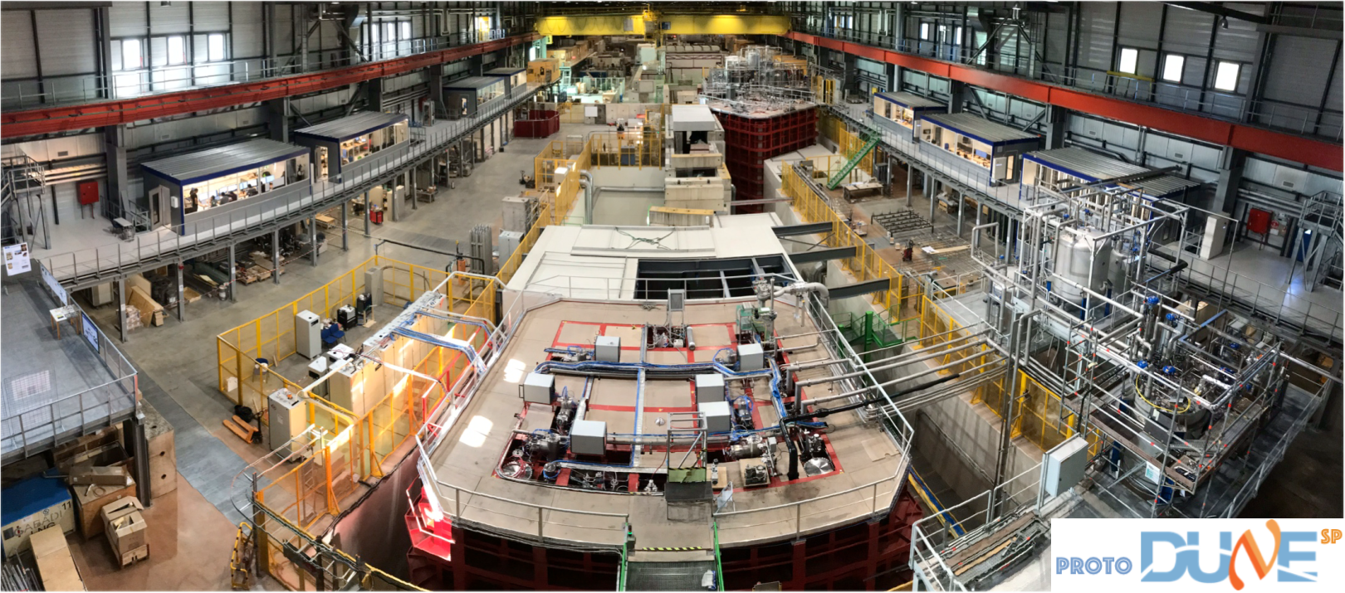
Facilities designed and constructed by NP
NP-02: Vertical
NP-04: Horizontal
@ cern; CERN-SPSC-2020-011 ; SPSC-SR-270
NP02 and NP04 proto-DUNE installations at CERN:
Test of Membrane Cryostat Principle
Test of Cryogenic Principle
Test of Liquid Argon Purification Principle
Test of Detector Principles (installation of detector, cabling, cool-down, operational results (cosmic and with beam);

Slide 16
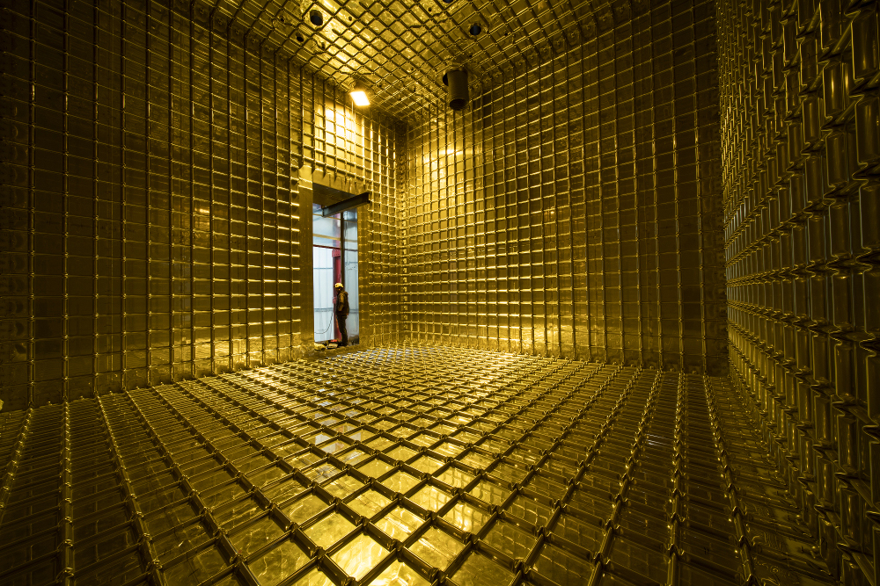
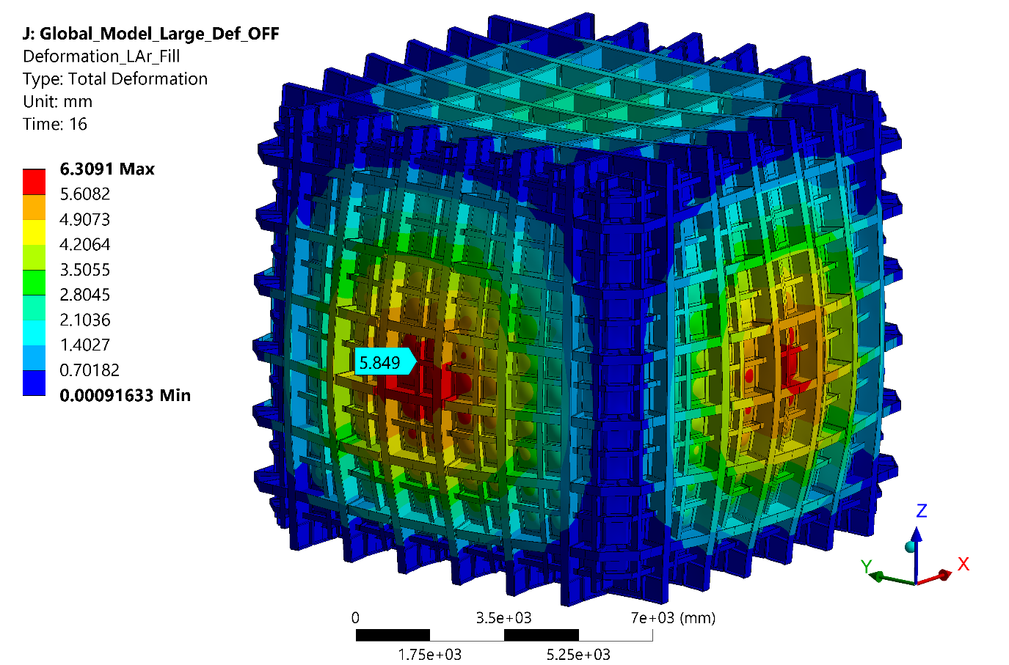
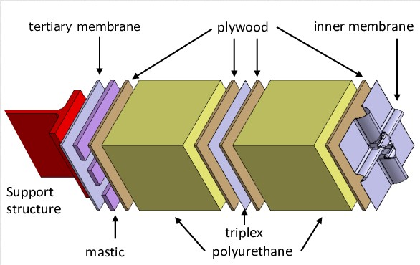
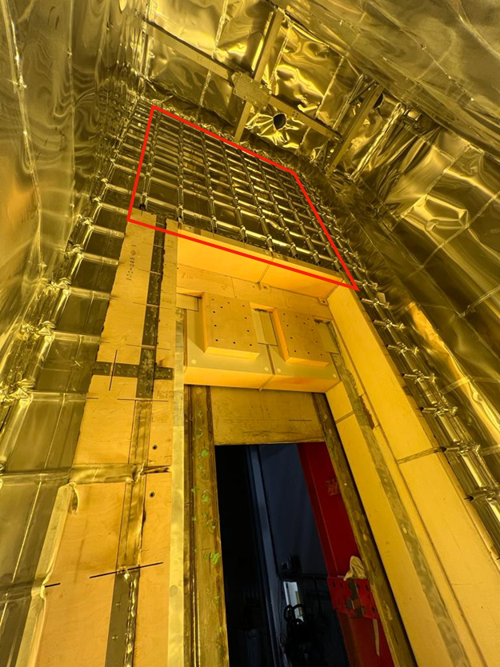
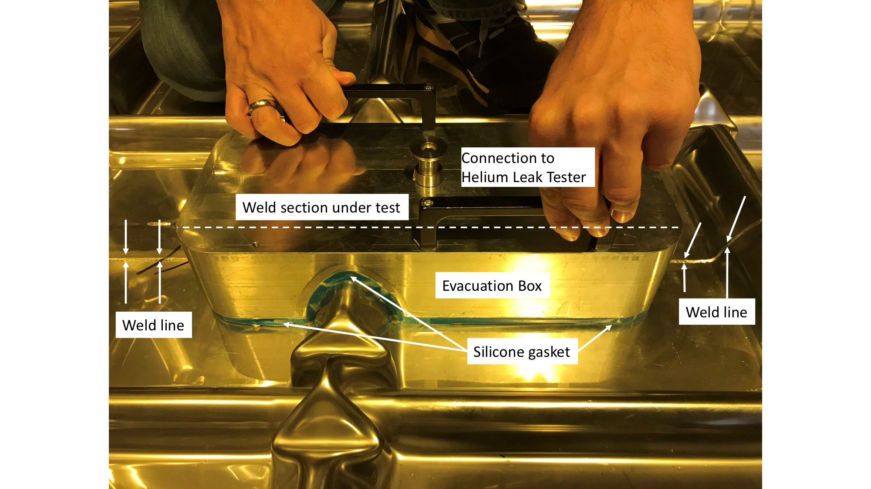
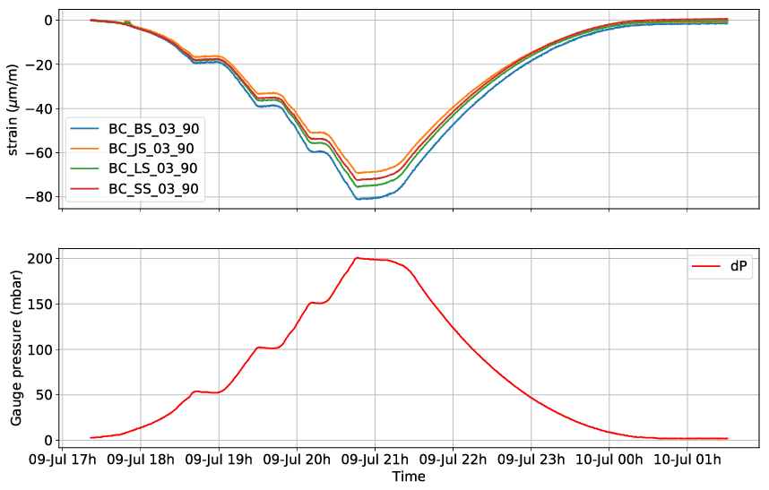
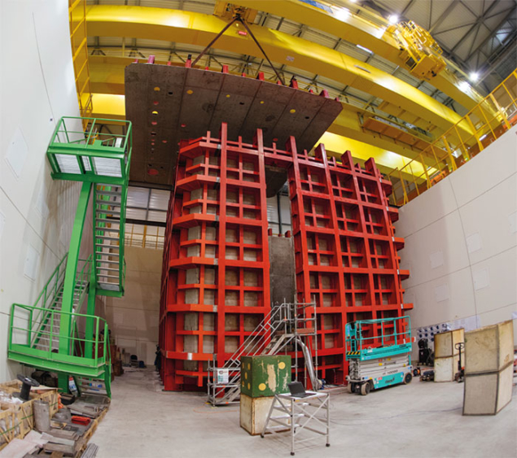
NP02 and NP04 proto-DUNE membrane Cryostat principle
In filled cryostat: no condensation on the outside
Measured heat load through cryostat surface 8 W/m²
No argon leak to insulation space

Slide 17
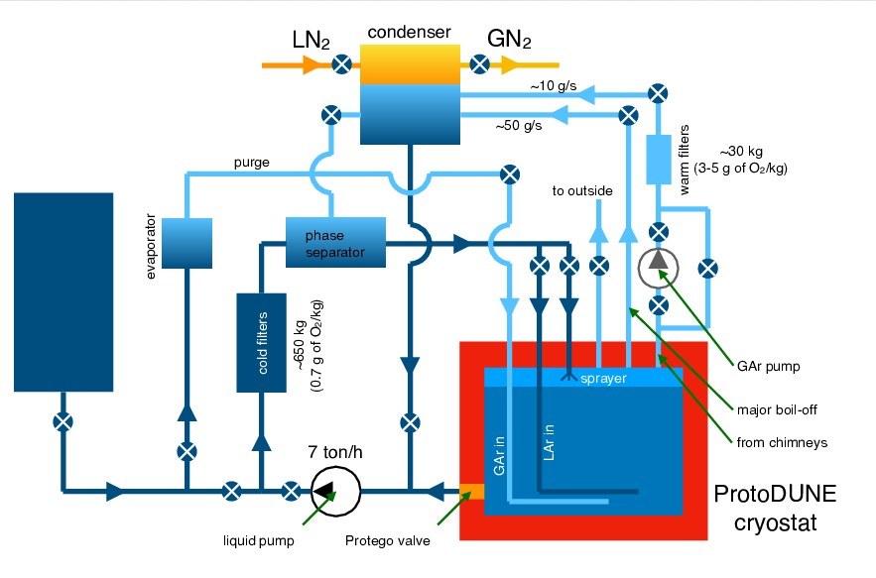
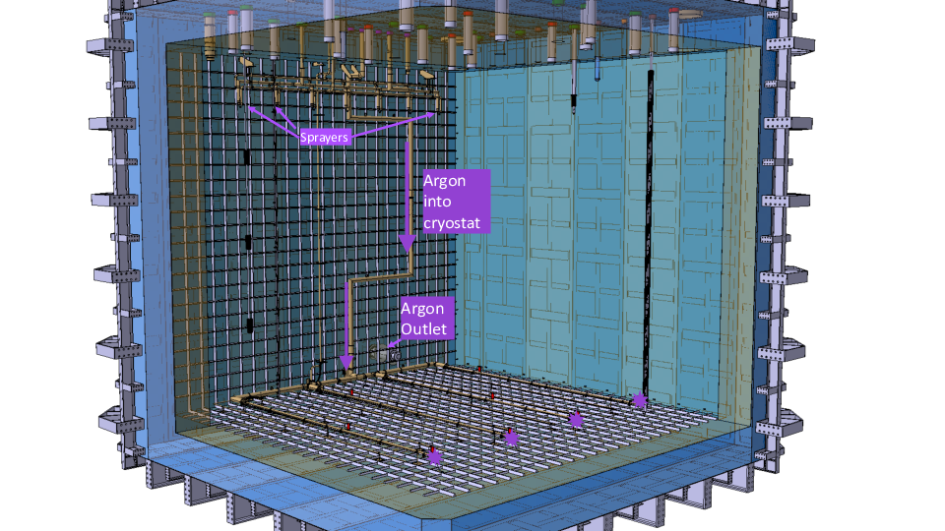
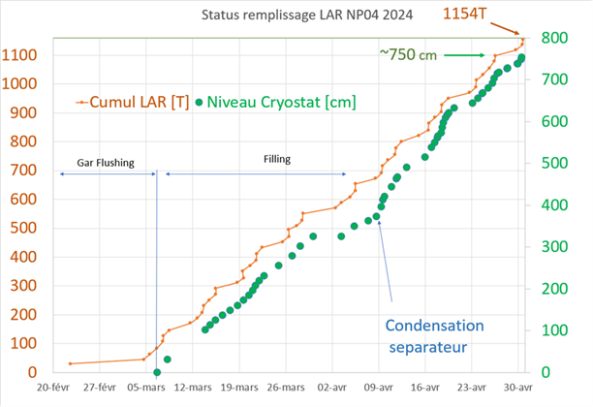

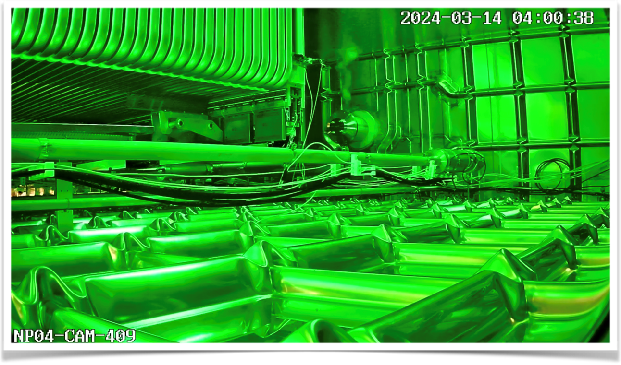
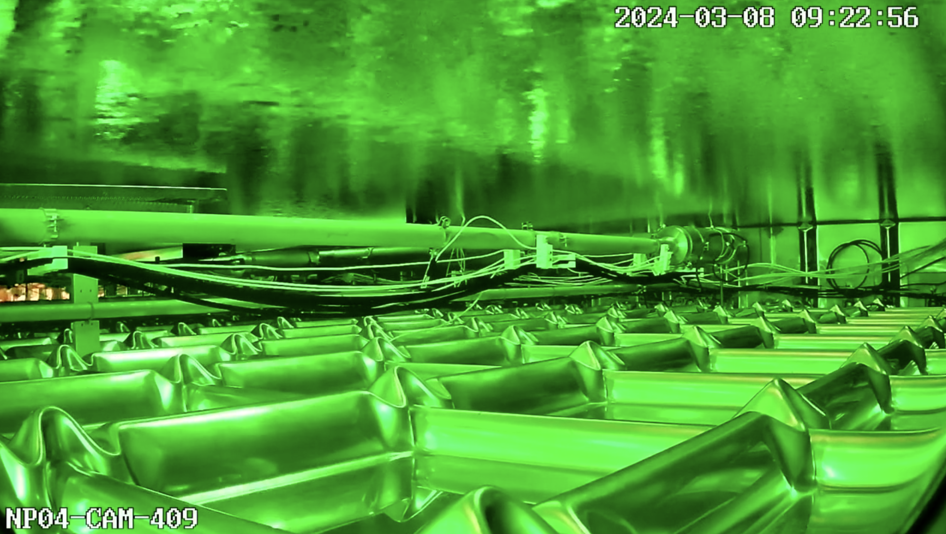
NP02 and NP04 proto-DUNE Cryogenic principle
Cooling principle:
Will be presented by Caroline
Before cooldown: no under-pressure possible: piston purge purification
During filling: liquid from bottom, pulverized liquid argon from top: diminish gradients and pollution
In operation warmer liquid returned to bottom and cooling at the top of cryostat: breaking the stratification
NP04 during filling

Slide 18
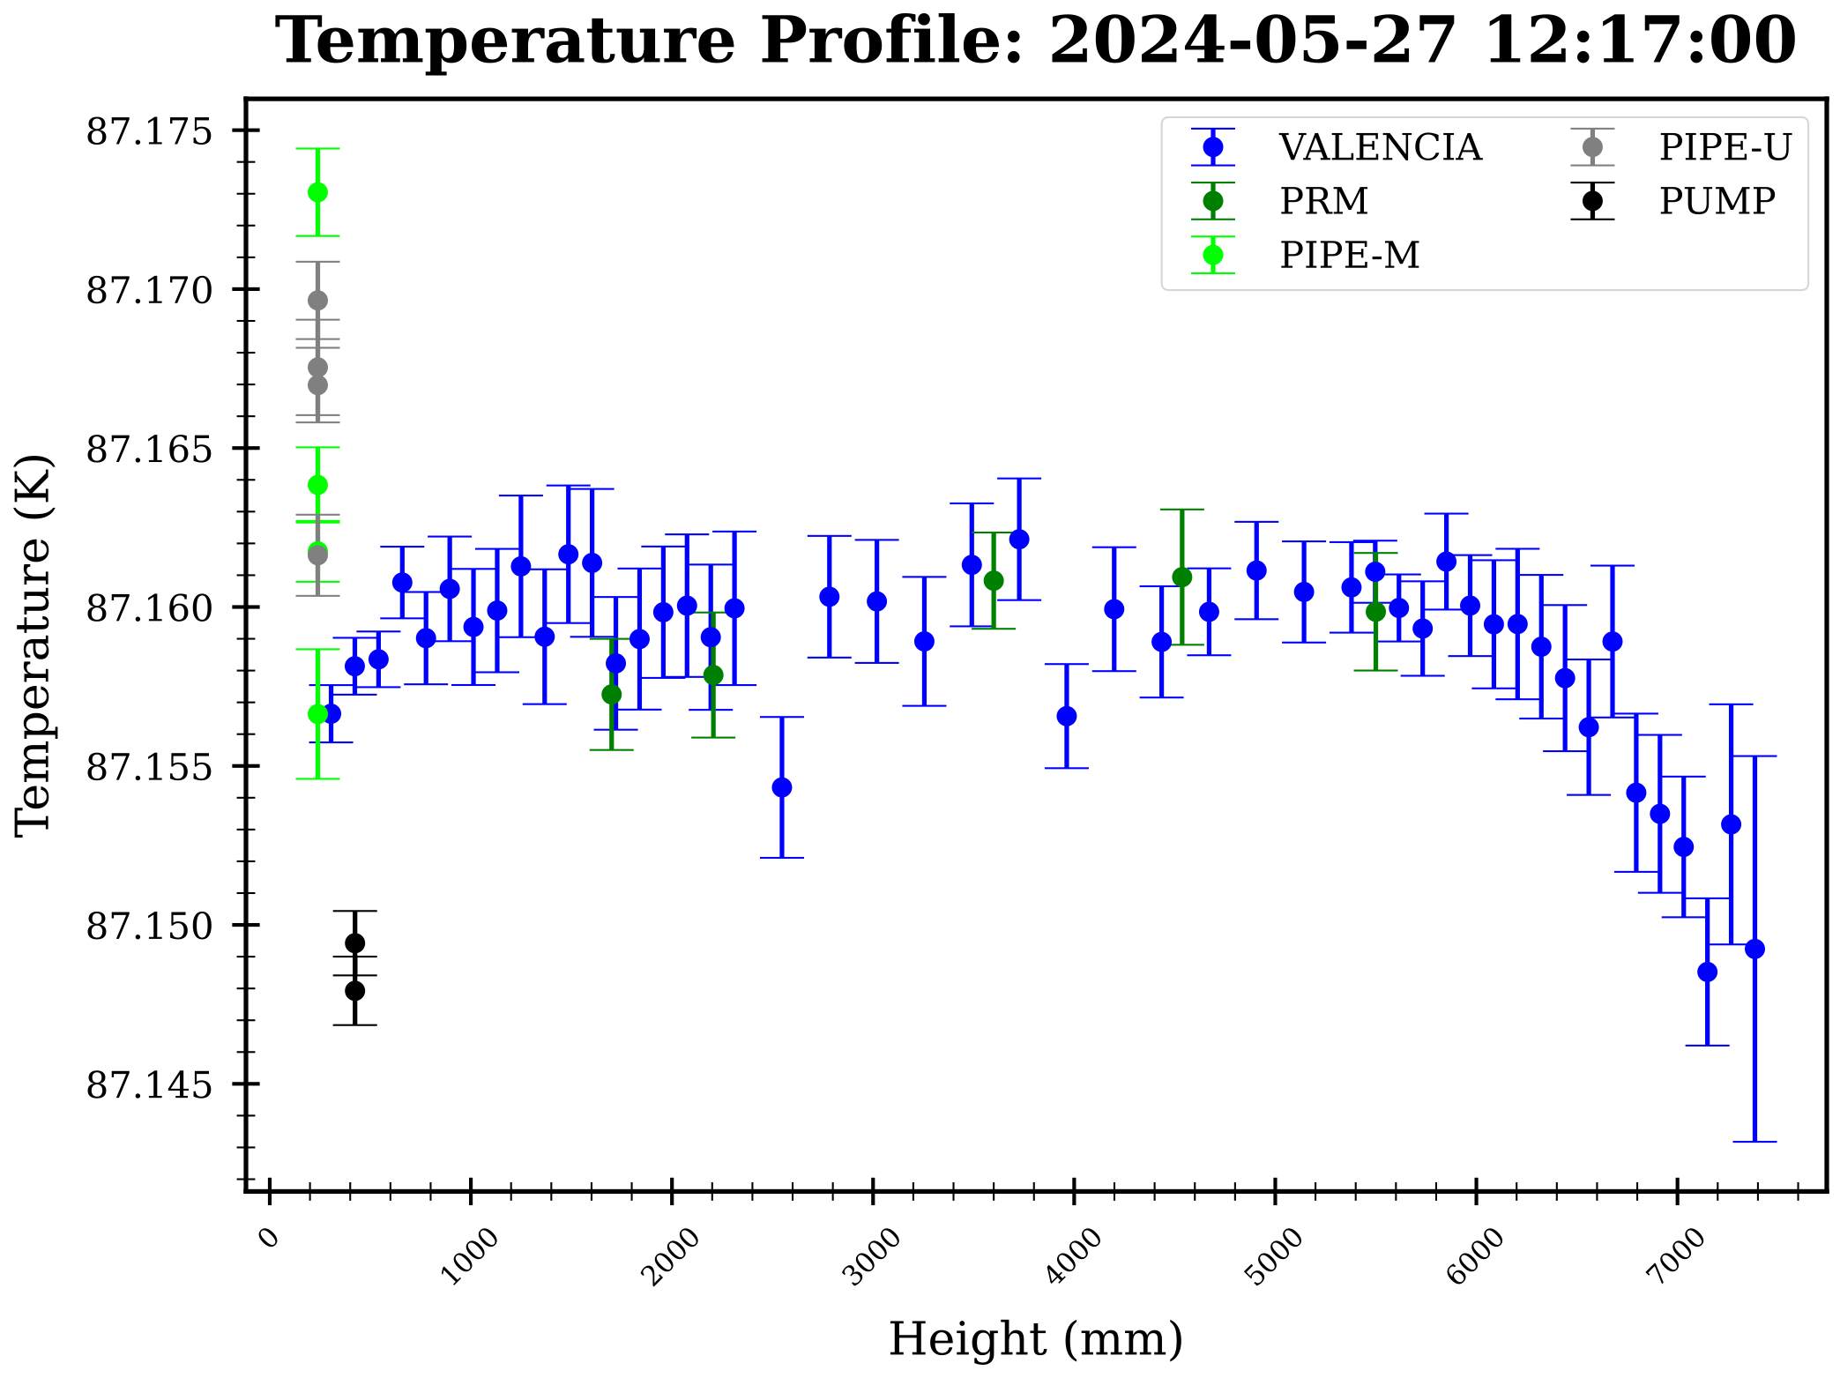
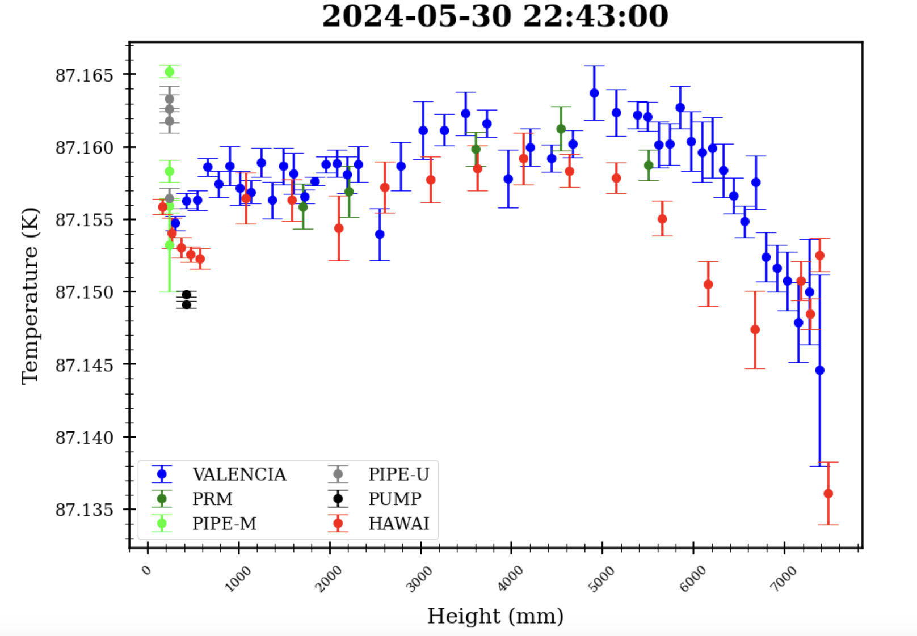
NP02 and NP04 proto-DUNE Cryogenic principle
Preliminary results NP04 temperature distribution / stability ongoing measurements

Slide 19
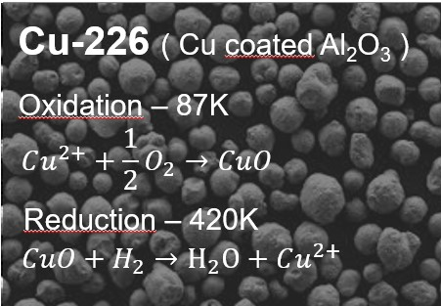
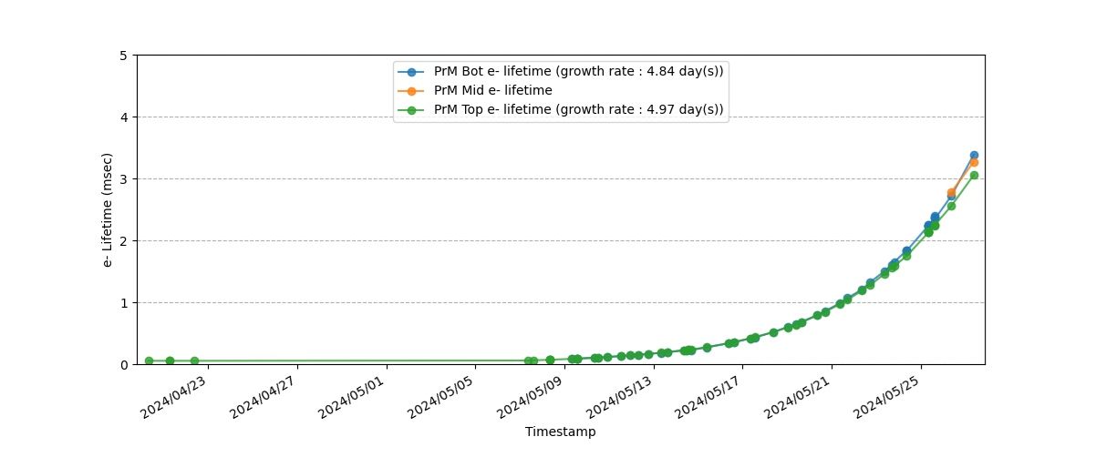
NP02 and NP04 proto-DUNE Purification principle
To arrive at a very low O₂ contamination level:
No surface materials which can include pollutions (air, Cl, F₂, H₂O) are used in detector construction
Vacuum purging of piping and piston purging of cryostat volume before cooldown. Outgassing of warm surfaces to be considered
Warm gas from feedthroughs passes warm and cold purifier system before being returned to the cryostat
Liquid argon is continuously (2kg/s) passing through cold purifier system
Purification principle:
Will be presented by Caroline

Slide 20
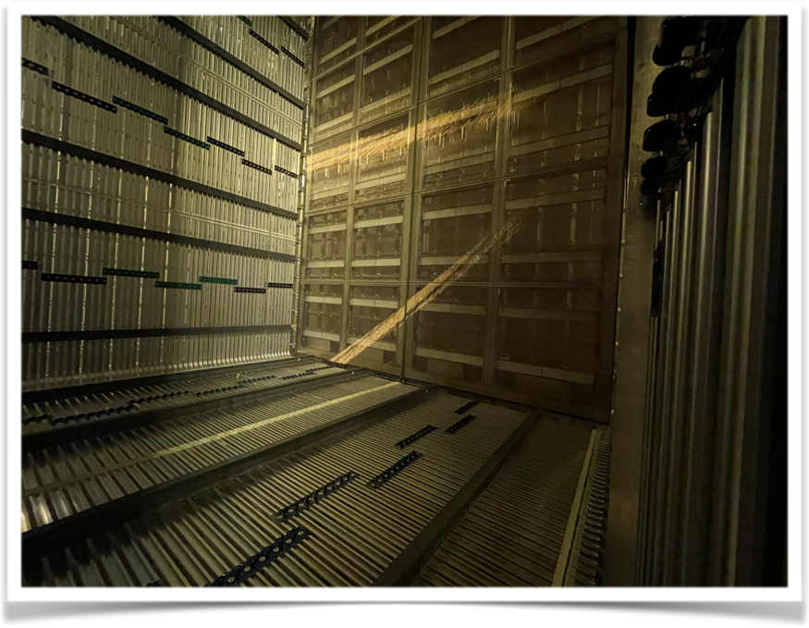

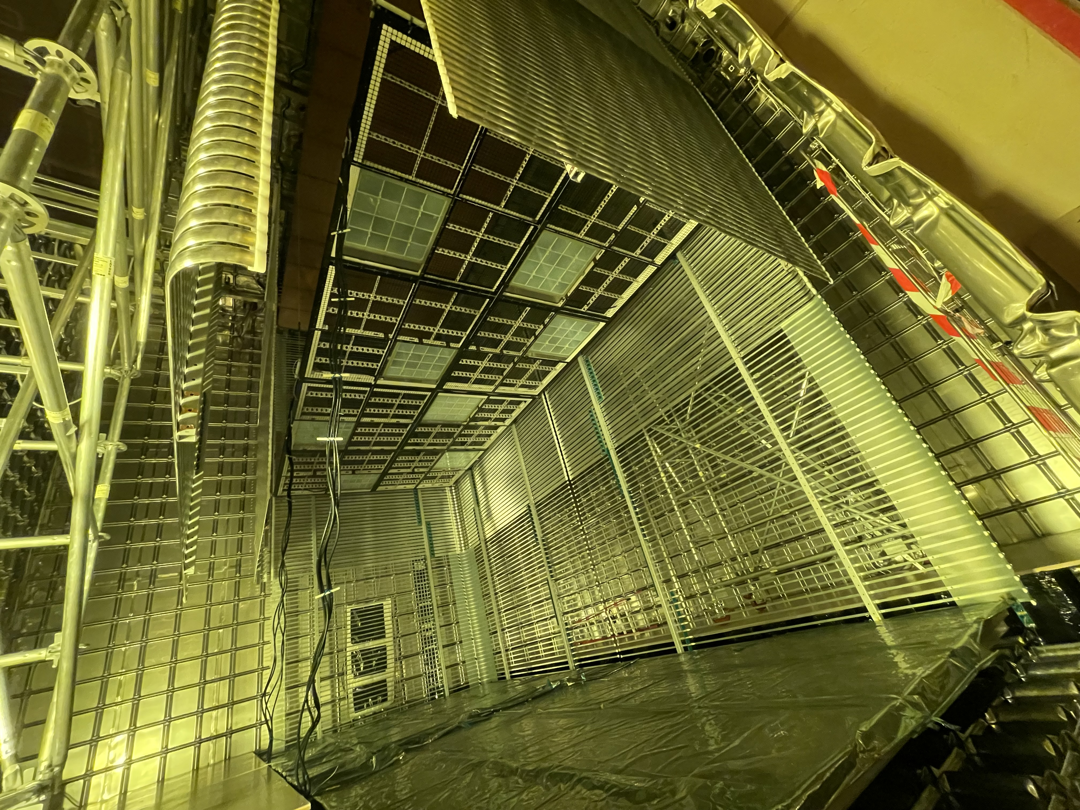
NP02 and NP04 proto-DUNE Detector principles
Horizontal Drift (in NP04)
- APA: three sets of wires winded around a SS frame
- Electronics in LAr including digitisation
- Drift of 3.5 m, CPA at -175 kV nominal voltage
- PDS embedded in the APA frames
- In cold test now, beam end of June
Vertical Drift (in NP02)
- CRP: perforated PCBs stuck with electrodes segmented
- Top CRPs readout with accessible electronics
- Bottom CRPs electronics in LAr including digitisation
- 6.5 m drift, -300 kV nominal
- PDS on the cryostat walls and on the cathode
- 2nd half 2024 transfer liquid NP04 to NP02 and start cold testing

Slide 21
Conclusions
The NP had been charged with the development of e.g. the cryostat and cryogenic systems for DUNE, with the building of the cryostat and cryogenics infrastructure for the Fermilab based Short Baseline, and a test area at CERN to verify the functionality of these systems and to use them as a test area for detection principles to be applied in DUNE
The SB at Fermilab installations are operational (FD for more than 4 years) well within the demanded cryogenic limits
The results of the proto-DUNE area show that the cryostat and the cryogenic systems are fulfilling their requirements
Cryostat and Cryogenic principles are sufficiently aged to be implemented at DUNE
(see presentation by Caroline)

Slide 22
