Slide 1

HiRadMat: a high power targetry facility at CERN
N. Charitonidis, A. Goillot, A. Ebn Rahmoun, P. Alexaki
10th November 2023 – HPTW2023

Slide 2

Beam Testing facilities at CERN
The CERN accelerator complex, layout in 2022. © CERN

Slide 3
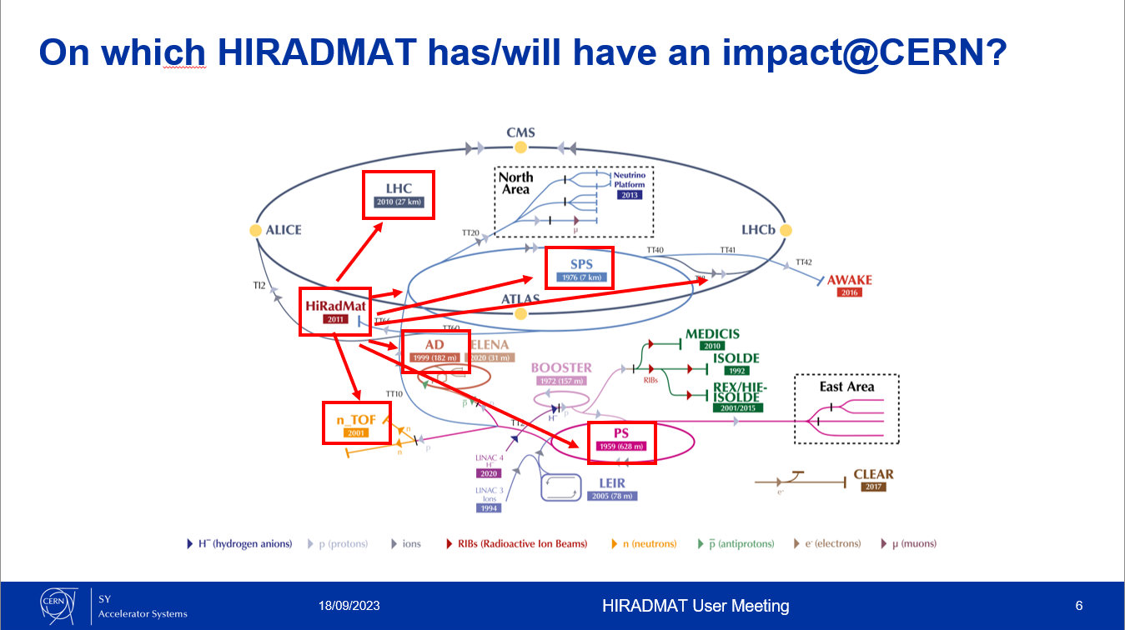
Courtesy of S. Gilardoni (SY-STI)

Slide 4
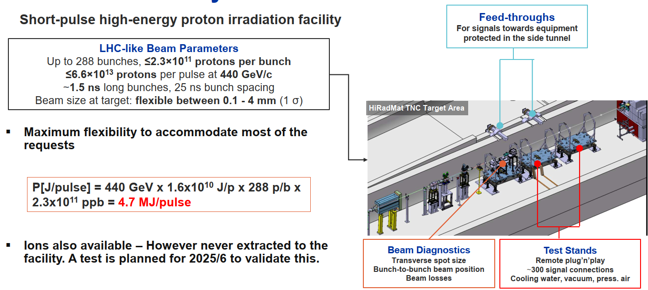
HiRadMat Facility

Slide 5
Operation schedule
HiRadMat commissioned
2021 - 2026
2011 - 2012
Operation
2013 - 2014
2015 - 2018
Long Shutdown 1
Operation
2019 - 2020
Long Shutdown 2
Long Shutdown 3
2027 - 2028
Experiments
18 Materials R&D
11 Accelerator component prototyping
6 Targetry R&D
9 Beam diagnostics
2 Particle detectors
3 Plasma Physics
60 publications
Future experiments
Beam diagnostic devices
Material for nuclear reactor
Superconducting material damage mechanisms
Muon collider (and other) windows
DPA theory research
Plasma physics for astrophysics phenomena
Also look for more

Slide 6
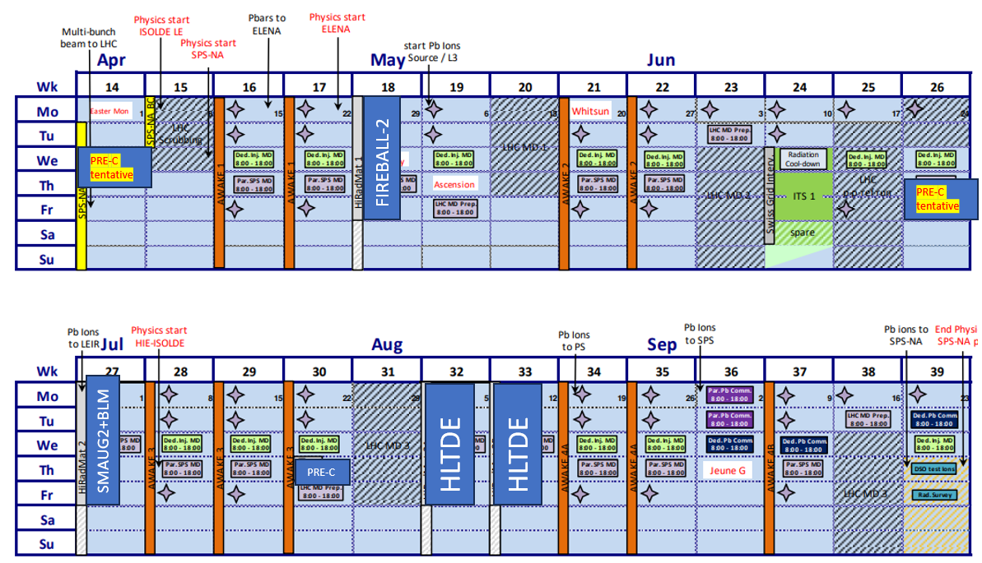
2024 summary

Slide 7
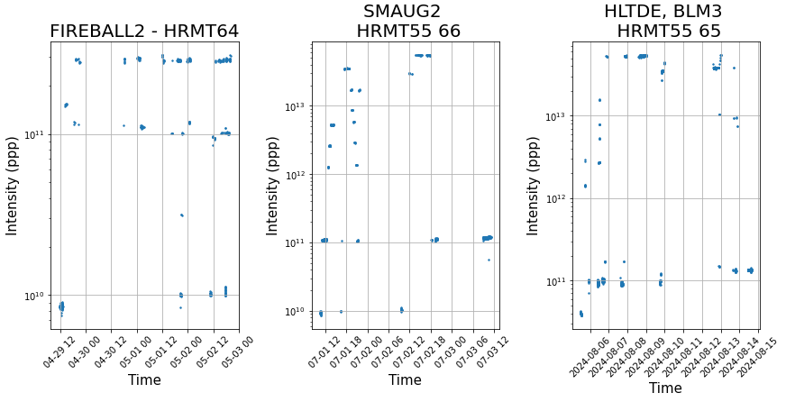
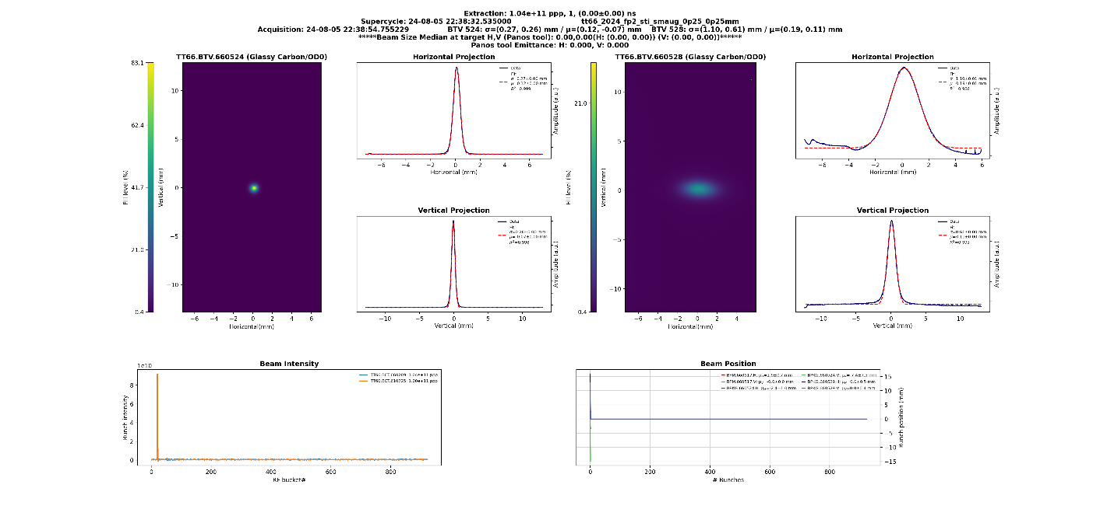
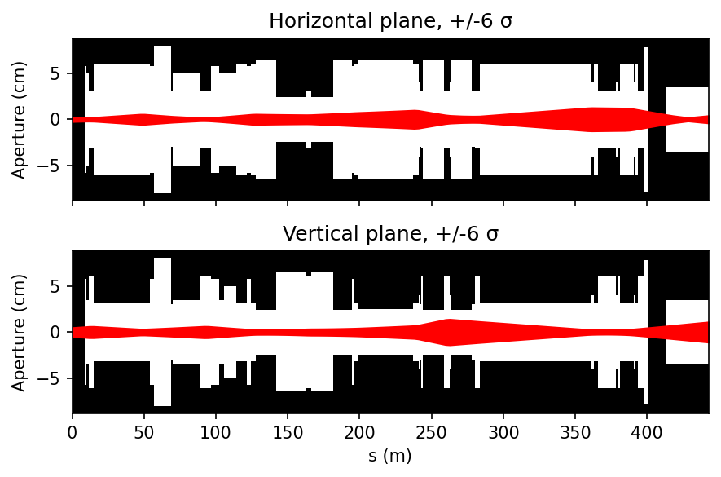
Overall run feedback
1500 extractions including
475 with 288 bunches
950 with 1 bunch
Precommissioning helped to be more efficient during data taking
New version of our vistar and logbook
Scripts for the experiment controls and data taking
Beam size computing new tool the at the experiment live (input: emittance in SPS, dispersion estimation, beam shape, size at BTV)

Slide 8
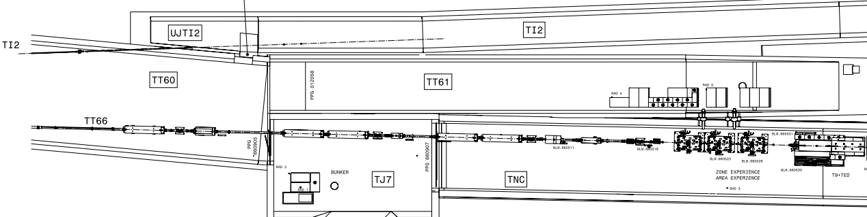
23/24 (last) YETS upgrade
Please see last year presentation for details (https://indico.cern.ch/event/1321764/)
Dump upgrade [SY-STI]
Downstream experiment OTR BTV [SY-BI, BE-EA]
Partition of TT66 Vacuum Sector [TE-VSC]
Vacuum upgrade [TE-VSC & BE-CEM]
Dump did not reach critical temperature
None of the windows (dump, BTV, beam line) failed
Implementation (mechanical and controls) was a success
BTV study ongoing, will likely change the tank material
4. Vacuum modifications
TT61 – shielded area
Tunnel infrastructures
1. Dump modifications
Injection from SPS
TJ7 bunker
3. Partition of the beam line
TNC – Irradiation area
2. BTV, optical line and camera installation

Slide 9
HiRadMat Outlook for 2025+
▪ 4 [+1 tentative] experiments being planned for 2025
HRMT-63 DPA
  Measurement of displacement cross-sections
HRMT-68 Fireball-III
  Follow-up of measured instability with further improved setup
Radiate-II
  Test of various materials for future target systems
SCcoils-II
  Study of damage limit in SC coils for HL-LHG magnets
BLM-IV
  Test and validate multiple types and production runs of Beam Loss Monitors (BLMs)
ENLARGE THE POSSIBILITIES
Ions beams
Lower momentum (<440 GeV)
Improve the softwares

Slide 10
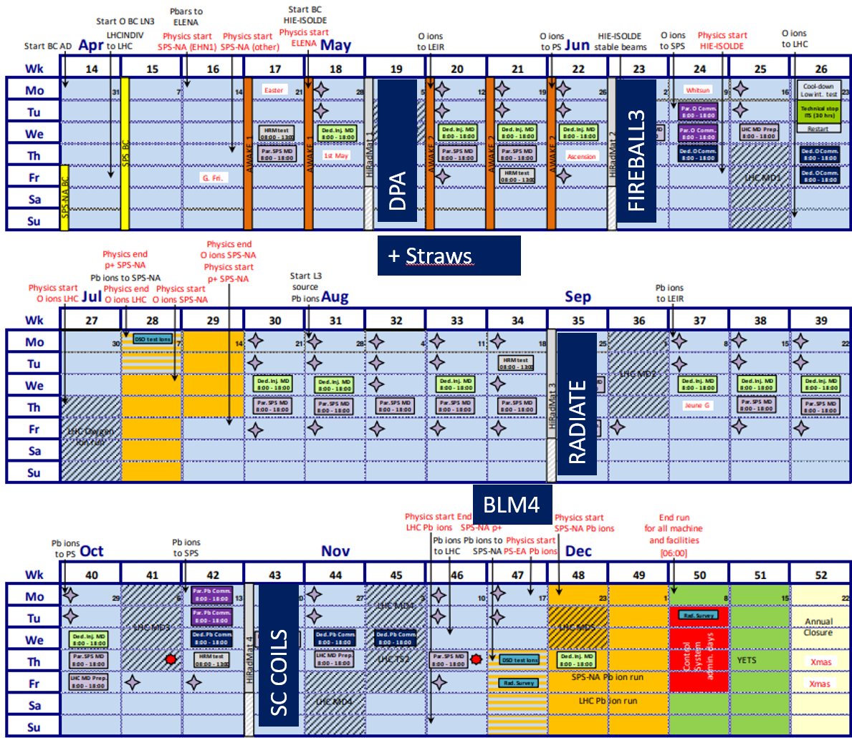
2025 schedule

Slide 11
A big thank you to the members of the working group and also everyone else along the ATS sector for their dedication and help in the operation of HiRadMat facility since 2011!
SY-STI
EN-MME
SY-BI
BE-ASR
TE-MPE
BE-GM
BE-CEM
HSE-RP
SY-ABT
BE-OP
EN-HE
BE-EA

Slide 13

This project has received funding from the European Union’s Horizon Europe Research and Innovation programme under Grant Agreement No 101057511.

Slide 14
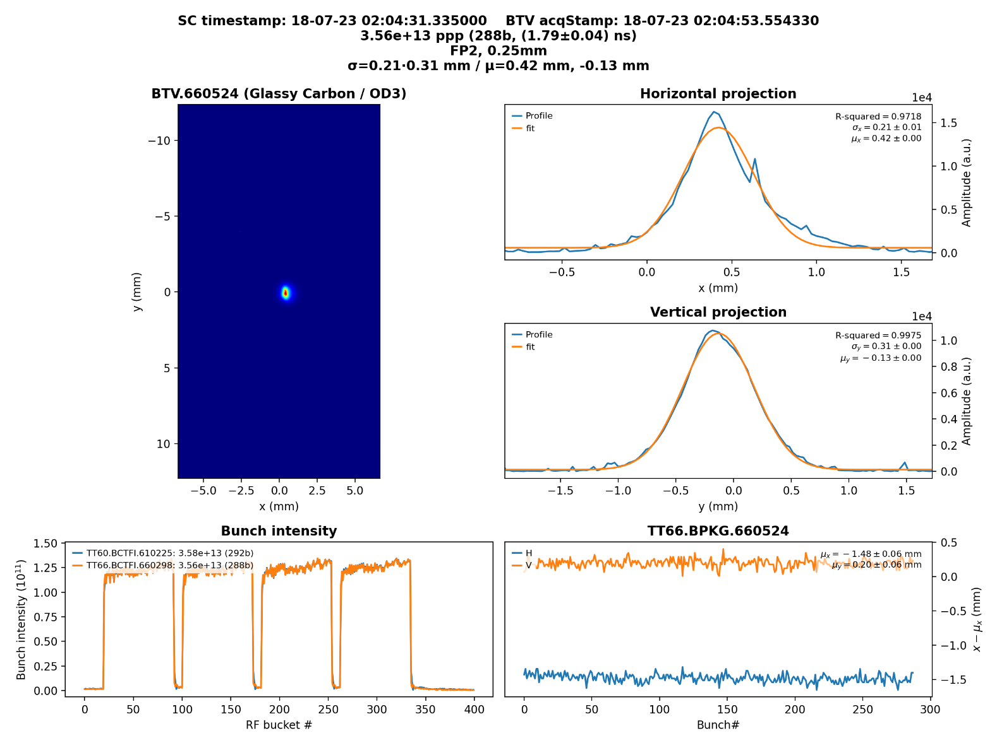
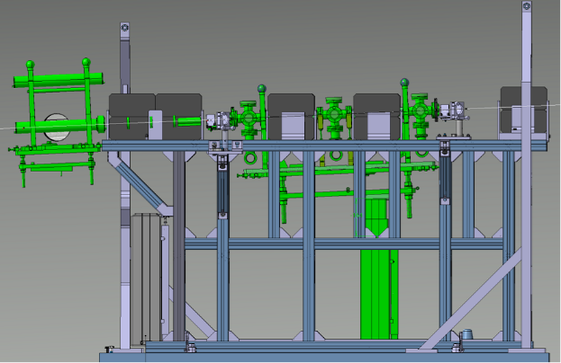
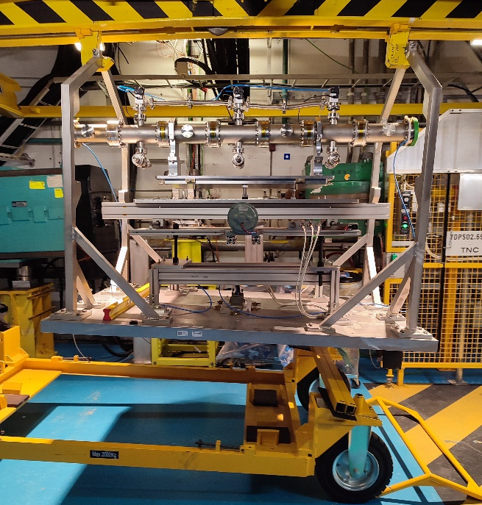
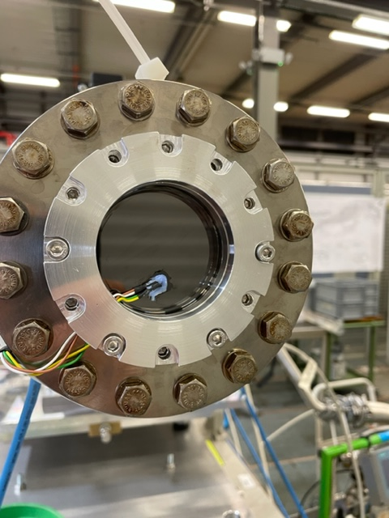
Expertise provided to users
Experiment preparation
3D integration & mechanical studies
Installation & survey
Transport and handling
On-line diagnostic equipment and expertise
Sensors, Cameras & LED
Movable stages (H&V)
Remote control of the equipment
Beam diagnostics
Beam parameters
Automatic parameter display
Auto-logging in CERN infrastructure

Slide 15
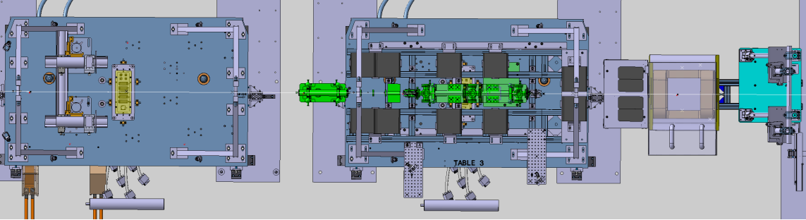
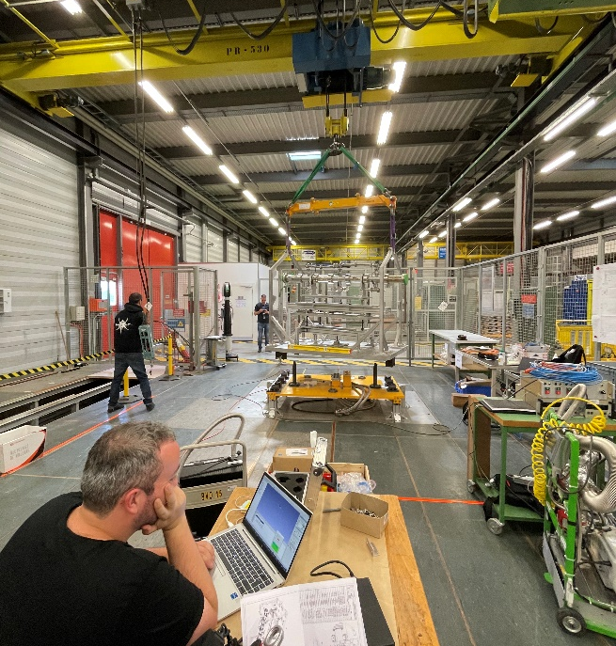
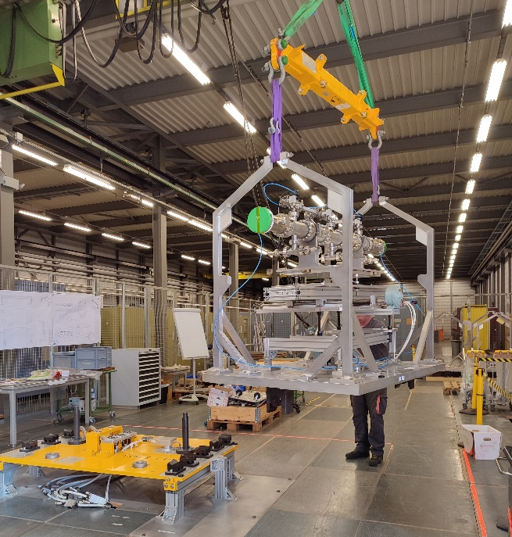
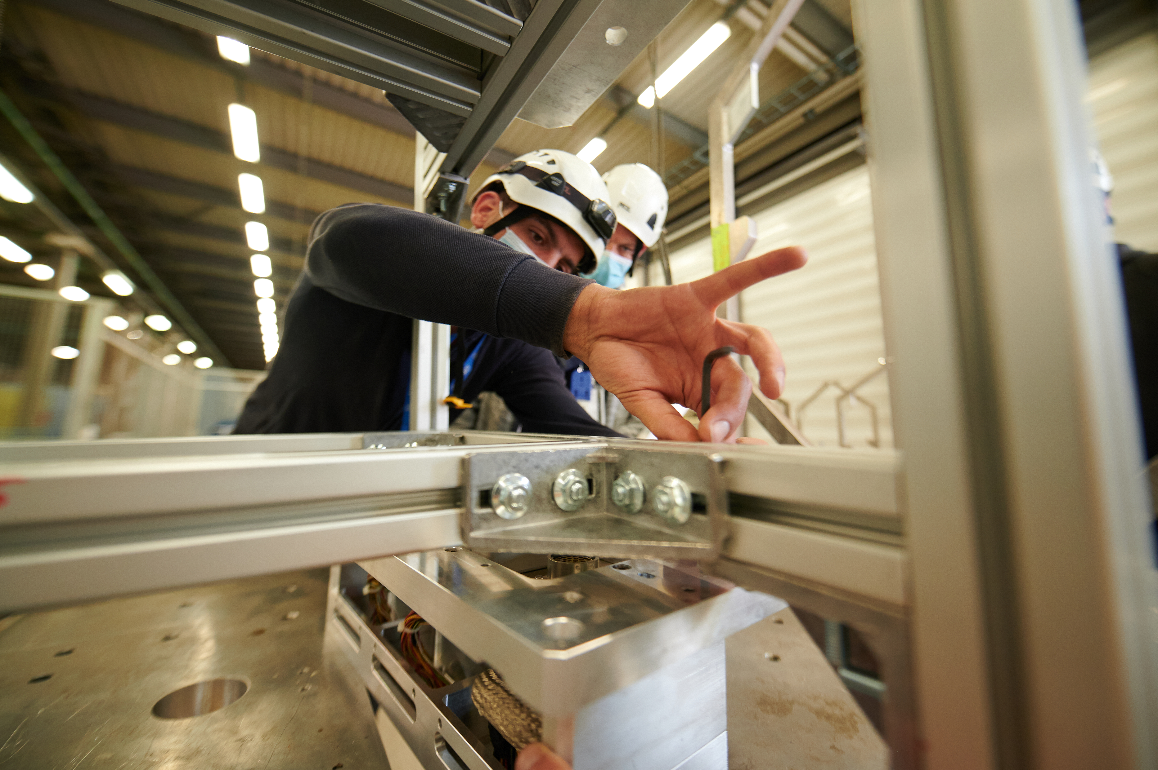
Experiment preparation
Integration in 3D layout
Mechanical evaluation
Survey (alignment precision < 1 mm)
Handling and transport
Disassembling
Assembly
Installation
Notes:
Split and less crowed and same bullet size

Slide 16
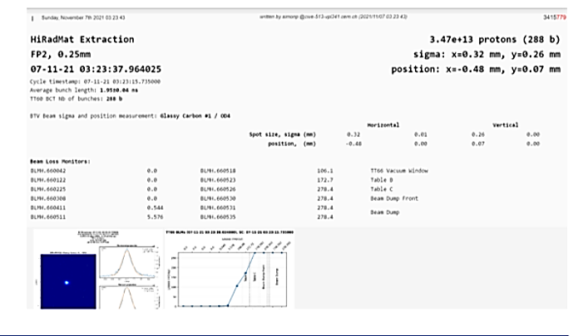
Beam diagnostics
HiRadMat vistar
Beam TeleVision
Beam Current Transformer
Beam Position Monitor
Bean Loss Monitor
Vistar and logging automatisation for each shot
HiRadMat auto e-logbook

Slide 17
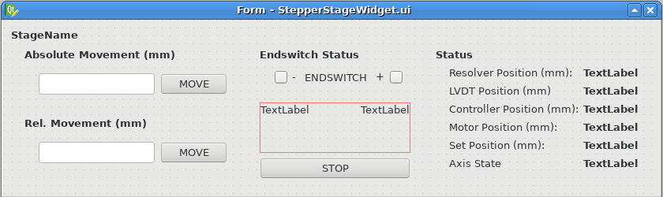
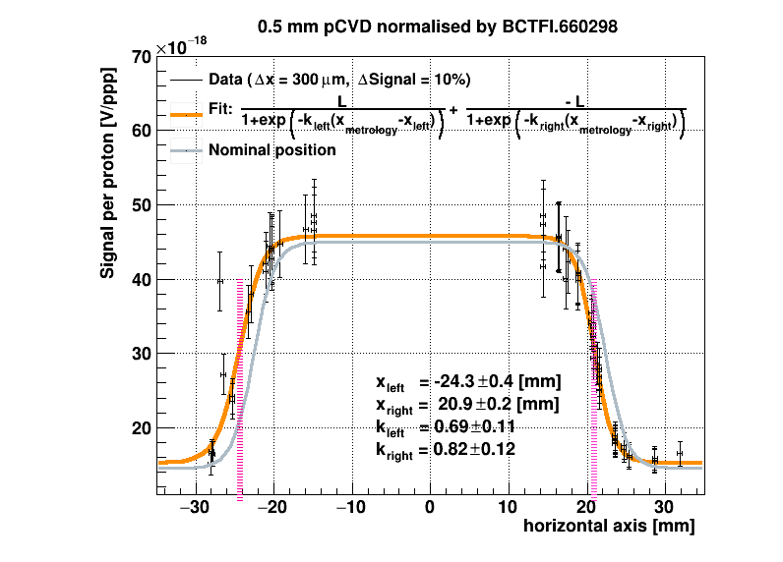
Flexible software for users
Interface for motor stage control:
  DC stage
  Step-motor stage
Beam based alignment automatisation
Data acquisitions (temperature, cameras, pressure…)

