Slide 1
Processing and mechanical characterization of materials for superconducting magnet impregnation
Jacob Bertsch
TE-MSC-SMT
Supervisor: Christian Scheuerlein
Technical Student
01.06.2023 – 31.05.2024

Slide 2
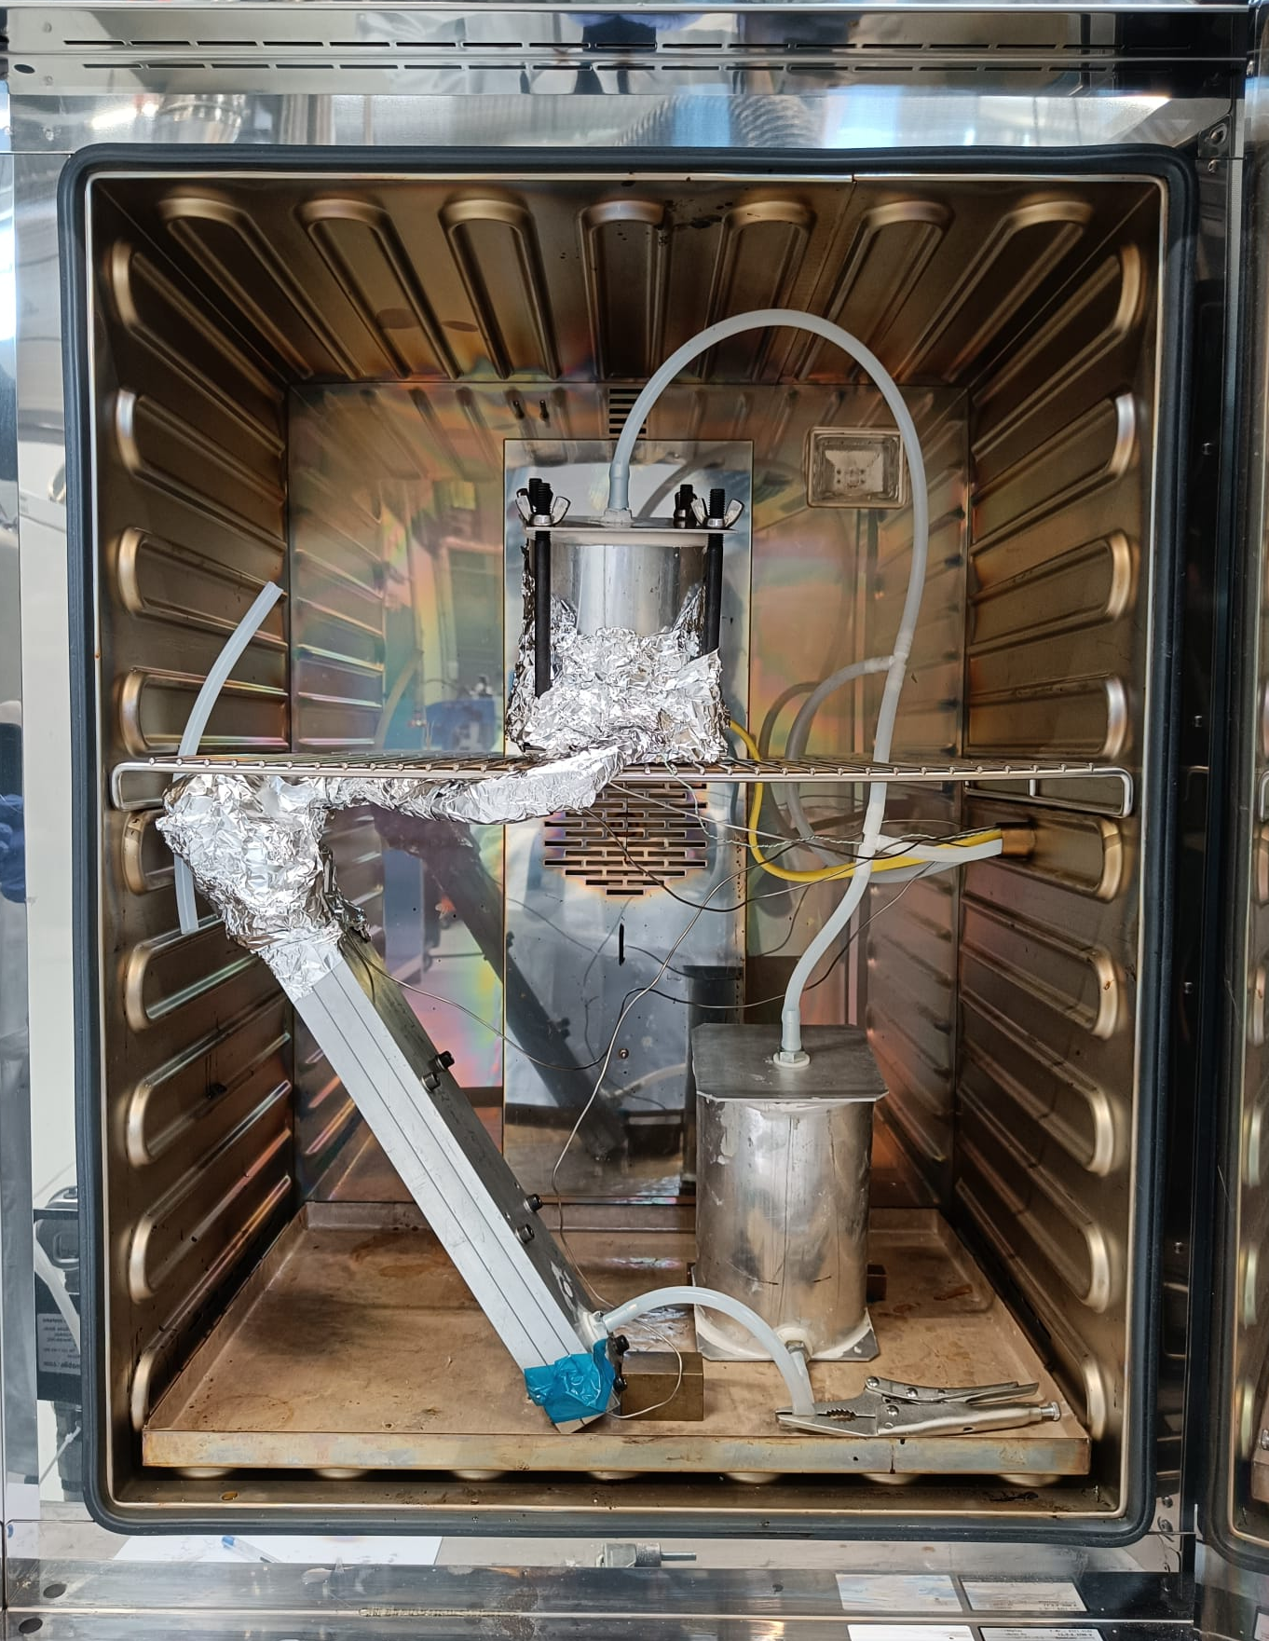
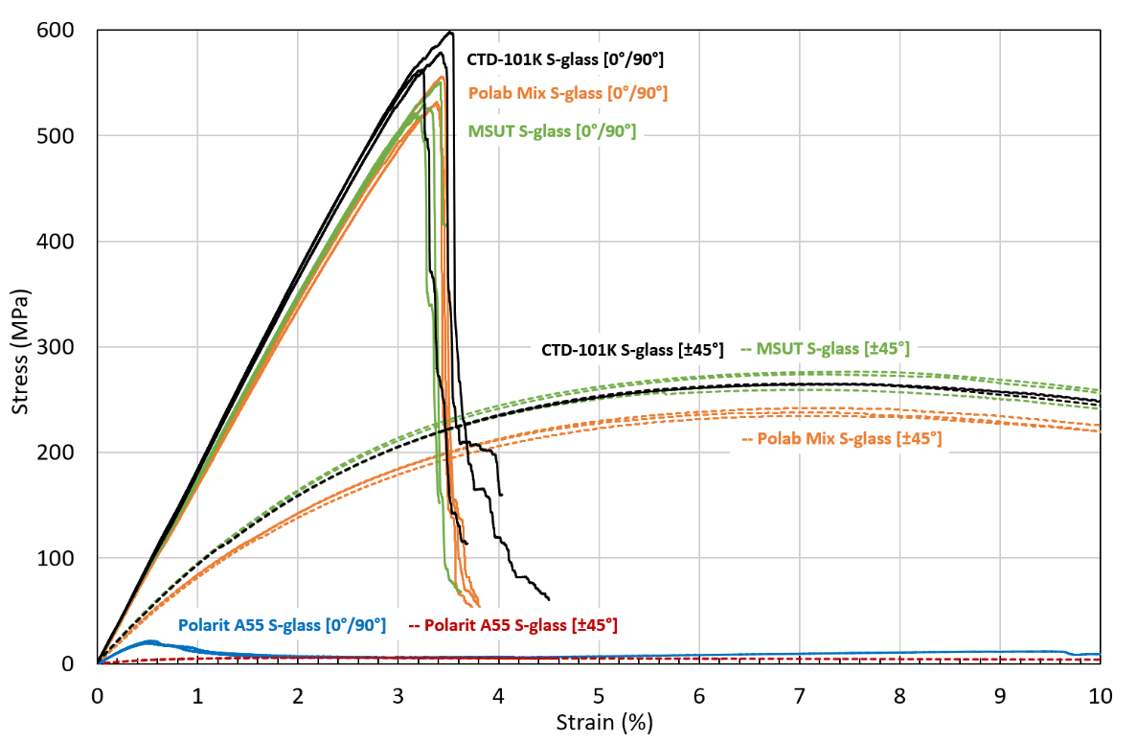
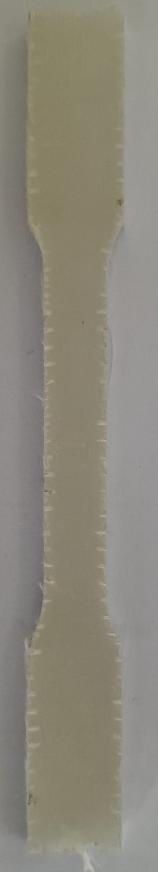
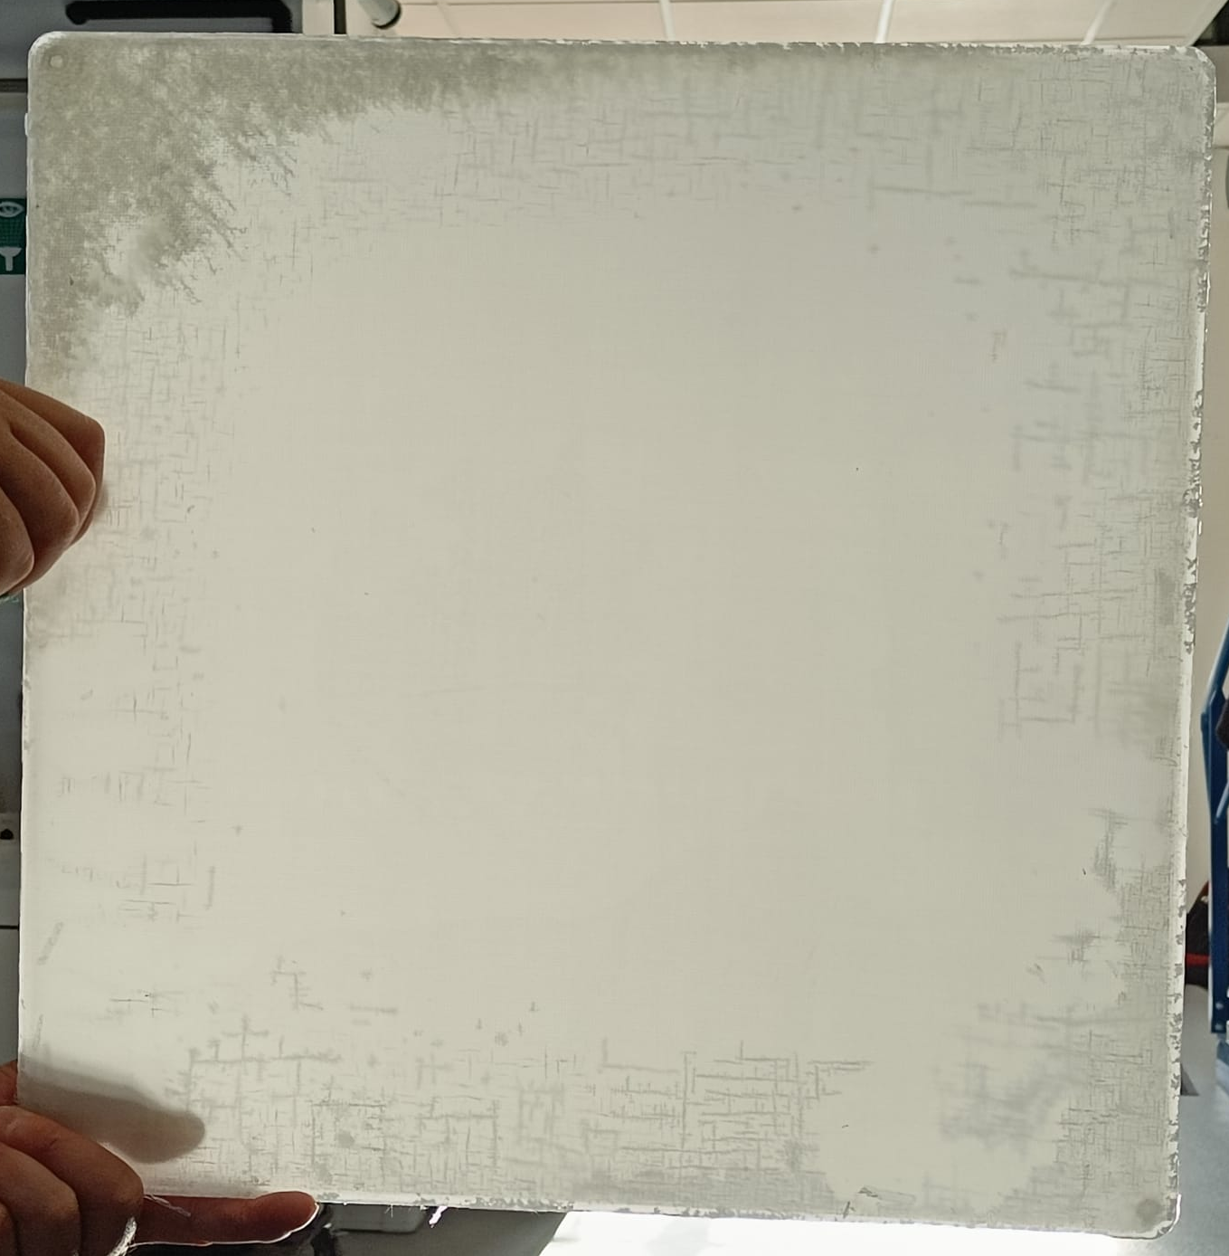
Mechanical testing of fibre reinforced wax and epoxy resins
Development of a vacuum impregnation process using wax
Manufacturing of pure and fibre reinforced wax and epoxy resin samples
Tensile, compressive, flexural, and impact testing at RT and 77K
Heater
Vacuum pump
Flexural stress-strain curves of fibre reinforced epoxy and wax:
Mould
Wax
S-glass reinforced wax plate
water-jet cut sample

Slide 3
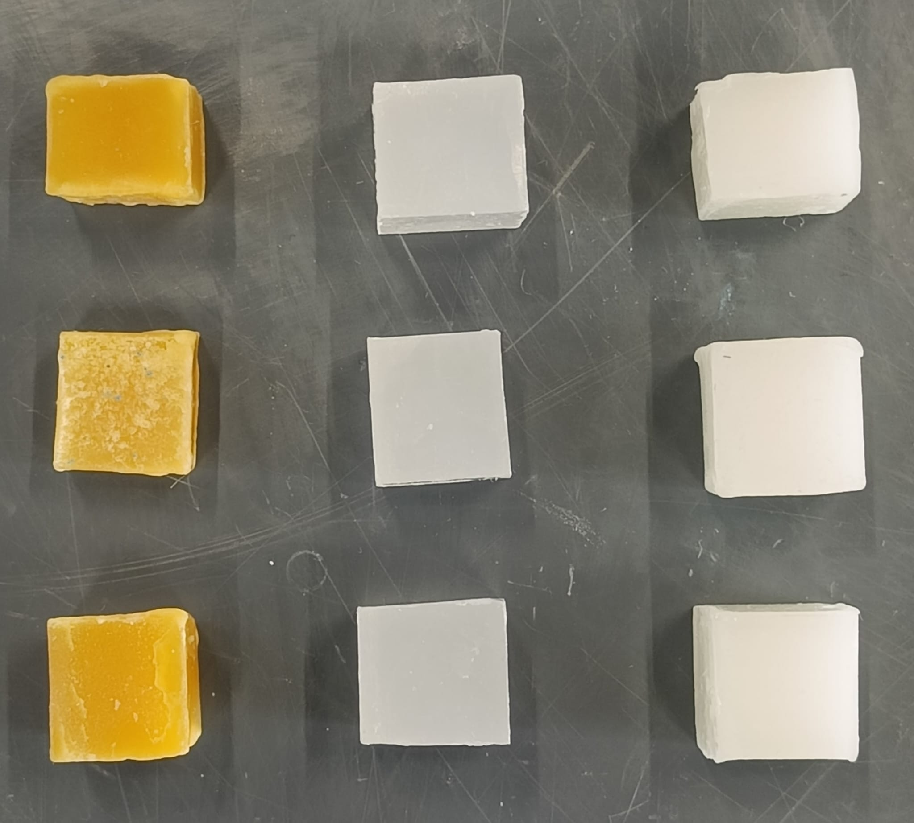
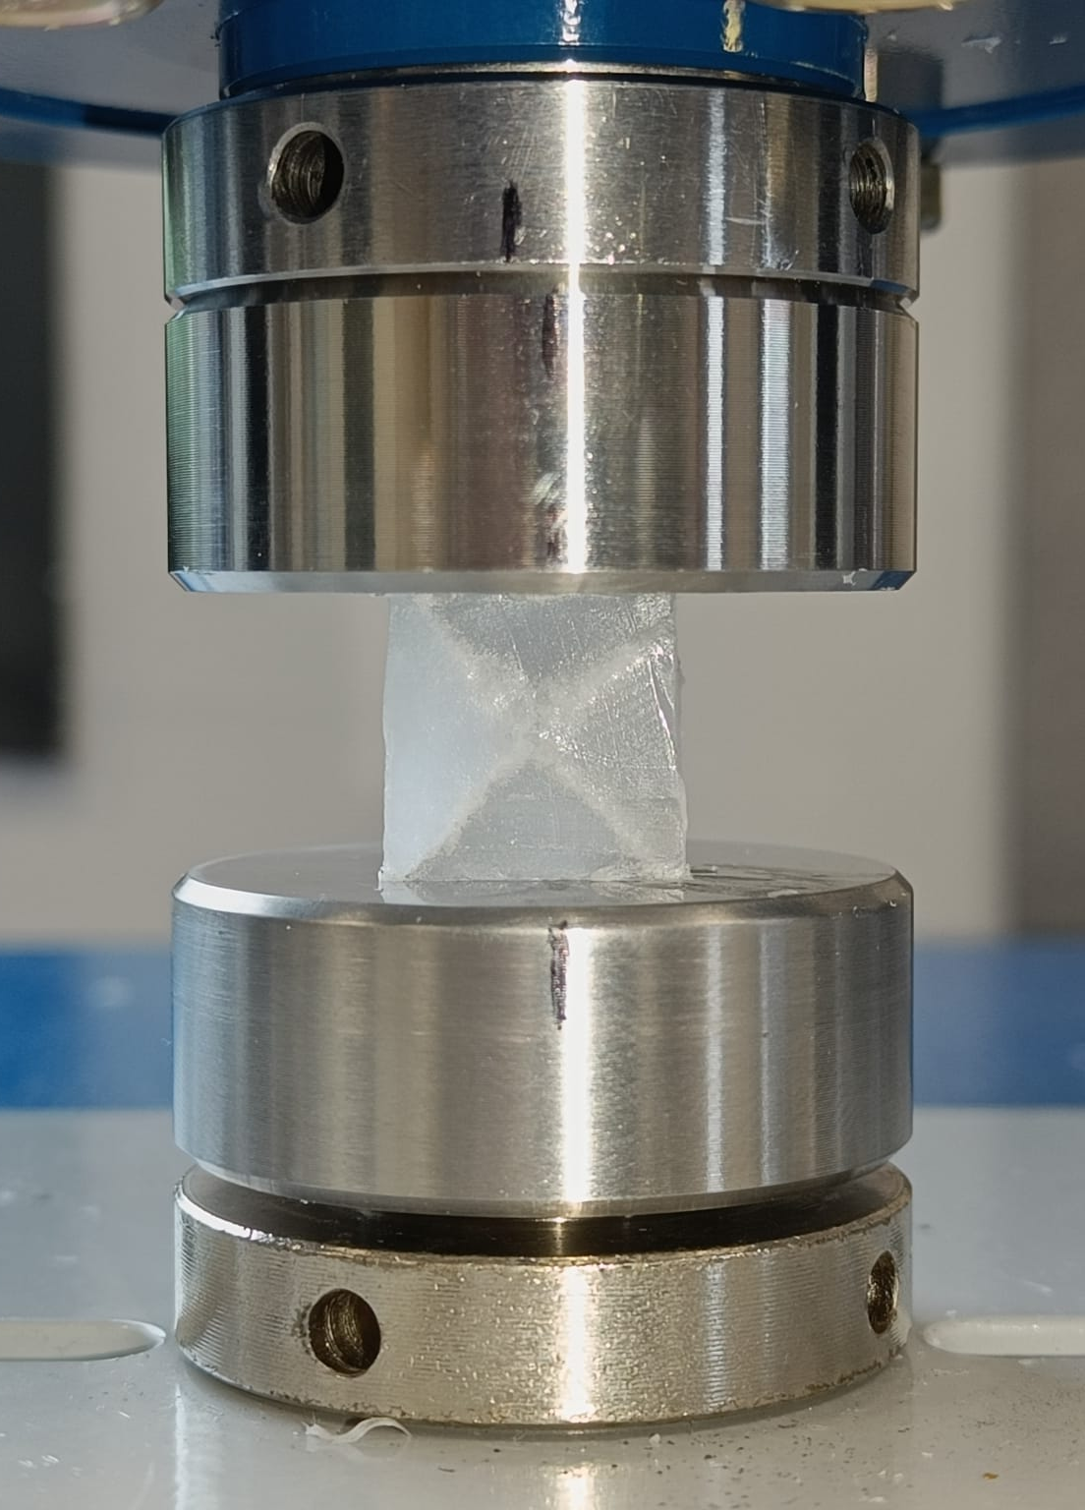
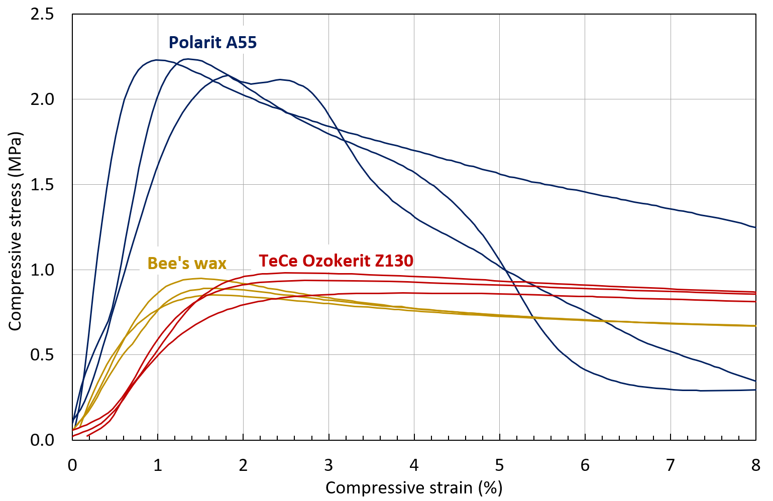
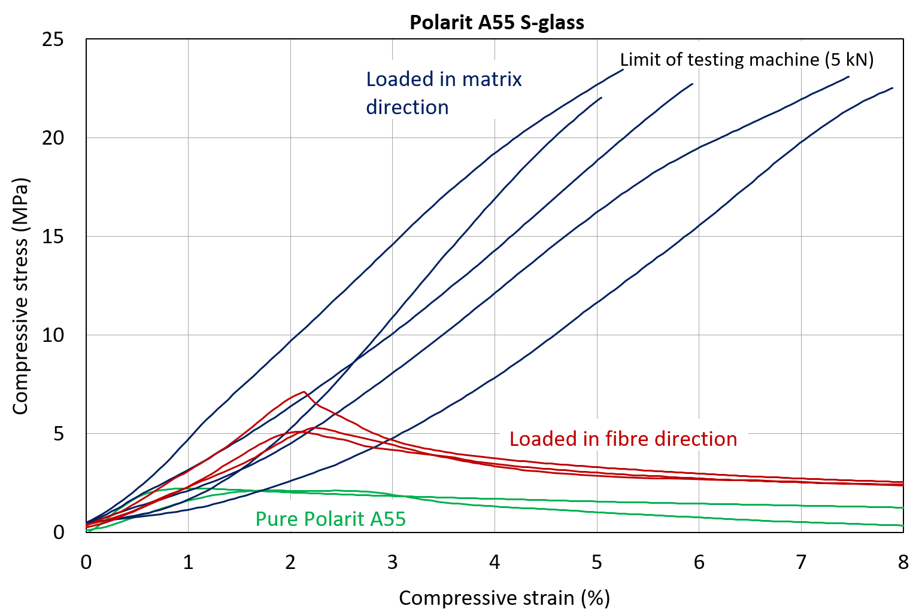
Compressive testing of wax
Compression of rectangular cubes ~ 15x15x15 mm
3 pure waxes and 1 fibre reinforced wax
Strain calculated from machine position -> determination of modulus inaccurate
Samples loaded in fibre direction fail from due to delamination
Pure Polarit A55 shows shear failure
Pure Bee’s wax and Ozokerit Z130 wax fail due to yielding

Slide 4
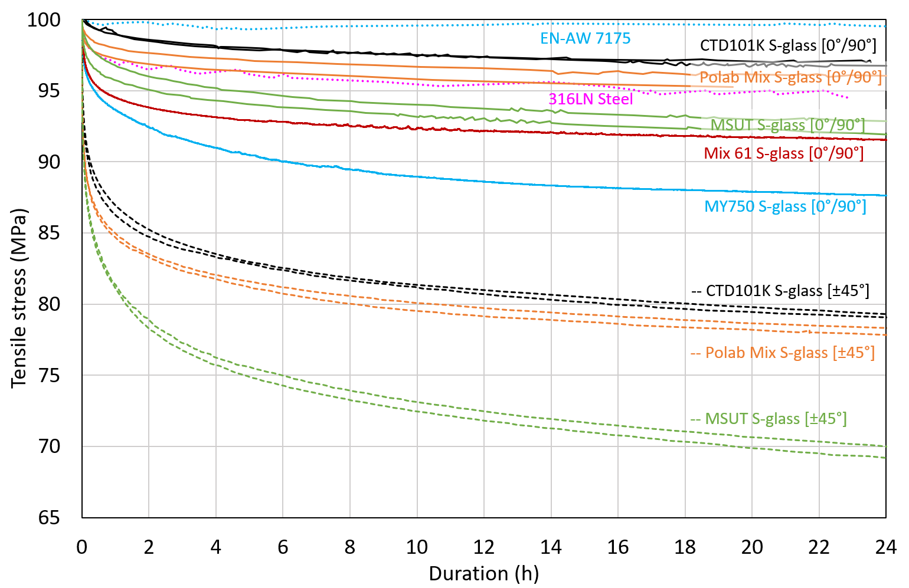
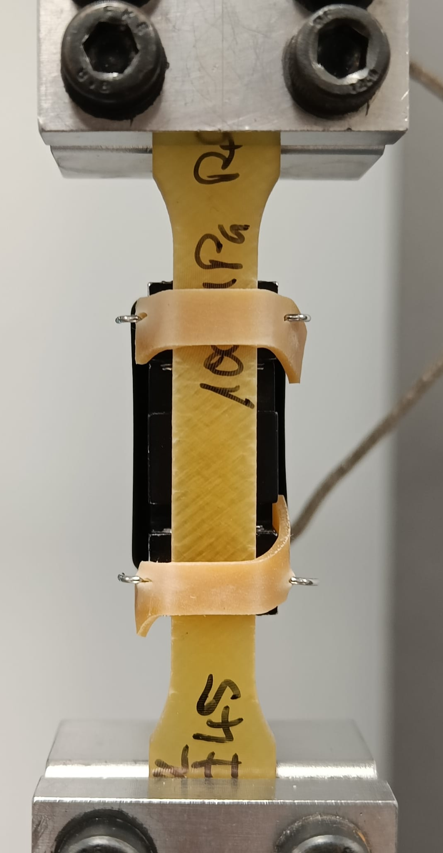
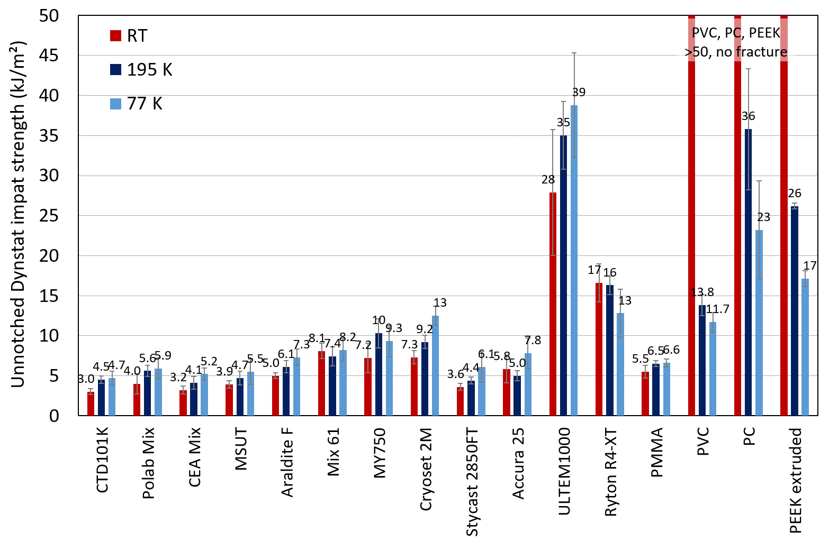
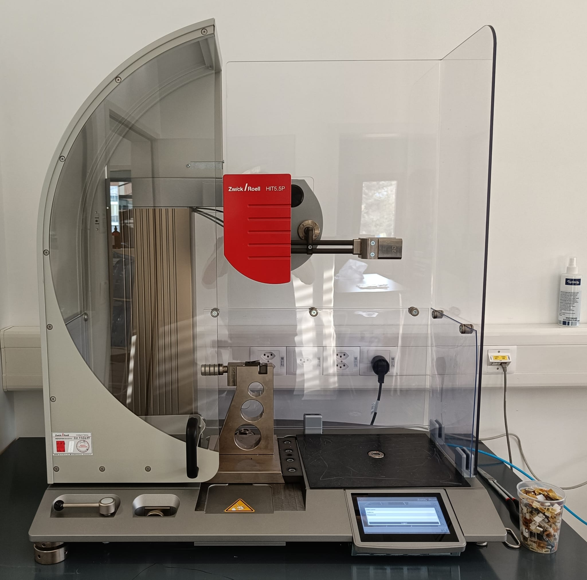
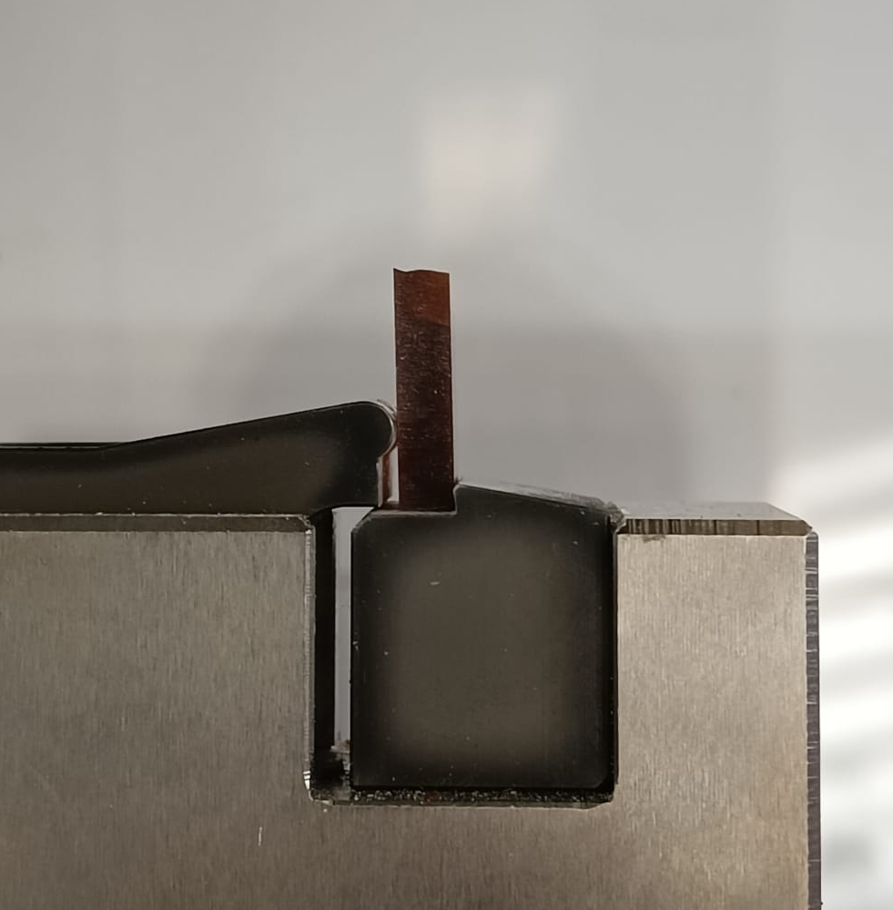
Stress relaxation and impact testing of polymers
Stress at constant strain as a function of time:
Applying 100 MPa uniaxial tensile stress, then holding sample strain constant
Even [0°/90°] fibre reinforced epoxy resins loaded in fibre direction lose pre-stress over time, the behaviour is affected by the matrix
Significantly more stress relaxation when samples are loaded 45° to fibre orientation
Impact strength at RT, 195K, and 77K:
Epoxy resins have comparatively low impact strength
Impact strength of most tested epoxy resins seems to increases with decreasing temperature?
Impact strength of most thermoplastics tested decreases with decreasing temperature
Epoxy resins

