Slide 1
1 graduate, 2 slides, 3 minutes
Studies of the chemistry, ageing and adhesion properties of polymers
27.05.2024
Vincent SCHENK, TE-MSC-SMT-Polymer lab
Supervisor: Roland PICCIN
Start date: 01.12.2023
Experienced Project Graduate (Quest)

Slide 2

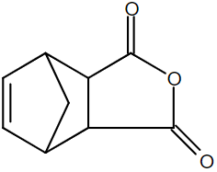
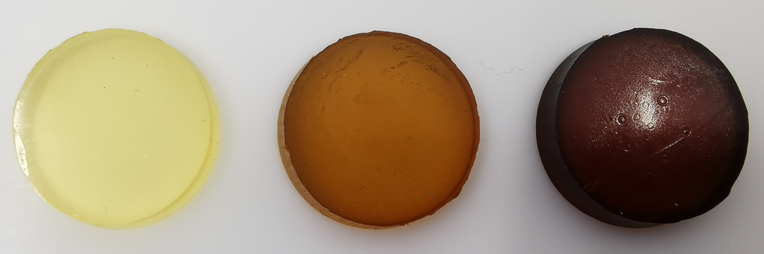
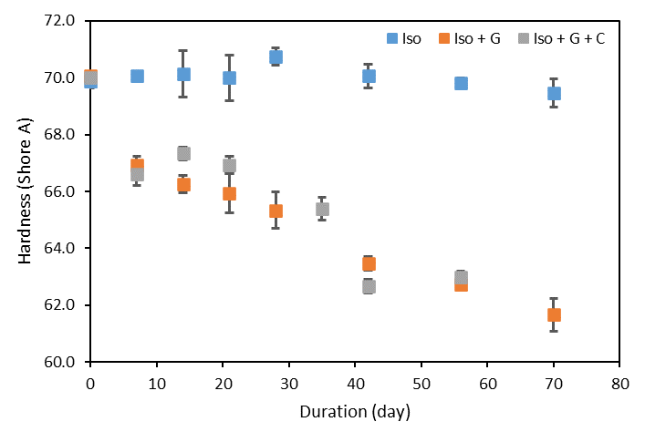
Experiences and current activities
Previous experiences:
2016 – 2018 – Master’s degree in mechanical and materials engineering
2018 – 2020 – Materials and processes engineer at Airbus Defence & Space
2020 – 2023 – PhD degree on polymer composites for Aeronautics
*1st of December 2023: PhD defense and 1st day at CERN
Projects at CERN:
Study of the polymer chemistry toward the final properties
+
?
Accelerated ageing of PU jacks used for magnet alignments, reproduce and understand the failures
Ageing
Ageing

Slide 3
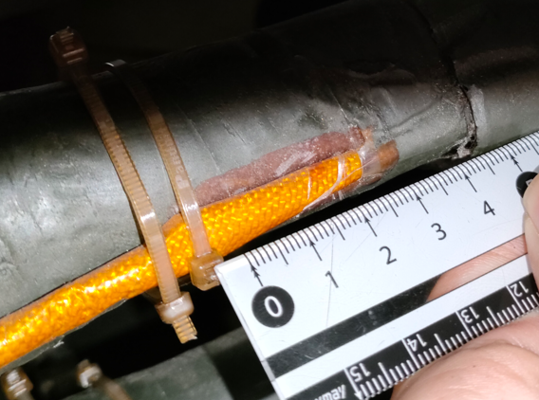
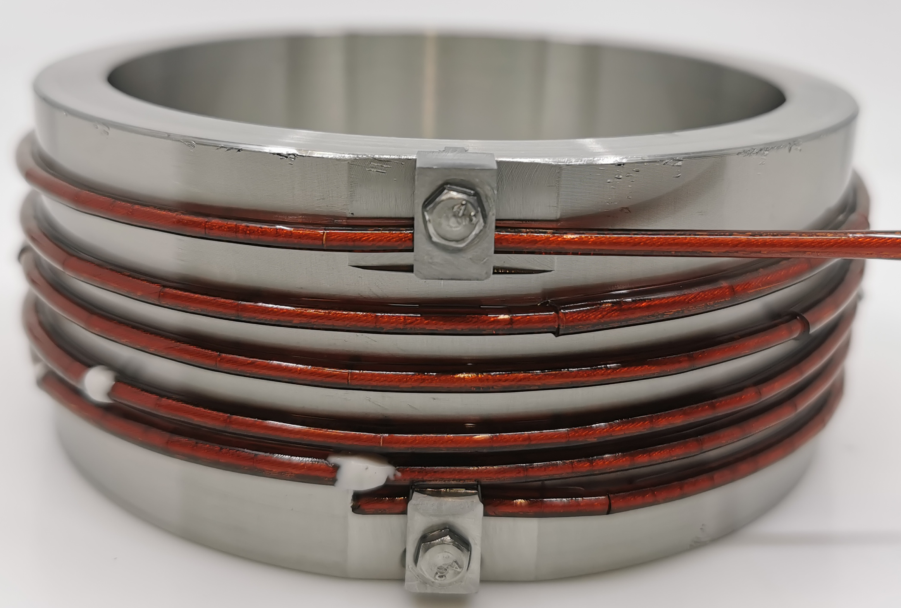
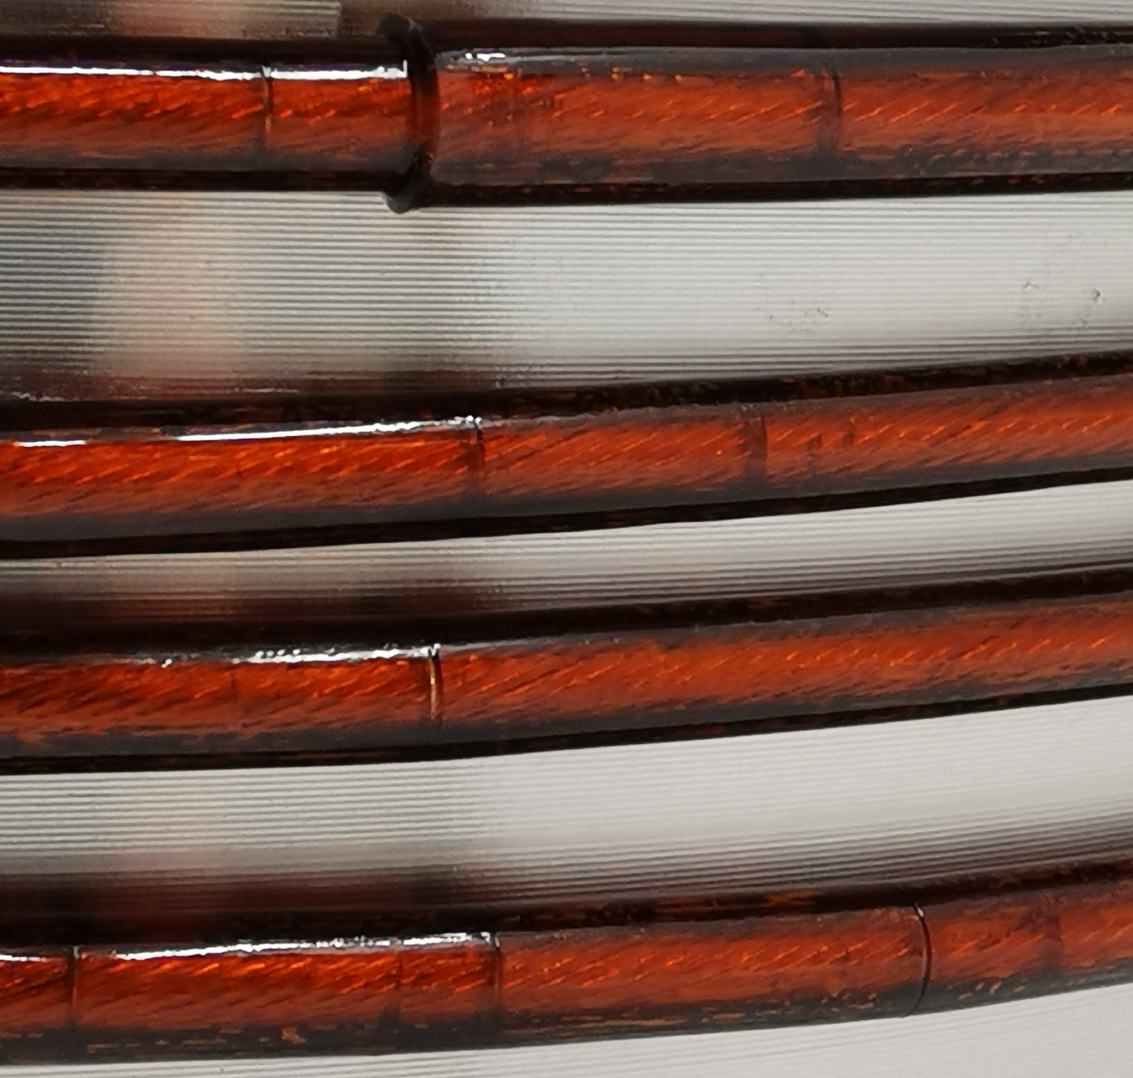
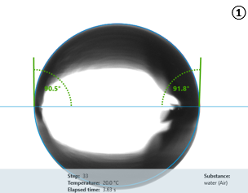
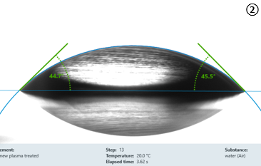
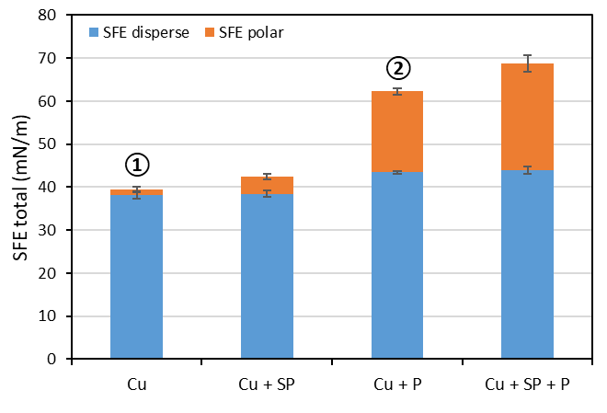
Current activities
Environmental stress cracking of TPI HV wires in superconducting magnets (ITER project), reproduce the failure conditions and define the limitations
Real case
Test set-up
ESC
Study of the adhesion (surface energy and tension) between several materials with different treatments (e.g. plasma), useful for bonding improvement or coils impregnation
Plasma treatment
Copper
Copper plasma treated

