Slide 1
DMA characterization of “overheated” CTD101K plates cured in open and closed mold
Polymer laboratory meeting
David Mate Parragh, Cedric Urscheler, Christian Scheuerlein
16/05/2024

Slide 2
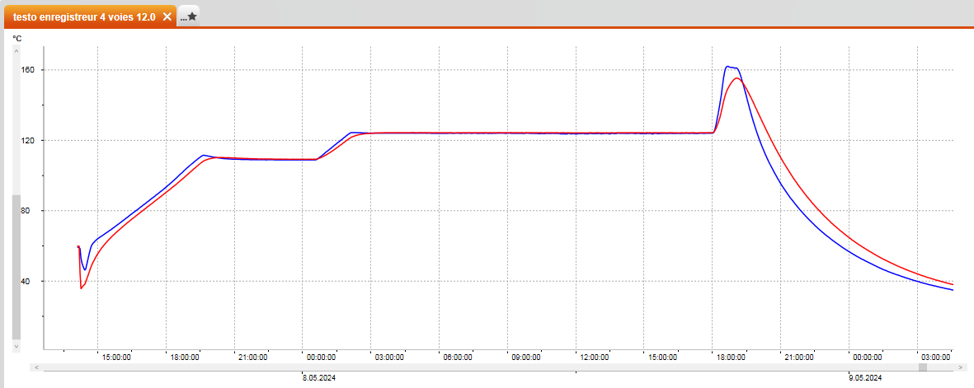
Experiment
Cedric produced 2 CTD101K plates to assess the effect of a temperature spike at the end of thermal curing
  One of the plates was cured in an open mold and the other via vacuum impregnation (closed mold) to also compare the effect of curing configuration

Slide 3
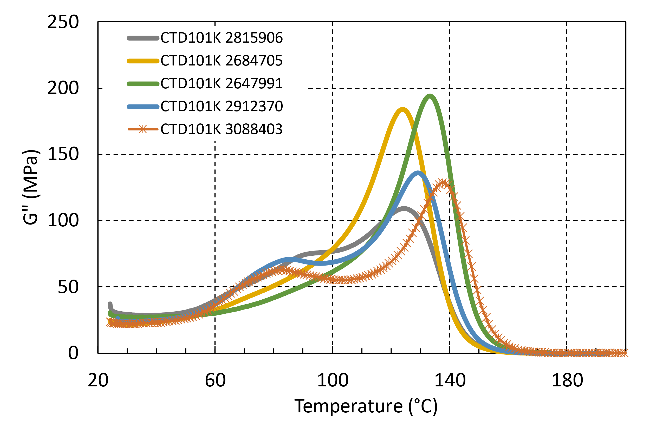
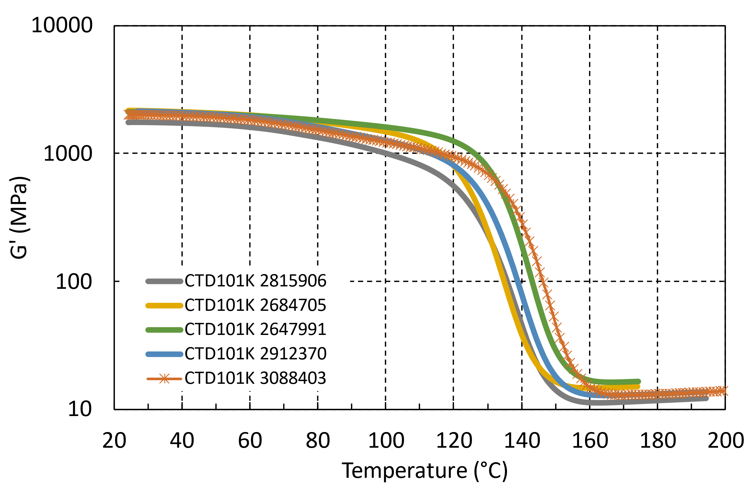
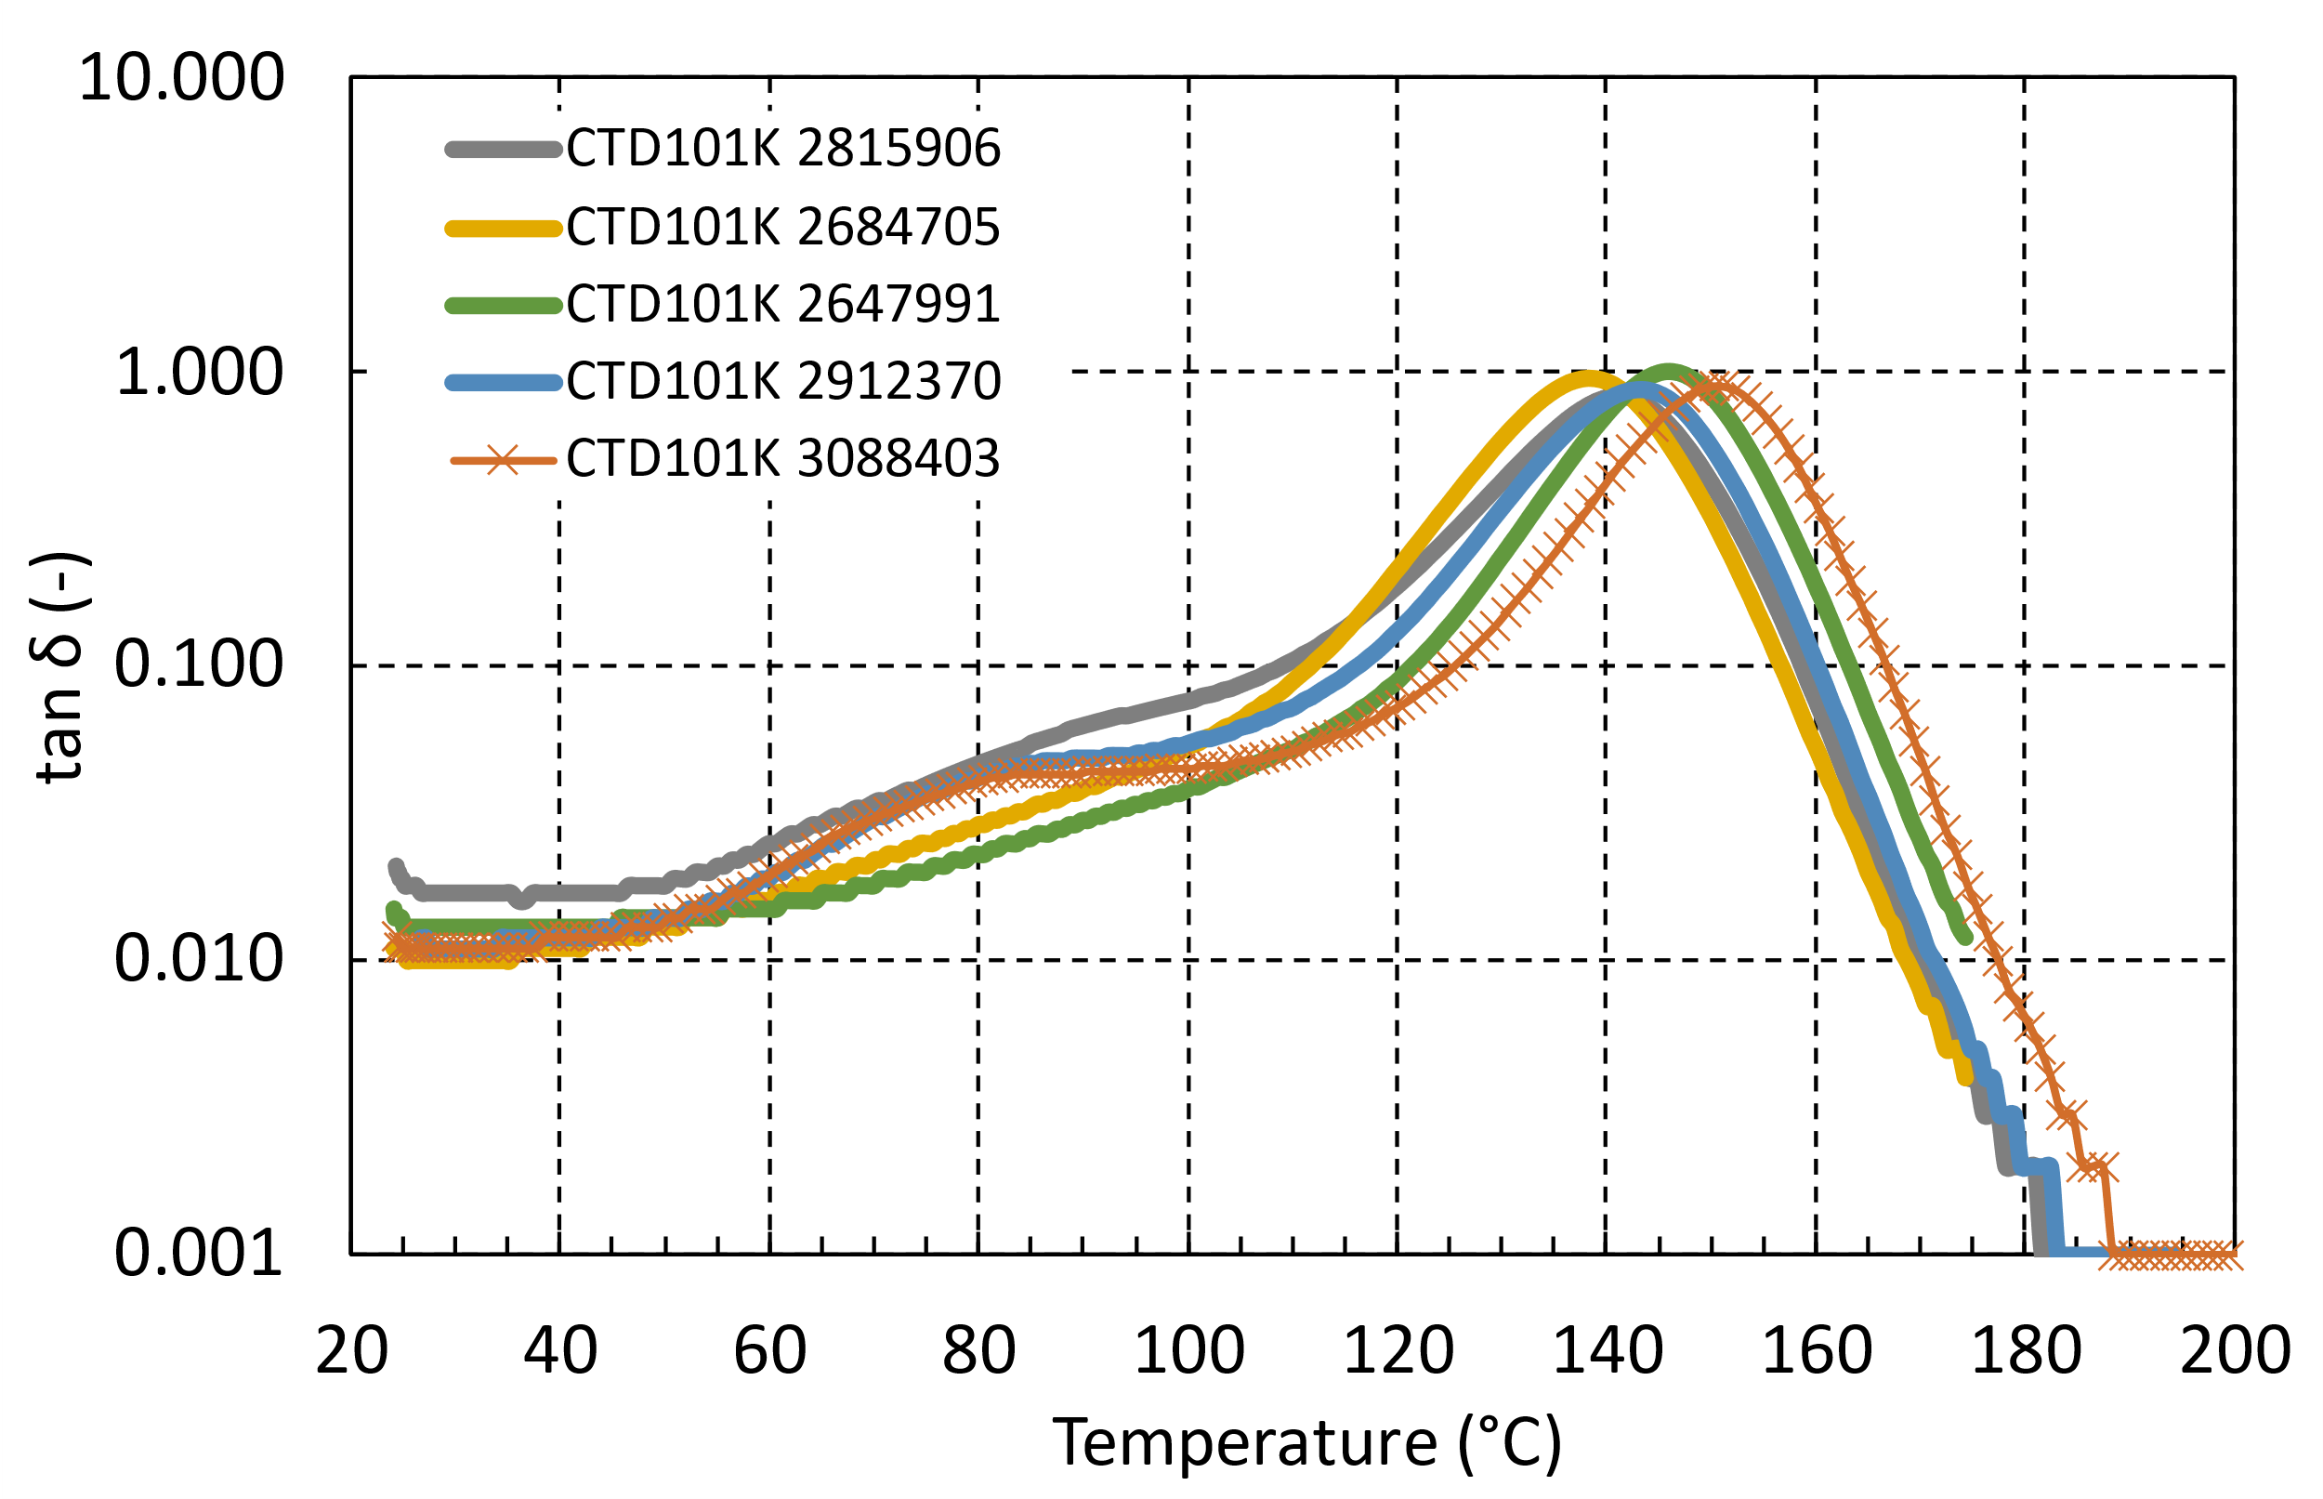
DMA comparison with other CTD101K batches
The DMA temperature sweep of the “overheated” CTD101K sample is comparable to other previously produced and tested plates

Slide 4
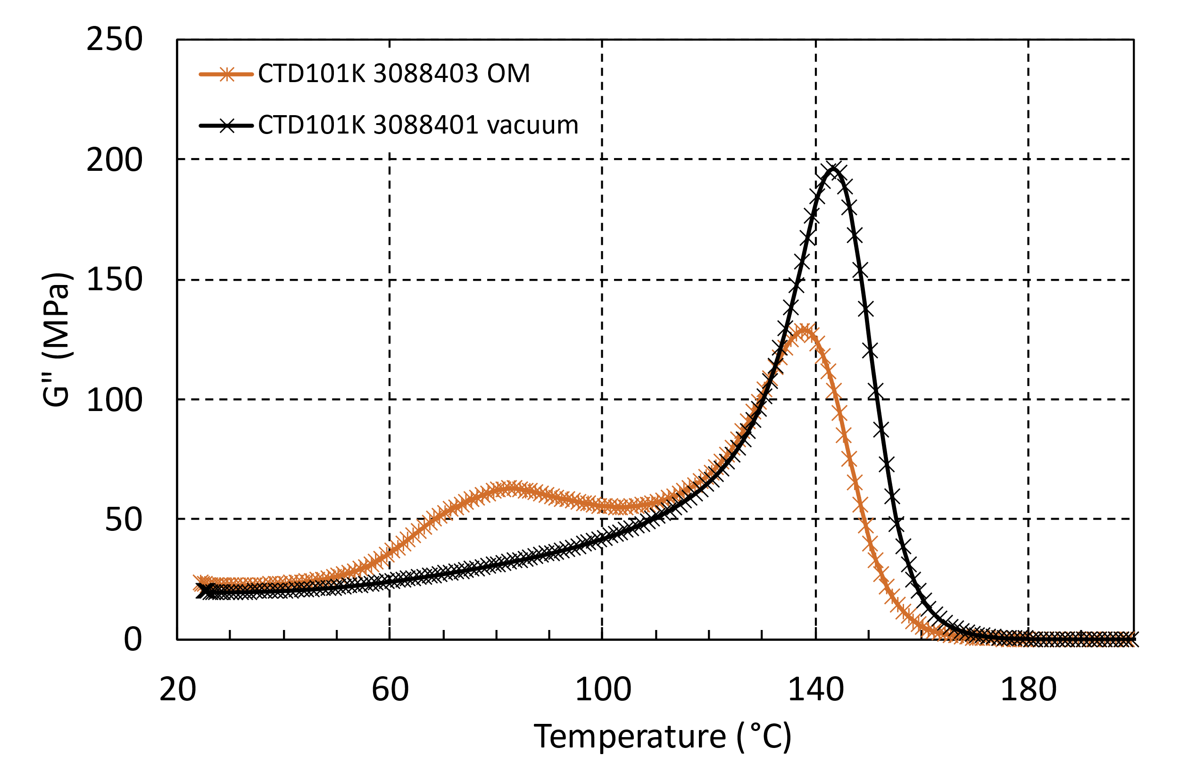
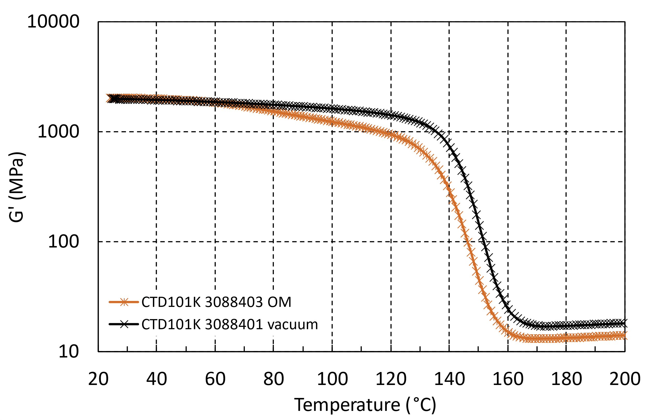
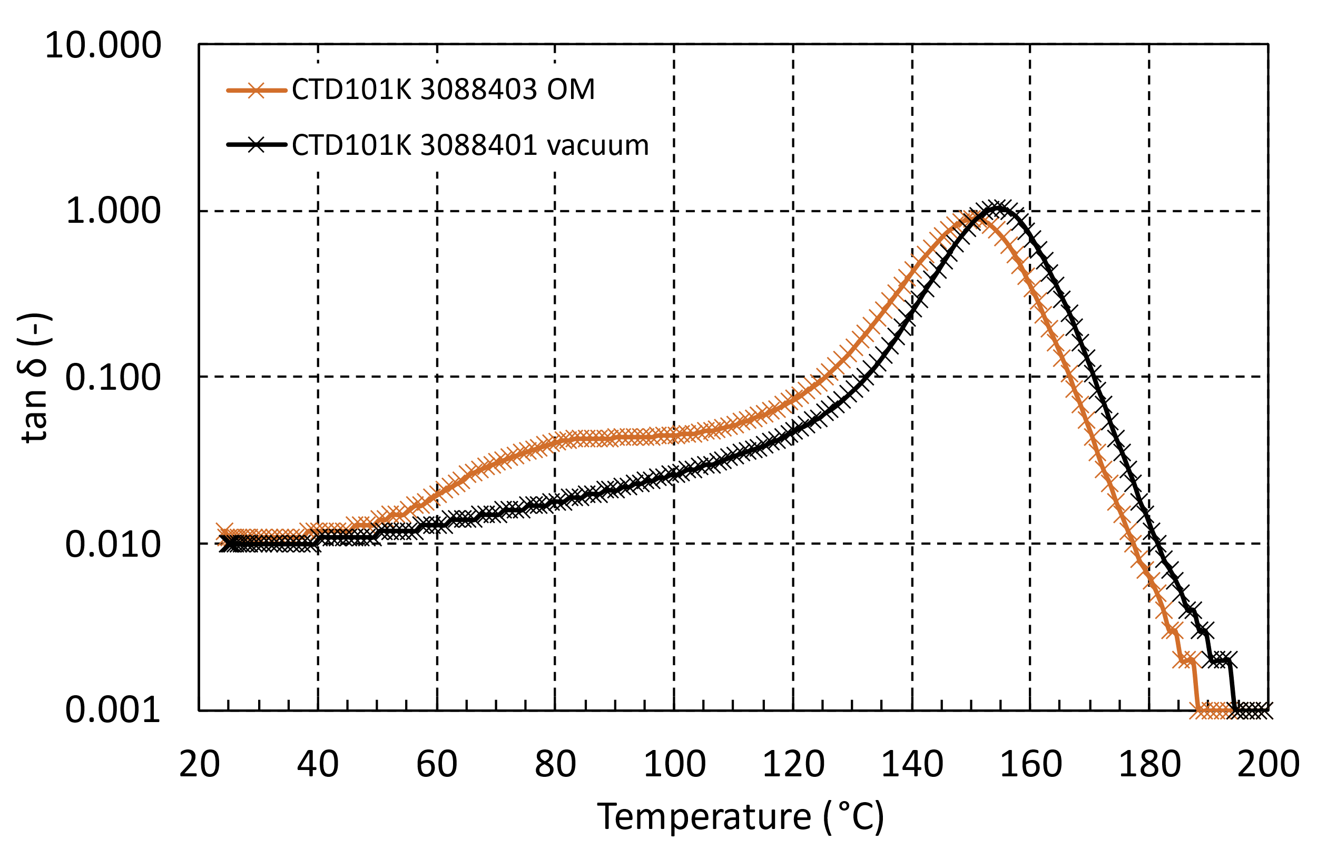
DMA comparison between open and closed mold curing
Curing in a vacuum impregnated closed mold configuration seems to lead to a more complete curing
  This is potentially related to interaction with oxygen when cured in an open mold

Slide 5
References
DMA report for assessing curing of CTD101K with temperature spike at the end of the thermal curing
https://edms.cern.ch/document/3091154/1
DMA report comparing effect of curing in open and closed mold
https://edms.cern.ch/document/3090189/1
Sample plate production report of open mold cured CTD101K
https://edms.cern.ch/document/3088403/1
Sample plate production report of close mold (vacuum impregnated) cured CTD101K
https://edms.cern.ch/document/3088401/1

