Slide 1
Algorithm for Electric Field Calculation in Garfield++ with neBEM
Supratik Mukhopadhyay
on behalf of the neBEM team

Slide 2
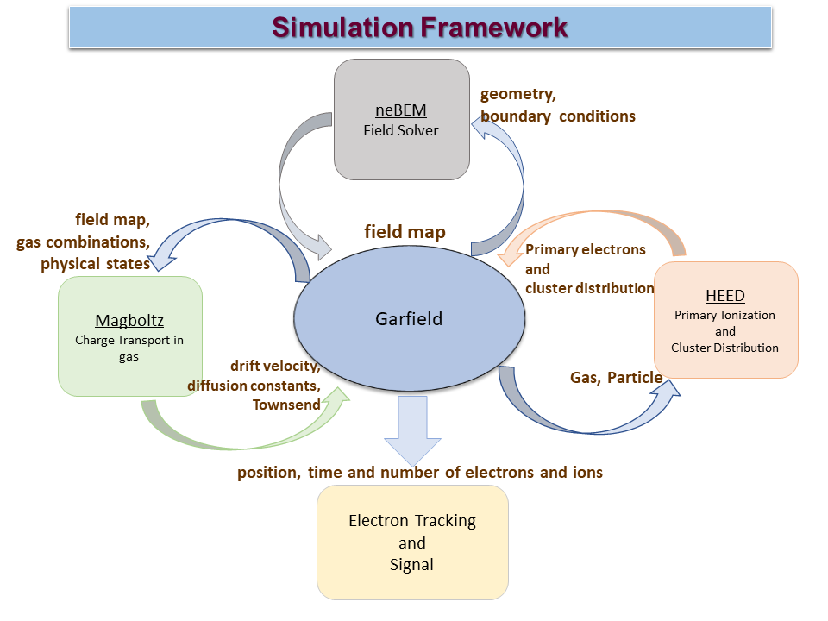
RD51 simulation framework since 2009
Each and every component is open-source and free
Garfield: garfield.web.cern.ch, Heed: heed.web.cern.ch,
Magboltz: magboltz.web.cern.ch, neBEM: nebem.web.cern.ch

Slide 3
Field Solver Possibilities
Solve Poisson’s equation
BEM
FEM / FDM
Reduced dimension
Accurate for both potential and its gradient
Nearly arbitrary geometry
Flexible
Analytic
Interpolation using shape functions for non-nodal points
Solves for potentials and fields are relatively poorly represented
Difficulty in unbounded domains
Exact
Simple interpretation
Complex numerics
Numerical boundary layer
Numerical and physical singularities
Restricted
2D geometry
Small set of geometries

Slide 4
Solution of 3D Poisson's Equation using BEM
Numerical implementation of boundary integral equations (BIE) based on Green’s function by discretization of boundary.
Boundary elements endowed with distribution of sources, doublets, dipoles, vortices.
Electrostatics BIE
Green’s function
Potential at r
discretization
ε - permittivity of medium
Charge density at r’
Accuracy depends critically on the estimation of [A], in turn, the integration of G, which involves singularities when r → r'.
Most BEM solvers fail here.
Influence Coefficient Matrix
{ρ} = [A]⁻¹{Φ}

Slide 5
Conventional BEM
Major Approximations
Constant element approach
Singularities assumed to be concentrated at centroids of the elements, except for special cases such as self influence.
While computing the influences of the singularities, the singularities modeled by a sum of known basis functions with constant unknown coefficients.
The strengths of the singularities solved depending upon the boundary conditions, modeled by shape functions.
  Mathematical singularities can be removed:
  Sufficient to satisfy the boundary conditions at centroids of the elements.
Difficulties in modeling physical singularities
boundary condition singularity
geometric singularity
Numerical boundary layer

Slide 6
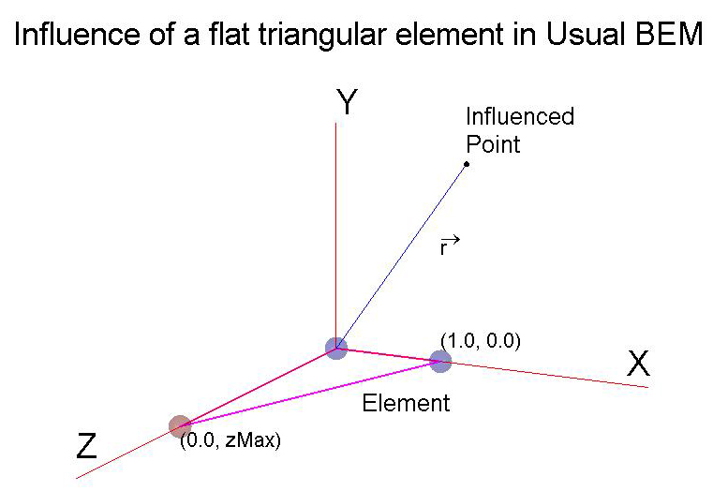
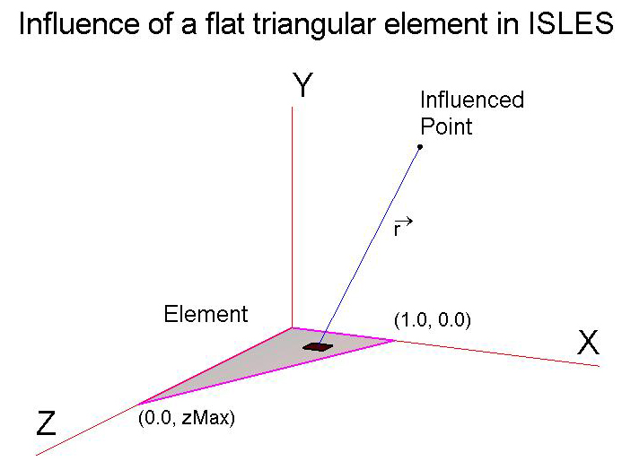
Contrast of approaches nodal versus distributed

Slide 7
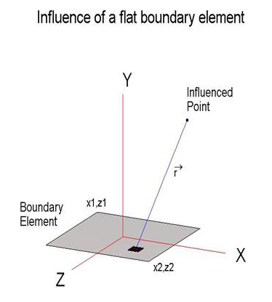
Foundation expressions of ISLES
Inverse Square Law Exact Solutions
Rectangular element
4 log terms
4+4 complex tanh⁻¹ terms
Value of multiple dependent on strength of source and other physical consideration
May need translation and vector rotation

Slide 8
neBEM approach
Analytic expressions of potential and force field at any arbitrary location due to a uniform distribution of source on flat rectangular and triangular elements. Using these two types of elements, surfaces of any 3D geometry can be discretized.
Restatement of the approximations
Singularities distributed uniformly on the surface of boundary elements
Strength of the singularity changes from element to element.
Strengths of the singularities solved depending upon the boundary
conditions, modeled by the shape functions
ISLES library and neBEM Solver
Foundation expressions are analytic and valid for the complete physical domain

Slide 9
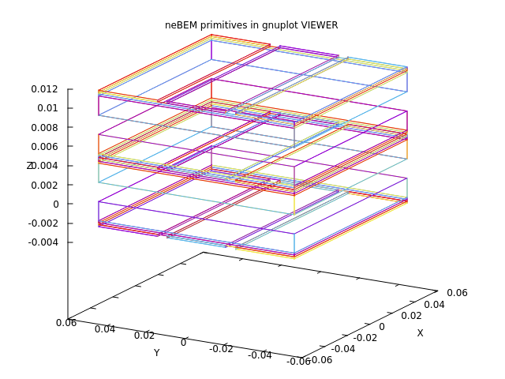
Before neBEM starts working …
The device is created before neBEM begins its work.
  Simple Constructive Solid Geometry (CSG) is used at present.
  Has huge scope of improvement.
Device creation can be done by any code that specifies a 2D / 3D geometry in terms of few basic primitives – lines, rings, discs, triangular areas, rectangular areas.
  It is important to have primitives with non-overlapping materials. This can be a difficult criterion to meet.
Specify
  Potentials on different conductors.
  Dielectric permittivity of insulating components.
An MRPC represented by simple primitives.
Two gas gaps, nine readout electrodes.
Necessary glass sheets, graphite coatings, mylar sheets are all there.

Slide 10
neBEM algorithm
Discretize primitives into small elements.
  charge density on each element is considered uniform.
Assign boundary conditions on these elements (usually in terms of potential, or field).
Prepare the influence coefficient matrix (potential and field at the j^{th} element due to unit charge density on the i^{th} element).
Incorporate influence due to charged dielectrics and space charge accumulation.
Solve for the charge density on each element that satisfies the prescribed boundary condition.
Use the charge density on device boundaries and other known charges (space charge, charging up etc.) to compute potential and field at any arbitrary point.

Slide 11
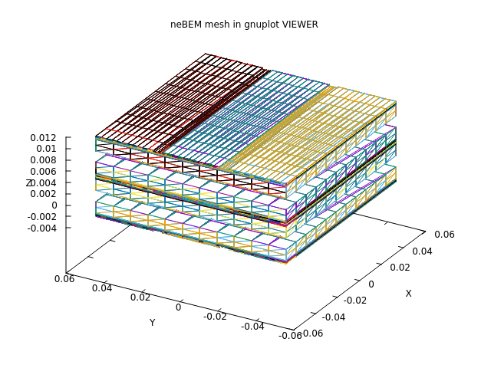
1 & 2) Discretize primitives
Discretize primitives to create elements.
  Line primitives give rise to line elements.
  For area primitives, try to create as many rectangular elements as possible, since triangular elements are computationally more demanding.
  Try to minimize aspect ratio of the elements.
Using knowledge of primitives, specify boundary conditions on elements.
Has huge scope of improvement.
Primitives constituting an MRPC
Elements from Primitives

Slide 12
3, 4 & 5) Influence coefficient matrix generation, decomposition and inversion
Influence coefficient matrix: Extensive use of ISLES Library.
Matrix decomposition using LU, or SVD: GSL and NR.
Solve for charge densities that satisfy the boundary conditions.
Each step is time-consuming and resource hungry.
Evaluation of many mathematical functions, conditional statements.
Coordinate transformations (Global to element-local and vice-versa).
Intense work going on to accelerate all these processes
  OpenMP implemented partially.
  GPU (NVidia, CUDA) in progress.

Slide 13
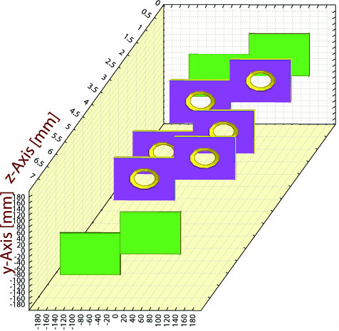
Reduced-Order Modelling (ROM)
Typical scenario for a Triple-GEM
Foil thickness : 50 μm
Copper thickness : 5 μm
Hole dia (outer) : 70 μm
Hole dia (inner) : 50 μm
Hole pitch : 140 μm (staggered)
Gap configuration : 3:1:2:1 (mm)
Repetitions in X and Y: ~100
Base device
Can we ignore the variation of charge density on a virtual GEM that is far away from the base device?
Repetitions that are far from the field point, consider their structure to be made of primitives, rather than elements.
Has good potential. Present implementation being improved.

Slide 14
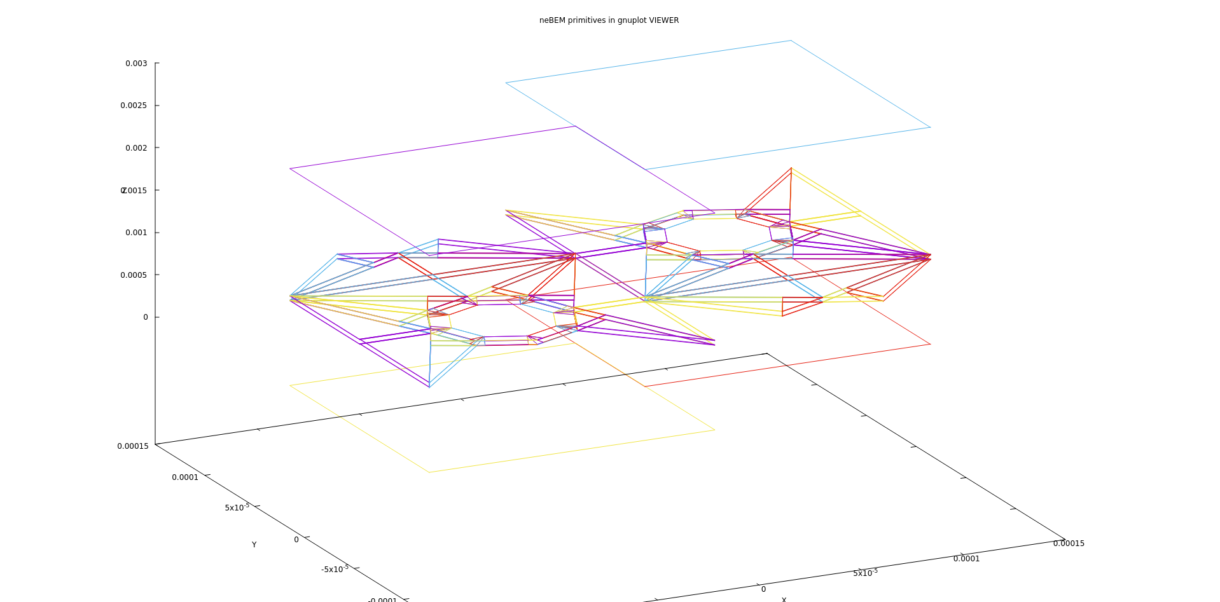
6) Evaluation of electric potential / field
Large number of field points where properties are evaluated.
  Influenced by all the elements / primitives.
  Charges due to charging up process and space charge accumulation need to be considered.
  Other physical / chemical processes can complicate matter further.
Extensive use of the ISLES library (influence for charges represented as points, lines, areas, rings, discs).
Very recently, Heinrich modified a part of the code that has accelerated computation by good measure.
Intense activity here as well:
  OpenMP has been partially implemented.
  GPU computations are under way.
Cathode
Staggered GEM holes
Anode
Field point can be anywhere within the domain.
Only primitives are shown, for convenience.

Slide 15
Fast Volume is a way out
Potential and field provided on a cartesian 3D map.
Potential and field evaluated at arbitrary points by trilinear interpolation.
Implementation available but can be improved further.
This part of the work will be taken up once OpenMP and GPU implementations are in place.
White volume is on the base device. Rest are repeated.
Sorry for the state of the figure – could not locate a better one

Slide 16
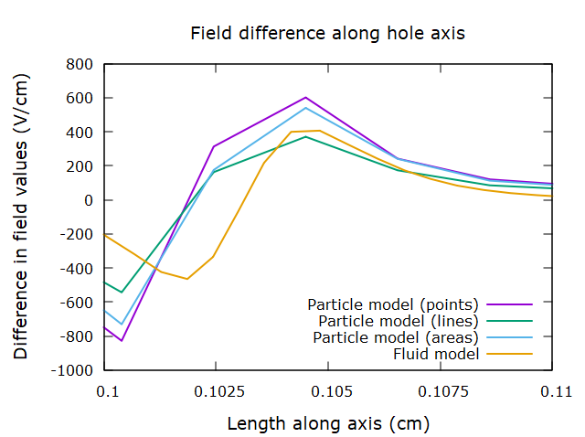
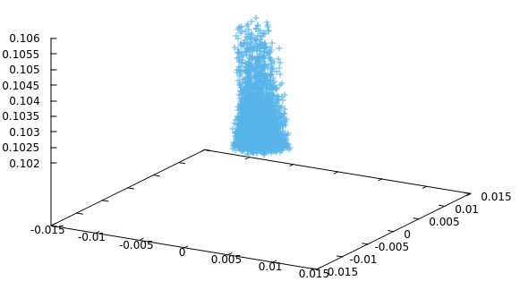
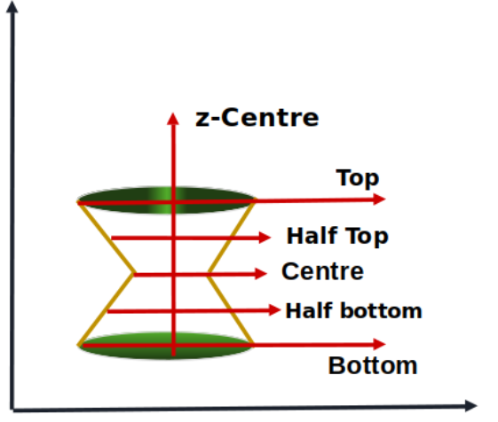
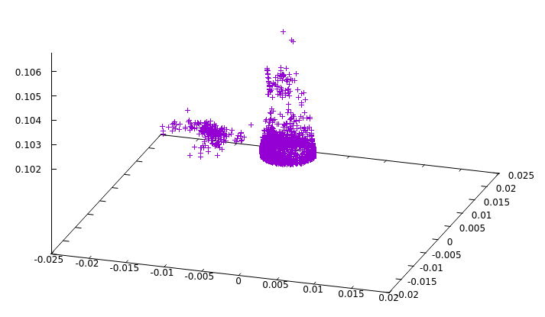
Space charge and charging up
These additional charges accumulated in the gas volume, or the insulating boundaries, have the option of being represented as
  Points, lines, rings, discs and, triangular and rectangular areas.
  Different representations (including fluid model) lead to similar results, thankfully!
Especially GPU computation can accelerate this part of the computation and work in under way.
Ions
Evaluation lines
Electrons

Slide 17
Resistive materials
This is one aspect that we have not worked upon using Garfield++.
  FEM packages have been used to compute the effects of such materials.
  The necessary governing equations will be implemented in neBEM.
Excellent work has recently been done in the community on signal induction through resistive materials.
  Hope to implement such models in neBEM. External support welcome.
RPC material studies using FEM (Comsol)
Dark current through a button spacer

Slide 18
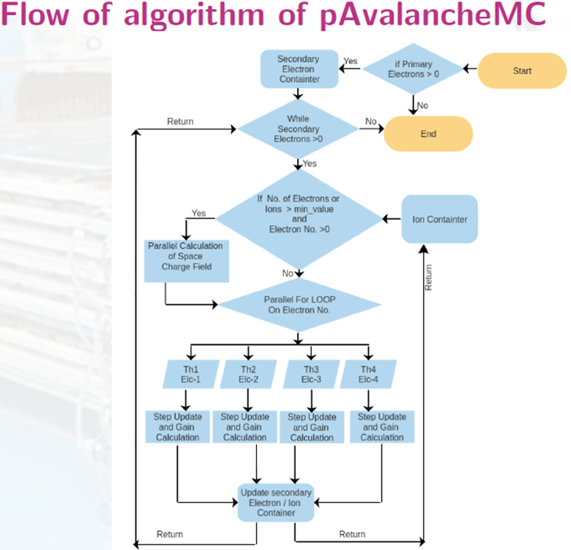
RPC space charge using OpenMP
In Garfield++, a new class has been added to the existing framework:
pAvalancheMC (loosely based on class AvalancheMC)
The new class contains several new functions such as
  SetNumberOfThreads(20) – carries out OpenMP parallelization.
  SpaceChargeEffectOn()
  SetMinSpCharge(1e4,0)
  SetGridElements(dthta, dx, dy, dz, dr)
  SetElectrodePropertise(thickness, thickness, gasgap, epsilon, true);
  SetElectrodeLocations(electrode_Center1_alongz, electrode_Center2_alongz, gas_Center_alongz);
  GlobalTimeWindow(time);
etc …
Till now, specific to RPCs.
Without space charge
Space charge
+
negative ions
OpenMP implementation in neBEM is undergoing further improvement.
Parallelization of AvalancheMC

Slide 19
GPU-CUDA in neBEM
Garfield++ built using CUDA.
OS: Ubuntu 22.04, GPU h/w: NVidia Quadro K2200, Libraries: cuda, cuBLAS.
Impressive initial performance observed in matrix multiplications within neBEM.
One PhD student working. Expect several interesting developments in the near future.

Slide 20
Present team
Bhattacharya, Purba
Dey, Tanay
Dutta, Shubhabrata
Majumdar, Nayana
Mukhopadhyay, Supratik
Schindler, Heinrich
Veenhof, Rob
Happily acknowledge support from members of the RD51 / DRD1 collaboration.

Slide 21
Thanks a lot for your patience!

