Slide 1
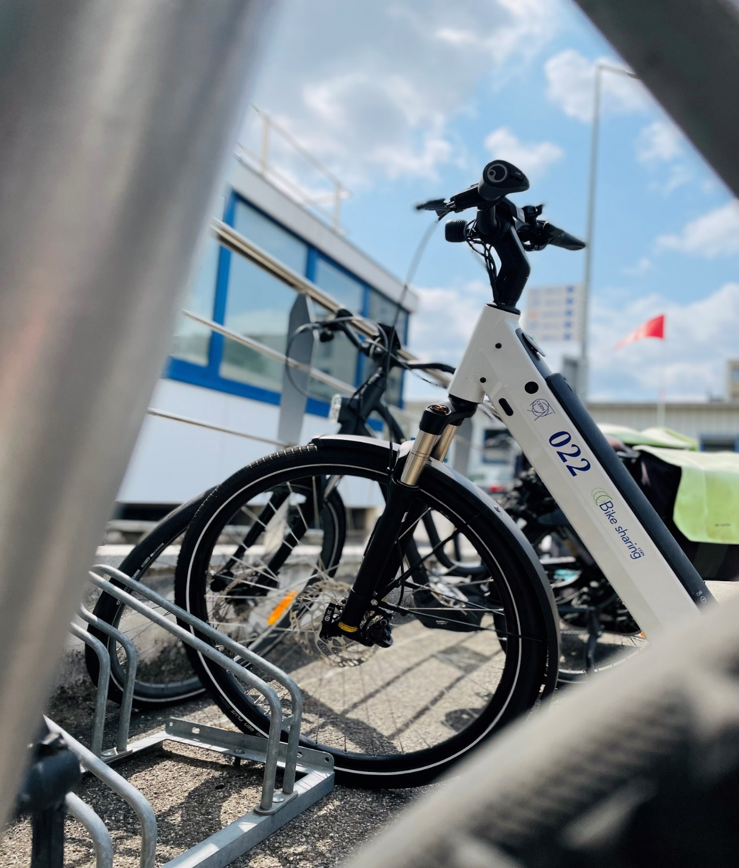

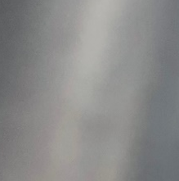
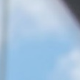





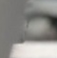


MOBILITY

Slide 2
CERN Mobility Plan – General goals
The update of CERN’s Mobility Plan is grounded in the feedback from the survey, continuous analysis of opportunities, and the ambition to minimize the impact of CERN's activities on the environment. This mobility plan embodies a dynamic and long-term approach to accompany changes in behaviour regarding safety and mobility, emphasizing the promotion and fostering of equality among different modes of transportation, including accessibility for individuals with reduced mobility. This document outlines how the SCE department will implement various initiatives to enhance mobility services and infrastructures.
The implementation relies on short-, medium- and long-term actions. These actions can be divided into four categories:
Motorized Individual Transportation (TIM)
Alternative Mobility (ALT)
Accessibility (ACC)
Communication (COM)

Slide 3
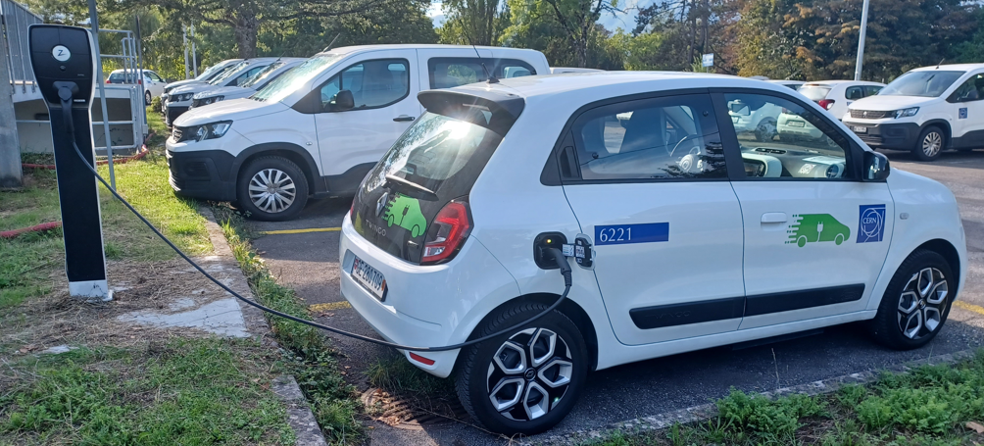
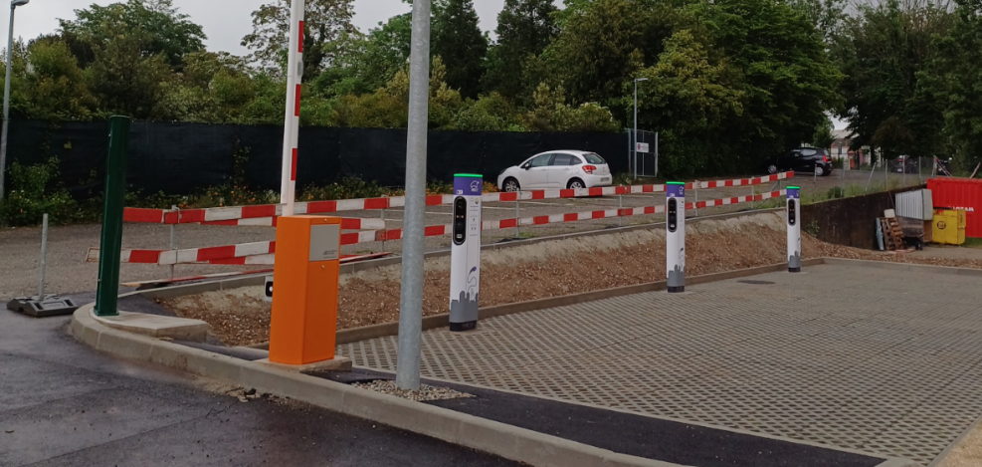
CERN Mobility Plan
[TIM-1] Optimization and Reduction of the CERN car Fleet, Electrification of the Vehicle Fleet
Reduce CERN vehicle fleet (-25%)
Electrify 50% of the CERN vehicle fleet (2030)
- Buy electrical cars
- Install charging points for CERN Cars
- “clean vehicles” for shuttles
Electrical chargers for private cars (collaboration – not to found the charge)
- 1 parking area close to Meyrin
- 1 parking area close to Prévessin

Slide 4
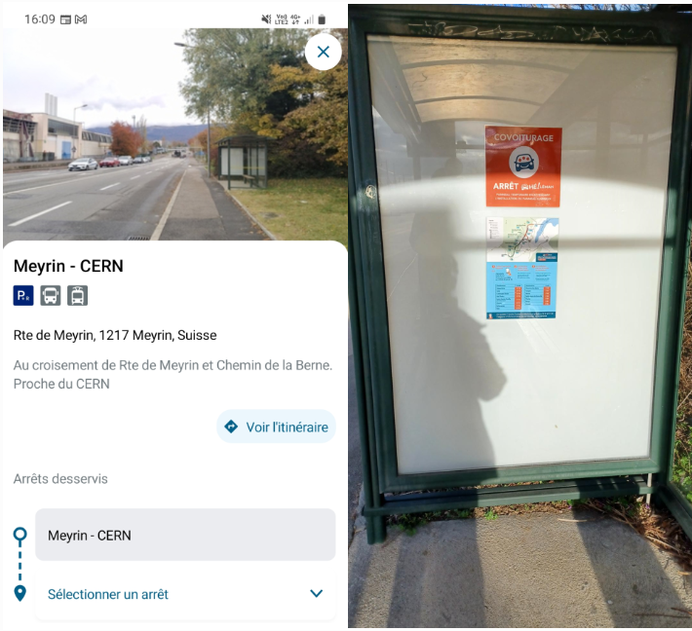



CERN Mobility Plan
[TIM-2] Promoting Carpooling
Promotion of different carpooling platforms
- Events (He-Leman; Mov’ici)
- Stop for He-Leman platform in front of entrance B

Slide 5
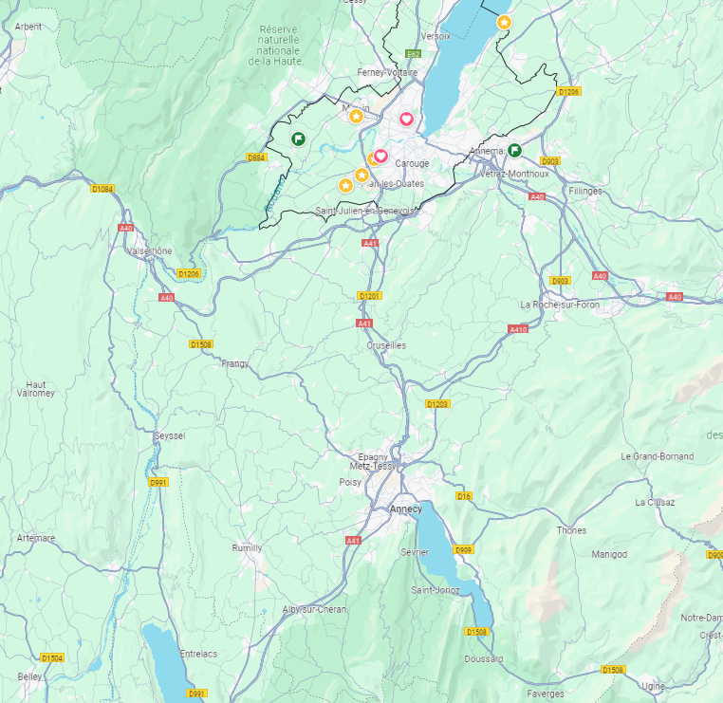
CERN Mobility Plan
[TIM-3] Promoting Vanpooling & Public Transport
Feasibility study of alternatives (shuttle, TPG lines)
- Conduct a survey oriented to users from specific points of trip origin
“Circuit A” :
Rumilly –Annecy nord - Crusey – Meyrin / Prévessin TBC
“Circuit B” :
Bonneville – Chal / vallée verte sortie 15 - Etrembières– Meyrin / Prévessin TBC
“Circuit C” :
Frangy – Vullebins – Meyrin / Prévessin TBC
Arrivées au CERN : 7h45 – 8h30
Départs du CERN : 16h45 – 17h30/45

Slide 6


CERN Mobility Plan
[TIM-4] Hitchhiking Service
Launch a pilot project between Meyrin and Prévessin sites
Implement up to 30 hitchhiking stops in Meyrin and Prévessin for intra-site travel
Create an electronic platform for managing hitchhiking at all established stops, optimizing usage, and reducing user wait times

Slide 7
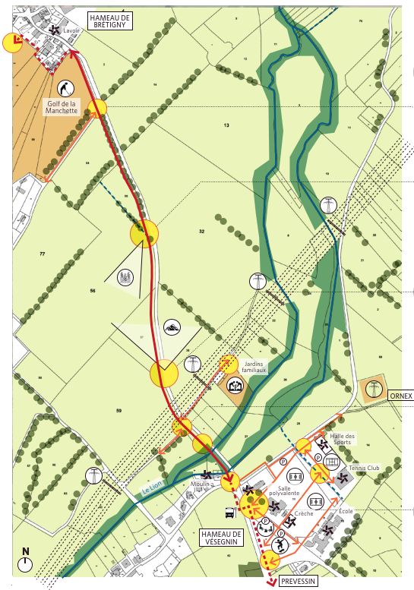
CERN Mobility Plan
[ALT-1] Promoting the Improvement of Cycling and Pedestrian Networks both Inside and Outside CERN
Improve and upgrade sidewalks, pedestrian paths, and cycling lanes across different CERN sites
- Project “site development plan”
Collaborate with local authorities to promote the creation of new safe cycling lanes in the region
ENTREE A
Voies vertes – Rte Sénat. Fouilloux

Slide 8
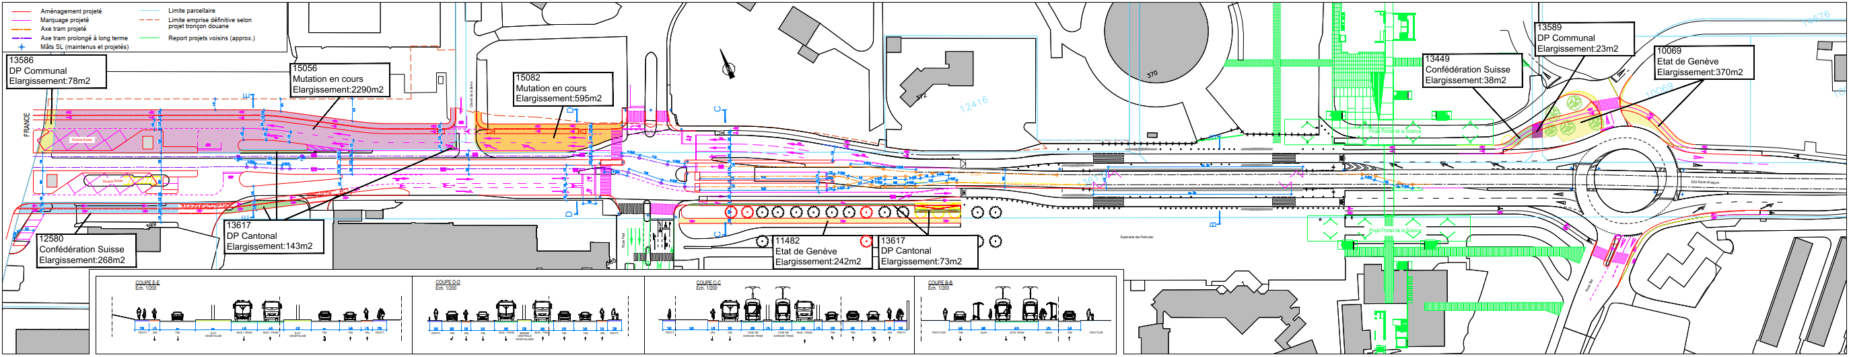
CERN Mobility Plan
[ALT-1] Promoting the Improvement of Cycling and Pedestrian Networks both Inside and Outside CERN
BHNS

Slide 9
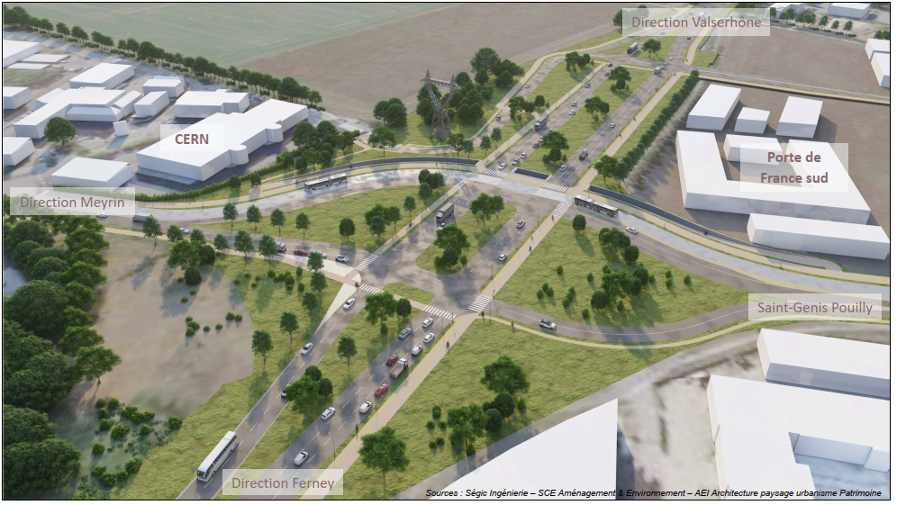
CERN Mobility Plan
[ALT-1] Promoting the Improvement of Cycling and Pedestrian Networks both Inside and Outside CERN
LCC

Slide 10
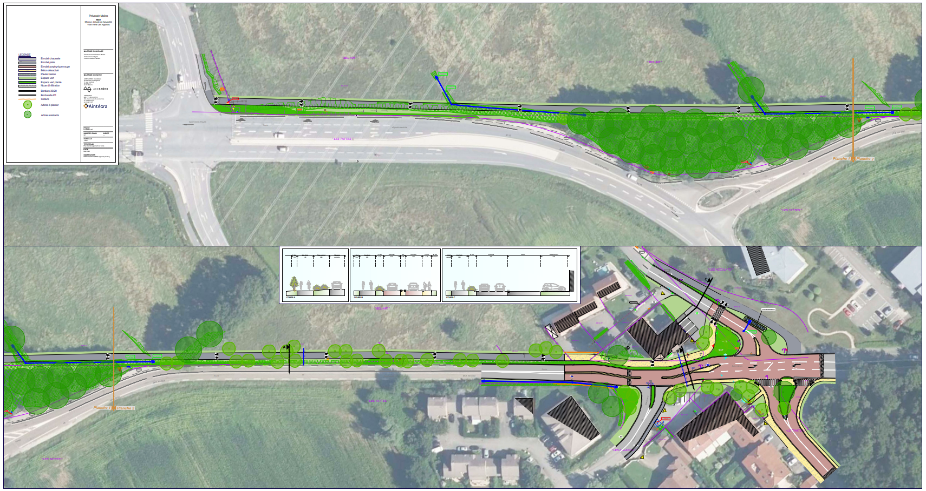
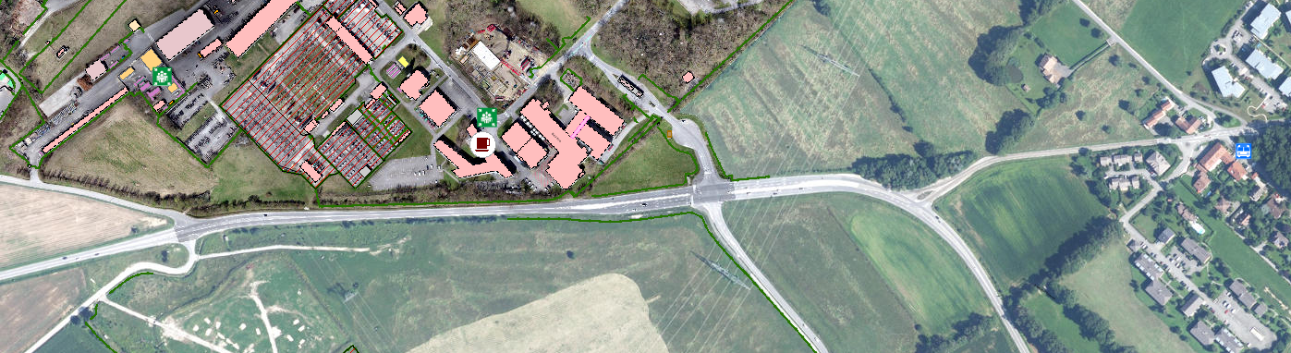
CERN Mobility Plan
[ALT-1] Promoting the Improvement of Cycling and Pedestrian Networks both Inside and Outside CERN
En études
Réalisé

Slide 11
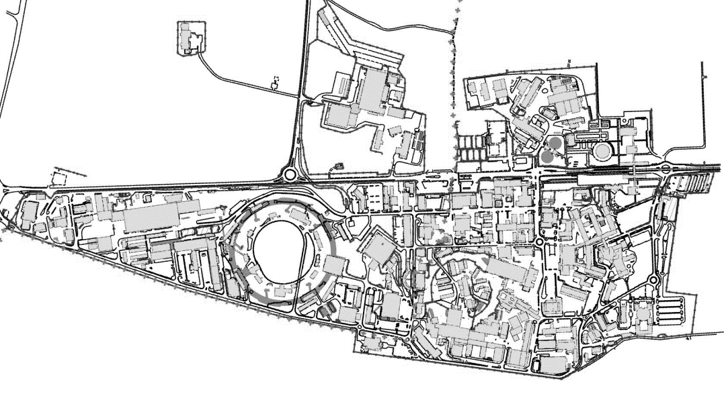
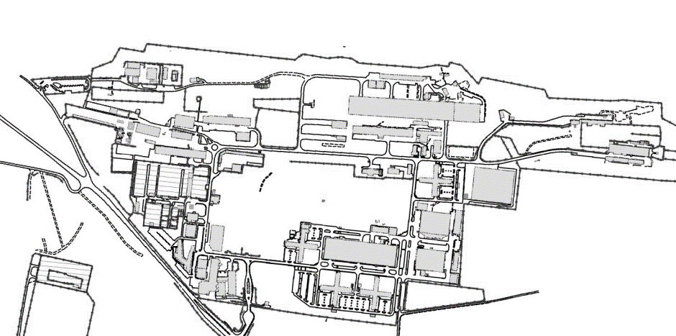
CERN Mobility Plan
[ALT-2] Bicycle Parking Infrastructure
Increase available bicycle parking spaces by 1600 in 2024
Increase covered bicycle parking spaces by 500 by 2026
Install new bike parking areas
Install 10 private electric bicycle charging points for CERN’s community
15-20 points with new racks (apart from covered areas)
Raised an existing bike shelter (112)
12 new shelters for up to 225 new covered bike places
25 new racks in 7 covered existing areas -> ~ 115 bike covered places more
100 covered places in the parking 864-865 (replacing ~30 existing places)

Slide 12
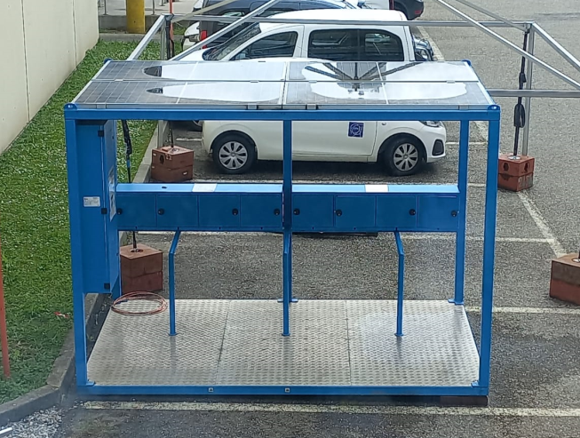
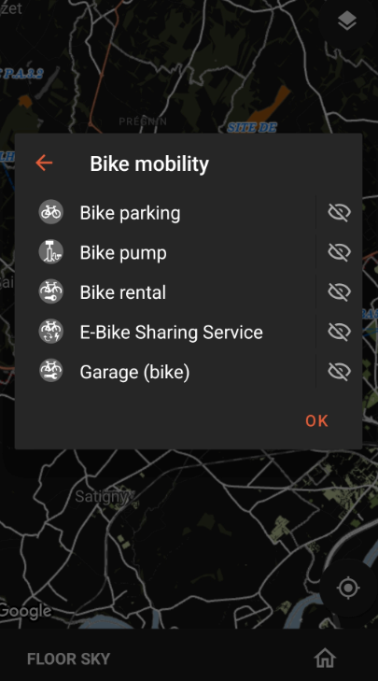
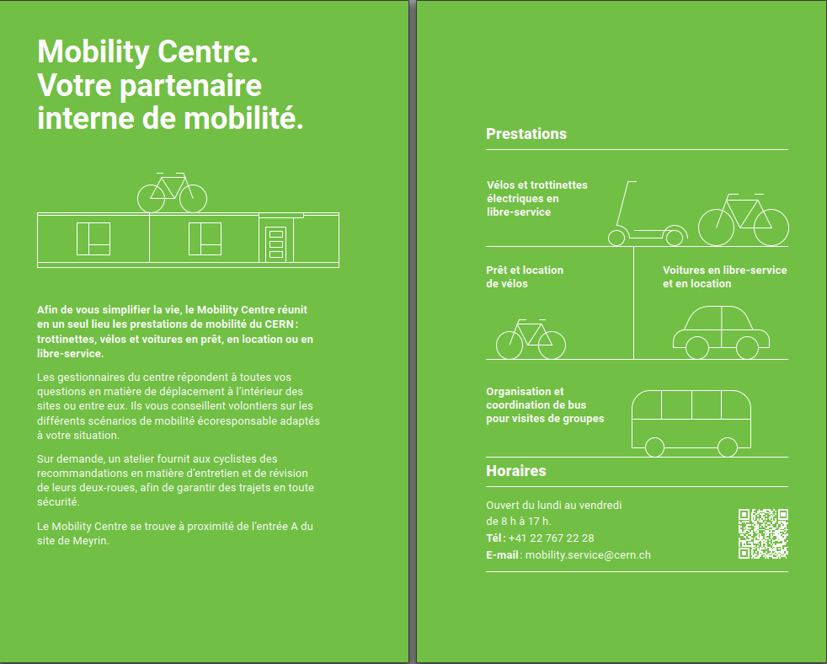
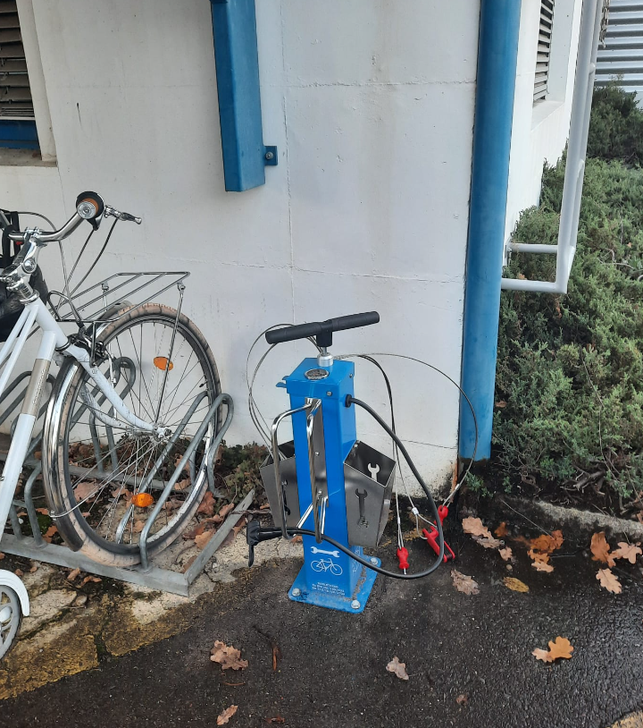
CERN Mobility Plan
[ALT-2] Bicycle Parking Infrastructure

Slide 13
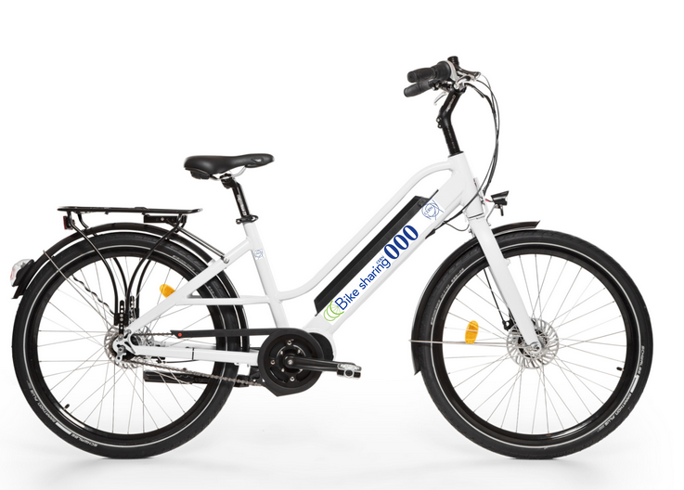
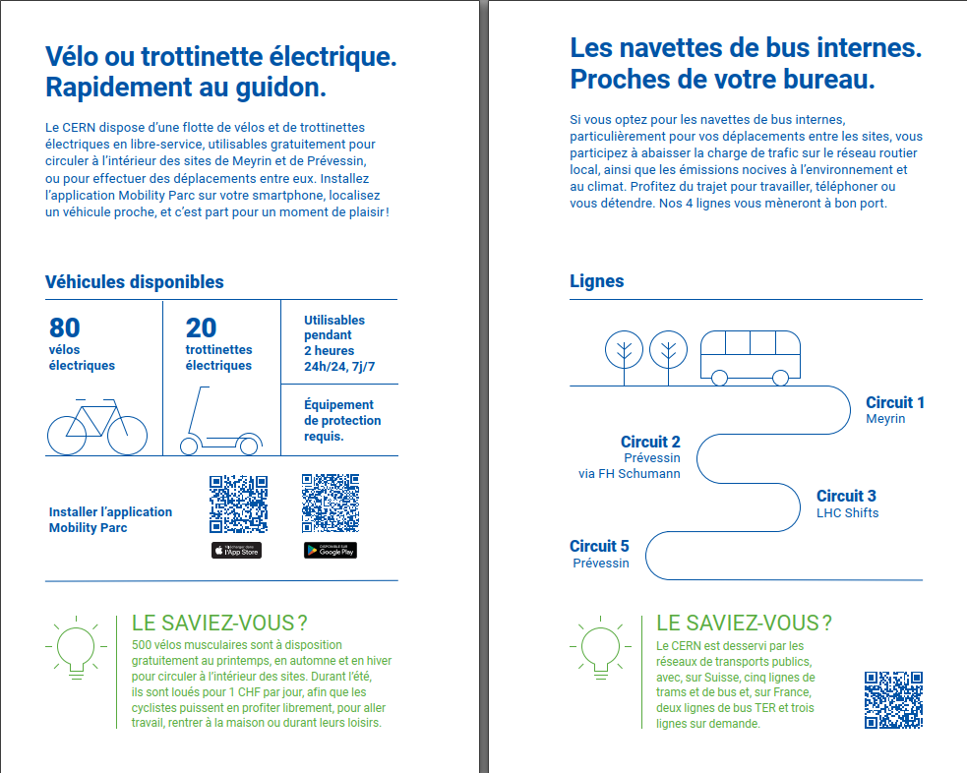
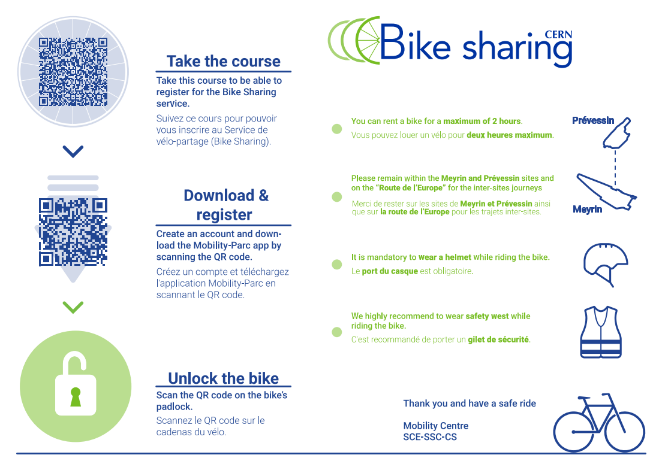
CERN Mobility Plan
[ALT-3] Expanding and Diversifying the Available CERN Bicycle Fleet
110 e-bikes shared in 2024 (30 new)
>500 rent bikes
20 e-scooters

Slide 14

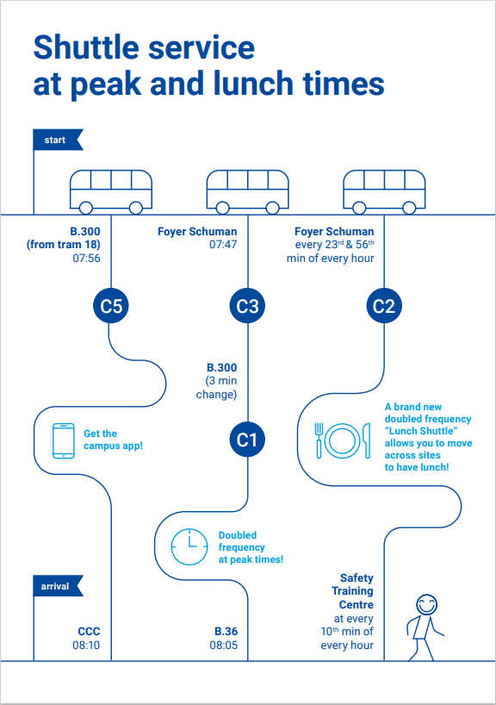
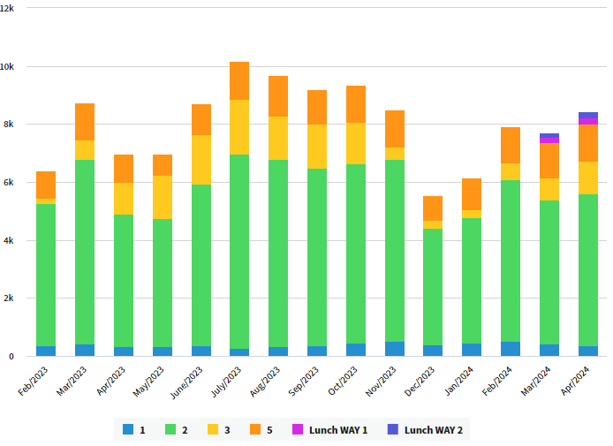
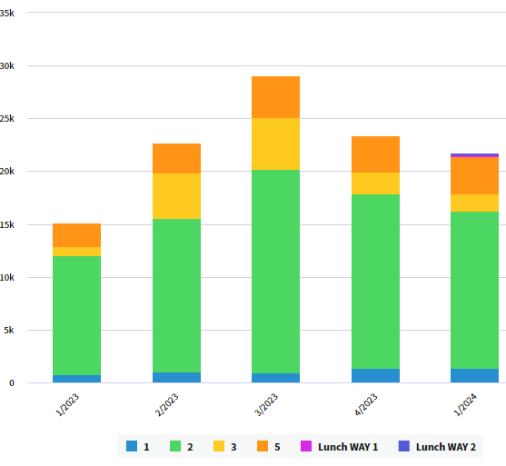
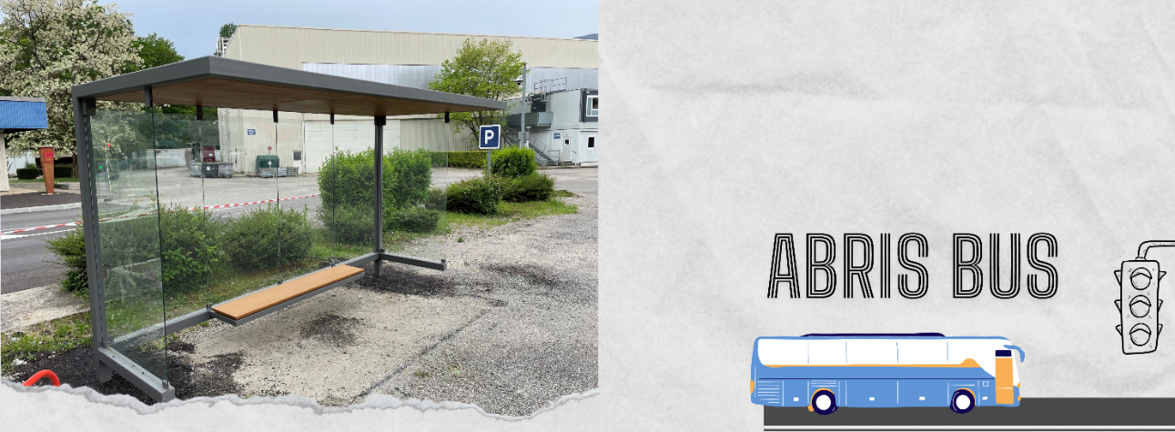
CERN Mobility Plan
[ALT-4] Optimization of the Internal CERN Suttle Network and Infrastructure
Shuttle service communication
The promotion of the service is being revamped and increased with new visuals in preparation
Shuttles Pilot (circuit 5)
  The attendance of the circuit lines have increased since Feb-24
LHC-2, 5, 8

Slide 15
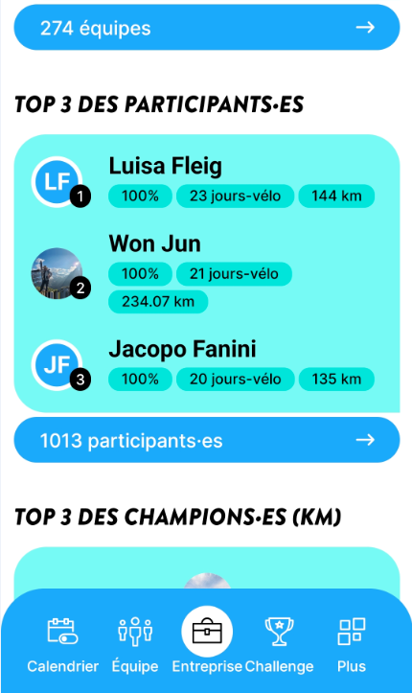
CERN Mobility Plan
[ALT-5] Incentives to Promote Alternative Transportation
Promotion and sponsor of the bike to work event (collaboration with cyclist groups)
Establish collaborations/partnerships with local businesses in the alternative mobility sector
Analysis to propose incentives among users who access CERN on a sustainable transport/mode

Slide 16
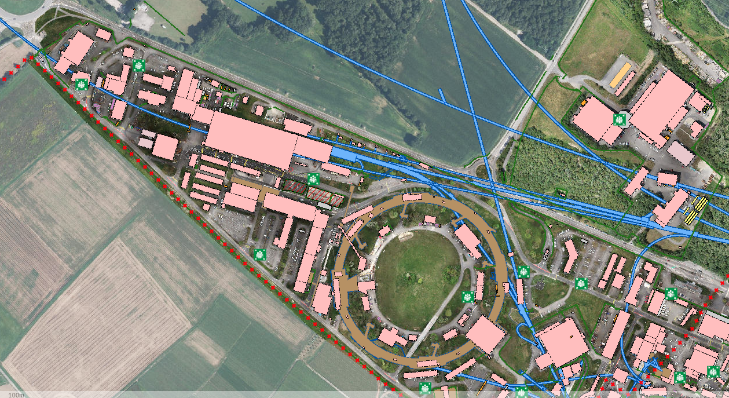
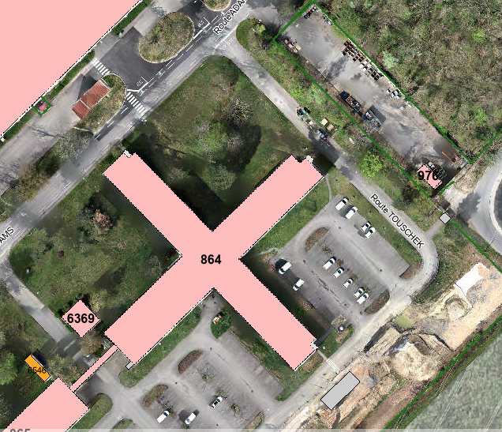
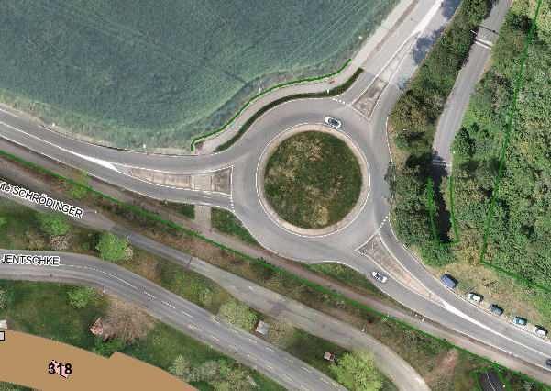
CERN Mobility Plan
[ACC-1] Improvement of Accessibility and Safety for Alternative Means of Transportation
Renovate the entrances at the different sites
Carry out a feasibility study (technical and legal) for creating a new access point for bicycles and pedestrians in Meyrin
Create a new path for pedestrian and cyclist from the entrance in the “Route de Maroc”

Slide 17
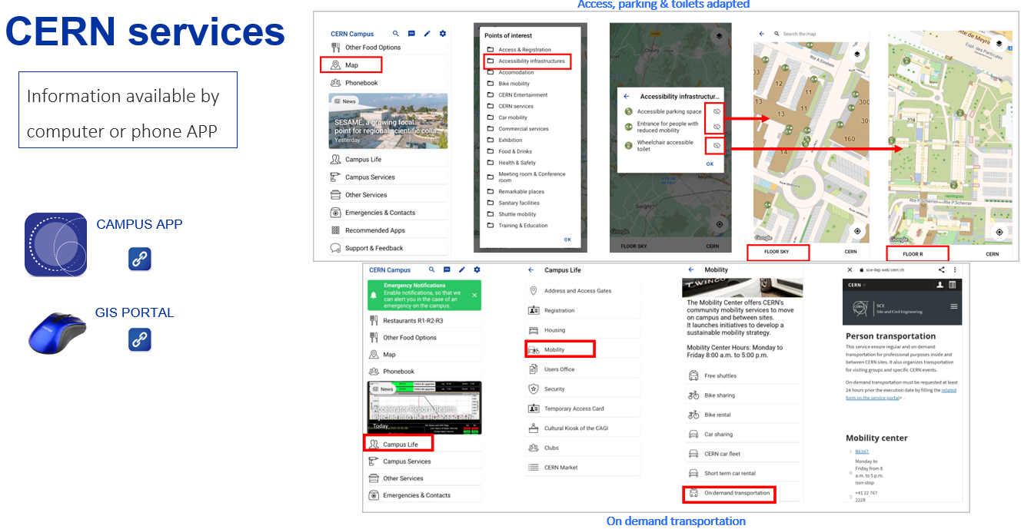
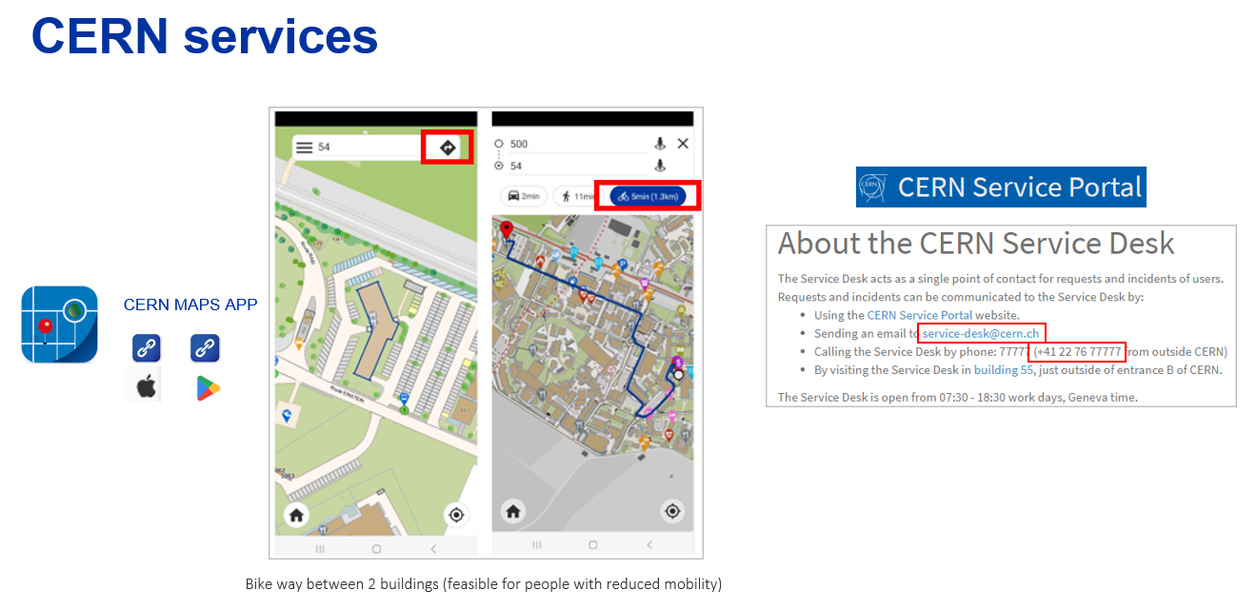
CERN Mobility Plan
[ACC-2] Improvement of Accessibility and Internal Mobility for People with Reduced Mobility
Provision of electric vehicles adapted for individuals with mobility issues
Integration and supplementation of information in existing mobile applications

Slide 18



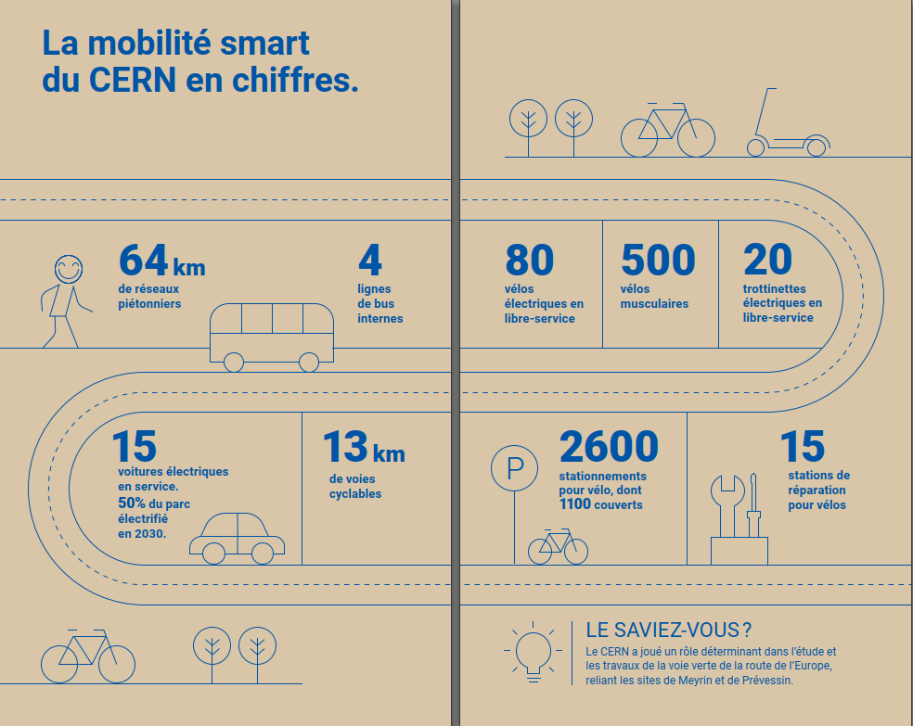

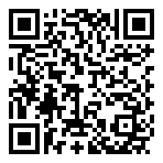
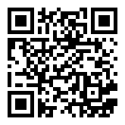
CERN Mobility Plan
[COM-1] Communication Campaign on Mobility Actions
New web-site
Update existing App
Mobility for newcomers
Mobility survey

Slide 19
CERN Mobility Plan
[COM-2] Promotion and Participation in Sustainable Mobility Events
European mobility week
Bicycle riding courses
Bike maintenance courses/assessment
Car free day at CERN (priority for pedestrian/bikes)
Others

Slide 20
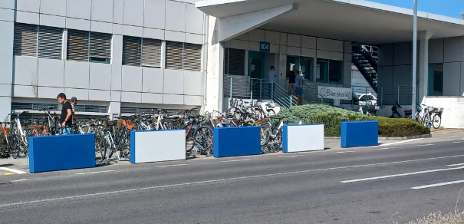
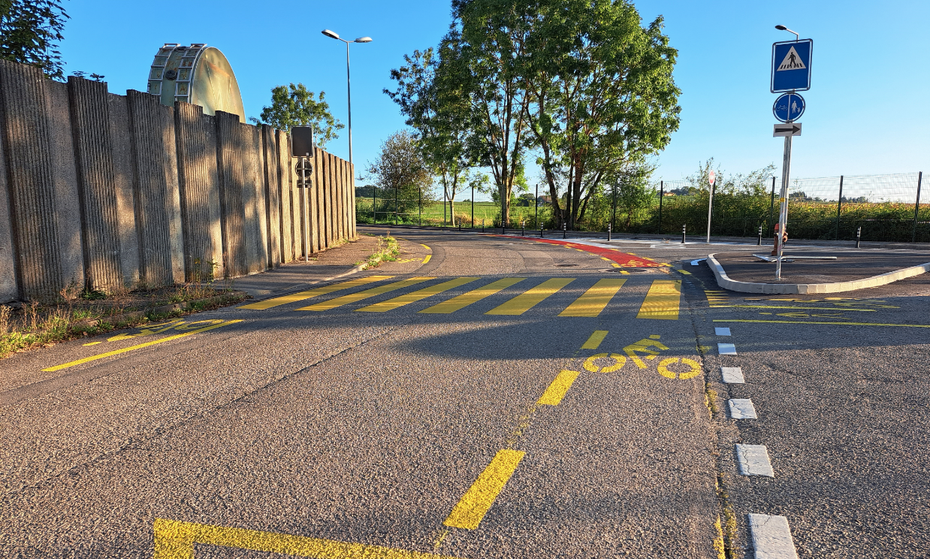
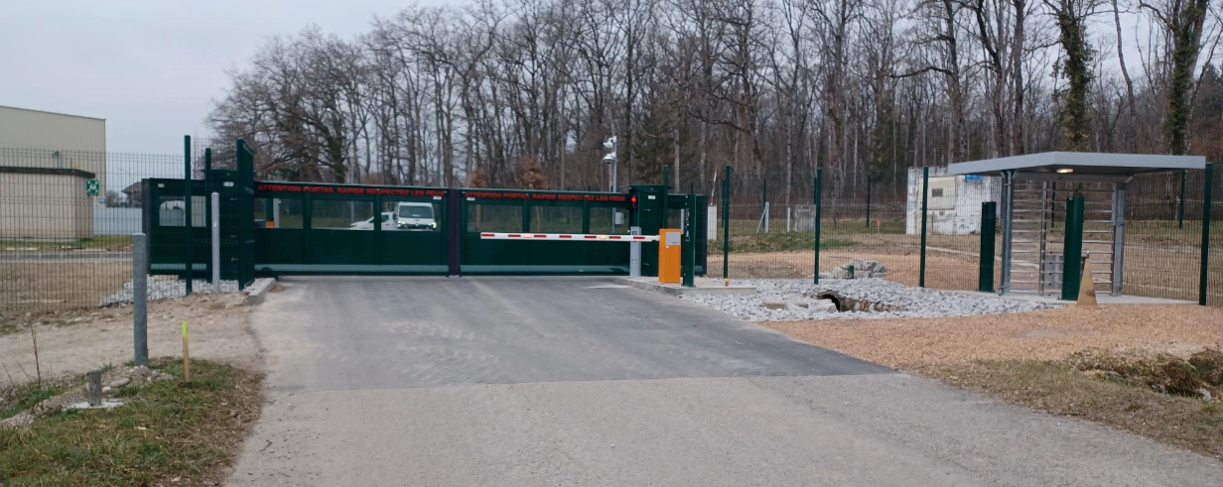
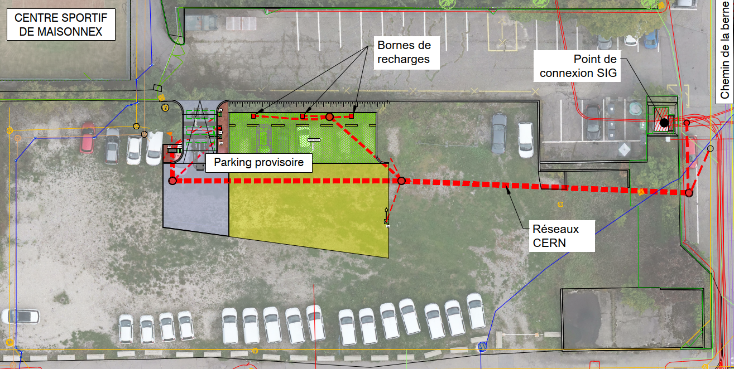
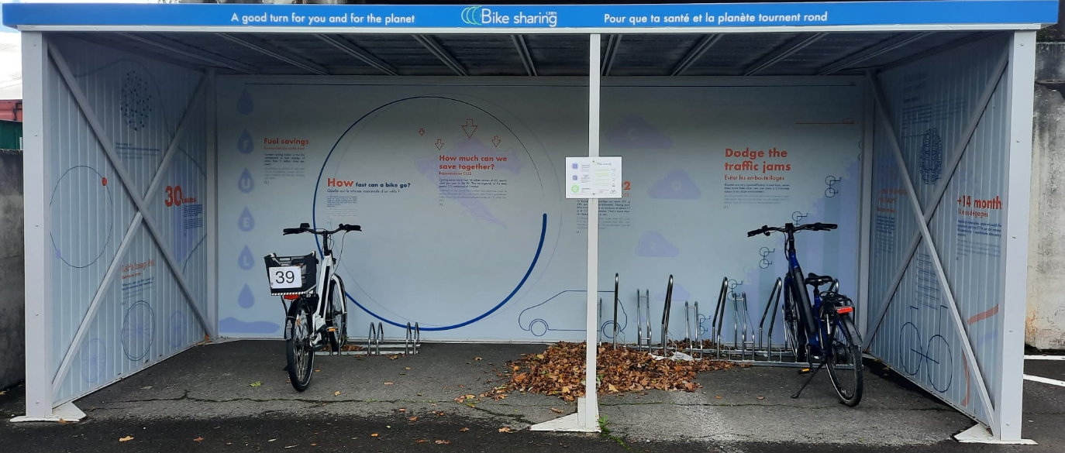
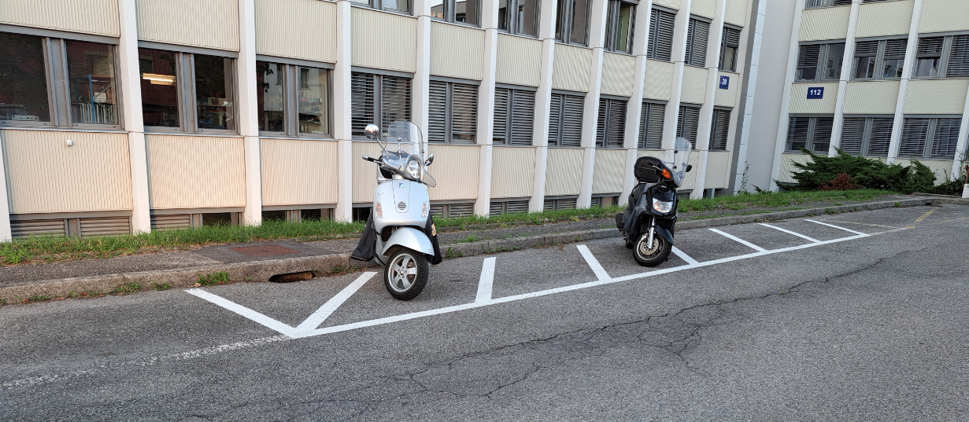
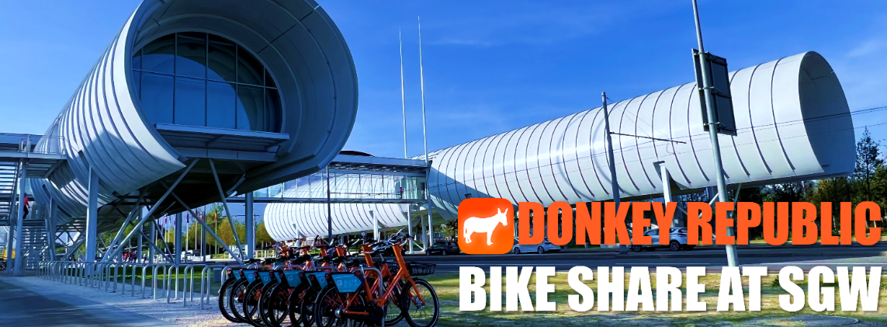

CERN Mobility Plan

Slide 21

