Slide 1
First operational experience with
the BCCM
251st Machine Protection Panel meeting
31/05/24
Marek Gasior, Tom Levens
SY-BI-IQ

Slide 2
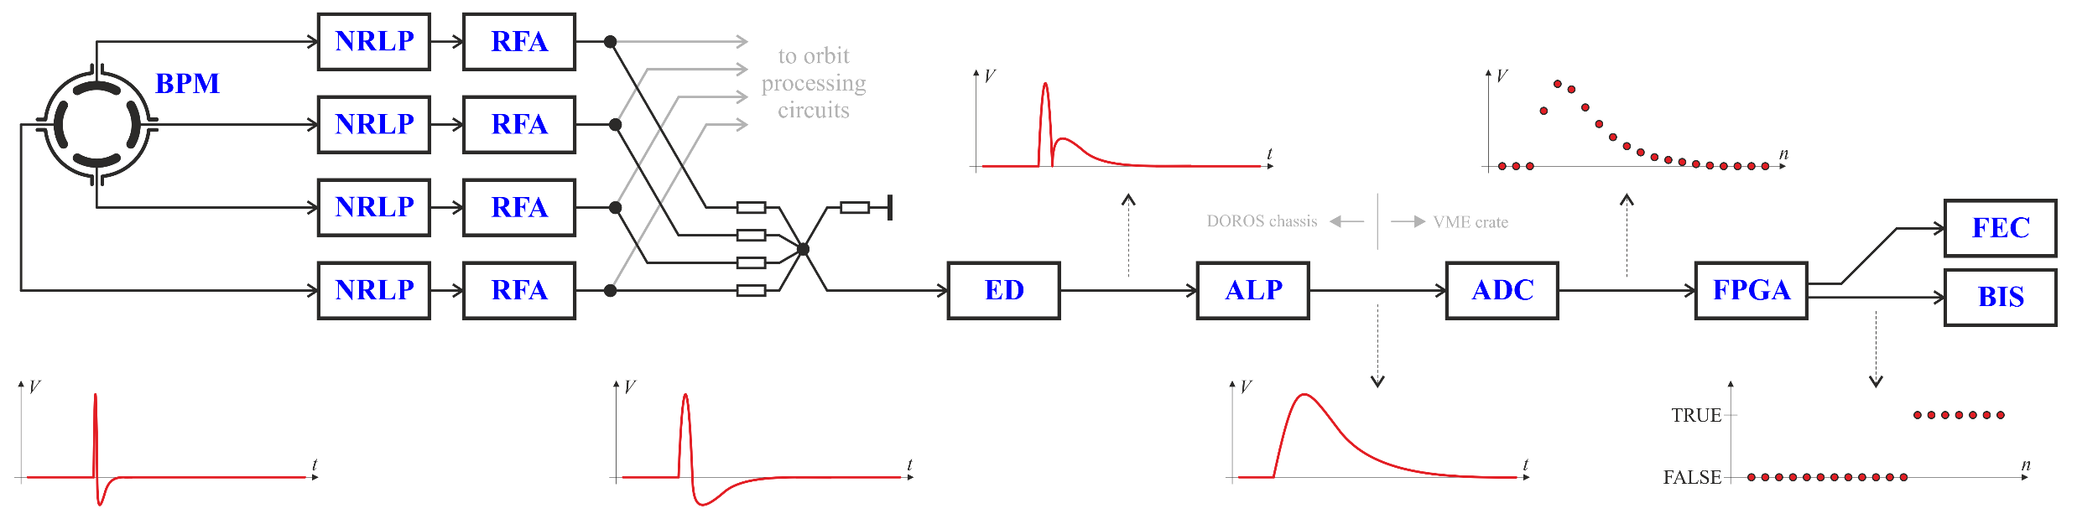
BCCM (dI/dt) system
shared BPMs:
system A: BPMYA.5R4.B1+B2
system B: BPMYA.6R4.B1+B2
NRLP – Non-Reflective Low-Pass (≈ 80 MHz)
RFA – RF Amplifier
ED – Envelope Detector
ALP – Active Low-Pass (≈ 2 MHz)
BCCM uses BPM signals with the position dependency removed by summing the electrode signals
Extensive analog processing to make the signals
as slow as possible, allowing digitization with the highest possible resolution: low-pass filtering, amplification, envelope detection/rectification, further filtering
Two operational redundant systems in UA47 ( A + B )
+ one R&D not connected to the BIS in UA43 ( C )
+ one R&D in the lab ( TST )
The BCCM dump triggers were unmasked on 8 April
(connection to BIC in September 2018)
Window [turn] | 1 | 4 | 16 | 64 | 225 | 1125
< 0.5 | 6 | 6 | 6 | 6 | 6 | 10
≥ 0.5 | 3 | 3 | 3 | 3 | 5 | 10
Energy [TeV] | Losses [1e11]

Slide 3
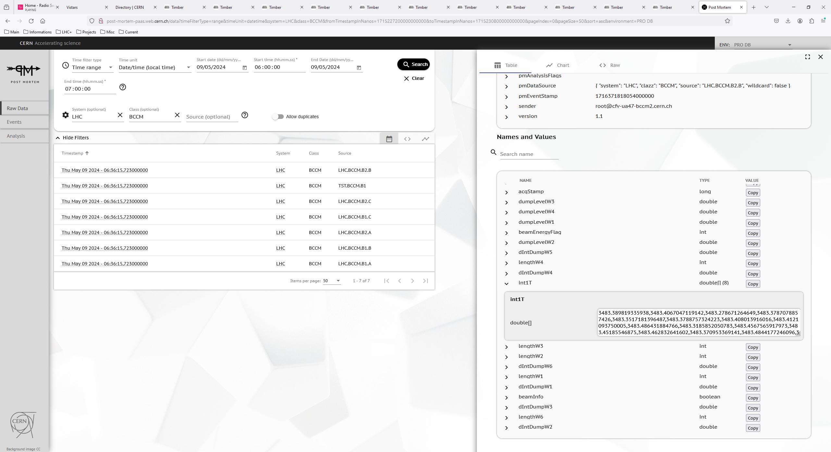
BCCM in service: first dump on 9 May (fill #9609)

Slide 4
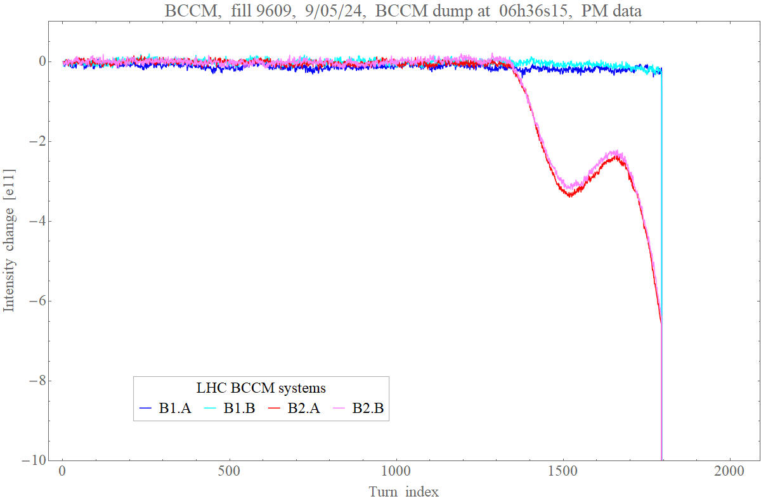
BCCM in service: first dump on 9 May (fill #9609)

Slide 5
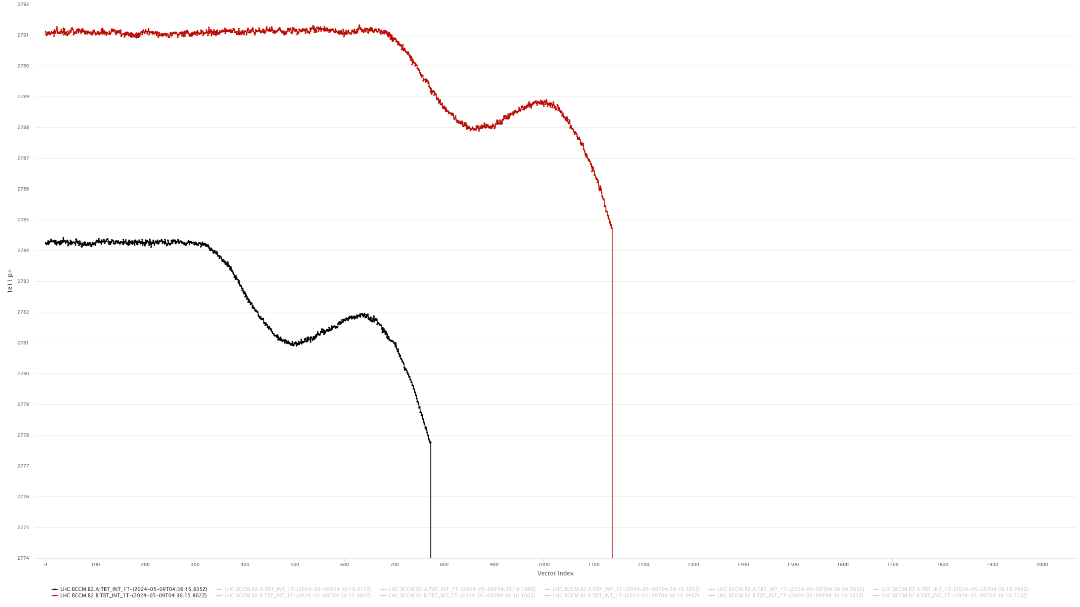
Dump #1: TbT intensity from the (continuous) logging
B2.B
B2.A

Slide 6
Dump #1: summary from the PM data
window | W1 | W2 | W3 | W4 | W5 | W6
length [turns] | 1 | 4 | 16 | 64 | 225 | 1125
dump level [e11] | 3 | 3 | 3 | 3 | 5 | 10
 |  |  | dtDumpFlag | [turn]
B1.A | 3 | 3 | 3 | 3 | 3 | 3
B2.A | 2 | 2 | 2 | 0 | 2 | 2
B1.B | 3 | 3 | 3 | 3 | 3 | 3
B2.B | 2 | 2 | 2 | 2 | 2 | 2
 |  |  | dIntDump | [e11]
B1.A | 2694.3 | 2694.4 | 2694.3 | 2694.5 | 2694.4 | 2694.4
B2.A | 2684.9 | 2685.0 | 2685.7 | 3.04 | 2688.4 | 2691.3
B1.B | 2704.8 | 2705.4 | 2705.5 | 2705.6 | 2705.7 | 2705.5
B2.B | 2700.0 | 2700.1 | 2700.7 | 2702.8 | 2703.5 | 2706.3

Slide 7
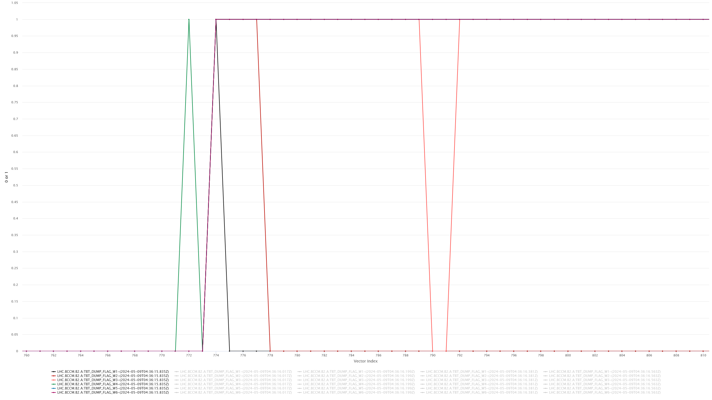
Dump #1: dump flags for system B2.A (TbT logging)
W4

Slide 8
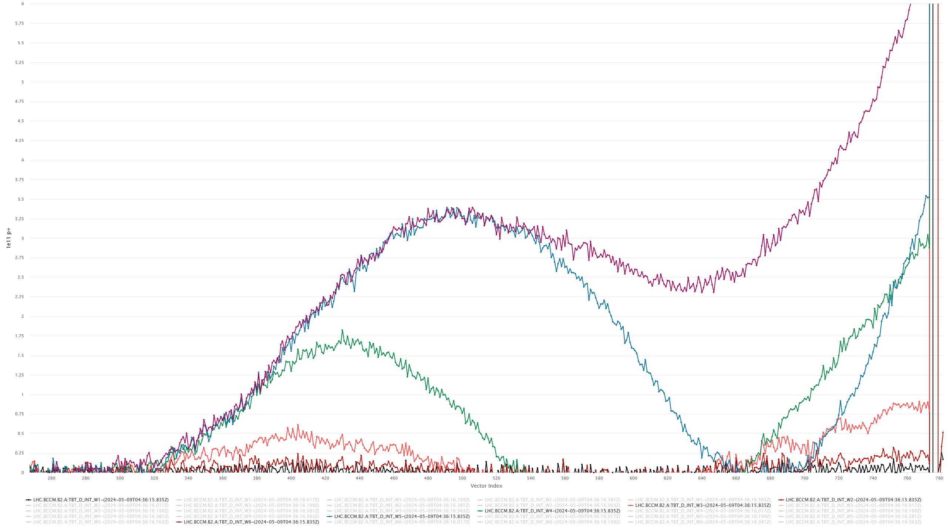
Dump #1: running sums for system B2.A (TbT logging)

Slide 9
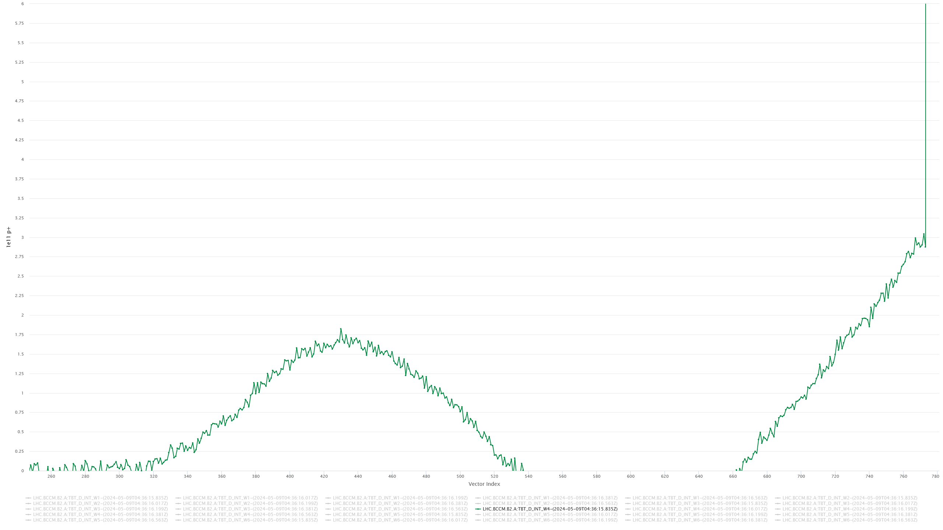
Dump #1: B2.A W4 running sum

Slide 10
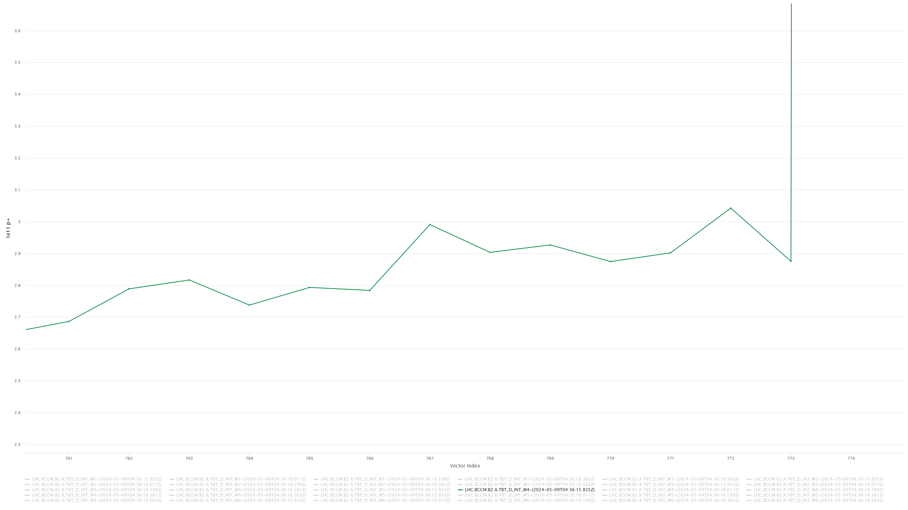
Dump #1: B2.A W4 running sum – zoom
3 e11

Slide 11
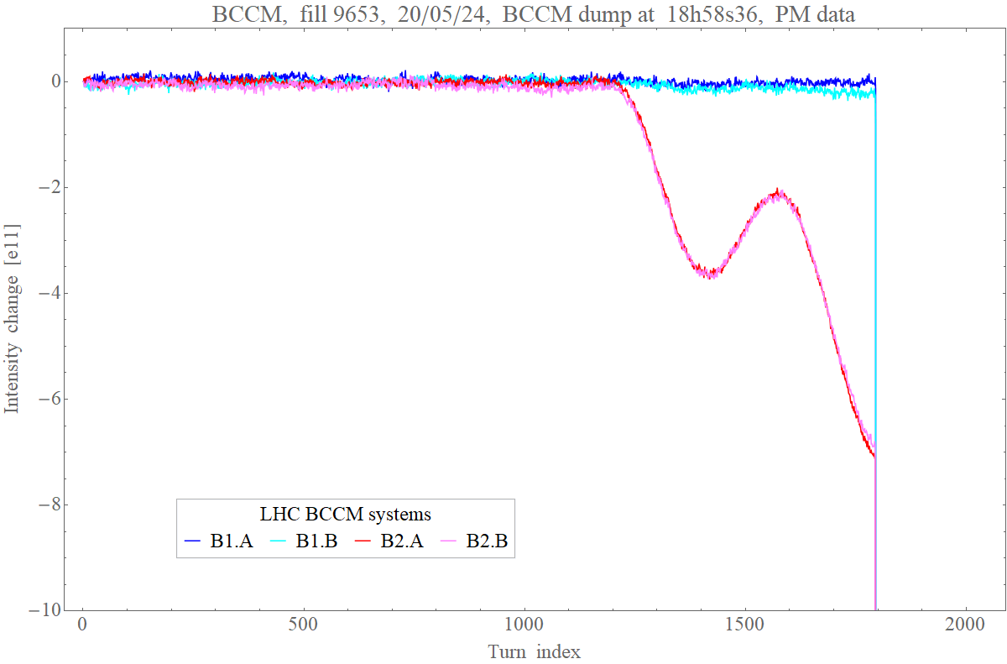
Dump #2 on 20 May (fill #9653)

Slide 12
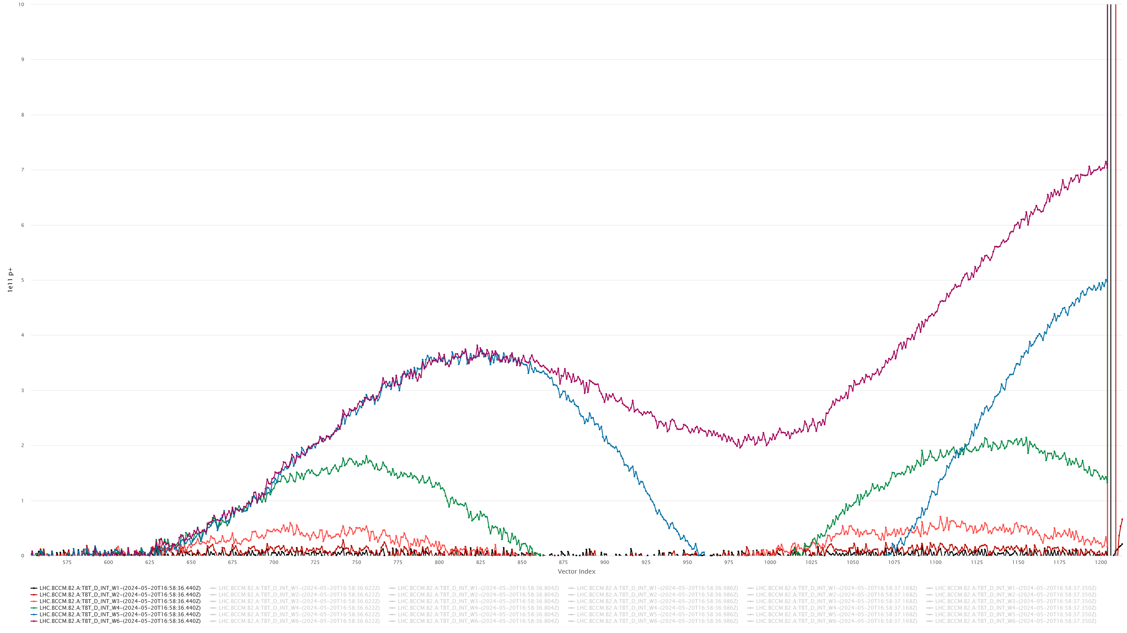
Dump #2: running sums for system B2.A (TbT logging)

Slide 13
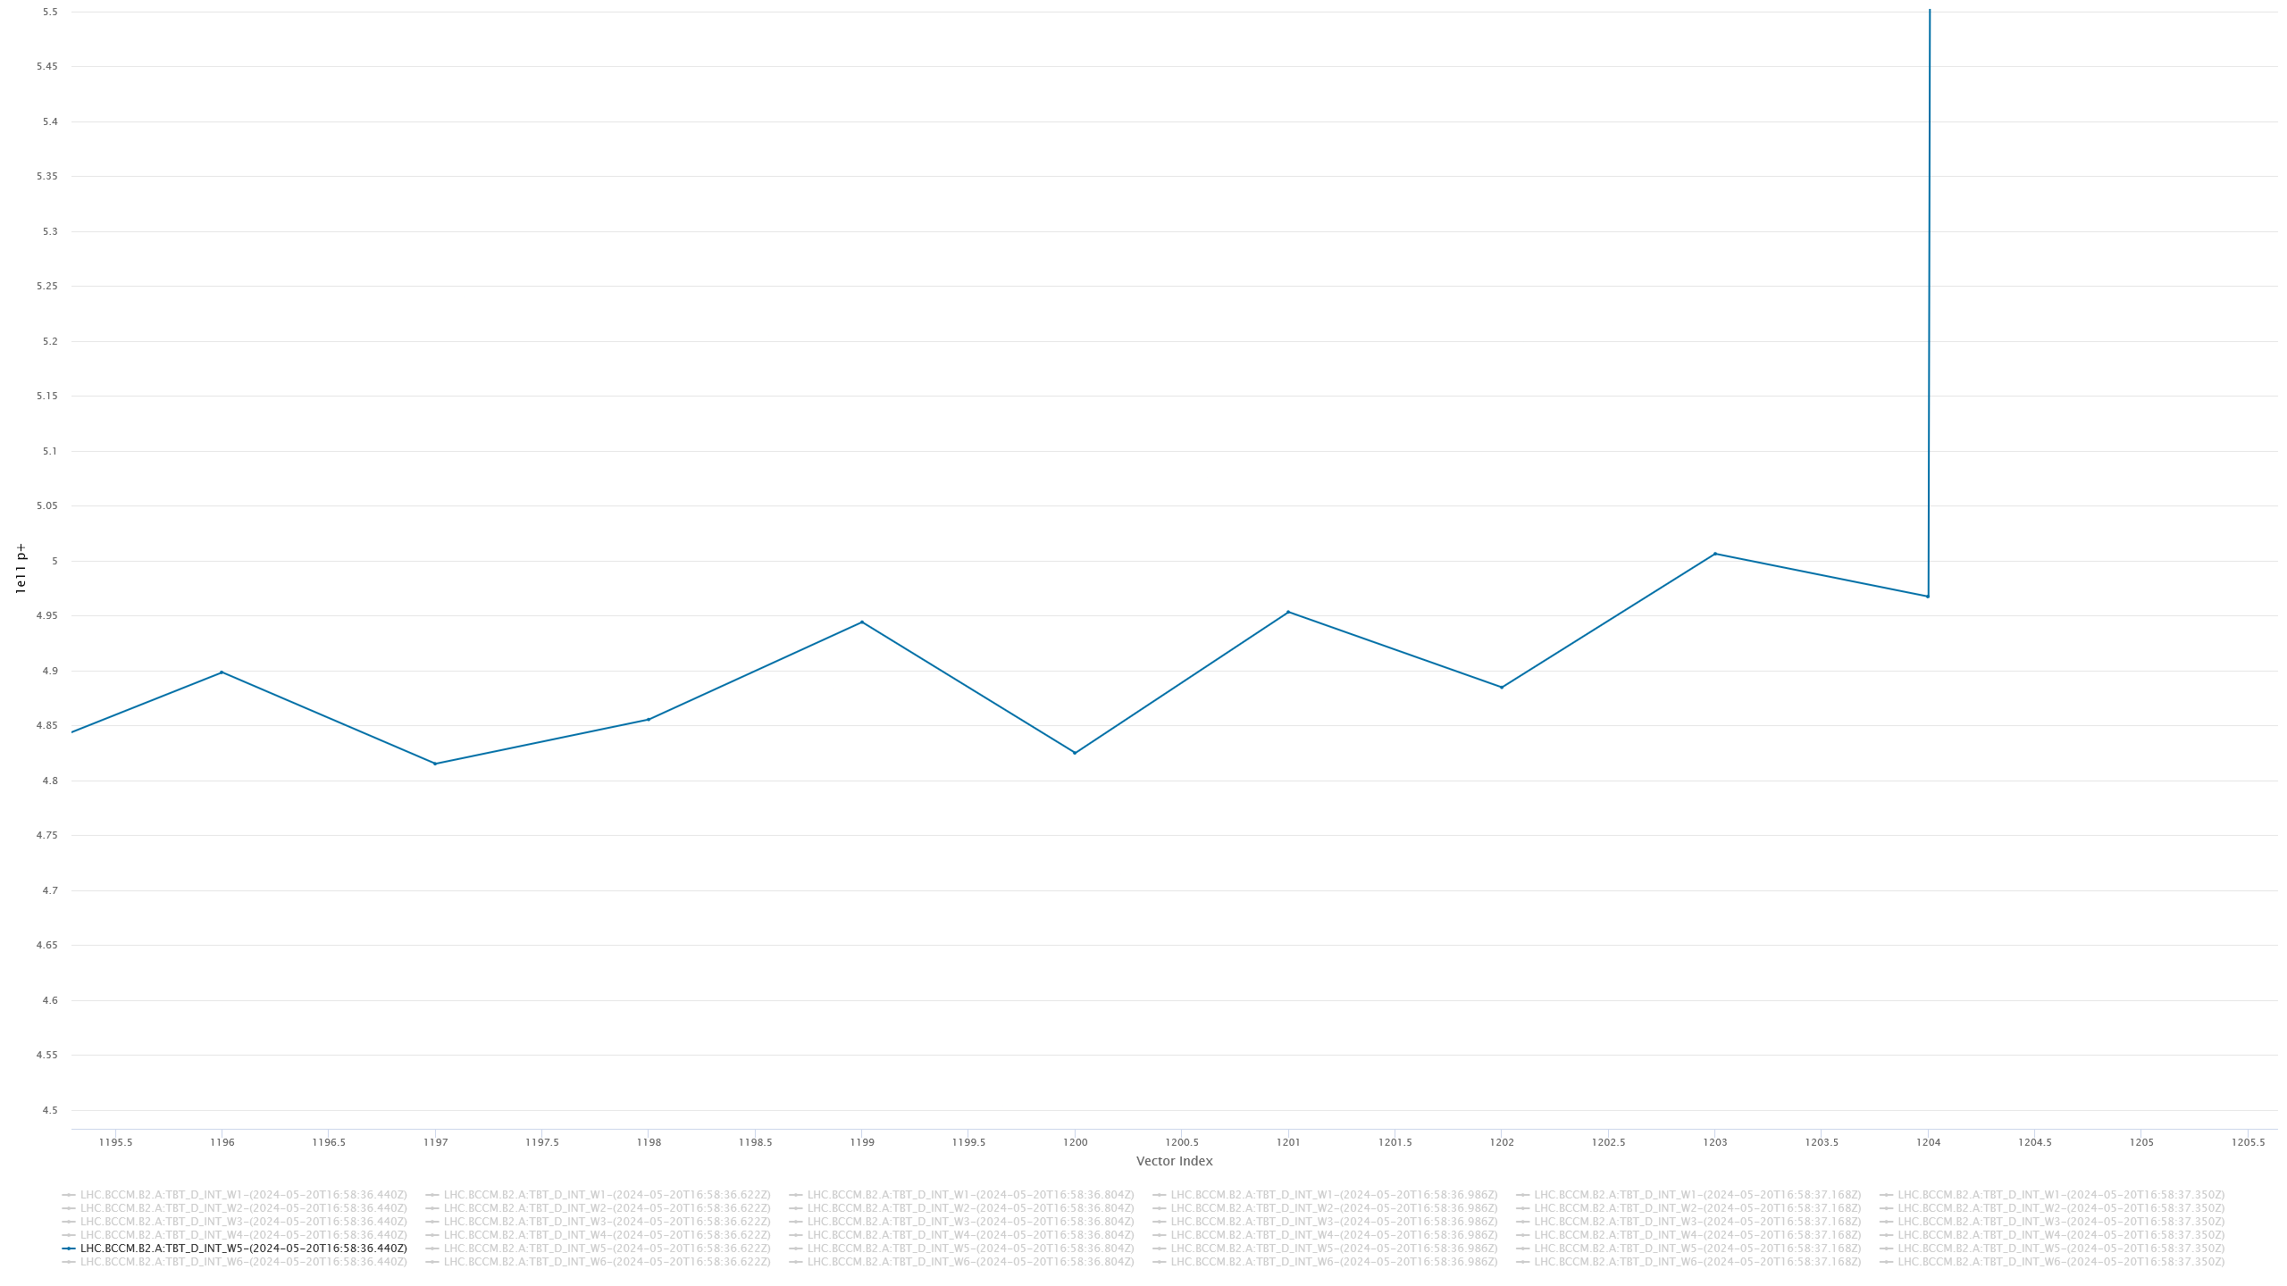
Dump #2: B2.A W5 running sum – zoom
5 e11

Slide 14
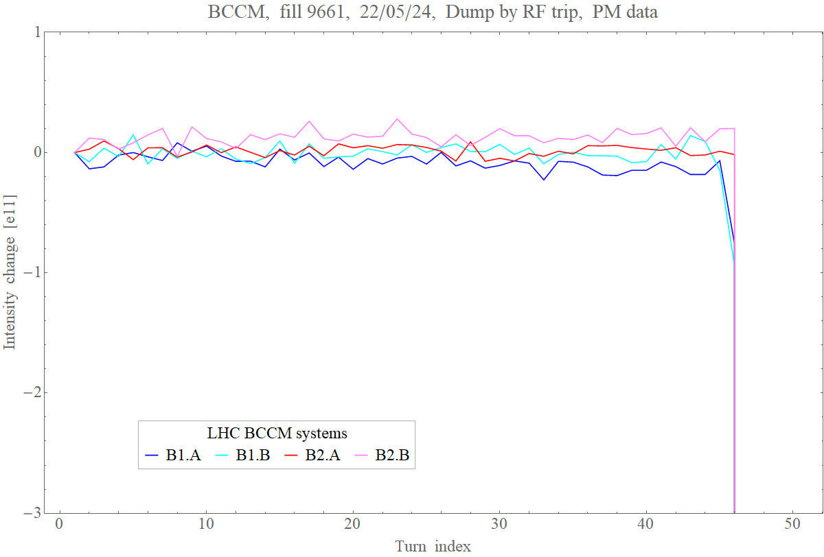
RF trip on 22 May (fill #9661)

Slide 15
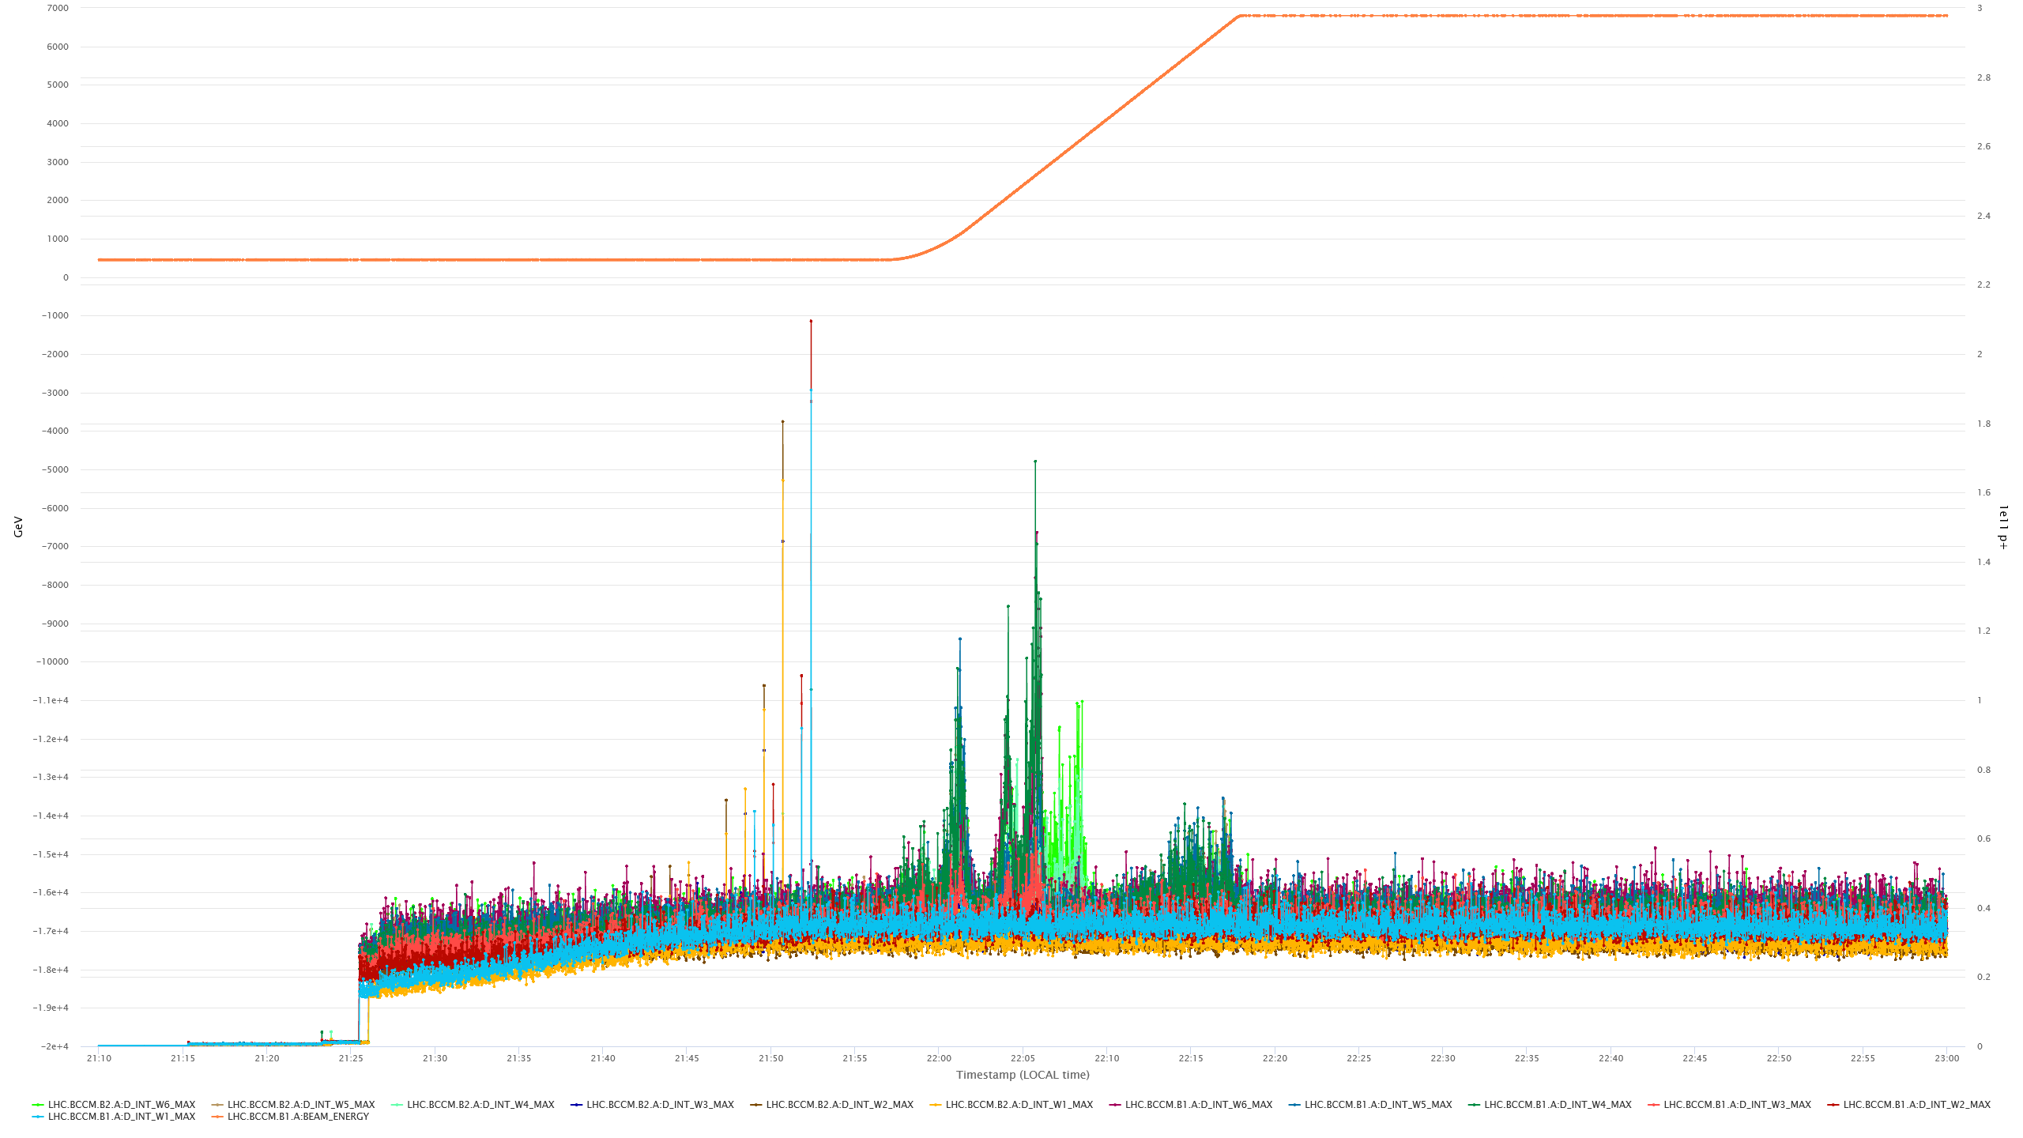
Weakness #1: sensitivity to the bunch length (oscillations)
energy
dI/dt signals
all windows
B1+2.A

Slide 16
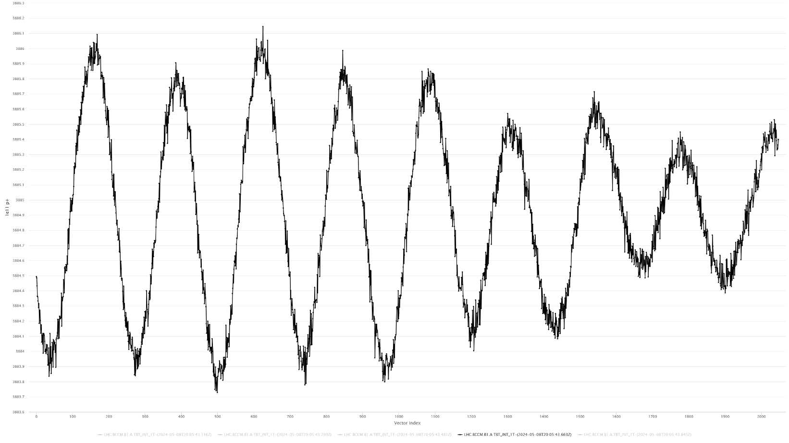
Weakness #1: sensitivity to the bunch length (oscillations)
Largest (TbT) intensity oscillations
are during the RF longitudinal blowup
Oscillations ≈ 2.5 e11 peak-peak
on intensity ≈ 3900 e11, i.e. ≈ 0.06 %,
which is a very small imperfection
for analogue signal processing
TbT intensity, B1.A
Beam signals are taken from BPMs, which are first order high-pass systems
The current performance has been achieved with flattening the system frequency characteristic in the range
≈ 20 – 80 MHz, which was done at the expense of sacrificing ≈ 75 % of the beam signal
FBCT signals were also used for tests, but with much worse results, despite the flat bandwidth ≈ 1 kHz – 80 MHz
After LS3 BCCM is planned to have dedicated BPMs, resulting in larger beam signals, which may allow extending
the system bandwidth with flat frequency response. The wider flat response MAY reduce the bunch length sensitivity.

Slide 17
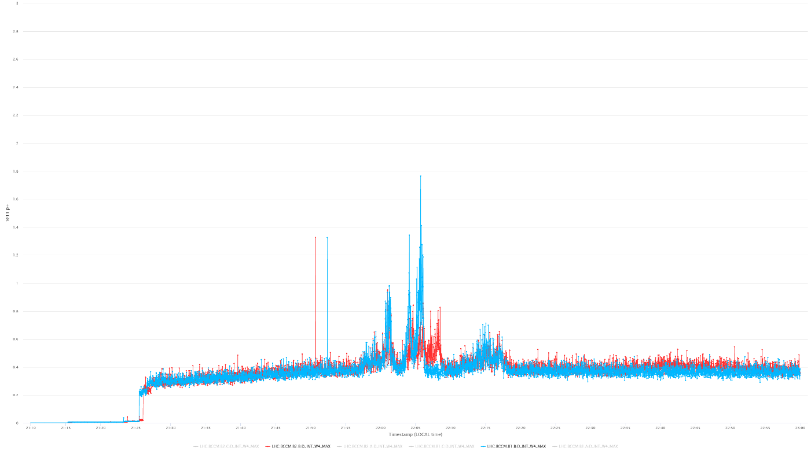
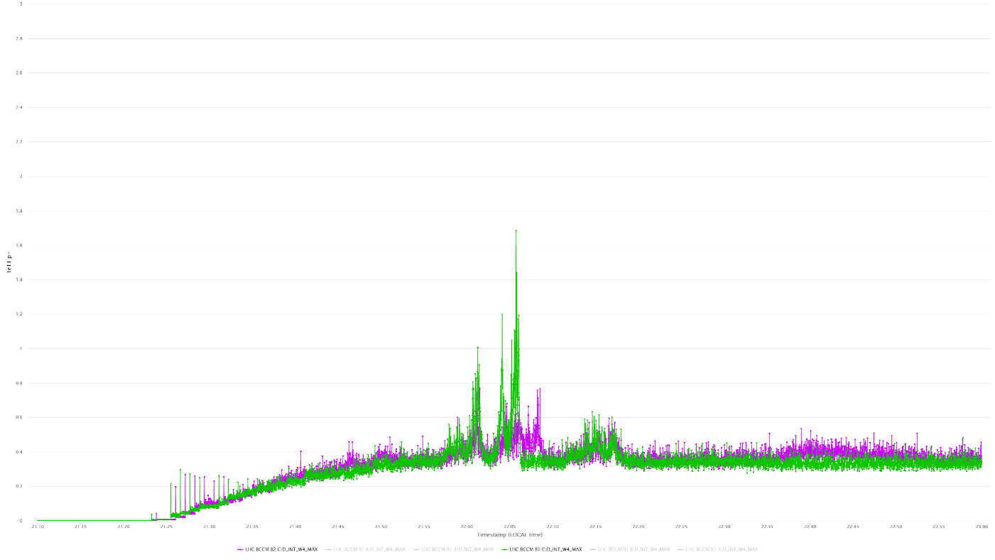
Weakness #2: spurious dI/dt signals during injections
W4 dI/dt
system A
W4 dI/dt
system C
Related to baseline shifts caused by the signal duty cycle increasing during the filling of the machine
Special settings on R&D system C allowed almost complete reduction of the spurious signals,
at the expense of very unfavourable settings for small intensities (pilots not seen at all)
Ongoing FPGA code development to allow more flexible settings, which should be optimal for all intensities
Hope to deploy the new code on system C during TS1 and test it during the rest of the run.
Then we report the results to decide whether the new code should be used operationally during the 2025 run.

Slide 18
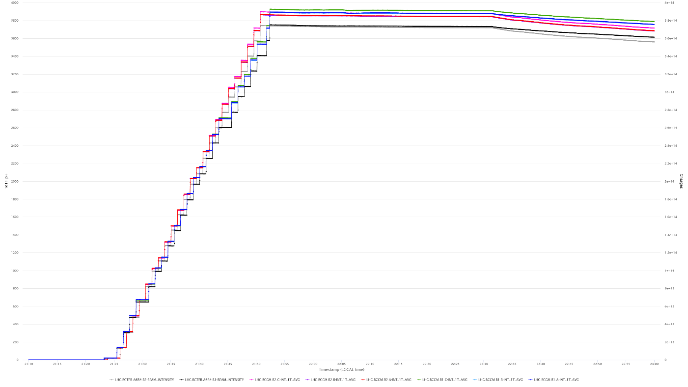
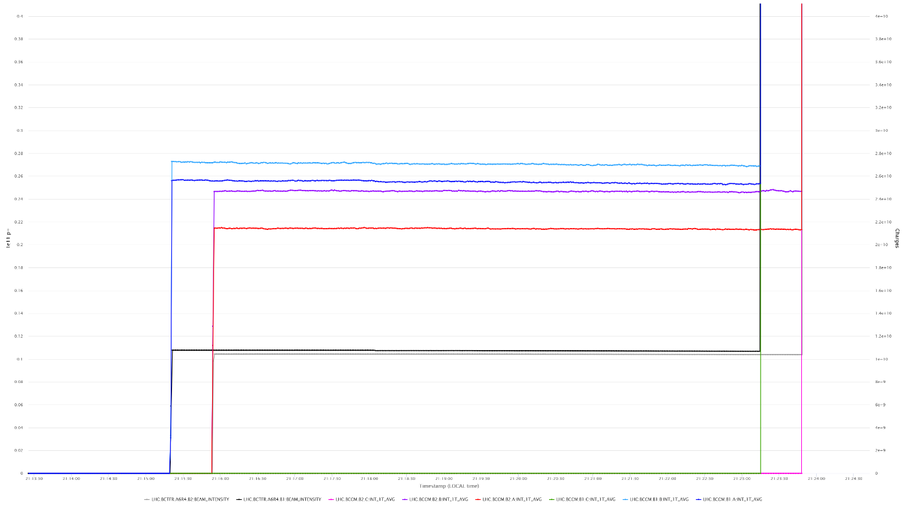
Weakness #3: Intensity overestimation for larger bunch spacing
pilots
B1.A, B1.B, B1.C
B2.A, B2.B, B2.C
FBCT.B1, FBCT.B2
full machine
Related to “unconventional” usage of a key RF component (an envelope detector chip), which, however,
cannot be replaced by anything else without deteriorating the system performance
Ongoing long-term hardware development to use the critical component in a different way, involving much faster sampling
(completely new 16-bit acquisition with 200 MHz sampling, different filtering and amplification)

Slide 19
Conclusions and outlook
BCCM is operational and reliable
Two dumps triggered so far, both related to beam debunching after an RF trip.
In both cases the system acted as expected designed.
During physics fills the 64-turn window (W4) is typically the closest to the dump trigger level,
with the highest values of ≈ 60 % during the RF longitudinal blowup
System has not undergone a thorough testing with beam.
Dedicated beam time is needed.
PM automatic analysis module is being discussed
Weaknesses of the system:
    Spurious dI/dt during injections:
    being addressed in the FPGA code, deployment potentially for the startup 2025
    Intensity overestimation for larger bunch spacing:
    ongoing development to increase the sampling rate to 200 MHz, to be able to relax filtering on the envelope detector block; some hope to test with beam on system C before LS3
    Sensitivity to the bunch length oscillations:
    potentially addressed after LS3, with larger signals from dedicated new BCCM BPMs

Slide 20
Spare slides

Slide 21
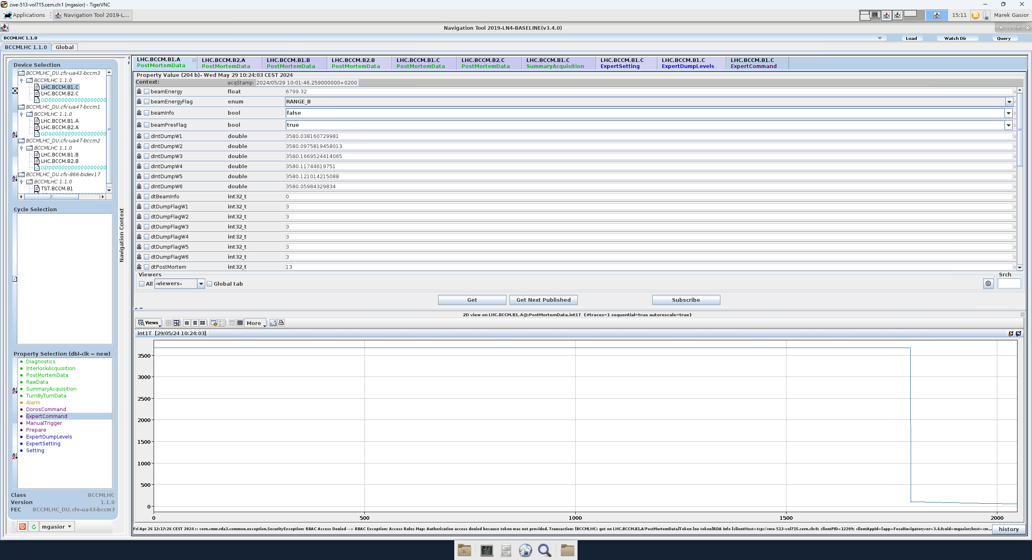
BCCM FESA post-mortem

Slide 22
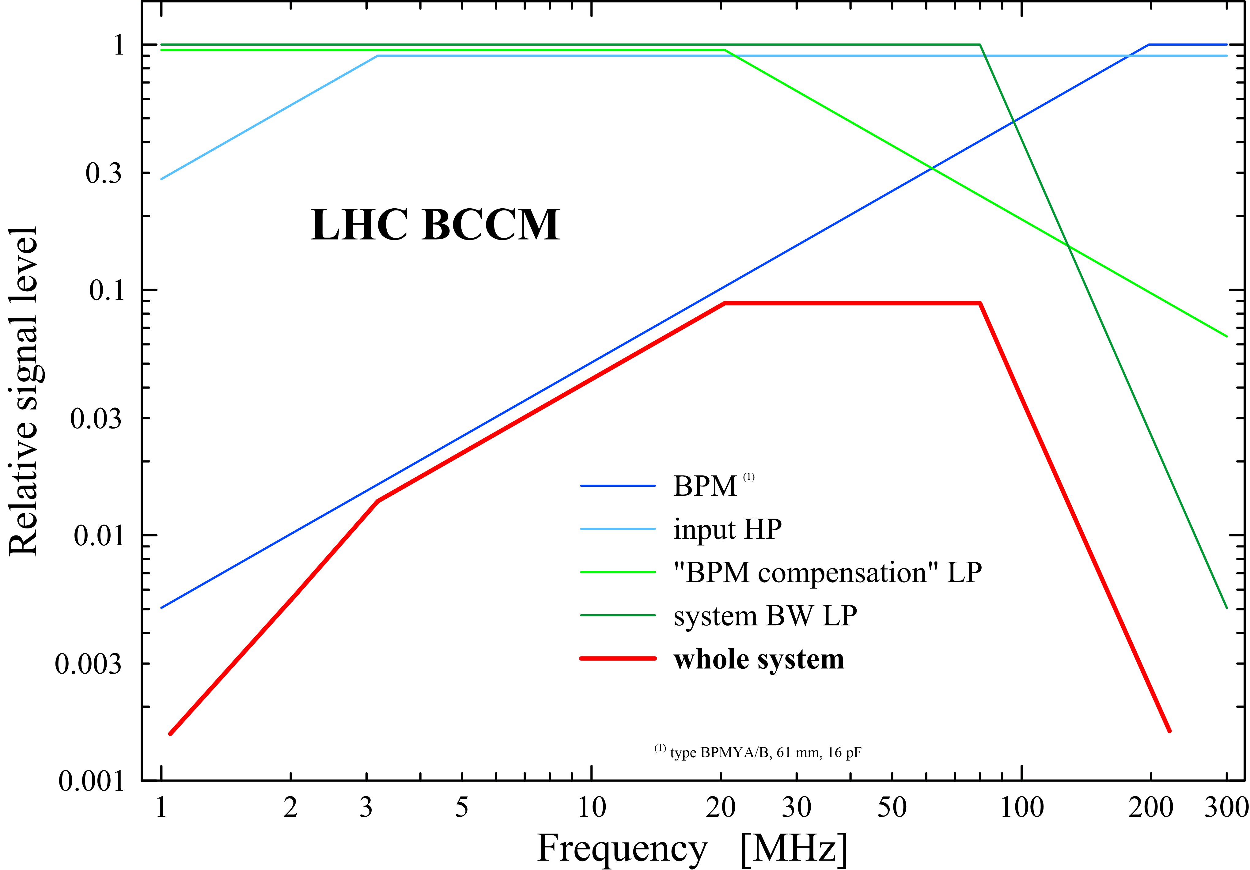
BCCM bandwidth

Slide 23
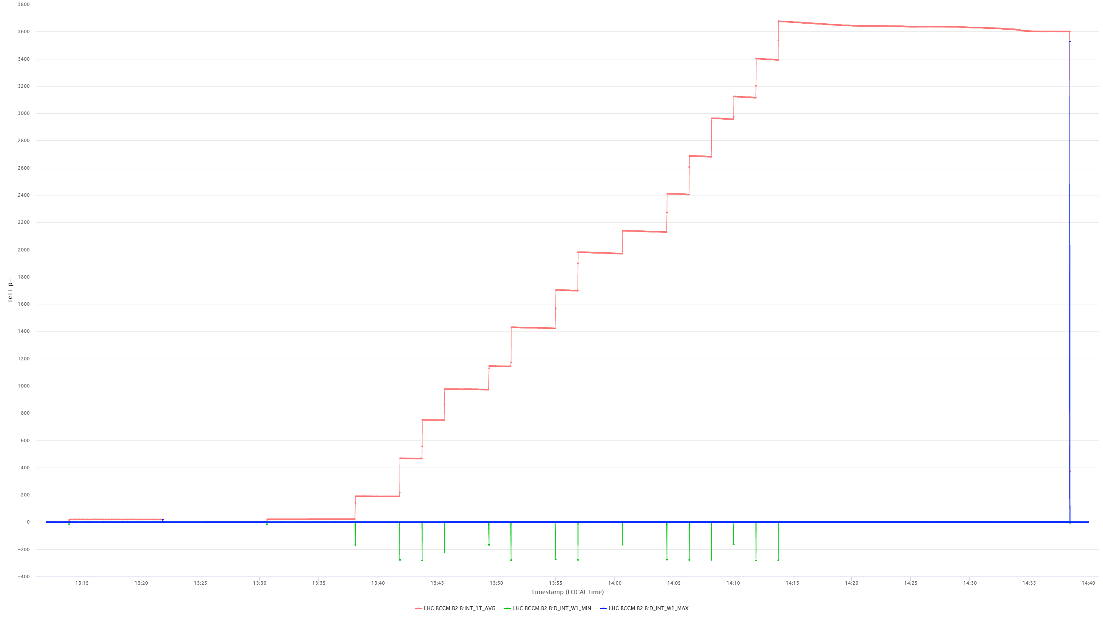
BCCM (– dI/dt) polarity convention
positive dI/dt signals = beam loss
negative dI/dt signals = beam gain (injections)
beam intensity
dI/dt positive = intensity decrease
(here a beam dump)
dI/dt negative = intensity increase
(here beam injections)

Slide 24
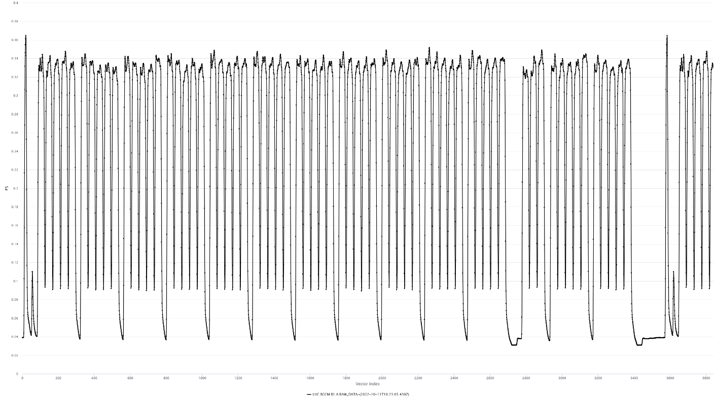
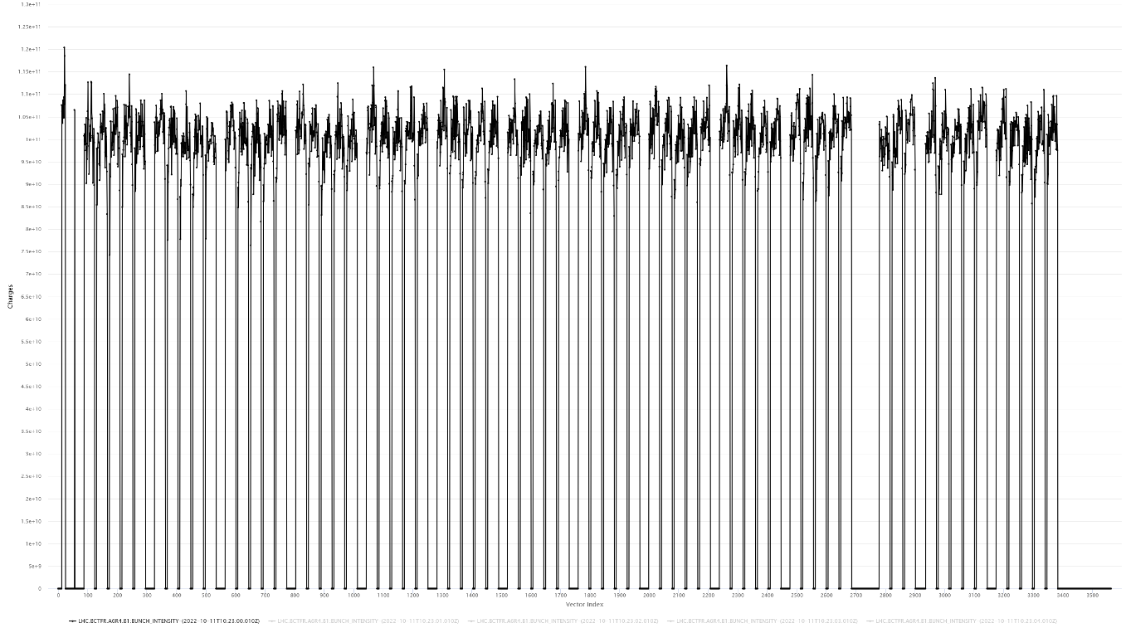
25 ns data: BCCM vs FBCT
one turn of BCCM data with full machine
one turn of FBCT data with full machine

Slide 25
Dump threshold levels
Window [turn] | 1 | 4 | 16 | 64 | 225 | 1125
< 0.5 | 6 | 6 | 6 | 6 | 6 | 10
≥ 0.5 | 3 | 3 | 3 | 3 | 5 | 10
Energy [TeV] | Losses [1e11]
Window [turn] | 1 | 4 | 16 | 64 | 225 | 1125
< 0.5 | 1 | 1 | 1 | 1 | 1 | 1.7
≥ 0.5 | 0.5 | 0.5 | 0.5 | 0.5 | 0.8 | 1.7
Energy [TeV] | Relative losses [‰] (FS = 6e14)

Slide 26
BCCM (dI/dt) system
shared BPMs:
system A: BPMYA.5R4.B1+B2
system B: BPMYA.6R4.B1+B2
NRLP – Non-Reflective Low-Pass (≈ 80 MHz)
RFA – RF Amplifier
ED – Envelope Detector
ALP – Active Low-Pass (≈ 2 MHz)
The system is based on BPM signals shared with the LHC beam position measurement system (passive RF splitters)
The beam position dependence is removed by summing the four electrode signals
Analog operations on the signals: low-pass filtering, amplification, envelope detection + rectification + level shifting, low pass filtering
Digitization: 16-bit, 40 MHz sampling synchronous to the circulating beam (one revolution period is exactly 3564 ADC clocks).
The 40 MHz ADC B1 and B2 clocks are derived from the 400 MHz RF frequencies received by optical fibers from the RF system.
One turn “raw intensity” is a sum of ADC samples above a “beam presence threshold” minus “no beam offset”, selected from one turn 3564 samples
One turn “raw dI/dt signal” is a difference of the one turn raw integrals from two consecutive turns
“Raw dl/dt signals” in the five other integration windows are calculated as running sums of the one-turn “raw dI/dt signals”
Every turn each of the “raw dI/dt signals” are compared to its corresponding raw dump threshold level and potential beam dump triggers are generated.
All real-time calculations are done in the FPGA in an integer arithmetic.
The BCCM absolute intensities in elementary charges are calculated by scaling the “raw intensities” using a “BCCM/BCT scaling factor”.
The factor is a constant for each system and is obtained by matching the beam intensity evaluated by the BCCM to the corresponding BCT readings.
The absolute dump thresholds in elementary charges are translated into “raw dump thresholds” using the same “BCCM/BCT scaling factor”.

