Slide 1
Planned adjustment of the temperature interlock of the BBCW
Adriana Rossi @ 251st MPP meeting – 31 May 2024

Slide 2
Outline
Recall on how the BBCW temperature interlock and the measurements made on the spare wire-in-jaw to establish the threshold value
TCTPH.4L5.B1 wire over threshold
Results from the tests in the machine (TCTPH.4L5.B1 and TCTPH.5R5.B2 for comparison)
Outlook

Slide 3
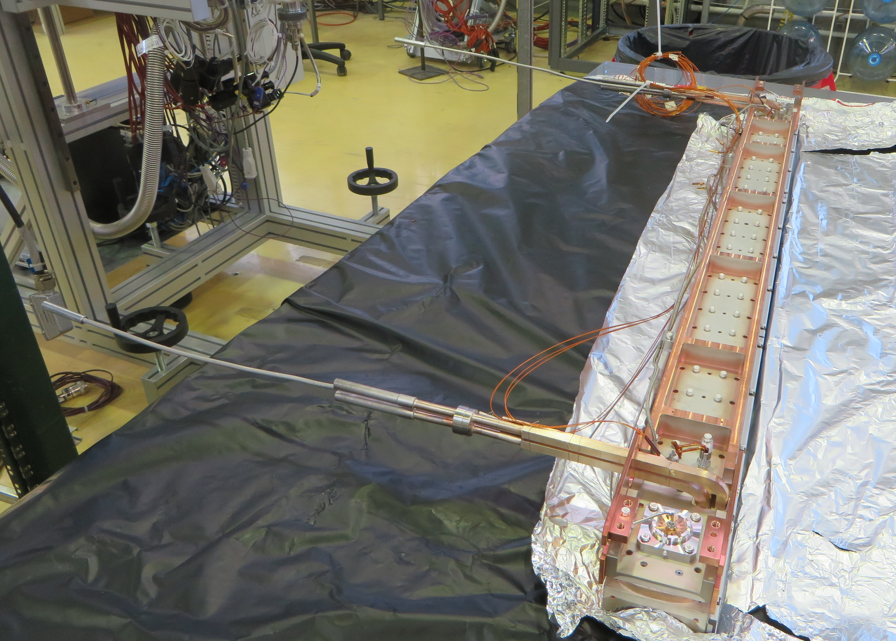
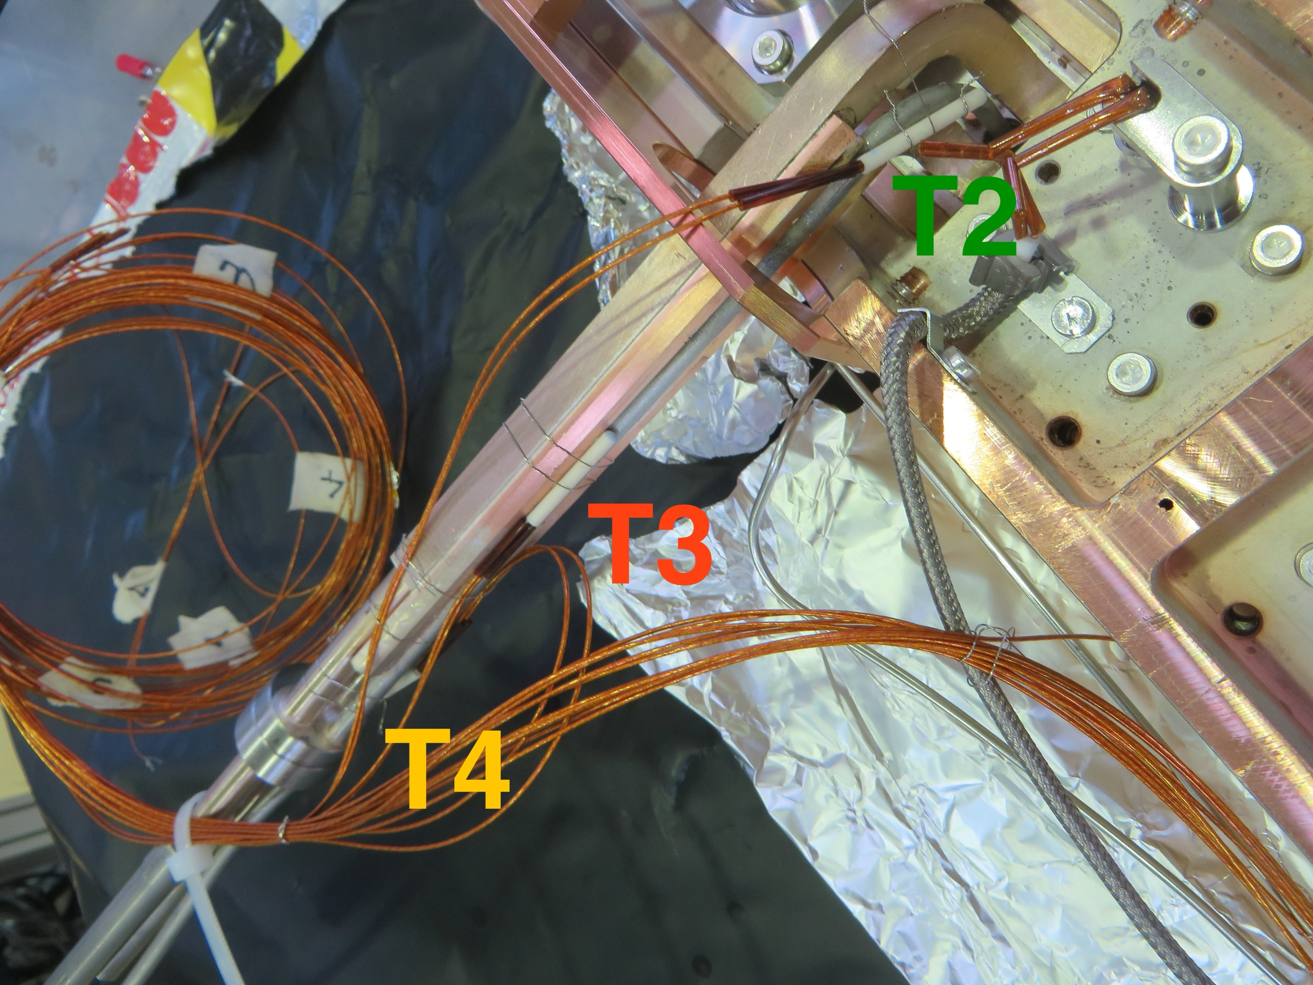
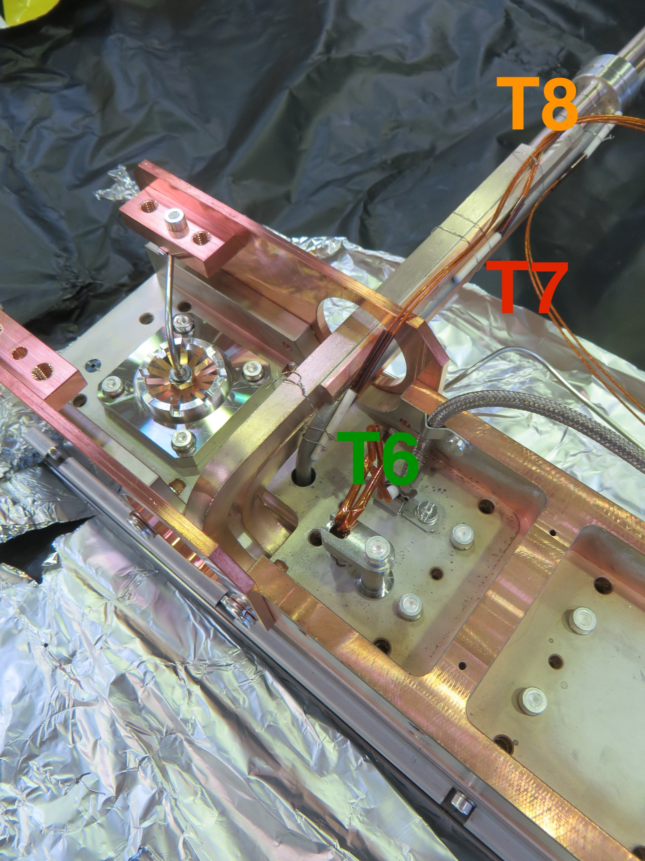
Spare wire-in-jaw equipped with T sensors

Slide 4
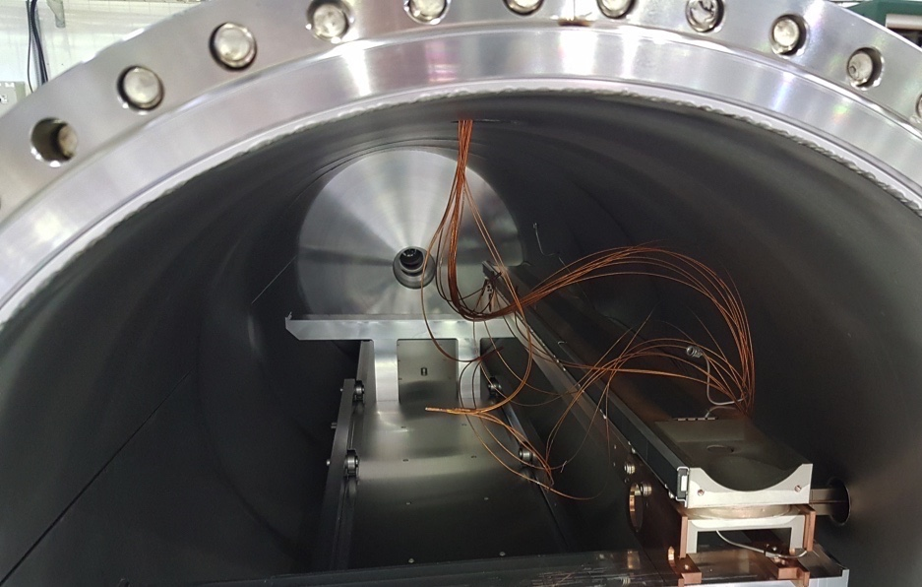
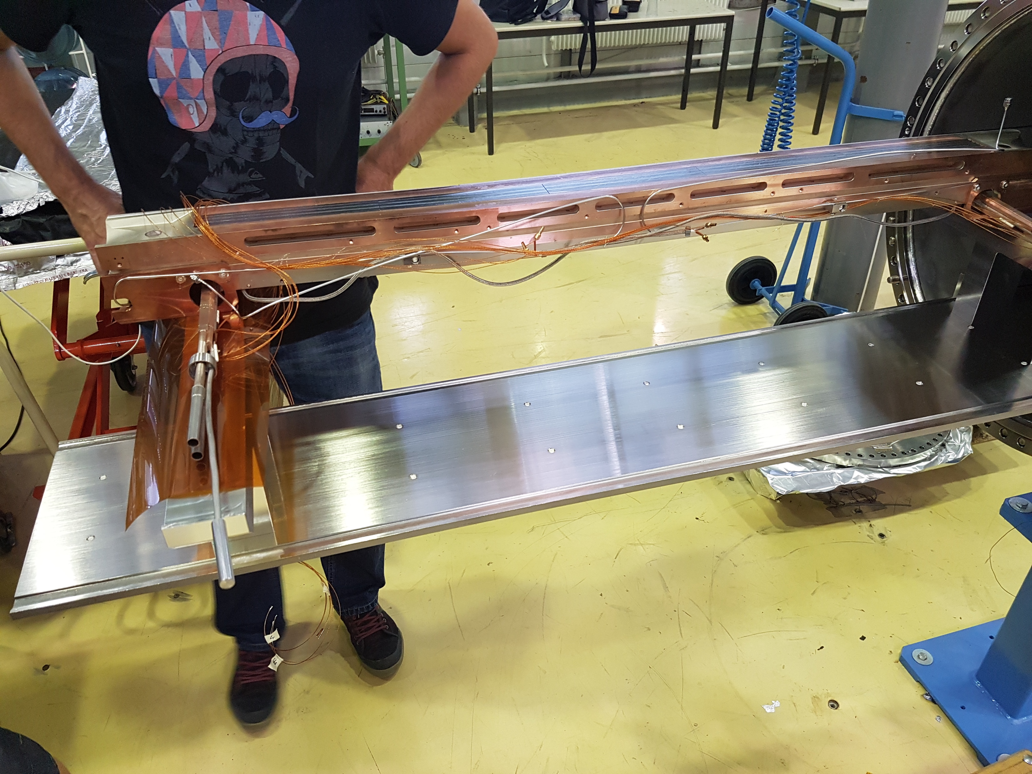
Spare wire-in-jaw equipped with T sensors
W jaw insert
Pick-up button

Slide 5
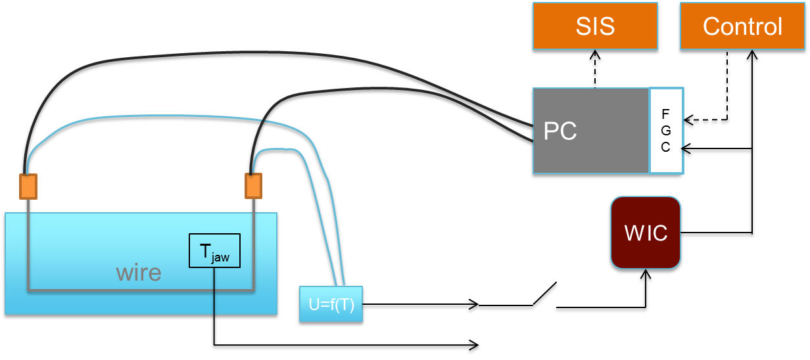
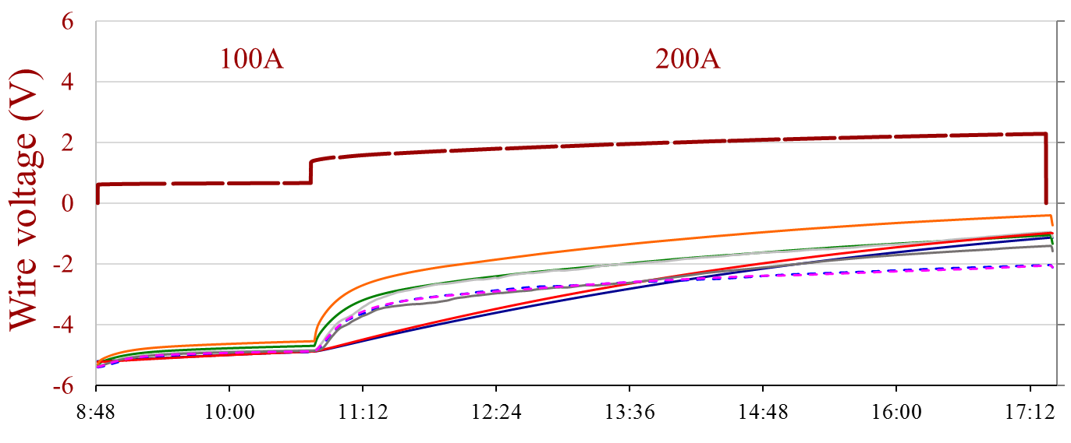
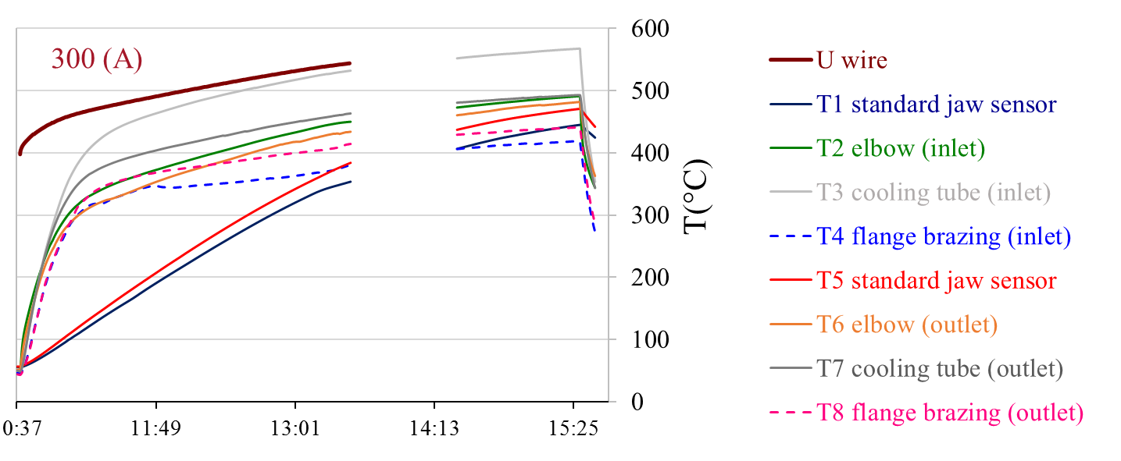
Wire interlock threshold determined with measurements under vacuum / without cooling
Note the time evolution of several minutes

Slide 6
Wire interlock threshold
Wire resistivity f(T)
If wire voltage > 2.6V*
= if hottest point @ 300A inside vacuum ~ 200°C, WIC cuts the PC
WIC dumps at the ~ same time
Long time constant of system, no constraints on collimator HW
✵ this also correspond to Iw=375A @RT

Slide 7
T interlock triggered on TCTPH.4L5.B1
Interlock tested @ 375A
Wire temperature measured in situ for 20-25 min @ 350A
Around Easter, interlock triggered after ~ 40 min @ 350A only on this collimator
Operation resumed after rMPP @ 315A

Slide 8
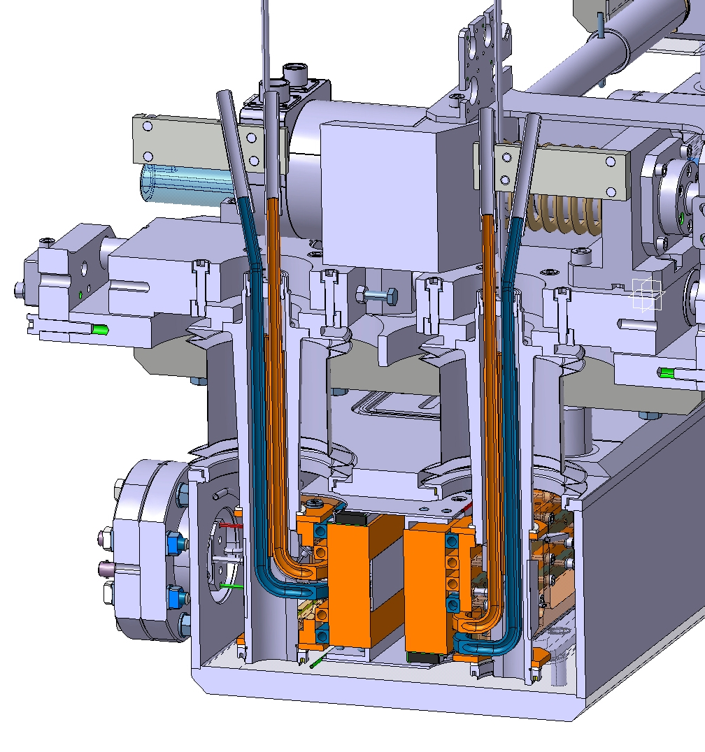
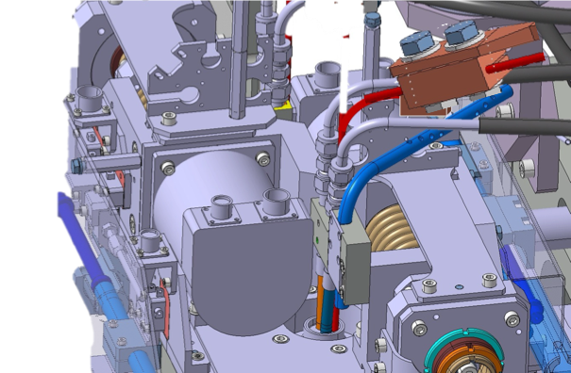
Wire after repair (courtesy of L. Gentini)

Slide 9
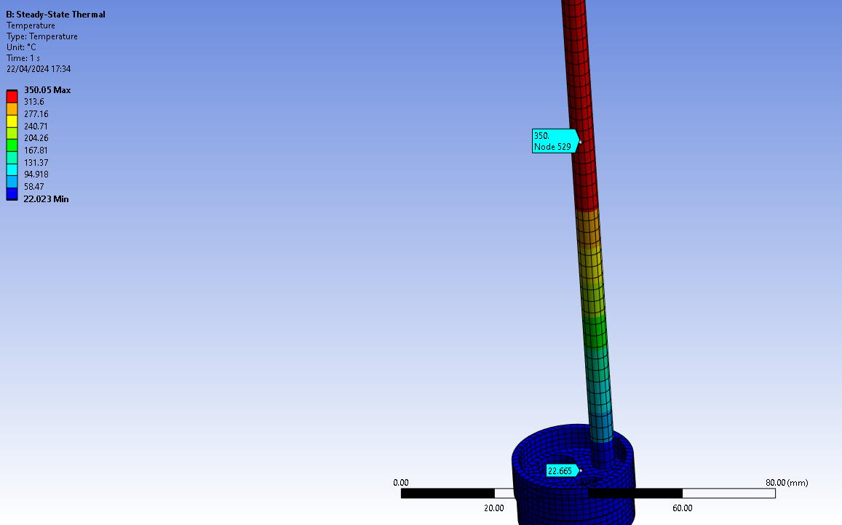
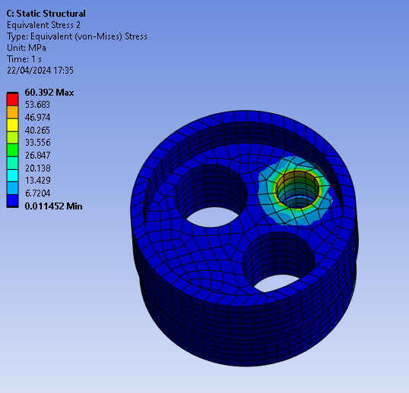
T simulations (courtesy of F. Carra)
350ºC
Very pessimistic assumptions
Ignoring point of anchor
22ºC

Slide 10
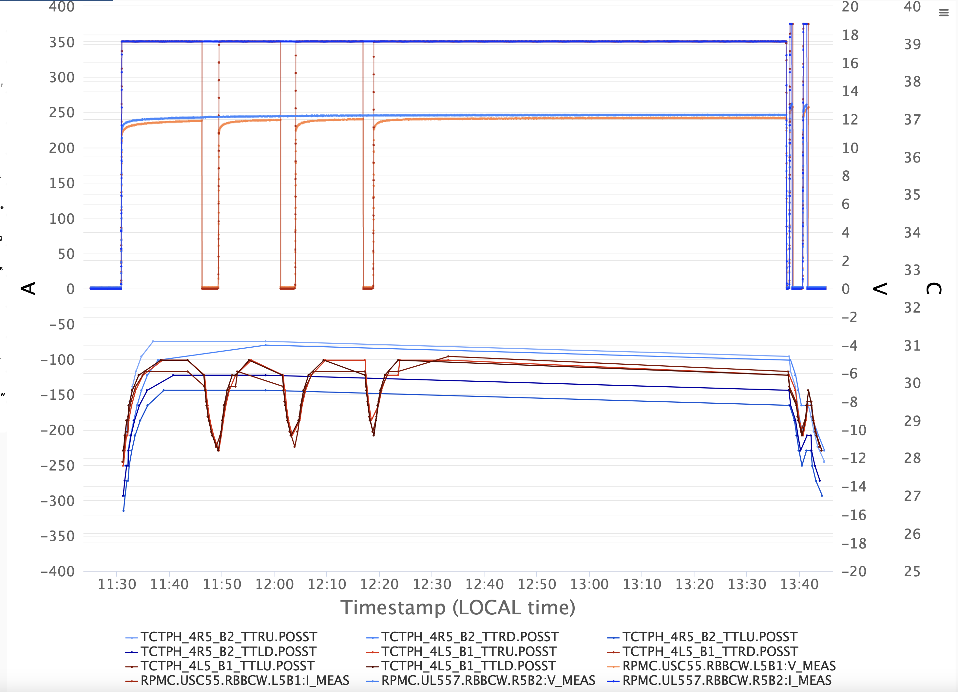
Test on 4 April 2024
interlock triggered by moving cables
Voltage @ Power Converter ( )
Test of interlock @ 375A with new threshold
Interlock while modifying the threshold value
Jaw temperature (º )
( ) Wire current
Interlock while just touching the voltmeter cable to thd lvl 1-1

Slide 11
Threshold values (each wire has a reading + card)
2.7V
2.7V
2.85V
2.7V
2.7V
2.7V
2.85V
2.7V

Slide 12
Conclusions and outlook
Tests show that the wire temperature inside the collimator reaches equilibrium around 30ºC, both on TCTPH.4R5.B2 and TCTPH.4L5.B1
One wire-in-jaw exceeds threshold at 350A
If rising the threshold (by < 6%), the voltage measured across the wire goes to equilibrium, indicating that there is no temperature run away
The T externally to that wire was measure > 300ºC: could it be the clamp not tighten as elsewhere?
TS1
➔ Tighten the connection suspected to cause the problem
➔ Repeat tests @ 350A over 1h or more measuring the temperature outside (still to see how)

Slide 13
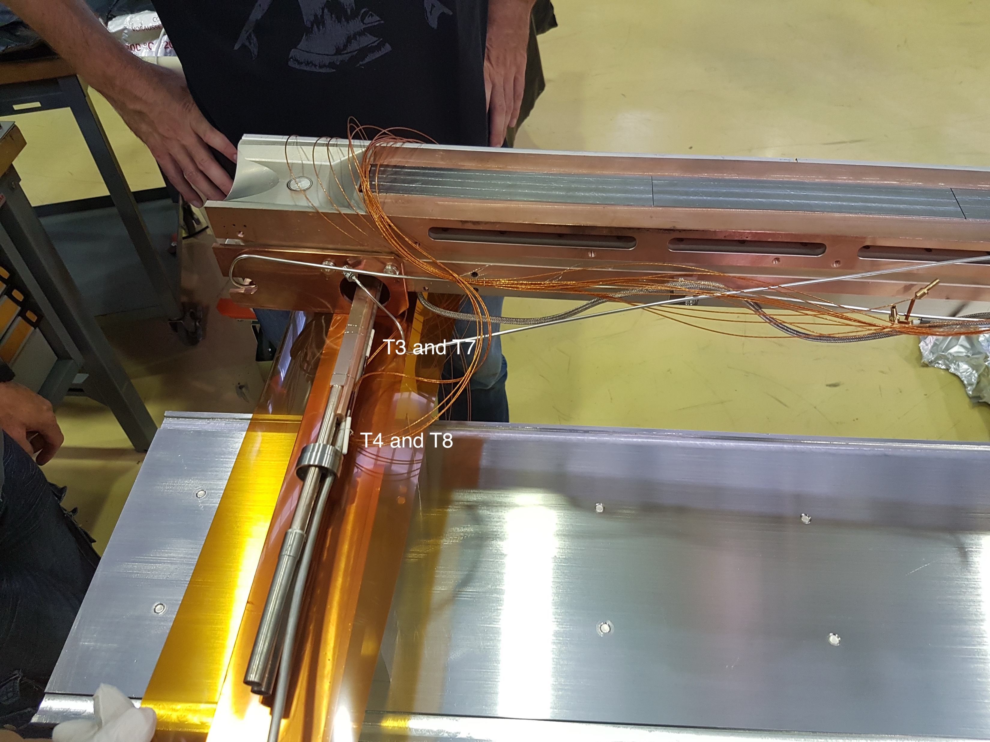
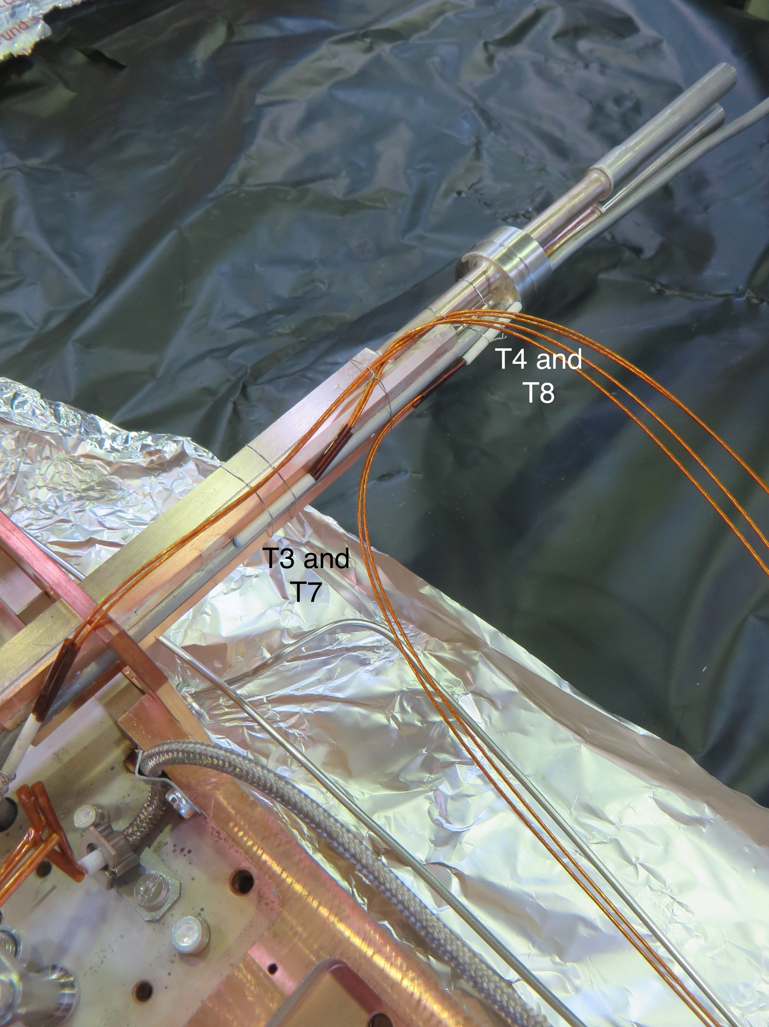
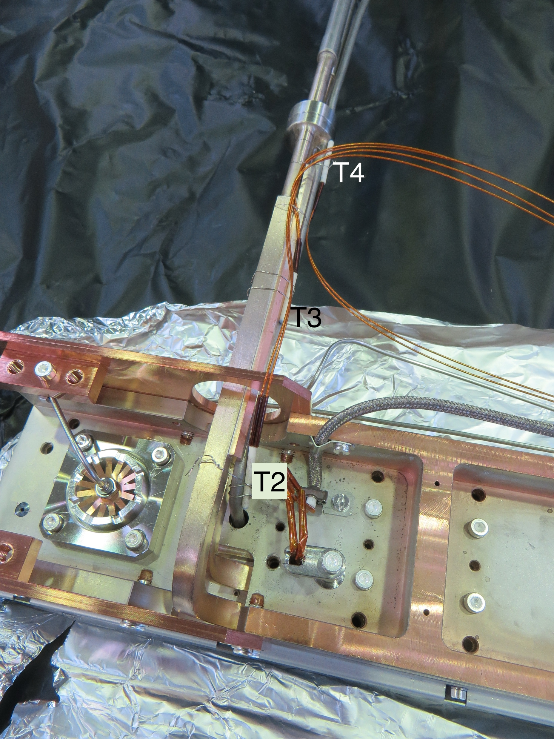
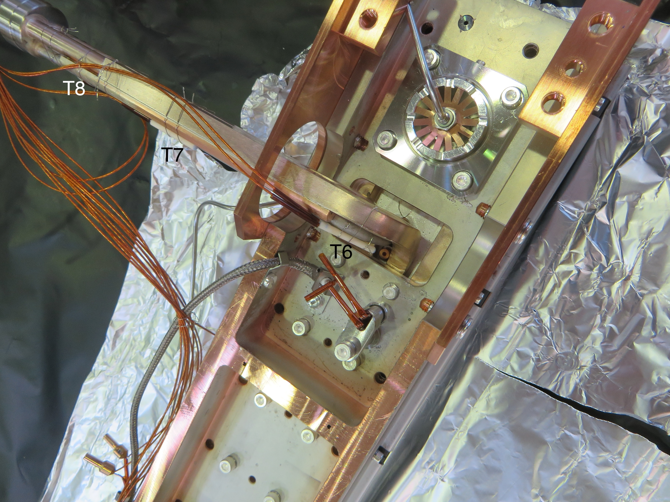

Slide 14
