Slide 1
Procedure in case of issues with sparking RF fingers
C. Hernalsteens, A. Lechner, C. Wiesner, J. Uythoven, D, Wollmann

Slide 2
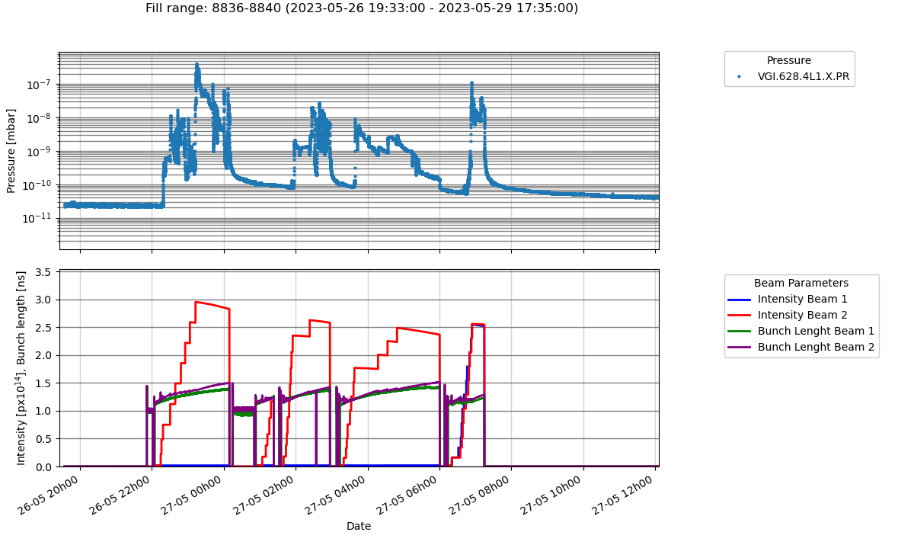
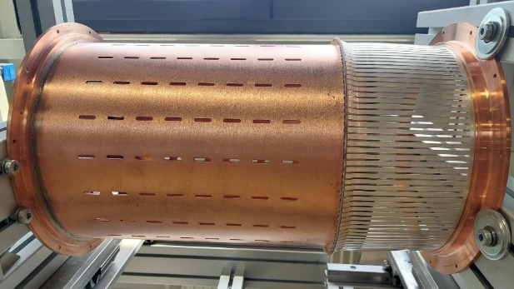
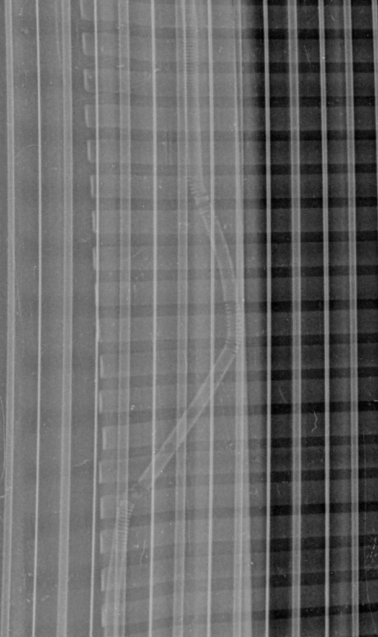
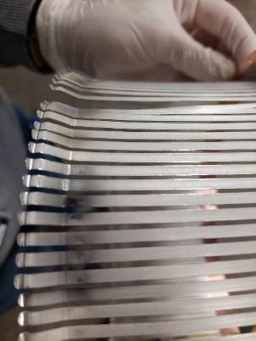
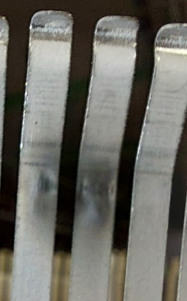
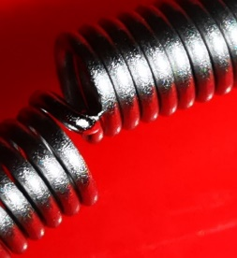
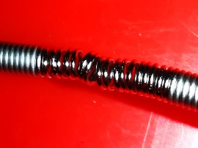
Motivation – 2023 4L1
End of May 2023 beam losses were observed at the triplet left of IP1, leading to beam aborts during the ramp.
The losses were traced back to vacuum pressure spikes in the warm vacuum modules in cell four L1, caused by sparking RF fingers following a damage of the spring in a VMBG type vacuum module.
The module was replaced and operation continued with bunch intensities limited to 1.6e11 ppb.
Courtesy G. Bregliozzi

Slide 3
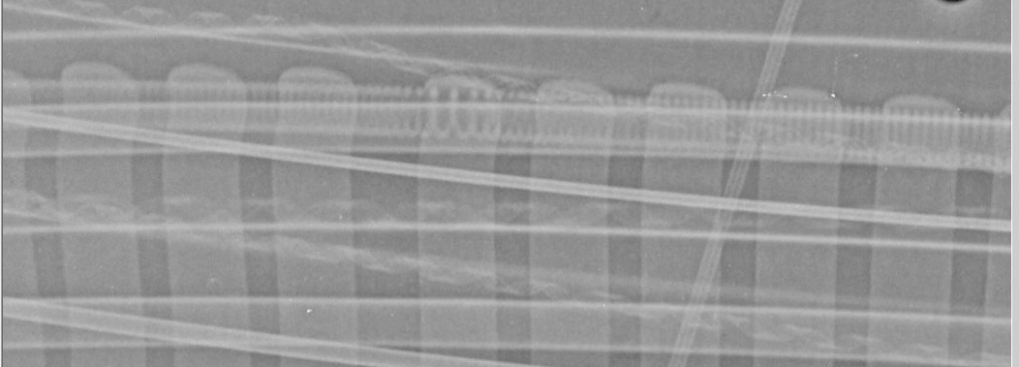
Motivation – EYETS observations
Investigation during the EYETS 23/24 revealed that
  Eight warm vacuum modules of the VMBG showed degradations of springs and RF fingers.
  Three warm vacuum modules with elliptical shape (VMCK, total 24 units) in the recombination areas of IP1 and IP5 had developed defects of springs
47oo71 VMBG modules were consolidated during the EYETS 23/24 with DRF and anchored modules.
The remaining 24 VMBG modules will be consolidated in EYETS 24/25 and remain in the LHC during the run 2024.
The damaged springs in the elliptically shaped modules were replaced. The VMCK modules will remain in the LHC until LS3.
Similar modules exist in the cold part of the LHC.
→ Procedure of steps to be followed in case a failure of a spring and of RF fingers develop in a vacuum module
→ Monitor carefully bunch intensity and bunch length
Courtesy G. Bregliozzi

Slide 4
Procedure to be followed (1/4)
Following diagnostics of vacuum pressure rise or unexplained beam losses, stop operation with high intensity beams.
Perform X-rays of the RF fingers of the suspected vacuum modules and identify the damaged module. Verify bunch length over the previous fills and make corrections to the RF system and bunch length interlocking if a bunch shortening has been observed.
Perform FLUKA studies to estimate the expected energy deposition in the downstream sc. magnets to identify possible safe beam intensity levels for operation, without risk of quenching.
Continue operation with beam intensities, which do not show any relevant increase in vacuum and beam losses. Based on previous experience these should directly be visible during the injection of trains. This period should cover the time for FLUKA studies and/or the preparation of the replacement of a module.
Perform tests at injection with increasing number of trains to characterise the onset of sparking. Stay below the maximum bunch intensity and above the minimum bunch length used before the incident.

Slide 5
Procedure to be followed (2/4)
Based on the outcome of the FLUKA simulations and in agreement with BLMTWG, MP3 and MPP, increment the thresholds of the concerned BLMs where necessary. Ensure that the thresholds are chosen to avoid quenches of downstream sc. magnets due to the beam gas interactions. Furthermore, ensure that the adjusted BLM thresholds provide sufficient protection against other critical failure cases or that these are covered by other (nearby) BLMs.
  In case of triplet magnets, the energy deposition due to beam-gas interactions should be limited to 2 mW/cm3 in the triplet coils in a first step (providing about a factor 5 margin to the expected quench level).
If required and considered safe increment vacuum interlock thresholds in the concerned region (< 2e-5 mbar).
Check point: Based on the above observations, tests and simulations, can the LHC operate with the observed vacuum levels and without quenching with > 2000 bunches? If no, the replacement of the defect module has to be triggered. If yes, go to the next steps.

Slide 6
Procedure to be followed (3/4)
Perform a validation fill with 400 bunches and the nominal maximum train length to stable beams (> 2h). Check beam losses and vacuum levels and compare to the expectations from the simulations. Compare the observed BLM signals with the expectations from the FLUKA simulations and extrapolate to the pre-issue intensity, respectively the full machine. Increment the thresholds of the concerned BLMs based on the observed losses and the evolutions of the vacuum pressure.
Step to half pre-issue intensity a go to stable beams (> 2h). Check beam losses and vacuum levels and compare to expectations from simulations. Compare the observed BLM responses with the expectations from the FLUKA simulations and extrapolate to the pre-issue intensity. If required, adapt the BLM thresholds based on the observed losses and the evolutions of the vacuum pressure.
Note:
  In case of triplet magnets and if required for reliable operation the BLM thresholds can be adapted to allow an energy deposition from the beam-gas interaction of 3.5 – 5 mW/cm3 with full intensity.
  In the case the issue appears close to an experiment, get feedback on the observed background levels in the experiment.

Slide 7
Procedure to be followed (4/4)
Perform X-rays of the RF fingers of the damaged module and verify that the geometry has not changed significantly as compared to first X-ray.
Step to the pre-issue intensity and go for standard operation.
Observe the evolution of the vacuum activity and the losses from beam-gas interactions. If the situation degrades, perform X-rays of the RF fingers of the damaged module and verify that the geometry has not changed significantly in comparison to the first X-ray.

Slide 8
Next steps
Circulate procedure for Engineering check in EDMS
Present at LMC for approval

Slide 9
References
G. Bregliozzi: Report on 4L1 Issues and RF Fingers, LMC #466
G. Bregliozzi: Warm Vacuum Modules ID212.7: Task Force report, LMC #474
G. Bregliozzi: AOB: Update on RF Fingers Consolidation, LMC #477
C. Antuono: Limitations from LHC RF fingers, JAPW23
G. Bregliozzi: Addressing known non-conformities LS3; RF (spring) bridges & Warm bellows, Chamonix 2024
MPP - Expert discussion on scenarios for operating with sparking RF Fingers 7th March
MPP - Expert discussion on scenarios for operating with sparking RF Fingers 21st March

