Slide 1
EESD Cold mass suspension
First heat load estimation
D. Ramos, 24/5/2024

Slide 2
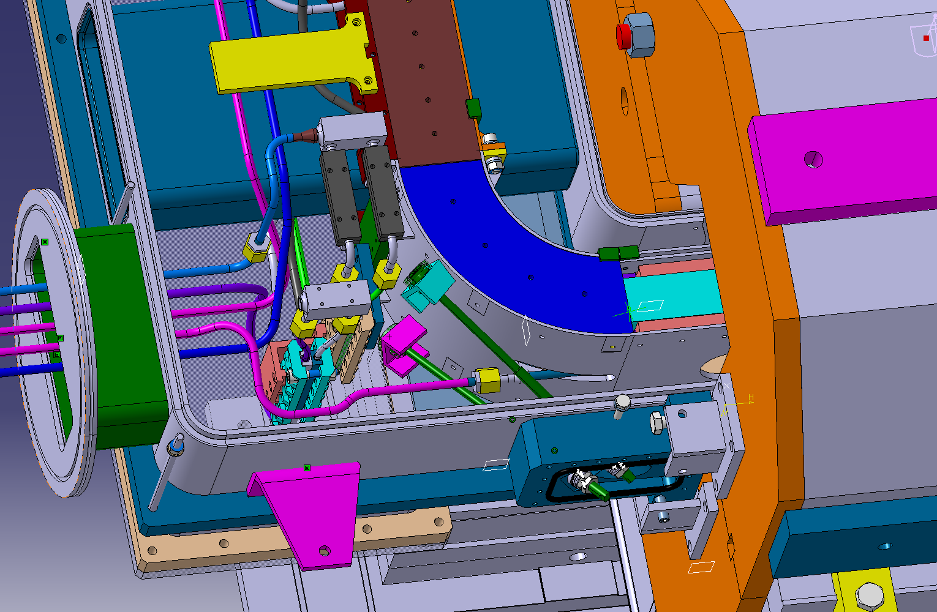
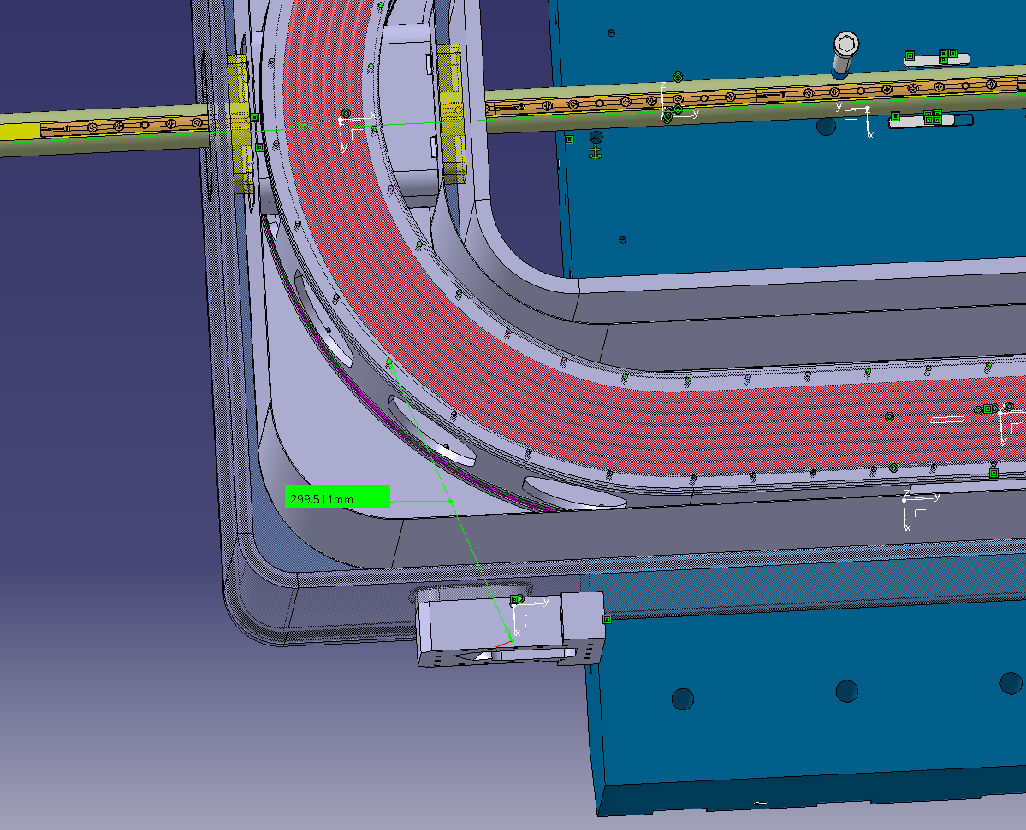
Suspension rods
8 rod system, preloaded at assembly
  ex. up to ~13 kN preload for annealed Invar on 2/3 of 0.2% yield strength
Partial loss of preload with cooldown
Load supported by the yoke to avoid reinforcing the vacuum vessel shell
Thermo-mechanical model to be prepared: material selection, angles and preload loss
Fast cycled magnet
EESD

Slide 3
Heat load estimation
10 mm diameter rods with M12 threaded ends
Thermal insulation length in the order of 250 mm
For example, Invar 36 machined from diameter 20 mm rods
Cold end at 20 K, warm end at 300 K
Heat intercept in the range 80 to 100 K, with optimised location for minimum mechanical work
Heat loads
  At cold end: 0.2 to 0.3 W per rod, i.e. 1.6 to 2.4 W for 8 rods
  At heat intercept: 1.6 W per rod. i.e. 13 W for 8 rods

