Slide 1
FCC tuning comparisons
Optics correction: phase dispersion and RDTs
S.Liuzzo, ESRF

Slide 2
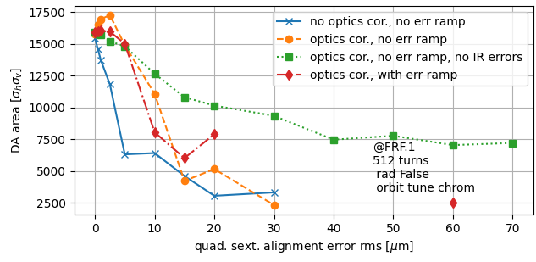
Optics correction: phase, dispersion and RDTs
Optics correction are the only left potential difference AT vs MADX. “LOCO vs “Phase correction”.
LOCO implementation:
Same as real measurement,
Fit of errors. Not == to set errors
“Phase correction”:
Use “twiss” file (pyAT get_optics)
Not realistic, needs to study also
error in phase measurement.

Slide 3
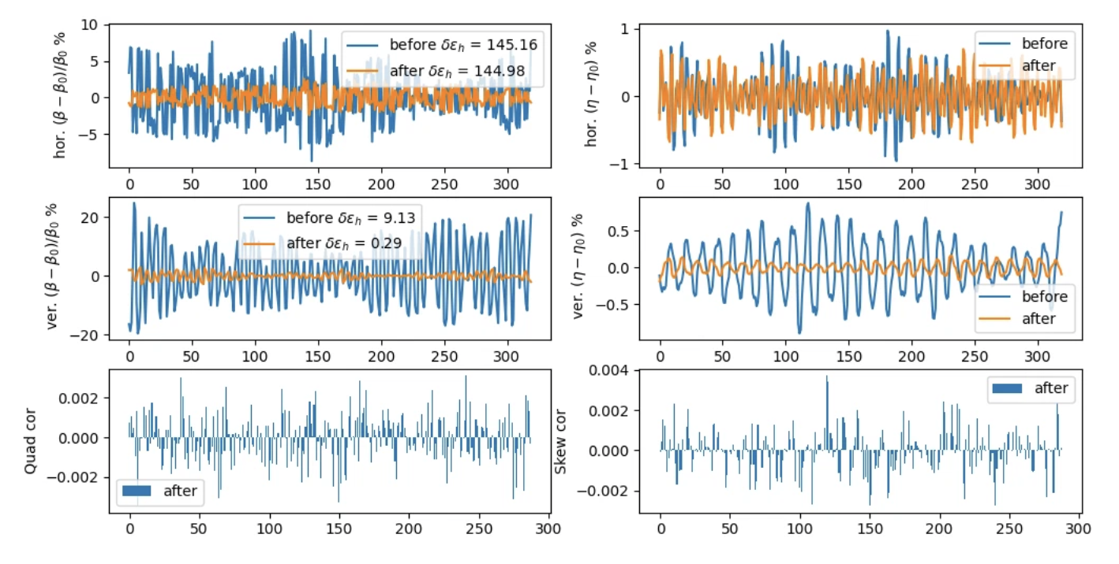
Phase/dispersion/tune/RDT correction for EBS

Slide 4
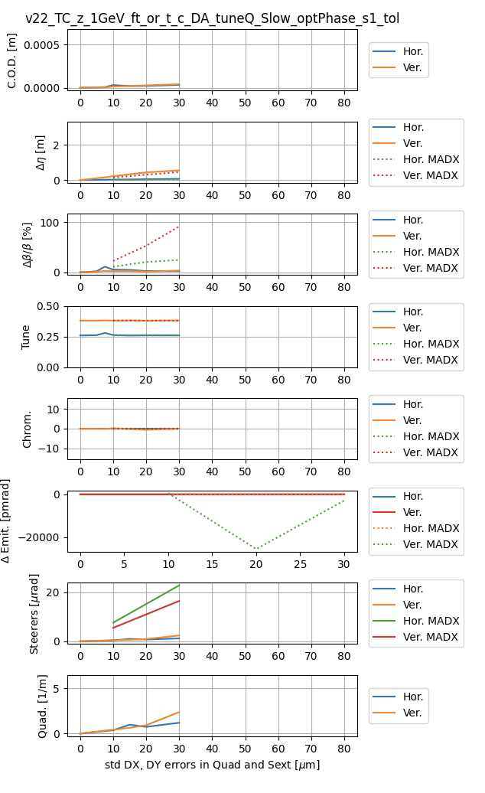
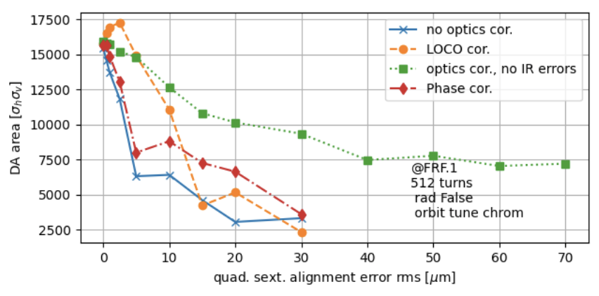
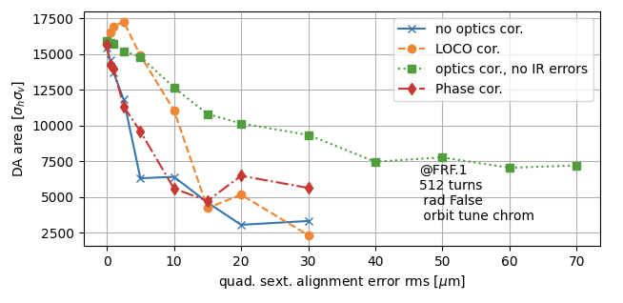
Use phase-RDT-Dispersion correction
Hor plane: Delta phase 2 consecutive BPMS + hor disp + tune
Ver plane: RDTs (imag and real) + ver disp
Vertical dispersion not reducing more. May be weights need tuning.

Slide 5
Why does it fail
At 40um there is an orbit fund of several mm, and orbit correction fails. Likely optics too far, theory ORM not usable.
Code modified to give the possibility to force trajectory correction even if there is a closed orbit already. No improvement. Trajectory correction starts, progress, but does not find a closed orbit again.

