Slide 1
Basics at CERN
Polish Teacher Programme
03 March 2025

Slide 2
Welcome to CERN!
Polish Teacher Programme 2025

Slide 3
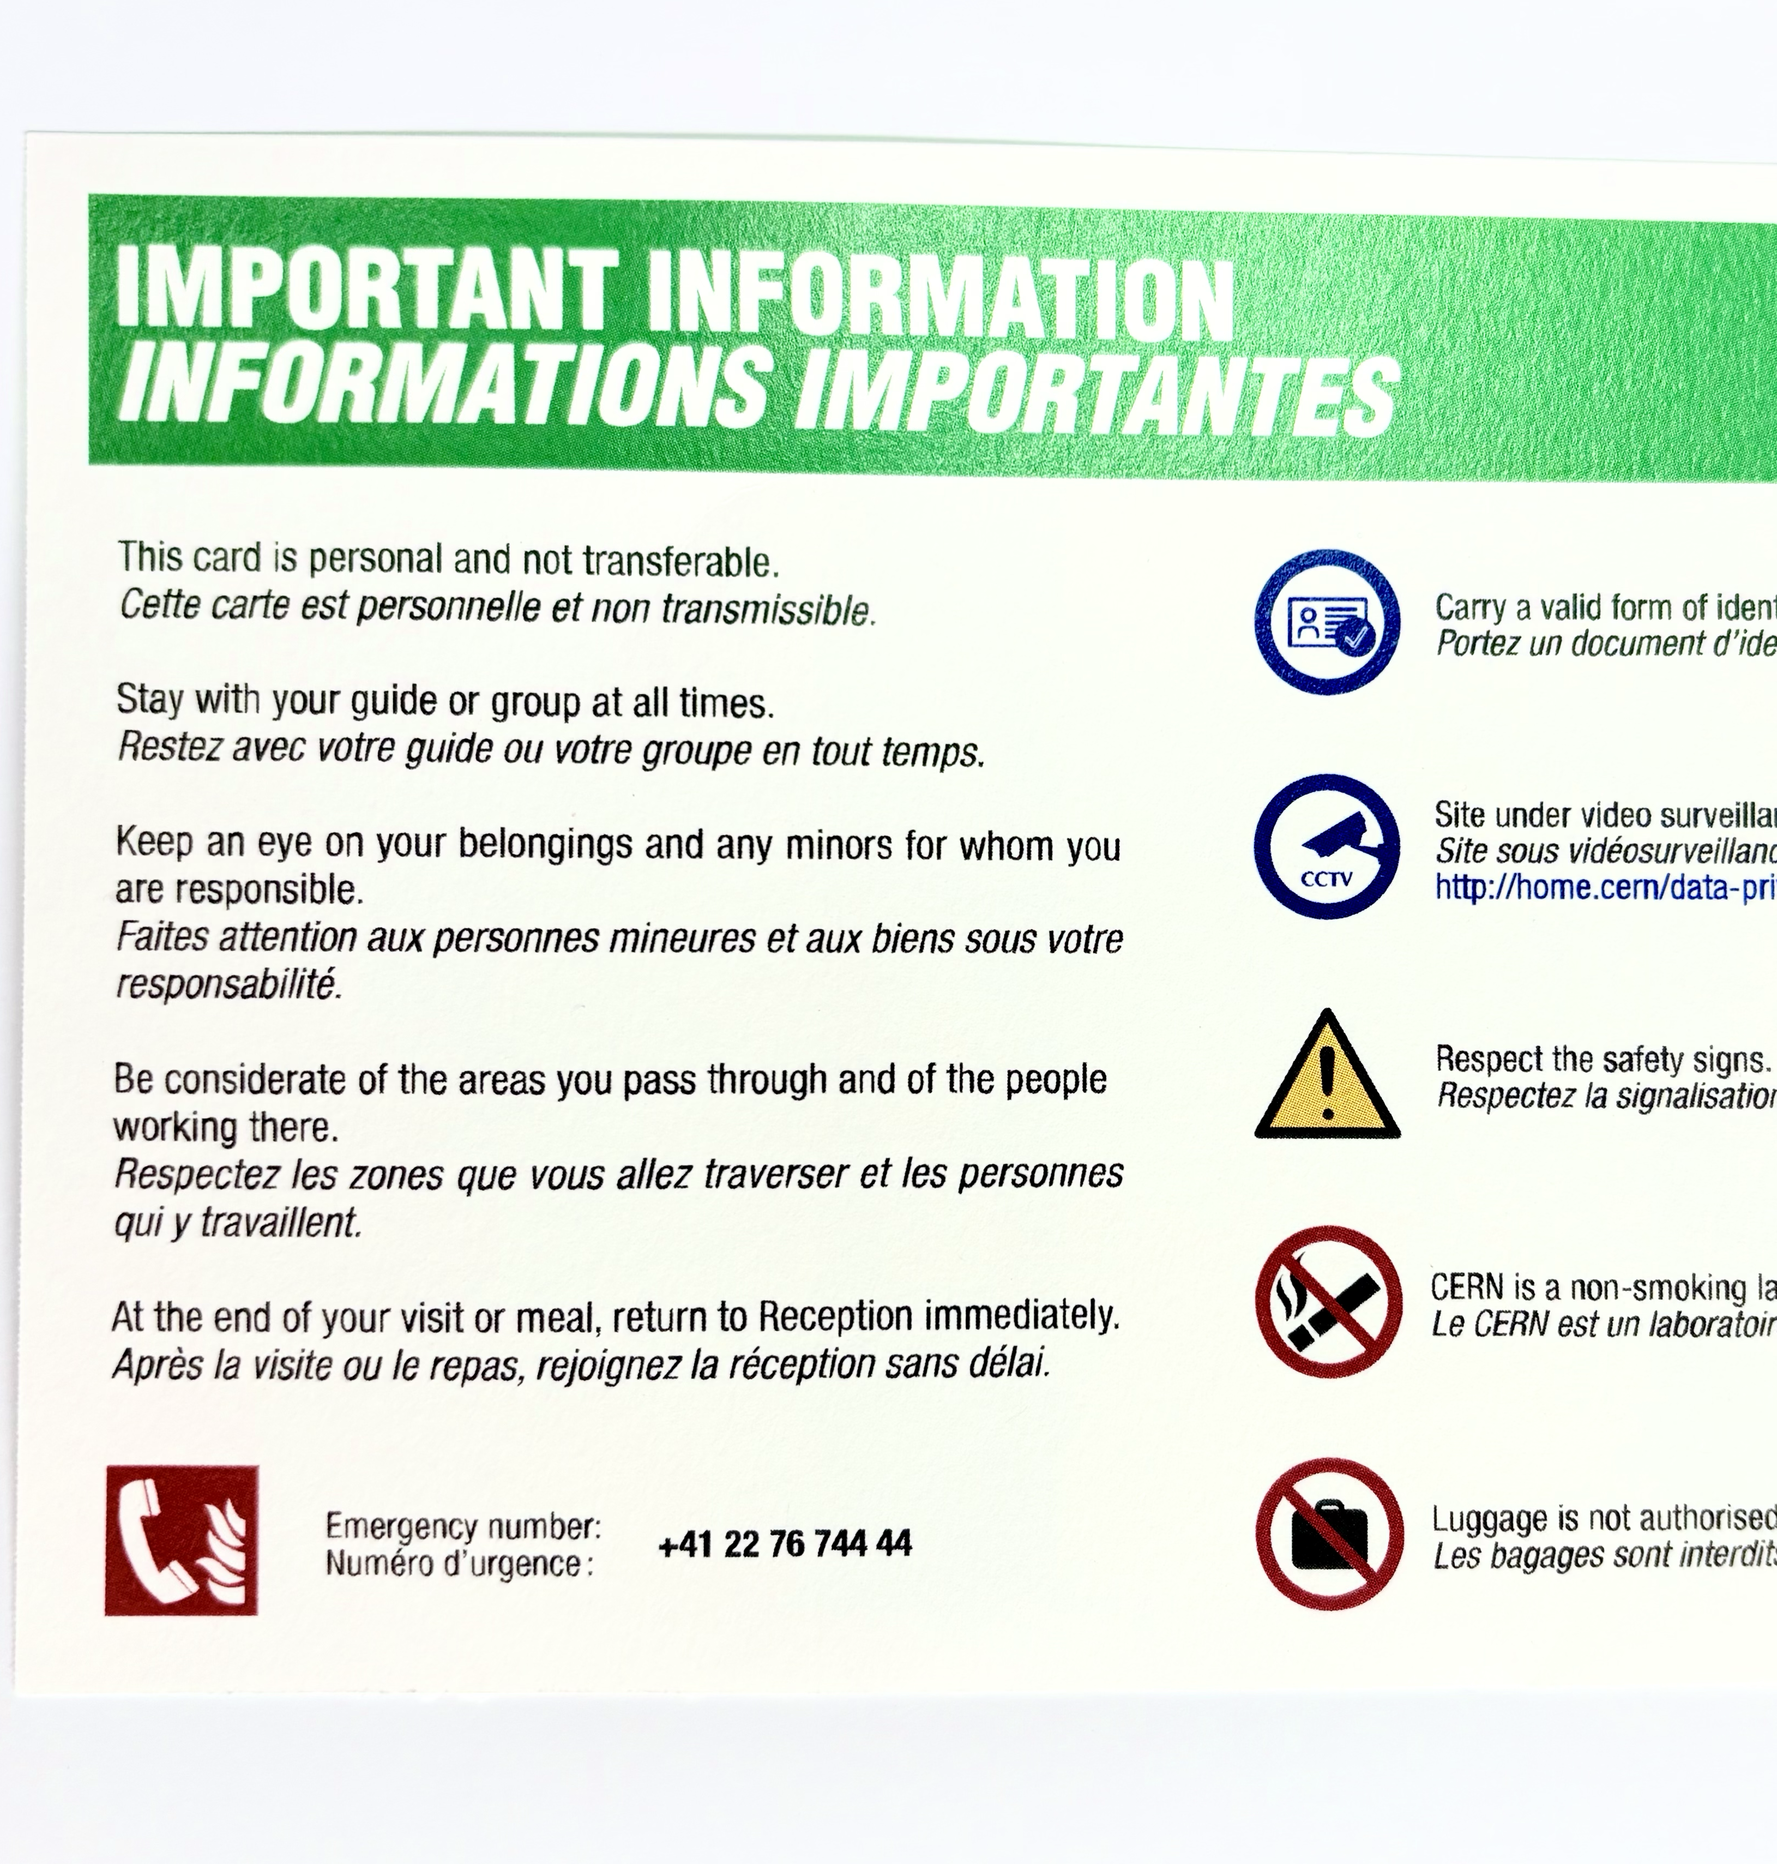
Important Numbers
EMERGENCY
Fire brigade
+41 22 76 74444
NON-EMERGENCY
CERN medical service
+41 22 76 73802
CERN TEAM
Milena Vujanović: +41 75 411 1667
Jeff Wiener: +41 75 411 9010

Slide 4
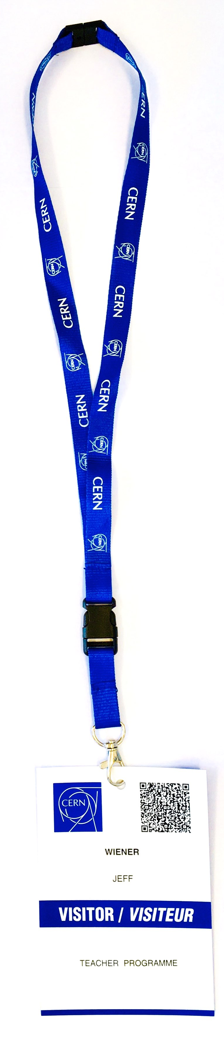
Access & Benefits

Slide 5
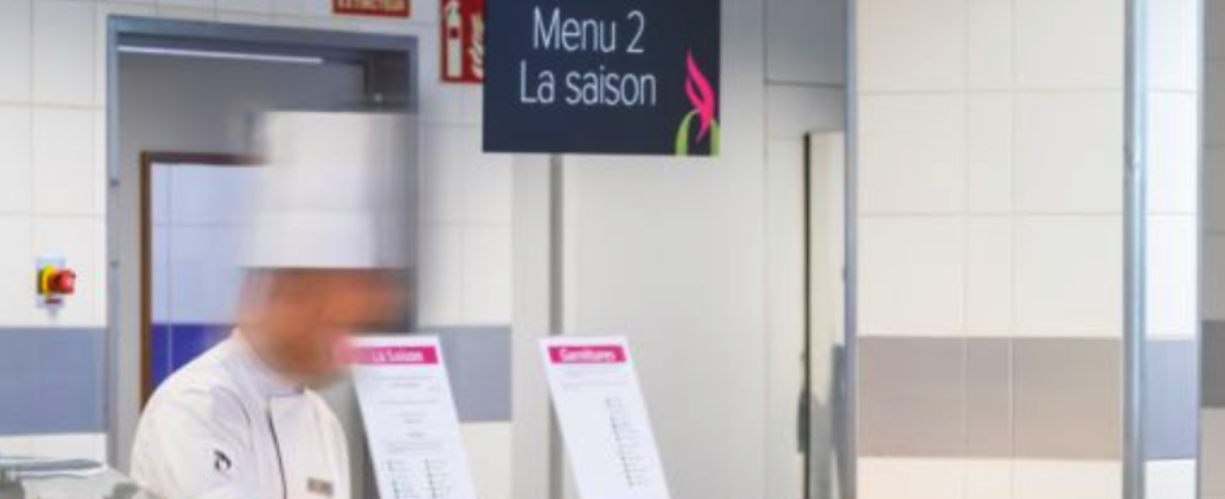

Restaurants
Restaurant 1
7:00 - 22:00 (Mo-Su)
Restaurant 2
7:00 - 17:00 (Mo-Fr)
Breakfast | Lunch | Dinner
7:00-9:00 | 11:30-14:00 | 18:00-20:00

Slide 6

CERN Visits

Slide 7
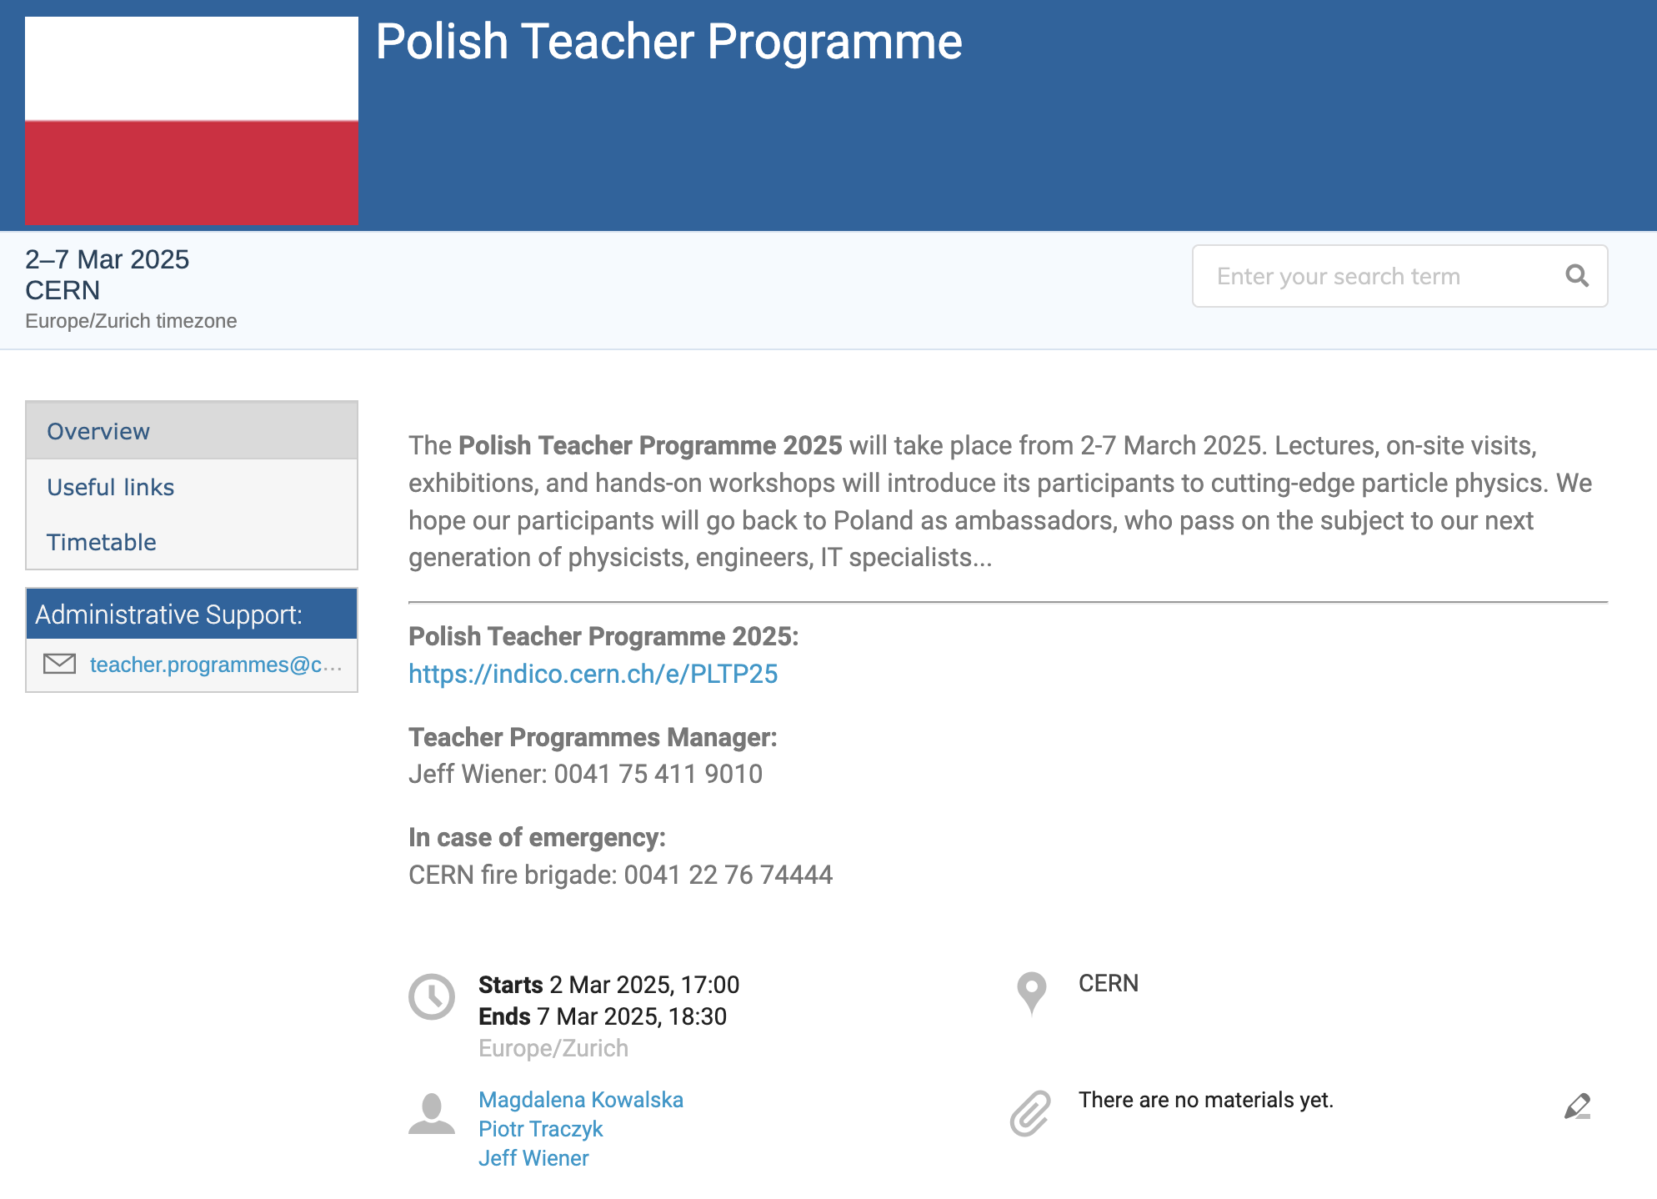
Programme Website
indico.cern.ch/e/PLTP25

Slide 8


Slide 9

Internet Access
🛜 CERN-Visitors

Slide 10
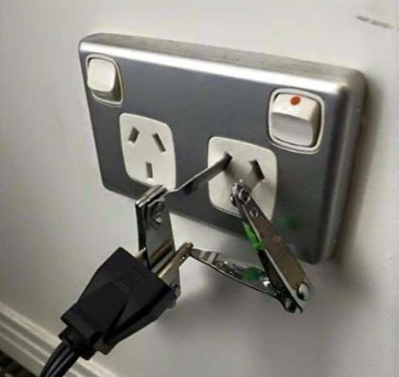
Adapter
CERN Hotel Reception

Slide 11
Merci beaucoup!
Questions?

