Slide 1
Programme Objectives
Polish Teacher Programme
03 March 2025

Slide 2
Why do we do all this?
?
To bring modern science into the classroom!
☞scientific awareness☜

Slide 3
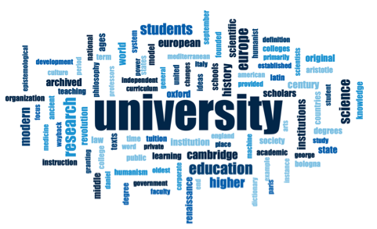
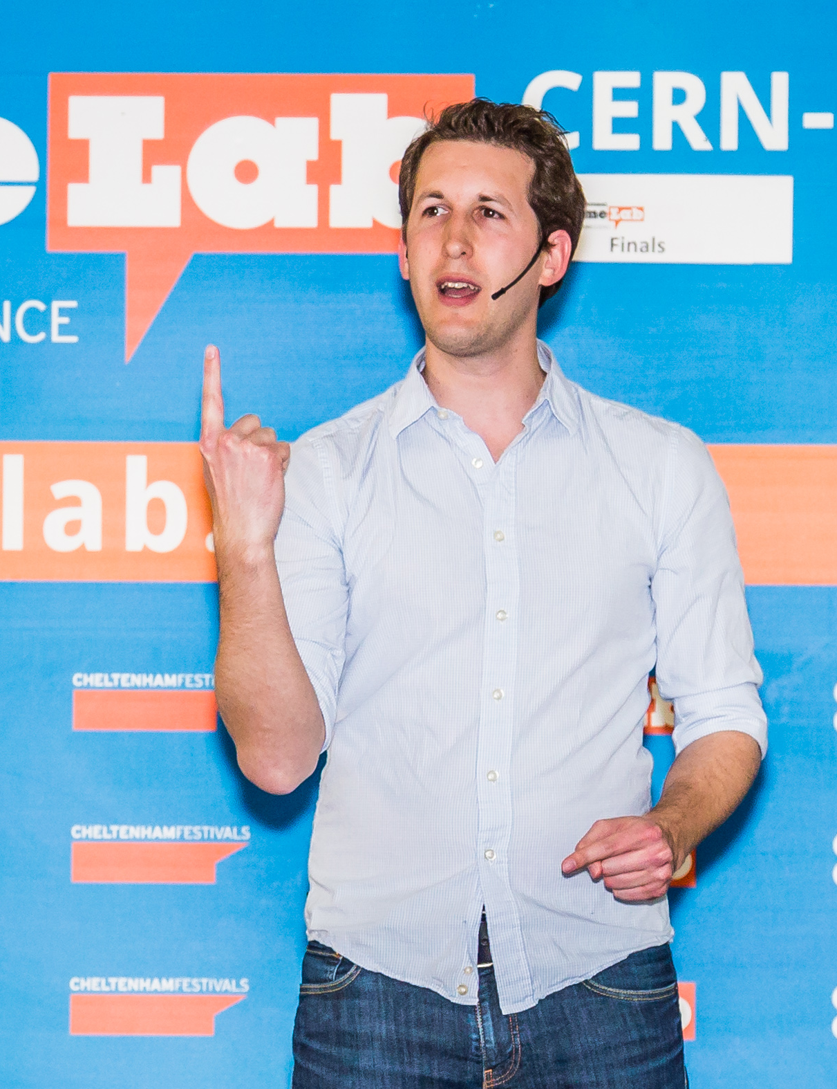
Classical Approach

Slide 4
CERN’s Approach

Slide 5
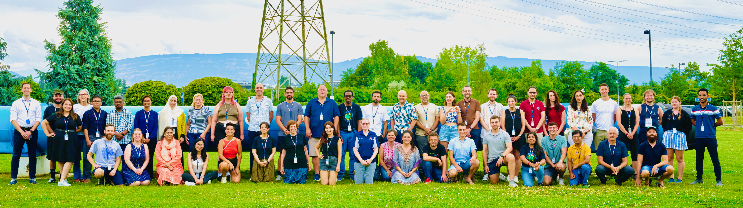
CERN’s Teacher Programmes
National Teacher Programmes in native language | 4-6 days
International Teacher Programmes in English | 2 weeks

Slide 6
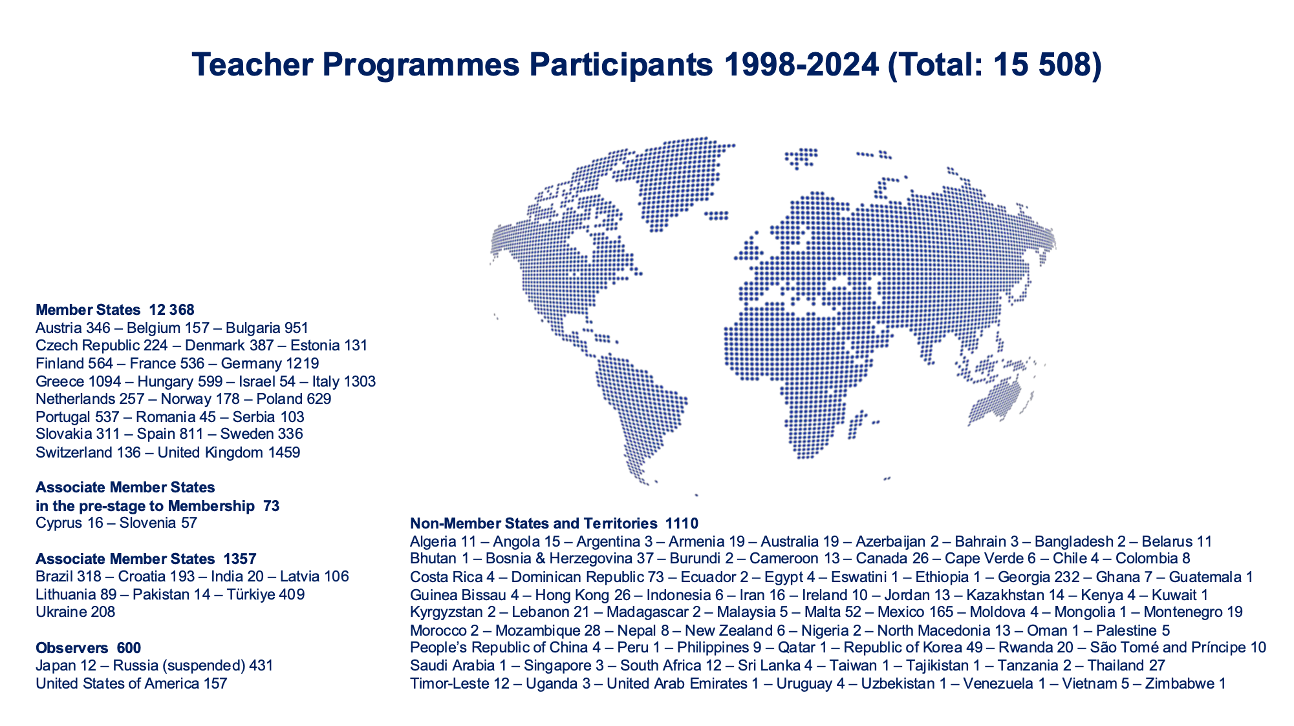

Slide 7
Outcome and To-Do-List
Share your experience with your students,
your colleagues, and the general public.
Act as ambassadors for science/engineering
and in particular for particle physics.
Organise follow-up activities.

Slide 8
Merci beaucoup!
Questions?

