Slide 1

CERN
Globalne laboratorium
Magdalena Kowalska
CERN & UNIGE
Notes:
1

Slide 2
Podziękowania
Finansowanie tegorocznego wydania:
CERN and Science Foundation
Ministerstwo Edukacji Narodowej
‚lobbying’:
Naukowcy pracujacy w i współpracujący z CERN
Stałe Przedstawicielstwo RP w Genewie (spotkanie we wtorek)
Polskie Towarzystwo Fizyczne
Wiele innych osób, które spotkaliśmy w ciagu ostatnich 12 lat
Organizacja:
ORE, Małgorzata Szeja, Marcin Karkut
CERN Educational Team: Jeff Wiener, Milena Vujanovic
CERN staff: Piotr Traczyk, Andrzej Siemko, MK

Slide 3
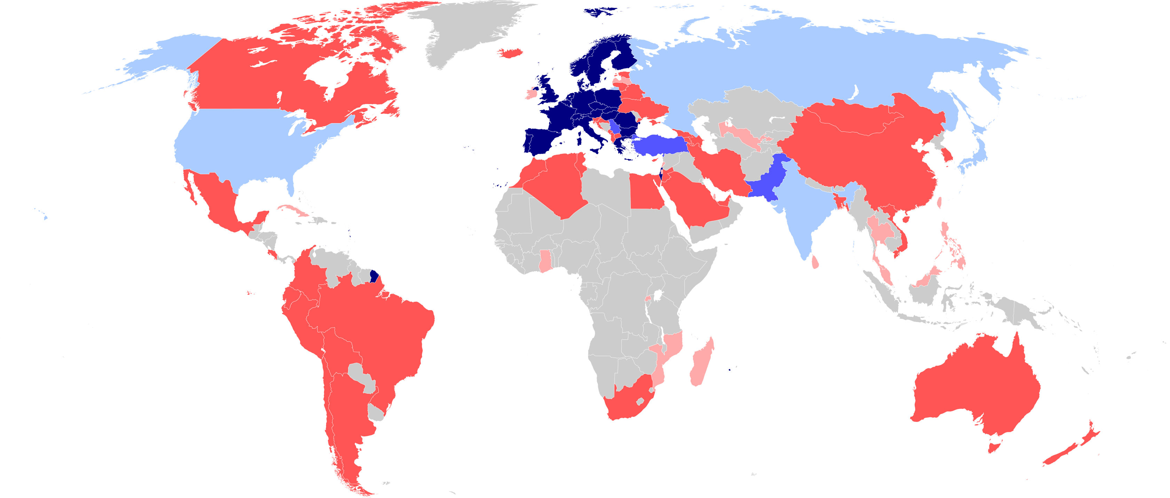
CERN = Conseil Europeen pour la Recherche Nucleaire zalożony w 1954 roku przez 12 krajów członkowskich z Europy
Dziś: 24 kraje członkowskie
Austria, Belgium, Bulgaria, Czech Republic, Denmark, Estonia, Finland, France, Germany, Greece, Hungary, Israel, Italy, Netherlands, Norway, Poland, Portugal, Romania, Serbia, Slovak Republic, Spain, Sweden, Switzerland and United Kingdom
As of 2024
Employees:
Almost 3000 staff, 900 graduates
Associates:
12 000 users, 1500 others
3 Associate Member States
in the pre-stage to membership
Cyprus – Slovenia
7 Associate Member States
Croatia – India – Latvia – Lithuania – Pakistan
Türkiye – Ukraine
6 Observers
Japan – Russia (suspended) – USA
European Union – JINR (suspended) – UNESCO
Around 50 Cooperation Agreements
with non-Member States and Territories
Albania – Algeria – Argentina – Armenia – Australia – Azerbaijan – Bangladesh – Belarus – Bolivia
Bosnia and Herzegovina – Brazil – Canada – Chile – Colombia – Costa Rica – Ecuador – Egypt – Georgia – Honduras
Iceland – Iran – Jordan – Kazakhstan – Lebanon – Malta – Mexico – Mongolia – Montenegro – Morocco – Nepal
New Zealand – North Macedonia – Palestine – Paraguay – People's Republic of China – Peru – Philippines – Qatar
Republic of Korea – Saudi Arabia – Sri Lanka – South Africa – Thailand – Tunisia – United Arab Emirates – Vietnam
Notes:
The speaker can highlight CERN’s second mission as stated when it was established: to foster peaceful collaborations between nations that had recently been at war.
Additional information (OPTIONAL)
More than 40% of CERN’s budget is returned to industry through materials, utilities and services

Slide 4
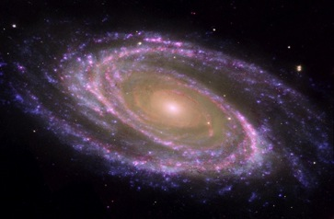
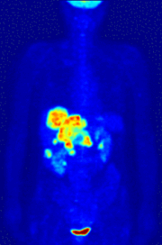
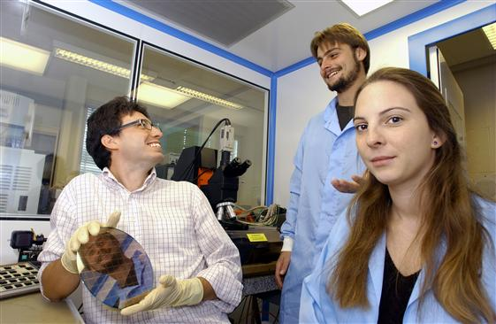
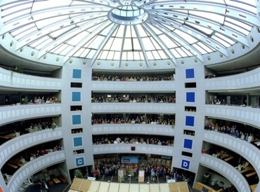
Misje CERN
Pchanie do przodu granic poznania
Rozwijanie nowych technologii
Trening naukowców i inżynierów jutra
Łączenie ludzi z różnych krajów i kultur

Slide 5
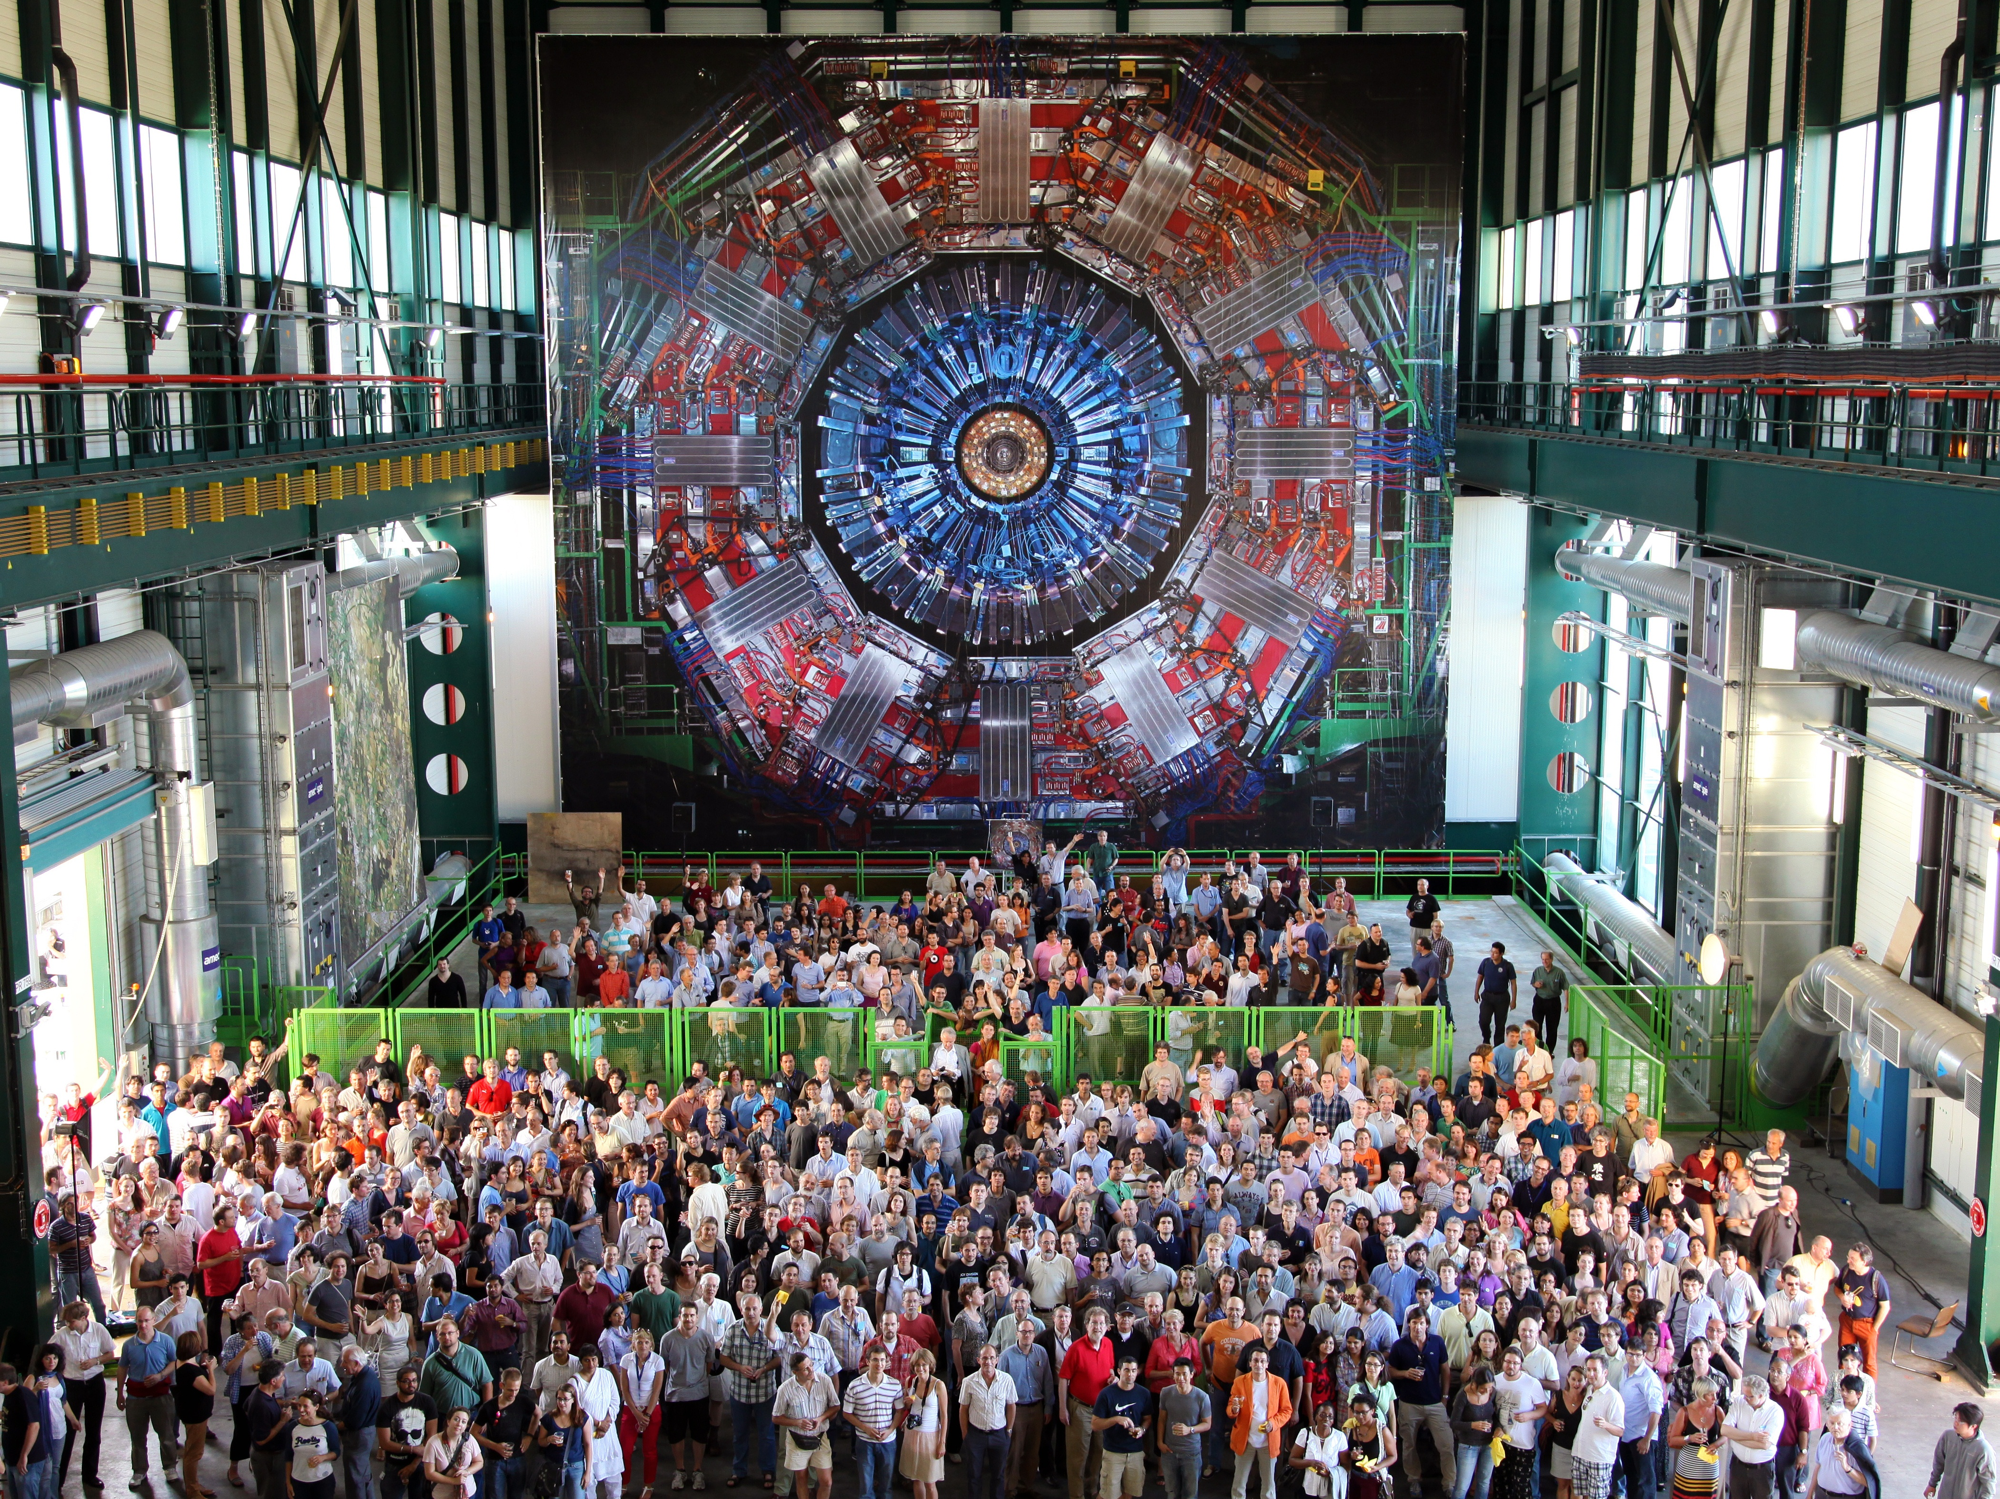
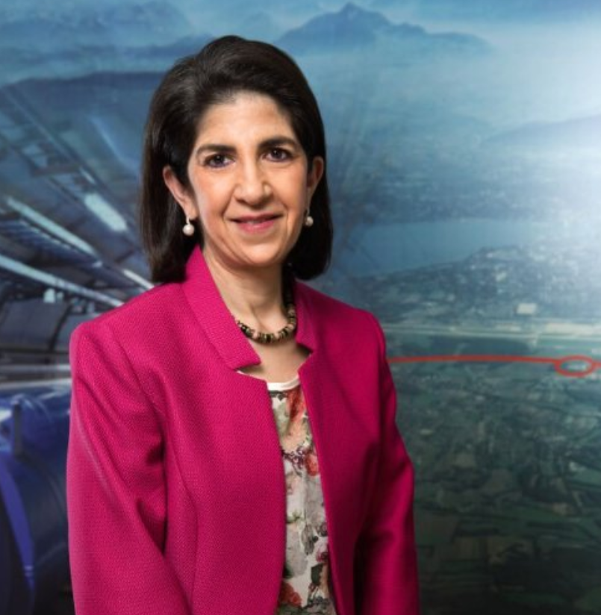
Współpraca ponad granicami i podziałami

Slide 6
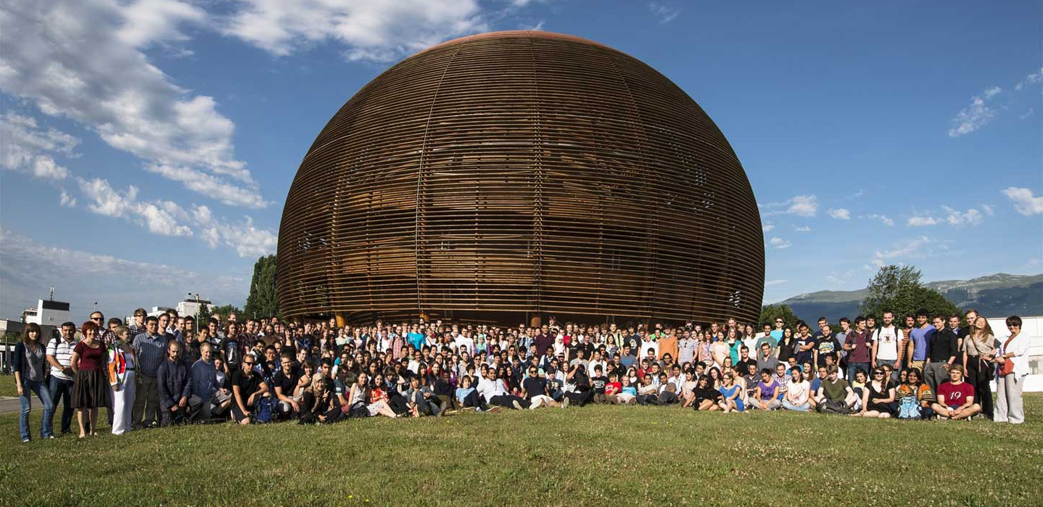
Trening
Uczniowie i nauczyciele
Studenci
Naukowcy
Inżynierowie

Slide 7
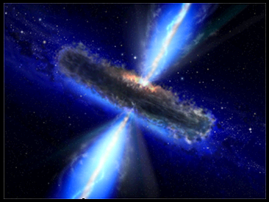
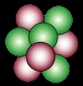
CERN poszukuje odpowiedzi…
… na pytania fundamentalne
Co się działo po urodzinach Wrzechświata?
Z czego składa się materia dookoła nas?
Co powoduje zjawiska, które obserwujemy, np. siły i masa?

Slide 8
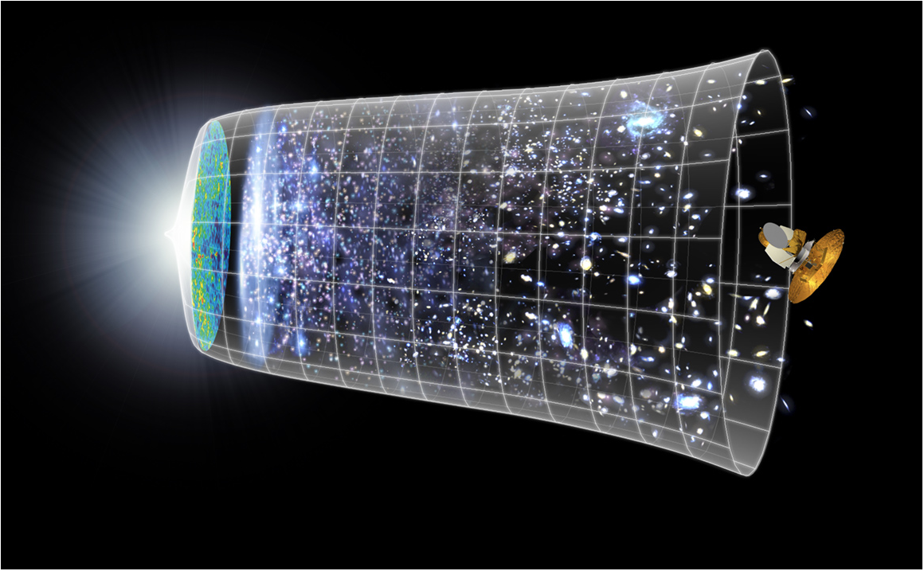


Następne naukowe wyzwanie:
Zrozumiec pierwsze chwile Wszechświata po Wielkim Wybuchu
Big Bang
WMAP
13.8 Billion Years
Today
10²⁸ cm

Slide 9
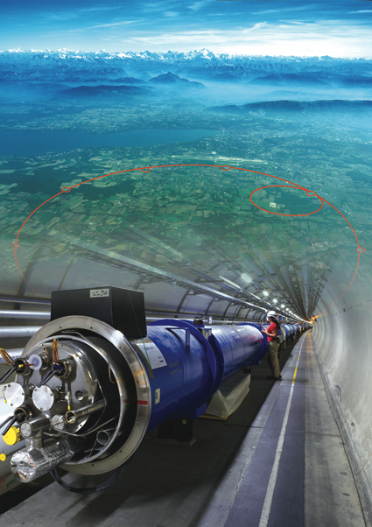
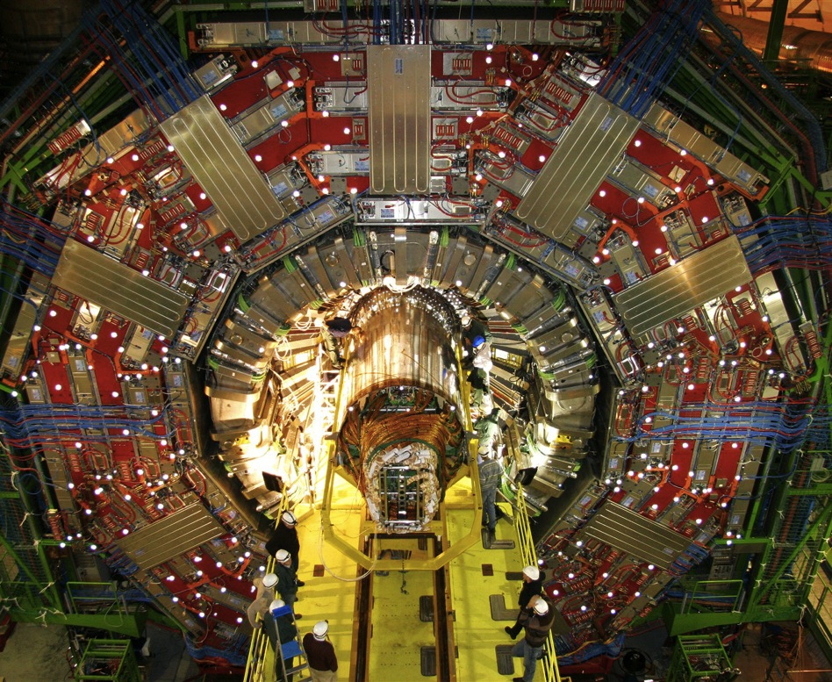
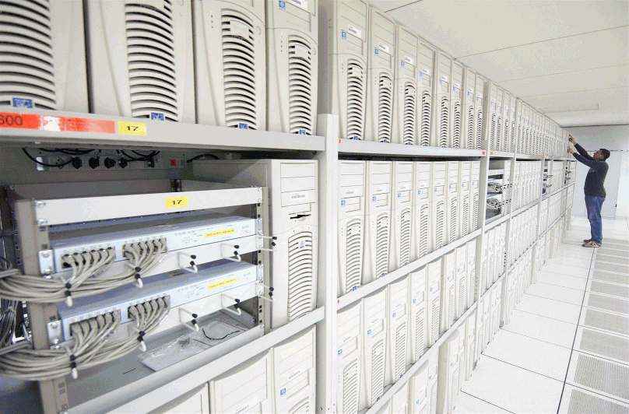
Używane narzędzia:
1. Particle accelerator :
Boost particles to high energies and make them collide
2. Detectors :
Gigantic instruments that observe and record the results of the collisions
(particle trajectories, energy, charge..)
3. Computers :
Collect, store, and send around the world the big quantity of data received from the detectors for data analysis.
Now you know why CERN employs ten times more engineers and technicians than research physicists.

Slide 10

Kompleks przyspieszaczy CERN
Laboratoria naukowe przy każdym przyspieszaczu:
fizyka jądrowa – struktura hadronów – fizyka cząstek - zastosowania
COMPASS/AMBER, NA61/SHINE, AWAKE, NA63

Slide 11
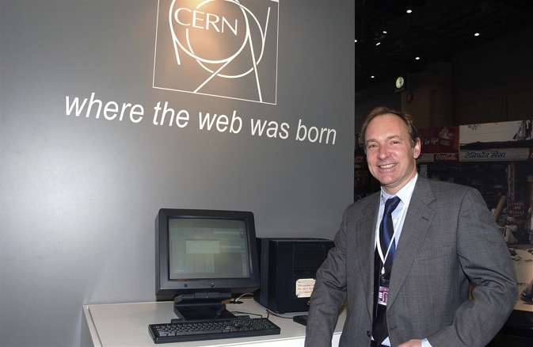
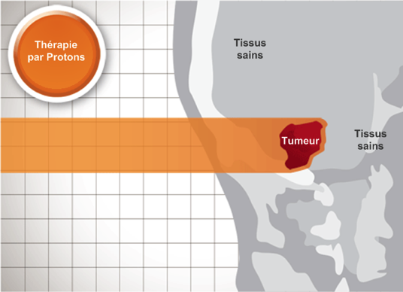
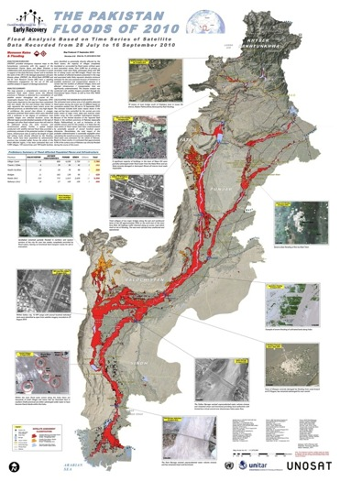
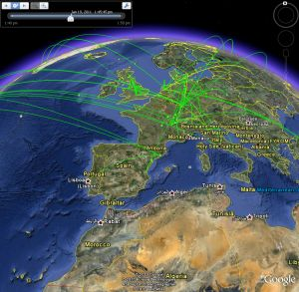
Applications of CERN Research
The World Wide Web invented at CERN… freely available
Particle detectors… medical imaging, cancer treatment
Without fundamental research, there is are no applied studies
The computing Grid … climatology, cartography, medicine,…

Slide 12
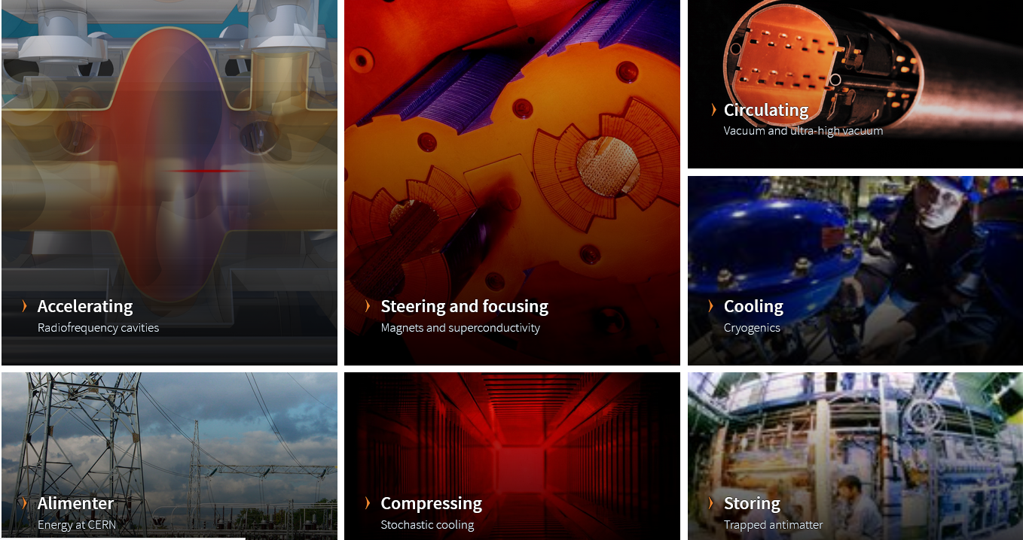
Key engineering technologies
https://home.cern/science/engineering

Slide 13
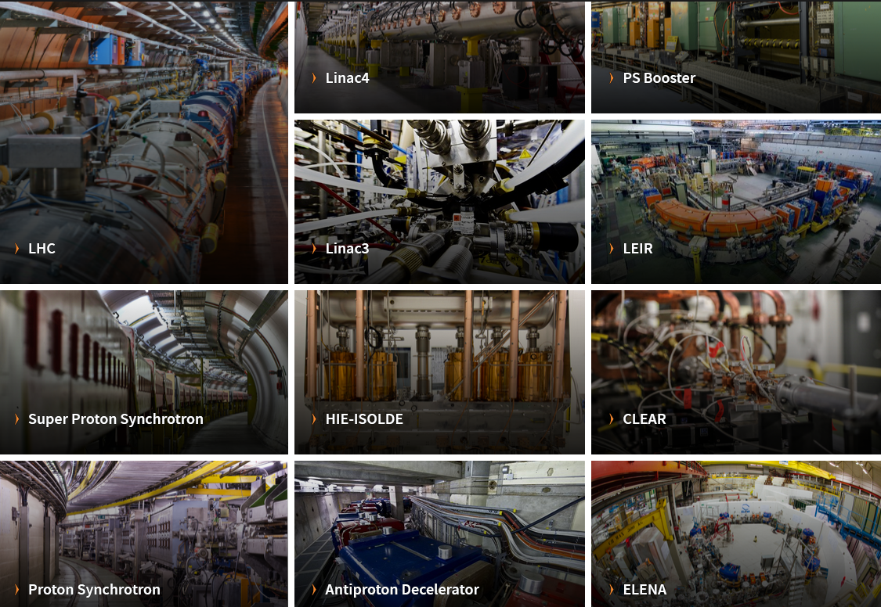
CERN accelerator complex

Slide 14
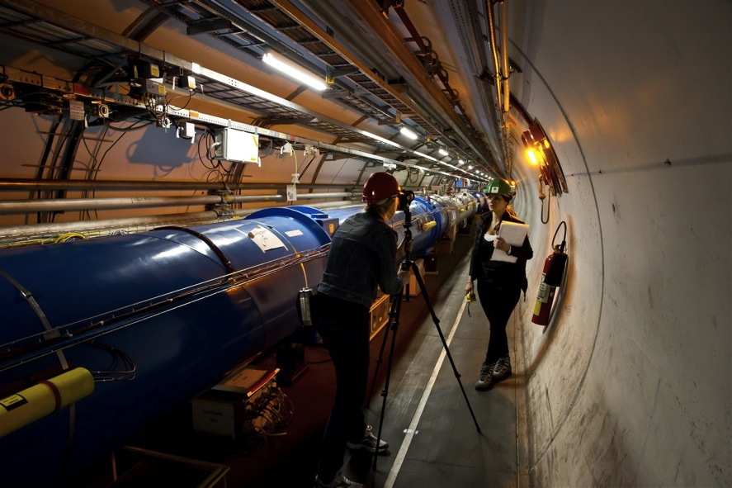
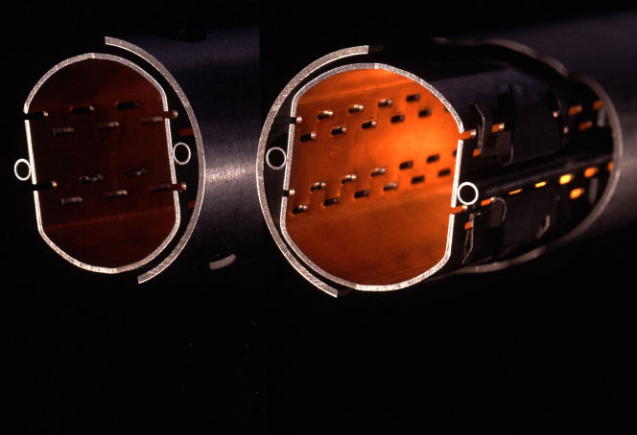
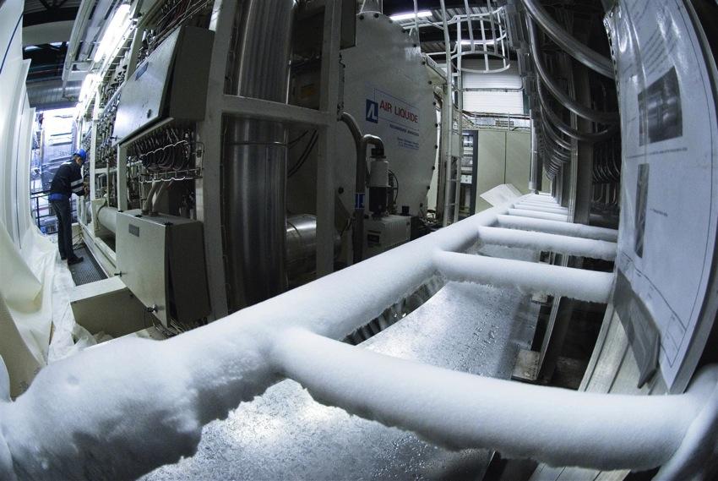
LHC: the most powerful particle accelerator
  27km tunnel
  Thousands of superconducting magnets
  Ultrahigh vacuum:
  10x stronger vacuum than on the Moon
  The coldest place in the universe:
  -271.3° C

Slide 15
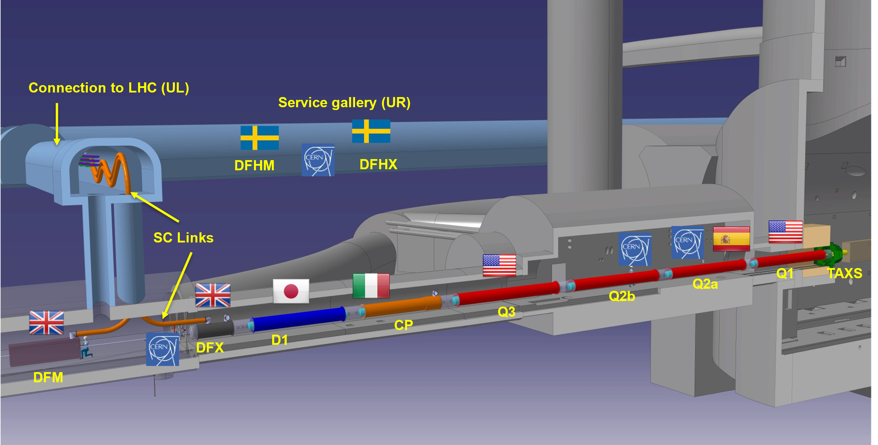
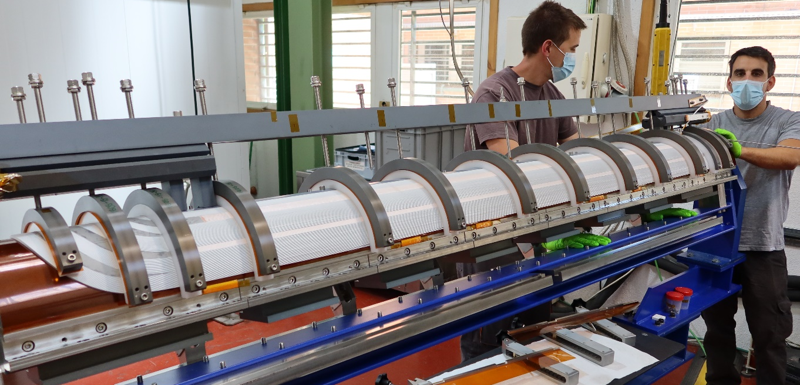
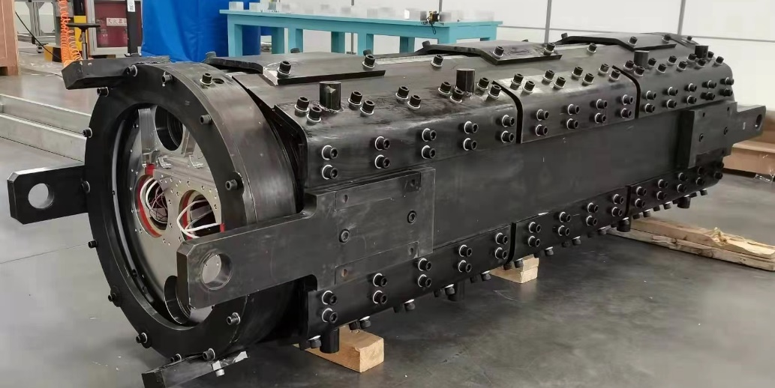
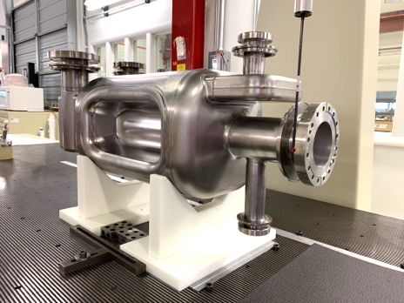
High Luminosity LHC: “the near future”
The HL-LHC requires a new generation RF cavities and variety of new generation magnet families to replace the existing LHC final focus magnets for high luminosity experiments ATLAS and CMS
MCBXF – CIEMAT, Elytt
MCBRD – IHEP, BAMA
RF-Dipole Cavity – US & Canada
Notes:
This is the title slide for the CRG Group.

Slide 16
FCC, CLIC, MuC: “options for more distant future”
The present vision to go beyond what we can do in particle physics today is to study feasibility of future collider options: FCC-ee, FCC-hh, FCC-eh, CLIC and MuC.
Notes:
This is the title slide for the MPE Group.

