Slide 1

CP violation in tau decays into states with neutral kaons
Guglielmo Papiri
In collaboration with Yuval Grossman, Paolo Leo, Alberto Martini, Armine Rostomyan
23rd Conference on Flavor Physics and CP Violation, June 5, 2025

Slide 2
CP Violation in tau decays
There is (almost) no CPV in the lepton sector;
The tau is the only lepton with decay modes in hadrons;
The study of CPV in semi-leptonic tau decays can be used to test the SM and probe New Physics;
We can study CPV in tau decays using Kaon Physics;

Slide 3

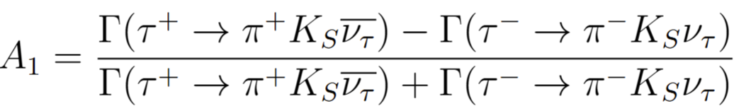

The anomaly
There is CPV due to neutral kaons oscillation in final state (no direct CPV in the lepton sector):
The (old) SM prediction (Bigi and Sanda, 2005):
BaBar (Phys. Rev. D 85, 099904):
BELLE (PhysRevLett.107.131801): compatible with zero
Flavor anomaly
3 sigma away from SM prediction

Slide 4
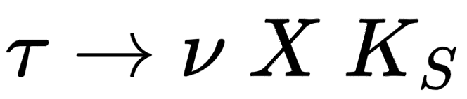


CPV in
Artificial CPV
Due to different detection efficiency of decay products of tau+ and tau-
(This is known)
Direct CPV in tau decay
In the SM this is negligible
CPV due kaons oscillation
Oscillations in vacuum
Regeneration in matter

Slide 5
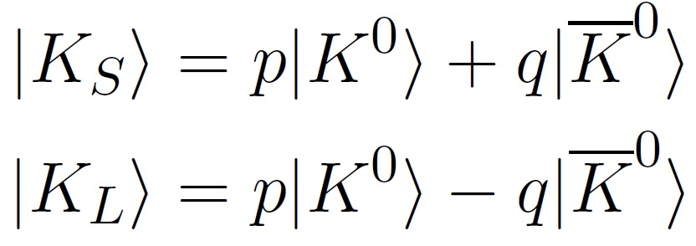
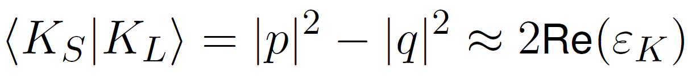
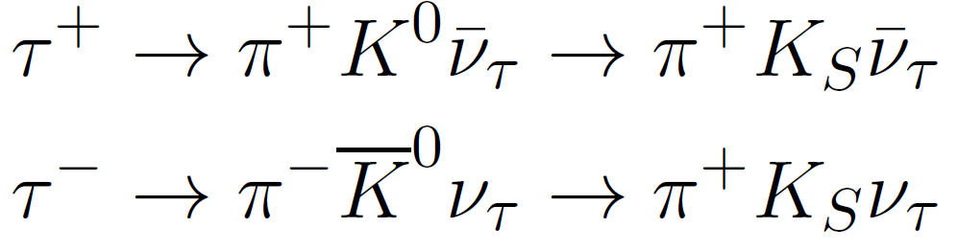
CPV in neutral kaons oscillations
Kaons mass eigenstates
CPV in kaons oscillation
The difference in the rate is given by

Slide 6
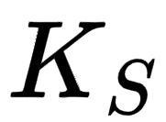
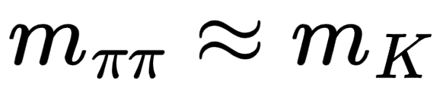
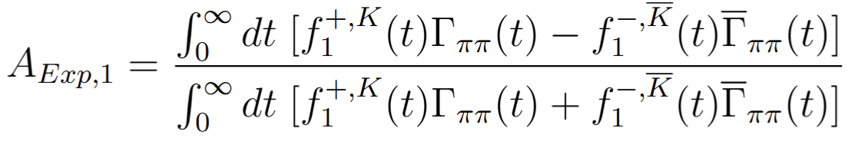
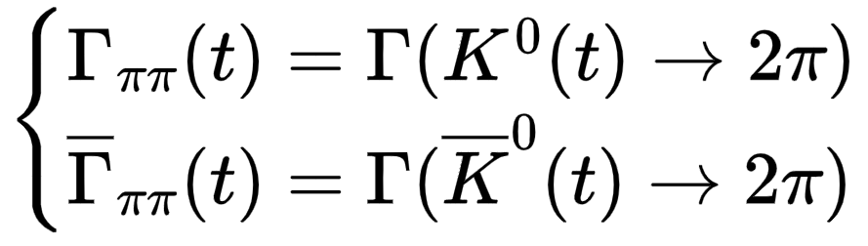
SM theory prediction
Is this correct? Theoretically yes, but this is not what we measure!
Experimentally, what we call is a system of two pions with
We need to compute the time integrated decay rates for the decay of the kaons interaction eigenstates into two pions

Slide 7
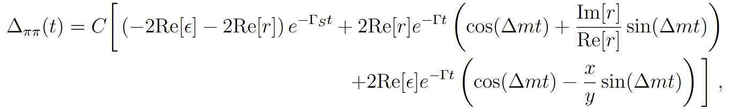
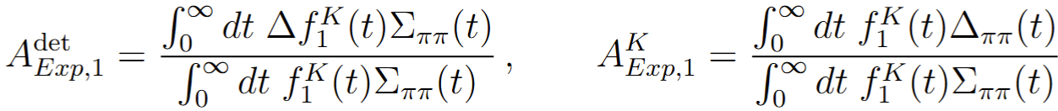
SM prediction
The K-short and K-long interference term is as important as the pure K-short term
The asymmetry that we measure in a realistic experiment is

Slide 8
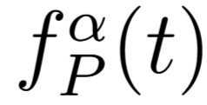
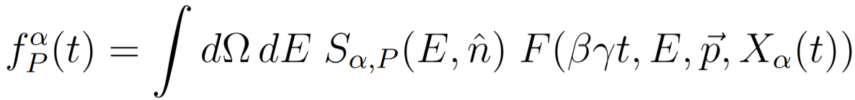
The efficiency function
To make a theory prediction, we need the experimental reconstruction efficiency parameterized by the kaon’s decay time t
The efficiency function is factorized in two parts
Kaon spectrum in the lab frame
Depends on the process P
Universal detector efficiency
Only depends on the features of the experiment

Slide 9
The efficiency function
Key observations: the theory prediction of the CP asymmetry will depend on:
The reconstruction efficiency of the detector used in the experiment;
The specific process from which the neutral kaon originated (different energy distributions);
Whatever the neutral kaon is emitted from a tau+ or a tau- (FB asymmetry in tau production);
Toy model: the efficiency is only due to fix cuts of geometrical acceptance

Slide 10
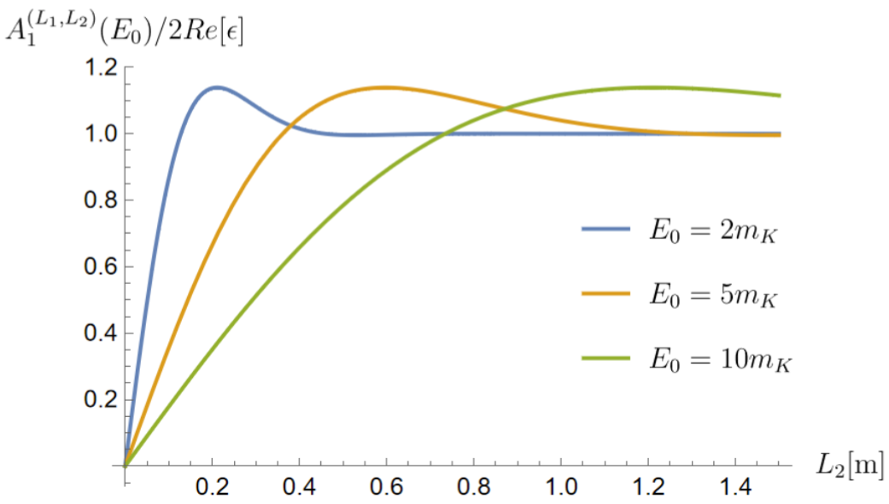

A simplified model

Slide 11
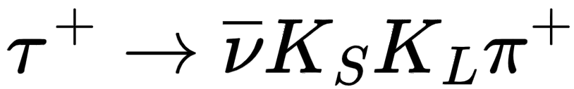
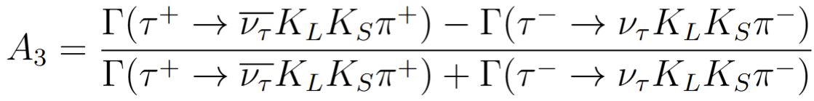

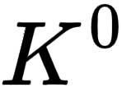
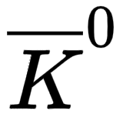
How about ?
Is there CP asymmetry for the tau decay into three pseudoscalar mesons?
At first we would expect A3=0 because the asymmetry of K and Kbar cancel each other;
However, and can have different energy spectrum, which means different decay time experimental cuts. This effect makes the CP asymmetry non vanishing;

Slide 12
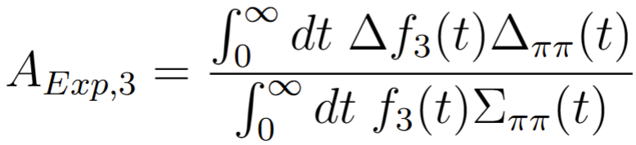
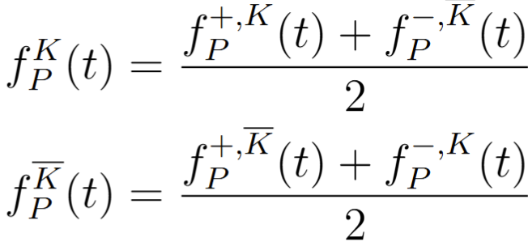
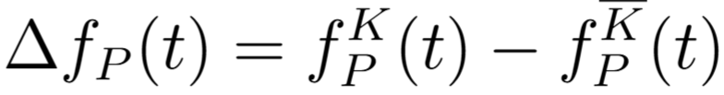
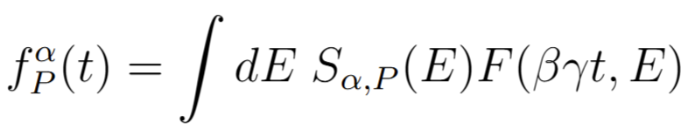
CP violation in
This channel is CP violating, and the CP asymmetry is given by
The asymmetry comes from the different energy with which the neutral kaons are emitted:
The asymmetry is due to the finite efficiency of the experiment and to the different energy spectrum of the neutral kaons.

Slide 13
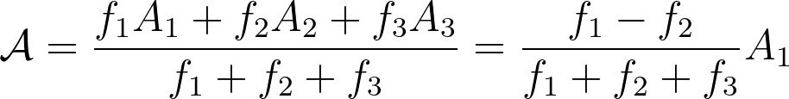


Relevance to BELLE II
BELLE II aims to provide a new measurement of the CP asymmetry soon, to further investigate the anomaly and search for direct CP violation in semi-leptonic decays;
There are signal decay modes that contribute the background:
The total measured decay asymmetry including all the signal decay modes is

Slide 14
Relevance to BELLE II
BELLE II aims to provide a new measurement of the CP asymmetry soon, to further investigate the anomaly and search for direct CP violation in semi-leptonic decays;
There are signal decay modes that contribute the background:
The total measured decay asymmetry including all the signal decay modes is
We need to understand the corrections

Slide 15
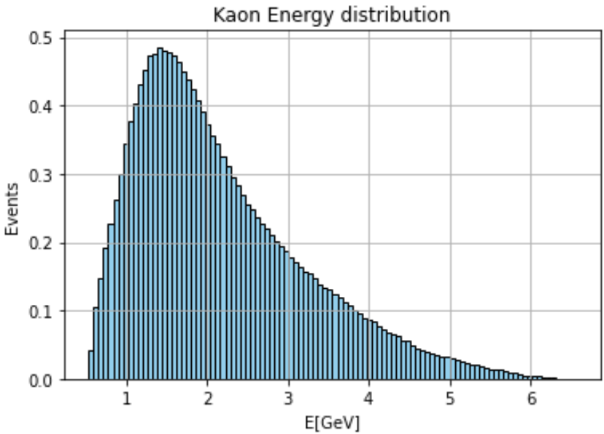
Applications to BELLE II
To make a theory SM prediction we need the information of the reconstruction efficiency function of the detector, as well as the energy spectra of the of the kaons emitted in the different processes;
We generated 10M K in BELLE II kinematics;
We simulate decay time, length and energy;
We divide the sample in 10 bins of energy;
Apply selection cuts used in the analysis;

Slide 16
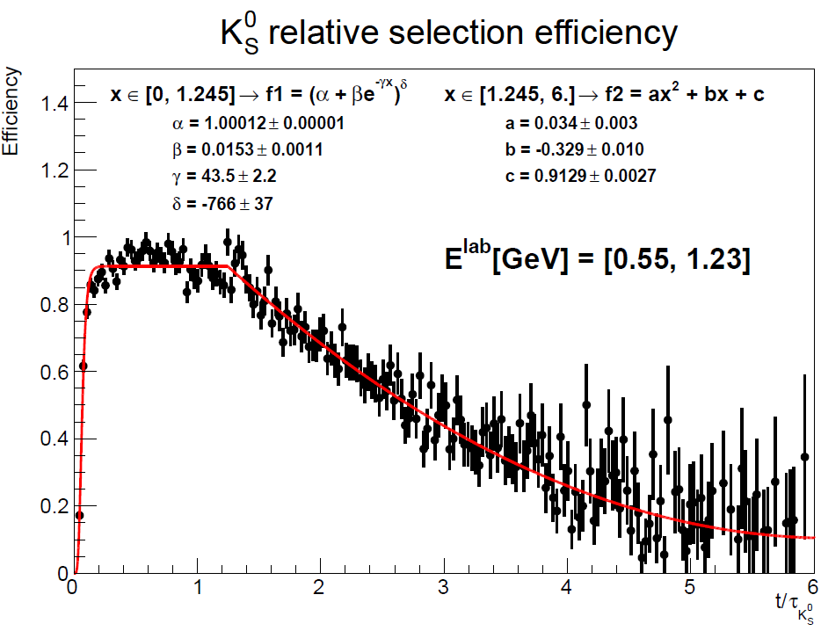
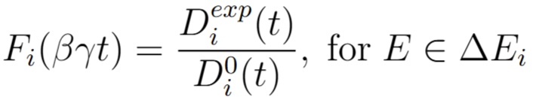
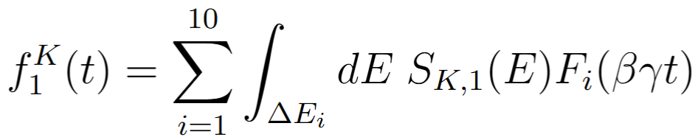
Applications to BELLE II
For every energy bin we find the selection efficiency as the ratio of the generated distribution and the after selection cuts distribution:

Slide 17
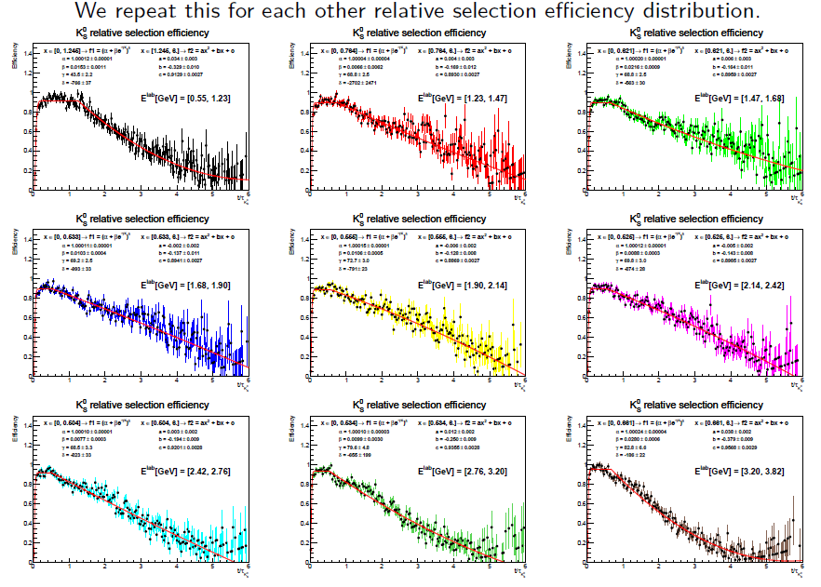

Slide 18
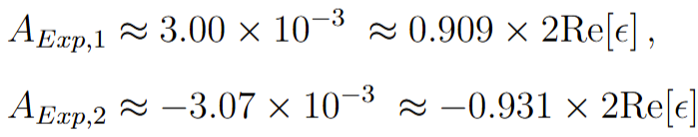
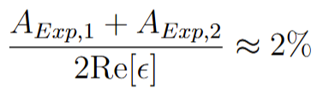
Predictions for BELLE II
We simulate the spectrum of the kaons generated by the different processes for a BELLE II type detector (10.28GeV invariant mass, asymmetric machine);
Prediction for A3:
This is under the sensitivity of BELLE II

Slide 19
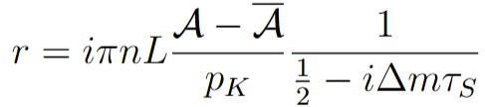
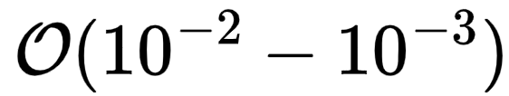
Kaons interactions in matter
A realistic detector is made of matter. The presence of matter can affect kaons oscillation, by making the effective mass eigenstates different from the ones in vacuum:
When neutral kaons propagate in matter, they scatter with nuclei by strong interaction and the scattering amplitude distinguishes the two interaction eigenstates;
r has a value of the order for solid state systems;

Slide 20

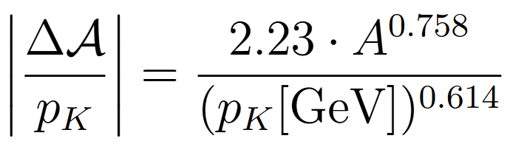
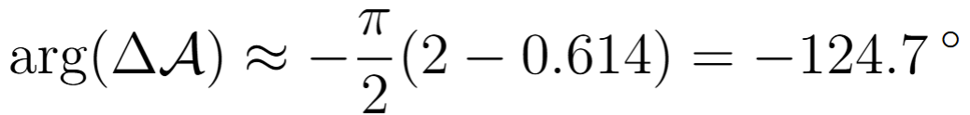
Kaons oscillation in matter
r has been measured for different materials for high energy kaons
Theory estimated at low energy and measurements for Carbon show a significant theoretical uncertainty on the phase of r
A. Gsponer et al., 1979
J. Roehrig et al., 1977
Ko, Won, Golob, and Pakhlov, 2011
P. H. Eberhard and F. Uchiyama, 1994
Angelopoulos et al., 1997

Slide 21
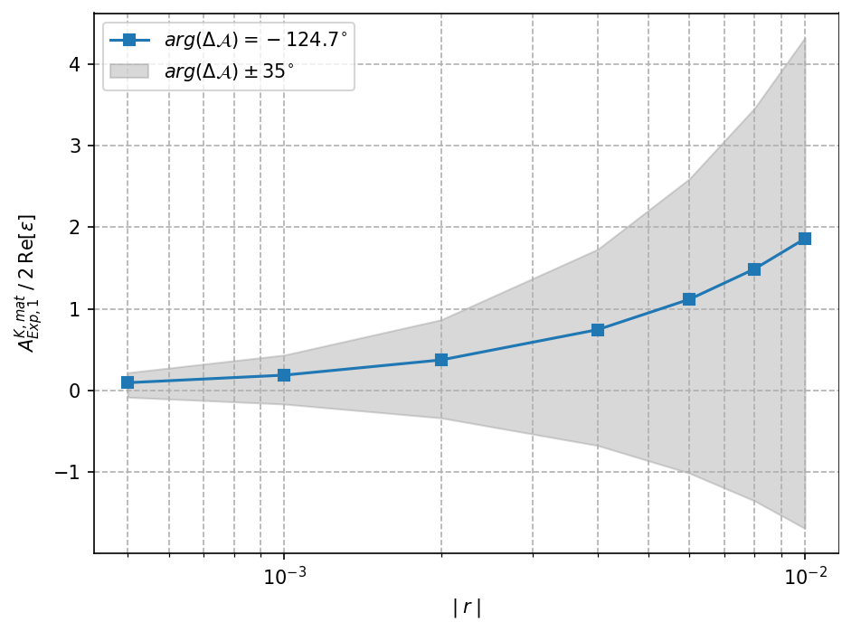

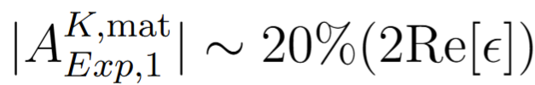
Kaons oscillation in matter
M. Bjørn and S. Malde, 2019

Slide 22

Conclusions
Studying CPV in semi-leptonic tau decays is a good probe for physics BSM;
BaBar and BELLE and measured an anomaly at 3 sigma level;
In the SM we expect CPV to come from kaons oscillation in final state;
The efficiency function plays a crucial rule in the theory prediction;
The CP asymmetry depends on the detector features and on the specific decay process which originates the neutral kaons in final state;
The asymmetry is non vanishing in realistic experiments;
Prediction for BELLE II, corrections of order for the asymmetry;
Kaons regeneration can be the dominant uncertainty… need measurements;

Slide 23
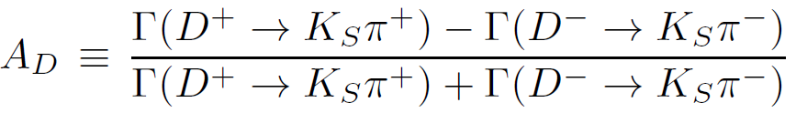
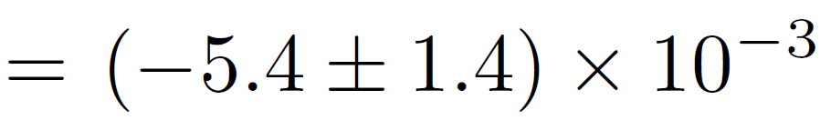
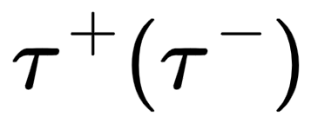
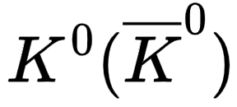
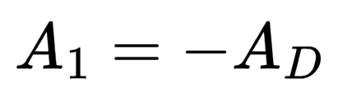
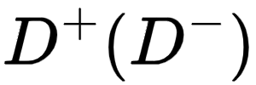
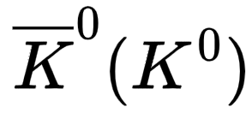
Another anomaly
From average of BaBar, BELLE, CLEO, FOCUS:
produce a
produce a
Objective: refine the SM theory prediction to investigate the anomaly
CPV from kaon oscillation: Naïve expectation
Excluded at 3.3 sigma

Slide 24
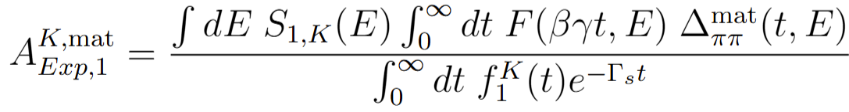
Kaons regeneration in matter
It has an impact on the measured CP asymmetry due to kaon oscillation:
The kaons regeneration parameter depends on the energy of the kaon;
We need to know r to make theory predictions;

