Slide 1
New physics from light scalars in rare kaon decay
Graduate Student: Rahul Pradeep
Affiliation: University of Cincinnati
Advisor: Jure Zupan

Slide 2
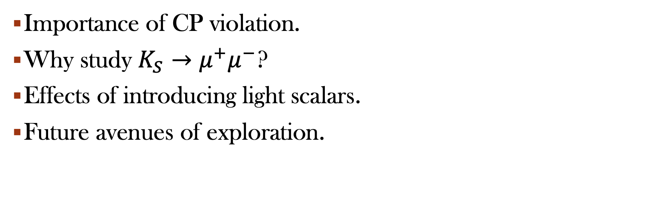
Outline
Importance of CP violation.
Why study $K_{S}→μ^{+}μ^{−}$?
Effects of introducing light scalars.
Future avenues of exploration.

Slide 3
Why Study CP Violation?
Required to explain Baryon asymmetry.
  Integral part of the Sakharov conditions.
Standard model predictions fail to explain observed asymmetry.
Possible to measure such violations with current experimental methods.
Notes:
Standard Model has CP violation via phase in CKM matrix. Not enough to explain existing baryon asymmetry, so we search for other possible explanation, including BSM models. Another good reason is that measurements rely on interactions we are capable of measuring experimentally, so it is an aspect of the SM which we are capable of probing.

Slide 4
Why Neutral Kaons?
Physical neutral kaon states exist in an oscillating superposition of flavour eigenstates.
Mass eigenstates are eigenstates of the Hamiltonian.
They are not CP eigenstates.
Can measure CP violation from decay rates of mass eigenstates.
Notes:
Neutral kaons show clear and obvious CP violation in both mixing and direct decay rate asymmetries. Because of above details. This makes them an ideal setting to study the phenomenon.

Slide 5
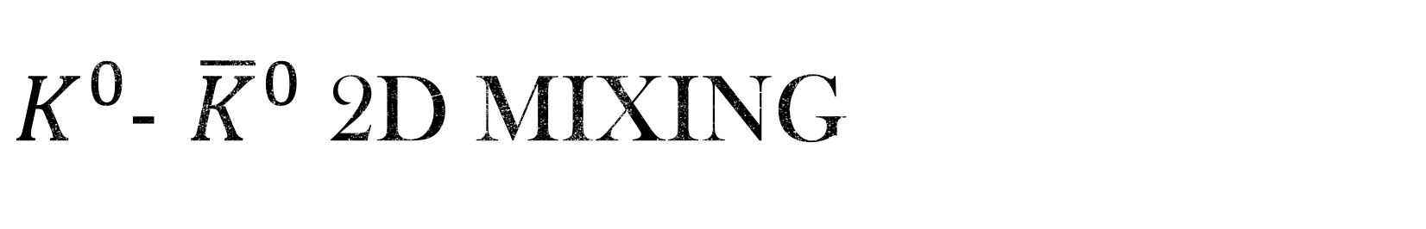
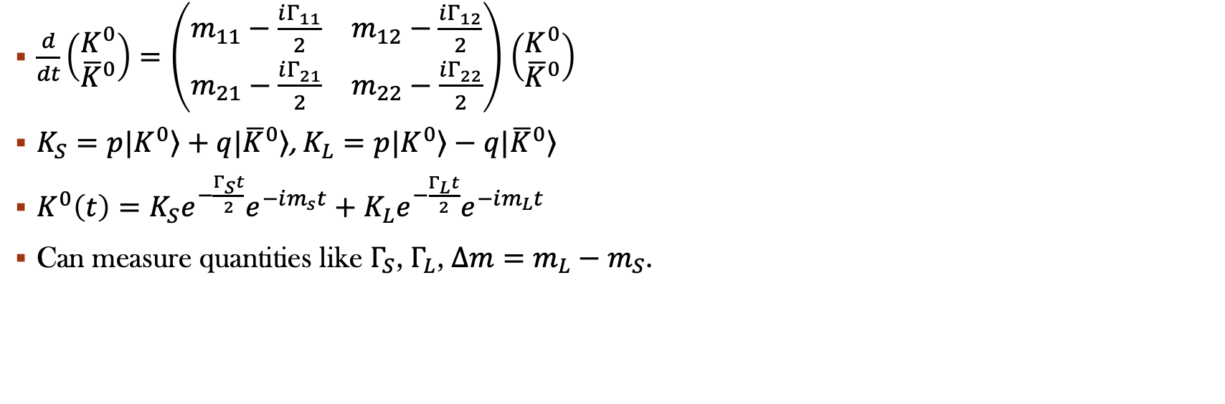
$K^{0}$- ${\overline{K}}^{0}$2d mixing
$\frac{d}{dt}\left(\begin{matrix}K^{0} \\ {\overline{K}}^{0}\end{matrix}\right)=\left(\begin{matrix}m_{11}−\frac{iΓ_{11}}{2} & m_{12}−\frac{iΓ_{12}}{2} \\ m_{21}−\frac{iΓ_{21}}{2} & m_{22}−\frac{iΓ_{22}}{2}\end{matrix}\right)$ $\left(\begin{matrix}K^{0} \\ {\overline{K}}^{0}\end{matrix}\right)$
$K_{S}=p\left.|K^{0}\right\rangle +q\left.|{\overline{K}}^{0}\right\rangle$, $K_{L}=p\left.|K^{0}\right\rangle −q\left.|{\overline{K}}^{0}\right\rangle$
$K^{0}\left(t\right)=K_{S}e^{−\frac{Γ_{S}t}{2}}e^{−im_{s}t}+K_{L}e^{−\frac{Γ_{L}t}{2}}e^{−im_{L}t}$
Can measure quantities like $Γ_{S}$, $Γ_{L}$, $Δm=$ $m_{L}−m_{S}$.

Slide 6
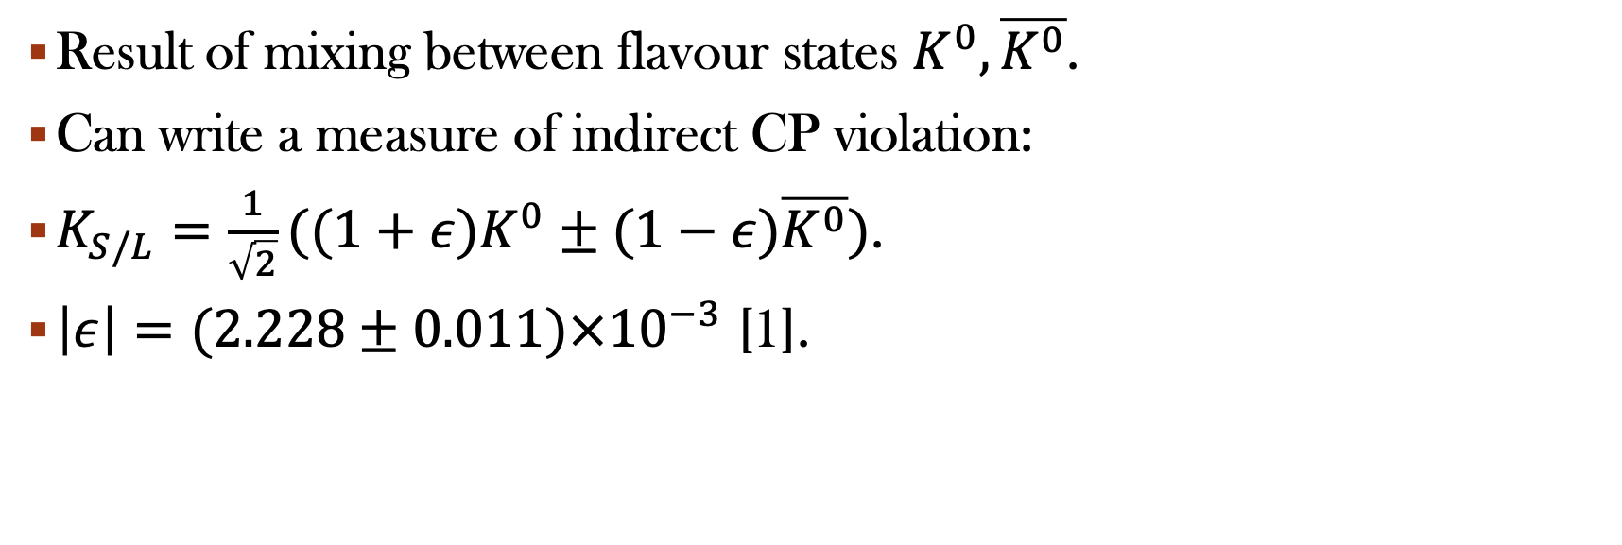
InDirect CP violation
Result of mixing between flavour states $K^{0},\overline{K^{0}}$.
Can write a measure of indirect CP violation:
$K_{S/L}=\frac{1}{\sqrt{2}}((1+ε)K^{0}±(1−ε)\overline{K^{0}})$.
$\left|ε\right|=(2.228±0.011)×{10}^{−3}$ [1].
[2] 2209.07445v3 [hep-ph]
Notes:
This is the essence of indirect CP violation in neutral kaons.

Slide 7
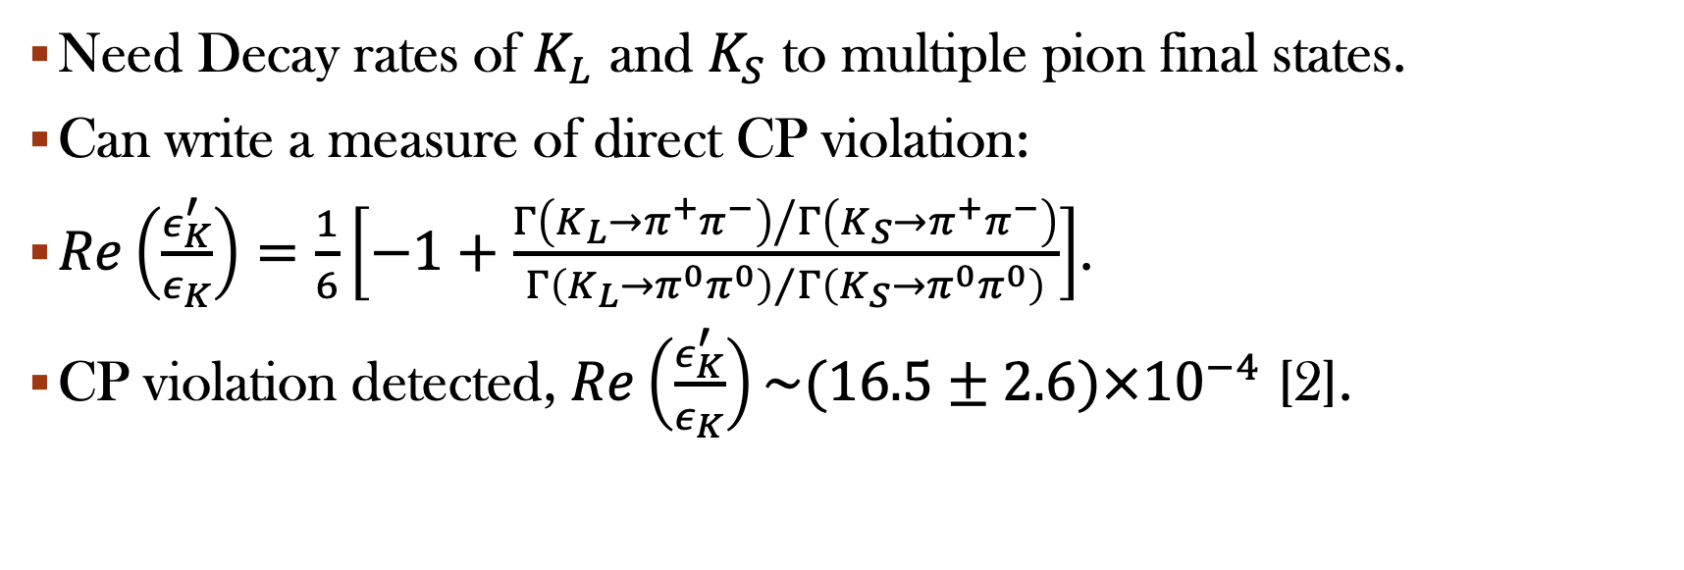
Direct CP violation
Need Decay rates of $K_{L}$ and $K_{S}$ to multiple pion final states.
Can write a measure of direct CP violation:
$Re\left(\frac{ε_{K}^{′}}{ε_{K}}\right)=\frac{1}{6}\left[−1+\frac{{Γ\left(K_{L}→π^{+}π^{−}\right)}/{Γ\left(K_{S}→π^{+}π^{−}\right)}}{{Γ\left(K_{L}→π^{0}π^{0}\right)}/{Γ\left(K_{S}→π^{0}π^{0}\right)}}\right]$.
CP violation detected, $Re\left(\frac{ε_{K}^{′}}{ε_{K}}\right)\sim (16.5±2.6)×{10}^{−4}$ [2].
[2] hep-ex/0208009
Notes:
This is the essence of direct CP violation in neutral kaons.

Slide 8
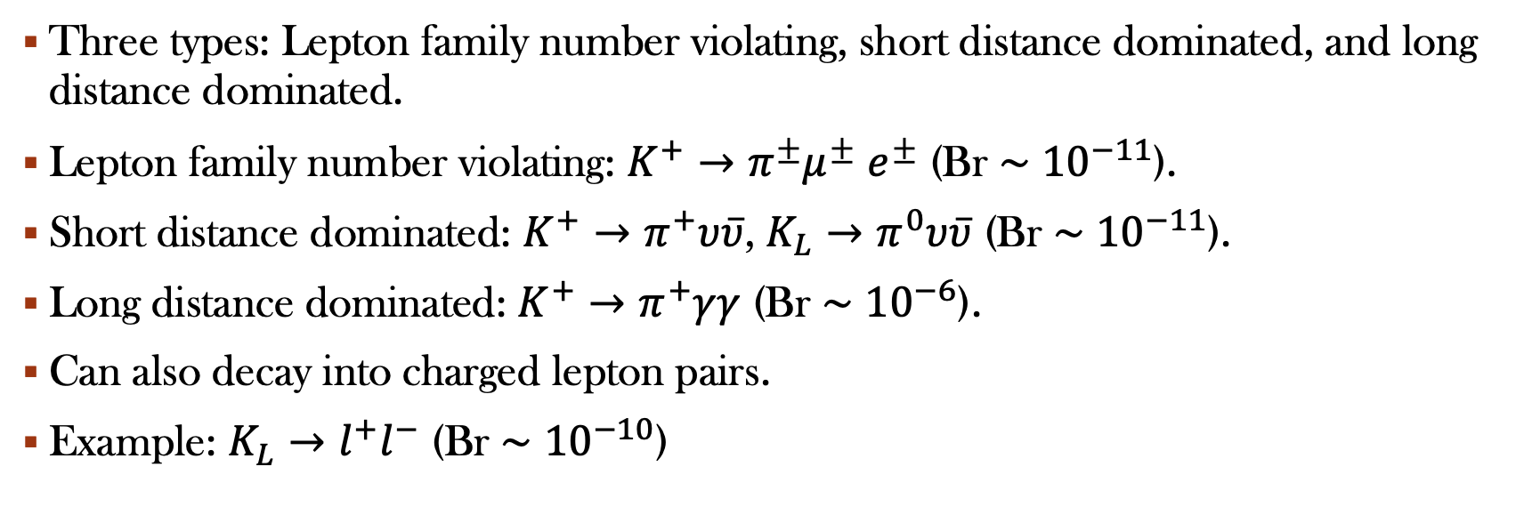
Rare Kaon Decays
Three types: Lepton family number violating, short distance dominated, and long distance dominated.
Lepton family number violating: $K^{+}→π^{±}μ^{±}$ $e^{±}$ (Br $\sim$ ${10}^{−11}$).
Short distance dominated: $K^{+}→π^{+}υ\overline{υ}$, $K_{L}→π^{0}υ\overline{υ}$ (Br $\sim$ ${10}^{−11}$).
Long distance dominated: $K^{+}→π^{+}γγ$ (Br $\sim$ ${10}^{−6}$).
Can also decay into charged lepton pairs.
Example: $K_{L}→l^{+}l^{−}$ (Br $\sim$ ${10}^{−10}$)
Notes:
Kaons also have rare decays, some of which allow for clean CKM measurements and others provide possible mechanisms for CP violation.

Slide 9
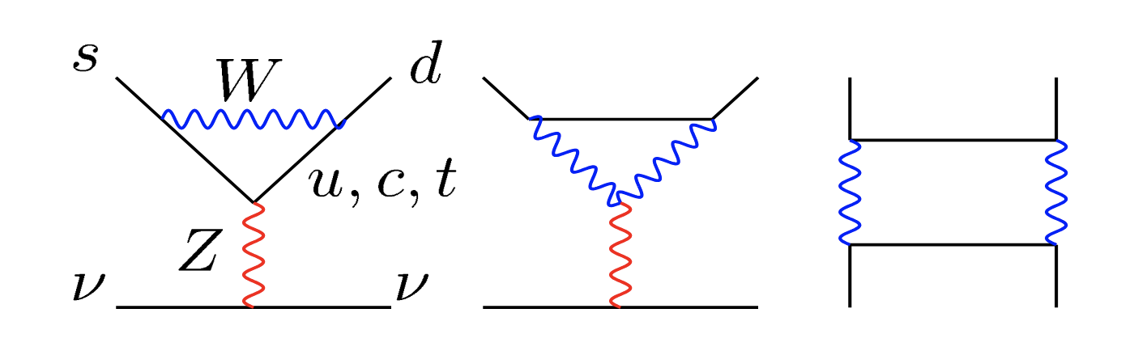
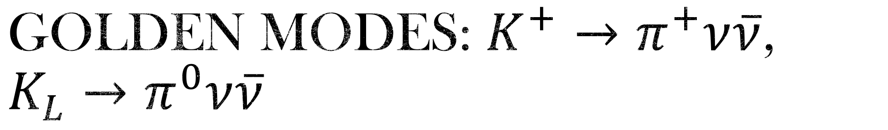
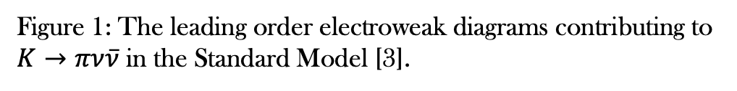
Golden modes: $K^{+}→π^{+}ν\overline{ν}$, $K_{L}→π^{0}ν\overline{ν}$
Induced by semi-leptonic loop FCNCs.
“Clean” decays, largely free of theoretical uncertainties.
Can determine CKM matrix elements.
Provides a measure of CP violation in Standard Model.
Figure 1: The leading order electroweak diagrams contributing to $K→πν\overline{ν}$ in the Standard Model [3].
[3] hep-ph/0103166
Notes:
Come from Z0 penguin and box diagrams.
Short-distance dominated, perturbative treatment valid.
Theoretical uncertainty from QCD and electroweak uncertainties for K+, NO real theoretical uncertainties, largely parametric ones from CKM and m_t.
K_L has fewer theoretical uncertainties because charm contribution drops out since K_L is largely CP odd.
SM suppression by CKM means good for looking for non-standard signals.

Slide 10
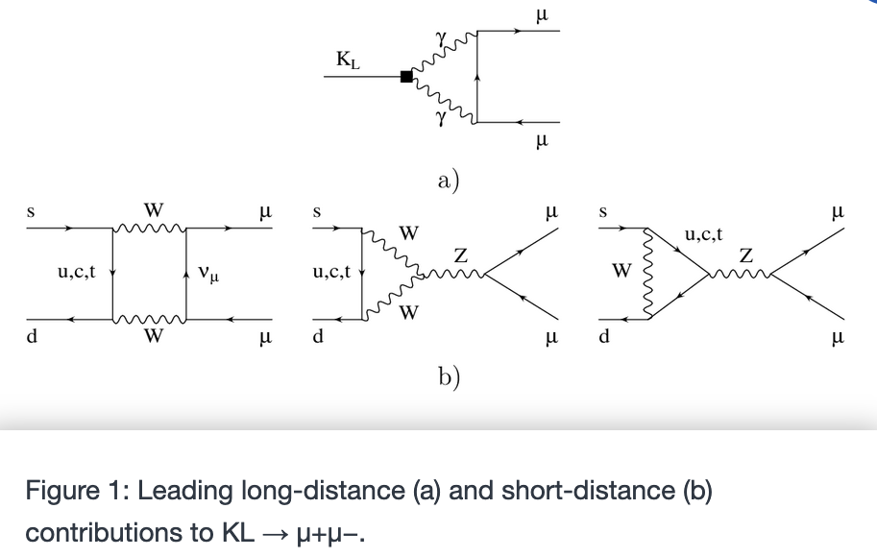
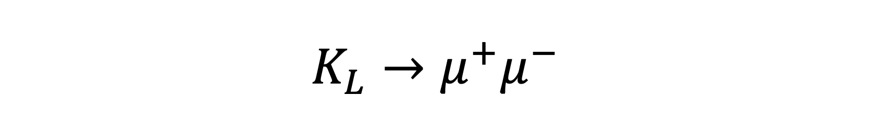
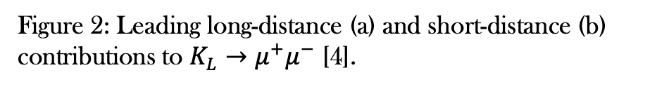

$$K_{L}→μ^{+}μ^{−}$$
CP violating for $l=1$.
Can be used to probe CP violation in long distance effects for $K_{S}→μ^{+}μ^{−}$.
Figure 2: Leading long-distance (a) and short-distance (b) contributions to $K_{L}→μ^{+}μ^{−}$ [4].
[4] hep-ph/9708326
Notes:
Trouble is the long-distance contributions cannot be accurately determined in a model-independent fashion due to difficulty in determining the dispersive contribution. Kaon to pion or eta and uncertainty makes it difficult to make any real predictions. In addition, depends on kaon to gamma gamma sign which suffers from some ambiguity in constructive or destructive interference between LD and SD contributions.
CP odd almost because l=0 state contributes most

Slide 11
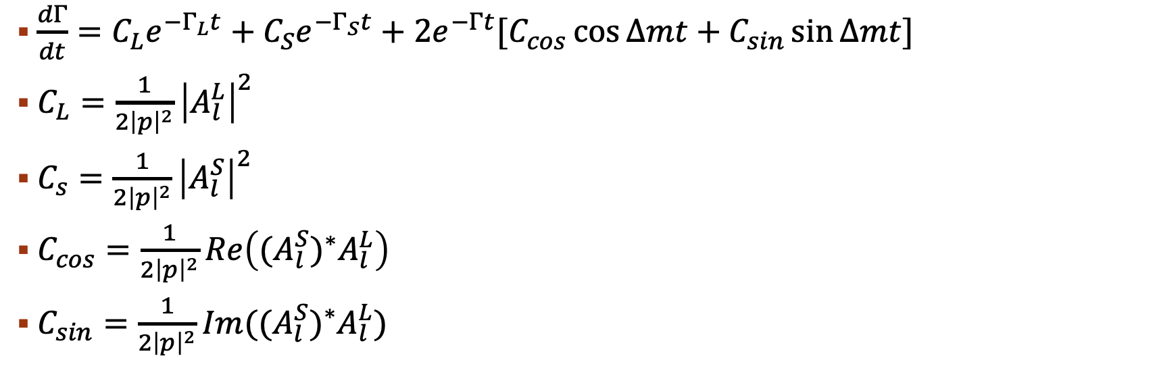
Extracting experimental parameters
$\frac{dΓ}{dt}=C_{L}e^{−Γ_{L}t}+C_{S}e^{−Γ_{S}t}+2e^{−Γt}[C_{cos}\cos{Δmt}+C_{sin}\sin{Δmt}]$
$C_{L}=\frac{1}{2{\left|p\right|}^{2}}{\left|A_{l}^{L}\right|}^{2}$
$C_{s}=\frac{1}{2{\left|p\right|}^{2}}{\left|A_{l}^{S}\right|}^{2}$
$C_{cos}=\frac{1}{2{\left|p\right|}^{2}}Re\left((A_{l}^{S})^{∗}A_{l}^{L}\right)$
$C_{sin}=\frac{1}{2{\left|p\right|}^{2}}Im((A_{l}^{S})^{∗}A_{l}^{L})$
Notes:
These are experimental parameters that can be extracted from the decay rate for a pure K0 beam to a given final state. Later we will extend this to the case of a 4d mixed state.

Slide 12
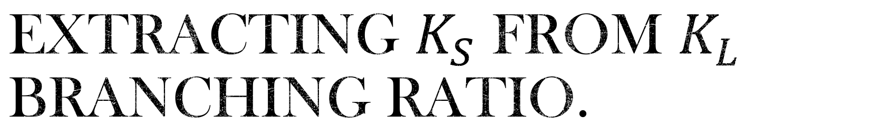

Extracting $K_{S}$ from $K_{L}$ branching ratio.
Assume that $A_{1}^{L}=0.$
$\frac{Br(K_{S}→μ^{+}μ^{−})_{l=0}}{Br\left(K_{L}→μ^{+}μ^{−}\right)}=\frac{{\left|A_{l}^{S}\right|}^{2}Γ_{L}}{{\left|A_{l}^{L}\right|}^{2}Γ_{S}}$.
$Br(K_{S}→μ^{+}μ^{−})_{l=0}=Br\left(K_{L}→μ^{+}μ^{−}\right)∗\frac{τ_{S}}{τ_{L}}∗{\left(\frac{C_{int}}{C_{L}}\right)}^{2}.$
Notes:
Make assumption because effective Lagrangian suggests CP violation is only for l=0.

Slide 13
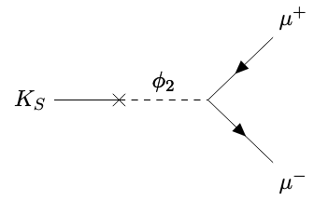
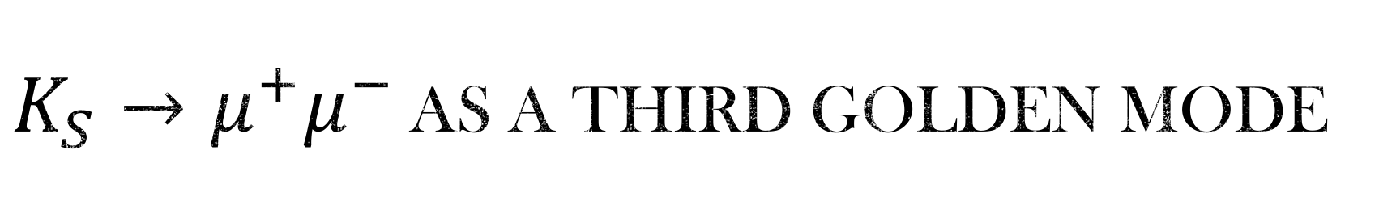
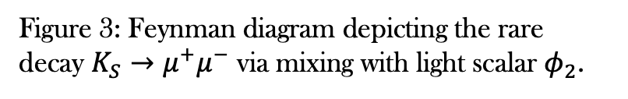
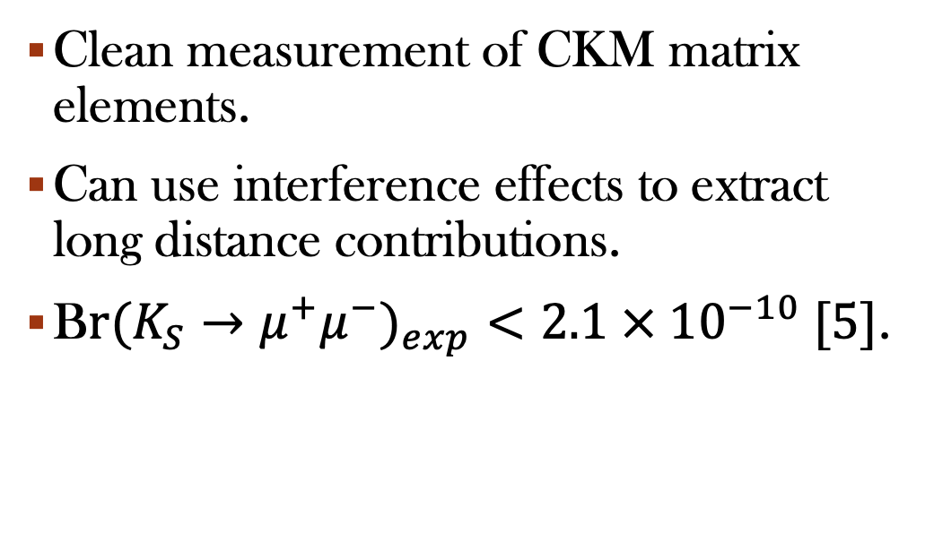
$K_{S}→μ^{+}μ^{−}$ As a Third Golden Mode
Clean measurement of CKM matrix elements.
Can use interference effects to extract long distance contributions.
B$r(K_{S}→μ^{+}μ^{−})_{exp}<2.1 × {10}^{−10} [5]$.
Figure 3: Feynman diagram depicting the rare decay $K_{S}→μ^{+}μ^{−}$ via mixing with light scalar $φ_{2}$.
[5] hep-ex/2001.10354

Slide 14
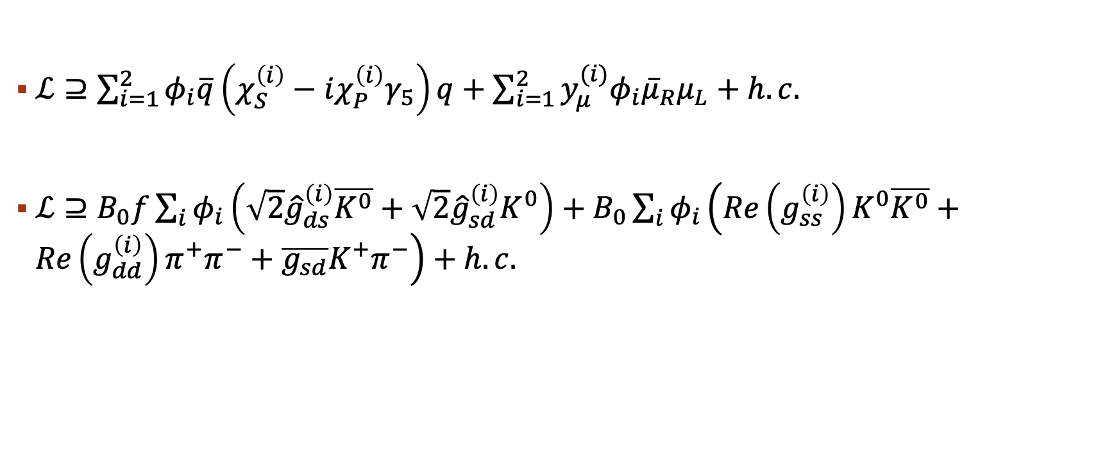
Light scalar physics
$ℒ⊇\sum_{i=1}^{2}{φ_{i}\overline{q}\left(χ_{S}^{\left(i\right)}−iχ_{P}^{\left(i\right)}γ_{5}\right)q+\sum_{i=1}^{2}{y_{μ}^{(i)}φ_{i}{\overline{μ}}_{R}μ_{L}}+h.c.}$
$ℒ⊇B_{0}f\sum_{i}{φ_{i}}\left(\sqrt{2}{\hat{g}}_{ds}^{\left(i\right)}\overline{K^{0}}+\sqrt{2}{\hat{g}}_{sd}^{\left(i\right)}K^{0}\right)+B_{0}\sum_{i}{φ_{i}\left(Re\left(g_{ss}^{\left(i\right)}\right)K^{0}\overline{K^{0}}+Re\left(g_{dd}^{\left(i\right)}\right)π^{+}π^{−}+\overline{g_{sd}}K^{+}π^{−}\right)}+h.c.$
Notes:
BM2 benchmarks chosen for maximum NP in mixing.
BM1 benchmarks chosen for no new CP violation in mixing.

Slide 15
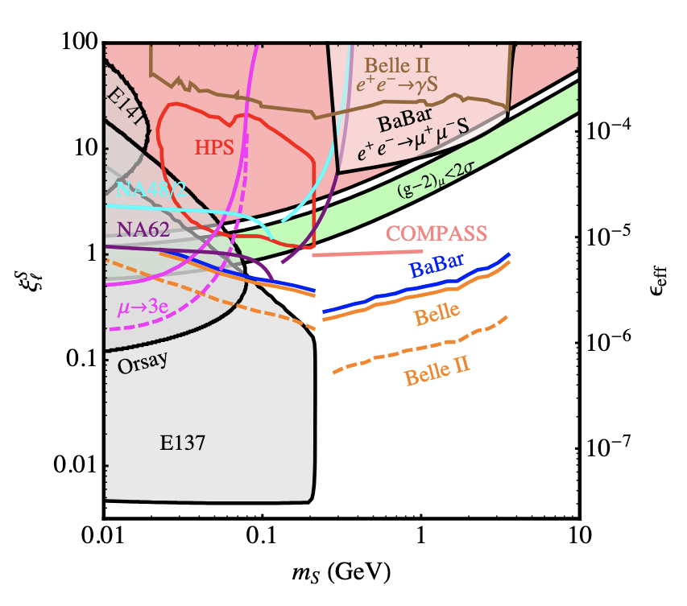
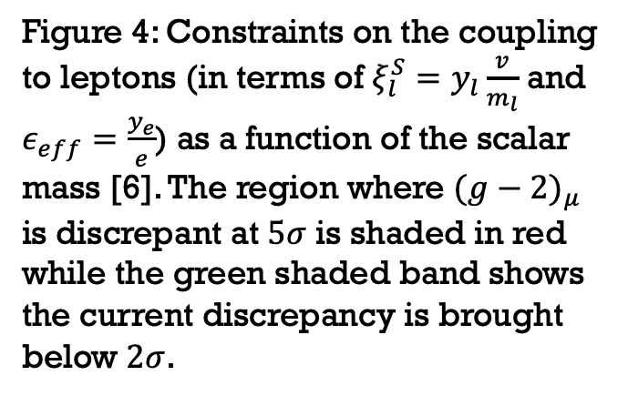
Constraints from muonic interactions
Figure 4: Constraints on the coupling to leptons (in terms of $ξ_{l}^{S}=y_{l}\frac{v}{m_{l}}$ and $ε_{eff}=\frac{y_{e}}{e}$) as a function of the scalar mass [6]. The region where $(g−2)_{μ}$ is discrepant at $5σ$ is shaded in red while the green shaded band shows the current discrepancy is brought below $2σ$.
[6] hep-ph/1606.04943v1
Notes:
Cannot have scalars less than 30 MeV for g-2 discrepancy.

Slide 16

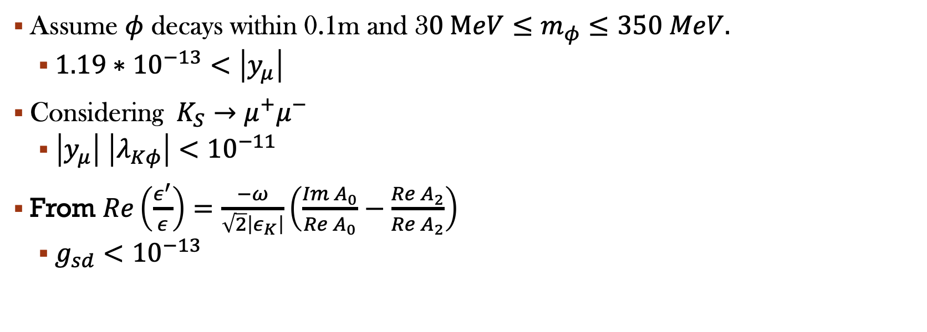
Coupling constraints from $K_{S}→μ^{+}μ^{−}$ and Mixing
Assume $φ$ decays within 0.1m and 3$0 MeV≤m_{φ}≤350 MeV.$
  $1.19∗{10}^{−13}<\left|y_{μ}\right|$
Considering $K_{S}→μ^{+}μ^{−}$
  $\left|y_{μ}\right|$ $\left|λ_{Kφ}\right|<{10}^{−11}$
From $Re\left(\frac{ε^{′}}{ε}\right)=\frac{−ω}{\sqrt{2}\left|ε_{K}\right|}\left(\frac{Im A_{0}}{Re A_{0}}−\frac{Re A_{2}}{Re A_{2}}\right)$
  $g_{sd}<{10}^{−13}$

Slide 17
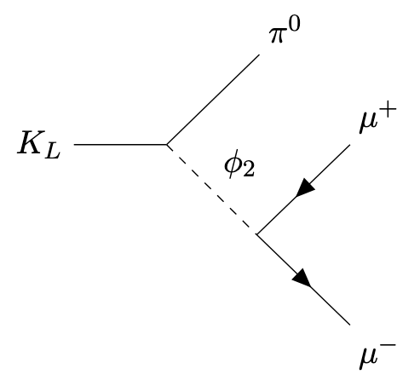
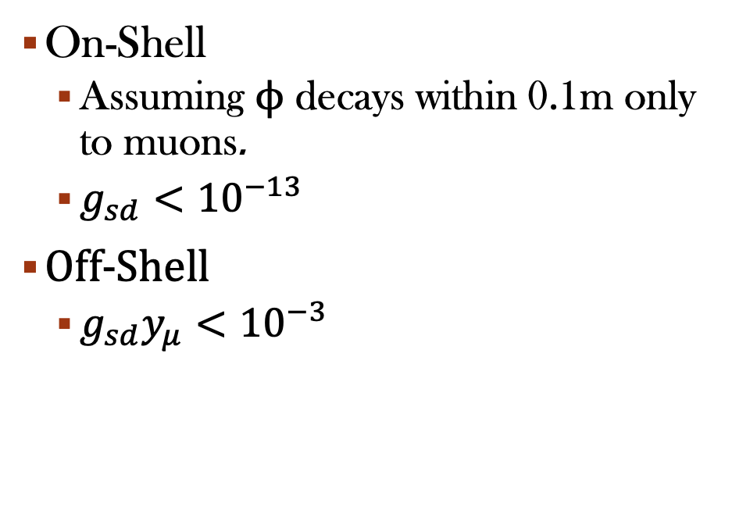
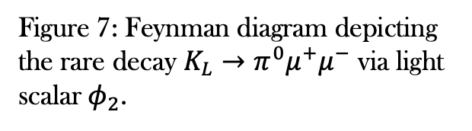
Coupling constraints from other rare decays
On-Shell
  Assuming $ϕ$ decays within 0.1m only to muons.
  $g_{sd}<{10}^{−13}$
Off-Shell
  $g_{sd}y_{μ}<{10}^{−3}$
Figure 7: Feynman diagram depicting the rare decay $K_{L}→π^{0}μ^{+}μ^{−}$ via light scalar$φ_{2}$.
Notes:
From

Slide 18
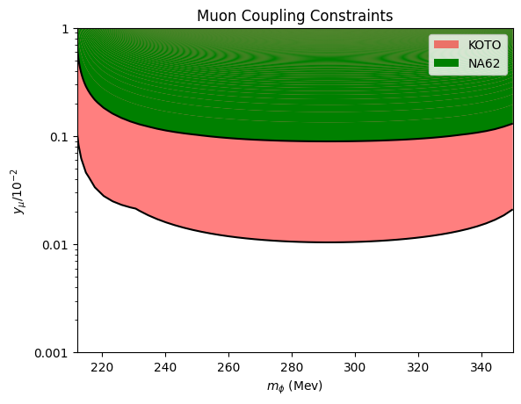
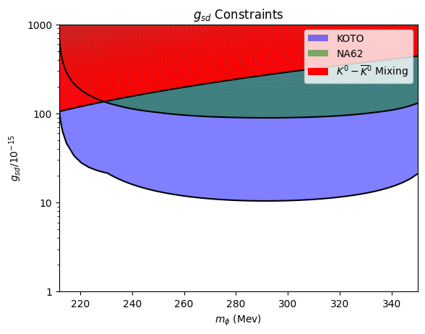
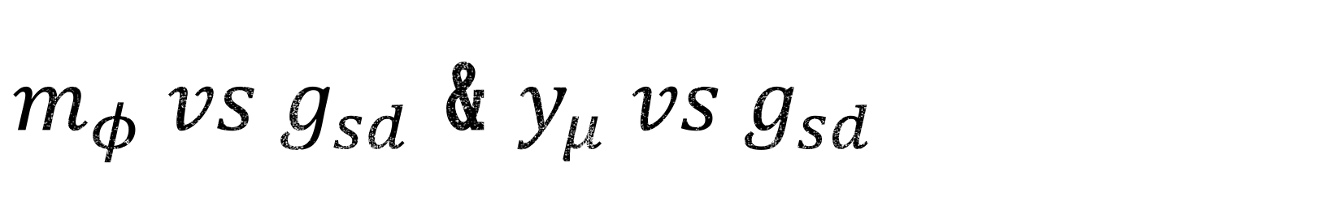
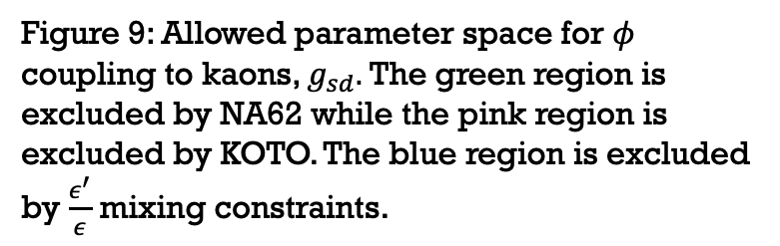
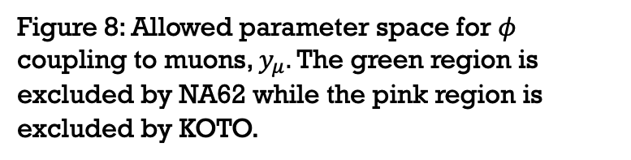
$m_{φ} vs g_{sd}$ & $y_{μ} vs g_{sd}$
Figure 8: Allowed parameter space for $φ$ coupling to muons, $y_{μ}.$ The green region is excluded by NA62 while the pink region is excluded by KOTO.
Figure 9: Allowed parameter space for $φ$ coupling to kaons, $g_{sd}.$ The green region is excluded by NA62 while the pink region is excluded by KOTO. The blue region is excluded by $\frac{ε^{′}}{ε}$ mixing constraints.

Slide 19
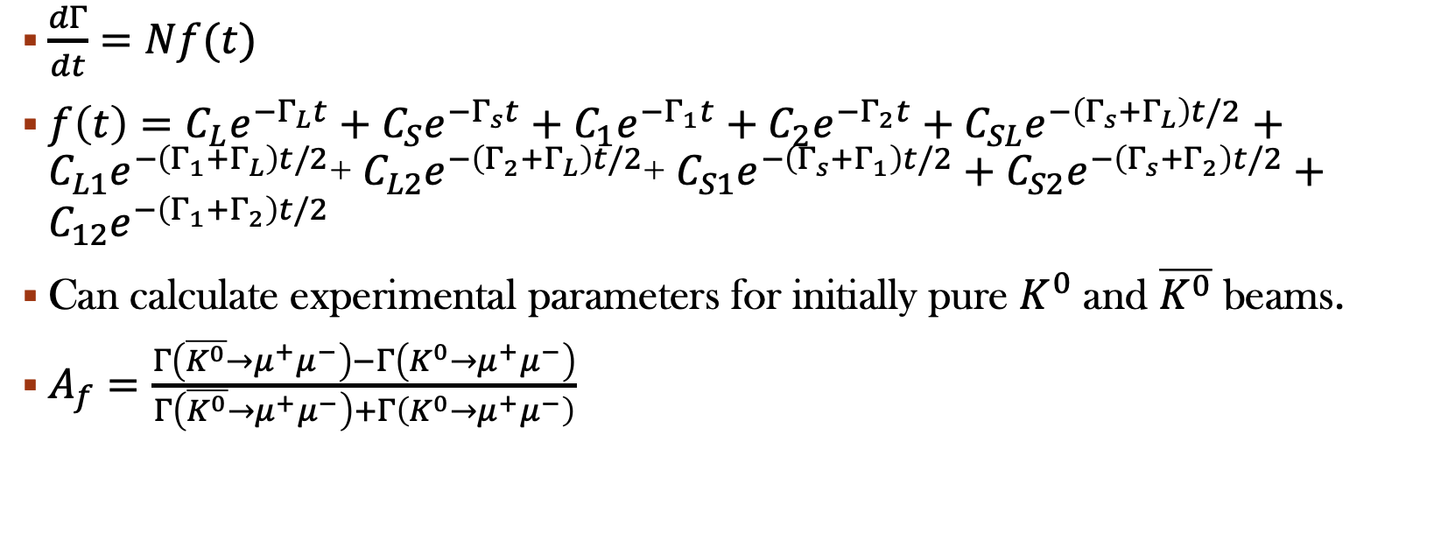
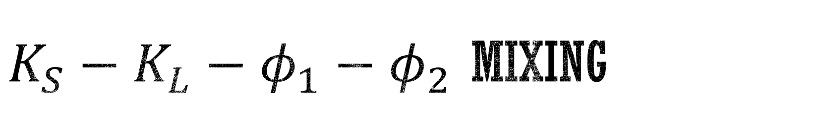
$K_{S}−K_{L}−φ_{1}−φ_{2}$ mixing
$\frac{dΓ}{dt}=Nf(t)$
$f\left(t\right)=C_{L}e^{−Γ_{L}t}+C_{S}e^{−Γ_{s}t}+C_{1}e^{−Γ_{1}t}+C_{2}e^{−Γ_{2}t}+C_{SL}e^{−\left(Γ_{s}+Γ_{L}\right)t/2}+C_{L1}e^{−\left(Γ_{1}+Γ_{L}\right)t/2}$+ $C_{L2}e^{−\left(Γ_{2}+Γ_{L}\right)t/2}$+ $C_{S1}e^{−\left(Γ_{s}+Γ_{1}\right)t/2}+C_{S2}e^{−\left(Γ_{s}+Γ_{2}\right)t/2}+C_{12}e^{−\left(Γ_{1}+Γ_{2}\right)t/2}$
Can calculate experimental parameters for initially pure $K^{0}$ and $\overline{K^{0}}$ beams.
$A_{f}=\frac{Γ\left(\overline{K^{0}}→μ^{+}μ^{−}\right)−Γ\left(K^{0}→μ^{+}μ^{−}\right)}{Γ\left(\overline{K^{0}}→μ^{+}μ^{−}\right)+Γ\left(K^{0}→μ^{+}μ^{−}\right)}$

Slide 20
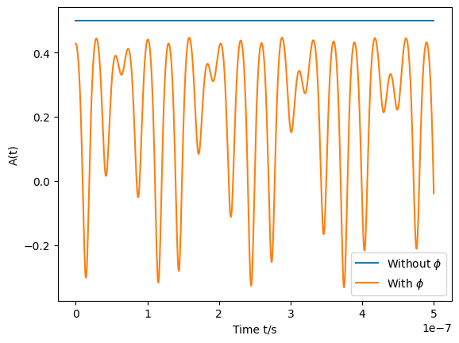
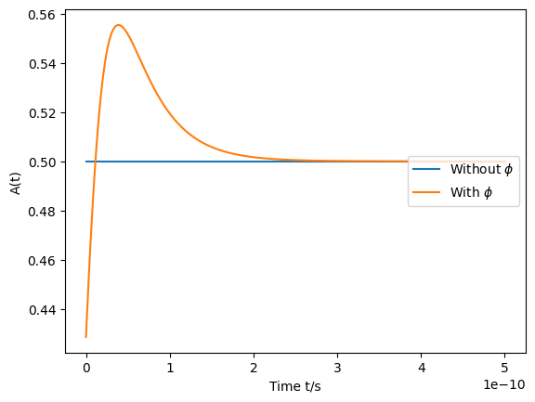
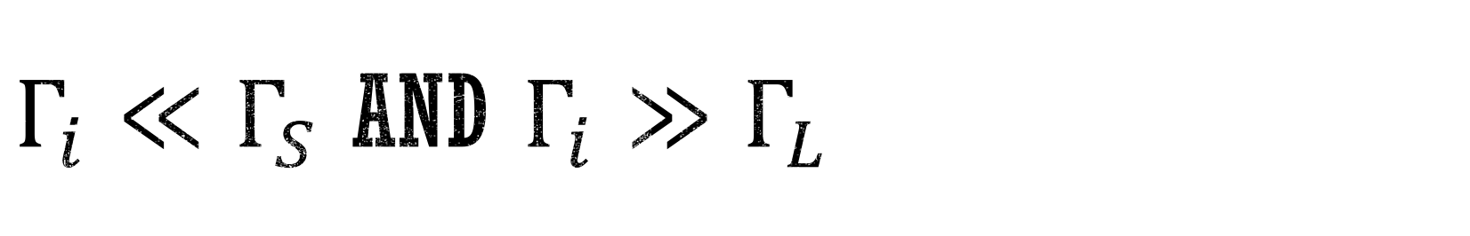


$Γ_{i}≪Γ_{S}$ and $Γ_{i}≫Γ_{L}$
(a) Expanding in $Γ_{i}≪Γ_{S}$ regime:
(b) Expanding in${ Γ}_{i}≫Γ_{S}$ regime:
Figure 12: Time evolution of CP asymmetry for $K_{S}→μ^{+}μ^{−} under both regimes$(a) and (b).

Slide 21
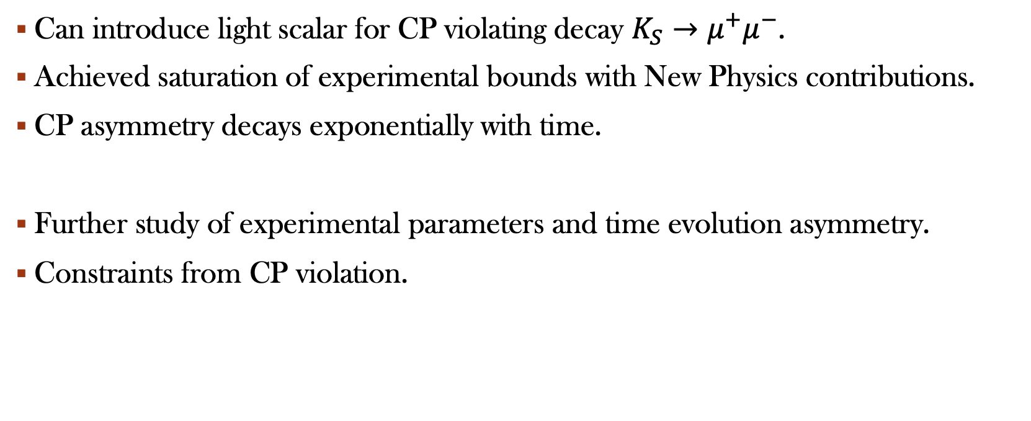
Summary and the future
Can introduce light scalar for CP violating decay $K_{S}→μ^{+}μ^{−}$.
Achieved saturation of experimental bounds with New Physics contributions.
CP asymmetry decays exponentially with time.
Further study of experimental parameters and time evolution asymmetry.
Constraints from CP violation.

