Slide 1
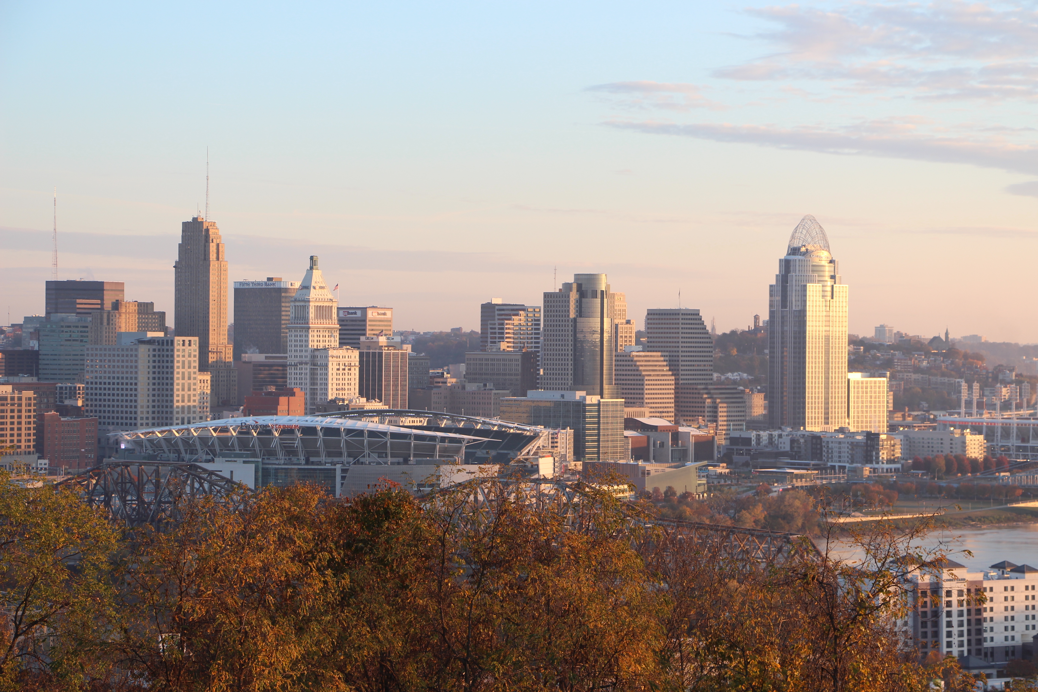
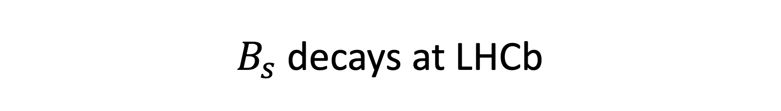
$B_{s}$ decays at LHCb
Michael K. Wilkinson
of the University of Cincinnati
on behalf of the LHCb collaboration
23rd Conference on Flavor Physics and CP Violation
5 June 2025

Slide 2
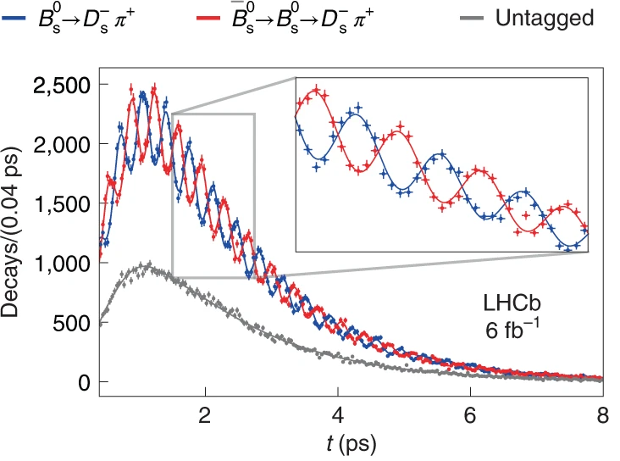
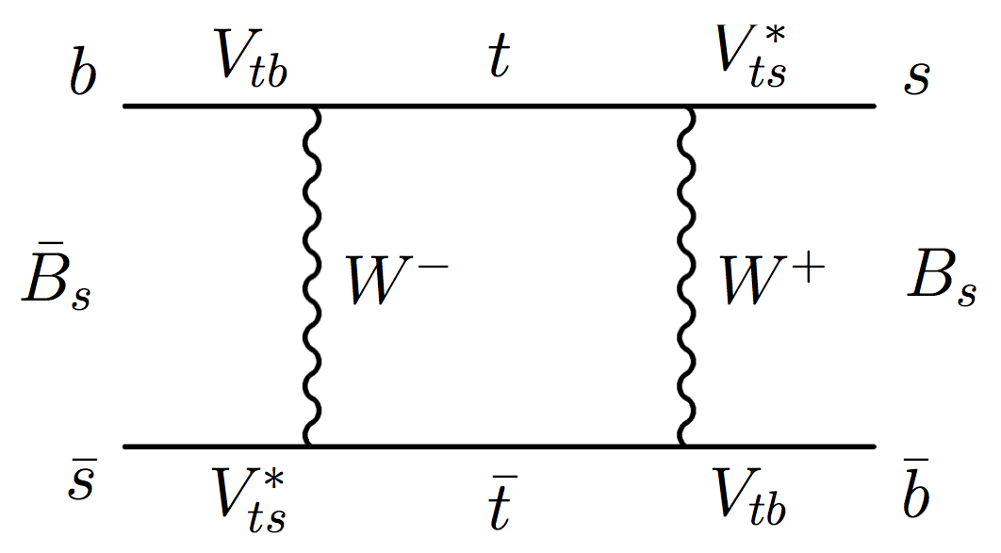
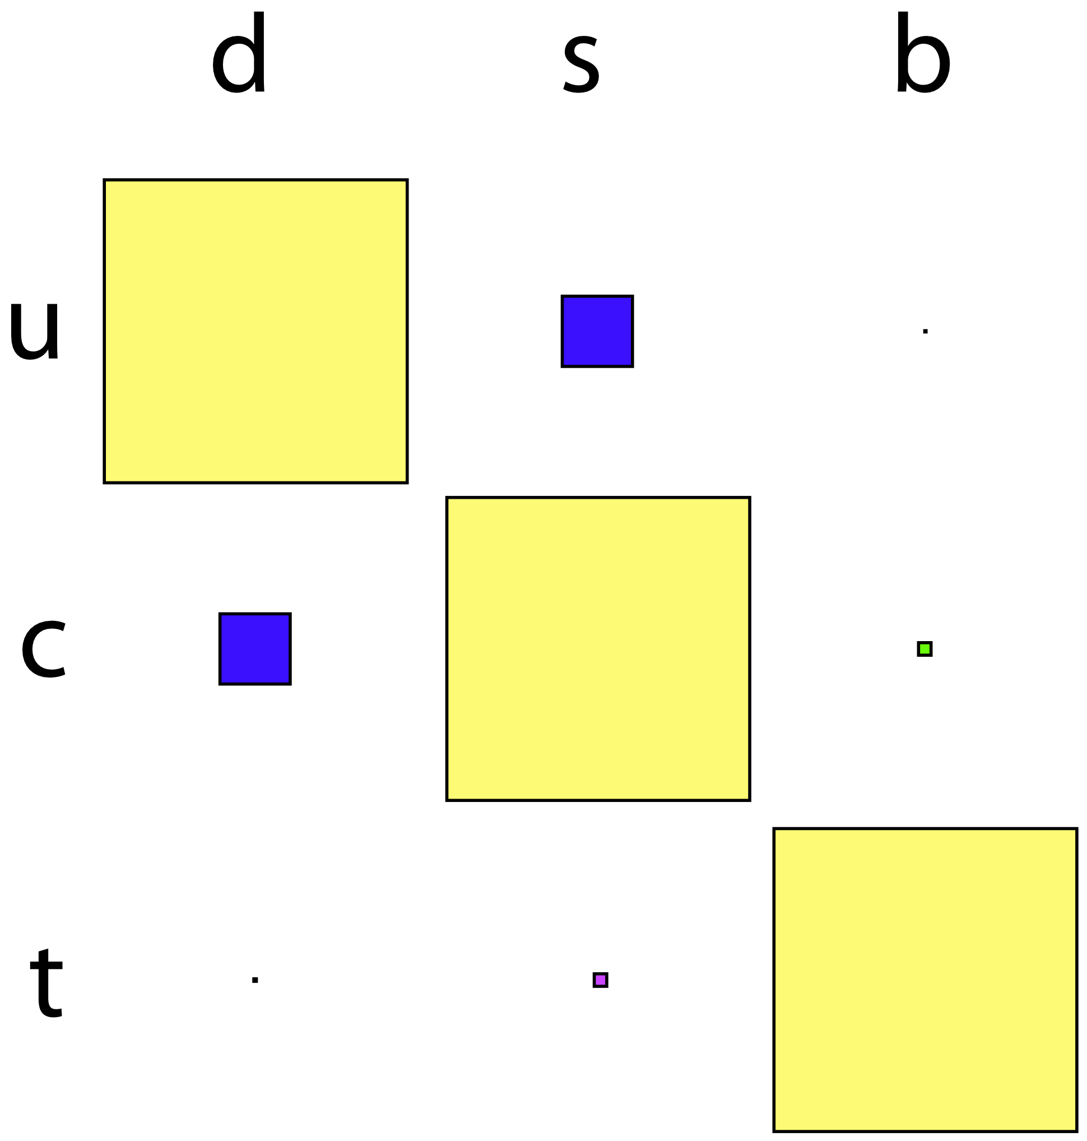
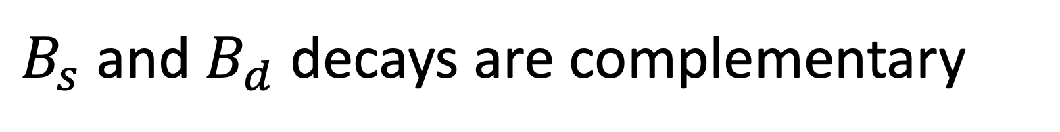
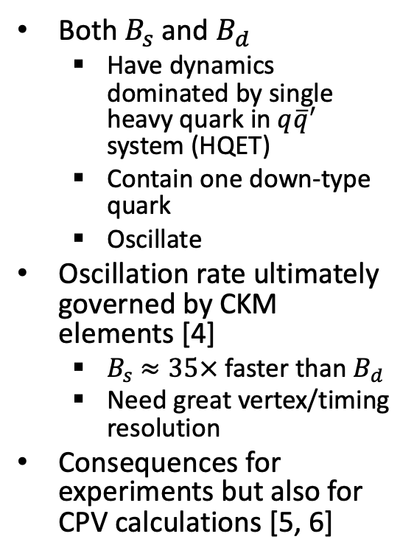
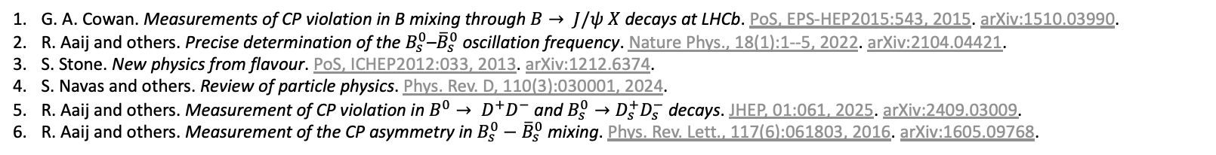
$B_{s}$ and $B_{d}$ decays are complementary
Both $B_{s}$ and $B_{d}$
  Have dynamics dominated by single heavy quark in $q{\overline{q}}^{′}$ system (HQET)
  Contain one down-type quark
  Oscillate
Oscillation rate ultimately governed by CKM elements [4]
  $B_{s}$ $≈35×$ faster than $B_{d}$
  Need great vertex/timing resolution
Consequences for experiments but also for CPV calculations [5, 6]
Useful for cross-checks
The difference
[2]
Illustrative box diagram [1]
G. A. Cowan. Measurements of CP violation in B mixing through $B→ J/ψ X$ decays at LHCb. PoS, EPS-HEP2015:543, 2015. arXiv:1510.03990.
R. Aaij and others. Precise determination of the $B_{s}^{0}$–${\overline{B}}_{s}^{0}$ oscillation frequency. Nature Phys., 18(1):1--5, 2022. arXiv:2104.04421.
S. Stone. New physics from flavour. PoS, ICHEP2012:033, 2013. arXiv:1212.6374.
S. Navas and others. Review of particle physics. Phys. Rev. D, 110(3):030001, 2024.
R. Aaij and others. Measurement of CP violation in $B^{0}→ D^{+}D^{−}$ and $B_{s}^{0}→D_{s}^{+}D_{s}^{−}$ decays. JHEP, 01:061, 2025. arXiv:2409.03009.
R. Aaij and others. Measurement of the CP asymmetry in $B_{s}^{0}−{\overline{B}}_{s}^{0}$ mixing. Phys. Rev. Lett., 117(6):061803, 2016. arXiv:1605.09768.
[3]
Notes:
From PDG, oscilation rates for Bd and Bs are
Δmd = 50.63 x 10^10 / s
Δms = 17.765 x 10^12 / s

Slide 3
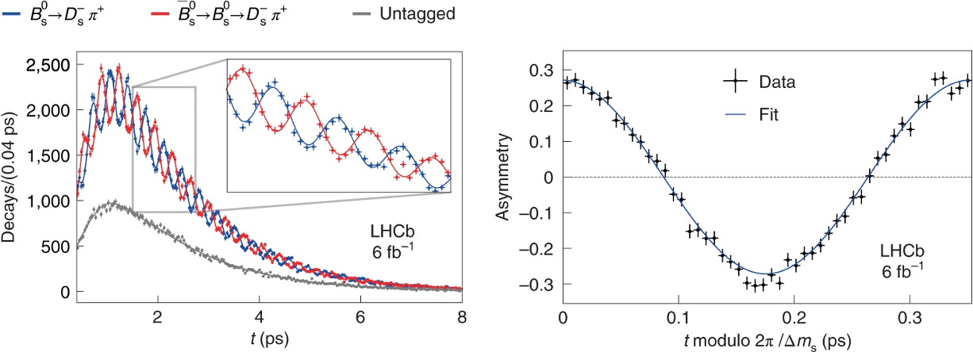
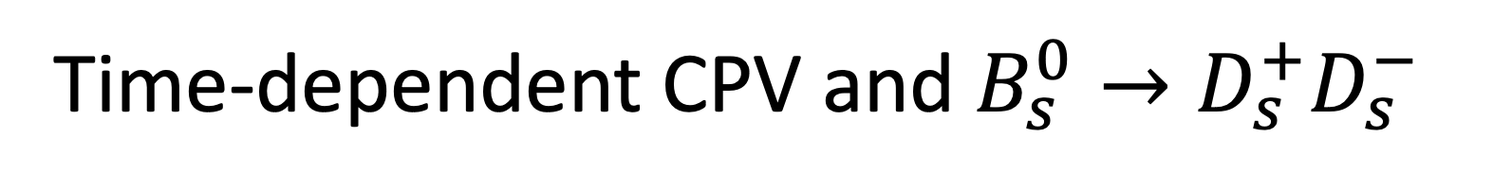
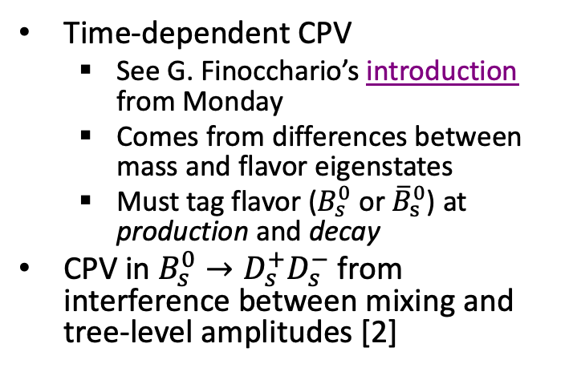
Time-dependent CPV and $B_{s}^{0}→D_{s}^{+}D_{s}^{−}$
Time-dependent CPV
  See G. Finocchario’s introduction from Monday
  Comes from differences between mass and flavor eigenstates
  Must tag flavor ($B_{s}^{0}$ or ${\overline{B}}_{s}^{0}$) at production and decay
CPV in $B_{s}^{0}→D_{s}^{+}D_{s}^{−}$ from interference between mixing and tree-level amplitudes [2]
[1]
Tree-level
Exchange
Penguin
Penguin annihilation
[2]
R. Aaij and others. Precise determination of the $B_{s}^{0}$–${\overline{B}}_{s}^{0}$ oscillation frequency. Nature Phys., 18(1):1--5, 2022. arXiv:2104.04421.
R. Aaij and others. Measurement of CP violation in $B^{0}→ D^{+}D^{−}$ and $B_{s}^{0}→D_{s}^{+}D_{s}^{−}$ decays. JHEP, 01:061, 2025. arXiv:2409.03009.

Slide 4
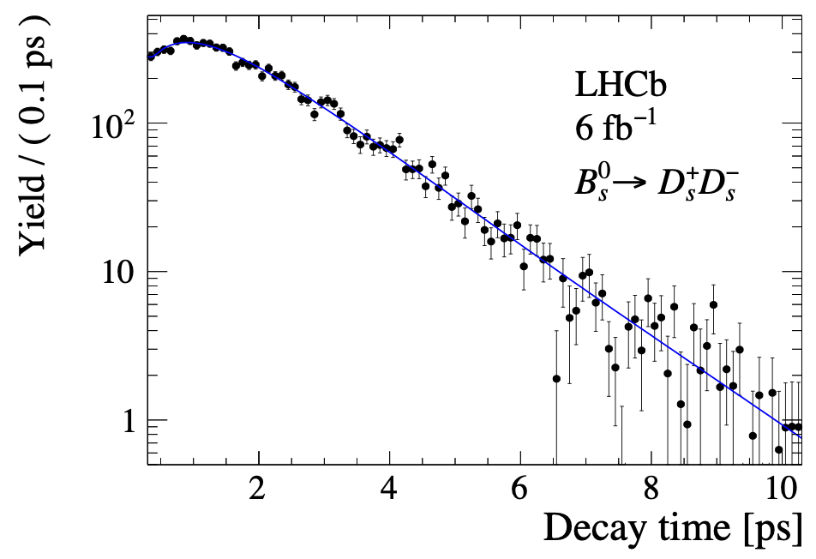
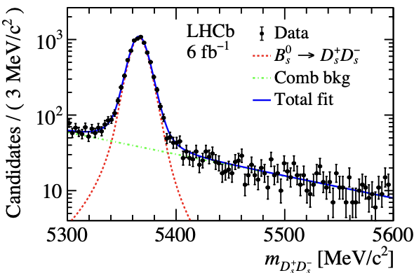
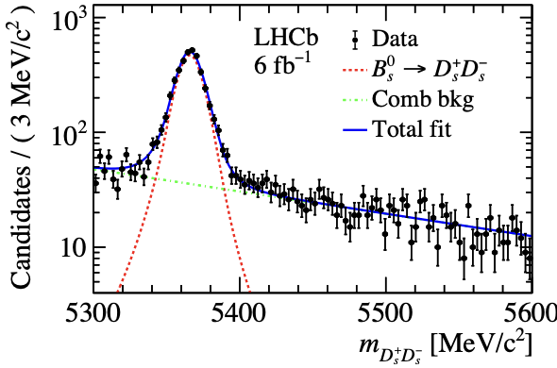
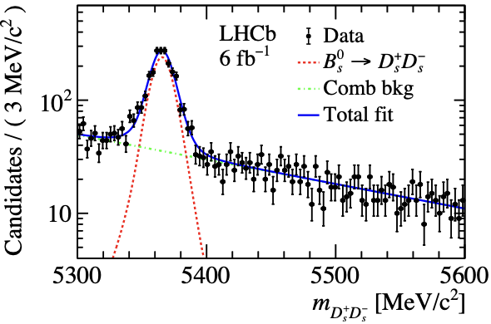
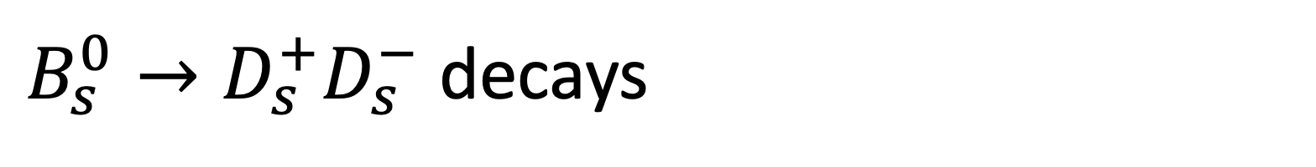



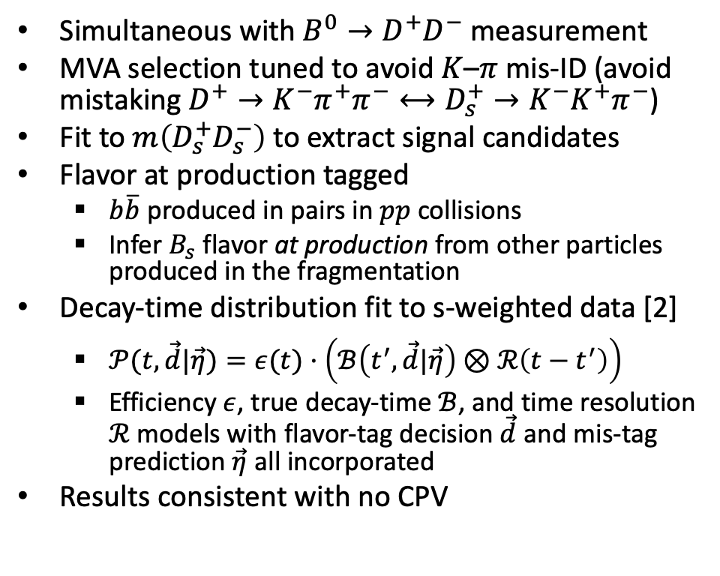
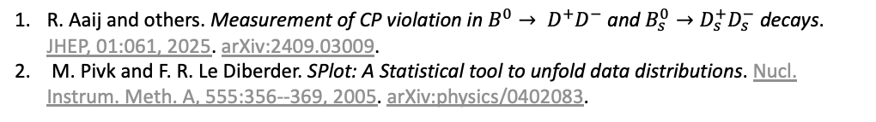
$B_{s}^{0}→D_{s}^{+}D_{s}^{−}$ decays
Simultaneous with $B^{0}→D^{+}D^{−}$ measurement
MVA selection tuned to avoid $K$–$π$ mis-ID (avoid mistaking $D^{+}→K^{−}π^{+}π^{−}⟷D_{s}^{+}→K^{−}K^{+}π^{−}$)
Fit to $m\left(D_{s}^{+}D_{s}^{−}\right)$ to extract signal candidates
Flavor at production tagged
  $b\overline{b}$ produced in pairs in $pp$ collisions
  Infer $B_{s}$ flavor at production from other particles produced in the fragmentation
Decay-time distribution fit to s-weighted data [2]
  $𝒫(t,\vec{d}|\vec{η})=ε(t)·\left(ℬ\left(t^{′},\vec{d}|\vec{η}\right)⊗ℛ\left(t−t^{′}\right)\right)$
  Efficiency $ε$, true decay-time $ℬ$, and time resolution $ℛ$ models with flavor-tag decision $\vec{d}$ and mis-tag prediction $\vec{η}$ all incorporated
Results consistent with no CPV
$$D_{s}^{+}→K^{−}K^{+}π^{+}$$
$$D_{s}^{+}→π^{−}K^{+}π^{+}$$
R. Aaij and others. Measurement of CP violation in $B^{0}→ D^{+}D^{−}$ and $B_{s}^{0}→D_{s}^{+}D_{s}^{−}$ decays. JHEP, 01:061, 2025. arXiv:2409.03009.
M. Pivk and F. R. Le Diberder. SPlot: A Statistical tool to unfold data distributions. Nucl. Instrum. Meth. A, 555:356--369, 2005. arXiv:physics/0402083.
[1]
$$D_{s}^{+}→π^{−}π^{+}π^{+}$$
Notes:
Most precise single-measurement of CPV parameters in Bs->DsDs

Slide 5
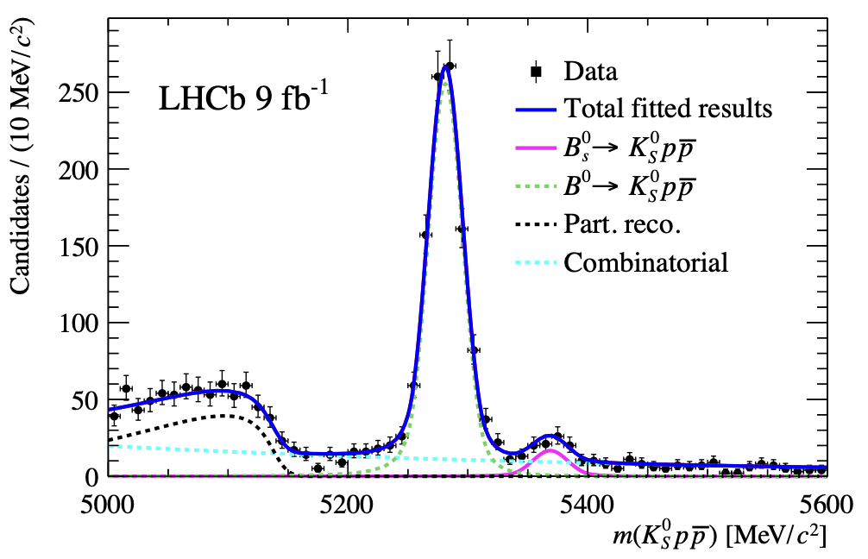
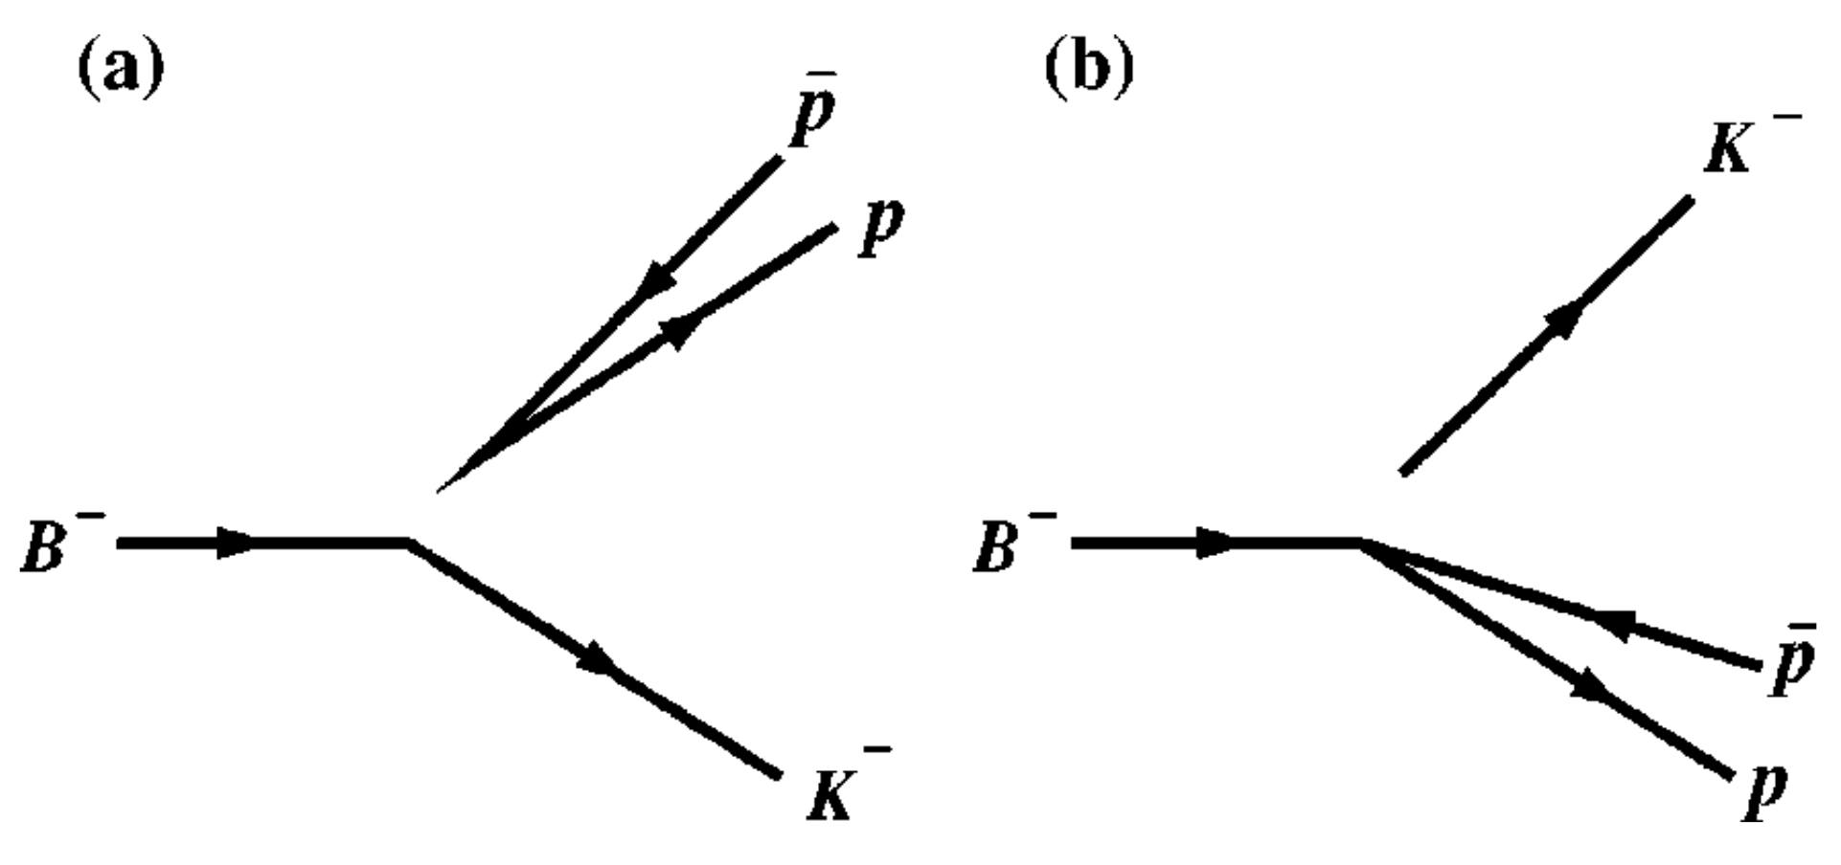
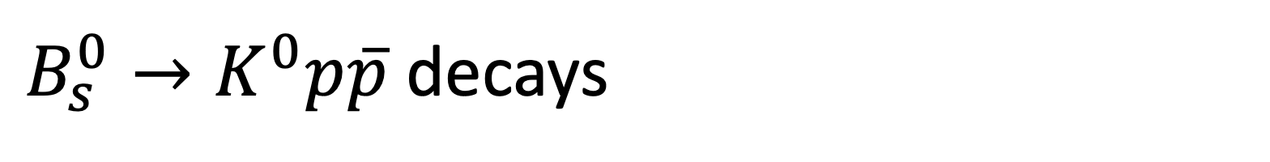
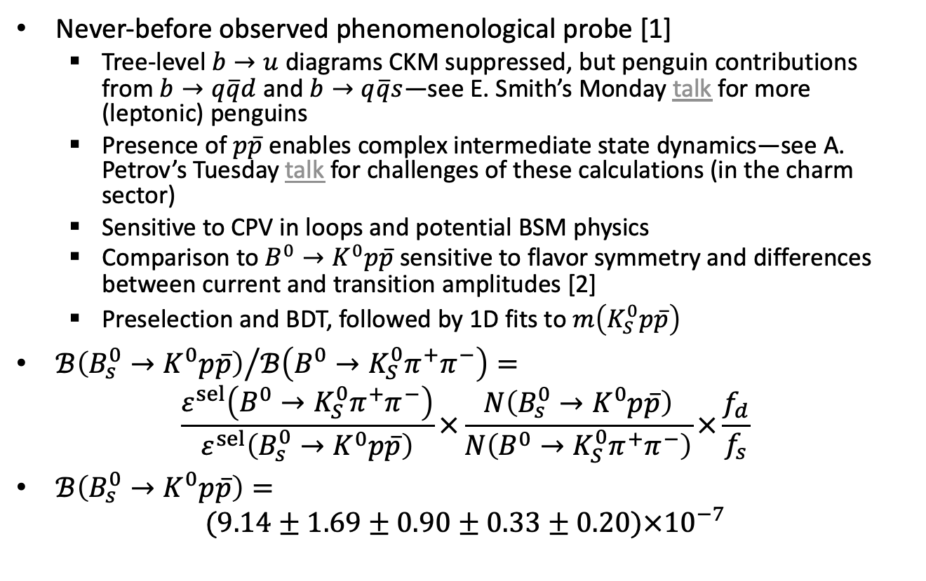
$B_{s}^{0}→K^{0}p\overline{p}$ decays
Never-before observed phenomenological probe [1]
  Tree-level $b→u$ diagrams CKM suppressed, but penguin contributions from $b→q\overline{q}d$ and $b→q\overline{q}s$—see E. Smith’s Monday talk for more (leptonic) penguins
  Presence of $p\overline{p}$ enables complex intermediate state dynamics—see A. Petrov’s Tuesday talk for challenges of these calculations (in the charm sector)
  Sensitive to CPV in loops and potential BSM physics
  Comparison to $B^{0}→K^{0}p\overline{p}$ sensitive to flavor symmetry and differences between current and transition amplitudes [2]
  Preselection and BDT, followed by 1D fits to $m\left(K_{S}^{0}p\overline{p}\right)$
${ℬ\left(B_{s}^{0}→K^{0}p\overline{p}\right)}/{ℬ\left(B^{0}→K_{S}^{0}π^{+}π^{−}\right)}=$
$\frac{ε^{sel}\left(B^{0}→K_{S}^{0}π^{+}π^{−}\right)}{ε^{sel}\left(B_{s}^{0}→K^{0}p\overline{p}\right)}×\frac{N\left(B_{s}^{0}→K^{0}p\overline{p}\right)}{N\left(B^{0}→K_{S}^{0}π^{+}π^{−}\right)}×\frac{f_{d}}{f_{s}}$
$ℬ\left(B_{s}^{0}→K^{0}p\overline{p}\right)=$
$(9.14±1.69±0.90±0.33±0.20)×{10}^{−7}$
[1]
current
transition
[2]
R. Aaij and others. Observation of the decay $B_{s}^{0}→K^{0}p\overline{p}$ and measurement of the $B_{\left(s\right)}^{0}→ K^{0}p\overline{p}$ branching fractions. 2025. arXiv:2504.21269.
C.-K. Chua and others. Charmless three-body baryonic B decays. Phys. Rev. D, 66:054004, 2002. arXiv:hep-ph/0204185.
Notes:
current-produced baryon pair with a recoil meson transition
baryon pair transition with current-produced recoil meson
“Measurements of branching fractions and CP asymmetries are essential for testing and refining theoretical model [8, 9]. The relative branching fractions of B0 →K0pp and B0s→K0pp decays provide precise tests of flavour symmetries, as their quark-level diagrams are related not only through the interchange of d and s spectator quarks but also through modifications to the weak decay process to ensure the correct final-state quark content. Additionally, these decays serve as key observables for studying CP violation in loop-dominated processes [10]. Time-dependent Dalitz analyses can measure CP-violating parameters, providing sensitivity to potential physics beyond the Standard Model [11,12].”

Slide 6
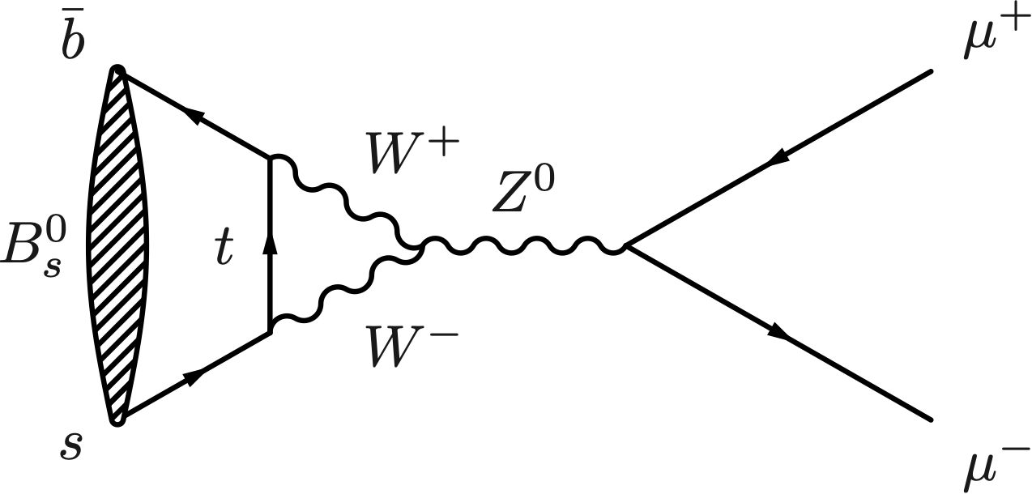
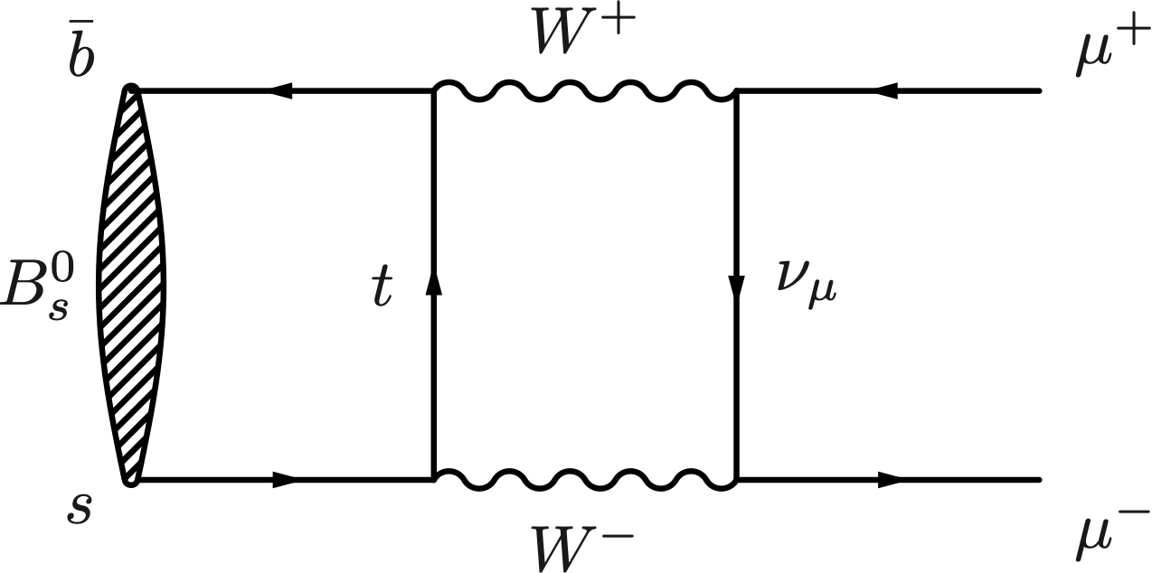
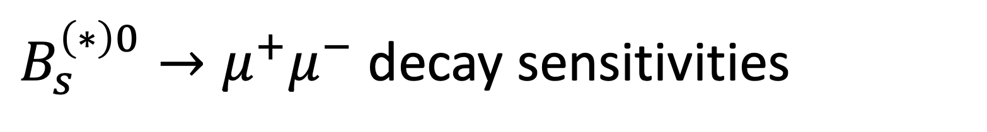
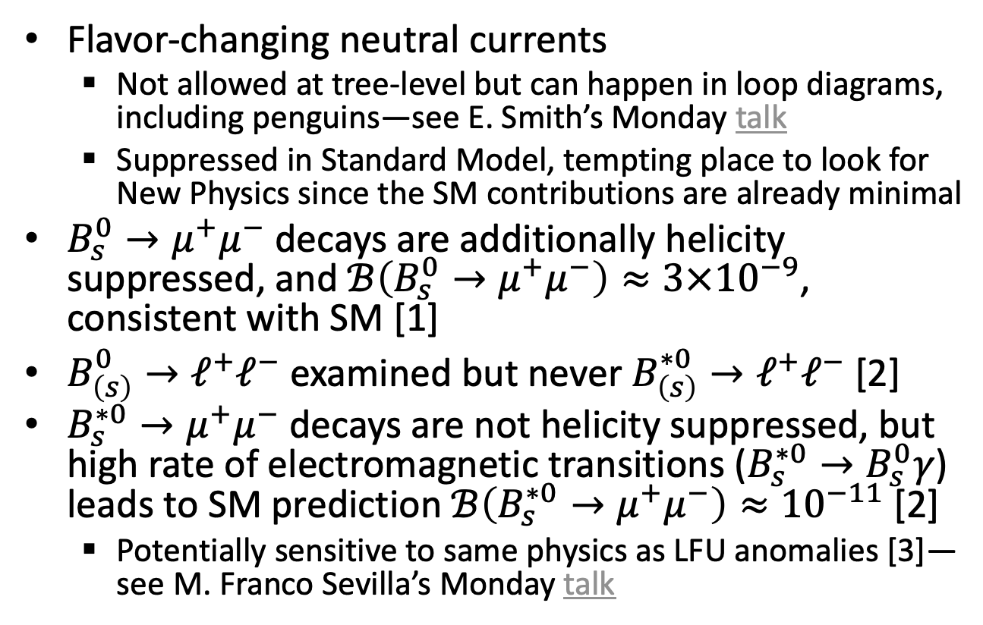
$B_{s}^{\left(∗\right)0}→μ^{+}μ^{−}$ decay sensitivities
Flavor-changing neutral currents
  Not allowed at tree-level but can happen in loop diagrams, including penguins—see E. Smith’s Monday talk
  Suppressed in Standard Model, tempting place to look for New Physics since the SM contributions are already minimal
$B_{s}^{0}→μ^{+}μ^{−}$ decays are additionally helicity suppressed, and $ℬ\left(B_{s}^{0}→μ^{+}μ^{−}\right)≈3×{10}^{−9}$, consistent with SM [1]
$B_{\left(s\right)}^{0}→ℓ^{+}ℓ^{−}$ examined but never $B_{\left(s\right)}^{∗0}→ℓ^{+}ℓ^{−}$ [2]
$B_{s}^{∗0}→μ^{+}μ^{−}$ decays are not helicity suppressed, but high rate of electromagnetic transitions ($B_{s}^{∗0}→B_{s}^{0}γ$) leads to SM prediction $ℬ\left(B_{s}^{∗0}→μ^{+}μ^{−}\right)≈{10}^{−11}$ [2]
  Potentially sensitive to same physics as LFU anomalies [3]—see M. Franco Sevilla’s Monday talk
penguin
box
[1]
R. Aaij and others. Measurement of the $B_{s}^{0}→μ^{+}μ^{−}$ decay properties and search for the $B^{0}→μ^{+}μ^{−}$ and $B_{s}^{0}→μ^{+}μ^{−}γ$ decays. Phys. Rev. D, 105(1):012010, 2022. arXiv:2108.09283.
R. Aaij and others. Search for $B_{\left(s\right)}^{∗0}→μ^{+} μ^{−}$ in $B_{c}^{+}→π^{+}μ^{+}μ^{−}$ decays. Eur. Phys. J. C, 85(1):20, 2025. arXiv:2409.17209.
F. Abudinén and others. Prospects for studies of $D^{∗0}→μ^{+}μ^{−}$ and $B_{\left(s\right)}^{∗0}→μ^{+}μ^{−}$ decays. Eur. Phys. J. C, 82(5):459, 2022. arXiv:2202.03916.

Slide 7
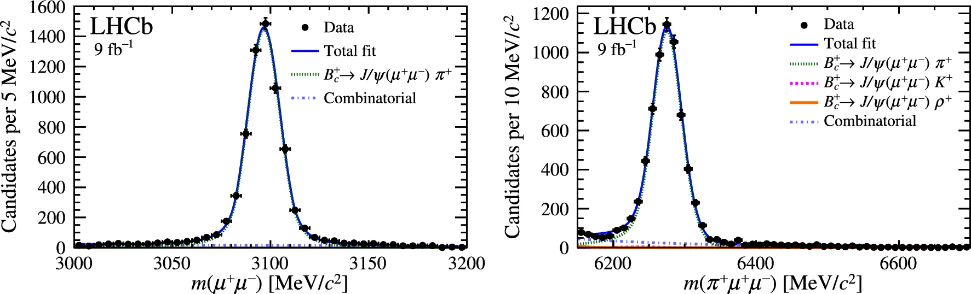
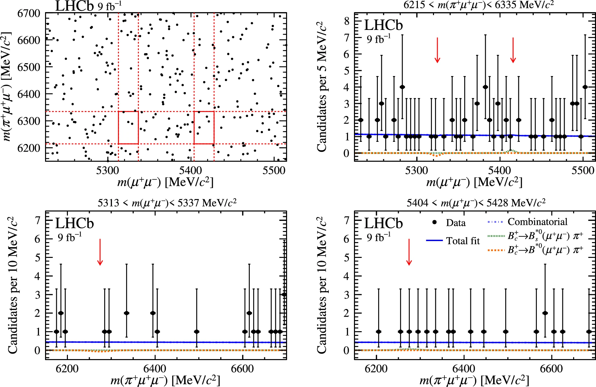
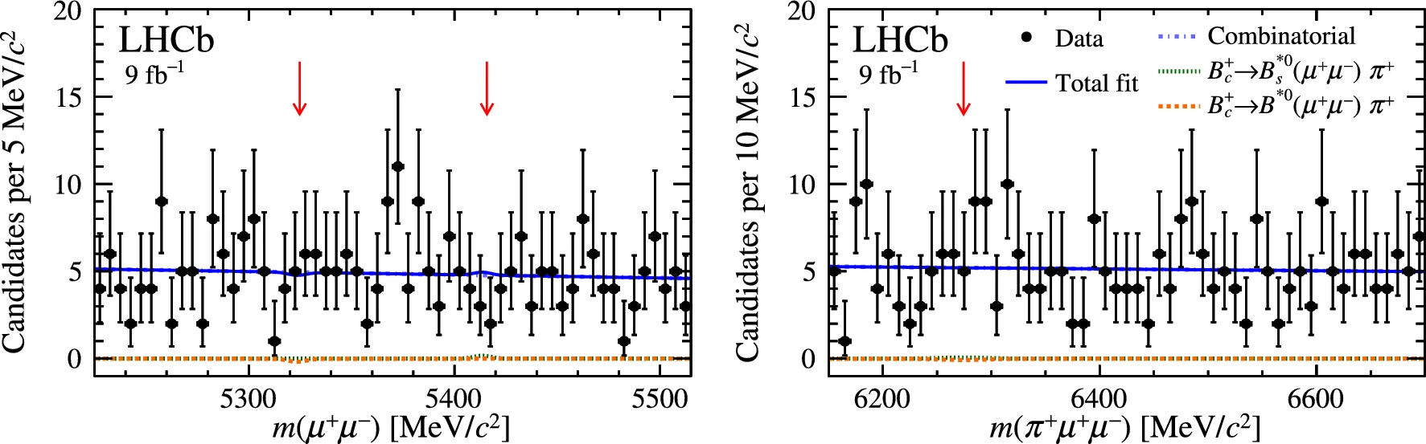


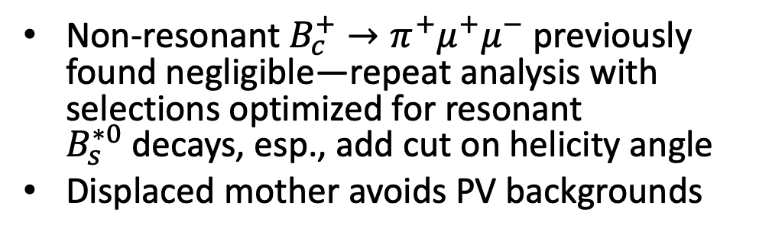








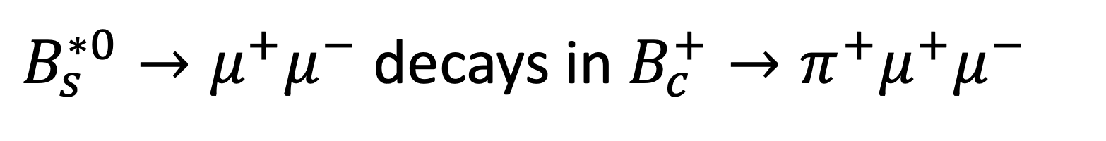



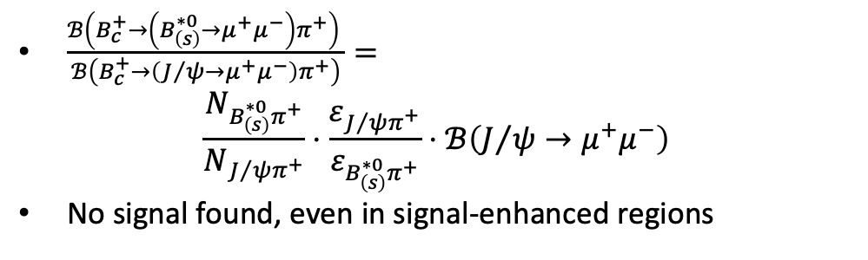

$B_{s}^{∗0}→μ^{+}μ^{−}$ decays in $B_{c}^{+}→π^{+}μ^{+}μ^{−}$
$$B^{∗0}$$
$$B_{s}^{∗0}$$
Normalization
$$B_{\left(s\right)}^{∗0}$$
$$μ^{+}$$
$$B^{∗0}$$
$$B_{s}^{∗0}$$
$$μ^{−}$$
$$B_{c}^{+}$$
$$B_{c}^{+}$$
$$B_{c}^{+}$$
$$p$$
$$B_{c}^{+}$$
$$π^{+}$$
$$p$$
Signal
Non-resonant $B_{c}^{+}→π^{+}μ^{+}μ^{−}$ previously found negligible—repeat analysis with selections optimized for resonant $B_{s}^{∗0}$decays, esp., add cut on helicity angle
Displaced mother avoids PV backgrounds
$\frac{ℬ\left(B_{c}^{+}→\left(B_{\left(s\right)}^{∗0}→μ^{+}μ^{−}\right)π^{+}\right) }{ℬ\left(B_{c}^{+}→\left(J/ψ→μ^{+}μ^{−}\right)π^{+}\right)}=$
$\frac{N_{B_{\left(s\right)}^{∗0}π^{+}}}{N_{J/ψπ^{+}}}⋅\frac{ε_{J/ψπ^{+}}}{ε_{B_{\left(s\right)}^{∗0}π^{+}}}⋅ℬ\left(J/ψ→μ^{+}μ^{−}\right)$
No signal found, even in signal-enhanced regions
R. Aaij and others. Search for $B_{\left(s\right)}^{∗0}→μ^{+} μ^{−}$ in $B_{c}^{+}→π^{+}μ^{+}μ^{−}$ decays. Eur. Phys. J. C, 85(1):20, 2025. arXiv:2409.17209.
Notes:
Appropriate since this is nominally in the rare-decays session
B(Bs to mu mu) = 3 * 10^-9

Slide 8
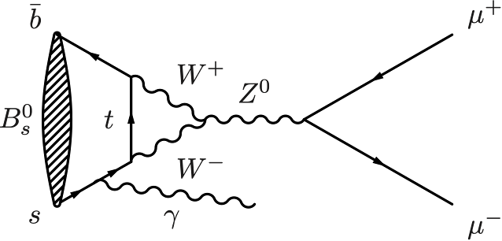
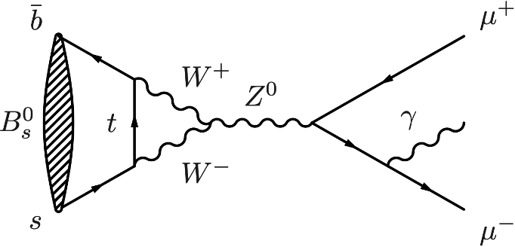
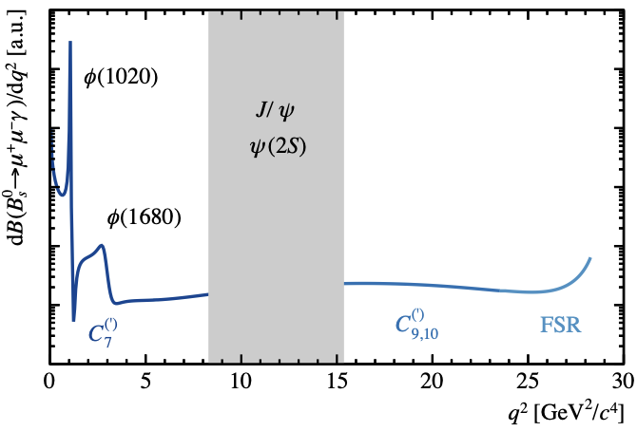

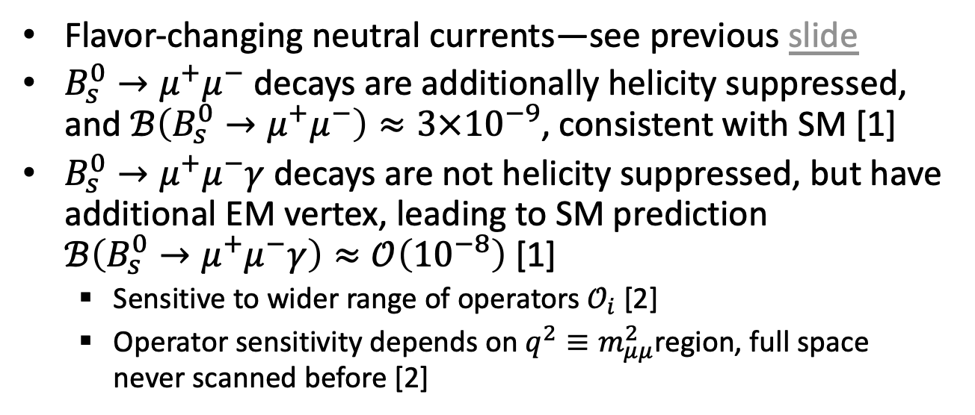



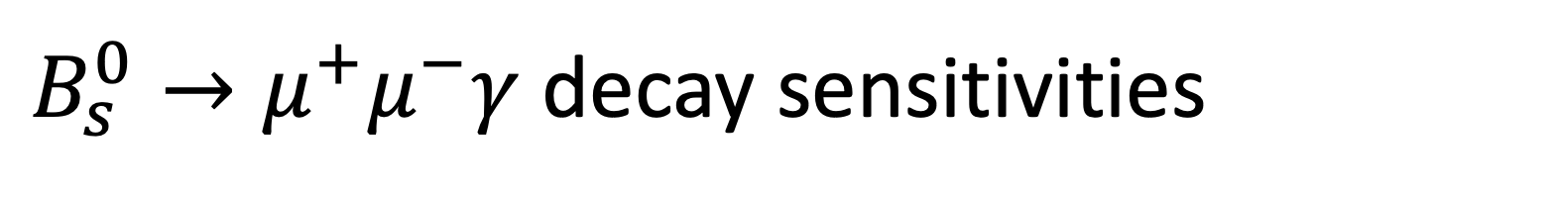
$B_{s}^{0}→μ^{+}μ^{−}γ$ decay sensitivities
Flavor-changing neutral currents—see previous slide
$B_{s}^{0}→μ^{+}μ^{−}$ decays are additionally helicity suppressed, and $ℬ\left(B_{s}^{0}→μ^{+}μ^{−}\right)≈3×{10}^{−9}$, consistent with SM [1]
$B_{s}^{0}→μ^{+}μ^{−}γ$decays are not helicity suppressed, but have additional EM vertex, leading to SM prediction
$ℬ\left(B_{s}^{0}→μ^{+}μ^{−}γ\right)≈𝒪\left({10}^{−8}\right)$ [1]
  Sensitive to wider range of operators $𝒪_{i}$ [2]
  Operator sensitivity depends on $q^{2}≡m_{μμ}^{2}$region, full space never scanned before [2]
ISR
$$𝒪_{7}^{\left(′\right)}$$
$$𝒪_{1,2}$$
[2]
[2]
$$𝒪_{9,10}^{\left(′\right)}$$
$$𝒪_{9,10}^{\left(′\right)}$$
FSR
[1]
R. Aaij and others. Measurement of the $B_{s}^{0}→μ^{+}μ^{−}$ decay properties and search for the $B^{0}→μ^{+}μ^{−}$ and $B_{s}^{0}→μ^{+}μ^{−}γ$ decays. Phys. Rev. D, 105(1):012010, 2022. arXiv:2108.09283.
R. Aaij and others. Search for the $B_{s}^{0}→μ^{+}μ^{−}γ$ decay. JHEP, 07:101, 2024. arXiv:2404.03375.

Slide 9
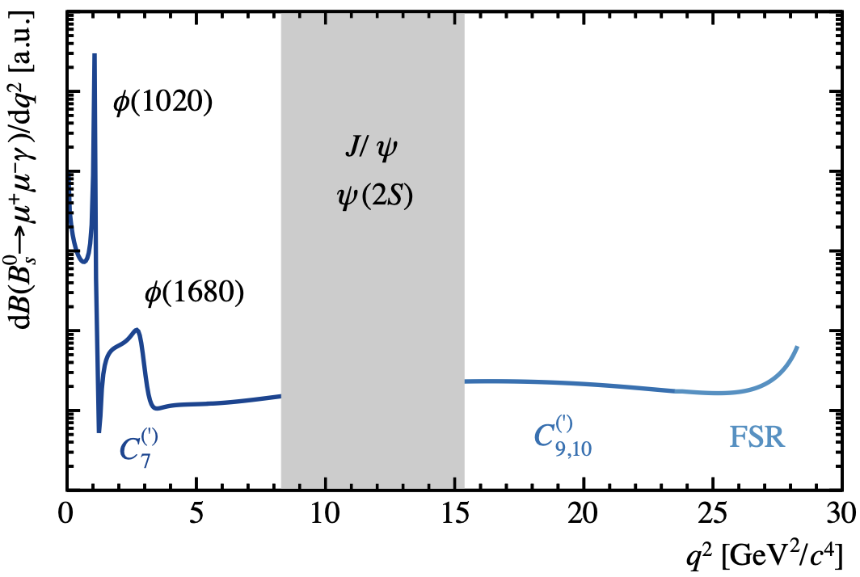
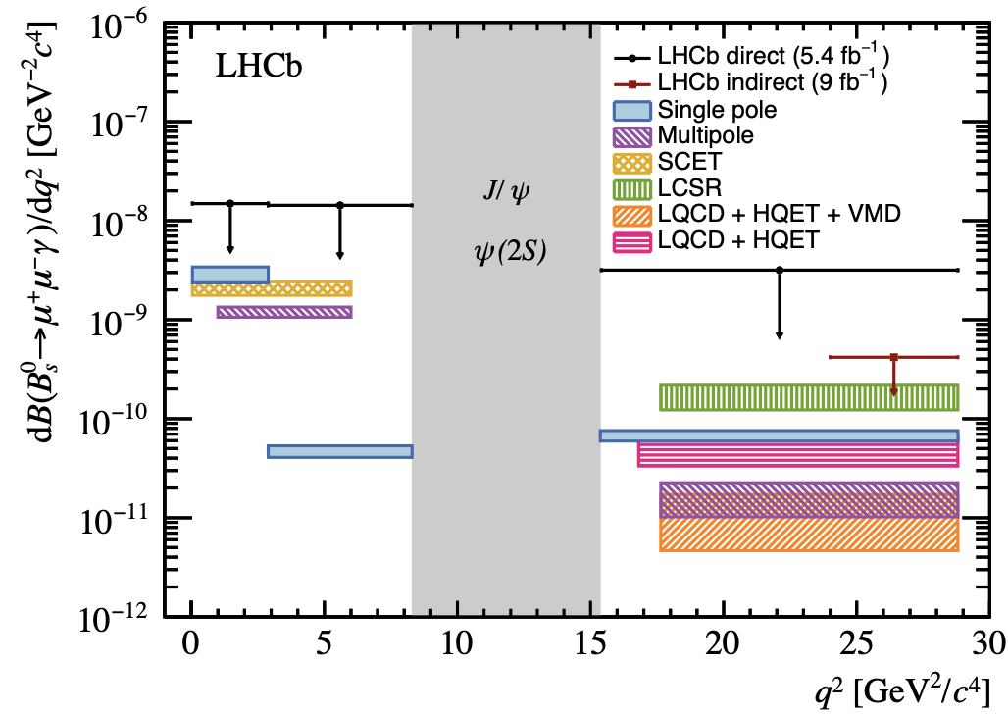
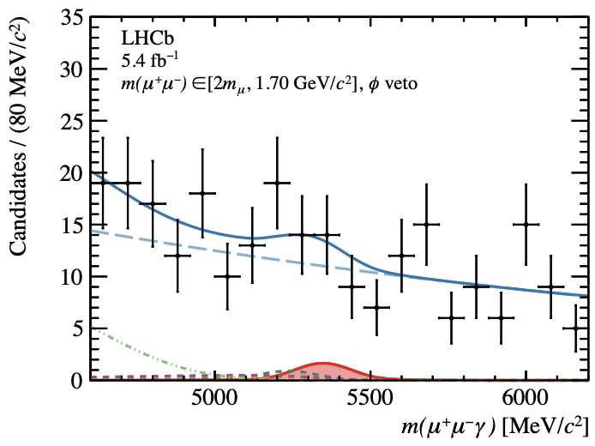
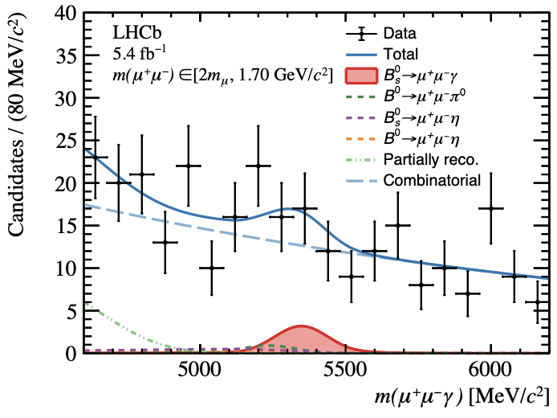
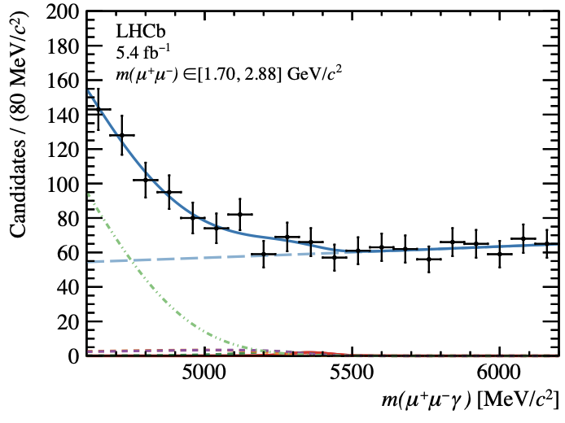
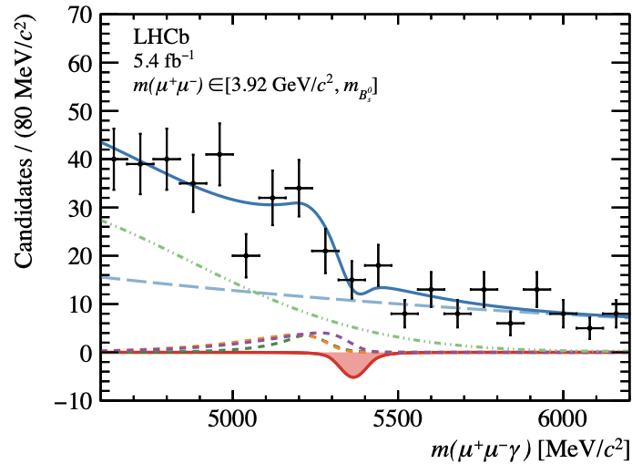
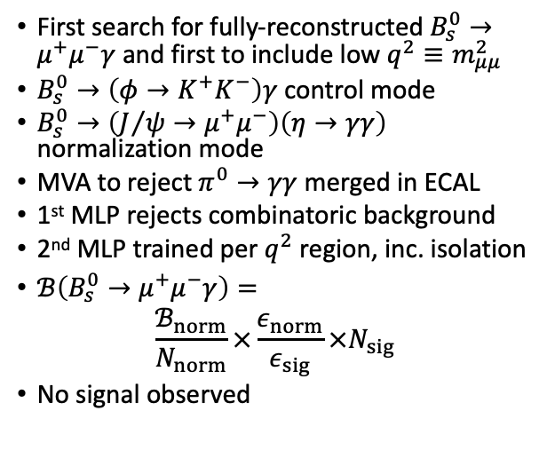
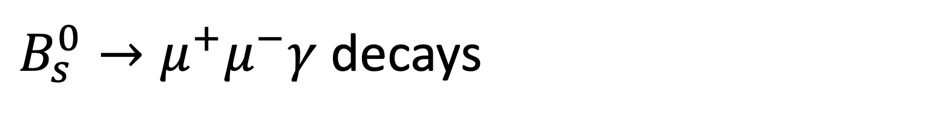
$B_{s}^{0}→μ^{+}μ^{−}γ$ decays
First search for fully-reconstructed $B_{s}^{0}→μ^{+}μ^{−}γ$ and first to include low $q^{2}≡m_{μμ}^{2}$
$B_{s}^{0}→\left(φ→K^{+}K^{−}\right)γ$ control mode
$B_{s}^{0}→\left(J/ψ→μ^{+}μ^{−}\right)\left(η→γγ\right)$ normalization mode
MVA to reject $π^{0}→γγ$ merged in ECAL
1st MLP rejects combinatoric background
2nd MLP trained per $q^{2}$ region, inc. isolation
$ℬ\left(B_{s}^{0}→μ^{+}μ^{−}γ\right)=$
$\frac{ℬ_{norm}}{N_{norm}}×\frac{ε_{norm}}{ε_{sig}}×N_{sig}$
No signal observed
I
II
III
I
II
III
I*
I
II
III
R. Aaij and others. Search for the $B_{s}^{0}→μ^{+}μ^{−}γ$ decay. JHEP, 07:101, 2024. arXiv:2404.03375.
Notes:
SCET: soft-collinear effective theory
LCSR: light-cone sum rules
LQCD: lattice QCD
HQET: heavy quark effective theory
VMD: vector meson dominance
All the above (also “single pole” and “multipole”) refer to different ways to calculate the B0s→γ local form factor

Slide 10
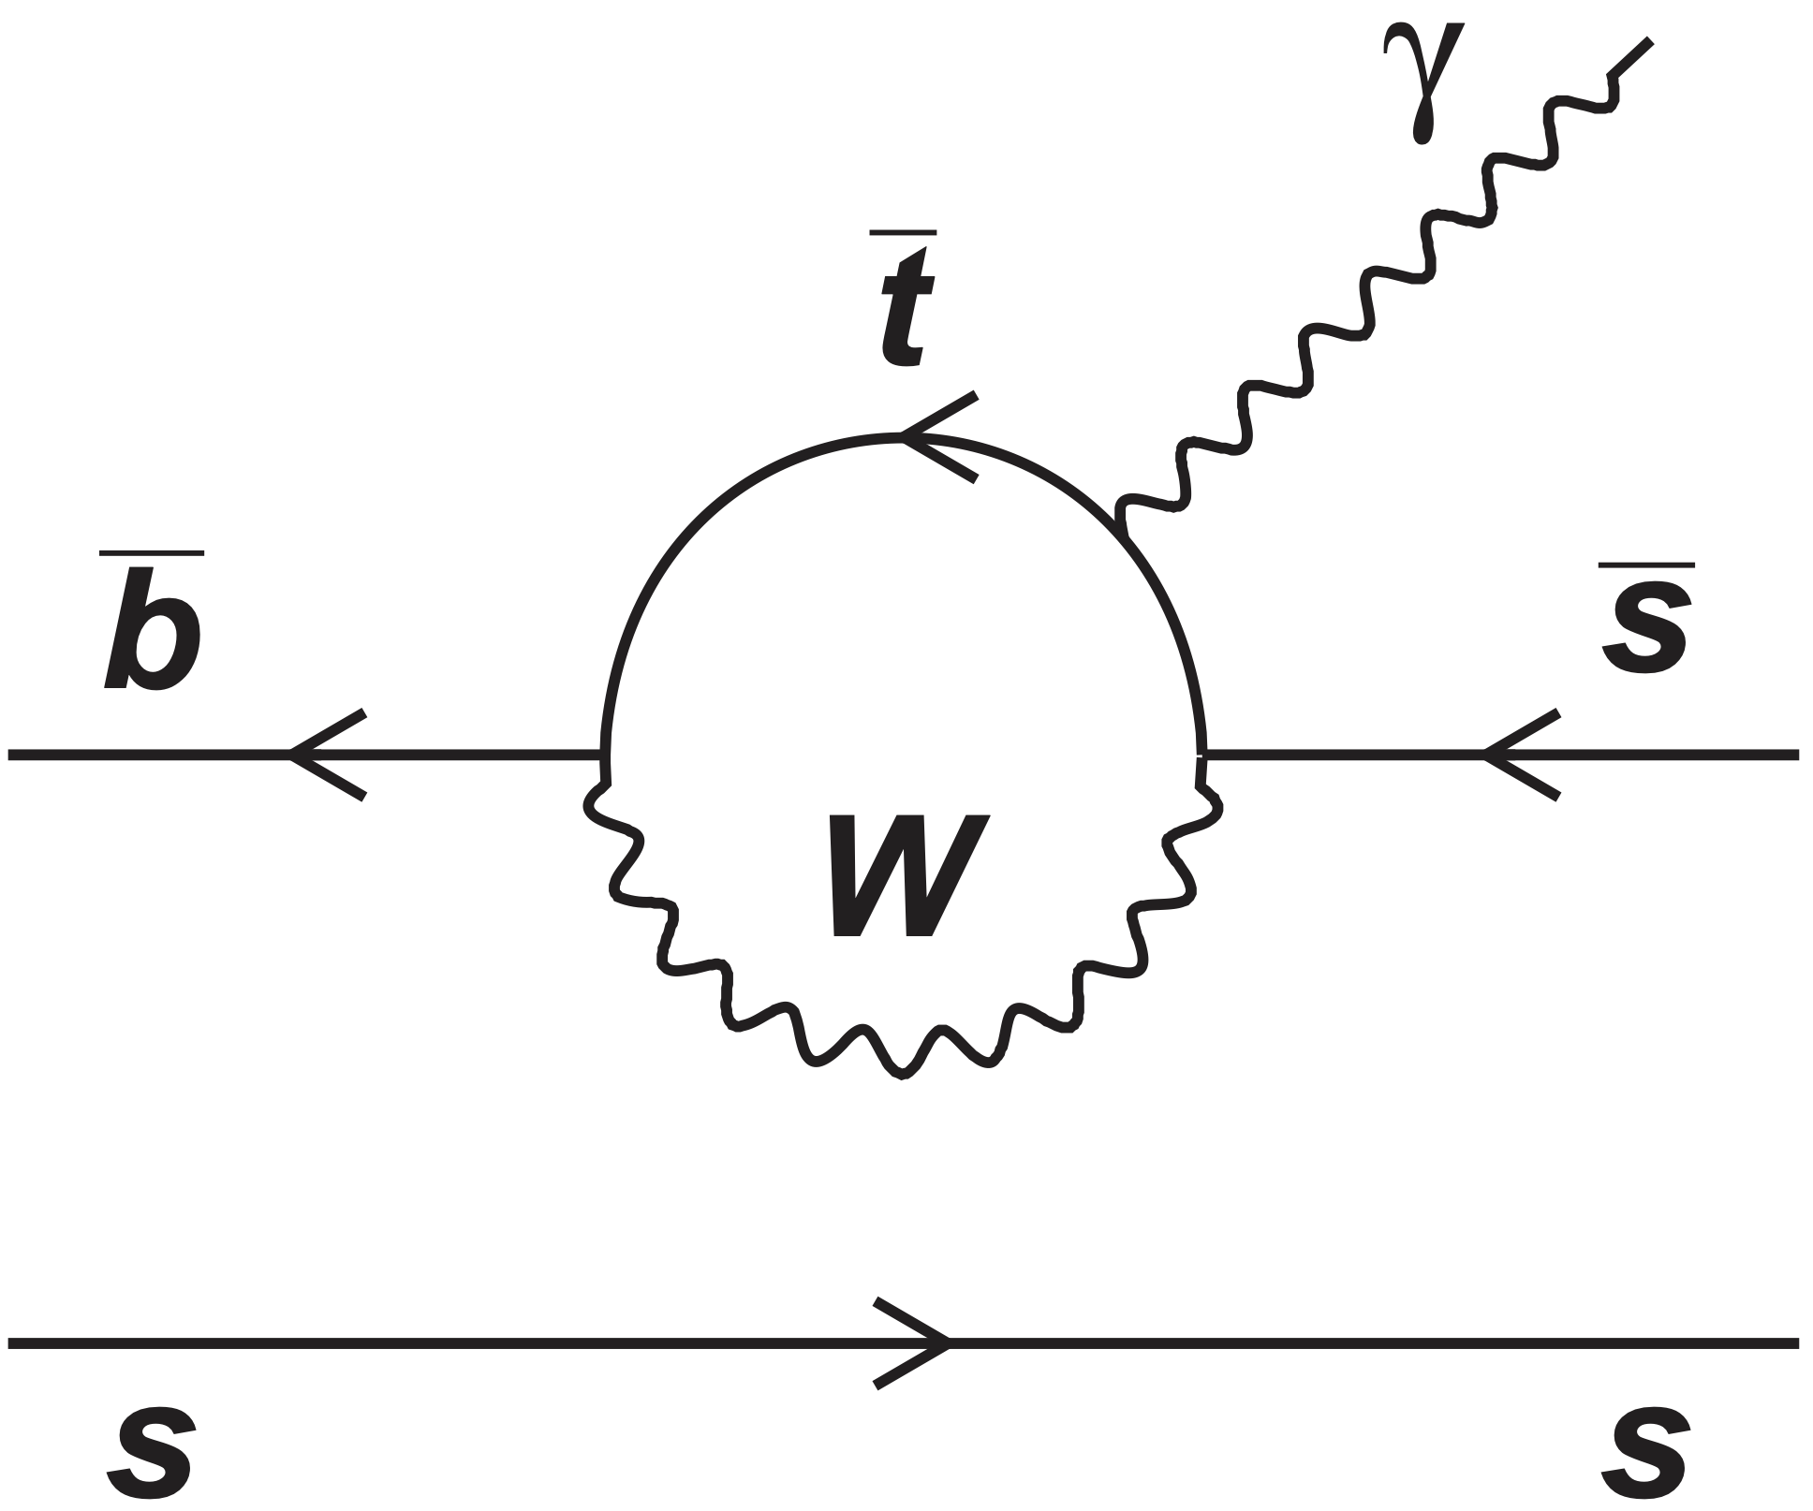
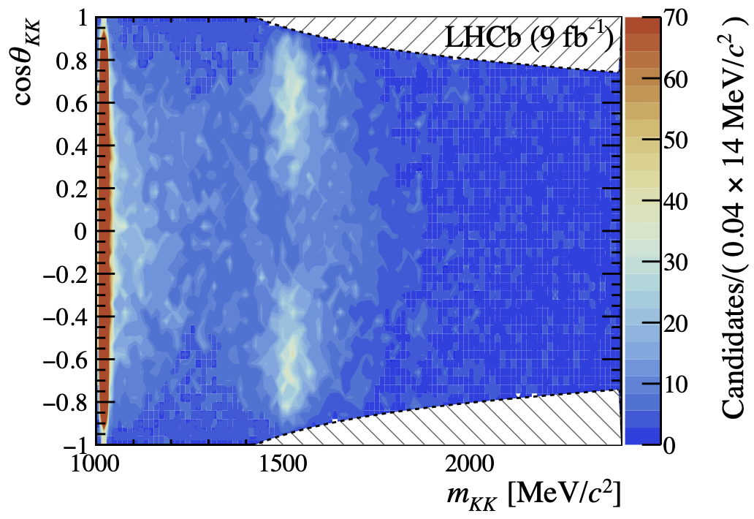


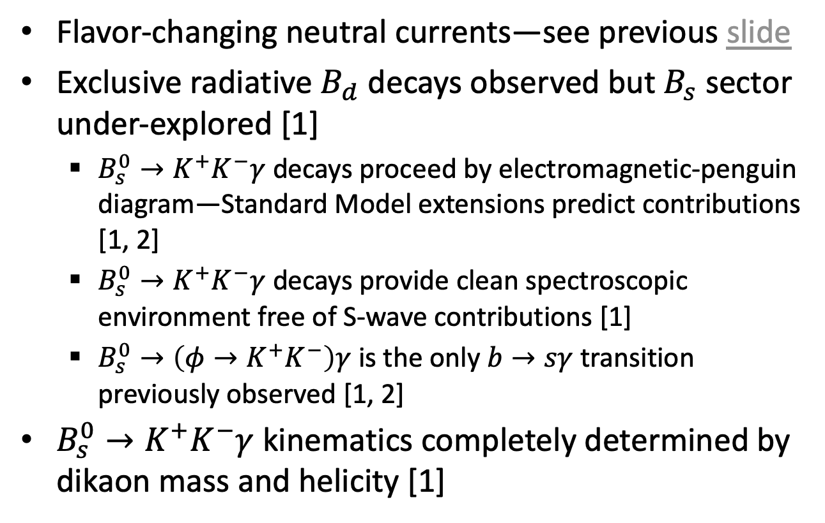






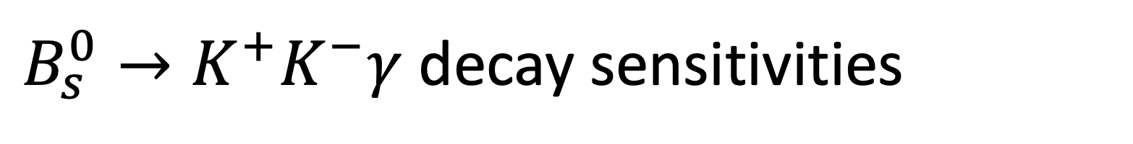

$B_{s}^{0}→K^{+}K^{−}γ$ decay sensitivities
Flavor-changing neutral currents—see previous slide
Exclusive radiative $B_{d}$ decays observed but $B_{s}$ sector under-explored [1]
  $B_{s}^{0}→K^{+}K^{−}γ$ decays proceed by electromagnetic-penguin diagram—Standard Model extensions predict contributions [1, 2]
  $B_{s}^{0}→K^{+}K^{−}γ$ decays provide clean spectroscopic environment free of S-wave contributions [1]
  $B_{s}^{0}→\left(φ→K^{+}K^{−}\right)γ$ is the only $b→sγ$ transition previously observed [1, 2]
$B_{s}^{0}→K^{+}K^{−}γ$ kinematics completely determined by dikaon mass and helicity [1]
$$K^{+}$$
$$K^{−}$$
$$θ_{KK}^{∗}$$
$$p$$
$$B_{s}^{0}$$
$$γ$$
[2]
$$p$$
$$φ$$
$$f_{2}^{′}$$
[1]
R. Aaij and others. Amplitude analysis of the radiative decay $B_{s}^{0}→K^{+}K^{−}γ$. JHEP, 08:093, 2024. arXiv:2406.00235.
D. Dutta and others. Search for $B_{s}^{0}→γγ$ and a measurement of the branching fraction for $B_{s}^{0}→φγ$. Phys. Rev. D, 91(1):011101, 2015. arXiv:1411.7771.

Slide 11
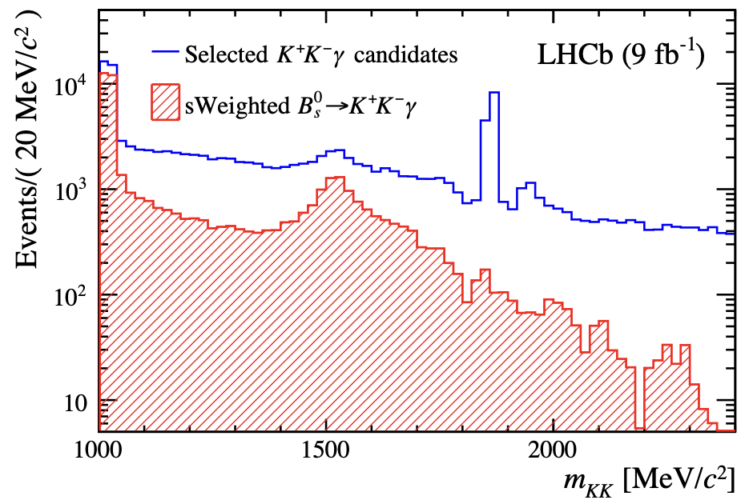






$B_{s}^{0}→K^{+}K^{−}γ$ decays
Mentioned in E. Smith’s Monday talk
$m\left(K^{±}γ_{{→π}^{0}}\right)>2 GeV>m_{D_{s}}=$ anti-charm veto
BDT trained on kinematics and isolation to reduce comb. bkg.
Amplitude analysis, retaining significant contributions
Degenerate solutions obtained, headline results:
  $F_{\left\{f2\right\}}=16.8±0.5±0.7\%$
  ${ℬ\left(B_{s}^{0}→f_{2}^{′}γ\right)}/{ℬ\left(B_{s}^{0}→φγ\right)}=$
  ${19.4}_{−0.8−0.5}^{+0.9+1.4}±0.5\%$
  first observation of
  $B_{s}^{0}→f_{2}^{′}\left(1525\right)γ$
R. Aaij and others. Amplitude analysis of the radiative decay $B_{s}^{0}→K^{+}K^{−}γ$. JHEP, 08:093, 2024. arXiv:2406.00235.
Notes:
“The narrow peak around 1860MeV/c2 and its small reflection 100MeV/c2 above correspond to D0 →K+K−and to misidentified D0 →K−π+ decays, which are strongly suppressed in the sWeighted distribution.”

Slide 12




Conclusion
$B_{s}$ decays provide useful probes for a variety of interesting physics, complementary to $B_{d}$
  Time-dependent CPV [1]
  Penguins and FCNCs [2, 3, 4, 5]
  Many not covered today…
Look forward to HL-LHC era for rare decay sensitivity
[1]
[2]
[3]
[5]
[4]
R. Aaij and others. Measurement of CP violation in $B^{0}→ D^{+}D^{−}$ and $B_{s}^{0}→D_{s}^{+}D_{s}^{−}$ decays. JHEP, 01:061, 2025. arXiv:2409.03009.
R. Aaij and others. Observation of the decay $B_{s}^{0}→K^{0}p\overline{p}$ and measurement of the $B_{\left(s\right)}^{0}→ K^{0}p\overline{p}$ branching fractions. 2025. arXiv:2504.21269.
R. Aaij and others. Search for $B_{\left(s\right)}^{∗0}→μ^{+} μ^{−}$ in $B_{c}^{+}→π^{+}μ^{+}μ^{−}$ decays. Eur. Phys. J. C, 85(1):20, 2025. arXiv:2409.17209.
R. Aaij and others. Search for the $B_{s}^{0}→μ^{+}μ^{−}γ$ decay. JHEP, 07:101, 2024. arXiv:2404.03375.
R. Aaij and others. Amplitude analysis of the radiative decay $B_{s}^{0}→K^{+}K^{−}γ$. JHEP, 08:093, 2024. arXiv:2406.00235.

Slide 13
Fin
Questions?

