Slide 1
Status of MBRD series production (KE4417)
S. Farinon INFN - Genova
On behalf of CERN-INFN WP3 Collaboration for D2 Construction for HL-LHC
Genova, October 7th, 2024
https://indico.cern.ch/event/1421594/contributions/5978352/

Slide 2
SUMMARY
Introduction
Status of series coil production
Status of MBRD1
Status of MBRD2
Status of MBRD3
Status of MBRD4─6
Field quality
Schedule

Slide 3
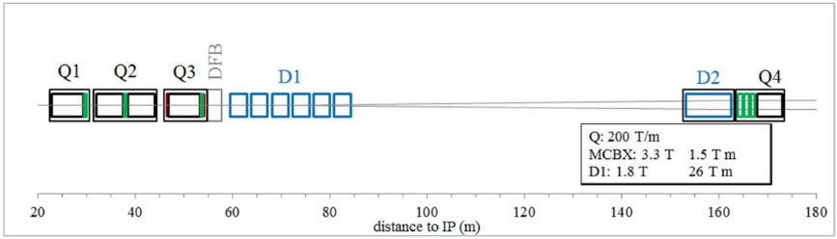
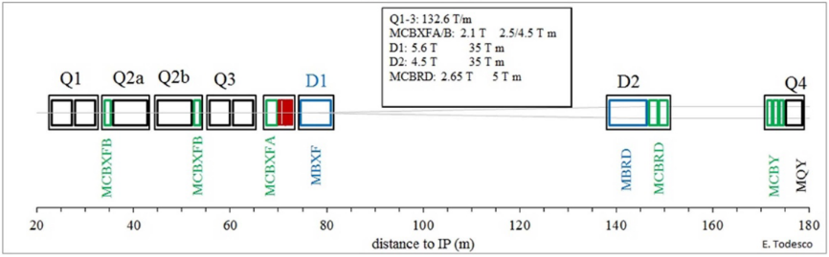
D2 layout and function
The D2 dipole (MBRD, Main Bending Recombination Dipole) is housed within the D2 cold mass along with the orbit correctors around IP1 and IP5.
Key characteristics include:
  Identical field direction in both apertures, connected in series
  Integrated field of 35 T·m at 7 TeV
  Integrated field of 37.6 T·m at 7.5 TeV (ultimate field)
  Two apertures, each 105 mm in diameter, with a total length of 8010 mm.
  LHC
  HL-LHC
# magnets | # apertures | # coils
4 series | 8 | 16
2 spares | 4 | 8
Total = 6 | Total = 12 | Total = 24

Slide 4
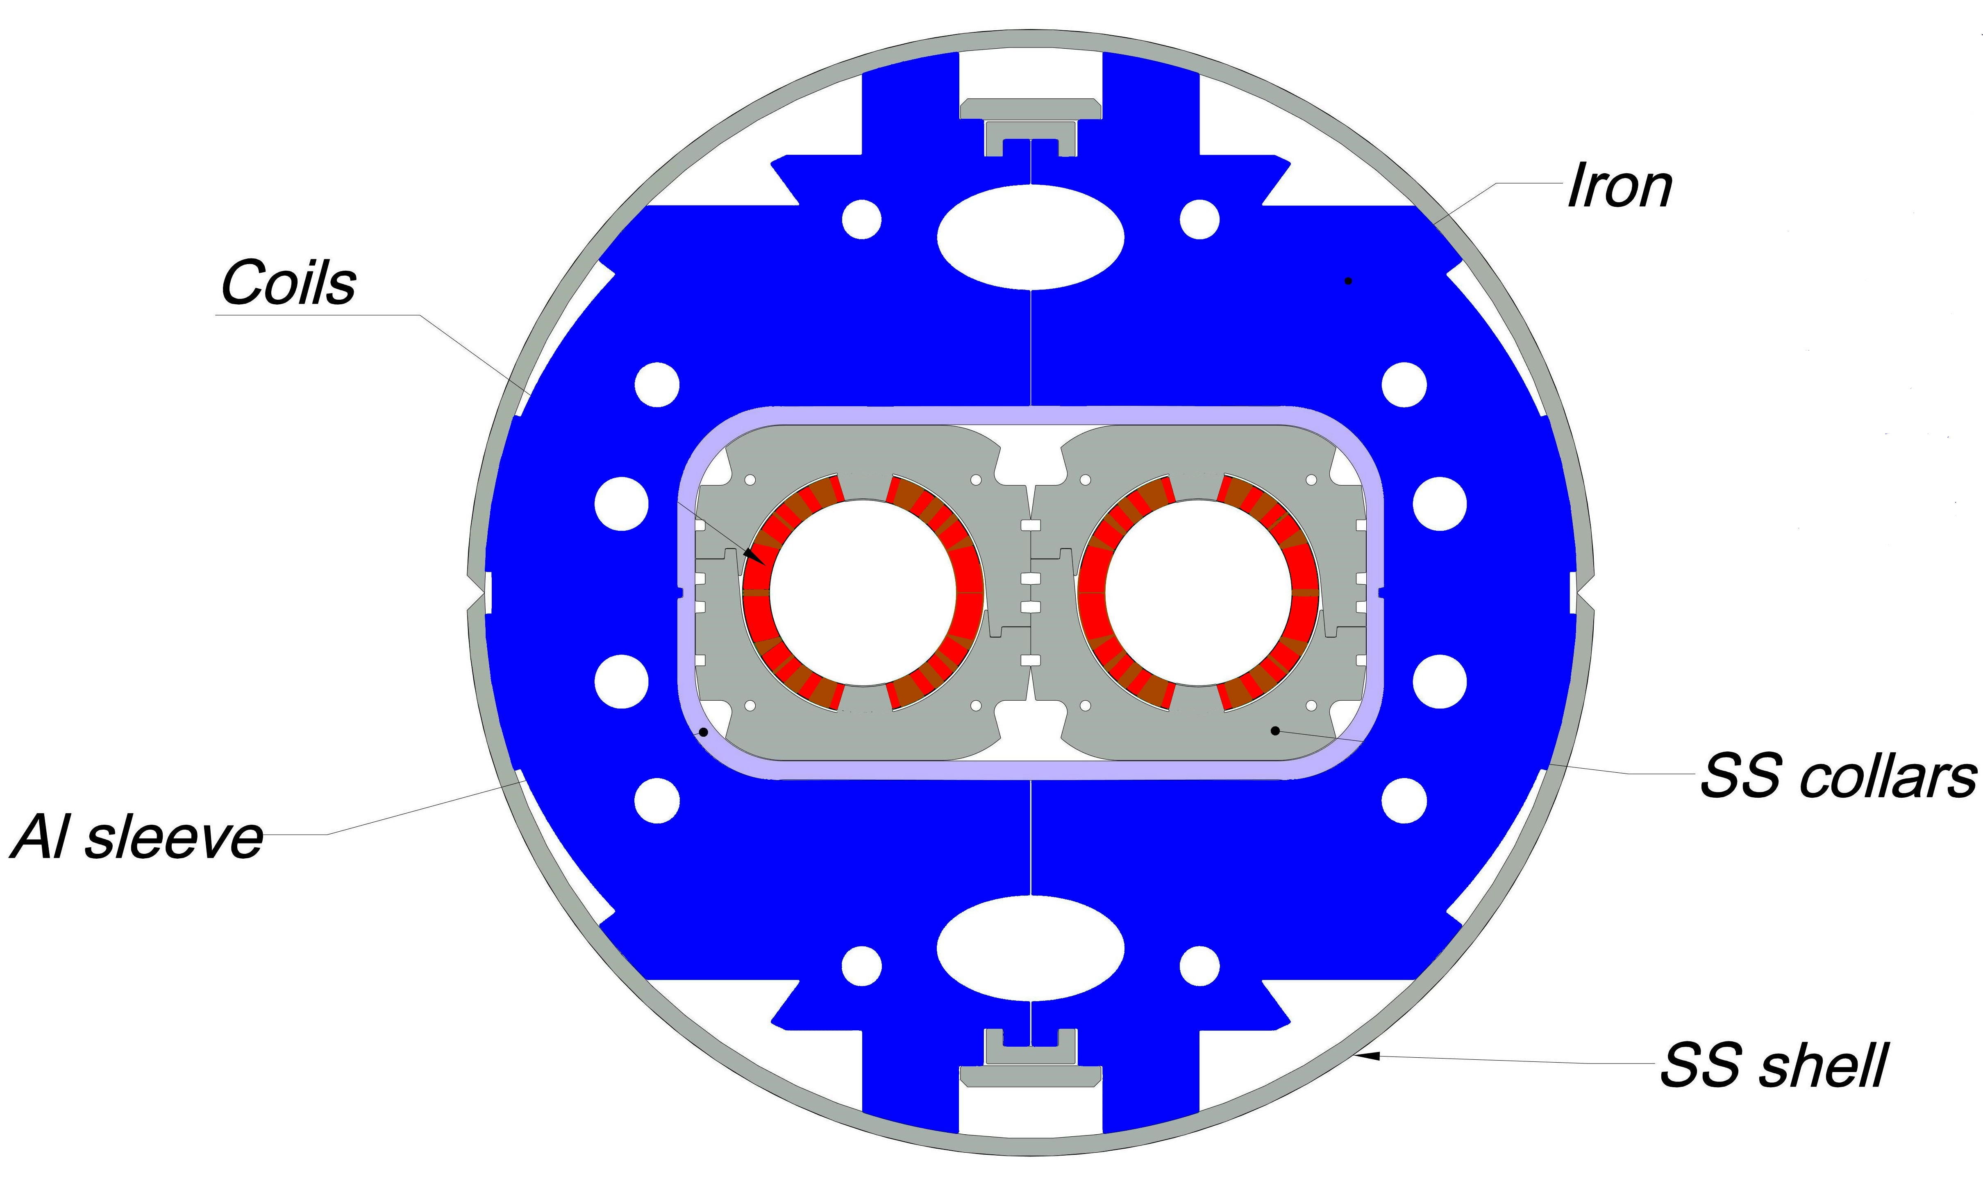
MBRD MAGNET CHARACTERISTICS
Bore field: 4.5 T (4.8 T ultimate field)
Magnetic length: 7.8 m (8.01 m physical length)
Challenges:
  Field quality optimization based on asymmetric coils
  Novel mechanical structure for the two apertures based on aluminum shells
Main characteristics of the D2 dipole
Bore magnetic field | 4.5 T
Magnetic length | 7.78 m
Peak field | 5.26 T
Operating current | 12.330 kA
Stored energy | 2.26 MJ
Overall current density | 478 A/mm²
Magnet physical length | 8.01 m
Aperture | 105 mm
Beam separation at cold | 188 mm
Operating temperature | 1.9 K
Loadline fraction | 67.5%
Multipole variation due to iron saturation | <10 units

Slide 5
CERN/INFN collaboration agreements
Framework agreement KN3083
  Addendum No.1 KE3084/TR/HL-LHC
    Collaboration on the design and prototyping of MBRD superconducting magnets before series production, as part of the High Luminosity upgrade for the LHC at CERN.
    Main deliverables: a short model (MBRDS1) and a prototype (MBRDP1) of the MBRD magnet. The manufacturing of both these components were contracted to ASG Superconductors.
  Addendum No.11 KE4417/TR/HL-LHC
    Collaboration on the construction of the series MBRD magnets within the framework of the High Luminosity upgrade for the LHC at CERN.
    Main deliverables: six magnets of the series (MBRD1 to MBRD6). The manufacturing of these magnets was awarded to ASG Superconductors on March 9th, 2021.

Slide 6
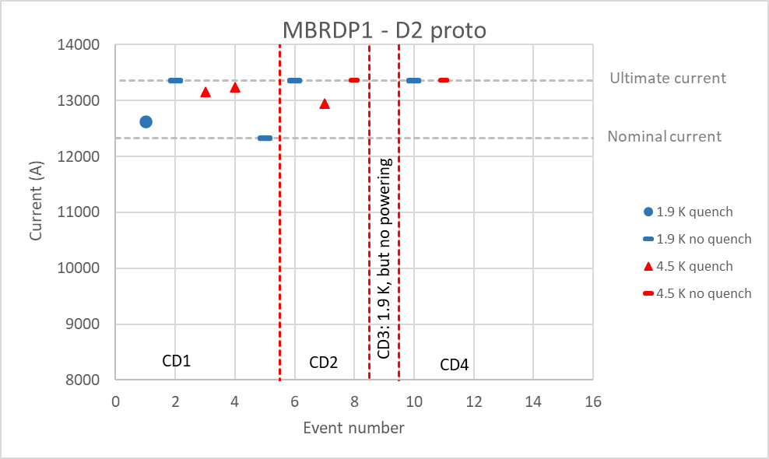
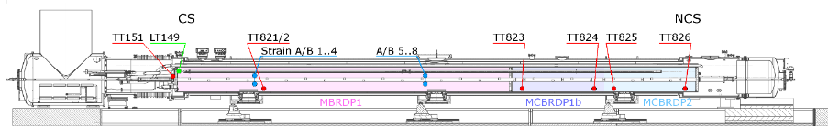
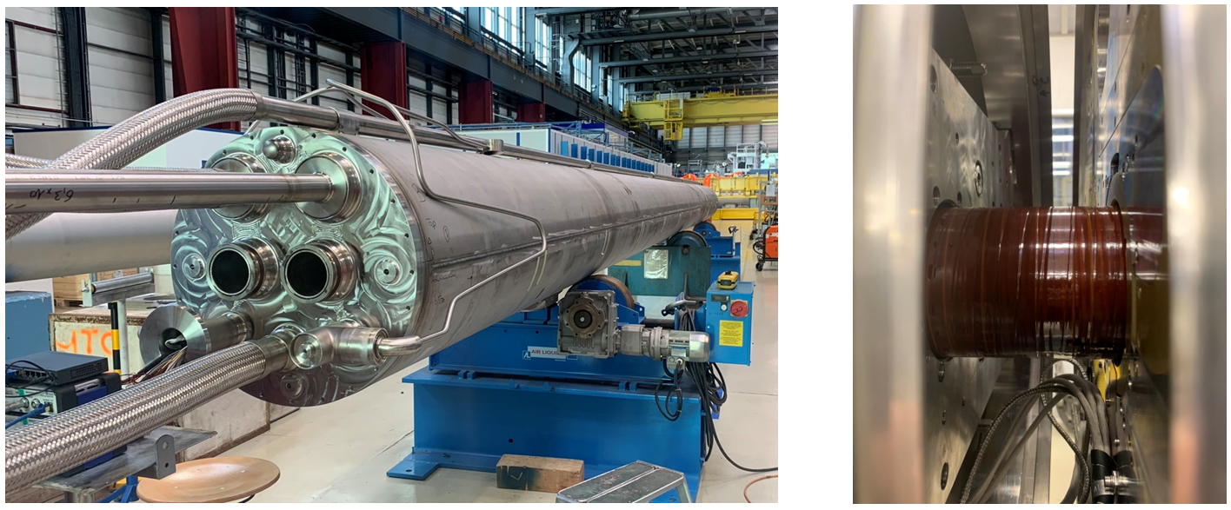
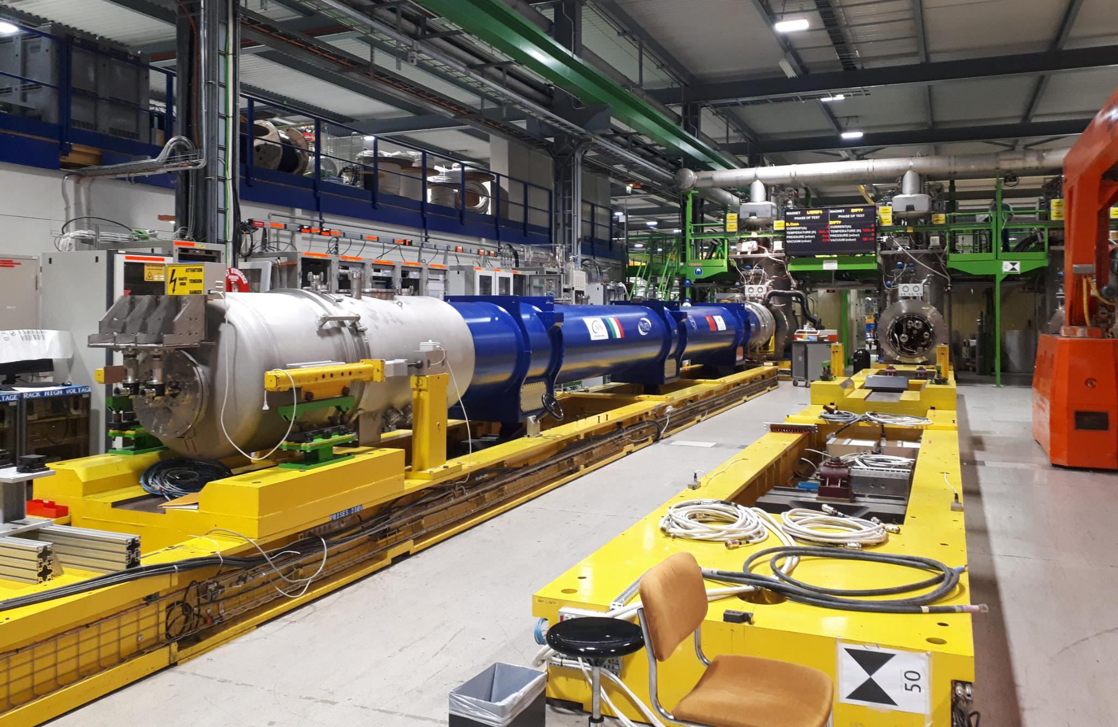
D2 PROTOTYPE
D2 prototype cold mass was tested at CERN in Oct. 2022 to May 2023, in 4 cool-downs:
  in the first thermal cycle:
  @ 1.9 K: it reached nominal current without quenching
  @ 1.9 K: it reached ultimate in 1 quench
  @ 4.5 K: it quenched @ 96% of SS limit
  no other natural quench occurred in the first test campaign
  ramp rate studies were performed up to 200 A/s
  in the second thermal cycle
  @ 1.9 K: it reached ultimate without quenching
  @ 4.5 K: it reached ultimate in 1 quench
  In the fourth thermal cycle it reached ultimate without quenching at both 1.9 and 4.5 K

Slide 7
SUMMARY
Introduction
Status of series coil production
Status of MBRD1
Status of MBRD2
Status of MBRD3
Status of MBRD4─6
Field quality
Schedule

Slide 8
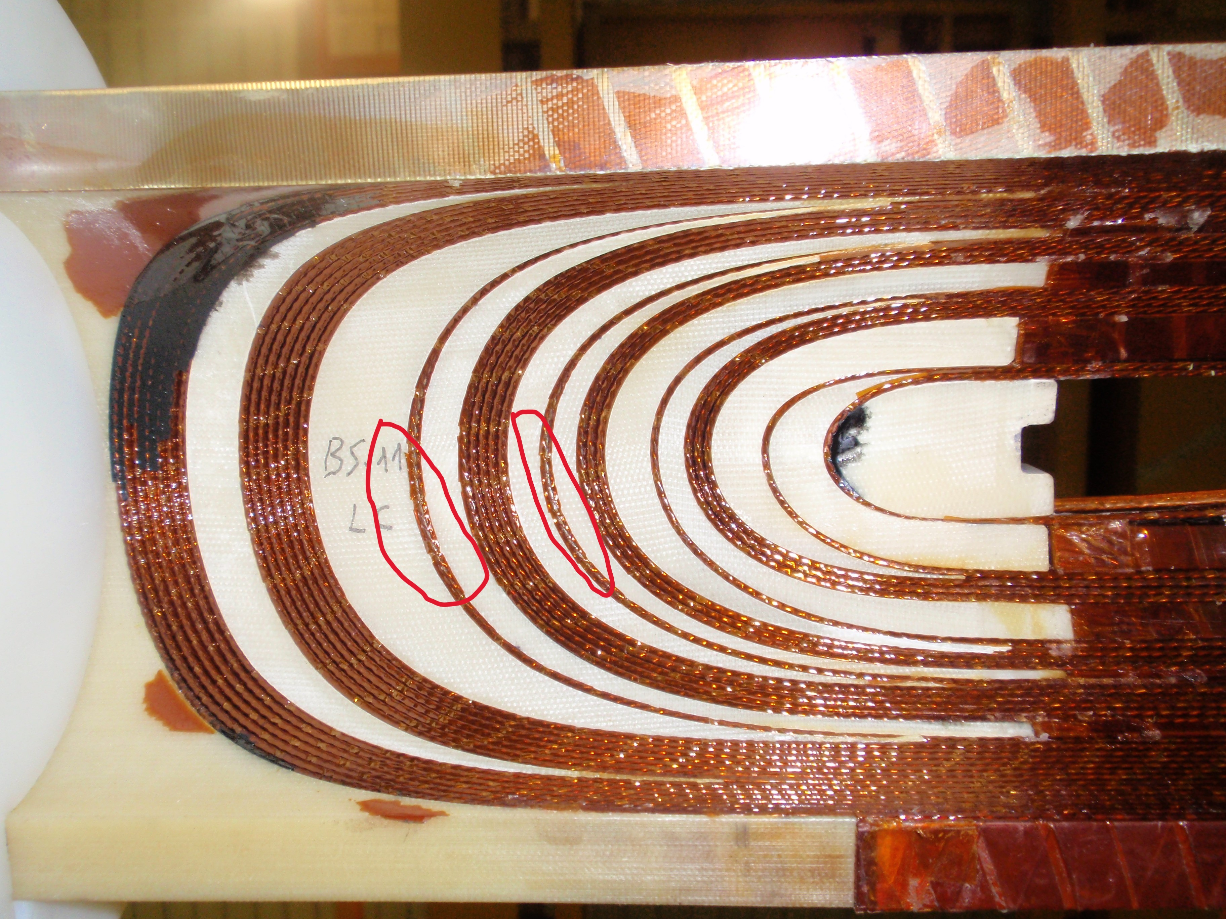
STATUS OF COIL PRODUCTION
The winding and curing of all 24 coils have been completed.
Two issues have been identified:
  Insulation damage at the coil ends
    During the curing process, the coil is
    pressed against the mandrel at 90 MPa,
    which can cause damage to the turn
    insulation in certain areas.
    ASG has developed a process to restore
    the insulation in both collared and single
    coils (approved by CERN/INFN).
    This repair has already been implemented on
    MBRD2 at CERN and on MBRD1 at ASG;
    The remaining coils will undergo the same repair procedure before collaring.
    (https://edms.cern.ch/ui/file/3088308/1.0/28837_1_MBRD_TURN_INSULATION_RESTORING.pdf)
  Excess coil size
Inner side of the coil

Slide 9
SINGLE COIL STATUS
Type A Coils
  AS-03: No issues to report.
  AS-08: Requires two repairs: one on the CS and one on the NCS, located on the first turn adjacent to the filler.
  AS-09: No issues to report.
  AS-10: One point on the NCS needs further investigation to determine if it is dirt or insulation damage (the coil needs to be rotated). Everything is OK on the CS.
  AS-11: Requires a repair on the first turn adjacent to the first filler on the CS. Everything is OK on the NCS.
  AS-12: Requires a repair on the first turn adjacent to the first filler on the CS. Everything is OK on the NCS.
Type B Coils
  BS-03: No issues to report.
  BS-05: Requires a repair on the first turn adjacent to the first filler on the NCS. No issues to report on the CS.
  BS-09: Requires a repair on the second turn adjacent to the first filler on the NCS. No issues to report on the CS.
  BS-10: No issues to report.
  BS-11: Requires a repair on the CS and two repairs on the NCS.
  BS-12: No issues to report.

Slide 10
STATUS OF COIL PRODUCTION
The winding and curing of all 24 coils have been completed.
Two issues have been identified:
  Insulation damage in the coil ends
  Excess coil dimension in 4 coils
    The issue arises from the lack of sufficient margin with the available shimming sheets to accommodate the larger coils while maintaining the nominal field quality.
    We collaborated with WP2 to adjust the coil pairing strategy, distributing the dimensional variations across the last two magnets.
Coil dimensions are measured at 70 MPa
collared apertures
single coils

Slide 11
















SHIMMING SCHEMES
  Baseline
  Shimming1
  Shimming2
$$584.2 μm$$
$$+$$
$$127 μm$$
$$533.4 μm$$
$$+$$
$$50.8 μm$$
$$457.2 μm$$
$$+$$
$$50.8 μm$$
$$50.8 μm$$
$$711.2 μm$$
$$584.2 μm$$
$$508 μm$$
$$76.2 μm$$
$$127 μm$$
  Shimming3
  Shimming4
  Shimming5
$$482.6 μm$$
$$+$$
$$50.8 μm$$
$$406.4 μm$$
$$+$$
$$50.8 μm$$
$$304.8 μm$$
$$+$$
$$50.8 μm$$
$$533.4 μm$$
$$457.2 μm$$
$$355.6 μm$$

Slide 12
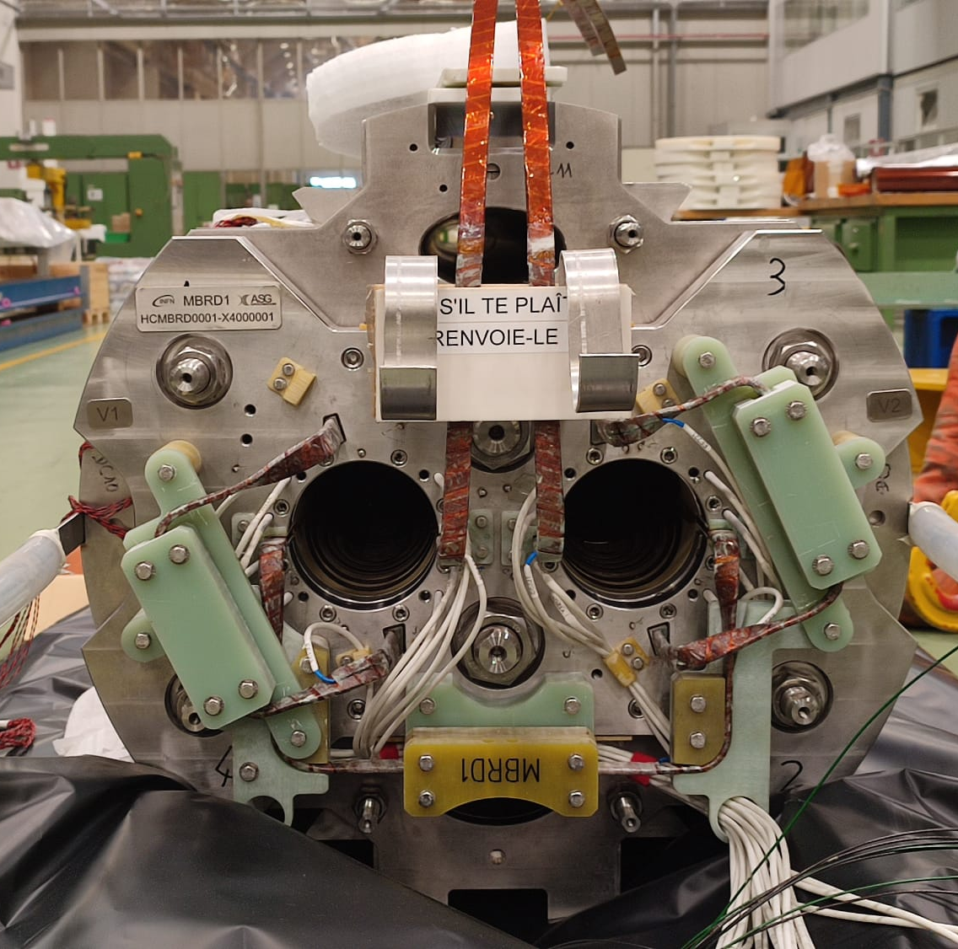
SUMMARY
Introduction
Status of series coil production
Status of MBRD1
Status of MBRD2
Status of MBRD3
Status of MBRD4─6
Field quality
Schedule

Slide 13
MBRD1 STATUS
MBRD1 arrived at CERN in October 2023 (with partial loading of the longitudinal tie rods).
In December 2023, with INFN staff, the tie rods were successfully loaded to their nominal load.
Subsequent electrical tests at high voltage (3.1 kV) revealed a short circuit to ground in QH Y112.
  Since no electrical tests were planned upon receipt, it's impossible to determine whether the short occurred during transportation or during the loading of the tie rods.
  The revised acceptance procedure now includes high-voltage electrical tests upon receipt.
CERN technicians attempted to locate the source of the fault using endoscopy but, in the end, it was decided to disassemble the end plate.

Slide 14
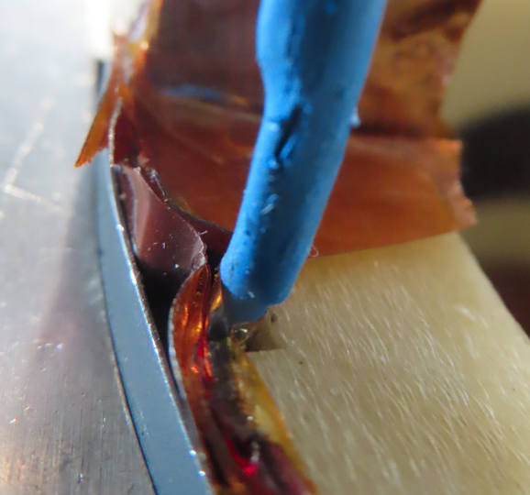
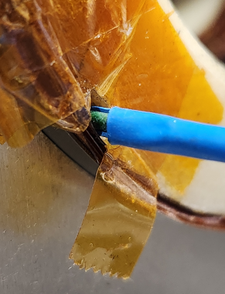
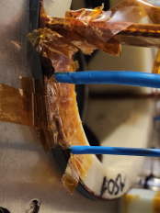
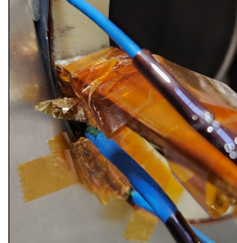
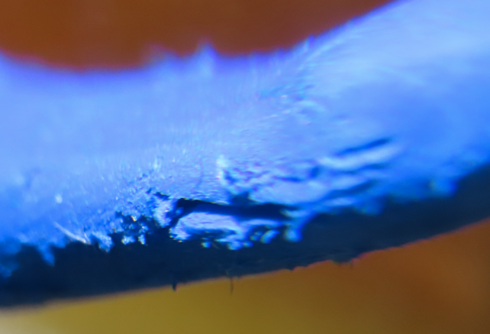
MBRD1 STATUS
After end plate removal, an anomaly is found at QH Y112 wasn’t traced by ASG.
A local electrical test at 3.1 kV was performed between YT112 and an aluminum sheet enclosing the wire. The investigation
precisely identified the defect's location at the repaired
section with the polyimide tape.

Slide 15
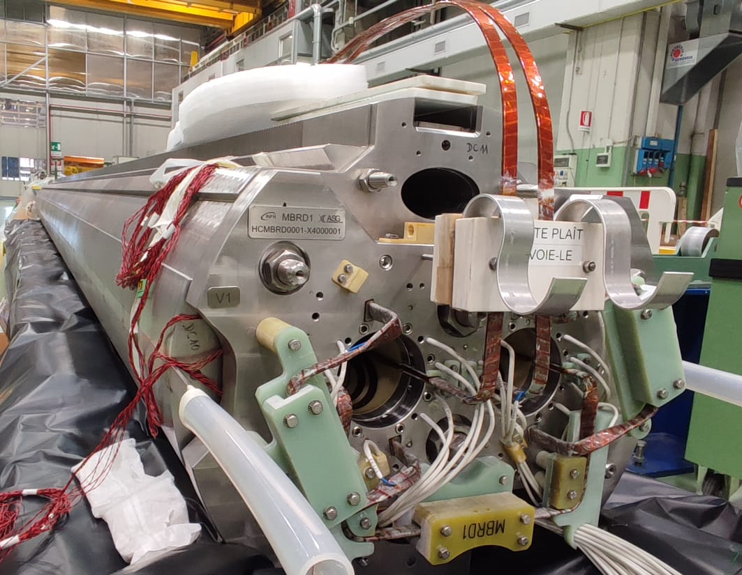
MBRD1 STATUS
Corrective actions:
  MBRD1 has been temporarily reassembled for transportation back to ASG, a decision made by ASG.
    However, this transportation process experienced some delays due to customs documentation, and has been delivered to ASG on July 2024.
  MBRD1 has been repaired with the highest priority.
    The repair process has involved several steps, including
    repairing of QH Y112, bending of the SS protection
    sheets, reassembling of the end plate, repairing of the
    stabilizer brazing, splicing, and attaching VTs according
    to CERN's procedural guidance.
    According to the current schedule, its delivery to CERN
    is expected in the second half of October 2024, possibly
    next week.

Slide 16
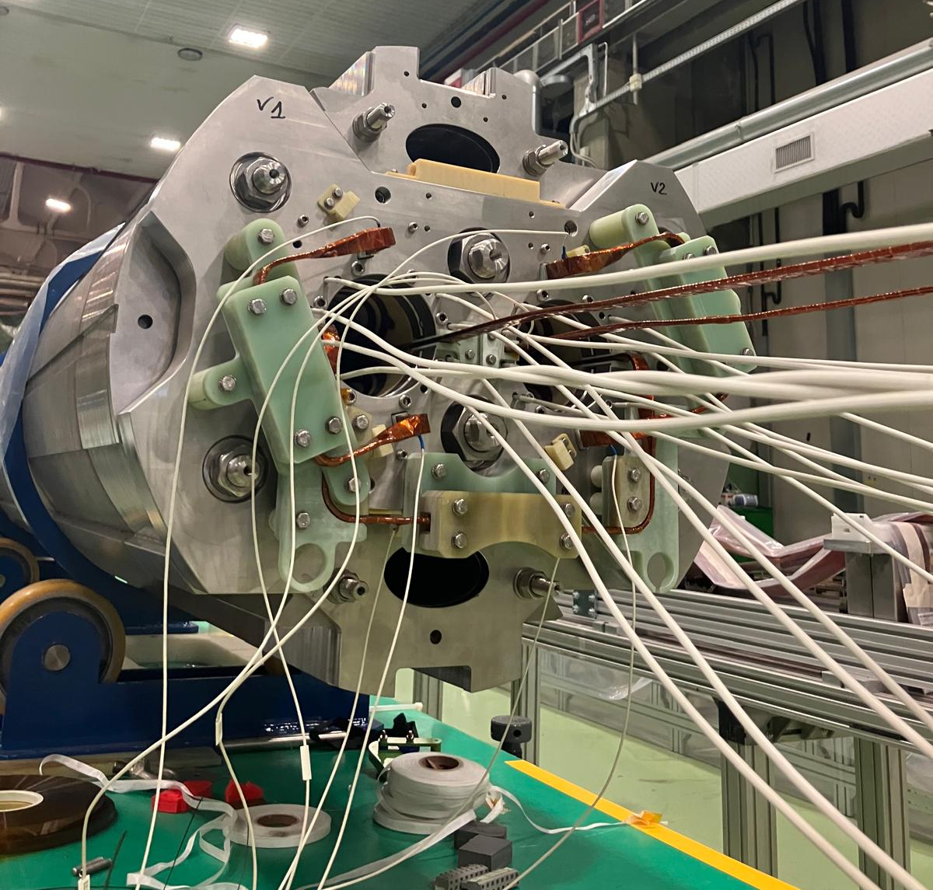
SUMMARY
Introduction
Status of series coil production
Status of MBRD1
Status of MBRD2
Status of MBRD3
Status of MBRD4─6
Field quality
Schedule

Slide 17
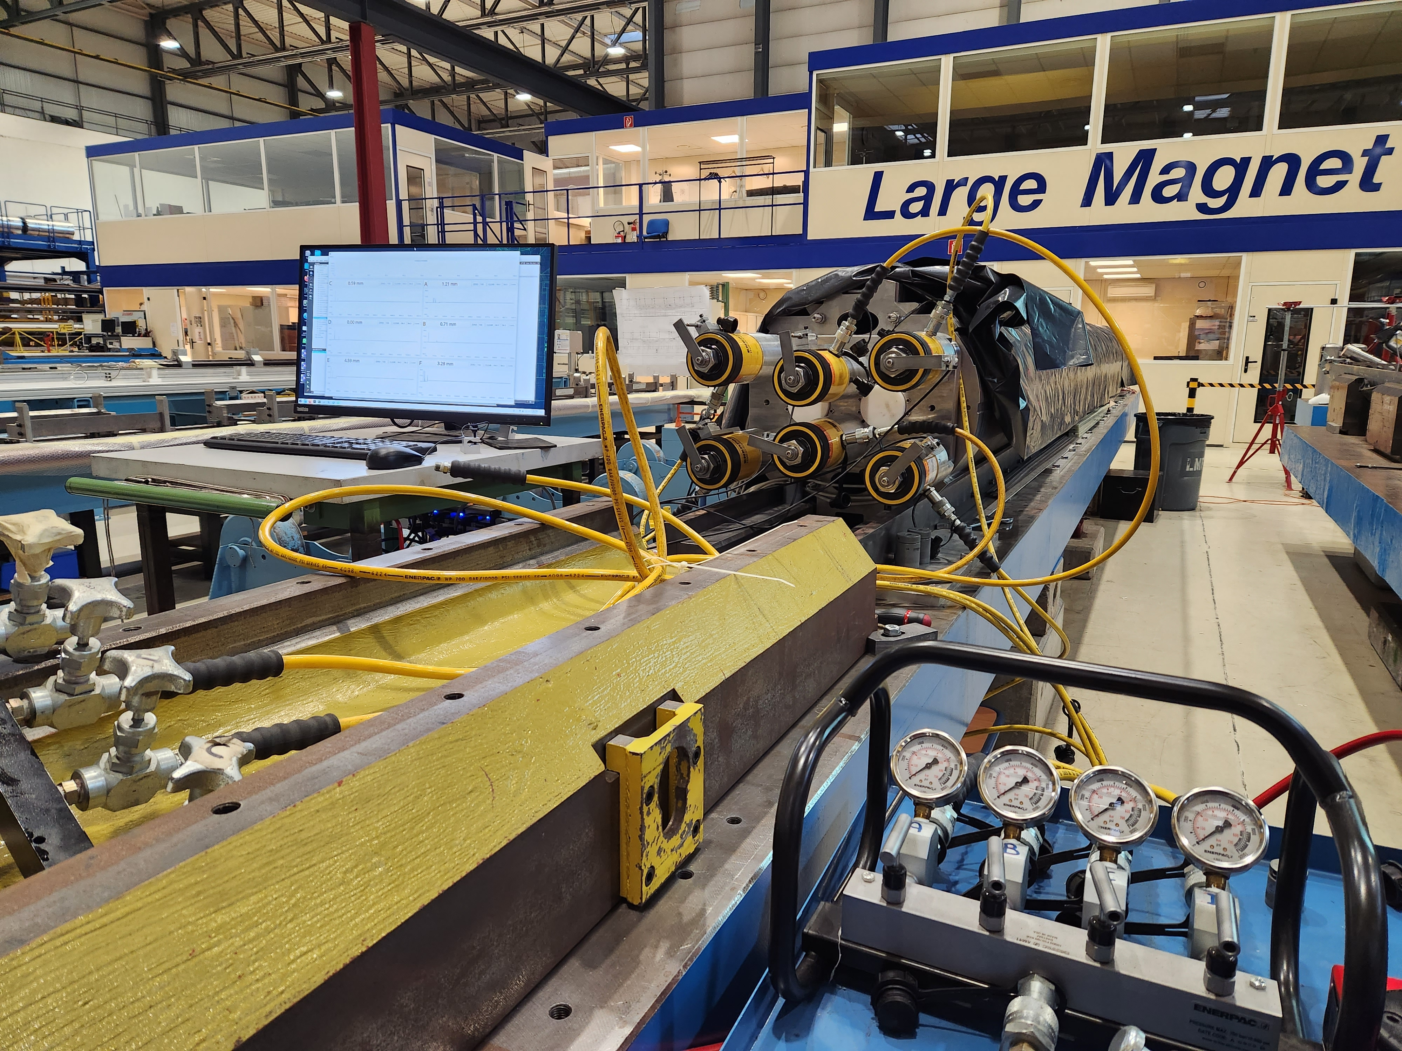
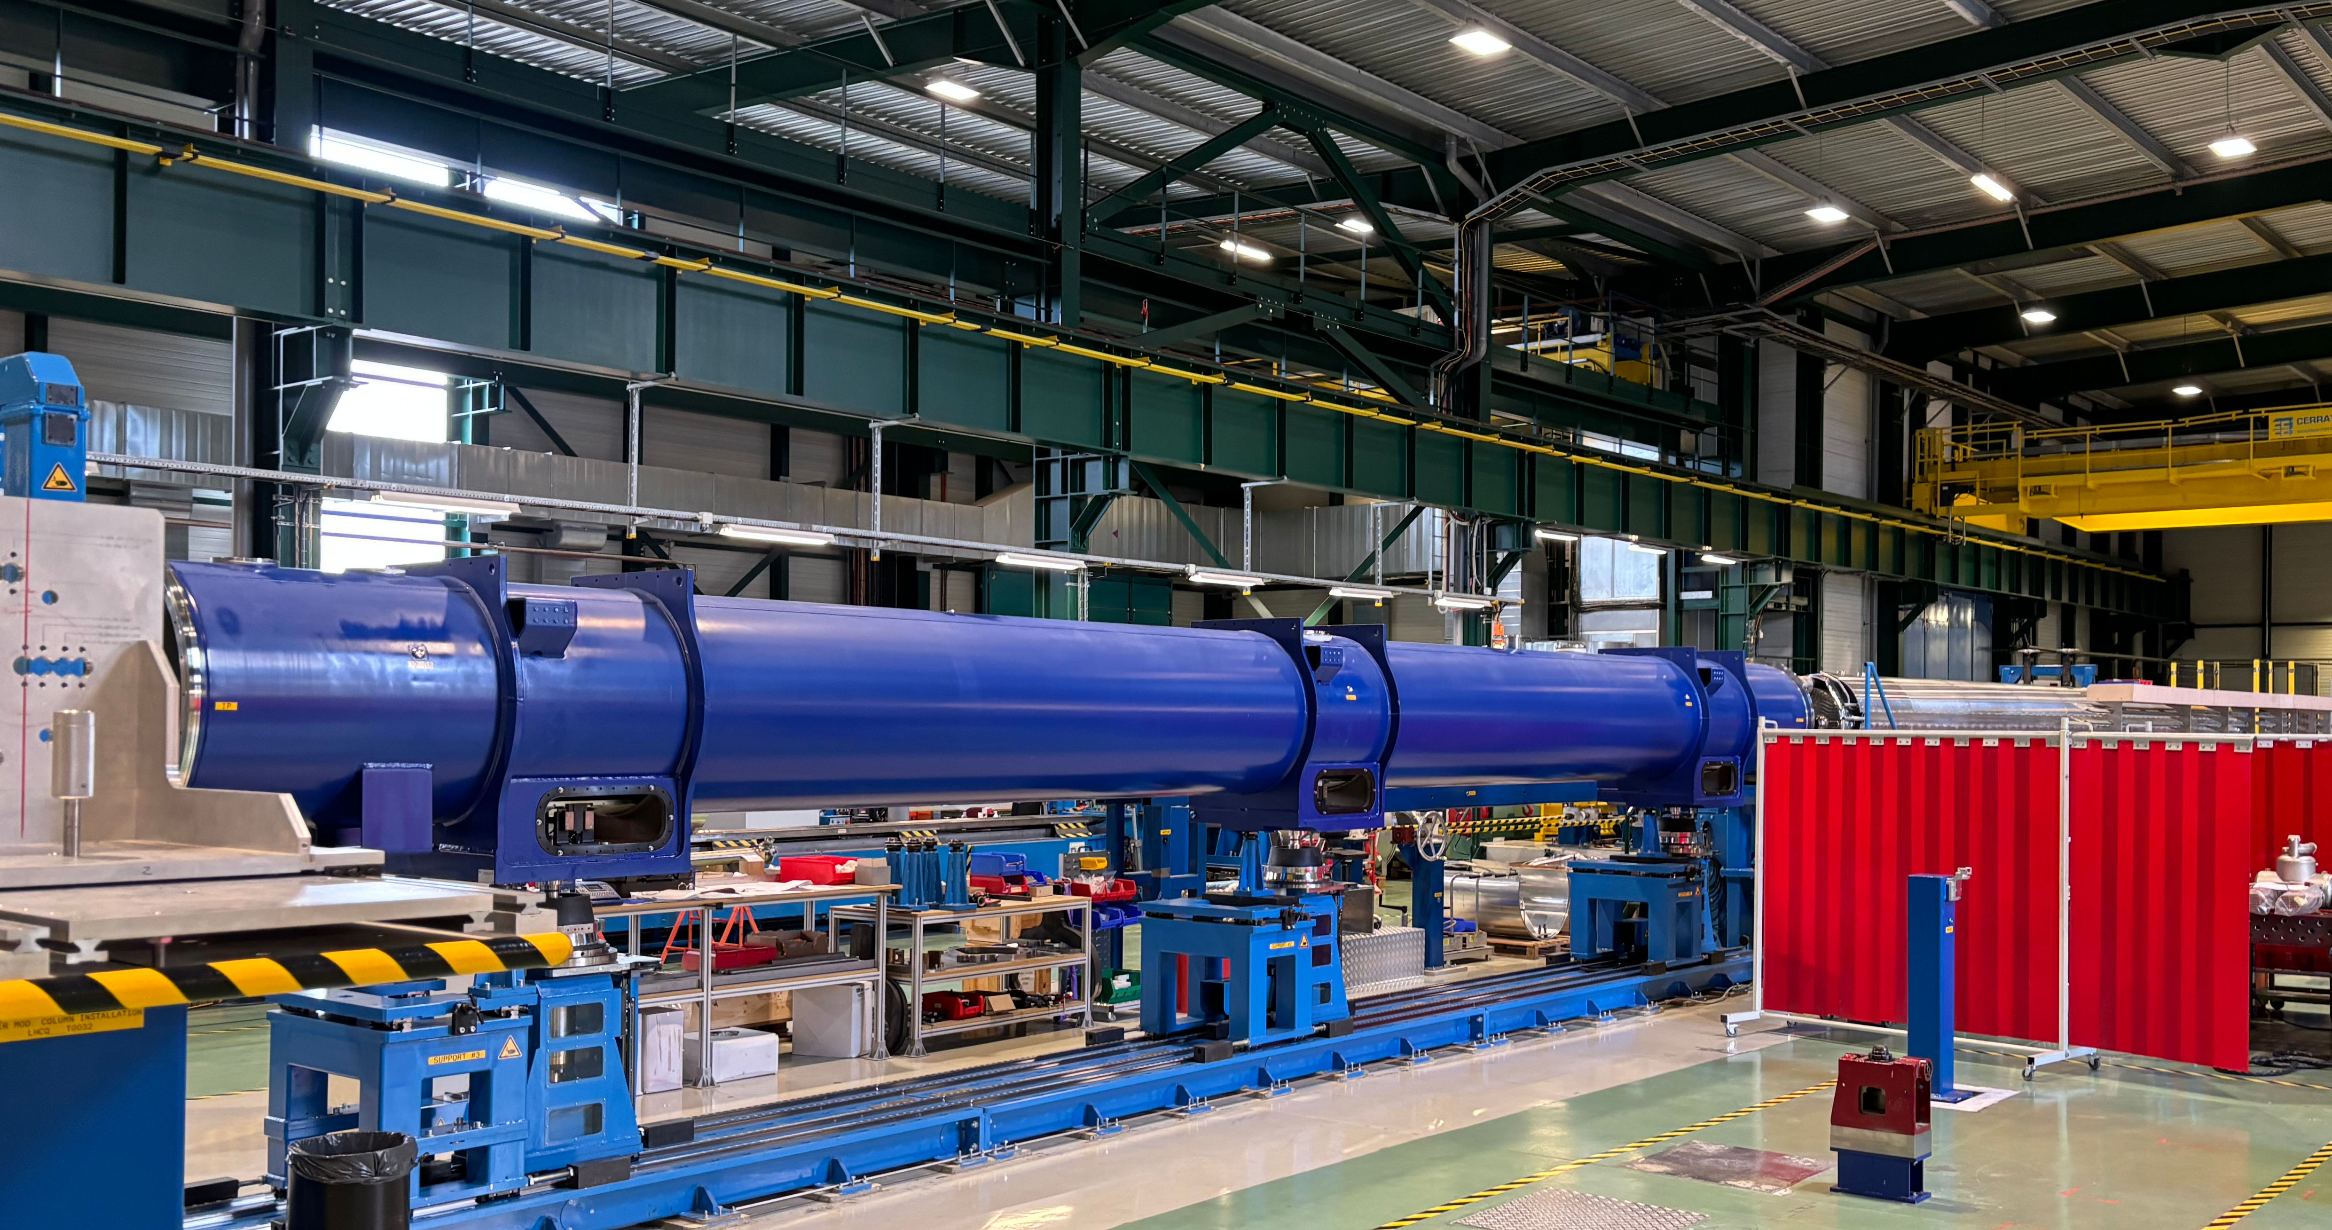
MBRD2 STATUS
MBRD2 arrived at CERN in April 2024.
Following the findings on MBRD1, in ASG the tie rods were loaded up to nominal load.
  Upon reception at CERN, about 50% of this load was lost (most likely due to vibrations during transportation) and had to be restored with the new developed hydraulic tightening system.
MBRD2 successfully passed all reception tests and was accepted.
It is the first MBRD magnet to be assembled in the D2 cold mass.
The first D2 cold mass with MBRD2 is completed and it is now in the cryostating phase.

Slide 18
SUMMARY
Introduction
Status of series coil production
Status of MBRD1
Status of MBRD2
Status of MBRD3
Status of MBRD4─6
Field quality
Schedule

Slide 19
MBRD3 STATUS
MBRD3 will consist of apertures:
  VS-05 which includes AS-05 and BS-07 coils, coupled with shimming scheme 2.
    This aperture has been collared without any issues.
  VS-06 which includes AS-07 and BS-08 coils, coupled with shimming scheme 3.
    This aperture encountered several issues:
      Event 1 (10.04.2024): a short QH vs coil AS-07.
      Event 2 (17.04.2024): a short coil BS-08 vs ground.
      Event 3 (28.05.2024): a short QH vs coil BS-08.
        After this event, specific activities focused on cleaning the coil and its surrounding environment in the workshop were carried out.
      Event 4 (01.07.2024): a short QH vs coil BS-08.
        Following this event, a design change has been agreed upon and will be implemented in future magnets as well.
    VS-06 has been successfully collared on September 19th 2024.
      The collaring pressure was lower than expected (320 vs 375 bars), but it remained within acceptable limits.
      This may suggest localized and limited plastic deformation in some components.
        The single aperture field quality measurements of VS-06 are consistent with those of the other apertures.

Slide 20
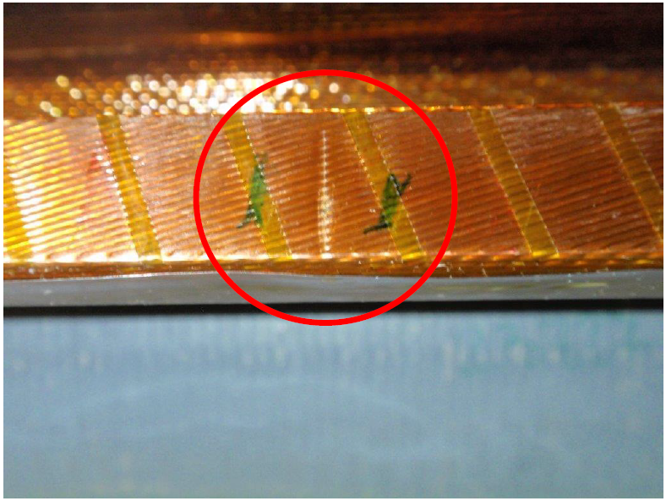
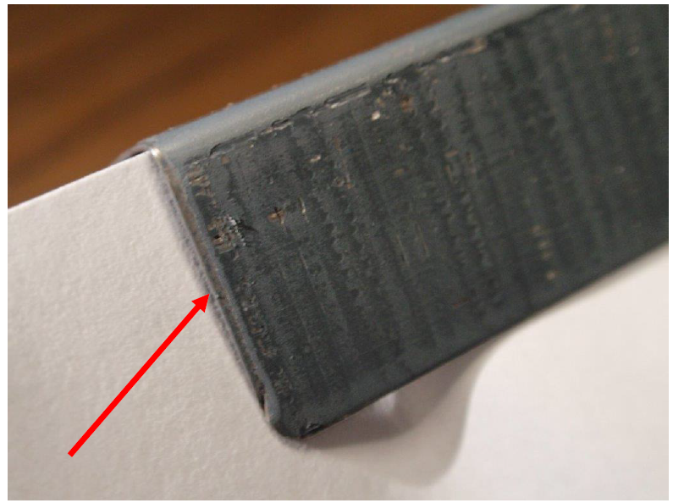
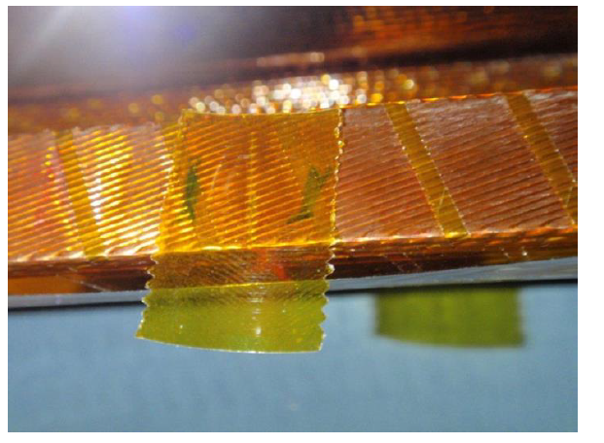
SHORT COIL BS-08 VS GROUND
The cause of this issue was the unforeseen overlapping of two adjacent coil protection sheets side by side.
This overlapping resulted in an increase in thickness, which under pressure led to damage to all the ground insulation layers (no damage to the conductor strands).
Accepted repair proposal includes the replacement of damaged GI and QH and the local application of a single layer of polyimide adhesive tape (20 mm in width and 0.05 mm in thickness).

Slide 21
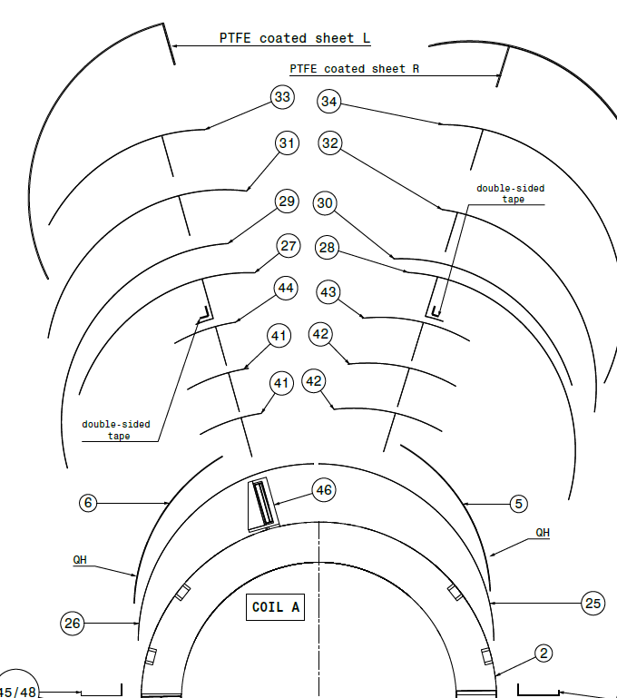
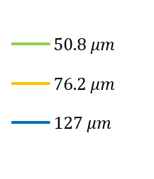


DESIGN CHANGES TO MITIGATE THE ISSUE OF QH SHORTS
Interlayer coil/QH increase from 51 to 76 μm
1 GI layer 127 μm thick replaced with 76 μm
radial thickness reduced by 25 μm
SS sheet
SS sheet
GI layer
GI layer
baseline
modified
GI layer
L-balance
L-balance
L-balance
L-balance
QH
QH
interlayer coil/QH
interlayer coil/QH
coil
coil

Slide 22
SUMMARY
Introduction
Status of series coil production
Status of MBRD1
Status of MBRD2
Status of MBRD3
Status of MBRD4─6
Field quality
Schedule

Slide 23
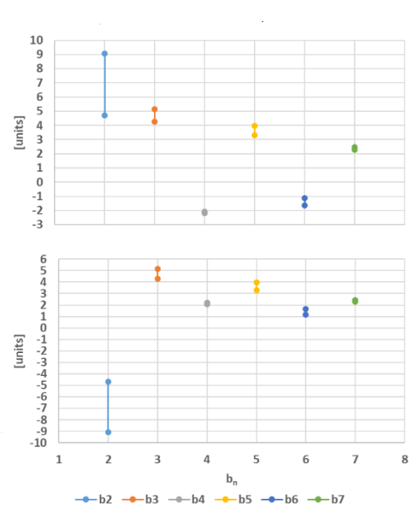
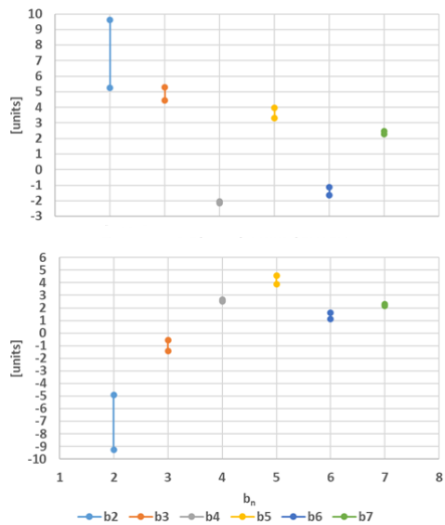
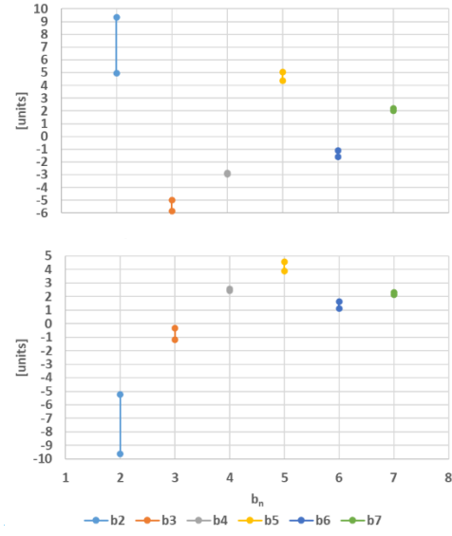
STATUS OF MBRD4─6
The pairing of coils into apertures and apertures into magnets has been fully defined with support from WP2.
The baseline plan from ASG involves producing the magnets in series, ensuring a consistent completion rate.
If necessary, acceleration of the process can be considered.
Expected AP1 @ I_{nom} CENTER – MBRD4
Expected AP1 @ I_{nom} CENTER – MBRD5
Expected AP1 @ I_{nom} CENTER – MBRD6
Expected AP2 @ I_{nom} CENTER – MBRD4
Expected AP2 @ I_{nom} CENTER – MBRD5
Expected AP2 @ I_{nom} CENTER – MBRD6

Slide 24
SUMMARY
Introduction
Status of series coil production
Status of MBRD1
Status of MBRD2
Status of MBRD3
Status of MBRD4─6
Field quality
Schedule

Slide 25
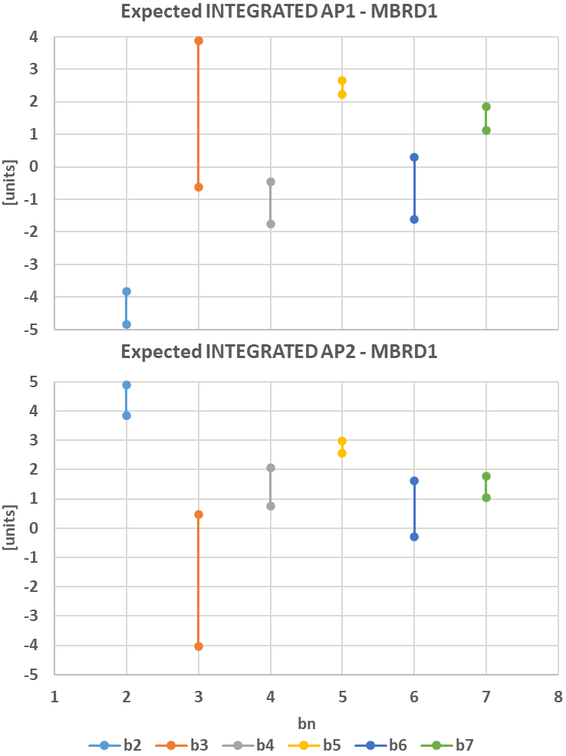
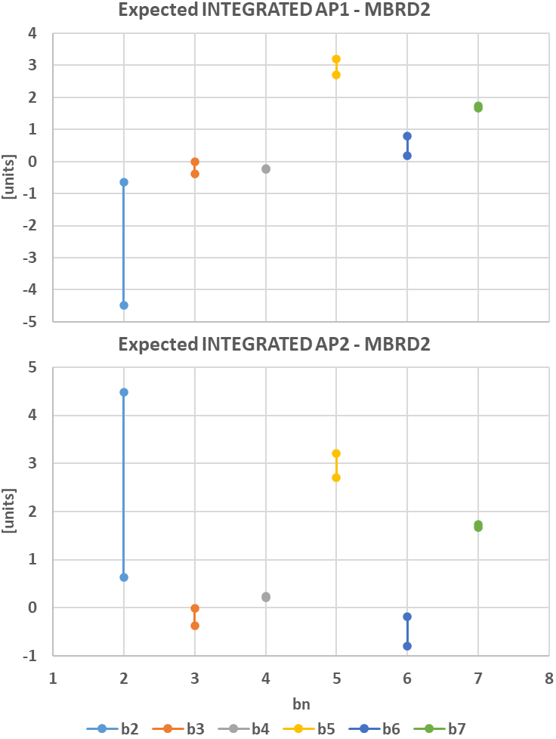
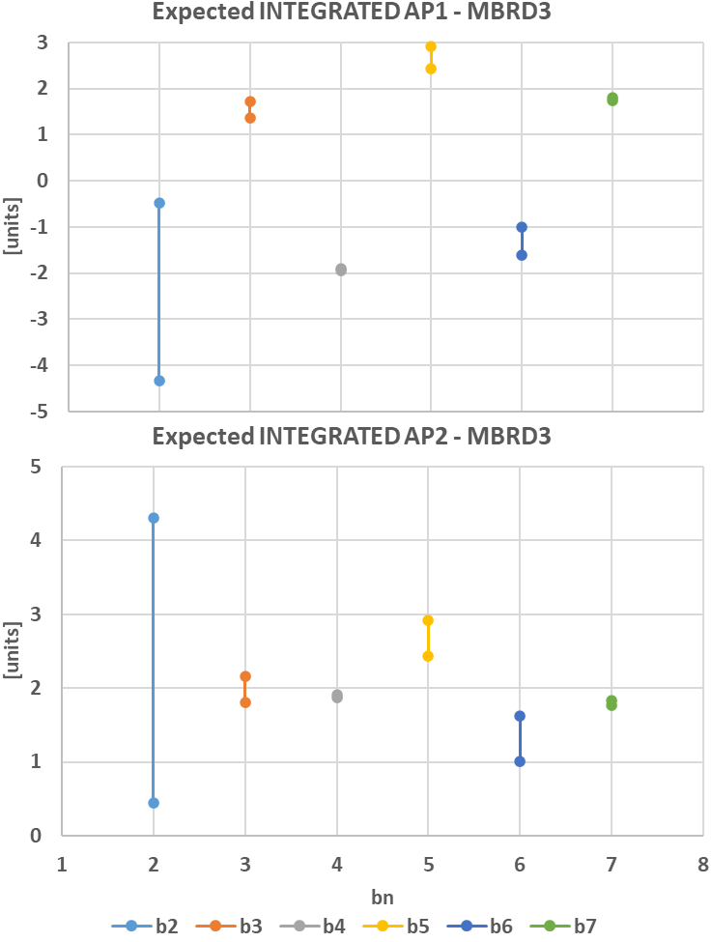
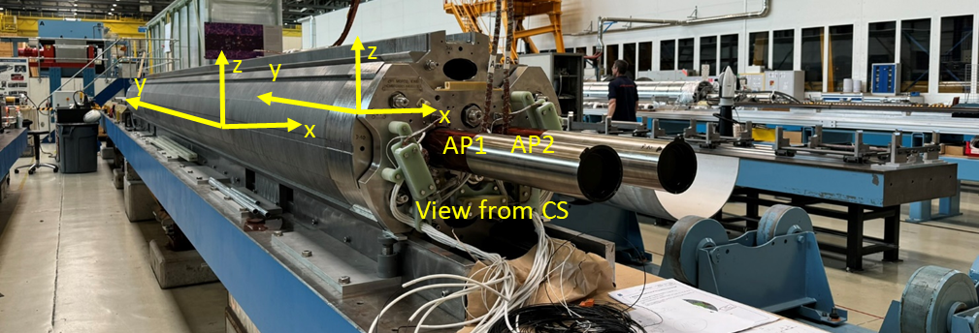
EXPECTED INTEGRATED HARMONICS @ NOMINAL CURRENT
4
4
3
-5
-5
-5
5
5
5
-5
-1
0
The error bars in the expected harmonics at I_{nom} depend on how the expectations are calculated. They can be based on either:
  Cold measurements of the prototype
  Warm measurements of the series magnets

Slide 26
SUMMARY
Introduction
Status of series coil production
Status of MBRD1
Status of MBRD2
Status of MBRD3
Status of MBRD4─6
Field quality
Schedule

Slide 27
Schedule
Magnet delivery schedule (ASG plan):
  MBRD1 October 2024
  MBRD2 April 2024 delivered
  MBRD3 December 2024
  MBRD4 April 2025
  MBRD5 September 2025
  MBRD6 January 2026

Slide 28
CONCLUSIONS
  Series Coil Production:
    All 24 coils have been successfully wound and cured, though some issues were identified, including insulation damage and excess coil size. These have been addressed through repairs and adjustments.
  MBRD Magnet Status:
    MBRD1: Electrical issues were resolved, with the magnet expected for delivery in Oct. 2024.
    MBRD2: Successfully passed tests and will be the first magnet integrated into the cold mass.
    MBRD3: Faced several short circuits but VS06 was successfully collared and assembled by Sept. 2024.
  Future Magnet Production:
    MBRD4 to MBRD6 are planned for completion between April 25 and January 26.
  Design Improvements:
    Various corrective measures, such as adjustments to SS protection sheets and design changes to mitigate short circuits in quench heaters, were implemented to prevent recurring issues.
The overall conclusion is that production is progressing well, with significant lessons learned from first magnet assembly. The delivery schedule remains on track for the final integration phase.

Slide 29
THANKS FOR THE ATTENTION
Acknowledgments
INFN: A.Bersani, B.Caiffi, F.Levi, A.Pampaloni
CERN: A.Foussat, E.Todesco

Slide 30
COIL PAIRING IN MAGNETS
MBRD1 and MBRD2 completed
MBRD3: both apertures collared
MBRD4 to MBRD6 pairing planning
Largest coils (>0.6 mm) in MBRD6

Slide 31
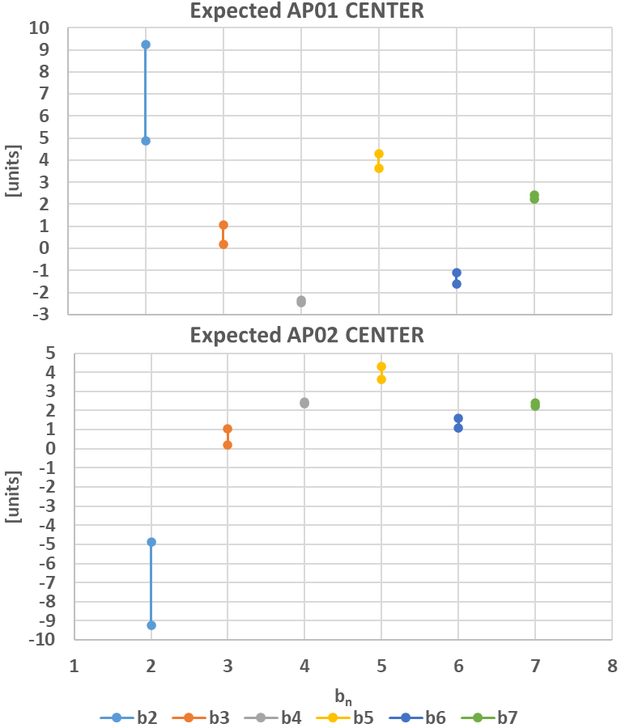




Expected Field Quality of MBRD2 @ Nominal Operation
 | CENTER
 | AP03 |  |  | AP04
 | SIMU | EXPE PROTO | EXPE SERIE | SIMU | EXPE PROTO | EXPE SERIE
b2 | 5.70 | 4.87 | 9.24 | -5.70 | -4.87 | -9.24
b3 | -15.18 | 0.19 | 1.05 | -15.18 | 0.19 | 1.05
b4 | -1.57 | -2.34 | -2.45 | 1.57 | 2.34 | 2.45
b5 | -1.06 | 3.62 | 4.29 | -1.06 | 3.62 | 4.29
b6 | -0.52 | -1.59 | -1.09 | 0.52 | 1.59 | 1.09
b7 | 2.44 | 2.40 | 2.23 | 2.44 | 2.40 | 2.23
b8 | 1.00 | 2.85 | 0.79 | -1.00 | -2.85 | -0.79
b9 | 1.51 | 1.06 | 1.14 | 1.51 | 1.06 | 1.14
b10 | 0.10 | -2.18 | 0.74 | -0.10 | 2.18 | -0.74
a2 | 0.00 | 3.48 | 1.56 | 0.00 | -3.47 | -1.56
a3 | -0.01 | 2.62 | -2.62 | 0.01 | 2.63 | -2.61
a4 | 0.00 | 0.16 | 0.55 | 0.00 | -0.16 | -0.55
a5 | 0.00 | 1.67 | -0.32 | 0.00 | 1.67 | -0.32
a6 | 0.00 | 0.08 | 0.00 | 0.00 | -0.08 | 0.00
a7 | 0.00 | 0.94 | 0.86 | 0.00 | 0.94 | 0.86
a8 | 0.00 | -1.50 | -0.20 | 0.00 | 1.51 | 0.20
a9 | 0.00 | 1.57 | -0.62 | 0.00 | 1.57 | -0.62
a10 | 0.00 | 2.78 | 0.13 | 0.00 | -2.78 | -0.13
$$∆_{1}={Meas}_{PROTO}^{@ I_{nom}}−{Simu}_{PROTO}^{@ I_{nom}}$$
$$∆_{2}={Meas}_{SERIE}^{iron @ RT}−{Simu}_{SERIE}^{iron @ RT}$$
$$EXPE PROTO={Simu}_{SERIE}^{@ I_{nom}}+∆_{1}$$
$$EXPE SERIE={Simu}_{SERIE}^{@ I_{nom}}+∆_{2}$$

Slide 32
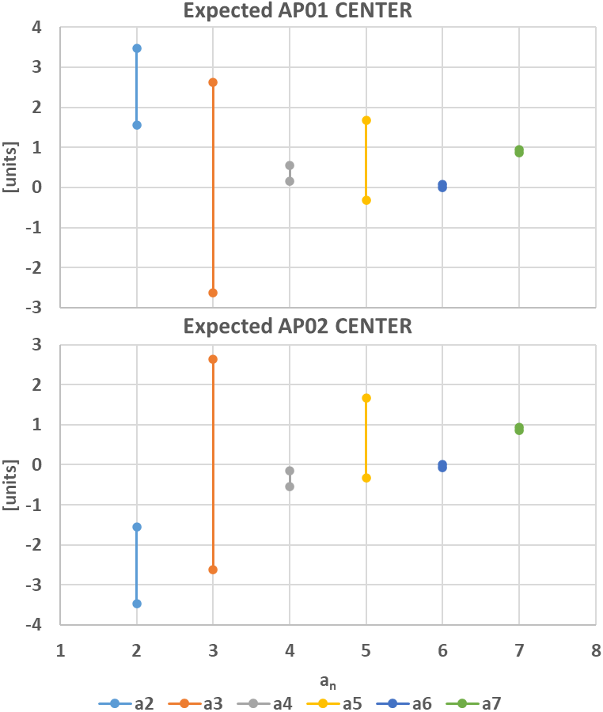
Expected Field Quality of MBRD2 @ Nominal Operation
 | CENTER
 | AP03 |  |  | AP04
 | SIMU | EXPE PROTO | EXPE SERIE | SIMU | EXPE PROTO | EXPE SERIE
b2 | 5.70 | 4.87 | 9.24 | -5.70 | -4.87 | -9.24
b3 | -15.18 | 0.19 | 1.05 | -15.18 | 0.19 | 1.05
b4 | -1.57 | -2.34 | -2.45 | 1.57 | 2.34 | 2.45
b5 | -1.06 | 3.62 | 4.29 | -1.06 | 3.62 | 4.29
b6 | -0.52 | -1.59 | -1.09 | 0.52 | 1.59 | 1.09
b7 | 2.44 | 2.40 | 2.23 | 2.44 | 2.40 | 2.23
b8 | 1.00 | 2.85 | 0.79 | -1.00 | -2.85 | -0.79
b9 | 1.51 | 1.06 | 1.14 | 1.51 | 1.06 | 1.14
b10 | 0.10 | -2.18 | 0.74 | -0.10 | 2.18 | -0.74
a2 | 0.00 | 3.48 | 1.56 | 0.00 | -3.47 | -1.56
a3 | -0.01 | 2.62 | -2.62 | 0.01 | 2.63 | -2.61
a4 | 0.00 | 0.16 | 0.55 | 0.00 | -0.16 | -0.55
a5 | 0.00 | 1.67 | -0.32 | 0.00 | 1.67 | -0.32
a6 | 0.00 | 0.08 | 0.00 | 0.00 | -0.08 | 0.00
a7 | 0.00 | 0.94 | 0.86 | 0.00 | 0.94 | 0.86
a8 | 0.00 | -1.50 | -0.20 | 0.00 | 1.51 | 0.20
a9 | 0.00 | 1.57 | -0.62 | 0.00 | 1.57 | -0.62
a10 | 0.00 | 2.78 | 0.13 | 0.00 | -2.78 | -0.13
$$∆_{1}={Meas}_{PROTO}^{@ I_{nom}}−{Simu}_{PROTO}^{@ I_{nom}}$$
$$∆_{2}={Meas}_{SERIE}^{iron @ RT}−{Simu}_{SERIE}^{iron @ RT}$$
$$EXPE PROTO={Simu}_{SERIE}^{@ I_{nom}}+∆_{1}$$
$$EXPE SERIE={Simu}_{SERIE}^{@ I_{nom}}+∆_{2}$$

Slide 33
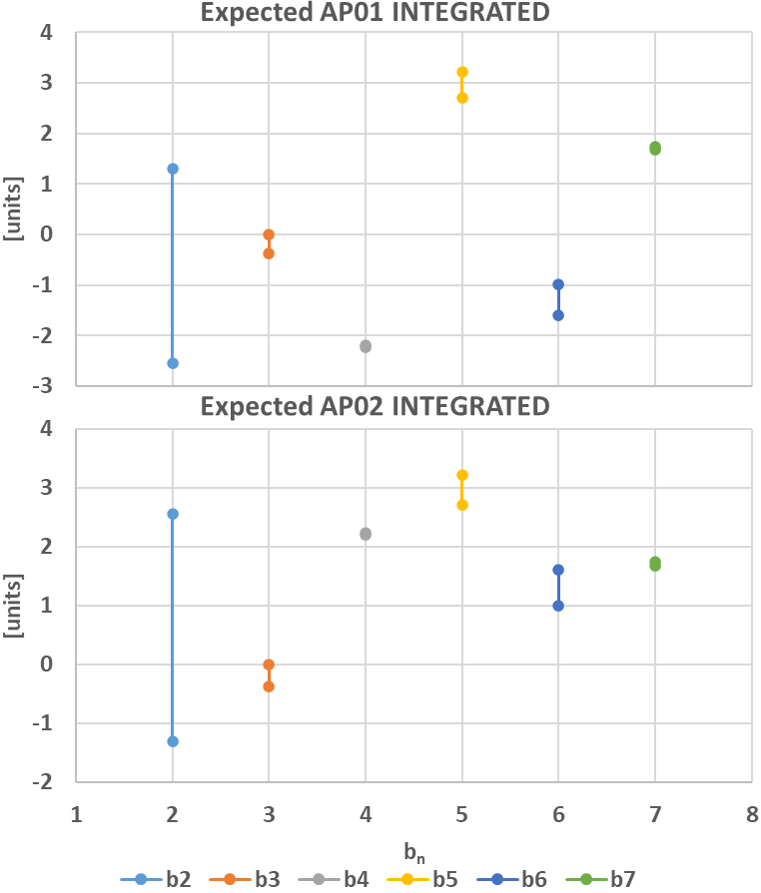
Expected Field Quality of MBRD2 @ Nominal Operation
 | INTEGRATED
 | AP03 |  |  | AP04
 | SIMU | EXPE PROTO | EXPE SERIE | SIMU | EXPE PROTO | EXPE SERIE
b2 | -1.59 | -2.55 | 1.30 | 1.59 | 2.55 | -1.30
b3 | -15.51 | -0.01 | -0.37 | -15.51 | -0.01 | -0.37
b4 | -1.22 | -2.20 | -2.23 | 1.22 | 2.20 | 2.23
b5 | -2.05 | 2.71 | 3.21 | -2.05 | 2.71 | 3.21
b6 | -0.41 | -1.61 | -1.00 | 0.41 | 1.61 | 1.00
b7 | 1.99 | 1.73 | 1.67 | 1.99 | 1.73 | 1.67
b8 | 1.07 | 3.23 | 0.84 | -1.07 | -3.23 | -0.84
b9 | 1.33 | 0.68 | 0.68 | 1.33 | 0.68 | 0.68
b10 | 0.20 | -2.47 | 0.80 | -0.20 | 2.47 | -0.80
a2 | 0.16 | 2.46 | 1.49 | -0.16 | -2.46 | -1.49
a3 | -0.55 | 2.49 | -3.23 | -0.55 | 2.49 | -3.23
a4 | 0.00 | -0.11 | 0.43 | 0.00 | 0.11 | -0.43
a5 | -0.02 | 1.63 | -0.35 | -0.02 | 1.63 | -0.35
a6 | 0.01 | -0.04 | -0.04 | -0.01 | 0.04 | 0.04
a7 | 0.00 | 0.93 | 0.90 | 0.00 | 0.93 | 0.90
a8 | 0.00 | -1.18 | -0.17 | 0.00 | 1.18 | 0.17
a9 | 0.00 | 1.41 | -0.72 | 0.00 | 1.41 | -0.72
a10 | 0.00 | 0.83 | 0.07 | 0.00 | -0.83 | -0.07
$$∆_{1}={Meas}_{PROTO}^{@ I_{nom}}−{Simu}_{PROTO}^{@ I_{nom}}$$
$$∆_{2}={Meas}_{SERIE}^{iron @ RT}−{Simu}_{SERIE}^{iron @ RT}$$
$$EXPE PROTO={Simu}_{SERIE}^{@ I_{nom}}+∆_{1}$$
$$EXPE SERIE={Simu}_{SERIE}^{@ I_{nom}}+∆_{2}$$

Slide 34
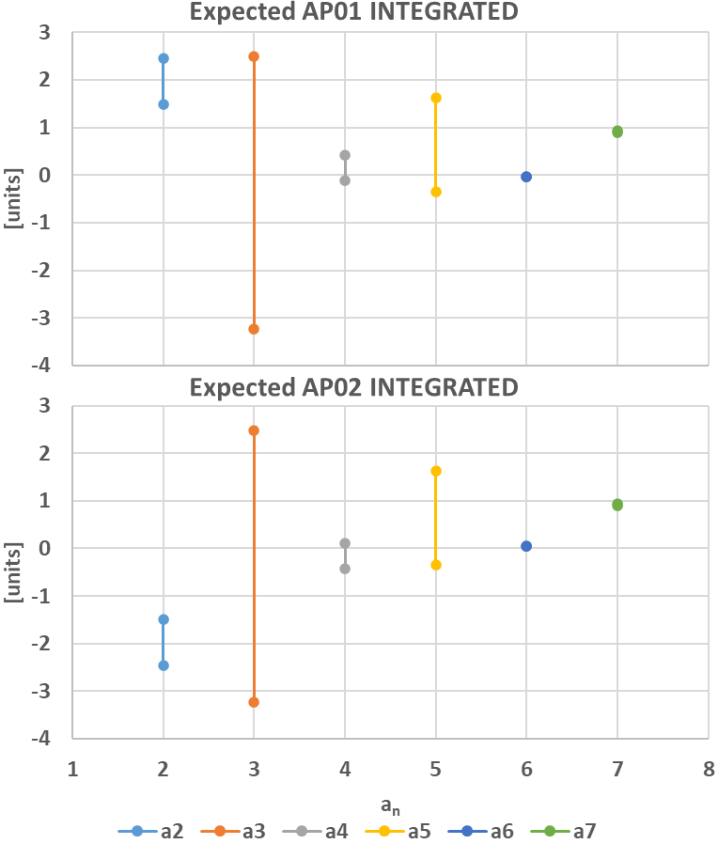
Expected Field Quality of MBRD2 @ Nominal Operation
 | INTEGRATED
 | AP03 |  |  | AP04
 | SIMU | EXPE PROTO | EXPE SERIE | SIMU | EXPE PROTO | EXPE SERIE
b2 | -1.59 | -2.55 | 1.30 | 1.59 | 2.55 | -1.30
b3 | -15.51 | -0.01 | -0.37 | -15.51 | -0.01 | -0.37
b4 | -1.22 | -2.20 | -2.23 | 1.22 | 2.20 | 2.23
b5 | -2.05 | 2.71 | 3.21 | -2.05 | 2.71 | 3.21
b6 | -0.41 | -1.61 | -1.00 | 0.41 | 1.61 | 1.00
b7 | 1.99 | 1.73 | 1.67 | 1.99 | 1.73 | 1.67
b8 | 1.07 | 3.23 | 0.84 | -1.07 | -3.23 | -0.84
b9 | 1.33 | 0.68 | 0.68 | 1.33 | 0.68 | 0.68
b10 | 0.20 | -2.47 | 0.80 | -0.20 | 2.47 | -0.80
a2 | 0.16 | 2.46 | 1.49 | -0.16 | -2.46 | -1.49
a3 | -0.55 | 2.49 | -3.23 | -0.55 | 2.49 | -3.23
a4 | 0.00 | -0.11 | 0.43 | 0.00 | 0.11 | -0.43
a5 | -0.02 | 1.63 | -0.35 | -0.02 | 1.63 | -0.35
a6 | 0.01 | -0.04 | -0.04 | -0.01 | 0.04 | 0.04
a7 | 0.00 | 0.93 | 0.90 | 0.00 | 0.93 | 0.90
a8 | 0.00 | -1.18 | -0.17 | 0.00 | 1.18 | 0.17
a9 | 0.00 | 1.41 | -0.72 | 0.00 | 1.41 | -0.72
a10 | 0.00 | 0.83 | 0.07 | 0.00 | -0.83 | -0.07
$$∆_{1}={Meas}_{PROTO}^{@ I_{nom}}−{Simu}_{PROTO}^{@ I_{nom}}$$
$$∆_{2}={Meas}_{SERIE}^{iron @ RT}−{Simu}_{SERIE}^{iron @ RT}$$
$$EXPE PROTO={Simu}_{SERIE}^{@ I_{nom}}+∆_{1}$$
$$EXPE SERIE={Simu}_{SERIE}^{@ I_{nom}}+∆_{2}$$

Slide 35
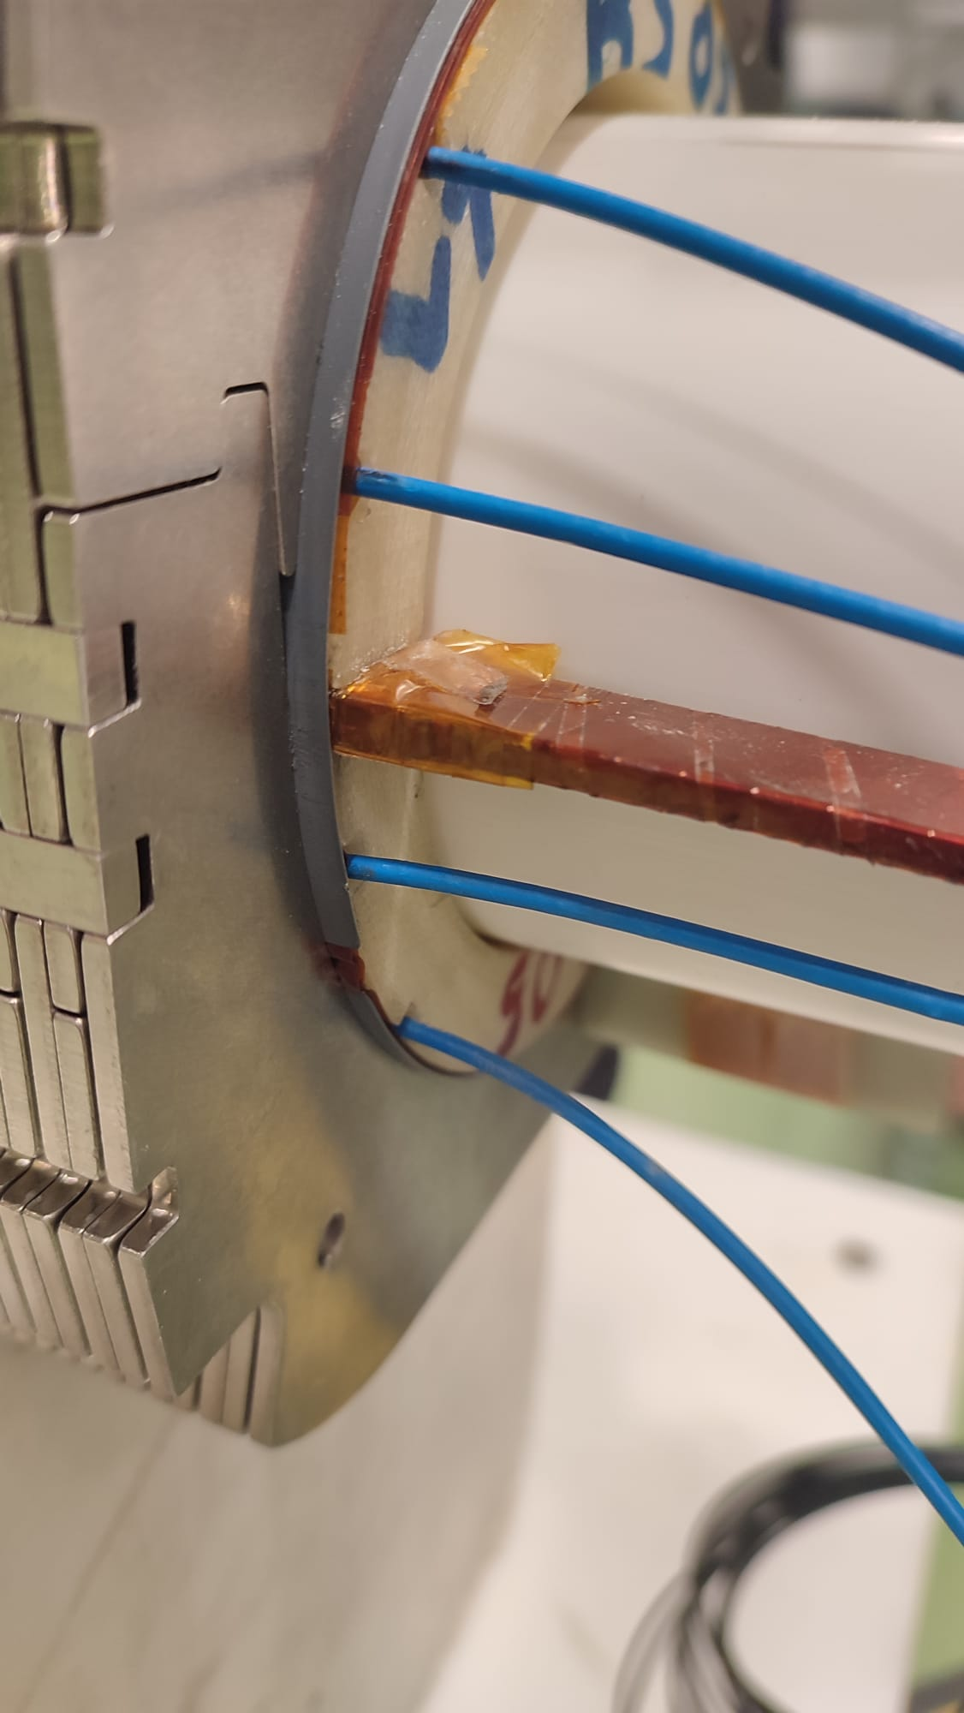
PROTRUDING SS PROTECTION SHEETS
This issue, which has affected all collared apertures, was initially detected on MBRD1.
The root cause consists in the fact that, according to the drawings, the SS protection sheets are as long as the coils.
Due to the inherent difficulty of precisely controlling their position, this protrusion occurs in almost all apertures, leading to the encountered problems.

Slide 36
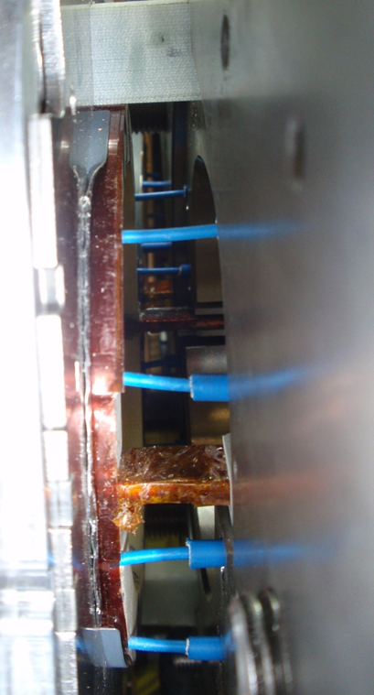
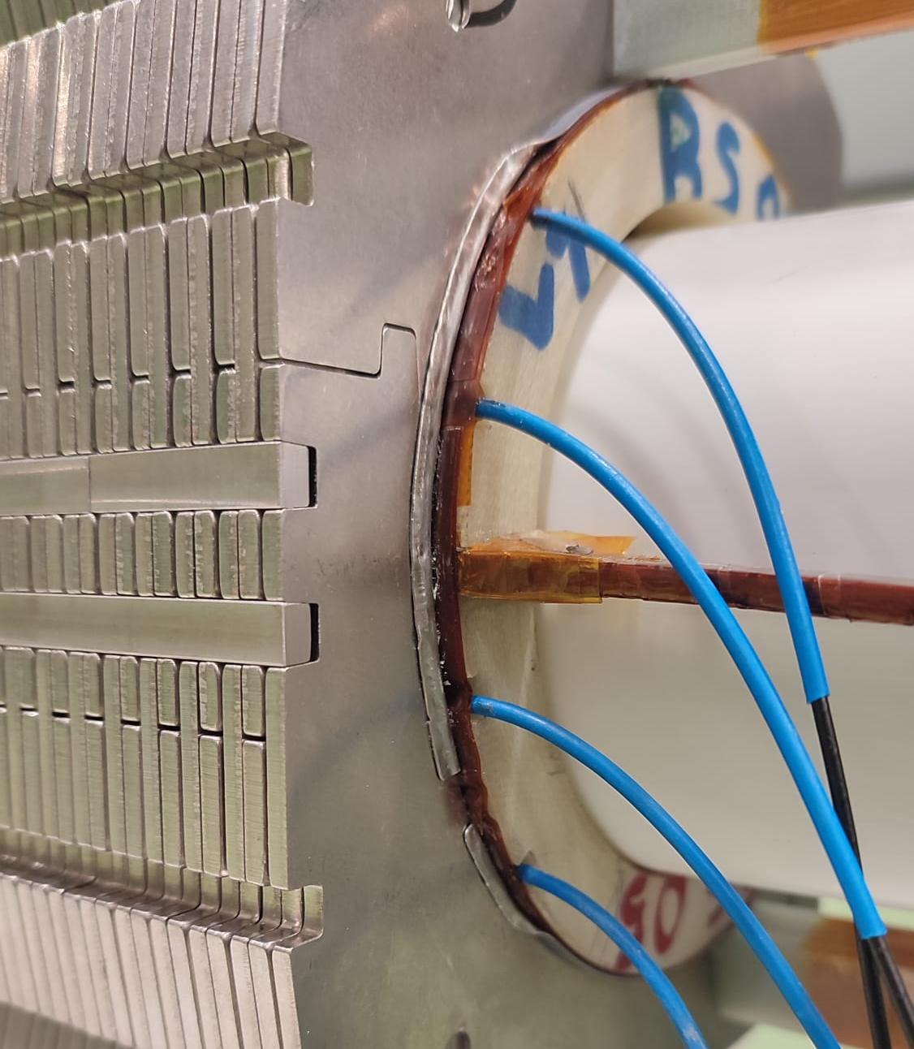
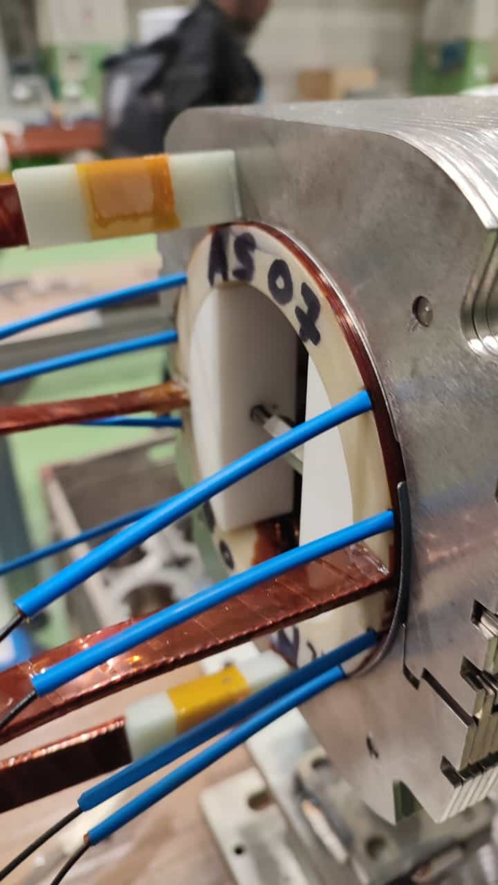
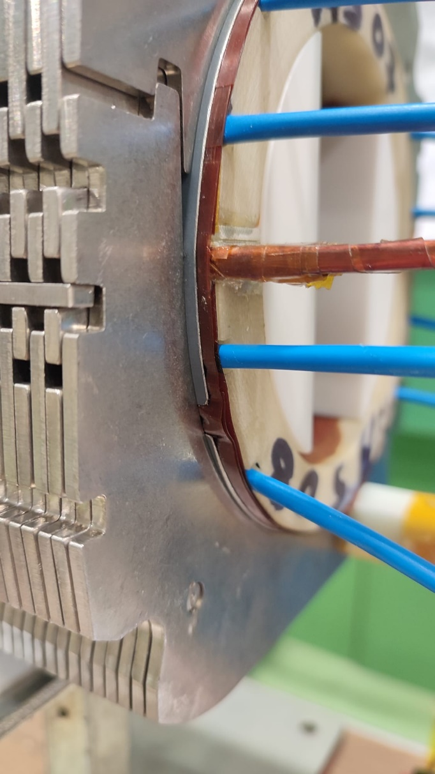
PROTRUDING SS PROTECTION SHEETS: accepted solution
In assembled apertures & magnets:
  The SS protection sheets have been bent toward the collars
In apertures yet to be collared:
  The length of the SS sheet positioned on
  the coil end will be reduced by 2.5±0.5 mm using a rotating rasp abrasion method.
  It is expected that this action will completely solve the issue of protrusion.
  However, there is a possibility that the SS sheet might end up slightly recessed under the last collar: this is not expected to cause any issues.

