Slide 1







HL-LHC
Interaction Region Magnets
E. Todesco, D. Duarte Ramos, S. Izquierdo Bermudez, A. Milanese,
G. Ambrosio, S. Feher, T. Nakamoto, Q. Xu, F. Toral, S. Farinon, M. Statera
A. Foussat, J.-C. Perez,
G. Vandoni, I. del Rosario Crespo Garrido, S. Fleury
October 10th 2024, Genova

Slide 2
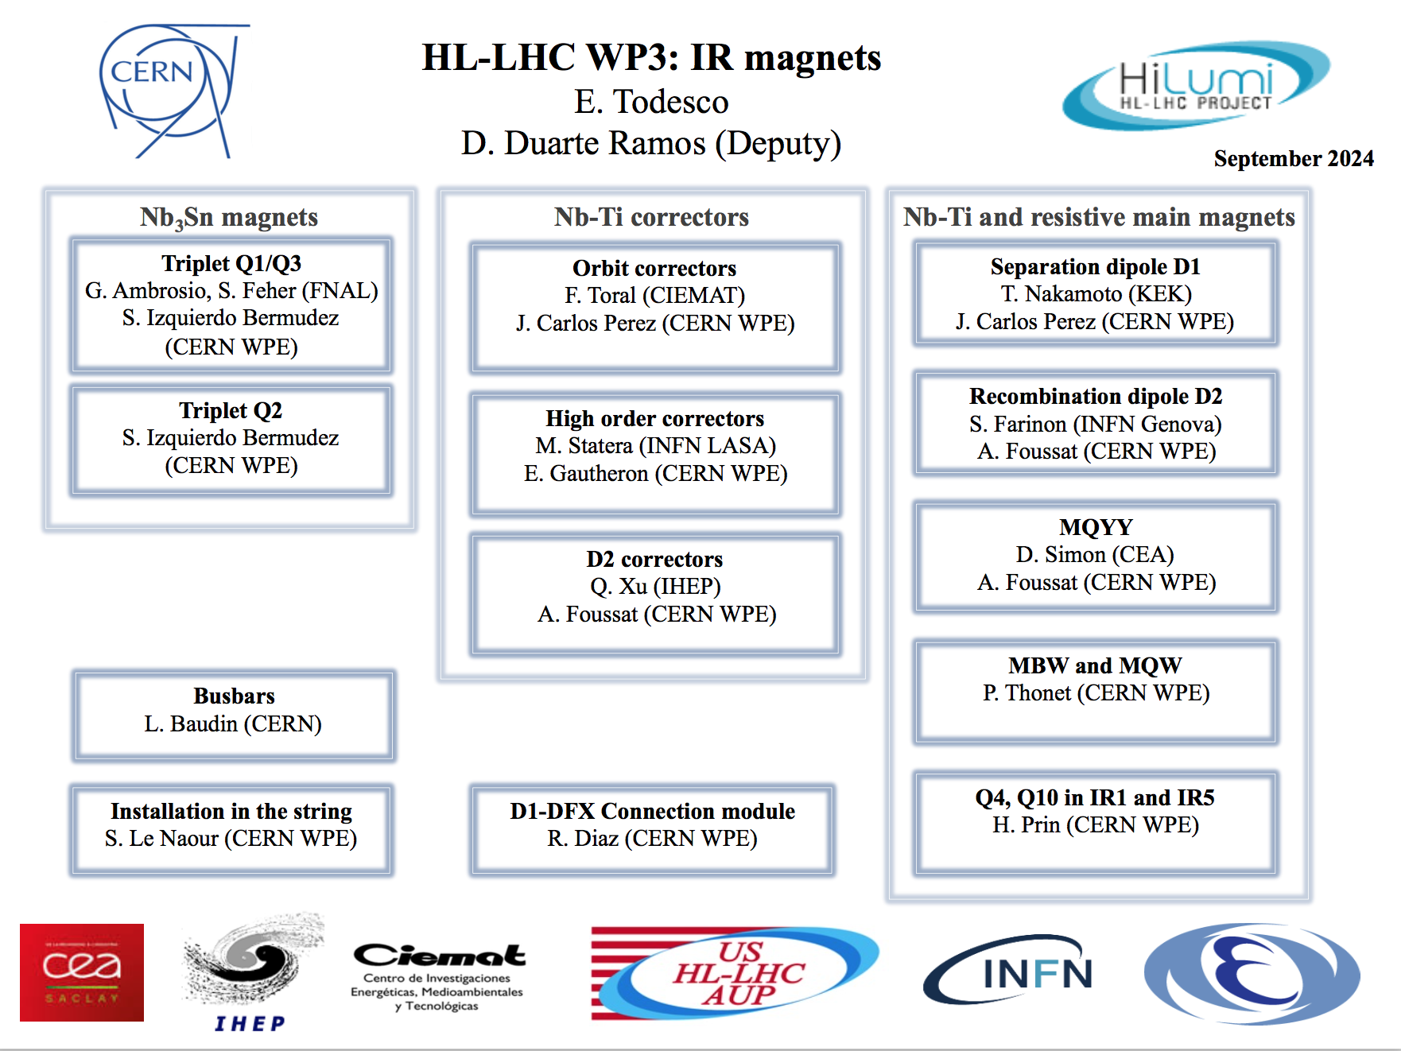
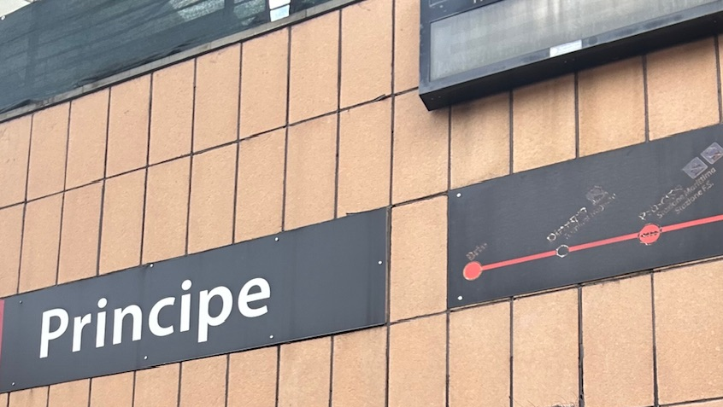

Structure update
Thanks to Rosario Principe !
Welcome to Lucie Baudin and to
Ruth Diaz Vez

Slide 3


MQXFA (see talks by G. Ambrosio, S. Feher)
10 conform magnets
First cold mass limited at 6.8 TeV after test at CERN
30% of NC test, but repair is succesful (coil replacement)
CM01
String
CM02 (ongoing)
MQXFAP1: ≥11.6 T, but electrical short
MQXFA10
MQXFA13b
MQXFAP2: ~10 T, broken structure
MQXFA11
MQXFA03
MQXFA08b
T₀+4
MQXFA04
MQXFA13: ~10.7 T
T₀: aperture and cable selection
11.6 T: 7 TeV (nominal)
MQXFA05
MQXFA14
Program
Project
String
MQXFA06
MQXFA07b
DOE approval
MQXFA07: ~10.7 T
MQXFA15
MQXFA08: ~9.5 T
MQXFA17
2013
2014
2015
2016
2017
2018
2019
2020
2021
2022
2023
2024
2025
2026
2027
12 magnet tested, 9 more new magnets to test (9,12,16, 18-23)

Slide 4
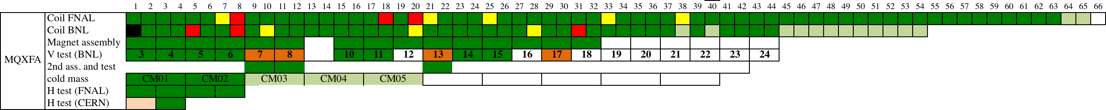
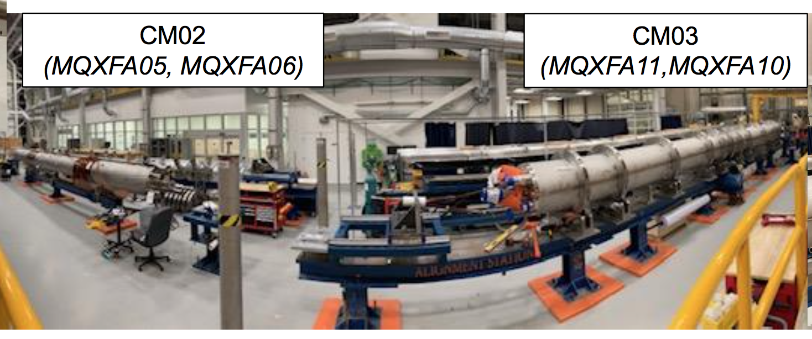
MQXFA (see talks by G. Ambrosio, S. Feher)
Assembly of cold masses in FNAL (S. Feher,, et al.)

Slide 5

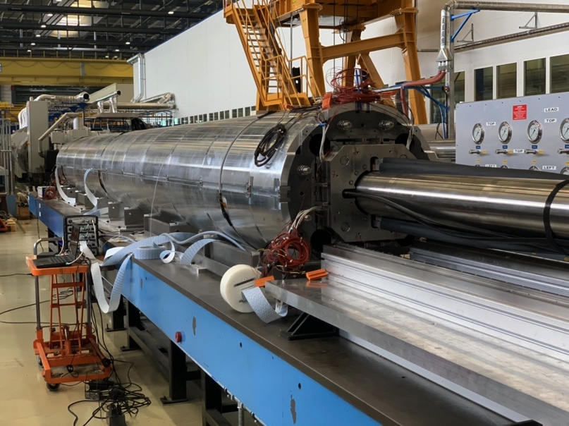
MQXFB (see talk by S. Izquierdo Bermudez)
Green: conform ≥ 11.6 T
Red: non conform
Grey: to come
Light grey: spares
MQXFBP1: ~10.5 T
String
MQXFB06
MQXFBP2: ~11.2 T
MQXFB07
MQXFBP3
MQXFB08
MQXFB02*
MQXFB09
T₀: aperture and cable selection
MQXFB03
MQXFB10
MQXFB04
MQXFB11
MQXFB05
(ongoing)
spares
MQXFB12
2013
2014
2015
2016
2017
2018
2019
2020
2021
2022
2023
2024
2025
2026
2027
7 more magnets to test
* MQXFB02 had a non conform HV test, will be disassembled

Slide 6
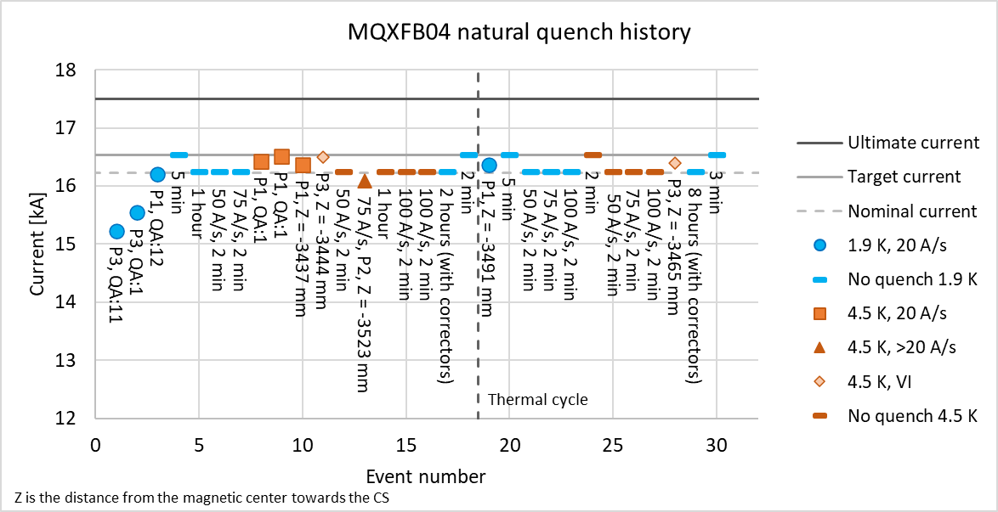
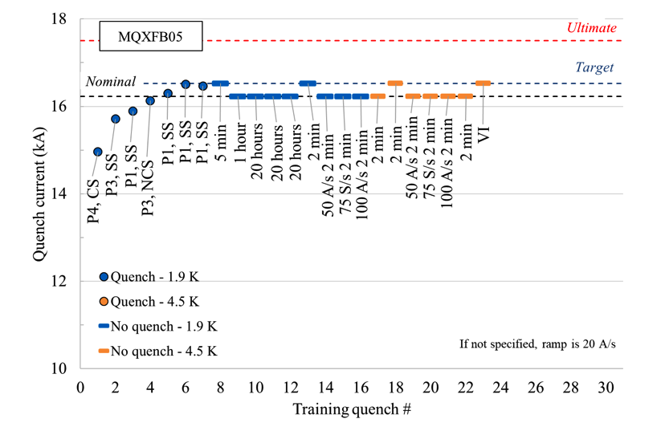
MQXFB (see talk by S. Izquierdo Bermudez)
MQXFB05 reached requirements in 1st thermal cycle – 3rd new generation magnet
We gain performance, and a bit more virgin training – good bargain
All magnets reach nominal also at 4.5 K (90% of sh. sample): important for HFM
Quench performance of MQXFB04 and 05
(Test eng. F. Mangiarotti, G Willering,, WPE: S. Izquierdo Bermudez, et al.)

Slide 7
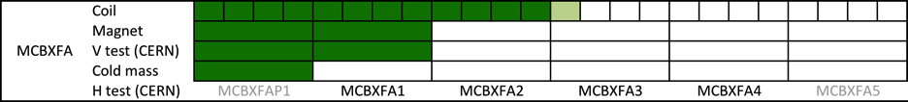

MCBXF (see talk by F. Toral)
Internalization according to plans – MCBXFB06 completed
MCBXFB04
Green is conform
Red is non conform
MCBXFB05
MCBXFA1
MCBXFB10
MCBXFB06
MCBXFA5
MCBXFBP1
MCBXFBP2d
MCBXFB07
spares
T₀: aperture and cable selection
MCBXFBP1b
String
MCBXFAP1
MCBXFA2
MCBXFBP1c
MCBXFB01
MCBXFB08
MCBXFBP1d
MCBXFB02
MCBXFA3
MCBXFBP2
MCBXFB03
MCBXFB09
MCBXFBP2b
MCBXFA4
2013
2014
2015
2016
2017
2018
2019
2020
2021
2022
2023
2024
2025
2026
2027
9 magnets to test

Slide 8

D1 (see talk by T. Nakamoto)
2.5 magnets conform
MBXF5 2nd thermal cycle is pending
Large delay between magnet vertical test and delivery, today the last magnet for installation is MBXF5, ready for installation in mid 2027
MBXFP1 ≥6.1 T
(CERN)
String
Green is conform > 6.1 T
Red is non conform
MBXF2 ≥6.1 T
T₀: aperture and cable selection
MBXF3
MBXFS1: ~5.6 T
MBXFP1: ≥5.9 T
MBXF5 (2st cycle)
5.6 T: 7 TeV (nominal)
6.1 T: 7.5 TeV (ultimate)
MBXFS1b: ≥6.1 T
MBXF1 ≥6.1 T
MBXF6
spares
MBXFS2: ≥6.1 T
MBXF5 ≥6.1 T
(1st cycle)
MBXFS3: ≥6.1 T
MBXF4
2013
2014
2015
2016
2017
2018
2019
2020
2021
2022
2023
2024
2025
2026
2027
Contract
Hitachi
3.5 magnets to test (in KEK)

Slide 9
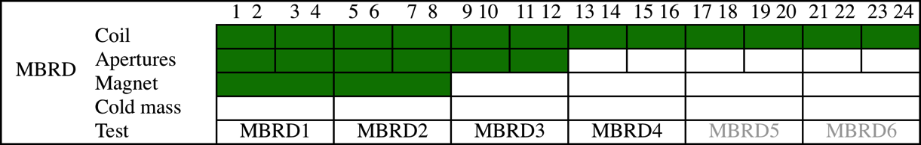


D2 (see talk by S. Farinon)
Coil manufacturing finished
Issues with collaring are being solved
MBRD1 back to CERN in October
MBRD2 at CERN, cold mass assembly ongoing
4.5 T: 7 TeV (nominal)
4.8 T: 7.5 TeV (ultimate)
MBRDS1: ≥4.8 T, but in one aperture
Green is conform
Red is non conform
MBRD1
T₀: aperture and cable selection
MBXFS1c: ≥4.8 T,
but retraining
MBRD4
spares
T₀: collaboration
agreement
MBRDP1: ≥4.8 T
MBRD5
Contract to ASG
MBRD2
MBRD6
MBRD3
2013
2014
2015
2016
2017
2018
2019
2020
2021
2022
2023
2024
2025
2026
2027
6 more magnets to test

Slide 10


D2 corrector (see talk by Q. Xu)
Green is conform
Red is non conform
At CERN, the second magnet with Chinese components MCBRD12 still to be completed – test will be in early 2025
MCBRD05 and MCBRD06 completed, but test is lagging
2.8 T: 7 TeV (nominal)
3.1 T: 7.5 TeV (ultimate)
MCBRD12
MCBRD11
MCBRD01
MCBRD5
MCBRDP1
MCBRD02
T₀: aperture and cable selection
MCBRD6
MCBRDP2
MCBRD03
MCBRD7
T₀: collaboration
agreement
MCBRD04
Contract
to BAMA
MCBRDP3
MCBRD8
MCBRDP4
MCBRD9
MCBRD10
2013
2014
2015
2016
2017
2018
2019
2020
2021
2022
2023
2024
2025
2026
2027
7 more magnets to test

Slide 11
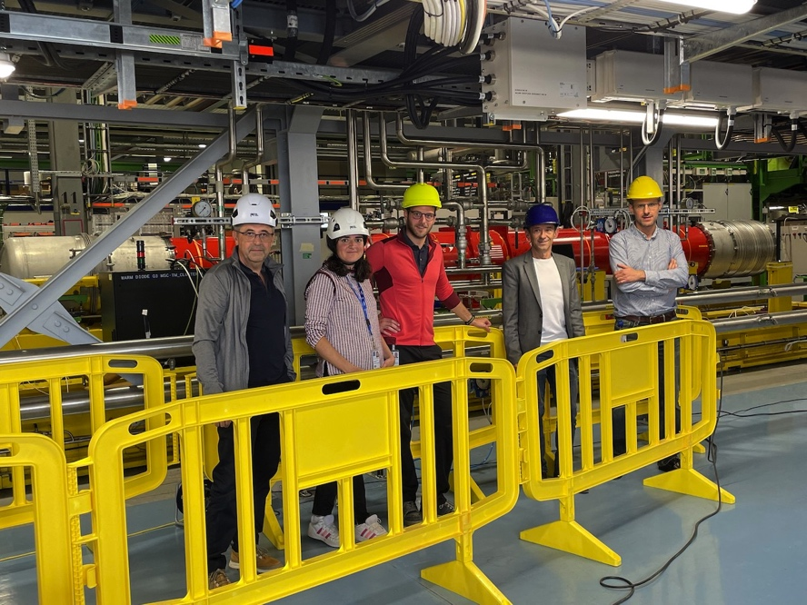
Conclusions
Production is advancing well, but far from being finished!
Integration of magnets from three continents is being proved
New baseline for MQXFB coils shows performance reproducibility
US MQXFA production shows ability to recover performance limitations via coil replacement
First magnet installed in the string

Slide 12
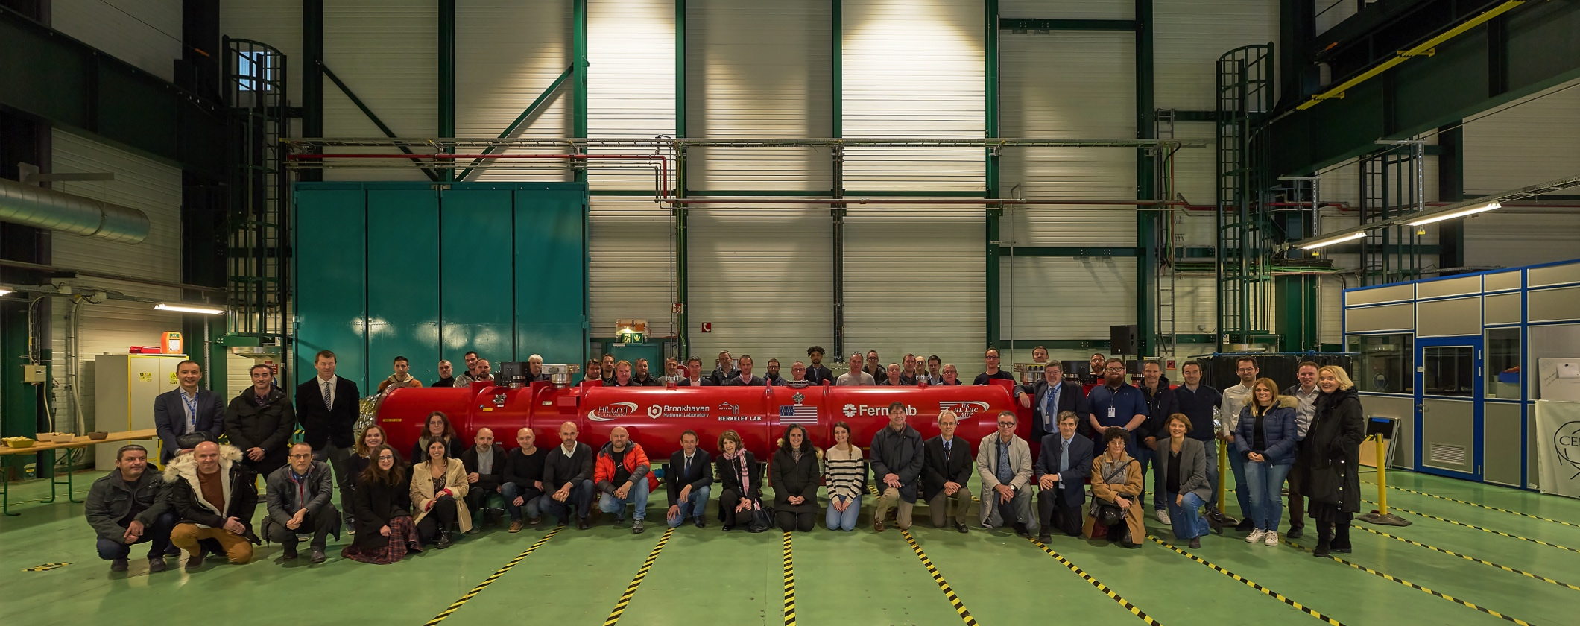
THANKS !

