Slide 1

MCBXF magnet assembly and powering tests results at CERN
J. C. Pérez
CERN TE-MSC-SMT
On behalf of MCBXF team.
Acknowledgments to people who contributed to this presentation.
14th HL-LHC Collaboration Meeting - Genoa
7-10 October 2024
https://indico.cern.ch/event/1421594/overview

Slide 2
Outline
MCBXF: Spanish in-kind contribution for HL-LHC
Series magnet production status in October 2023
Remaining magnets production at CERN
Summary

Slide 3





Spanish in-kind contribution for HL-LHC
CIEMAT and CDTI signed a contract in March 2021 with ELYTT Energy (Spain) to produce the series magnets:
  6 MCBXFA
  11 MCBXFB
During the prototyping phase, 2 MCBXFB and 1 MCBXFA prototypes, as well as the first MCBXFB for the series, were built within a collaboration between CIEMAT and CERN.
Q2a
Q1
TAXS
Q2b
Q3
CP
DFX
D1
MCBXFB
MCBXFA
DFM

Slide 4
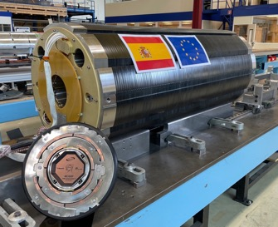
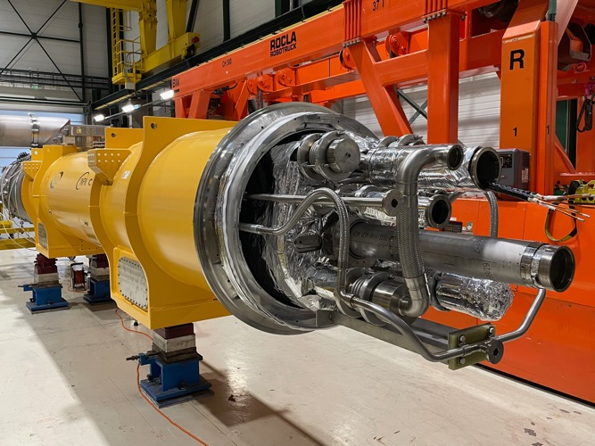
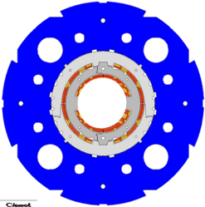
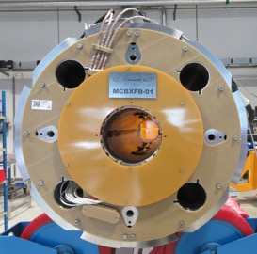
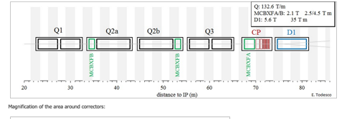
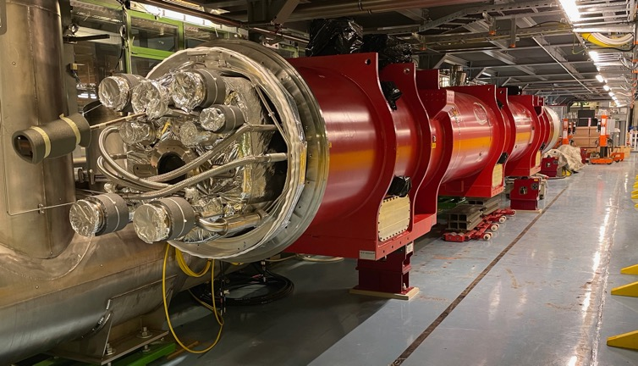
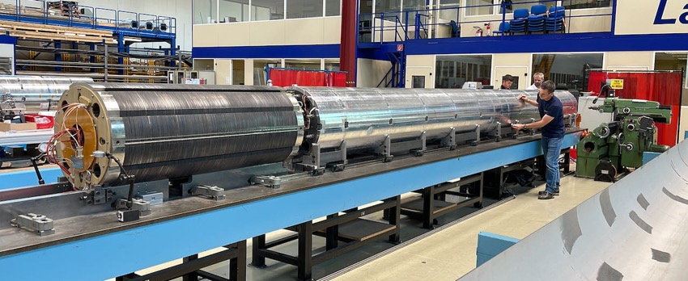
MCBXF combined dipole orbit correctors for HL-LHC
Insertion Region Layout
Q2 type Cold Mass assembly in LMF
First CP cold mass waiting in SMS18 for cold powering tests
First Q2a cold mass installed in the IT-String

Slide 5
MCBXF series magnet production
From March 2021 until September 2023 ELYTT Energy delivered to CERN 3 MCBXFB magnets
The series production contract was stopped in September 2023 by mutual agreement between CIEMAT, CDTI and ELYTT.
The situation was:
4 MCBXFB (1 made by CIEMAT & CERN) magnets over the 18 foreseen to be built by ELYTT were delivered
33 Coils still to be produced:
  16 MCBXFB
  17 MCBXFA
No MCBXFA assembled at ELYTT
14 Magnets still to be assembled at CERN:
  8 MCBXFB
  6 MCBXFA
A strategy to complete the remaining magnet production, on schedule, was presented in October 2023.
The idea was to split the manufacturing into two separate sites:
  CIEMAT to produce the missing coils in its new laboratory in Madrid and will oversee the production of the remaining components
  CERN to be responsible for assembling the magnets in its facilities in Geneva

Slide 6
Magnet production planning presented in January 2024
 | 2024 |  |  |  |  |  |  |  |  |  |  |  |  |  |  |  |  |  |  |  |  |  |  |  | 2025 |  |  |  |  |  |  |  |  |  |  |  |  |  |  |  |  |  |  |  |  |  |  |  | 2026
 | Jan |  | Feb |  | Mar |  | Apr |  | May |  | Jun |  | Jul |  | Aug |  | Sep |  | Oct |  | Nov |  | Dec |  | Jan |  | Feb |  | Mar |  | Apr |  | May |  | Jun |  | Jul |  | Aug |  | Sep |  | Oct |  | Nov |  | Dec |  | Jan |  | Feb |  | Mar |  | April |  | May
MCBXFB05 |  |  |  | B05
MCBXFA1 |  |  |  |  |  |  |  |  |  | A1
MCBXFB06 |  |  |  |  |  |  |  |  |  |  |  |  |  |  | B06
MCBXFB07 |  |  |  |  |  |  |  |  |  |  |  |  |  |  |  |  |  |  |  | B07
MCBXFA2 |  |  |  |  |  |  |  |  |  |  |  |  |  |  |  |  |  |  |  |  |  |  |  |  | A2
MCBXFB08 |  |  |  |  |  |  |  |  |  |  |  |  |  |  |  |  |  |  |  |  |  |  |  |  |  |  |  |  |  | B08
MCBXFA3 |  |  |  |  |  |  |  |  |  |  |  |  |  |  |  |  |  |  |  |  |  |  |  |  |  |  |  |  |  |  |  |  |  | A3
MCBXFB09 |  |  |  |  |  |  |  |  |  |  |  |  |  |  |  |  |  |  |  |  |  |  |  |  |  |  |  |  |  |  |  |  |  |  |  |  |  |  | B09
MCBXFA4 |  |  |  |  |  |  |  |  |  |  |  |  |  |  |  |  |  |  |  |  |  |  |  |  |  |  |  |  |  |  |  |  |  |  |  |  |  |  |  |  |  |  | A4
MCBXFB10 |  |  |  |  |  |  |  |  |  |  |  |  |  |  |  |  |  |  |  |  |  |  |  |  |  |  |  |  |  |  |  |  |  |  |  |  |  |  |  |  |  |  |  |  |  |  |  |  | B10
MCBXFA5 |  |  |  |  |  |  |  |  |  |  |  |  |  |  |  |  |  |  |  |  |  |  |  |  |  |  |  |  |  |  |  |  |  |  |  |  |  |  |  |  |  |  |  |  |  |  |  |  |  |  |  |  | A5
MCBXFA6
MCBXFB11
MCBXFB12
Today
The initial planning accounts for a delivery rate of 1 magnet every 2.5 months, exception for the first magnet (B05), with an assembly time of 3 months (used for knowledge transfer and production line set-up) to cope with WP3 master plan.

Slide 7
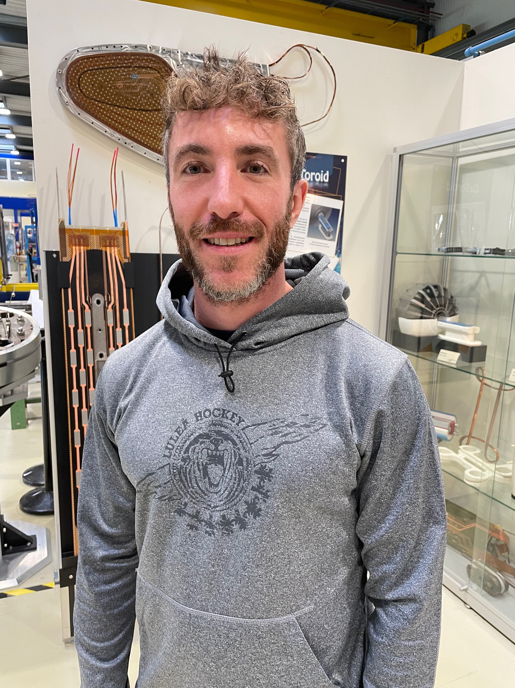
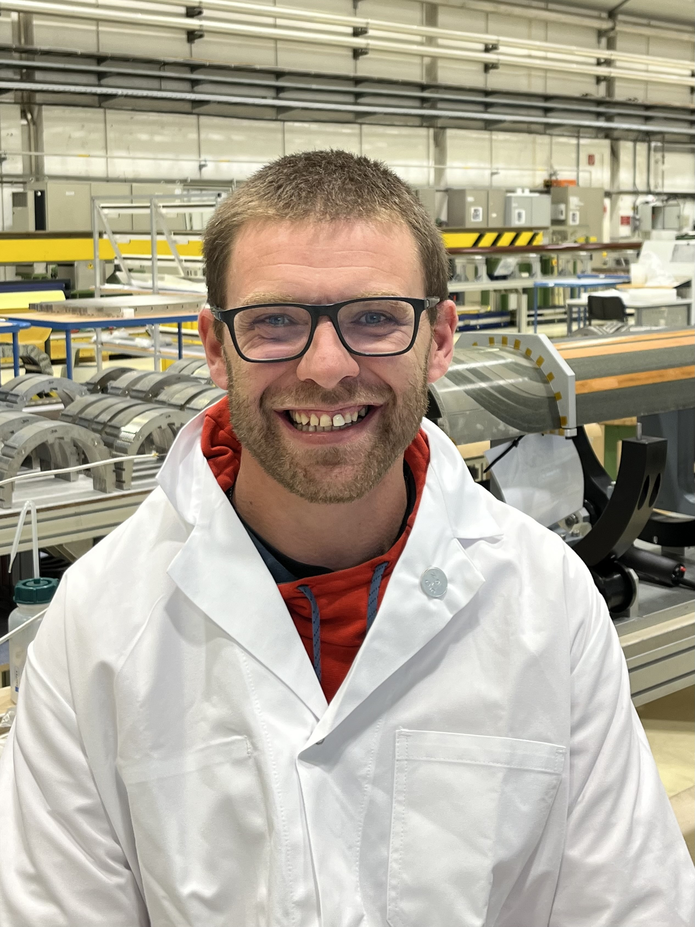
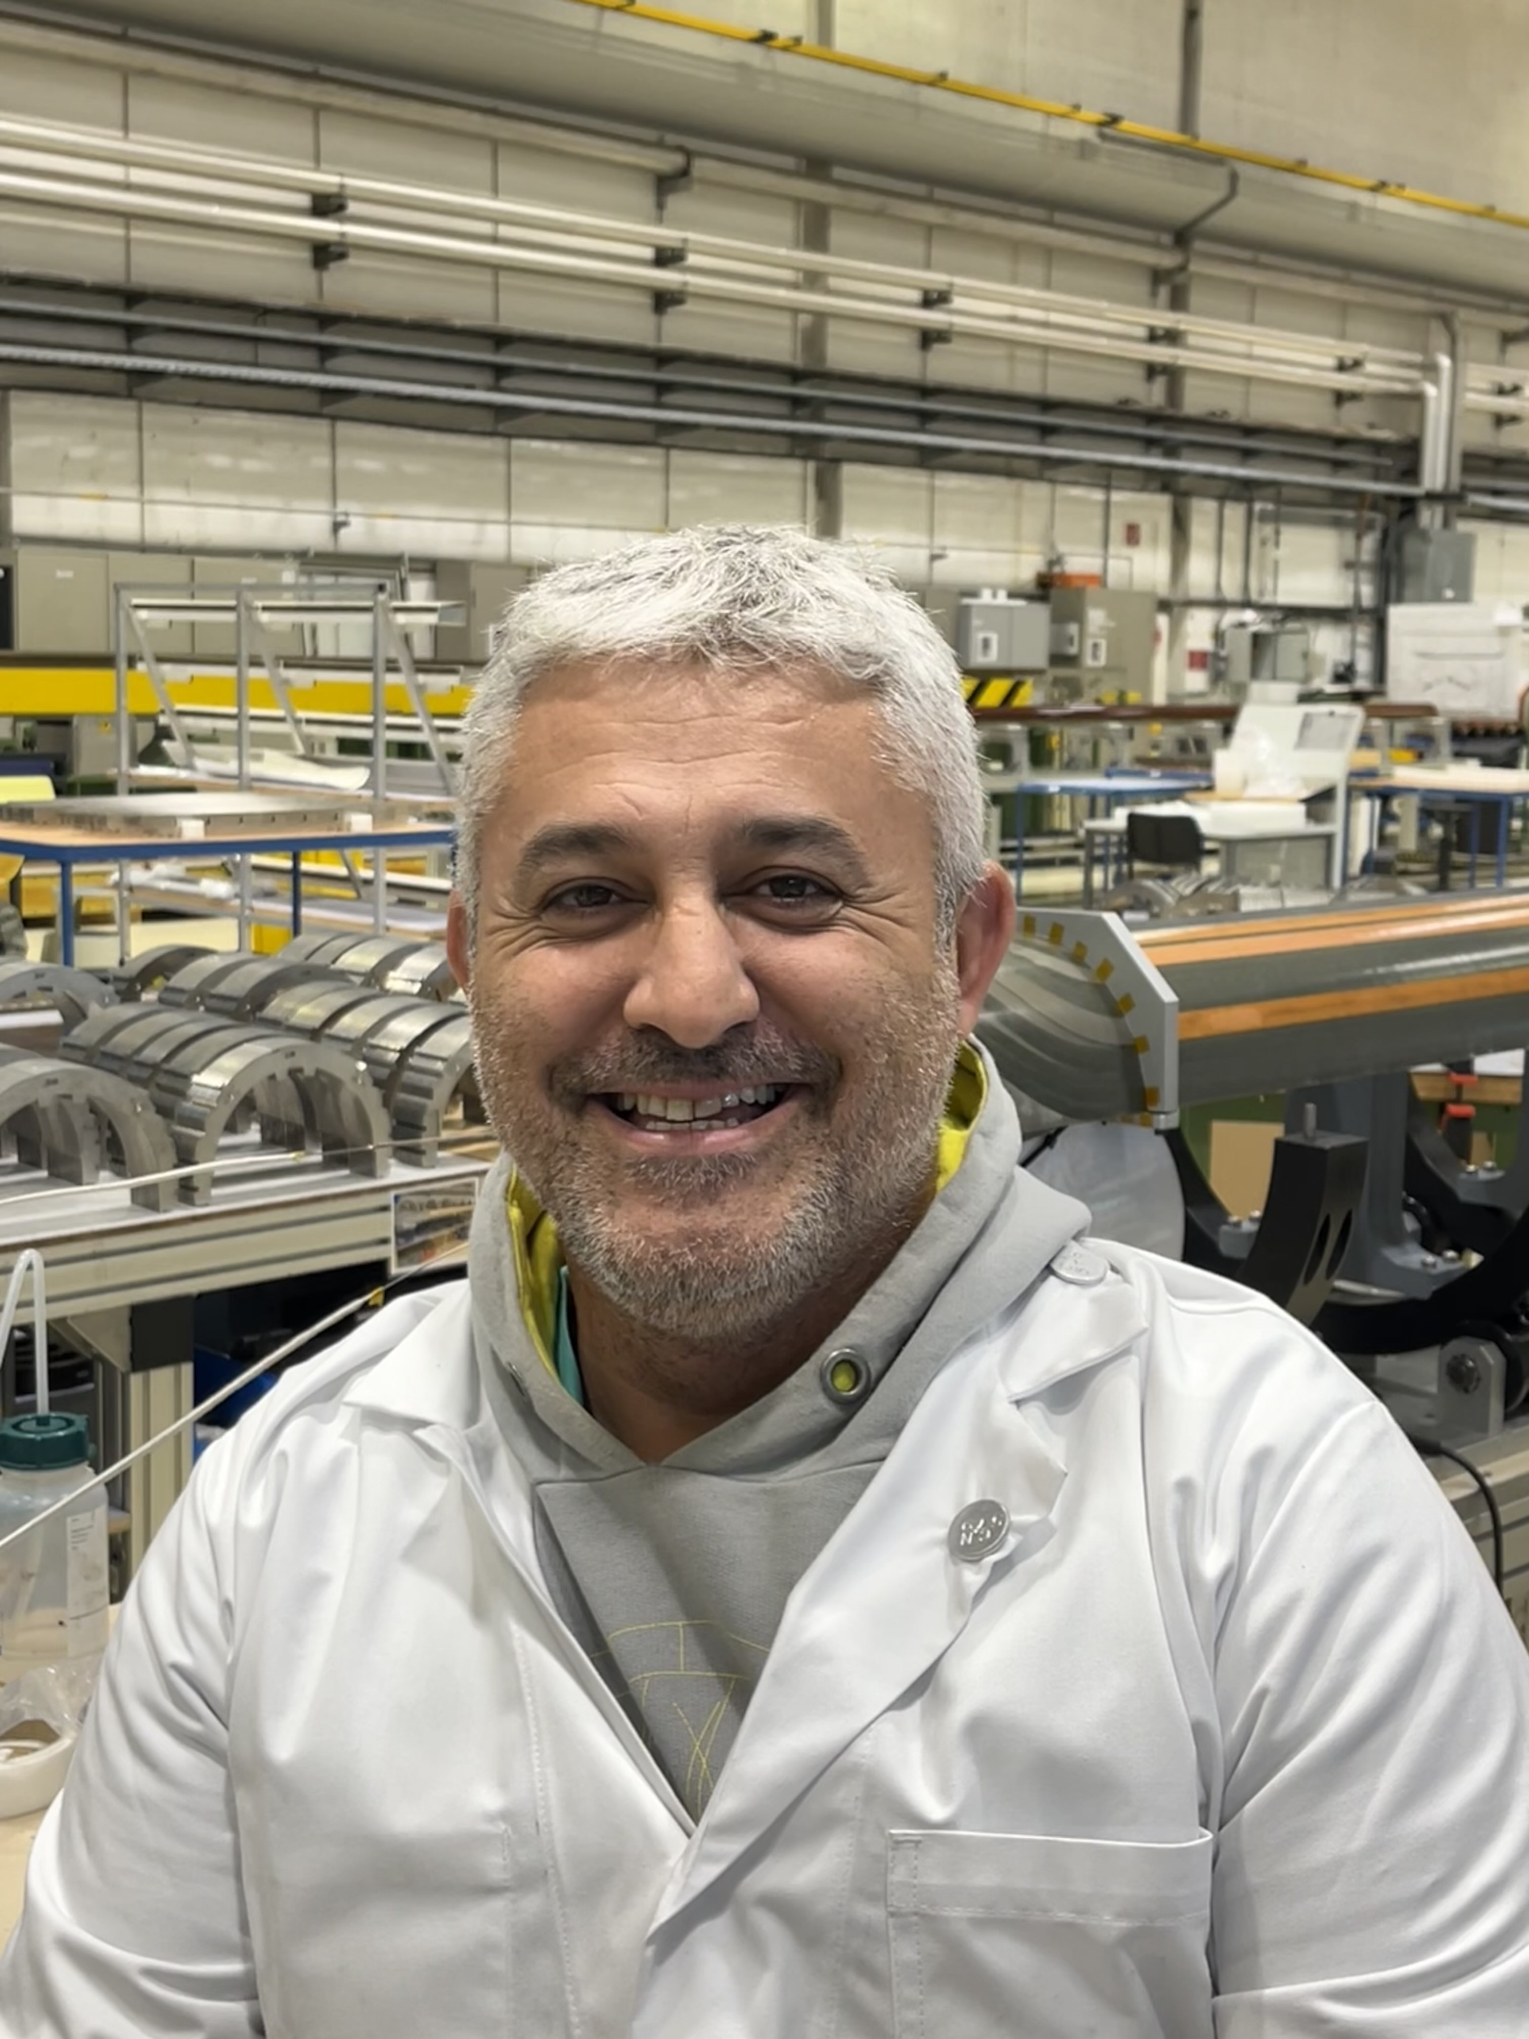
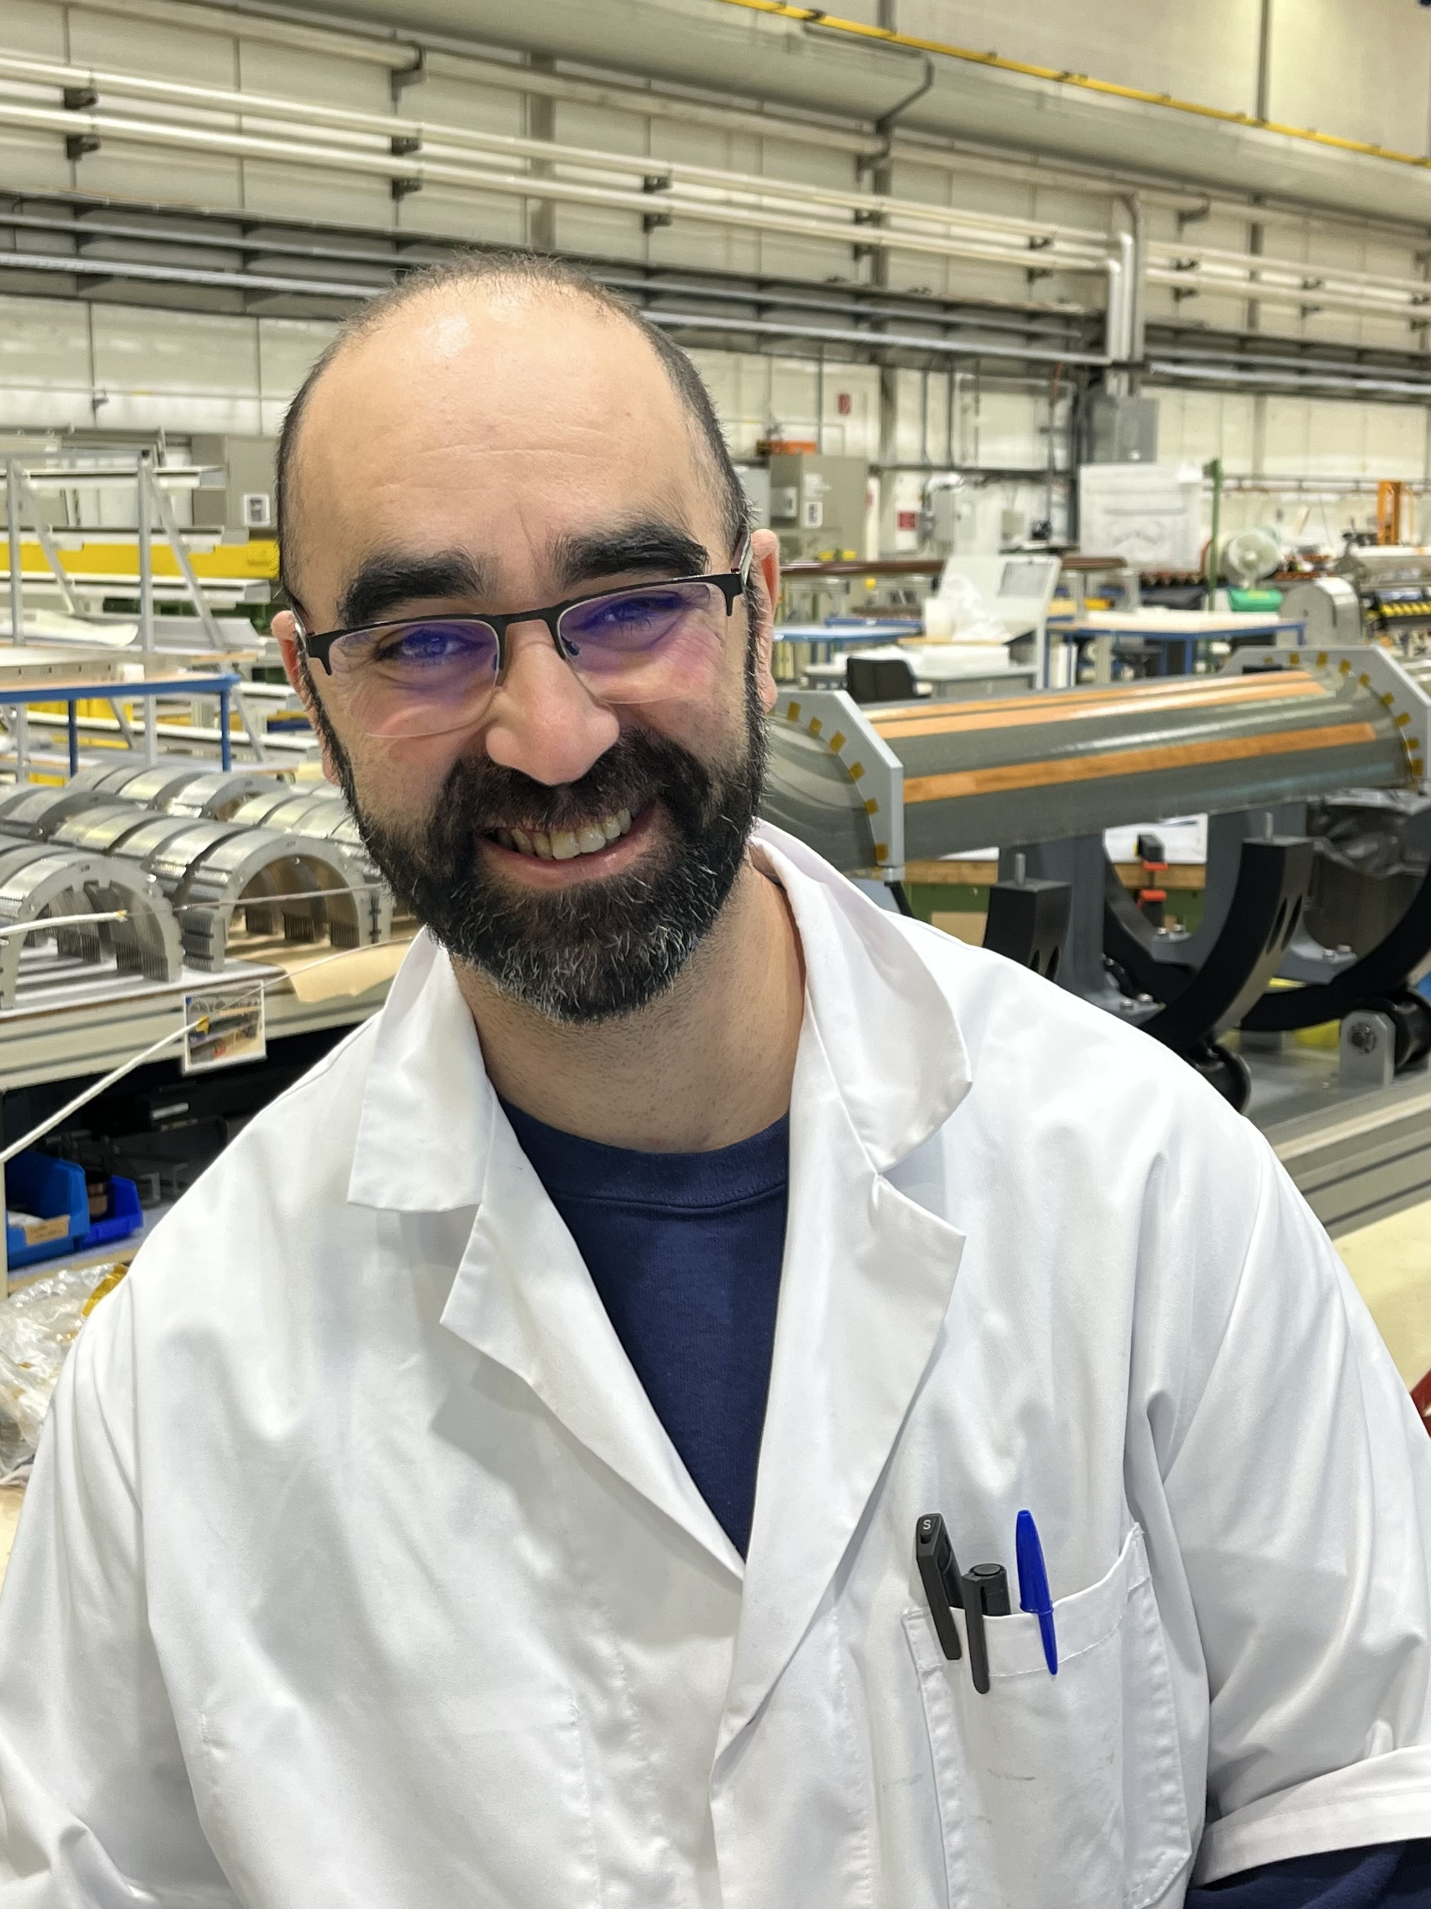
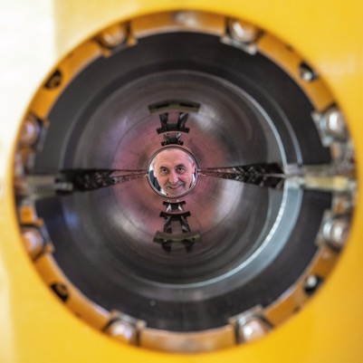
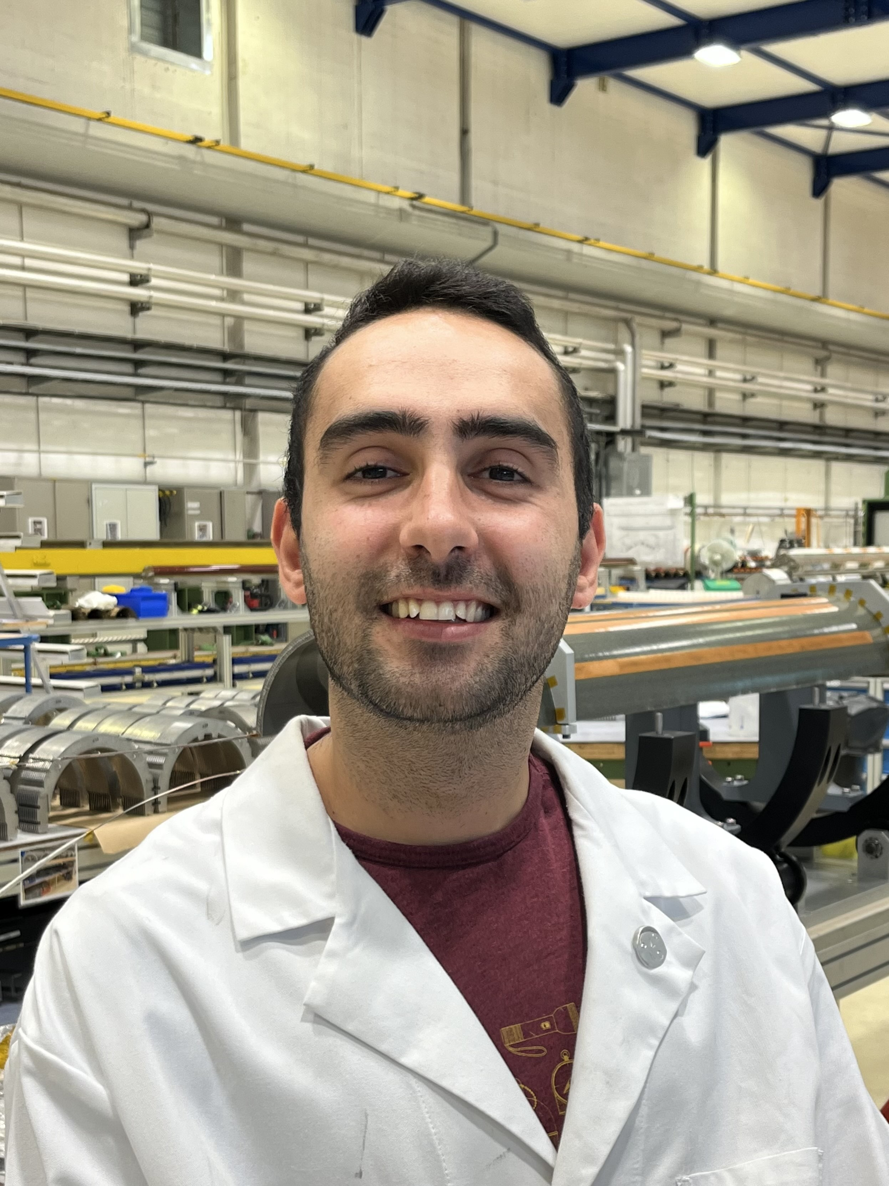
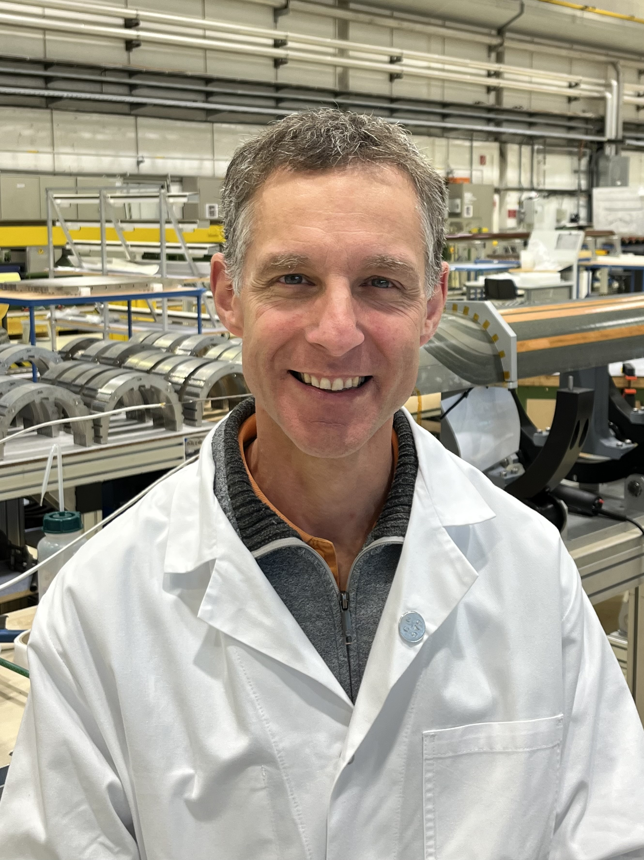
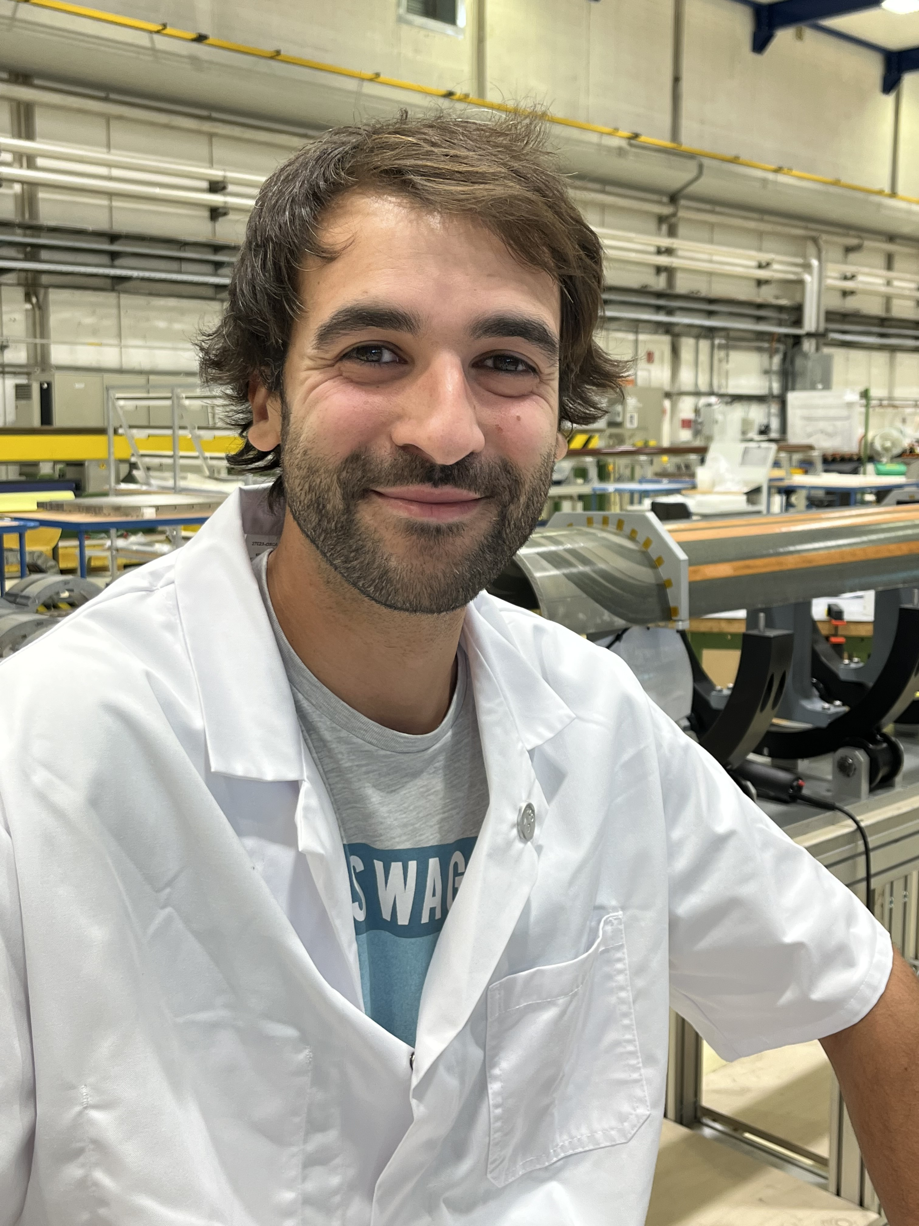
The team
EN-MME
MSC-LMF
MSC-SMT
ATS-DO
All prototypes were developed and assembled at CERN in close collaboration with CIEMAT until fall 2021.
CERN’s team has the required know-how to perform this task, but a series production approach was required.
A small, fully dedicated core team to MCBXF assembly activities has been formed.
WP3 Project engineer
1 engineer for production follow-up
Magnet assembly activities:
  1 trained engineer for assembly
  1 CERN trained technician to teach the newcomers (during first assembly)
  3 technicians for assembly
1 technician part time for electrical measurements
Punctual support from MSC-LMF, MSC- SMT , EN-MME and ATS-DO is provided

Slide 8
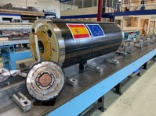

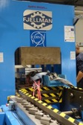
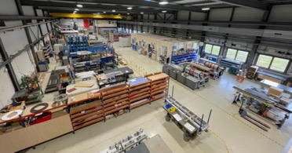

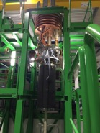
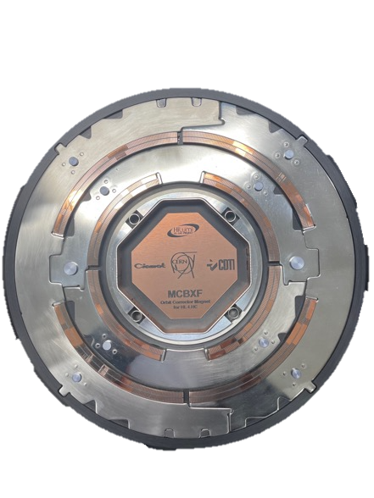
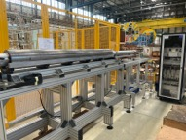
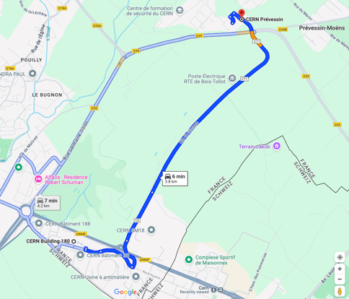
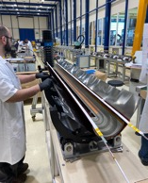
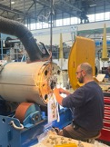
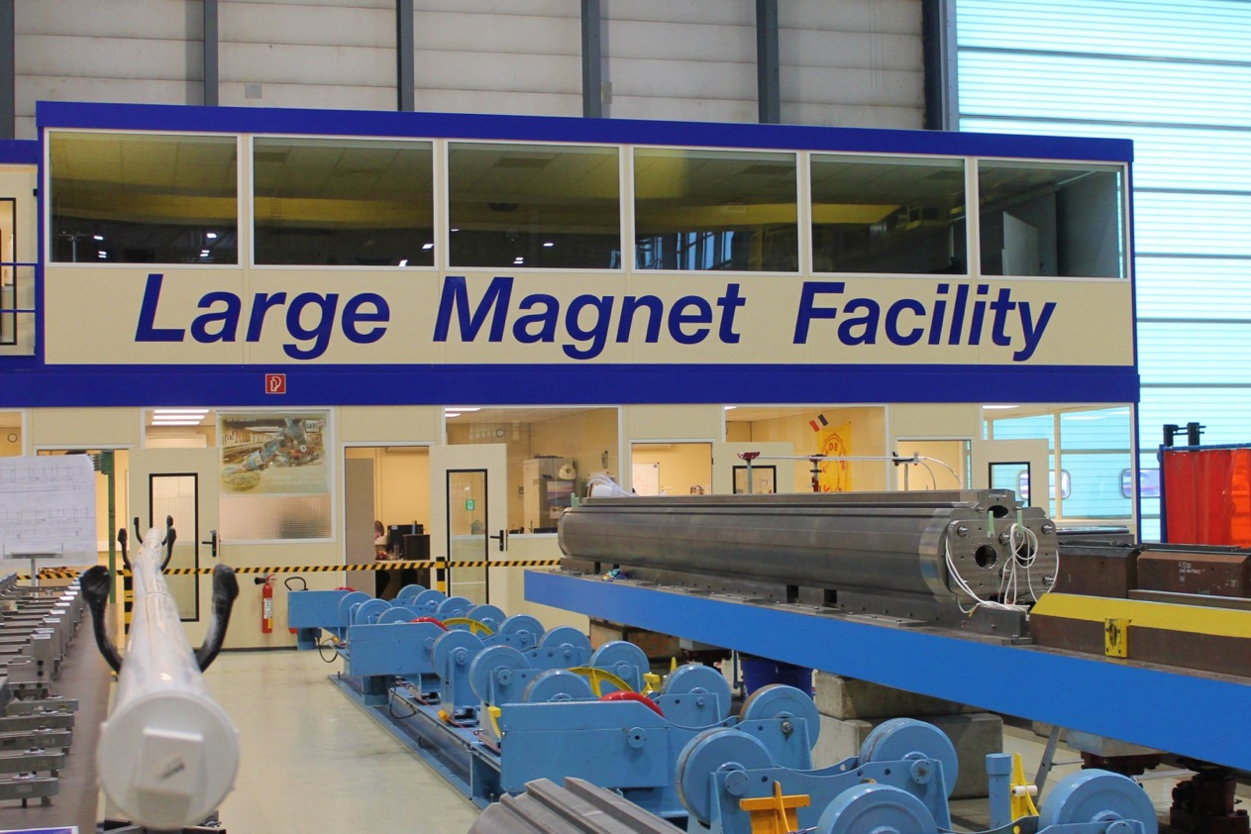
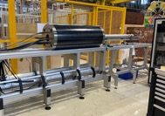
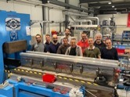
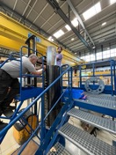
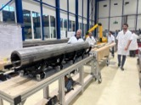
Magnet assembly life cycle
To 927
Inner Dipole assembly in 180
Inner Dipole collaring in 927
Inner Dipole WMM in 180
Outer Dipole assembly in 180
Outer Dipole collaring in 927
Cold powering tests in SM18
Magnet storage in 180 waiting for assembly in a cold mass
Outer dipole WMM in 180
Yoke assembly in 180
WMM in 180
Electrical connections
927 Laboratory
The decision was made to separate the assembly of the magnets between two different production sites
To 180
To 180
To SM18
To 927
To 180

Slide 9
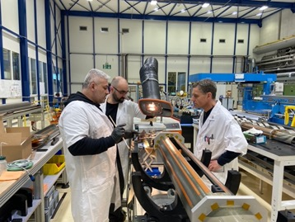
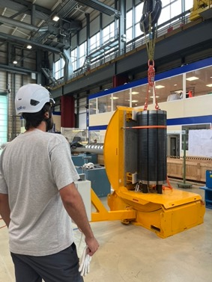
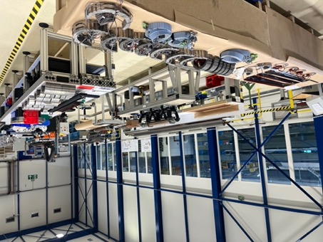
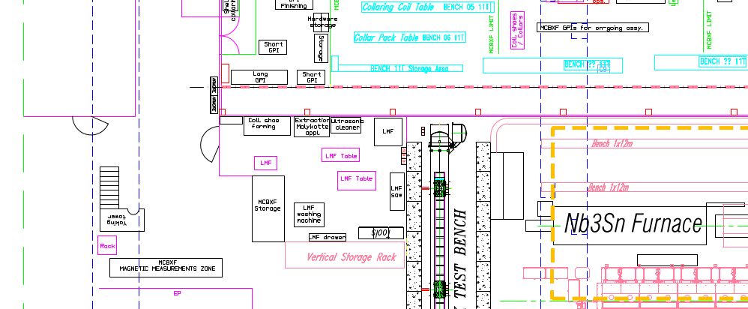
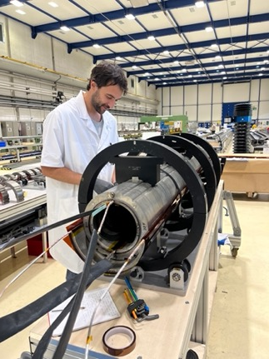

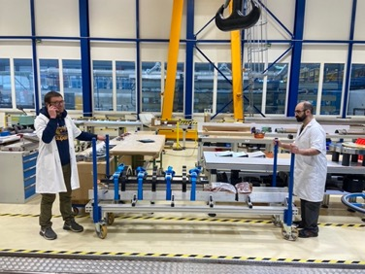
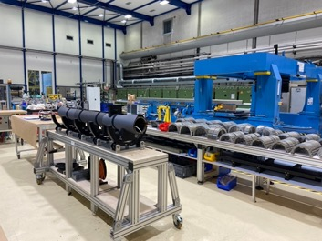
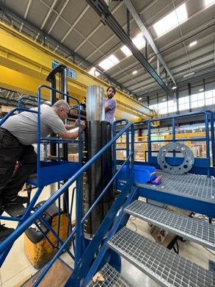
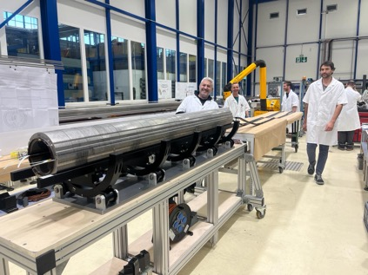
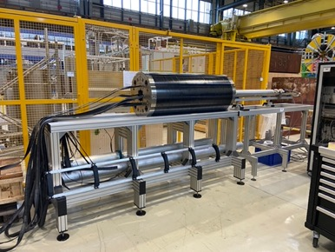
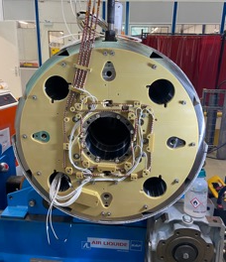
Set up of the assembly line at CERN: Building 180
All assembly operations but the Collaring are performed in building 180: 3 zones for MCBXF
ZONE 2: Collared coil assembly hall
ZONE 1: Ground insulation and collar-packs preparation area
LMF winding house
ZONE 3: Yoking, WMM and auxiliary workshop

Slide 10
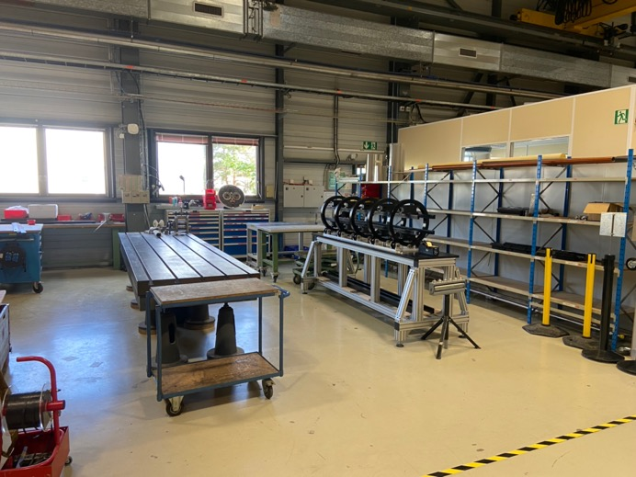
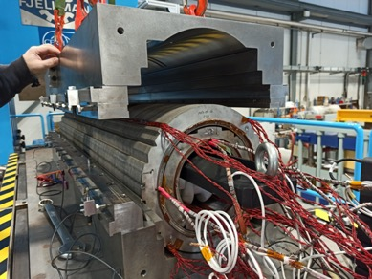
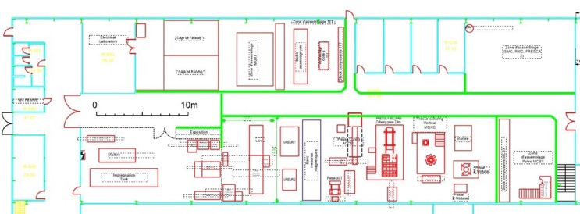

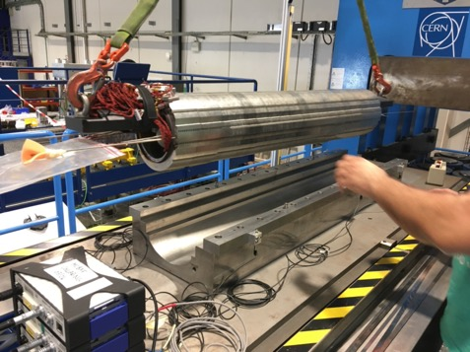
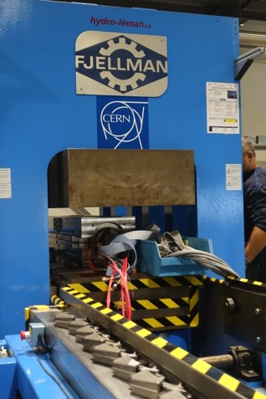
Set up of the assembly line at CERN: Building 927
ZONE 4: Collaring press and assembly area at B.927

Slide 11
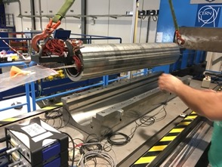
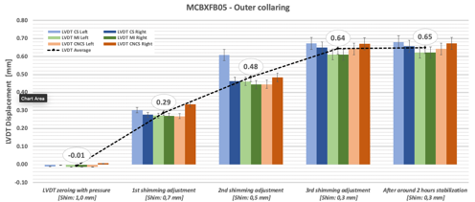
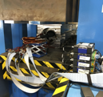
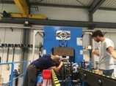
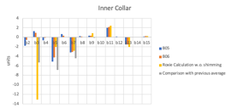


Quality Control Measurements
MAGNETIC
MECHANICAL
 |  | INNER at 1740A |  | INNER at 0A |  |  | INNER at 1740A |  | INNER at 1400A
 |  | OUTER at 0A |  | OUTER at 1430A |  |  | OUTER at 1135A |  | OUTER at 1430A
Norm. TF | Tm/kA | -1.4593 |  |  |  |  | -1.4345 |  | -1.4201
Skew TF |  |  |  | 1.772 |  |  | 1.7558 |  | 1.7488
Multipoles | n | bn | an | bn |  | an | bn | an | bn | an
 | 2 | 3.58 | 1.25 | 0.11 |  | -2.68 | 4.76 | -0.63 | 4.37 | -1.56
 | 3 | 2.72 | 1.09 | -0.36 |  | 3.15 | -14.55 | -10.93 | -21.80 | -10.25
 | 4 | 0.61 | 0.66 | -0.02 |  | 0.20 | 0.53 | 0.40 | 0.27 | 0.26
 | 5 | 3.97 | 0.69 | 0.08 |  | 0.49 | 2.41 | 1.79 | 1.80 | 2.19
 | 6 | -0.02 | 0.59 | 0.13 |  | 0.31 | 0.02 | 0.89 | 0.05 | 0.80
 | 7 | 2.78 | 0.32 | 0.23 |  | -2.51 | 3.12 | -1.74 | 2.59 | -2.24
 | 8 | 0.16 | 0.20 | 0.04 |  | -0.19 | 0.30 | 0.14 | 0.37 | 0.18
 | 9 | -0.22 | -0.10 | -0.06 |  | 0.51 | -0.25 | 0.36 | -0.19 | 0.42
 | 10 | 0.51 | -0.14 | 0.02 |  | -0.04 | 0.50 | 0.04 | 0.35 | 0.12
 | 11 | -1.80 | -0.41 | -0.08 |  | 0.05 | -1.81 | -0.51 | -1.36 | -0.56
Performed in 927, 180 and SM18
ELECTRICAL
Support by TE-MSC and EN-MME
WMM data analysis by CIEMAT

Slide 12






MCBXF Cold Powering
Each dipole is tested in standalone mode up to its ultimate current
Then the magnet is trained in combined powering up to its ultimate field
Then the magnet is powered around its nominal perimeter by performing two rectangular powering cycles
Nominal torque per unit length at straight section is very high: 147 kNm/m, about 84 MPa at the inner dipole coil.

Slide 13

MCBXFB05 powering test results
  Cold test (1st thermal cycle)
    Single powering:
      1 quench while powering the inner dipole on standalone configuration
      No quench for the outer dipole
    Combined powering:
      No quenches in the first quadrant, but 5 quenches in the second quadrant to reach ultimate.
      We then went through all quadrants without further quenches (see the five markings in the current vs time plot).
  Cold test (2nd thermal cycle)
    Single powering:
      No quench
    Combined powering:
      No quench
  Documentation and EDMS status:
    Documentation is up to date. NCRs are closed
MCBXFB05 is the first magnet tested after the restart of assembly activities by CERN at CERN.
Courtesy of G. Willering

Slide 14

MCBXFA1 powering test results
  Cold test (1st thermal cycle)
    Single powering:
      No quench for the inner dipole
      No quench for the outer dipole
    Combined powering:
      1 quench in the first quadrant at almost ultimate current.
      We then went through all quadrants without further quenches.
  Cold test (2nd thermal cycle)
    Single powering:
      No quench
    Combined powering:
      No quench
  Documentation and EDMS status:
    Documentation is up to date. NCRs are closed
Courtesy of G. Willering

Slide 15






Documentation status
MTF Assets (Coils/Magnets) modified to represent the new production scheme
Results from the incoming inspections on the materials used from previous production are available
NCRs from previous production are being closed
Manufacturing and assembly procedures issued
All updated drawings uploaded to PLM
Documentation systematically upload by both teams to MTF
NCRs from assembly at CERN well documented (root cause identification, corrective and preventive actions)
Courtesy of H. Garcia

Slide 16
CERN assembly activities timeline
Meeting CIEMAT-CERN on Sept. 22nd
to announce contract interruption
Magnet assembly activities resumes at CERN with
MCBXFB05
MCBXFB05
Powering Test
MCBXFA1
Powering Test
MCBXFB06
Powering Test
Last truck taking material from ELYTT
Oct. 23
Dec. 23
Feb. 24
April. 23
June. 24
Aug. 24
Nov. 23
Jan. 24
March. 24
May. 24
Jul. 24
Sept. 24
Preparation of the new production line starts at CERN (infrastructure)
First CERN internal meeting on Oct. 19th to propose a production line location
MCBXFB05 completed
Start of MCBXFA1 assembly
MCBXFB06 assembly completed
Meeting CIEMAT-CERN @ CERN
to inform progress on contract cancelation
MCBXFA1 inner dipole collaring completed
Start of MCBXFB07 assembly
Start of MCBXFB06 assembly

Slide 17
Summary
Today we have:
  MCBXFB05 and MCBXFA01 have been assembled and successfully tested
  MCBXFB06 is waiting for cold powering tests
  MCBXFB07 assembly has started
The provisional schedule presented at the beginning of the year is being perfectly followed and is in line with the requirements of the general WP3 schedule
Less than a year ago, we were in a crisis situation following the closure of a contract for the manufacturing of the series for the combined orbit corrector magnets
The necessary infrastructure to cover the assembly activities was set up in record time
Today, we are in a stable situation with an assembly pace aligned with the forecasts made at the beginning of the year
We are confident about the continuation of operations thanks to the establishment of a dedicated and stable team
The results achieved so far, despite the unexpected challenges caused by the decision to close the contract signed with ELYTT, would not have been possible without the support of many individuals who may not always be visible at the forefront
My sincerest thanks to all of them for their contribution

Slide 18



It is much easier to achieve ambitious goals with a cheerful and motivated team.
Thank you guys !!!!

Slide 19

Thank you for your attention

Slide 20

Acknowledgements to:
Cristóbal Alcázar, Lyudmyla Andriychyk, Manuel Domínguez, Óscar Durán, Javier García, Jesus Angel García Matos, Luis Garcia-Tabarés, Luis González, Pablo Gómez, Jesús Jiménez, Ricardo López, Teresa Martínez, Carla Martins, José Antonio Pardo, José Manuel Pérez, Pablo Sobrino, Fernando Toral, Manuel Verastegui from CIEMAT
Guillermo Morón and Juan Luis Morato from Arquimea
Steve Becle, Nicolas Bourcey, Federico Ben el Caid, Pierre-Antoine Contat, Nicolas Eyraud, josé Ferradas, Lucio Fiscarelli, Bertrand Fornes, Hector Garcia, Ludovic Grand-Clement, Victor Guillen, Jean-Luc Guyon, Hector Garcia, Gonzalo Hernando, Olivier Housiaux, Michael Guinchard, Susana Izquierdo, Karim Kallat, Nicholas Lusa, Sebastien Luzieux, Franco Mangiarotti, Gregory Maury, Sabine Menu, Attilio Milanese, Sylvain Mugnier, Nicolas Peray, Francois-Olivier Pincot, Hervé Prin, Pietro Rizzo, Piotr Rogacki, Frederic Rougemeont, Ezio Todesco, Yanick Thuau, Patrick Viret, Gerard Willering from CERN…
and many others that I certainly forgot to mention.

