Slide 1

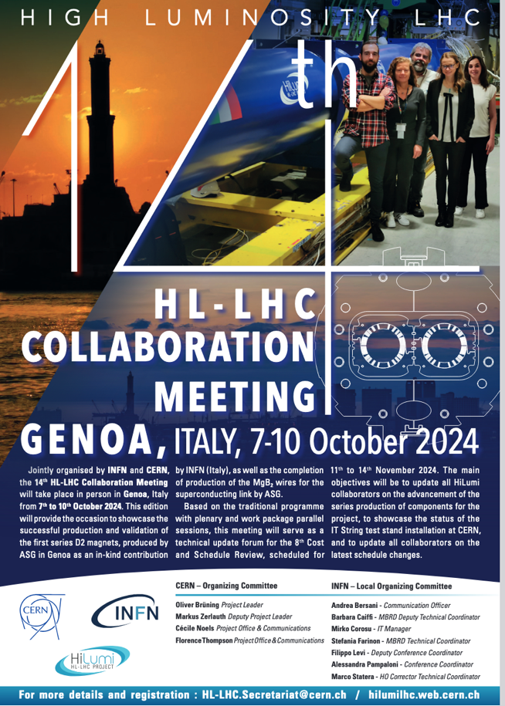








Summary and Status of
HL-LHC Collaborations
From the HL-LHC Collaboration Office
M. Zerlauth on behalf of the Collaboration Office
14th HL-LHC Collaboration Meeting – Genoa – 7-10 October 2024

Slide 2
Collaboration Agreements and Procurement I
All collaboration agreements are signed and are being executed.
Procurement being prepared (see presentation from H. Garcia Gavela).
Since last HL-LHC Collaboration Meeting (in 2023)
  KN5175/TE/HL-LHC ADD.22 with INFN, September 2023 (Extension).
  Amendment 2 to KE3297/BE/HL-LHC with UNIMAN, September 2023 (Extension).
  KR5708/TE/HL-LHC ADD.4 with KEK, December 2023 (QHPS contribution).
  Amendment 2 to KE3797/TE/HL-LHC with CIEMAT, January 2024 (updated production baseline).
  Amendment 1 to KE5162/TE/HL-LHC with Uppsala University, February 2024 (updated invoicing).
  KR5904/SY/HL-LHC ADD.5 with KEK, May 2024 (High Power RF contribution).
Notes on Invoices
  CERN-UK Phase 1: one invoice missing (RFD repair).
  CERN-UK Phase 2: no invoices yet.

Slide 3
Collaboration Agreements and Procurement II
Deliberations for possible additional future contributions
  Following Brazil’s accession to CERN Associate Membership, interest from CNPEM-Brazil for possible personnel contributions to HL-LHC.
  Expression of interest from Greece for personnel contribution to HL-LHC.
  Project has already shared some possible areas of contributions incl. IT String operation, electro-mechanical assemblies and SAT, (de-)installation activities.

Slide 4
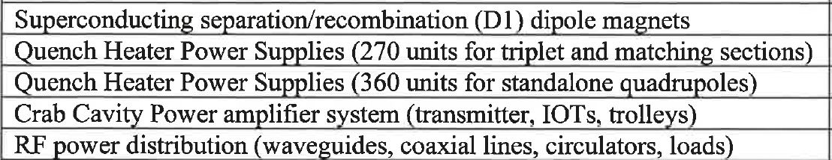
Collaboration with Japan / KEK
At its 218th Session on 26 September 2024, CERN Council decided to grant Japan Observer status in respect of the HL-LHC project, for the duration of the construction and operation of the HL-LHC, in addition to the Observer status Japan already holds in respect of LHC.
Contributions to the HL-LHC project
  In-kind contributions amounting to total estimated core value of 23 MCHF:
  Financial contribution with a core value of 2 MCHF to be paid fully in cash (Agreement to be signed).
ICA-JP-010+KN4074
KR5708
KR5904

Slide 5
The Inner Triplet Region: Collaborations
Connection to LHC (UL)
Service gallery (UR)
DFHM
DFHX
QHPS
SC Links
Q2a
Q1
Q2b
Q3
CP
D1
DFX
DFM

Slide 6

The MS (Matching Section) Region: Collaborations
UA gallery
Service cavern
CC High Power RF
+ distribution
Q4
Crab cavities
D2
Collimators

Slide 7
Collaboration Steering Committee Meetings
  Since the 2023 HL-LHC Collaboration Meeting
    8 Steering Committee meetings held (AUP, CIEMAT, IHEP, INFN, KEK, TRIUMF, UNIMAN, UPPSALA)
  During HL-LHC Collaboration Meeting (Genoa, 7-10 October 2024)
    INFN / Italy 9 October 2024
    CIEMAT / Spain 10 October 2024
    FNAL / US 10 October 2024
    TRIUMF / Canada 10 October 2024
  Following HL-LHC Collaboration Meeting
    IHEP / China December 2024
    KEK / Japan Q1 2025
    UNIMAN / UK April 2025
    Uppsala / Sweden April 2025
Numerous other recurrent technical meetings within the work-packages!

Slide 8
In-kind Contributions (September 2024)
 | Country | Agreement | Institute | Brief description of the collaboration
R&D | France | KE2736 | CEA | Thermal Design of Superconducting High Field Magnets at CERN
 | UK | KE3298 | Manchester | Beam instrumentation
 | UK | KE3299 | Manchester | Cold powering: DFBX for String
 | UK | KN3362 | ASTeC+Dundee | Laser treatment prototype (LESS)
Prototypes and BASELINE | Italy | KE3085 | INFN | High-order corrector magnets + prototypes
 | Spain | KE2292 | CIEMAT | Nested orbit correctors + prototypes
 | Spain | KE3797 | CIEMAT | Nested orbit correctors + prototypes
 | China | KN4154 | IHEP | D2 Correctors
 | Sweden | KE3082 | Uppsala Univ. | Cold testing of corrector magnets and crab cavities
 | Japan | ICA-JP-010+KN4074 | KEK | D1 magnet model and cold mass
 | Italy | KE2291 | INFN | D2 model + prototype + magnet
 | Italy | KE3084 | INFN | D2 model + prototype + magnet
 | Italy | KE4417 | INFN | D2 model + prototype + magnet
 | USA | P131 | Several | 10 Crab Cavities + HOM Couplers
 | USA | P131 | Several | Triplet magnets
 | Canada | P095 | TRIUMF | 5 RFD Crab-cavities cryomodules (including TE-VSC contribution)
 | Sweden | KE5162 | Uppsala Univ. | DFHM and DFHX 8+2 units
 | UK | KE5170 | SOTO | DFM and DFX 7+2 units
 | UK | KE5168 | ASTeC+Lancaster | 4 DQW Crab-cavities cryomodules (including TE-VSC contribution)
 | UK | KE5169 | LIV+RHUL | Beam instrumentation EO-BPM
 | UK | KE5169 | Liverpool | Beam Instr. For Hollow e-lens
 | UK | KR5171 | Dundee | Laser treatment final (LESS)
 | Serbia | No contract num | Ministry | Magnets and CC jacks
 | Japan | KR5708 | KEK | Quench Heater Power supplies
 | Japan | KR5904 | KEK | High Power RF and distribution system for Crab cavities
Total contributions
for ~107 MCHF
Incoming: Japan financial contribution with a core value of 2 MCHF to be paid fully in cash

Slide 9

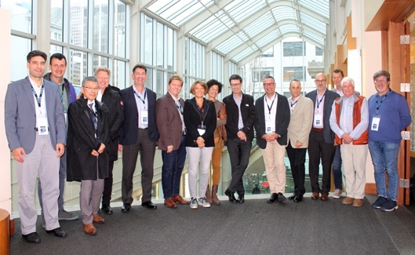
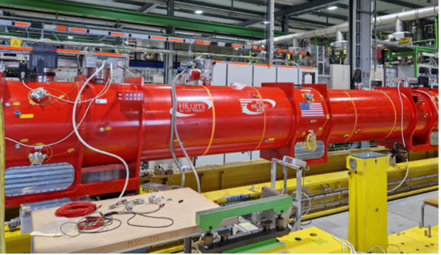
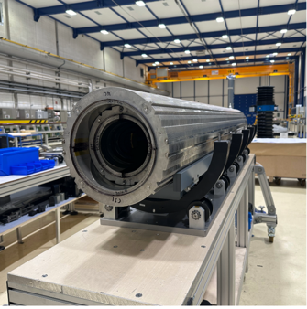
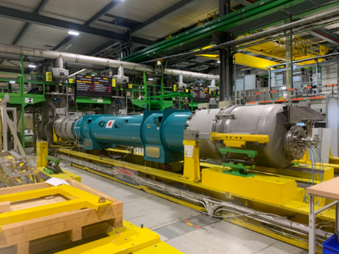
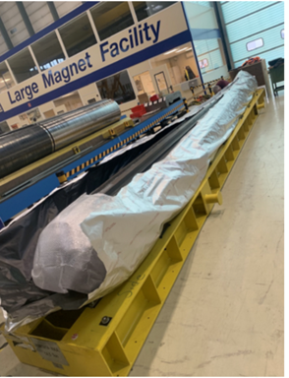
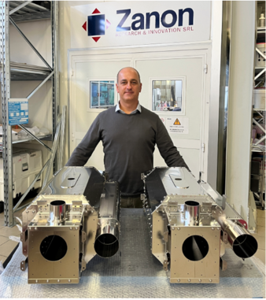
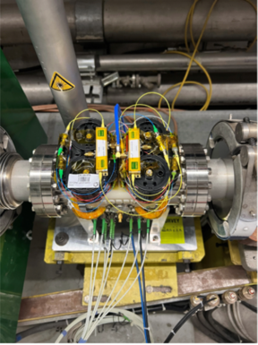
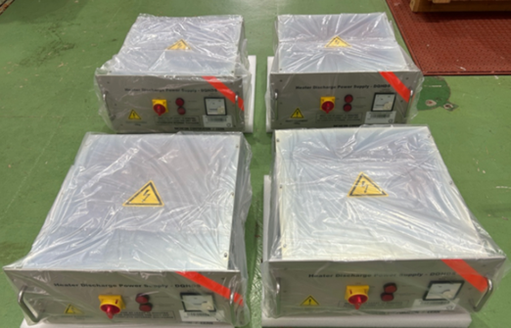
HL-LHC CB Newsletter Highlights
https://hlcb-newsletter.web.cern.ch/
HL-LHC Collaboration Board Members at Vancouver
First US inner triplet cryoassembly connected to CERN test station
MCBXFA1 (CIEMAT)
at CERN
KEK D1 prototype under test
at CERN.
First series magnet
MBRD1 (INFN-Genoa) at CERN, with two D2
correctors from IHEP in background
Magnetic shields & helium tank materials ready for first two bare RFD cavities (Zanon, IT)
Electro-Optical BPM prototype (RHUL, UK) installed on SPS beamline
QHDS pre-series units (Japan)
delivered to CERN

Slide 10
Conclusions
International collaborations continue to play a vital role for the HL-LHC project.
  Series production in full swing for all existing collaboration agreements.
  Detailed status of collaborations will be presented throughout this HL-LHC Collaboration Week.
Some Amendments to Agreements are being prepared for schedule reasons to cover extensions.
Finalised contributions (in kind and financial) from Japan / KEK.
Steering Committee meetings being planned for the next 7 months.
Highlights of HL-LHC collaborations recorded in newsletter.
Collaboration Office is available to provide support across WPs

