Slide 1

Run 4 operational scenario
Nicolas Mounet and Rogelio Tomás, for WP2
With lots of input from C. Accettura, D. Amorim, C. Antuono, G. Arduini, H. Bartosik, P. Baudrenghien, B. Bradu, R. Bruce, O. Brüning, X. Buffat, R. Calaga, R. De Maria, J. Dilly, C. Droin, I. Efthymiopoulos, L. Fiscarelli, A. Foussat, L. Giacomel, M. Giovannozzi, G. Iadarola, P. Hermes, S. Izquierdo Bermudez, I. Karpov, S. Kostoglou, B. Lindström, E. Maclean, L. Mether, E. Métral, F.‑X. Nuiry, Y. Papaphilippou, K. Paraschou, T. Pugnat, S. Redaelli, G. Rumolo, B. Salvant, L. Sito, G. Sterbini, H. Timko, E. Todesco, F. Van der Veken, A. Wegscheider, J. Wenninger, M. Zampetakis, C. Zannini, M. Zerlauth
14th HL-LHC collaboration meeting – 07/10/2024

Slide 2
Run 4 operational scenario: current baseline
 | Standard | BCMS
Number of bunches | 2760 | 2744
Pile up | 130 | 132
Emittances [μm] | 2.3/2.1 (2.5 in coll.) | 2/1.7 (2.2 in coll.)
Octupole current [A] | 380 (120 in coll.) | 460 (120 in coll.)
β* [m] | 1 → 0.2
Intensity [10¹¹ protons/bunch] | 2.3 (2.2 in collisions)
Levelled luminosity | 5.10³⁴ cm⁻²s⁻¹
Collimators | Relaxed (TCP IR7 8.5σ)
Chromaticity Q’ | 15
Half crossing anfle (crabbing angle) | 250 μrad (-190 μrad) Hor. in IP1 / Ver. in IP5
R. Tomás et al, HL-LHC Run 4 proton operational scenario, CERN-ACC-2022-0001

Slide 3
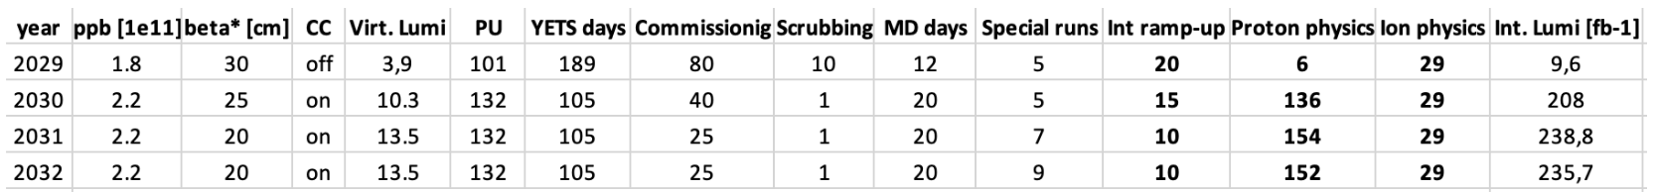
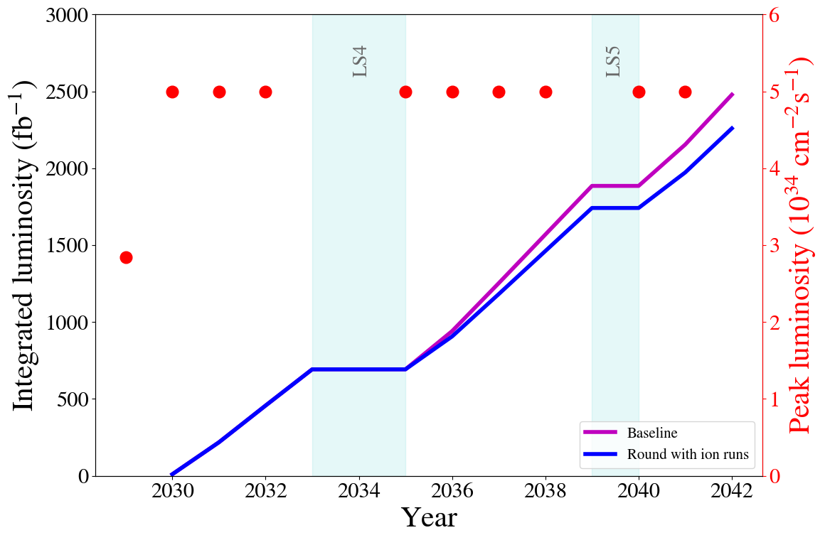
Run 4 operational scenario: current baseline
Assumptions on operational days (M. Zerlauth et al, EDMS 2902691):
Recent change of schedule shifts everything by one year (and removes one long shutdown) → no change in integrated luminosity (running 10 years)
Insufficient for the bunch intensity ramp up in 1st year
Total integrated luminosity estimate:
+1% with BCMS (IP1 & 5)
(also depending on several unknowns, e.g. emittance growth, transverse tails).
~460 fb⁻¹ should be added for the LHC runs.
No ion runs beyond run 4
With ion runs beyond run 4
S. Kostoglou, 228th WP2 meeting, 02/07/2024, and WP2/5/7 session, Tu. 8/10 4 pm

Slide 4
How robust is the current baseline?
Recent LHC achievements:
  348 bunches of 2.3 10¹¹ protons injected in the LHC,
  full cycle (with collisions) for one train with 1.8 10¹¹ protons with 8σ long-range separation (beyond the requirements of HL-LHC) –even smaller separation achievable with wire compensation
  (see X. Buffat, WP2/5/7/10 session, Wed. 9/10 3pm, and Long-range beam-beam wire compensation review on Oct. 14-15th at CERN)
Still, a number of LHC observations require more studies:
  Hierarchy breakage at the end of squeeze
  (see E. Maclean, WP2/5/7 session, Tu. 8/10 5:40 pm, and C. E. Montanari, WP2/5/7/10 session, Wed. 9/10 2:40 pm)
  Unexplained blow-up (injection, ramp) – see S. Kostoglou, WP2/5/7 session, Tu. 8/10, 4 pm.
  Losses at injection (see S. Morales Vigo, WP13 session, Wed. 9/10 9:30am)
  Increased IBS for BCMS, and losses at start of ramp (see B. E. Karlsen-Bæck, WP2/WP4 session, Th. 10/10 9:10 am)

Slide 5
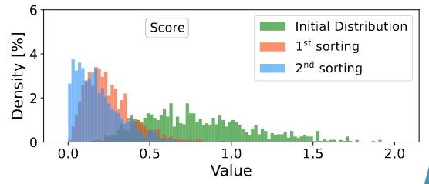
How robust is the current baseline?
Magnets field quality
  Voltage spikes on MQXFAs: not too worrying (not occurring at steady nominal current), but field measurements ongoing at CERN (see G. Ambrosio et al, WP2/WP3 meeting, 24/04/2024, and J. Dilly, WP2/3 session, Wed. 9/10 10 am)
  Impact of D2 multipole errors:
    b2 not problematic, a2 can be corrected but needs to be more studied (J. Dilly, WP2/3 session, Wed. 9/10 10 am),
    Dynamic aperture (DA) from b3 in D2 is ok (T. Pugnat, 230th WP2 meeting, 03/09/2024)
  MQXF sorting: promising results on beta-beating:
  ⟹ Good progress with field quality (more studies needed).
    T. Pugnat, WP2/WP3 meeting, 30/04/2024, and THPC16, IPAC’24
    A. Wegscheider, 222nd WP2 meeting, 21/11/2023
    M. Giovannozzi,WP2/3 session, Wed. 9/10, 9:30 am

Slide 6
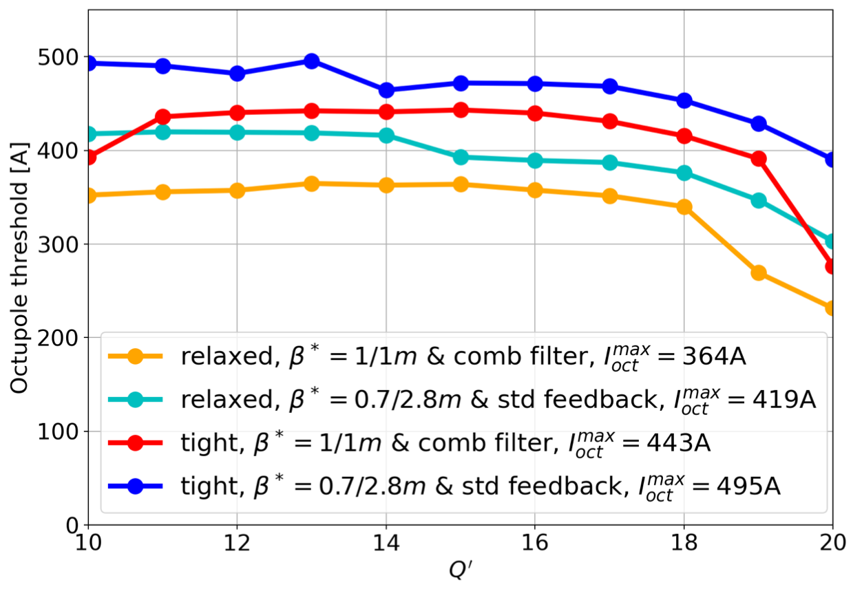
Transverse impedance & stability (1/2)
In general, transverse stability is less critical than past predictions, as LIU beams were observed to have tails (past predictions considered no tails)
and tails are beneficial for stability.
On the other hand, the fundamental mode of the crab cavity became a concern → a comb filter is required to mitigate it
Tight collimator settings are also still on the table → impedance increase
Stability limits revised: octupole threshold vs Q’ (positive octupole polarity)
Tight collimator settings, no comb filter for crab cavities but flat optics
NM et al, JINST 19 T05016 (2024)
⟹ Limit depends on CC and its mitigation
In case comb filter has issues, flat optics is an efficient backup mitigation.
Baseline: relaxed collimator settings, comb filter for crab cavities
See L. Giacomel et al, JINST 19 P05046 (2024)
as well as WP2/5/7 session, Tu. 8/10 5 pm, and WP2/4 session, Th. 10/10 9:50 am

Slide 7
Transverse impedance & stability (2/2)
Negative octupole polarity can help (particularly true with tails) → tested in MD
Collimator impedance can be further optimised with rematched optics (IR7 + IR3 with the option to relax IR3 settings instead of rematching IR3)
→ IR3 & IR7 optics validated in MD (see R. De Maria and B. Lindström, LSWG, 02/07/2024, and WP2/5/7 session, Tu. 8/10, 4:20 & 4:40 pm)
Another potential reduction: “sweet spot” found in MD, around Q’=20 (see X. Buffat, WP2/5/7/10 session, Wed. 9/10 3pm)
L. Giacomel, WP2/5/7 session, Tu. 8/10 5 pm.

Slide 8
DA potential bottlenecks (1/2)
End of collapse, scanning octupole current:
Flat (but octupoles are more effective – ATS optics)
Round
⟹ DA remains tight for octupoles >300 A (needed for stability).
⟹ but negative octupole polarity can help.
C. Droin et al, THPC77, IPAC’24, and C. Droin, S. Kostoglou & G. Sterbini, WP2/5/7/10 session, Wed. 9/10 2pm

Slide 9
DA potential bottlenecks (2/2)
End of levelling, scanning crossing angle (flat optics with β*=7.5/18 cm)
I = - 60 A
I = 60 A
C. Droin, S. Kostoglou & G. Sterbini, WP2/5/7/10 session, Wed. 9/10 2pm
⟹ With low Q’ and negative octupoles, one could reduce further the crossing-angle. Q’=6 is already operational in the LHC during levelling.

Slide 10
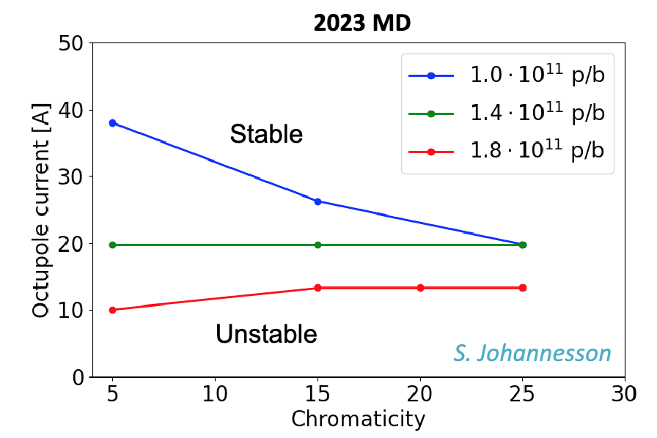
e-cloud: LHC news
E-cloud situation degraded during LS1/LS2, leading to increased heat load.
Cryo capacity estimates in several sectors have been lowered (operation in S78 more limited than estimated in heaters measurements)
⟶ moved to 3x36 bunches per train (2350 bunches with ~1.6 x 10¹¹ p+/b).
Negative octupole polarity remains to be tested at injection in the LHC.
Still, some good news:
  stability improvement with high bunch intensity
  → lower Q’ / octupole at injection for HL intensity.
  Conditioning observed in 2024
  → we may be able to increase the number of bunches.
L. Mether, HiLumi special joint WP2/WP3 Meeting, 23/01/2024,
and WP2/5/7/10 session, Wed. 9/10 3:20 pm

Slide 11
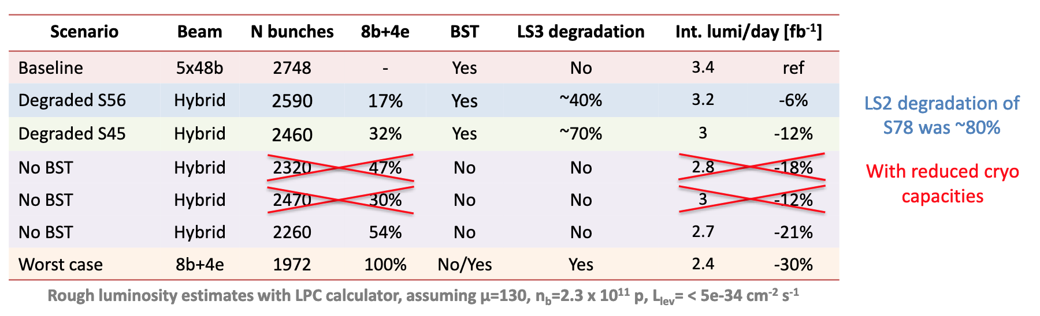
e-cloud: filling scheme mitigation
The e-cloud situation in run 4 remains largely unknown (degradation in LS3).
Filing schemes containing 8b+4e trains (“hybrid”) are an effective means to reduce e-cloud:
  absolutely necessary without beam screen treatment (BST)
  could be necessary with BST if significant further degradation occurs in sectors with little margin
→ depending on the situation, various options are envisaged, with different impact on luminosity:
4x72b
2760
See also L. Mether, WP2/5/7/10 session, Wed. 9/10 3:20 pm.
L. Mether, 228th WP2 meeting, 02/07/2024

Slide 12
Aperture
Crossing: V IP1 / H IP5
Aperture updates with round and flat optics:
The choice of the flat VH optics implies inverting the crab cavities. Such an inversion was always assumed to be possible, even after LS3, but should be decided sufficiently well in advance.
 | TDR Round | New Round | Flat CC HV | Flat CC HV | Flat CC VH | Flat CC VH
β* Xing/Sep [cm] | 15/15 | 15/15 | 18/9 | 18/7.5 | 18/7.5 | 18/8
Xing angle [μrad] | ±295 | ±250 | ±240 | ±240 | ±240 | ±240
Crossing plane IP5 | V (or H) | V (or H) | V | V | H | H
Aperture in Pt. 5 | 12.5 | 13.1 | 13.7 | 12.6 | 12.4 | 12.8
MKD-TCT [°] IP5 [B1/B2] | 30/31 | 30/31 | 40/45 | 51/54 | 27/25 | 27/25
H Ap. Protected Ti./Re. | 11.9/12.9 | 11.9/12.9 | 13.3/14.3 | 14.1/15.1 | 11.7/12.7 | 11.7/12.7
Ap. Margin [σ], Tight | 0.6 | 1.2 | 0.4 | -1.5 | 0.7 | 1.1
Ap. Margin [σ], Relaxed | -0.4 | 0.2 | -0.6 | -2.5 | -0.3 | 0.1
TCT-TCDQ retraction (thus protected ap.) closely linked to MKD-TCT phase advance
R. De Maria
Round and flat (VH) are similar for aperture

Slide 13
Performance estimates for various options
Baseline (fb⁻¹) | Round hybrid | Round BCMS | Flat 8/18 cm | Vbaseline extended ions | Round hybrid extended ions | Round BCMS extended ions | Flat 8/18 cm extended ions
2478.5 | -10.55% | 0.77% | 3.28% | -8.85% | -18.45% | -8.13% | -5.79%
In addition, if the crossing angle is reduced one would gain 1.6% with round optics (220 μrad), or 1% with flat optics (210 μrad).
Summary of the luminosity options:
  Slight increase with BCMS (+1% in IP1 & 5)
  +3% with flat optics (+4% with reduced crossing angle)
  -9% with ions beyond run 4
  -6 to -12% with hybrid scheme
(2440 coll.)
S. Kostoglou, 228th WP2 meeting, 02/07/2024, and WP2/5/7 session, Tu. 8/10 4 pm this meeting

Slide 14
Conclusions
Current baseline is robust in terms of stability, magnets field quality (studies on-going), aperture, and to some extent DA.
Large unknowns remain regarding the e-cloud issue, with a possible impact on the filling scheme.
A few open questions should be studied, including the comb filter for the crab cavities (to be tested), and the blow up at injection and ramp.
Optimisations can be done:
  for stability and DA risk mitigation:
    rematched optics and/or IR3 collimator optimisation,
    flat optics for crab cavity impedance,
    negative octupoles & low chromaticity,
  for luminosity improvement (in IP1 and 5):
    Flat VH optics,
    BCMS beam,
    crossing angle reduction.

Slide 15
Backup

Slide 16
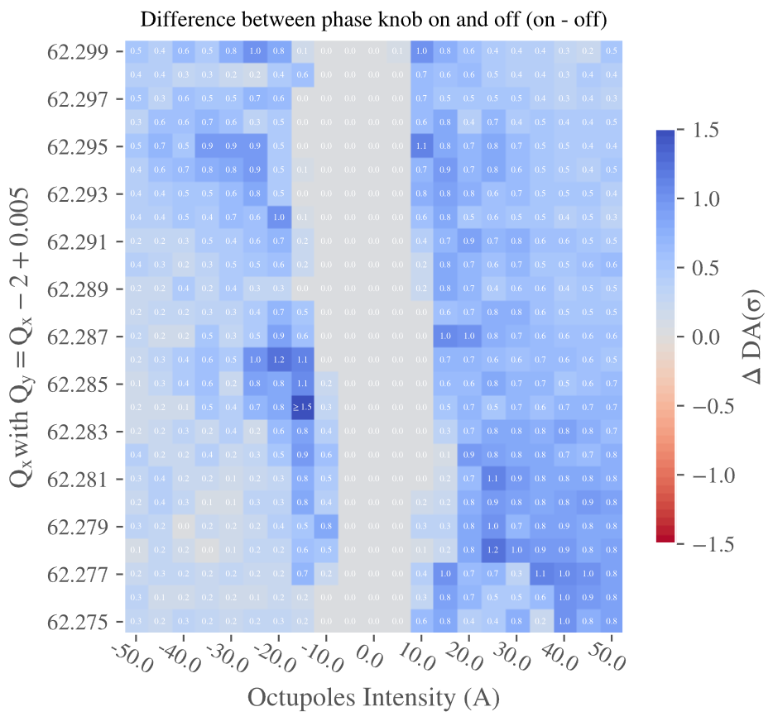
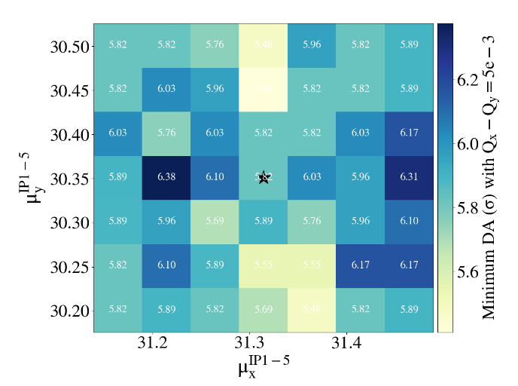
Dynamic Aperture: various investigations
Injection: phase knob octupole compensation (DA difference vs. oct.)
Optimisation vs. phase advance (start of levelling)
C. Droin, 223rd WP2 meeting, 28/11/2023
R. De Maria et al, THBP21, HB’23
Single-particle DA with flat optics and magnet errors (T. Pugnat, 220th WP2 meeting, 17/11/2023) – marginally worse with flat, correction performance to investigate.
Impact of new IR3/IR7 optics (see below) – DA minimally affected (C. Droin, WP2/WP3 meeting, 23/01/2024).
Assessing DA reproducibility (Xsuite) / exploring alternatives to min DA.
Beam-beam wire compensation: review to take place on Oct. 14-15 (CERN), paper by C. E. Montanari, “Measurement of the nonlinear diffusion of the proton beam halo at the CERN LHC”, under review

Slide 17
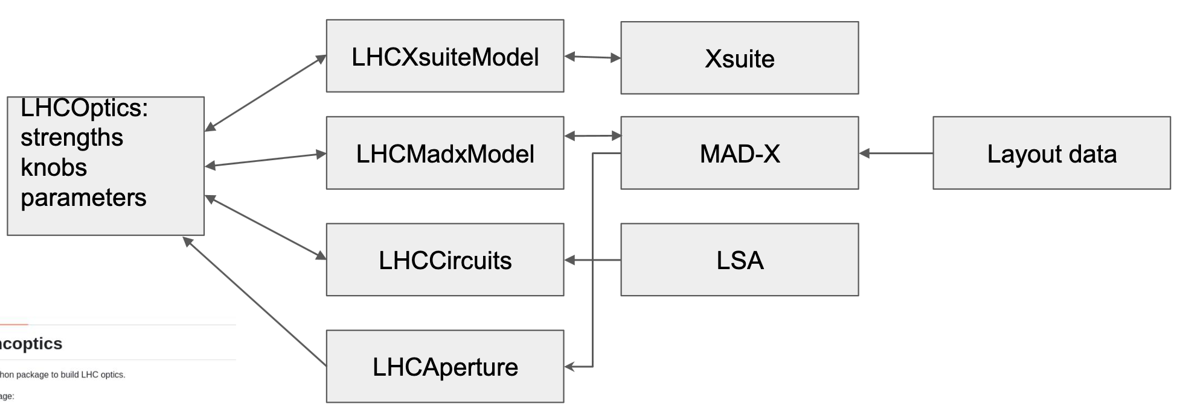
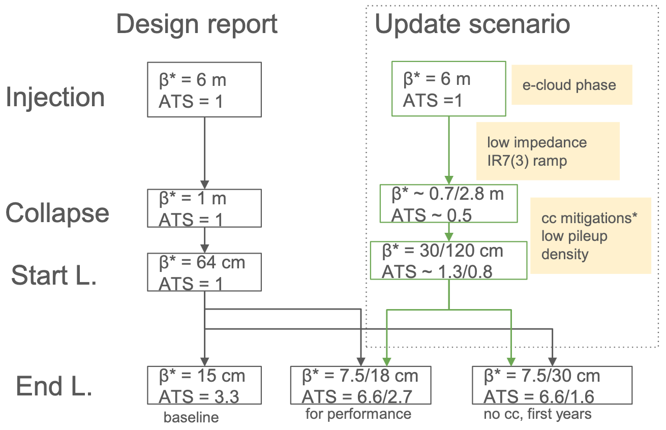
Optics and layout
New optics/layout version (v1.8) – R. De Maria & Y. Angelis, 227th WP2 meeting, 28/05/2024.
  PPS2 added
  first layout using only layout
  database data
  layout approval in ~September.
IR3/7 new optics – B. Lindström (see next talk)
  tested in MDs
  promising impedance mitigation (see below)
New cycle proposal:
Proposed
8
8
alternative

Slide 18
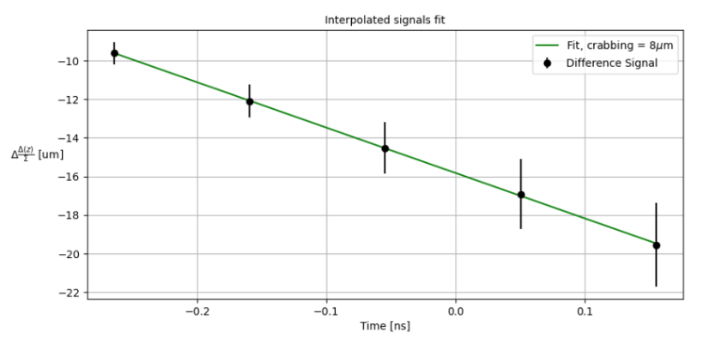
Crabbing measurements & commissioning
MDs in the LHC (2024) with residual crabbing from head-on beam-beam (inj.):
Commissioning and conditioning plans reviewed (R. De Maria / R. Calaga (WP4) / D. Wollmann (WP7), WP2/WP4/WP7 joint meeting, 25/06/2024):
  Conditioning during hardware commissioning, continuing in operation
  Proposal: first year with 1 MV, counter phased.
  Impedance & noise measurements almost parasitically obtained
  MD (or beam commissioning) tests to check full RF-ON sequence + CC-specific machine protection tests foreseen: interlocks, switch off cavities on one IP side, etc.
⟹ LHC residual crabbing measurable & conform to expectations
A. Fornara, LSWG, 02/07/2024

Slide 19
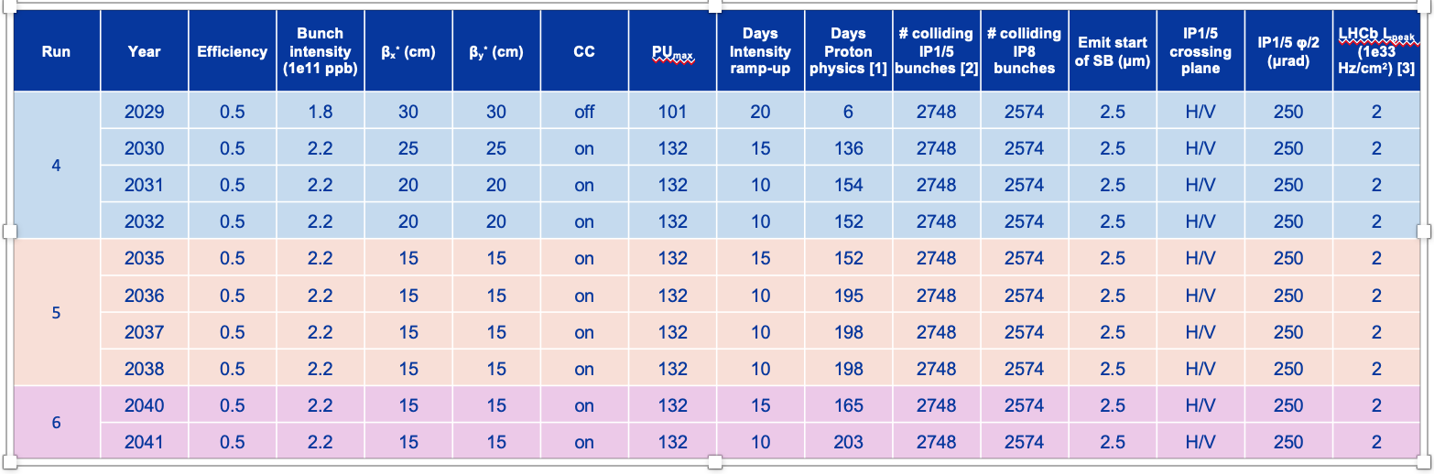
Update of performance estimates
Baseline assumptions
  intensity ramp-up included
  physics days (M. Zerlauth et al, EDMS 2902691, in preparation):
Extended ions after run 4 ⟶ 22-24 less days
Hybrid: 2440 / 2240
BCMS: 2736 / 2370
BCMS: 2.2
S. Kostoglou, 228th WP2 meeting, 02/07/2024

Slide 20
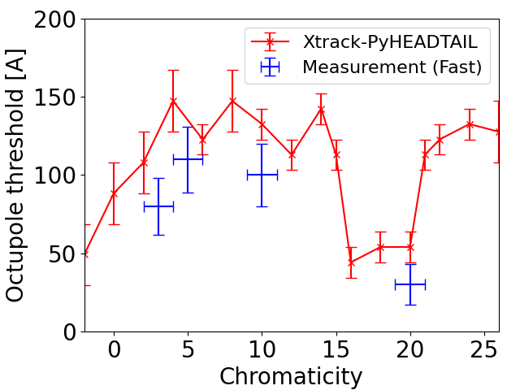
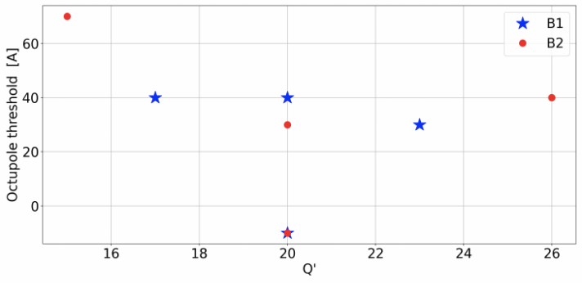
Transverse impedance & stability
LHC MDs on octupole threshold: potential large improvement at very high Q’ from non-linear longitudinal motion
Stability limits revised: octupole threshold vs Q’
L. Giacomel, LSWG, 02/07/2024
MD 2024
Latency effect not included
MD 2023
X. Buffat, 2024 LHC Chamonix workshop, 31/01/2024, and this meeting
Assumptions: Gaussian transverse tails, positive octupole polarity, latency effect included
⟹ Limit depends on CC and its mitigation (flat optics, comb filter)
⟹ A few factors might help and are studied: new optics + non-linear RF
NM et al, JINST 19 T05016 (2024)
See also L. Giacomel, this meeting

Slide 21
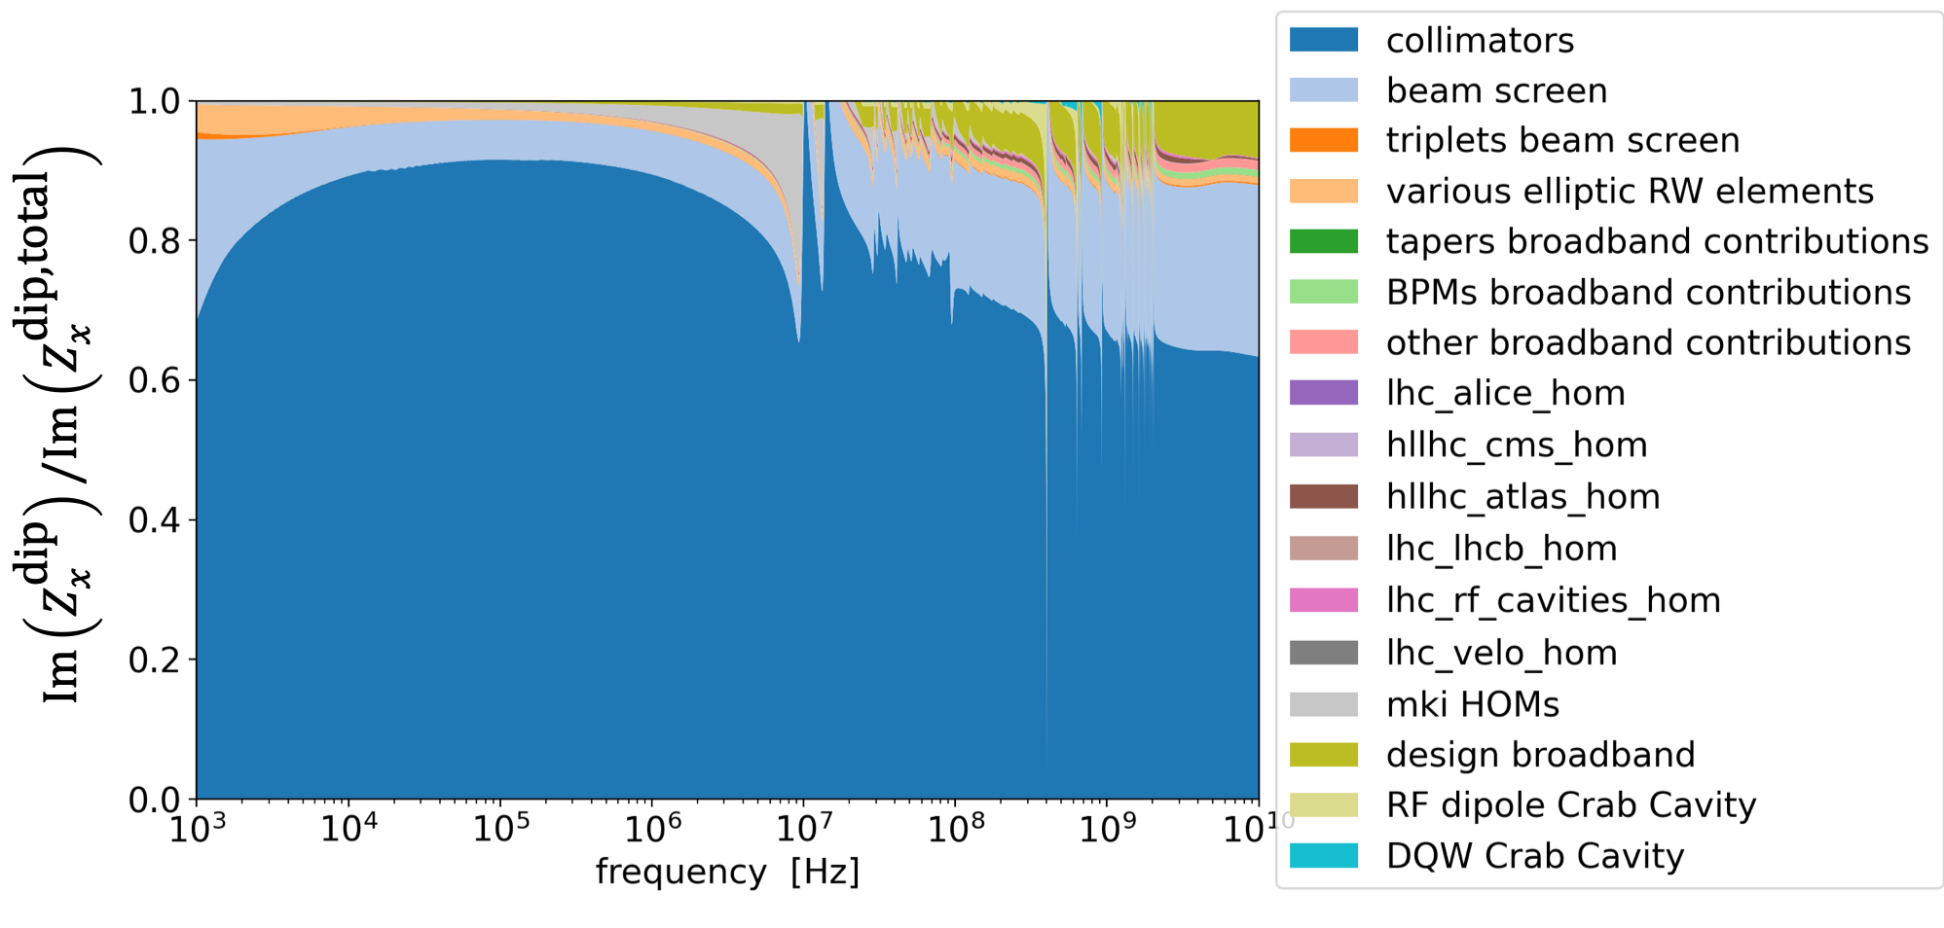
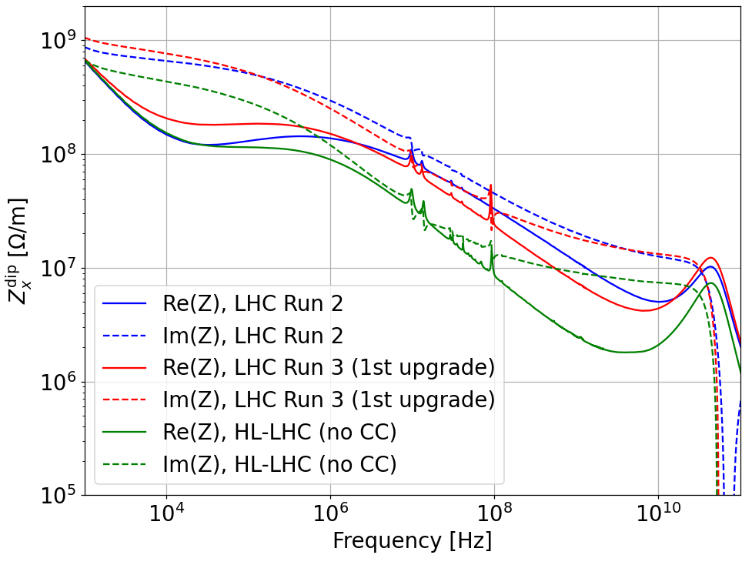
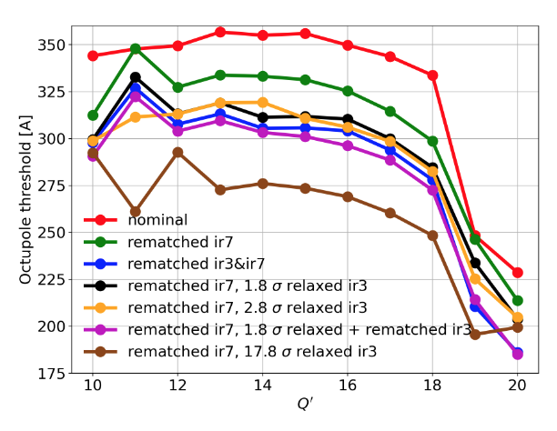
Transverse impedance & stability
Collimators dominate transverse impedance ⟹ coll. upgrade beneficial:
New optics for IR7 (see B. Lindström, next talk), and in IR3, would decrease even further the impedance:
  ⟹ IR3 & IR7 optics validated in MD (see R. De
  Maria and B. Lindström, LSWG, 02/07/2024)
NM et al, JINST 19 T05016 (2024)
Impedance decrease
L. Giacomel, 224th WP2 meeting, 11/12/2023
L. Giacomel / B. Lindström, WP2/WP5 meeting, 27/02/2024; this meeting

Slide 22
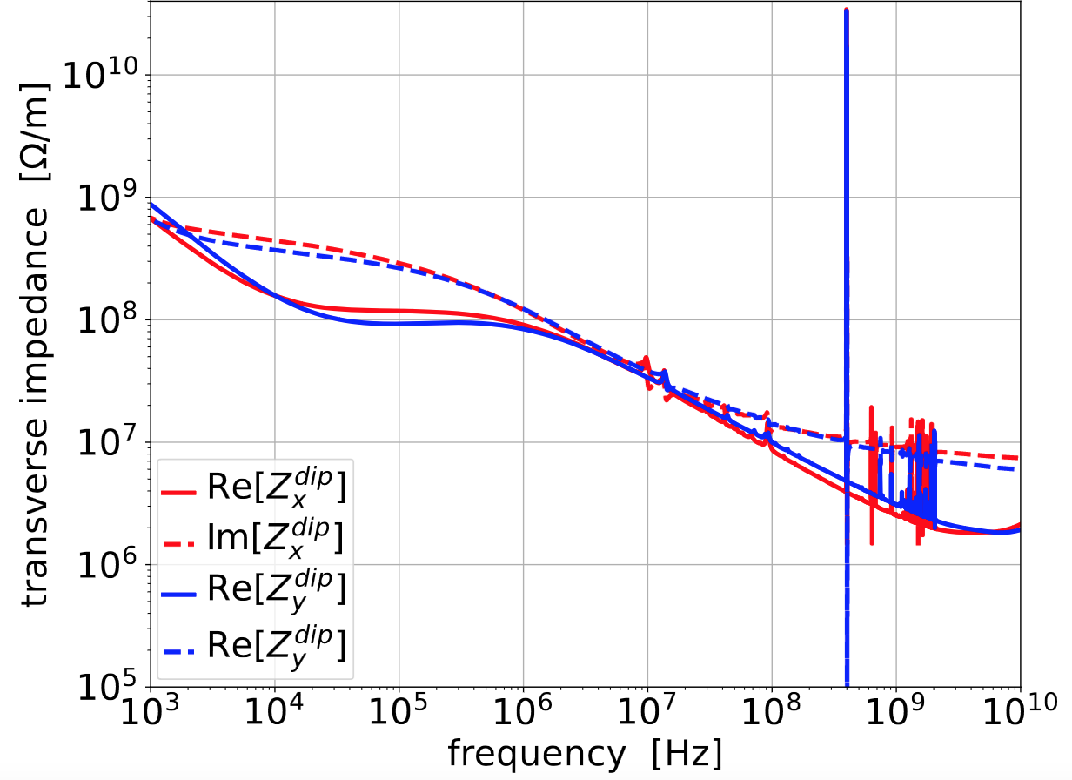
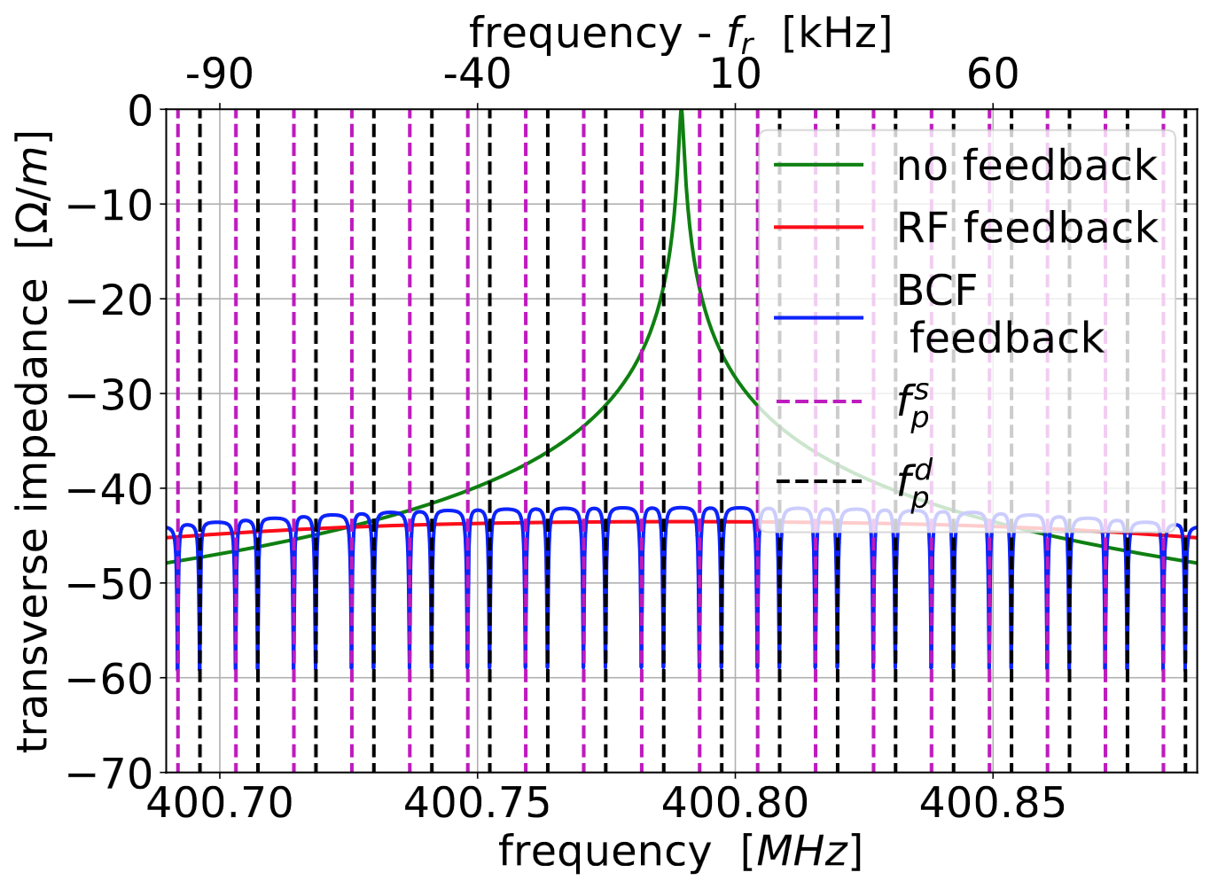
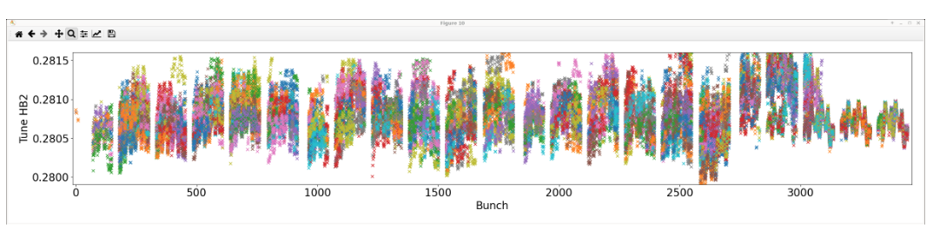
Crab cavities (with WP4) – impedance
Fundamental mode has a strong effect on transverse impedance:
Mitigations: RF feedbacks (std, betatron comb filter), optics (flat)
L. Giacomel et al, JINST 19 P05046 (2024)
Betatron frequency
Growth rates in the SPS (MD 2023)
Tune acceptance (~5 10⁻³) can be an issue.
⟶ Need to check multibunch tune shifts.
Encouraging results from MD 2024:
Lowering impedance at betatron frequencies
within 1.5x10⁻³
L. Giacomel, LSWG, 02/07/2024

Slide 23
Reports, publications and proceedings
M. Carlà, F. Carlier, R. Calaga, R. Tomás, S. Kostoglou, H. Bartosik, Status of the Beam-based Measurement of the Skew-sextupolar Component of the Radio Frequency Field of a HL-LHC-type Crab-Cavity, IPAC’23, MOPL001, https://doi.org/10.18429/jacow-ipac2023-mopl001.
R. De Maria, R. Bruce, X. Buffat, G. Iadarola, S. Kostoglou, M. Giovannozzi, B. Lindström, L. Mether, E. Métral, N. Mounet, S. Redaelli, G. Sterbini, R. Tomás, High Luminosity LHC Optics Scenarios for Run 4, IPAC’23, MOPL034, https://doi.org/10.18429/jacow-ipac2023-mopl034.
S. Kostoglou, H. Bartosik, R. De Maria, G. Iadarola, G. Sterbini, R. Tomás, Dynamic aperture studies for the first run of High Luminosity LHC, IPAC’23, WEPL102, https://doi.org/10.18429/jacow-ipac2023-wepl102.
G. Sterbini, A. Bertarelli, Y. Papaphilippou, A. Poyet, A. Rossi, P. Bélanger, Potential and Constraints of a Beam-Beam Wire Compensator in the HL-LHC Era, IPAC’23, WEPL103, https://doi.org/10.18429/jacow-ipac2023-wepl103.
A. Fornara, G. Sterbini, R. Appleby, Impact of Crab Cavity RF noise on the transverse beam profiles in the HL-LHC, IPAC’23, WEPL119, https://doi.org/10.18429/jacow-ipac2023-wepl119.
C. Accettura, N. Biancacci, R. Bruce, F. Carra, N. Mounet, A. Kurtulus, F.-X. Nuiry, A. Perillo Marcone, S. Redaelli, Overview of Material Choices for HL-LHC Collimators, IPAC’23, WEPA148, https://doi.org/10.18429/jacow-ipac2023-wepa148.
C.E. Montanari, A. Bazzani, M. Giovannozzi, A. Poyet, G. Sterbini, Modelling the Experimental Data for Long-Range Beam-Beam Wire Compensators at the CERN LHC with Diffusive Models, IPAC’23, WEPA021, https://doi.org/10.18429/jacow-ipac2023-wepa021.
C.E. Montanari, A. Bazzani, M. Giovannozzi, P. Hermes, S. Redaelli, Recent Measurements and Analyses of the Beam-Halo Dynamics at the CERN LHC using Collimator Scans, IPAC’23, WEPA022, https://doi.org/10.18429/jacow-ipac2023-wepa022.
B. Lindström, R. Bruce, X. Buffat, R. De Maria, L. Giacomel, P.D. Hermes, D. Mirarchi, N. Mounet, T.H.B. Persson, S. Redaelli, R. Tomás García, F.F. Van der Veken, A. Wegscheider, Mitigating Collimation Impedance and Improving Halo Cleaning with New Optics and Settings Strategy of the HL-LHC Betatron Collimation System, HB’23, TUC4C2, https://doi.org/10.18429/JACoW-HB2023-TUC4C2.

Slide 24
Reports, publications and proceedings
R. De Maria, Y. Angelis, C.N. Droin, S. Kostoglou, F. Plassard, G. Sterbini, R. Tomás, Increasing High Luminosity LHC Dynamic Aperture Using Optics Optimizations, HB’23, THBP21, https://doi.org/10.18429/JACoW-HB2023-THBP21.
L. Giacomel, P. Baudrenghien, R. Calaga, X. Buffat, N. Mounet, Mitigation strategies for the instabilities induced by the fundamental mode of the HL-LHC Crab Cavities, 2024 JINST 19 P05046, https://iopscience.iop.org/article/10.1088/1748-0221/19/05/P05046/pdf.
N. Mounet at al, High intensity beam dynamics assessment and challenges for HL-LHC, 2024 JINST 19 T05016, http://dx.doi.org/10.1088/1748-0221/19/05/T05016.
T. Pugnat, A. Wegscheider, E. Todesco, M. Giovannozzi, R. Tomás, Sorting strategies for the new superconducting magnets for the CERN HL-LHC, IPAC’24,THPC16, https://www.jacow.org/ipac2024/doi/jacow-ipac2024-thpc16/index.html.
C. Droin, G. Sterbini, I. Efthymiopoulos, N. Mounet, R. De Maria, R. Tomás, S. Kostoglou, Status of beam-beam studies for the high-luminosity LHC, IPAC’24, THPC77, https://www.jacow.org/ipac2024/doi/jacow-ipac2024-thpc77/index.html.
L. Giacomel, B. Lindstrom, G. Iadarola, G. Rumolo, N. Mounet, R. Bruce, X. Buffat, Assessment of the real part of the impedance of the LHC collimators with instability growth rate measurements, IPAC’24, THPC57, https://www.jacow.org/ipac2024/doi/jacow-ipac2024-thpc57/index.html.
A. Fornara, G. Trad, G. Sterbini, H. Bartosik, N. Triantafyllou, P. Baudrenghien, R. Calaga, S. Kostoglou, T. Levens, X. Buffat, R. Appleby, Emittance growth studies due to Crab Cavity induced amplitude noise in the SPS, IPAC’24, THPC63, https://www.jacow.org/ipac2024/doi/jacow-ipac2024-thpc63/index.html.
L. Mether, G. Iadarola, G. Rumolo, K. Paraschou, L. Sabato, S. Johannesson, The electron cloud and its impact on LHC and future colliders, IPAC’24, WEZD2, https://www.jacow.org/ipac2024/doi/jacow-ipac2024-wezd2/index.html.
K. Paraschou, G. Iadarola, L. Mether, Simulations of incoherent effects driven by electron clouds forming in the inner triplets of the Large Hadron Collider, IPAC’24, WEPR57, https://www.jacow.org/ipac2024/doi/jacow-ipac2024-wepr57/index.html.
…

