Slide 1



Status of RFD Cryomodules
Bob Laxdal
TRIUMF Hi-Lumi Technical Coordinator
Oct. 7, 2024

Slide 2
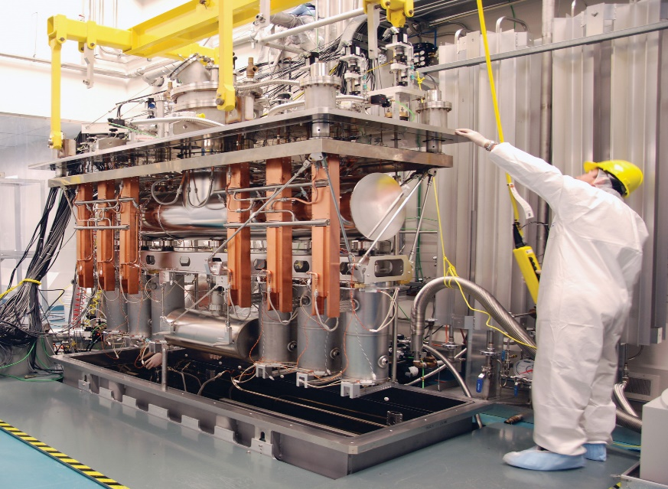
TRIUMF is Canada’s particle accelerator centre

Slide 3
Scope and constraints

Slide 4
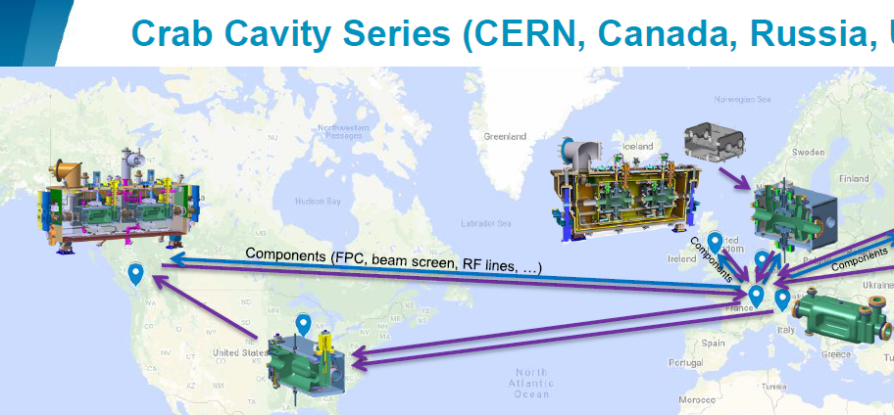
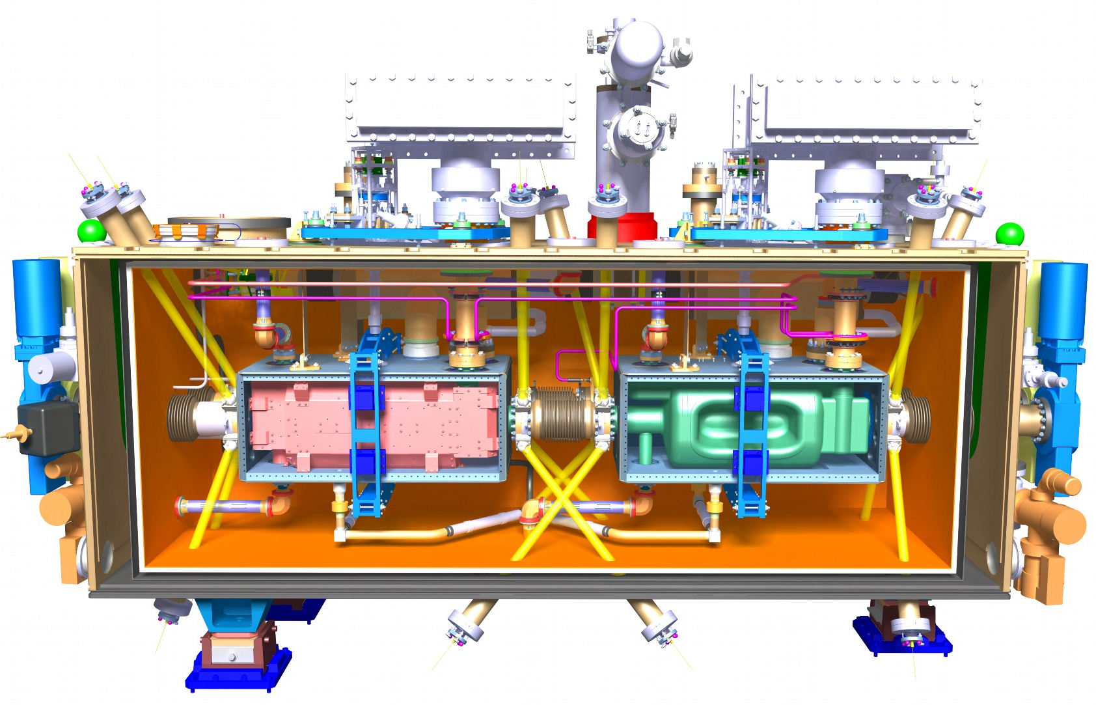
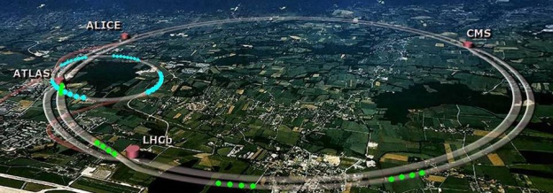
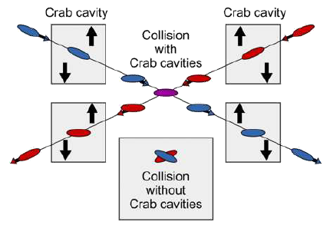
TRIUMF is part of global collaboration (CERN, USA, UK) that will deliver RFD Crab Cavity modules as a Canadian contribution to Hi-Lumi

Slide 5
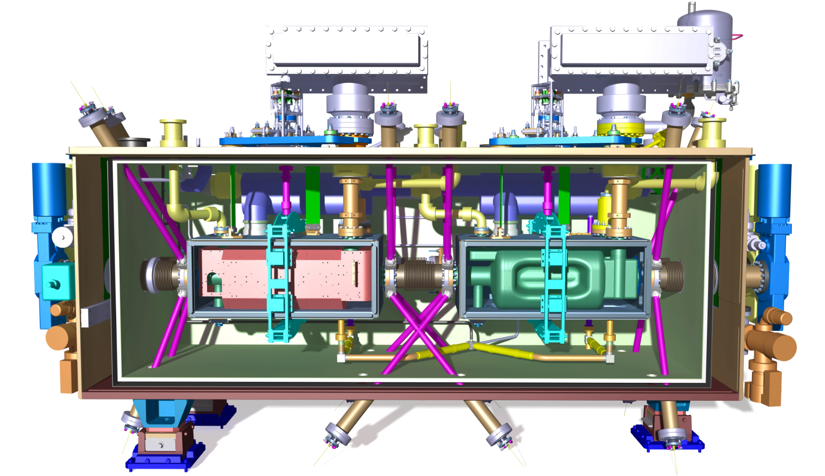
Scope of Canadian Contribution
TRIUMF to work with CERN and UK colleagues to develop RFD cryomodule design and tooling
TRIUMF to receive and re-qualify 10 dressed RFD resonators (US-AUP scope)
TRIUMF to install the fundamental power coupler (CERN scope) and to assemble each pair of RFDs into five hermetic strings
TRIUMF to assemble hermetic strings into five crymodules and qualify performance
TRIUMF to package and ship cryomodules to CERN

Slide 6
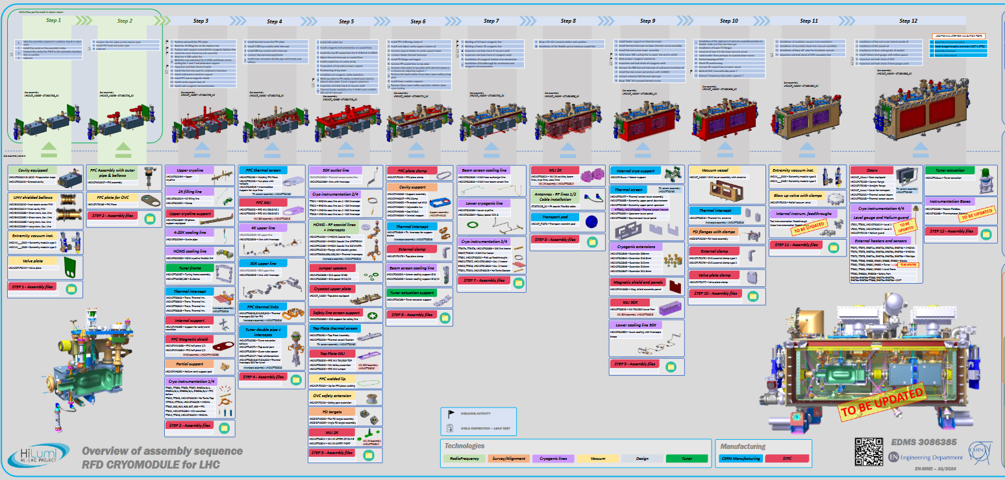
The RF Dipole Cryomodule- Step by step

Slide 7

Project Strategy
The project strategy calls for procurement of parts for a single cryomodule, TCM0, followed by procurement of parts for the production series TCM1-4
Project slippages due to Covid and other forces vs. boundary conditions on project funds are having an impact on this strategy
  Shifting timelines for
    TCM0 cavities from AUP
    Released drawings, deliverables and parts lists from CERN
  Fixed timeline for spending the funds
The present strategy has been to procure series components as soon as drawings are released and strategically assign some scope to CERN in order to spend $$ within fixed timeline
7

Slide 8
Funding and priorities
Due to the nature of the funding agreement ALL funds for the project must be spent and all parts received (to trigger payment) before April 2025
Over 5M$ has been committed over the last year - TRIUMF has presently spent or committed 97% of the funds
Present risks
  Over 50% of funds are encumbered including 19% from CERN that need delivery to TRIUMF before April 2025
  Some drawing packages and procured parts lists are still not released
8

Slide 9

Cryomodule Assembly Boundary Conditions
CM string assembly requires cavities from AUP, FPCs and beamline assemblies from CERN – first articles are required to assemble TCM0 and TCM1
TRIUMF also requires delivery of CM parts from CERN for both in scope articles and added scope articles (at least for first units):
TRIUMF site planning calls for a long shutdown in 2026 to help concentrate effort on the ARIEL project – all cavity qualification tests will be completed but a slowdown in Hi-Lumi CM assembly is foreseen
AUP, CERN
TRIUMF
AUP Delivery Projection
Cavity Pair | Module | Delivery
Prototype | TCM0 | Feb 2025 | -
Caviies 1 and 2 | TCM1 | May 2025
Caviies 3 and 4 | TCM2 | Jun 2025
Caviies 5 and 6 | TCM3 | Jul 2024
Caviies 7 and 8 | TCM4 | Aug 2025
Caviies 9 and 10 | TCM5 | Sep 2025

Slide 10
Timeline

Slide 11
Recent Milestones

Slide 12
Recent milestones
Milestone | Application | Achieved
Clean room contract issued | Infrastructure | Sep 2023
OVC material order received | TCM1-5 | Feb. 2024
OVC fabrication order issued | TCM1-5 | Feb 2024
MLI contract issued | TCM1-5 | Mar. 2024
Dummy cavity received | Infrastructure | June 2024
Mu-metal received | TCM1-3 | Aug. 2024
Top assembly frame received | Infrastructure | Aug. 2024
Tuner frame/flexures fabrication issued | TCM1-5 | Sept. 2024
Thermal shield fabrication issued | TCM1-5 | Sept. 2024
String assembly cart complete | Infrastructure | Sept. 2024

Slide 13
Recent milestones
Milestone | Application | Achieved
Clean room contract issued | Infrastructure | Sep 2023
OVC material order received | TCM1-5 | Feb. 2024
OVC fabrication order issued | TCM1-5 | Feb 2024
MLI contract issued | TCM1-5 | Mar. 2024
Dummy cavity received | Infrastructure | June 2024
Mu-metal received | TCM1-3 | Aug. 2024
Top assembly frame received | Infrastructure | Aug. 2024
Tuner frame/flexures fabrication issued | TCM1-5 | Sept. 2024
Thermal shield fabrication issued | TCM1-5 | Sept. 2024
String assembly cart complete | Infrastructure | Sept. 2024

Slide 14
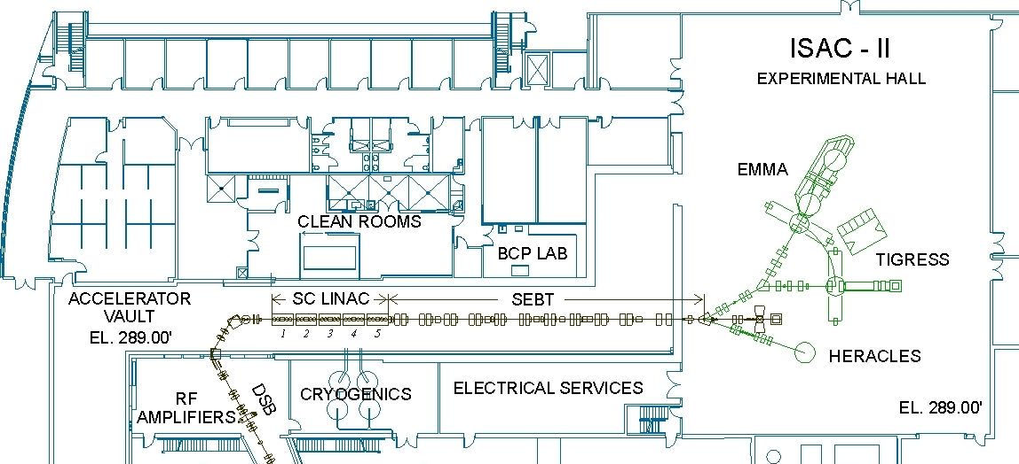
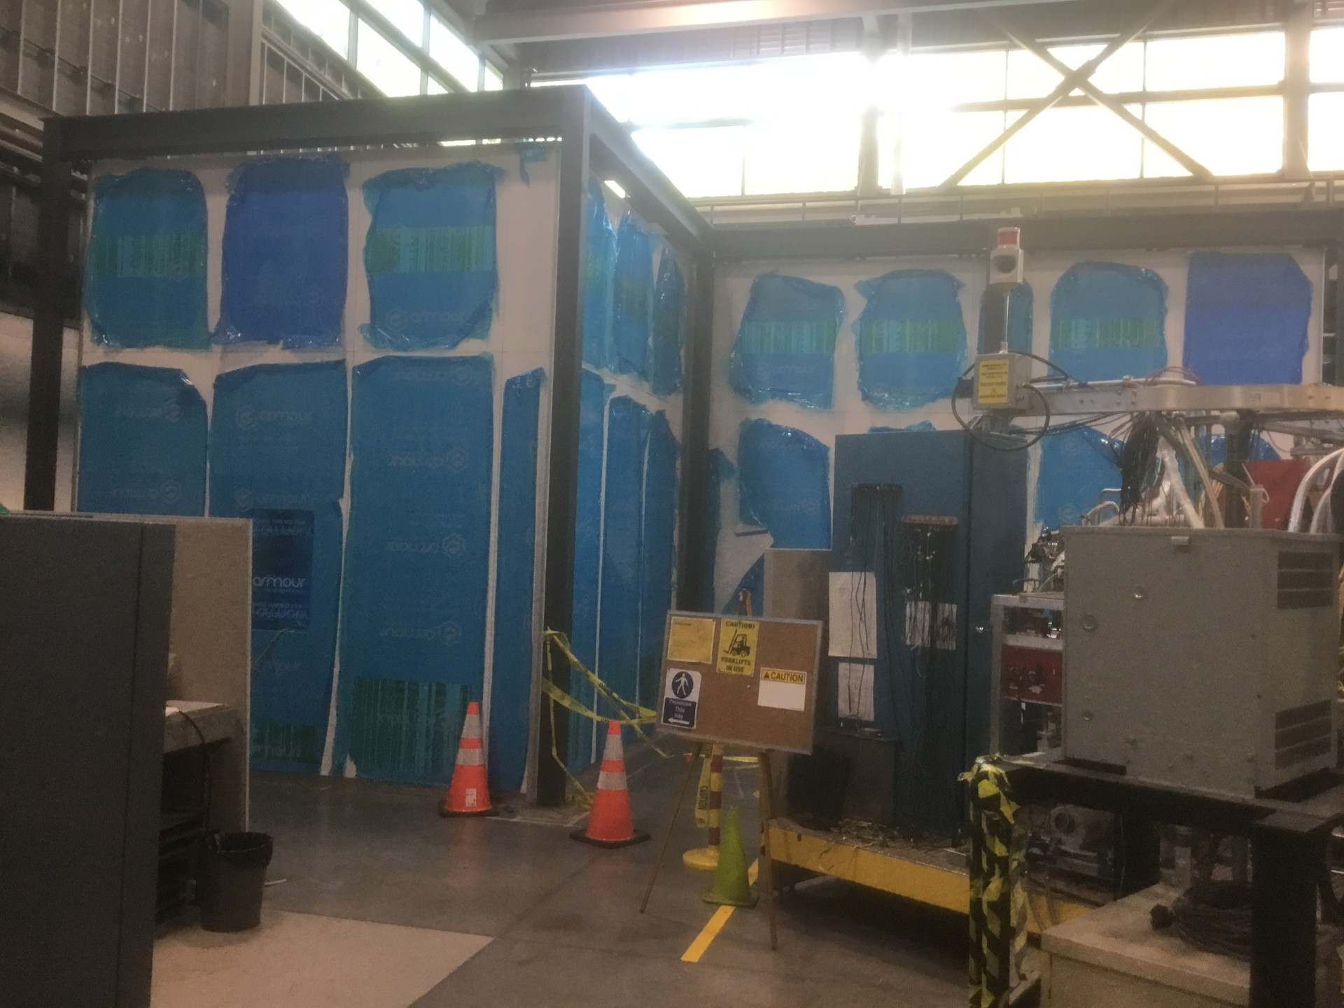
TRIUMF SRF Facilities – Hi-Lumi Upgrade
To improve the throughput of Hi-lumi CMs we are installing a second clean-room in the ISAC-II experimental hall
The clean room will allow dedicated string assembly over the life of the project – being installed and ready November 2024
Dirty assembly
Clean assembly
RF
HPWR
Prep room
Cavity/CM testing
Clean assembly
BCP

Slide 15
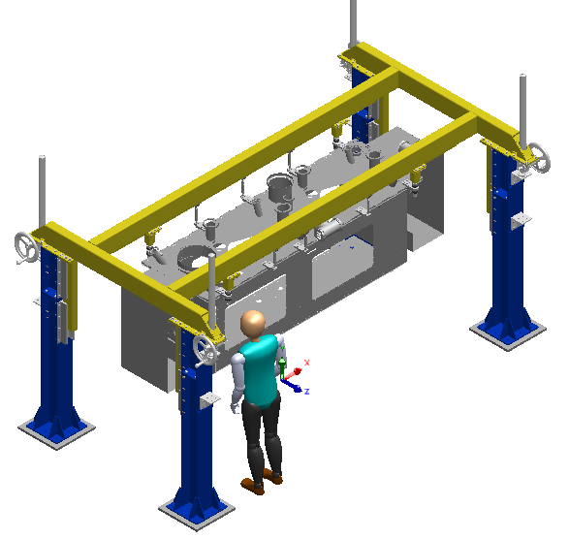
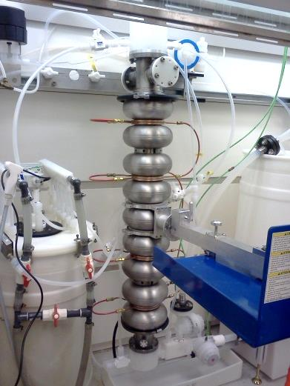
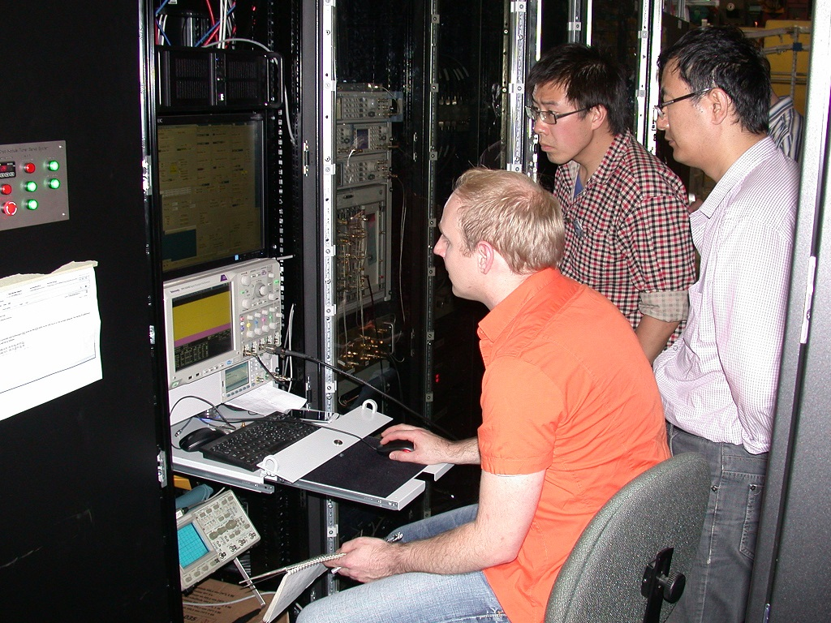
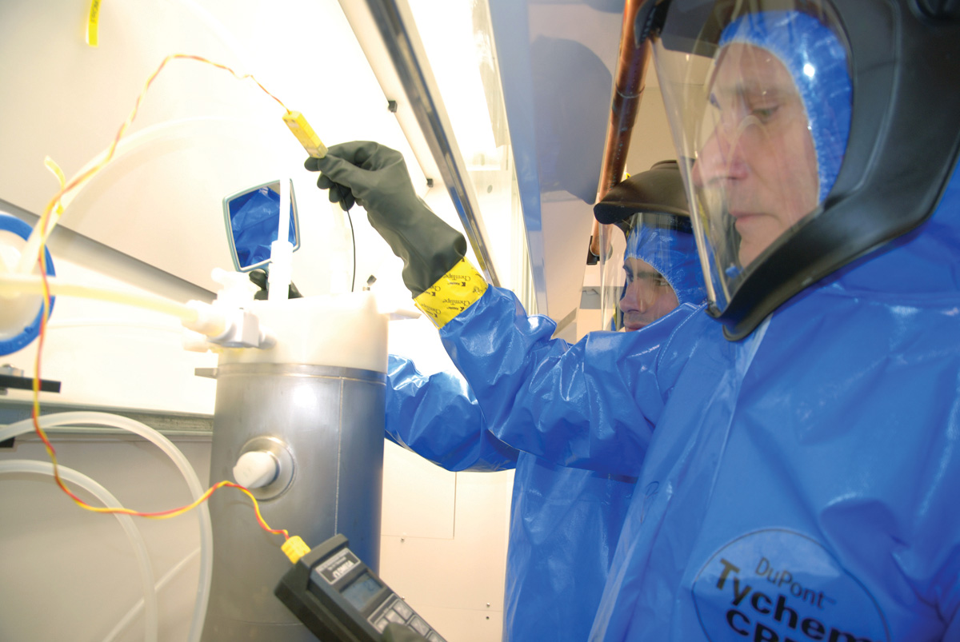
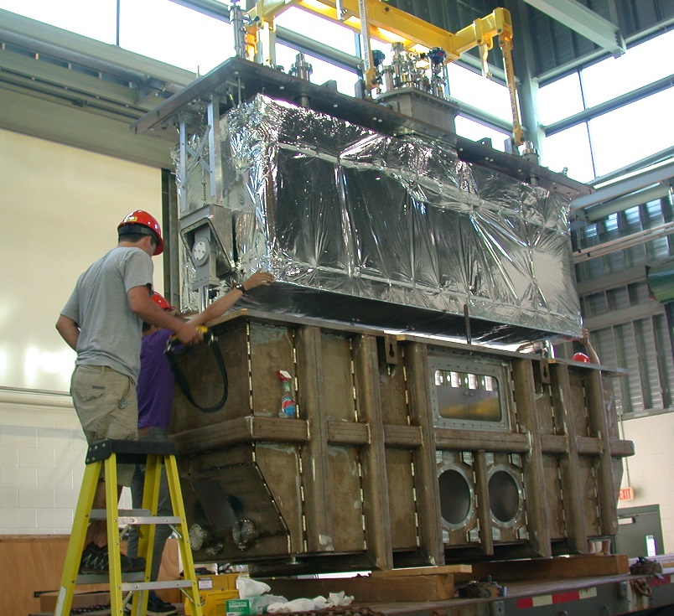
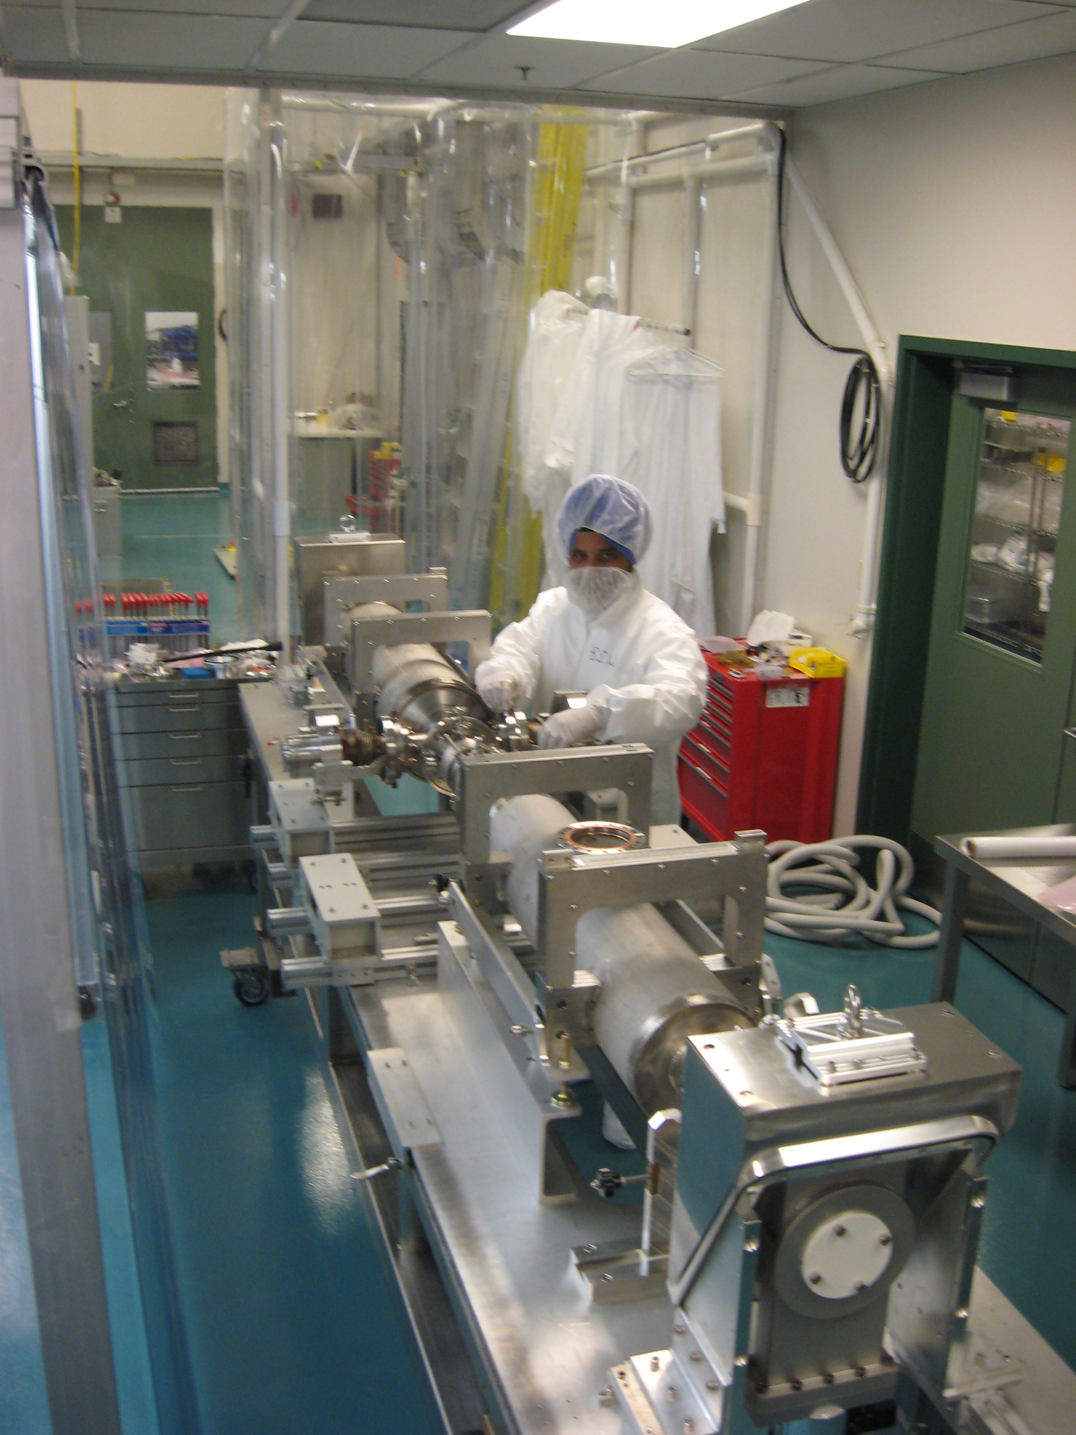
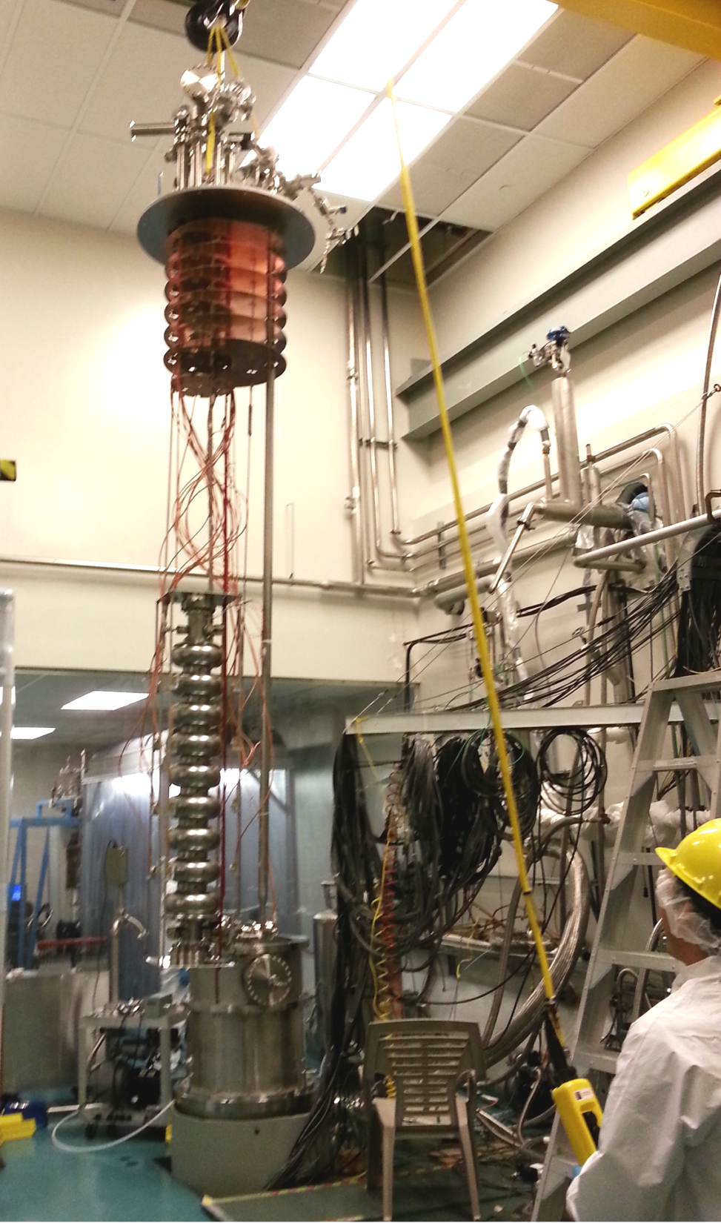

TRIUMF SRF Facilities
New Hi-Lumi Area
Dirty assembly
Clean assembly
RF
HPWR
Prep room
Cavity/CM testing
Clean assembly
BCP

Slide 16
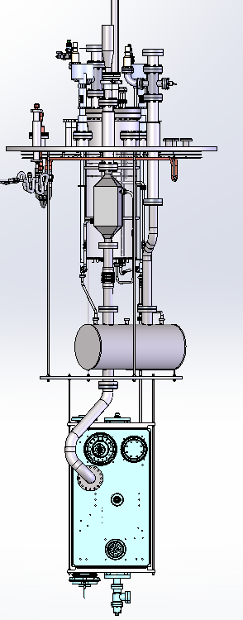
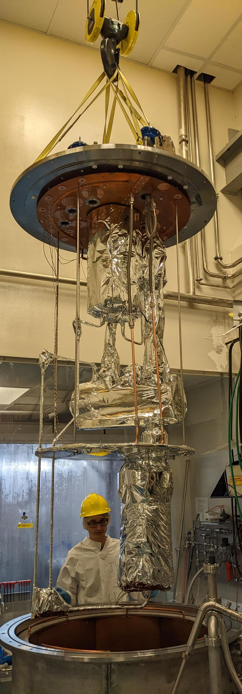
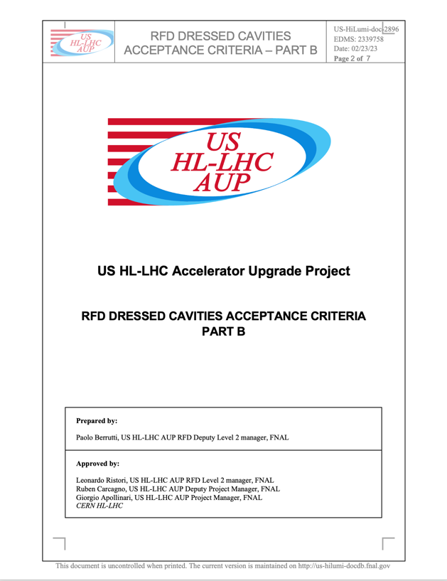
Preparation for cavity testing
TRIUMF will requalify the AUP cavities upon delivery from JLab
TRIUMF has upgraded the cavity test facility
Prepared and qualified cryo-insert for multi-purpose cryostat to test dressed cavities at 2K in jacketed mode
Worked with AUP to draft cavity requalification test criteria

Slide 17
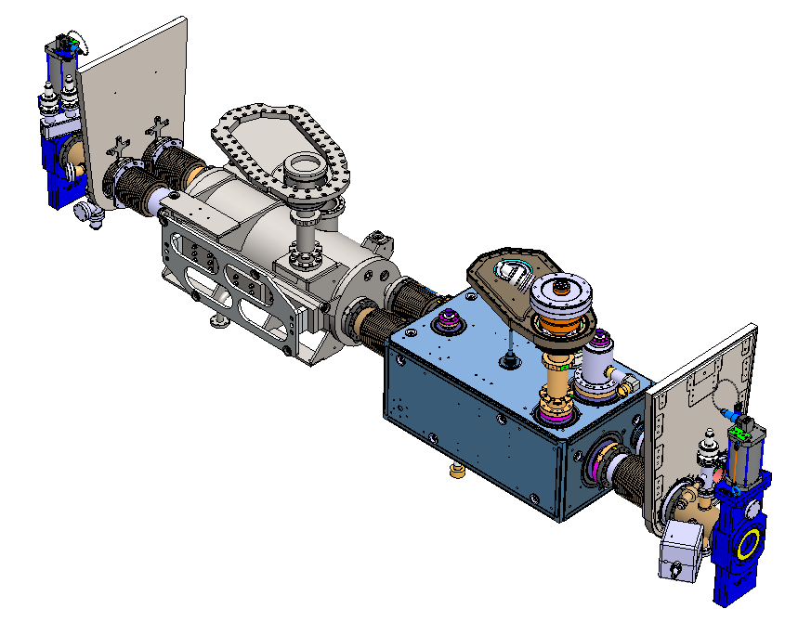
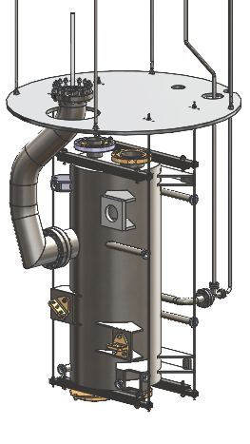
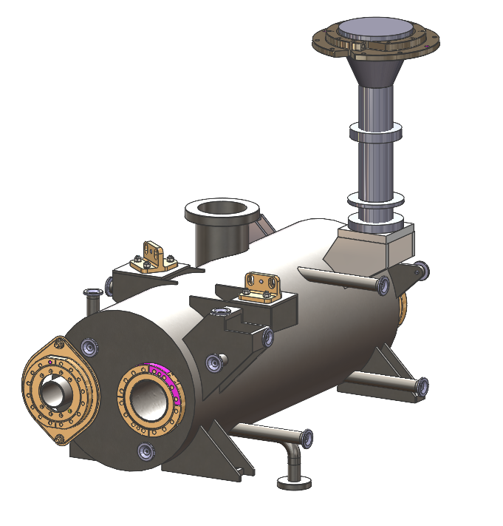
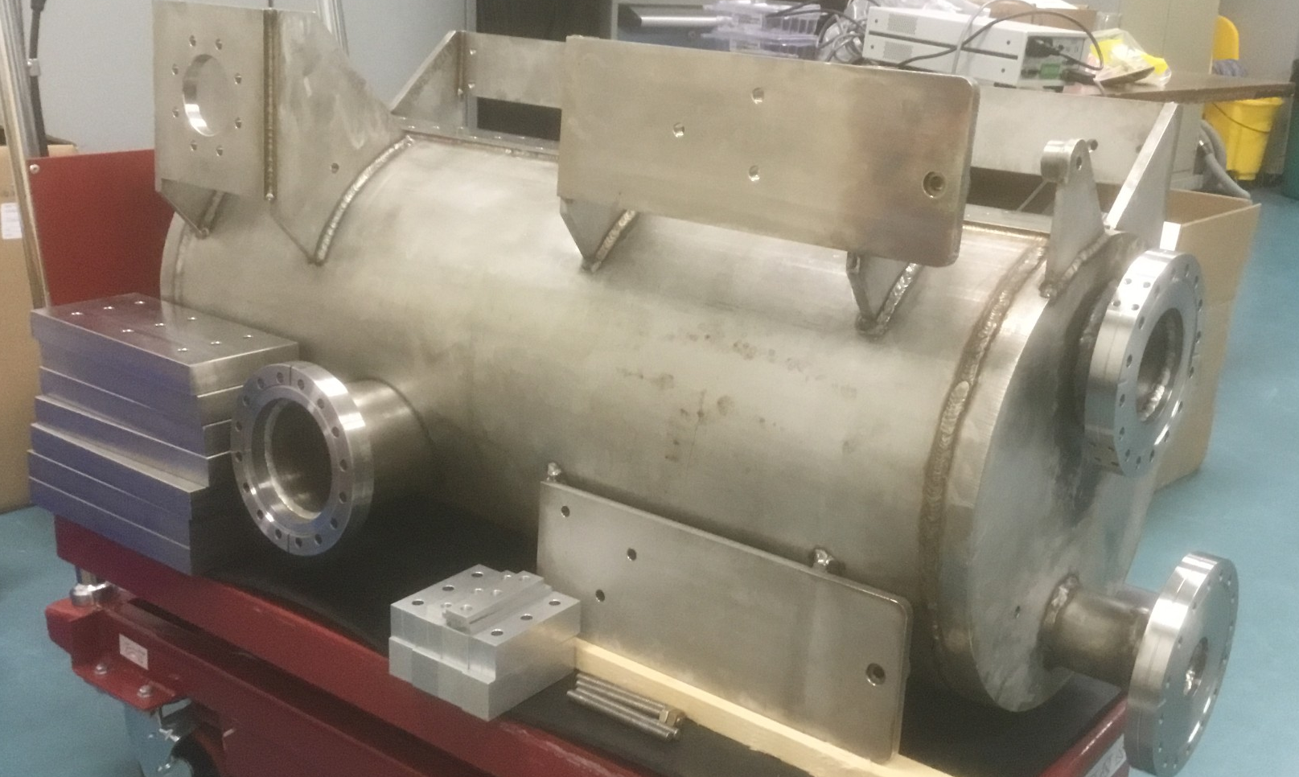
Dummy cavity for TCM0
AUP anticipates only one TCM0 cavity in Feb. 2025
TRIUMF has designed and fabricated a dummy cavity to replicate the RFD cavity
  Identical LHe volume and mass as the actual cavity
  Identical beam and helium interfaces as the RFD cavity
  Identical support interfaces
Will be used for testing prior to cavity delivery and during assembly of TCM0 cavity string

Slide 18
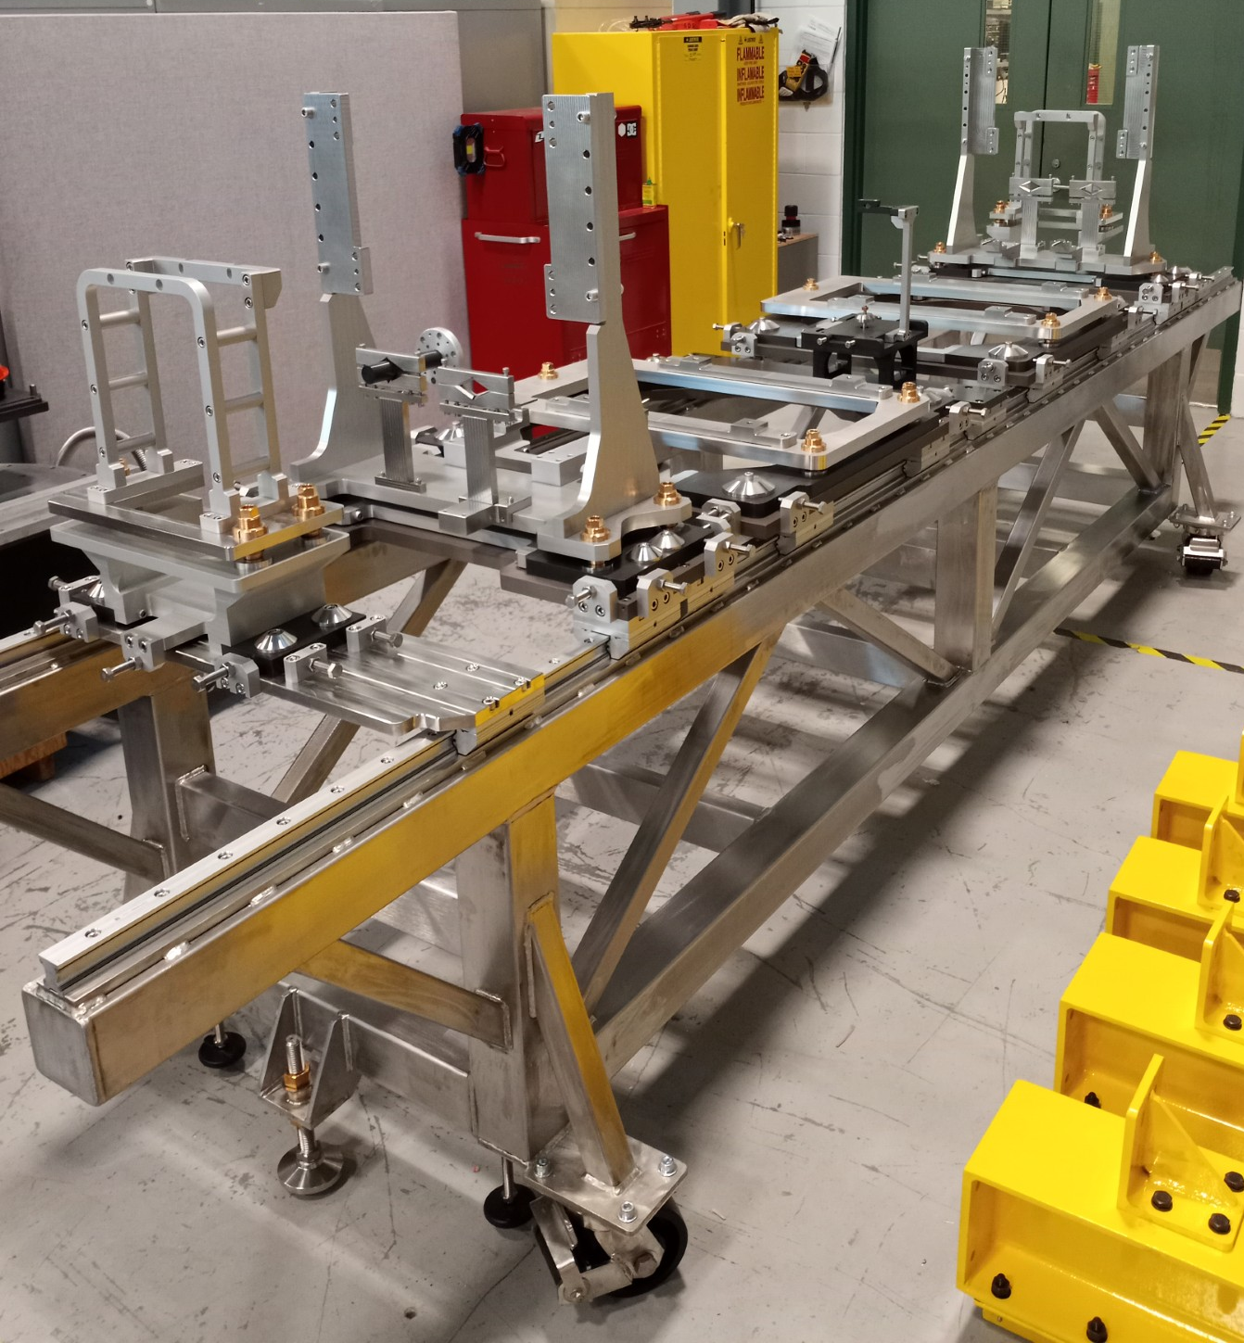
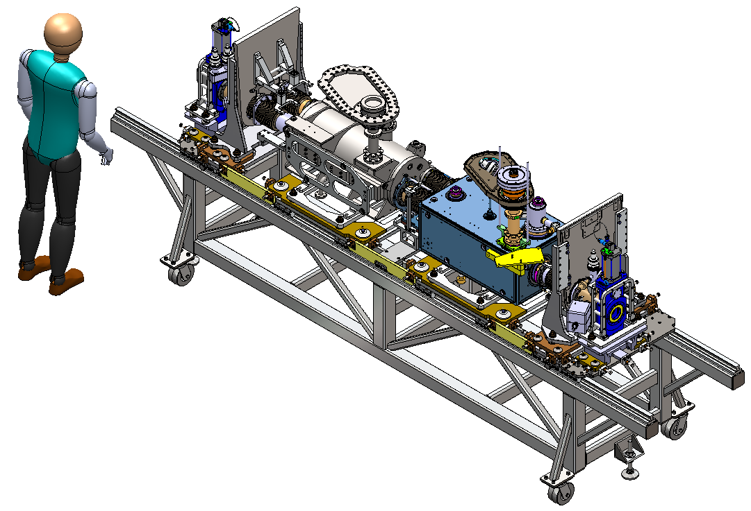
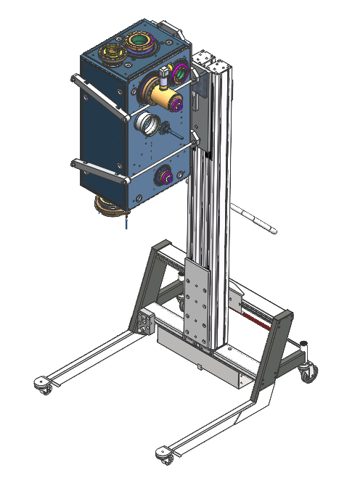
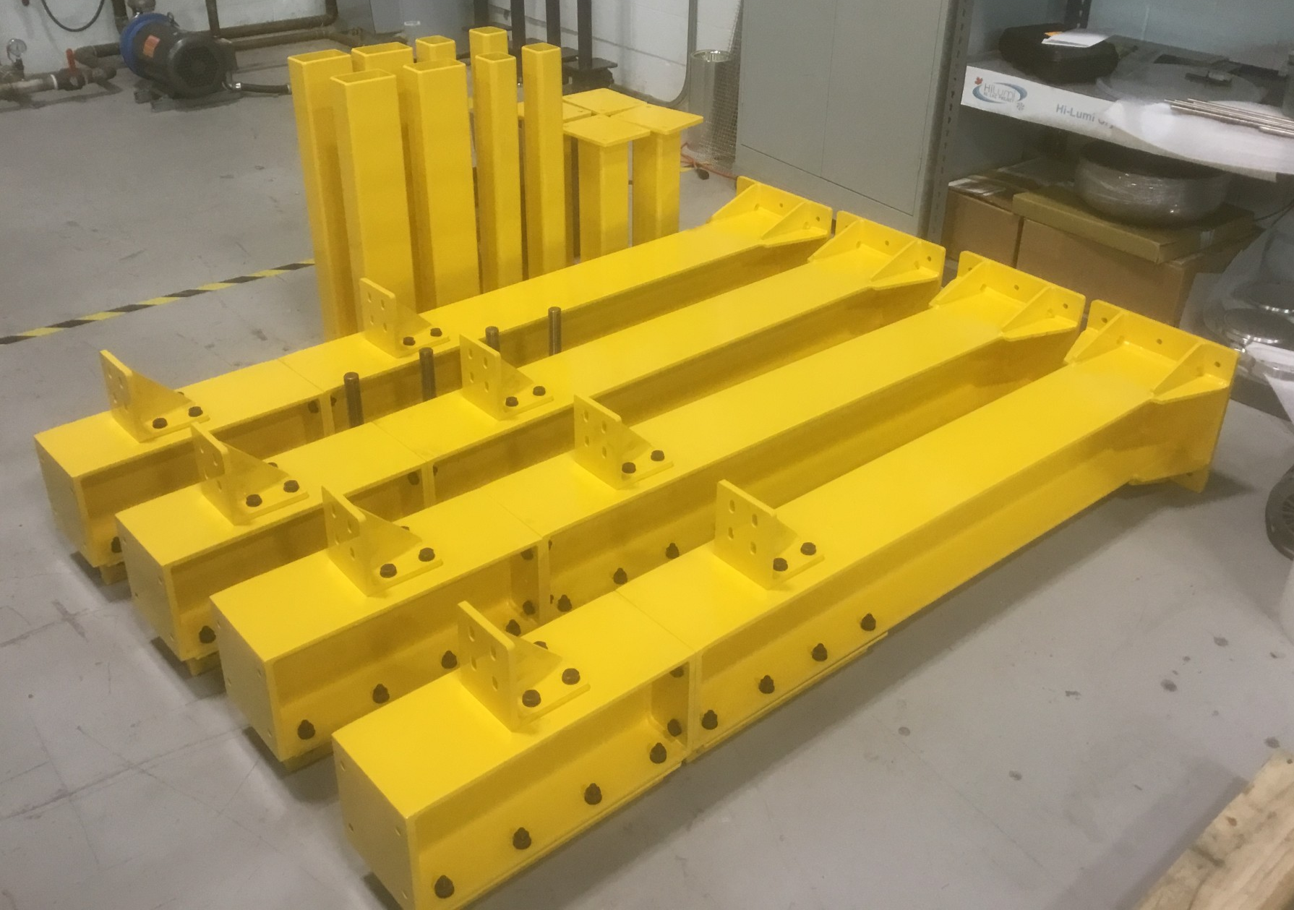
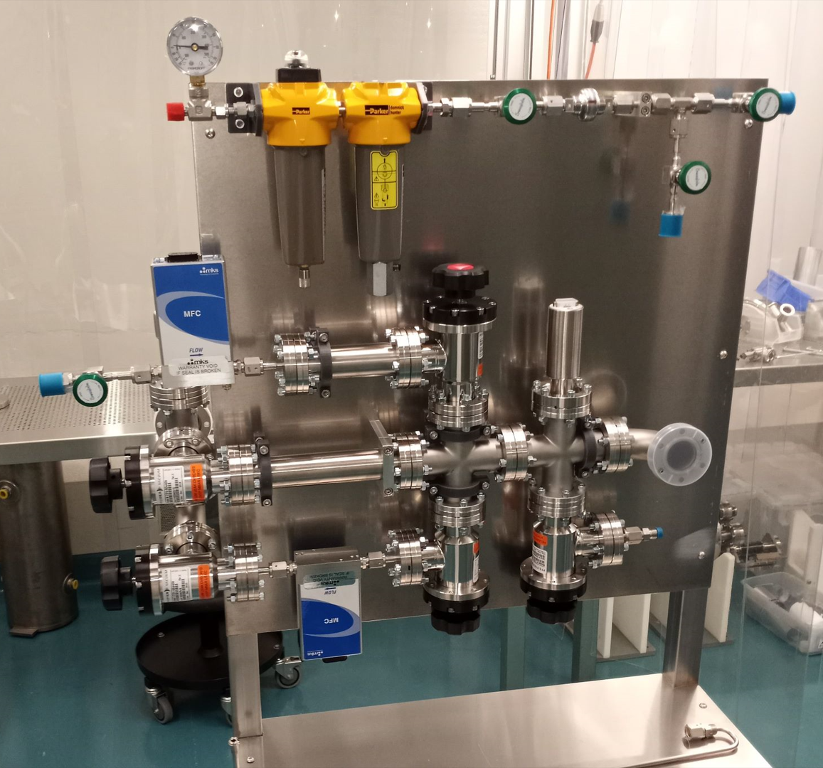
Other Infrastructure
String assembly frame received
  Based on UK design
  Ready for assembly
Top assembly frame
  Assembled and ready for TCM0
Cavity manipulation/rinsing tooling
  Received
Pumping/Venting stand
  Ready for commissioning

Slide 19
Infrastructure upgrade status
 |  | specified | designed | ordered | received
Clean room upgrade | New clean room |  |  |  | Nov 2024
 | Rinse facility |  |  | Nov 2024 | Jan 2024
 | Pumping/venting
Cavity testing | 4k/2k insert
 | Test diagnostics
 | Clean venting system |  |  |  | Oct. 2024
 | Qualification (dummy cavity) |  |  | Nov 2024 | Dec 2024
Assembly fixtures | Hermetic string cart
 | Dummy cavity
 | Cavity handling tooling
 | Top down assembly stand
 | Cryomodule trolley

Slide 20
Recent milestones - Cryomodules
Milestone | Application | Achieved
Clean room contract issued | Infrastructure | Sep 2023
OVC material order received | TCM1-5 | Feb. 2024
OVC fabrication order launched | TCM1-5 | Feb 2024
MLI contract issued | TCM1-5 | Mar. 2024
Dummy cavity received | Infrastructure | June 2024
Mu-metal received | TCM1-3 | Aug. 2024
Top assembly frame received | Infrastructure | Aug. 2024
Tuner frame/flexures fabrication launched | TCM1-5 | Sept. 2024
Thermal shield fabrication launched | TCM1-5 | Sept. 2024
String assembly cart complete | Infrastructure | Sept. 2024

Slide 21
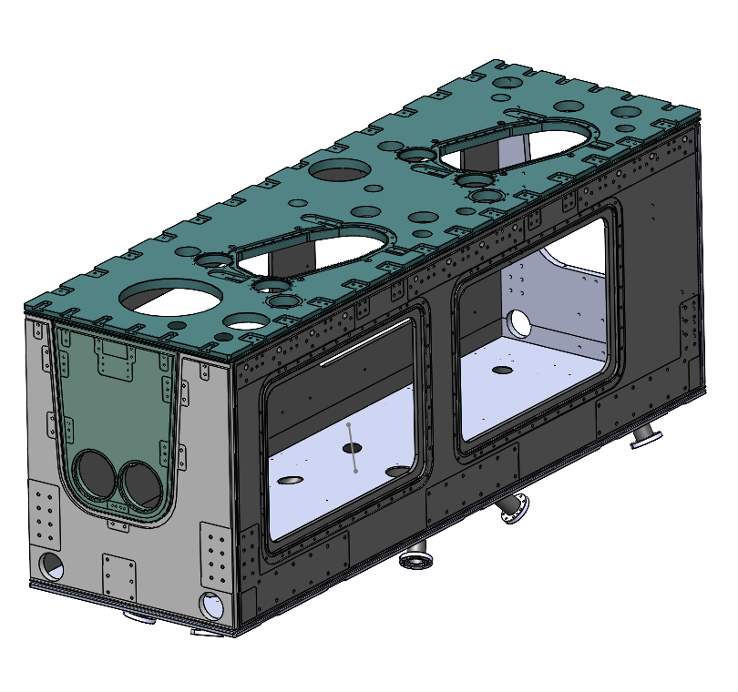
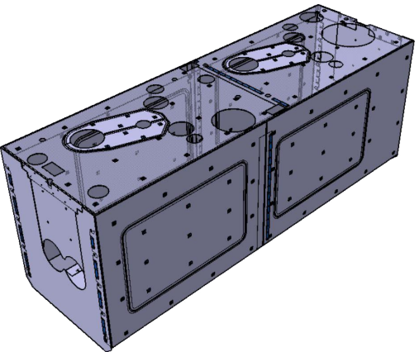
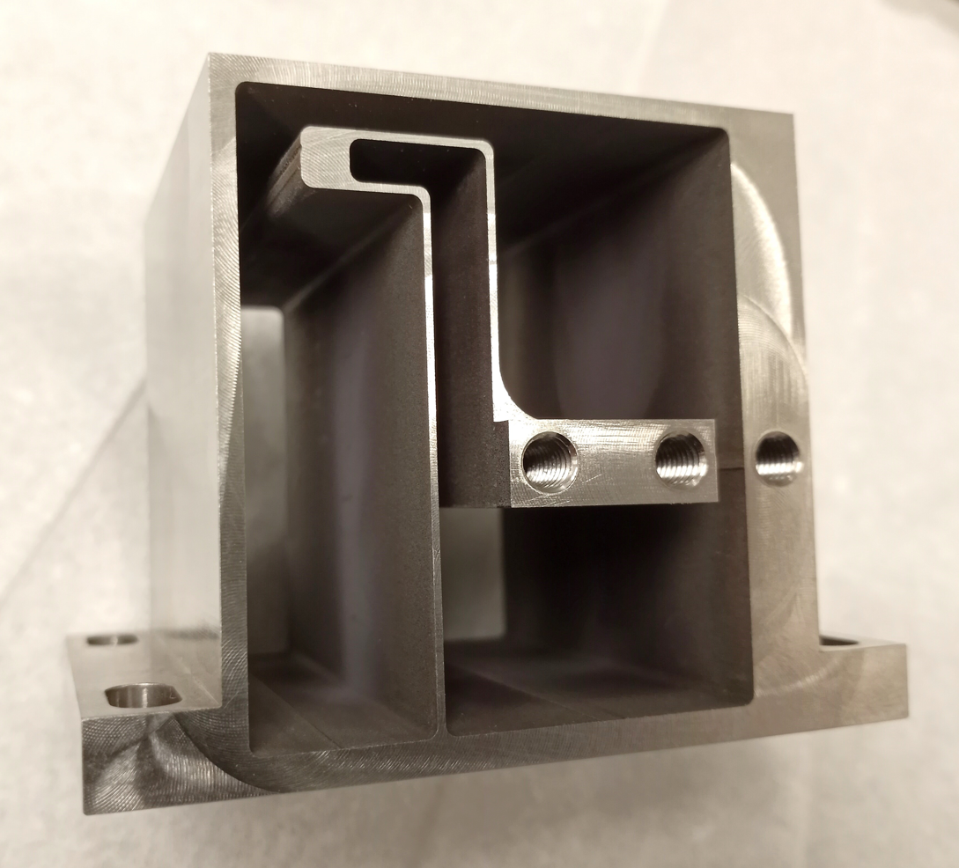
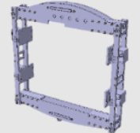
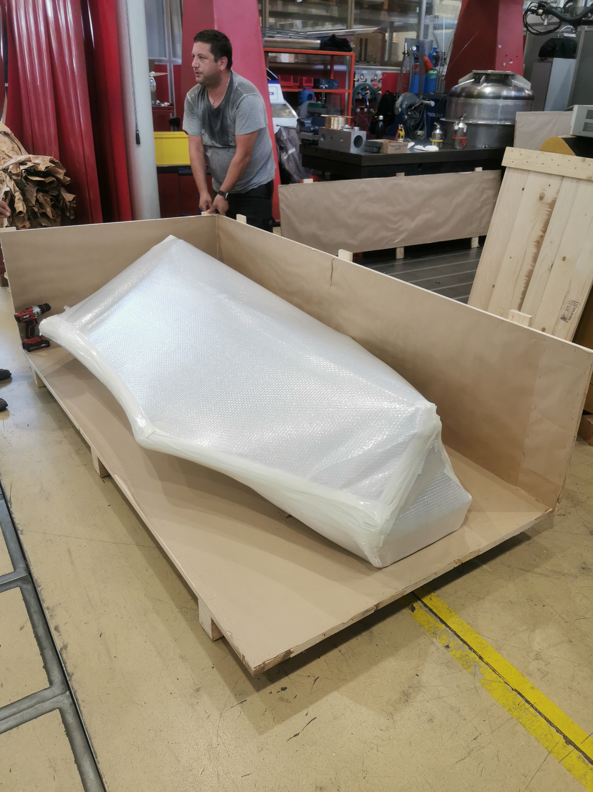
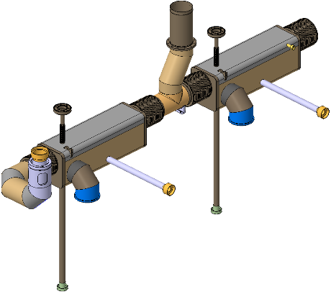
Cryomodule fabrication milestones
Outer vacuum chamber (OVC)
TCM0 and Series contract issued to Axton (Vancouver)
Material for five OVCs received
Mu-metal series
Three articles received with all expected by Dec. 2024
Thermal shield - series
Material in hand and major fabrication contracts launched
Tuner - series
Tuner frame fabrication launched
Bi-phase lines
Production well advanced at CERN with first article for TCM1 delivered

Slide 22

OVC Status
Document Name | Action | Status 2023 | Status 2024
3D Models | N/A | Completed | Completed
2D Drawings | N/A | Completed | Completed
Manufacturing drawings | TRIUMF | In Progress | Completed
Manufacturing and Inspection Plan (MIP) | Axton | In Progress | Completed
Welder Certification | Axton | In Progress | In Progress
Welding Procedure Specifications (WPS) | Axton | In Progress | In Progress
Welding Procedure Qualifications Records (WPQR) | Axton | In Progress | In Progress
Raw material certificates | TRIUMF | In Progress | Completed
Filler material certificates | CERN | In Progress | Completed
Material samples | TRIUMF | In Progress | In Progress
Scheduling (incl. preliminary dates) | Axton | In Progress | Completed
Traceability procedure | Axton | In Progress | Completed
Cleaning procedure | TRIUMF | In Progress | Completed
Leak test procedure | TRIUMF | In Progress | Completed

Slide 23
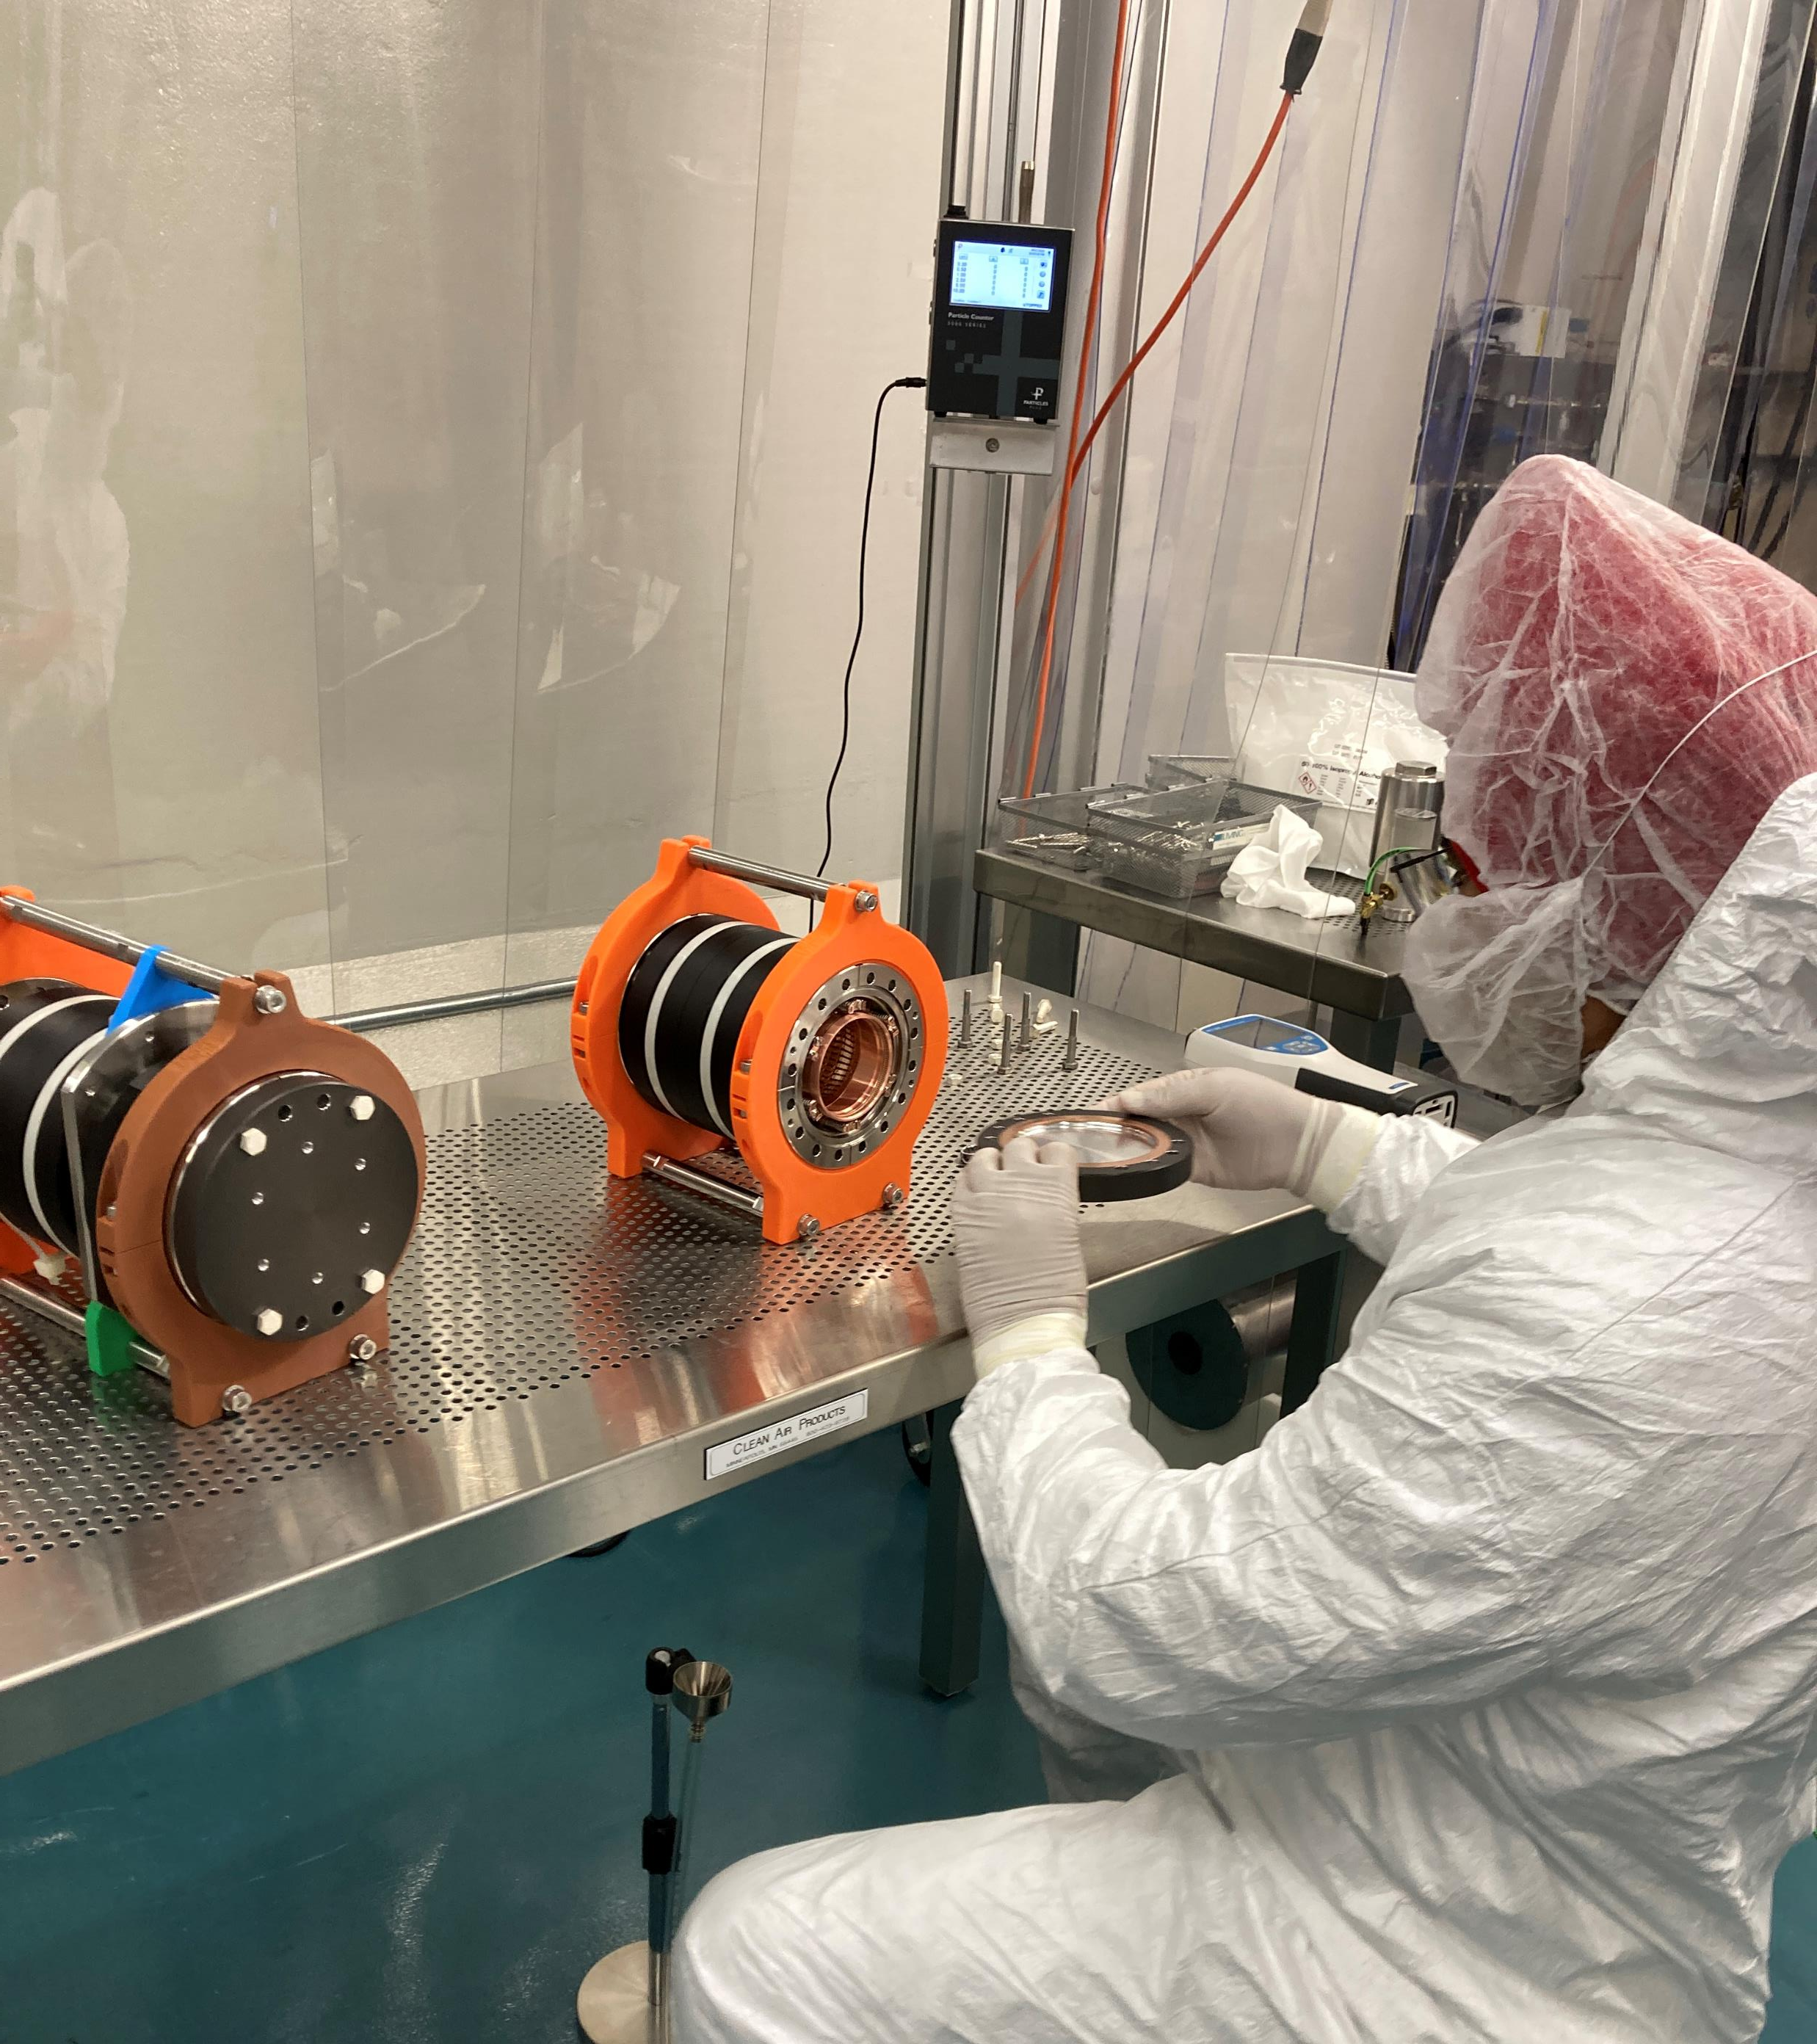
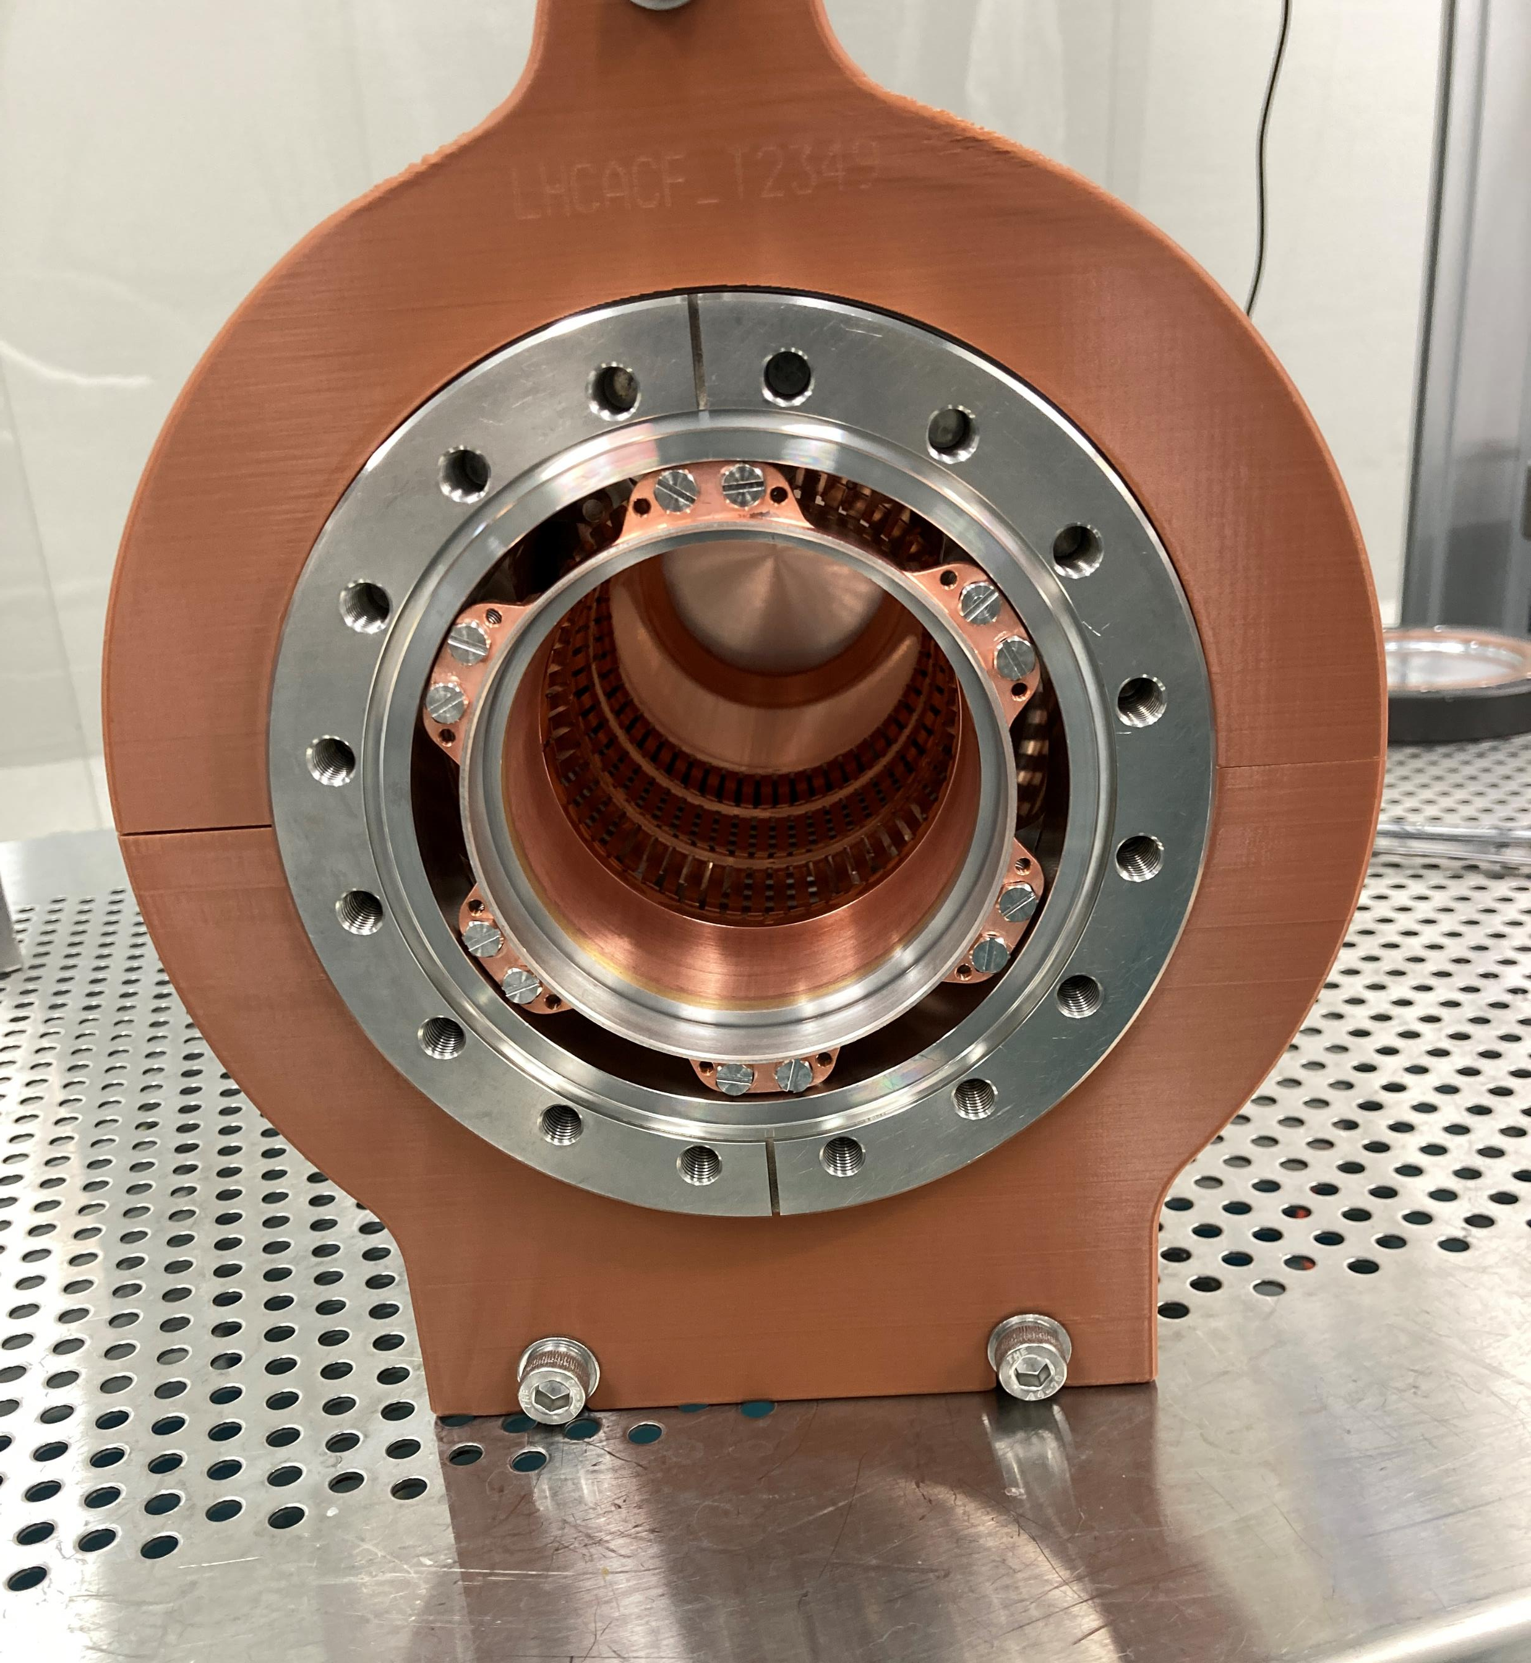
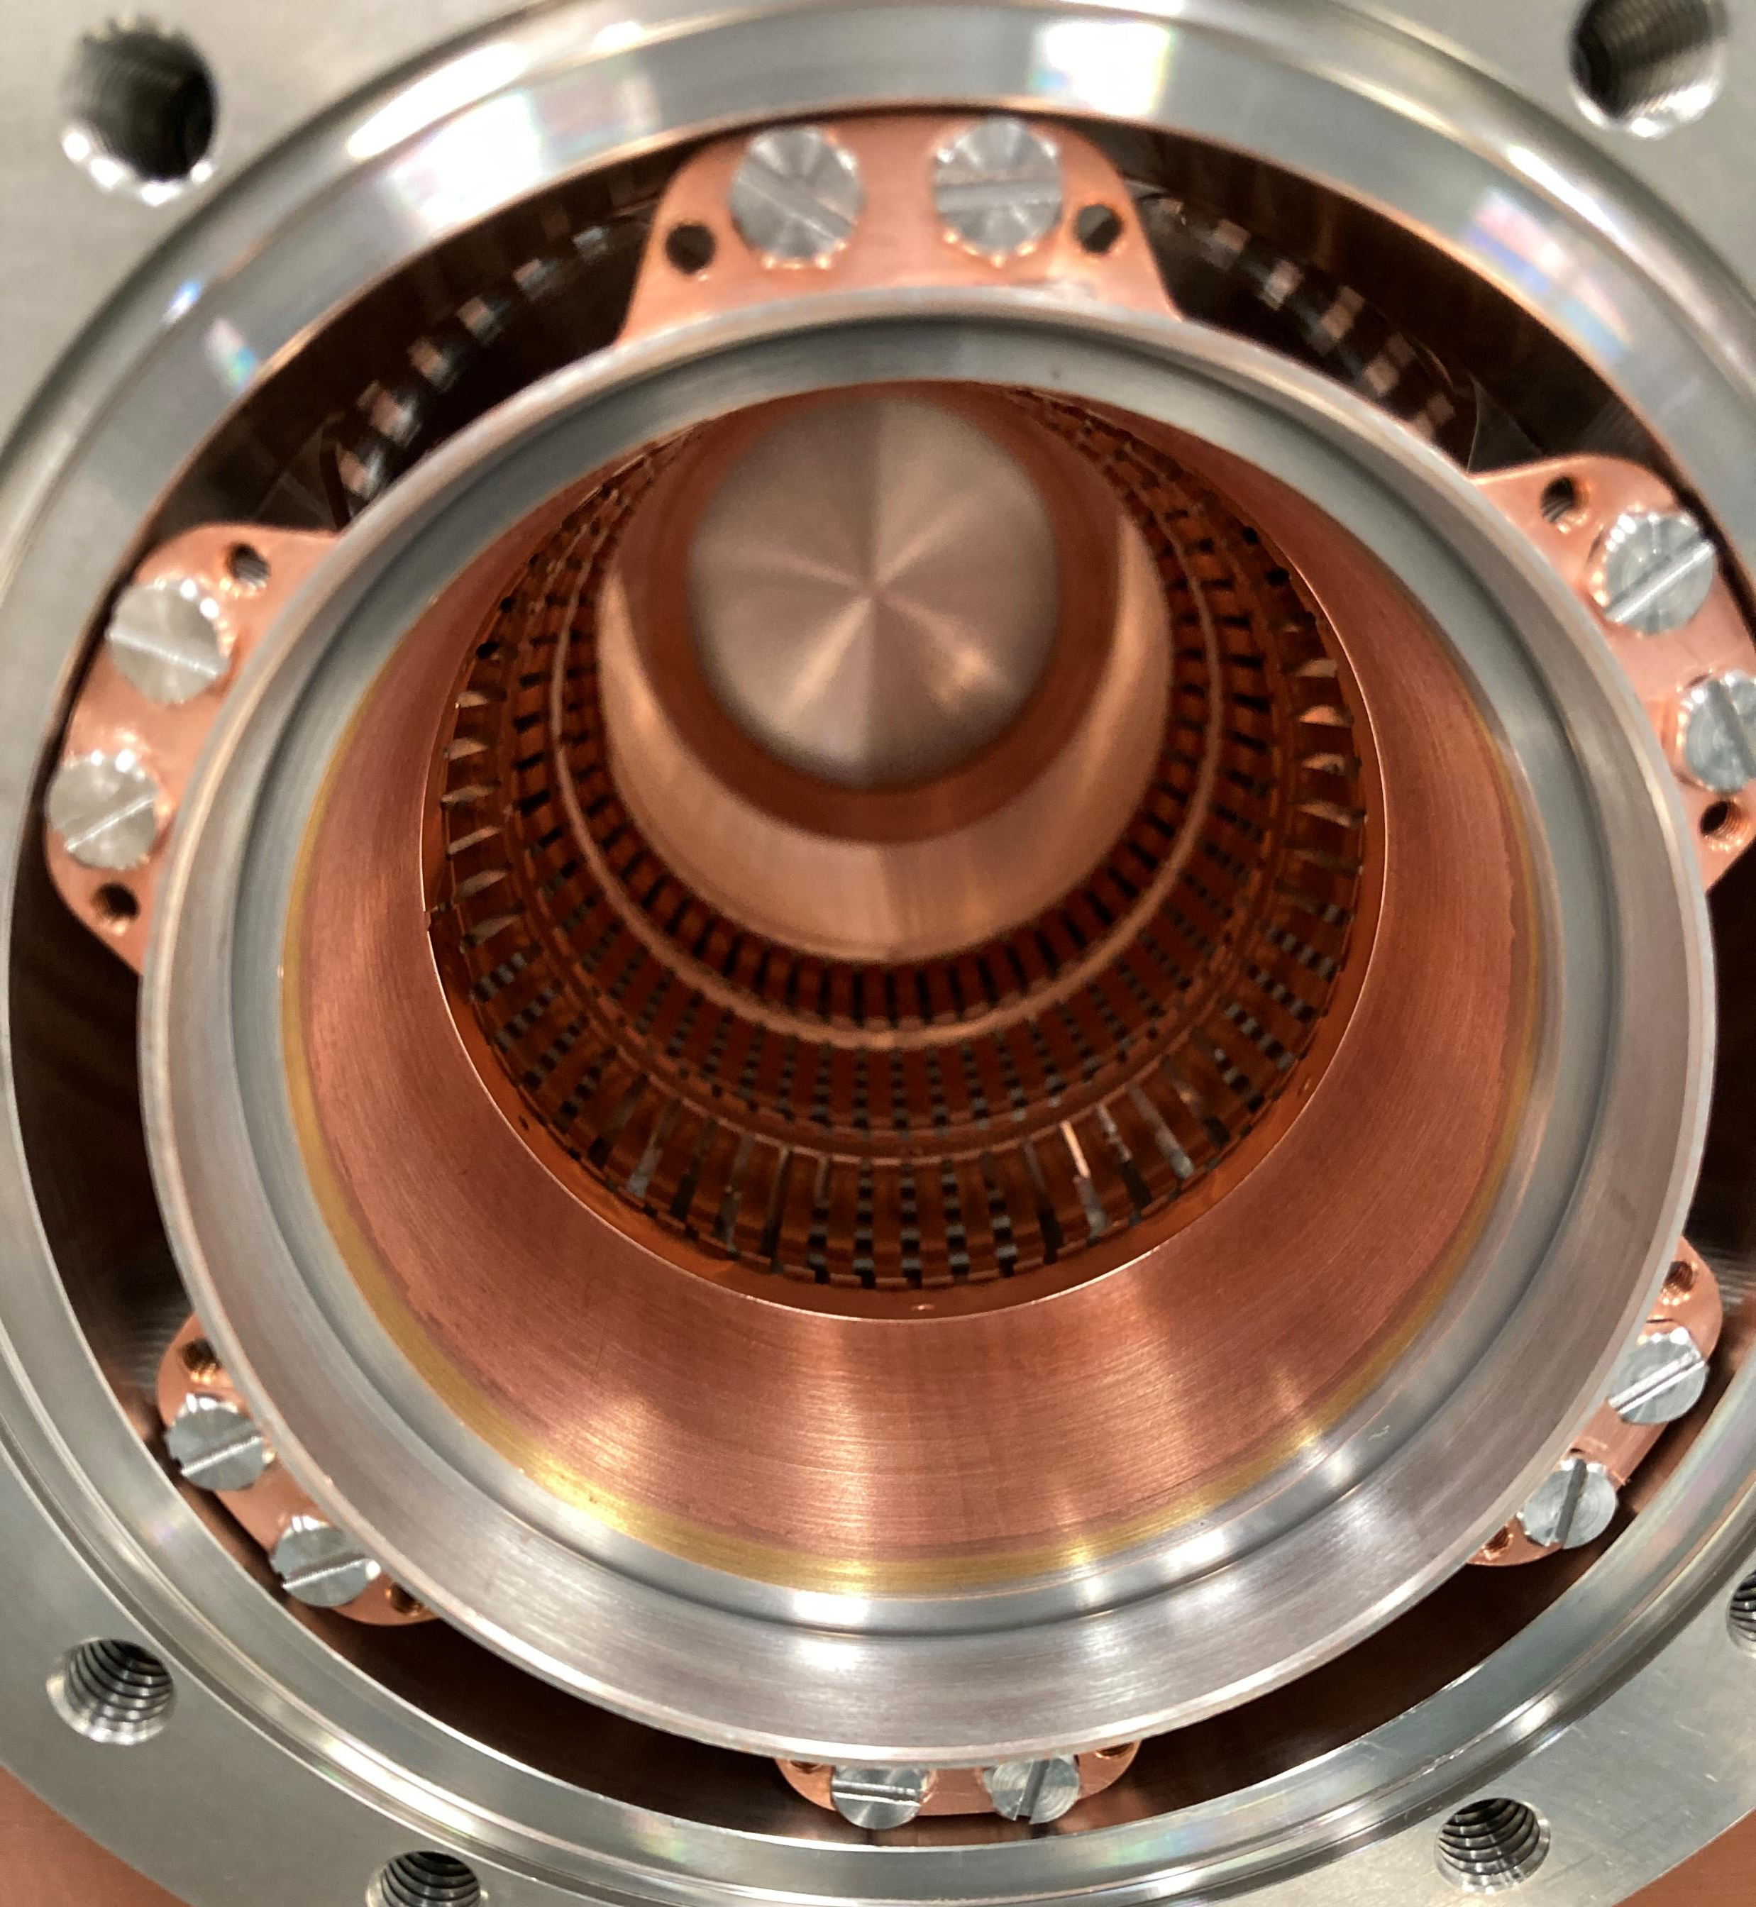
First PIMs received from CERN
Components for first string assembly
Tested in clean room for particulate

Slide 24
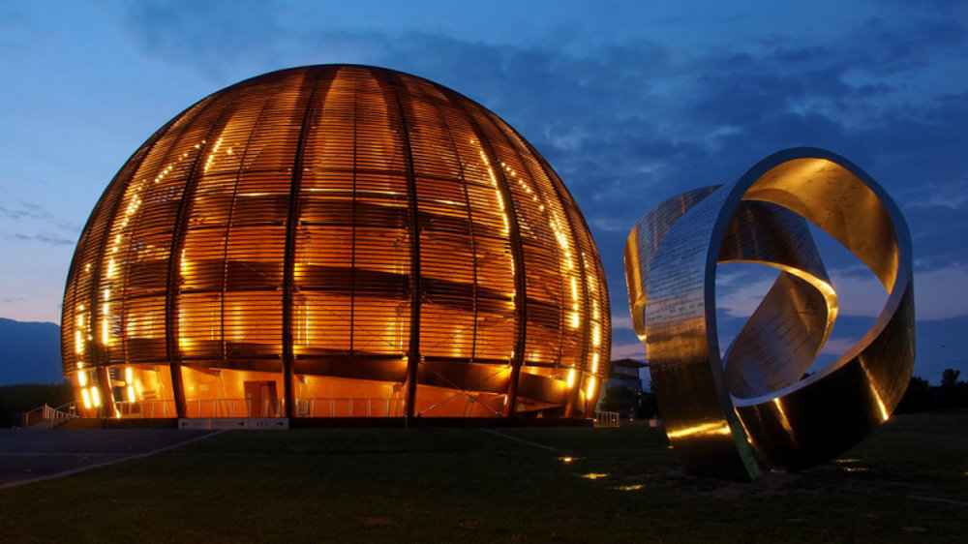
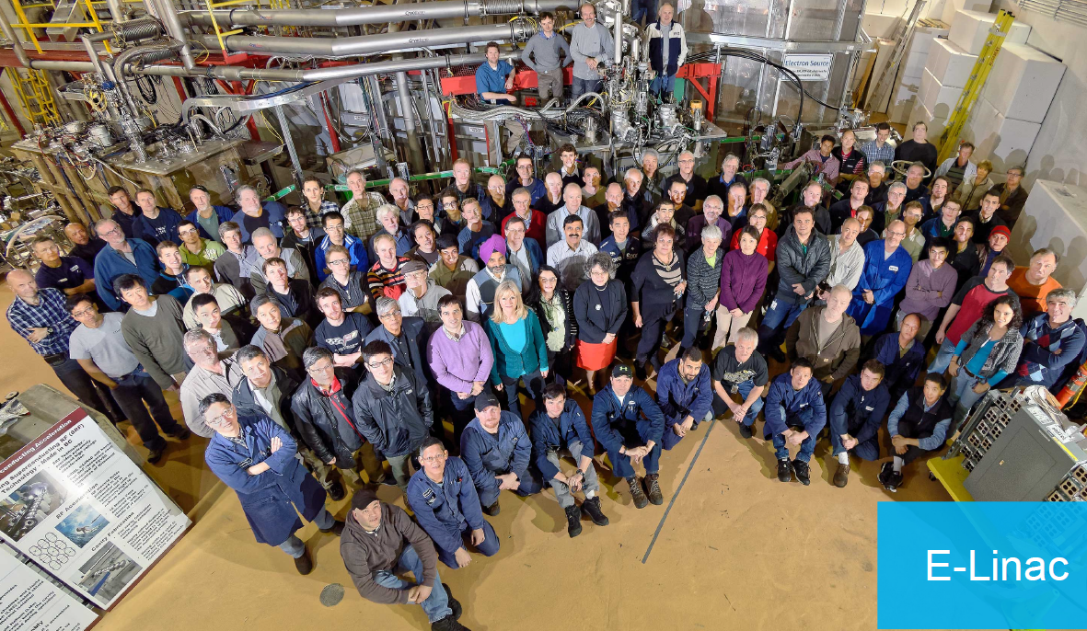

Summary
2024 strategy addresses finite time window for available funds
  Requires timely delivery from vendors (and CERN) of agreed deliverables in order to make payments
Preparing TCM0 and series production CMs
  OVC production launched – series
  OVC material received - series
  Mu-metal – 3 articles received
  First out of scope fabricated parts received from CERN
Cavity testing infrastructure
  4k/2k assembly tested and meets all specs
  Pumping station installed
  Ready for 2k testing
New clean room being installed for Nov. 2024 commissioning
Major assembly infrastructure in hand

Slide 25
Backup slides

Slide 26
Cavity Re-qualification at TRIUMF
CERN acceptance of AUP cavities will happen at TRIUMF
Acceptance criteria are established in a document from AUP following CERNs engineering specification
TRIUMF will receive qualified cavities under vacuum and with test coupler and vacuum diagnostic on board
The acceptance document itemizes a series of warm and cold measurements to confirm that the cavity has not been degraded during transport and is acceptable to be installed in the CM.
26

Slide 27
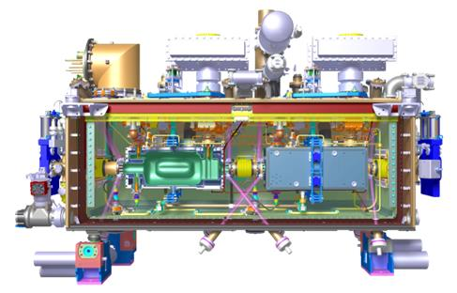
Cryomodule Qualification/Commissioning at TRIUMF
To verify as many performance requirements as possible in cold test
Requirements can be found in CM engineering specification (EDMS 2043014)
  Vacuum cycles
  Warm RF checks
  Cooldown to 77K
  Cooldown to 4K
    Heat loads at 4K
    RF tests at 4K
    alignment check
  No 2K test
A test plan is being drafted.
A CM test is expected to take 4 weeks with 1 week of preparation, 2 weeks of testing and 1 week of warm-up and removal.
The amplifier will be supplied by CERN
27

