Slide 1


Qualification of the first Cold Powering System for the HL-LHC triplets
14th HL-LHC Collaboration Meeting
Amalia Ballarino for the WP6a
A. Ballarino, Y. Leclercq, C. Barth, G. Willering, V. Gahier, F. Pasdeloup,
W. Bailey*, Y. Yang*
*University of Southampton
Genova (Italy), 7-10 October 2024

Slide 2
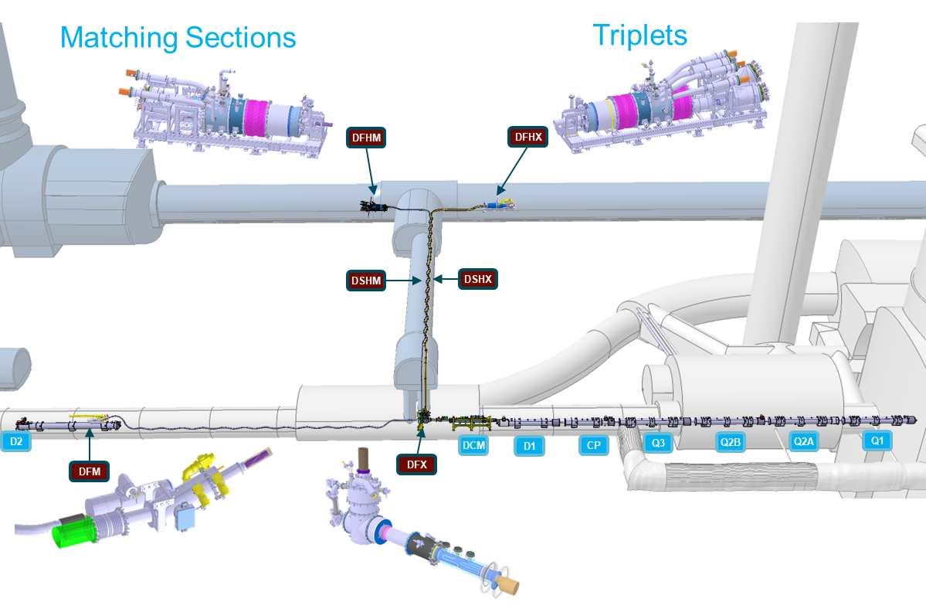
Powering the HL-LHC magnets
8+2 Systems
Two types
SC Link
SC Link
120 m long
|40| kA DC
74.5 m long
|117| kA DC
Vertical path ∼ 8 m

Slide 3
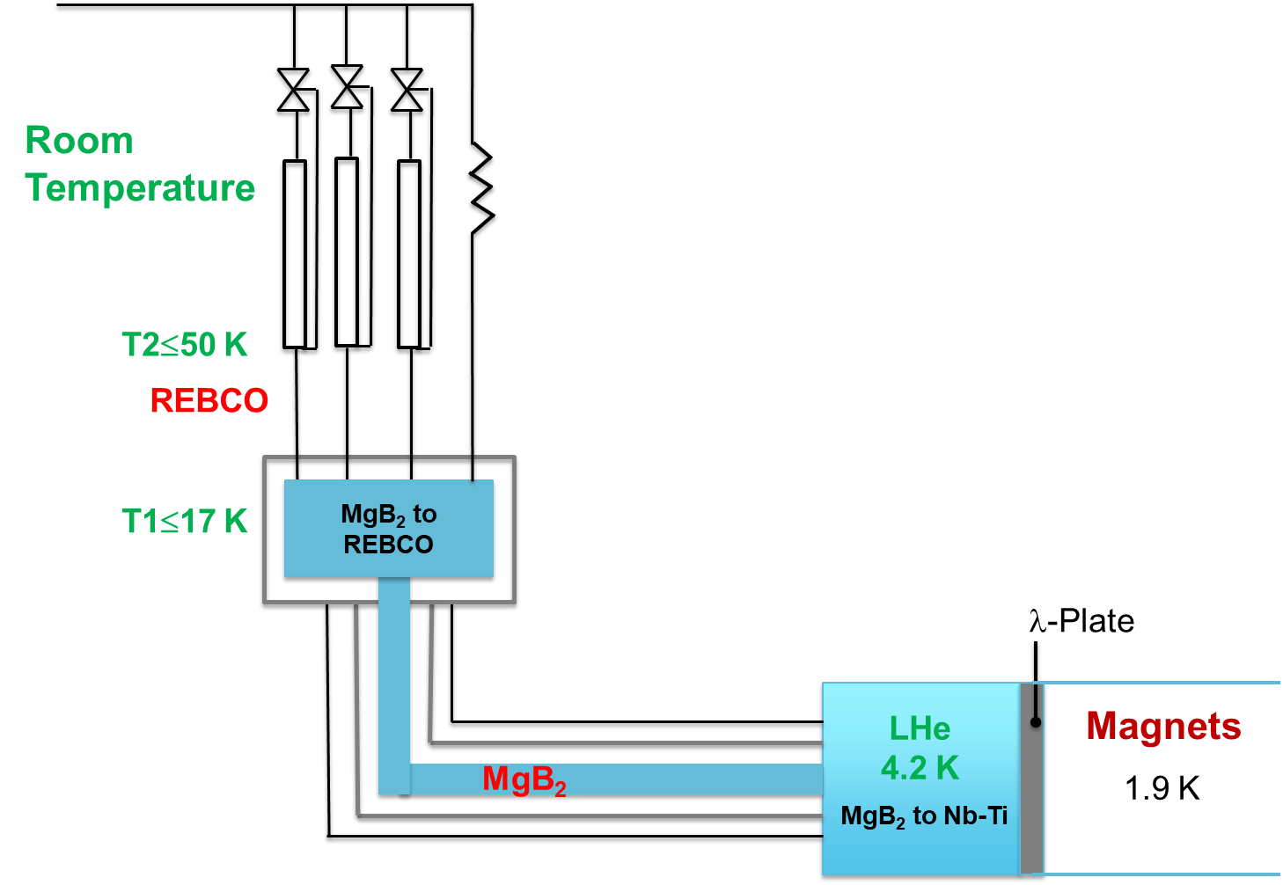
Cold Powering System for HL-LHC Magnets
Itot up to 117 kA DC
mHe by design ≤ 5.5 g/s
mHe controlled by TREBCO
He mass flow rate imposed by the cooling of the current leads
SC Link: transfer line for the helium gas needed for the cooling of the current leads → Low heat load cryostat
Current Leads
TREBCO ≤ 60 K
TMgB₂ ≤ 20 K
DFHX
DFX
SC Link

Slide 4
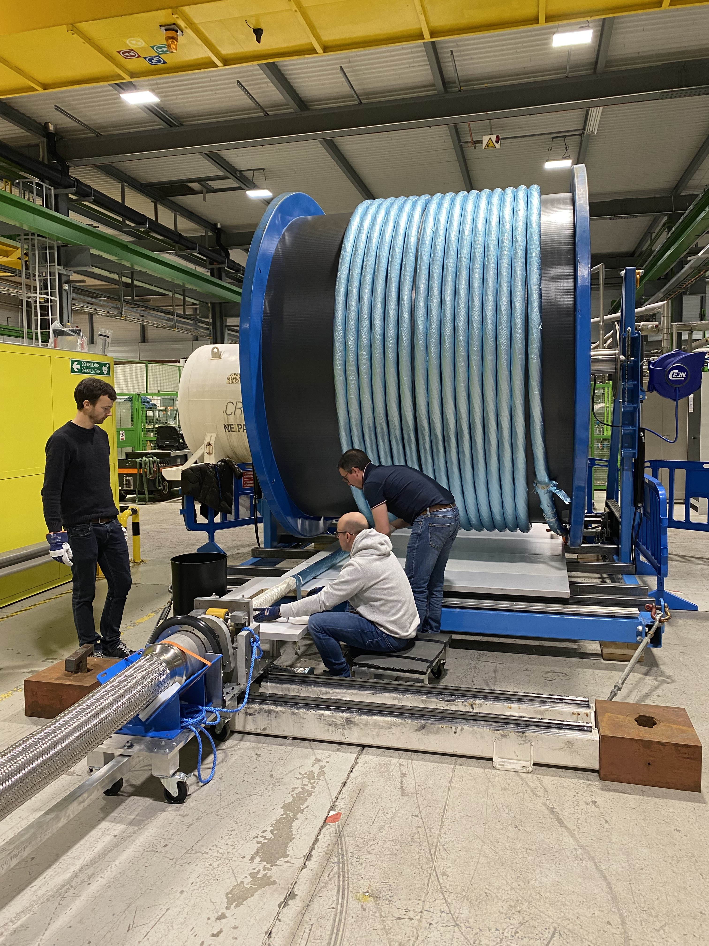
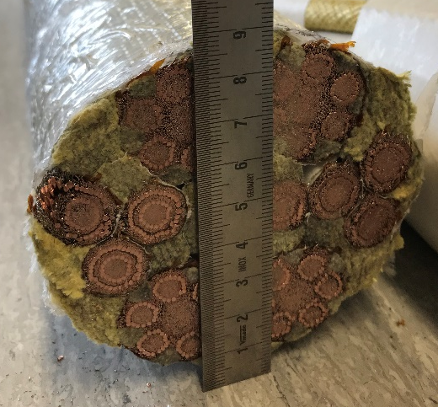
The Superconducting Link for HL-LHC
| 117 | kA @ 25 K
Φ ∼ 90 mm, ∼ 25 kg/m
MgB₂
4×18 kA
12×2 kA (coaxial)
3×7 kA
19 Polarities
REBCO
MgB₂ wire produced at ASG Superconductors
Superconducting Link cryostat produced at Cryoworld
MgB₂ cabling performed at ICAS/TRATOS
REBCO cabling at CERN
A. Ballarino

Slide 5
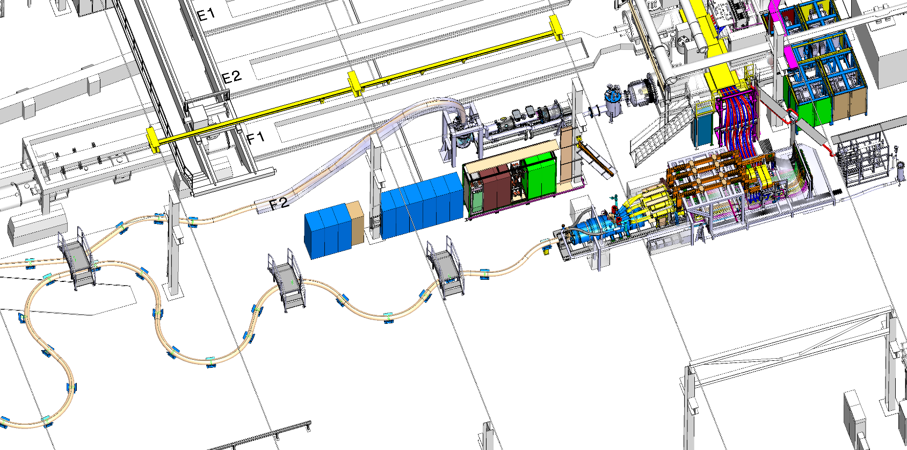
Cold Powering System in the SM-18
LHe
DFX
GHe recovery
DFHX
Superconducting Link
Powering 18 kA, 15 kA, 2 kA, 2 kA

Slide 6
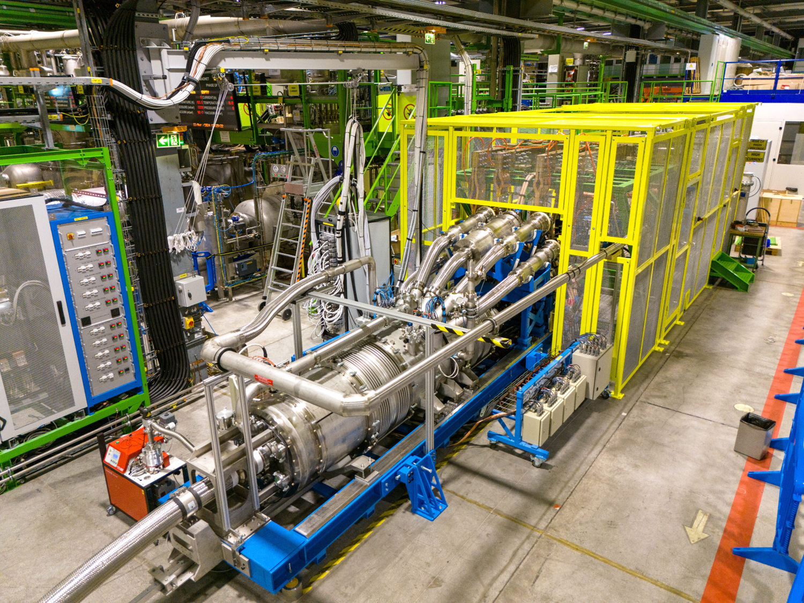
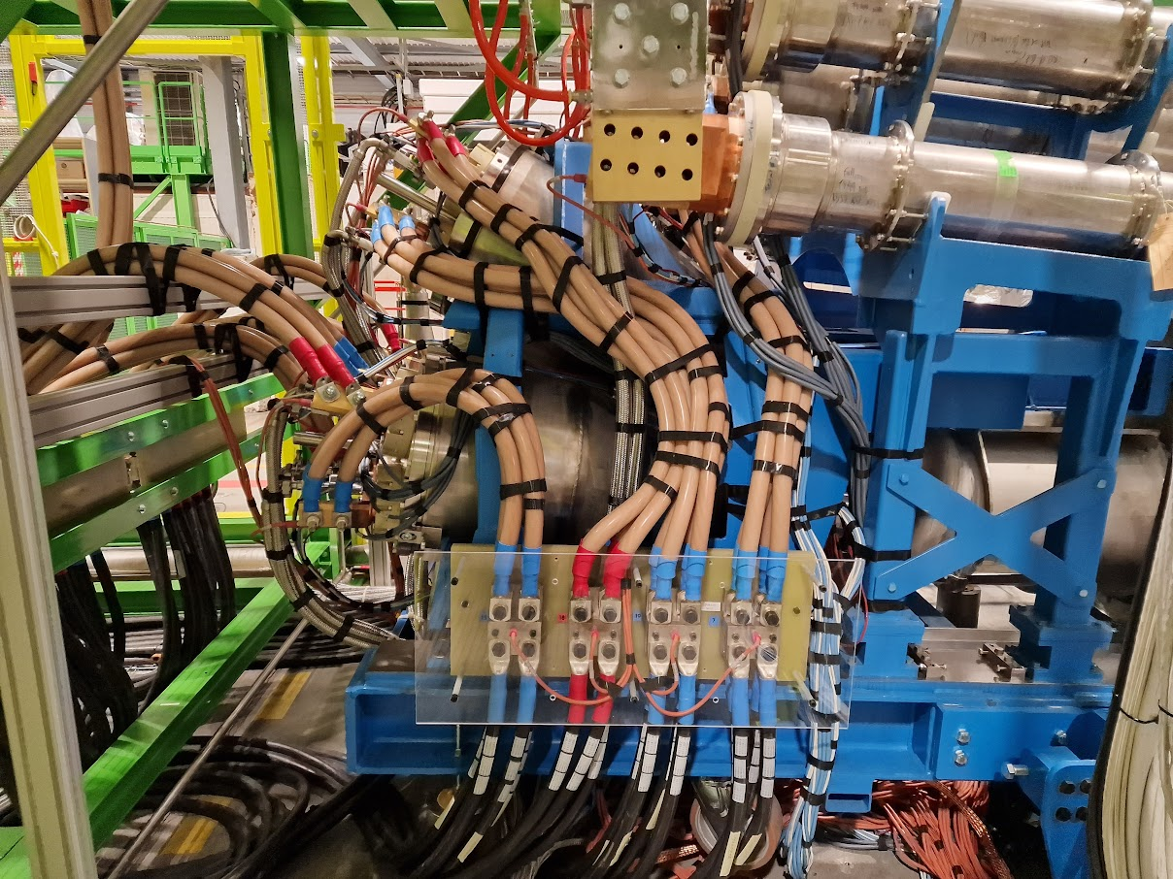
Cold Powering System in the SM-18
DFHX
= System assembly in the SM-18
- Not a “Prototype” – spare system for HL-LHC
- Many “first time” – cryo,vacuum,
mechanical, electrical..
19 Current Leads
Φext ∼ 1 m
Ltot = 5.5 m
Bending radius ≥ 2 m
Q ∼ 1.6 W/m
Cooling with GHe: no thermal shields
Instrumentation signals: 304 voltage taps and 105 temperature sensors

Slide 7
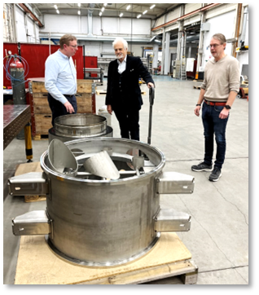
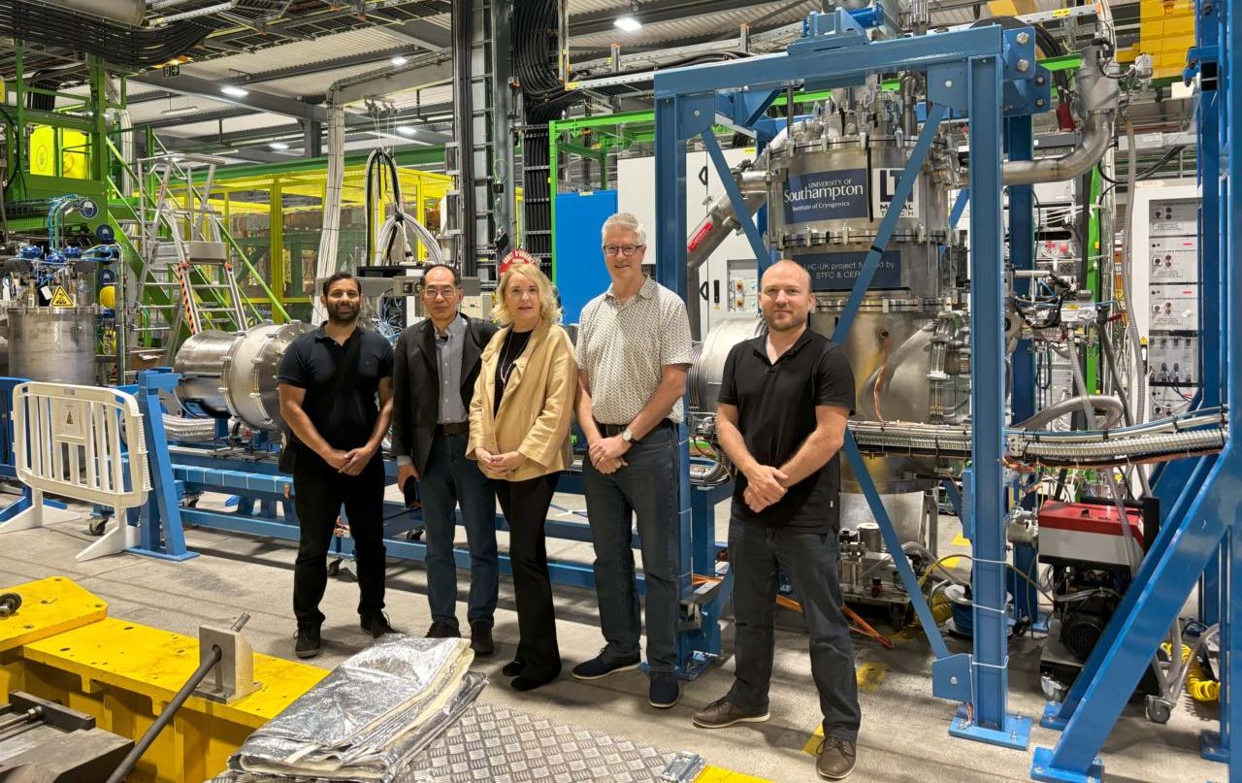
Contributions from our collaborators
University of Southampton - DFX
Uppsala University/RFR – Three components of DFHX
CERN Main Workshop
Manufacturing/assembly of resistive parts of
current leads
Manufacturing of mechanical components of DFHX
Welds in the SM-18
A successful collaborative effort

Slide 8
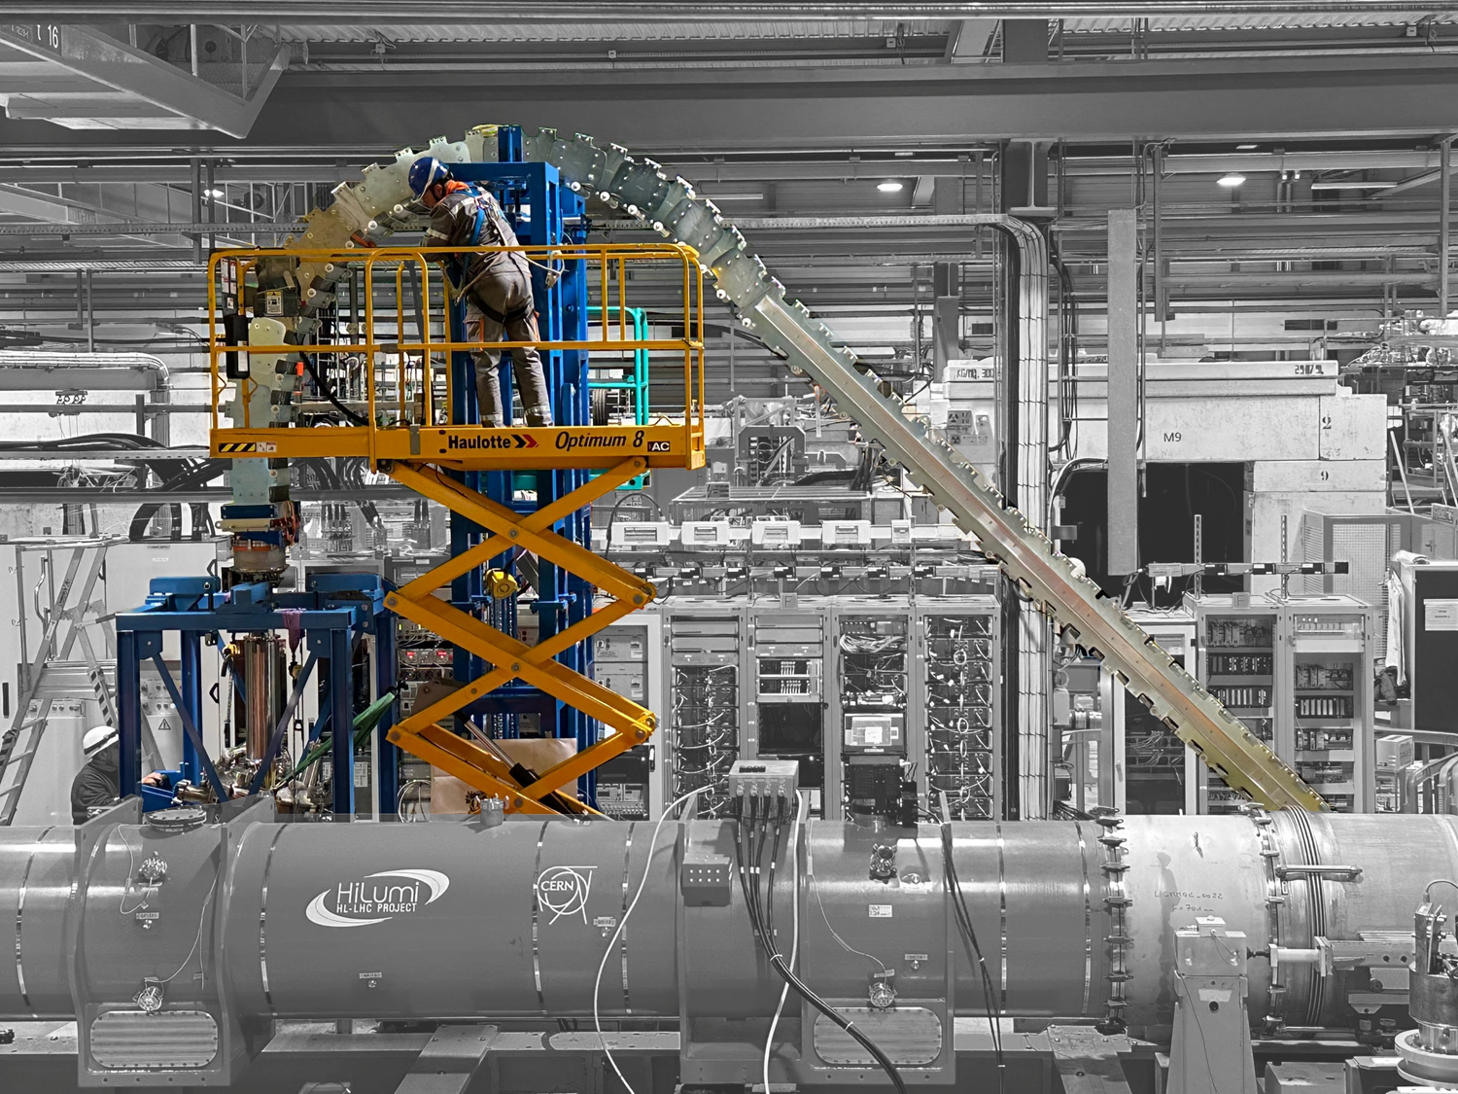
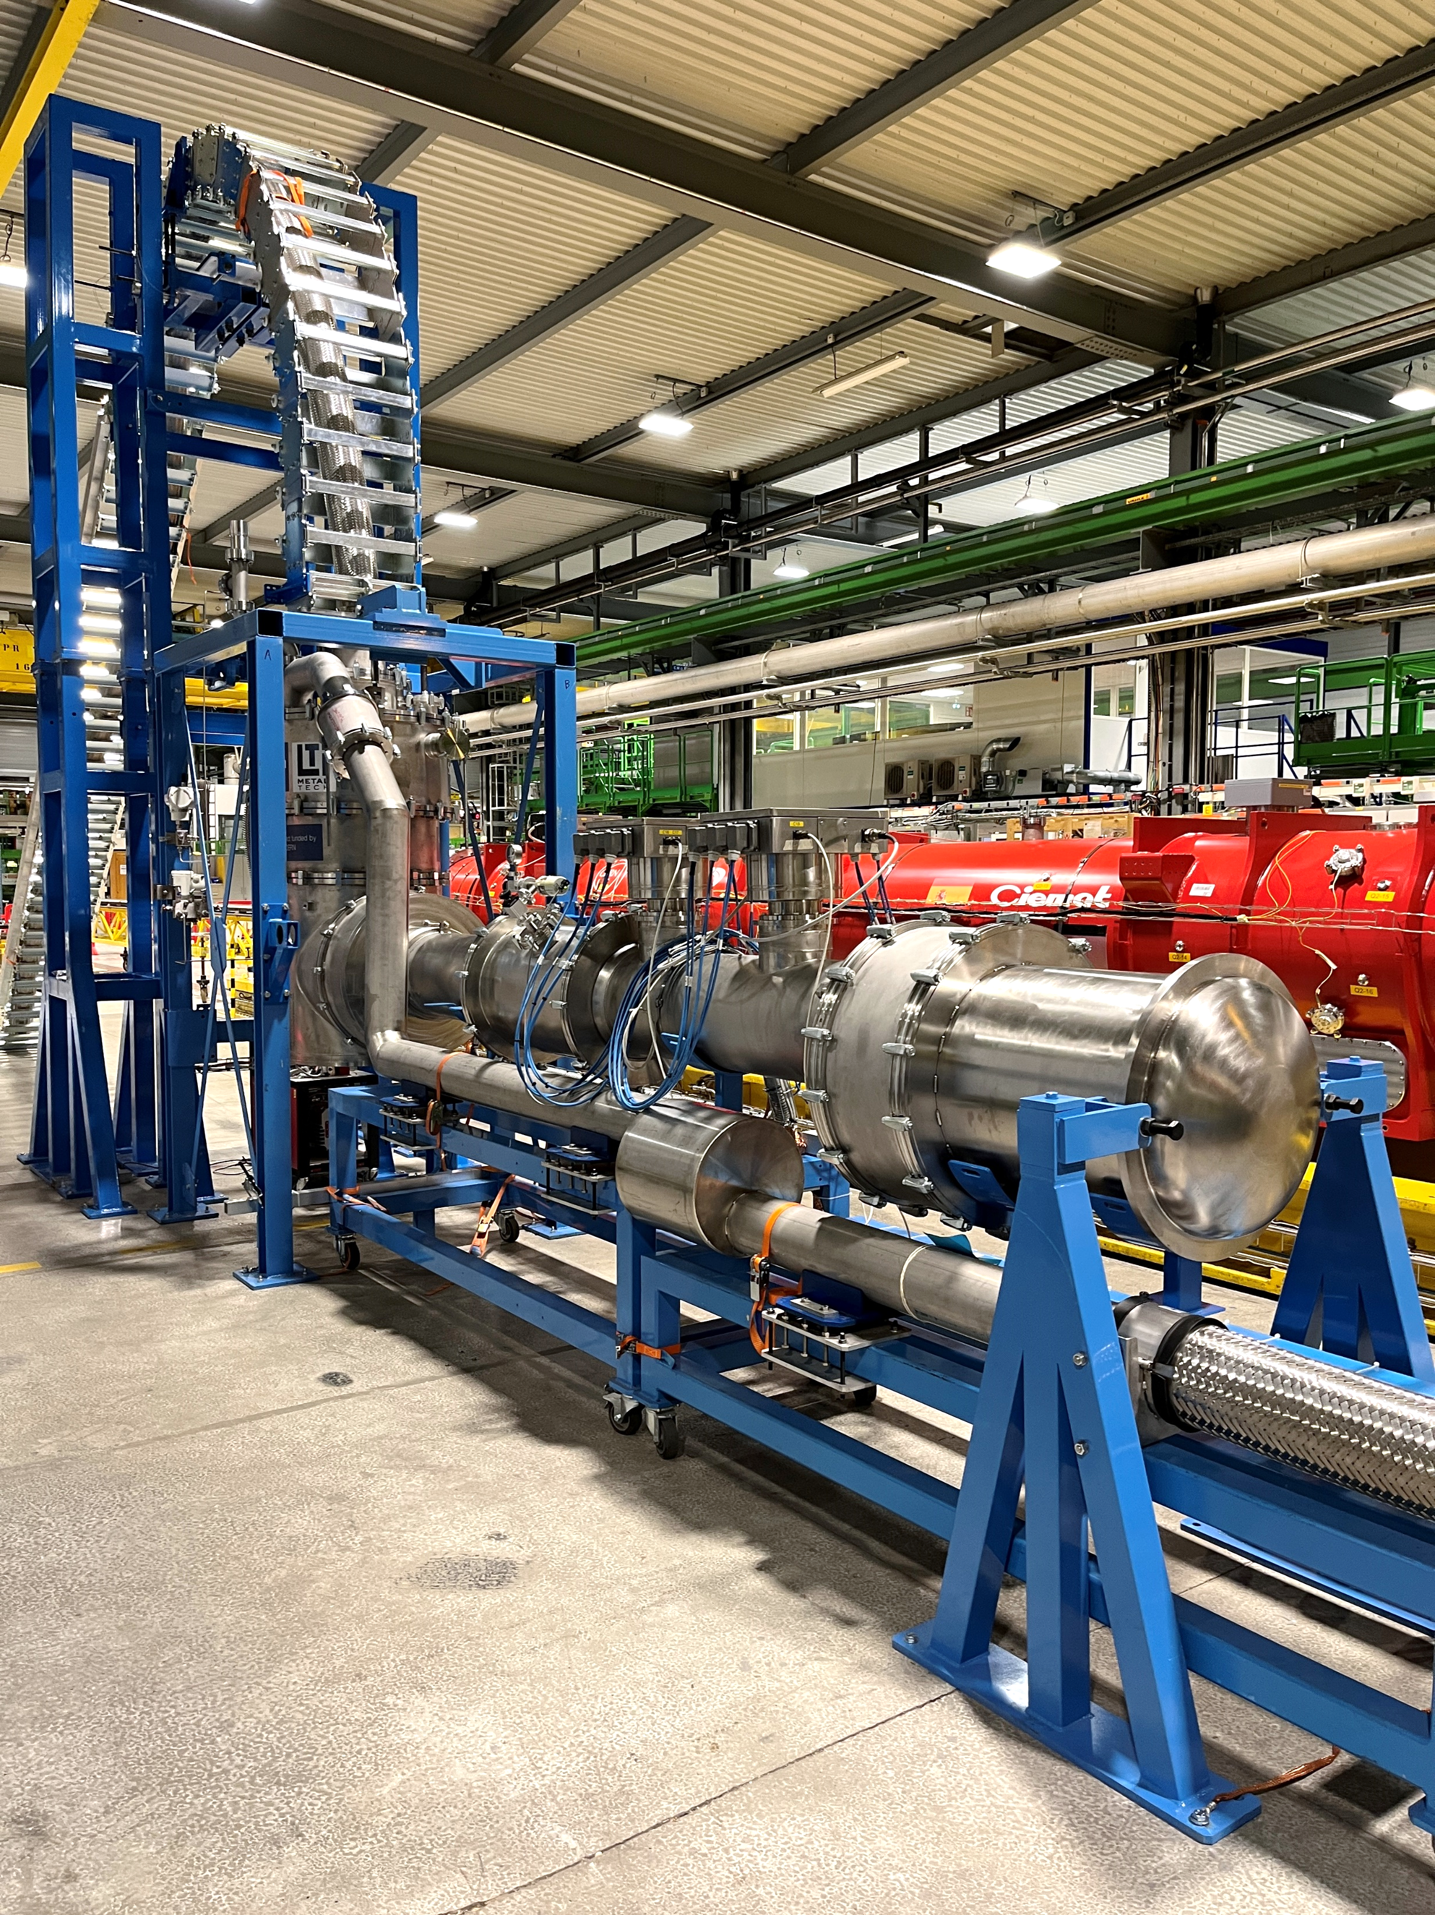
Vertical Path of Superconducting Link
SOTON

Slide 9
Cool-down
After the pressure test (4.6 bara) and the leak test (helium leak rate better than
1.0 × 10⁻⁸ mbar·l·s⁻¹), cool-down to nominal cryogenic conditions was performed
DFHX Temperature
ΔT ≤ 50 K
from RT to 160 K
ΔT ≤ 70 K
from 160 K to 15 K
DFX Temperature
m = 2 g/s - 3 g/s
15 K

Slide 10
Layout of DFX
MgB₂ to Nb-Ti
Nb-Ti
WP6a
WP3

Slide 11
Dealing with Thermal Contractions
F = Fixed Point
Movements
(up to 3 cm)
Two thermal cycles (from room temperature to cryogenic conditions) followed by powering of all circuits. Repetitive performance
Notes:
guide rollers

Slide 12
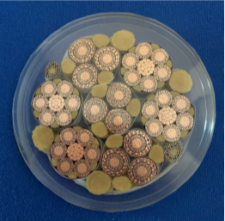
Powering Scheme
Four power converters:
18 kA – I_{HL-LHC} = 16.23 kA (Nb₃Sn quadrupole)
15 kA – I_{HL-LHC} = 12.11 kA (Separation dipole)
2 kA – I_{HL-LHC} = 2 kA (Trim)
2 kA – I_{HL-LHC} = 1.74 kA (Correctors)
T sensors on MgB₂
to REBCO
T sensors on REBCO
T sensors on MgB₂
Maximum current delivered by the power converters: 94 kA

Slide 13
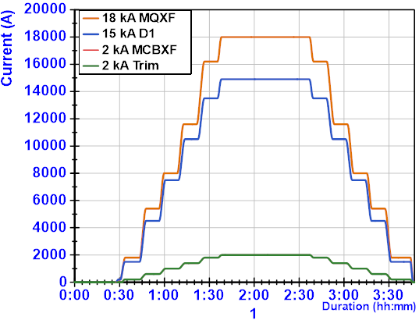
Cryogenic and Electrical Performance (1/2)
94 kA
4.9 g/s
0 A
3.5 g/s
Mass flow rate dominated by requirement of optimized current leads: ∼ 0.05 g/(s⋅kA)

Slide 14
Cryogenic and Electrical Performance (2/2)
94 kA
0 A
4.9 g/s
4.9 g/s
3.5 g/s
High voltage tests (2.3 kV among polarities and between each polarity and the ground) in nominal cryogenic conditions successfully performed (leakage currents < 10 μA)

Slide 15
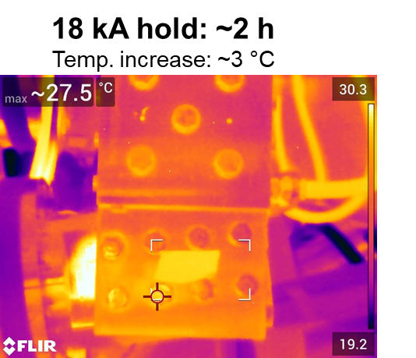
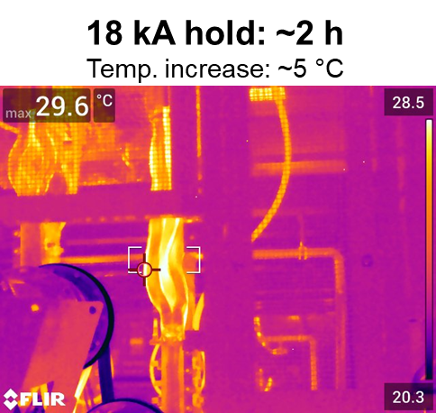
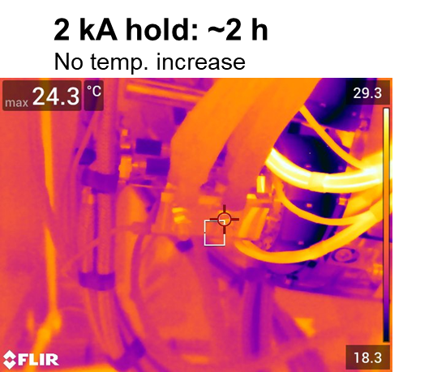
Room Temperature Terminations
Maximum 5 °C increase at maximum current, no condensation during any operating condition (both at zero current and with current)

Slide 16
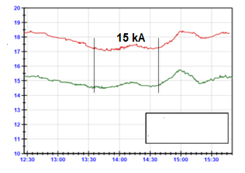
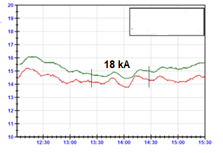
Splices
REBCO to MgB₂, GHe @ 20 K
MgB₂ to Nb-Ti, LHe @ 4.5 K
Nb-Ti to Nb-Ti, LHe @ 4.5 K
Stable performance, no overheating, temperature of splices independent of current (± 1 K)
MgB₂ to REBCO
MgB₂ to
REBCO
Temperature
Temperature
MgB₂ to
REBCO
time
time

Slide 17
Transient Behavior
Successfully validated:
  Cryogenic requirement during transients
Capability of operating without liquid helium supply during 10 minutes with MgB₂ to Nb-Ti splices immersed in liquid helium. Capability of producing up to 10 g/s of GHe
  Electrical requirement (cross talks)
Absence of cross talk among circuits – via electro-magnetic coupling. Fast discharges (up to 100 A/s) of the 2 kA circuits do not trigger the quench protection system of any of the other circuits
  High Voltage insulation
  Each circuit tested at 5 kV in air, 2.3 kV in nominal cryogenic conditions, and 1.1 kV in GHe at room temperature. Measured leakage currents 100 times lower than specified limit

Slide 18
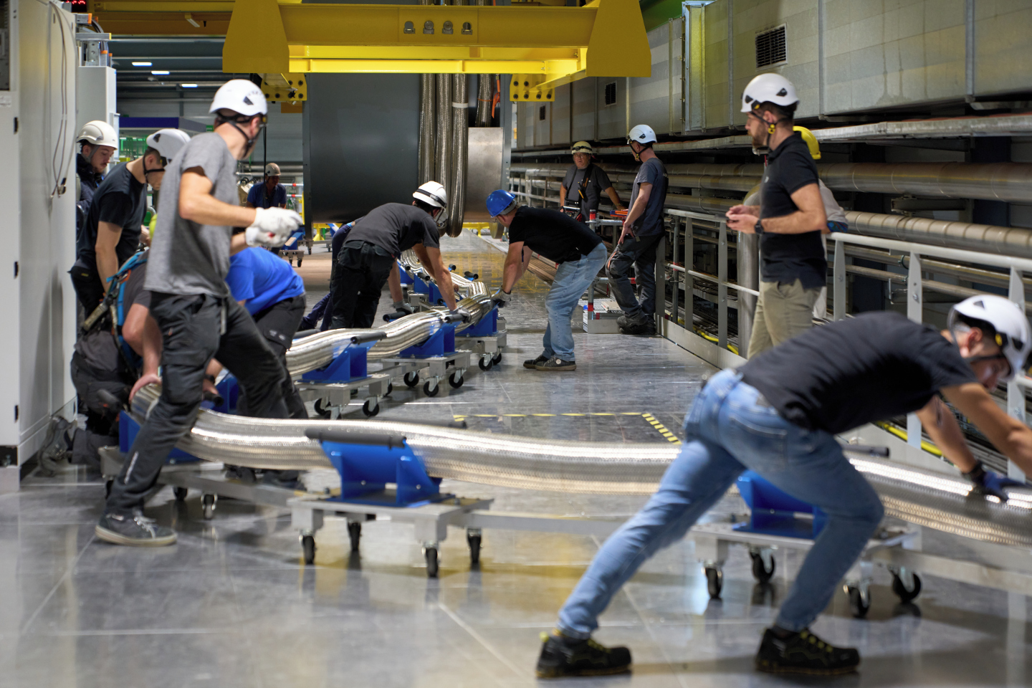
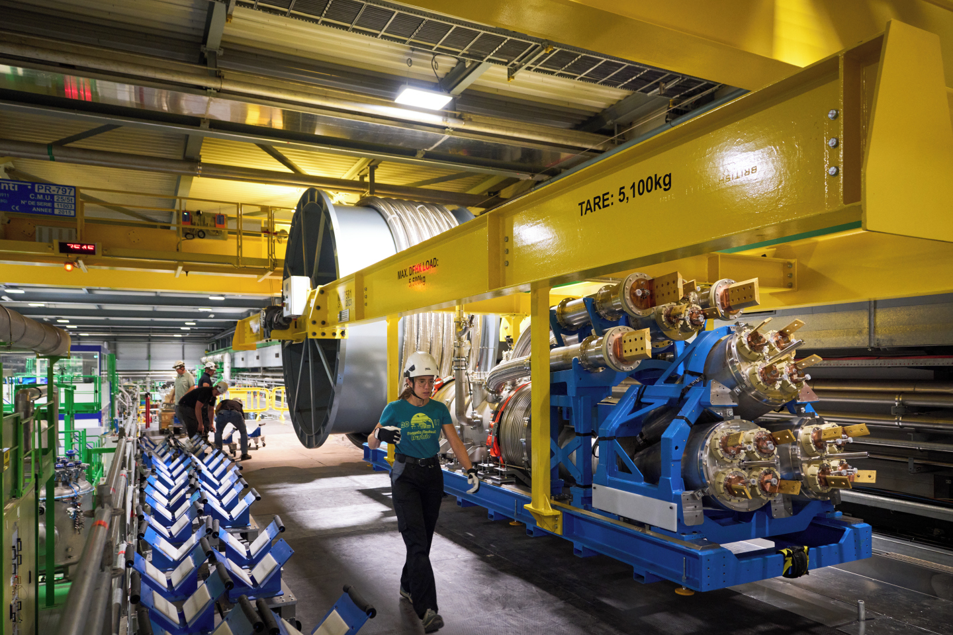
Re-spooling/Transport of SC Link + DFHX
Compactness of DFHX and flexibility of the SC Link enable assembly and qualification of the
Systems at the surface (before installation in the LHC underground)
See presentation of Y. Leclercq on Wednesday (WP6a in String)

Slide 19
Conclusions
The first Cold Powering System for the HL-LHC Triplets has been successfully validated: cryogenic, electrical and mechanical performance all met design parameters. Robustness of the system in different operating modes was proven
The system transferred up to |94| kA (maximum current delivered by power converters) in DC mode and in nominal cryogenic conditions: MgB₂ @ 20 K and REBCO @ 60 K. Operation of MgB₂ is up to 29 K and of REBCO up to 70 K (∼ 10 K temperature margin)
Components of the Cold Powering Systems have been industrialized. They are today in an advanced phase of series production, and several series productions are completed (recently DFHX components)
The system has been opened, re-spooled, transported and installed in the String. This was also a good exercise for what will have a to done for the tunnel installation

Slide 20
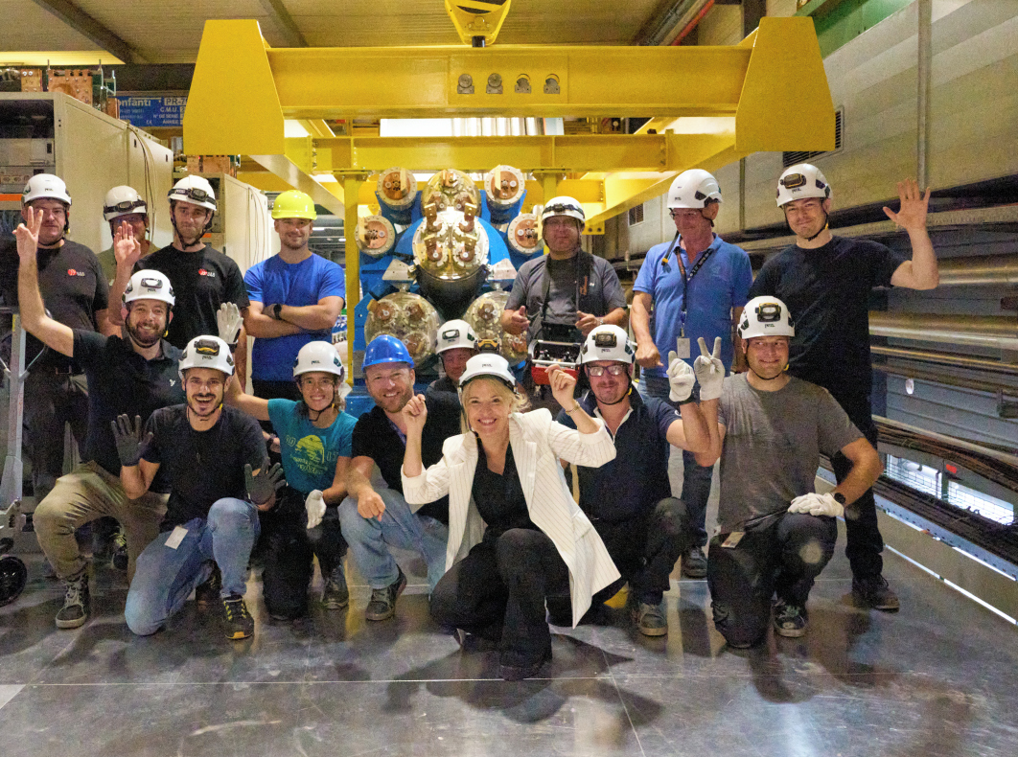
A phantastic team !

Slide 21
Thanks for your attention !
Acknowledgements:
O. Pirotte, R. Mauny and J. Gery from the TE-CRG group
G. Pichon and S. Juberg form SM-18 TE-MSC operating team
W. Maan and G. Barlow from the TE-VSC group
P. Moyret and L. Deparis from the EN CERN Main Workshop
QPS and ELQA teams from the TE-MPE group
C. Bertone and E. Richards and the EN-HE transport team
Our collaborators: University of Southampton and University of Uppsala

Slide 22
