Slide 1

WP6B outlook on IT String Operation
Michele Martino – CERN
on behalf of WP6B
14th HL-LHC Collaboration Meeting – Genova – Italia – October 8th 2024

Slide 2
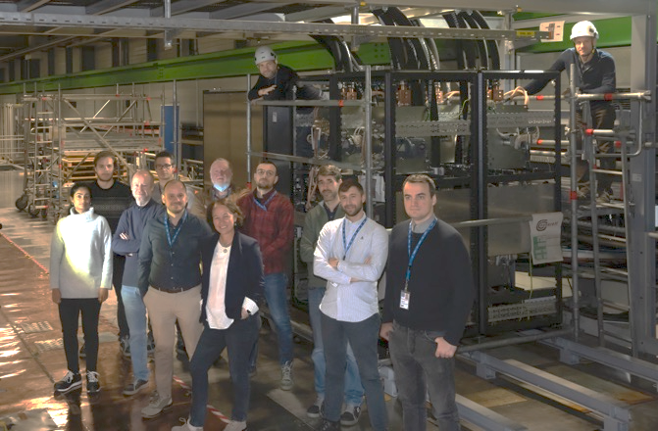
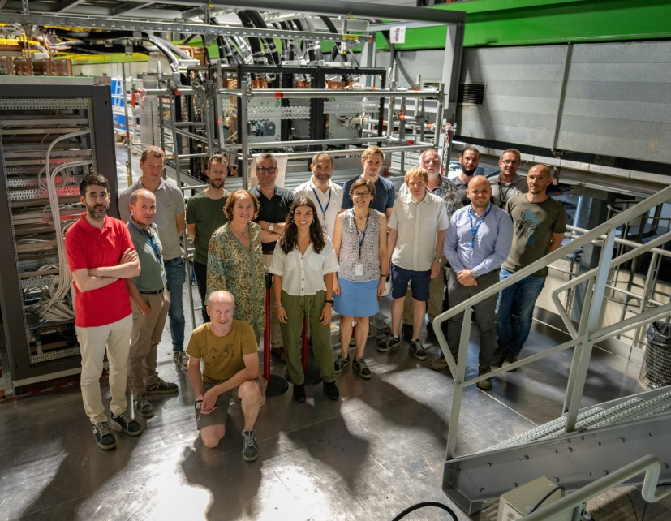
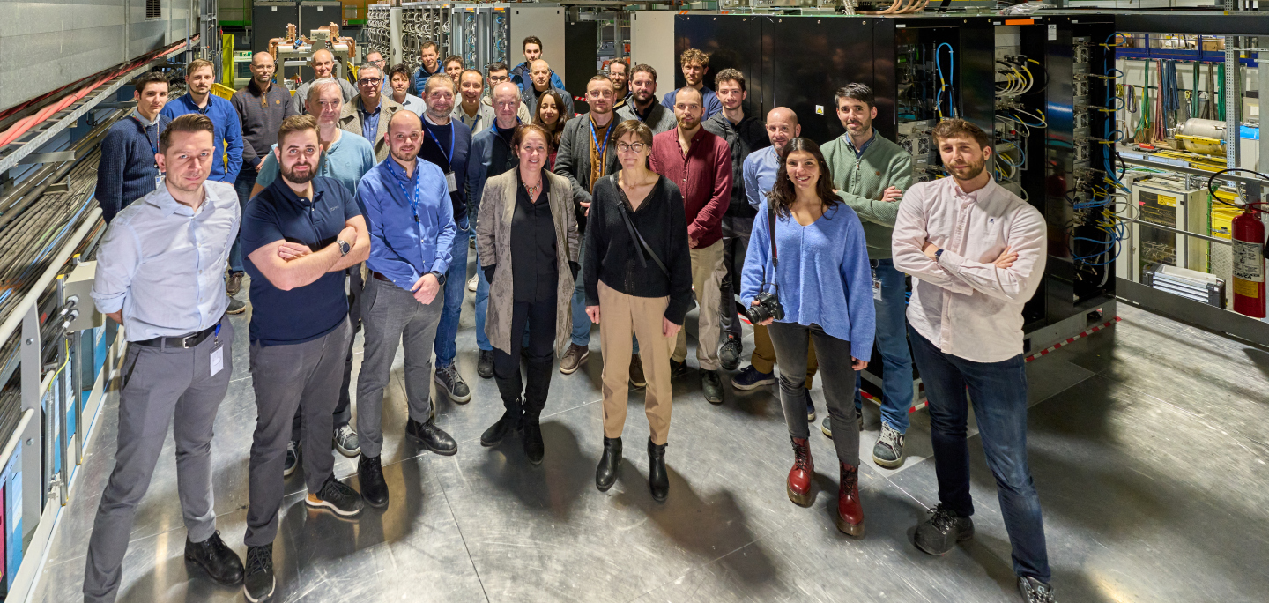
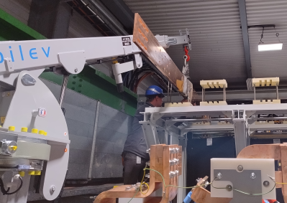
Brief summary of the installation steps
CDBs installed in the STRING with SY-EPC and STRING team October 2022
PC racks installed in the STRING with SY-EPC, WP6B March 2023
“…the CDBs were the first equipment belonging to a HL-LHC WP (the WP6B) installed into the STRING…”
All WP6B equipment installed but WCBBs and 18kA crowbar January 2024
Installation of WCBBs April 2024

Slide 3
First Commissioning Steps
Lessons learnt
Control, Signal and Power Cables QC
Water Cooling Network QC
Electrical Distribution
Network QC
1
    “Experience with WP6B equipment operation in the HL-LHC IT String”
    by H. Thiesen – MCF Parallel Session- Thursday October 10th – 9:10
    +
    Dedicated sessions in WP15 in May and September 2024
Results
    “IST and SCT in the IT String: results” by S. Yammine – WP16 Parallel Session – Wednesday October 9th – 11:30
2
Water Cooled Cables IST
LHC-XMS-OP-0002
Connection of Systems to Infrastructure
(Power Cables, Electrical Distribution and Water Cooling)
3
    “Experience with WP6B equipment operation in the HL-LHC IT String”
    by H. Thiesen – MCF Parallel Session- Thursday October 10th – 9:10
4
HSE Inspection
(Hydraulic and Electrical)
Power Converter and CDB IST
Energy Extraction System IST
LHC-XMS-OP-0001
5
LHC-XMS-OP-0005
6
Short Circuit Tests (with PICv2)
LHC-XMS-OP-0003
Courtesy of Samer Yammine (TE-MPE/WP16)

Slide 4
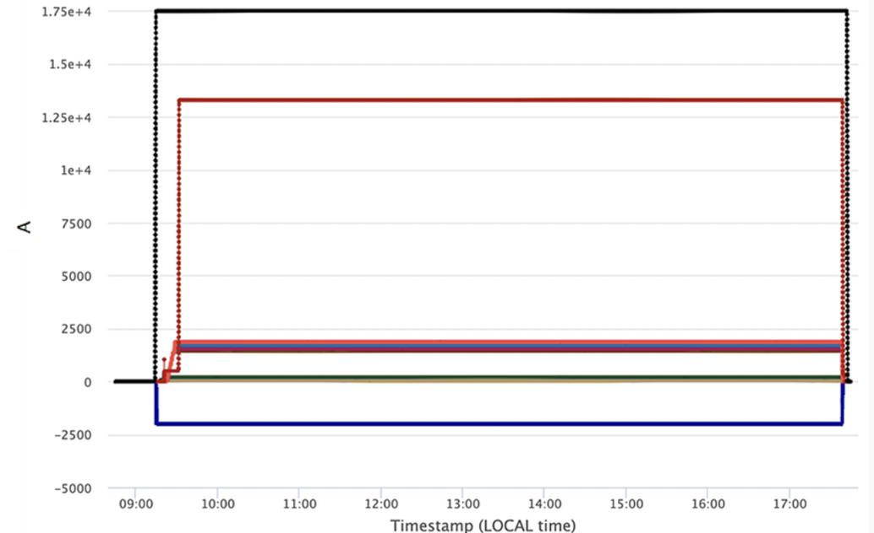
First Commissioning Steps
  Successful completion of ISTs and SCTs in May’24 with 8h Heat Run at Ultimate Currents _{or beyond} ✓
  18kA RPAFE proto tested for the first time in IT String
  Tests included all WP6B equipment with short circuits implemented by means of the dedicated CLs mock-up put in place by WP16
when “boring” _{Marta Bajko words} is good news
17.5 kA IT Main
13.3 kA D1
A big thank you to all teams involved in WP6B and other WPs !
Courtesy of Marta Bajko (TE-MPE/WP16)
Up to 1.864 kA OCs
-2 kA IT Trims

Slide 5
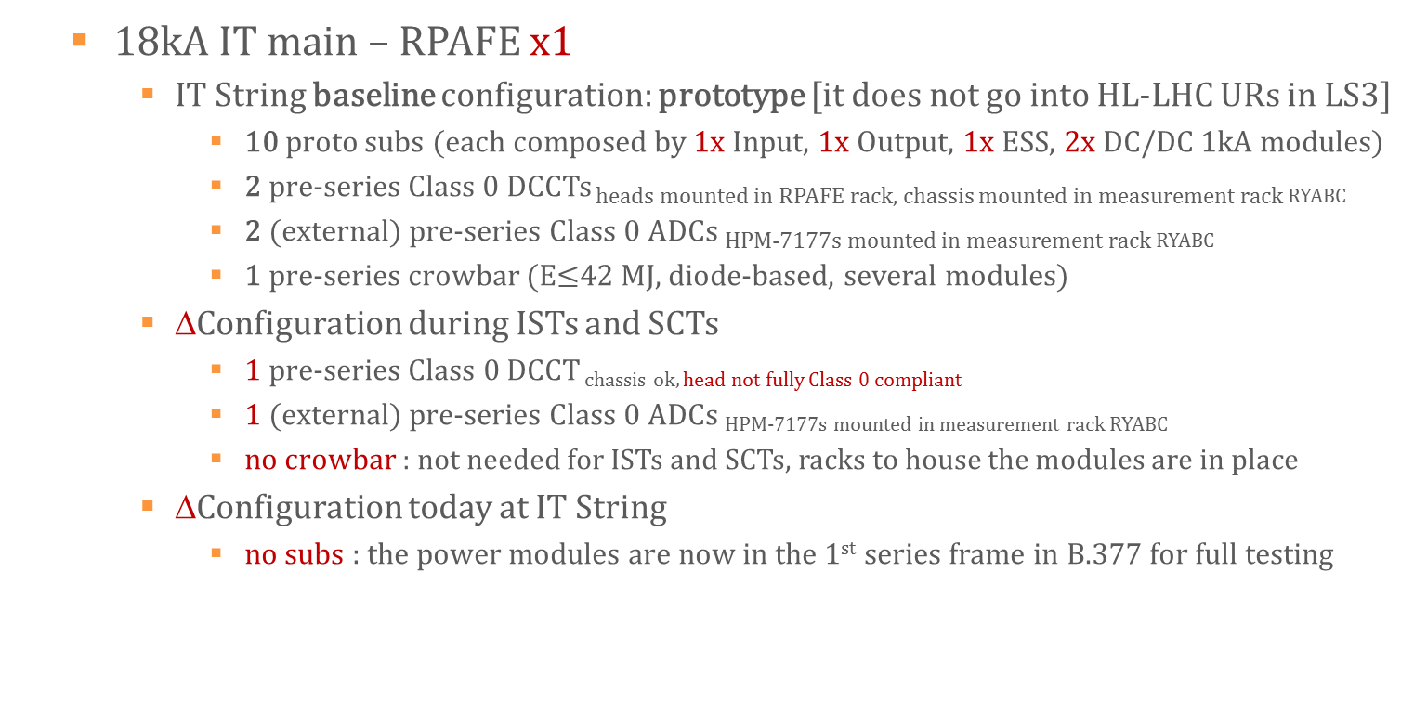
Status of WP6B IT String equipment
  18kA IT main – RPAFE x1
    IT String baseline configuration: prototype [it does not go into HL-LHC URs in LS3]
      10 proto subs (each composed by 1x Input, 1x Output, 1x ESS, 2x DC/DC 1kA modules)
      2 pre-series Class 0 DCCTs heads mounted in RPAFE rack, chassis mounted in measurement rack RYABC
      2 (external) pre-series Class 0 ADCs HPM-7177s mounted in measurement rack RYABC
      1 pre-series crowbar (E$≤$42 MJ, diode-based, several modules)
    ∆Configuration during ISTs and SCTs
      1 pre-series Class 0 DCCT chassis ok, head not fully Class 0 compliant
      1 (external) pre-series Class 0 ADCs HPM-7177s mounted in measurement rack RYABC
      no crowbar : not needed for ISTs and SCTs, racks to house the modules are in place
    ∆Configuration today at IT String
      no subs : the power modules are now in the 1st series frame in B.377 for full testing

Slide 6
Status of WP6B IT String equipment
  14kA D1 – RPAFF x1
    IT String baseline configuration: prototype [it does not go into HL-LHC URs in LS3]
      8 proto subs (each composed by 1x Input, 2x Output modules)
      2 pre-series Class 0 DCCTs heads mounted in RPAFF rack, chassis mounted in measurement rack RYABC
      2 (external) pre-series Class 0 ADCs HPM-7177s mounted in measurement rack RYABC
      1 proto diode-based crowbar (3 independent free-wheeling paths)
    ∆Configuration during ISTs and SCTs
      7 operational proto subs : the 8th proto sub needs repairing
      1 pre-series Class 0 DCCT chassis ok, head not fully Class 0 compliant
      1 (external) pre-series Class 0 ADCs HPM-7177s mounted in measurement rack RYABC
    ∆Configuration today at IT String
      no subs : the power modules are now in B.377 for full testing

Slide 7
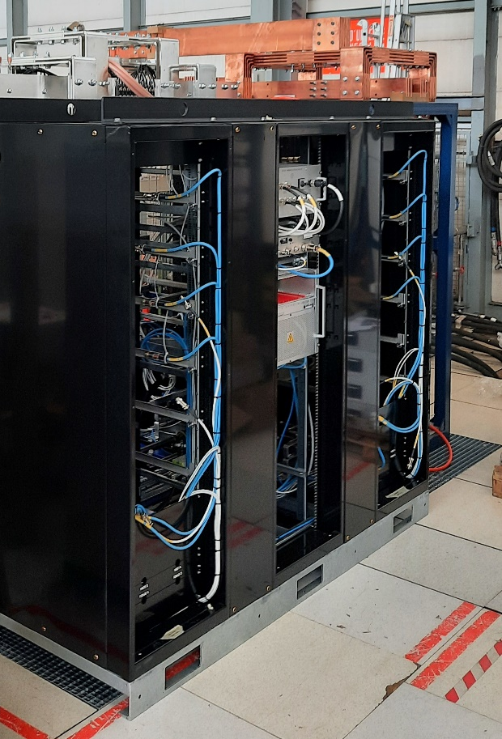
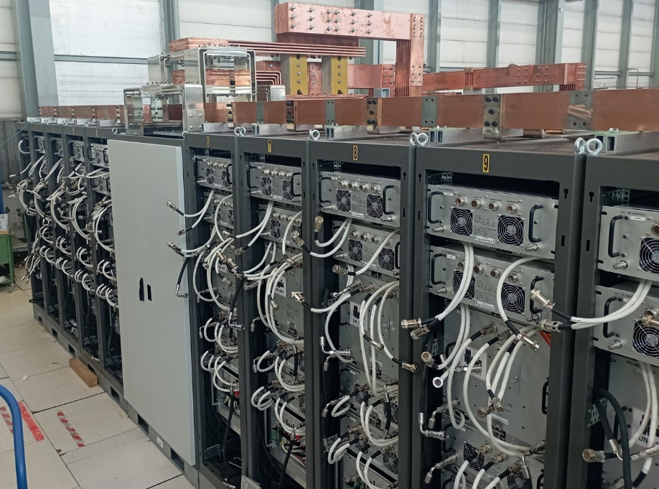
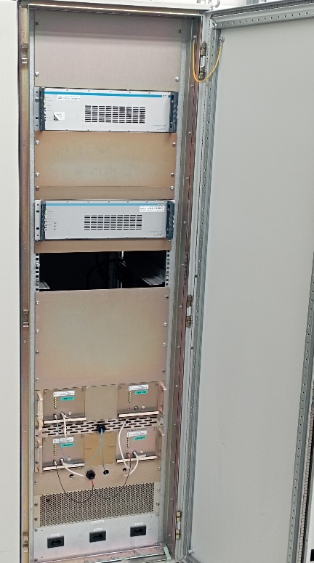
Status of WP6B IT String equipment
Reference
DCCTs
chassis
ADCs
18kA RPAFE under test in B. 377
14kA RPAFF under test in B. 377

Slide 8
Status of WP6B IT String equipment
  2kA IT Trims – RPBAF x2
    IT String baseline configuration: pre-series
      6 pre-series subs (rated 400A)
      2 pre-series Class 2 DCCTs heads and chassis both mounted in RPBAF rack
      2 (external) pre-series Class 0 ADCs HPM-7177s mounted in RPBAF rack
      1 pre-series diode-based crowbar
    ∆Configuration during ISTs and SCTs
      1 temporary DCCT SY-EPC spare – head and chassis mounted in RPBAF rack
      0 (external) pre-series Class 0 ADCs, using FGC3.1 internal ADC (ANA103) instead
    ∆Configuration today at IT String
      one of the two RPBAF is fully equipped, the temporary DCCT chassis of the other one has been de-installed
      water distribution already improved* although strictly needed only in the URs ☺
*: 195th TCC – M. Martino - Technical update WP6B – 24/05/2024

Slide 9
Status of WP6B IT String equipment
  2kA Orbit Correctors – RPBAE x6
    IT String baseline configuration: pre-series
      6 pre-series subs (rated 400A)
      2 pre-series Class 2 DCCTs heads and chassis both mounted in RPBAE rack
      2 (external) pre-series Class 0 ADCs HPM-7177s mounted in RPBAE rack
      1 pre-series thyristor-based crowbar
    ∆Configuration during ISTs and SCTs
      1 temporary DCCT SY-EPC spare – head and chassis mounted in RPBAE rack
      0 (external) pre-series Class 0 ADCs, using FGC3.1 internal ADC (ANA103) instead
    ∆Configuration today at IT String
      one of the six RPBAE is fully equipped, the temporary DCCT chassis of the other five have been de-installed
      water distribution already improved although strictly needed only in the URs ☺
*: 195th TCC – M. Martino - Technical update WP6B – 24/05/2024

Slide 10
Status of WP6B IT String equipment
  200A SF 2nd order Corrector – RPMBG x1
    IT String baseline configuration: series
      as operational R2E-LHC-600A-10V units, but special EES in HL-LHC _{grounded at mid-EES}
      Class 3 accuracy performance _{of rating = 600A}
    ∆Configuration during ISTs and SCTs
      no discrepancies
      it requires a series inductance to safely perform SCTs (due to EES)*
    ∆Configuration today at IT String
      no discrepancies
*: 195th TCC – M. Martino - Technical update WP6B – 24/05/2024

Slide 11
Status of WP6B IT String equipment
  120A SF HO Correctors – RPLBB x8
    IT String baseline configuration: spare LHC [they don’t go into HL-LHC URs in LS3]
      as LHC-120A-10V units currently in operation in LHC
      FGCLite Controller (as in the HL-LHC machine), Class 4 performance _{of rating = 120A}
    ∆Configuration during ISTs and SCTs
      no discrepancies
    ∆Configuration today at IT String
      no discrepancies

Slide 12
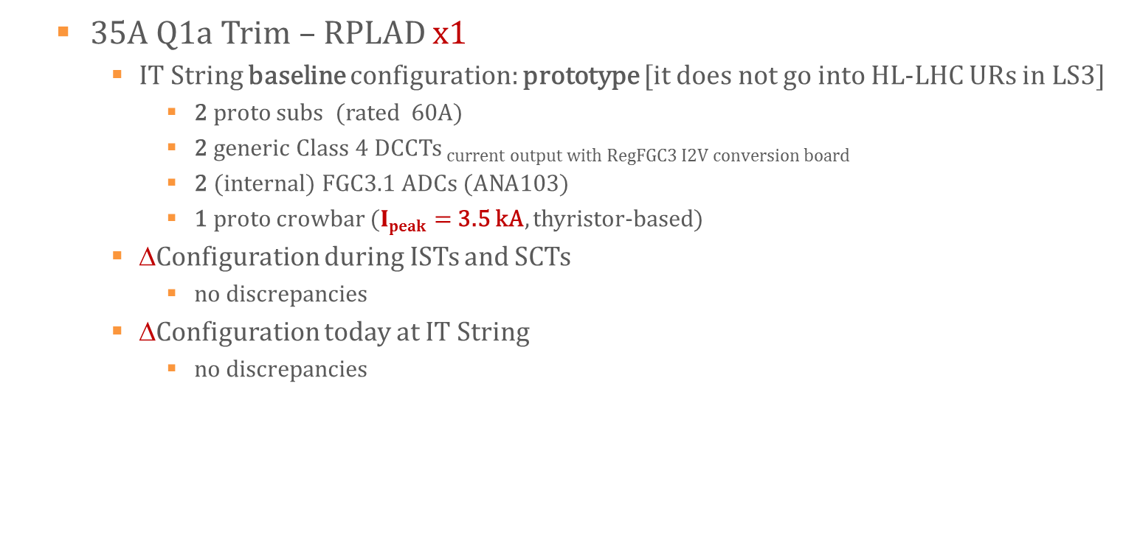
Status of WP6B IT String equipment
  35A Q1a Trim – RPLAD x1
    IT String baseline configuration: prototype [it does not go into HL-LHC URs in LS3]
      2 proto subs (rated 60A)
      2 generic Class 4 DCCTs current output with RegFGC3 I2V conversion board
      2 (internal) FGC3.1 ADCs (ANA103)
      1 proto crowbar ($Ipeak=$ 3.5 kA, thyristor-based)
    ∆Configuration during ISTs and SCTs
      no discrepancies
    ∆Configuration today at IT String
      no discrepancies

Slide 13
Status of WP6B IT String equipment
  CDBs 18kA x2 _{18kA and 14kA}
    IT String baseline configuration: (pre)series
    ∆Configuration during ISTs and SCTs
      no discrepancies
    ∆Configuration today at IT String
      no discrepancies
  CDBs 2kA x8 and 600A x2 _{35A + warm diodes}
    IT String baseline configuration: (pre)series
    ∆Configuration during ISTs and SCTs
      no discrepancies
    ∆Configuration today at IT String
      no discrepancies
  WCBBs 18kA x4 _{18kA x2 and 14kA x2}
    IT String baseline : (pre)series
    ∆Configuration during ISTs and SCTs
      no discrepancies
      WCPs do not comply yet in terms of electrical isolation
    ∆Configuration today at IT String
      no discrepancies
  Control Electronics
    Infrastructure is fully operational ✓
    WorldFIP_{FGCLite} + FGC_{etherFGC3.1} + PLC_{CDBs}
    Currently installed IT Interlock Panel proto is validated ✓

Slide 14
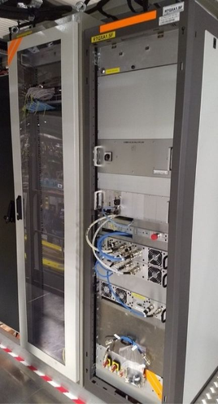
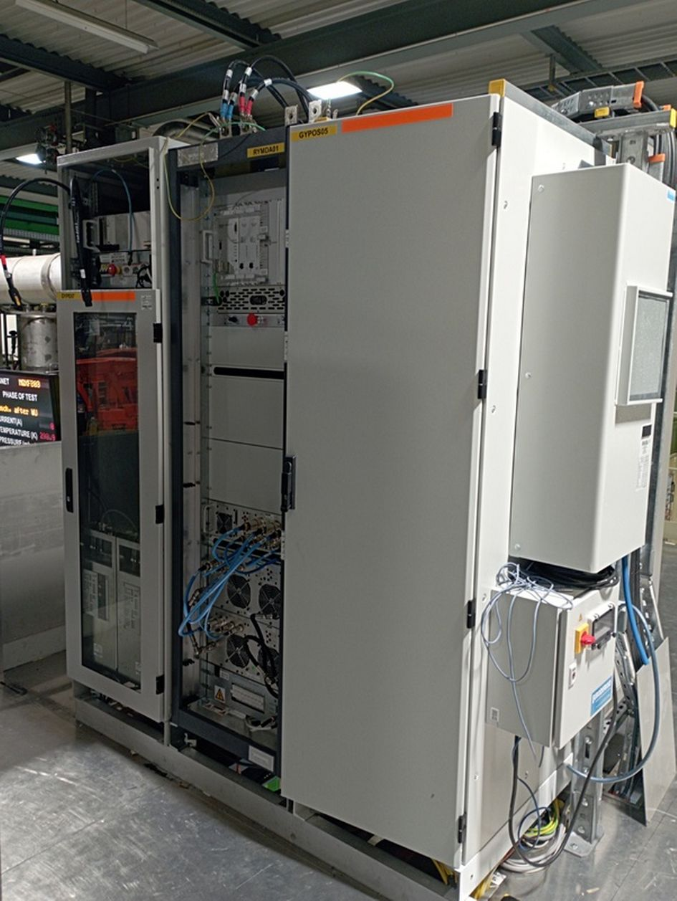
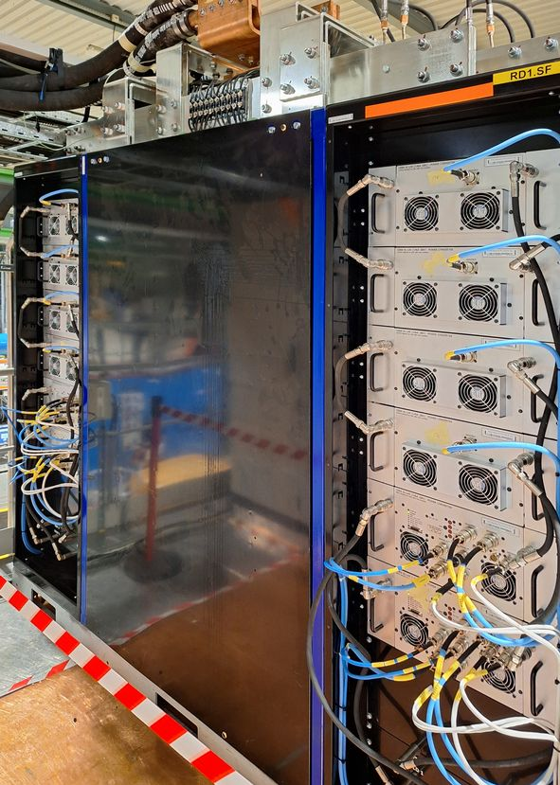
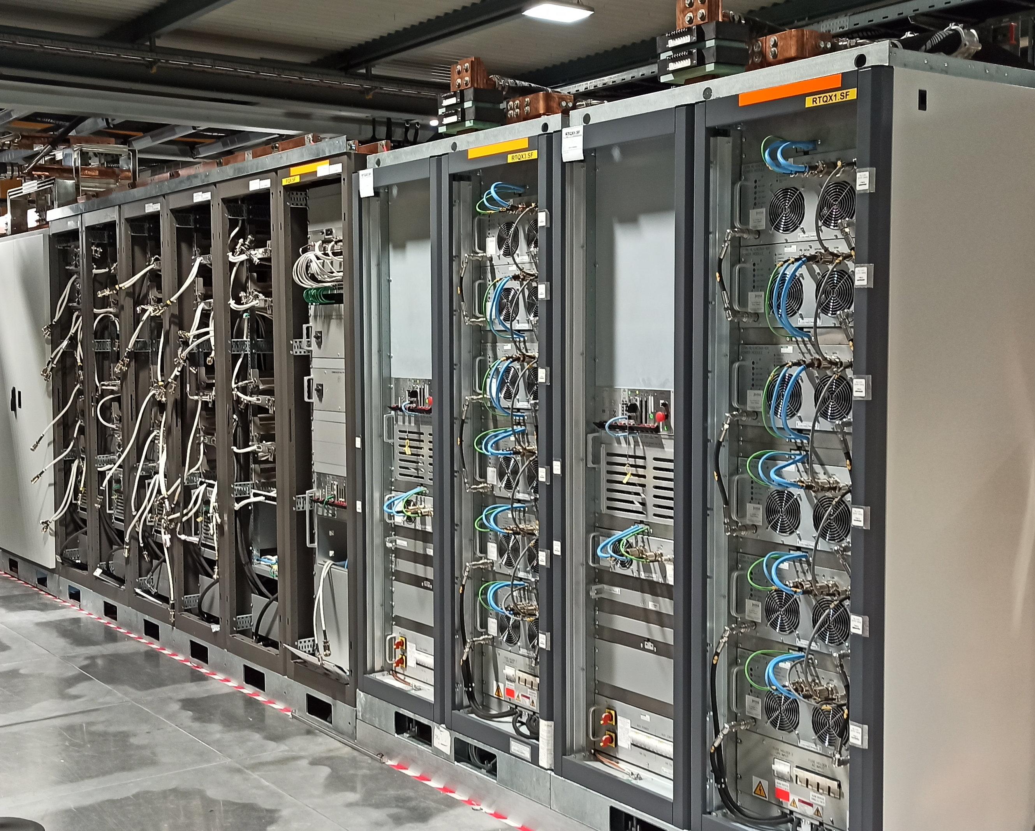

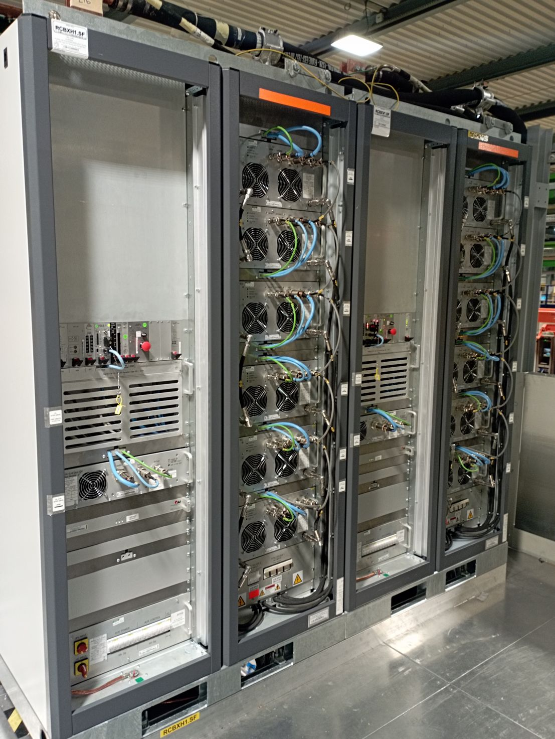
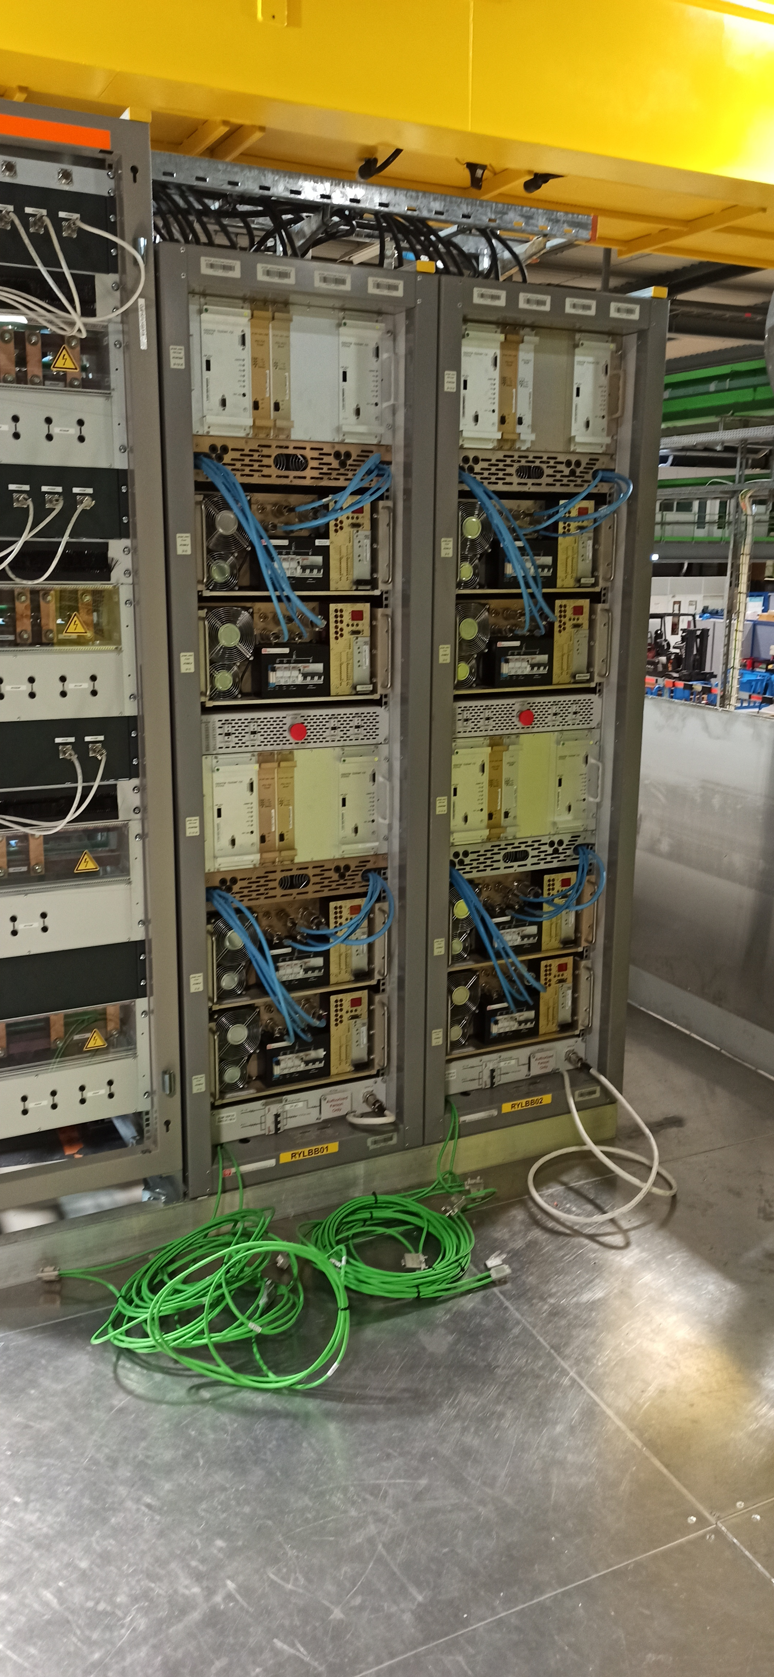
Readiness for IT String operation
WP6B fundamental milestones: 1st “Ampere” in the magnets
WP6B equipment in IT String Baseline configuration
03/10/2024
End Q2 2025
“120As”
27/10/2025
RCBX + RQSX3
10/11/2025
RD1
01/12/2025
RQX
15/12/2025

Slide 15
Readiness for IT String operation
  18kA IT main – RPAFE x1
    Proto subs currently used for full precision _{by end’24} and power tests _{by Q2 2025}
    1st pre-series diode-based crowbar unit to be received and tested by end’24, installation in IT String during Q2 2025
    Internal busbars (within subs racks) to be reworked in IT String in Q2 2025
    Class 0 ADCs series_{=pre-series} is available ✓, 2nd unit to be installed in RYABC_{measurement rack}
    1 head Class 0 DCCT pre-series expected to be fully Class 0 compliant expected by end’24 to be added to the currently installed one _{not fully Class 0 compliant}
      option: remove installed DCCT head(s) and install 2 series ones if delivery in advance of June’25 full series is expected by end of July’25

Slide 16
Readiness for IT String operation
  14kA RD1 – RPAFF x1
    Proto subs currently used for full precision _{by end’24} and power tests _{by Q2 2025}
    8th sub to be repaired and installed in the IT String by end of Q2 2025
    Class 0 ADCs series_{=pre-series} is available ✓, 2nd unit to be installed in RYABC_{measurement rack}
    2nd pre-series DCCT head _{not fully Class 0 compliant} already available to be added to the currently installed one also not fully Class 0 compliant
      option: remove installed DCCT head(s) and install 2 series ones if delivery in advance of June’25 full series is expected by end of July’25

Slide 17
Readiness for IT String operation
  2kA IT Trims – RPBAF x2
    Class 0 ADCs series _{=pre-series} is available, 2 units to be installed in RPBAF
    pre-series Class 2 DCCTs expected by end of ’24, to date 3x pre-series units are accepted ☺ , 2 units (heads and chassis) to be installed in each RPBAE in H1’25
  2kA Orbit Correctors – RPBAE x6
    Class 0 ADCs series _{=pre-series} is available, 2 units to be installed in RPBAE
    pre-series Class 2 DCCTs expected by end of ’24, to date 3x pre-series units are accepted ☺ , 2 units (heads and chassis) to be installed in each RPBAE in H1’25

Slide 18
Readiness for IT String operation
±1.5 ppm _{max} Spec for Class 2 DCCT
(irrespective of ADCs)
±5 ppm _{max} Spec for Class 2 PC
(isothermal with Class 0 ADCs)
15.5 ppm _{2 x rms} Spec for Class 2 PC
(with Class 0 ADCs)
Low risk for the Class 2 PC (i.e. overall) performance ☺
Furthermore, we think we know where this slight out of spec performance is coming from

Slide 19
Readiness for IT String operation
  2kA IT Trims – RPBAF x2
    Class 0 ADCs series _{=pre-series} is available, 2 units to be installed in RPBAF
    pre-series Class 2 DCCTs expected by end of ’24, to date 3x pre-series units are accepted ☺ , 2 units (heads and chassis) to be installed in each RPBAE in H1’25
  2kA Orbit Correctors – RPBAE x6
    Class 0 ADCs series _{=pre-series} is available, 2 units to be installed in RPBAE
    pre-series Class 2 DCCTs expected by end of ’24, to date 3x pre-series units are accepted ☺ , 2 units (heads and chassis) to be installed in each RPBAE in H1’25
  200A SF 2nd order Corrector – RPMBG x1
    new validated PIC-compatible Fast Abort interlock board to be installed
      scheduled in Nov’24 in the IT String unit, then in the remaining 3 RPMBGs x the machine
      to be implemented also in the R2E-LHC-600A-10V already installed in the LHC

Slide 20
Readiness for IT String operation
  120A SF HO Correctors – RPLBB x8
    ready for operation ✓
  35A Q1a Trim – RPLAD x1
    ready for operation ✓
  CDBs 18kA x2 _{18kA and 14kA}
    ready for operation ✓
  CDBs 2kA x8 and 600A x2 _{35A + warm diodes}
    ready for operation ✓
  WCBBs 18kA x4 _{18kA x2 and 14kA x2}
    ready for operation ✓ although with noncompliant WCPs _{plan B: flushing WCBBs x} _{ElQA}
    improved mounting options of the failing Kapton foils have been identified and components ordered for in situ testing
    WCPs are expected to be made compliant with ElQA by end of Q2 2025*
  Control Electronics
    ready for operation ✓
    option: new pre-series IT Interlock Panel to be installed if production completed in H1’25
*: if needed tests campaigns can be fitted in IT String agenda in H1’25

Slide 21
Readiness for the installation in HL-LHC URs
Most constraining “float” for “HL-LHC URs” Installation Phase 1 : Racks, CDBs/WCBBs and 2kA full PCs
Delivery dates presented in this InWork Masterplan are deemed realistic today, although a few important production contracts (power modules and other equipment) are still to be adjudicated.
Most constraining “float” for “HL-LHC URs”
Installation Phase 2 : Power modules + 600A PCs + 35A PCs
With the recently approved LS3 shift these margins can only increase!

Slide 22
“Constraints” for installation in LS3 of the IT String equipment
10 months before the installation of the last IP side of Point 5 the 2kA pre-series converters need to be de-installed from IT String and sent to the manufacturer for being updated into series
5 months before the installation of the last IP side of Point 5 the (pre)series WCBBs and CDBs and the series 200A need to be de-installed from IT String to be prepared for machine installation
Beware: the 200A goes into UL557 or USC55 so constraints go beyond URs

Slide 23
Conclusion in two words
☺
Positive outlook

Slide 24
Conclusion in a few (additional) words
  WP6B equipment has been the first _{non WP16} equipment to be installed in IT String and to complete with others the first hardware commissioning steps
  ISTs and SCTs have been completed successfully although not as part of the baseline planned sequence
  WP6B equipment in IT String was and is not 100% baseline although this had no consequences for the completion of the first commissioning steps
  No showstoppers to reach WP6B goal of baseline hardware by end Q2 2025
    furthermore 1st Ampere in any of the magnets is scheduled only in Q4 2025
  Readiness for installation in the machine is looking good
    even with the pre LS3 shift sufficient margins exist although few but important contracts still need to be adjudicated
    also the constraints for the WP6B equipment that goes in the last IP side of Pt 5 offer non negligible margins after the end of the IT String operation

Slide 25
Thank you for your kind attention
Credits to: V. Montabonnet, S. Pittet, N. Kuczerowsi, V. R. Herrero Gonzales, B. Todd, M. Cerqueira Bastos, R. Murillo Garcia, Y. Thurel, C. Coupat, H. Thiesen

Slide 26
Spare Slides

Slide 27
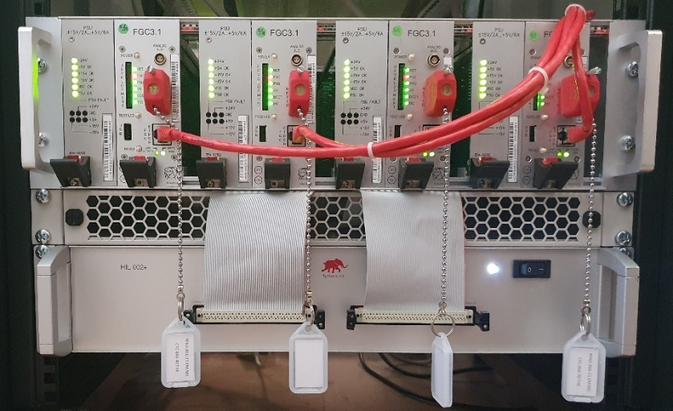
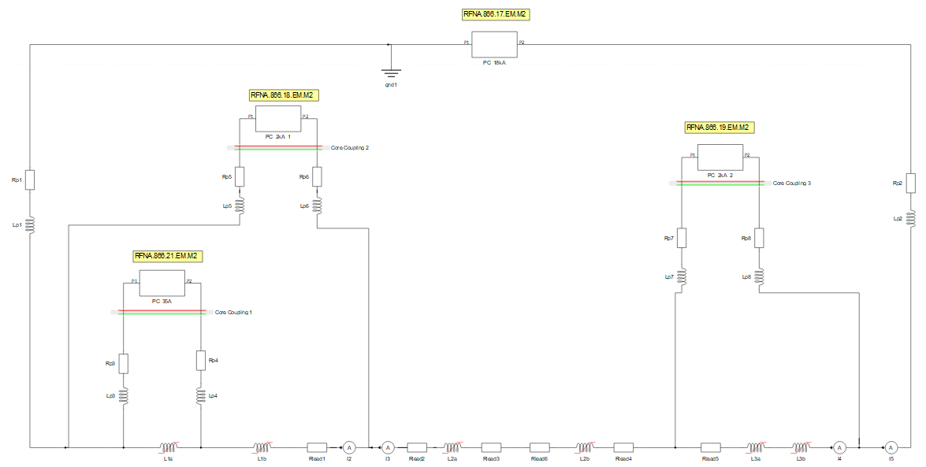
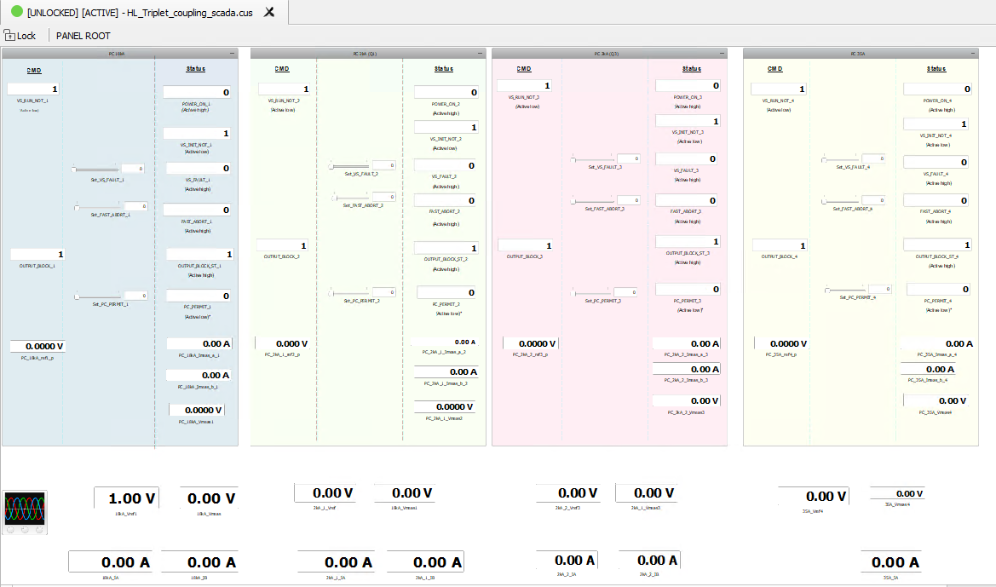
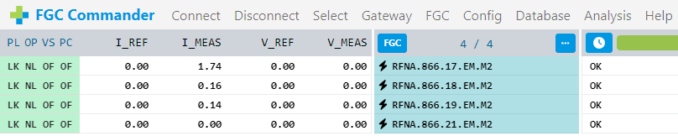
Readiness for IT String operation
IT model including magnets saturation
HIL IT decoupling control SW tester [Typhoon]
  Preliminary tests in ‘23 and ‘24 were successful* and lead to solving already minor issues _{such as initialization}
  Configuration tools* prepared to speed up commissioning
  Final HIL validation expected by end Q1 2025
*: 195th TCC – M. Martino - Technical update WP6B – 24/05/2024

Slide 28
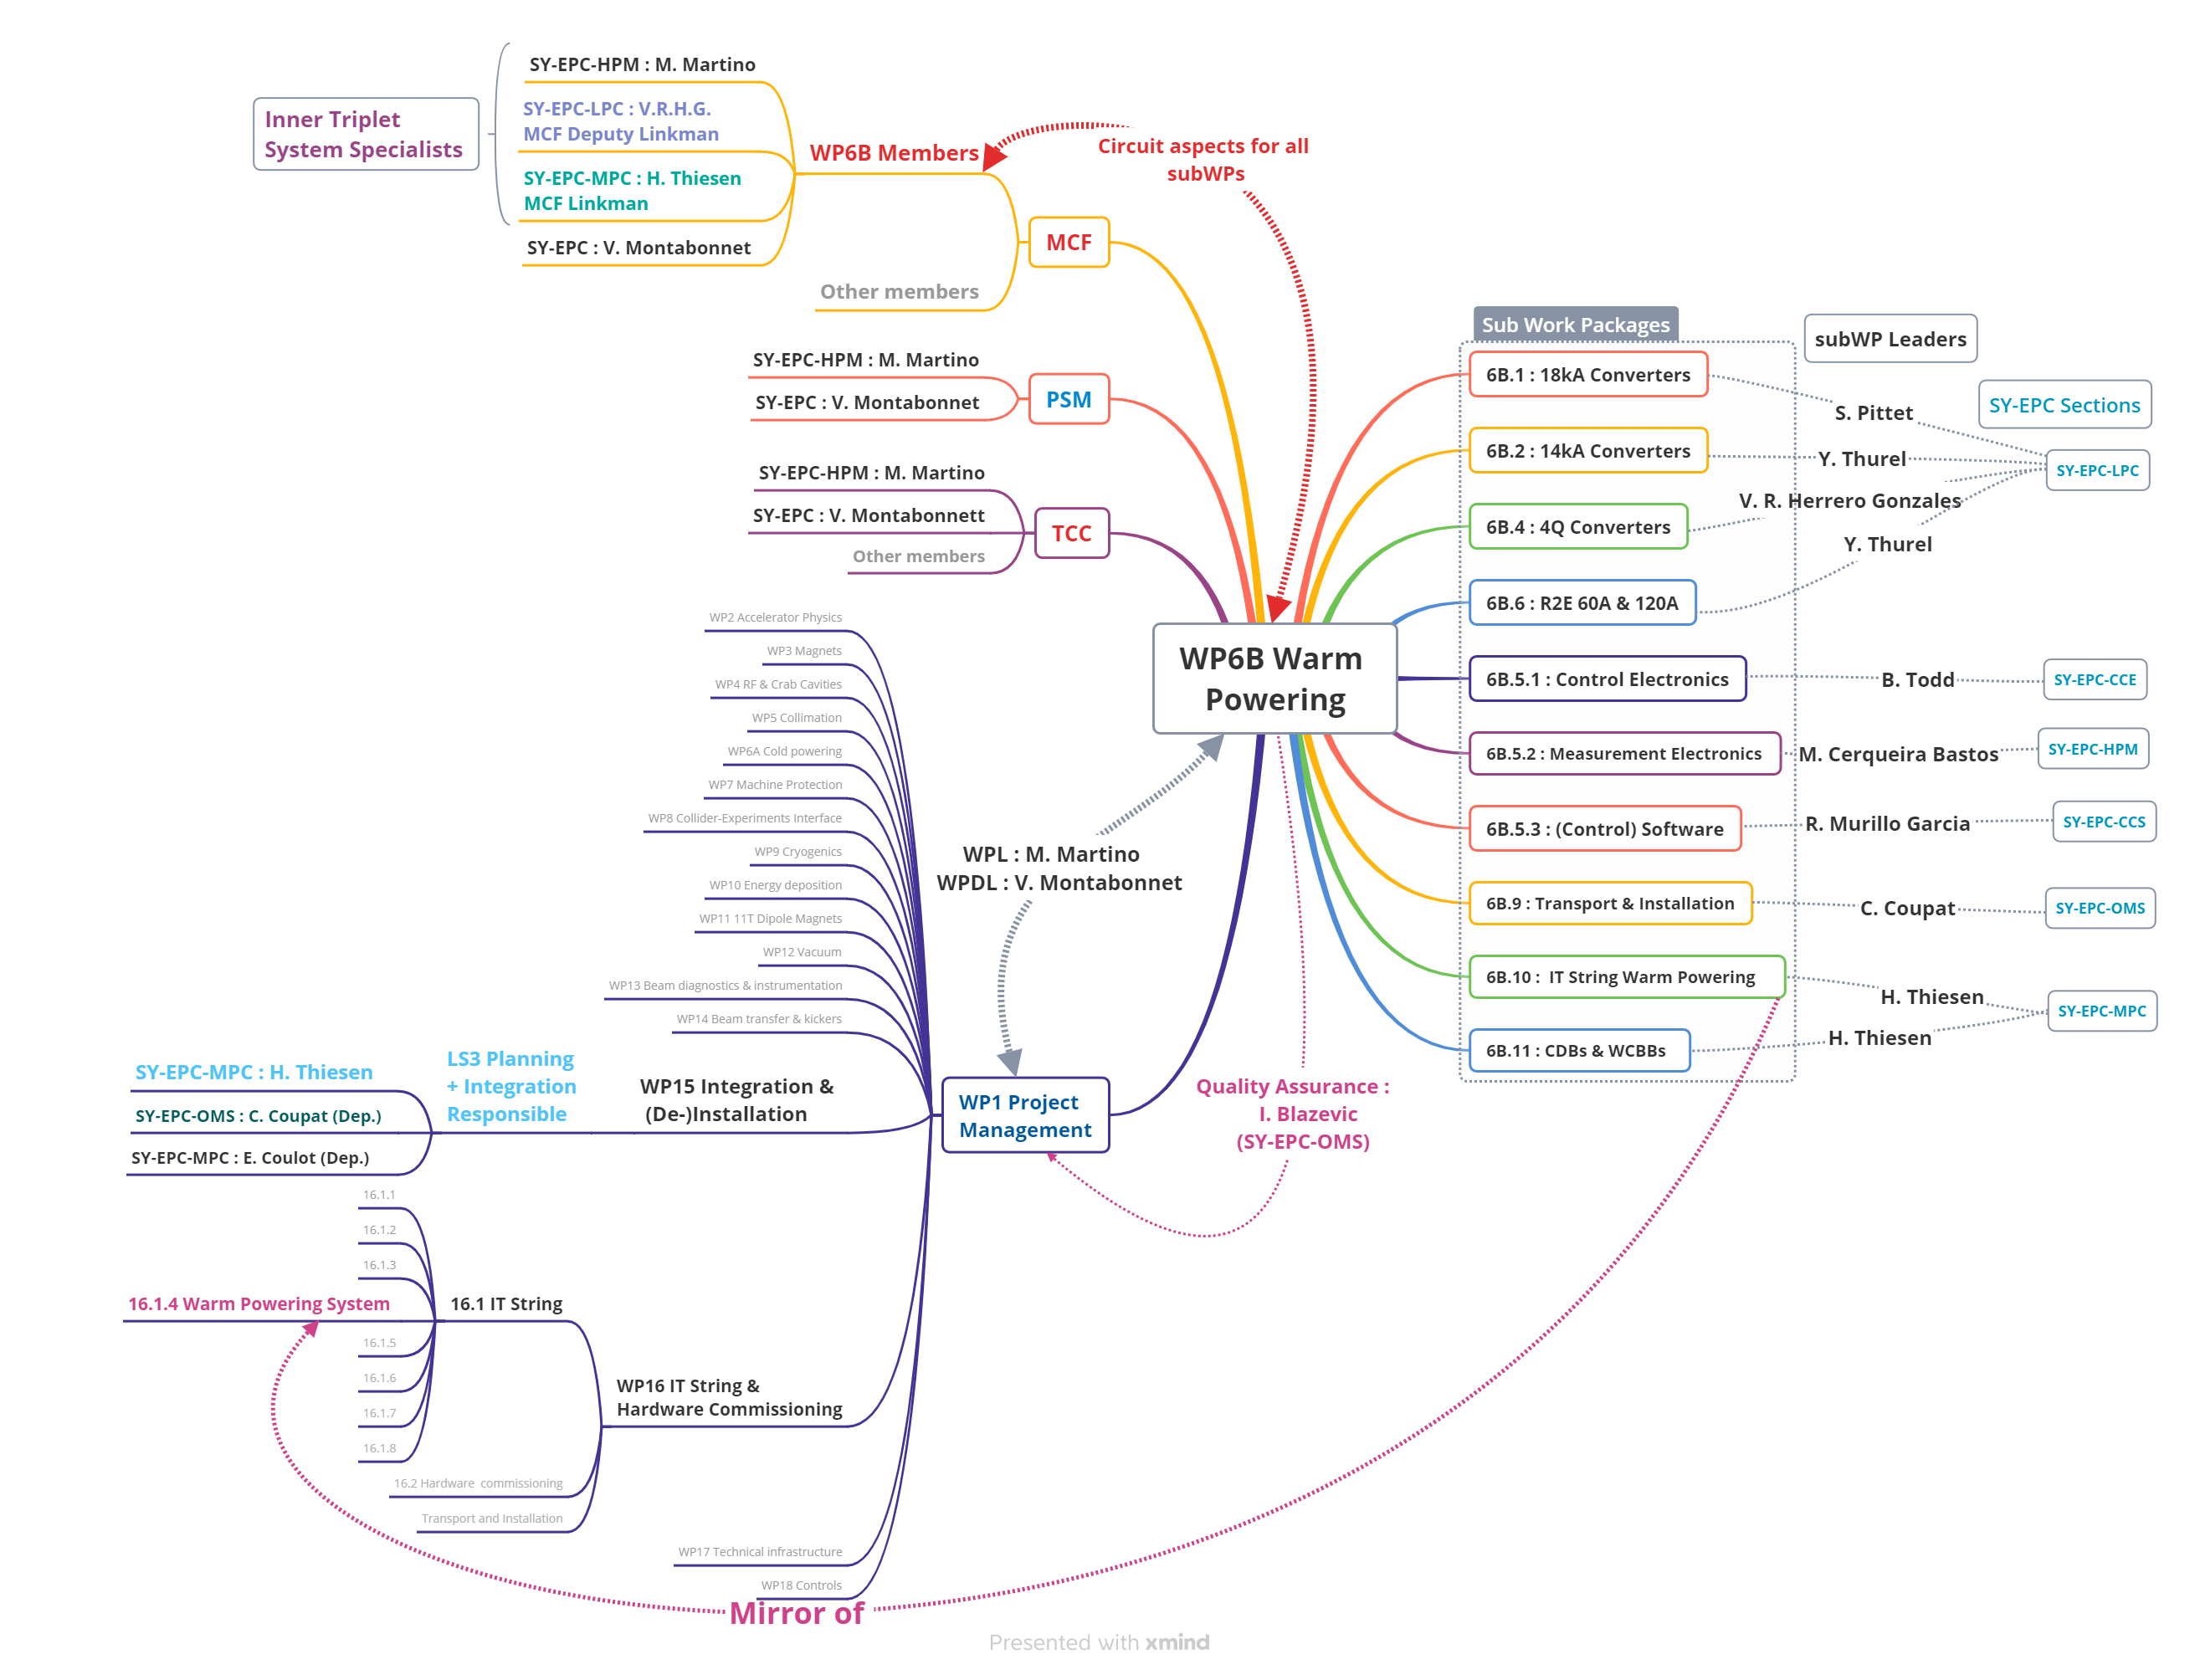
WP6B – Who’s who

Slide 29
Readiness for IT String operation
  2kA IT Trims – RPBAF x2
    Class 0 ADCs series _{=pre-series} is available, 2 units to be installed in RPBAF
    pre-series Class 2 DCCTs expected by end of ’24, to date 3x pre-series units are accepted ☺ , 2 units (heads and chassis) to be installed in each RPBAE in H1’25
  2kA Orbit Correctors – RPBAE x6
    Class 0 ADCs series _{=pre-series} is available, 2 units to be installed in RPBAE
    pre-series Class 2 DCCTs expected by end of ’24, to date 3x pre-series units are accepted ☺ , 2 units (heads and chassis) to be installed in each RPBAE in H1’25
  200A SF 2nd order Corrector – RPMBG x1
    new validated PIC-compatible Fast Abort interlock board to be installed
      scheduled in Nov’24 in the IT String unit, then in the remaining 3 RPMBGs x the machine
      to be implemented also in the R2E-LHC-600A-10V already installed in the LHC

