Slide 1

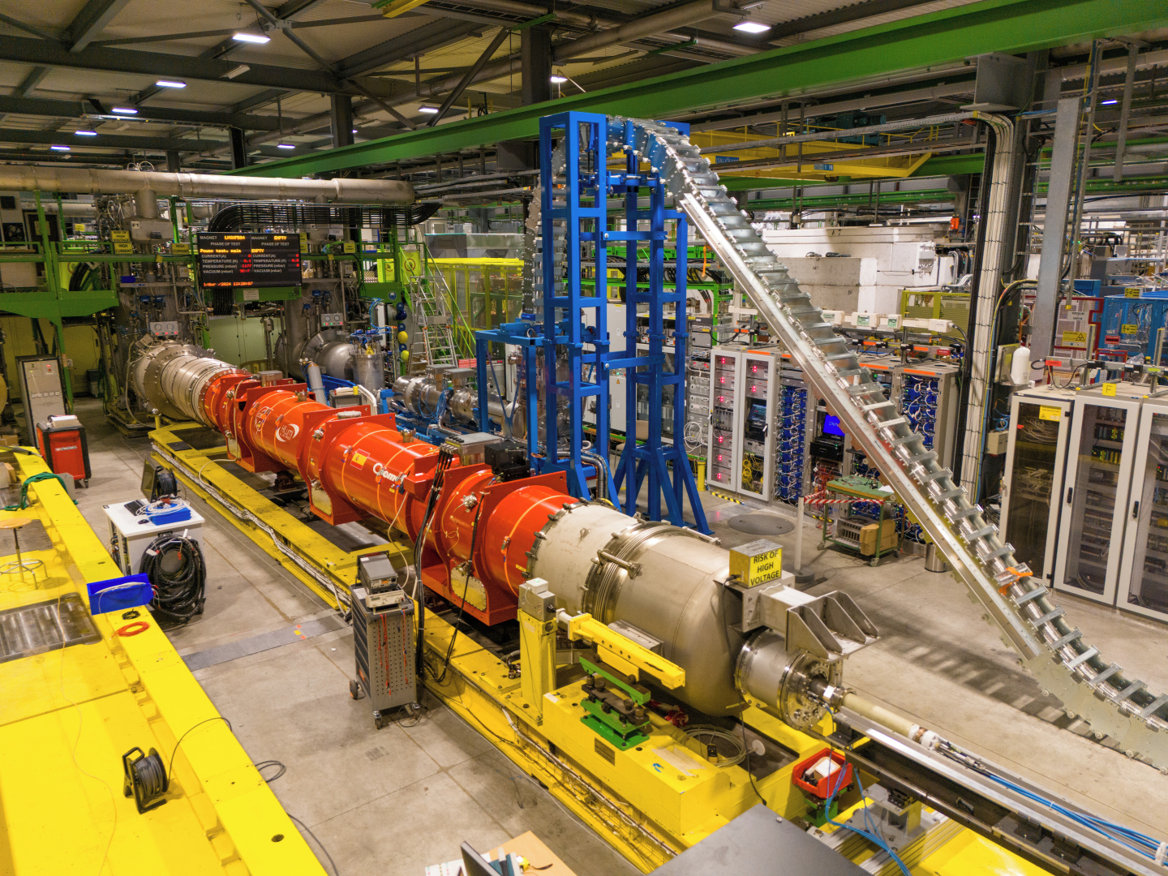
Progress on qualification tests and status of benches
Gerard Willering
8 October 2024
14th HL-LHC Collaboration Meeting
Genoa, Italy
Franco Mangiarotti, Gaëlle Ninet, Guillaume Pichon, Stian Juberg, Jerome Feuvrier, Patrick Viret, Marco Buzio, Stephan Russenschuck and all other members of the team.
With many thanks to FSU support and all other teams involved.
Acknowledgements to WP3, WP6a and all supporting teams.

Slide 2
Qualification of magnets and status of test benches in SM18 at CERN
Vertical benches
MCBXFA/B
MCBRD
MQML
MSCB
Horizontal benches
Q2
Q1/Q3
CP
D1
D2
SC-link
Q10

Slide 3
Tests on Vertical benches

Slide 4
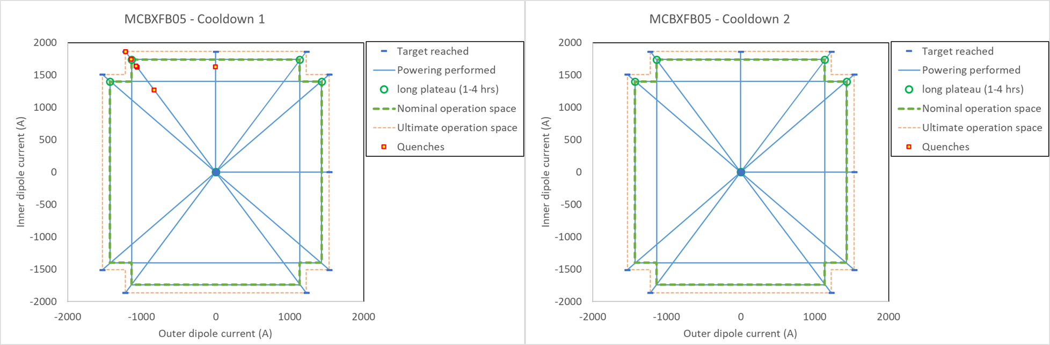
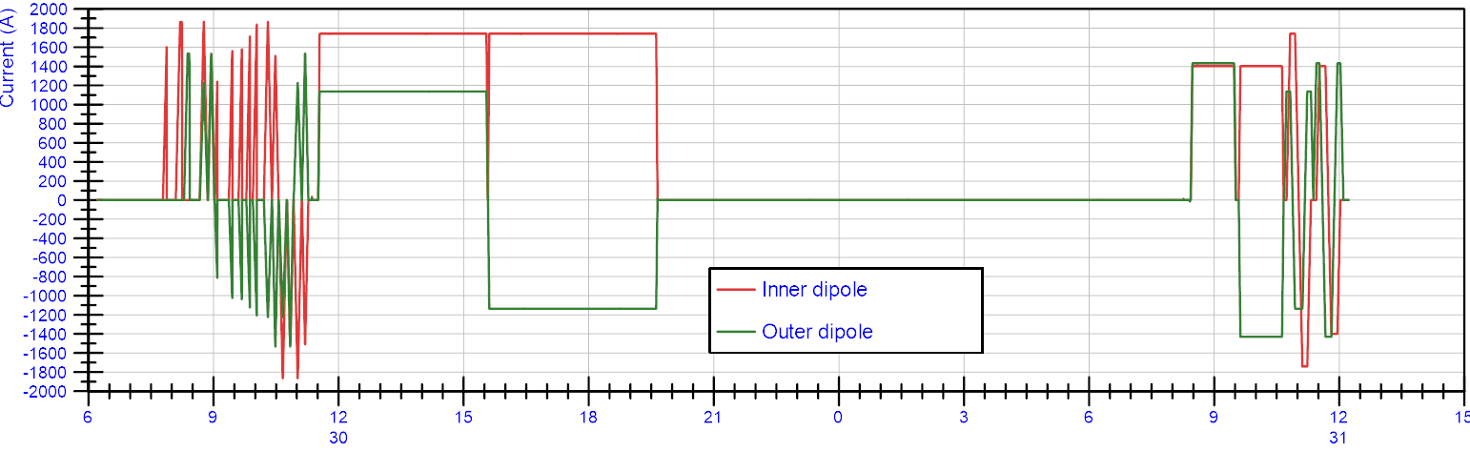
MCBXFA/B
Test station: Cluster D
Number of cool downs: 2
Test temperature: Only 1.9 K
Test station occupation: ~ 3 weeks
Magnetic measurements: Yes
Cold phase including powering: 3 days per cool down
Units to test: 12

Slide 5
MCBRD
Test station: Cluster D
Number of cool downs: 1 if already tested in China,
2 if not tested before.
Test temperature: Only 1.9 K
Test station occupation: ~ 3 weeks
Magnetic measurements: No
Cold phase including powering: 4-8 days per cool down (depends on training temperature.)
Units to test: 12
MCBRD tests are done at IMP in China.
Magnets 11 and 12 are produced at CERN.
Depending on test strategy (4.5 K training or 1.9 K training, 1 or 2 cool downs) the test can be short or long, see next slide for an example.

Slide 6
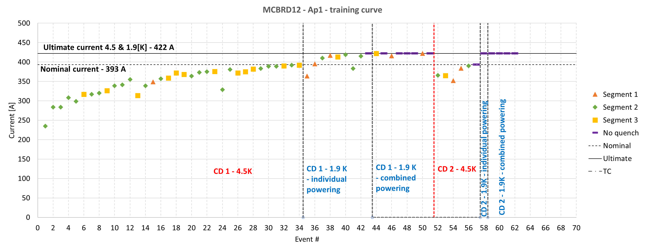
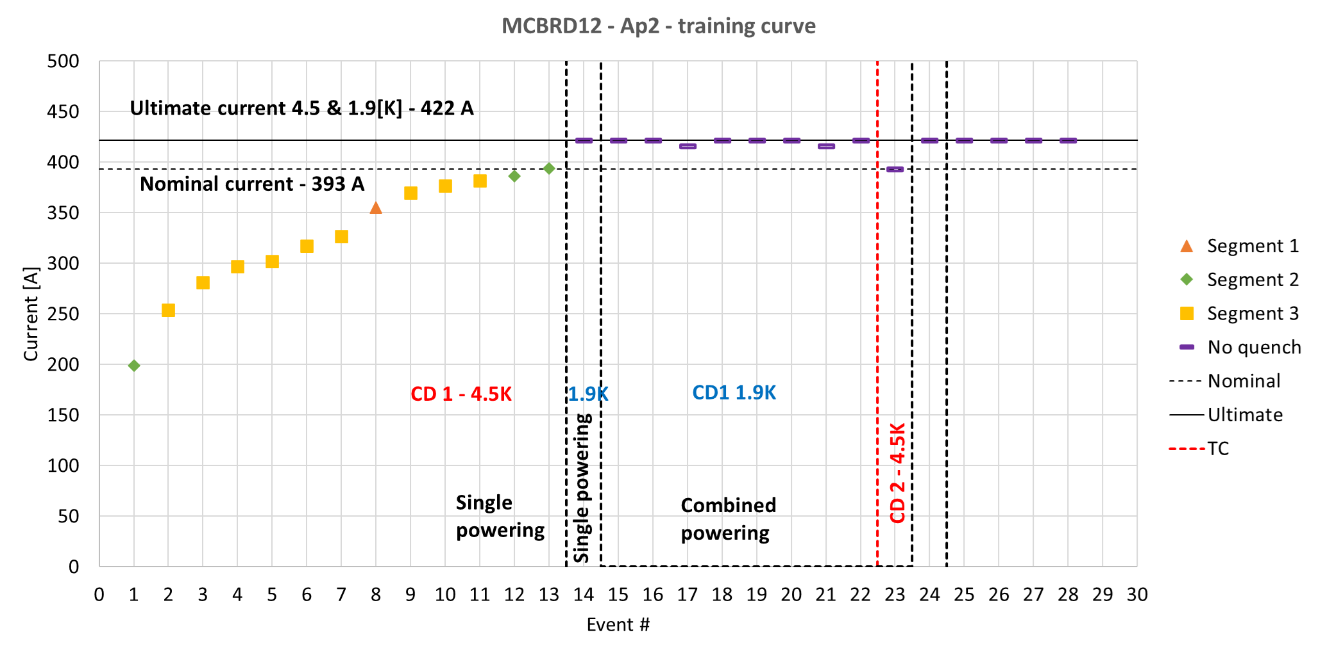
MCBRD – test example
MCBRD12 was produced at CERN, tested in March 2024.
Although operation temperature is 1.9 K, training was done at 4.5 K to be able to compare with training at IMP.
The training at 4.5 K with a sum of 47 quenches in both apertures. This costed 4 days of test time.
For this test campaign, including magnetic measurements, the test time was 2 weeks for the first cool down and 4 working days for the second cool down.
This can be reduced to 3 days per cool down if tests are only at 1.9 K. This assumes that at 1.9 K the training is much faster.

Slide 7
MQML
Test station: Cluster D
Number of cool downs: 1
Test temperature: Only 1.9 K
Test station occupation: 2 weeks
Magnetic measurements: No
Cold phase including powering: 3-4 days per cool down
Units to test: 1 this week, one to go in 2 weeks
Test results:
MQML42: One quench heater failed during first discharge, causing damage to coil insulation: Coil cannot be re-used and magnet is disqualified.
MQML41: Qualified. 2 training quenches close to ultimate current.
MQML39: Qualified. One training quench close to ultimate current.
MQML38: Today first powering…
Each of the four new Q10 assemblies requires one MQLM and one MSCB corrector magnet.
The 5 spare MQML magnets were built during LHC production, but never tested before (never assembled in horizontal cryostat and with 5 meter length there was no vertical cryostat available).
In 2023 the rotation tower for cluster D was completed, allowing magnets up to 5.2 meter length to be tested.

Slide 8
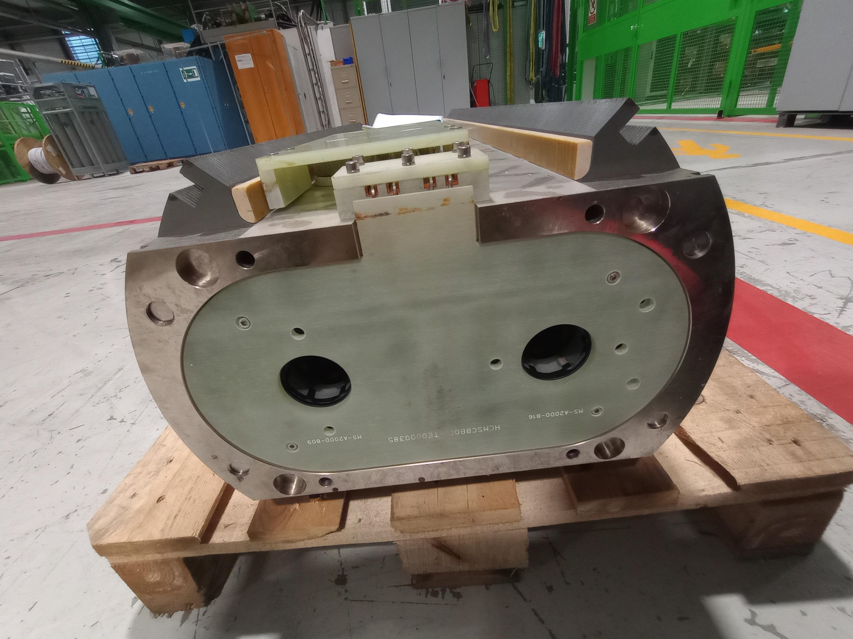
MSCB
Test station: Siegtal
Number of cool downs: 1
Test temperature: Only 1.9 K
Test station occupation: 2 weeks
Magnetic measurements: No
Cold phase including powering: 3 days per cool down
Units to test: 3
Each of the four new Q10 assemblies requires one MQLM and one MSCB corrector magnet.
Retesting these magnets before re-assembly of the Q10.
1 test done last year, 3 to test this year.
The Siegtal test station has a small cryo consumption. Little interference with other tests.

Slide 9
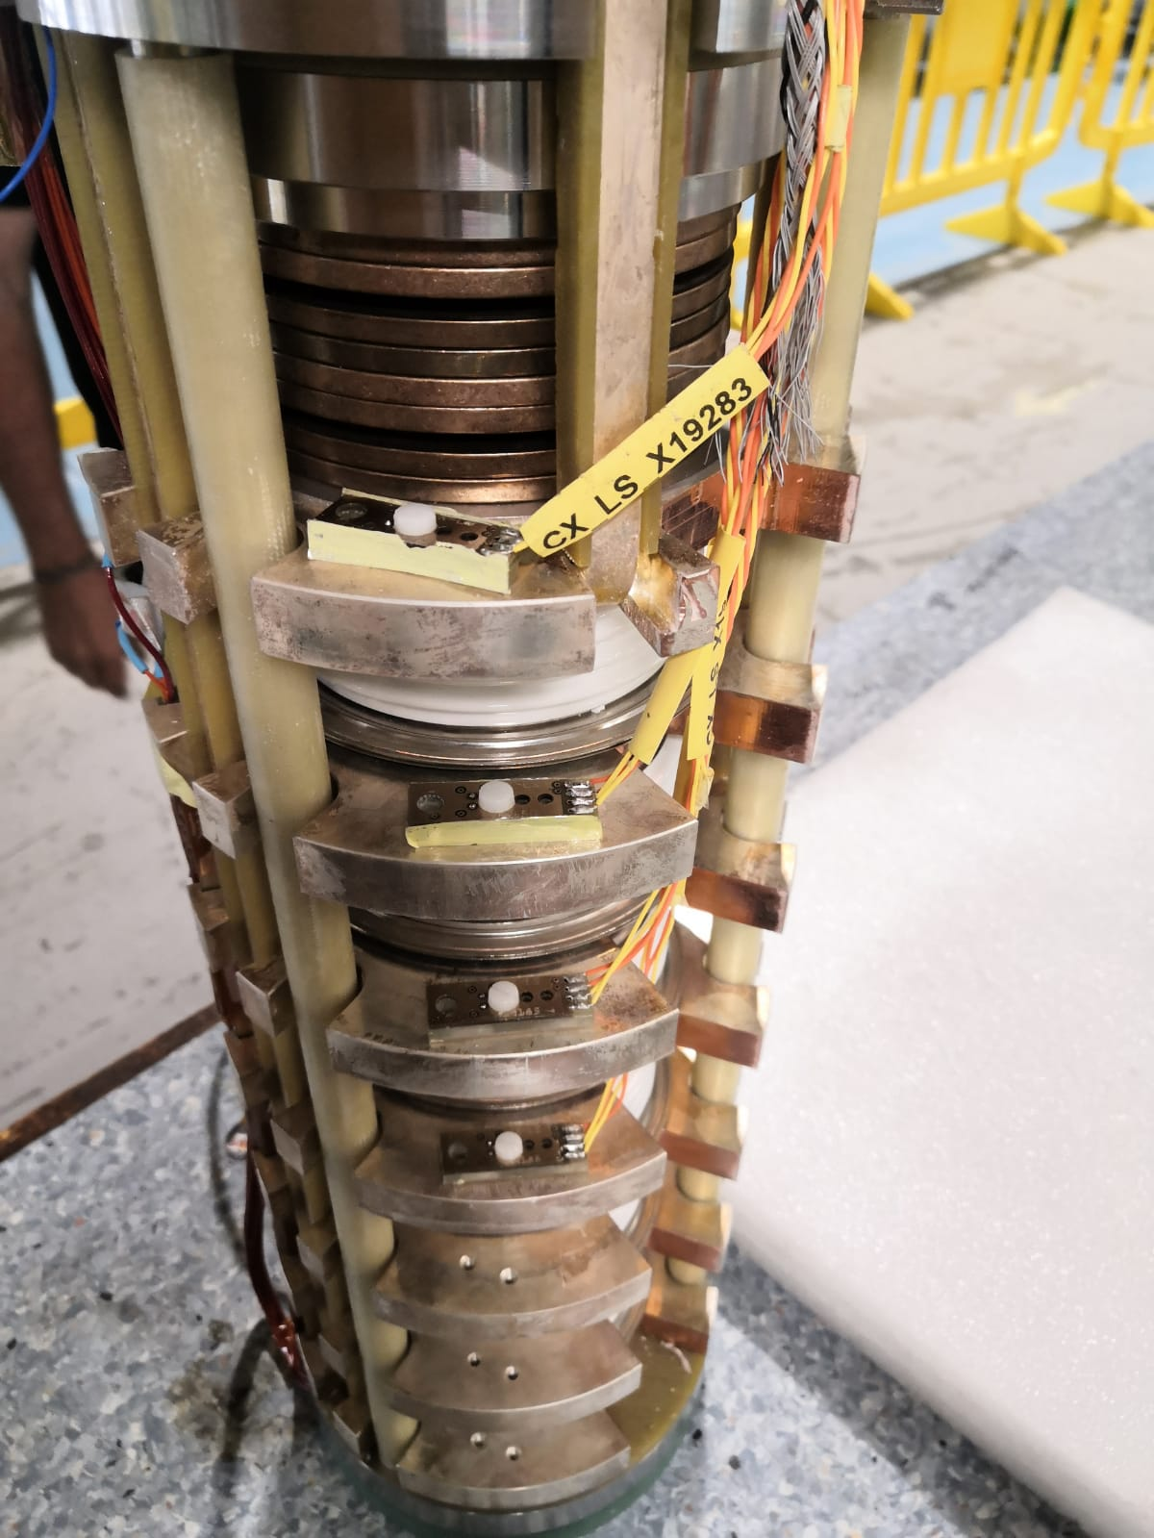
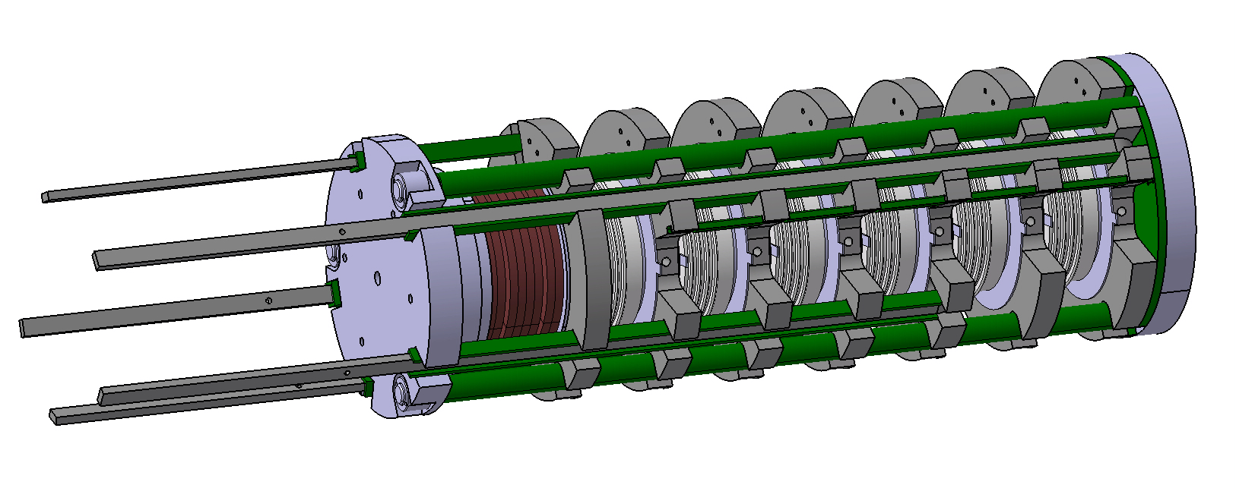
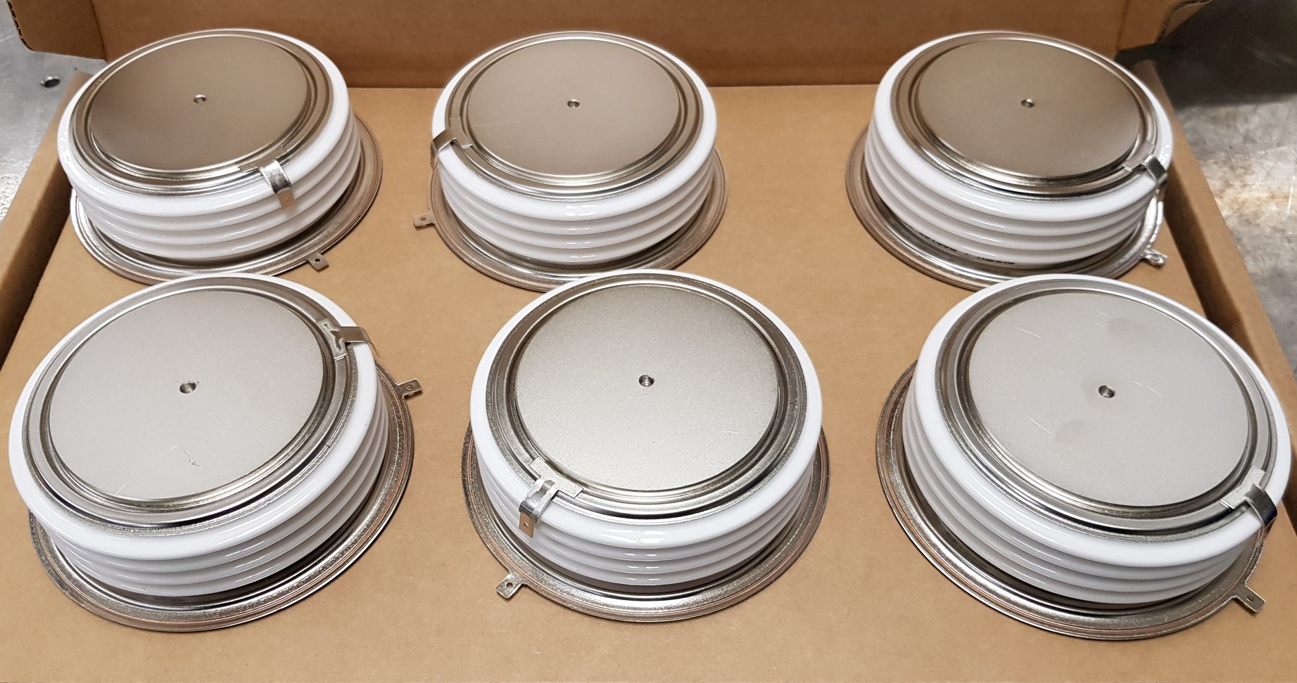
IT-diode stack
Test station: Diode
Number of cool downs: 1
Test temperature: Only 4.5 K
Test station occupation: 2 weeks
Magnetic measurements: No
Cold phase including powering: 3 days per cool down
Units to test: 5
The HL-LHC IT-diode stacks consist of 6 diodes and are part of the MQXF circuit.
The prototype stack has been tested in 2023 with good results and is qualified for the IT-String. It included LHC ‘standard’ diodes. The five series diode stacks include diodes with higher radiation tolerances.
Test program established. No showstoppers foreseen. Small cryo consumption.

Slide 10
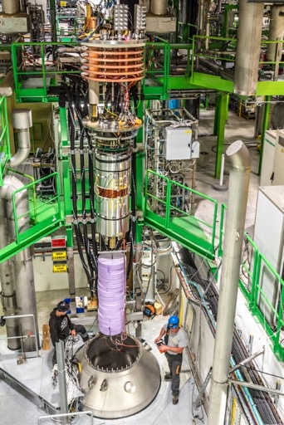
Cluster D
Cluster D is the work horse for HL-LHC magnets. It is the only cryostat that fits MCBXFA and MQML magnets, and it is the only station optimized for the 2*2 kA circuits for MCBXFA/B and MCBRD magnets.
Test efficiency is very important:
Recently cryogenics operation fully automated cool down, warm up and thermal cycle processes. Recent re-commissioning of the 25000 liter dewar increased cryo-efficiency.
Since one year overnight powering reduced test time by 1-2 days per cool down for MCBXF and MCBRD magnets.
Still 21 magnets to test. Critical test facility for HL-LHC as MCBXF magnets need to be delivered for Q2 and CP production.
Large volume of helium needed, and it has a rather large cryogenic consumption.
Important coactivity between cryo operators and magnet test operators.

Slide 11
Tests on horizontal benches

Slide 12
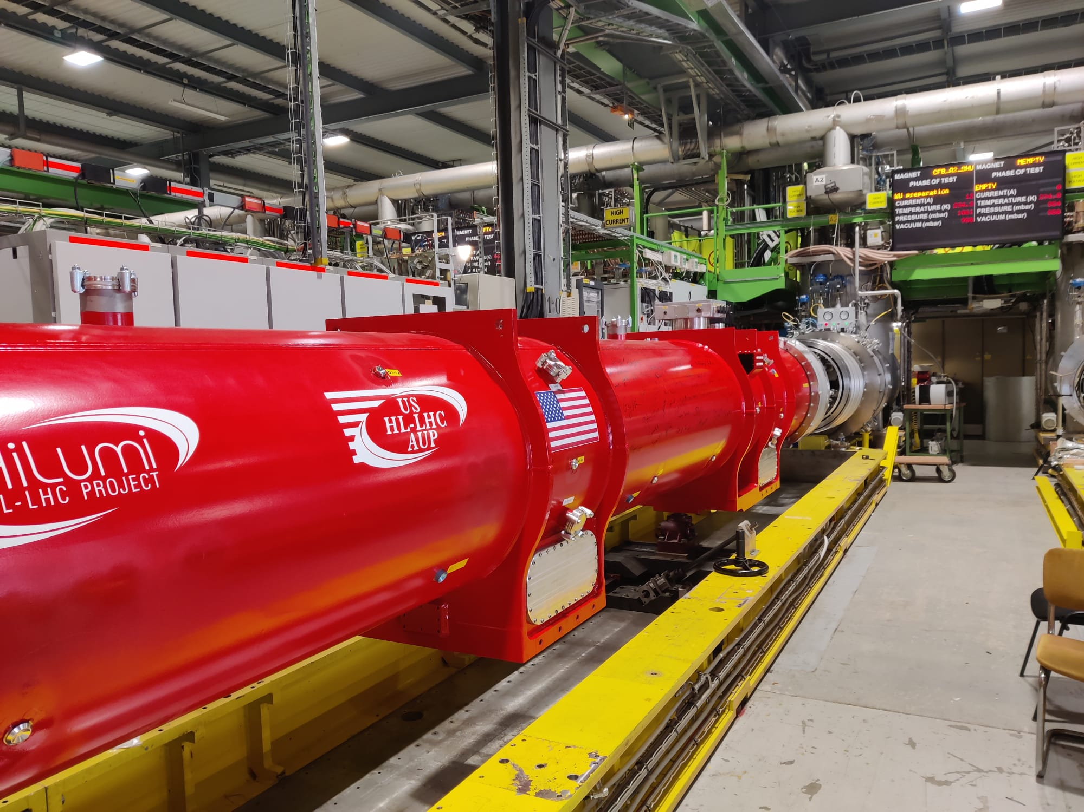
Q1/Q3
Test station: A2
Number of cool downs: 1 (magnet tested before at FNAL.)
Test temperature: 1.9 and 4.5 K
Test station occupation: 5 weeks
Magnetic measurements: Yes
Cold phase including powering: 3 weeks per cool down.
Warm up/cool down duration: ~6-7 days per warm up/cool down
Units to test: 1? (under discussion)
The test bench has been completed in April 2024 and the Q3 has undergone 2 cold powering phases.
Maximum 2 quenches per day.
Test sequence optimized by day/night and weekend powering. (see presentation G. Willering, Monday)
Stretched wire and alignment measurements are important (see presentation C. Petrone, Thursday).
Small leak detected from helium to vacuum, but not clear if it is on cold mass side or test bench side. (see presentation by F. Mangiarotti later this session)

Slide 13
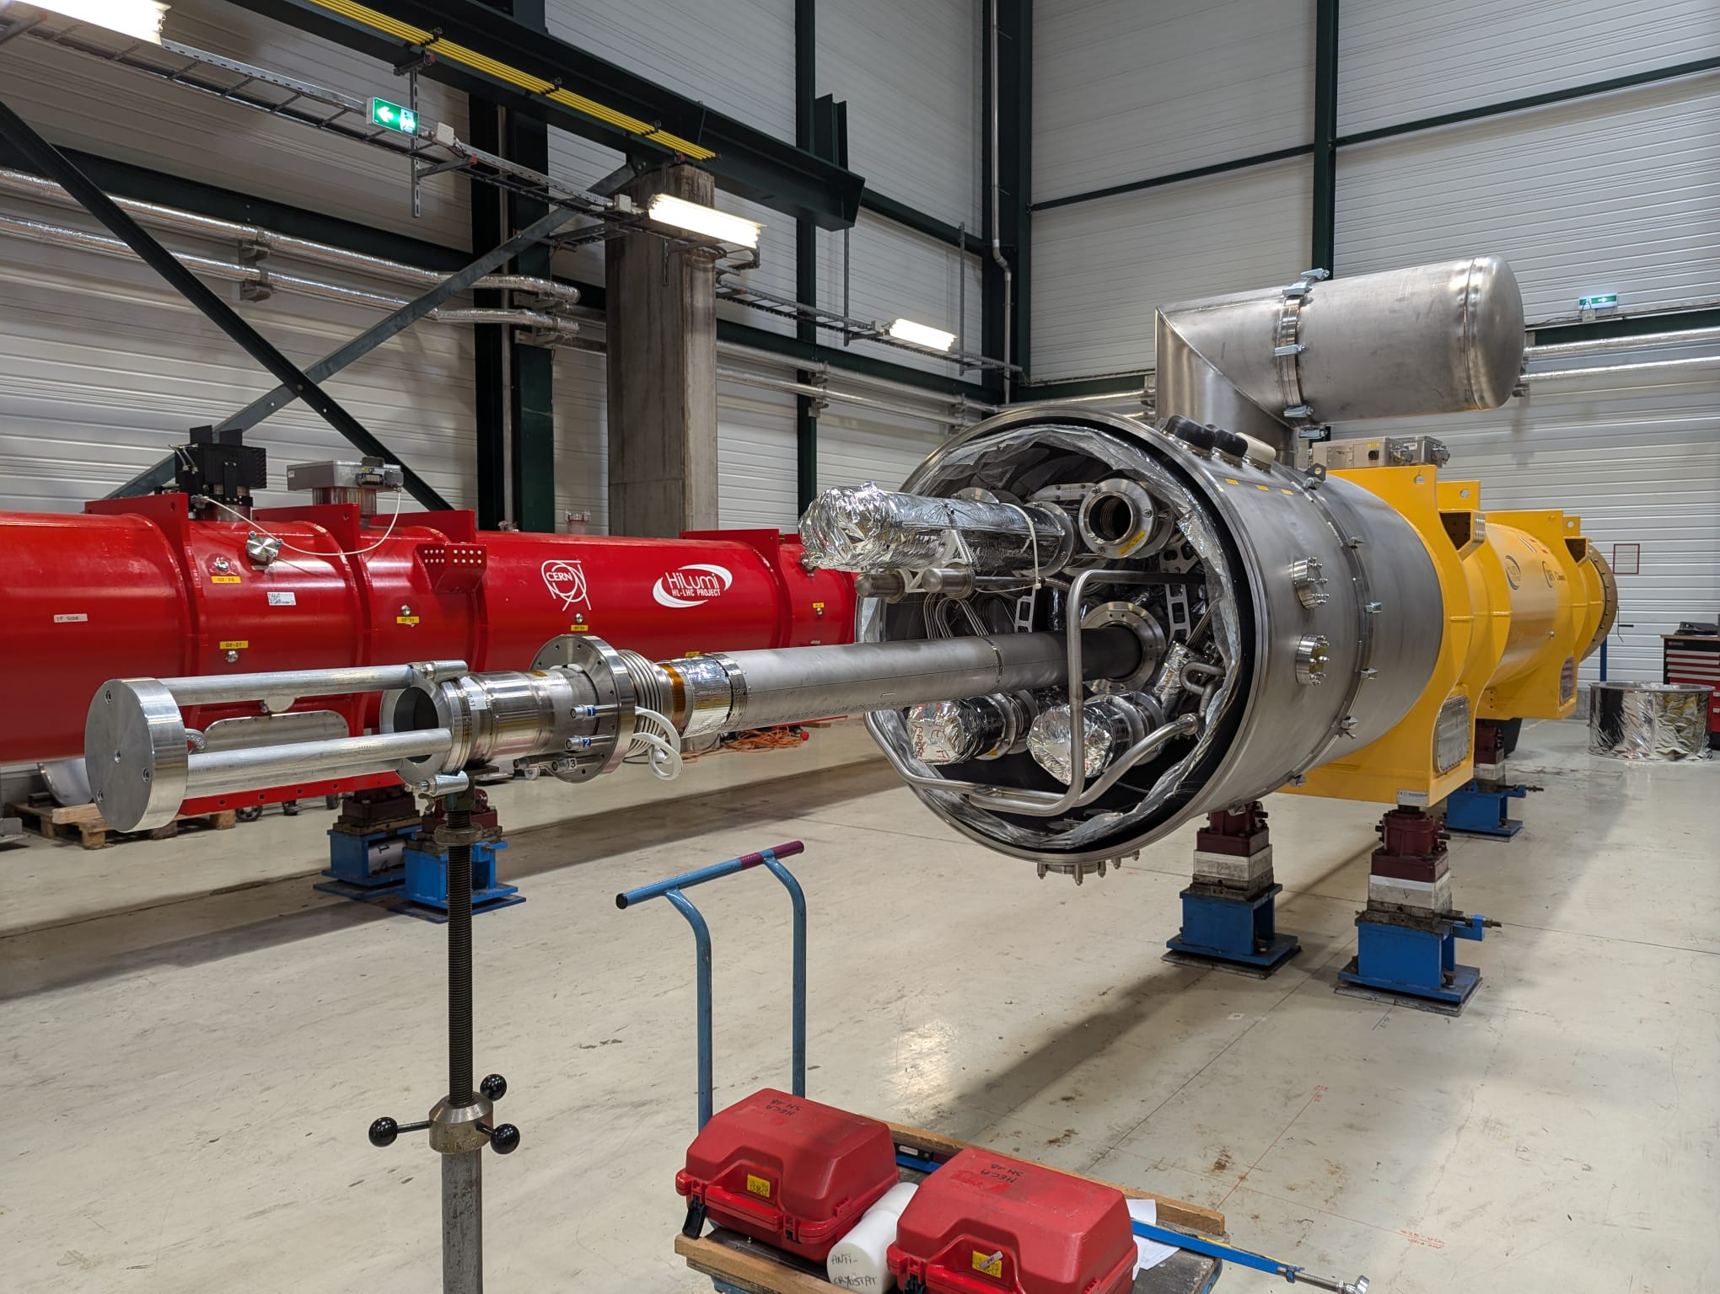
Corrector Package (CP)
Test station: A2
Number of cool downs: 1 (MCBXFA magnets tested at CERN, HO correctors tests at LASA.)
Test temperature: 1.9 K
Test station occupation: 5-6 weeks
Magnetic measurements: Yes
Cold phase including powering: 3 weeks per cool down.
Warm up/cool down duration: TBC
Units to test: 5
The first CP will be placed on the test bench this week, following delay due to the second cool down of the Q3.
The bench A2 with shuffling module has been fully commissioned first in stand-alone and then using the Q3 magnet.
CP is the last cryo-assembly to be tested at CERN for installation in the IT-String (following SC-link, D1, Q2a, Q2b, Q3).

Slide 14
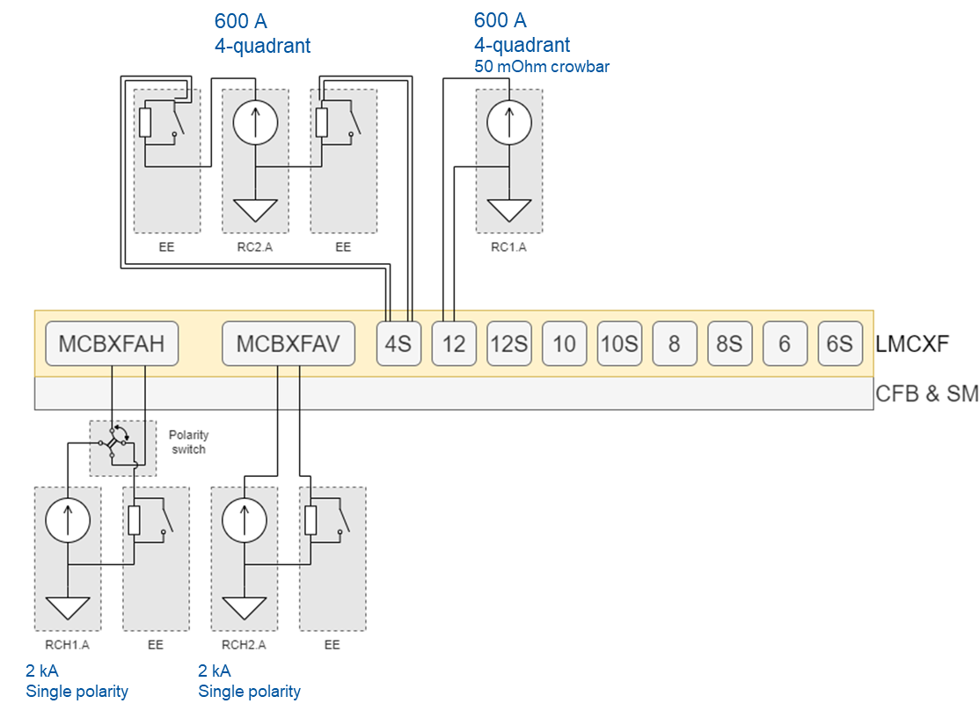
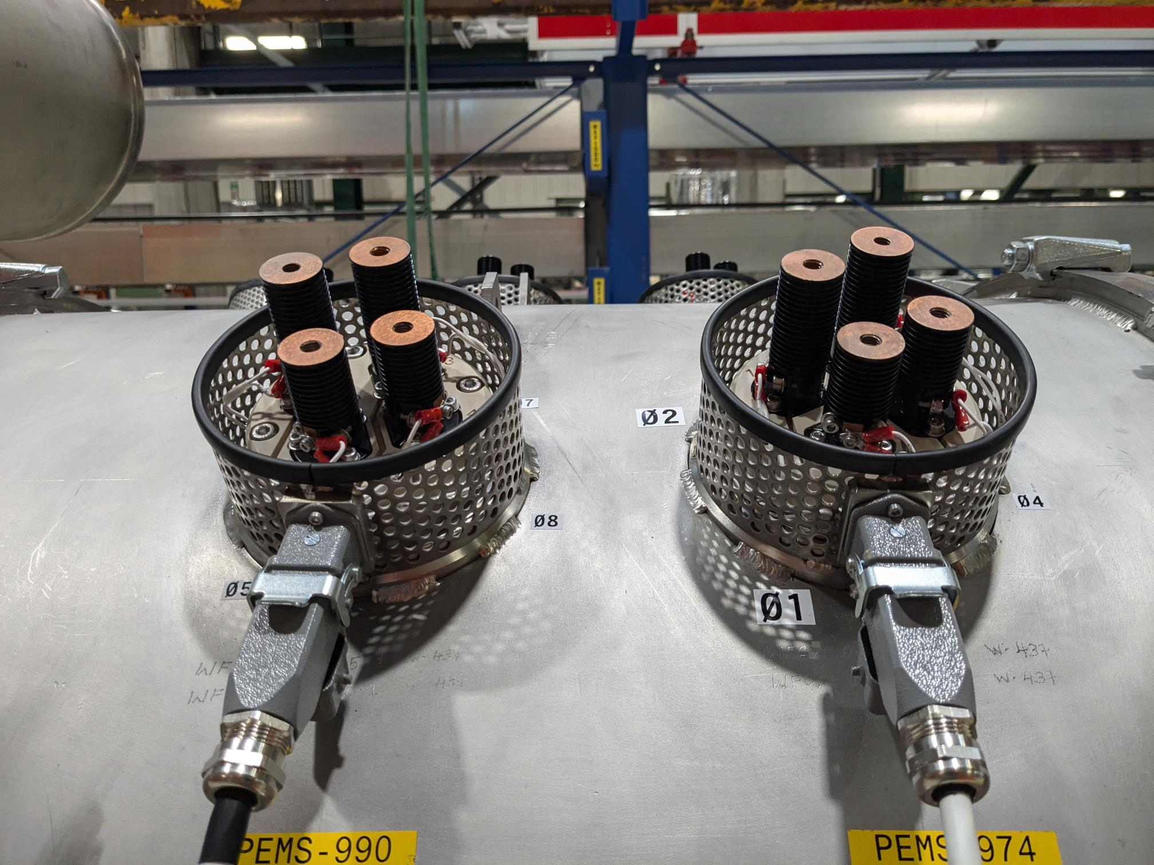
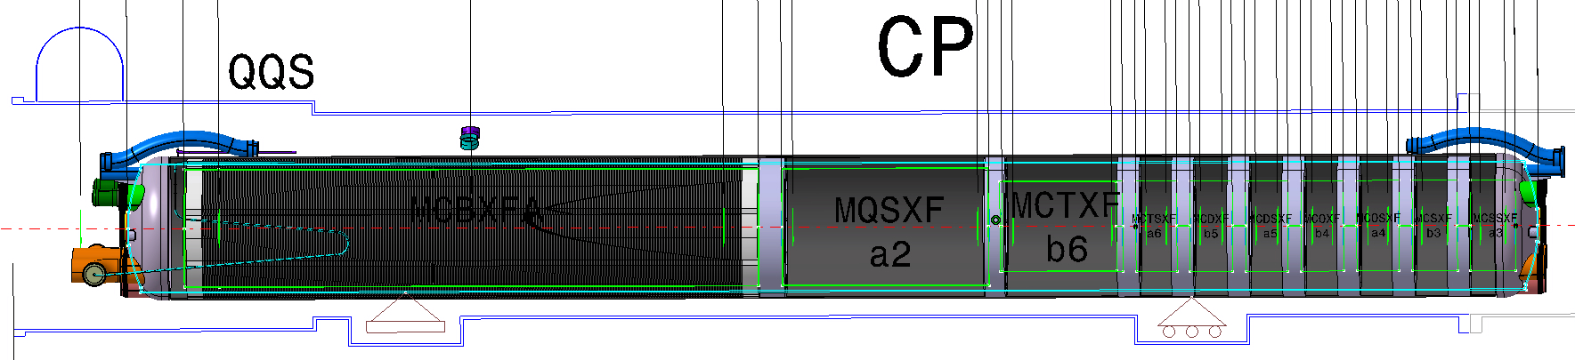
Corrector Package
11 magnet circuits. Powering sequence:
Single and combined powering for the 2kA MCBXFA magnets horizontal and vertical nested dipoles.
The MQSXF skew quadrupole remains always connected to the 600 A PC with the 2 EE systems. It is the only magnet requiring 200 A and has a double lead connection.
Finally the other 8 circuits, all 100 A, no EE will be powered one by one with another 600 A PC. The lead connection is done on on the outside of the cryostat.
The 120 A lead heat interception point is cooled by gas at ~ 70 K, the control needs to be commissioned.
The alignment measurements for each magnet are important. The MQXFS will remain connected for powering and will be the reference for the alignment of the other magnets.
120 A leads on the side of the cold mass.
2 kA leads through CFB

Slide 15
Q2
Test station: F1
Number of cool downs: 2 (magnet tested before at FNAL.)
Test temperature: 1.9 and 4.5 K
Test station occupation: ~9 weeks
Magnetic measurements: Yes
Cold phase including powering: 3 weeks first cool down, 2 weeks second cool down.
Warm up/cool down duration: 5 days per warm up/cool down
Units to test: 7 + 1
The test bench has been operational since 1 year. 5 cryo-magnets have been tested in 7 cool downs.
Maximum 2 quenches per day.
Test sequence optimized by day/night and weekend powering. (see presentation G. Willering, Monday)
Stretched wire and alignment measurements are important (see presentation C. Petrone, Thursday).

Slide 16
SC-link
Test station: F2
Number of cool downs: 1
Test station occupation: ~4-5 weeks (excluding assembly)
Cold phase including powering: 2 weeks cold test, of which 1 week of powering.
Warm up/cool down duration: ~ 4-5 days per warm up/cool down
Units to test: 9
The F2 bench has been fully qualified and optimized during the tests early 2024.
Important optimization was done of the powering circuits and schemes allows for fast testing.
SC-link shares the powering circuits with the Q2 magnets in test. The powering phase of the SC-link is short can be done during thermal cycle or installation of the Q2 magnets.
We expect minimal impact of using the same powering circuits for the SC-link as for the Q2.

Slide 17
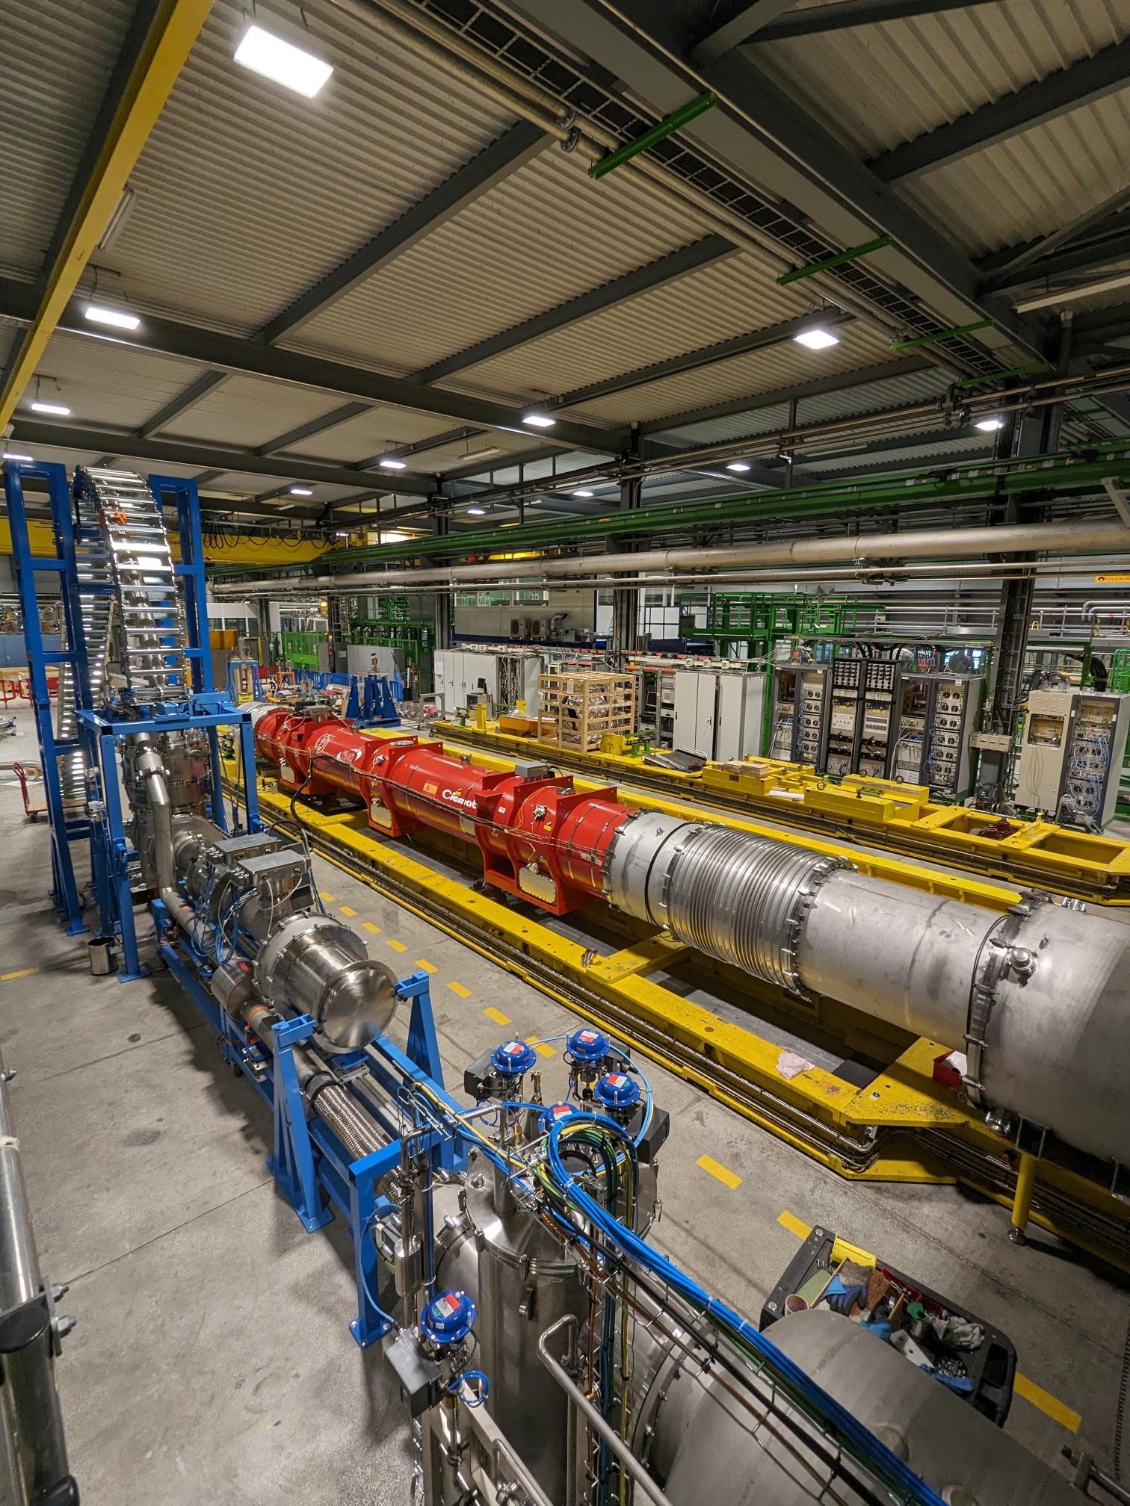
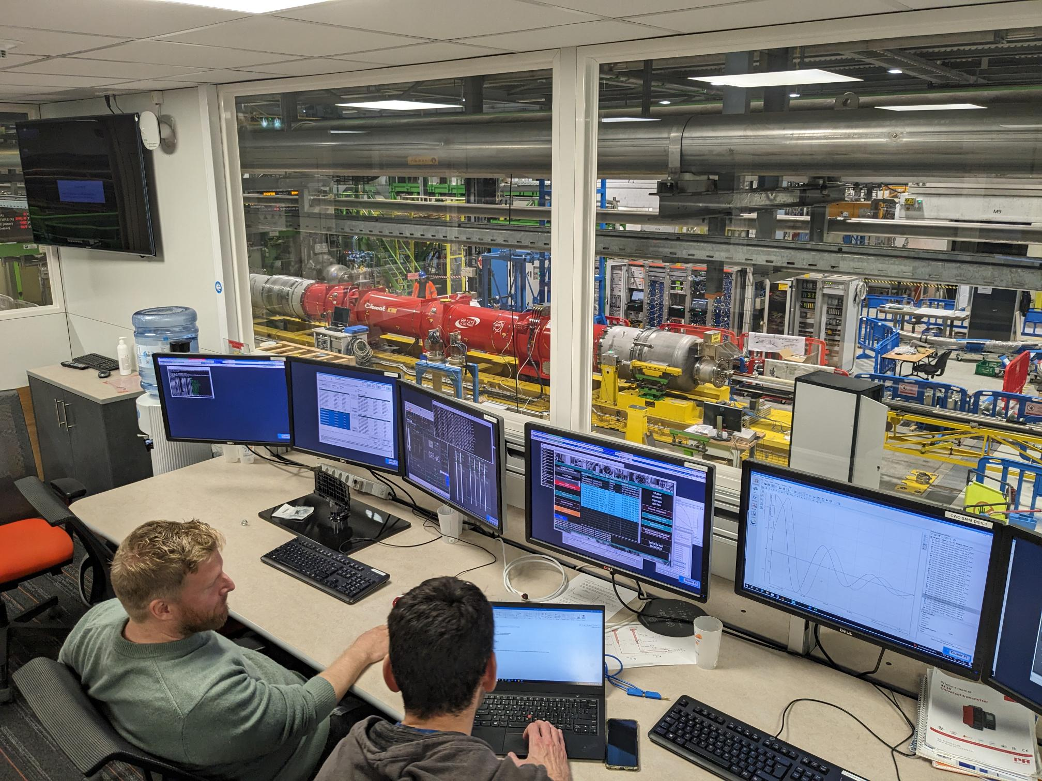
Bench F1/F2: Q2 and SC-link
Good experience with UQDS as DAQ.
Critical software layers were built around the DAQ, including a GUI user interface, recording all data on Post-Mortem and in the Logging database.
Data extraction tools were made to be able to analyze the data within 5-10 minutes from an event and the analysis software tools were updated to the new file types and analysis.

Slide 18
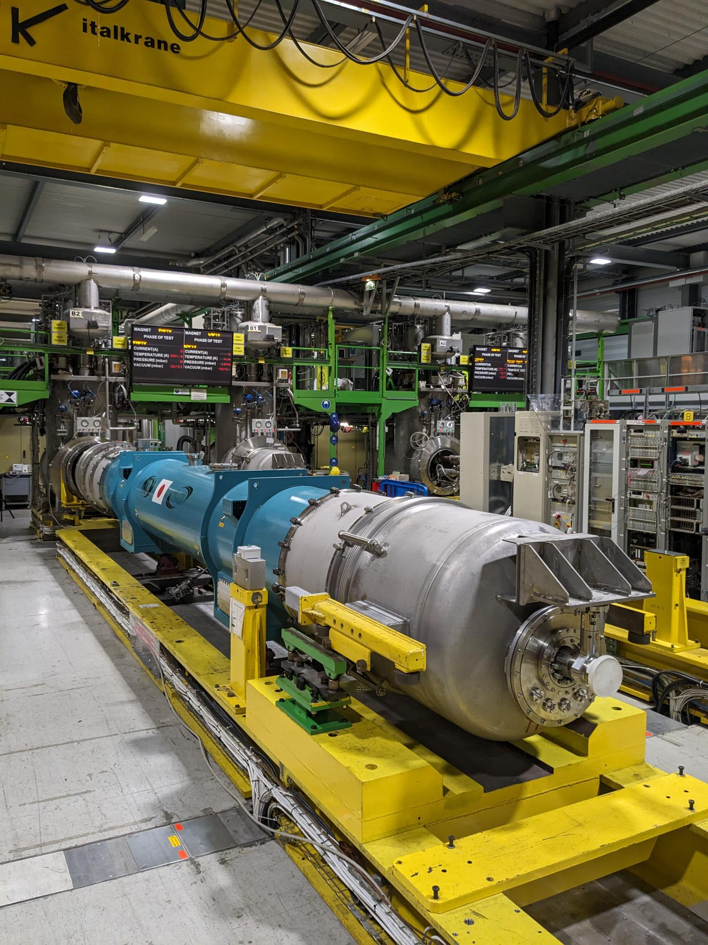
D1
Test station: B2
Number of cool downs: 1 (magnets tested vertically)
Test temperature: 1.9 only
Test station occupation: ~3-4 weeks
Magnetic measurements: Yes
Cold phase including powering: 2.5 week
Warm up/cool down duration: ~3? days per warm up/cool down
Units to test: 6
The test bench B2 is ready, the shuffling module is about to be completed in the next days. It requires a pressure test and cold verification this year.
The powering and protection systems are identical to the LHC type magnets and are in operational condition for the bench. No particular difficulties foreseen.

Slide 19
D2
Test station: C2
Number of cool downs: 2 (Main magnet only tested) horizontally)
Test temperature: 1.9 only
Test station occupation: ~6-7 weeks
Magnetic measurements: Yes
Cold phase including powering: 3 week -
Warm up/cool down duration: ~4? days per warm up/cool down
Units to test: 6
The test bench C2 is ready. It requires a pressure test and cold verification this year.
The powering and protection systems were already used for the D2 prototype magnet. No particular difficulties are foreseen, but the commissioning is pending, also including new anti-cryostats.

Slide 20
Q10
Test station: B1
Number of cool downs: 1 (magnets tested vertically)
Test temperature: 1.9
Test station occupation: ~3-4 weeks
Magnetic measurements: ?
Cold phase including powering: 1.5-2 weeks
Warm up/cool down duration: ~2? days per warm up/cool down
Units to test: 4
The Q10 assembly is the assembly that draws the least attention so far.
‘Standard’ LHC configuration, to be tested on bench B1.
Side note: 7 spare MB magnets require retest on the same bench. Some benches will keep their configuration for LHC cryo assemblies.

Slide 21
Parallel testing
SC-link powering test during thermal cycle of the Q2. Minimum impact expected, with some flexibility in the test plan, we can obtain maximum efficiency.
Insulation and instrumentation checks can be done at cold in parallel to other tests on the neigboring bench.
Two magnets tested in parallel on the horizontal bench is about the limit for cryogenics and human resources. As test plans get shorter, the same amount of work (preparation, installation, mechanics, etc.) needs to be done in a shorter amount of time.

Slide 22
Cryogenics
Cryogenics is the most important service for testing magnets.
Throughout the last years many optimizations have been done
Flexibility between using 35 g/s and 25 g/s cold box.
Re-installing 25.000 liter dewar with improved range.
Additional automation of cool down and warm up processes for vertical and horizontal benches.
Direct and daily coordination between test operators and cryogenics operators strongly improves efficiency.
After summer 2024, often 3 magnet test stations in test in parallel, while also 2 or 3 RF cavity test stations were in test, always using full capacity.
1.9 K pumping (2*12 g/s) is the main factor limiting capacity.
When the IT-string is in operation, it will use one pumping unit of 12 g/s, reducing pumping for magnets and RF to half capacity. This is foreseen to have a major impact on the test operation.

Slide 23
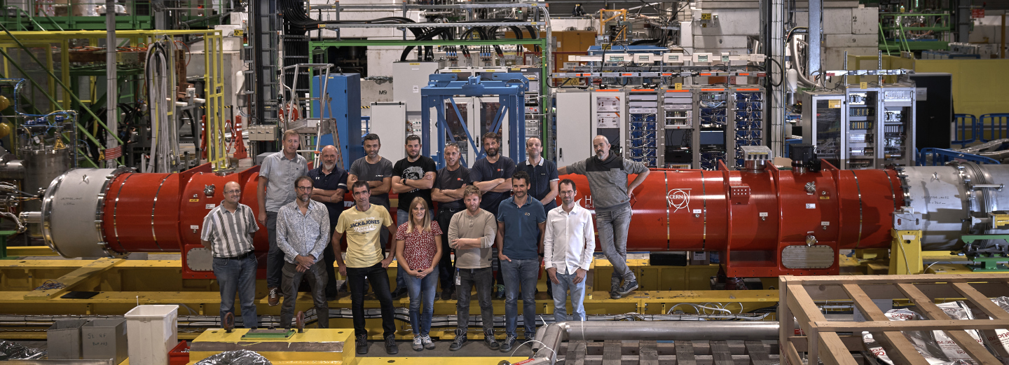
Summary
Vertical benches
Smooth test operation
All test plans well established and most magnets qualify without major issues. (Exception for one MQML magnet.)
Horizontal benches
Since last year bench F1, F2 and A2 are fully in operation.
Proven efficient test operation for Q2, Q3, SC-link.
Bench B2 and C2 have been completed, but not yet commissioned.
1.9 K pumping capacity could reduce test station throughput when IT-String operation starts, which is foreseen end 2025.
SM18 magnet test station is ready for HL-LHC!
Fully focused on test from now on.

Slide 25
Done since the 13th Hilumi collaboration meeting in the SM18 superconducting magnet test facility
Upgrades
Commissioning F1 bench with first Q2 cryo assembly
Completion and commissioning F2 bench with first SC-link full system
Completion and commissioning A2 bench with first Q3 cryo assembly
Completion C2 bench upgrade – ready for pressure test and cold test.
B2 bench upgrade ongoing – Next week ready for pressure test and cold test
Horizontal tests
One cool down MQXFB in test cryostat on bench A1.
One D1 prototype tests with two cool downs
Five Q2 cold mass tests (4 cold masses) with six cool downs.
One SC link full system type X tested with two cool downs.
One LHC MB test
One Q3 cold mass tests with two cool downs.
Vertical tests
Four MQML tests
One MSCB test
Three MCBXF tests
Two MCBRD tests
Five MQXFS tests
(15 tests for HFM and other projects.)

