Slide 1


Horizontal Test Results of LQXFA/B02 and Plans for testing LQXFA/B03
Guram Chlachidze
Fermilab
14th HL-LHC Collaboration Meeting
Genoa, Italy 7-10 October 2024

Slide 2
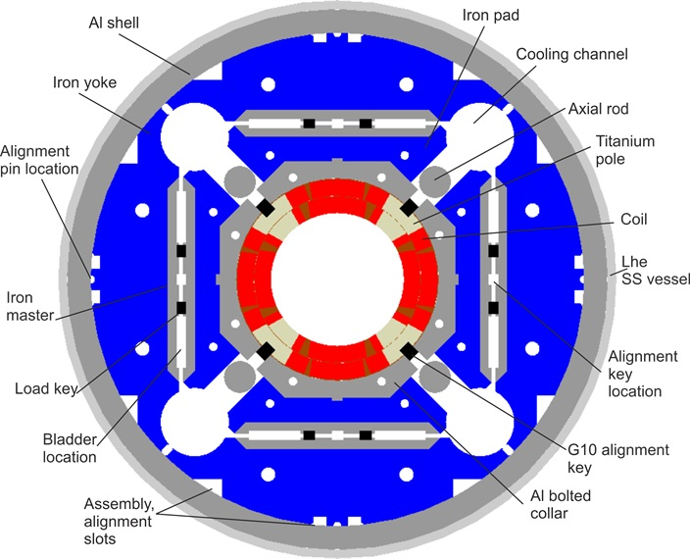
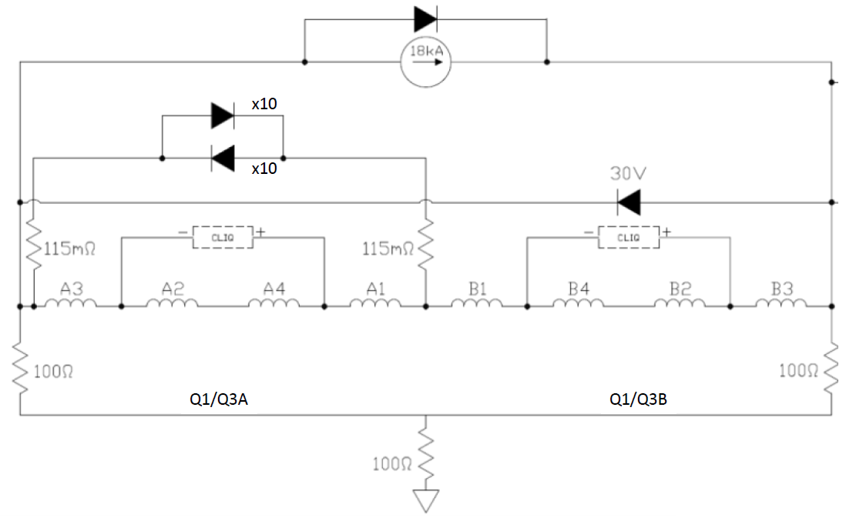
LQXFA/B02
MQXFA05 and MQXFA06 magnets of LQXFA/B02 have been trained at BNL
Quench protection includes CLIQ
& Strip heaters on the outer coil
No external EE (Dump delay 1s)
COIL 116
COIL 207
COIL 119
COIL 122
COIL 209
COIL 115
COIL 211
COIL 123
MQXFA05 (MQXFA.A)
MQXFA06 (MQXFA.B)
Notes:
COIL ARE fabricated

Slide 3
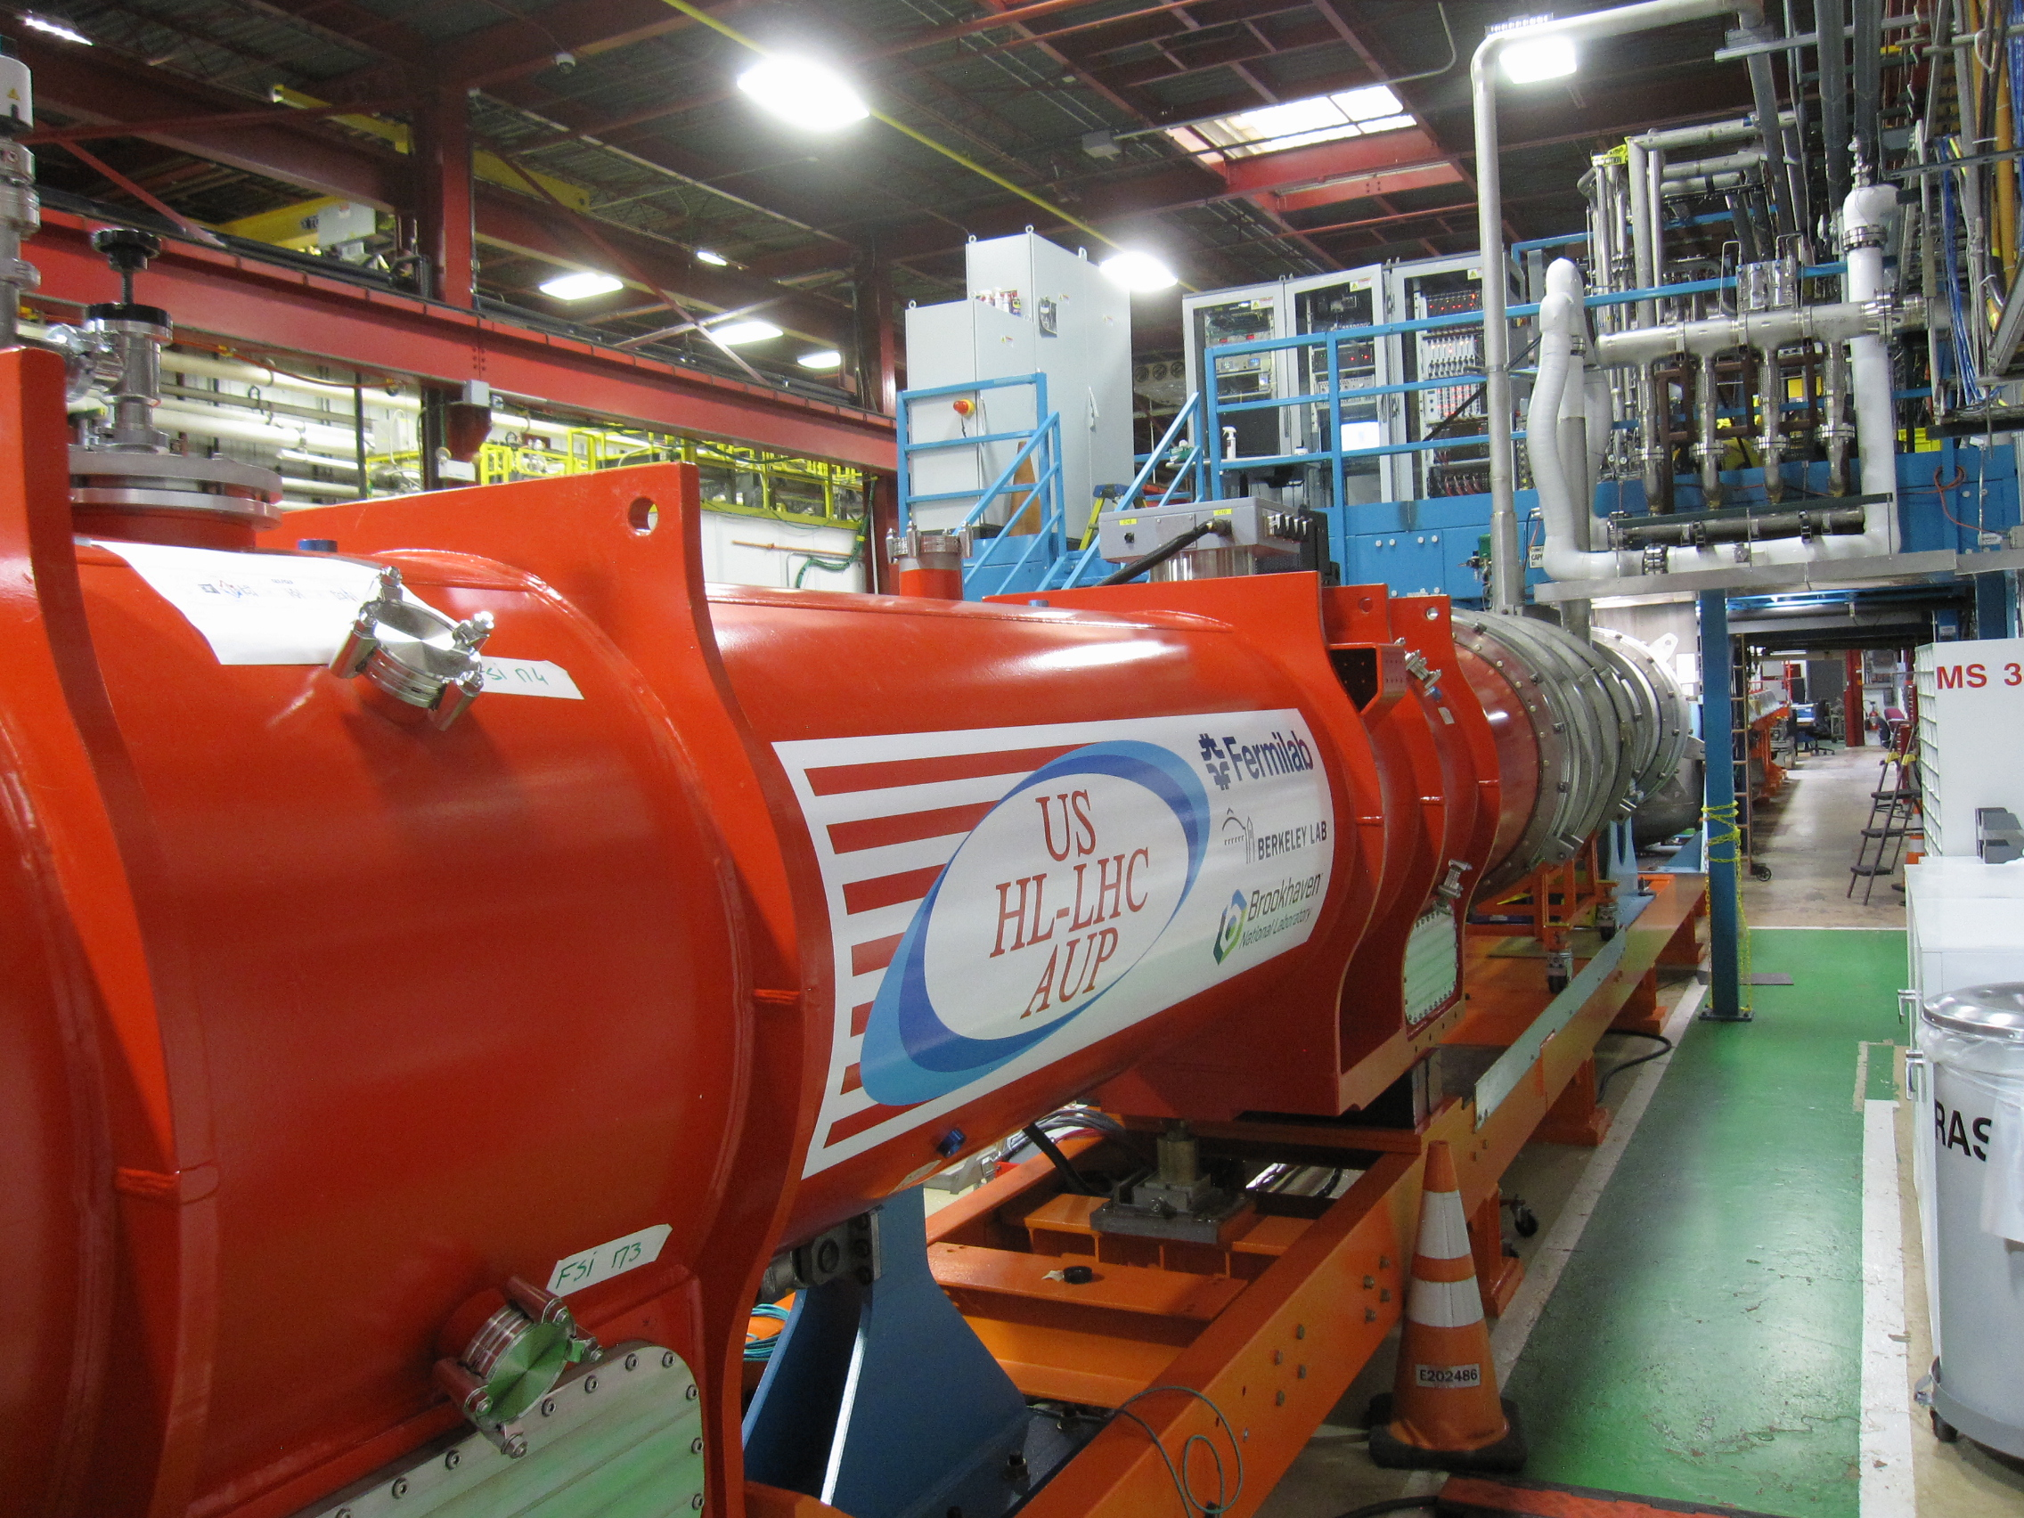
LQXFA/B02 at Fermilab’s horizontal test stand
Lead End
MQXFA05 (A)
MQXFA06 (B)

Slide 4
Initial Electrical Checkouts
All v-taps, temperature sensors and protection heaters functional
Fast pressure transducers installed at both ends of the cryo-assembly to measure pressure wave after the quench/trip
  Sensors with wiring will be removed after the test, before cryo-assembly is shipped to CERN
Successfully passed room temperature insulation (Hipot) tests
  Lead-to-ground at 2.5 kV, Top plate w/o magnets
  Coil-to-ground (heaters grounded) at 368 V
  Quench heater-to-coil (coil grounded) at 460 V
Cold insulation (Hipot) tests performed at 1.9 K
  Coil-to-ground (heaters grounded) at 1840 V (1.9 K)
  Quench heater-to-coil (coil grounded) at 2300 V (1.9 K)

Slide 5
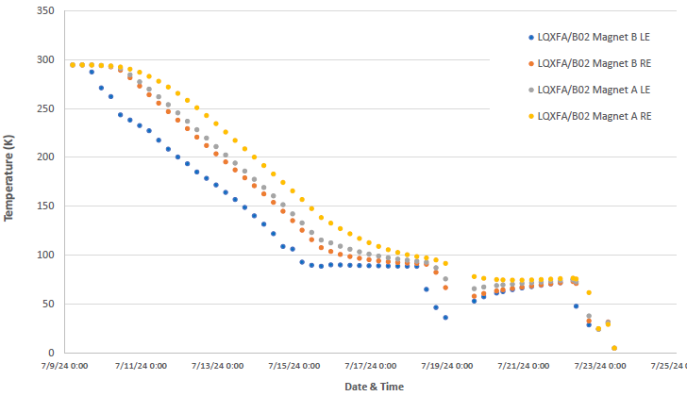
LQXFA/B02 controlled cooldown
14 days of cooldown from Jul 9 to Jul 23 (compare to 19 days in LQXFA/B01)
  Two days of downtime due to cybersecurity issues
  GHe mass flow rate varied from 9 g/s to 18 g/s
Two days of downtime
18 g/s
9 g/s

Slide 6
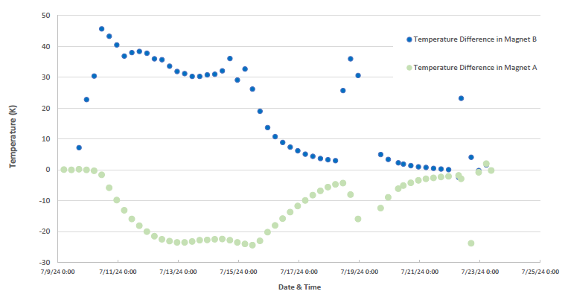
LQXFA/B02 Controlled cooldown (2)
Better temperature control with temperature sensors installed on both ends of each magnet in LQXFA/B02

Slide 7
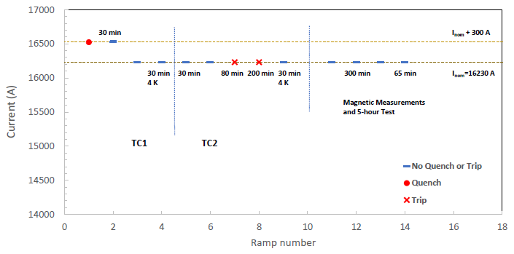
LQXFA/B02 Quench Performance
Only one quench in two test cycles
  Quench at 16524 A, see details on the next slide
Two power supply related trips during the holding current test at the nominal current of 16230 A

Slide 8
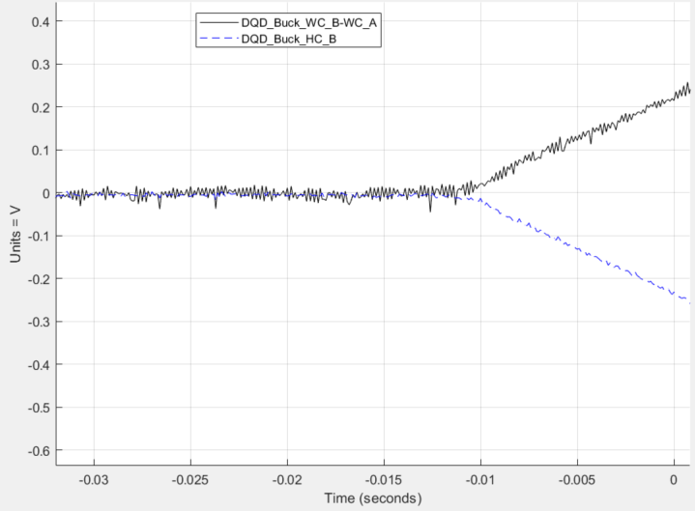
Quench in TC1
Only one spontaneous quench in MQXFA06 (B), coil 122 (pole 1)
  Quench current 16524 A
  Quench Integral 27.2 MIITs

Slide 9
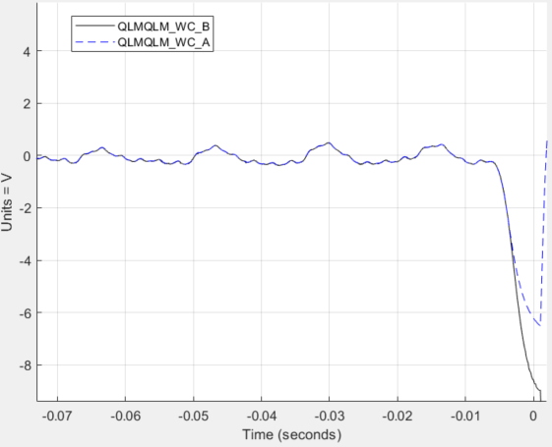
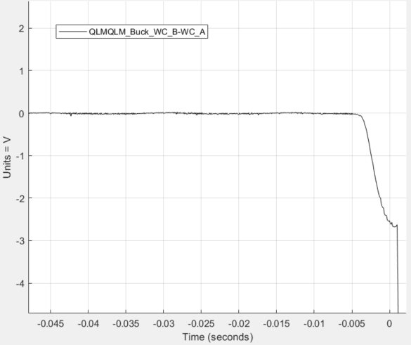
Trips at the nominal current
Two trips at I_{nom} with very similar pattern
  No resistive signals in coils or leads, only inductive signals in all coils
  Quench detection has been triggered due to difference between the inductive signals in magnets B and A

Slide 10
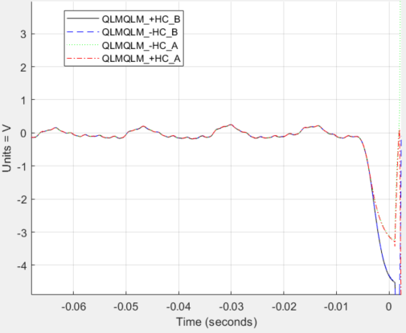
Trips at the nominal current (2)
Difference in the inductive signals could be related with the protection diode system connected to the magnet A
We are not familiar with this type of the power supply failure
  Investigation of these events still in progress, no apparent cause of the problem was found yet

Slide 11
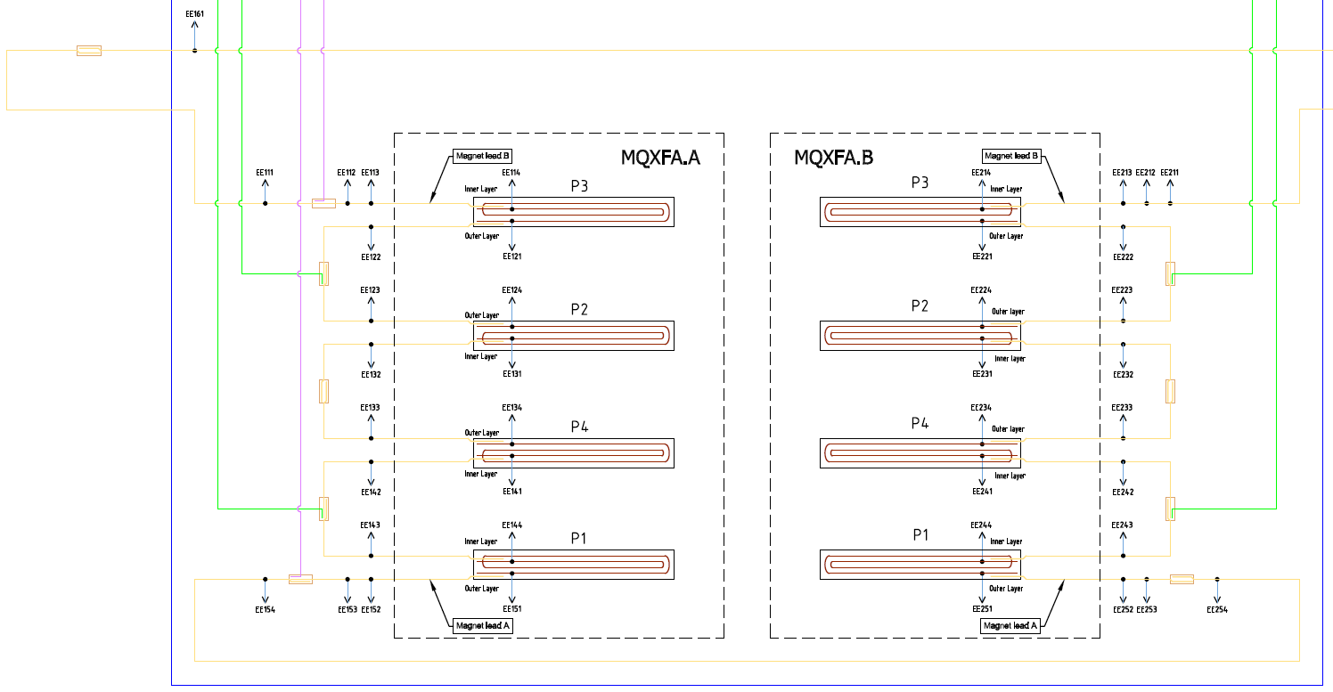
Splice measurements
All splices, made at Fermilab, have been measured
  Includes two splices required for connected magnets to the test facility

Slide 12
Splice measurements (2)
Measurements were performed at 1.9 K for currents up to 7 kA
All splice resistances are less than 1 nOhm

Slide 13
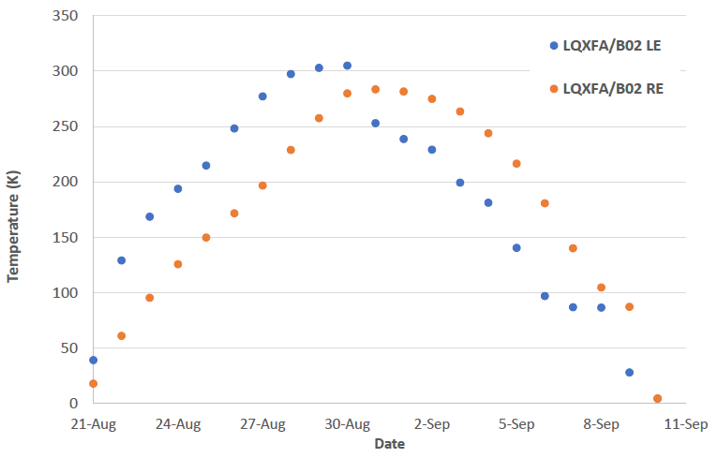
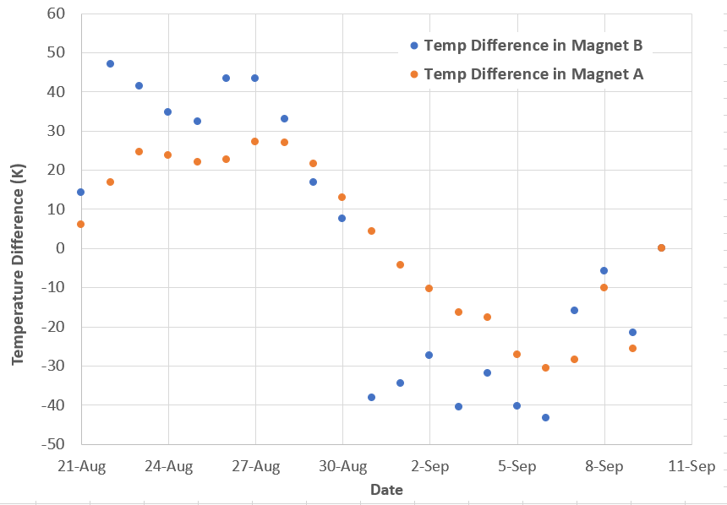
Thermal Cycle
Controlled warmup and cooldown from Aug. 21 to Sep. 10
  Total of 20 days. Further improvement will require modification or upgrade of the heat-exchanger in the helium return line

Slide 14
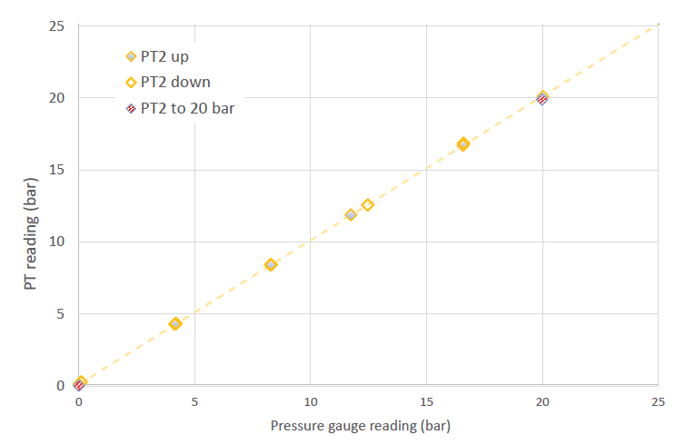
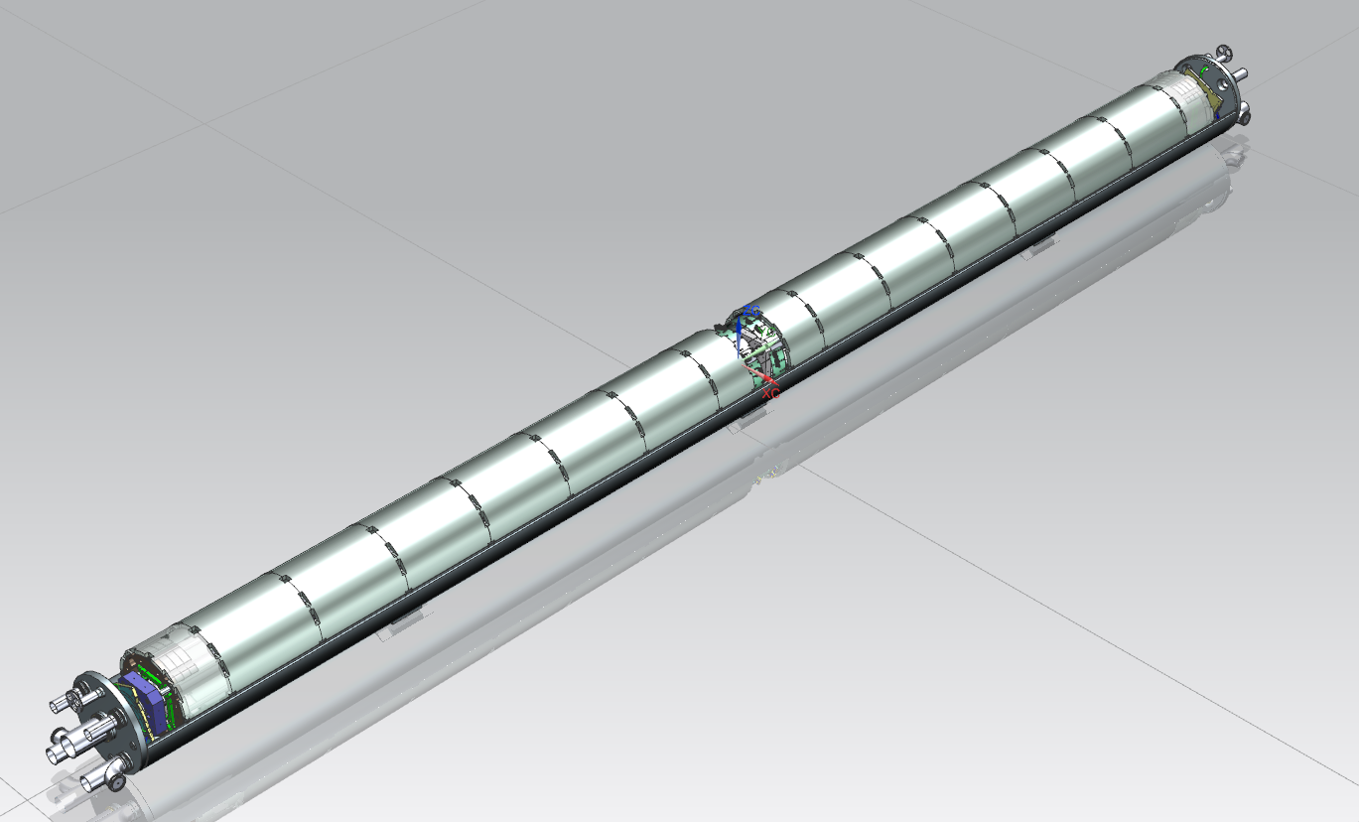
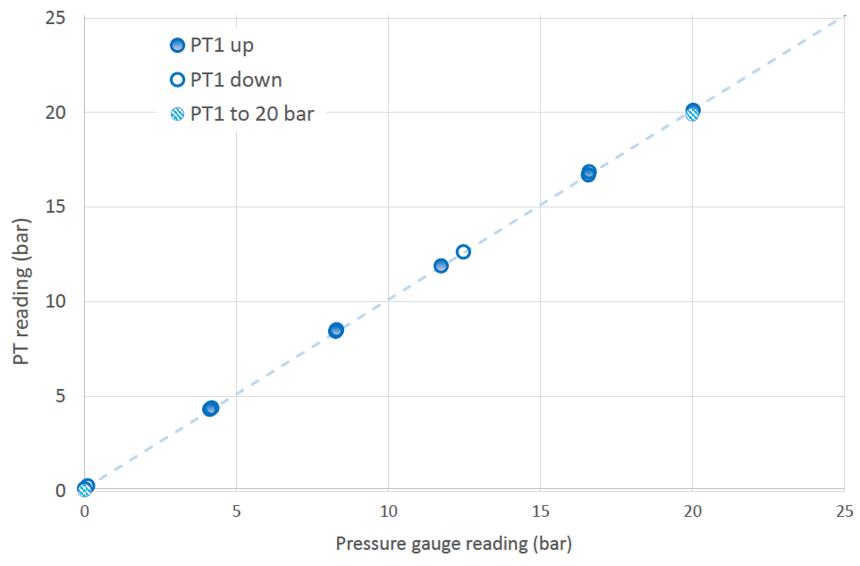
Pressure wave measurements
Fast “cold” pressure transducers by WIKA Sensor Technology were installed at both ends of the LQXFA/B02 cryo-assembly, close to the cold-mass end plates
  Rated for pressures up to 25 bar, frequency response above1000 Hz
  Sensors calibrated during the cold mass pressure test up to 20 bar

Slide 15
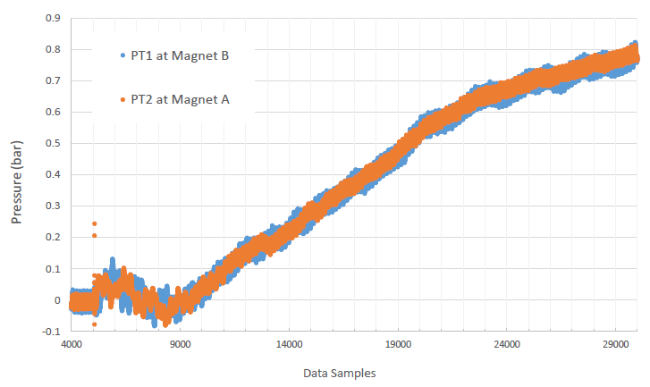
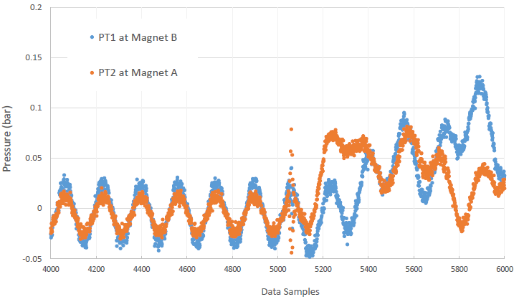
Pressure wave measurements (2)
Manual trip in Magnet A at 6 kA (single magnet configuration)
  Data analysis still in progress
  PT1 (B) signal delay with respect to PT2 (A) is about 20 ms
  Pressure PT2 reached about 0.08 bar in 5 ms
  At the nominal current, if pressure continues linear increase all 20 ms, it may reach 0.08 x 4 = 0.32 bar
  We plan high current tests with one of the future cryo-assemblies
0.08 bar
Sampling rate 10 kHz

Slide 16
Cryogenic System improvements
First cryo-assembly test demonstrated that cryogenic system improvements were necessary to meet the Horizontal CA test requirements
Following upgrades have been completed in preparation for LQXFA/B02 test
  Various monitoring instrumentation have been added for improvement of the controlled cooldown and warmup of the cryo-assembly
  Quench recovery automation was improved
  Fully automated 4.5 K overnight operation has been implemented
  Helium line heaters are installed to expedite the cooldown and warmup processes
  Most of the failed instrumentation was replaced or repaired (pressure transmitters, flowmeters and rotameters, leaking valves)
  Current lead joint improvement has been implemented

Slide 17
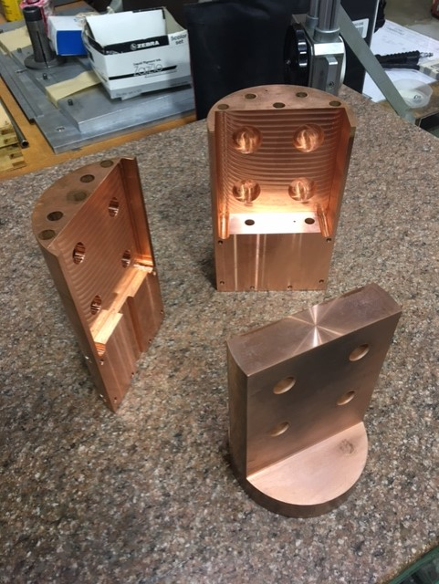
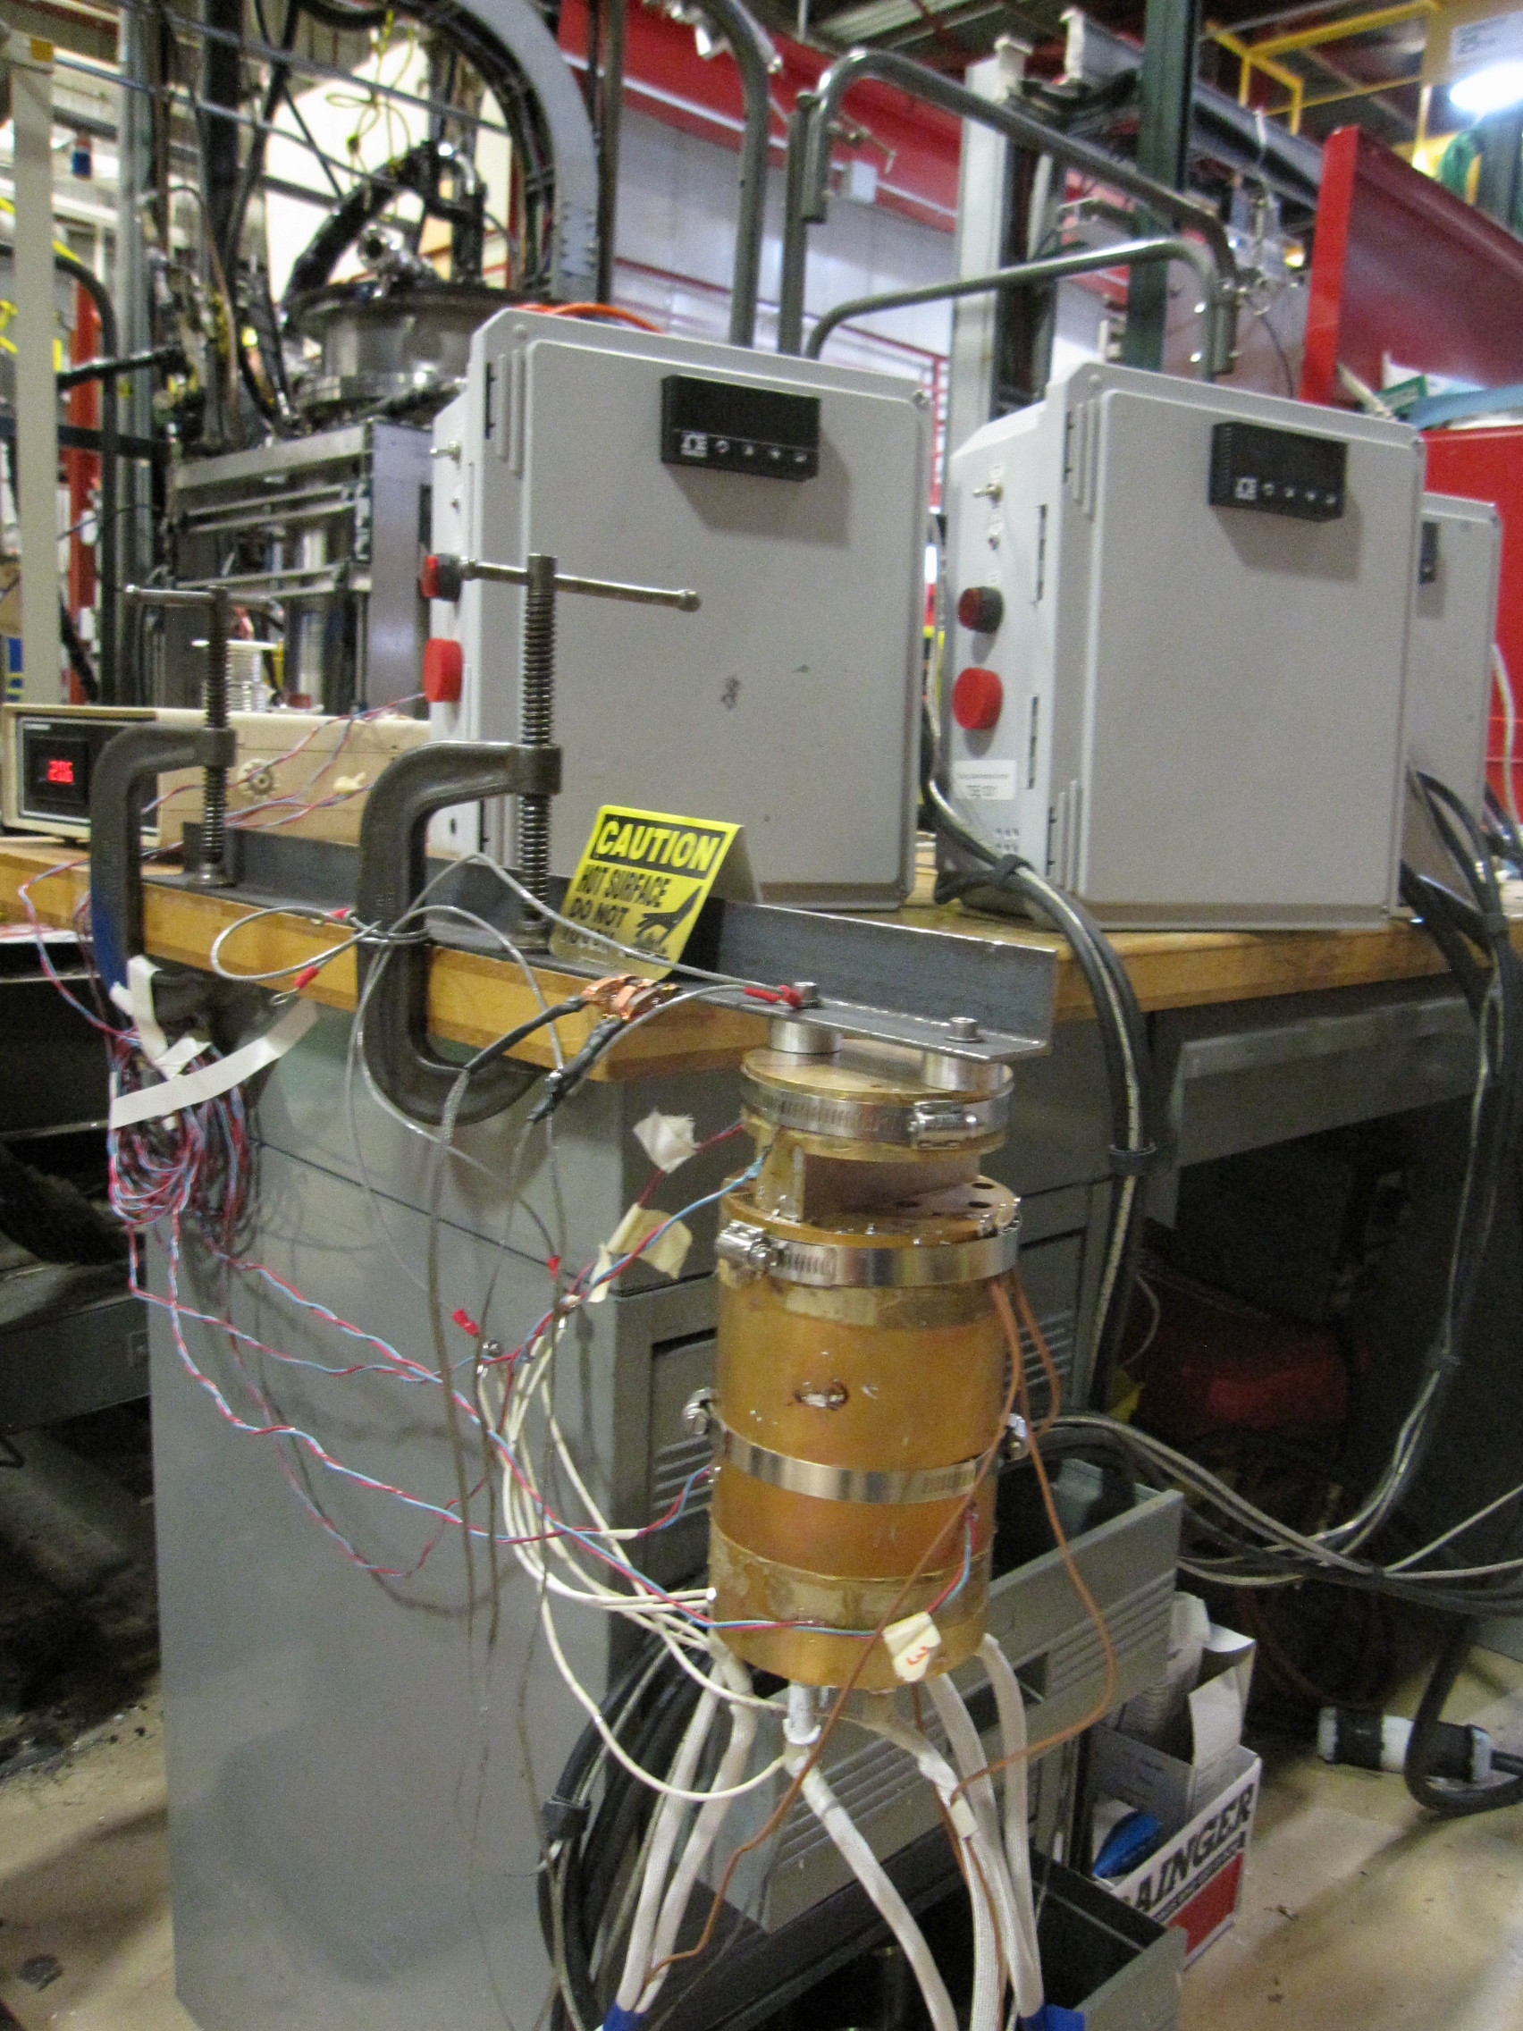
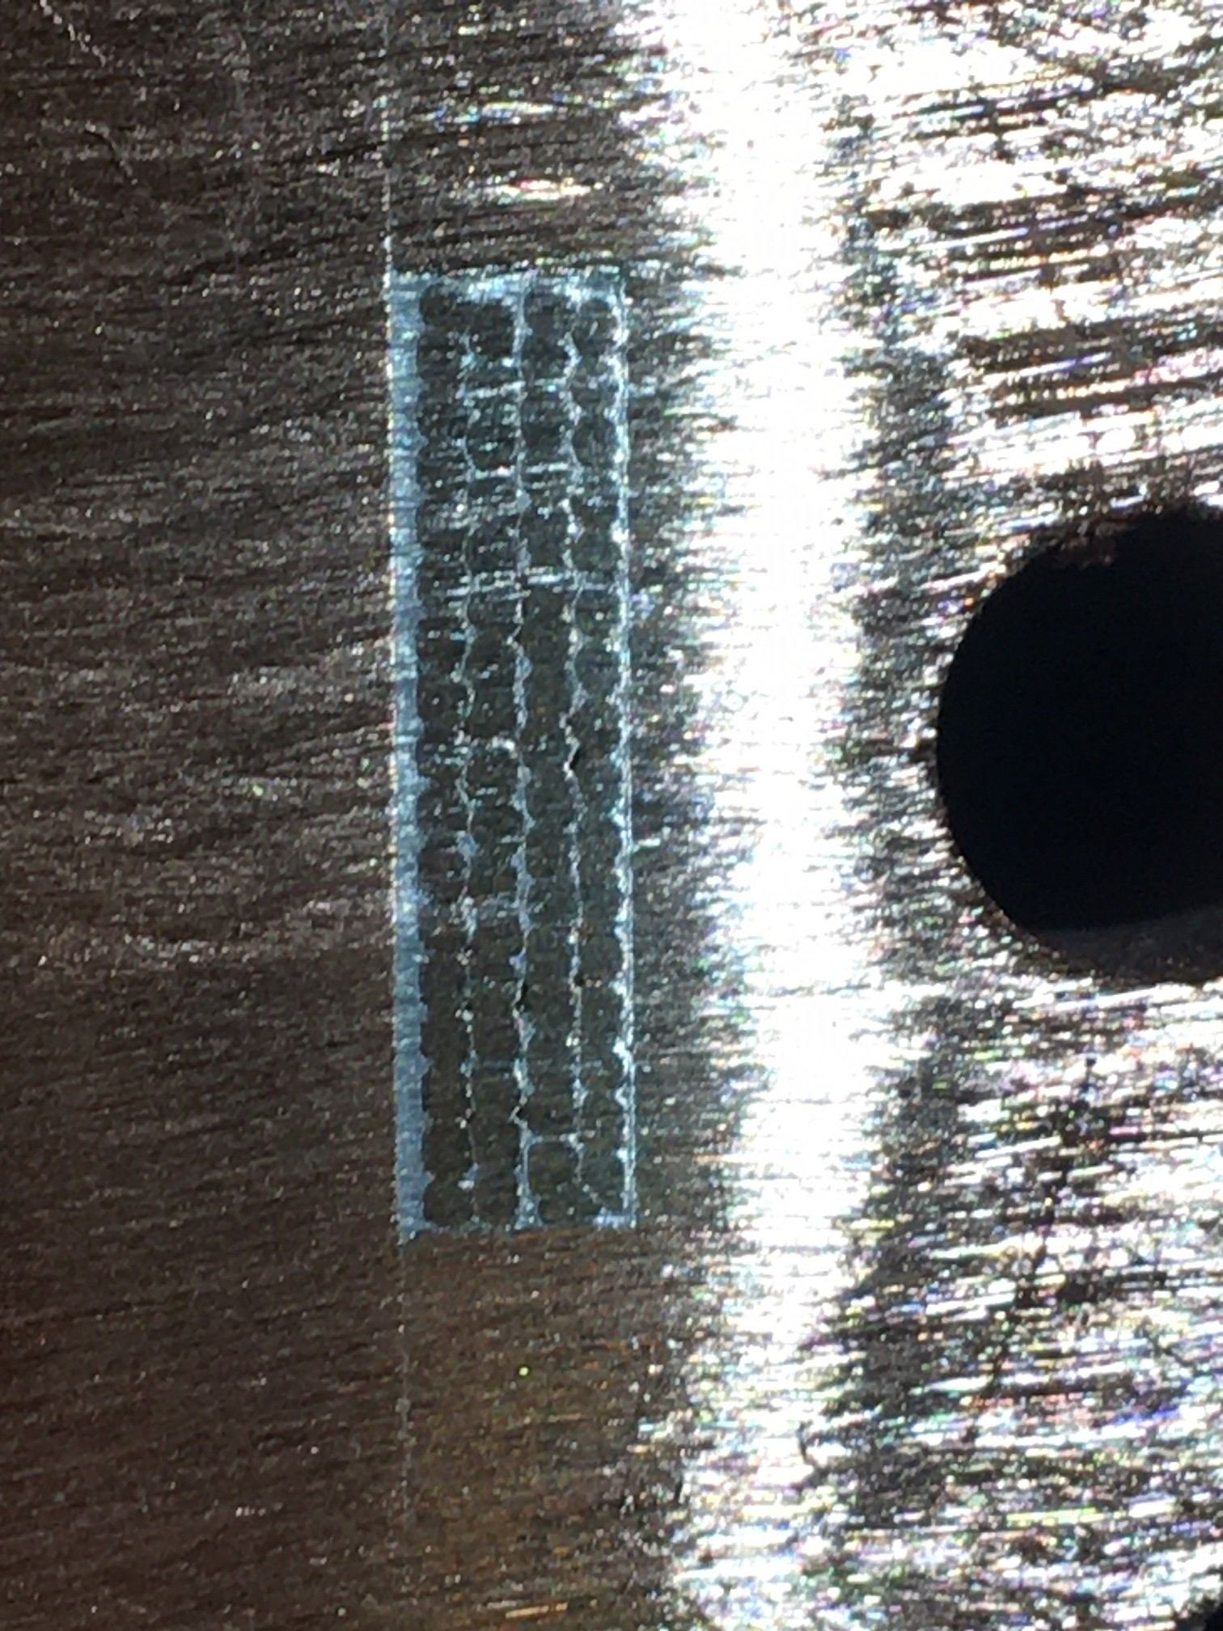
Current lead joint improvement
One of the current lead joints at Stand 4 exhibited increased resistance
  To avoid overheating of the superconducting bus, the helium liquid level was elevated accordingly
New copper fixture was designed, fabricated and tested to improve the cooling conditions of the lead joint
New copper fixture
Practice soldering setup
Practice lead joint cross-section

Slide 18
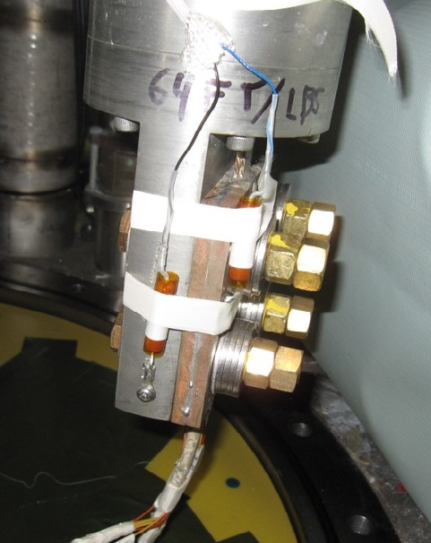
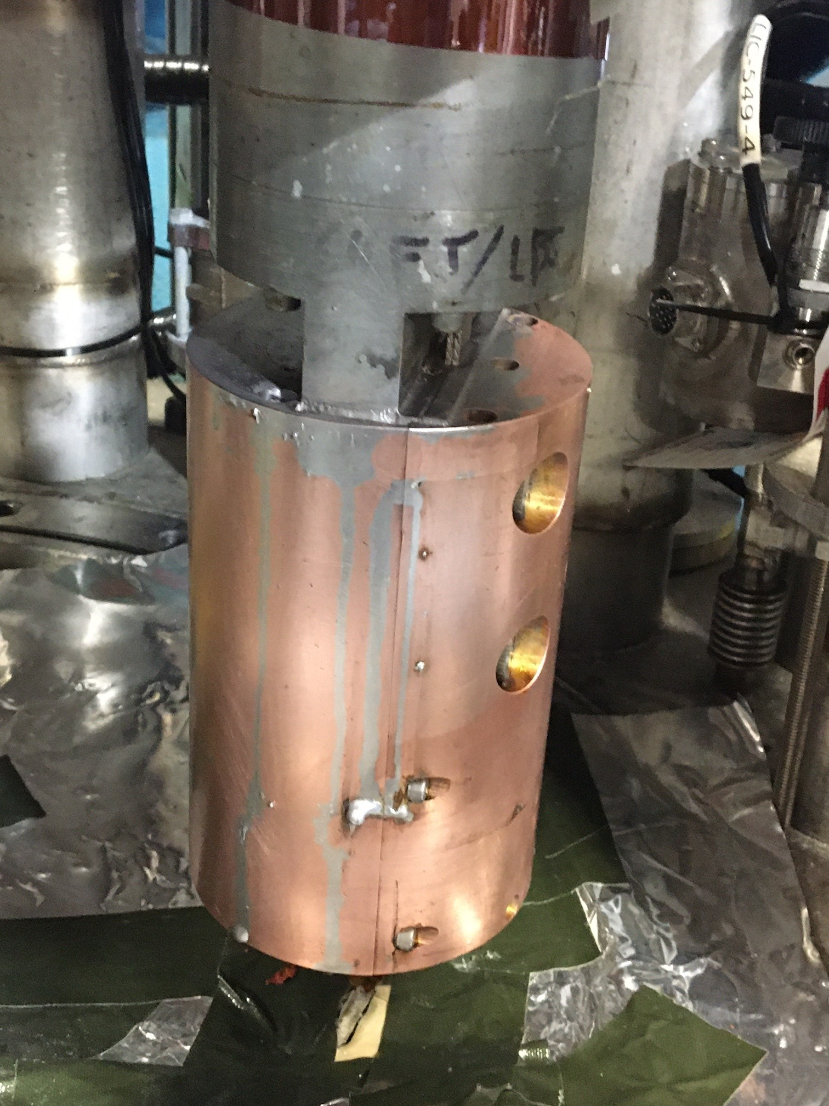
Current lead joint improvement (2)
The lead joint with increased resistance was modified with the newly developed fixture
  Heat load from this specific lead joint was reduced by factor of 10
  Other two lead joints will be modified later
Lead joint with increased resistance
Modified lead joint at Stand 4

Slide 19
LQXFA/B02 Test Summary &
Plans for LQXFA/B03 Test
LQXFA/B02 cryo-assembly successfully tested at Fermilab’s horizontal test stand
LQXFA/B02 test goals are achieved
  Only one spontaneous quench in two test cycles
  Nominal and acceptance currents are reached at 1.9 K
  Nominal current was reached at 4 K
  Ramping down at 150 A/s was validated
  Nominal current was successfully held for 5 hours
Horizontal Test Stand is ready for LQXFA/B03 test
  Cryogenic plant maintenance is scheduled for November
  Cold test of LQXFA/B03 is expected to start in December

