Slide 1

Effects of pre-loading on magnet performance in MQXFS model magnets
F. Mangiarotti, G. Willering, S. Izquierdo Bermudez, J. Feuvrier, J.-L. Guyon,
A. Haziot, et al
2024.10.08

Slide 2
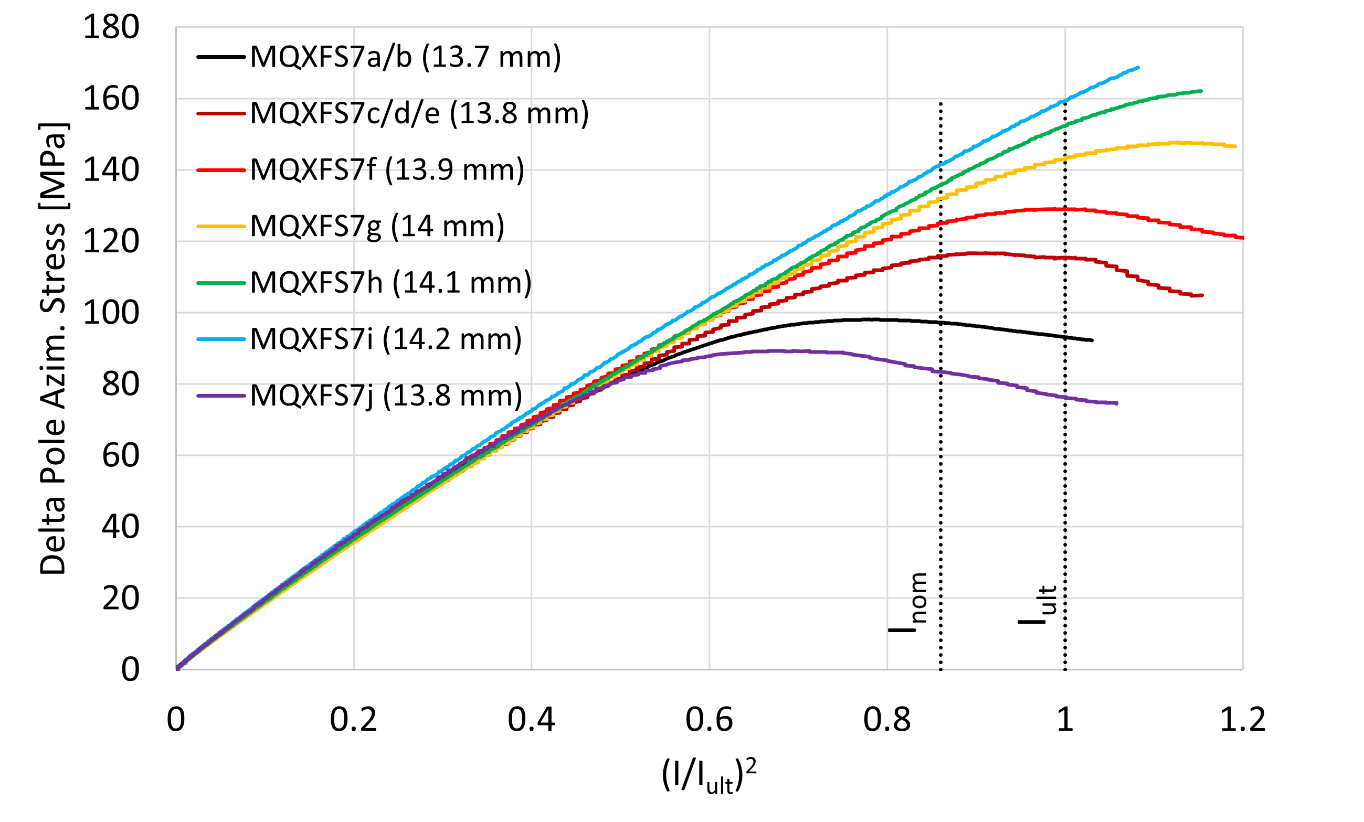
History of MQXFS7
MQXFS7 has:
Two RRP coils (113, 114)
One PIT coil (207)
One PIT bundle barrier coil (211)
Coil 211 has the lowest short sample limit
MQXFS7…
first assembly at ~100 MPa
welding SS shell
SS shell removed, ~115 MPa
validate new fix point solution
validate new loading procedure
~130 MPa
~150 MPa
~170 MPa
~190 MPa
~90 MPa
Only change is the preload
Data courtesy EN-MME, analysis by S. Izquierdo Bermudez

Slide 3
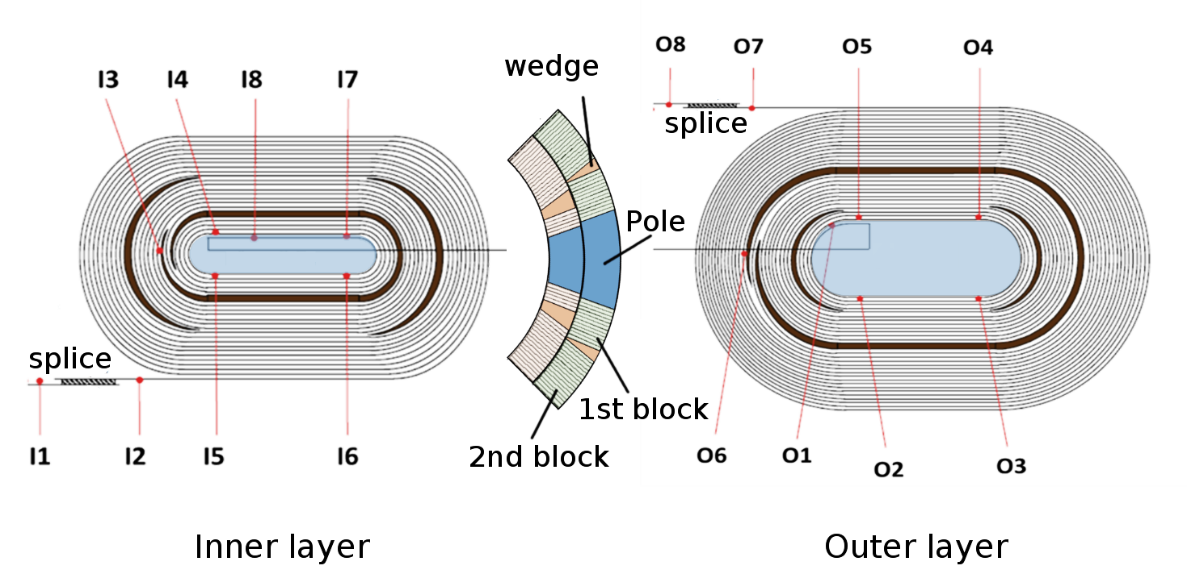
Three main quench locations
These three segments will come back several times. All in coil 211 (PIT with BB), inner layer pole turn straight segment + layer jump
211 I5-I6
211 I7-I8
211 I8-O1

Slide 4
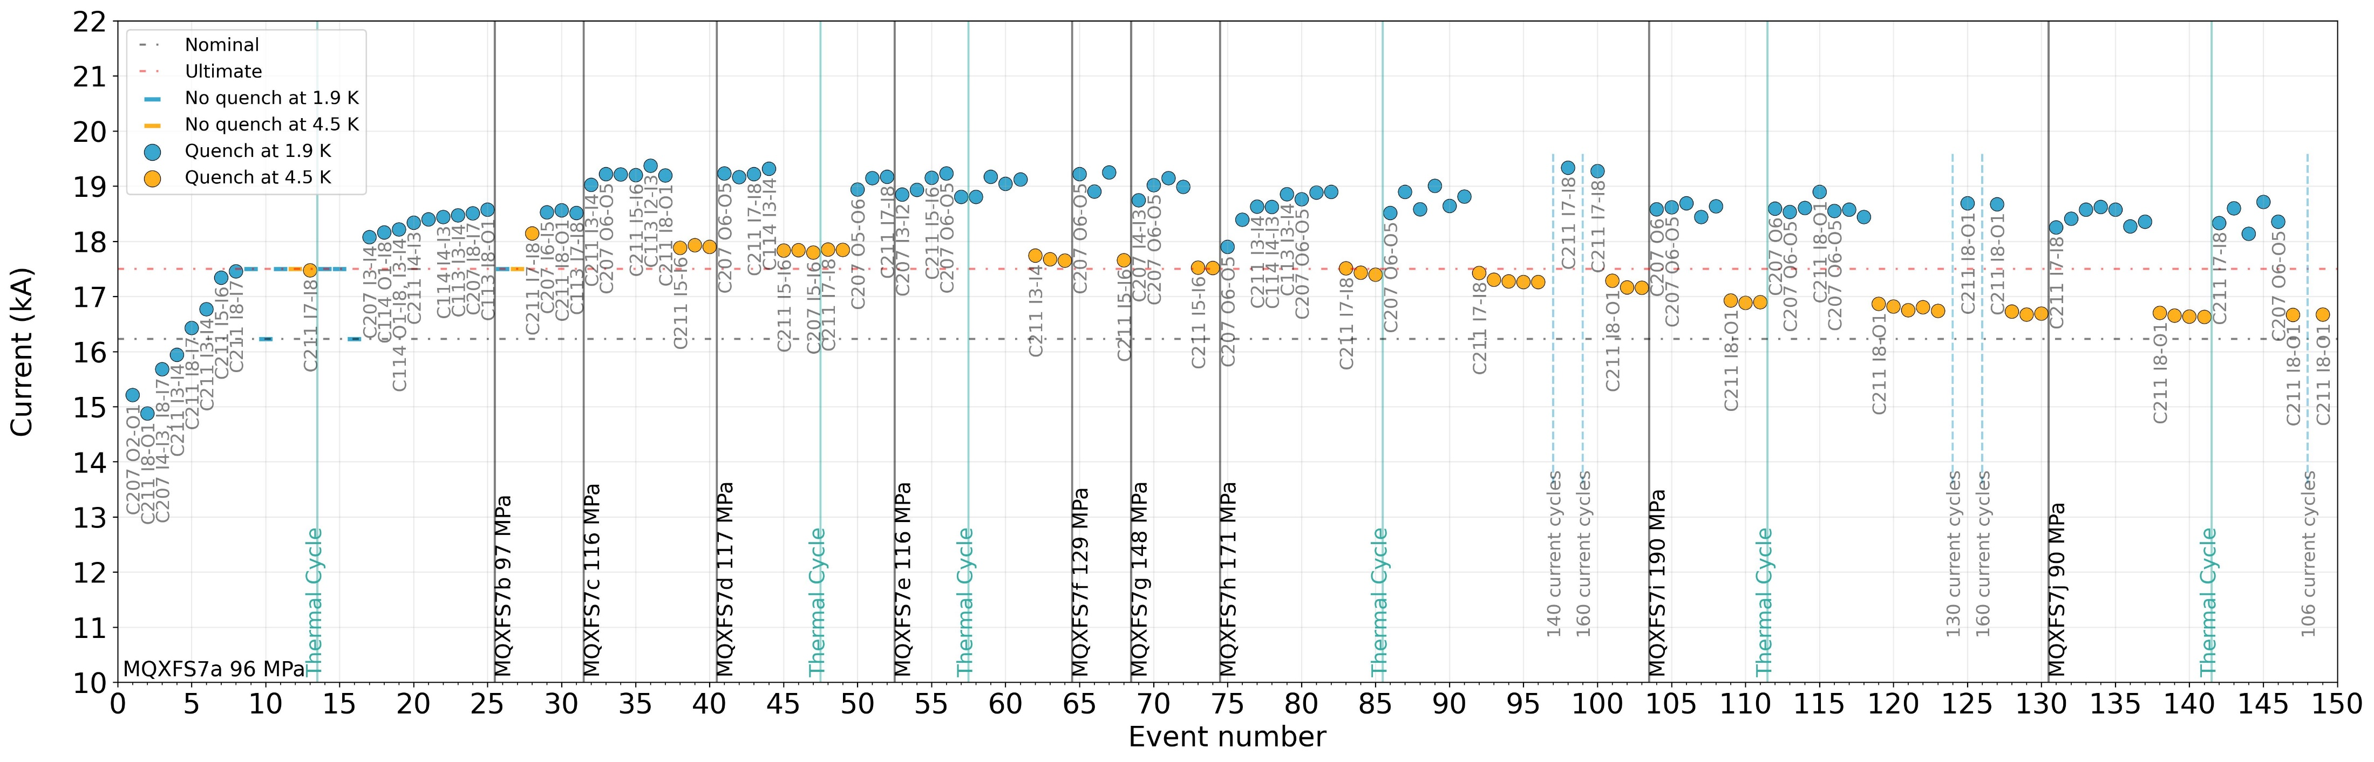
Training plot at 20 A/s
~140 quenches at nominal ramp rate, ~300 quenches in total (including provoked). Maximum 19.2 kA (118 % of I_{nom})
10 assemblies and 16 cool down / warm up cycles. Very good training memory after reassembly and thermal cycle.
Quench current gradually reduced with each new iteration.

Slide 5
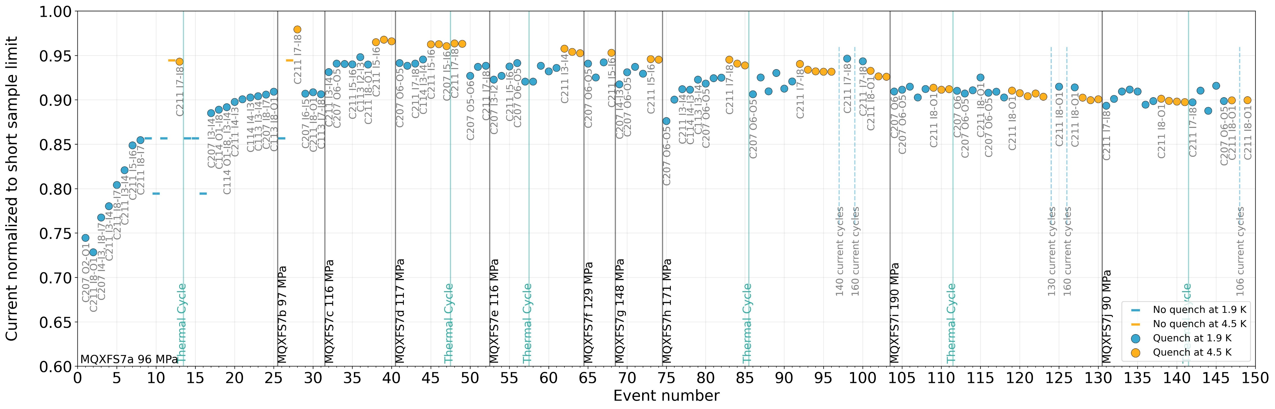
Training plot normalized to short sample limit
Until MQXFS7h, at 4.5 K we reached higher fraction of Iss: “blocked” by training at 1.9 K, by conductor at 4.5 K.
Note that in MQXFS7b we reached ~98 % of short sample limit, and at the end of the test series ~90 %.
Quench location: at 4.5 K in coil 211, at 1.9 K (after training) in coils 207 and 211.

Slide 6
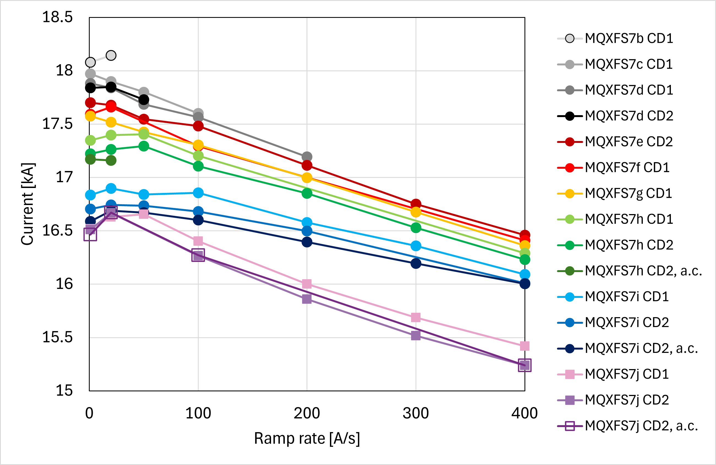
Ramp rate dependency at 4.5 K
 | Ramp rate [A/s]
MQXFS7.. | 1 | 20 | 50 | 100 | 200 | 300 | 400
b, CD1 | I3-I4 | I7-I8 | --- | --- | --- | c.207 | c.114
c, CD1 | I5-I6 | I5-I6 | I5-I6 | I5-I6 | --- | --- | ---
d, CD1 | I7-I8 | I5-I6 | I5-I6 | I5-I6 | I5-I6 | c.207 | c.114
d, CD2 | I7-I8 | I7-I8 | I5-I6 | --- | --- | --- | ---
e, CD2 | I3-I4 | I3-I4 | I3-I4 | I3-I4 | I3-I4 | I3-I4 | I3-I4
f, CD1 | I5-I6 | I5-I6 | --- | I5-I6 | --- | --- | I5-I6
g, CD1 | I7-I8 | I5-I6 | I5-I6 | I5-I6 | I5-I6 | I5-I6 | I5-I6
h, CD1 | I7-I8 | I7-I8 | I5-I6 | I5-I6 | --- | --- | I5-I6
h, CD2 | I7-I8 | I7-I8 | I7-I8 | I7-I8 | I5-I6 | I5-I6 | I5-I6
h, CD2, a.c. | I8-O1 | I8-O1 | --- | --- | --- | --- | ---
i, CD1 | I8-O1 | I8-O1 | I7-I8 | I7-I8 | I7-I8 | I5-I6 | I5-I6
i, CD2 | I8-O1 | I8-O1 | I8-O1 | I8-O1 | I8-O1 | --- | I5-I6
i, CD2, a.c. | I8-O1 | I8-O1 | I8-O1 | I8-O1 | I8-O1 | I8-O1 | I7-I8
j, CD1 | I8-O1 | I8-O1 | I8-O1 | I7-I8 | I7-I8 | I7-I8 | I7-I8
j, CD2 | I8-O1 | I8-O1 | --- | I7-I8 | I7-I8 | I7-I8 | I7-I8
j, CD2, a.c. | I8-O1 | I8-O1 | --- | I7-I8 | --- | --- | I7-I8

Slide 7
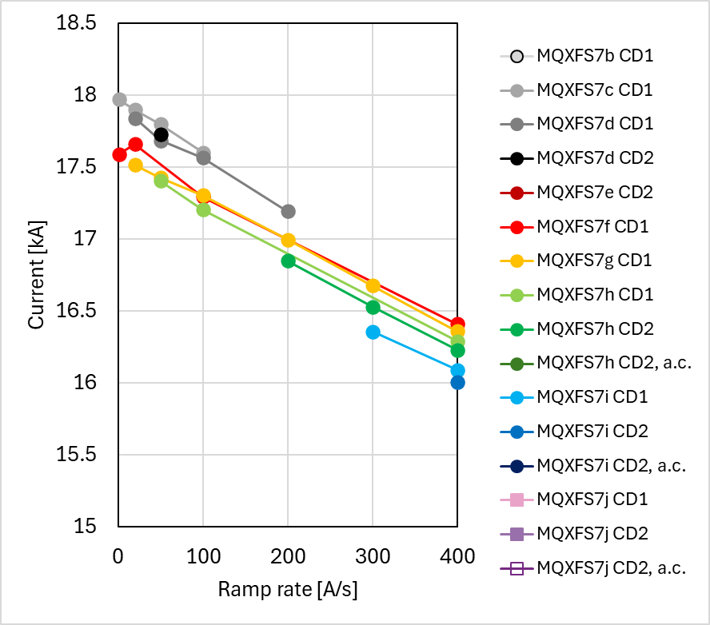
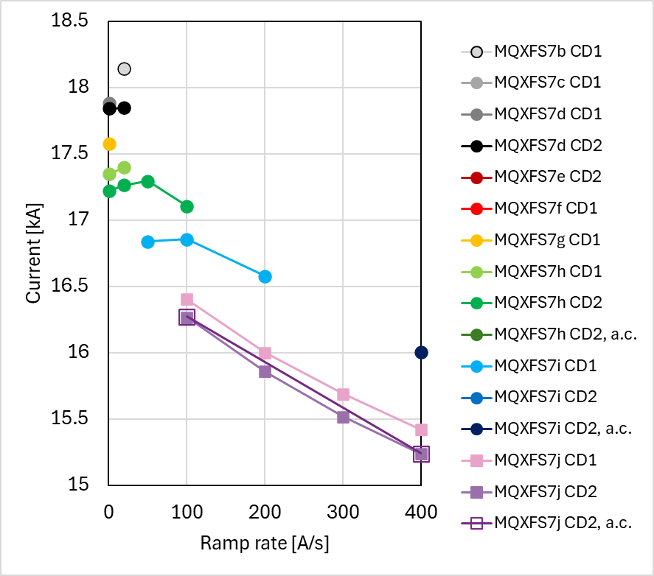
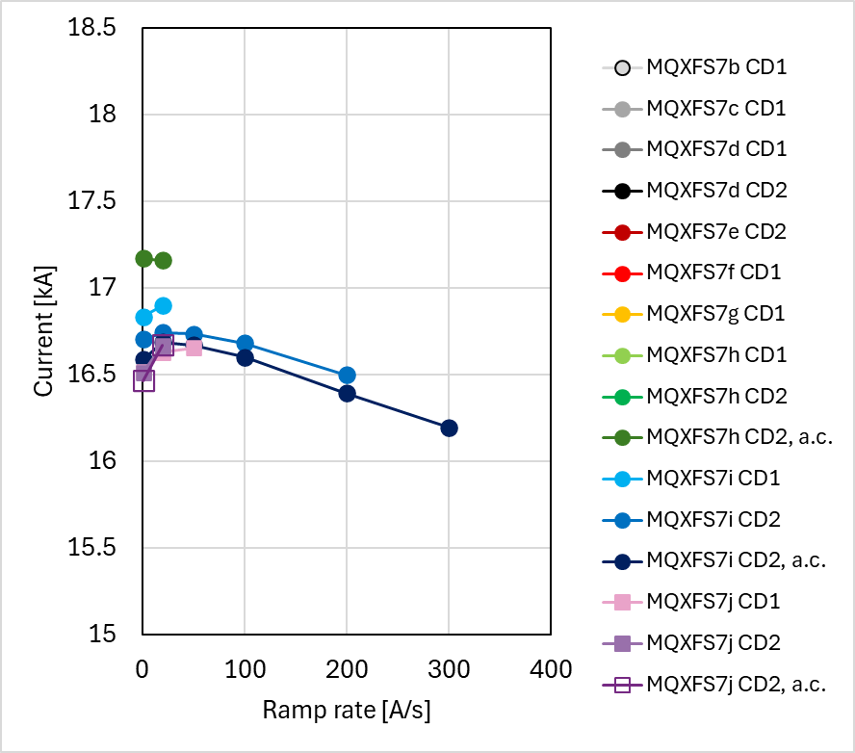
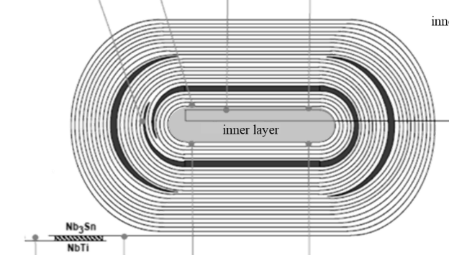
Ramp rate dependency at 4.5 K per location
C211 I5-I6
C211 I7-I8
C211 I8-O1

Slide 8
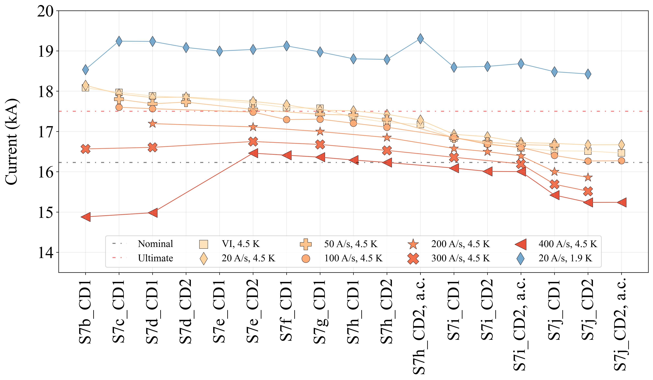
“Historical” view of the quench level

Slide 9
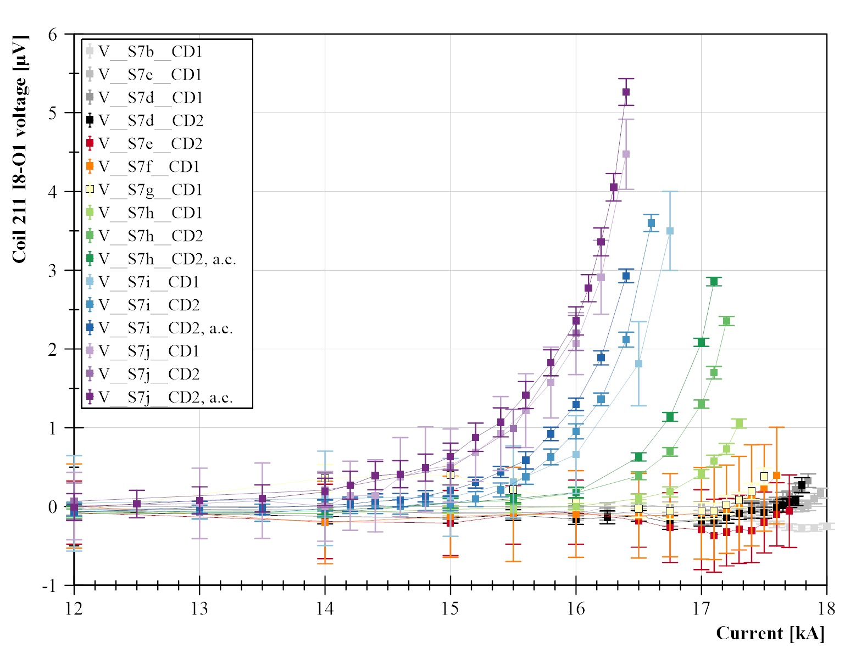
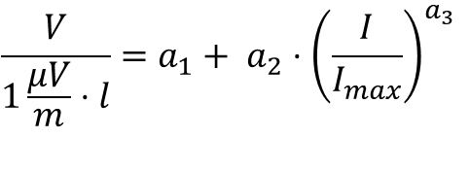
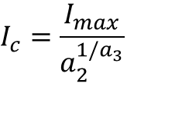
V-I measurements at 4.5 K. Example: 211 I8-O1
V-I measurements are fitted with this equation:
$$\frac{V}{1\frac{μV}{m}⋅l}=a_{1}+ a_{2}⋅{\left(\frac{I}{I_{max}}\right)}^{a_{3}}$$
From this we get the critical current:
$$I_{c}=\frac{I_{max}}{a_{2}^{1/a_{3}}}$$

Slide 10
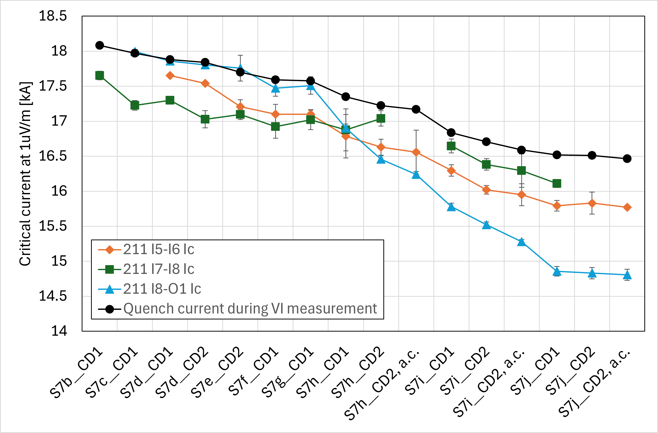
Critical current at 4.5 K from V-I measurements
Degradation in layer jump intensifies in MQXFS7h, and starts being the quench location at S7h CD2 a.c.
In MQXFS7j, the thermal cycle and current cycles did not significantly change Ic

Slide 11
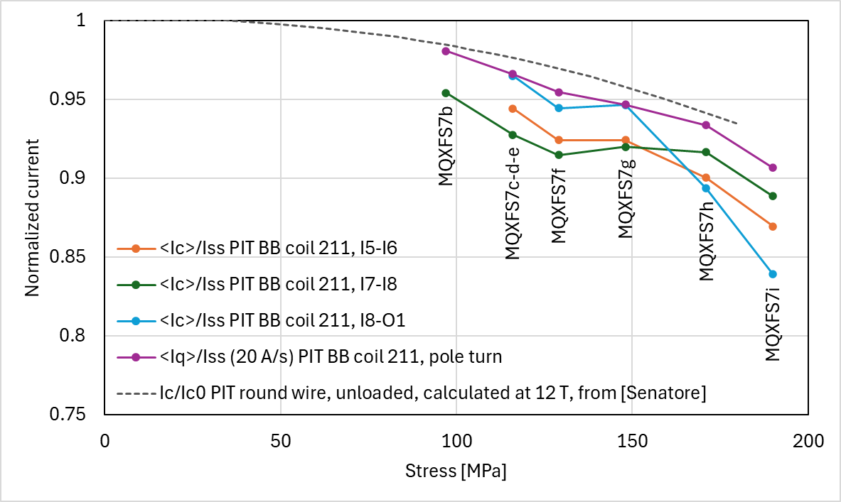
Performance indicators at 4.5 K vs prestress
This is the average performance indicator (critical or quench current) at each pre-stress level.
[Senatore]: https://iopscience.iop.org/article/10.1088/1361-6668/acca50

Slide 12
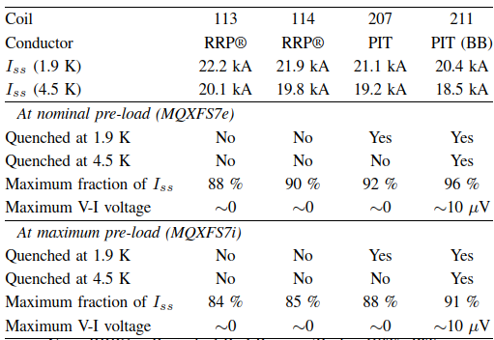
Overview of all coils
The RRP coils and the PIT no-BB coil did not show any reduction of performance up to the maximum current reached.
As the magnet was limited by coil 211, degradation above ~90% of the short sample limit could not be detected.
The PIT BB coil reached a maximum of 98% of the short sample limit in MQXFS7c (100 MPa), and a maximum of 91% in S7i (190 MPa).
In S7i, the lowest critical current measured was at 84% of Iss.
The degradation measured in the PIT BB coil is in the same order of magnitude as lab-scale measurements in PIT wires.

Slide 13

Outlook
MQXFS7 test campaign is finished with a wealth of data and solid conclusions regarding the degradation in a PIT coil
  Including an invited presentation and paper at ASC
Lessons learned regarding test sequence will be applied to the next magnets to be tested (MQXFS8 and MQXFS4)
  In particular: systematic thermal and current cycling
Generated with ChatGPT+DALL-E

