Slide 1

Alignment of TAXS and VAX
Dirk Mergelkuhl, Antje Behrens BE-GM-ESA
14th HL-LHC Collaboration Meeting - Genoa (Italy) - 7-10 October 2024

Slide 2
Table of content
Actual situation of ATLAS/CMS TAS
ATLAS TAXS alignment procedure and sequence
Vaxbox alignment ATLAS
CMS TAXS alignment procedure and sequence
Vaxbox alignment CMS
General conclusions

Slide 3

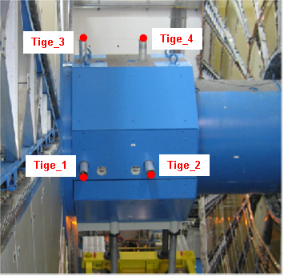
TAS actual situation (ATLAS)
The TAS has four reference points, no redundancy
Measured using 2.5 m long and flexible rods
The rods are of two pieces (ATLAS) passing through the shielding
Only 4 out of the 6 DOF can be calculated
The TAS has no roll interface
The TAS has no longitudinal reference
TAS is neighbouring element to Q1 but measured from the cavern side
Tige_8
Tige_7
Tige_6
Tige_5
Movements of ATLAS TAS:
Movement of TX1STM (and TAS) by 0.6-0.7 mm on IP-side due to removal of JFC1-3

Slide 4
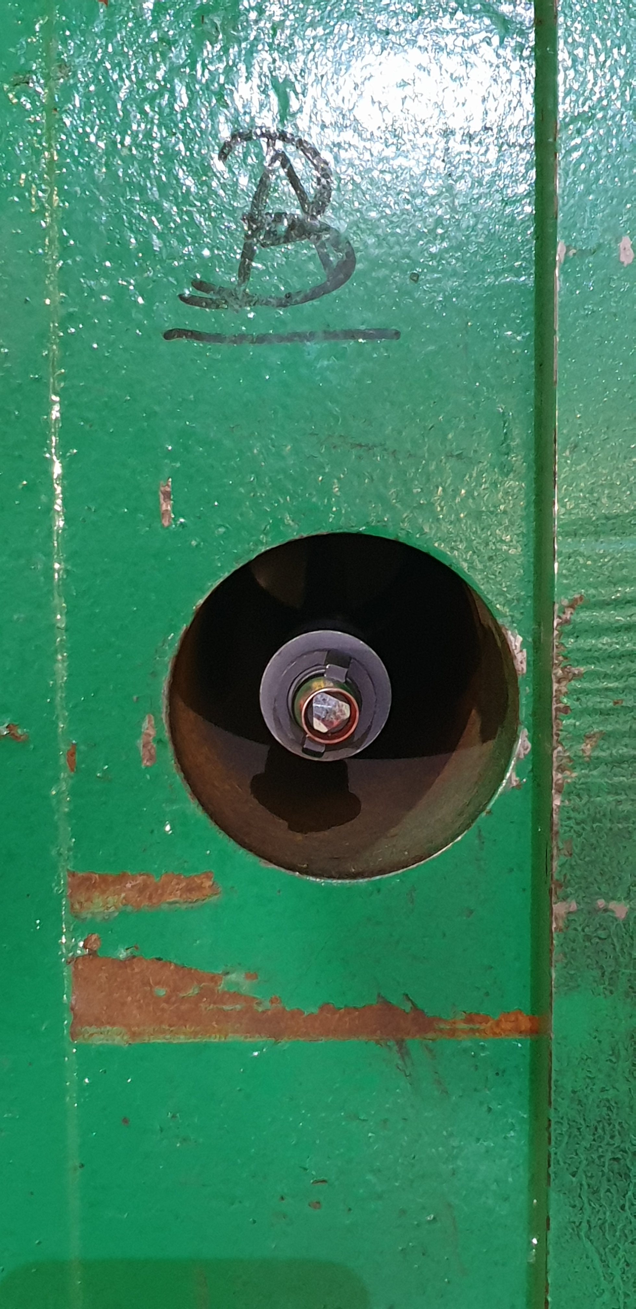
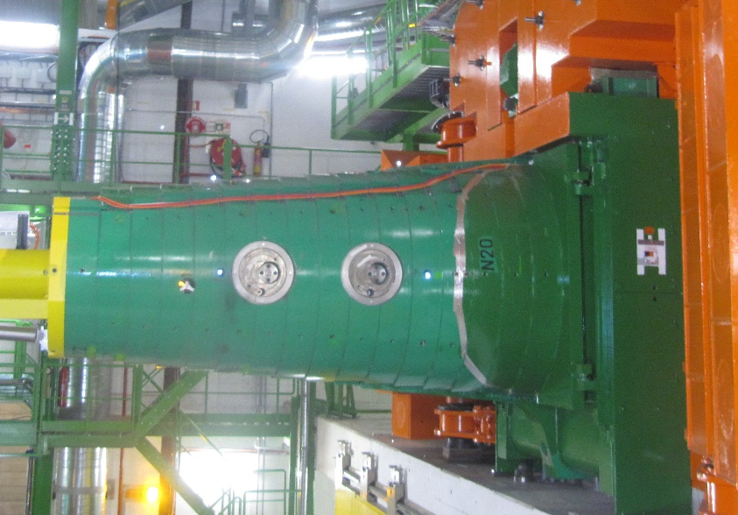
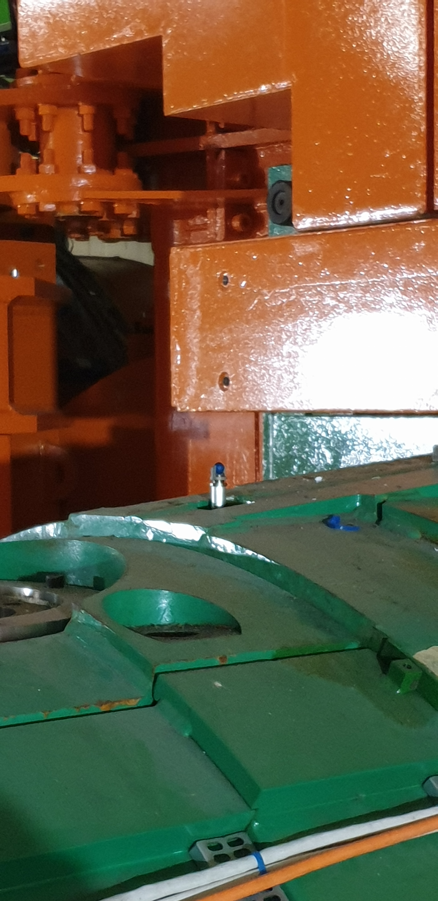
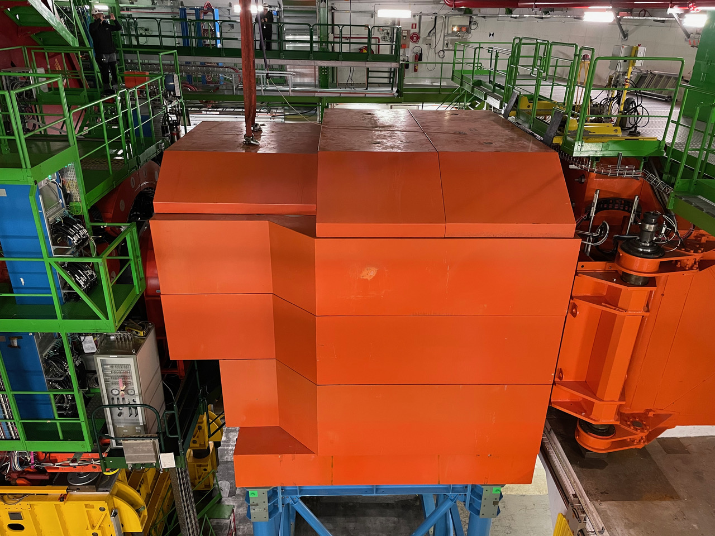
TAS actual CMS situation (CMS)
TAS alignment based on bars attached to TAS and traversing the FIN shielding (green)
Single parts of bars stay permanently
  Only the 1st part is fix inside FIN
  Laser Tracker targets are used since LS2
Non-contact measurement on permanent targets
NFS shielding needs to be dismounted and rotating shielding open for measurement
Z-coordinates of 2 top points determine vertical alignment
X-coordinates of 2 side points determine radial alignment
Manual intervention with constraints on configuration, planning

Slide 5
ATLAS TAXS Survey Procedure
Same alignment procedure as since 2007 for TAS (no motorisation)
Fiducials on 2 vertical and 2 horizontal bars, made of two parts
1st part fixed and 2nd part needs to be (dis-)mounted manually for opening/closing
Access with cherry picker for bar, target installation and adjustment
Measurement frequency: twice every YETS/EYETS/LS
Adjustment frequency to be defined, possible at each measurement
ATLAS: YETS/EYETS/LS if difference to nominal > threshold
Measurement with laser tracker (AT40x) and temporarily installed high precision 1.5-inch targets
Radiation dose next to TAXS bars < 10uSv/h as outside JFS in LS6

Slide 6
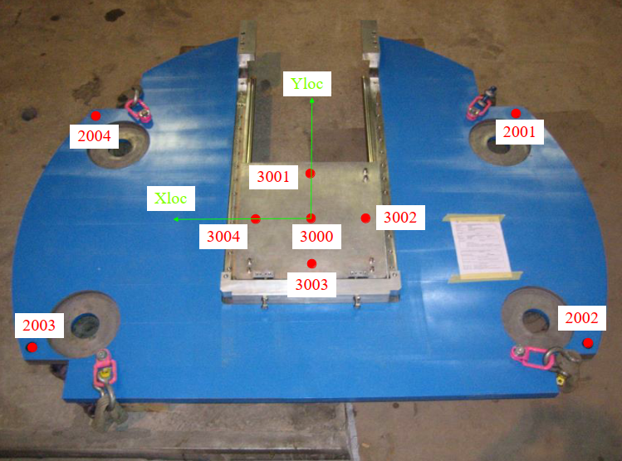
Surface measurements TAXS (ATLAS) 1
Fiducialisation measurement of the two new ATLAS VJ-plates (0.05-0.10 mm at 1 sigma level):
  Definition of the survey reference holes on the new VJ-plate (4x close to adjustment system)
  Fiducialisation in operational position (isostatic support)
  Measurement of 4x survey reference holes, adapter plate sliding on the two rails with 5 reference points, direct measurement of guiding rails
    Optional test measurement with the empty vaxbox
Original VJ-plate fiducialisation (2007)

Slide 7
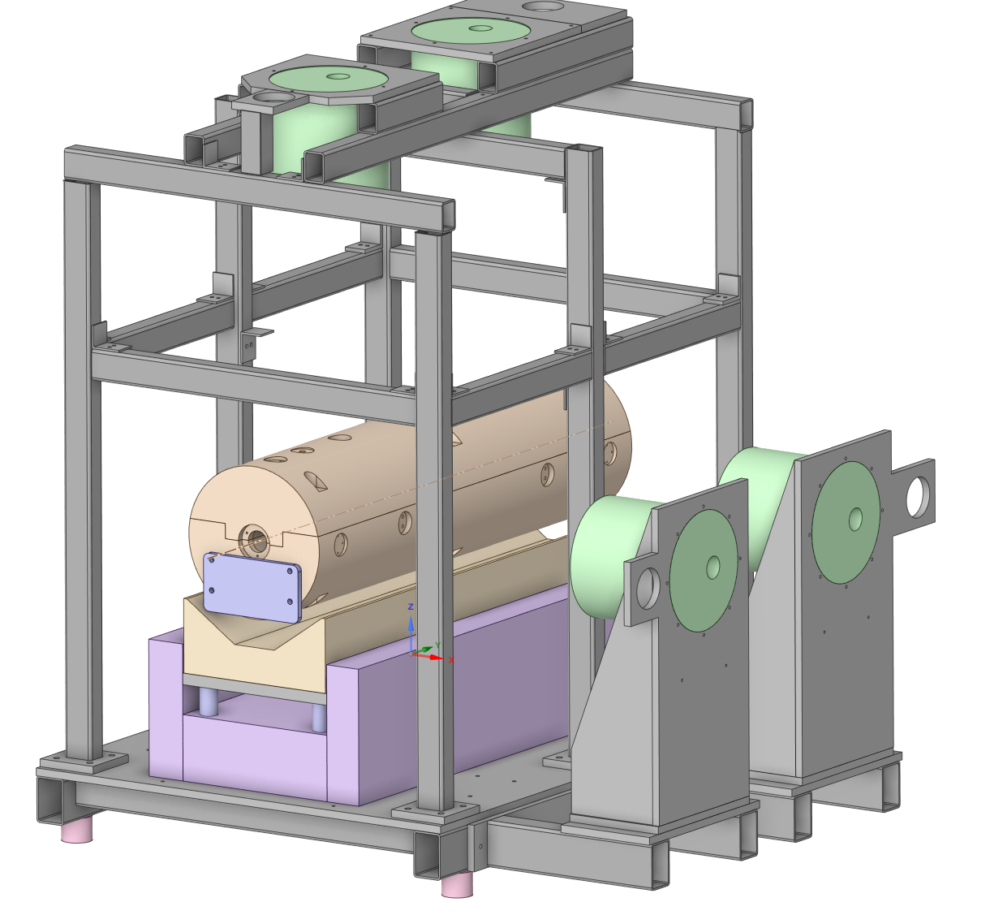
Surface measurements TAXS (ATLAS) 2
Fiducialisation measurement of TAXS on surface (0.05-0.10 mm at 1 sigma level):
In workshop B867 (stable floor, stable and stable bars installed perpendicular, which needs special tooling). The TAXS should be in inclined position (+-0.708°).
Check the perpendicularity of the bars to the beampipe. Measure M10 holes for bar fixation to TAXS.
List of measured features:
  4 fiducials per half shell
  4 fiducials on bar ends
  M10 holes for bar fixation
  Points along the vacuum pipe steps using prism on bar or a mole
  End flanges of the vacuum pipe
  Measurement of the survey reference points and 3 balls of the M1 support plate
  Measurement of the M1 references as beam pipe flanges (no bellows) to validate the alignment wrt TAXS beam pipe

Slide 8
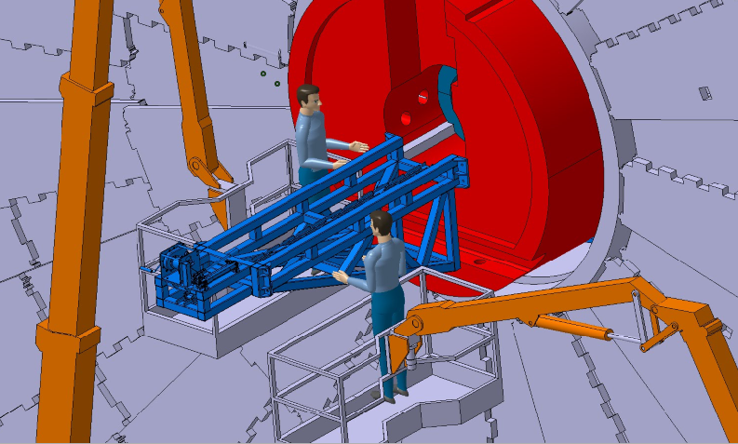
Cavern measurements TAXS (ATLAS)
Initial placement in the cavern at installation of TAXS before connection to beampipes (0.75 mm at 1 sigma level)
  Access via cherry-picker and special configuration with JFS and JFC1,2,3 dismounted and Big Wheel open
  Laser tracker on the extraction/insertion tool of the TAXS (visibility)
  Considering the ATLAS floor movements (~0.2 mm/year in cavern centre).
  Measurement of longitudinal position and initial roll of the TAXS at installation.

Slide 9
Cavern measurements TAXS (ATLAS)
Final alignment at end of LS3 (0.75 mm at 1 sigma level):
  Configuration and access for measurement (BW in run position, JFS, TAXS bars installed and accessible with Palazzani)
  Measurement of 2 x 2 TAXS reference points and access outside JFS shielding
  Precise alignment using alignment pods and fiducialisation data
    Nominal position to be provided by equipment owner
    Eventually considering the ATLAS ITK position after installation and its movement up to end of LS3.
    No measurement of longitudinal position
    No measurement of roll of TAXS

Slide 10
Cavern measurements TAXS (ATLAS)
Maintenance measurement at start and end of each YETS, EYETS and LS (0.75 mm at 1 sigma level)
  Measurement of position at opening
  Measurement and adjustment at closure based on physics data of ITK and inner triplet position
    No measurement of longitudinal position
    No measurement of roll of TAXS
  Access to survey targets outside the JFS possible up to LS6 confirmed by RP simulations

Slide 11
Measurements for ATLAS Vaxbox (surface)
Preparation:
  Integration of 4-8 permanent CERN survey references holes 8H7 that can be equipped with permanent targets
    Mainly facing USA-side, distributed close to the vaxbox corners
  Validation of the reference targets and the vaxbox envelope and visibility of references in cavern
  Deformation test of the vaxbox based on the weight of modules 2 and 3 and attached VJ beam pipe mechanics
Fiducialisation measurement of the vaxboxes (0.05-0.10 mm at 1 sigma level):
  Measurement of the spherical contact surfaces for the modules 2 and 3 (directly and using the alignment plates)
  Measurement of all available CERN survey reference holes on each vaxbox
  Measurement of the reference surfaces for the installation and local coordinate system
  Measurement of the cylindrical pins at different diameters (0.3 mm at 1 sigma level)
  Measurement of the key features for envelope as defined by equipment owner (1-2 mm at 1 sigma level)

Slide 12
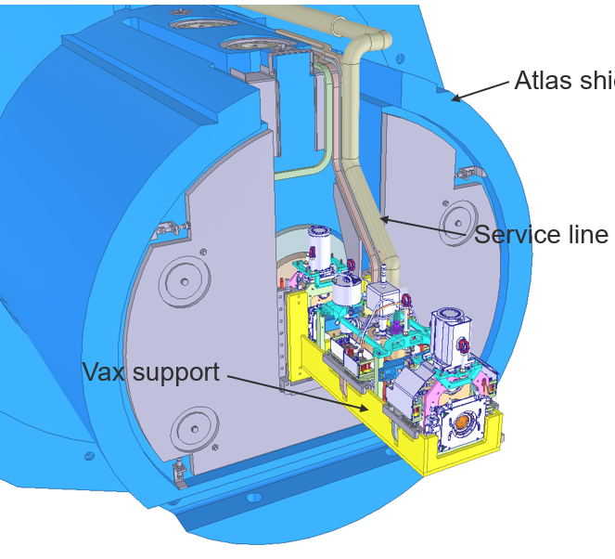
Measurements for ATLAS Vaxboxes (cavern)
Initial placement and adjustment in the cavern at end of LS3 (0.75 mm at 1 sigma level)
  Configuration and access using cherry picker for point installation and mechanical adjustment
  Precise alignment as for final adjustment using VJ-plates and bottom pushing screws
    Nominal position to be provided by equipment owner
    Eventually considering the ATLAS floor movements for the positioning.
Maintenance measurements of vaxbox (0.75 mm at 1 sigma level):
  Regular measurement of the permanent CERN survey reference points (every YETS, EYETS and 2x in LS approximately 1x per year)
  No further adjustment of the vaxbox is expected

Slide 13
Maintenance of ATLAS vaxbox
Preparation for the extraction of the vaxbox from ATLAS
  Measurement of TAXS position and vaxbox position (0.75 mm at 1 sigma level):
  Analysis of the TAXS and vaxbox measurement data to evaluate the relative alignment
    If better than 1 mm – no further action
    If worse than 2 mm
      Definition of displacement values for TAXS by WP8 and vacuum
      Voluntary displacement of TAXS to reduce the offset for disconnection of modules 1/2 (0.75 mm at 1 sigma level):
    If between 1 mm and 2 mm, discussion with vacuum and WP8 to take decision
Preparation for the re-installation of the vaxbox and connection of modules 1 and 2
  Optional re-measurement of TAXS position (0.75 mm at 1 sigma level):
  Analysis of the TAXS and earlier vaxbox measurement data to evaluate the relative alignment and action if needed
Re-installation of the vaxbox from ATLAS (0.75 mm at 1 sigma level):
  Measurement of vaxbox position
  Measurement and adjustment of TAXS position based on ATLAS ITK data
  Attention: vaxbox installation and TAXS measurement need different configuration!

Slide 14
CMS TAXS Survey Procedure
Similar alignment procedure as for TAS (no motorisation)
NFS dismounted and open position of the rotating shielding
Fiducials on 2 vertical and 2 horizontal bars
  Single part fixed on TAXS and with permanent laser tracker target
  Short and rigid bars provide 3D coordinates. In best case scenario redundancy, roll value and longitudinal position.
Measurement frequency: 1-2x every YETS/EYETS/LS
Adjustment frequency to be defined, possible at each measurement
Measurement with laser tracker and permanent installed 0.5-inch RFI targets
Notes:
CMS: YETS/EYETS/LS if difference to nominal > x.x mm
What will be the TAXS value? Probably more adjustments than for TAS

Slide 15
List of necessary measurements (CMS)
Test of adjustment system on surface mock-up (similar to ATLAS)
Fiducialisation of the two TAXS (similar to ATLAS)
  Installation of bars without support (single, shorter piece) to get them stable and straight during the measurement.
Fiducialisation of CMS vaxbox with ball interfaces and guiding pins
Adjustment of the new TAXS to final position soon after installation (pre-alignment, longitudinal)
Final adjustment of the TAXS at the moment of CMS closure following the usual procedure. A small adjustment of the TAXS has to be expected and authorized by vacuum team

Slide 16
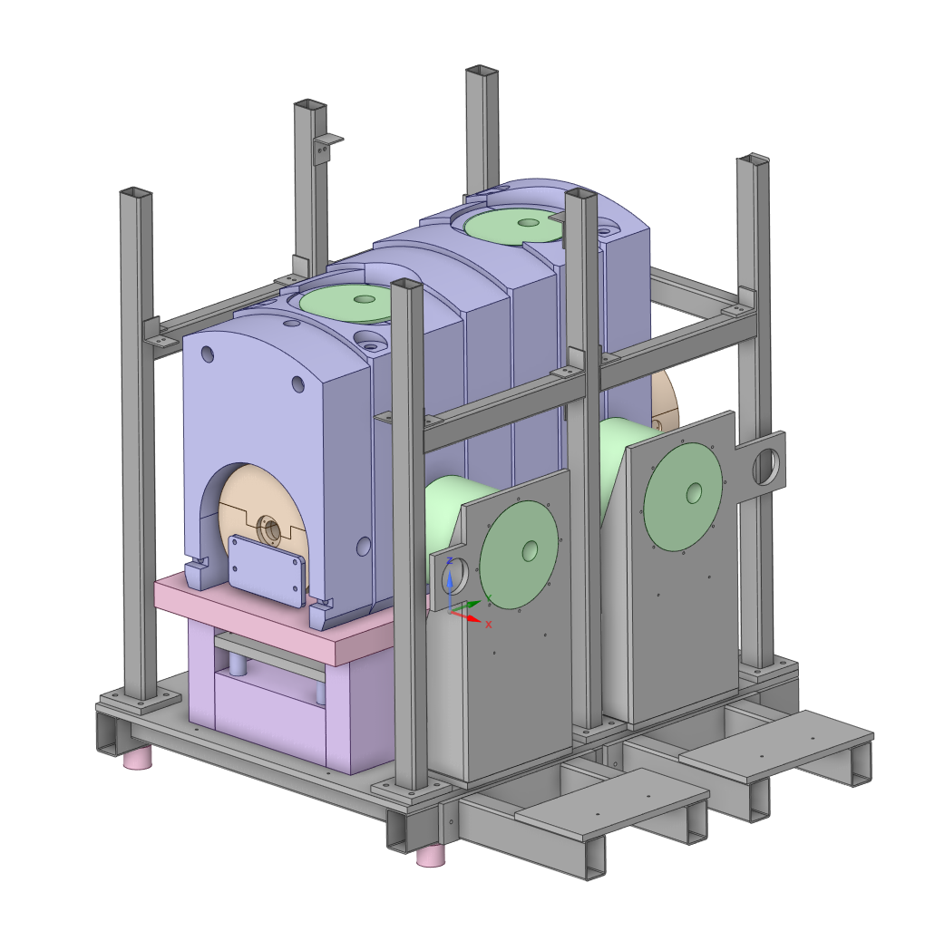
CMS preparation sequence (surface)
Fiducialisation measurement of TAXS on surface (0.05-0.10 mm at 1 sigma level):
In workshop B867 (stable floor, stable bars). The TAXS should be in inclined position (+-0.708°).
Check the perpendicularity of the bars to the beampipe. Measure M10 holes for bar fixation to TAXS.
List of measured features:
  4 fiducials per half shell
  4 fiducials on short bar ends
  M10 holes for bar fixation
  Points along the vacuum pipe step xxx mm using prism on bar or a mole
  End flanges of the vacuum pipe
  Measurement of the survey reference points and 3 balls of the M1 support plate
  Measurement of the M1 survey references and beam pipe flanges (no bellows) to validate the alignment to TAXS beam pipe

Slide 17
CMS TAXS alignment in cavern
Initial placement in the cavern at installation of TAXS before connection to beampipes (0.75 mm at 1 sigma level)
  Configuration like final measurement
  Measurement of 2 x 2 TAXS reference points
  Alignment precisely as for final adjustment using alignment pods using fiducialisation data
    Nominal position to be provided by equipment owner
  Using Fiducialisation results to define longitudinal position and initial roll of the TAXS at installation and fixation using the z-stopper.
Final measurement (alignment) at end of LS3 (0.75 mm at 1 sigma level):
  Alignment precisely for final adjustment using alignment pods using fiducialisation data
    Nominal position to be provided by equipment owner
    Eventually considering the CMS Inner Tracker position after installation and its movement up to end of LS3.
    measurement of longitudinal position based on fiducialisation
    measurement of roll of TAXS based on fiducialisation

Slide 18
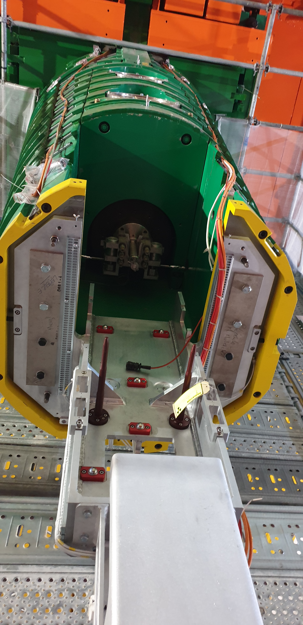
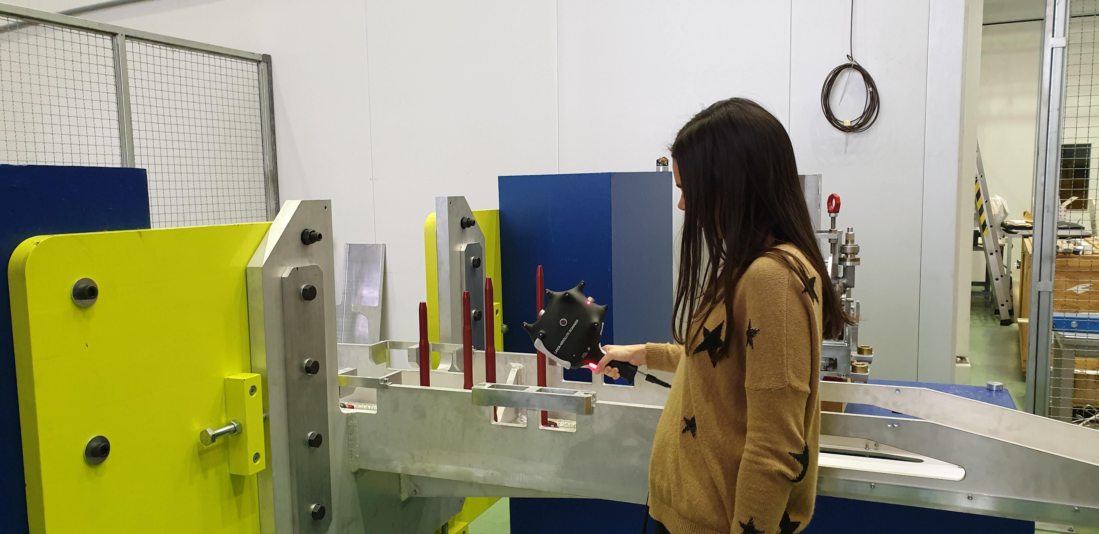
CMS VAX Box - Prototype
Integration of survey reference holes
Fiducialisation and installation of prototype done
Laser Tracker measurements of fiducials, VAX equipment guiding balls and rods
Re-design of vaxbox following feedback from LS2 installation
Detailed procedure to be defined once the new design is available
Notes:
Was planned for integration tests

Slide 19
Main differences of CMS to ATLAS
Single, stiff bars with permanent targets for TAXS
Measurement in different shielding configuration
  Run configuration for ATLAS
  Open rotating shielding for CMS
  No Shielding plugs in FIN
Non-contact measurements (no physical access needed after installation)
Mounting and adjustment procedure of the vaxbox
Different support of CMS vaxbox
Control of measurement in 3D due to stiff bars with longitudinal and roll information

Slide 20
Measurement needs for vacuum modules
ATLAS and CMS Vacuum modules 1, 2 and 3
Needs to be discussed in detail with equipment owner and could be:
Measurement of the beam pipe axis of module 1, 2 and 3 with respect to the contact surfaces (V1, V2, V3) as preparation for future replacement (0.05-0.10 mm at 1 sigma level):
  Measurement of beam pipe axis of installed modules with respect to TAXS or vaxbox fiducials in B867 mock-up
    Access and visibility to beam pipe flanges is mandatory (no bellows)
  Maintenance measurements for replacement module 1, 2 and 3 on surface (0.05-0.10 mm at 1 sigma level)
    Measurement of the beam pipe axis of module 1, 2 and 3 with respect to the contact surfaces (V1, V2, V3) as preparation for future replacement
  Envelope measurement of the module extremities as the valve top (1-2 mm at 1 sigma level)
  Maintenance measurements for modules in cavern – NONE!

Slide 21
Error budget for TAXS measurements
A) Target precision with support
B) Fiducialisation using mole or bar (to be produced)
C) Cavern network and link to UPS gallery
D) FRAS system (UPS gallery to Q1, Q2, Q3)
E) Fiducialisation of low-beta magnets
Worst case (linear add 1 sigma):
A) 0.03 mm, B) 0.25 mm, C) 0.30 mm
D) 0.10 mm, E) 0.08 mm => Total = 0.76 mm

Slide 22
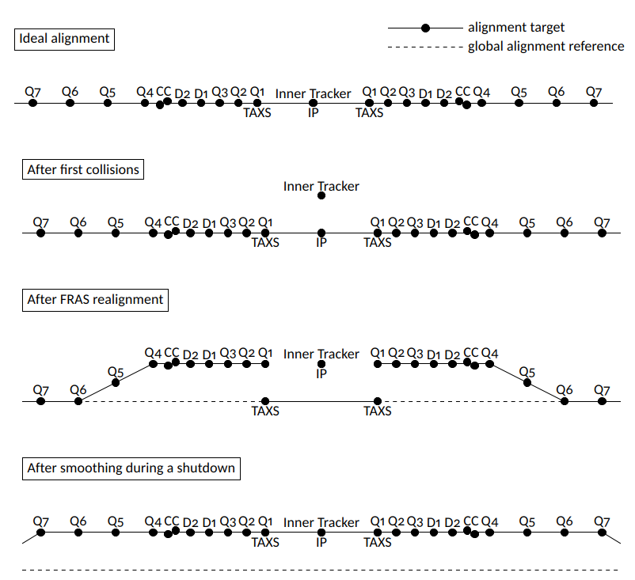
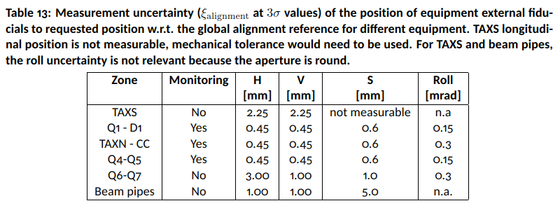
TAXS alignment sequence (ATLAS and CMS)
The TAXS is NOT part of the FRAS system and needs manual alignment
Major constraints for TAXS alignment due to inaccessibility of targets in RUN configuration
  NFS and rotating shielding in CMS, missing cherry picker in ATLAS
Critical case after first collisions and before first YETS to adjust the TAXS.
-------- YETS
REFERENCE : LHC-G-ES-0023

Slide 23
General conclusion
Measurement equipment and general procedure ready
Detailed testing procedure for mock-up needs to be developed
More details are needed for the measurements of vacuum modules 1, 2 and 3.
  Survey procedure for the exchange of modules
ATLAS and CMS procedure are similar but with significant differences in details
Deformation can be critical (vabox, shielding weight
Alignment setups will be improved with respect to TAS
Link to FRAS is manual but considered in procedures

Slide 24
Thanks for your attention!
Any questions?
Special thanks to all WP 8 members

Slide 25
BACK-UP SLIDES

Slide 26
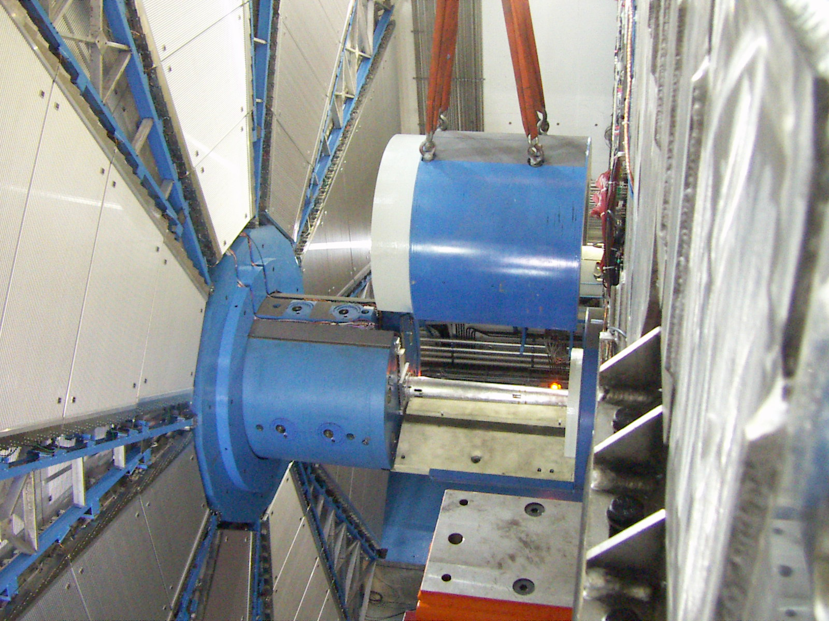
ATLAS TAXS movements due to JFC1-3
Weight of JFC1,2,3 changes position of TAXS and vaxbox
Vaxbox aligned without JFC2,3
TAXS aligned with JFC1,2,3 installed

Slide 27
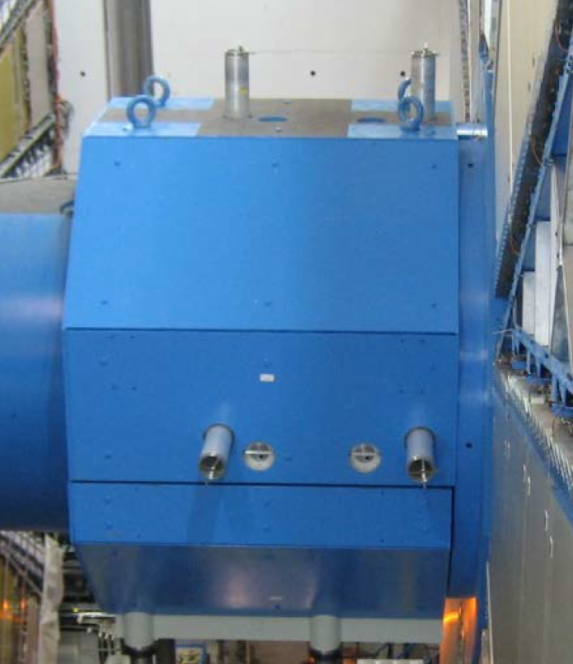
Disadvantages in ATLAS
The survey system in ATLAS, consists of four bars from the TAS to the outside of the shielding where each target is placed.
ATLAS: Removable targets on a removable bar connected to a permanent bar which connects with the TAS.
The connection of these two bars is complicated: deep distance, no vision and no feedback.
As there is no feedback, an endoscope is used to verify the connection is well done.
The aim is to simplify this operation and therefore to reduce the time of radiation exposure.
New system for bar connection to provide direct feedback at bar installation

Slide 28
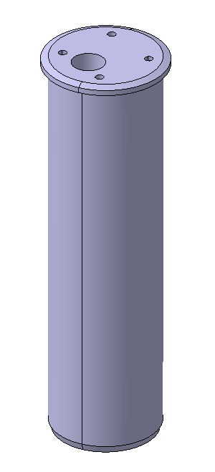
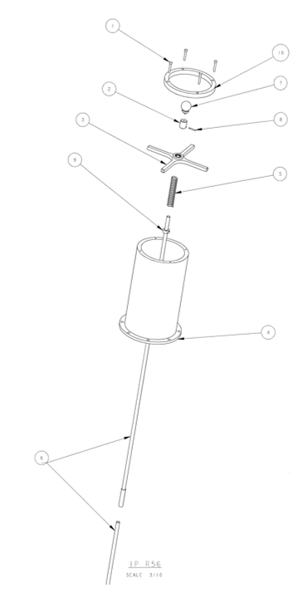
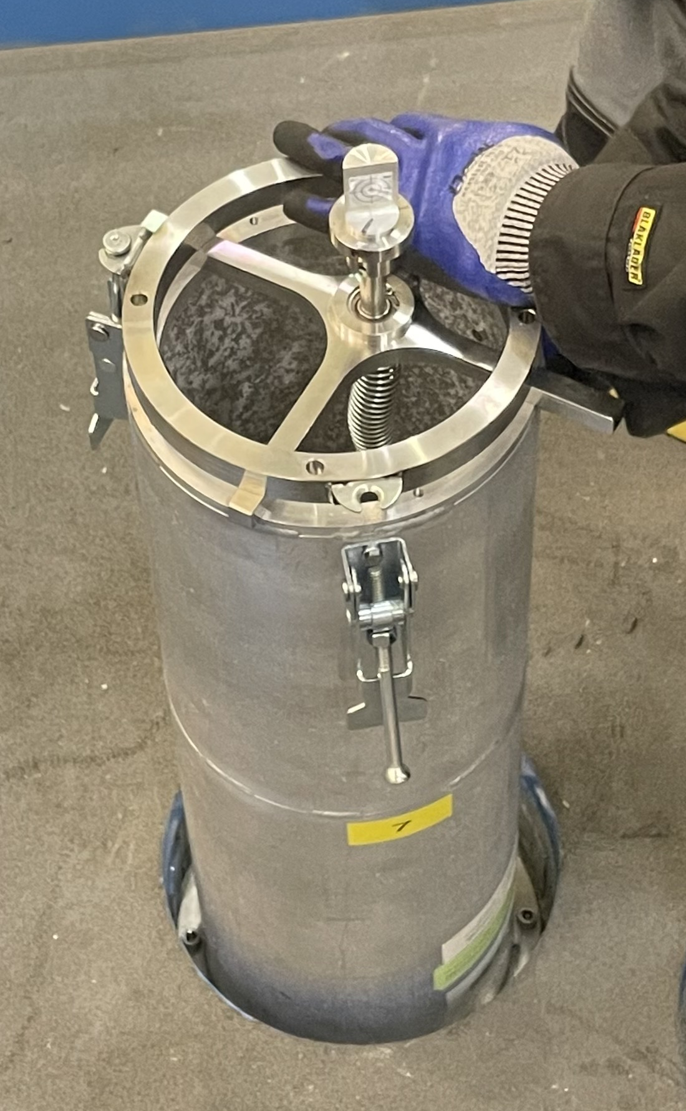
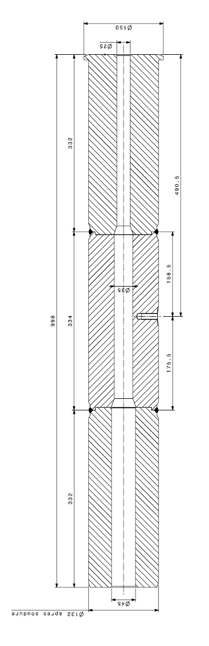
Details of ATLAS installation
ATLAS two bar system with fixation and survey target head
ATLAS shielding plugs in JFS and TX1STM shielding parts
  Reduction of background noise for the ATLAS experiment
  Diameters of holes 25 mm – 40 mm
Movement of TX1STM (and TAS) by 0.6-0.7 mm on IP-side due to removal of JFC1-3 shielding

