Slide 1

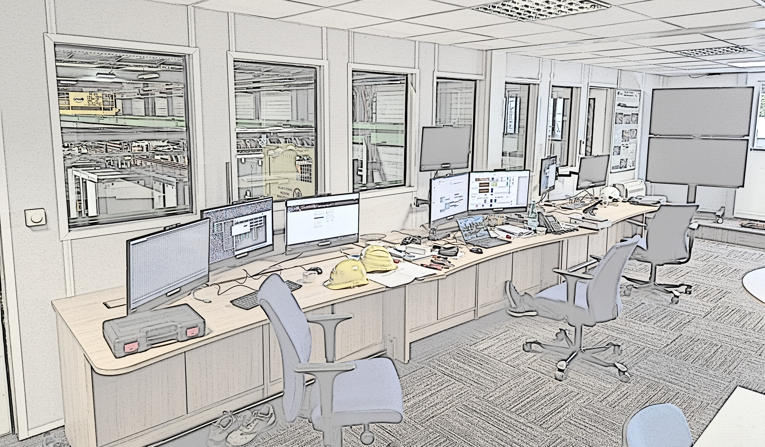
Organisation of the operation for the HL-LHC IT String
N. Heredia, M. Bajko on behalf of WP16
14th HL-LHC Collaboration Meeting, Genoa, 7-10 October 2024

Slide 2
Contents
Scope
Components of the IT String
The IT String location
The IT String Validation Program
Operation in the IT String
Organization of the IT String operation
Meetings for coordination and reporting
Conclusions

Slide 3
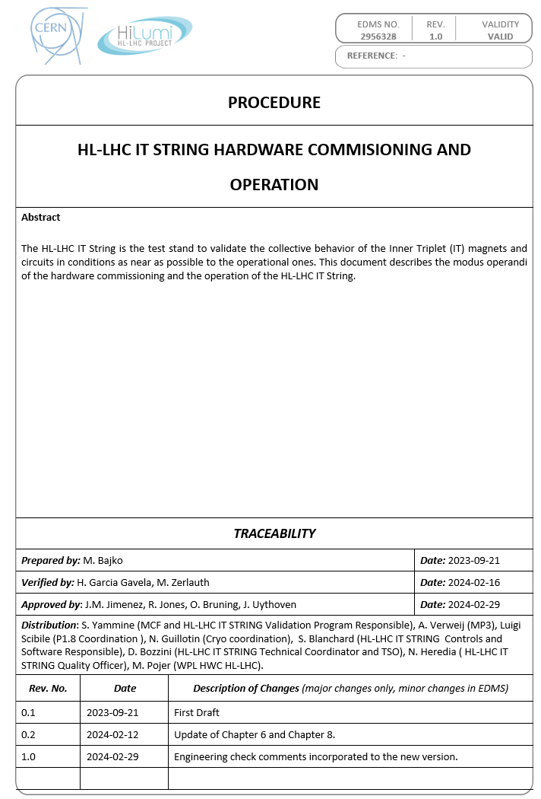
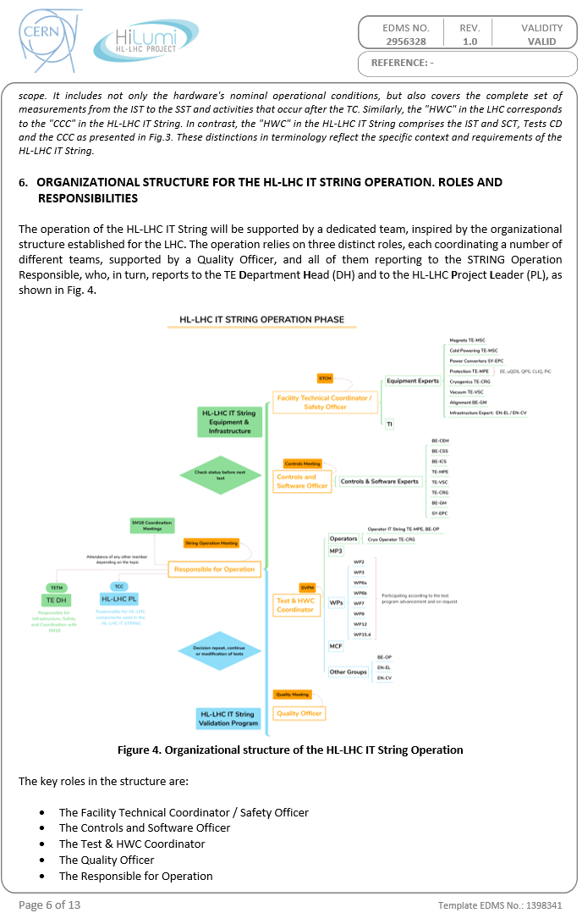
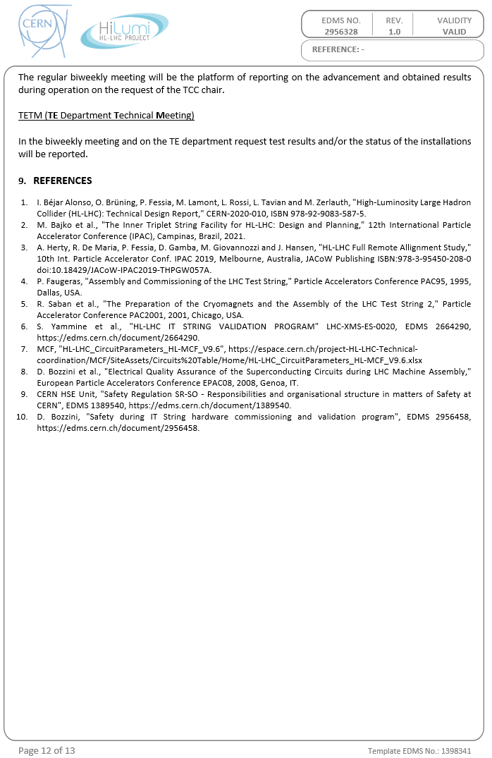
Scope
This presentation is focused on the organizational aspects during the operation of the IT String test stand.
It helps to better understand the scope of the following talks of the session.
The responsibilities for the different roles of the IT String Operation will be reflected.
It summarizes the information provided in the procedure “HL-LHC IT String hardware commissioning and operation”, M. Bajko, EDMS 2956328.
The document has been approved by the line and project management
RELEASED

Slide 4
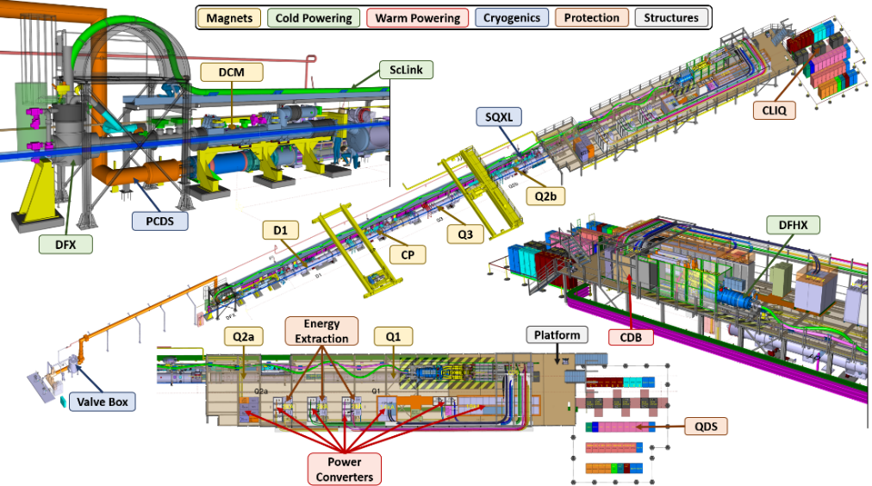
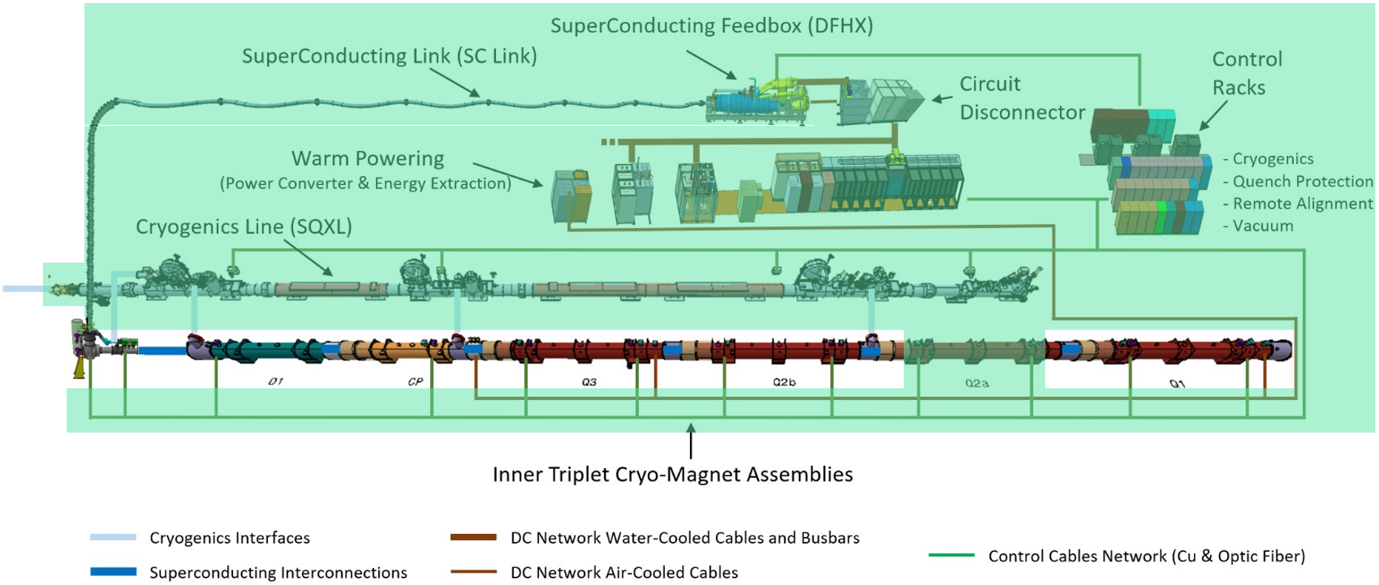
Components of the IT String
The IT String aims to replicate, as best as achievable, an entire Inner Triplet (IT) region of the HL-LHC, to validate the collective behaviour of key components, which will function in conditions close to the ones in the LHC.
Magnets: Q1, Q2a, Q2b, Q3, CP, D1.
Cold Powering: ScLink, DFHX, DFX.
Warm Powering: PCs, CDBs.
Cryogenic cooling: SQXL, PCDS.
Circuit Protection: QDS, QH, EE, bypass diodes, CLIQ.
Alignment system: FRAS.
Vacuum system

Slide 5
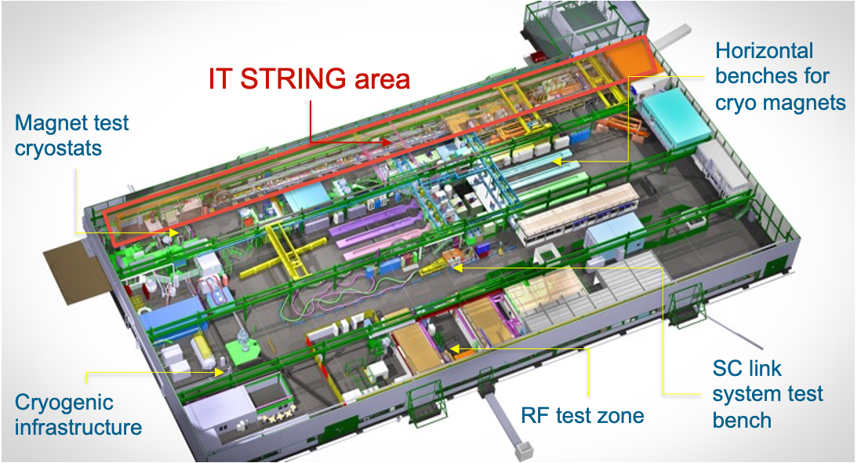
The IT String location
The SM18 facility (building 2173 at CERN) hosts the HL-LHC IT String as in the case of the String I and II.
The choice of the place was based on the available infrastructures that would allow such a test.
Major upgrades were implemented in the demin. water system, in the electrical network and in the cryogenic infrastructure.
Coordination will be required during operation as the pumping capacity remains limited and common between users .

Slide 6
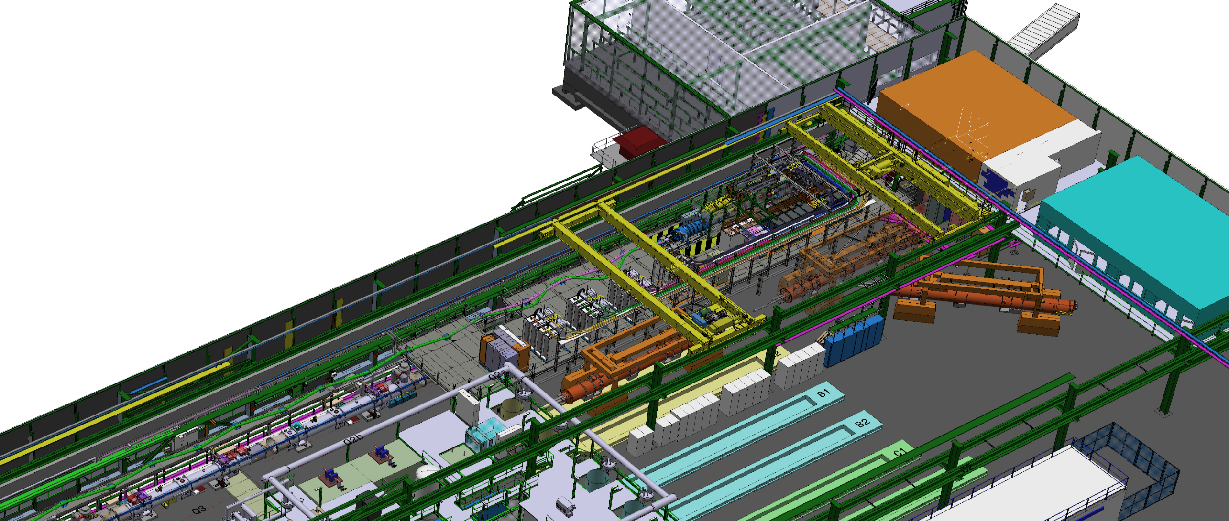
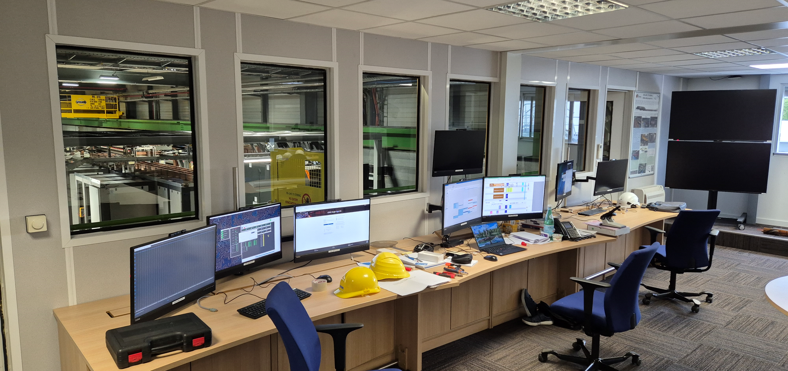
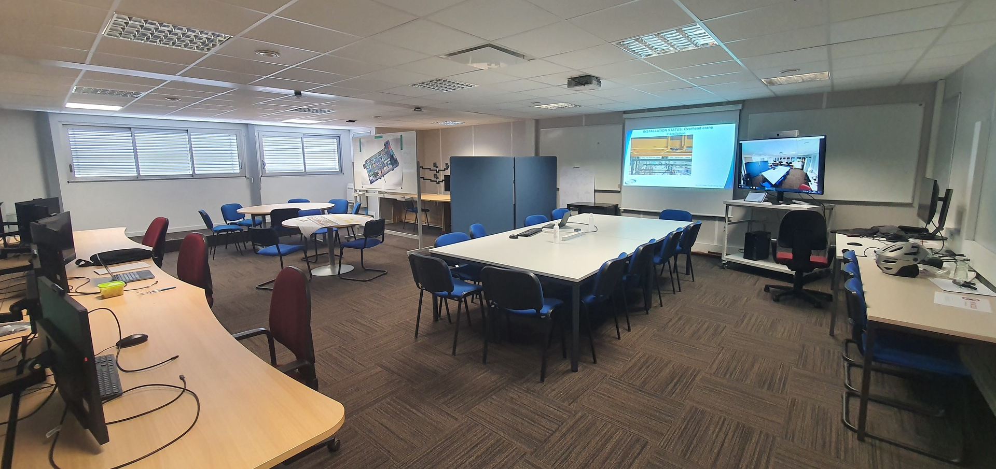
The IT String location
IT String control room
Located on the first floor of SM18 hall, with direct view over the metallic platform. Optimal communication between teams and intervention times.
The control room has stands equipped with computers and screens with access to any control system. Also, individual desks to plug-in laptops.
The control room will serve as the venue for coordination and technical discussions related to the test stand. A videoconference system allows remotely attendance to meetings.

Slide 7
The IT String Validation Program
Electrical circuit integrity test
Cryogenic system test
Vacuum system test
Quench detection and magnet protection tests
Performance tests
Assess insulation integrity of circuits. Verify instrumentation and protection systems wiring. Test ElQA procedures for HL-LHC.
Get familiar with thermal behaviour of the magnet chain, and how to operate efficiently the cryogenic cooling system.
The insulation vacuum will be qualified through leak testing.
Detection and protection system test is performed, approximately 200 quenches at different energy levels are planned.
Investigate the capability of the different subsystems to work together. A thermal cycle of the circuits is planned.
Powering interlock tests
Validation of the HL-LHC interlock, which will integrate and handle, with a given logic, signals from all subsystems.
Alignment system tests
Validation of full remote alignment and monitoring systems, confirming accuracy and reproducibility of cryostat alignment.
Controls and software tests
Debugging of DAQ, control and software systems, aiming to improve the efficiency during hardware commissioning.
Powering of IT magnets
Validation of crowbar system, lambda plate and connections. Study impact of flux jumps on current regulation.
The test program was defined in the String Validation Program Meeting (SVPM) among the chair and all WPs involved
The test program document is released (EDMS 2664290). The test procedures are at an advanced stage
Test parameters and acceptance criteria are specified by MCF, MP3 and SVP.

Slide 8
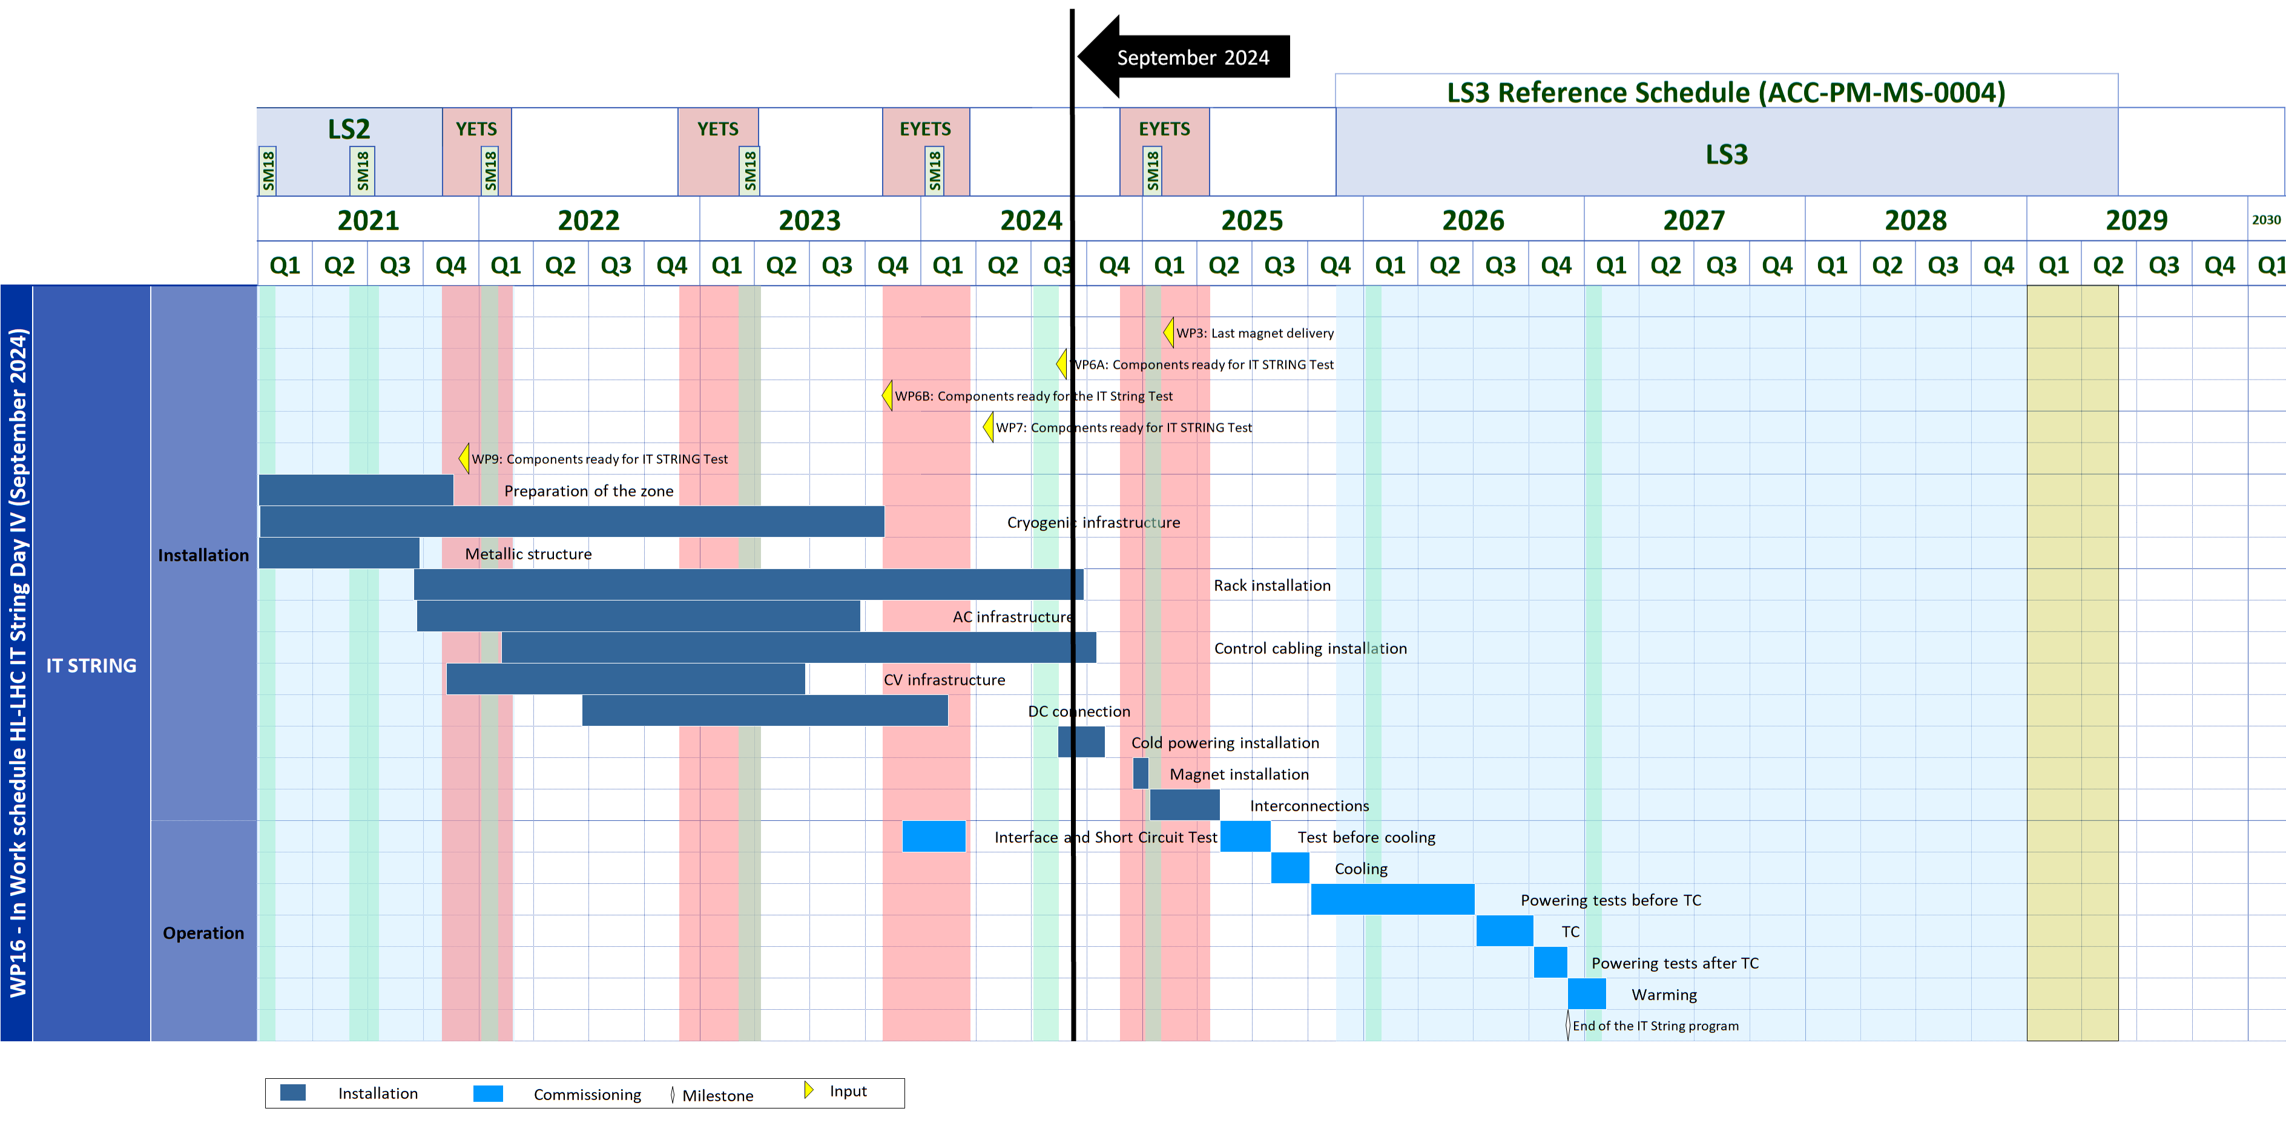
Operation in the IT String
Hardware Commissioning
Individual System Tests (IST)
String Specific Tests & Operation Cycles I
Thermal Cycle
Optimised Hardware Commissioning
Warm Up
Short Circuit Tests (SCT)
Test before Cool Down
Powering Tests for HWC
Operation Cycles II
Powering Tests for HWC
Checks after TC
1
2
3
4
5
6
7
8
1
2
3
9
4
5
6
7
8
9
10
10
Installation
Operation

Slide 9
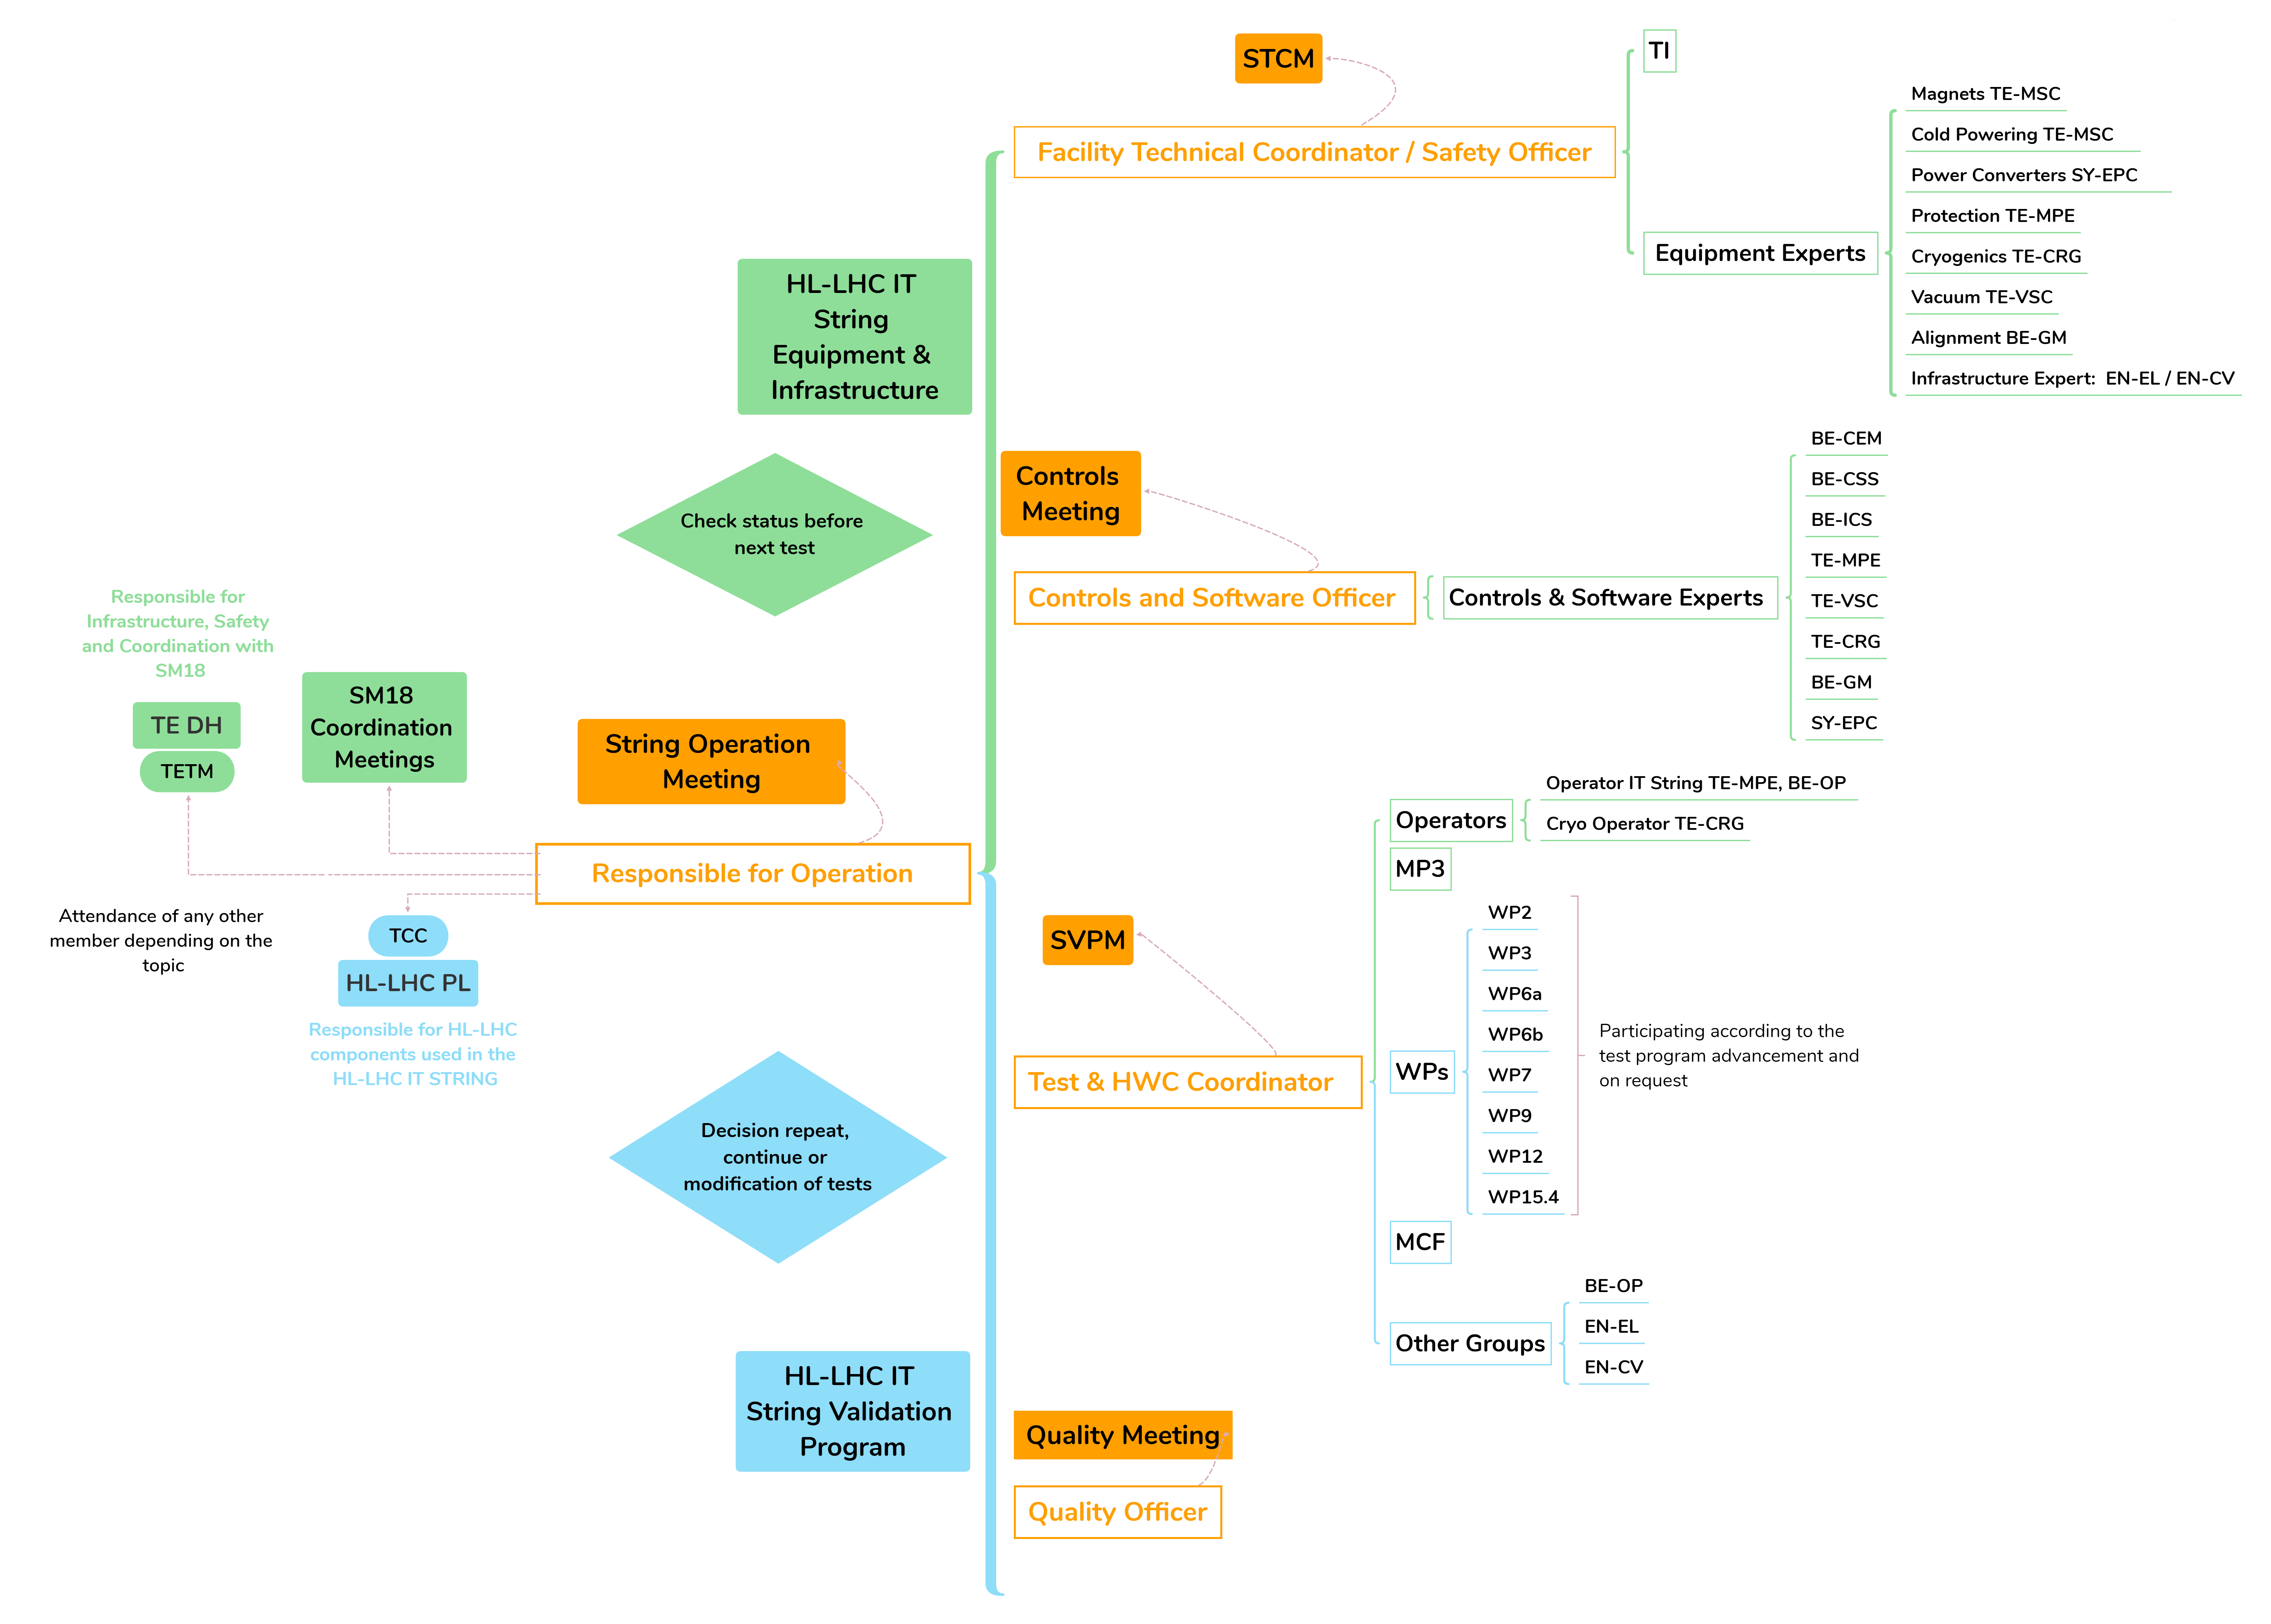
Organization of the IT String operation

Slide 10
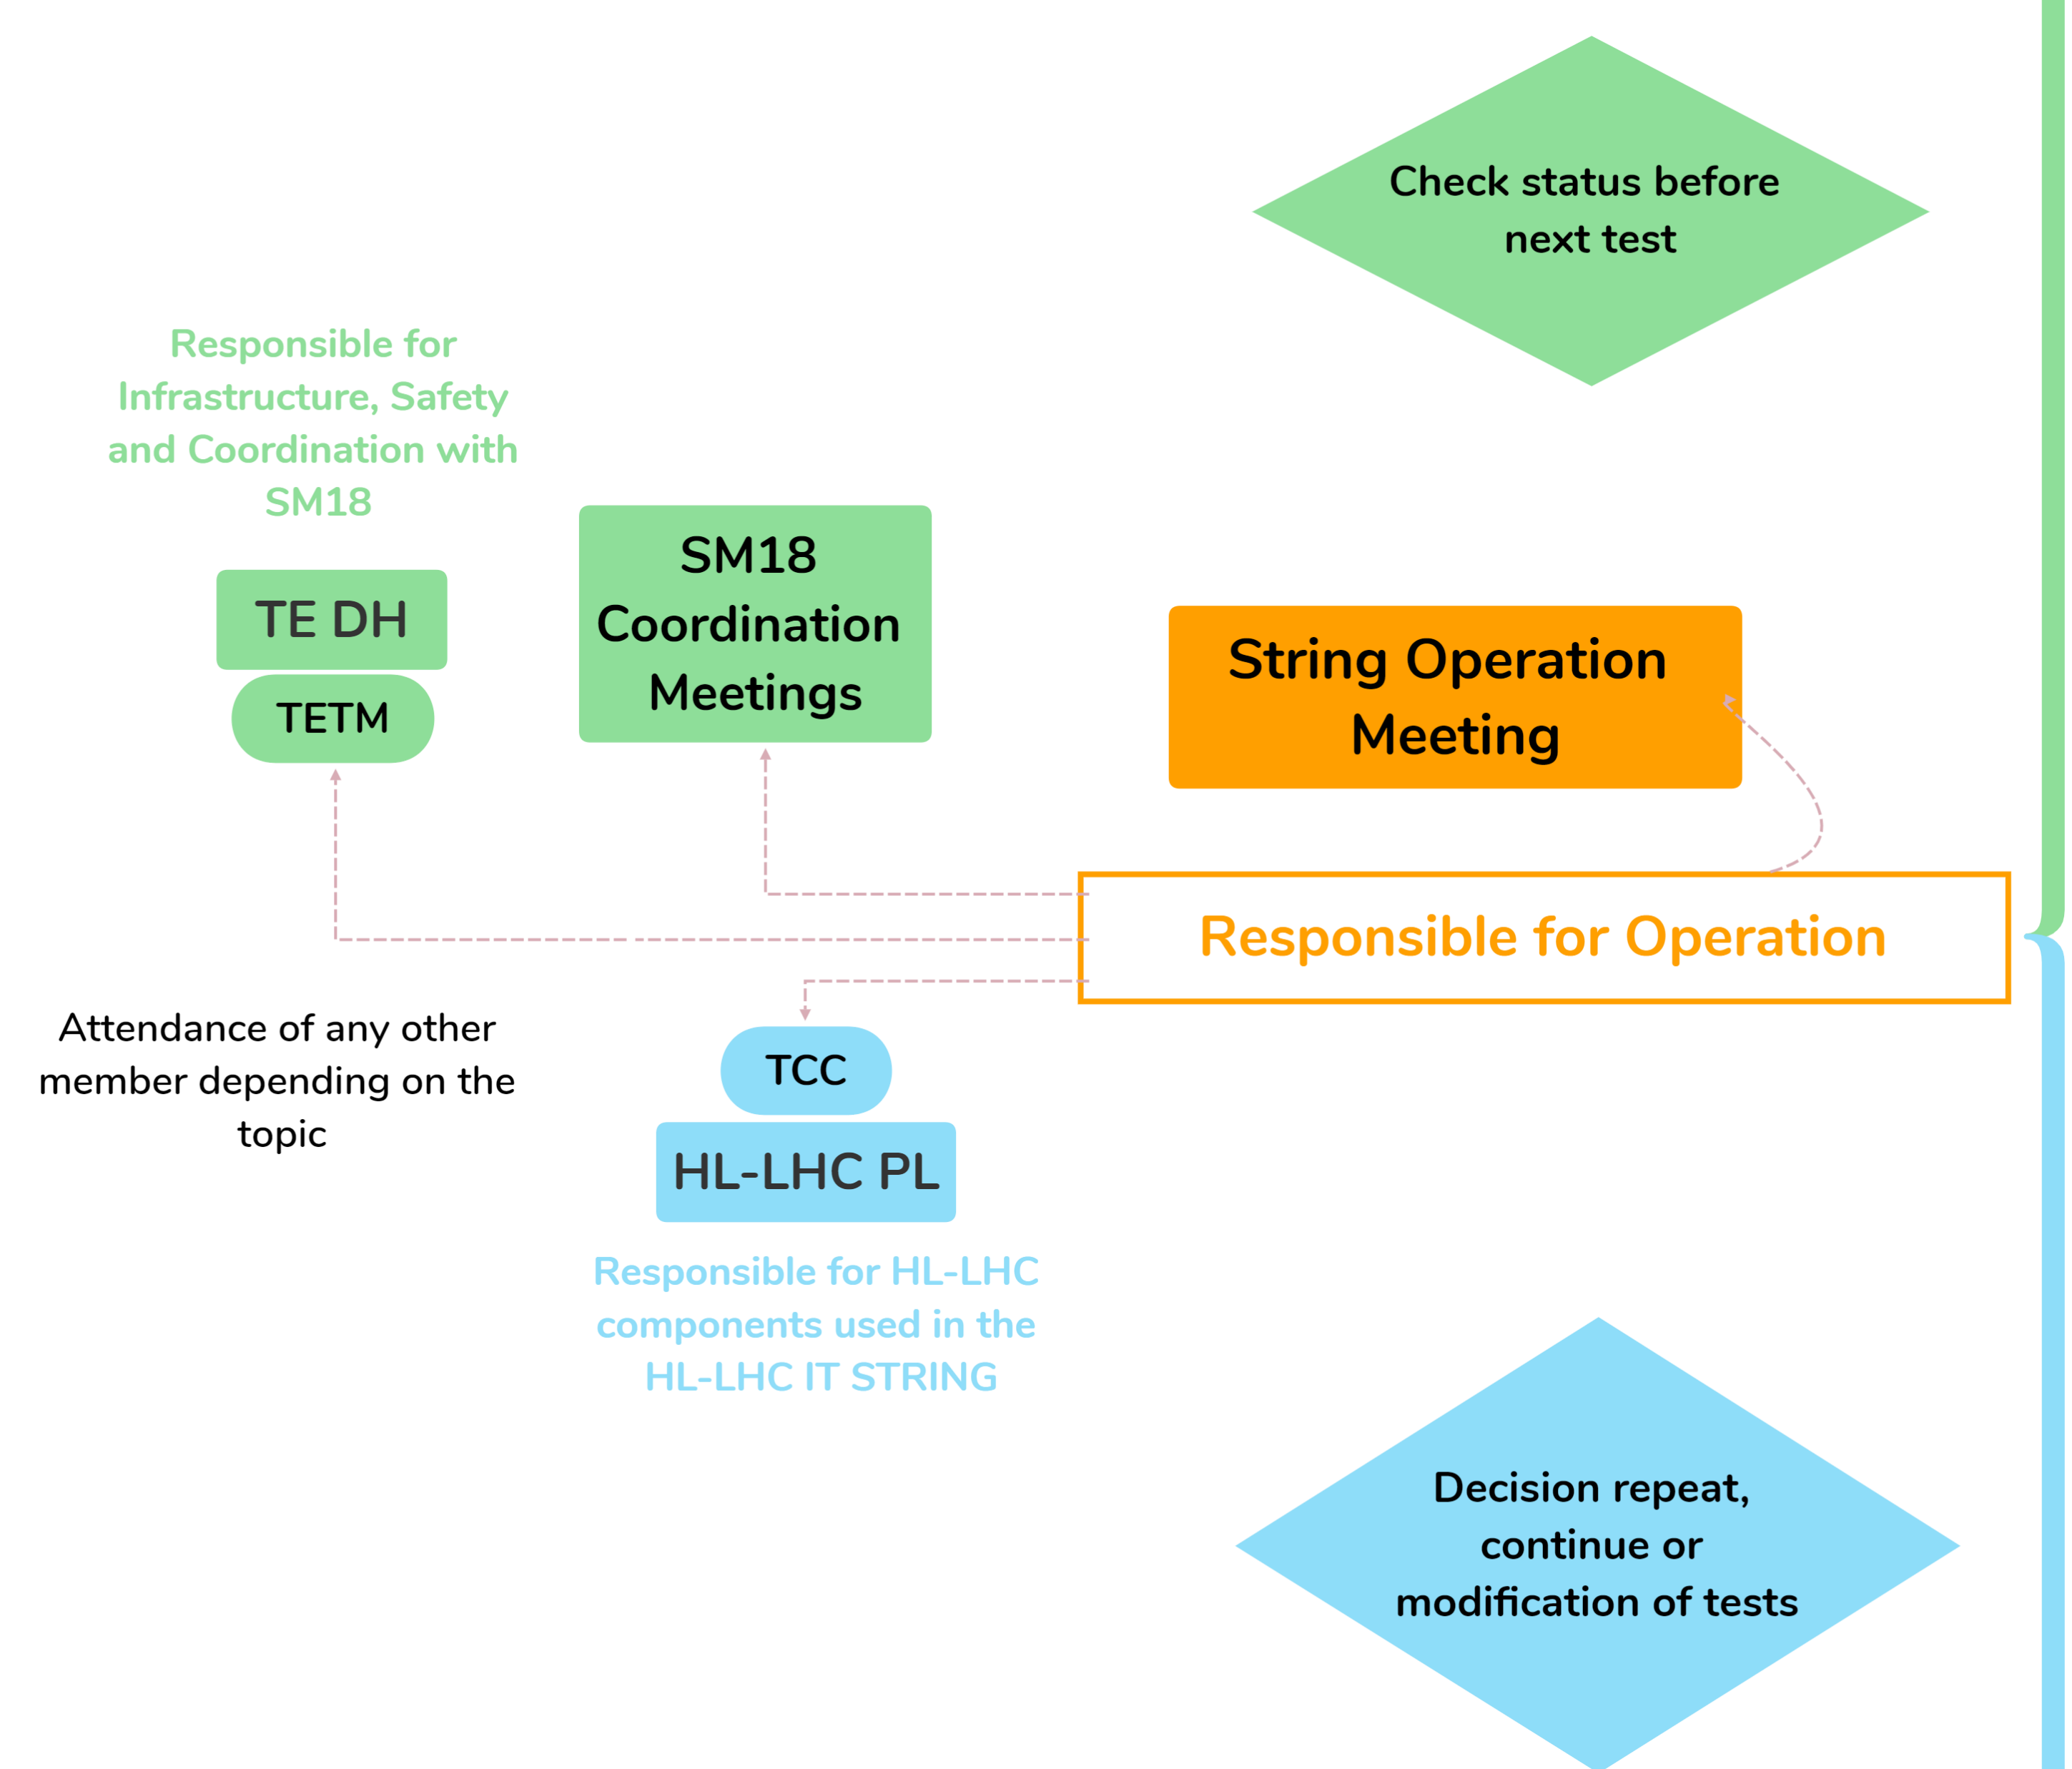
Organization of the IT String operation
Role: Responsible for the HL-LHC IT String Operation
Work in close collaboration with all the members of the IT String operation team.
Report the IT String operational needs in the SM18 coordination meeting.
Seek approval from the HL-LHC Project Leader (PL) and TE department Head (DH) for important decisions, changes or interventions concerning the test stand.
Allows the powering after major events in the facility. Approve changes in the test plan and key parameters considering inputs from the String operation team and relevant bodies.
Chair a meeting where operational aspects of the IT String are discussed.
Provides regular progress reports on the HL-LHC IT String operation to both line and project management.

Slide 11
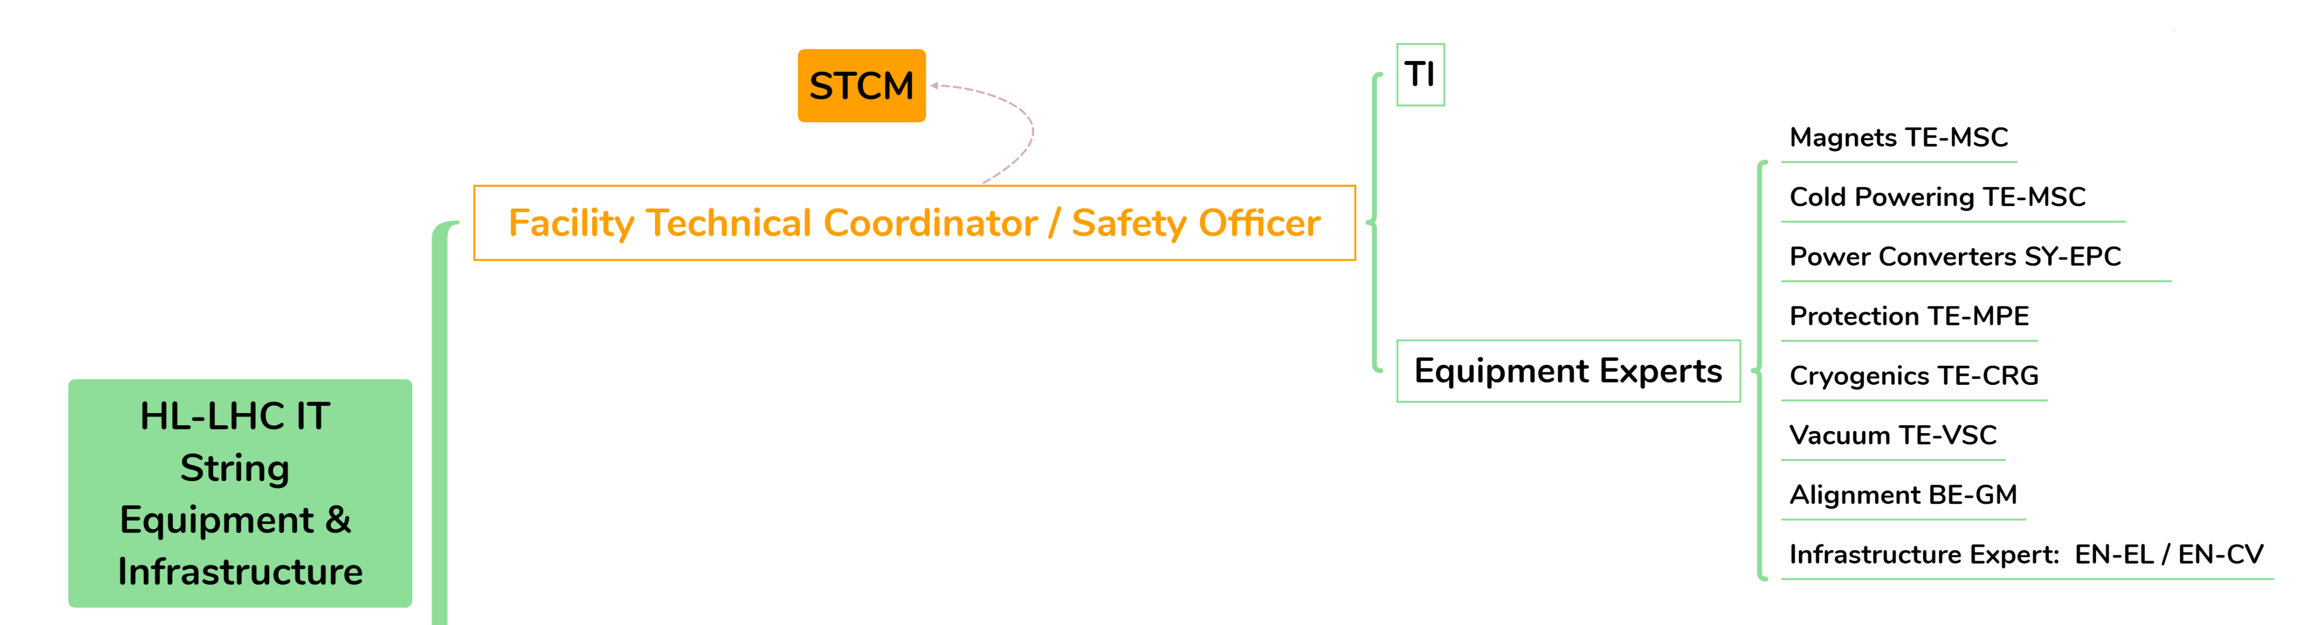
Organization of the IT String operation
Role: Facility Technical Coordinator
Coordinate interventions requested by stakeholders. Check procedure, monitor the activities onsite, ensure safe environment.
Ensure the compliance of executed lockouts with CERN safety rules and standards.
Report anomalies detected to the responsible of operation. Intervene on request of TI for unexpected incidents.
Chair a meeting where aspects related to interventions and safety are discussed.
Control access to the String area approving Impact in function of the test stand conditions.
Follow up status of equipment and confirm with experts the readiness of components and infrastructure for operation.

Slide 12
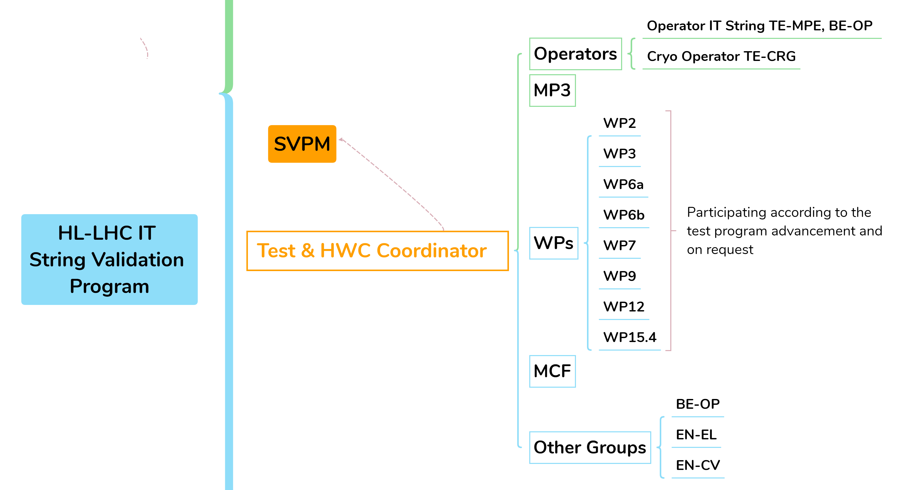
Organization of the IT String operation
Role: Test & HWC Coordinator
Assume responsibility for day-to-day operations, executing the String Validation Program.
Coordinate the operation team, and centralize the support from the MP3, the MCF and the SVPM.
Ensure adherence to the approved SVP and to the test procedures.
Discuss with the responsible of the IT String operation: Actions not planned in the SVP, modification of installations, safety related aspects, results that deviate from the expected test outcome.
Follow-up with the Facility Technical Coordinator any alarms or requests from MP3 or MCF.
Chair a meeting where aspects related to the String Validation Program are discussed.
Authorize each test step, checking that the requestors are satisfied with the results of the previous steps.

Slide 13
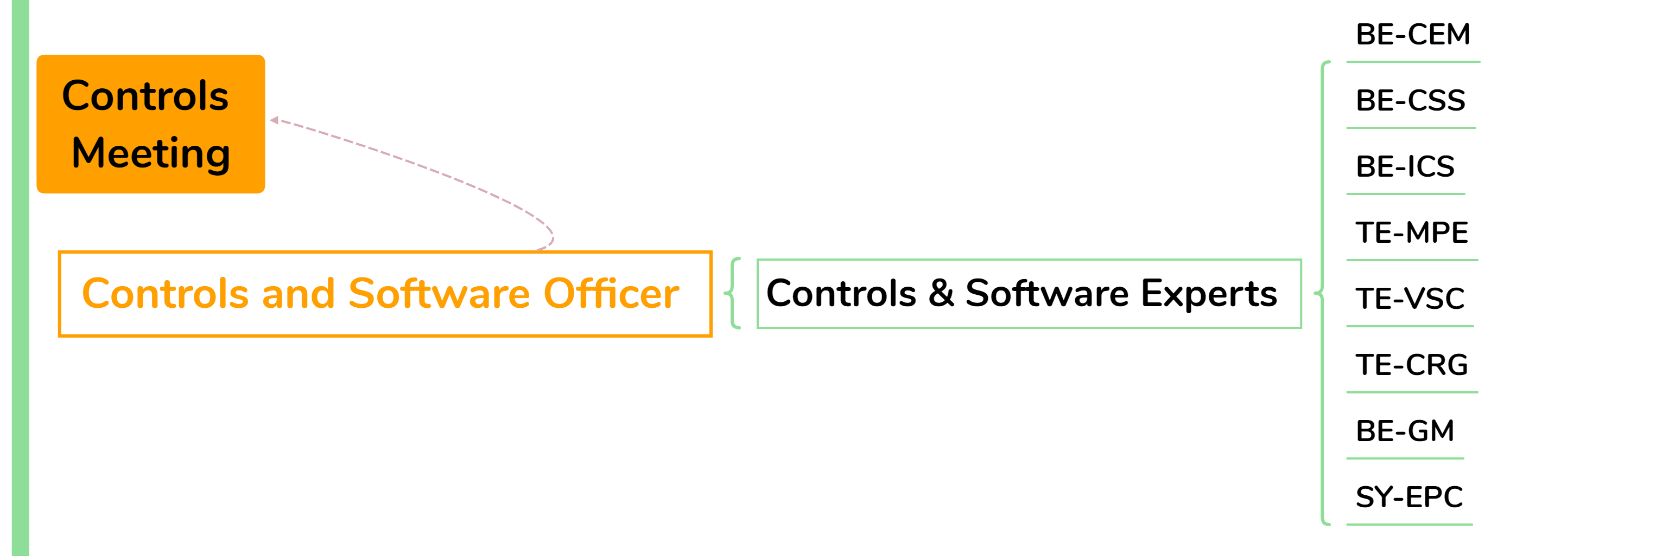
Organization of the IT String operation
Role: Controls and Software Officer
Ensure software and control systems are conformed with specifications and available during operation phases.
Coordinate interventions, updates and migrations concerning software and controllers according to schedule.
Validate communications and interfaces among the different control systems and with services.
Provide feedback on applications integrity, functionalities and user experience to the corresponding owner.
Chair a meeting where aspects related to software and controls are discussed.

Slide 14
Organization of the IT String operation
Role: Quality Officer
Ensure that all procedures for the different tests are available, and up-to-date.
Collaborate with the relevant actors to implement any change required in documentation linked to the IT String.
Chair a meeting where quality aspects of the IT String are discussed.
Follow up the test program using the MTF tool, updating the status of the different test steps and attaching the corresponding test result reports.
Write and follow up the approval process of any non-conformity detected.
Verification with the test coordinator of the parameters associated to each test.

Slide 15

Meetings for coordination and reporting
String Operation Meeting (SOM)
The objectives of the meeting:
  Summarise the activities of the previous week
  Establish the weekly planning
  Discuss urgent matters raised by any team
  Present preliminary results (or summary from MP3 members)
Attendance: IT String Operation team, WPs/groups representative in function of the tests to be executed during the week, MP3 representative, hardware experts on request, controls and software experts on request.
Weekly meeting, Indico agenda available and minutes distributed. Complemented by working meetings chaired by the Test & HWC Coordinator.

Slide 16
Meetings for coordination and reporting
String Validation Program Meeting (SVPM)
Presentation of analysis results for the executed tests.
Magnet Circuit Forum (MCF)
Validation of circuits performance (based on analysis of the op. team and MP3).
LHC Magnet Circuits, Powering and Performance Panel (MP3)
Responsible of powering test procedures and acceptance criteria.
String Technical Coordination Meeting (STCM)
Presentation of any intervention to be executed on the test stand, involving equipment or infrastructure installed.
Discussion of safety matters related to the test stand.
Recommendations about the following test steps to be executed.
Adaptation of circuit parameters, if needed.
Participation for specific test on request from the Test & HWC coordinator.
Report on the analysis and diagnostics of the executed tests.
Inform involved WPs about the status of the program.

Slide 17
Meetings for coordination and reporting
Controls and Software Meeting
Point 1.8 Coordination Meeting
Coordinate software and controls upgrades to minimize impact on the test stand operation.
SM18 Cryogenic Coordination Meeting
Find compromises among the users of the SM18 hall related to critical coactivities, conflicts or for the definition of SM18 shutdown periods.
Project Steering Meeting (PSM)
Ensure smooth cryogenic operations within the SM18 hall and manage necessary compromises. Test & HWC Coordinator will actively participate and inform the rest of the operation team.
Technical Coordination Committee (TCC)
TE Department Technical Meeting
Report by the WP16 WPL of any extra costs or delays incurred during operation.
Reporting on the advancement and obtained results during operation on the request of the TCC chair.
Reporting on the test results and/or the status of installation on the request of the TE department.
Provide feedback to the application owners.

Slide 18
Conclusions
A procedure describing the organization during the IT String operation has been approved.
Some phases of the operation have already been successfully executed.
The role of the facility technical coordinator and safety officer has been attributed.
The responsibilities of the different roles have been defined, specifying who does what and who approves/authorize what.
The meetings and forums that will support the IT String operation are already in place, with the exception of the weekly String Operation Meeting.

