Slide 1
Satus of cryostat activities at CERN
D. Ramos on behalf of the WP3 cryostat team
J. Mouleyre, V. Sanchis, A. Seller, M. Struik, D. Murge, O. Id Bahmane, F. Savary, R. Diaz Vez and many more…
14th HL-LHC Collaboration Meeting, October 2024

Slide 2
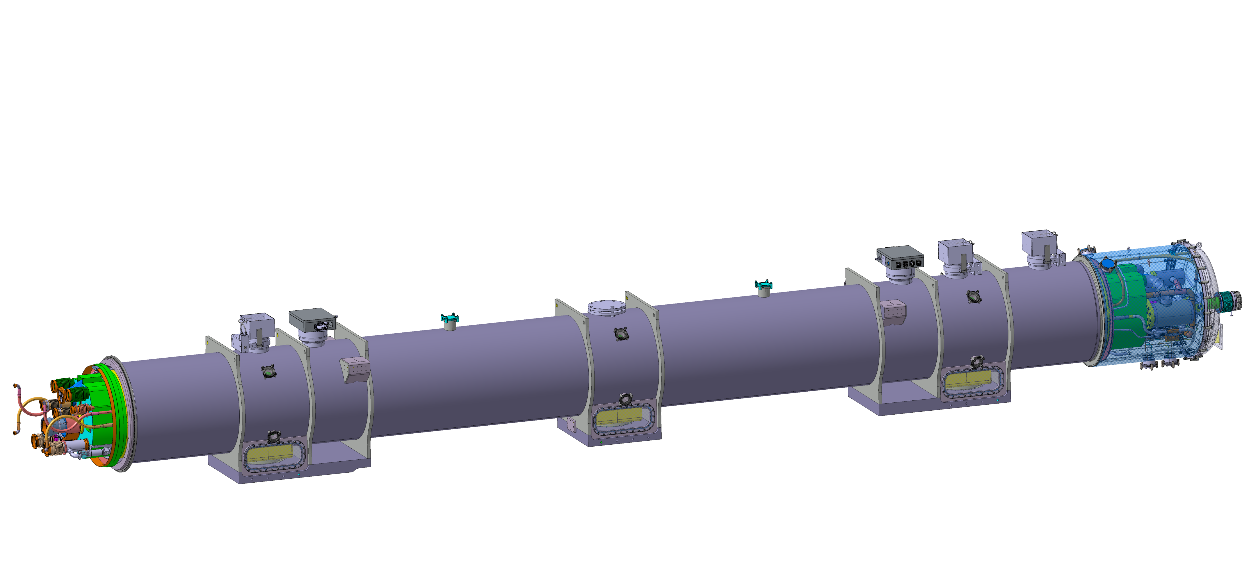
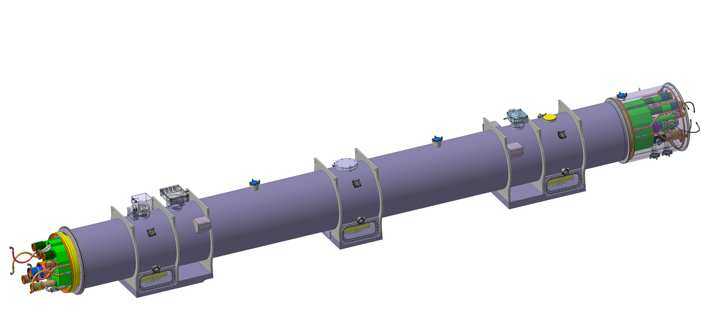
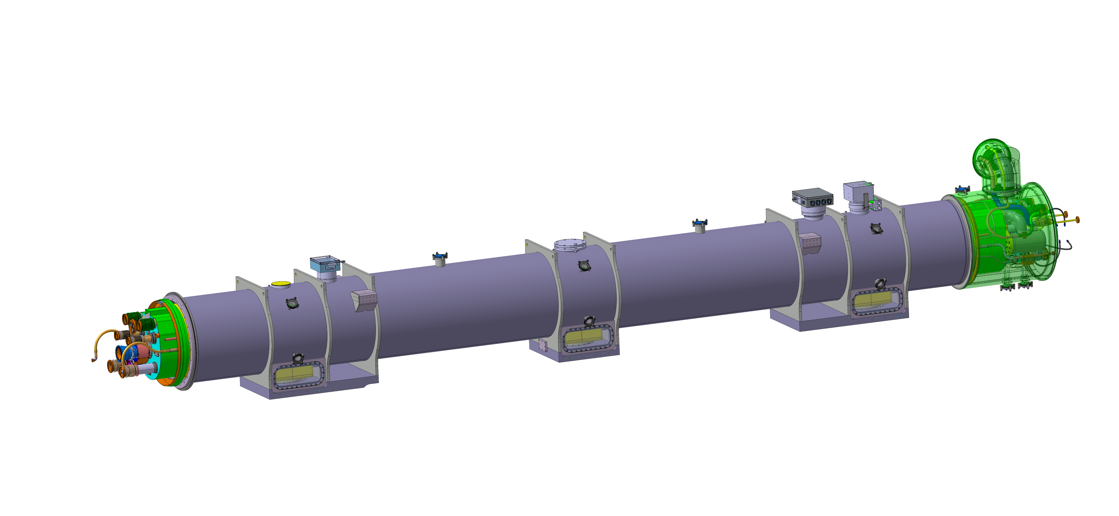
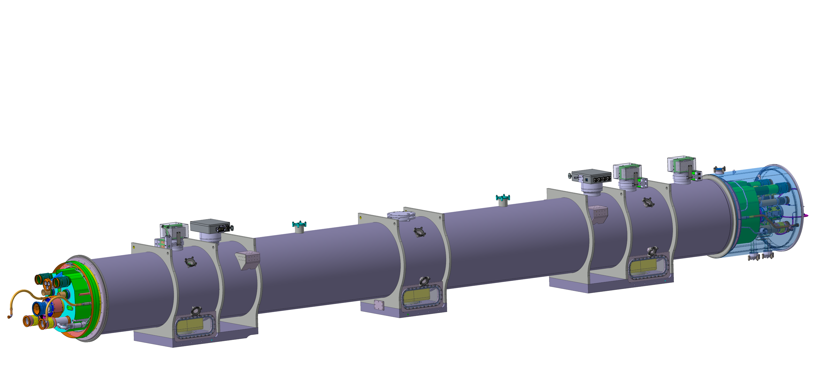
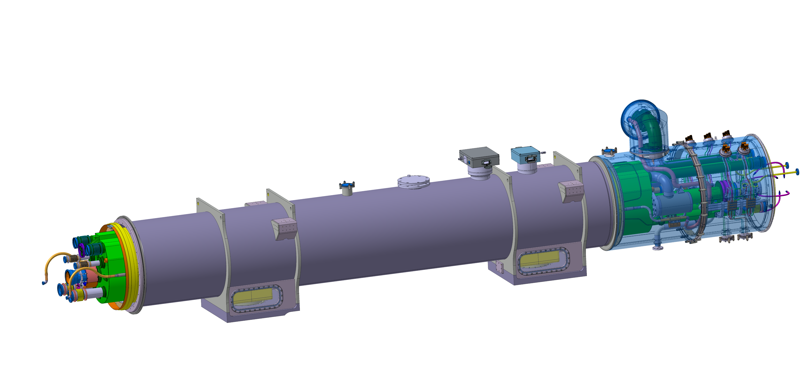
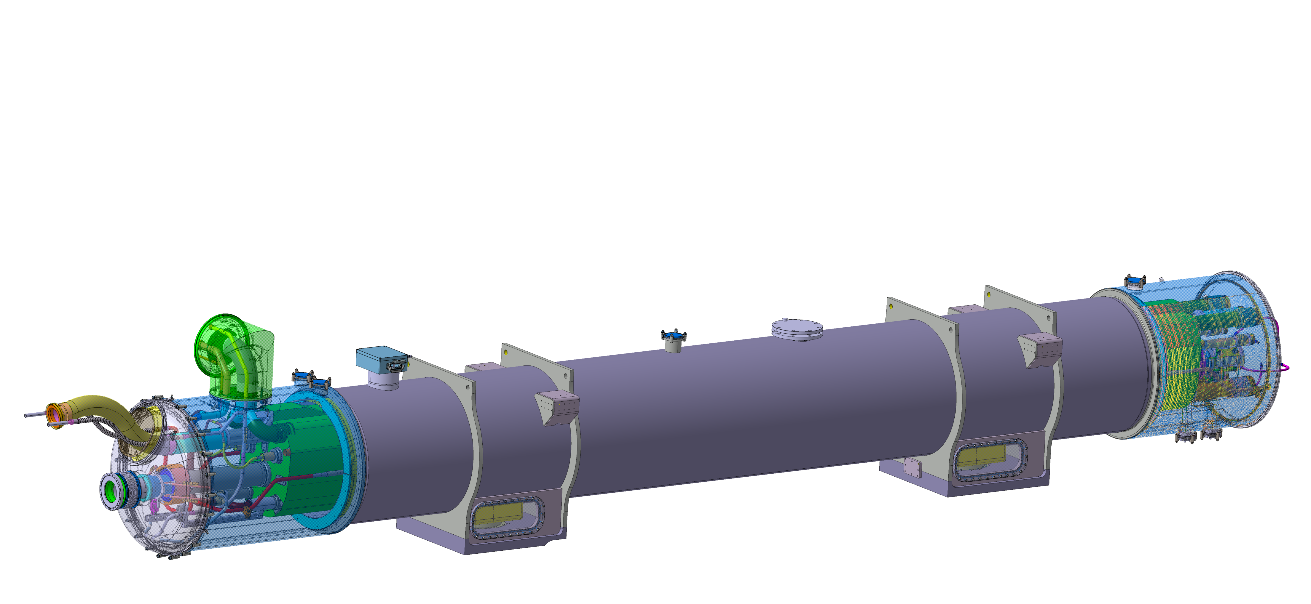
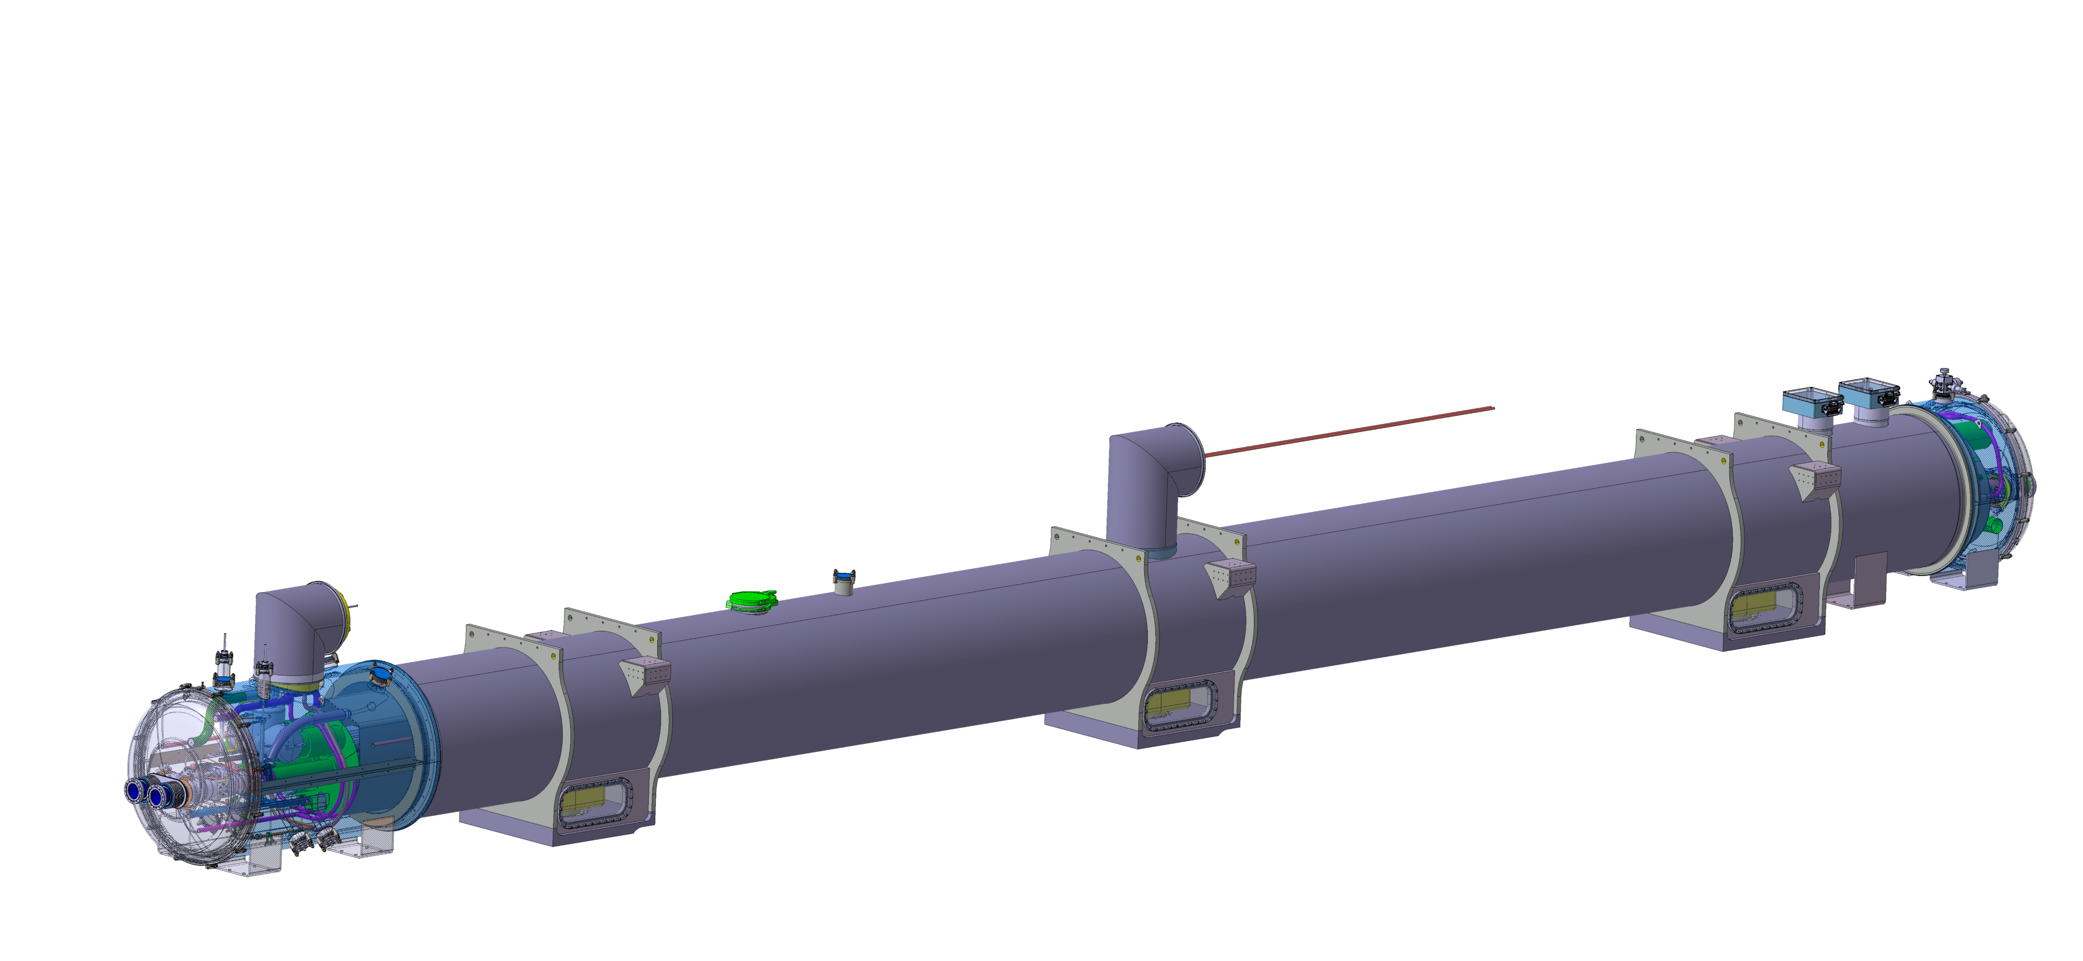
Cryostat types
Q1
Q2a
Q2b
 | String | IR1 Left | IR1 Right | IR5 Left | IR5 Right
Q1 | QQXFE | QQXFK | QQXFE | QQXFE | QQXFK
Q2a | QQXFG | QQXFC | QQXFG | QQXFG | QQXFC
Q2b | QQXFJ | QQXFN | QQXFO | QQXFR | QQXFL
Q3 | QQXFF | QQXFM | QQXFF | QQXFF | QQXFM
CP | QCXFC | QCXFE | QCXFF | QCXFG | QCXFH
D1 | QBXFC | QBXFE | QBXFF | QBXFG | QBXFH
D2 | - | QBRD
Q3
CP
19 cryostat types for 28 units installed in the LHC
The String was initially replicating IR5 Left but the QXL reconfiguration impacted all cryostats with jumpers. Because the change was not applied to the String, 3 additional cryostat types were created.
D1
D2

Slide 3

Cryostat assemby in phases
Phase 1: cold mass on cold supports, inside main vacuum vessel, with complete cold mass instrumentation. Ready for magnet cold testing in the case of Q1, Q2, and D1
Phase 2: final LHC interfaces, i.e. with crygenic service modules and piping configured for the installation slot
Phase 3: beam vacuum and BPM (by WP12). Ends covers in the case of Q1, D1 and D2
Phase 2
Phase 1
Phase 2

Slide 4
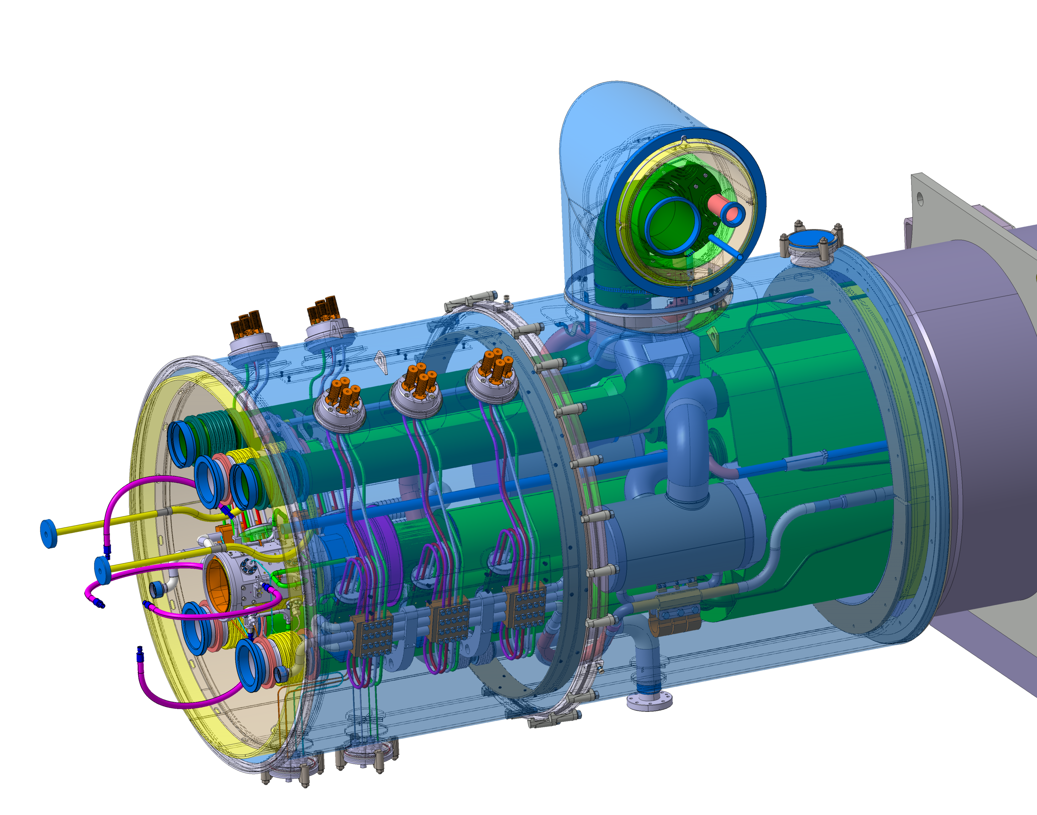
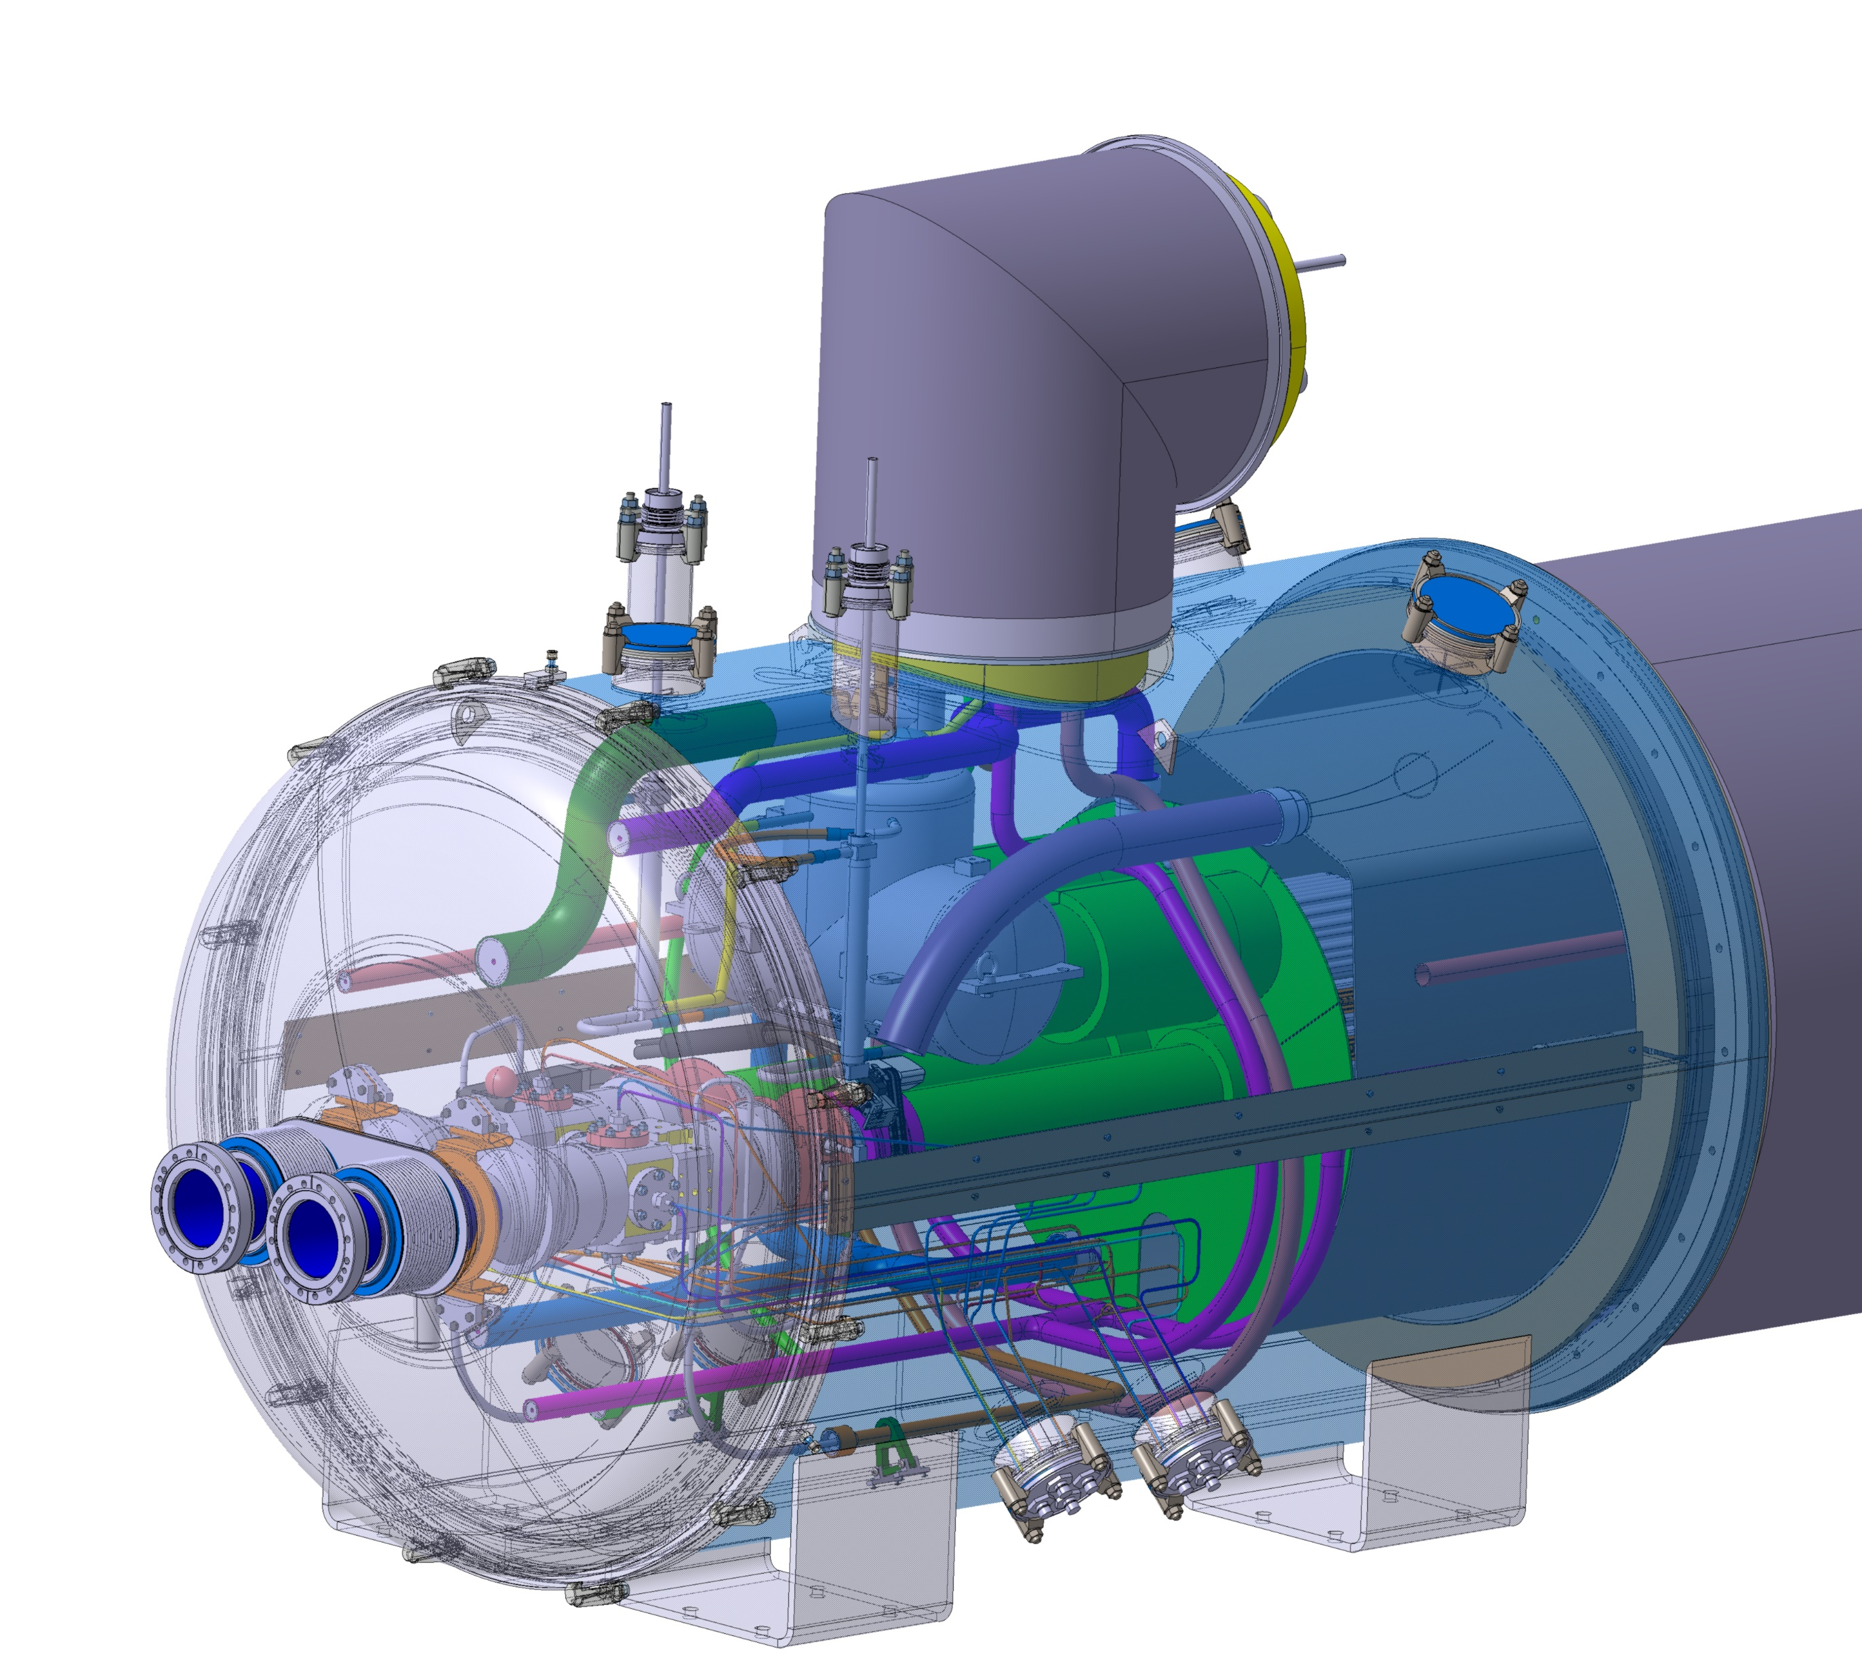
CP and D2 exceptions: Test after phase 2
CP: local conduction cooled leads
D2: finger heat exchanger

Slide 5
Assembly status
Phase 1 on-going
Phase 2 in 2025
Phase 2 in 2025
Phase 2 in 2025
Phase 2 assembly starting in October
Fully assembled, installed in the String
Fully assembled, ready for the String
Fully assembled, cold test starting soon
Phase 2 assembly on-going
Disassembled after cold test

Slide 6
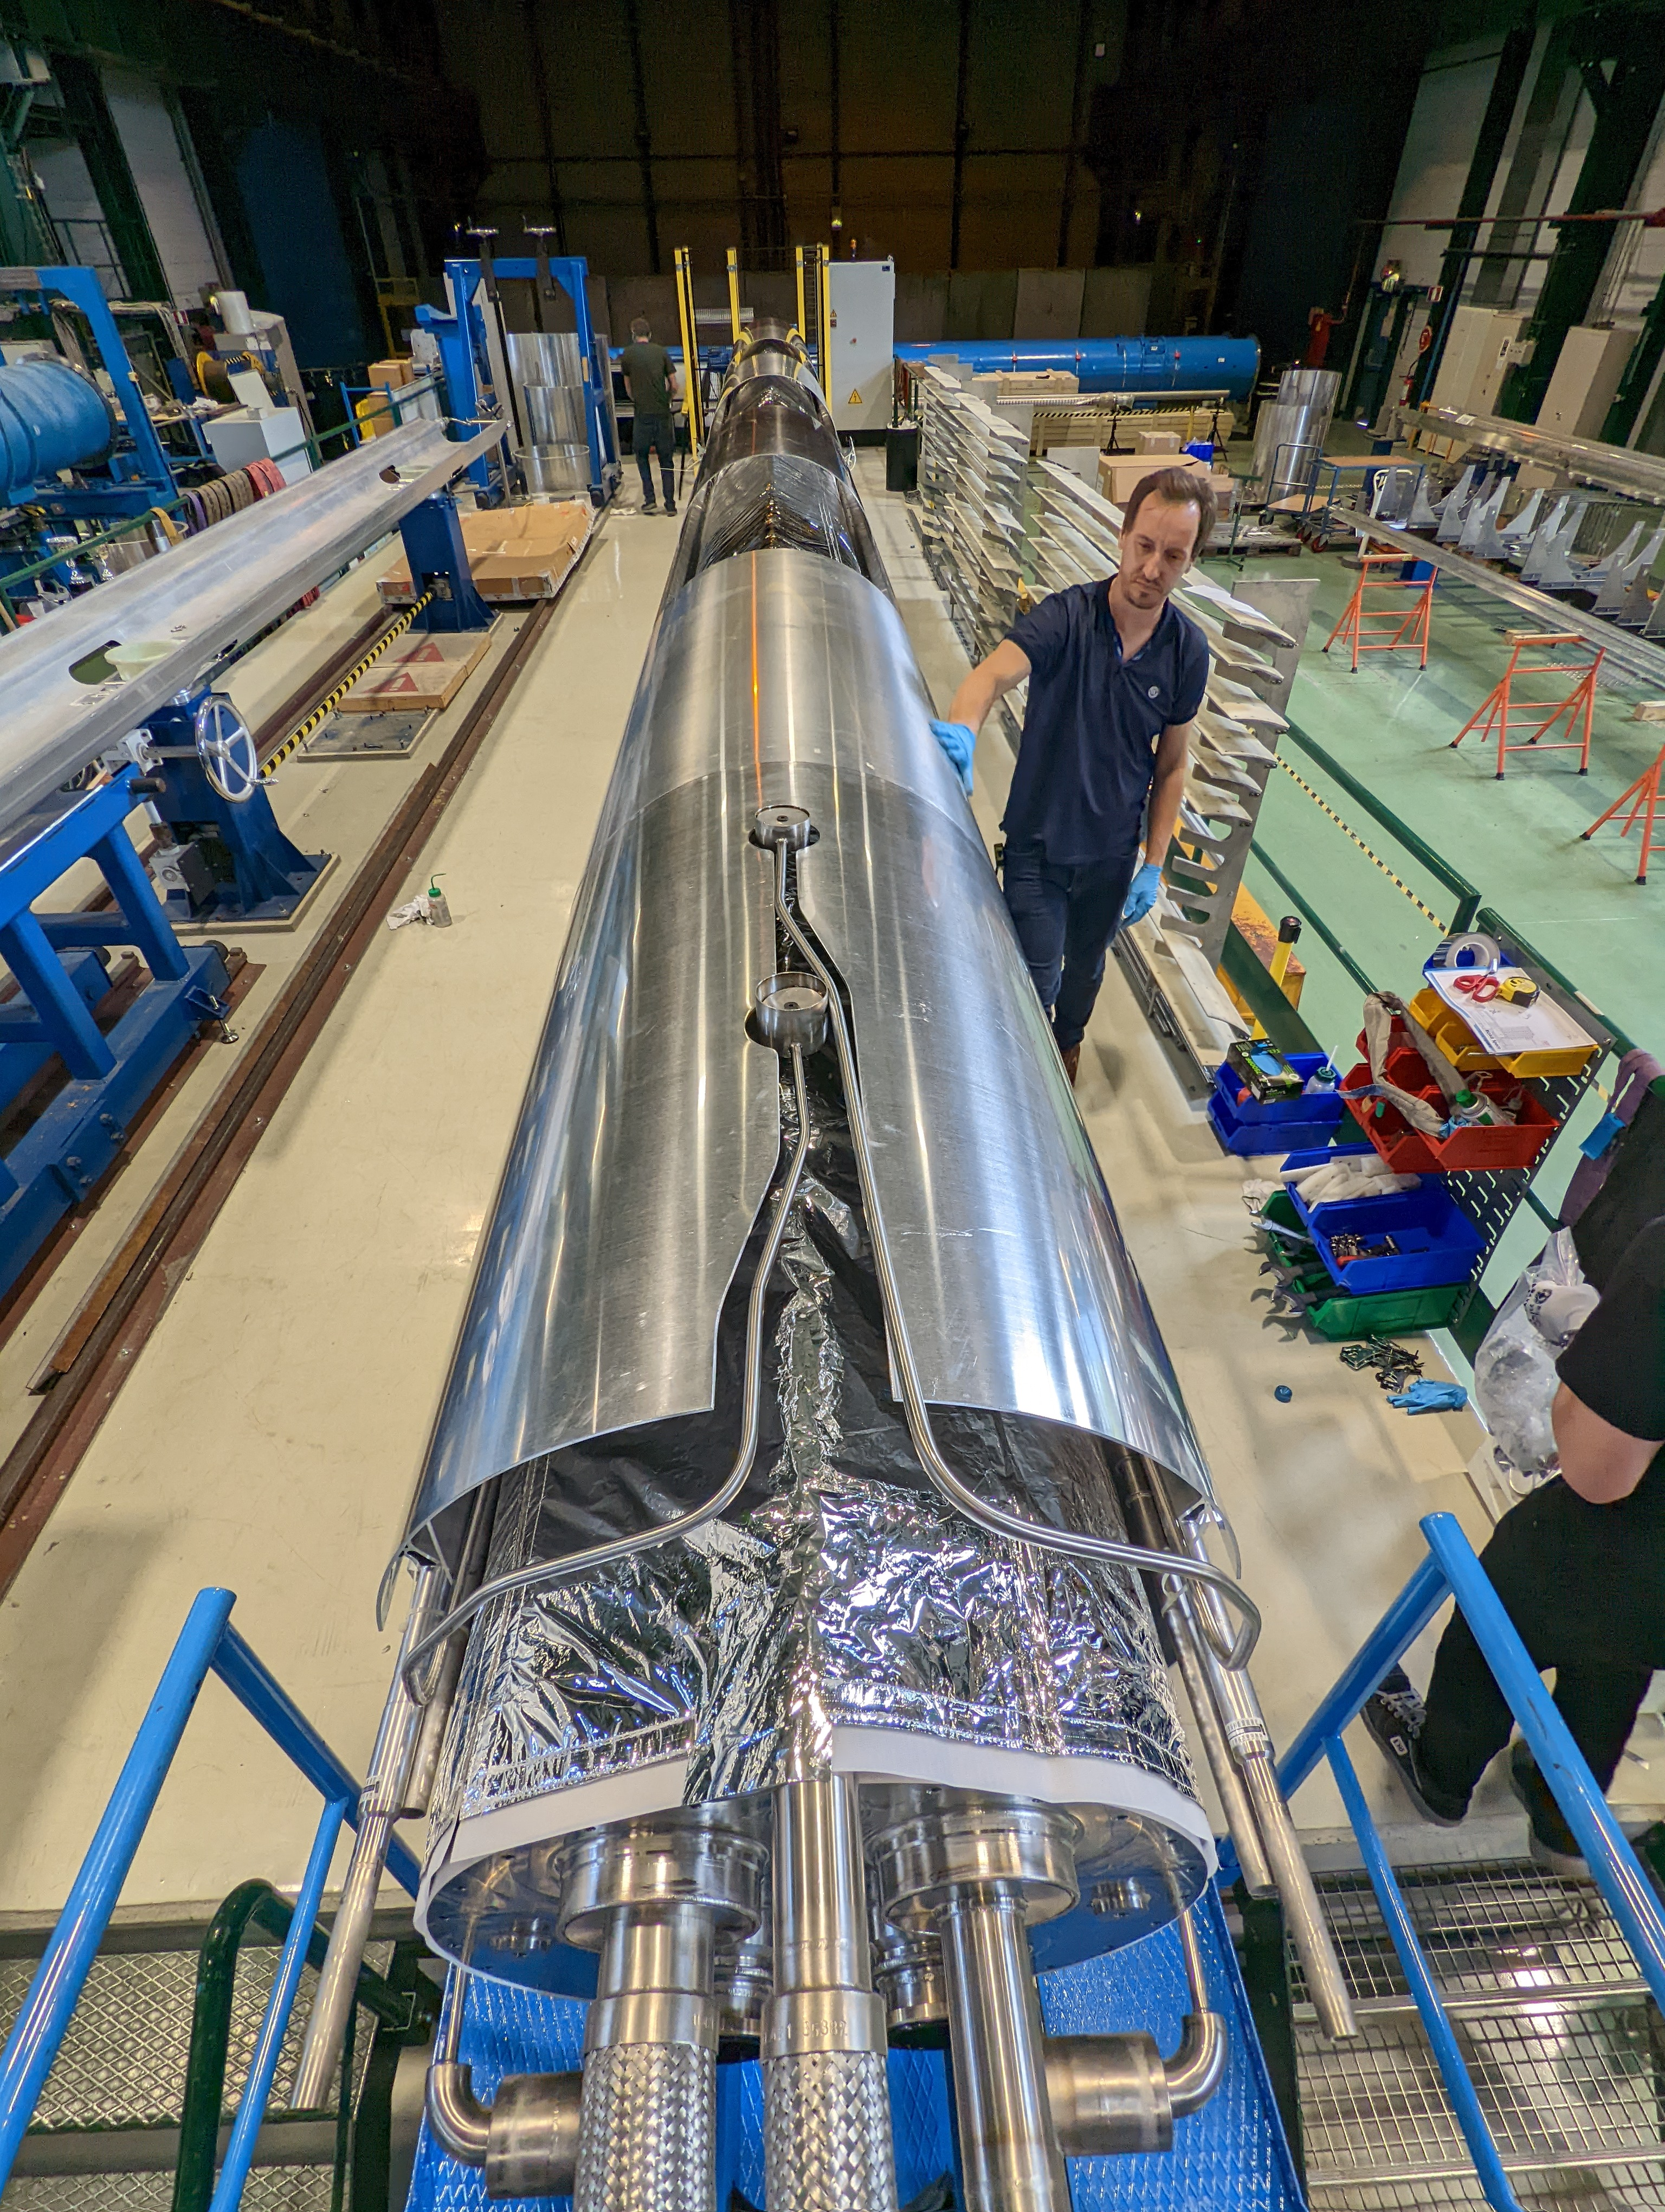
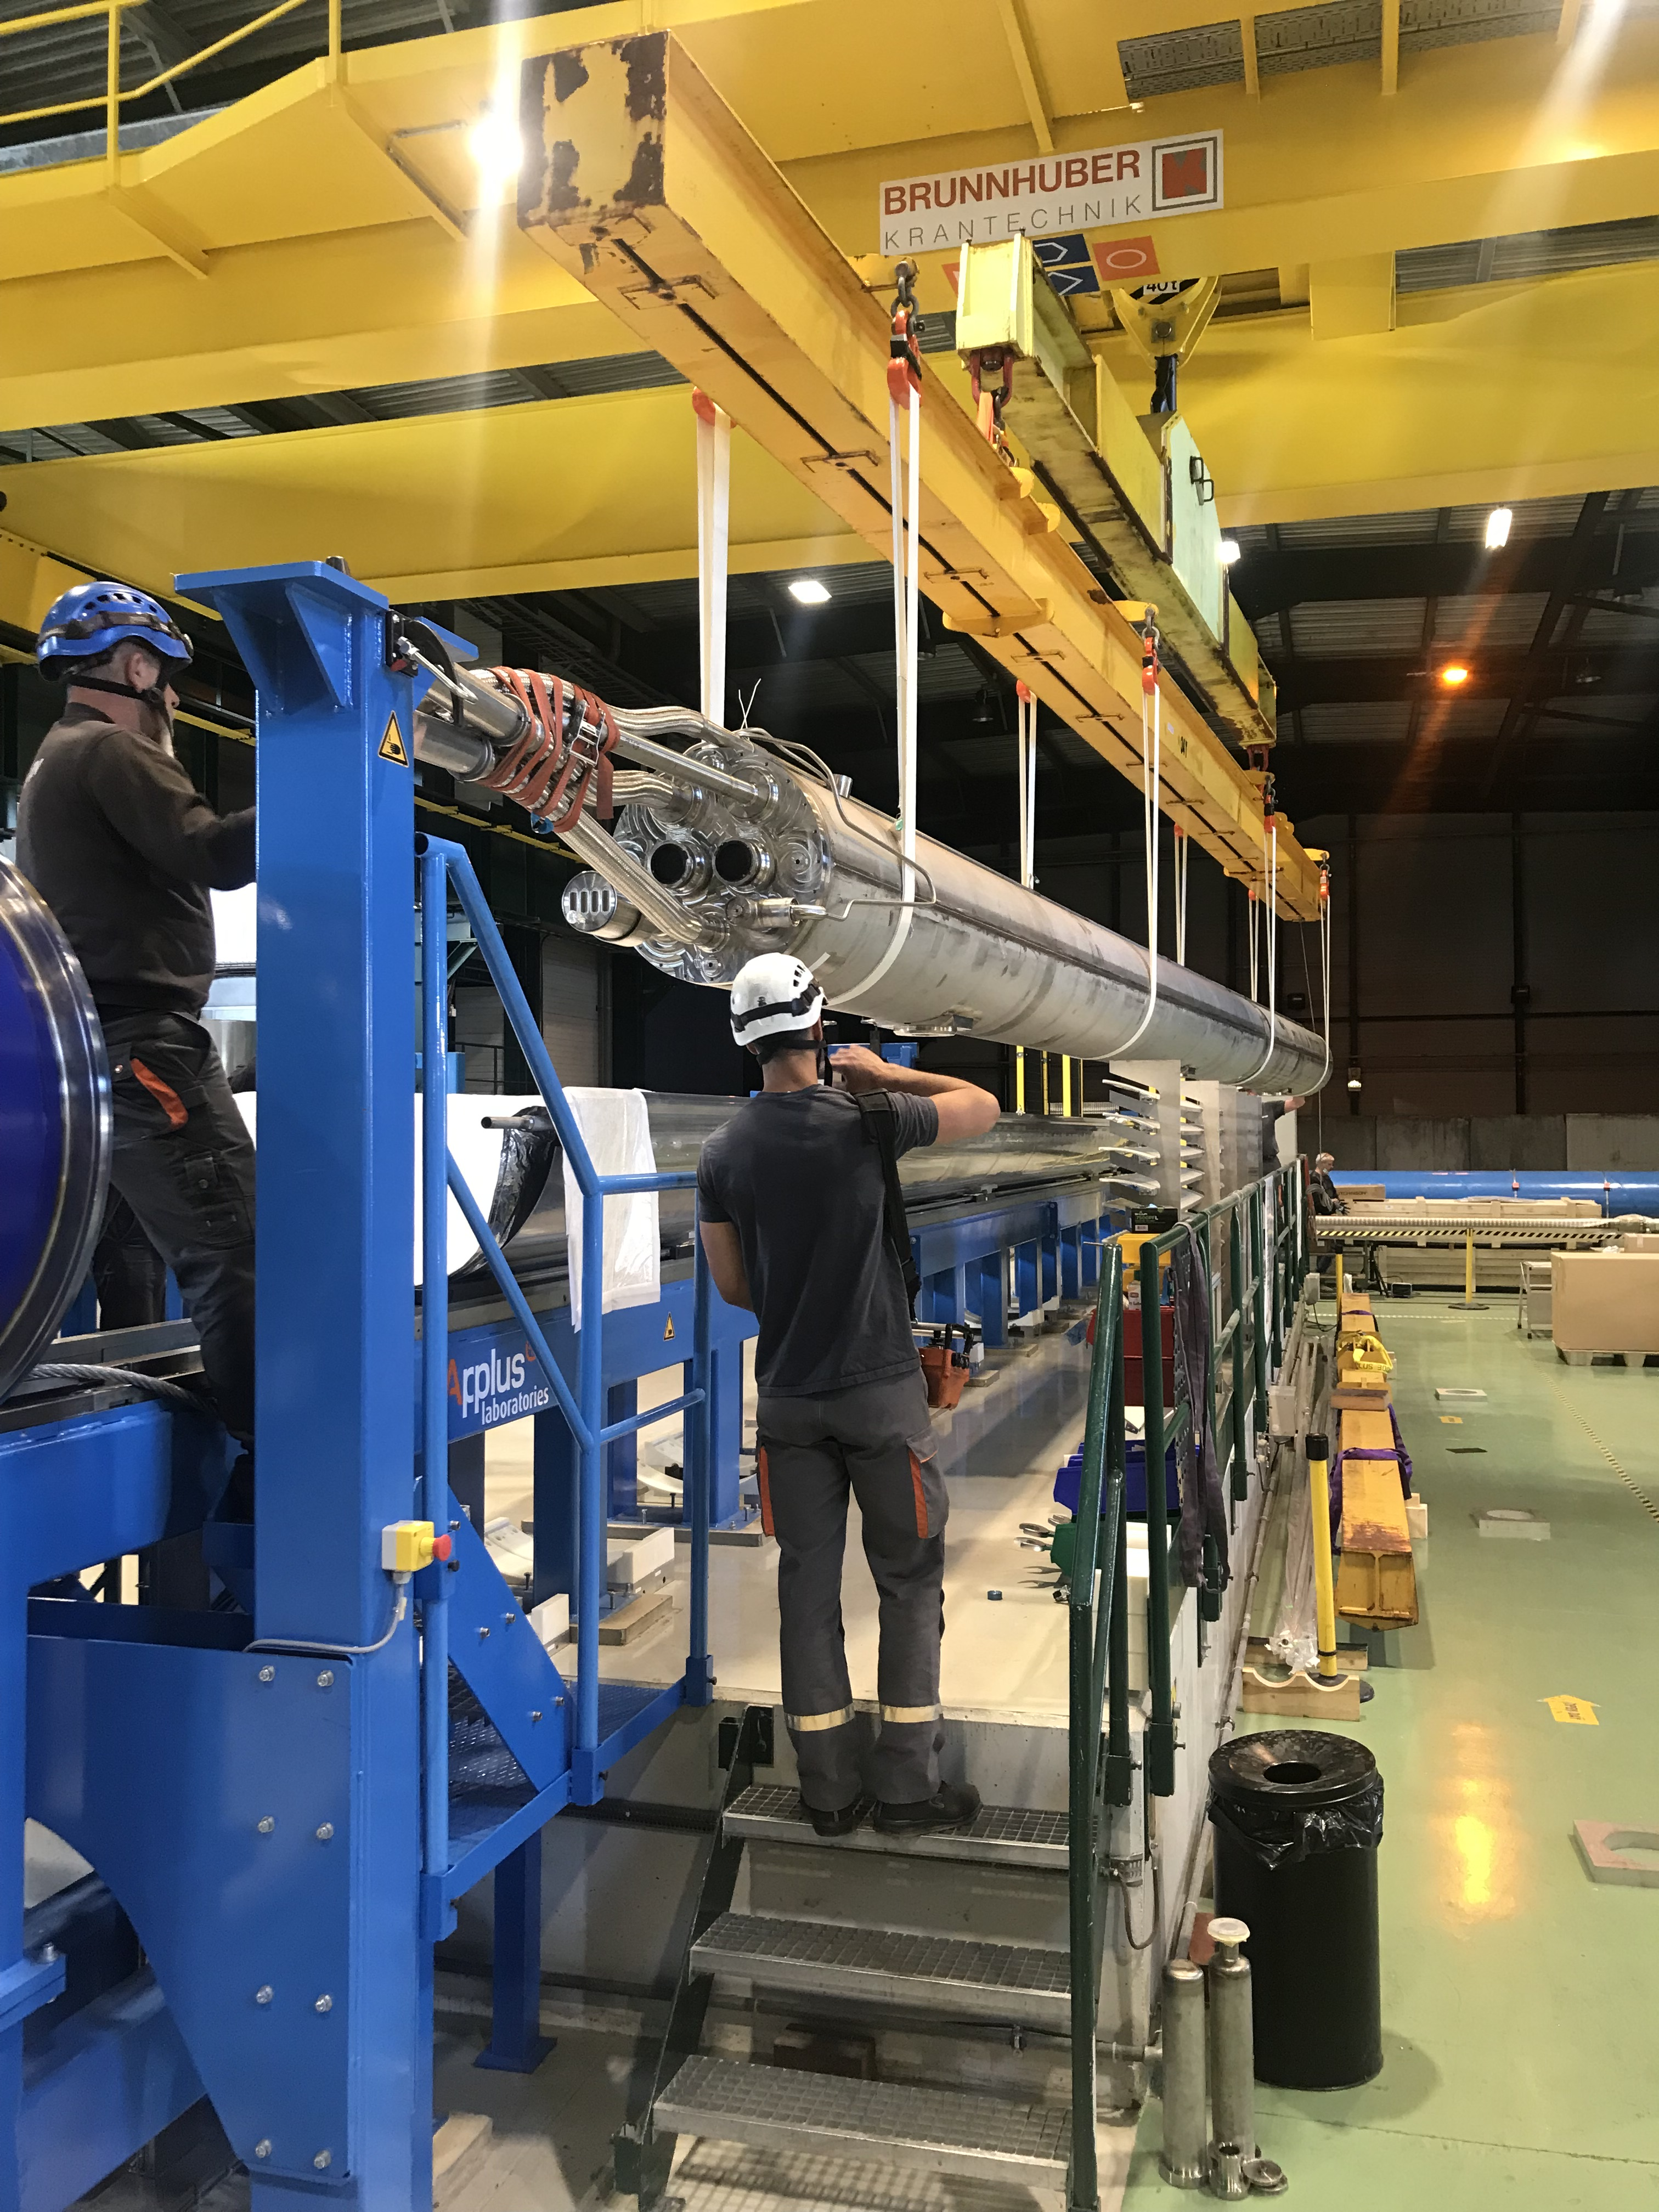
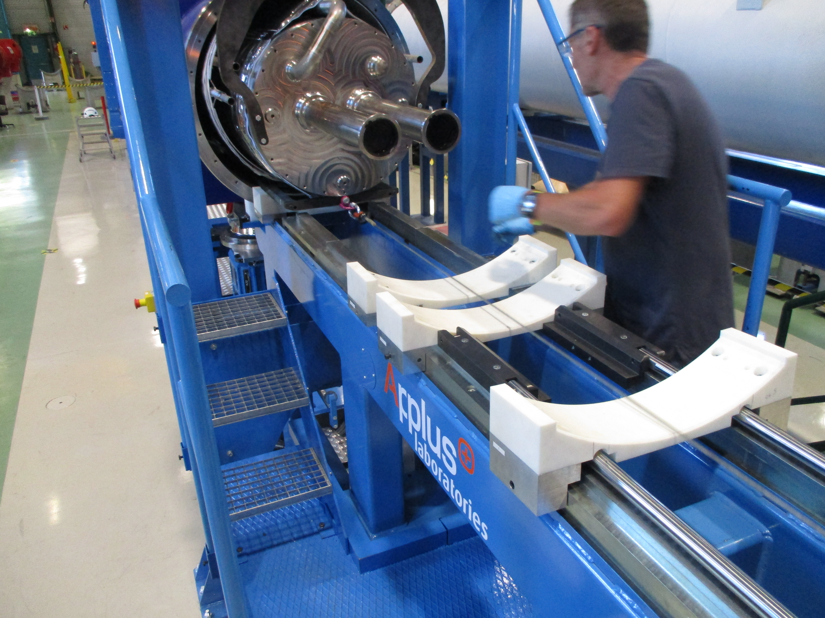
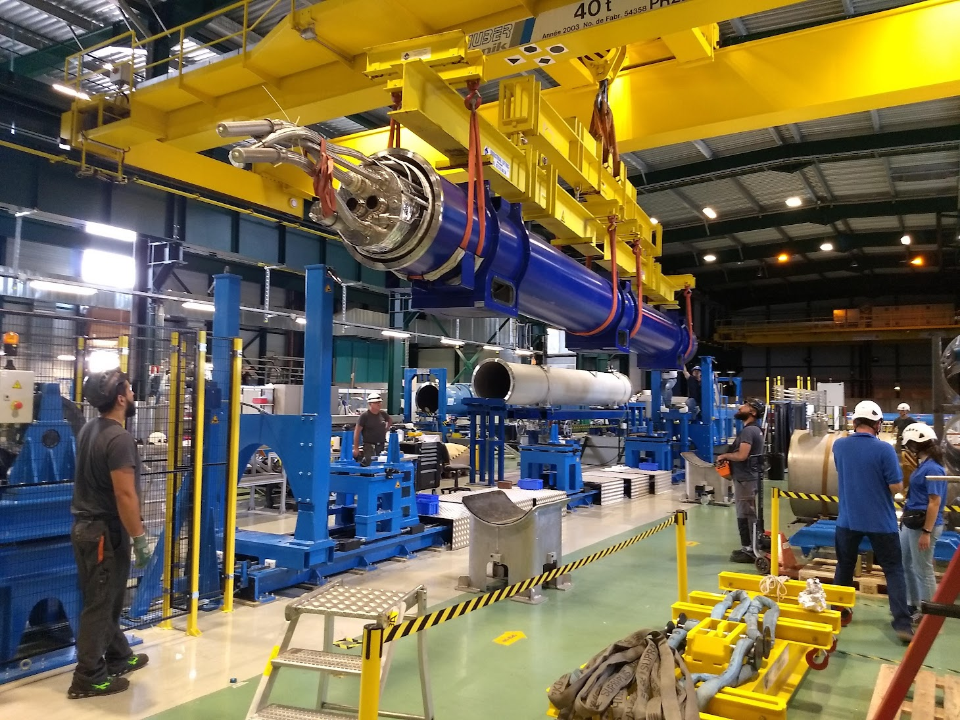
D2 QBRDP MBRDP
First HL-LHC cryostat assembly
May to July 2022 (11 weeks)
Validation of cold mass insertion tooling with the heaviest cold mass
See presentation from 2022 collaboration meeting (Uppsala) for a detailed description of the assembly process
Cryostat disassembled after cold test and components stored as spares

Slide 7
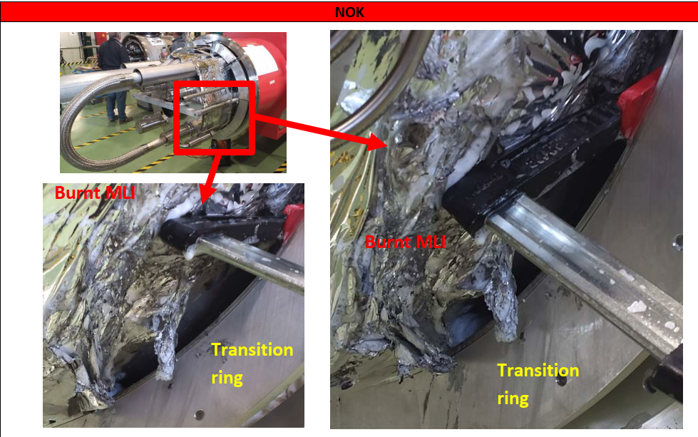
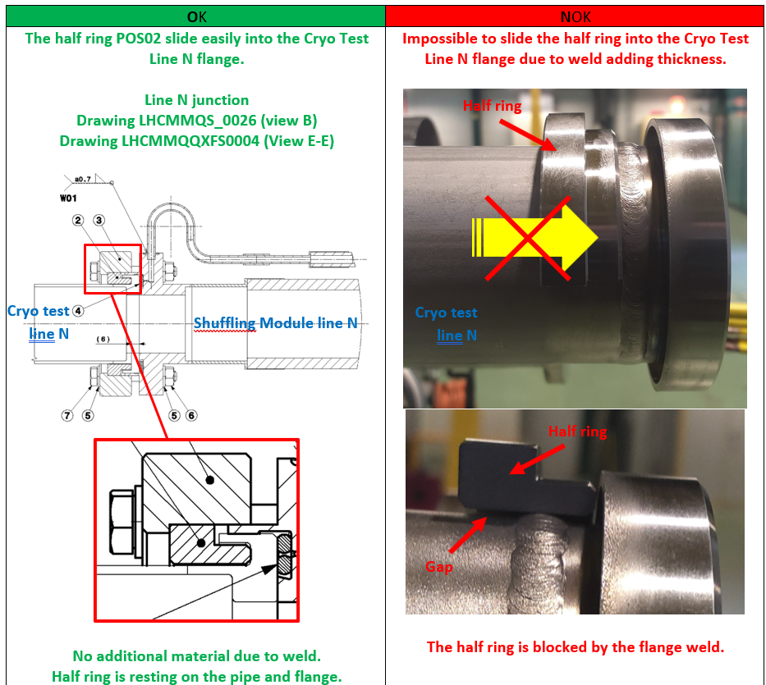
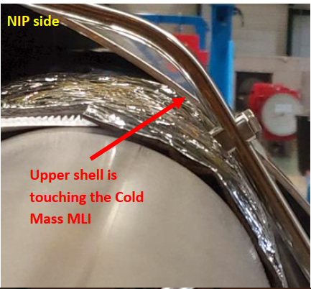
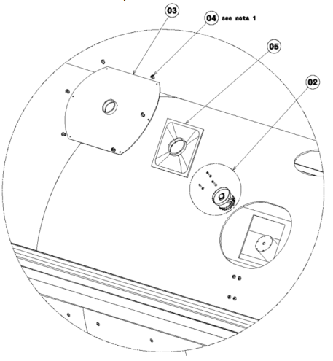
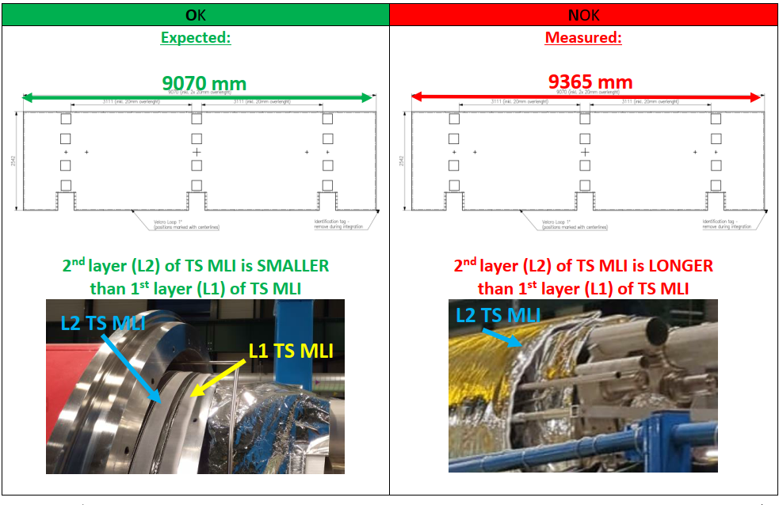
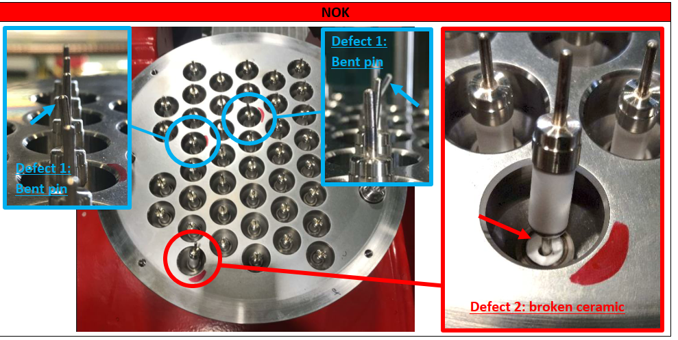
Q2b QQXFJ MQXFBP2 - Phase 1
Phase 1 assembly November 2022 to March 2023. Took more time than D2 (18 weeks) because of several issues:
  Thermal shield in contact with pumping lines due to oval shape. Tooling was improved, and rolling of shells now anticipates welding distortion.
  Modification of FSI patch positioning on thermal shield
  Non-conformity on MLI blanket
  Broken ceramic feedthrough required replacing of cover flange. PCB assembly improved
  MLI caught fire during thermal shield welding: safety measures improved
  Weld over thickness incompatible with test flange
Multiple improvements done on procedure and QC documents

Slide 8
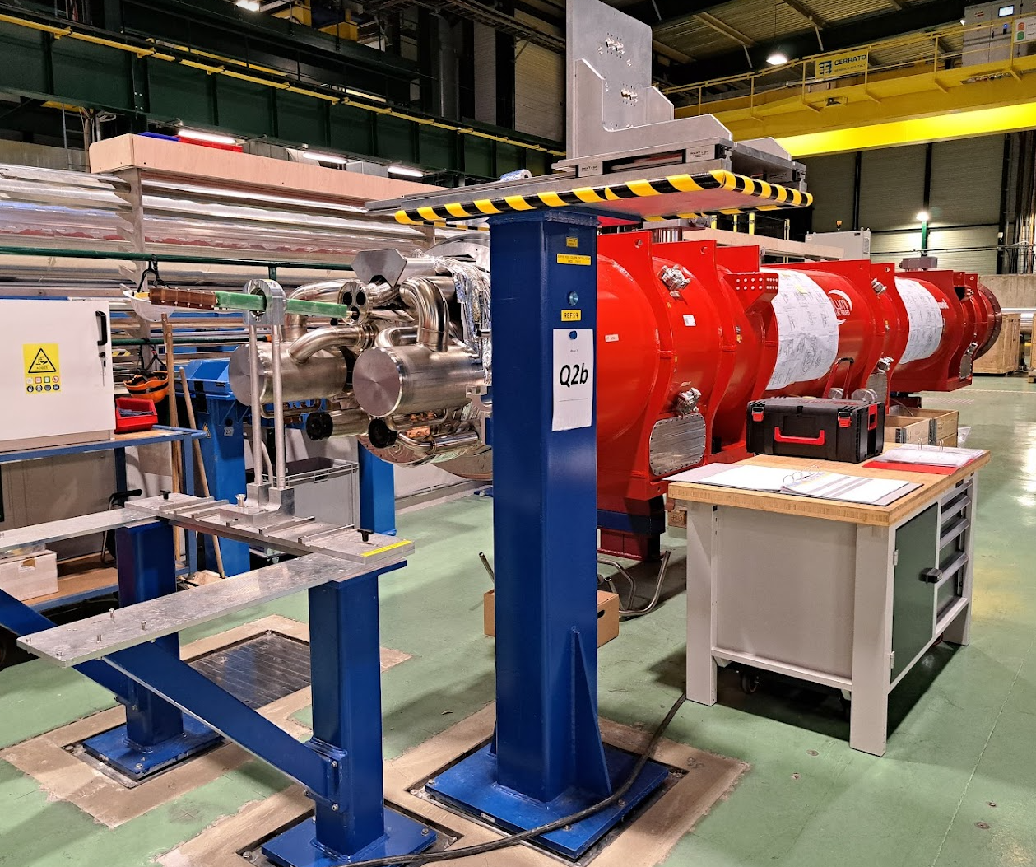
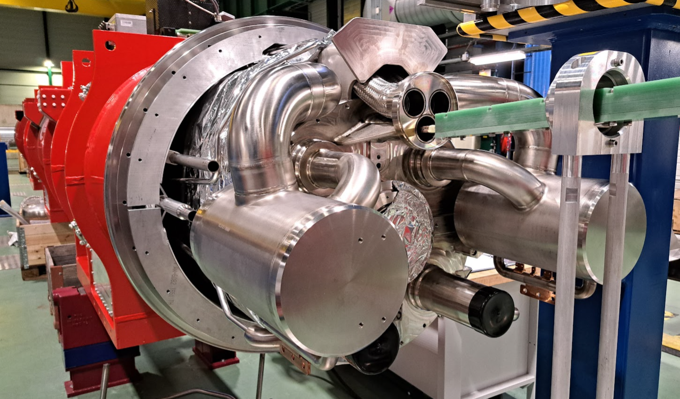
Q2b QQXFJ MQXFBP2 - Phase 2
Phase 2 assembly started in September 2024,
The goal is to finish before end of December (14 weeks), for installation in the String in January
  But is incurring delay due to bellows non-conformities (see slide 19)

Slide 9
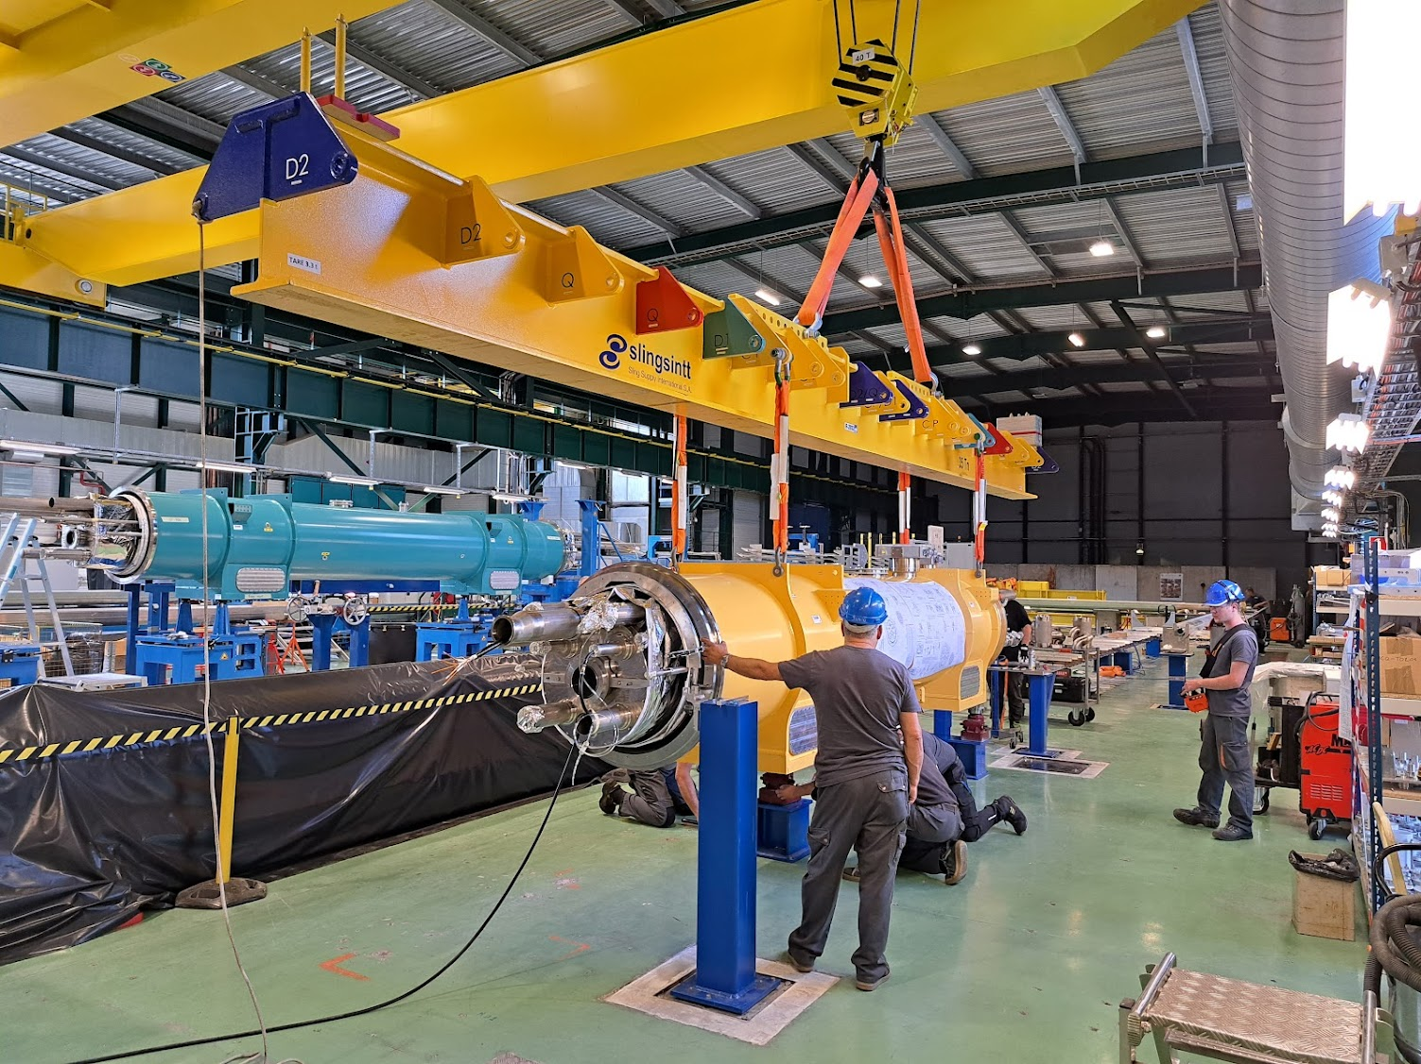
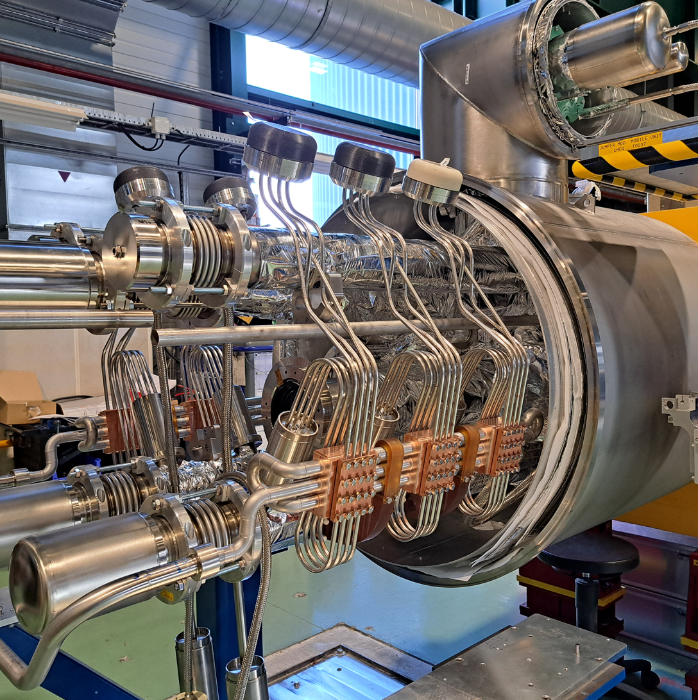
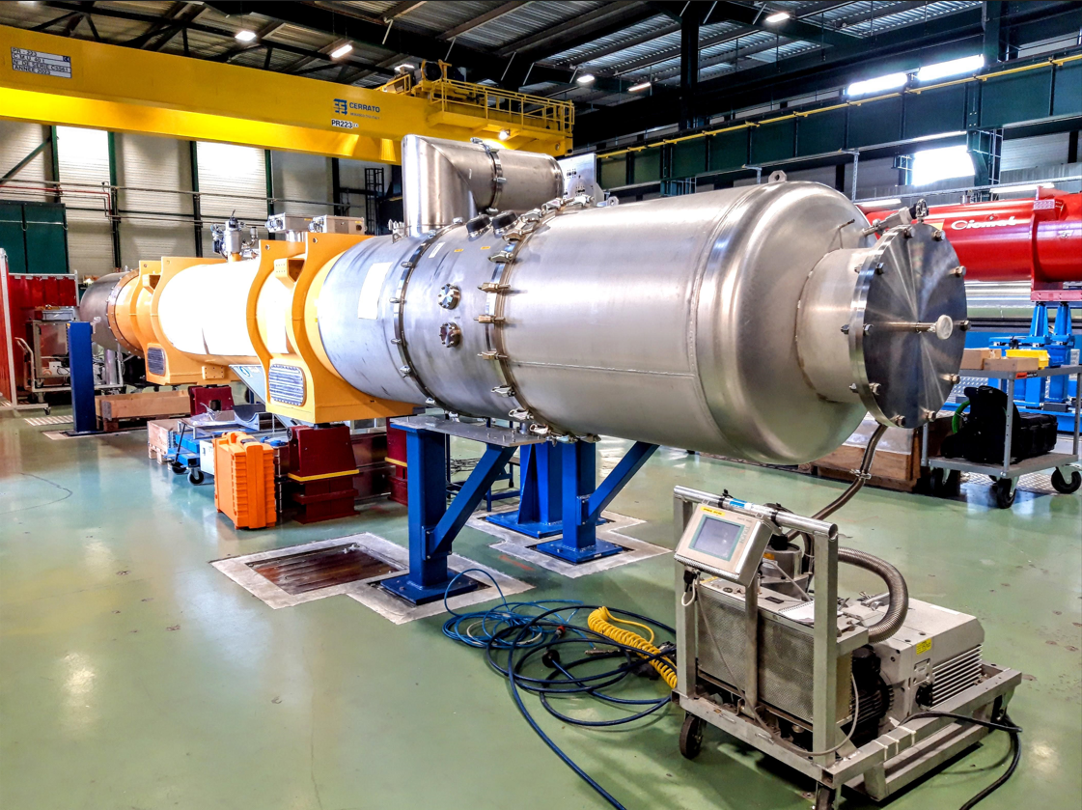
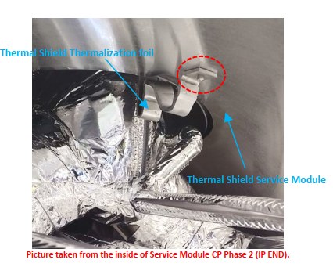
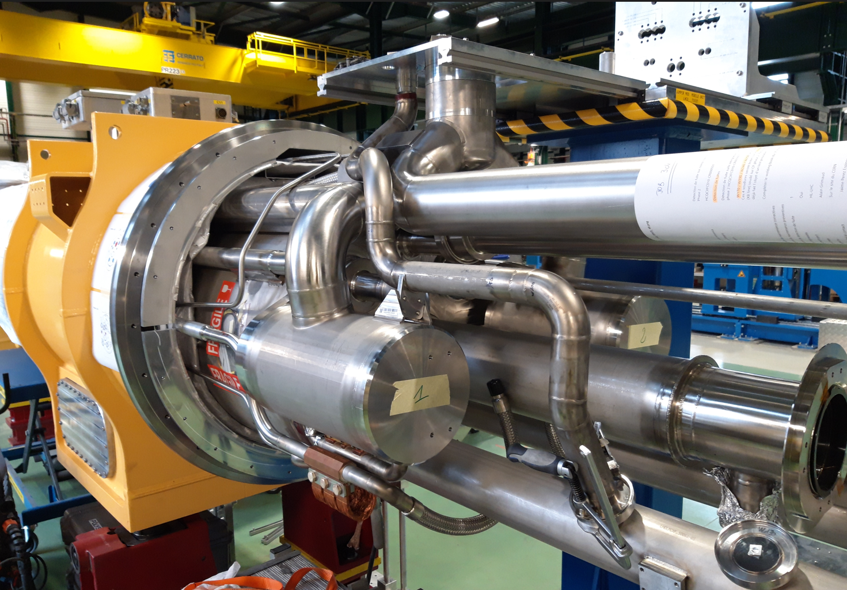
CP QCXFC MCBXFAP1
Trouble free Phase 1 assembly in May-June 2023 (8 weeks)
Phase 2 took from June 2023 to June 2024 (51 weeks)
  The most complex assembly, with over 200 welds
  First-time use of interface welding station. An alignment issue was found, requiring additional work on the tooling
  Impacted by late delivery of bellows expansion joints
  First assembly of complex pipe system on phase separators and jumper
  First assembly of current leads
  First global pressure and leak test
Lots of experience gained. Next assemblies are expected to take much less time (less than 20 weeks)

Slide 10
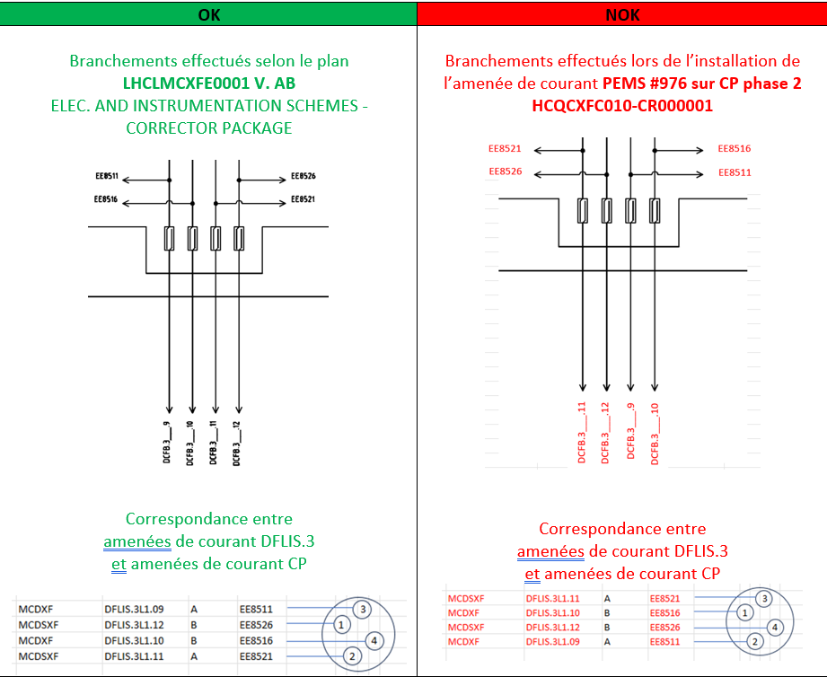
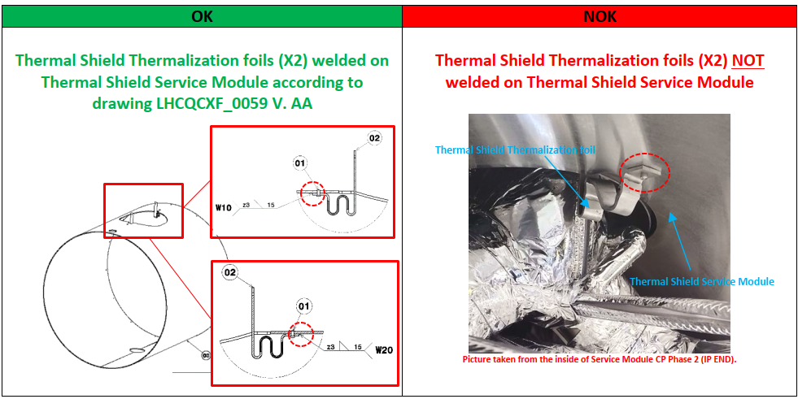
CP non-conformities
LHC-QCXF-QN-0006
LHC-QCXF-QN-0004
Decision: use as is for the String. Rework when configuring for use as machine spare

Slide 11
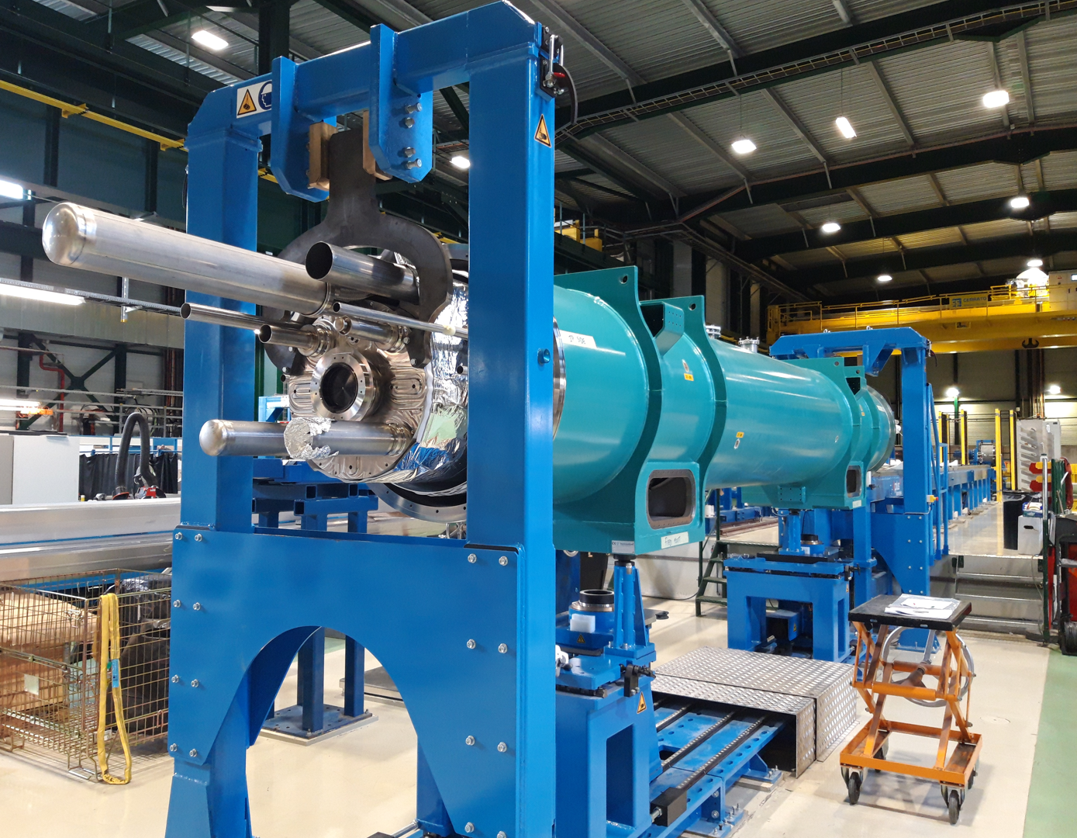
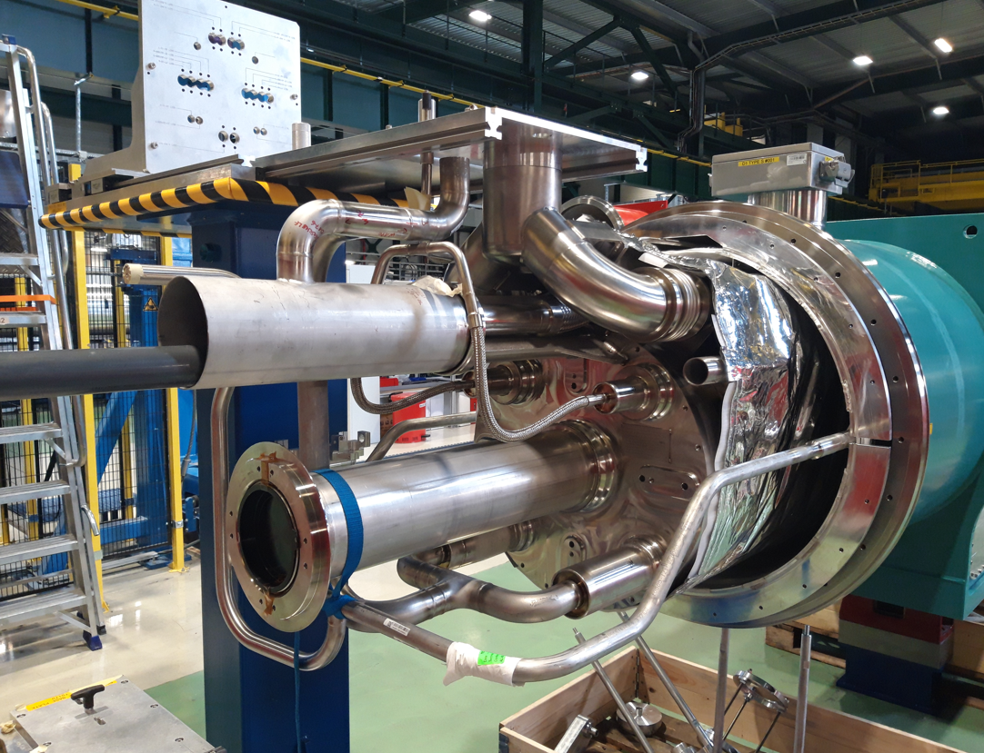
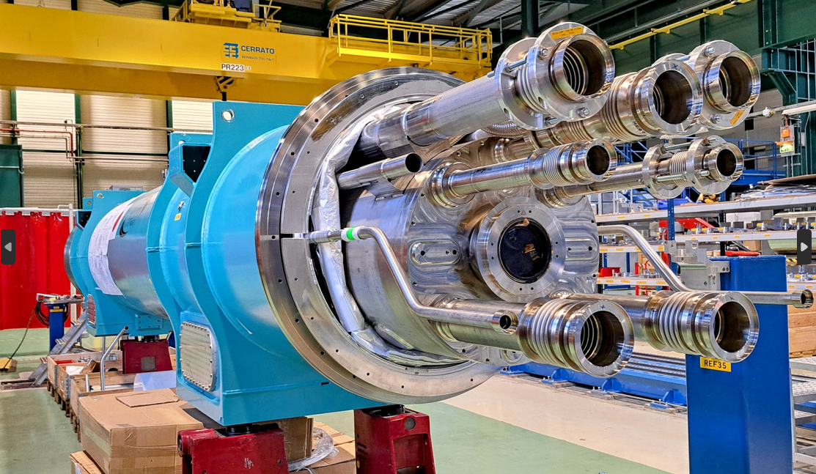
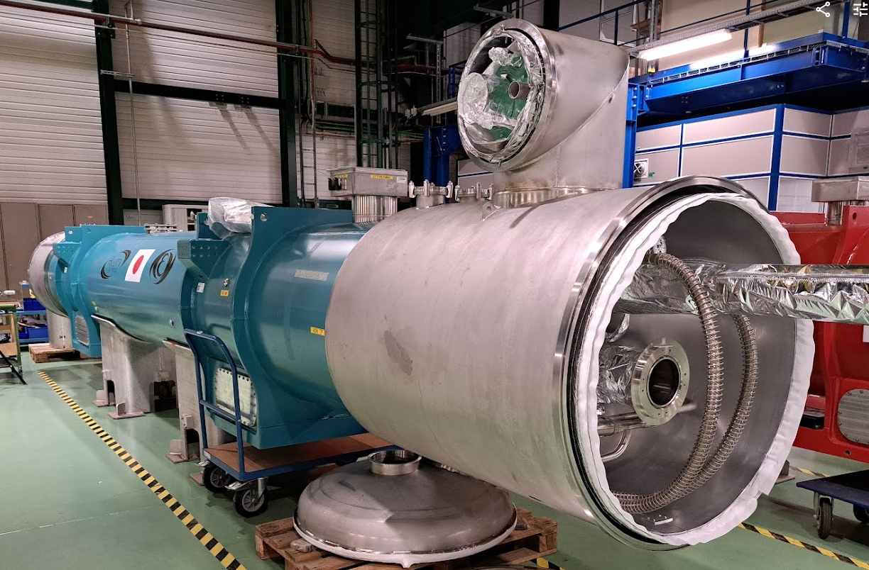
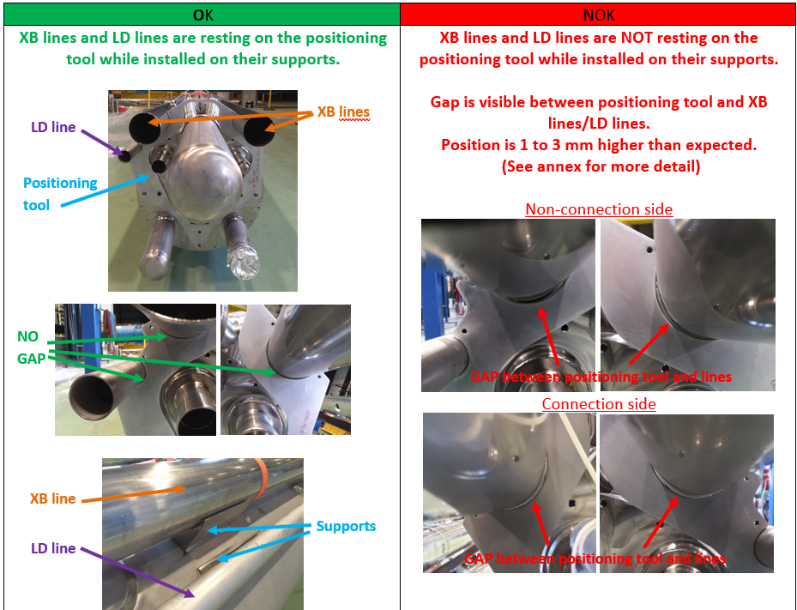
D1 QBXFC MBXFP1
Phase 1 done from May to July 2023 (9 weeks)
  Position of N and XB lines was off but could be corrected by re-machining pipe supports
  Error in V-tap wiring required corrective action on IFS
Phase 2 from March to August 2024 (24 weeks)
  Work performed without major issues
  A first-time assembly as with all units completed so far
  Will soon be installed in the String once the QXF jumper interface is ready

Slide 12
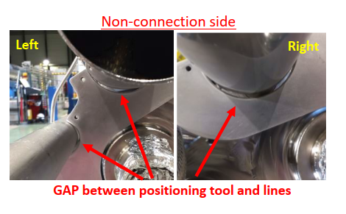
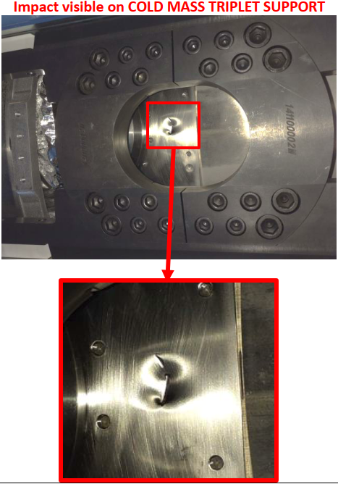
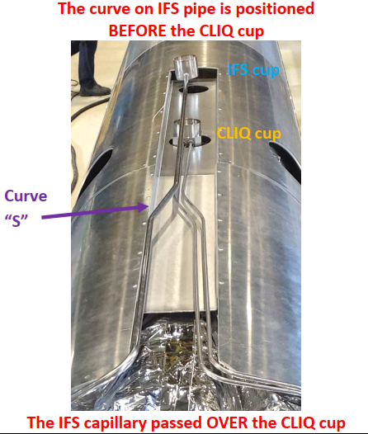
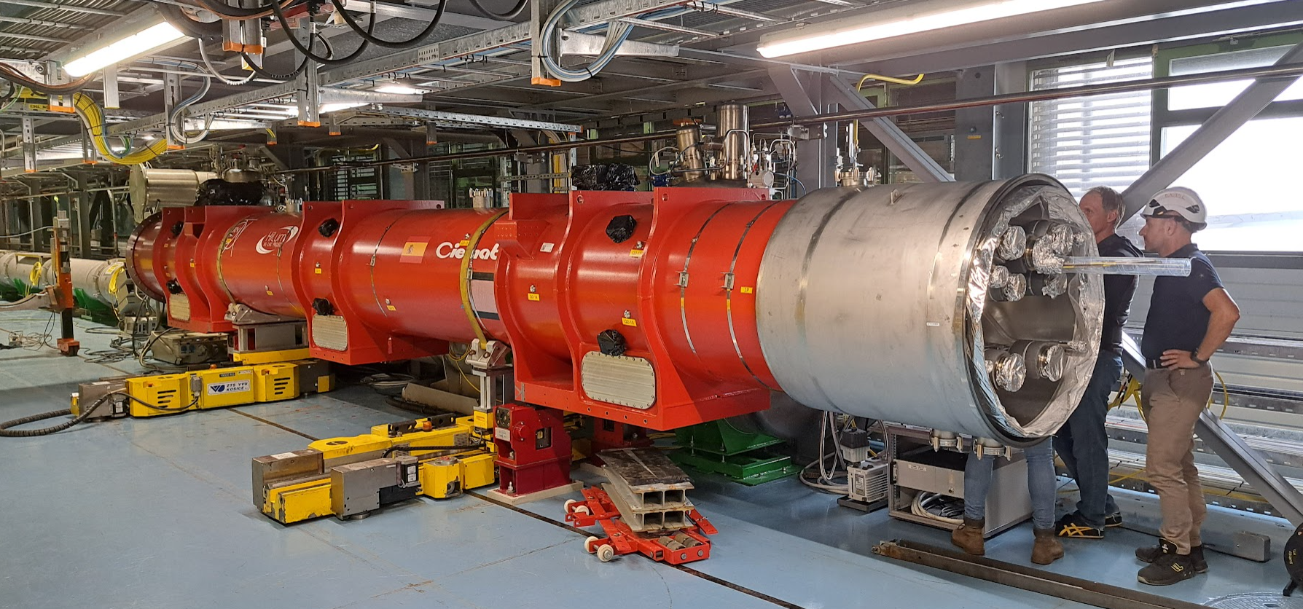
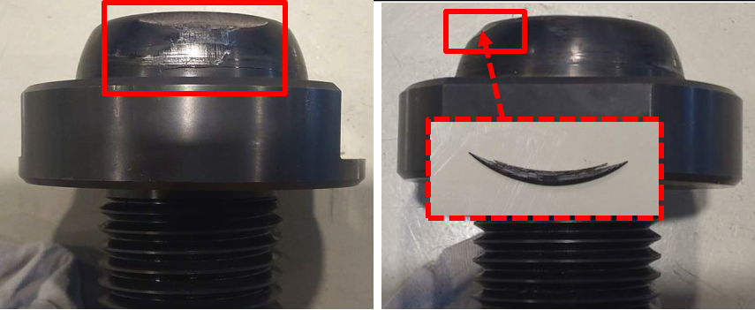
Q2a QQXFG MQXFBP3
Phase 1 done July to October 2023 (18 weeks)
  Re-machining of LD and XB lines to compensate offset between cold mass end covers and cylinder
  Impact on cold mass saddle of unknown origin
  Error when bending the IFS capillary
  Error when handling over the cryostating tooling because of wrong procedure being used
Phase 2 done May to August 2024 (14 weeks)
  Done in parallel with D1 phase 2, also with no issues
  Now installed in the String

Slide 13
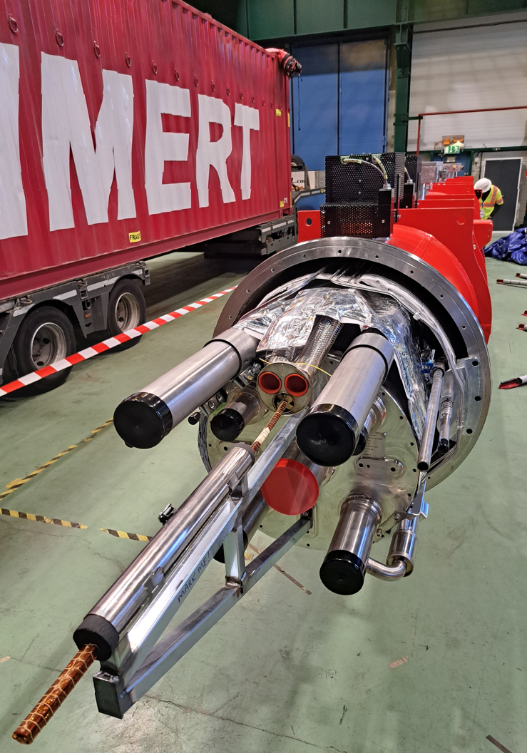
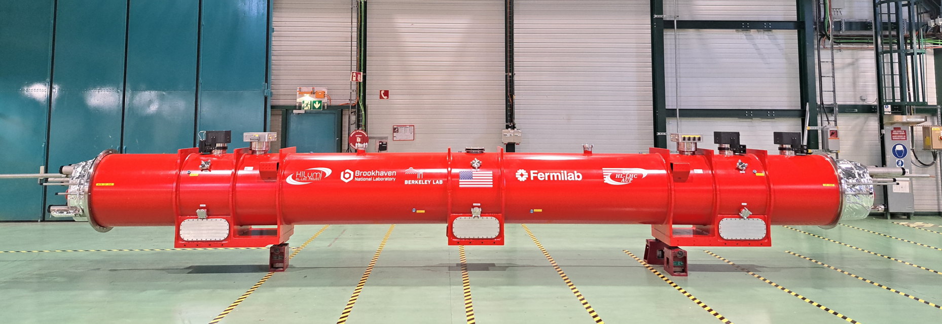
Q3 QQXFF MQXFA03+04
Arrived from FNAL end November 2023
Prepared for connection to cold test station at CERN from December to February 2024
Leak found on cold mass circuit when connected to cold test station. Attempts at localising the leak could not exclude the cryoassembly
Before starting phase 2 assembly: Replacement of M-N flanges followed by global pressure and leak test
Assuming no leak, it is expected to be ready for installation in the String by February 2025

Slide 14
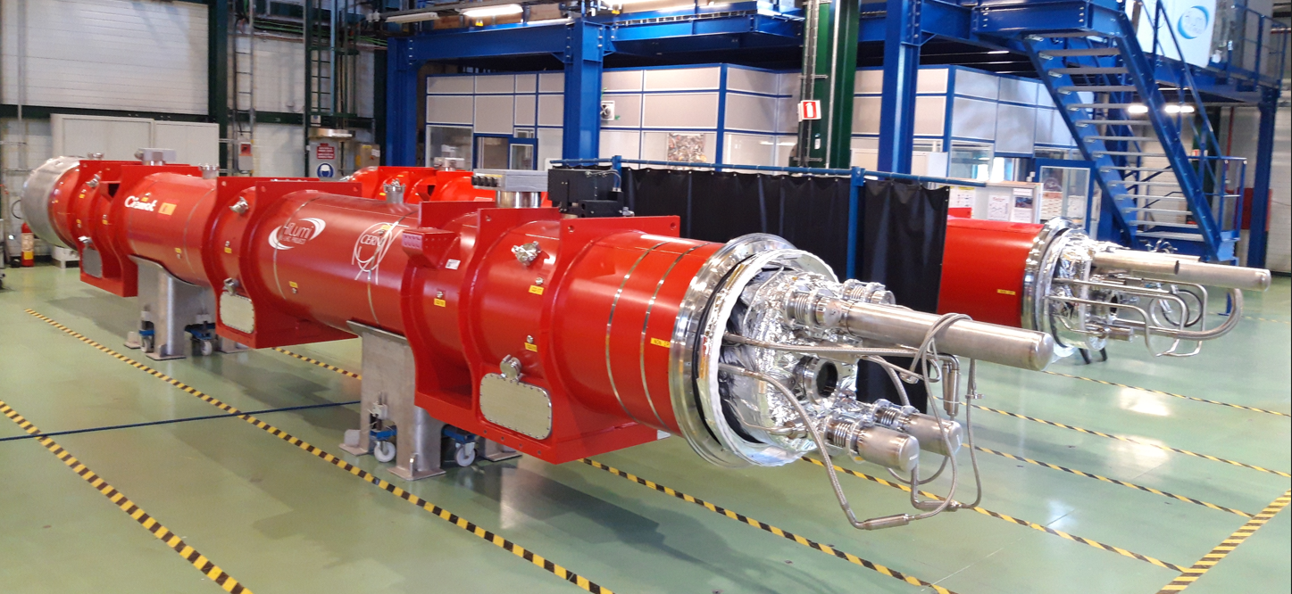
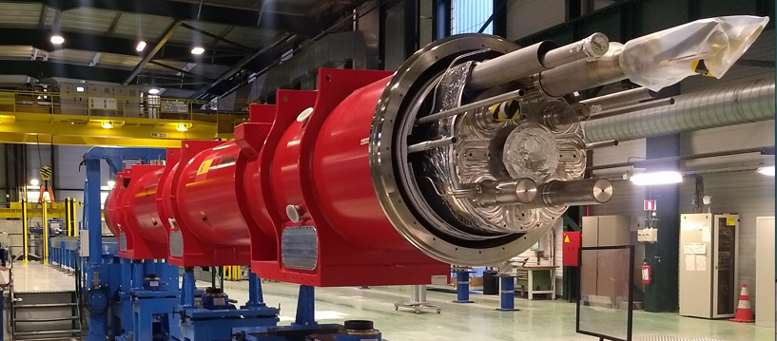
Q2b MQXFB04 & Q2a MQXFB03 & Q2a MQXFB05
Phase 1 assembly finished for the three units
  5 to 7 weeks assembly time per unit
  Tooling has been optimised
  Procedures are mature
  Teams are well trained
Phase 2 requires to know the installation slot
  will start in 2025 after sorting based on cold test results

Slide 15
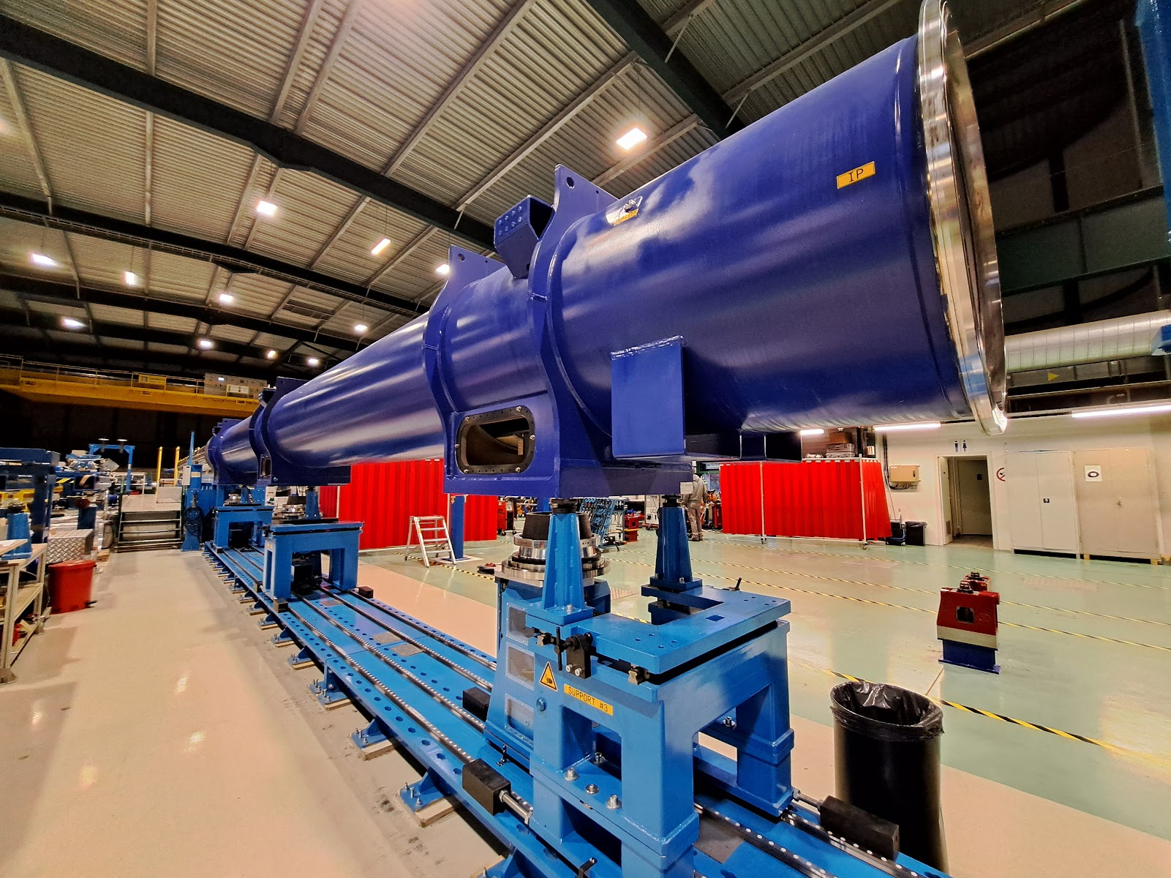
D2 QBRD MBRD2
Assembly started end September
Expected ready for cold test by mid-December
First time installation of finger heat exchanger
After cold test:
  remove testing interfaces
  cut the temporary busbar line
  partially assemble the busbar jumper (thermal shield and vacuum vessel done in the tunnel due to transport constraints)

Slide 16
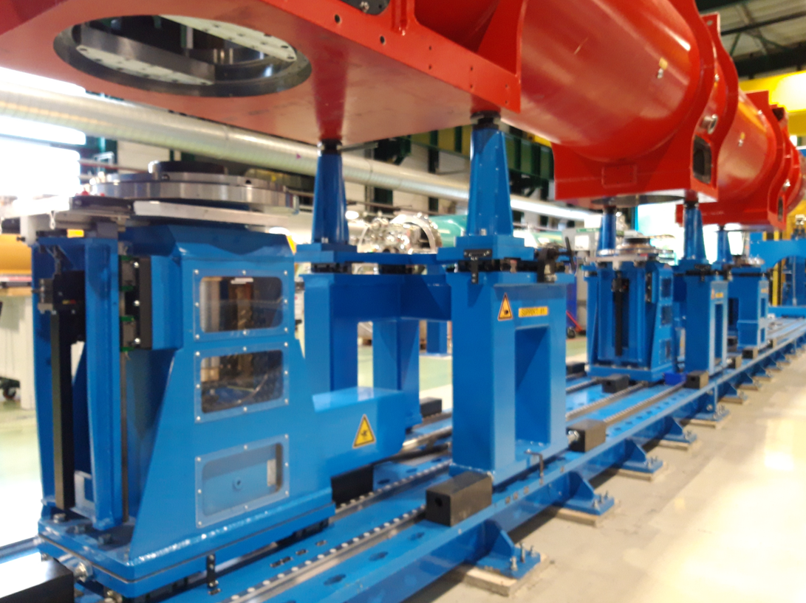
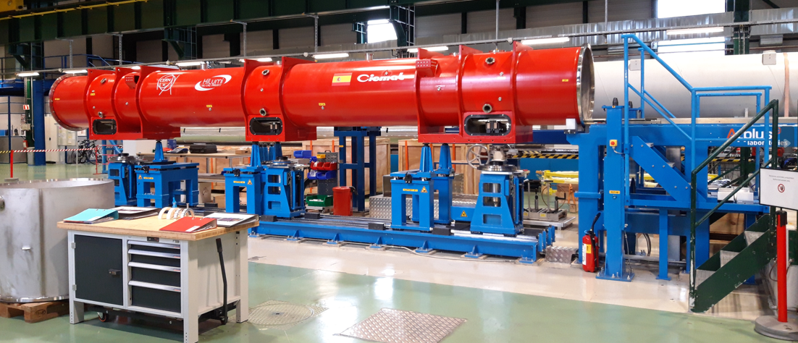
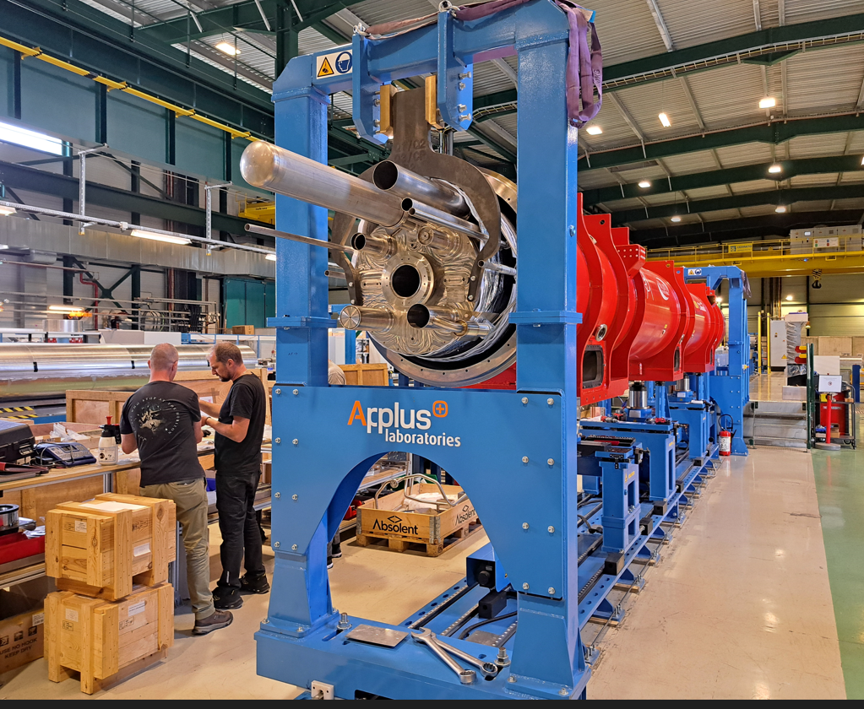
Cold mass insertion tooling
Cold mass insertion tooling is fully operational.
Improvements made for better (and safer) accessibility.
Stabilization columns were split for more clearance under the crane hook.
Limits on jack displacement adjusted to avoid control issues.

Slide 17
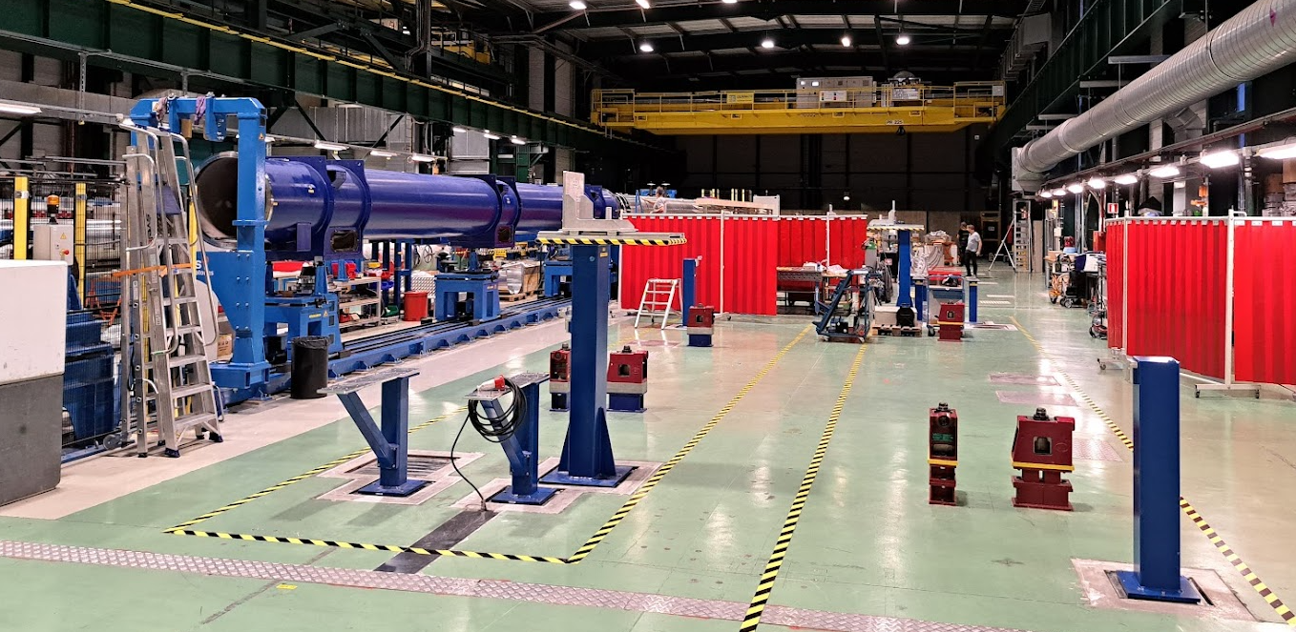
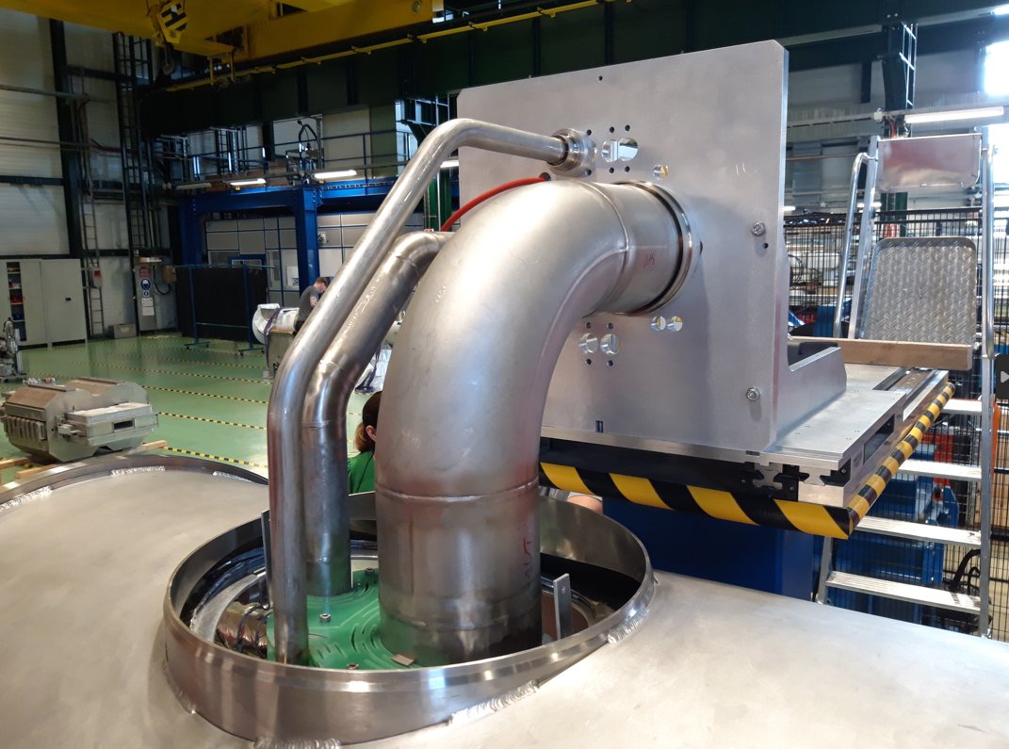
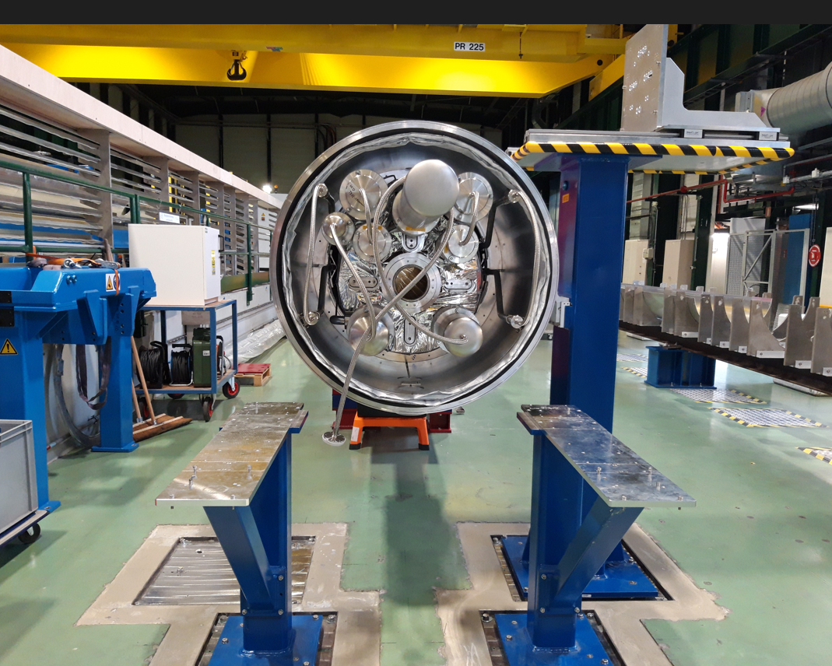
Phase 2 welding stations
Provides precise interface references for holding and checking the position of pipe extremities during and after welding.
All stations are modular and can be adapted to any cryostat variant for management flexibility.
Started with 3 stations but a 4th station has just been installed to allow more work in parallel.

Slide 18
Components
All components that were not impacted by the QXL reconfiguration ECR are available, except for expansion joints (next slide)
The remainder are under production according to the cryostat assembly schedule
  Machining and components subcontracted
  Welding is done on the shop floor to optimise resources and allow schedule flexibility
Thermal shield subassemblies are welded in advance but with a small buffer due to storage restrictions

Slide 19
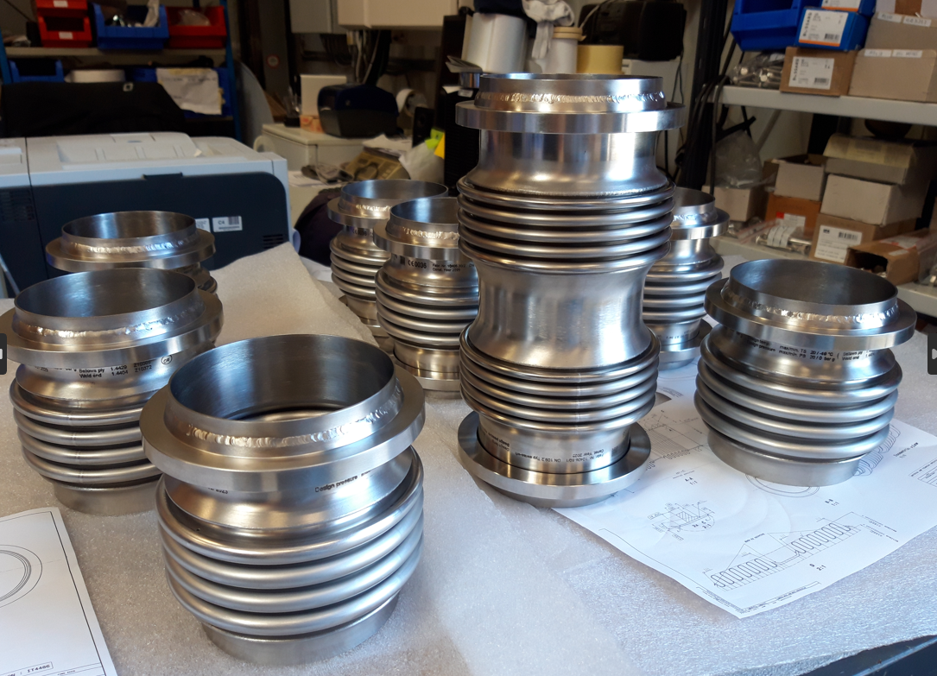


Bellows expansion joints for the interconnects
First manufacturing contract signed for 500 bellows failed to deliver as per specification and resulted in a major delay
A new supply was necessary to replace the full quantity
  A new price enquiry and purchase order done to cover the needs for the String. Later followed by a second order to cover six months of cryostat assemblies destined to the LHC.
  The remainder units needed for the LHC were ordered after a market survey and invitation to tender
  The same manufacturer won all tenders and is supplying the full quantity, although under separate purchase orders/contracts
The present manufacturer, despite its good reputation and successful supplies in the past, has so far been unable to deliver on time and the welds are not conform to specification
This supply is currently on the critical path with a risk of causing delays to the cryostat assembly activities

Slide 20
Combined pressure and leak test
All cryoassemblies are subjected to a simultaneous pressure and leak test prior to delivery
  Magnet and busbar circuit: 25 bar (PS 20 bar)
  Two phase heat exchanger circuit: 5 bar (PS 4 bar)
  Thermal shield and beam screen circuits: 31.25 bar (PS 25 bar)
Performed in a configuration comprising all components and joints that will be present during operation. No more welding is done after the test.
This ensures that any leaks found in the tunnel must be in components or welds made in-situ, therefore also accessible for in-situ repair.
Done outside working hours.
Because a leak found at this stage may need disassembly to be accessible for repair, all components and welds have previously been locally tested along the assembly process.

Slide 21




QA
Detailed procedures for all cryostat types and assembly phases
Electronic manufacturing inspection plan (e-MIP)
All QA& QC documents attached to the asset number, accessible through MTF

Slide 22

Overall assembly progress at CERN

Slide 23



How does the future look like
Cold mass insertion tooling has an occupancy of 55% on current schedule
With increase from 3 to 4 Phase 2 welding stations, their overall occupancy is ~70%
This gives margin some for treatment of non-conformities and schedule changes on upstream activities
Recruitment of additional team members necessary as workload increases

Slide 24


Cryostats interfacing magnets with SC-links
Also assembled in SMI2 building but in a separate area
Schedule is decoupled from magnet cryostat assembly
Comprise a vacuum barrier and hydraulic plug, separating the magnet cryogenics from SC-link cryogenics
Between D1 and DFX (DFM): Prototype has been completed, series units will follow
Between D2 and DFM (DQM): Cryostat drawings are nearly finished. Busbar detailed design starting soon. Component production starting Q1-2025, assembly starting Q3-2025

Slide 25
During LS3: Q4, Q5, Q10
Q4
  Modification of cryostat for operation as stand-alone (presently connected to D2) and layout change
  New beam screens with aC coating and different orientation (TE-VSC)
  Implementation of full remote alignment
Q5
  New beam screens with aC coating and different orientation (TE-VSC). Requires opening and closing of cryostat end covers
  Implementation of remote alignment system
Q10
  Cryostat complete disassembly and reassembly with new cold mass
  Cold test

Slide 26
Thank you for your attention

