Slide 1



MQXFA Fabrication Status & Schedule
Giorgio Ambrosio - FNAL
with contributions from the whole MQXFA team

Slide 2
Acknowledgement
US HL-LHC Accelerator Upgrade Project (AUP)
  BNL: K. Amm, M. Anerella, A. Ben Yahia, M. Bornstein, H. Hocker, P. Joshi, F. Kurian, J. Muratore, J. Schmalzle, P. Wanderer
  FNAL: G. Ambrosio, G. Apollinari, M. Baldini, J. Blowers, R. Bossert, R. Carcagno, G. Chlachidze, J. DiMarco, S. Feher, S. Krave, V. Lombardo, C. Narug, A. Nobrega, V. Marinozzi, C. Orozco, T. Page, J. Seyl, S. Stoynev, T. Strauss, M. Turenne, D. Turrioni, A. Vouris, M. Yu
  LBNL: D. Cheng, J. Doyle, P. Ferracin, L. Garcia Fajardo, E. Lee, M. Marchevsky, M. Naus, I. Pong, S. Prestemon, K. Ray, G. Sabbi, G. Vallone, X. Wang
  NHMFL: L. Cooley, J. Levitan, J. Lu, R. Walsh
CERN: HL-LHC Project
  G. Arnau Izquierdo, A. Ballarino, M. Bajko, C. Barth, N. Bourcey, B. Bulat, M. Cruovizier, A. Devred, H. Felice, S. Ferradas Troitino, L. Fiscarelli, J. Fleiter, M. Guinchard, O. Housiaux, S. Izquierdo Bermudez, N. Lusa, F. Mangiarotti, A. Milanese, A. Moros, P. Moyret, C. Petrone, J.C. Perez, H. Prin, R. Principe, E. Ravaioli, T. Sahner, S. Sgobba, P. Tavares Coutinho Borges De Sousa, E. Todesco, J. Ferradas Troitino, R. Van Weelderen, G. Willering

Slide 3
Outline
MQXFA17 Analysis
Status by Component
Schedule and Plans

Slide 4
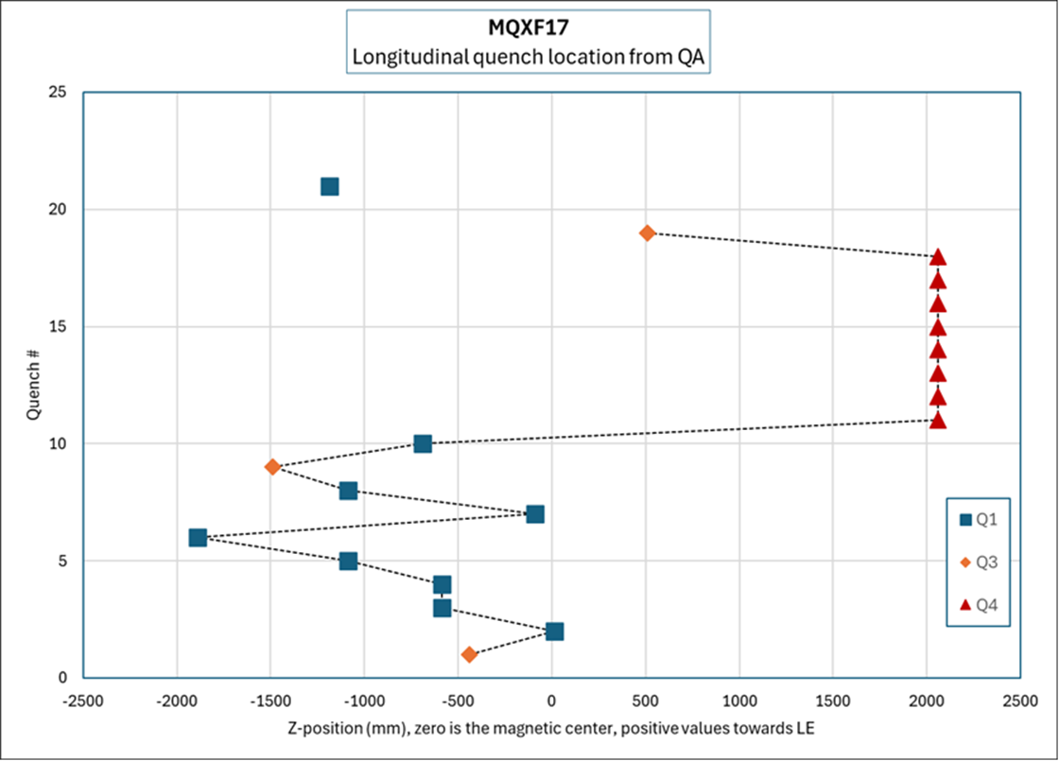
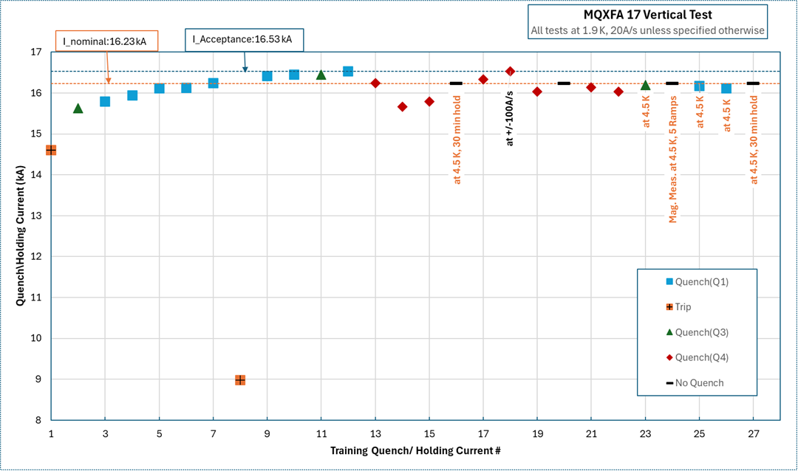
MQXFA17 Analysis I
MQXFA17 showed detraining and degradation in a single coil during vertical test
  Quench location (Lead End) similar to MQXFA13
  Inverse temperature and ramp-rate dependence
Analysis, in progress, has found:
  Main factor: low prestress in the lead end
  Possible contributing factor: variations in coil properties
MQXFA17 Test sequence

Slide 5
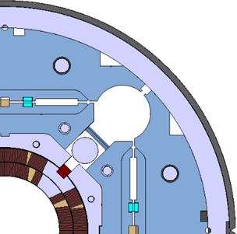
MQXFA17 Analysis II
Increased to 135 MPa
Main factor: low prestress in lead end
  Actual load keys (39 mil) < Target load keys (43 mil)
    One coil gauge reached max allowable stress (120 MPa) during bladder operation.
    Shell and Coil averages were also close to the max of their spec ranges
    MQXFA magnet Specs (doc-4009): “If, with such load key shim targets, the coil stress measured in 2+ strain gauges during the loading or during bladder inflation indicate that the coil stress may reach values above the coil stress spec. during subsequent loading steps or at the end of the loading, priority should be given to keeping the coil stress within the specs.”
More details in “MQXFA magnet assembly & preload” in this session
Load keys
Tapered load shims had not yet been demonstrated
Inserted in MQXFA18/12b/16 and will be used in all future magnets

Slide 6
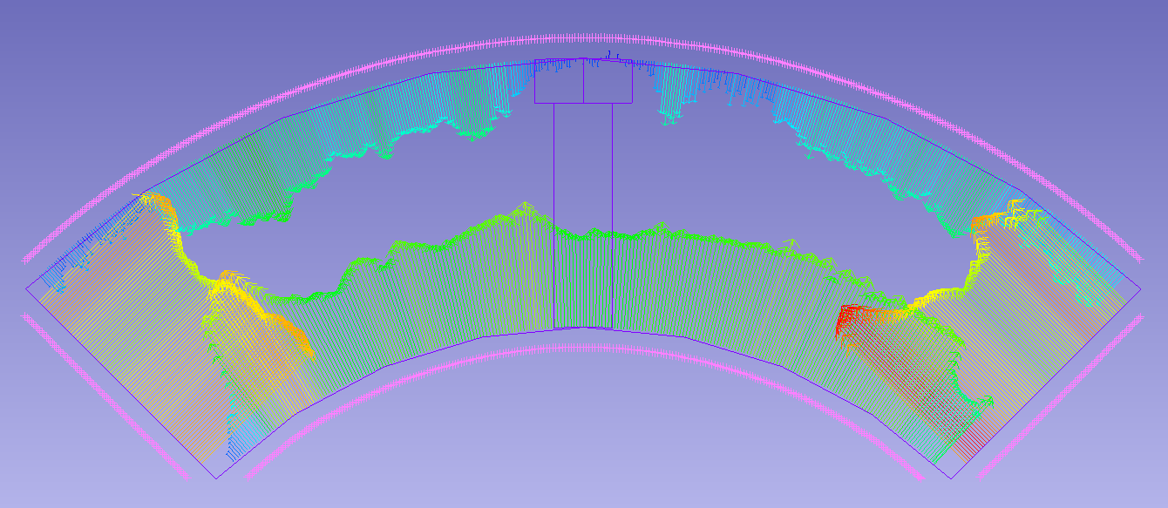
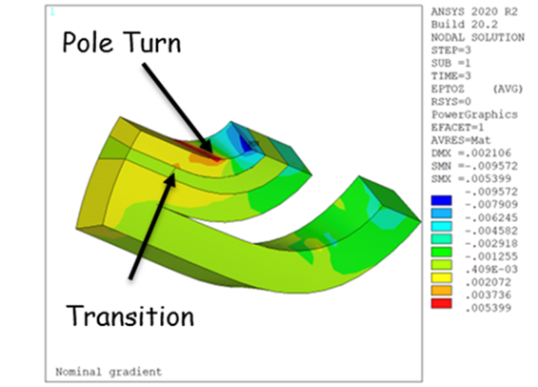
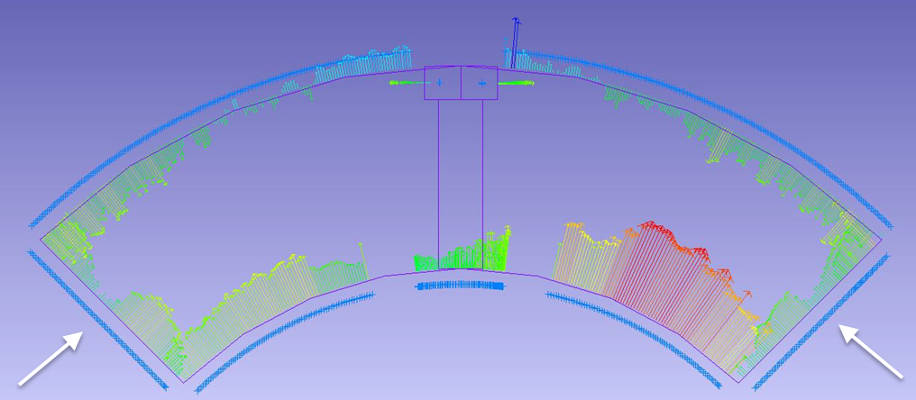
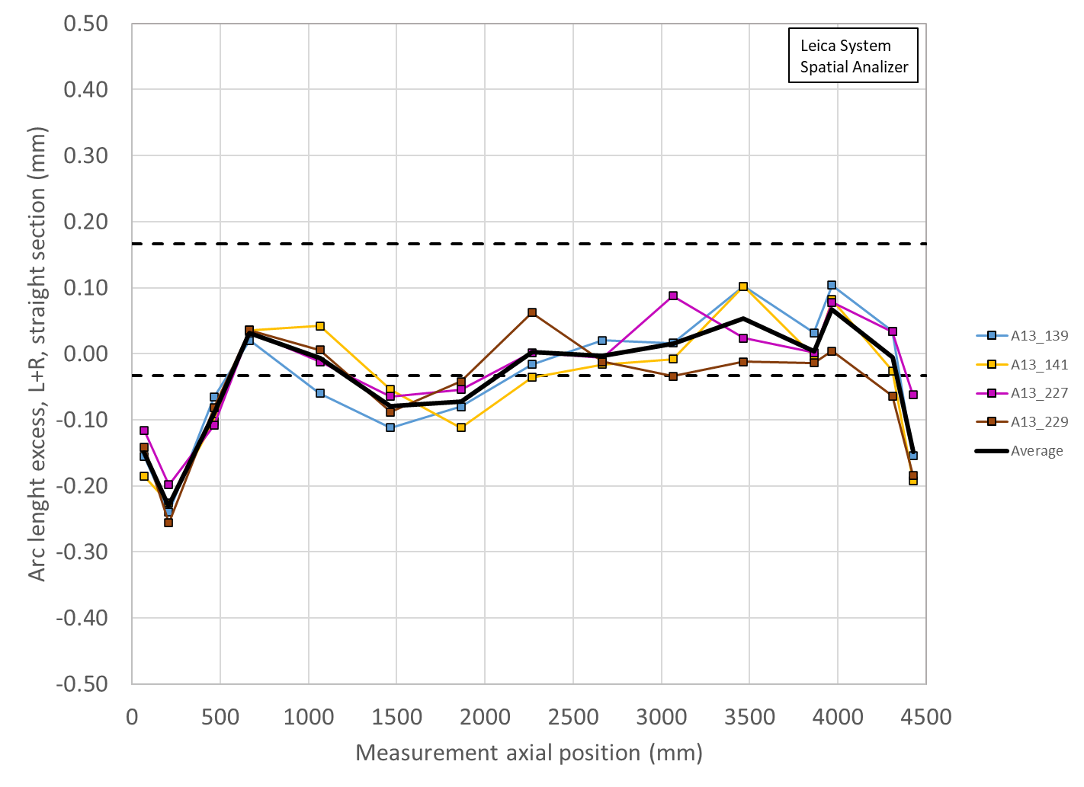
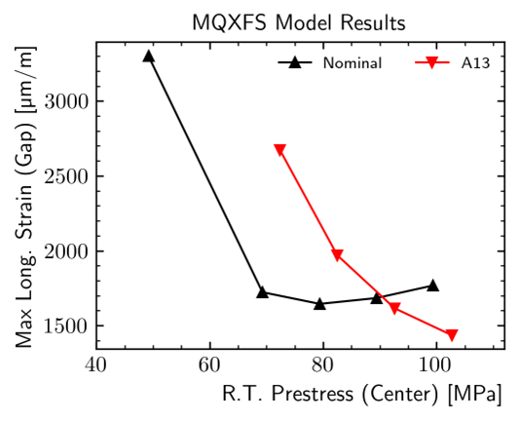
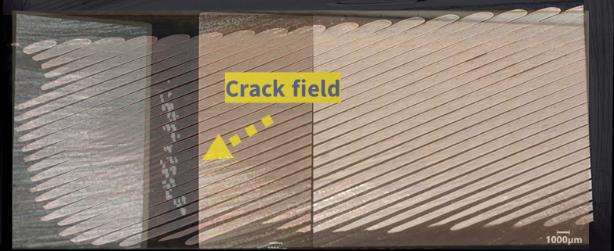
Lessons Learned from MQXFA13/17 test & analysis
If midplanes in coil ends are “too small” & there is low prestress ➔ risk of excessive strain
Coil lead end
Coil straight section
MQXFA13 coil arc-length error
Relative differences are more relevant than absolute numbers because of mesh size and de-bonding assumptions
Courtesy of A. Bartkowska

Slide 7
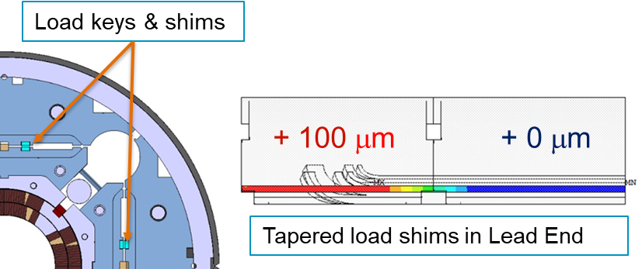
Preventive Actions
Main actions:
  Added Tapered Load Shims in magnet Lead End
    During last step of azimuthal preload
    Added coil dimension measurements in the critical area and FE analysis based on measured coil size
  Increased target prestress from 80 to 90 MPa
  Set target for minimum loading key size based on coil dimensions ➔ higher pre-stress controlled by dimensions
    Comparison with best magnets
  Increased the maximum allowable stress during preload from 110 to 135 MPa
    Based on feedback from CERN MQXFS program
More details in “MQXFA magnet assembly & preload” in this session

Slide 8
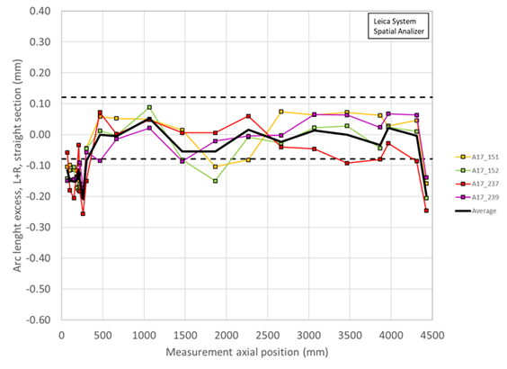
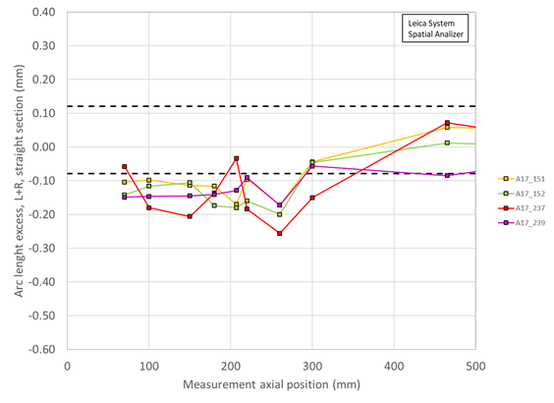
Limiting Coils
Coils in MQXFA magnets
 |  | CLIQ + |  | CLIQ +
Magnet | Q1 | Q2 | Q3 | Q4
MQXFA03 | 204 | 110 | 202 | 111
MQXFA04 | 203 | 113 | 206 | 112
MQXFA05 | 207 | 116 | 209 | 115
MQXFA06 | 122 | 119 | 211 | 123
MQXFA07 | 212 | 124 | 214 | 114
MQXFA07b | 212 | 124 | 218 | 114
MQXFA08 | 215 | 126 | 213 | 128
MQXFA08b | 215 | 126 | 219 | 128
MQXFA10 | 132 | 221 | 131 | 129
MQXFA11 | 223 | 222 | 134 | 135
MQXFA13 | 227 | 139 | 229 | 141
MQXFA14b | 217 | 230 | 143 | 231
MQXFA15 | 233 | 226 | 220 | 117
MQXFA17 | 151 | 237 | 152 | 239
MQXFA13b | 150 | 139 | 229 | 141
Coil issue caused by small/zero pole-key gaps in this magnet quadrant
Coil issue caused by small (average) arc-length in lead end.
All coils were affected
➔ Why coil 239 failed in MQXFA17?
MQXFA17 coil arc-length error
Lead
end
Coil lead end
Coil straight section

Slide 9
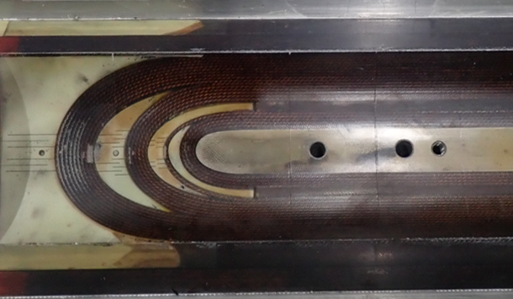
Coil Property Measurement & Simulations
Question: “Are there coil-coil differences that may cause a weakness in some coils?”
Measurements:
  Wedge to end-part gap dimension
  Bonding strength epoxy-wedge
Simulations:
  Impact of gaps dimension & “filled” epoxy properties on strain at wedge-part transition
Coils in MQXFA magnets
 |  | CLIQ + |  | CLIQ +
Magnet | Q1 | Q2 | Q3 | Q4
MQXFA03 | 204 | 110 | 202 | 111
MQXFA04 | 203 | 113 | 206 | 112
MQXFA05 | 207 | 116 | 209 | 115
MQXFA06 | 122 | 119 | 211 | 123
MQXFA07 | 212 | 124 | 214 | 114
MQXFA07b | 212 | 124 | 218 | 114
MQXFA08 | 215 | 126 | 213 | 128
MQXFA08b | 215 | 126 | 219 | 128
MQXFA10 | 132 | 221 | 131 | 129
MQXFA11 | 223 | 222 | 134 | 135
MQXFA13 | 227 | 139 | 229 | 141
MQXFA14b | 217 | 230 | 143 | 231
MQXFA15 | 233 | 226 | 220 | 117
MQXFA17 | 151 | 237 | 152 | 239
MQXFA13b | 150 | 139 | 229 | 141
Coil 239 after
epoxy impregnation

Slide 10
Outline
MQXFA17 Analysis
Status by Component
Schedule and Plans

Slide 11
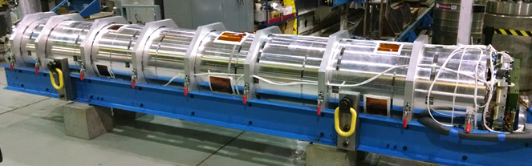
MQXFA Status Summary
Control Account | Component status wrt Baseline* | Comments
Strand procurement & QC (FNAL, FSU) | 96% complete | Procuring spare cond.
Cable fabrication & insulation (LBNL) | 100% complete
Coil part procurement (FNAL) | ~100% complete | Completing QC
Coil fabrication (FNAL) | 98% complete | Last coil fabrication
Coil fabrication (BNL) | 100% complete
Magnet part procurement (LBNL) | 100% complete
Magnet assembly (LBNL) | 58% complete
*Will change if additional cables/coils are added to Baseline
Main task is magnet assembly.
Supported by 4 reviews / meetings per magnet
MQXFA at BNL after shipment from LBNL

Slide 12
Coil Status
Coils available (completed, not yet power tested) | 38
Coils in production (at Fermilab) | 1
Coil rejected during fabric., magnet integr. & test |  | 13
Coil on hold after fabric., magnet integr. & test |  | 16
Coils to be recovered from on-hold – future issues | 1
Coils needed for magnets not yet tested (10) | - 40
Expected coils balance | 0
Two risks for additional coils in Risk Register
  Risk of coil issues during magnet test
  All other coil issues (mostly magnet assembly)

Slide 13
Conductor Status
Strand Inventory:
  Available strands for one MQXFB (~800 m) cable
  Incoming strand:
    for 3 MQXFA cables (~500 m) by end of October
    for 2 MQXFA cables by January 2026 (maybe earlier)
Cable inventory is empty:
  Planning to make one MQXFA cable in Nov./Dec.
  We may make 2 more cables in first quarter of 2025

Slide 14
Coil Parts
Coil Parts | Qt. in inventory
Pole | 3
End Parts | 3
Wedges | 16
QH Trace | 4
NbTi Cable | 13
Insulation Components | 3
Under procurement | Qt. | Status
CERN End Parts Coating | 14+ sets | In coating process at the vendor
MQXFA QH Trace | 2 | Under fabrication at CERN

Slide 15
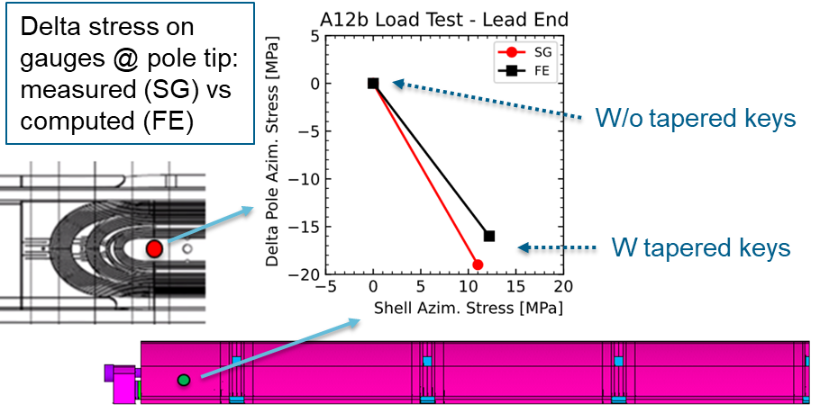
MQXFA Structures and Assembly
Structure procurement is complete (except a few spare parts).
Magnet assembly is at peak production with two assembly lines fully operational
20 MQXFA magnets assembled (MQXFA03-18, 7b, 8b, 13b, 12b):
  MQXFA12b: used to test insertion of tapered load shims
    Tapered load shims were inserted in the Lead End at ½ preload and removed to test the procedure.
    Data from additional gauges were analyzed ➔ very good agreement with FE
FMEA through all magnet assembly travelers to address integration issues (first round done, second in progress)
More details in “MQXFA magnet assembly & preload” in this session

Slide 16
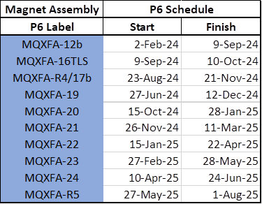
Plans and Schedule
Plans for next magnets:
  MQXFA18 (1st with TLS) is under test at BNL
  MQXFA12b retrofitted with TLS (50 um) is at BNL
  MQXFA16 retrofitted with TLS (50 um) almost complete
  Re-assembly of MQXFA17b has started
Working Schedule
  August update:

Slide 17
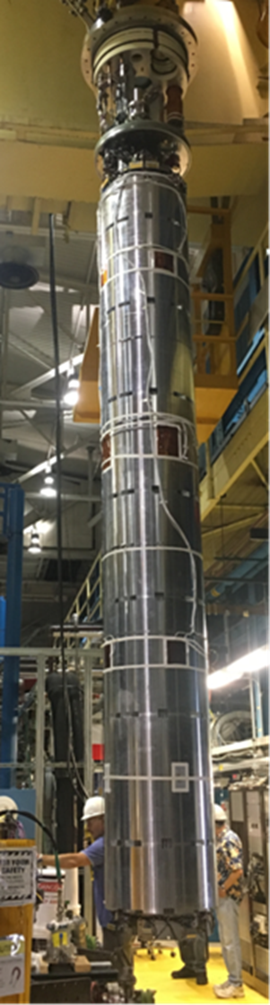
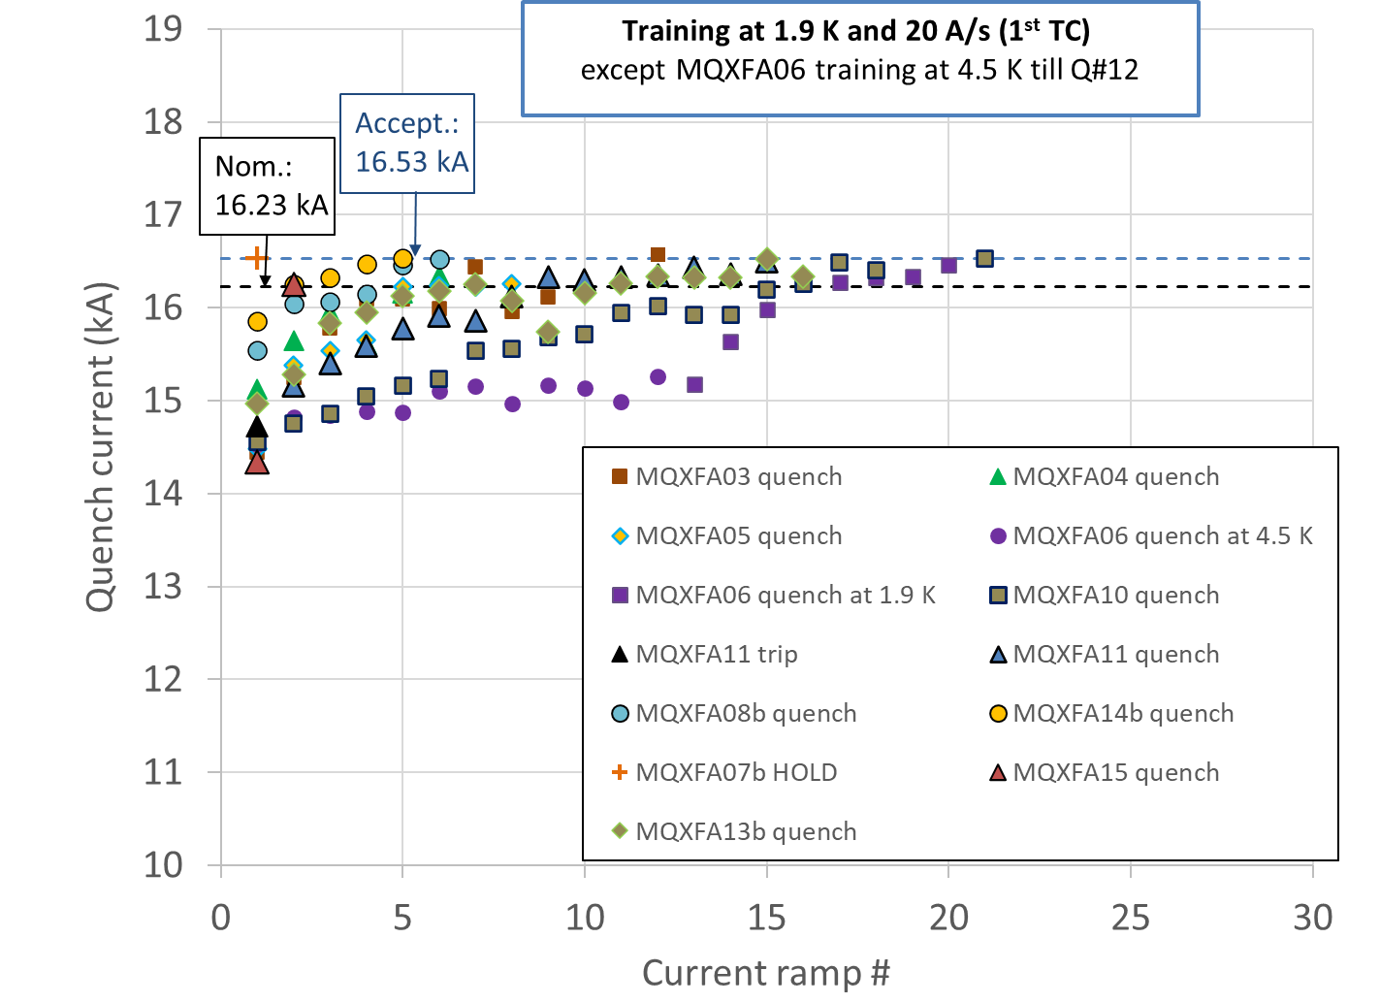
Magnet Tests
More details in “Production testing summary of the MQXFA magnets” in WP3 session Tue PM
Vertical test is done at BNL by 302.4.01, post-test analysis is done by 302.2.01
11 magnets met requirements during vertical test
  3 magnets (MQXFA07/08/13) needed a coil change to meet requirements
  1 magnet (MQXFA17) is waiting for a coil change
  MQXFA05 passed the Endurance Test
    7 thermal cycles (5 vertical + 2 in CA02), 53 quenches, 87+ power cycles
  MQXFA11 demonstrated resilience (after highway crash)
All magnets that showed limited test performance during vertical test were identified during the first thermal cycle (TC).
➔ All magnets will be tested vertically, with only one TC to be within budget.
MQXFA magnet being moved to vertical test station at BNL
17

Slide 18
MQXFA Summary
11 magnets met requirements, 10 more to go
  3 magnets that did not meet requirements were repaired by changing one coil and met requirements.
  All magnets will be vertically tested
Major procurements are complete
Last coil is in fabrication at Fermilab
Strands in inventory for up 5 coils (6 max)
Coil parts in inventory for up ~3 coils
Magnet assembly is at peak production rate
Lessons learned have been implemented in revised design features and assembly specs
We plan completing the assembly of all magnets by next HL-LHC Collaboration Meeting

Slide 19
Back up Slides

Slide 20
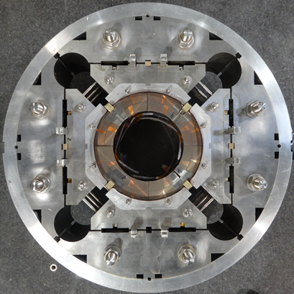
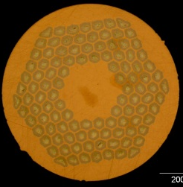
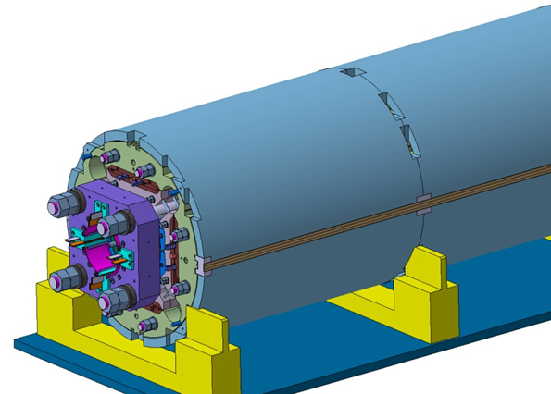
MQXFA/B Design
Parameter | Unit | MQXFA/B
Coil aperture | mm | 150
Magnetic length | m | 4.2/7.15
N. of layers |  | 2
N. of turns Inner-Outer layer |  | 22-28
Operation temperature | K | 1.9
Nominal gradient | T/m | 132.2
Nominal current | kA | 16.23
Peak field at nom. current | T | 11.3
Stored energy at nom. curr. | MJ/m | 1.15
Diff. inductance | mH/m | 8.26
Strand diameter | mm | 0.85
Strand number |  | 40
Cable width | mm | 18.15
Cable mid thickness | mm | 1.525
Keystone angle |  | 0.4
Nb₃Sn Conductor
RRP 108/127
P. Ferracin et al., “Development of MQXF, the Nb₃Sn Low-β Quadrupole for the HiLumi LHC ” IEEE Trans App. Supercond. Vol. 26, no. 4, 4000207
G. Ambrosio et al., “First Test Results of the 150 mm Aperture IR Quadrupole Models for the High Luminosity LHC” NAPAC16, FERMILAB-CONF-16-440-TD

Slide 21
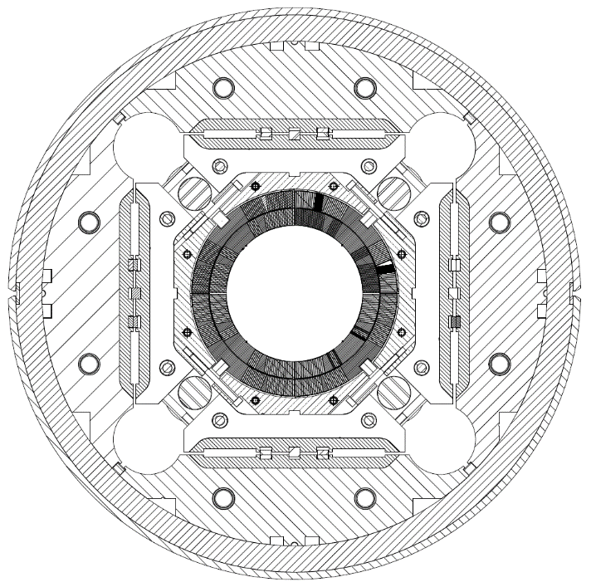
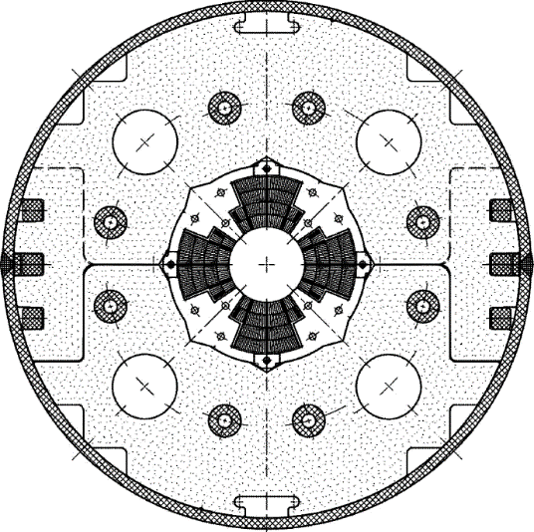
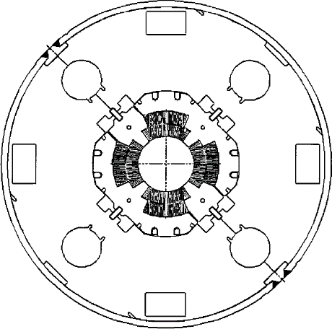
Low-β quadrupole magnets from LHC to HL-LHC
Cold mass OD from 490/420 to 630 mm
More than double the aperture: from 70 to 150 mm
~4 times the e.m. forces in straight section
~6 times the e.m. forces in the ends
State of the art quadrupoles at the time of LHC construction
MQXF
MQXA
MQXB
Same scale for all 3 plots

Slide 22
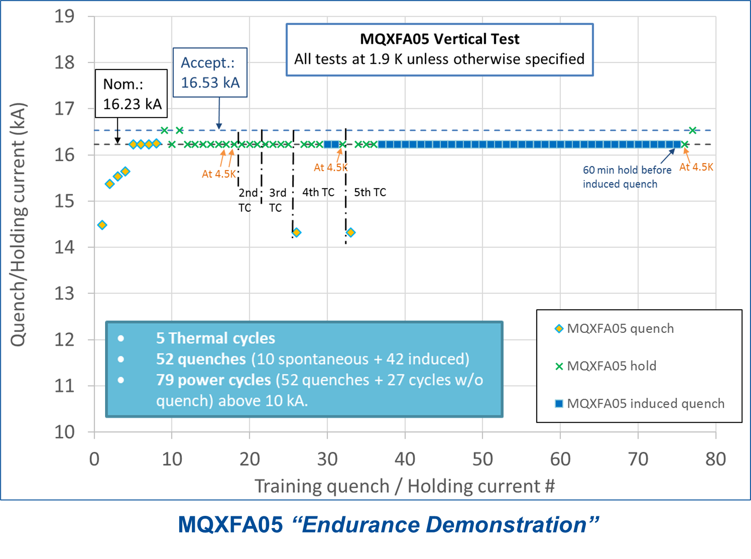
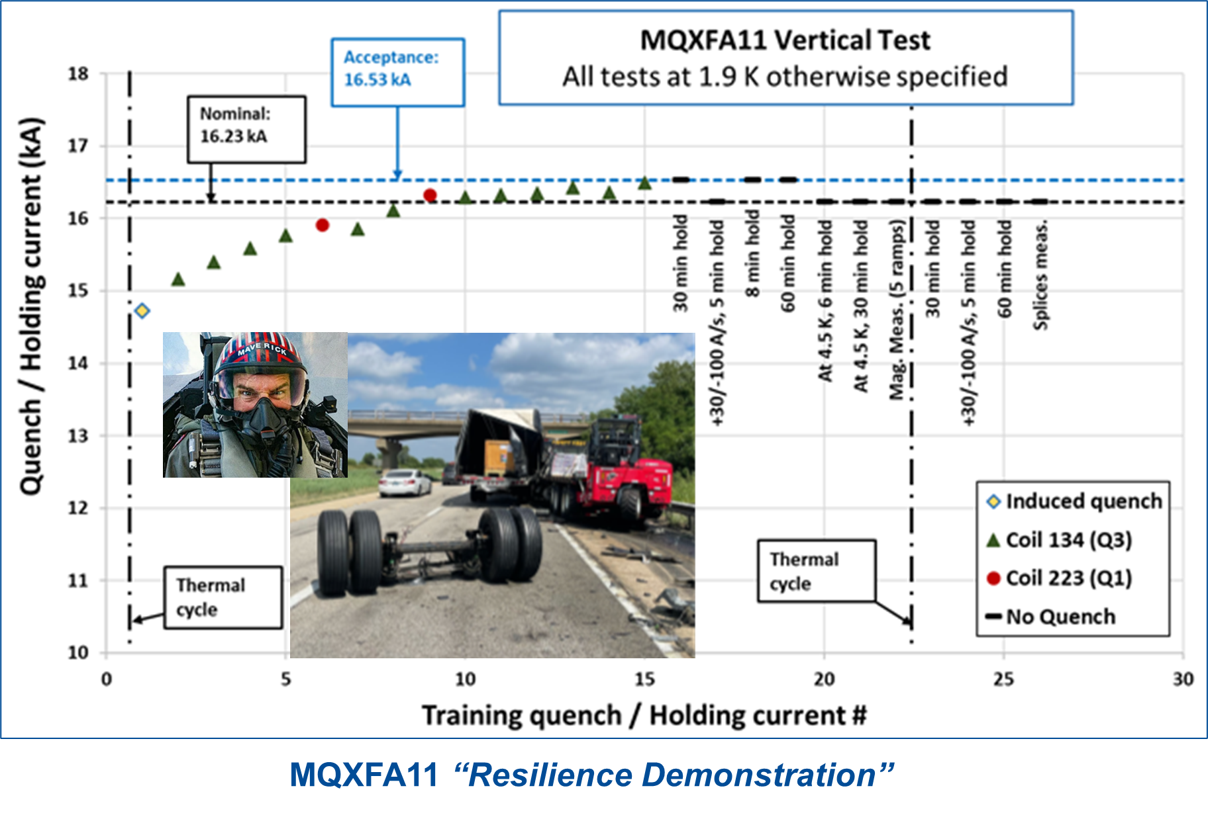
“Endurance” & “Resilience” Demonstrations
All magnets that met requirements demonstrated very good memory and temperature margin:
I_nom @ 4.5 K

