Slide 1
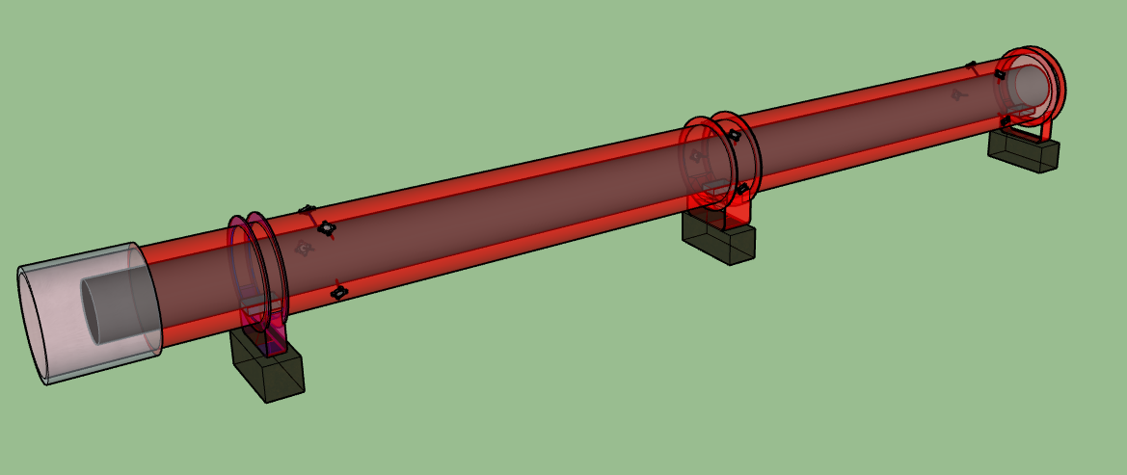
Alignment analysis on the low-beta quadrupoles during cold test
Vivien RUDE
2024-10-10
On behalf :
Mateusz SOSIN
Praneeth Sarvade,
Daniel Szarata
Clara Cala Franco
Julia Calmels
Carlo PETRONE
Mariano PENTELLA
Patrick BESTMANN
14th HL-LHC Collaboration Meeting, Genoa (Italy), 7-10 October 2024

Slide 2
Outline
Alignment Objectives (3 objectives)
Internal monitoring configuration
FSI measurements on different Q2
  Impact of transport on alignment
  Impact of pumping on alignment
  Impact of cooling down on alignment
FSI measurements on Q3 (at Fermilab and at CERN)
Mechanical and magnetic axes behaviour during cooling down

Slide 3
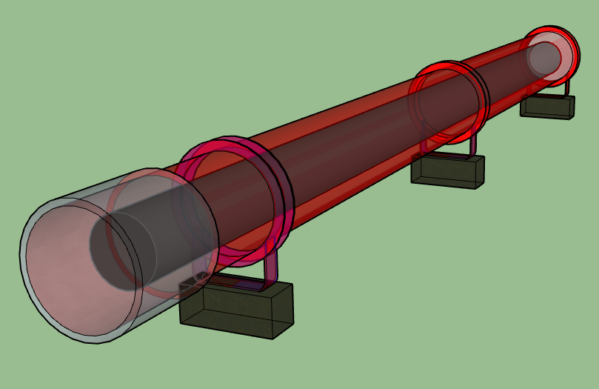
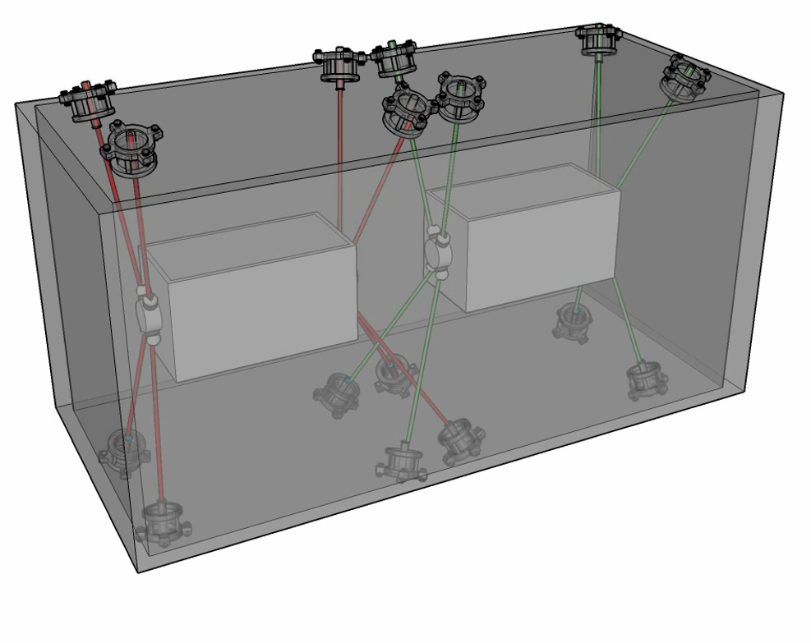
Internal monitoring for “special” components
Q1, Q2a, Q2b, Q3
Crab-Cavities
Cryomodule
Vacuum vessel
Cold mass
Crab cavities
Vacuum vessel
Cryomodule
Axis of the Cold mass
Nominal axis
Axis of the Crab cavities

Slide 4
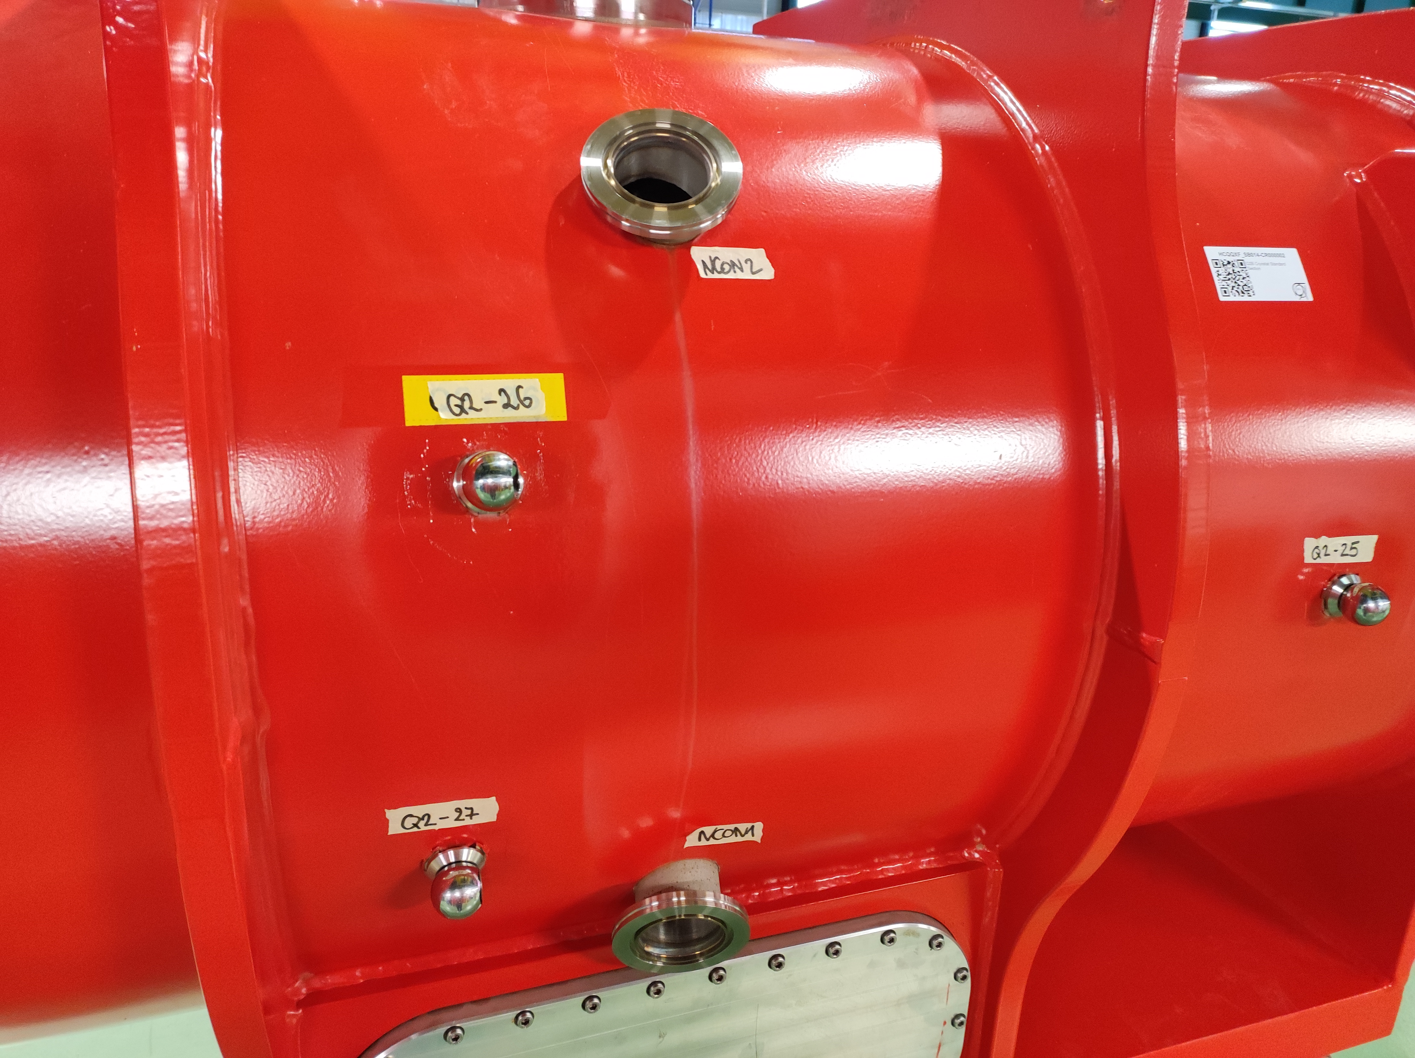
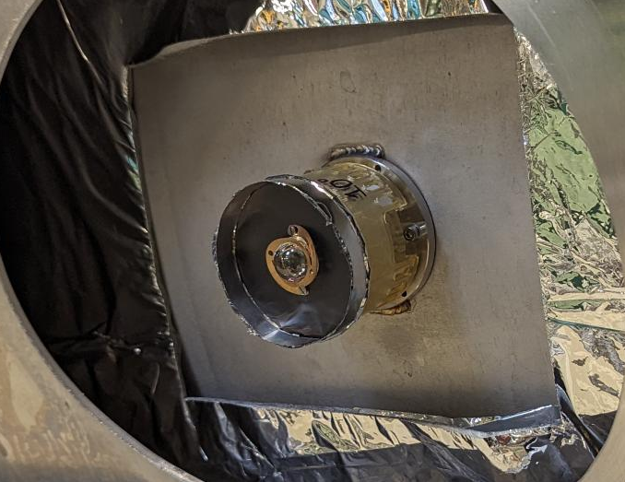
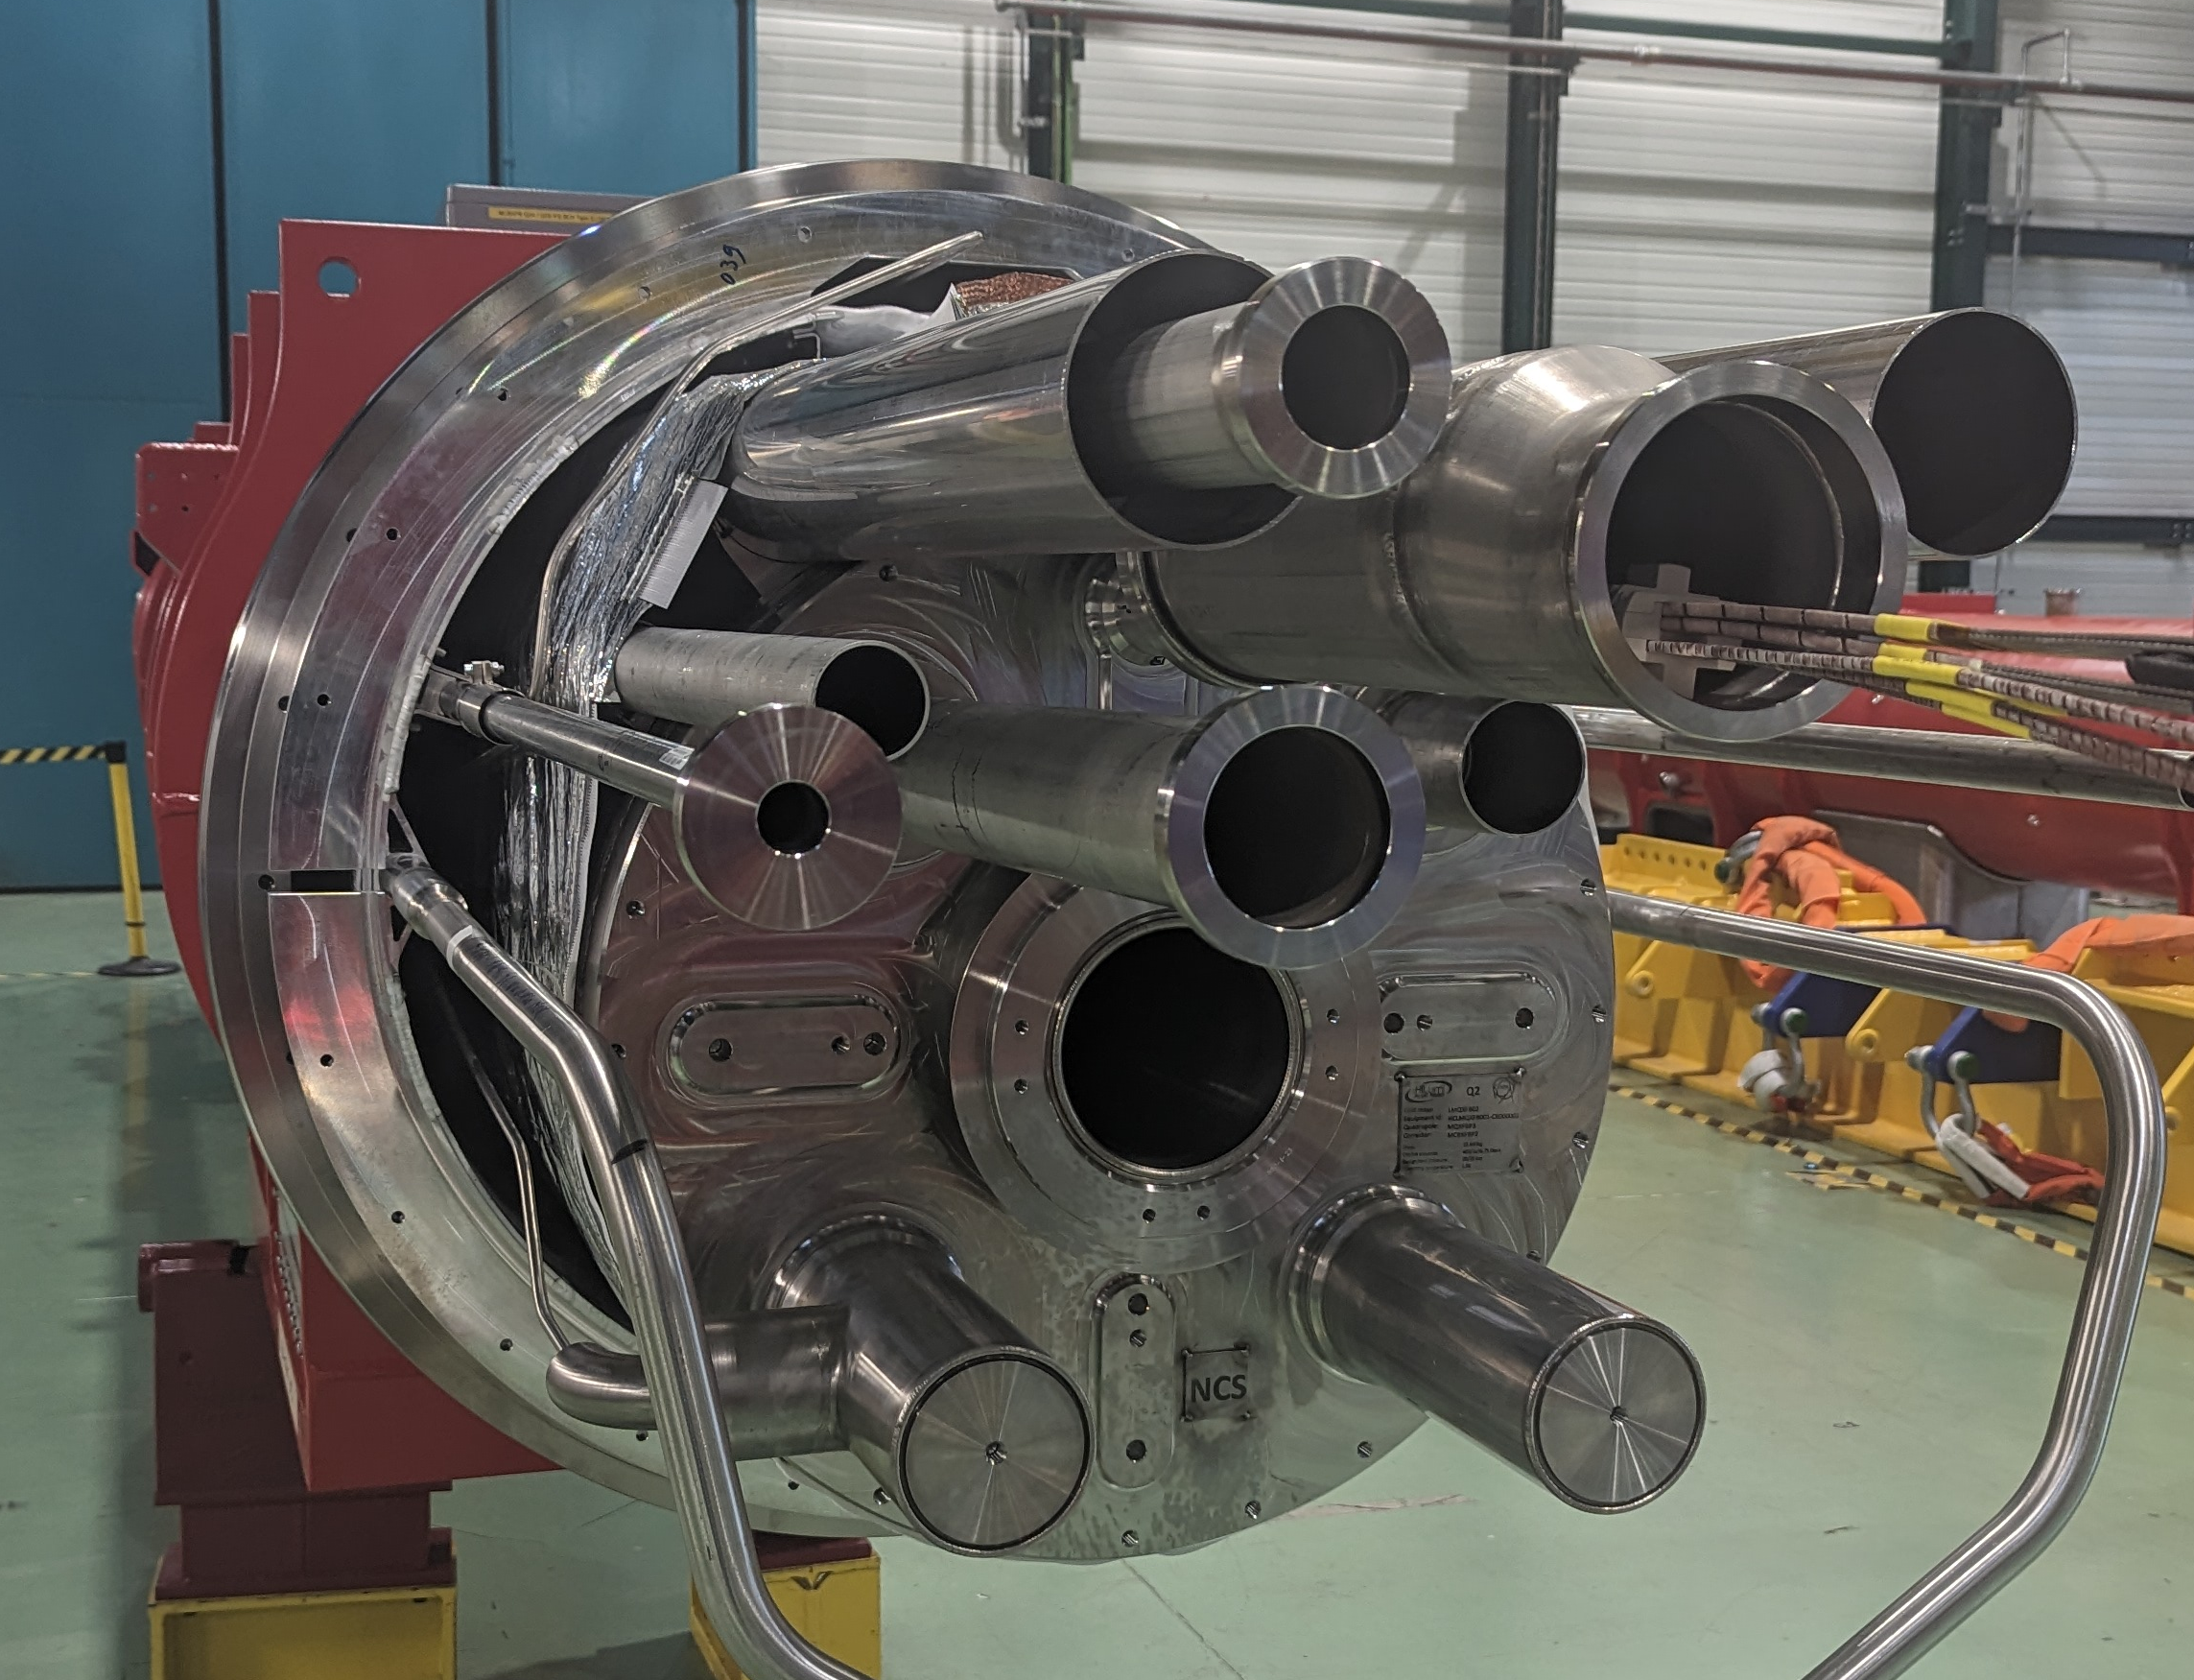
Mechanical Coordinate system
    Primary axis : Y : Regression line corresponding to the mechanical cold bore axis (determined from mechanical mole)
    Secondary axis : Z : Normal vector of the plane [Conn-D9, Conn-D10, NConn-D9, NConn-D10]
    Origin : Projection of the central cold feet on Y axis
NConn
D9
Cold bore . Mechanical measurement
NConn
D10
Mechanical axis :Regression line
Cold bore : Magnetic measurement
Magnetic axis :Regression line
Z
Y
X
D9
D10
Conn
D10
Conn
D9
D11

Slide 5
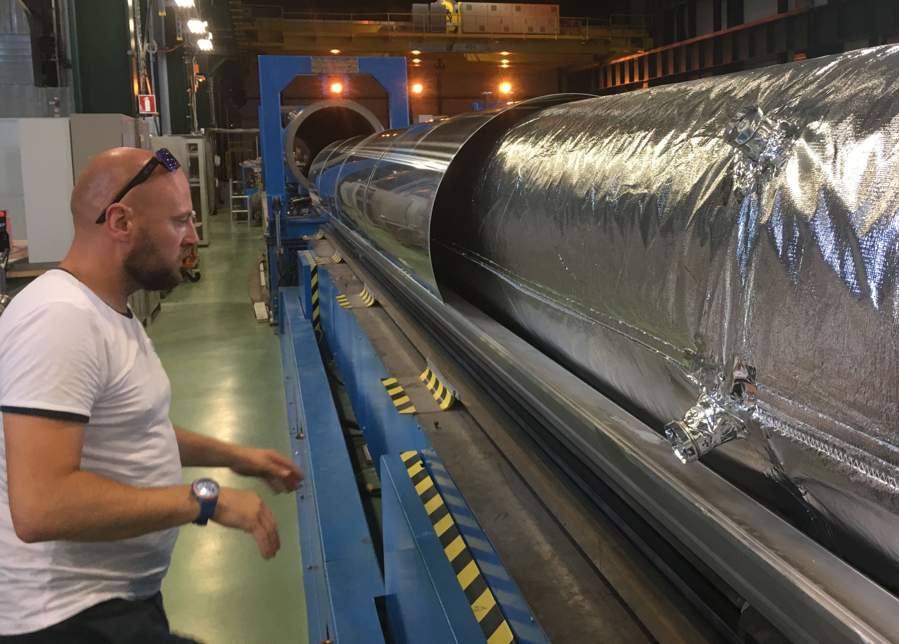
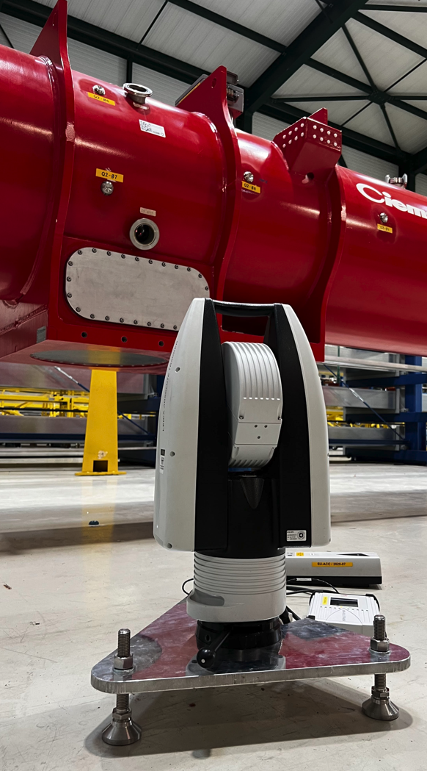
Alignment Objective n°1 : Fiducialisation
Alignment requirement
Position : 40 μm (1σ)
12 Alignment targets :
FSI targets
Magnetic axis
Z
Y
Mechanical axis

Slide 6
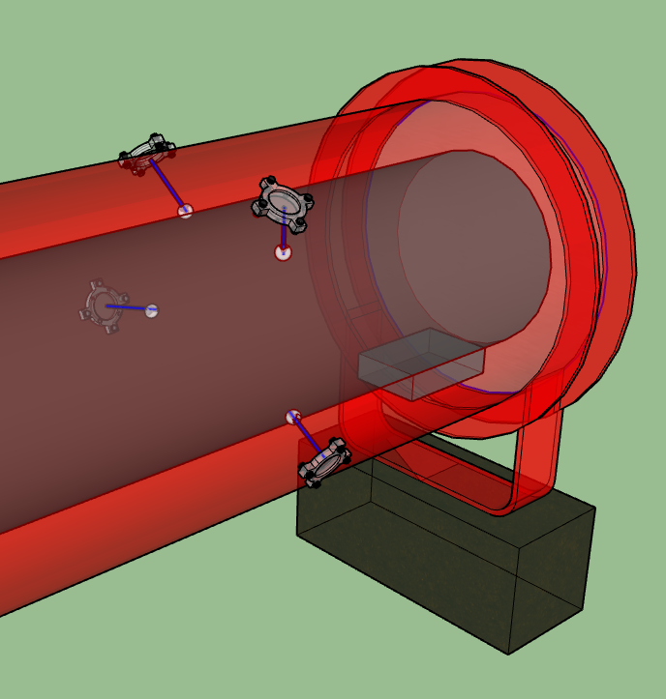
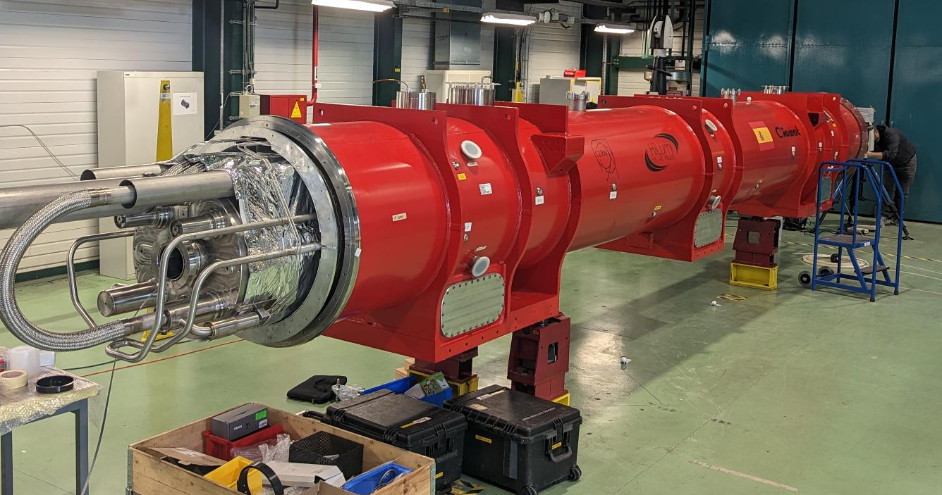
Alignment Objective n°2 : Internal monitoring
Alignment requirement
Position : < 100 μm (1σ)
Vacuum vessel
Cold mass
Cold mass
Vacuum vessel

Slide 7
Alignment Objective n°3 : External monitoring
UPS gallery
P1
P2
P3
P4
P5
P6
Alignment between Q5-left and Q5-right :
Vertical Limits : σ (1 sigma) < 0.17 mm
Radial Limits : σ (1 sigma) < 0.33 mm
Alignment between Q1 and Q5 :
Limits : σ (1 sigma) < 0.1 mm
Inner
Tracker
EXP.
Q5
Q4
CC2
CC1
D2
TCLX
TCTPH
TCTPV
TAXN
D1
CP
Q3
Q2b
Q2a
Q1
Q1
Q2a
Q2b
Q3
CP
D1
TAXN
TCTPV
TVTPH
TCLX
D2
CC1
CC2
Q4
Q5
Left
Right
R = 0.33 mm
R = 0.1 mm
R = 0.1 mm
Alignment requirement
Align all the components per IP side : < 100 μm (1σ)
Align all the components (Left and Right) : Vertical < 170 μm (1σ)
Align all the components (Left and Right) : Radial < 330 μm (1σ)
Roll : < 150 μrad (1σ)

Slide 8
Internal monitoring
Alignment requirement
Position : < 100 μm (1σ)
Roll : < 400 μrad (1σ)

Slide 9
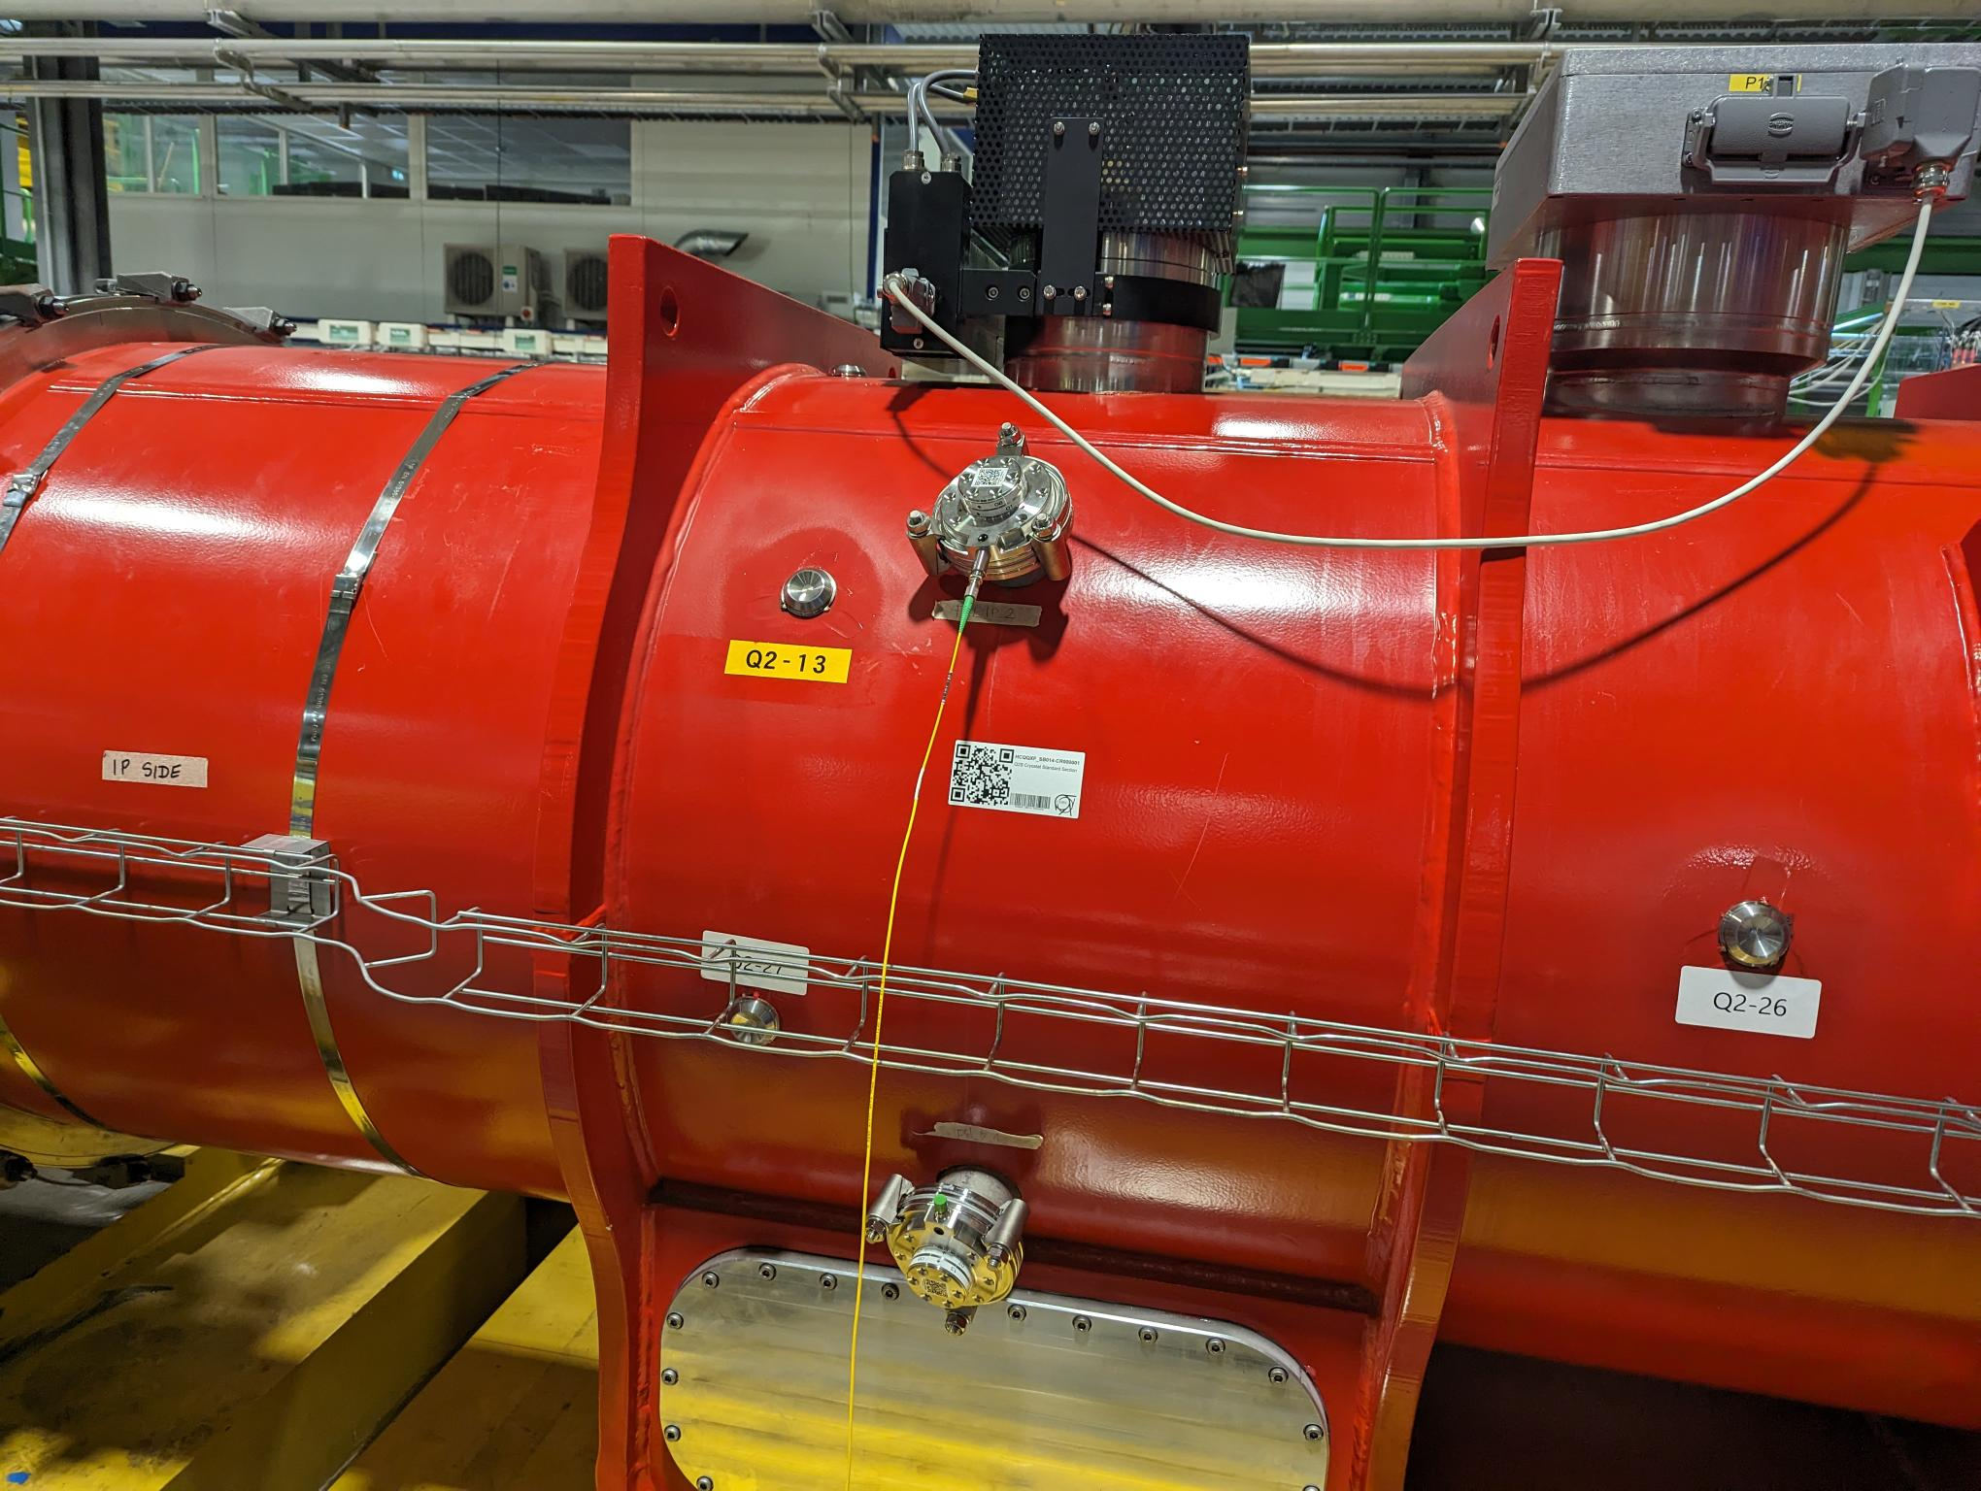
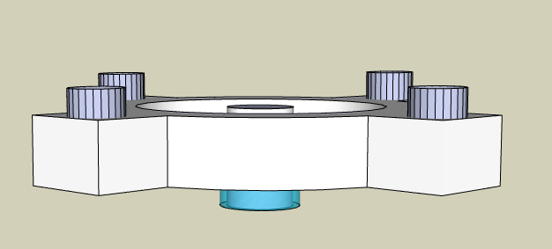
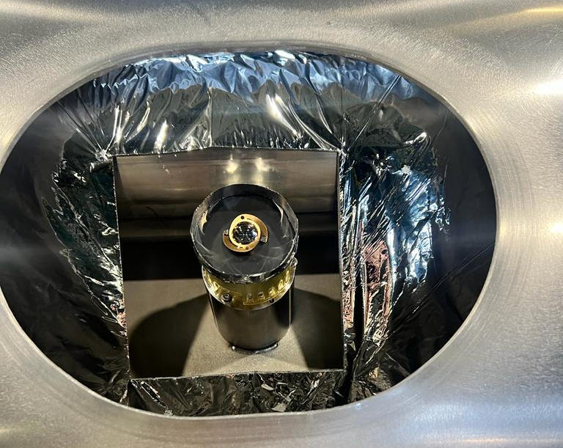
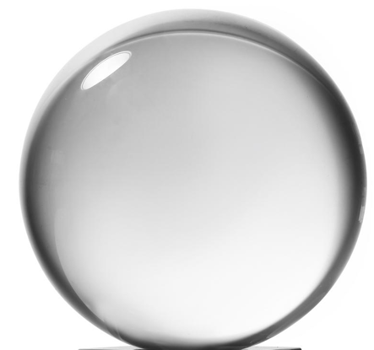
Internal monitoring : Configuration
Largest standard uncertainties | Uncertainty (1σ)
Position of the FSI Sensor in the framework of the vacuum vessel | 40 µm
Position of the FSI target in the framework of the cold mass | <15 µm
  FSI : Frequency Scanning interferometry
  → Absolute distance measuring interferometric technique
FSI Head (sensor)
on the vacuum vessel
FSI Acquisition system
Total : 12 observations
(3D distances)
Optical fibre
Feedthrough
(FSI Head)
Fiber ferrule tip
FSI target on the cold mass
Reflecting
glass sphere
(FSI target)
reflection
Support
FSI target
Cold mass

Slide 10
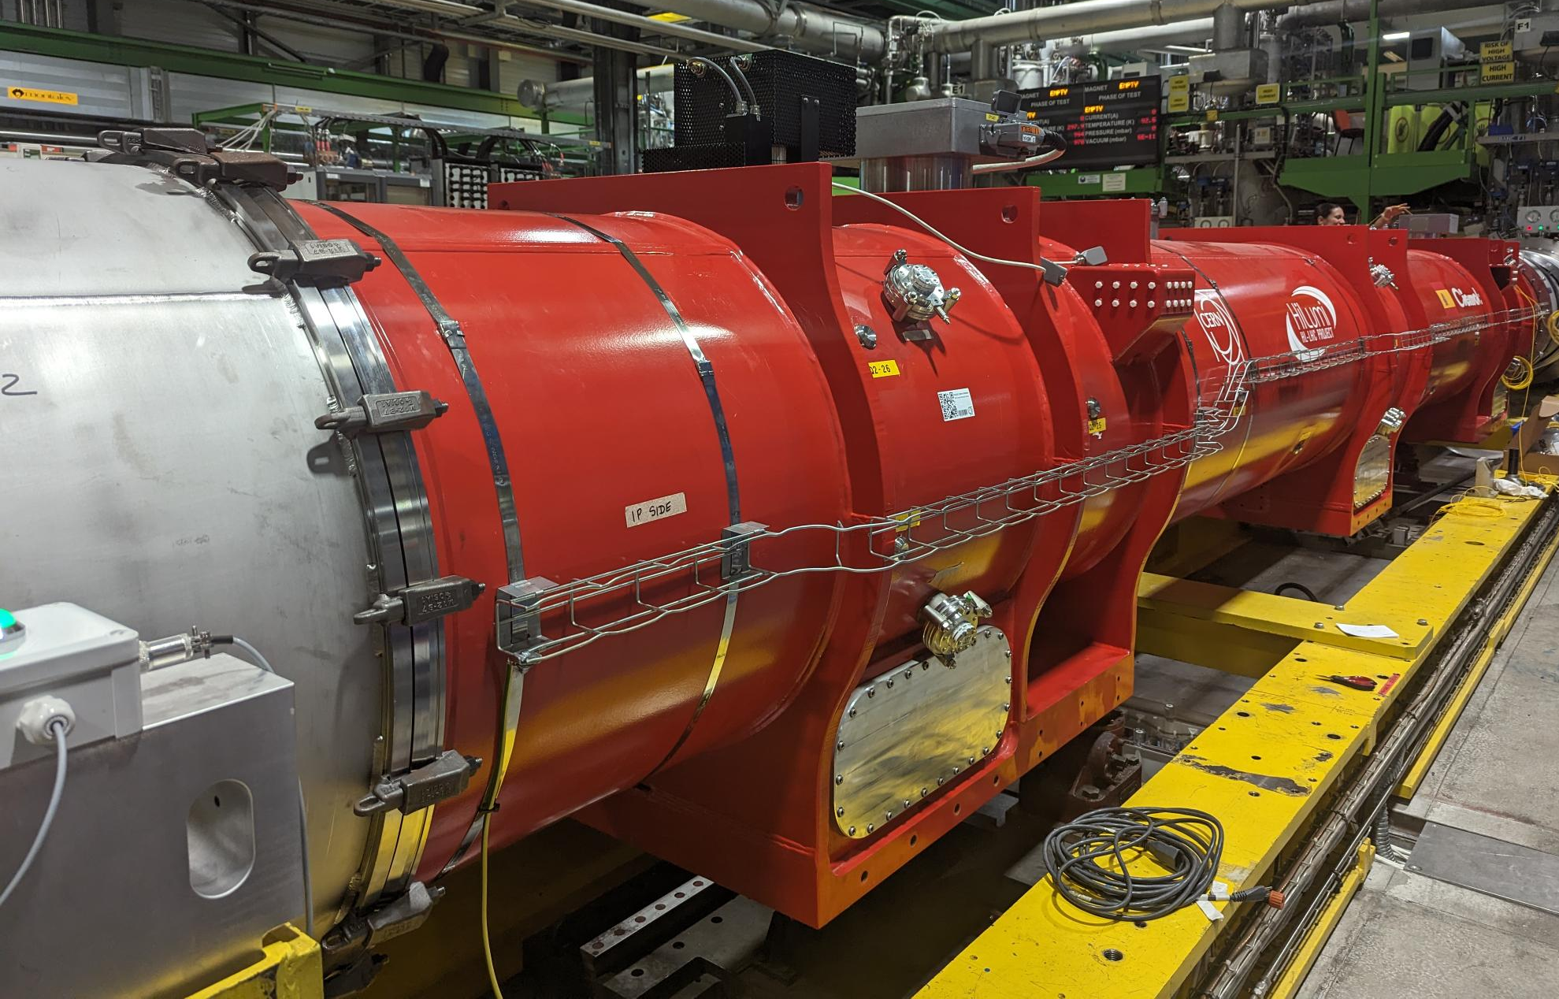
Alignment analysis of the Q2s
during cold test at CERN

Slide 11
Measurement steps for Q2
Fiducialisation
Transport
Ambient
Under vacuum
Cooling down
Place 1 : Fiducialisation bench
Place 2 : Cold test bench
Mechanical measurement
→ mechanical mole measurement
Mechanical measurement
→ FSI meas.
Magnetic measurement
→rotating coil scanner
Magnetic measurement
→ single-stretched wire (SSW)
Magnetic measurement
→ single-stretched wire (SSW)

Slide 12
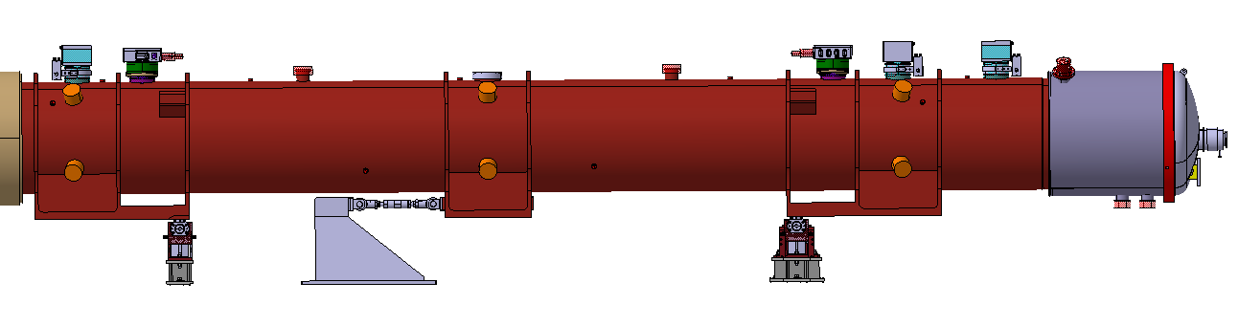
Impact of transport on vacuum vessel and cold mass shape
Vertical sag (mm)
Cold mass axis
(after transport)
Accuracy : +/- 30 μm
Cold mass and vacuum vessel axes
(before transport)
Section 2
Section 1
Section 3
Function
of temperature
35 μm / mm
Vacuum vessel axis
(after transport)
Accuracy : +/- 30 μm
Random
Deformation
0.2 mm
Installation 3
Impact of transport and external temperature :
The shape (in vertical) of the vacuum vessel is influenced by transport and temperature changes
→ This can be modelized by a 2nd order polynomial
The vertical slop of the cold mass is consistent with the vertical slope of the vacuum vessel
Installation 4
Installation 2
Installation 1

Slide 13
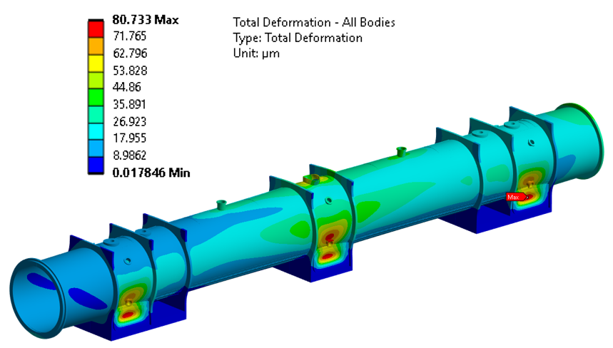
Impact of pumping on vacuum vessel and cold mass shape
Impact of pumping :
The vacuum vessel’s shape is distorted by pumping (up to 80 μm)
This impact can be modelled and is repeatable
Maximum difference between model and real observation is bellow 50 μm
No significant movement of the cold mass inside the vacuum vessel
80 μm
70 μm
60 μm
50 μm
40 μm
30 μm
20 μm
10 μm
0

Slide 14
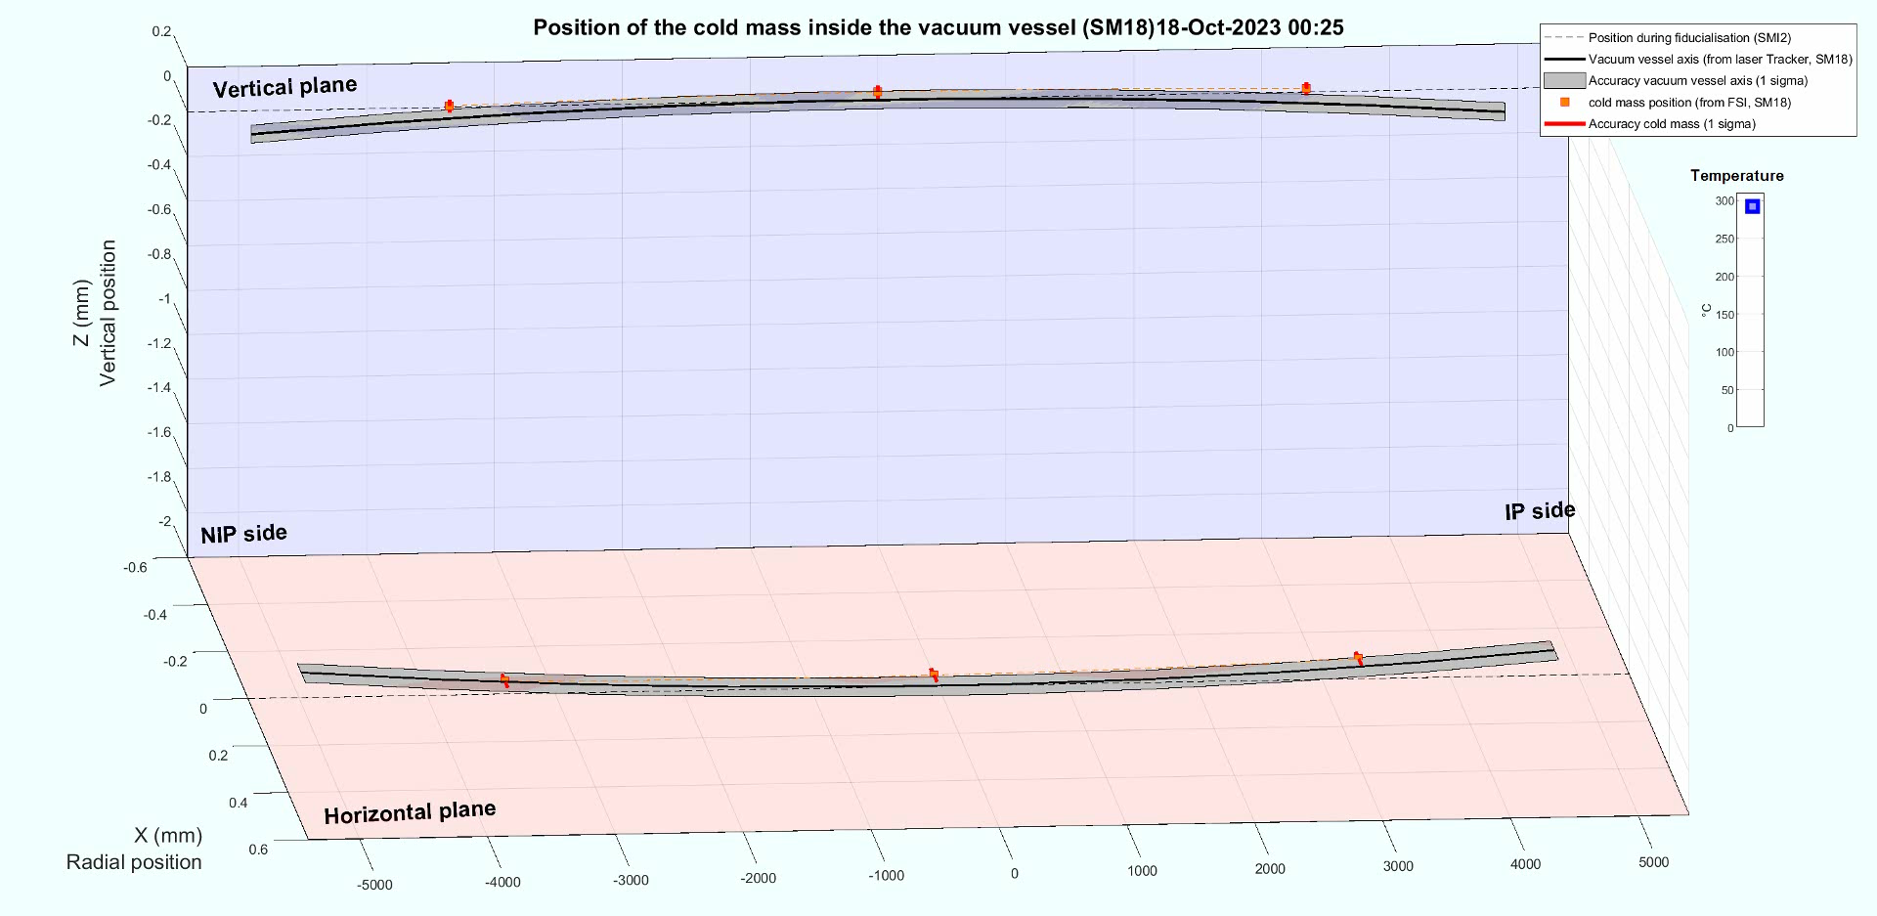
Impact of cooling down
Q2b-P2 ( LMQXFB01)

Slide 15
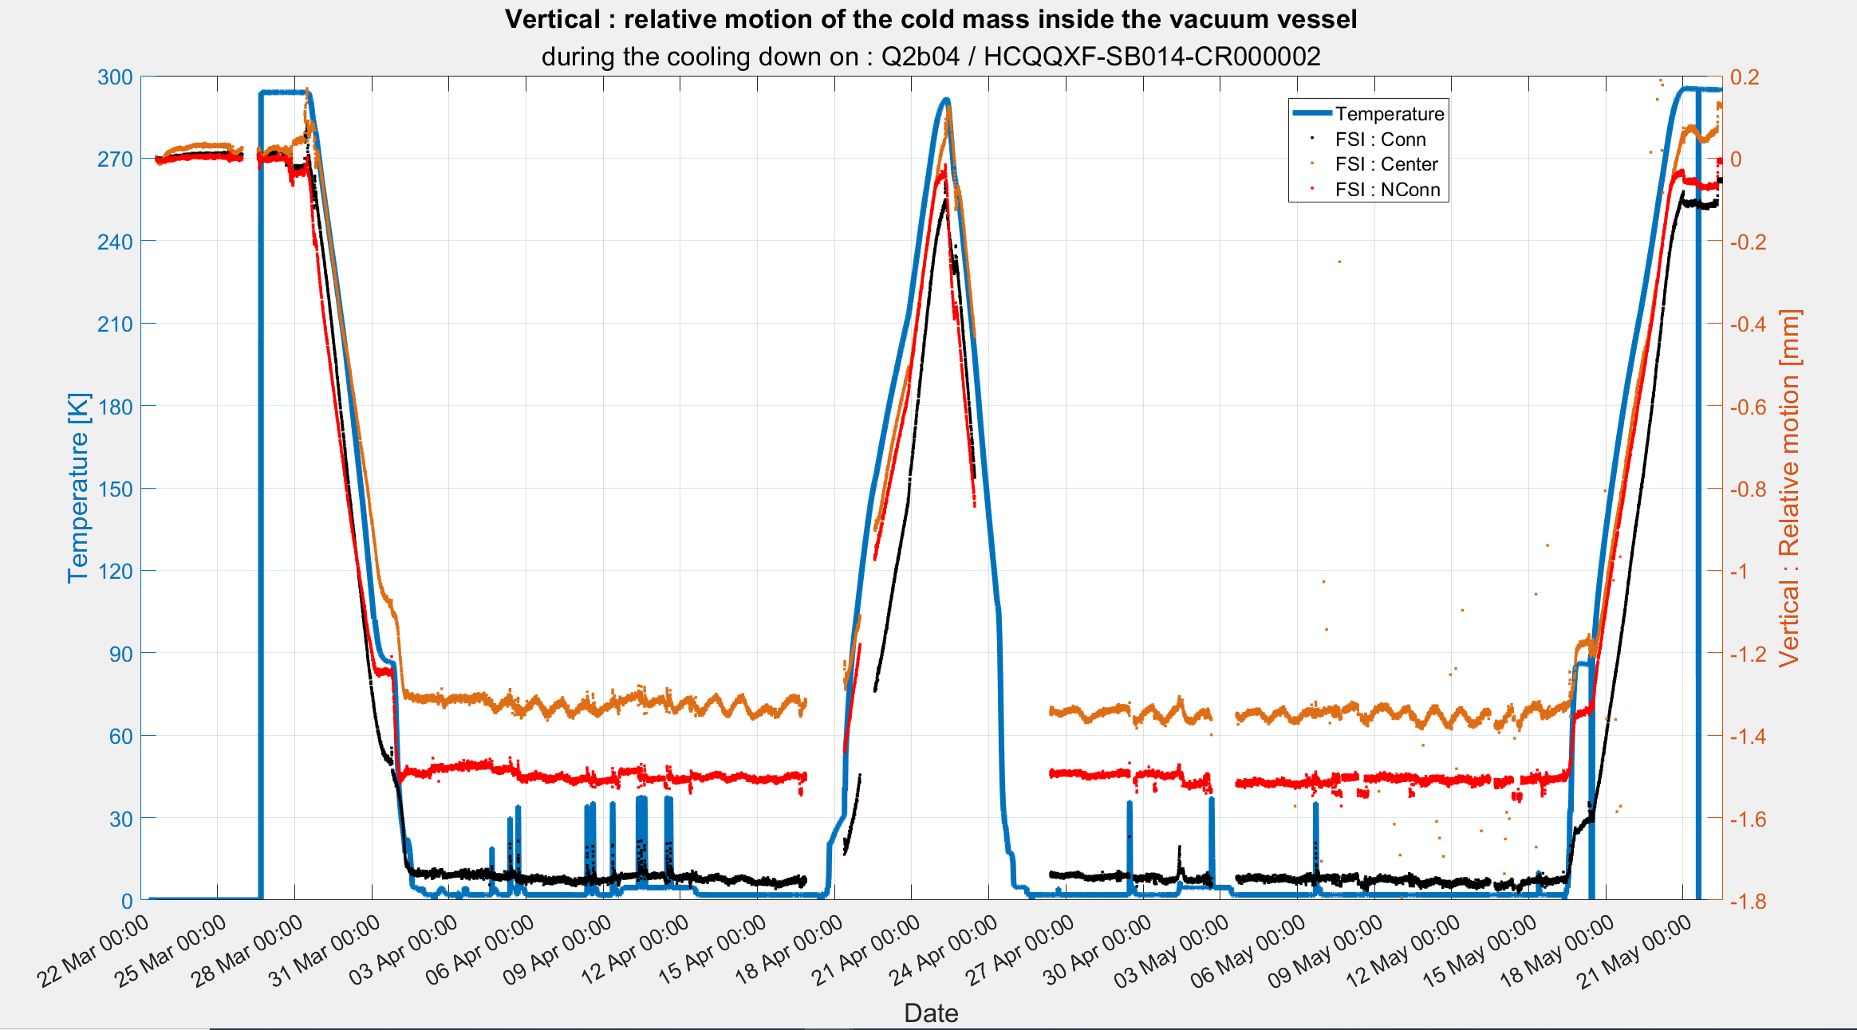
Q2b-04 ( LMQXFB04)
Accuracy FSI (1σ) : 0.03 mm
Return to ambiant pressure
Pumping
Ambiant pressure
First cooling down
Second cooling down
Second warm up
First warm up
Cold condition
Cold condition
Quench
Quench

Slide 16
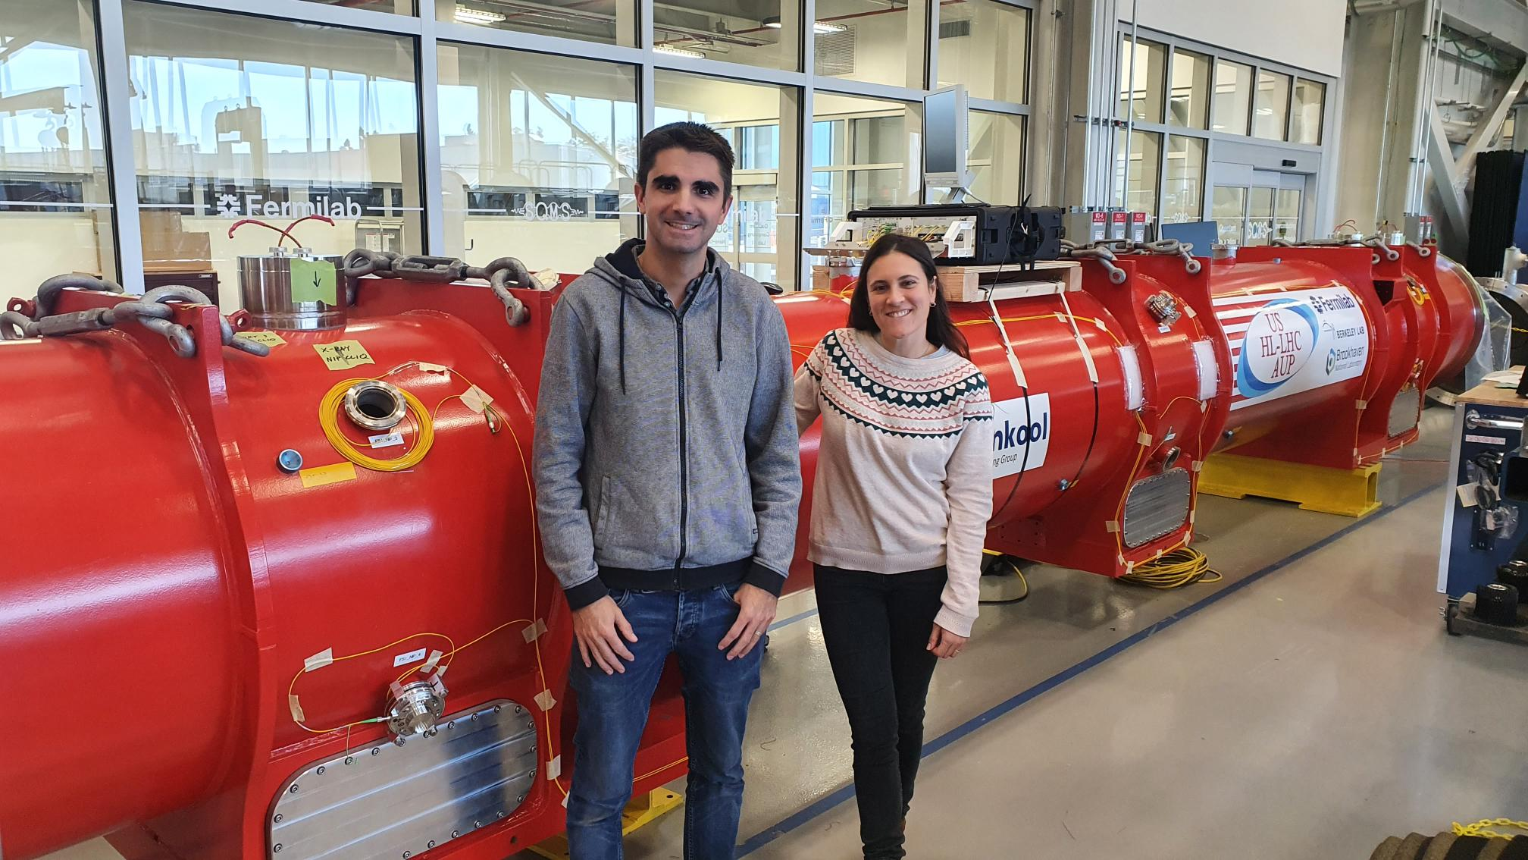
Cooling down at Fermilab and CERN

Slide 17
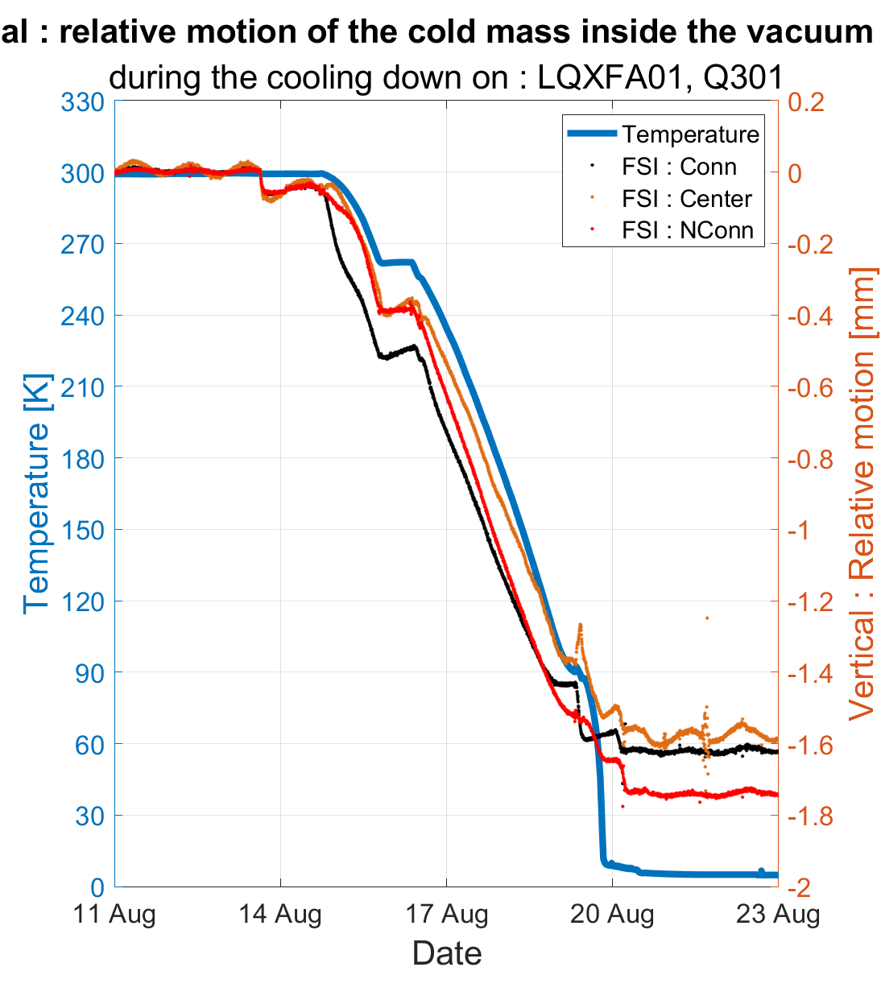
Mechanical measurements on Q3#01 at Fermilab and at CERN
Conn
NConn
Q3#01 : Cooling down at Fermilab
Q3#01 : Cooling down at CERN
2023
2024

Slide 18
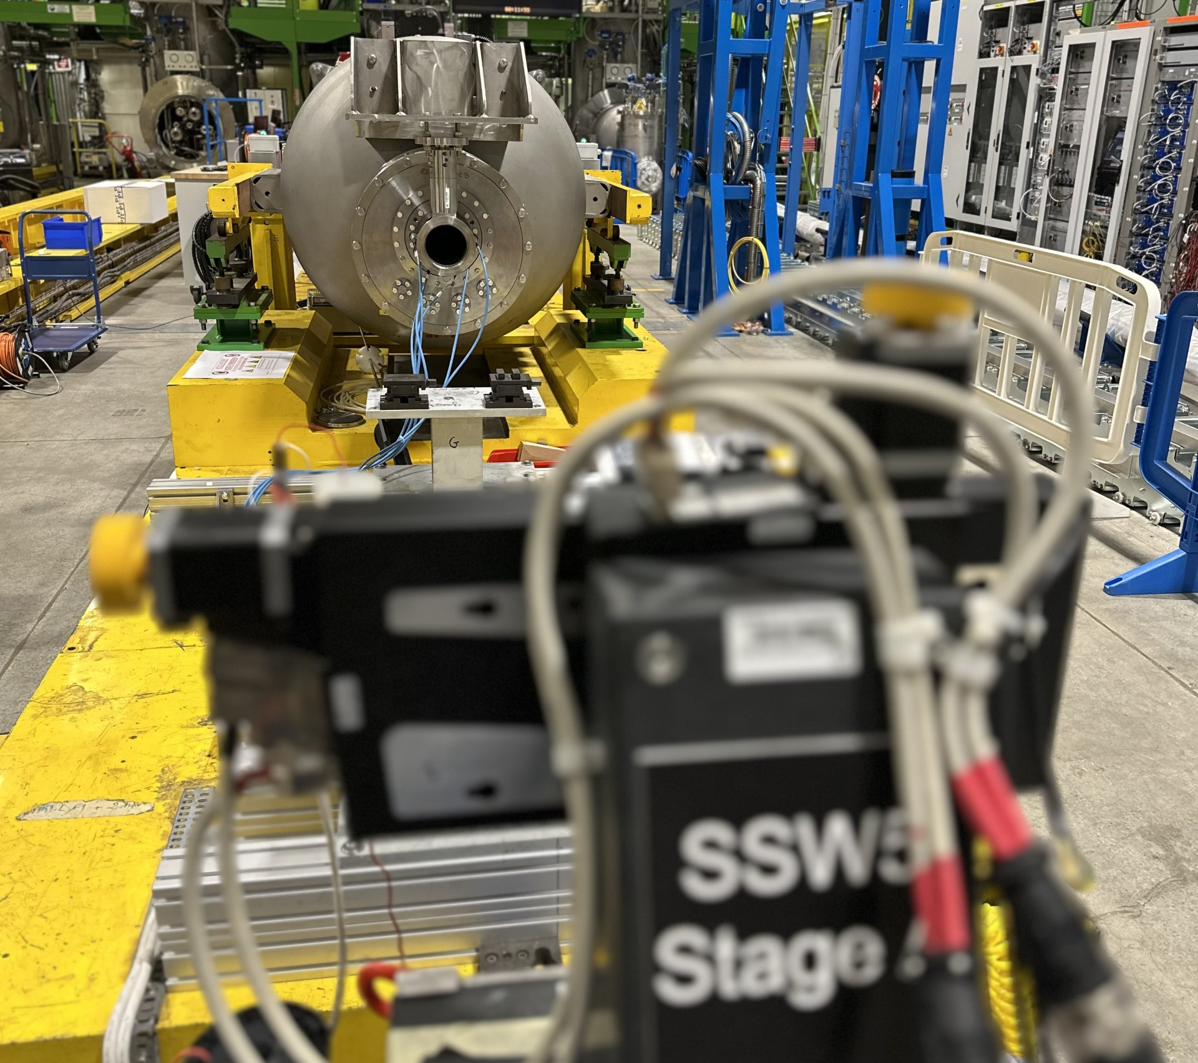
Mechanical and magnetic measurements

Slide 19
Mechanical and magnetic measurements at different steps
Mechanical measurement
→ mechanical mole measurement
Mechanical measurement
→ FSI meas.
Mechanical measurement
→ FSI meas.
Magnetic measurement
→rotating coil scanner
Magnetic measurement
→ single-stretched wire (SSW)
Magnetic measurement
→ single-stretched wire (SSW)
Rz (positive angle)
LGC convention
Δ =-0.26mm
Δ =-0.27mm
Δ =-0.34mm
Y
Mechanical axis
Vacuum
vessel
Mechanical axis
Mechanical axis
Δ =0.53 mm
Δ =0.62 mm
Vacuum
vessel
Δ =0.57 mm
Vacuum
vessel
Magnetic axis
X
Magnetic axis
Magnetic axis
Magnetic mole
measurement
Q2a-P3 (LMQXFB02)

Slide 20
Mechanical and magnetic measurements at different steps
Mechanical measurement
→ mechanical mole measurement
Mechanical measurement
→ FSI meas.
Q2a-P3 (LMQXFB02)
Mechanical measurement
→ FSI meas.
Magnetic measurement
→rotating coil scanner
Magnetic measurement
→ single-stretched wire (SSW)
Magnetic measurement
→ single-stretched wire (SSW)
Rx (positive angle)
LGC convention
Magnetic mole
measurement
Magnetic axis
Z
Δ =0.62 mm
Magnetic axis
Δ =0.70 mm
Mechanical axis
Vacuum
vessel
Mechanical axis
Δ =0.16 mm
Y
Vacuum
vessel
Vacuum
vessel
Δ =0.25 mm
Magnetic axis
Mechanical axis
Δ =0.76 mm
Δ =0.27 mm
Q2a-P3 (LMQXFB02)

Slide 21
Mechanical and magnetic measurements at different steps
Q2a-P3 (LMQXFB02)
Fiducialisation : SMI2 measurement
Magnetic field
WARM Ambient pressure : SM18
Magnetic field
COLD : SM18
Magnetic field
Mechanical direction
(Z axis)
Ry (positive angle)
LGC convention
Mechanical direction
(Z axis)
Mechanical direction
(Z axis)
Magnetic
field
Magnetic
field
Magnetic
field
0.316 mrad
0.259 mrad
0.256 mrad
Z
Z
Z
X
X
X
 | LGC conv.
Delta Roll. (mrad) meca → magn | -0.316
 | LGC conv.
Delta Roll. (mrad) meca → magn | - 0.259
 | LGC conv.
Delta Roll. (mrad) meca → magn | - 0.256

Slide 22
 | Installation FSI targets | Cryostating | CERN Mechanical Fiducialisation | CERN Installation FSI Sensors | CERN Cold test Magnetic and mechanical measurement at cold
MQXFBP2 | CERN | CERN
MQXFBP3 | CERN | CERN
MQXFB03 | CERN | CERN |  | Nov 2024
MQXFB04 | CERN | CERN
MQXFB05 | CERN | CERN |  |  | On going
MQXFA01 | Fermilab | Fermilab |  |  | On going
MQXFA02 | Fermilab | Fermilab | Dec 2024

Slide 23
Conclusions
Impact of transport on alignment
The shape (in vertical) of the vacuum vessel and the cold mass is influenced by transport and temperature changes
Impact of pumping on alignment
  The vacuum vessel’s shape is distorted by pumping (up to 80 μm)
Impact of cooling down on alignment
The cold mass goes down of 1.5 mm in average (between 1.3 mm to 1.8 mm)
Impact of quench on alignment
Elastic deformations (0.6 mm in longitudinal, 0.2 mm in vertical)
Mechanical and magnetic axes behaviour during cooling down
  Same behaviour

Slide 24
Thank you
for your attention

Slide 25
Spare

Slide 26
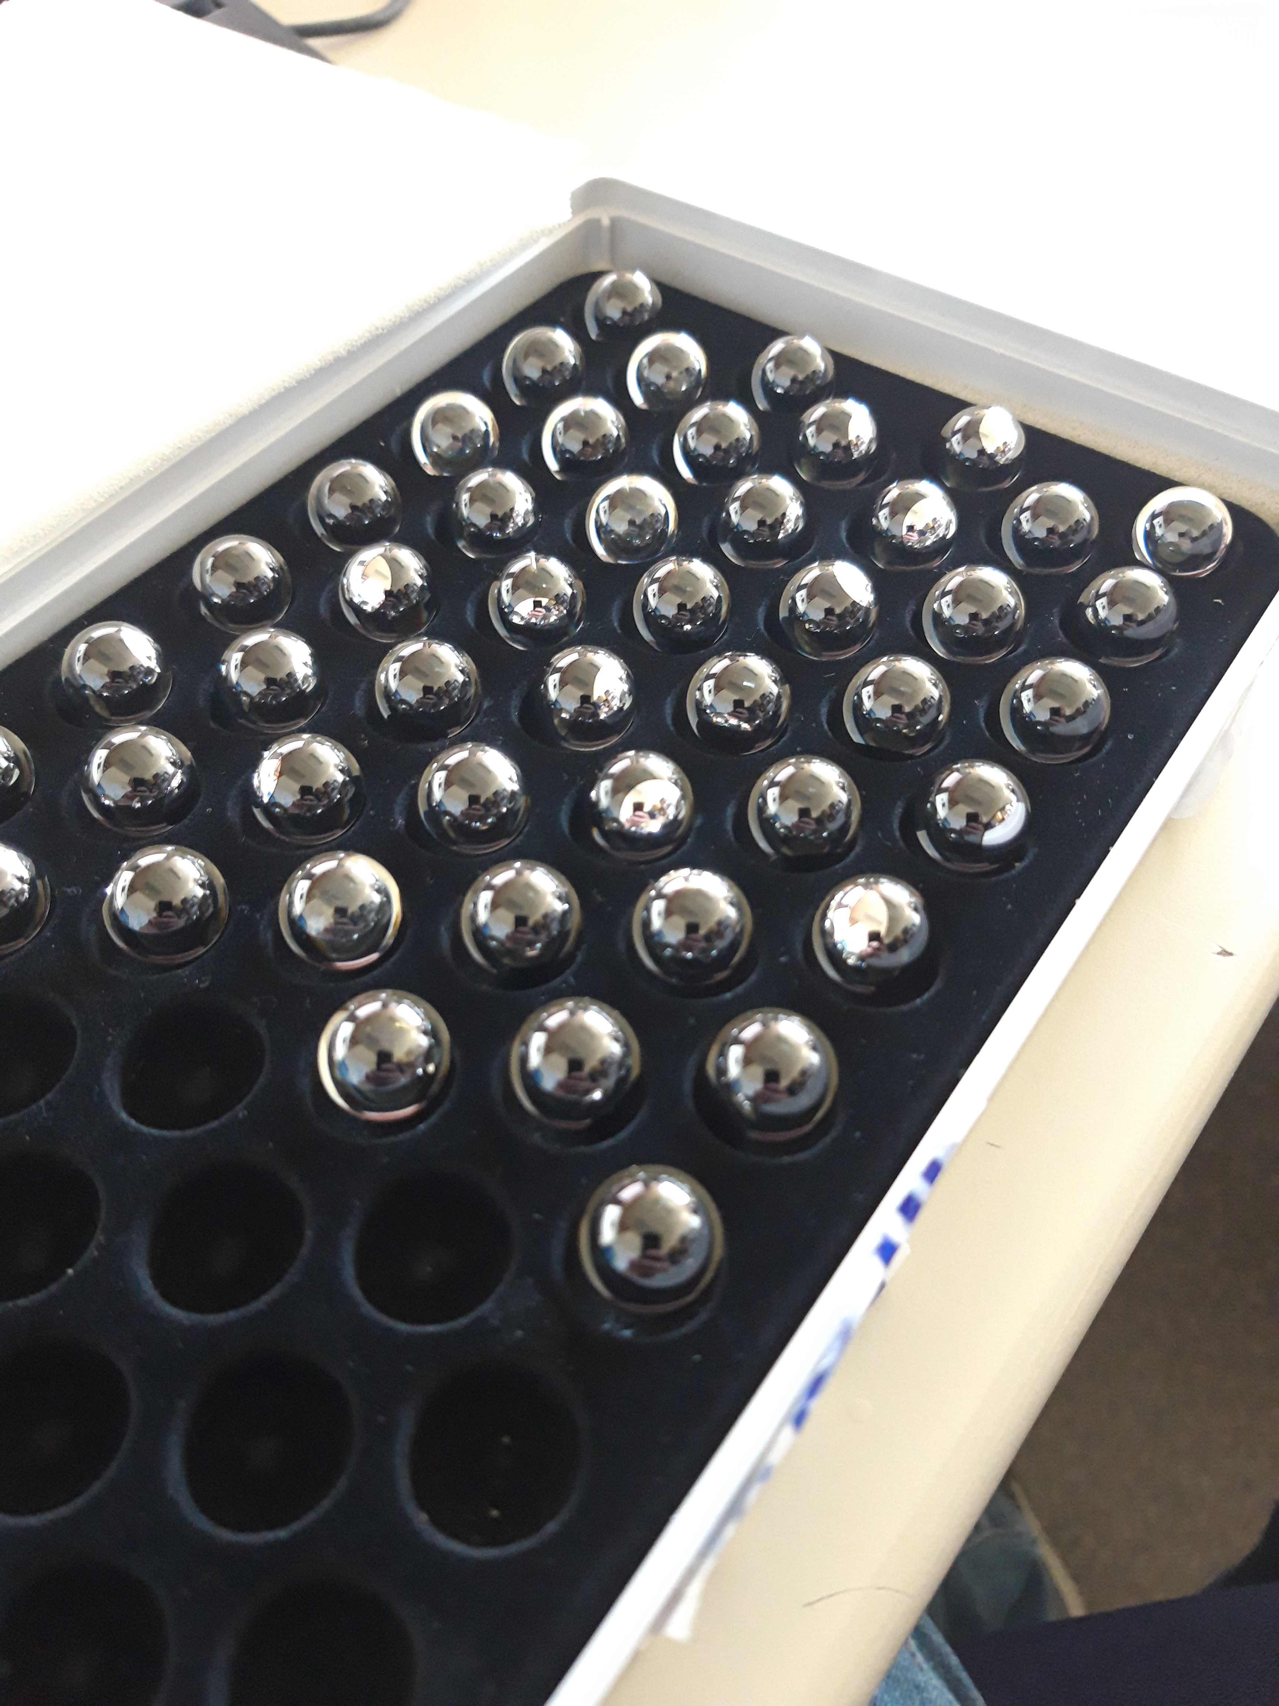
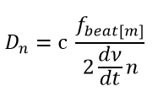
Multi-target FSI
n=2
RT3
RT1
$$f_{beat[n]}=ατ=α \frac{2D_{n}}{c}$$
RT2
α – is a sweep rate of the laser ( $α =\frac{dν}{dt}$ - laser frequency change in time );
c – speed of light;
n – refractive index of light transmission medium;
$τ$ – time of flight of laser to the target
from Mateusz Sosin

Slide 27
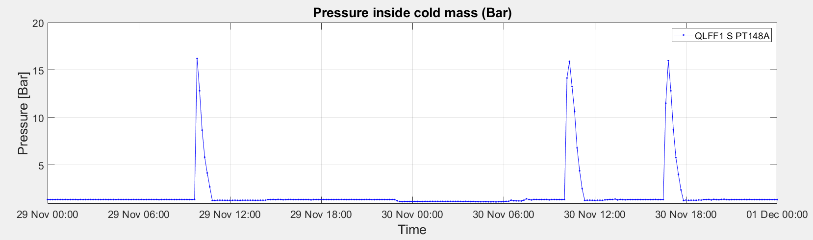
Impact of quench

Slide 28
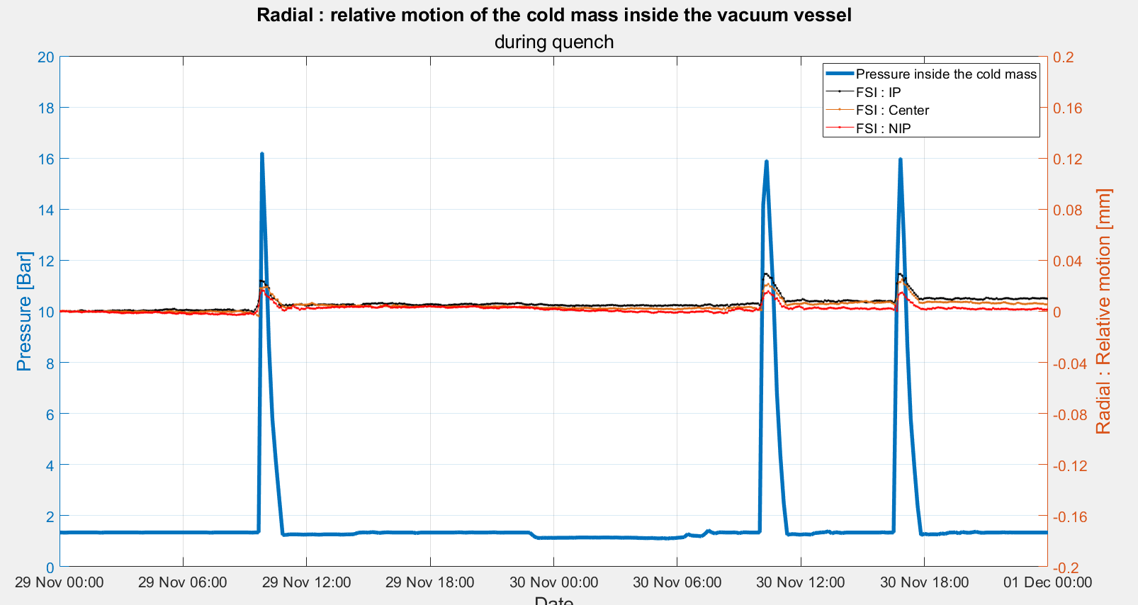
Accuracy FSI (1σ) : 0.03 mm
Small impact on radial

Slide 29
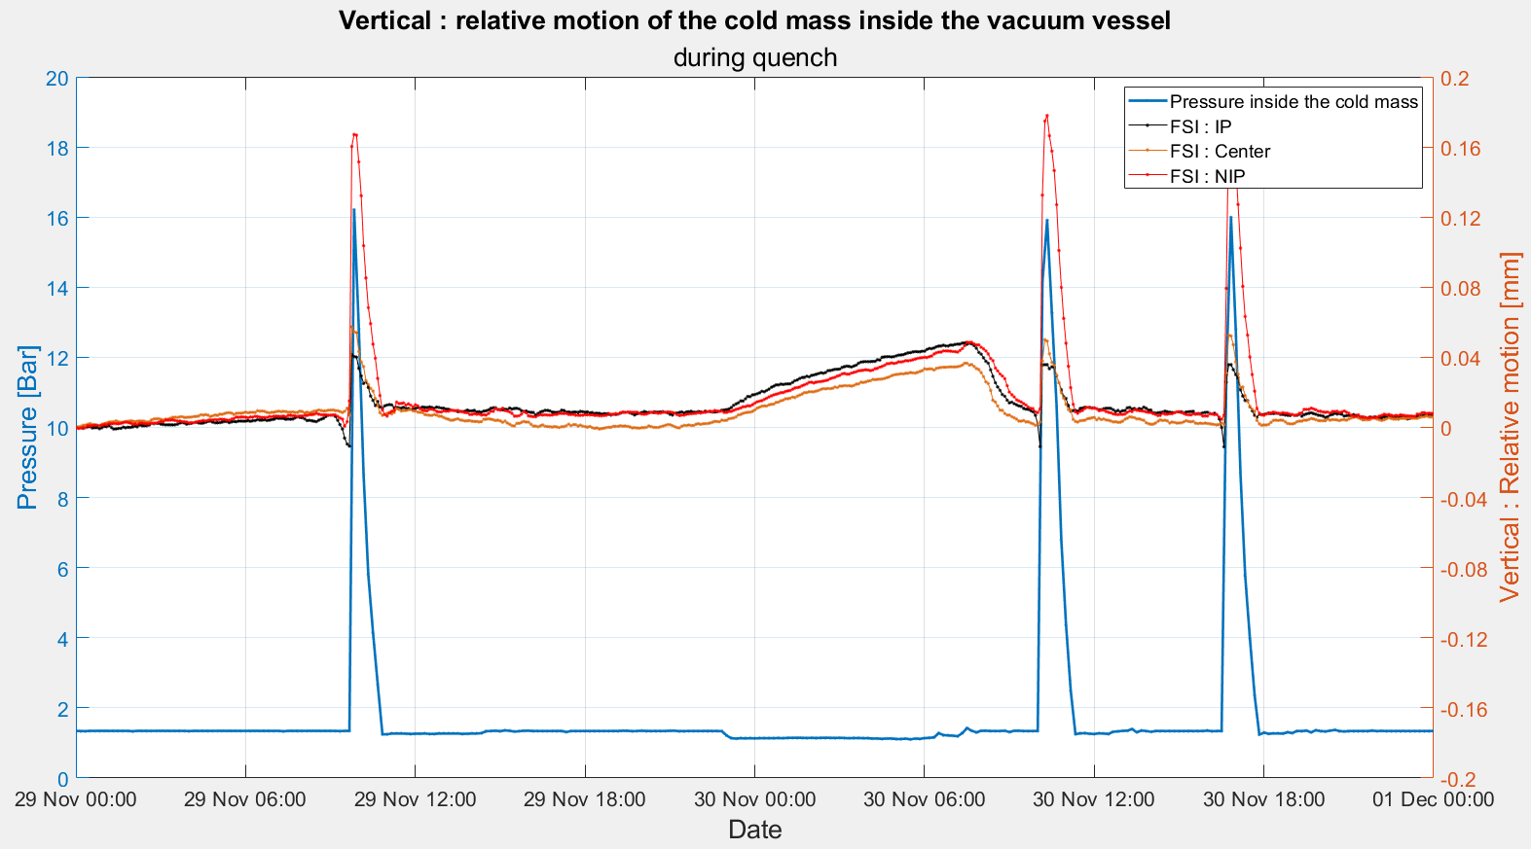
Accuracy FSI (1σ) : 0.03 mm
Impact up to 0.2 mm on vertical
Elastic deformation

Slide 30
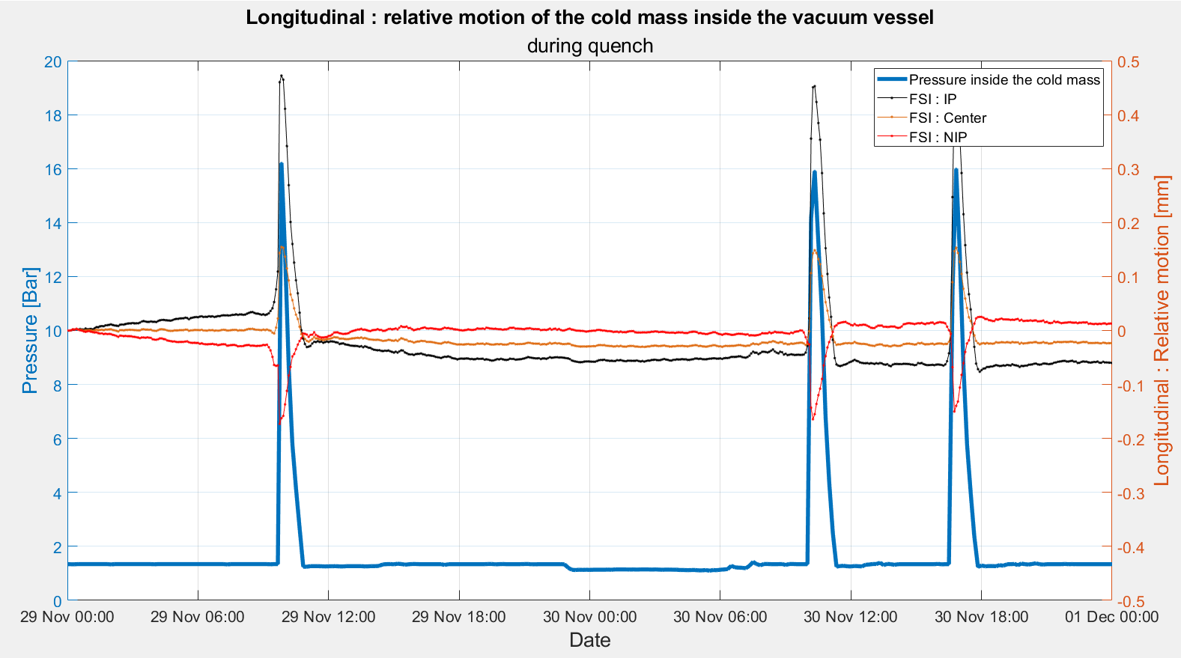
Accuracy FSI (1σ) : 0.1 mm
+0.3 mm
-0.3 mm
Impact up to 0.6 mm on longitudinal
Elastic deformation

Slide 31
Our needs from Fermilab for Q1/Q3 (For Survey)
In the same coordinate system :
Coordinate systems
    Primary axis : Y : Regression line corresponding to the mechanical cold bore axis (determined from mechanical mole)
    Secondary axis : Z : Normal vector of the plane [Conn-D9, Conn-D10, NConn-D9, NConn-D10]
    Origin : Projection of the central cold feet on Y axis
Cold mass
Reference points of the cold mass : D9, D10, D11 (Conn and NConn)
Mechanical mole measurement in the cold bore
Magnetic measurement with Rotating coil scanner
Magnetic field direction
Vacuum Vessel
Fiducials on the vacuum vessel

