Slide 1
Magnetic axis measurements of the superconducting quadrupoles (Q2) at CERN
Carlo Petrone, Mariano Pentella, Piotr Rogacki, Lucio Fiscarelli, Guy Deferne, Susana I. Bermudez, Herve Prin, Nicolas Bourcey, Vivian Rude, Julia Calmels, Patrick Bestmann, et al..
14th HL-LHC Collaboration Meeting – Genoa – 7 ÷ 10 October 2024

Slide 2
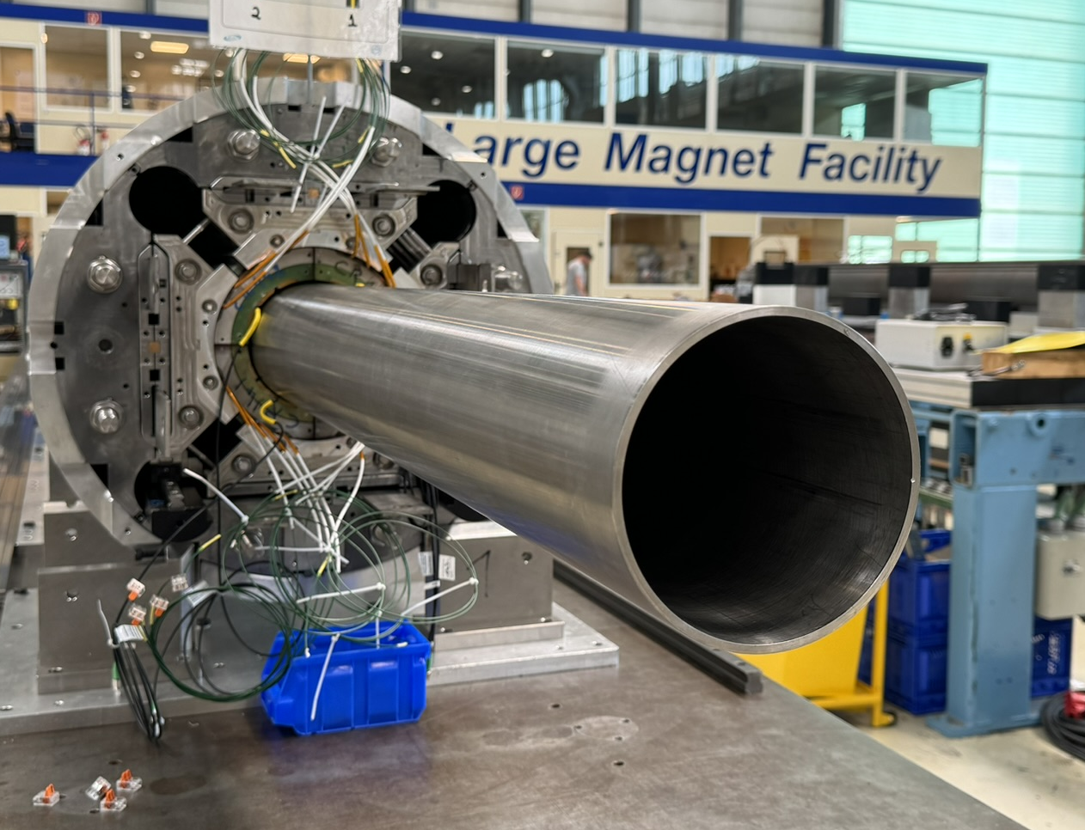
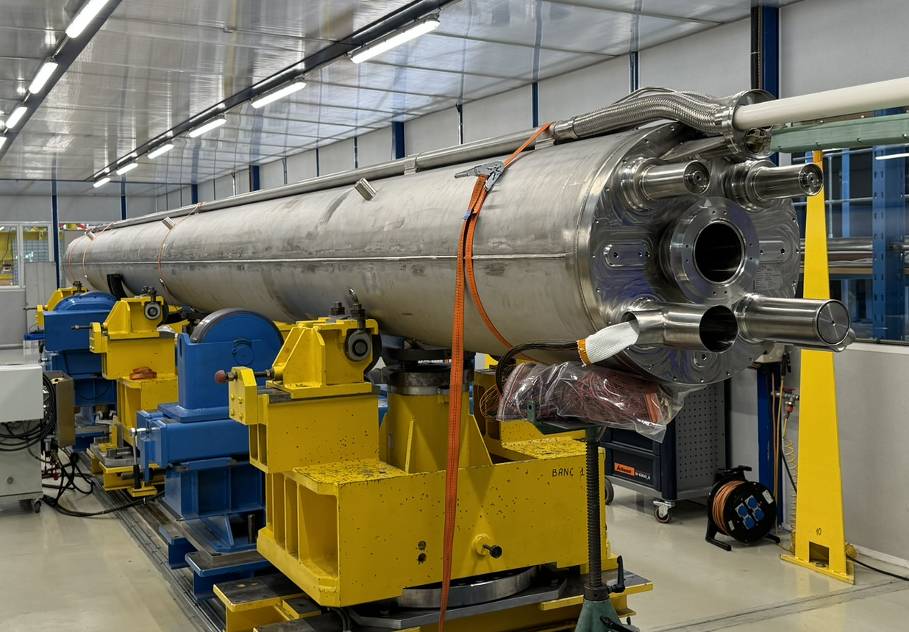
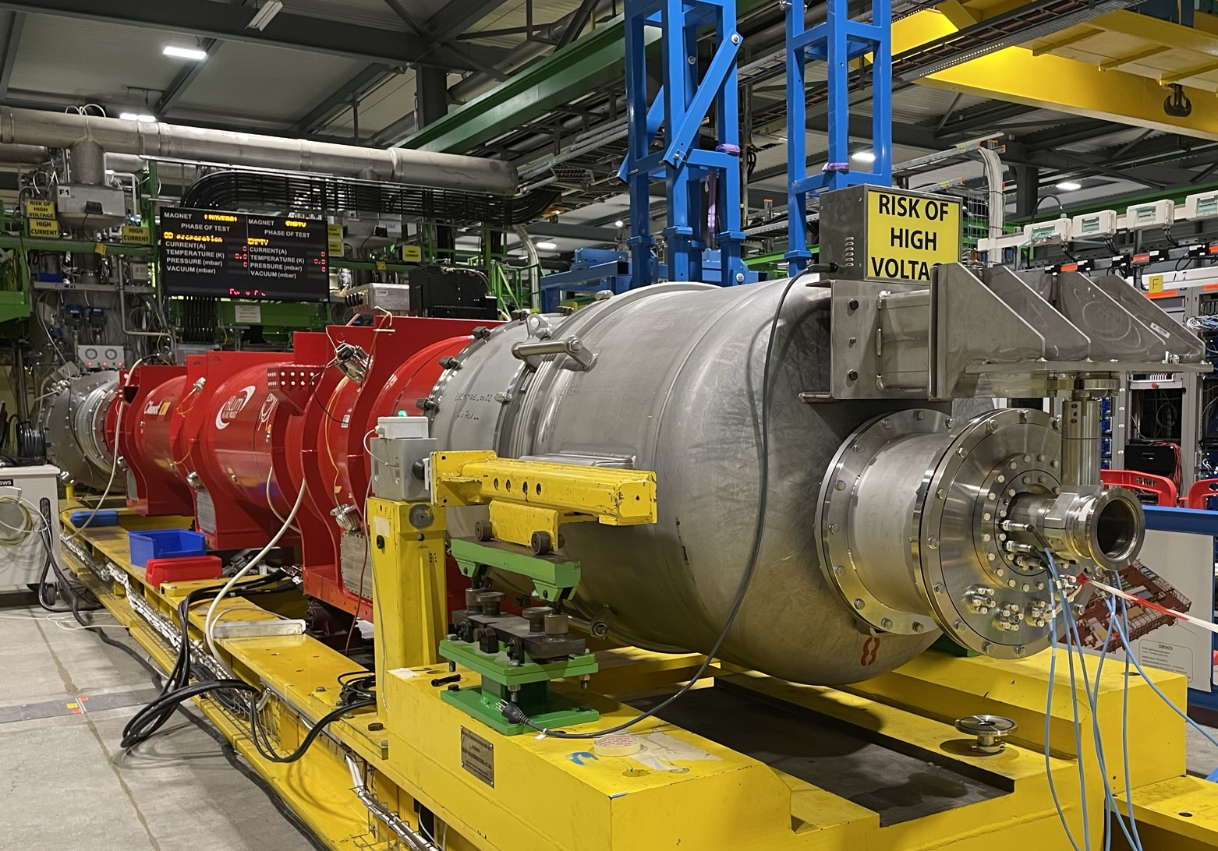
Q2 Magnetic measurements workflow
MQXFB
assembly
Cold mass assembly
Cryostating
Cryo-assembly
Coil pack insertion
Pre-alignment field angle with gravity before feet and endplates welding¹
Transfer function and field harmonics
Magnetic axis measurement at ambient temperature (180)
Insertion of cold mass in vacuum vessel
Mechanical fiducialization of vessel
Installation of FSIs
Transfer function and field quality at cold²
Magnetic axis measurement at ambient and cold temperatures (SM18)
Centering
Loading
¹ H. Prin: Status of cold mass activities ² L. Fiscarelli: Field quality update
Magnetic axis - Carlo Petrone - 14th HL-LHC Collaboration Meeting – Genoa – 10 October 2024

Slide 3
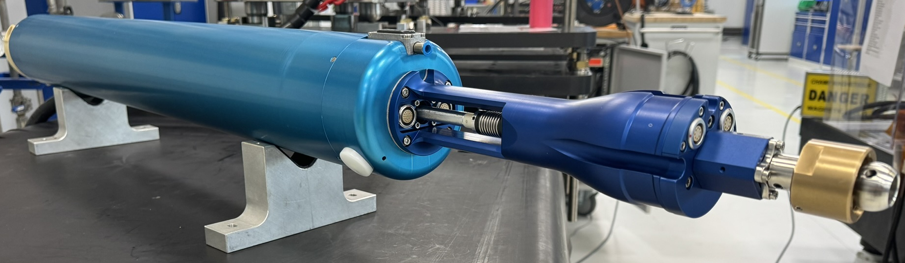
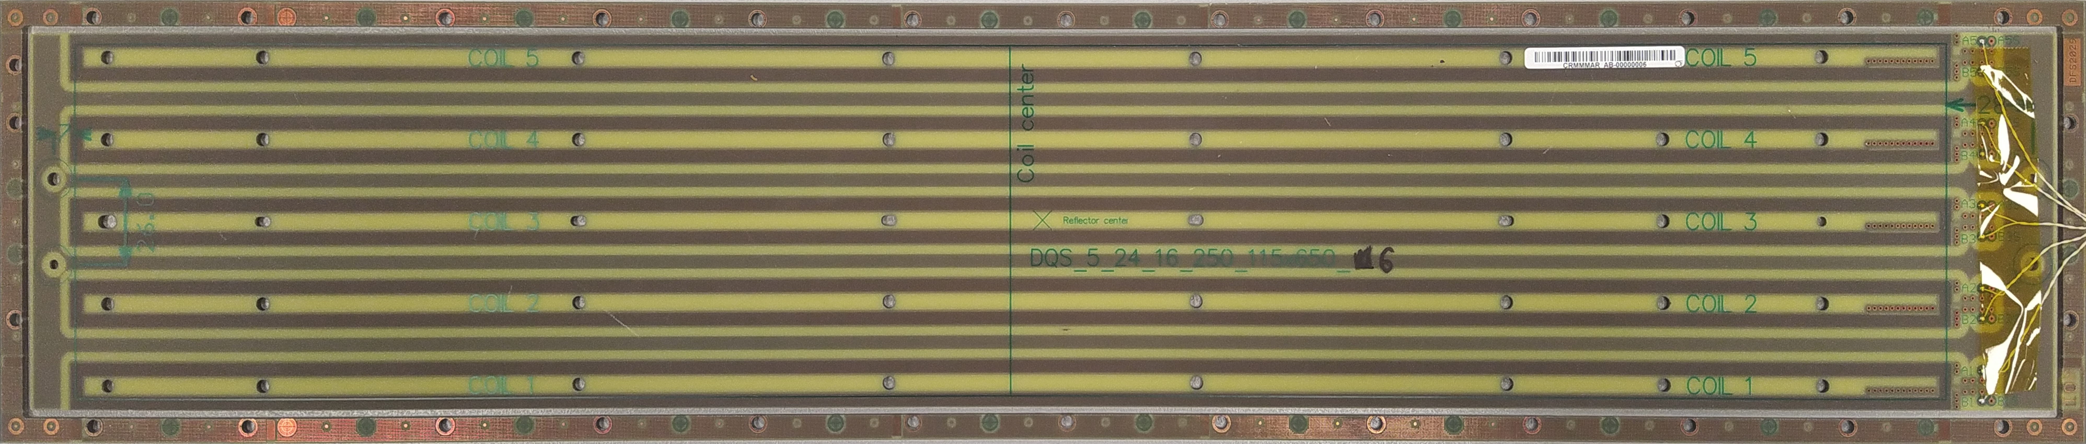
Measurement method: rotating-coil scanner
600 mm
115 mm
PCB: 2.33 m² as surface
Rotating-coil scanner (ambient temperature)
The harmonic coefficients (C₂ and C₁ used for the field center) are extracted by combining four measurements to compensate for systematics (±10 A, CW/CCW rotation direction) and applying sensitivity factors.
The field roll angle and the magnetic center frame referenced to gravity through the onboard tilt sensor, while a pneumatic brake increases mechanical stability.
Magnetic axis - Carlo Petrone - 14th HL-LHC Collaboration Meeting – Genoa – 10 October 2024

Slide 4
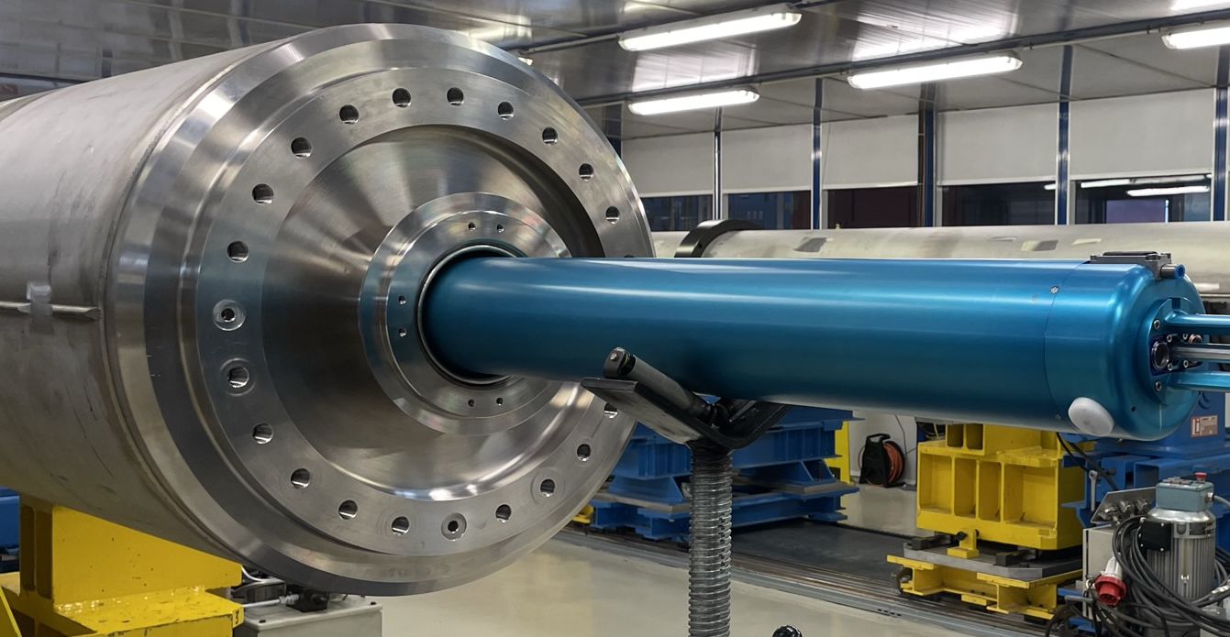
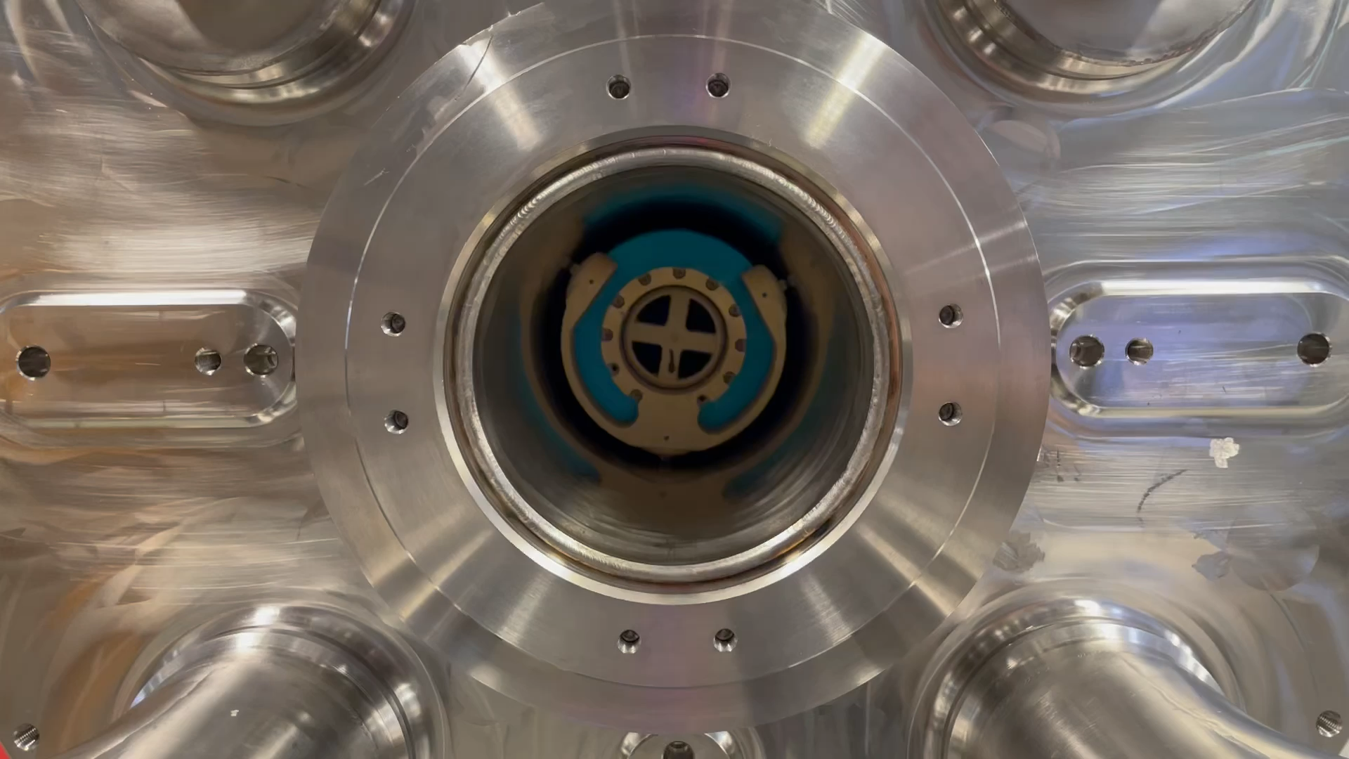
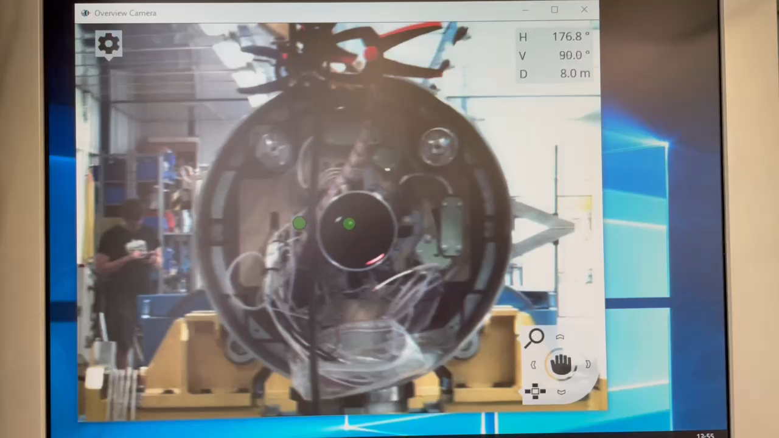
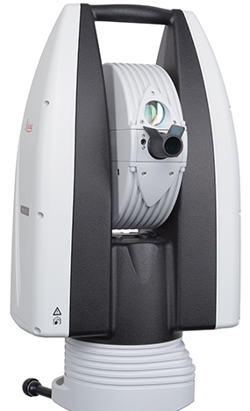
Cold-mass measurement procedure
The mechanical rotation axis is measured using a laser tracker, detecting a reflector rotating solidly with the printed circuit board (PCB).
Measurements expressed in a reference frame defined by the three fiducials on the two cold mass endplates (and gravity).
Procedure: Room temperature measurements of the MQXFB magnets and LMQXFB cold masses (EDMS 2901463)
Magnetic axis - Carlo Petrone - 14th HL-LHC Collaboration Meeting – Genoa – 10 October 2024

Slide 5
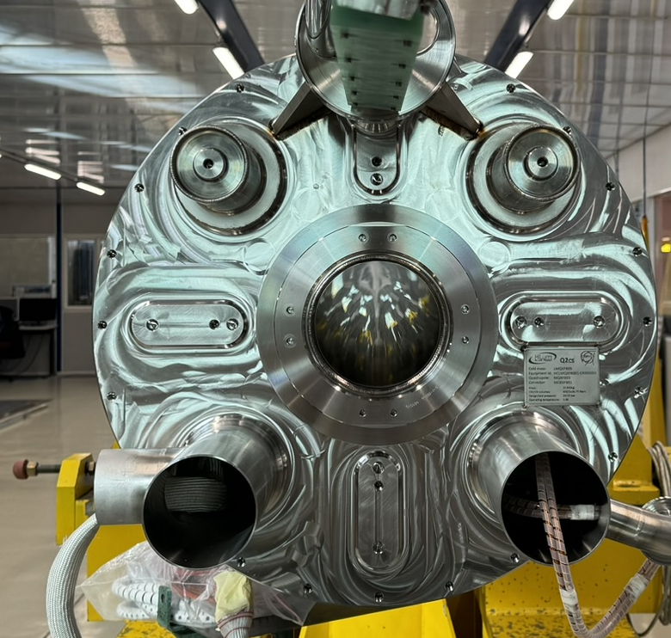
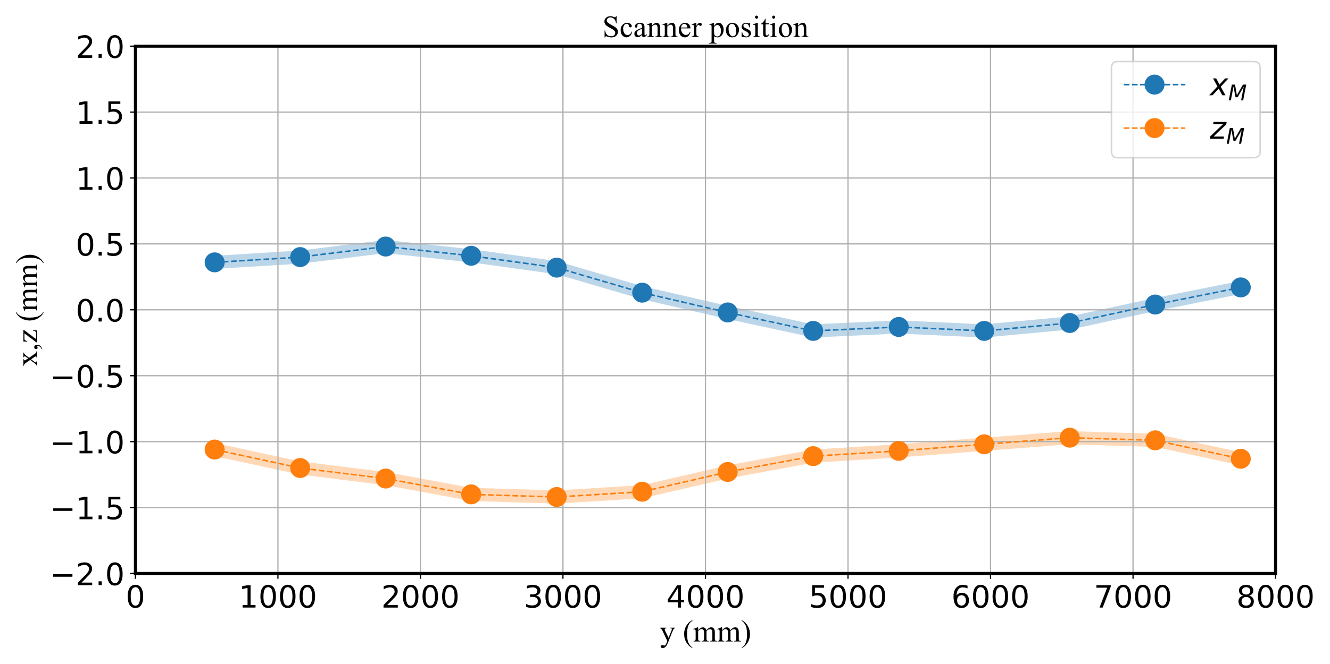

Cold-mass measurement procedure
z
Position 1
Position N
D9
D10
0
y
D11
Measurement performed at different longitudinal positions (magnetic axis).
The origin is the center of the three fiducials on the quadrupole connection side.
Magnetic axis - Carlo Petrone - 14th HL-LHC Collaboration Meeting – Genoa – 10 October 2024
Notes:
`

Slide 6
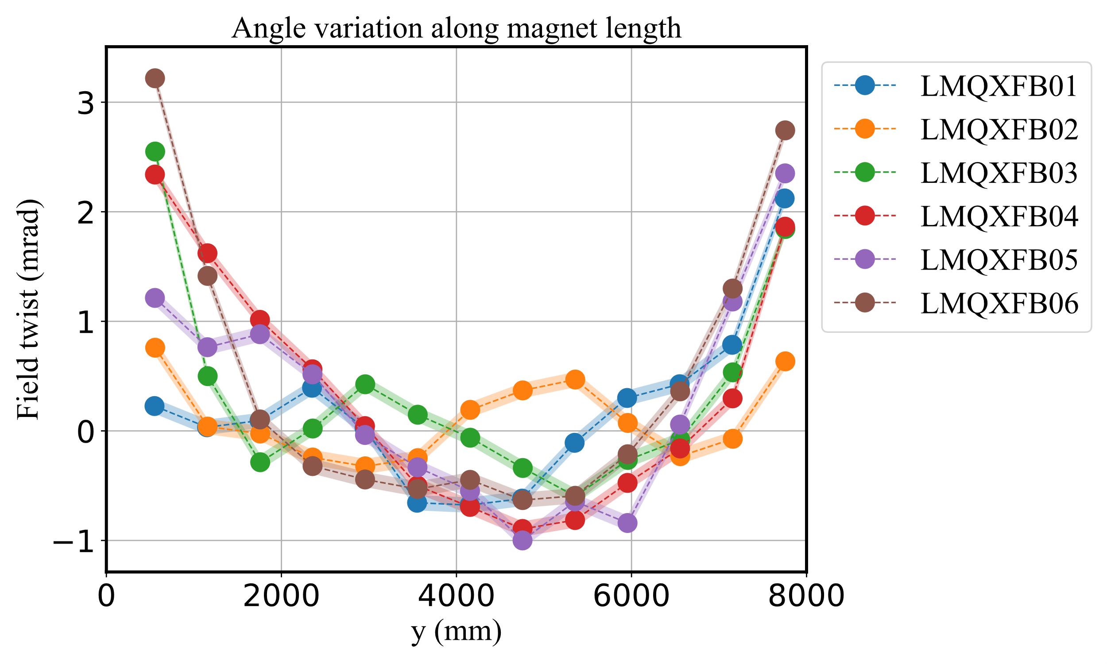
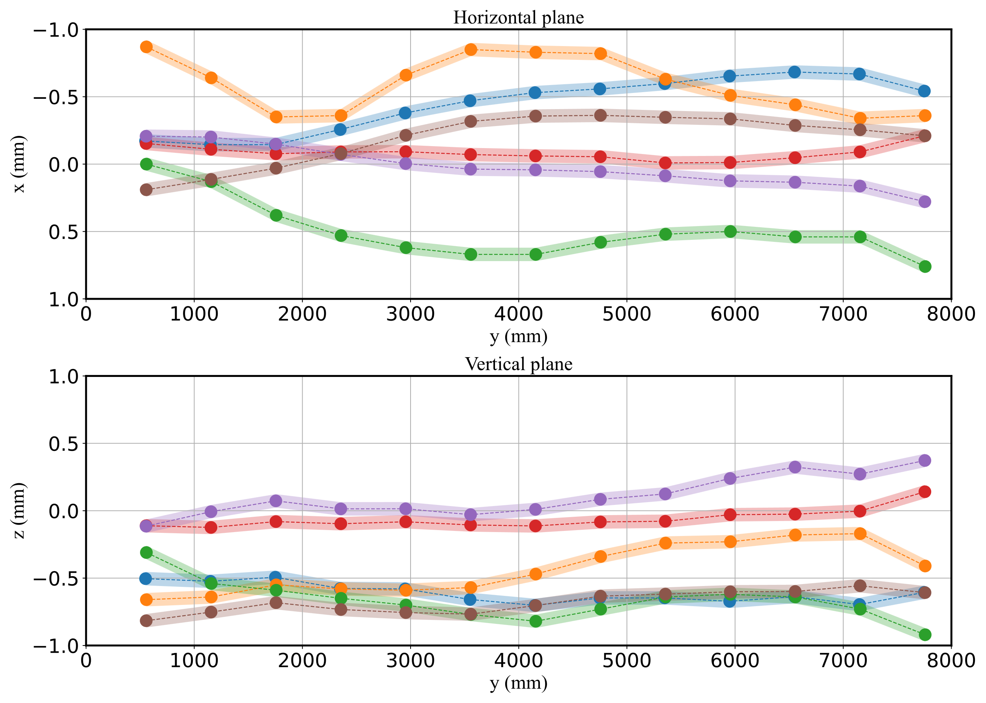
Measurement results
Magnetic axis measured over the 13 longitudinal positions of 6 cold masses.
The reference frame is referring to the cold masses D9, D10, and D11 points on both endplates.
Magnetic axis - Carlo Petrone - 14th HL-LHC Collaboration Meeting – Genoa – 10 October 2024

Slide 7
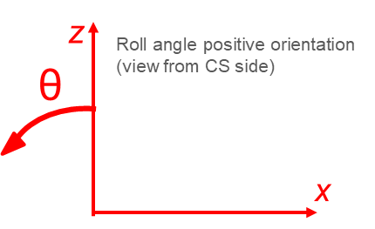
Measurement results
Magnetic field angle measured w.r.t. gravity.
The integral field angle smaller than 1 mrad on all cold masses:
Field angle integral [mrad]
LMQXFB01 | 0.27
LMQXFB02 | -0.10
LMQXFB03 | -0.20
LMQXFB04 | -0.04
LMQXFB05 | -0.28
LMQXFB06 | -0.68
Ambient temperature results are uploaded on MTF
Magnetic axis - Carlo Petrone - 14th HL-LHC Collaboration Meeting – Genoa – 10 October 2024

Slide 8
Q2 Magnetic measurements workflow
MQXFB
assembly
Cold mass assembly
Cryostating
Cryo-assembly
Coil pack insertion
Pre-alignment field angle with gravity before feet and endplates welding¹
Transfer function and field harmonics
Magnetic axis measurement at ambient temperature (180)
Insertion of cold mass in vacuum vessel
Mechanical fiducialization of vessel
Installation of FSIs
Transfer function and field quality at cold²
Magnetic axis measurement at ambient and cold temperatures in SM18
Centering
Loading
Presentation outline
¹ H. Prin: Status of cold mass activities ² L. Fiscarelli: Field quality update
Magnetic axis - Carlo Petrone - 14th HL-LHC Collaboration Meeting – Genoa – 10 October 2024

Slide 9
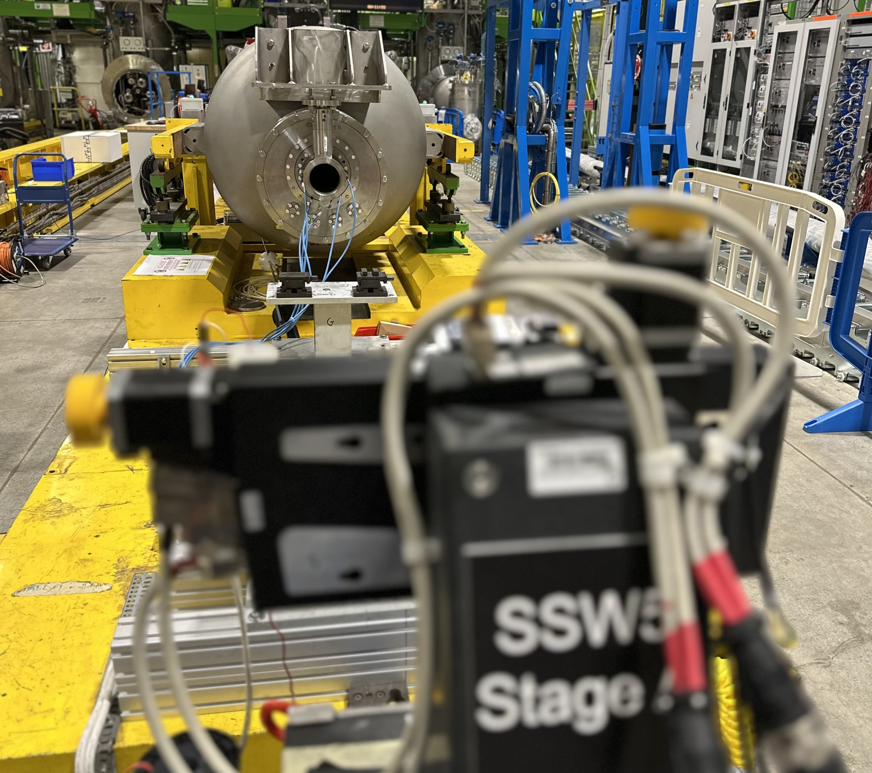
Magnetic axis of the cryo-assembly
Stretched-Wire for alignment measurements
Rotating coil scanner cannot be used.
The Stretched-Wire system is installed with Stage A on the CS side and aligned with gravity at over 0.01 mm/m.
Axis measurements at cryogenic and ambient temperature are performed also to assess the vertical mechanical variation (~ 1.5 mm).
Magnetic axis - Carlo Petrone - 14th HL-LHC Collaboration Meeting – Genoa – 10 October 2024

Slide 10
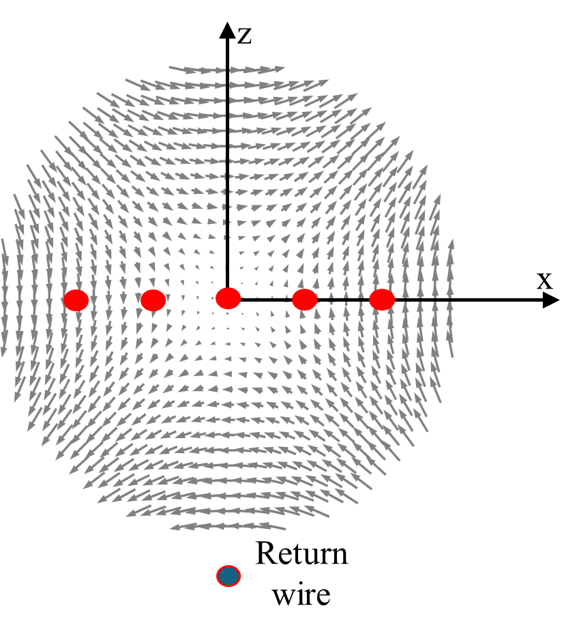
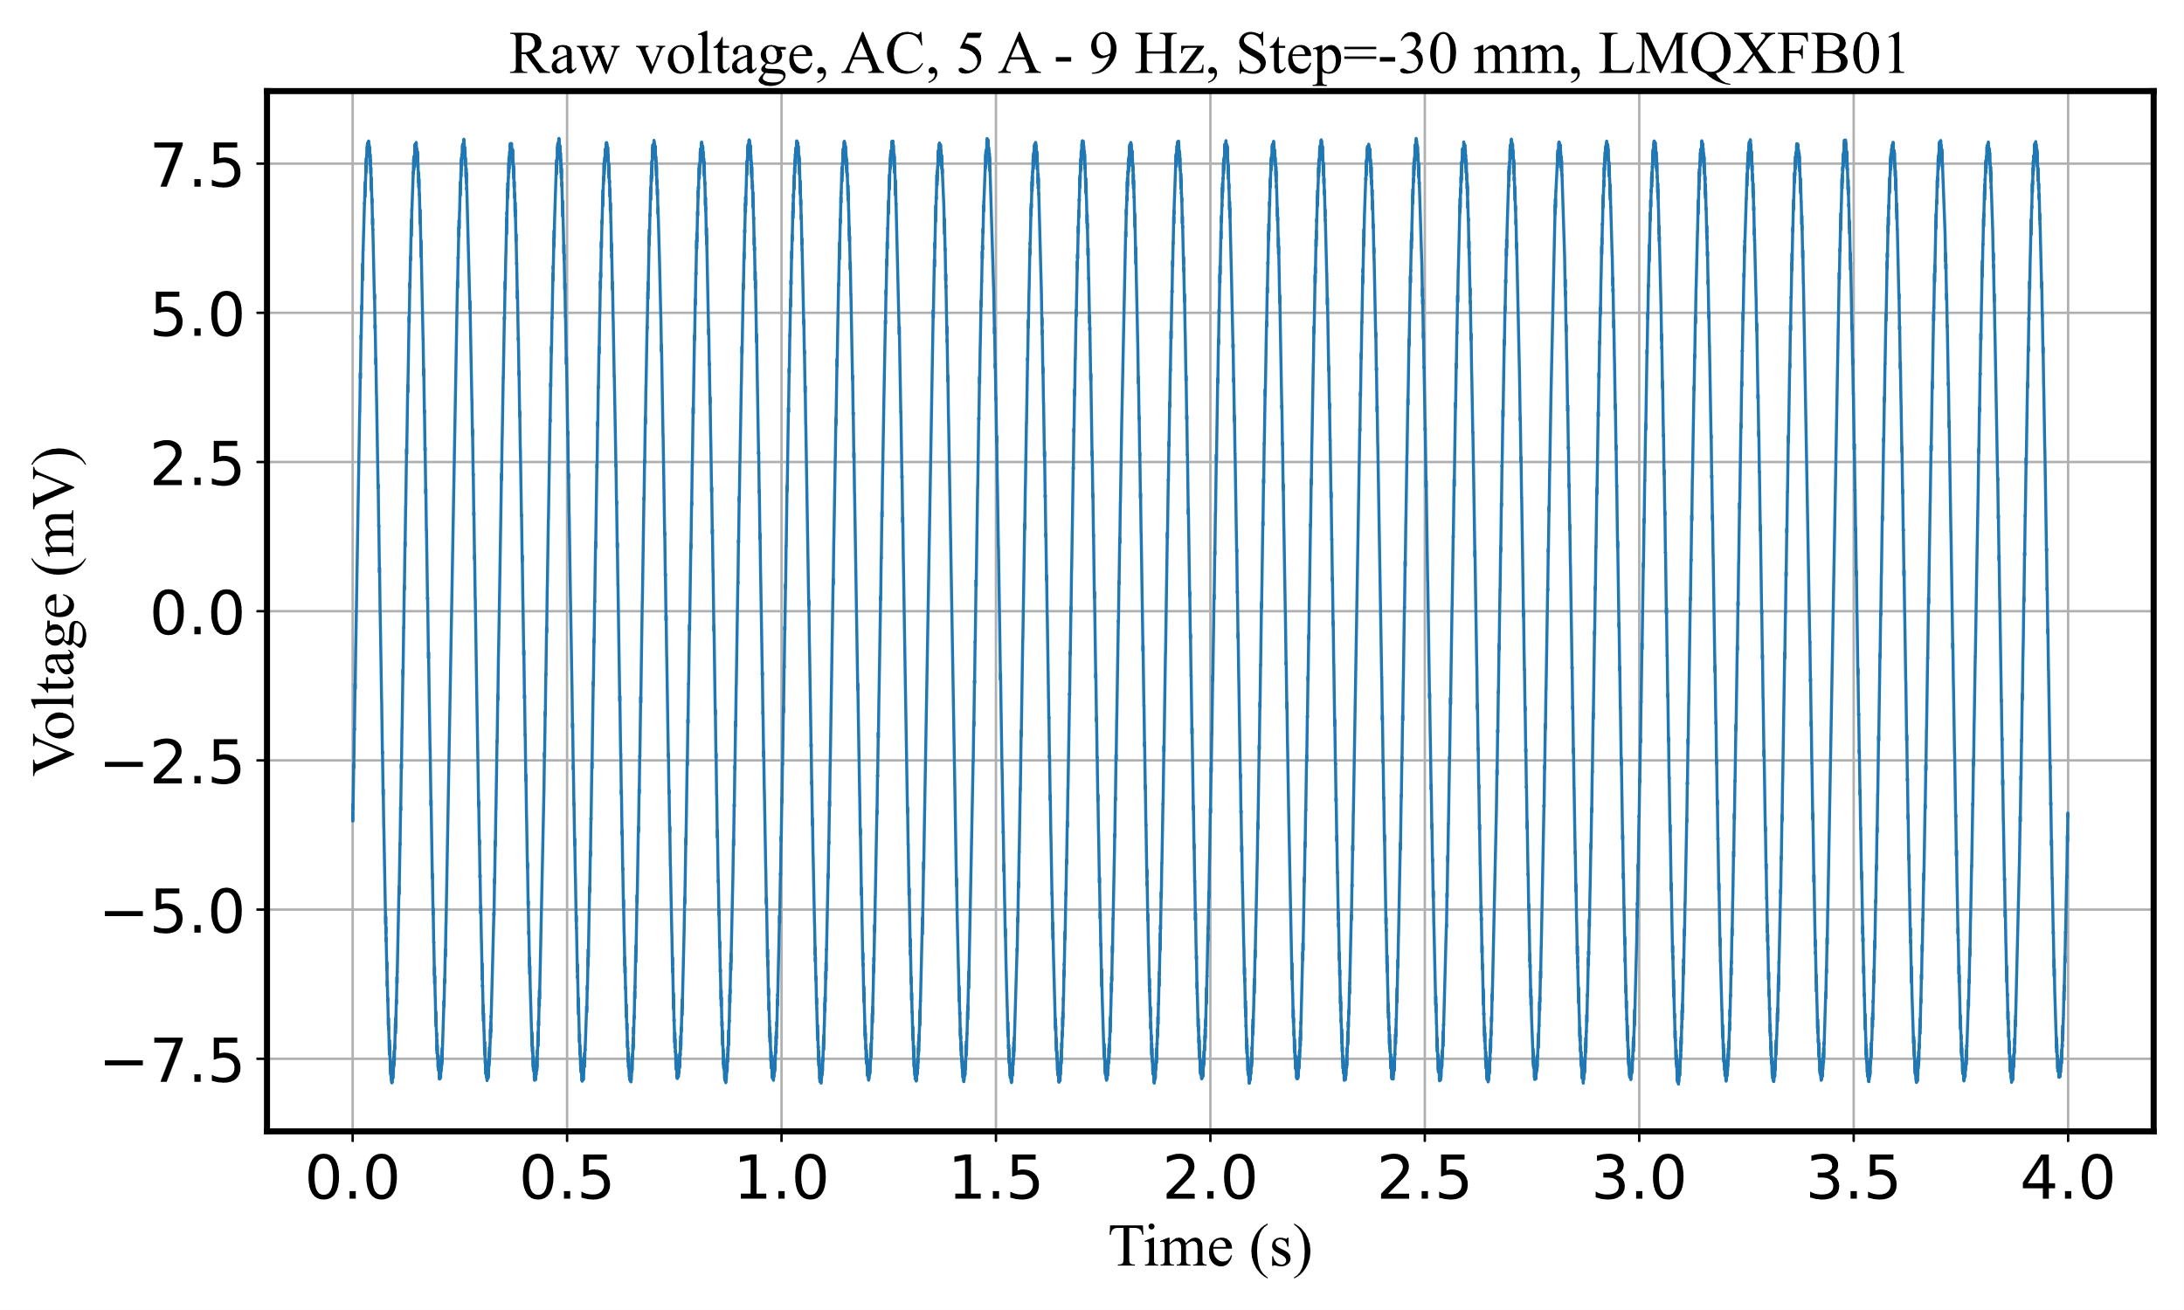
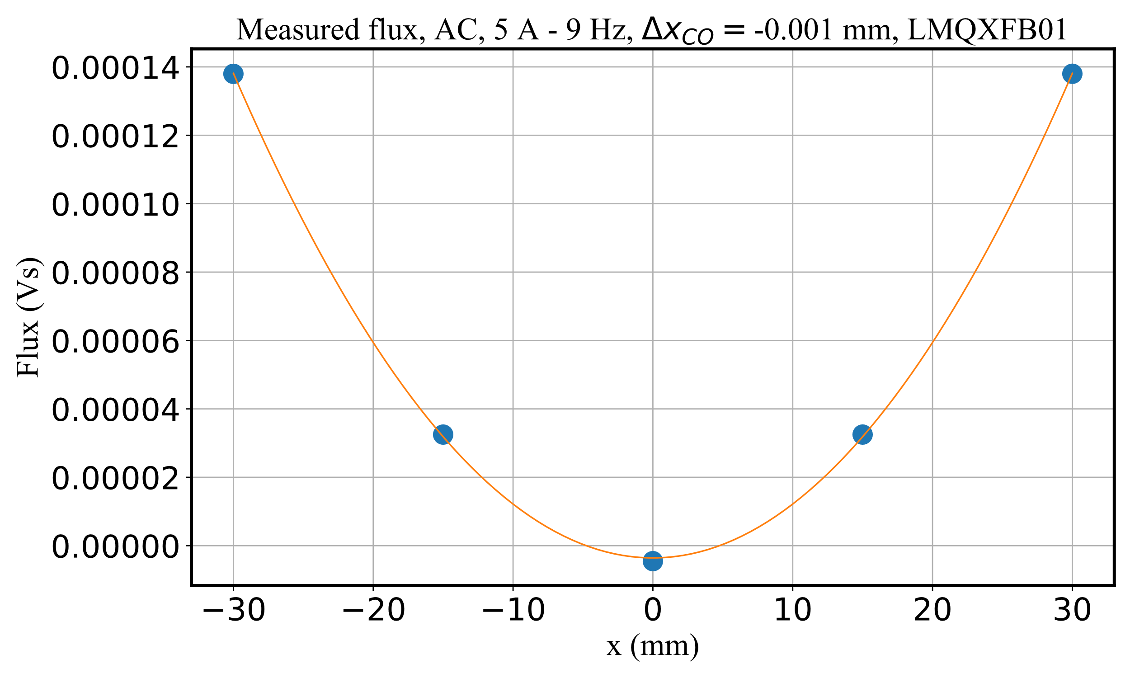
Measurement method: single stretched wire
AC measurements – SSW at ambient temperature
Measurements performed at 5 A AC, 9 Hz, with the wire used in stationary mode moving on a discretized trajectory (stop-wait-measure)
Flux value at a given position obtained by FT of the measured flux and selecting the tone corresponding with the magnet’s excitation current.
The measured points are fitted with parabolas.
Magnetic axis - Carlo Petrone - 14th HL-LHC Collaboration Meeting – Genoa – 10 October 2024

Slide 11
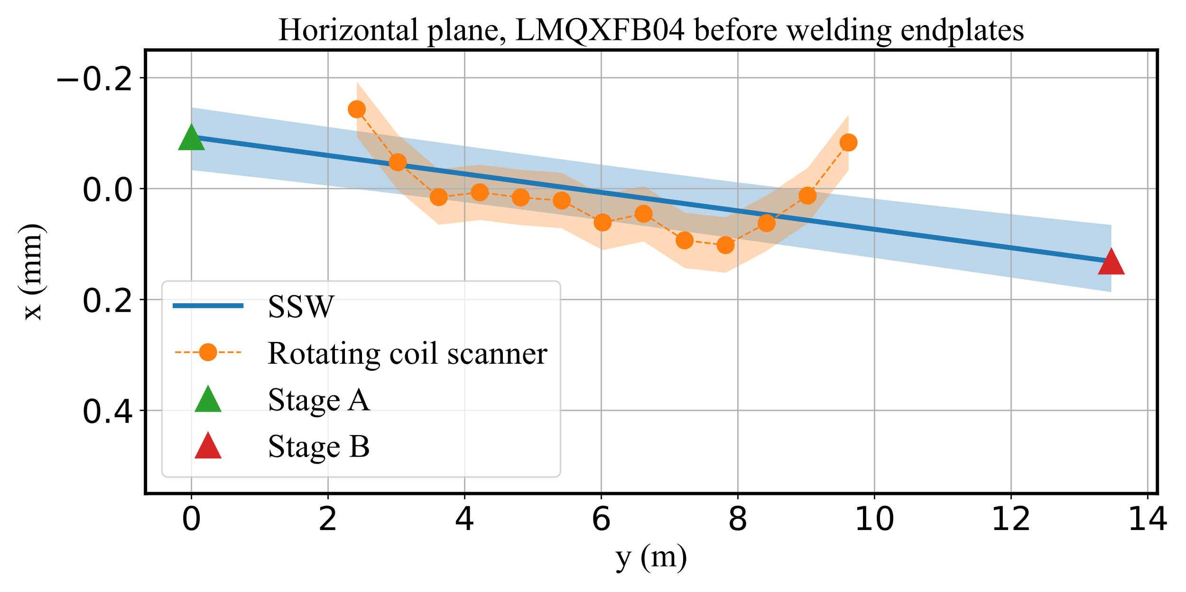
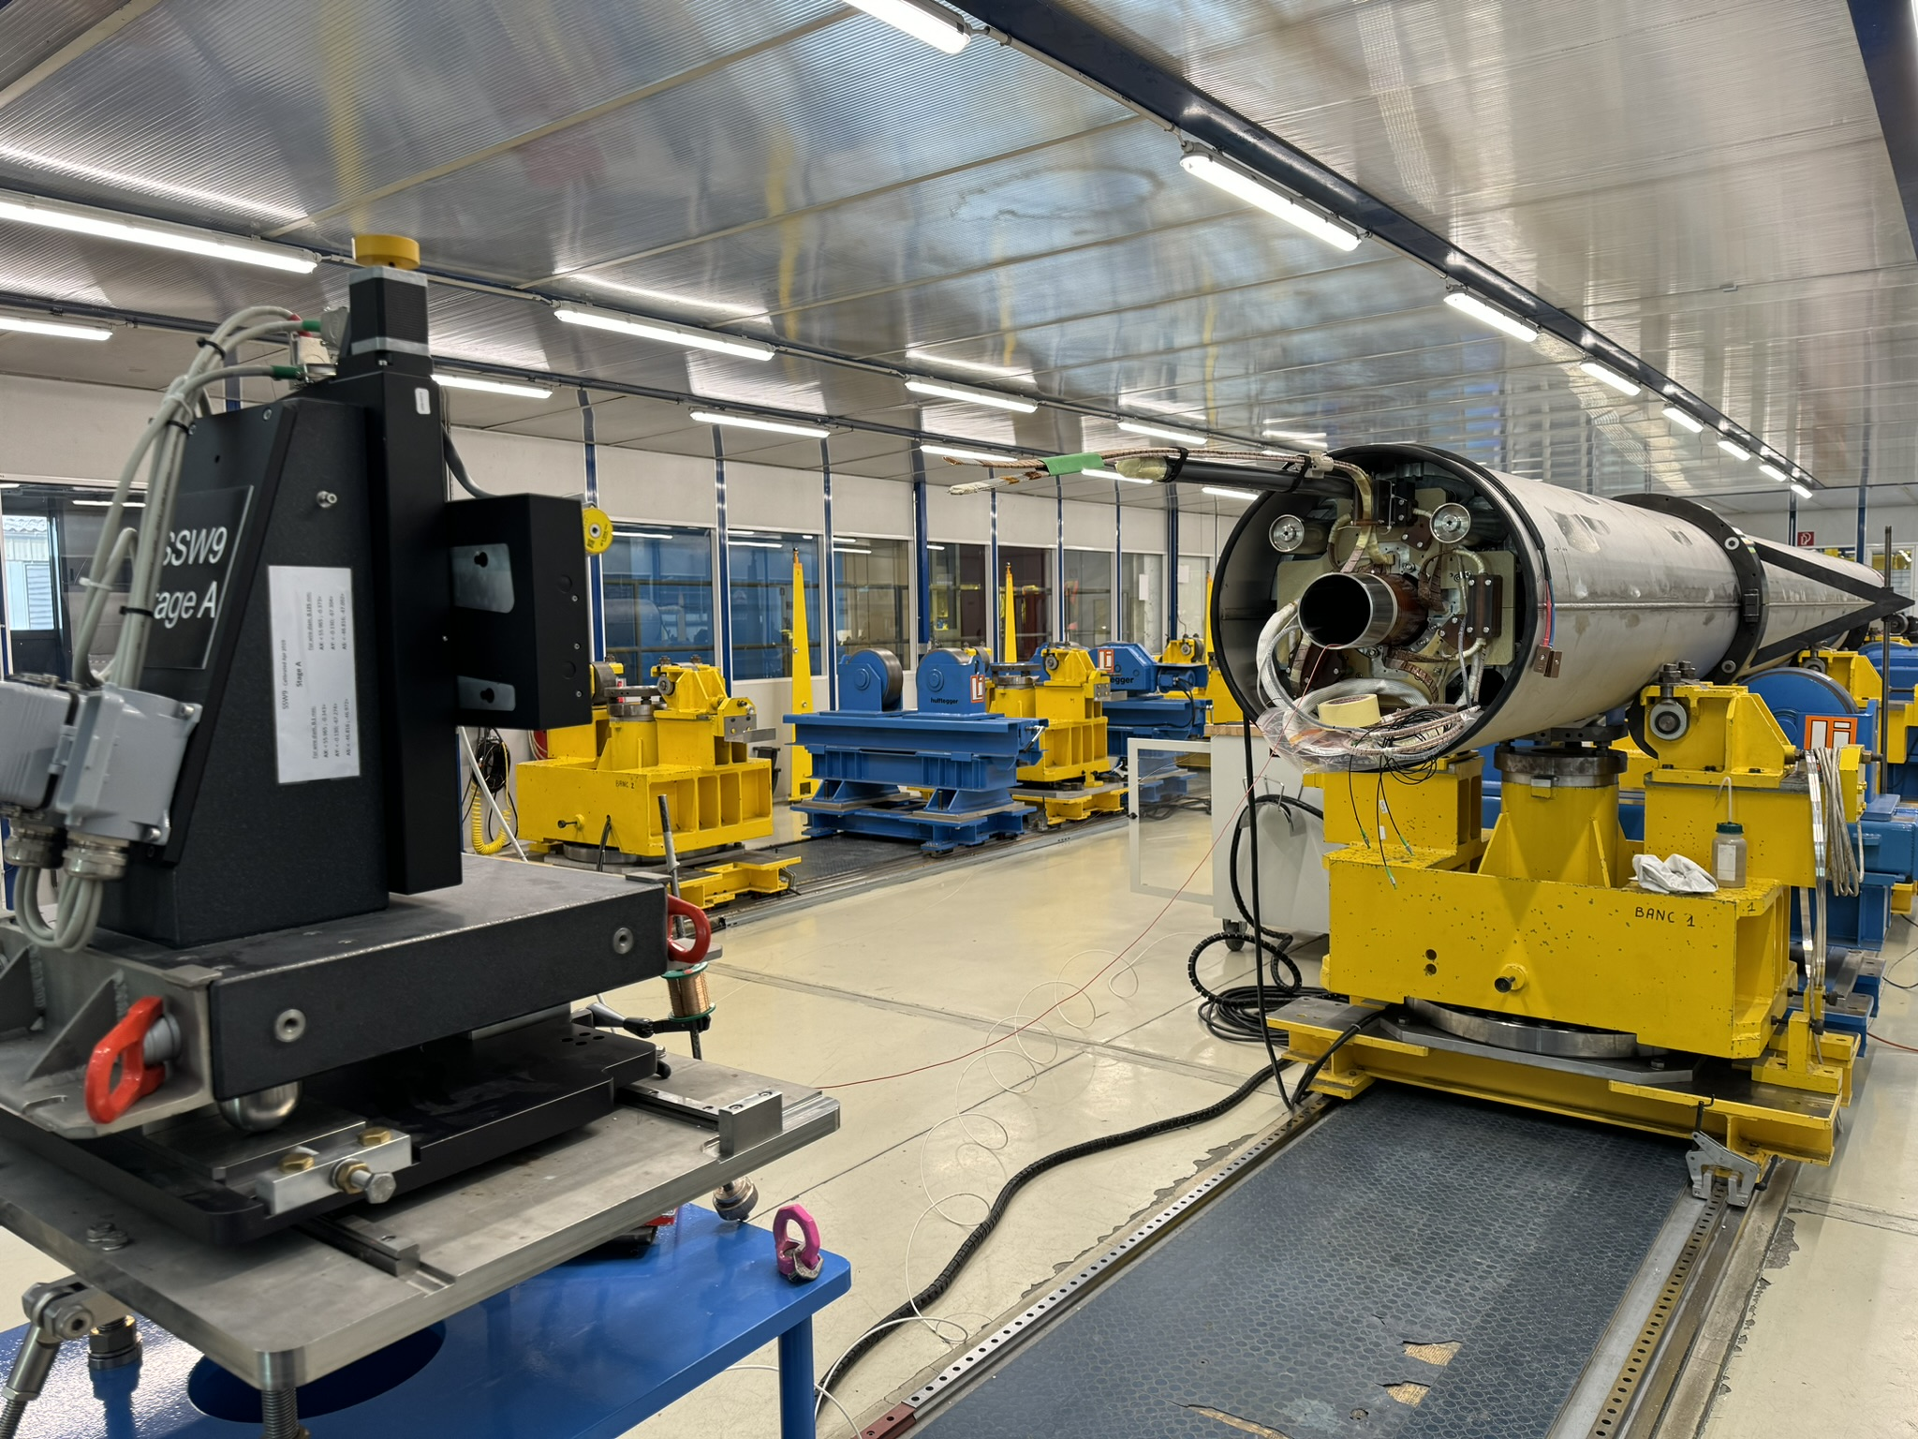
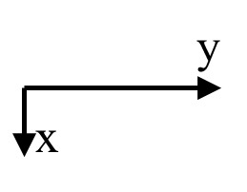
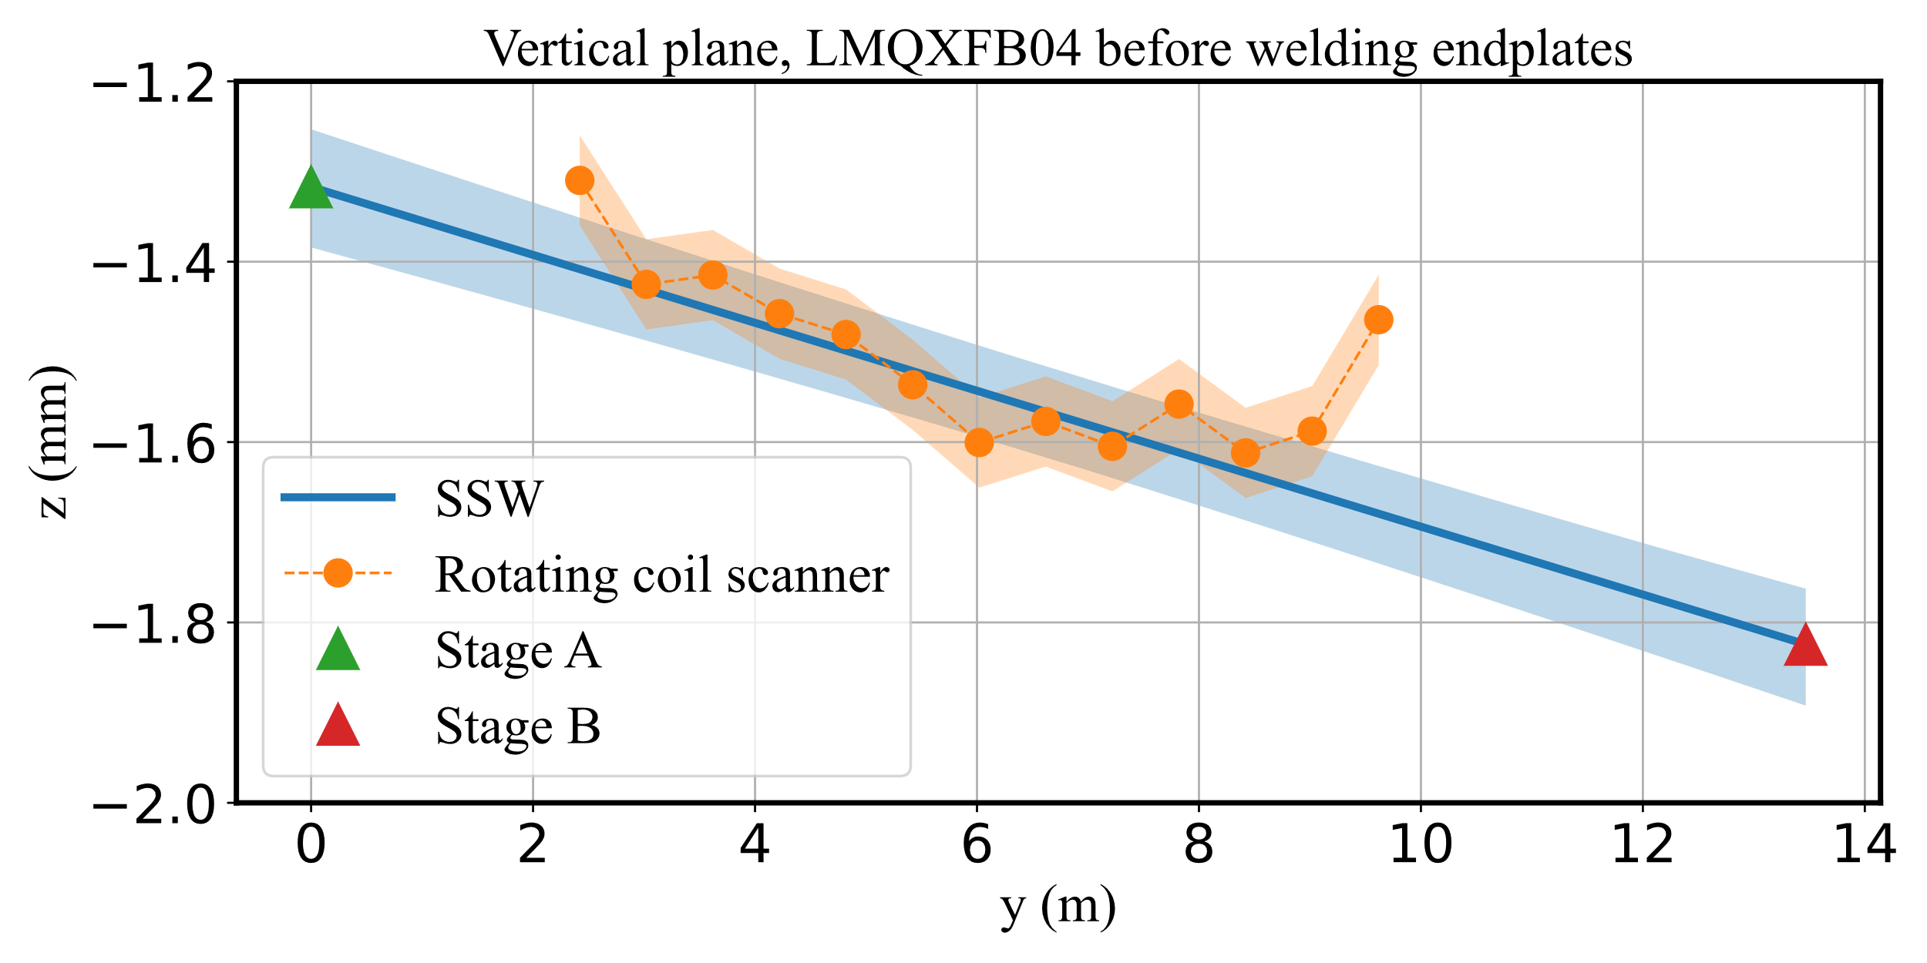
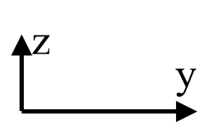
Measurement method: single stretched wire
AC measurements – Validation against rotating coil scanner
z
y
x
Gravity
Parameter | SSW Value | SSW unc. (1-σ) | Rot. coil scanner Value | Rot. coil scanner unc. (1-σ)
x (mm) | 0.01 | 0.05 | 0.02 | 0.05
z (mm) | -1.54 | 0.07 | -1.52 | 0.05
Roll (mrad) | 0.06 | 0.10 | 0.02 | 0.07
Yaw (mrad) | 0.01 | 0.01 | 0.01 | 0.00
Pitch (mrad) | -0.04 | 0.01 | -0.03 | 0.00
Magnetic axis - Carlo Petrone - 14th HL-LHC Collaboration Meeting – Genoa – 10 October 2024

Slide 12
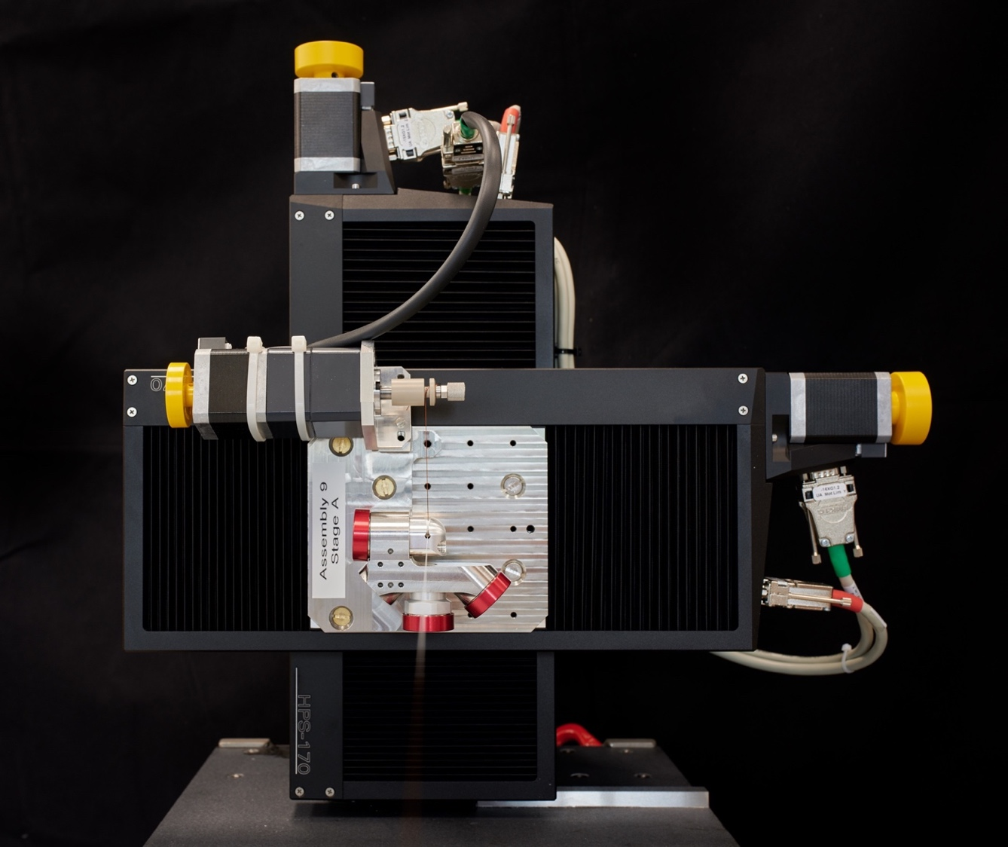
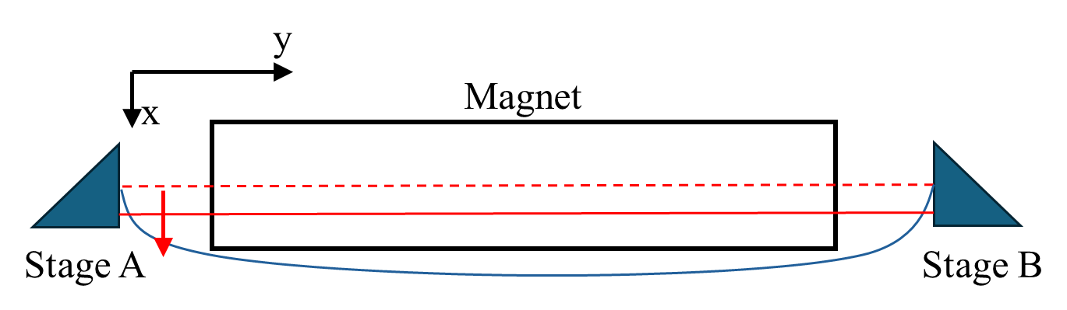
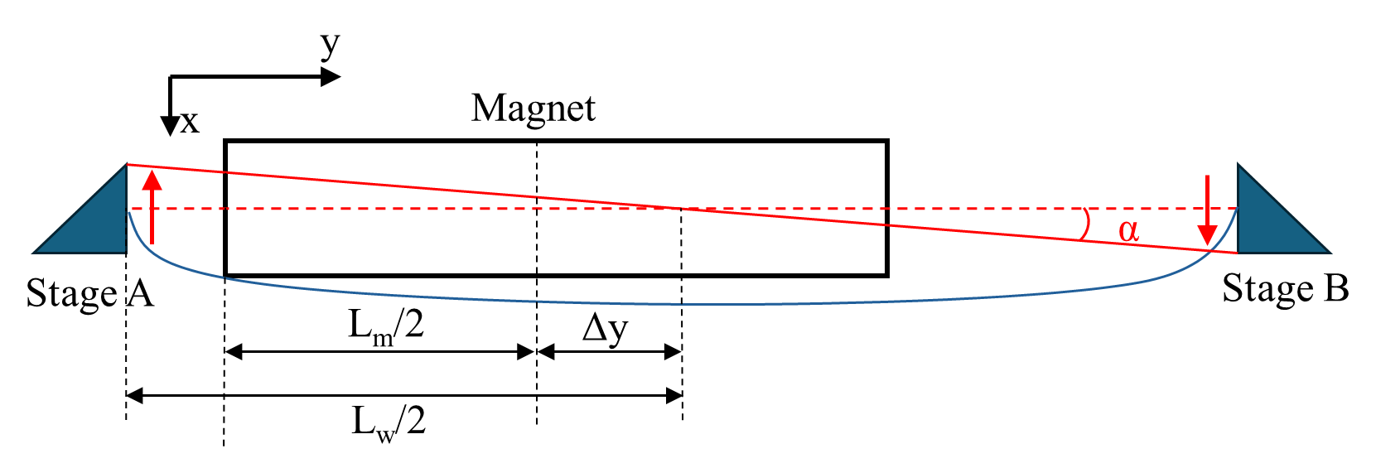


Measurement method: single stretched wire
DC measurements – SSW at cryogenic temperature
Alignment of the wire with the magnetic axis performed iteratively by combining two different wire movement types (CO and CN).
Knowledge about longitudinal magnet position is crucial for setting up wire stages movement appropriately, especially with an asymmetric setup.
Co-directional movement (CO)
Counter-directional movement (CN)
$$Φ\left(x_{1},x_{2}\right)=\left(GL_{m}\right) \frac{{x_{2}^{2}−x}_{1}^{2}}{2}$$
$$Φ\left(α_{1},α_{2}\right)=\left(GL_{m}\right)\frac{α_{2}^{2}−α_{1}^{2}}{2}\left(\frac{L_{m}^{2}}{12}+Δy^{2}\right)$$
The integrated gradient is measured with a CO movement.
Magnetic axis - Carlo Petrone - 14th HL-LHC Collaboration Meeting – Genoa – 10 October 2024

Slide 13
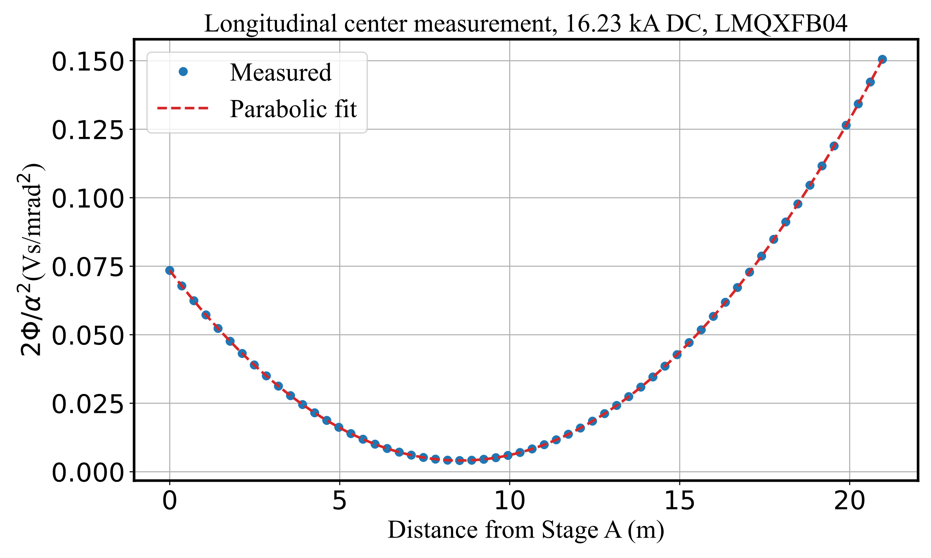

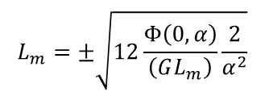
Measurement method: single stretched wire
Longitudinal center and magnetic length
The longitudinal center position is measured by a sequence of CN movements, with the pivot position $y_{P}$ moving along the longitudinal axis.
$$Φ\left(0,α\right)=\left(GL_{m}\right)\frac{α^{2}}{2}\left(\frac{L_{m}^{2}}{12}+Δy^{2}−y_{P}Δy\right)$$
$Φ\left(0,α\right)\frac{2}{α^{2}}$ describes a parabola with its minimum in $y_{P}=Δy$
When the pivot point corresponds with the longitudinal center, $y_{P}=Δy$
$$L_{m}=±\sqrt{12\frac{Φ\left(0,α\right)}{\left(GL_{m}\right)}\frac{2}{α^{2}}}$$
Magnetic axis - Carlo Petrone - 14th HL-LHC Collaboration Meeting – Genoa – 10 October 2024

Slide 14
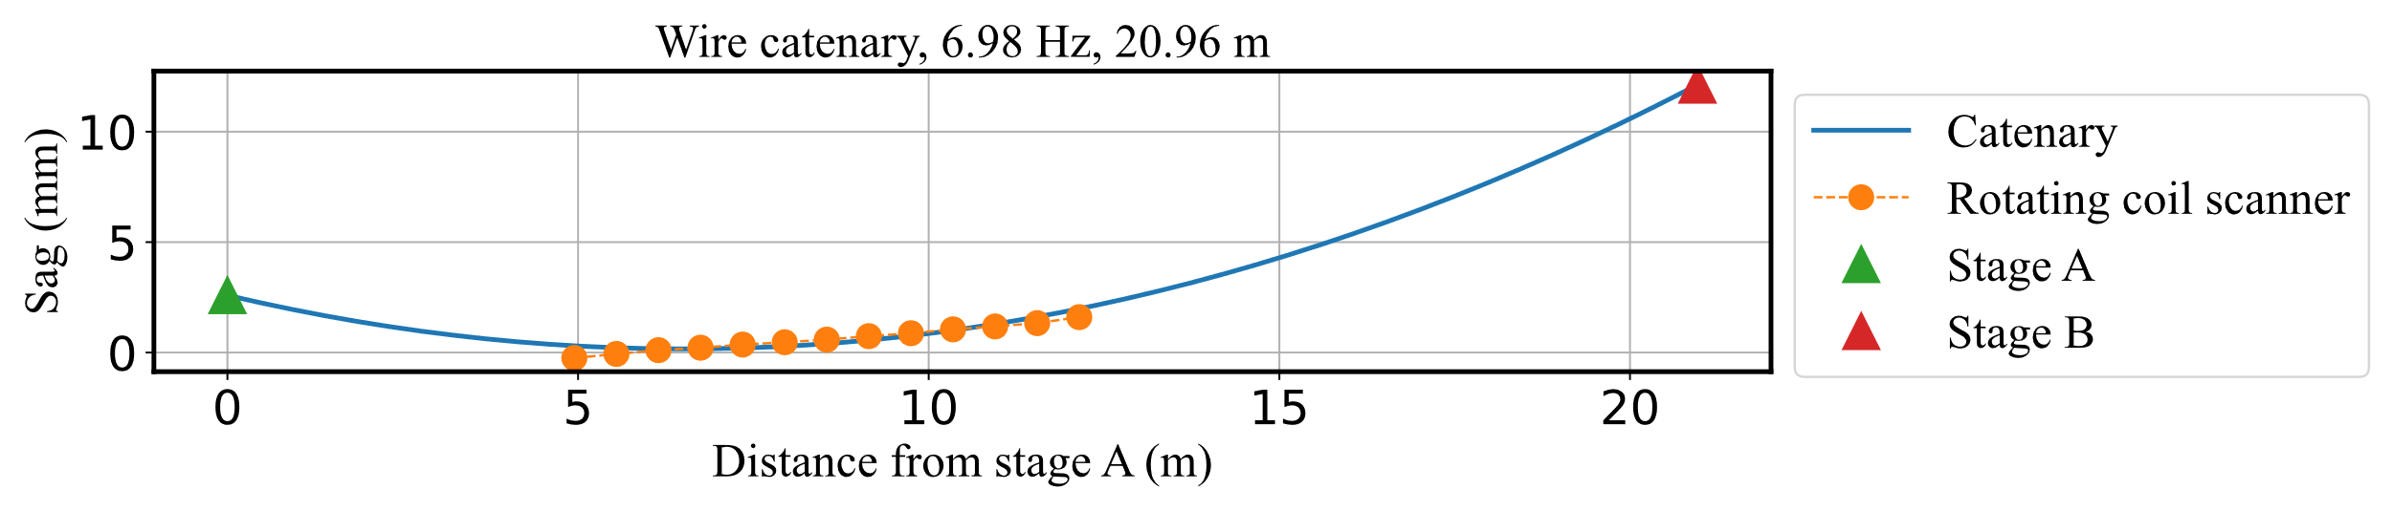

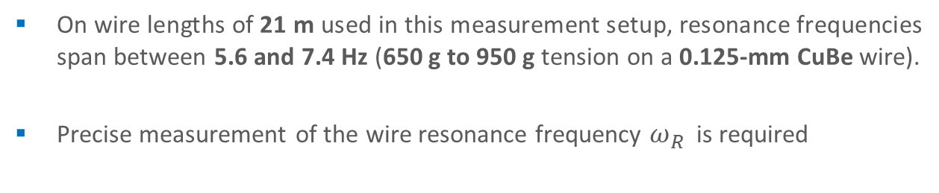
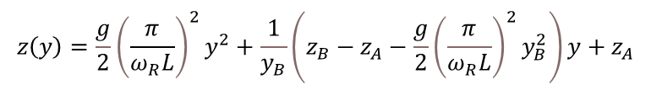
Measurement method: single stretched wire
Sagitta correction
$$z\left(y\right)=\frac{g}{2}{\left(\frac{π}{ω_{R}L}\right)}^{2}y^{2}+\frac{1}{y_{B}}\left(z_{B}−z_{A}−\frac{g}{2}{\left(\frac{π}{ω_{R}L}\right)}^{2}y_{B}^{2}\right)y+z_{A}$$
Gravity
$$z$$
On wire lengths of 21 m used in this measurement setup, resonance frequencies span between 5.6 and 7.4 Hz (650 g to 950 g tension on a 0.125-mm CuBe wire).
Precise measurement of the wire resonance frequency $ω_{R}$ is required
Magnetic axis - Carlo Petrone - 14th HL-LHC Collaboration Meeting – Genoa – 10 October 2024

Slide 15
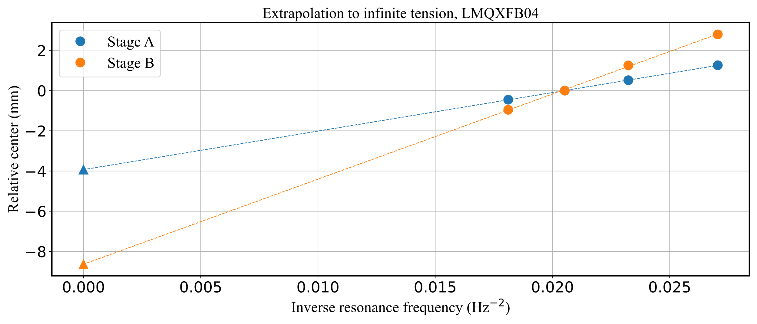
Measurement method: single stretched wire
Sagitta correction
-3.93 mm
-8.64 mm
Offset due to wire sagitta (or sag) corrected by performing the measurements at different wire tensions and extrapolating at infinite tension.
Precise measurement of the wire resonance frequency: uncertainty ~ 0.01-0.03 Hz.
Magnetic axis - Carlo Petrone - 14th HL-LHC Collaboration Meeting – Genoa – 10 October 2024

Slide 16
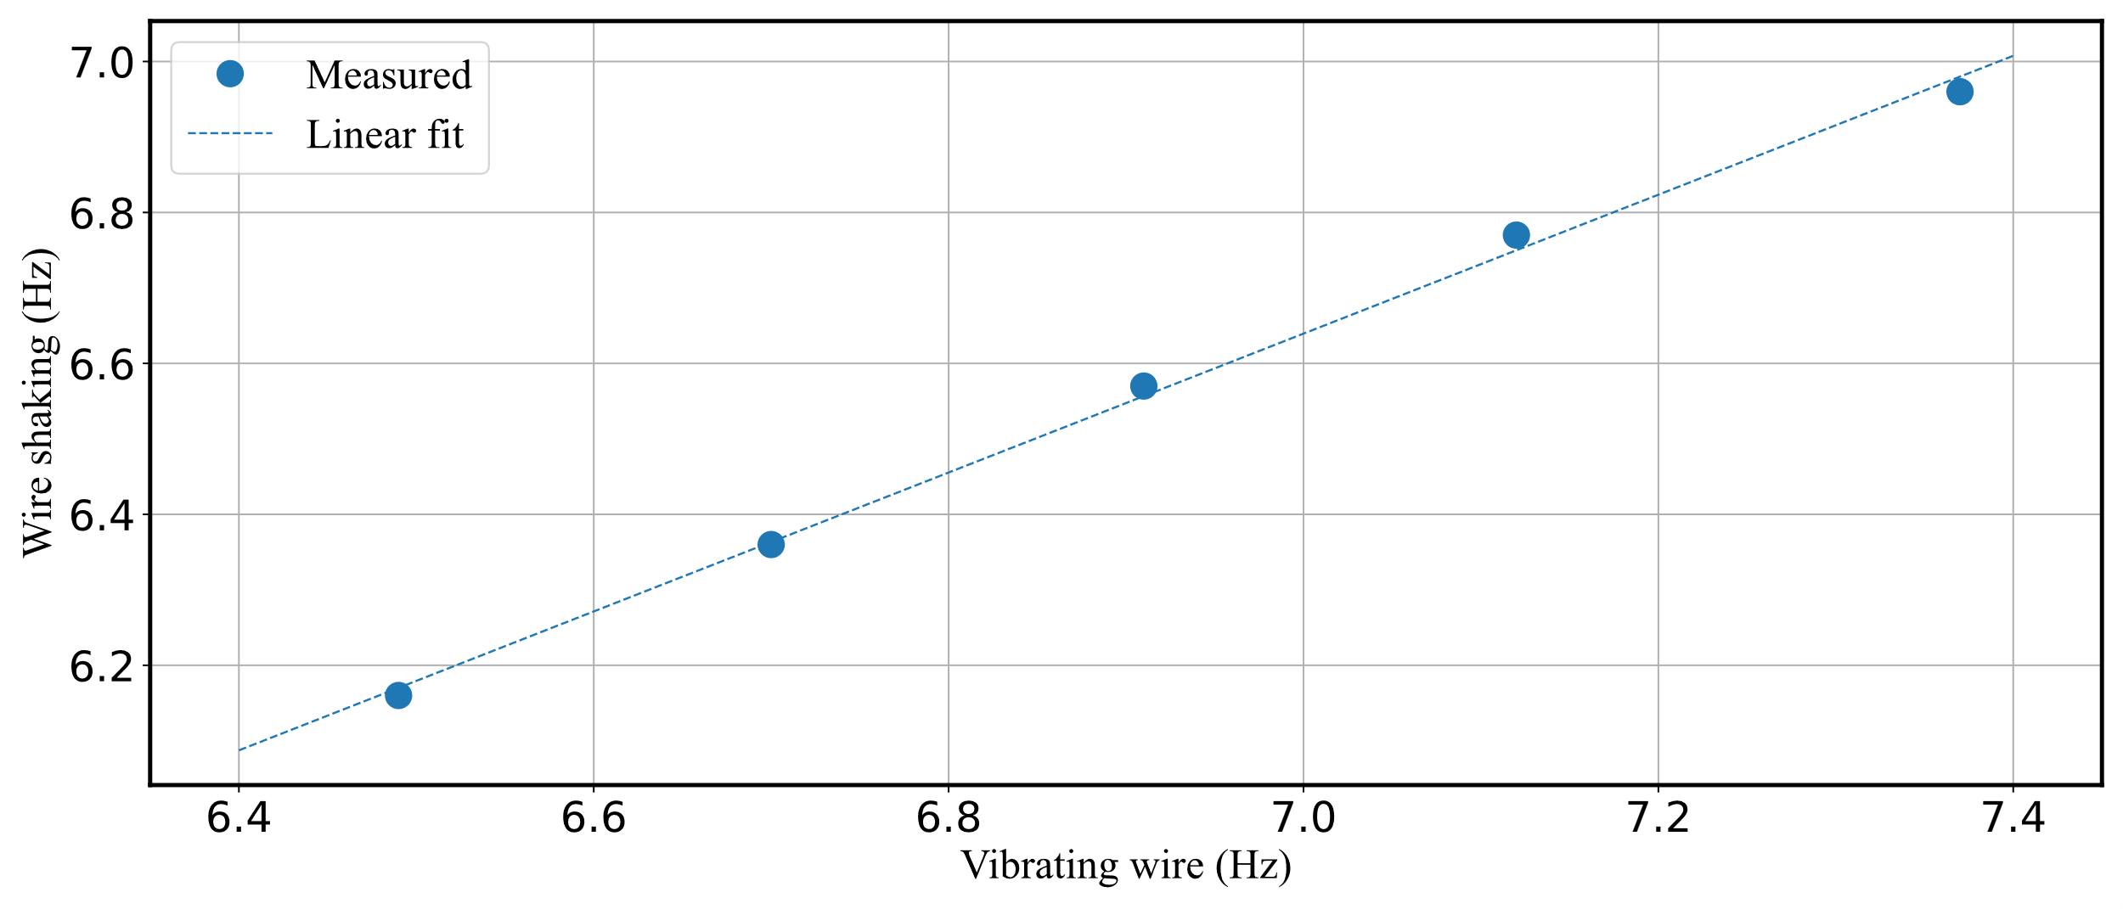

Measurement method: single stretched wire
Resonance frequency measurement
The wire susceptibility, thus magnetic forces, also impact the measurement of the wire resonance frequency. The plot of the frequencies measured by wire shaking against the wire measured with the vibrating wire in the lower field region (wire located around the axis)
$f_{R}\left\{shake\right\}≈$ 0.92 $f_{R}\left\{vibrating wire\right\}$+0.19
In practice, the residual 0.19 Hz impacts the extrapolation up to 0.2 mm for asymmetric stage-magnet configuration on the farther stage (stage B for the Q2s).
Choice: vibrating wire method for resonance frequency determination
Magnetic axis - Carlo Petrone - 14th HL-LHC Collaboration Meeting – Genoa – 10 October 2024

Slide 17
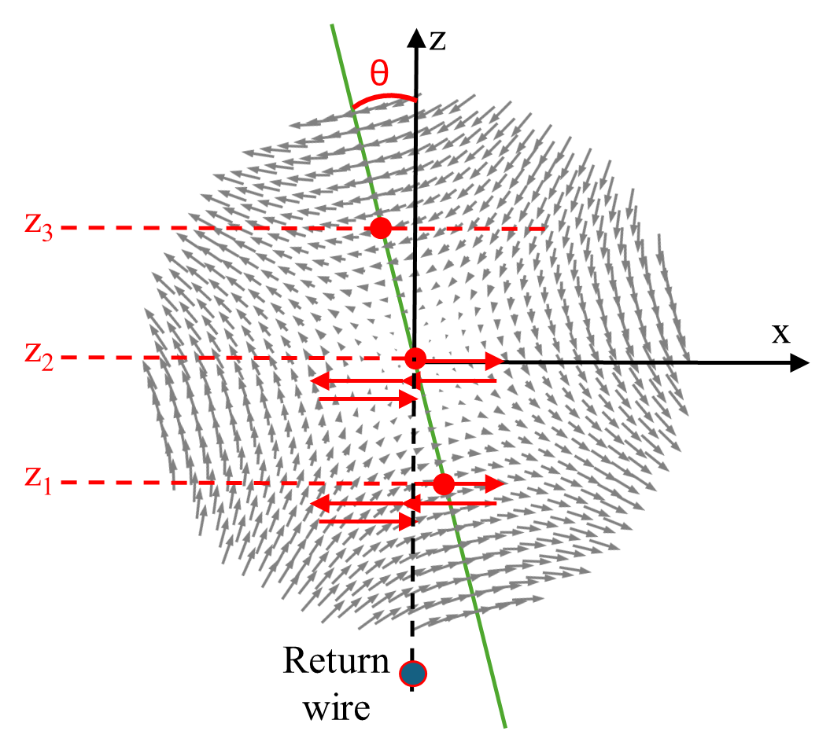

Measurement method: single stretched wire
Roll angle measured by linear interpolation of horizontal centers at different vertical coordinates
$$θ_{roll}=\frac{θ}{2}=−\frac{1}{2}\operatorname{atan}\left(\frac{x}{z}\right)$$
Magnetic axis - Carlo Petrone - 14th HL-LHC Collaboration Meeting – Genoa – 10 October 2024

Slide 18
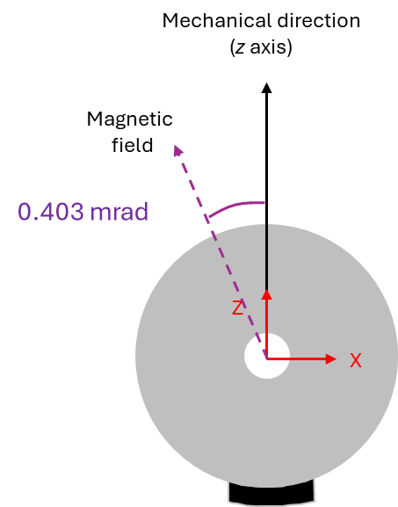
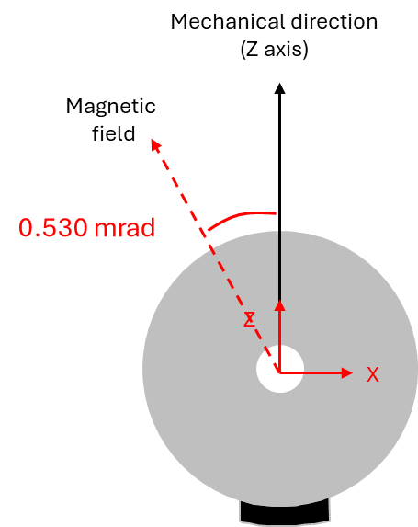
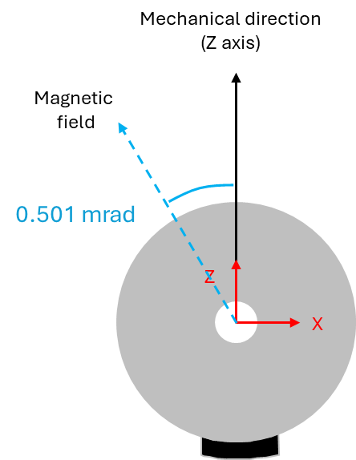
Measurement of LMQXFB04 – Roll angles
Rotating coil scanner (180)
SSW at room temperature (final)
SSW at cold, nominal current (final)
Magnetic axis - Carlo Petrone - 14th HL-LHC Collaboration Meeting – Genoa – 10 October 2024

Slide 19
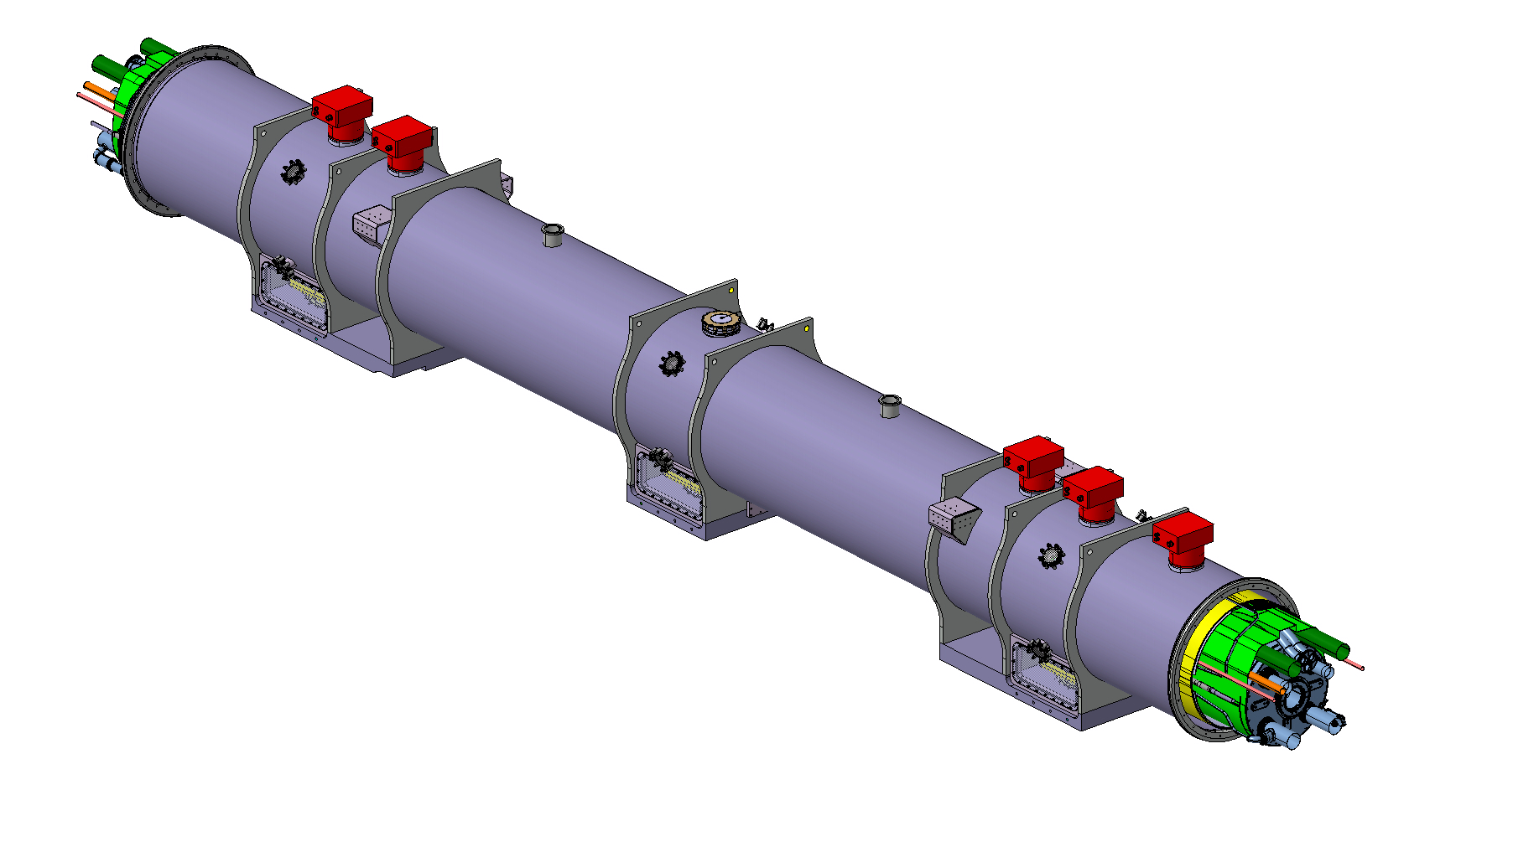
Final reference system definition
Final reference system
All final measurement results expressed in a reference frame where:
  Primary axis y – best-fit line of CBT, with positive direction from the quadrupole Connection Side (CS) to Non-Connection Side (NCS).
  Secondary axis z – Normal vector to the plane of D9 and D10, on CS and NCS side
  Origin: Intersection between the projection of the central cold support on y-axis and the y-axis
NCS side
z
y
x
CS side
Magnetic axis - Carlo Petrone - 14th HL-LHC Collaboration Meeting – Genoa – 10 October 2024

Slide 20
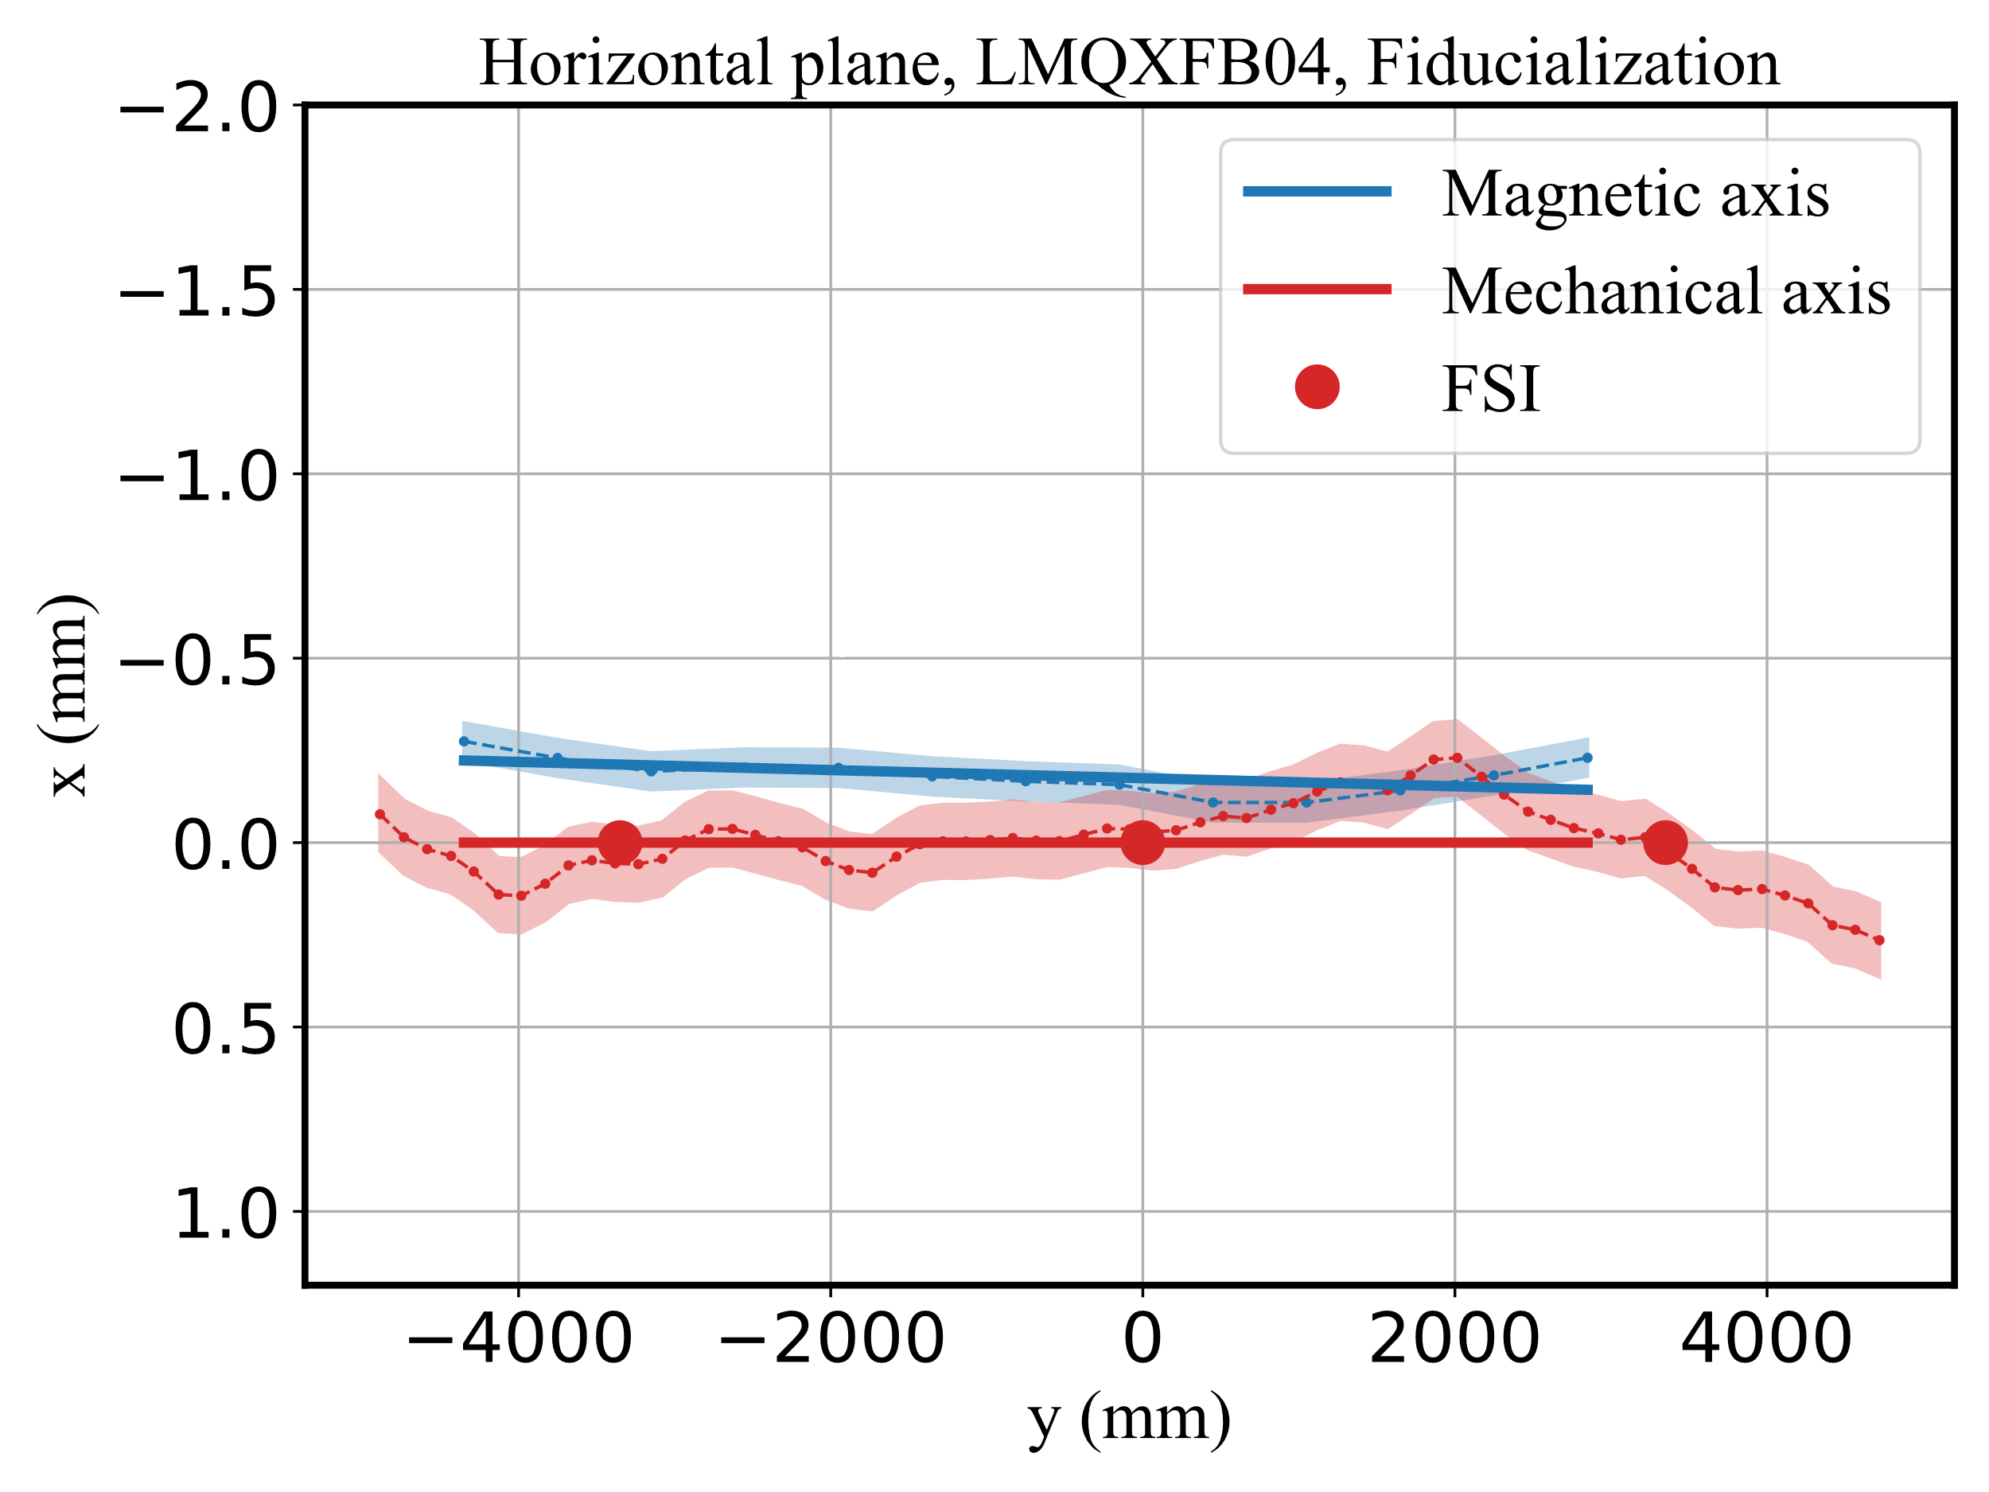
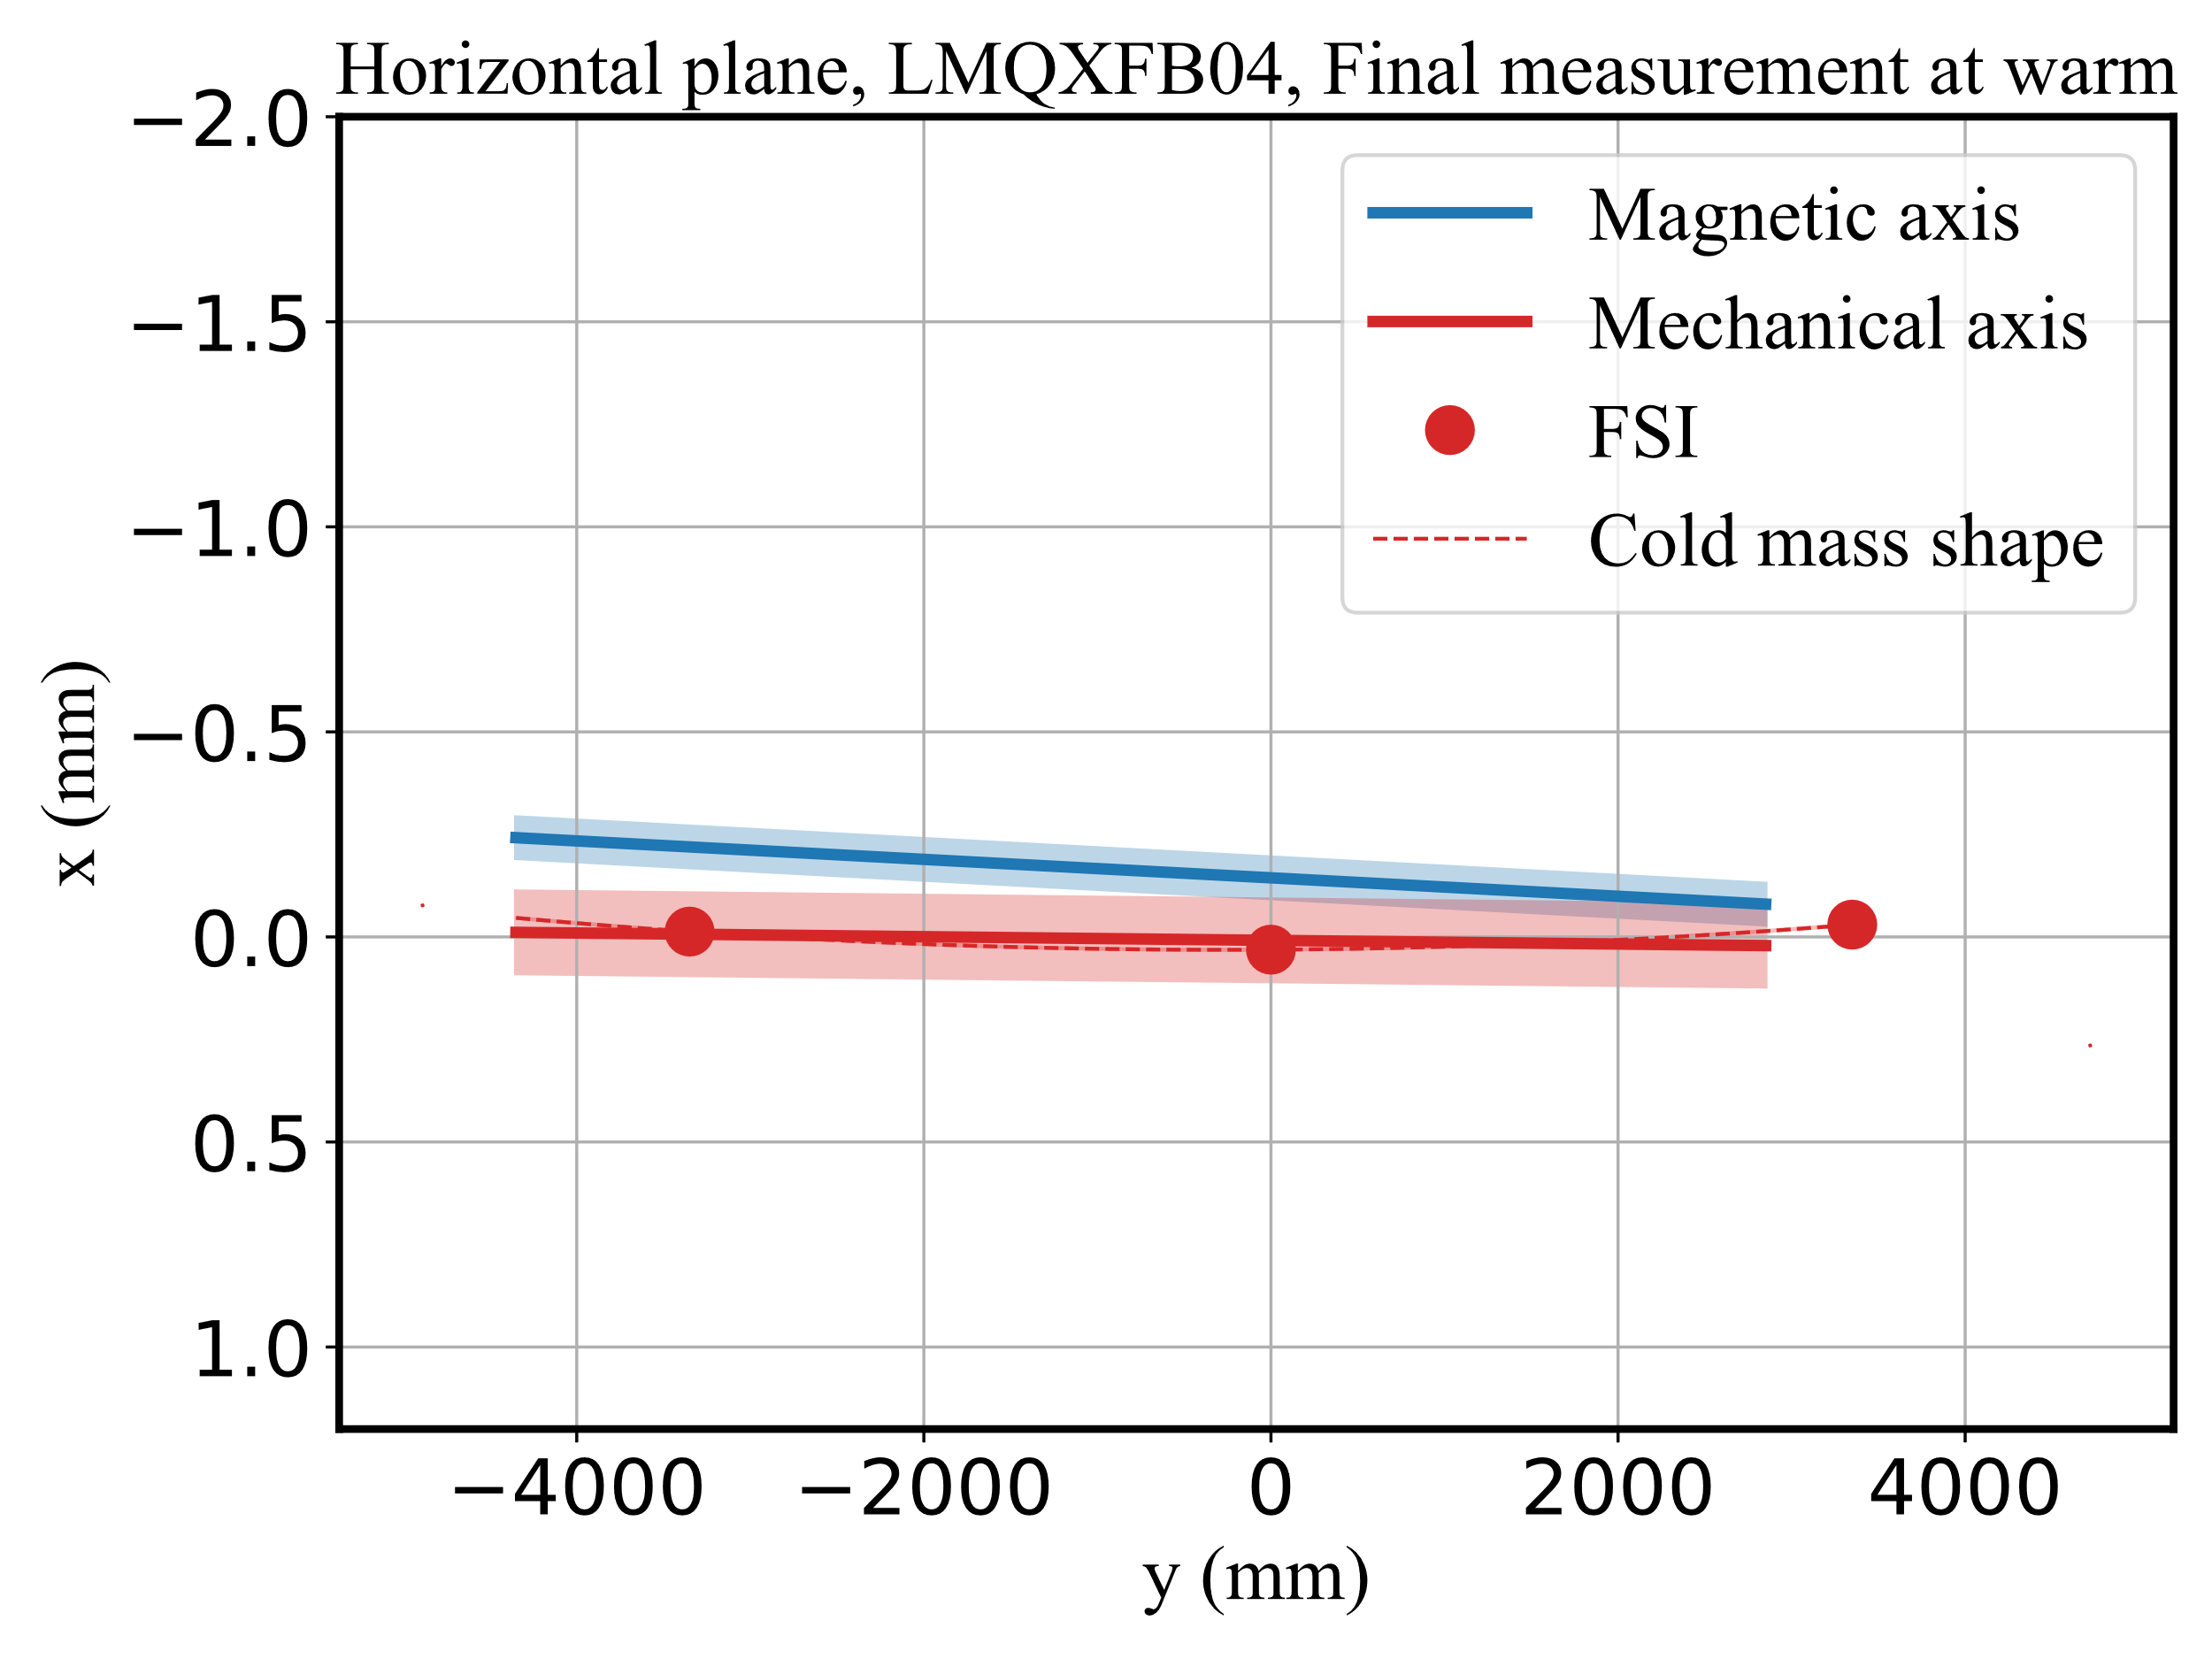
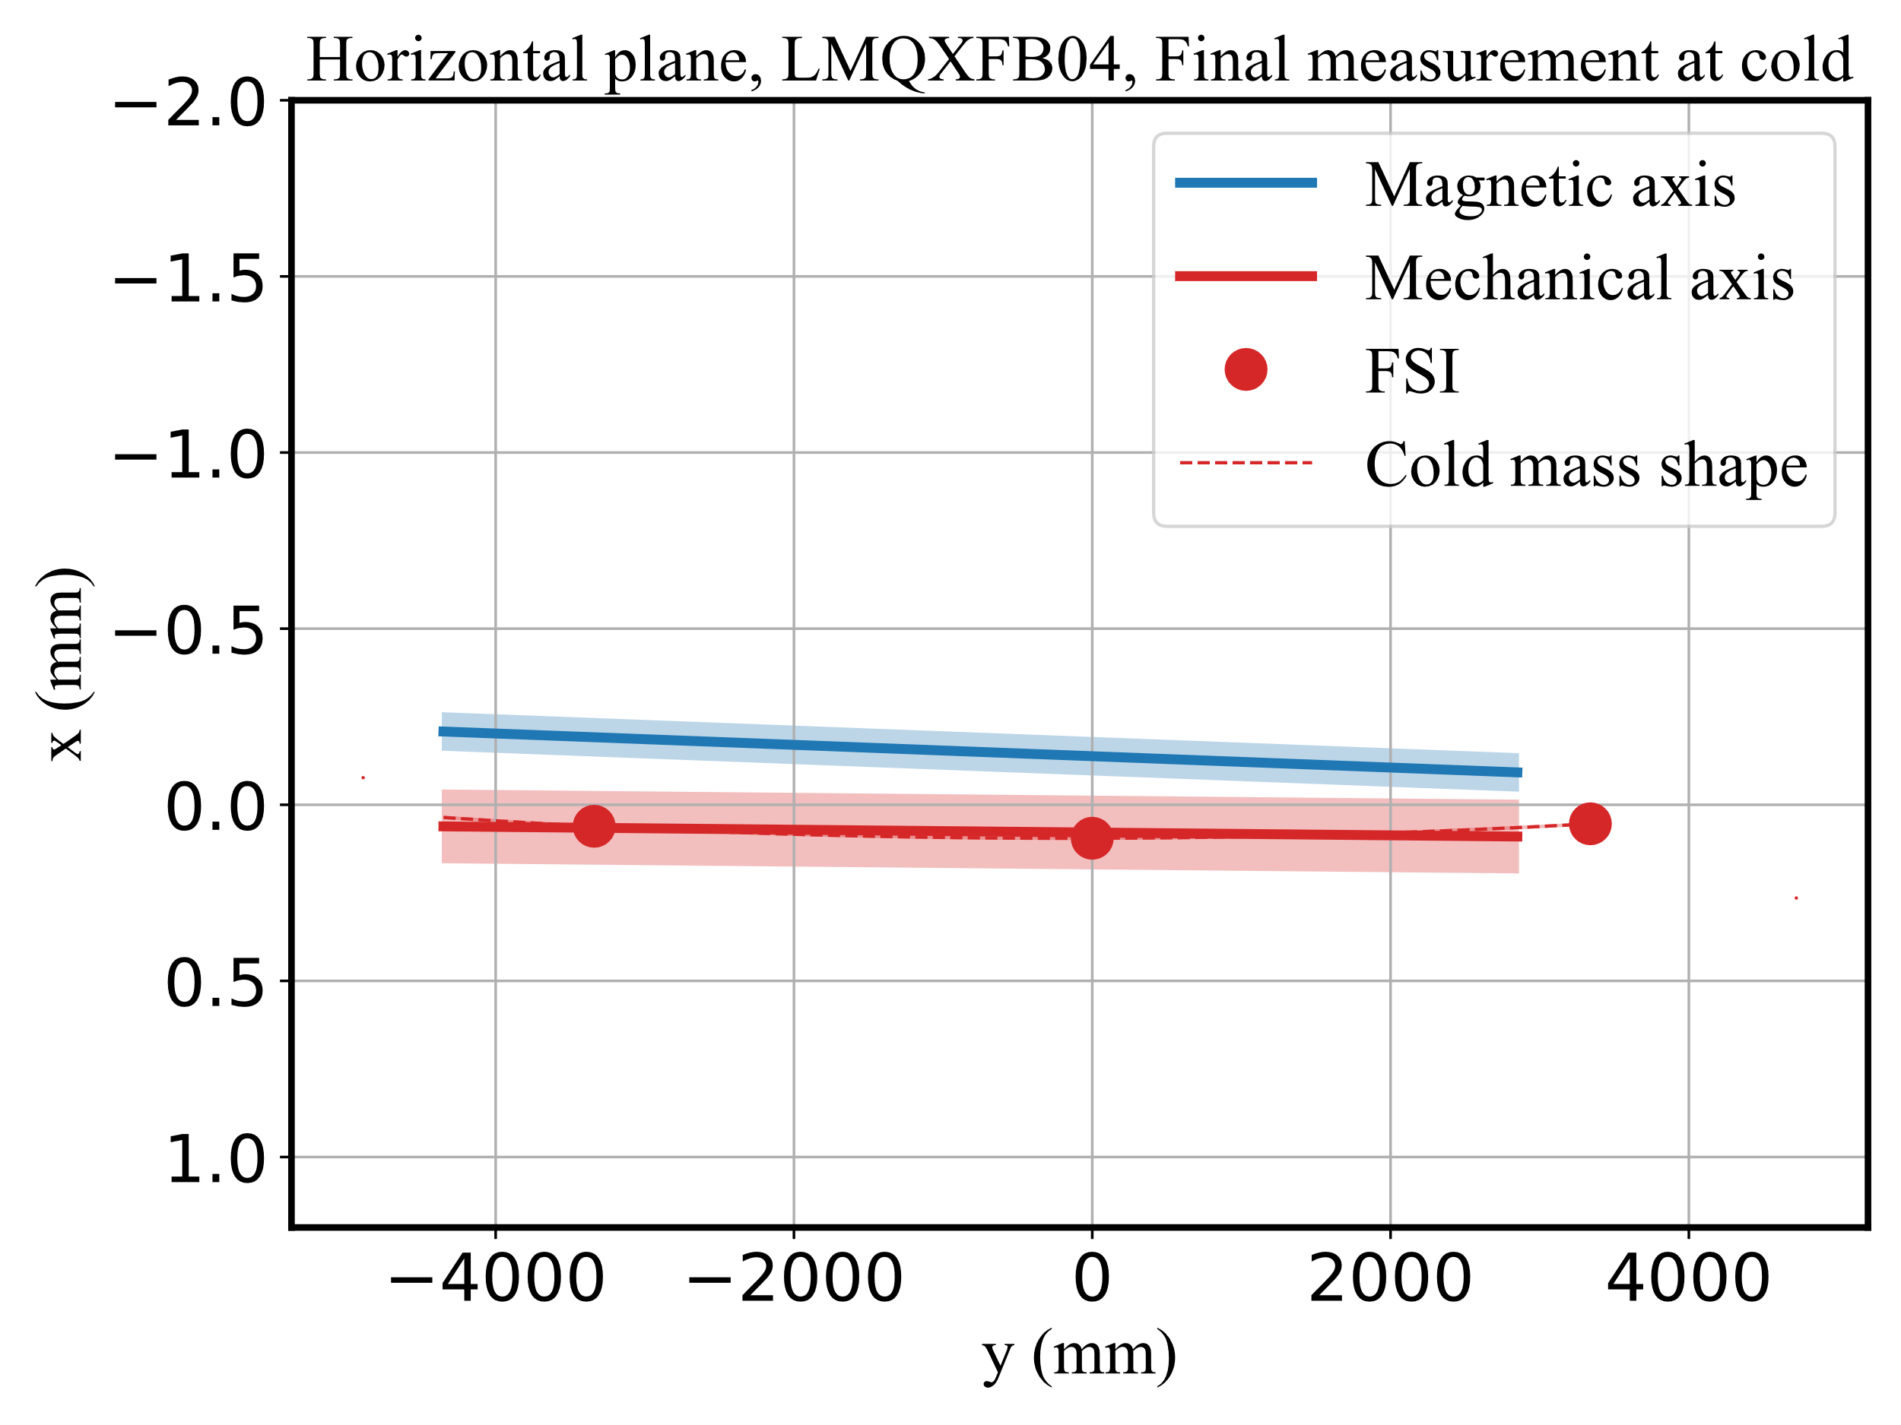
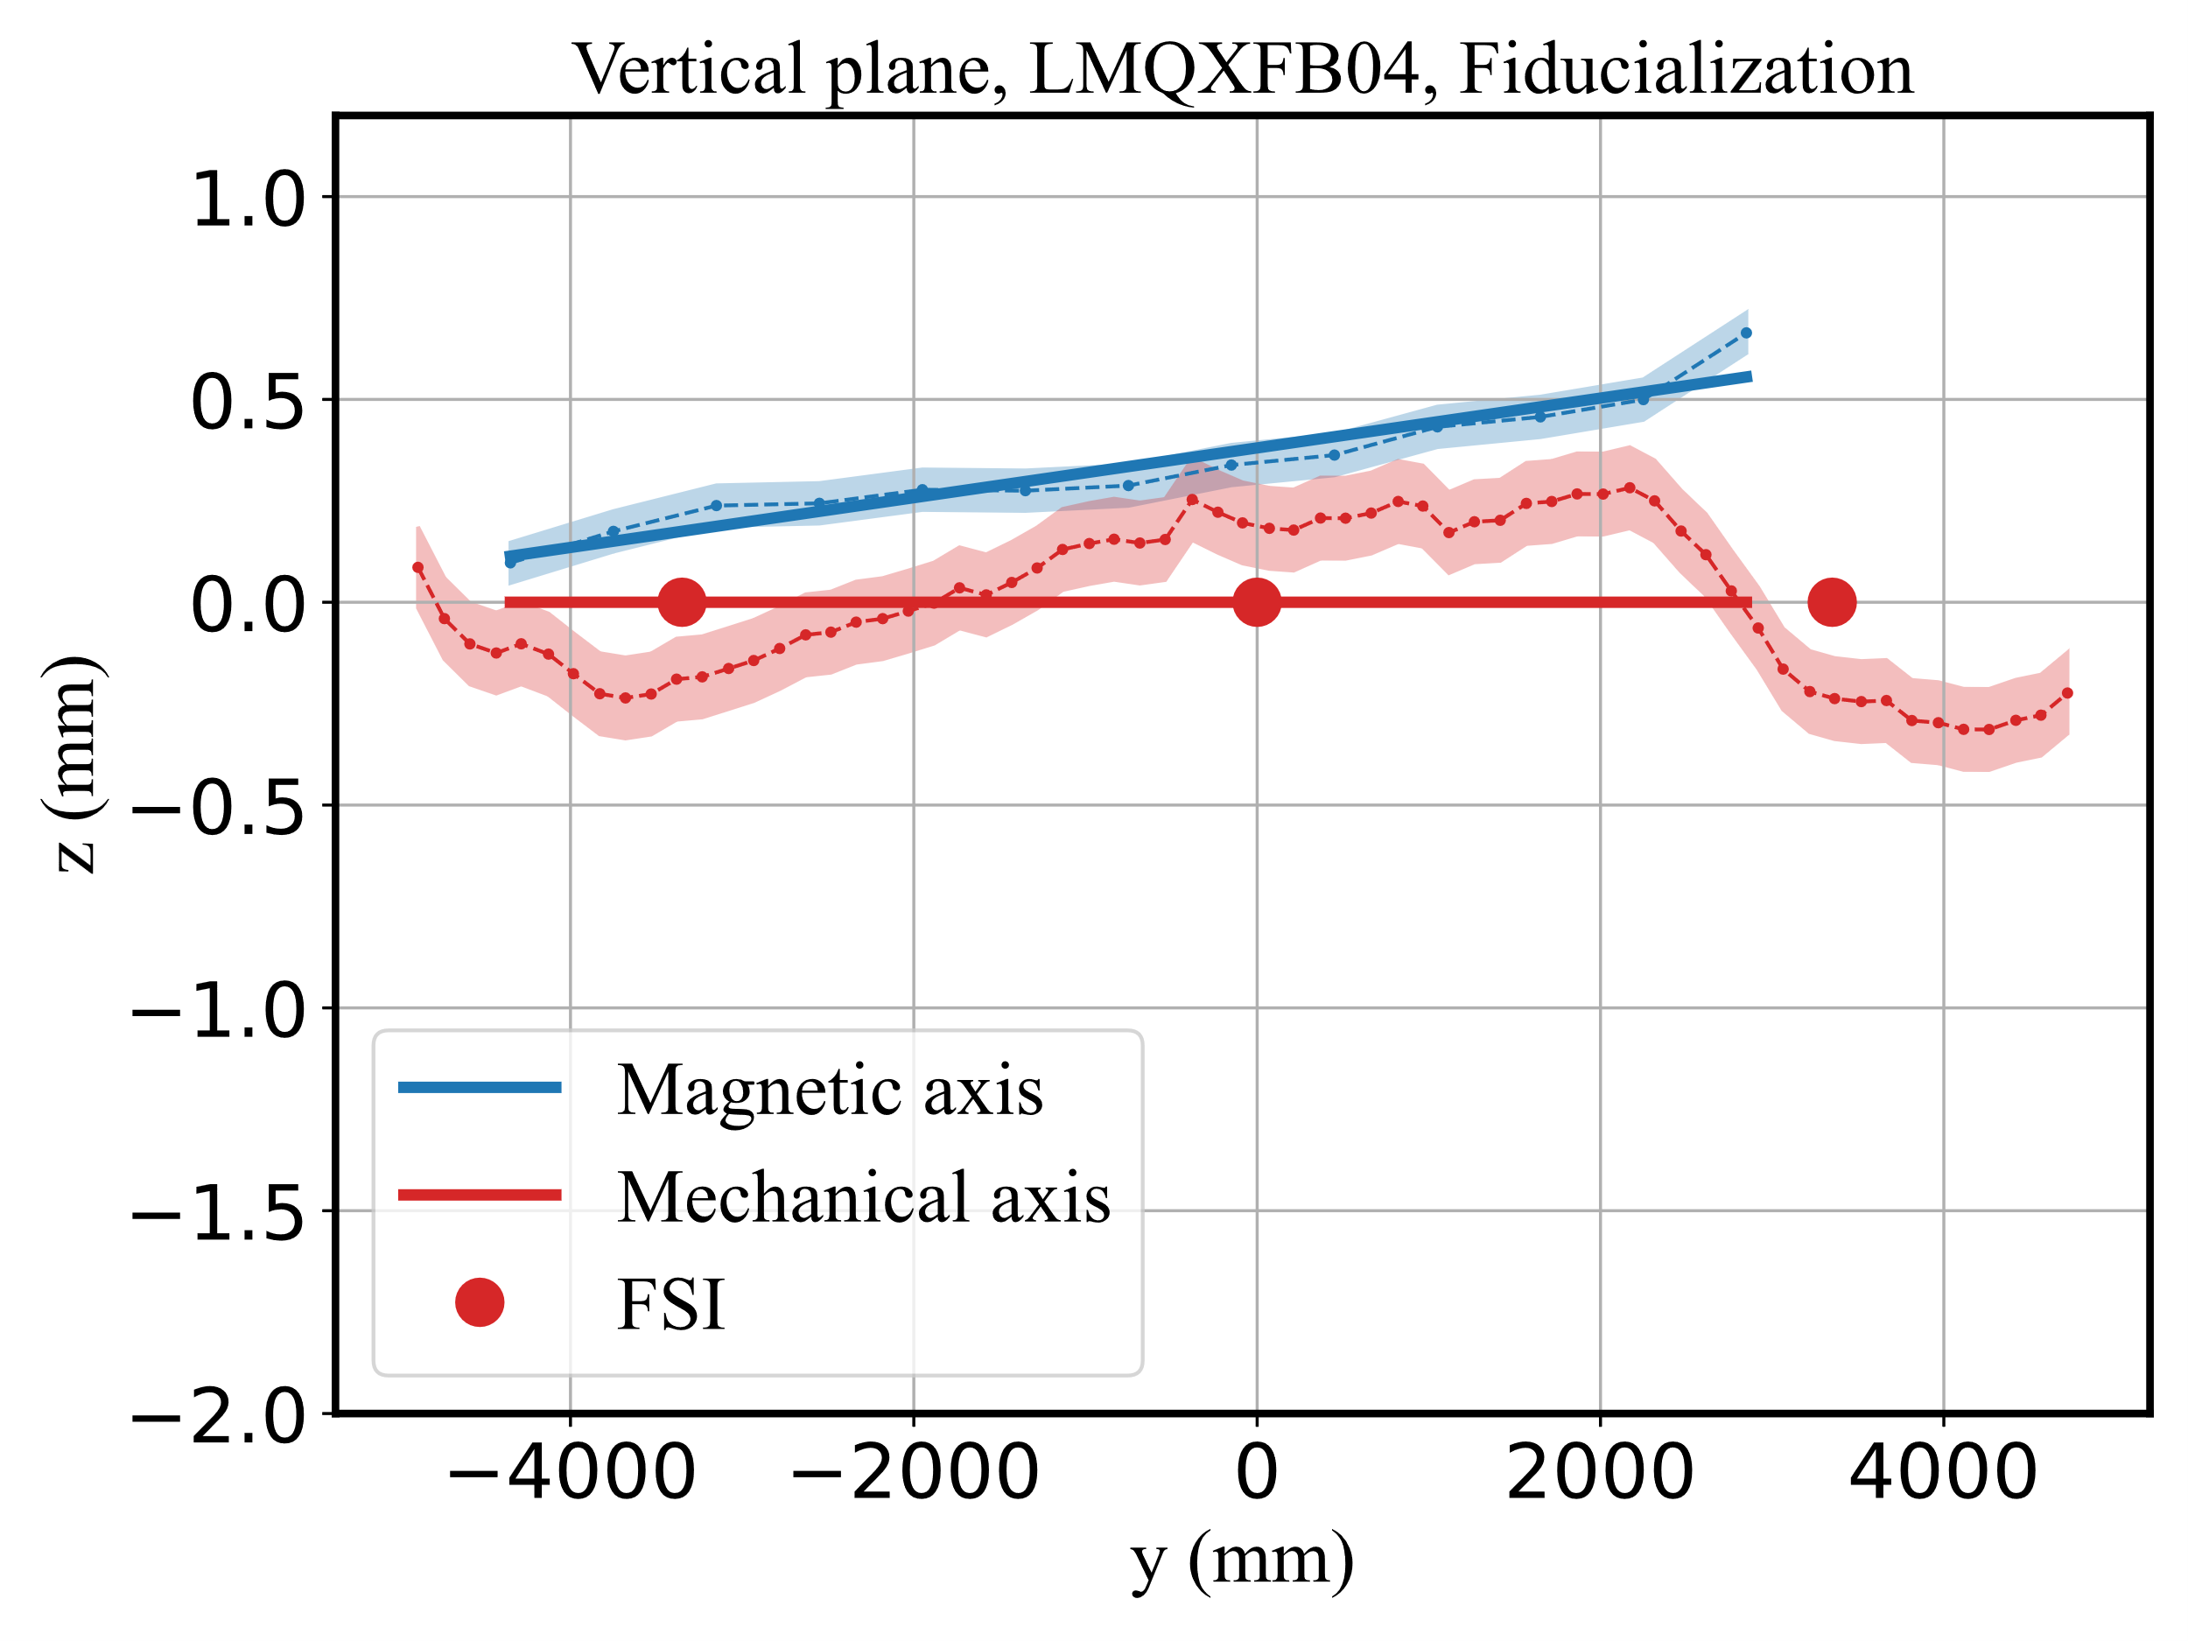
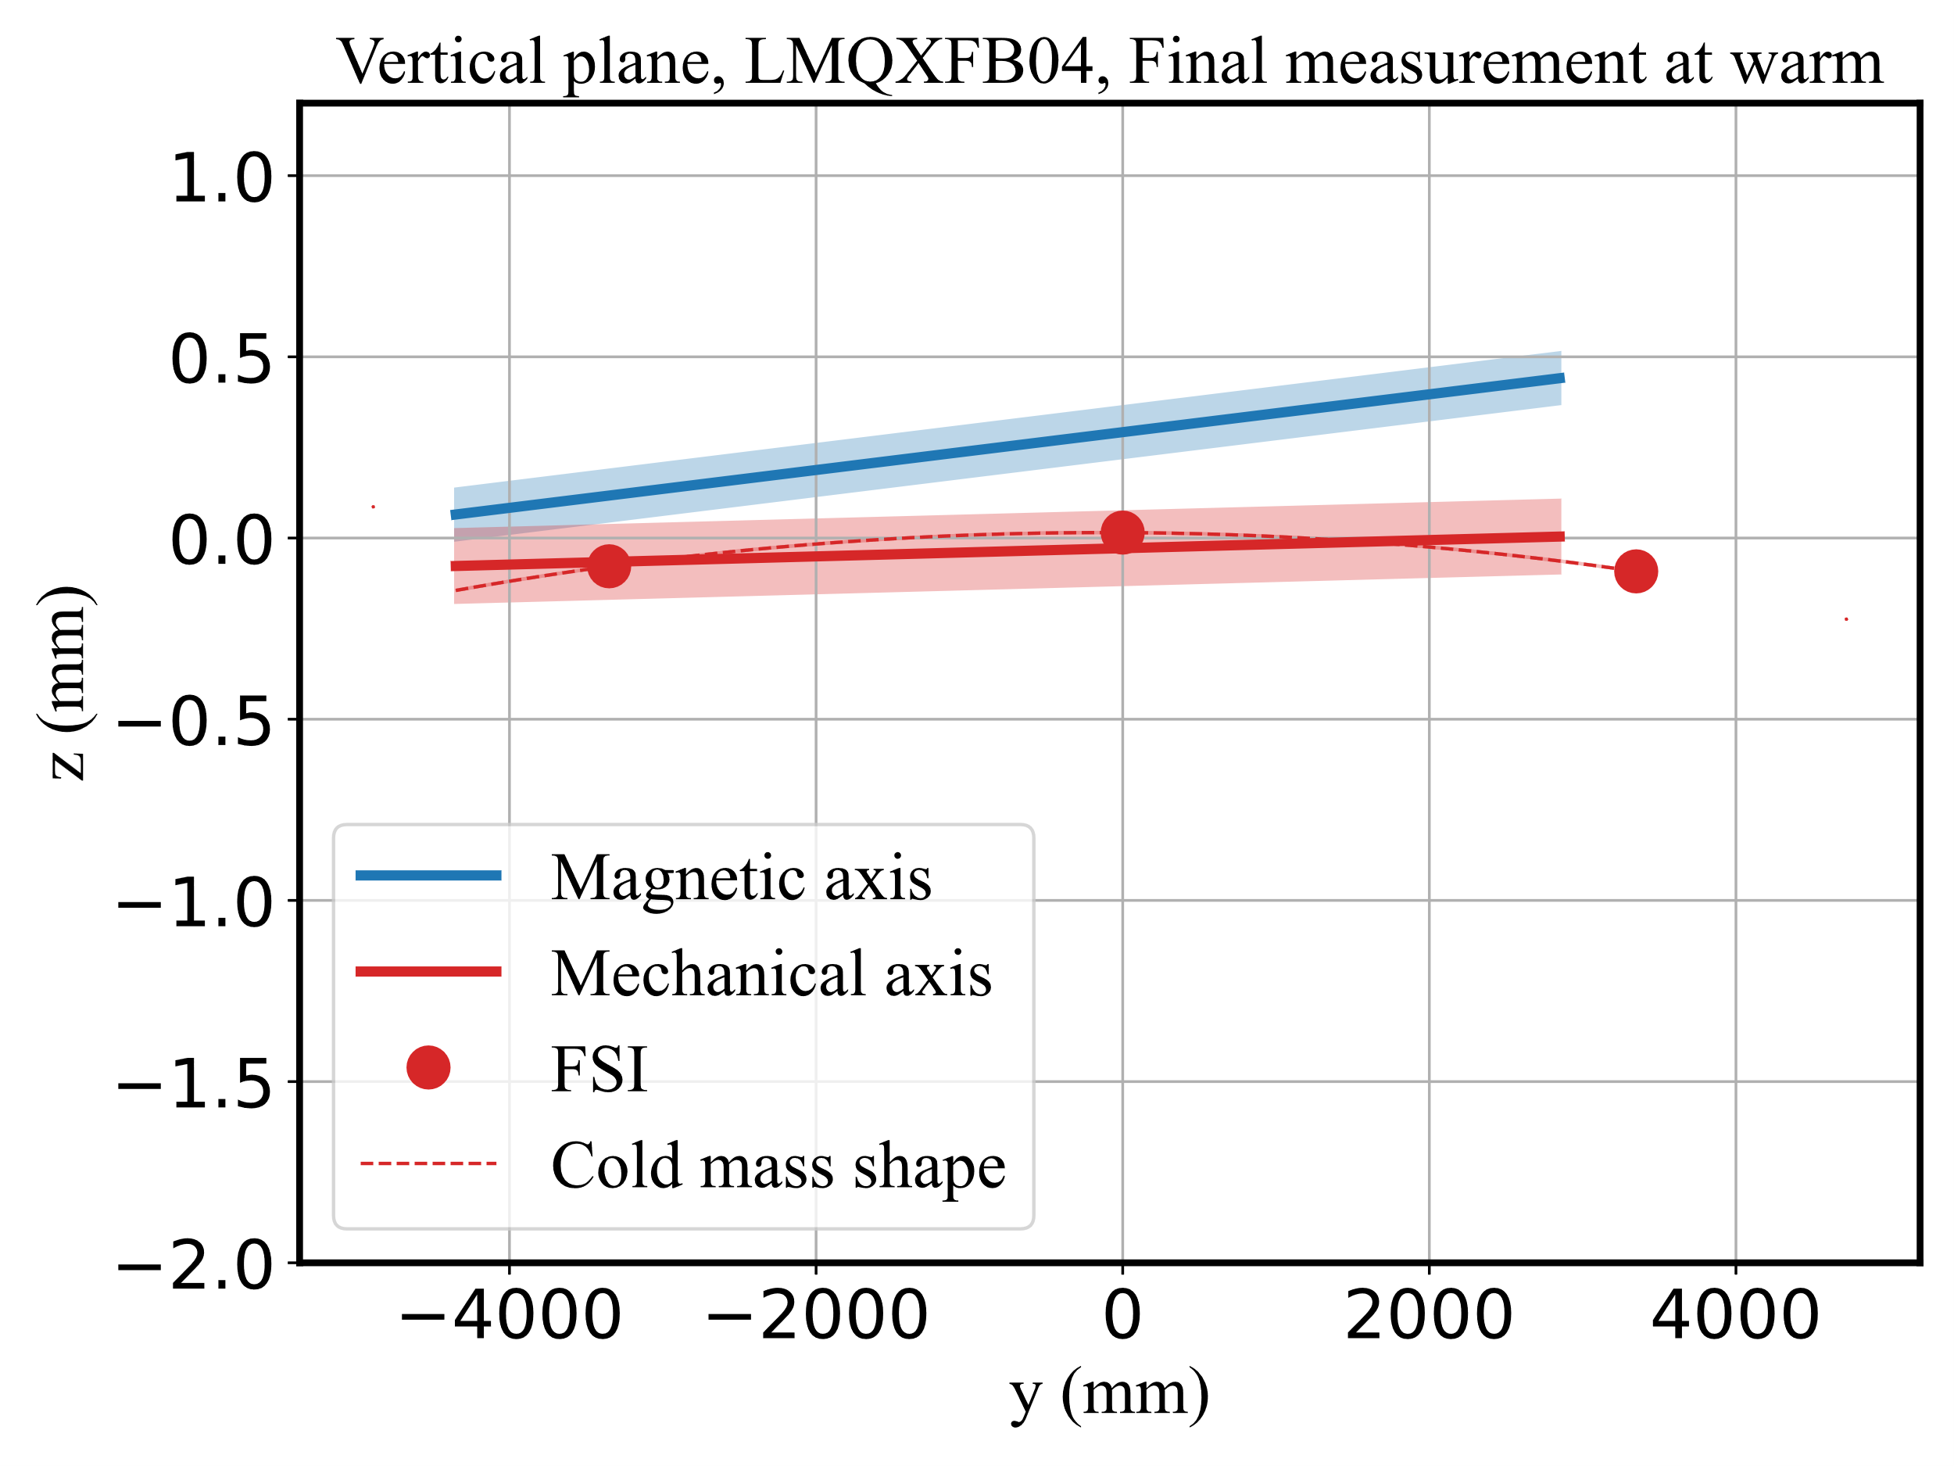
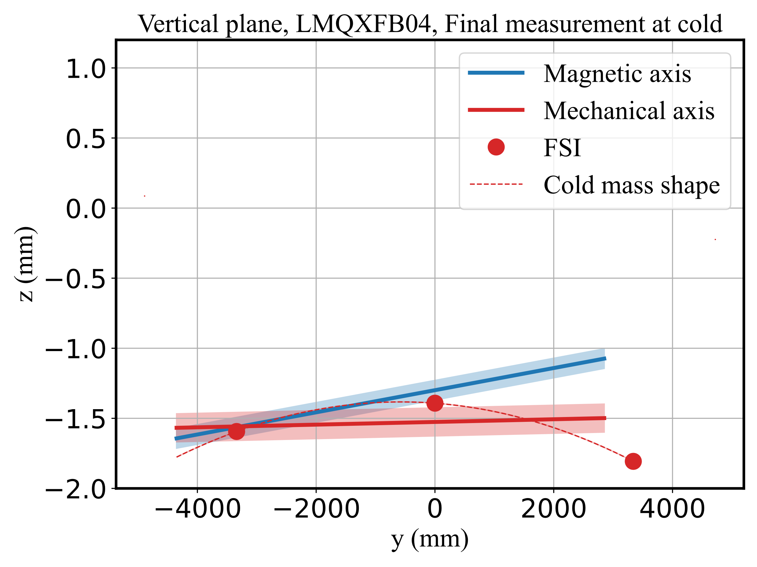
Measurement of LMQXFB04 – Magnetic axis
N.B: measurement performed after the cold test
-0.22 mm
-0.14 mm
-0.23 mm
-0.10 mm
-0.27 mm
-0.18 mm
0.56 mm
0.44 mm
0.11 mm
0.14 mm
-0.08 mm
0.42 mm
Cold-to-warm vertical variation: -1.61 mm (magnetic) and -1.55 mm (mechanical)
Magnetic axis - Carlo Petrone - 14th HL-LHC Collaboration Meeting – Genoa – 10 October 2024

Slide 21
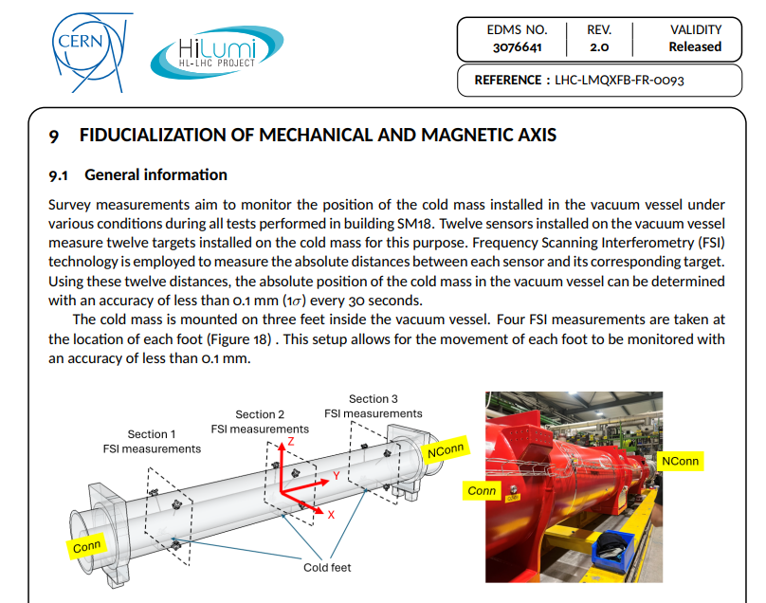
Magnetic measurement reports
Measurement results of the magnetic axis are compiled in a report synergically with the metrology teams.
Over last year gained experience in treating and transmitting data acquired.
Magnetic axis - Carlo Petrone - 14th HL-LHC Collaboration Meeting – Genoa – 10 October 2024

Slide 22
Conclusions
The longitudinal magnet scan is performed using the rotating coil scanner. This is also used for quality control during the production process (180).
The stretched-wire system is the reference for cold measurements, providing integral information about field strength and magnetic axis (SM18).
Alignment measurements consists of several steps.
The alignment and metrology team developed and implemented measurement procedures through a proactive and fruitful collaborative effort.
Magnetic axis - Carlo Petrone - 14th HL-LHC Collaboration Meeting – Genoa – 10 October 2024

Slide 23

Thank you
Magnetic axis - Carlo Petrone - 14th HL-LHC Collaboration Meeting – Genoa – 10 October 2024

Slide 24
Spare Slides
Magnetic axis - Carlo Petrone - 14th HL-LHC Collaboration Meeting – Genoa – 10 October 2024

Slide 25
Measurement requirements
Measurement uncertainty requirement values for different magnet types (3σ)
Magnet Type | Transverse center |  | Roll |  | Long. center |  | Mag. length | Mag. length
 | Warm (mm) | Cold (mm) | Warm (mm) | Cold (mm) | Warm (mm) | Cold (mm) | Warm (mm) | Cold (mm)
D1, D2, MCBXFB, MCBRD | 0.6 | NA | 0.3 | 0.2 | 5 | 5 | 5 | 5
Q1, Q2, Q3 | 0.4 | 0.2 | 0.2 | 0.2 | 5 | 5 | 5 | 5
MCBXFA, CP | 0.4 | 0.4 | 0.3 | 0.3 | 4 | 10 | 5 | 3
[1] Source: Engineering specification LHC-G-ES-0023
Magnetic axis - Carlo Petrone - 14th HL-LHC Collaboration Meeting – Genoa – 10 October 2024

Slide 26
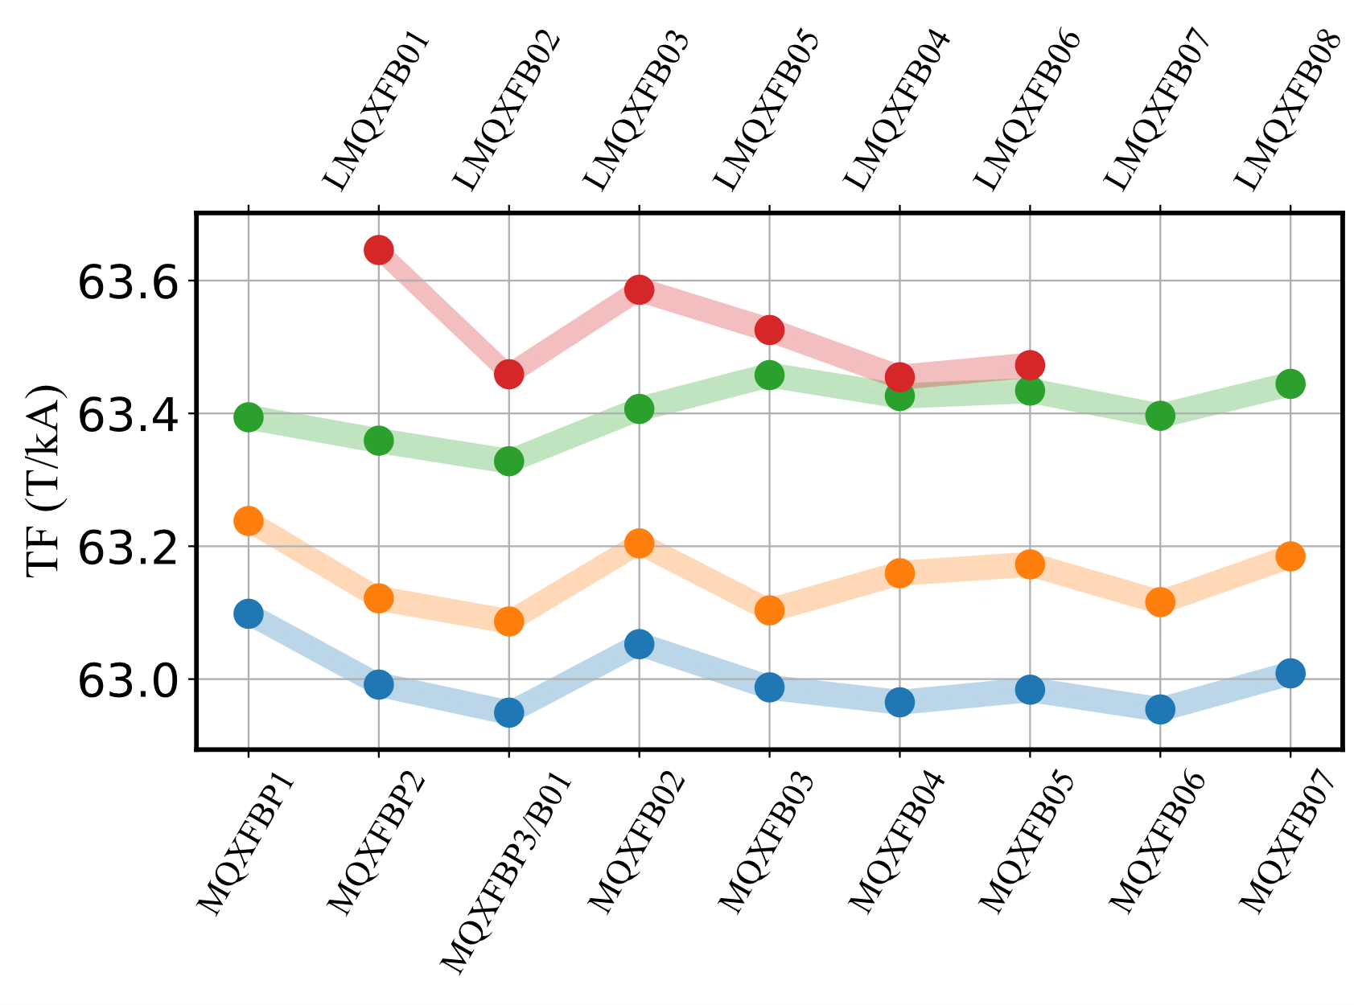
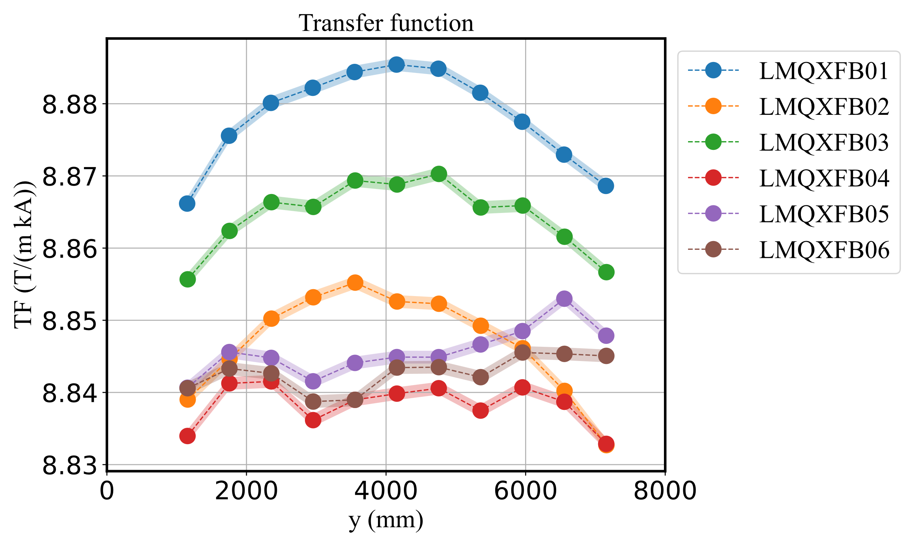

Measurement of the bare cold masses
Field profiles and integrated transfer functions
~5 units
~40 units
Former magnet coil design [2]
~20 units
Tested at cold in stand-alone configuration (compression of magnet coils)
Transfer function measured with 1-unit uncertainty (1σ). Integrated field measured with 3-unit uncertainty (1σ).
The longitudinal field profile can be correlated with the coil’s geometrical shape, and used for quality control [2].
Each manufacturing step increases the magnet transfer function (compression of magnet coils).
[3] S.I. Bermudez, et al. "Status of the MQXFB Nb3Sn quadrupoles for the HL-LHC." IEEE Transactions on Applied Superconductivity 33.5 (2023): 1-9.
Magnetic axis - Carlo Petrone - 14th HL-LHC Collaboration Meeting – Genoa – 10 October 2024
Notes:
The difference with the first cold masses is bigger because those magnets were in cold mass prototype. Permanent compression after cold test. Transfer function increases. Coil shape remains there.

Slide 27
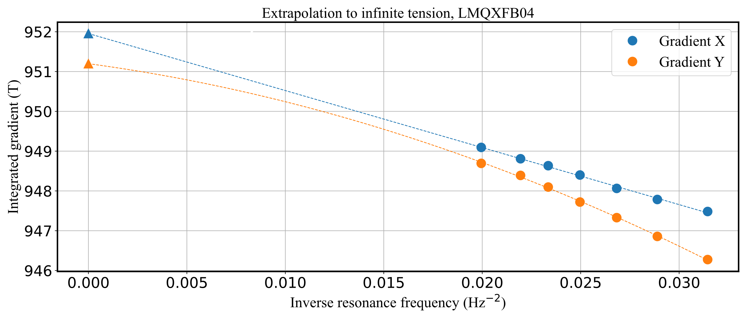
Measurement method: single stretched wire
Impact of finite tension on measured gradient
951.956 T
Parameter | Value
Wire length (m) | 20.96
Integrated gradient (T) | 929.547
Resonance frequency (Hz) | 7.38 | at 950 g
Step (mm) | 20
Expected measured gradient (T) | 927.114
Deformation (mm) | 0.026
951.198 T
Linear fit on x-axis.
Parabolic fit on y (sag + wire magnetization).
Besides gravity, another contribution to the wire deformation is given by magnetic forces.
The wire relative susceptibility determine magnetic forces not negligible on the wire for this measurements. The global effect is a repulsive force on both axes, given the wire diamagnetism.
Magnetic axis - Carlo Petrone - 14th HL-LHC Collaboration Meeting – Genoa – 10 October 2024

