Slide 1
Impact of mechanical and magnetic measurements on performance
R. De Maria
2024 HiLumi Annual meeting

Slide 2
Contents
Mechanical and magnetic measurements have an impact on the correction and the optimization of
Orbit
Optics
Coupling
Dynamic aperture
Insufficient corrections of the mentioned observables can prevent or several limit high luminosity operations!
Large corrections require time and iterations that reduce the number physics days.

Slide 3
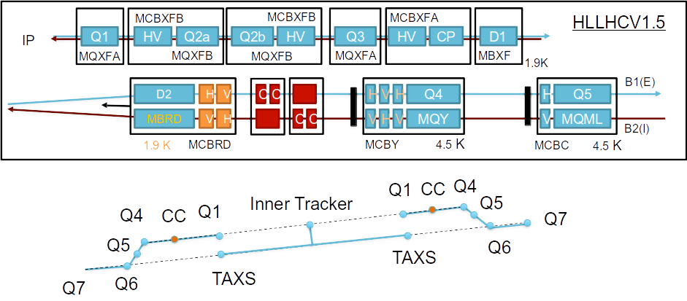
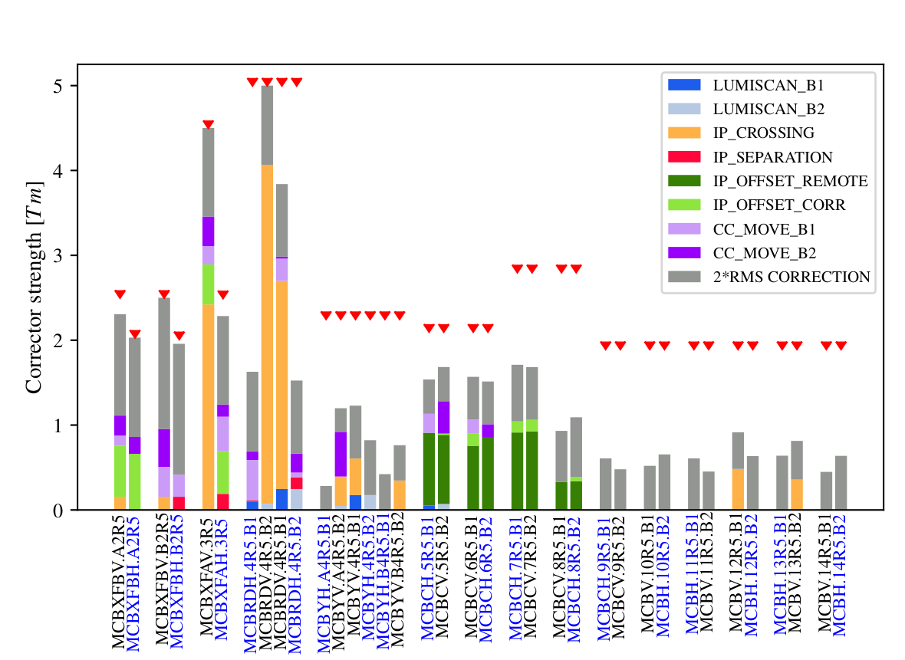
Orbit correction strategy
The presence of three strict orbit constraints in ATLAS and CMS (IP and crab cavities at <0.5 mm) requires
< 0.5 mm alignment of the quadrupole magnetic axis (e.g .~1 mm orbit offset equivalent to ~2 Tm orbit corrector)
An additional budget of 0.5 mm offset in the CC is given at the cost of a static slope in the cavities.
Essential to keep sufficient alignment range after construction (e.g. deformable RF bridges in between triplets have a range >2.5 mm, other bellows should allow similar margins.)
Ideally, imperfections before the first beam should be dominated by uncertainty (0.4 mm currently estimated at 3 σ) and not deviations.
Orbit correctors can only cope with <0.5 mm orbit imperfections!

Slide 4
Beam commissioning: main steps in the first year
Injection
Collimation
BI
RF-ADT
Dump
Experiments
In parallel and interleaved
450 GeV
Orbit
Polarity
Optics
Orbit
CC
pilot
MP validation for 48-72 >1.1·10¹¹ ppb bunches
day 20
First Collisions
TS: FRAS alignment
Optics, Orbit, …
Loss maps & aperture
day 40
up to 7 TeV GeV
Intensity ramp-up
Ramp&
squeeze
Levelling steps
MP
valid.
to 1.8·10¹¹ ppb
to 2748 bunches
Physics
day 80
Measure electrical centre of cavities and instrumentation with 48–72 bunches. Intensity ramp-up cannot start if the crab cavities are not well aligned
day 100

Slide 5
Orbit correction: potential scenarios
Nominal Scenario
Construction absorbs measured deviation from nominal alignment.
The machine is moderately well aligned at first beam, and fine tune corrections during collisions allow bringing the orbit correctors within established margins.
The commissioning time is scales with initial misalignments:
If orbit correctors are sufficient: 1-2 days needed to establish orbit
If also FRAS is needed for correction orbit: 1 week overhead
  Crab cavity center needs few nominal bunches
  A re-alignment would retrigger a revalidation cycle of loss maps
Non-conform scenario
If realignment does not bring the magnetic field axis to specs (e.g. beyond alignment range), there are increased chances of
driving to the limits the orbit corrector strengths
  For MCBXF, this leads to an increase of uncorrelated powering: less current margin and bad field quality, lower beam energy
Exceed orbit tolerances at crab cavities:
  Lower voltage, detuning, low beam current
If one of these conditions is realized, the machine is unrecoverable and requires heavy hardware intervention to realign.
Fiducialization and magnetic measurements are then mandatory for operation.
String test should be used to implement the "best knowledge" construction.

Slide 6
Optics correction strategy
Context
Optics (aka beta-beating) correction, that is control of beam sizes, betatron phase advances, dispersion in the ring is mandatory at many locations of the machine.
Although design optics constraints could be matched to any layout relatively close to the nominal, the correction strategy hinges on using a model as close to reality as possible such that the corrections converge quickly to the nominal model:
Contrary to orbit, optics response is non-linear in gradients and requires ~5-10 iterations to converge.
Optics measures and corrections are not time efficient and noisy, typically requiring 30 min per measurement/correction strategy.
Specifically at the interaction points, the beam size at the IP is key to achieve high luminosity, but cannot be measured directly (optics can be measured only at BPMs and Quads).
Specifically in Point 1 and 5 at low-beta*, the sensitivity to the model imperfections will be a factor 5 larger than what Run 3 experienced!
Optics correction strategy
Accurate magnetic modelling:
5 mm longitudinal accuracy of magnetic and BPM centers
good modelling of gradient fall down in the fringe region
good orbit correction and non-linear correctors to limit feed-down effects.
~10 units transfer function uncertainty for the quadrupoles.
Contrary to today practice, we plan to use the best knowledge optics model.
Significant development foreseen to take place in the following years.
Non conform scenarios
Uncorrected beta* results in lower luminosity virtual luminosity.

Slide 7
Coupling and DA optimization
Impact on performance
Correcting non-linear imperfection is increasingly time-consuming depending on the order.
Overhead for measurements and correction can take up to weeks.
Performance degradation not easy to estimates because it depends on many conditions:
A DA reduction at the end of levelling can be addressed by increasing beta*. The impact may be ~1-3% in ideal condition to 10% in degraded condition.
A DA reduction at the collpase, can lead to high losses. Mitigation could be increasing beta* and reduced bunch population. Crossing angle is limited by orbit corrector strengths and cannot be used as mitigation. The impact could more on ~10%.
Coupling is mostly generated by rolls in the magnetic axis:
can degrade luminosity at the IP (up to factor 2 seen in ALICE 2018)
reduces dynamic aperture (DA) and induces instabilities.
Dynamic aperture is reduced by residual fields imperfections (after corrections)
Low dynamic aperture is responsible for:
High losses at collapse preventing high intensity operations.
Low beam lifetime reducing integrated luminosity.

Slide 8
References and workflow
We are aiming at building “best knowledge” optics models.
We need a streamlined workflow that allows to transfer alignment and magnetic measurements into optics models.
There is time for it, but it will be more time efficient if we start right away.
Steps:
Define and agree on references: action WP3/WP15.
Define and agree on where to store data: action WP3/WP15.
Collect data and build optics model: actions WP2.

Slide 9
Conclusion
Installation, without considering magnetic measurements, may lead to a machine that cannot be corrected and thus not compatible with high-luminosity operations.
We should make sure that what the triplets region can be corrected.
A good starting magnetic and alignment model reduces drastically the time for commissioning, increasing integrated luminosity.
A good corrected orbit, optimizes dynamic aperture (e.g. MCBX field quality and feeddowns).

Slide 10
Backup

Slide 11
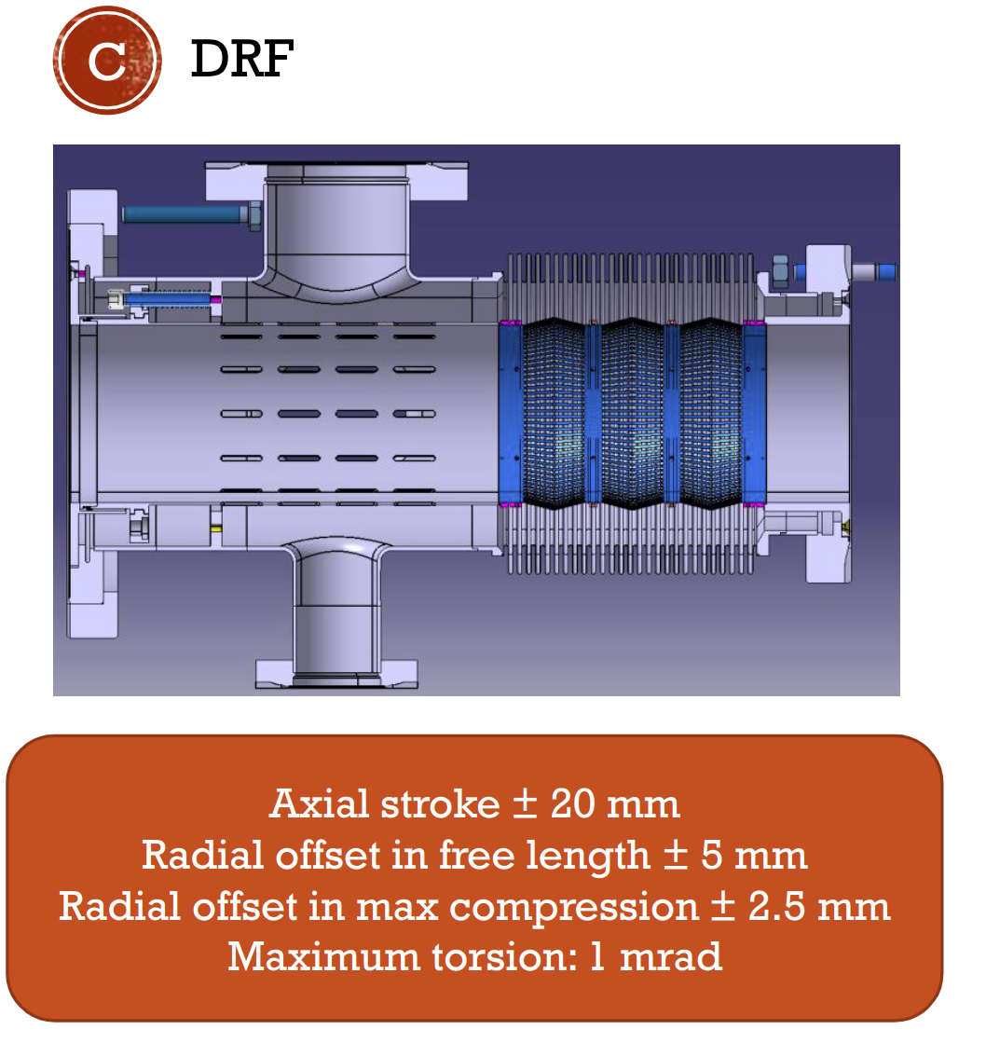
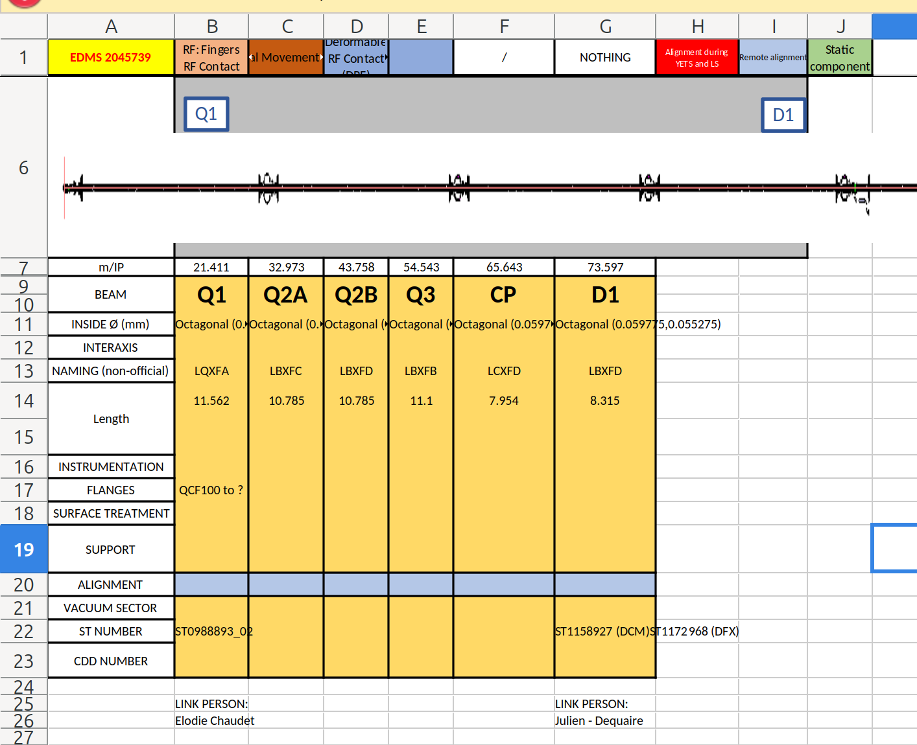
DRF

Slide 12
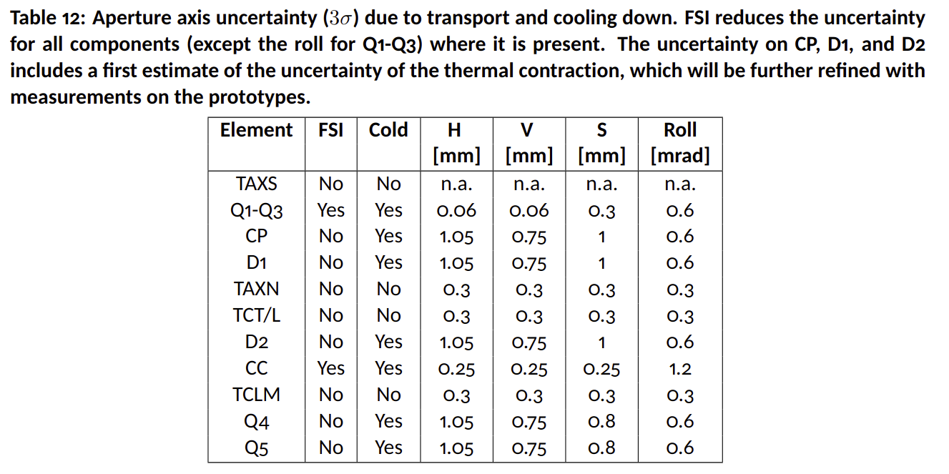
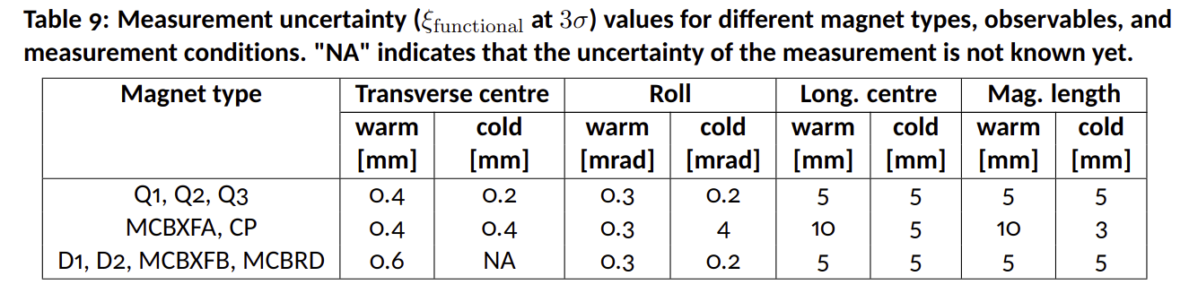
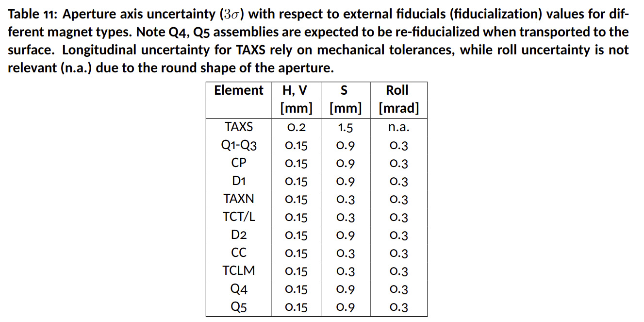
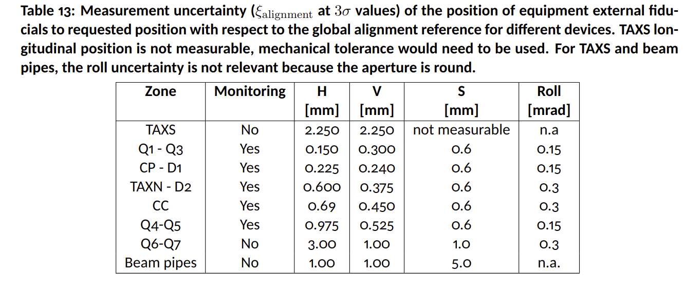
Present alignment uncertainties

Slide 13
