Slide 1
Magnet Circuit Forum Activities Related to Instrumentation
Roland Piccin, Alvaro Santiago Ferrer and Samer Yammine for the MCF
14th HL-LHC Collaboration Meeting, 7-10 October 2024 - Genova
2024-10-10

Slide 2
Contents
HL-LHC Magnet Circuit Forum Activities
Recall on HL-LHC Magnet Circuit Instrumentation Day 23
Update on HL-LHC Magnet Circuit Instrumentation
Conclusions

Slide 3
HL-LHC Magnet Circuit Forum

Slide 4
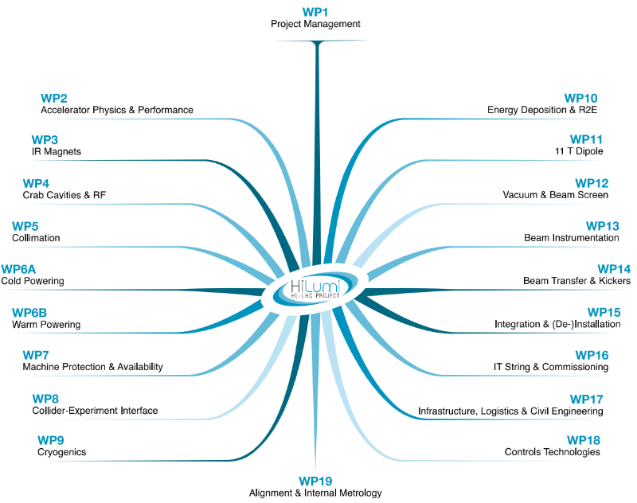
Magnet Circuit Forum (MCF) – A Snapshot
The meeting where all aspects related to powering and protection of the HL-LHC magnet circuits are discussed.
MCF chair – S. Yammine
Scientific Secretary – R. Piccin
Instrumentation Drawings – A. S. Ferrer
Mandate of the MCF includes among others:
Assure the optimization and quality of the Magnet Circuits including the instrumentation and quench detection scheme for HL-LHC
A few key figures:
Representations of 11 Work Packages
60 permanent members regularly invited with an average participation of 20 members (variation depending on topics)
Since June 2016, 137 MCF meetings (Indico; minutes repository)
Since September 2015, 59 MCF Topical meetings (Indico; minutes repository) for reduced technical audience

Slide 5
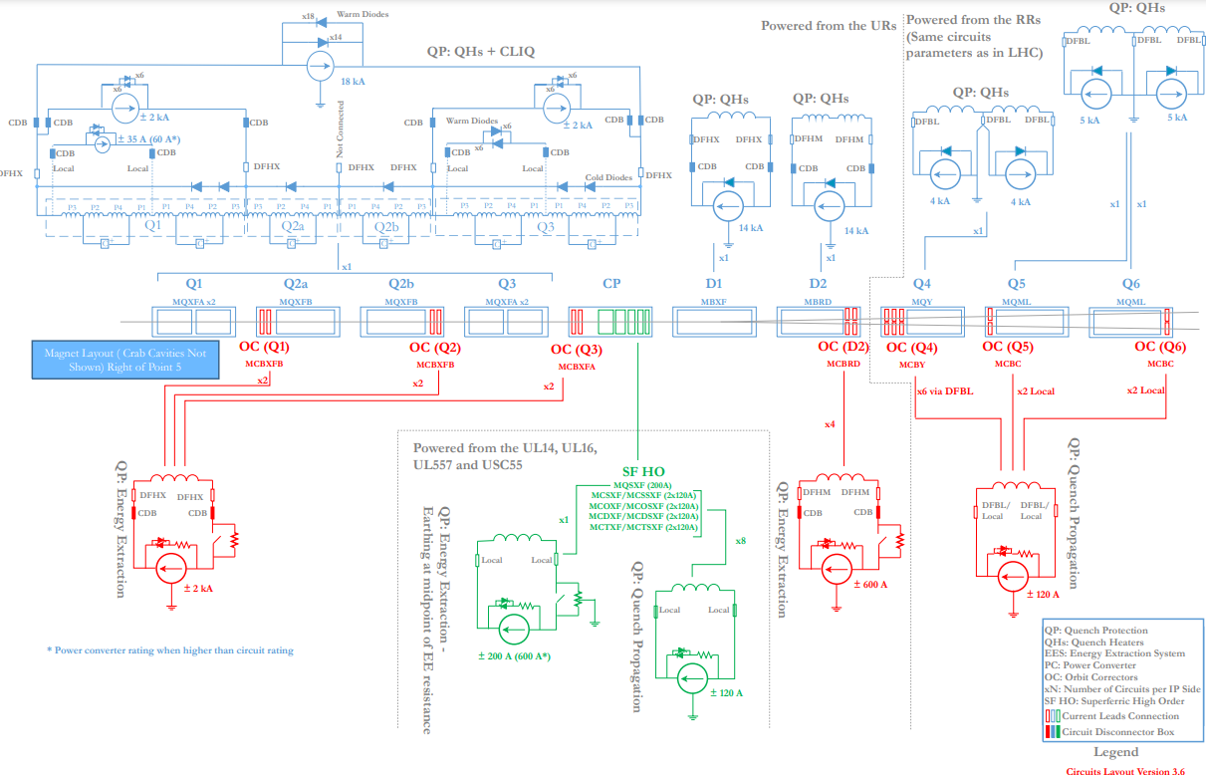
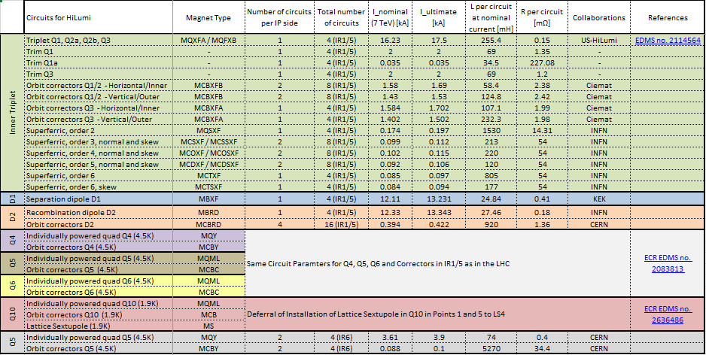
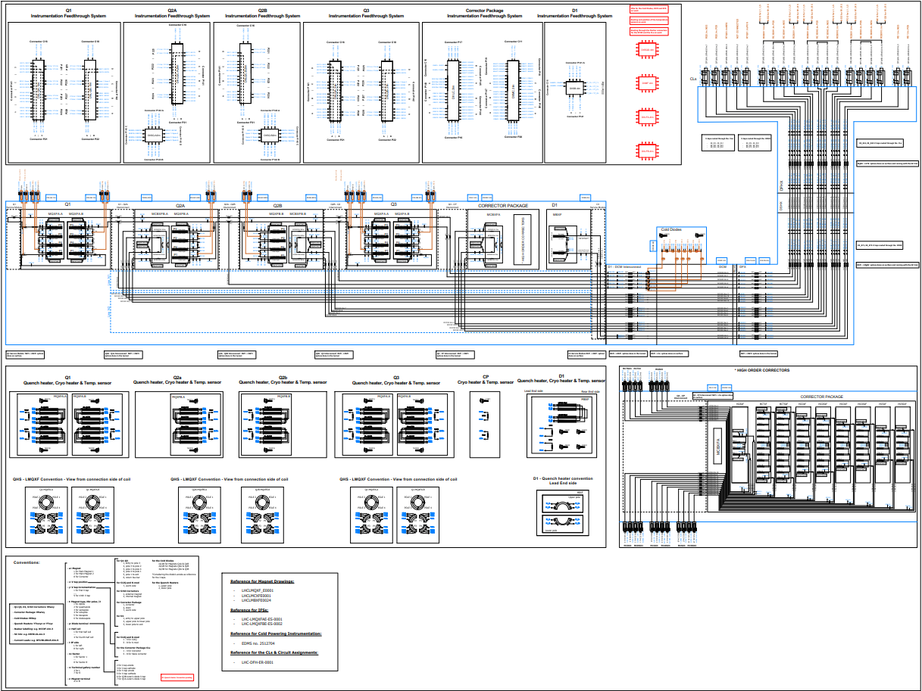
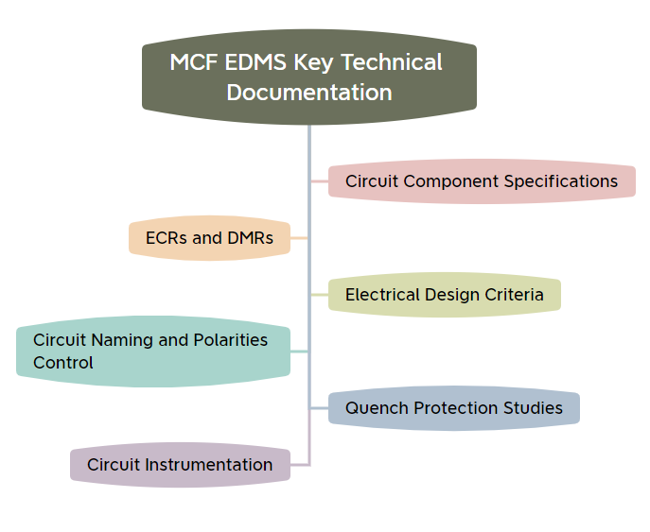
Activities and Responsibilities
Key Responsibilities:
MCF has the responsibility to maintain update the circuit configurations and parameters -> Circuit Parameter Table and Circuit Layout (MCF Sharepoint)
MCF has prepared the HL-LHC General Instrumentation Drawings in collaboration with WP3, WP6a, WP7 and WP9
MCF takes responsibility for the preparation of Engineering Change Requests (ECRs) and other documents related to circuit aspects
Documentation and updates are regularly communicated in the MCF meetings and validated by stakeholders
Circuits Layout V3.6
Circuit Parameters Table V9.9
HL-LHC General Instrumentation Drawings &
General Quench Detection Signal Representation
Document Repository

Slide 6
HL-LHC Magnet Instrumentation Day 2023

Slide 7
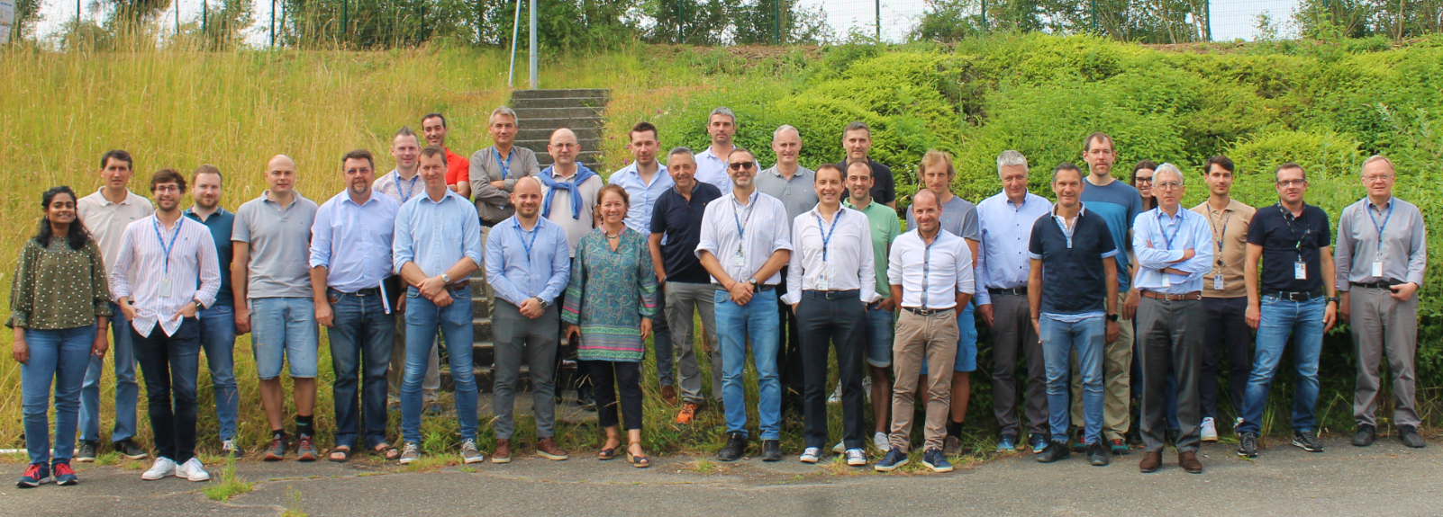
Scope of the Instrumentation Day 2023
The scope of the HL-LHC Magnet Circuit Instrumentation (MCI) Day 2023 (Indico link – Report no. 2936551) is to perform a final check of the requirements and of the commissioning practice for of the superconducting magnet circuit instrumentation.
The instrumentation Day follows the HL-LHC Circuit Instrumentation Review held in 2020 (Indico link – Report no. 2431168)
The scope includes quench detection and monitoring systems, interlocks, cryogenics instrumentation and insulation vacuum instrumentation.

Slide 8
Executive Summary of HL-LHC MCI Day 2023
The Executive Summary of the HL-LHC MCI Day 2023 was presented during the MCF #122 (link) and TCC #181 (link) :
  10 Findings and Comments – refer to annex
  14 Recommendations – refer to annex
The resolution and implementation of findings and recommendations is addressed to the system technical teams/WPs.
Progresses are reported and followed-up on the MCF meetings with the related stakeholders.

Slide 9
Recent Updates related to Instrumentation

Slide 10
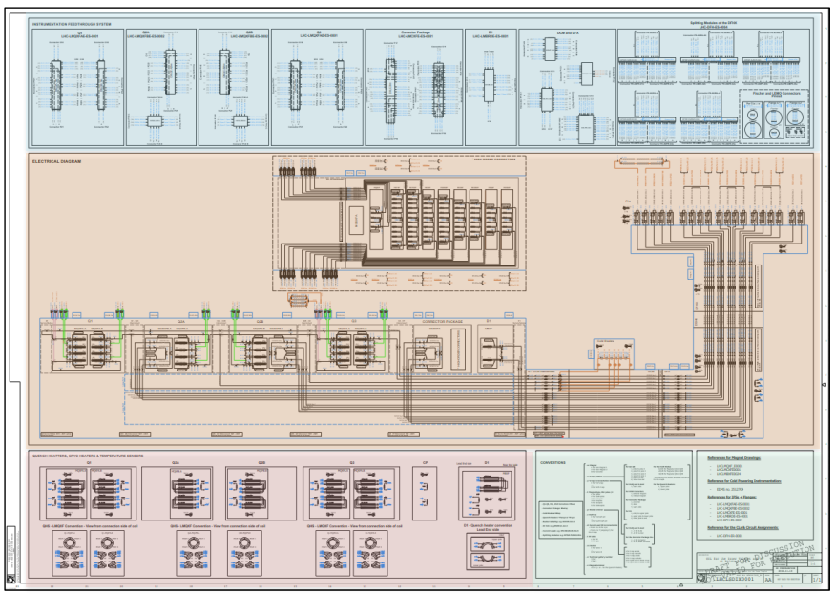
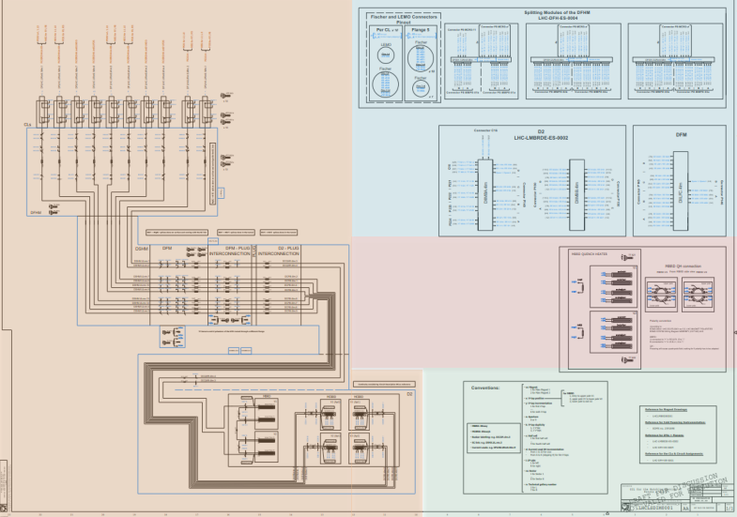
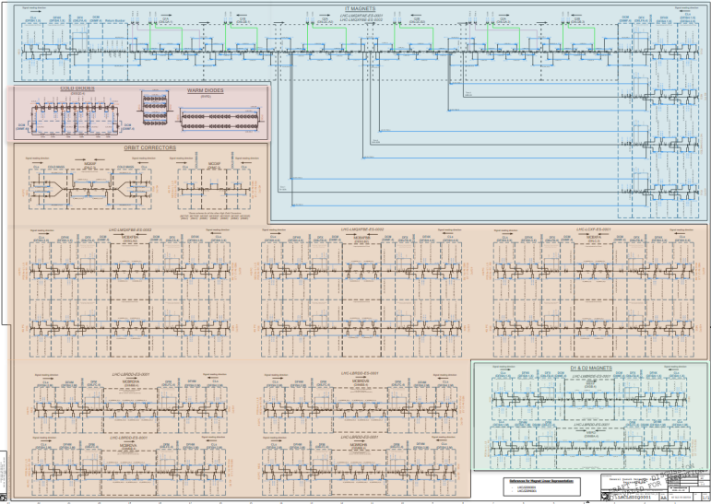
General Instrumentation Layouts – LHC LSDIX/M/Q
C4
Instrumentation Review
2020
Instrumentation Day
2023
General Instrumentation Layouts
2024
R3: A coherent documentation of the overall circuit instrumentation must be established, shared and approved between all WPs (including all protection as well as monitoring needs)
C4: synchronise as soon as possible (in view of approaching IT String) the naming conventions of the signal naming between the different documentation and the various databases.
Layout 1
Layout 2
GIL for the Inner Triplet & D1 at Points 1 and 5:
GIL for the Matching Section at Points 1 and 5:
Quench Detection Signal Representation for the Inner Triplet, D1 & D2 magnets:
Courtesy of A. Santiago Ferrer
LHCLSDIX0001
LHCLSDIM0001
LHCLSDIQ0001
Layout 3
GIL provides a full picture of the HL-LHC magnet and cold powering instrumentation
Support a wide-range of users (ElQA team, IFS box design and intervention, magnet & cold powering builders, circuit operators or circuit analysis)

Slide 11
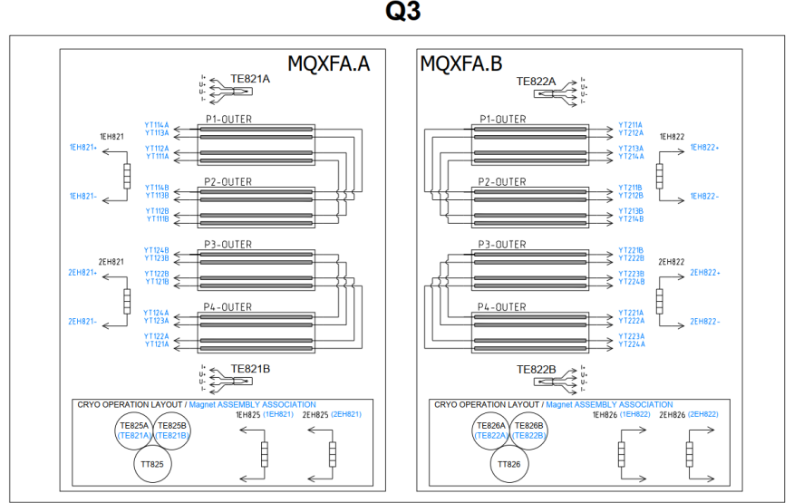
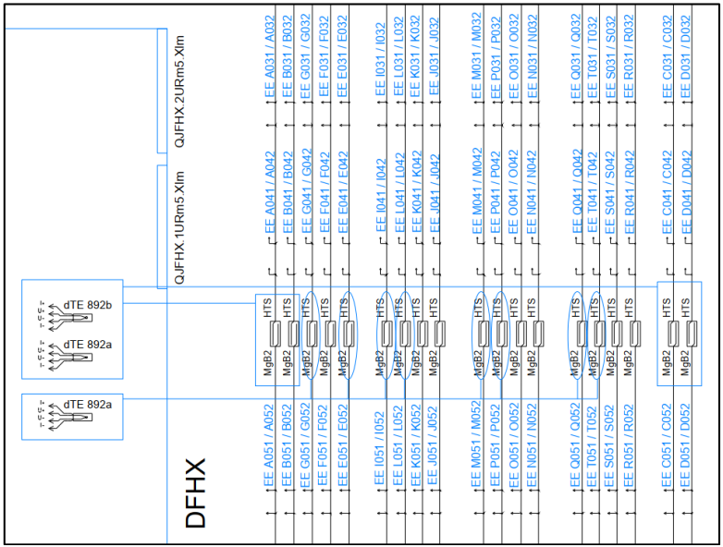
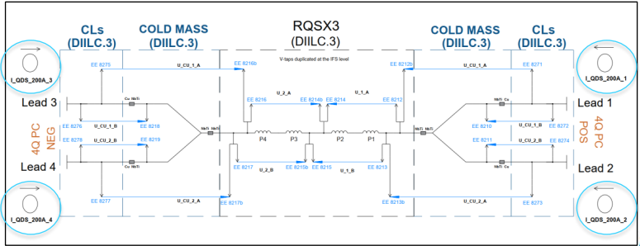
General Instrumentation Layouts – LHC LSDIX/M/Q
C4
Some of the latest updates presented at MCF#137/A. Santiago Ferrer (link Indico):
Correlation between the mechanical nomenclature of the TT sensors & EHs and the operational nomenclature
Updated to reduced number of DFHX/M temperature sensors
Current sensors have been included (RQX (monitoring & control), RCBXs, RQSX3, RD1 and RD2)
11

Slide 12
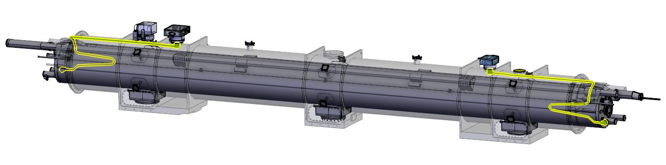
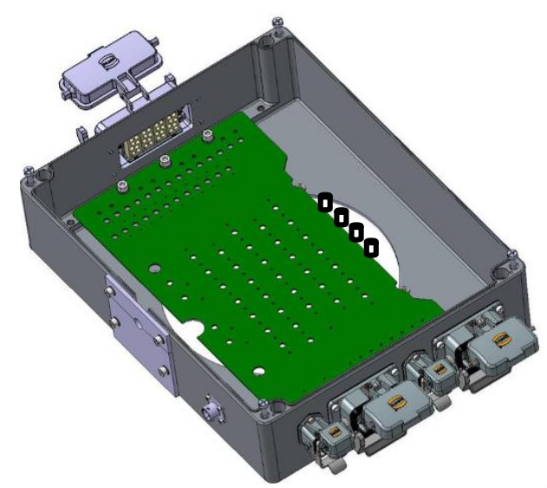
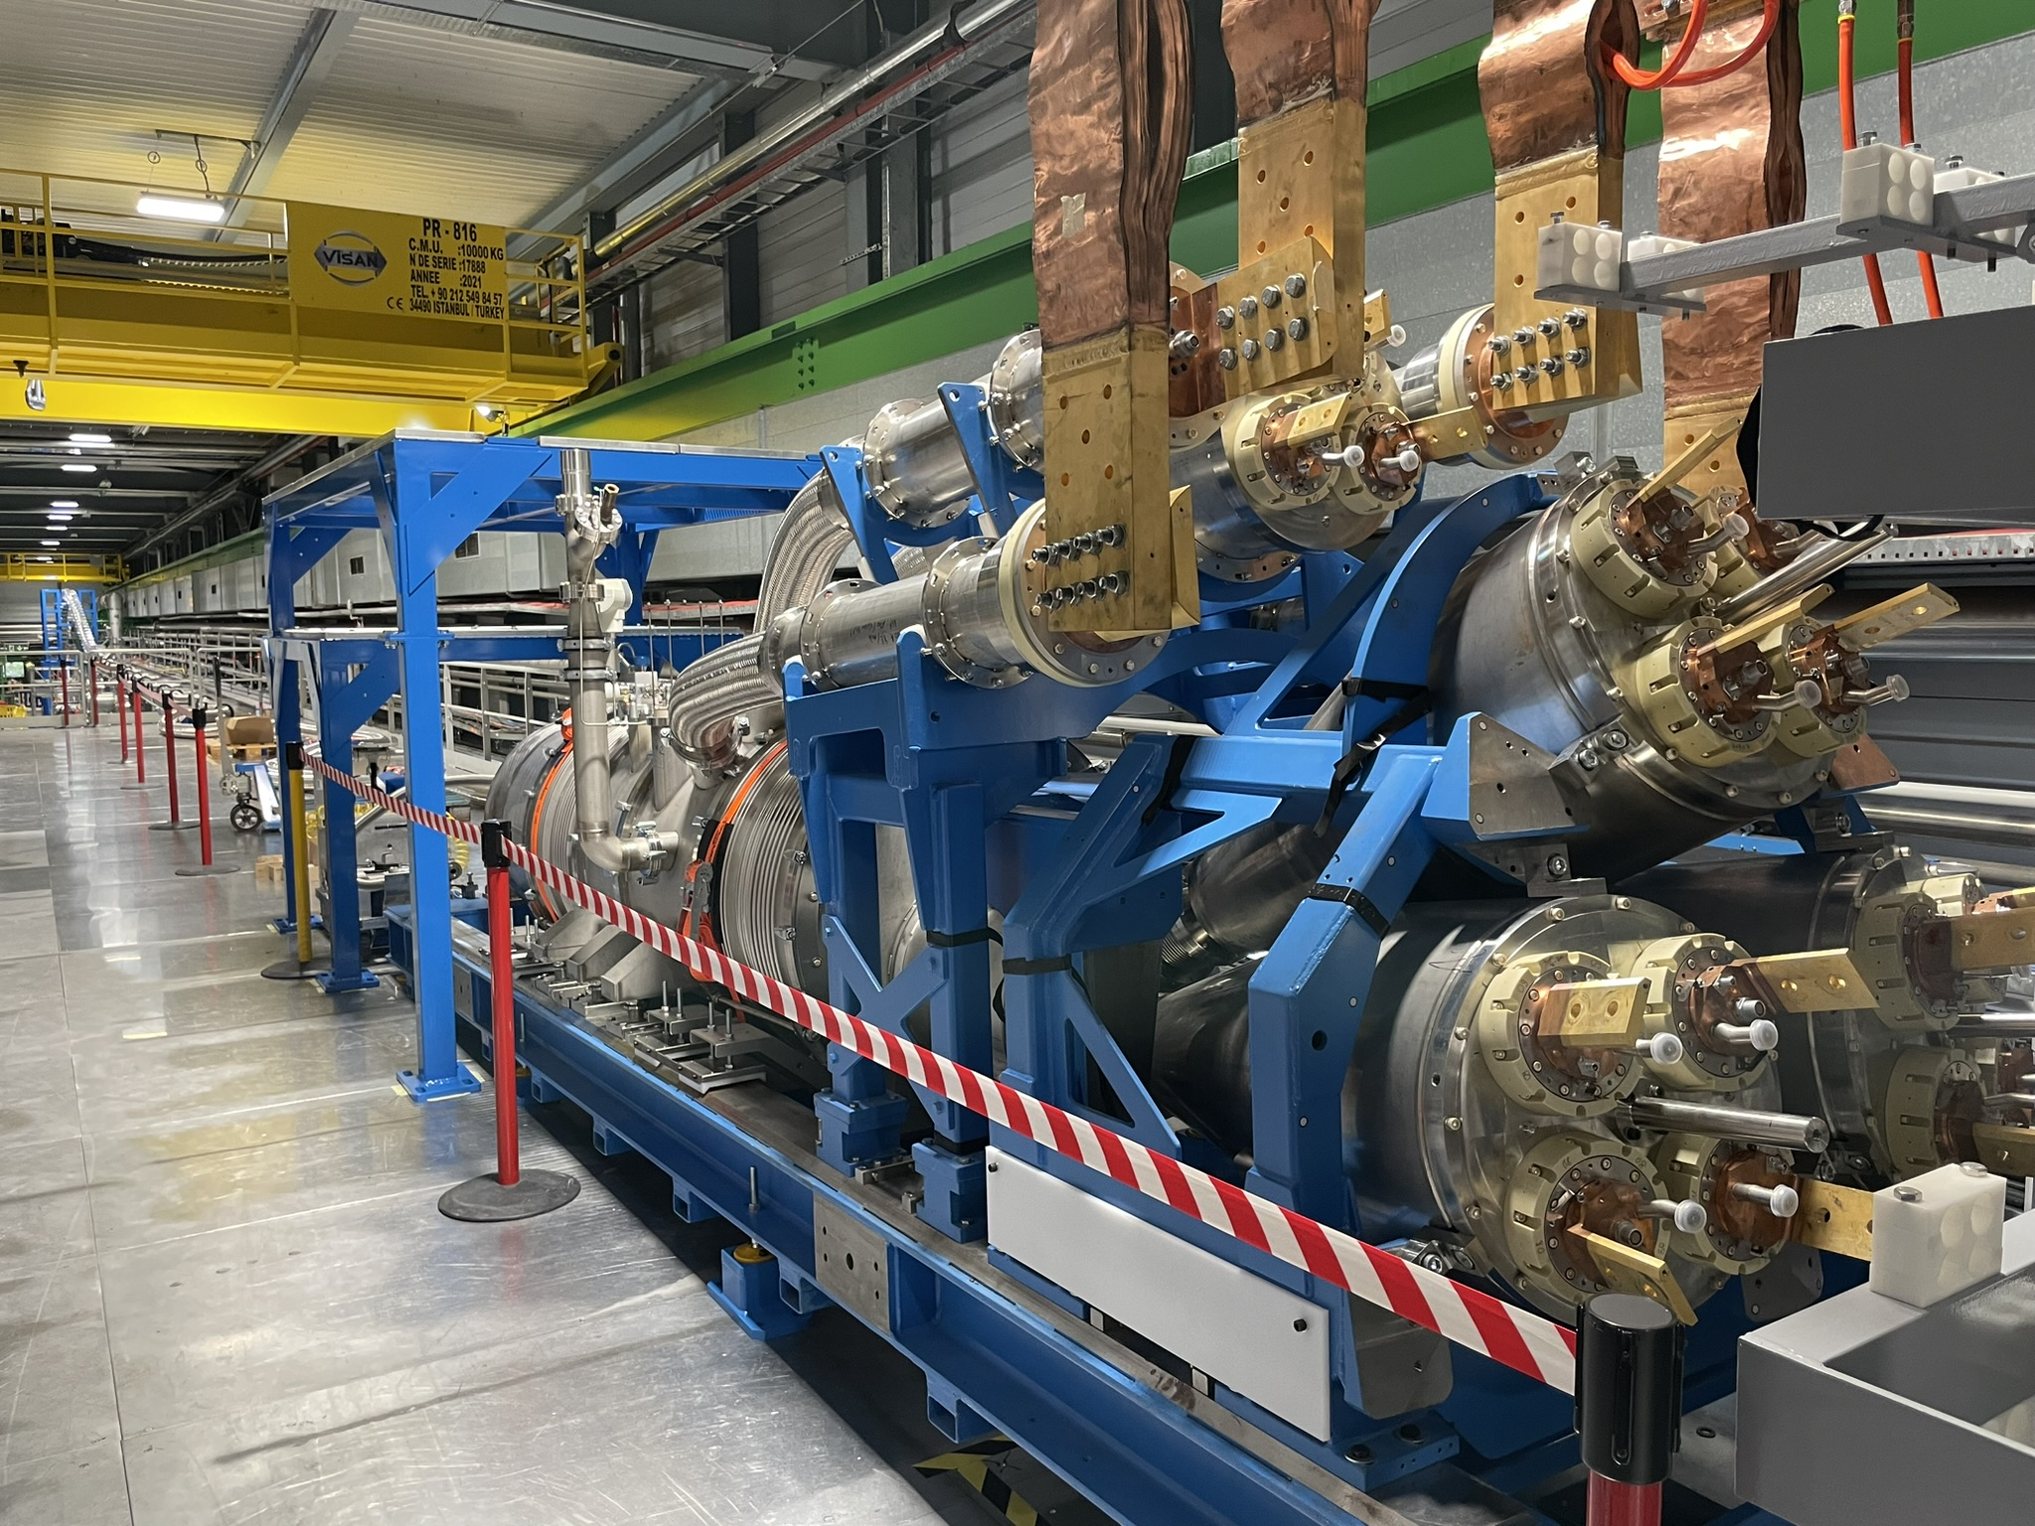
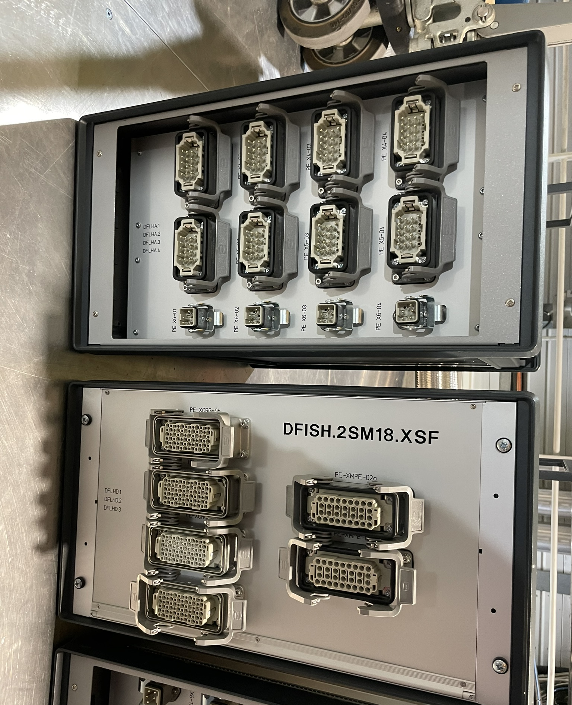
Quench Detection Instrumentation
R11: Insulation tests using tap water may degrade the insulator quality [...]
R1: A harmonization of the voltage levels and test strategies for the instrumentation cables [..].
QDS
Input Patch Panel
C8: […] general-purpose cables (purchased through the CERN stores and installed by EN/EL) may be used for voltages beyond the specified voltage […].
ElQA
Port
Magnet, DCM, DFX/M,
uQDS
IFS
C3: The new concept of the Quench Detection System (QDS) input patch panel [...] may exhibit high voltages during circuit operations […]
R13: A design of the DFHX/M splitting modules based on wire-to-wire connections […] Synergies and common designs with the PCB based design of the QDS input patch panel solution shall be explored […]
Splitting Modules
DFHX/M

Slide 13
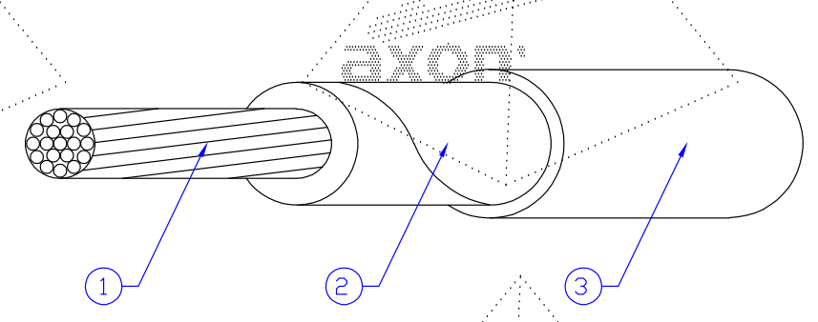
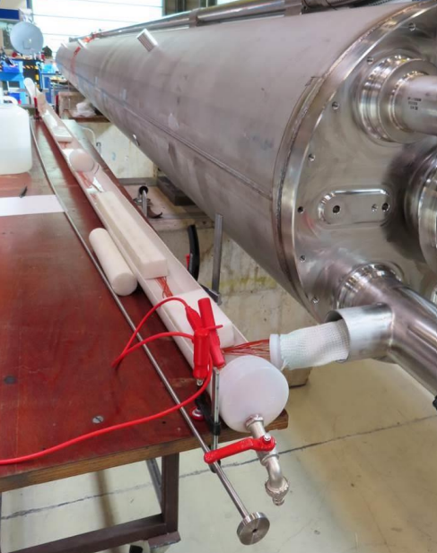
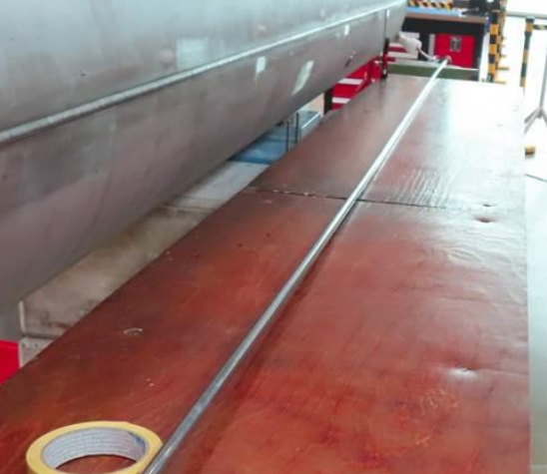
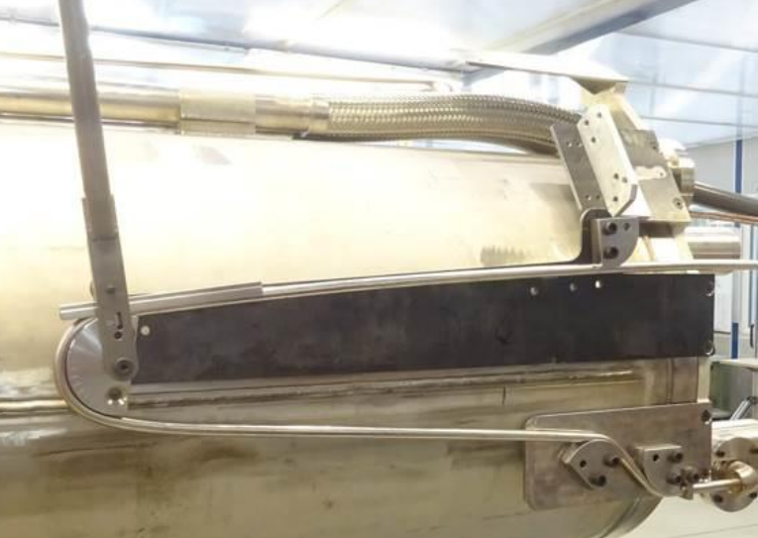
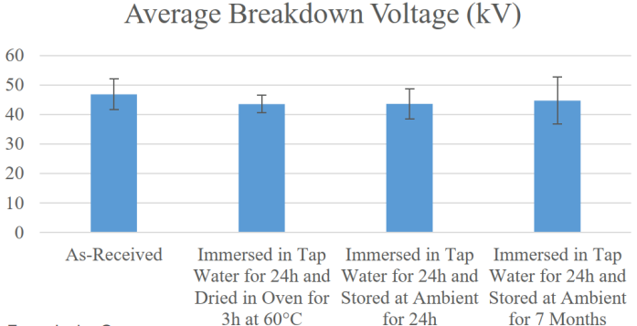
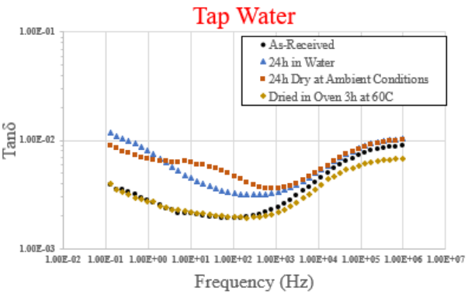
Magnet Wires Insulation Testing in Water
R11
R11: Insulation tests using tap water may degrade the insulator quality and introduce risk on the long-term operation of the insulation. A detailed study on the impact (including long-term effects) of tests with immersion of the insulated wires in tap water [...]
Insulation is based on Polyimide tape + Polyimide sealant
Dielectric test of the wires in water is performed before insertion of the wire bundle in the capillary and tube forming
A test campaign has been carried out to assess the effect of (tap) water intake (EDMS 3010970):
Dielectric strength is not affected after immersion in water.
No reduction of dielectric strength on the long term (7 months after immersion)
Test of wires in water
(steps 500 V/30 s – 1000 V/120s – 2000 V/120s) + Drying
Residual presence of humidity can be detected by the measurement of the dielectric losses (tan delta) on samples
An effective drying procedure is established:
  60 ℃ for at least 3 h
Test endorsed by MCF and recommended for collaborations
Presented at MCF#133 (link Indico) / R. Piccin, J. Osuna, H. Prin, L. Grand-Clement, F.O. Pincot

Slide 14
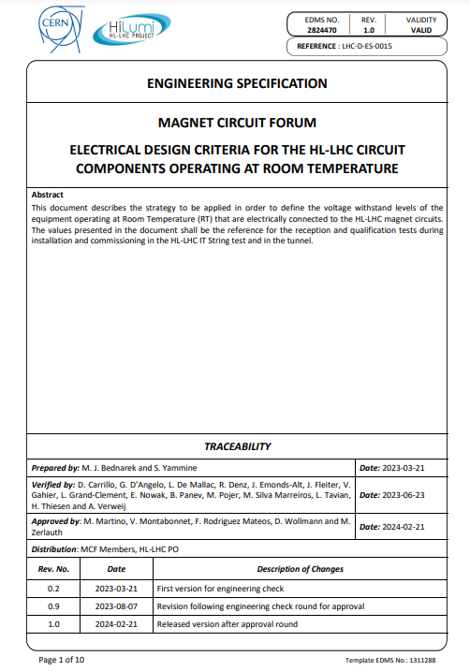
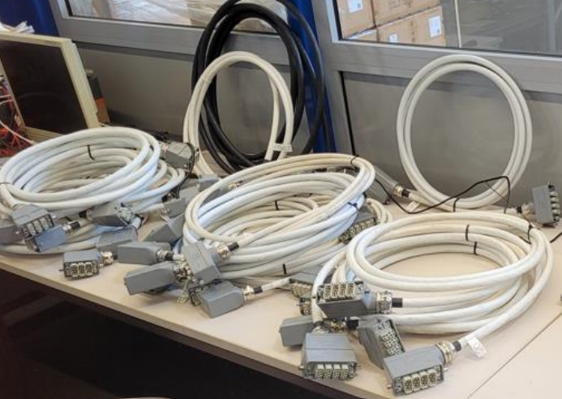
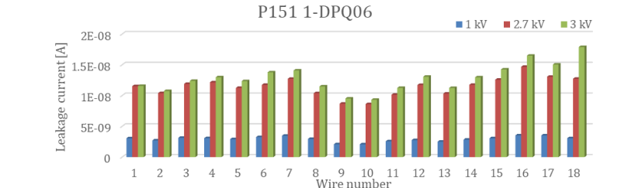
IFS – QDS Input Patch Panel Cabling
R1
C8
R1: A harmonization of the voltage levels and test strategies for the instrumentation cables used for circuit instrumentation should be performed. […] Working beyond specifications may be required by some applications. However, additional qualifications may be necessary under the full responsibility of the equipment owner.
C8: […] general-purpose cables (purchased through the CERN stores and installed by EN/EL) may be used for voltages beyond the specified voltage[…].
Test voltages of instrumentation cables defined in Electrical Design Criteria for the HL-LHC Circuit Components Operating at Room Temperature (EDMS 2824470)
The cables in IT String and HL-LHC are specified for 500V while the test voltage specified in the EDC is 2.7 kV.
ElQA team tested 22 cables (518 wires) built and tested by EN-EL according to the same procedures and using the same components as in the IT String.
Successful insulation test at 1 kV, 2.7 kV and 3 kV for all wires -> cables have a sufficient insulation margin for the use in the HL-LHC installation.
More details in the talk of G. West
Presented at MCF#136 (link Indico) / M. Bednarek & G. West

Slide 15
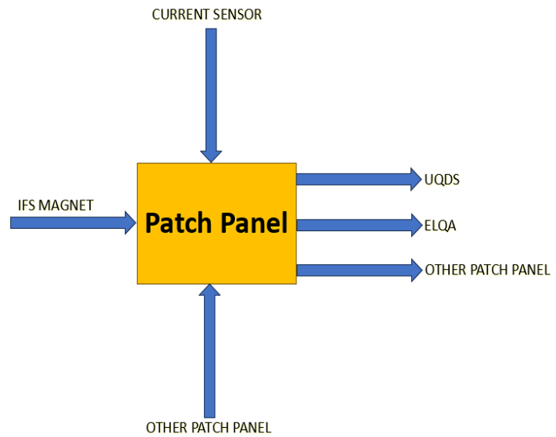
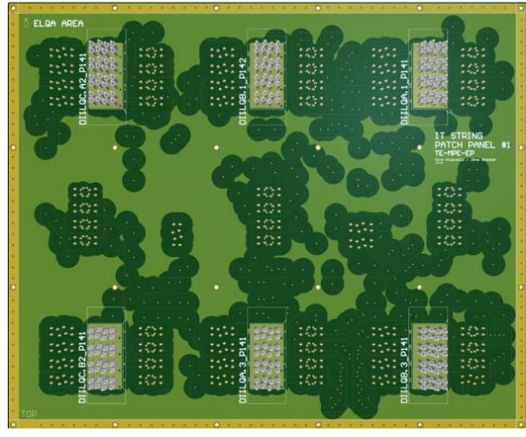
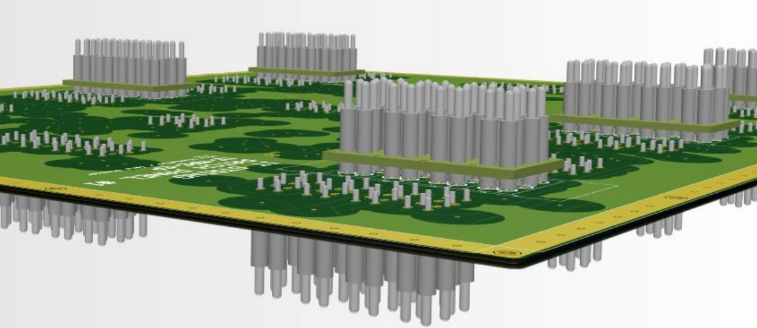
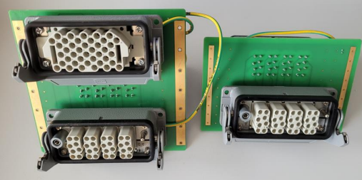
QDS Input Patch Panel
C3
R13
C3: The new concept of the Quench Detection System (QDS) input patch panel was presented during the day which deports the connections used for Electrical Quality Assurance (ElQA) tests [...] may exhibit high voltages during circuit operations as the connectors are galvanically connected to the magnet circuits […] An overall strategy for access and electrical intervention procedures must be defined for HL-LHC galleries […]
R13: A design of the DFHX/M splitting modules based on wire-to-wire connections has been presented for use in the IT String. Synergies and common designs with the PCB based design of the QDS input patch panel solution shall be explored and implemented for the series version
All PCB-based, no wires. This way the complexity is treated by internal routing and schematic of PCB
Insulation and withstand voltage test performed on PCB and connectors were successful ( 6 – 15 kV)
Protection cover shall be installed to avoid direct contacts in addition to mounting female connectors.
WP6a team will implement PCB-based design for the series splitting modules to be installed in HL-LHC
Presented at MCF#137 (link Indico) / J. Steckert, V. Vizziello, M. Bednarek

Slide 16
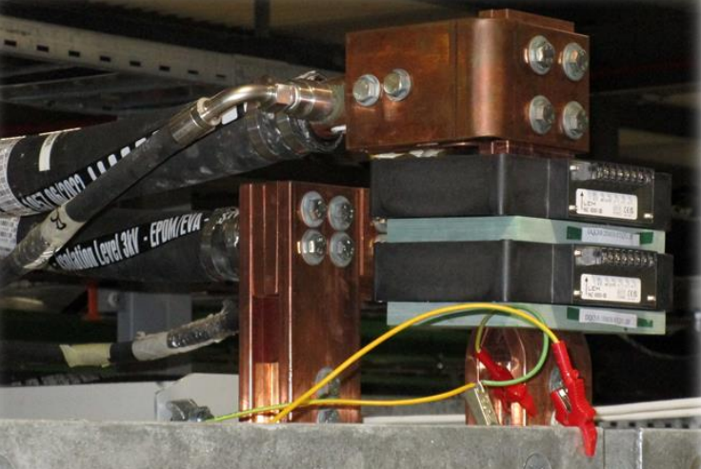
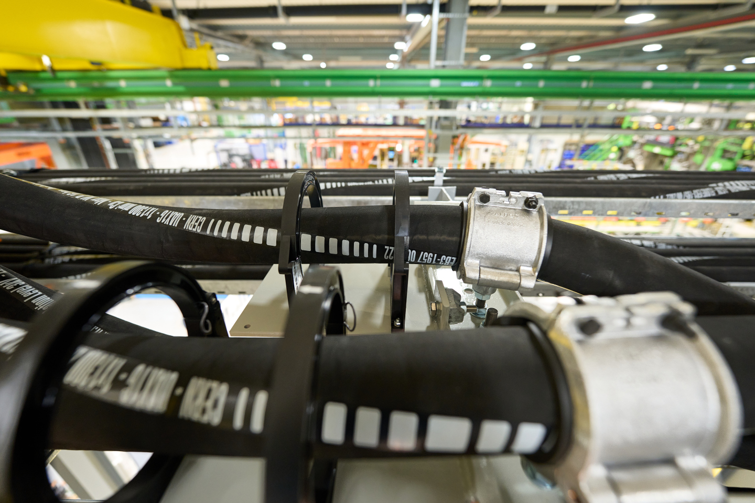
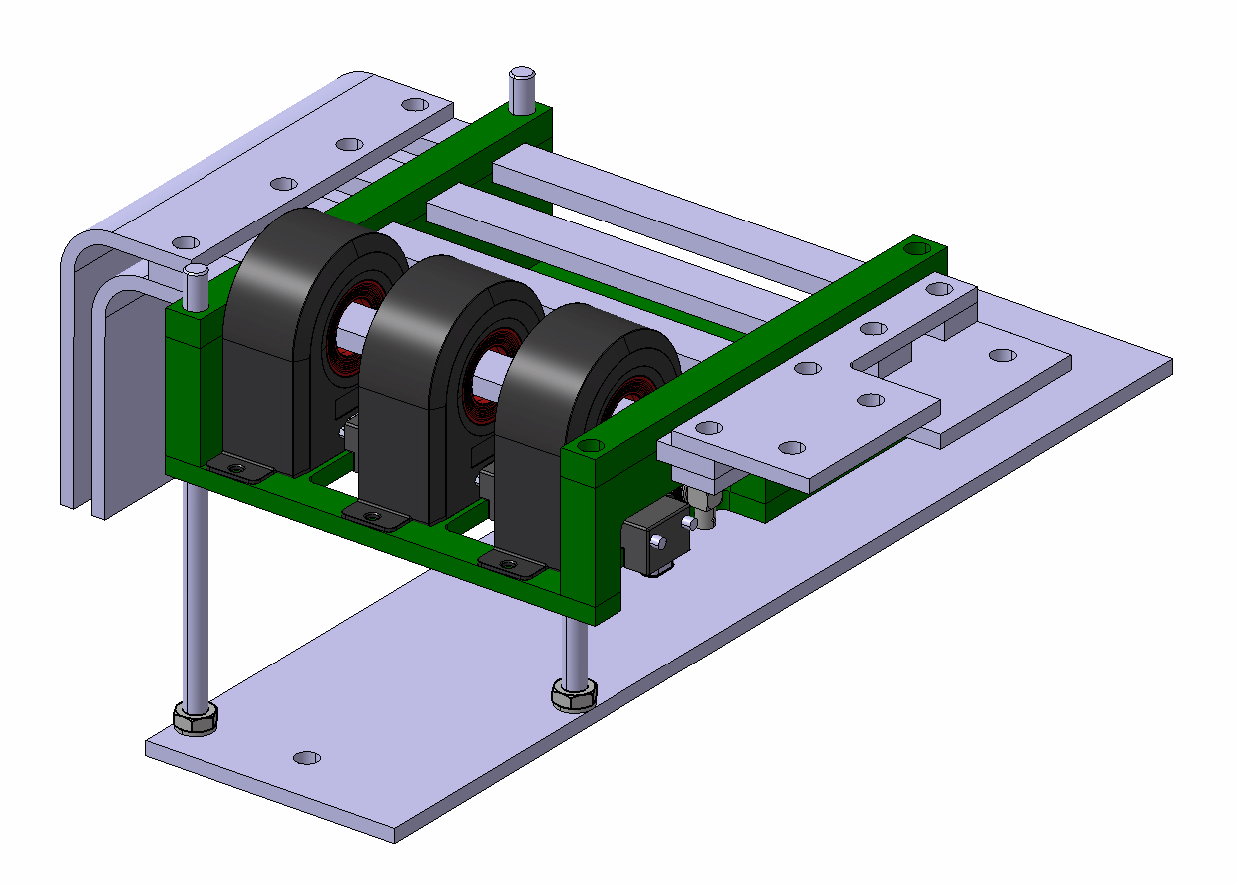
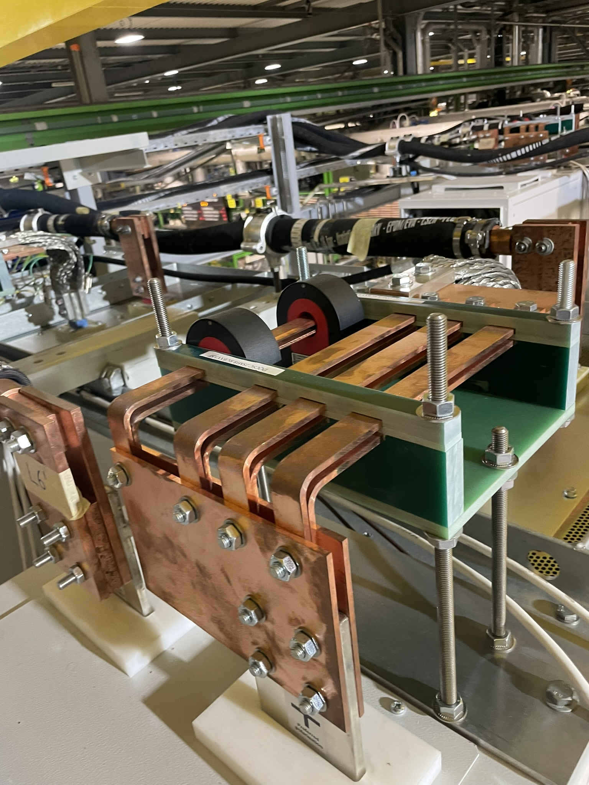
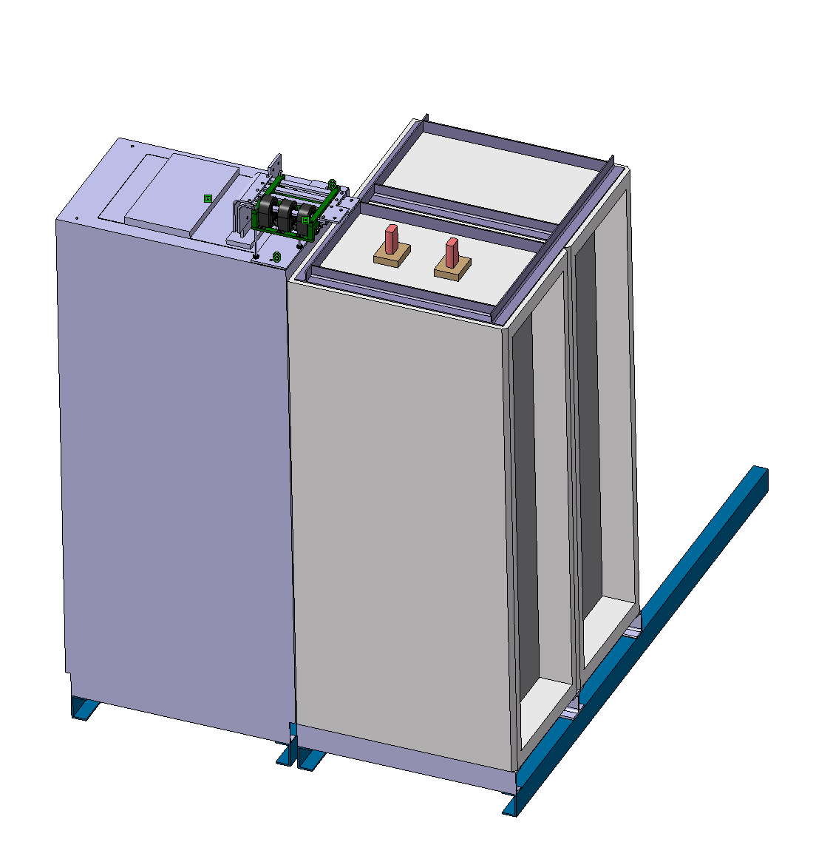
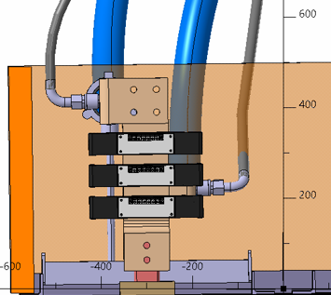
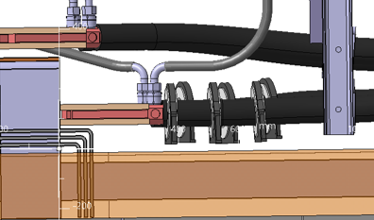
QDS Current measurement
R5
R5: To reduce the risk of down-time of the machine due to the very limited access possibilities on top of the power converters, the 2oo3 redundancy of QDS current measurement transducers shall be consistently applied for all current measurements.
2 kA RCBX Circuits
2 kA RTQX Circuits
RQX, RD1 and RD2
Reminder the current sensors are used either for symmetrical quench detection (dI/dt calculation) or to implement the current-dependent thresholds

Slide 17
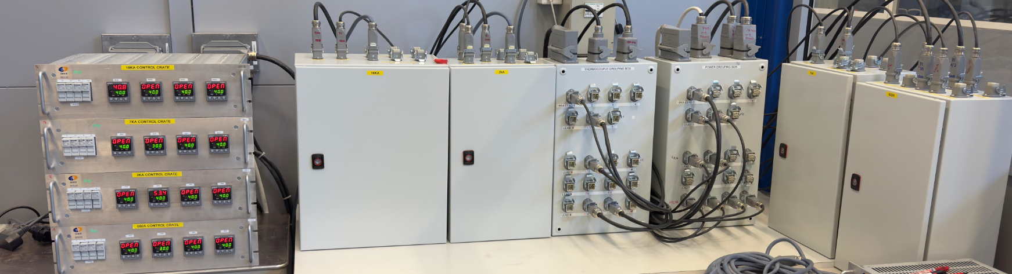
Current Lead Heating System (CLHS)
R9
R8
R10
To tackle recommendations 8, 9 and 10 and to validate the new components, a CLHS test bed (mock-up) has been prepared by WP7:
New components: power boxes for 18, 7 and 2 kA circuits together with power and thermocouple grouping boxes.
In-rush current of the 230/48 VAC transformers is being verified on the mock-up. However, for safety aspect related to local intervention on the current lead itself, the secondary is kept at 48 V which remains a baseline for HL-LHC.
New controllers for HL-LHC, based on the radiation tolerant design installed in RRs of the LHC since 2023
The temperature readout will be stored in the logging database at CERN (NXCALS) and make it available for the cryogenics team.
CLHS is equipped with a remote reset unit that will allow rebooting the controllers.
In case of malfunctioning of the CLHS (power is always ON), a safety breaker has been added to cut the power based on the reading from TE/CRG sensor (for redundancy).
Mock-up of the CLHS with power and thermocouple grouping boxes, using LHC controllers
Courtesy of G. D’Angelo

Slide 18
Conclusions
Based on recommendations from the HL-LHC MCID 23, the MCF is following (and soon finalizing) the HL-LHC magnet circuit activity.
Few activities are still ongoing like the studies on the current leads hearting system and will be presented soon by WP7 at MCF.
A general Engineering Change Request (ECR) for the instrumentation will be drafted to approve the changes.
The changes are applied, where possible, to the HL-LHC IT String installations to ensure the tests are representative.
A set of baseline drawings are drafted within the MCF scope and approved by the stakeholders, and a new schemes will be proposed to follow-up the non-conformities in the installations (String and HL-LHC).

Slide 19
Thanks for your attention

Slide 20
Annex Slides

Slide 21
Updates on PIC loops and Current Leads Heating System (CLHS)

Slide 22
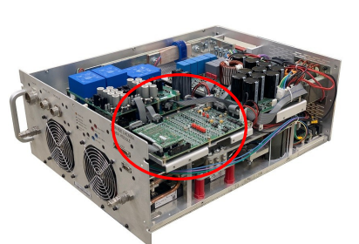
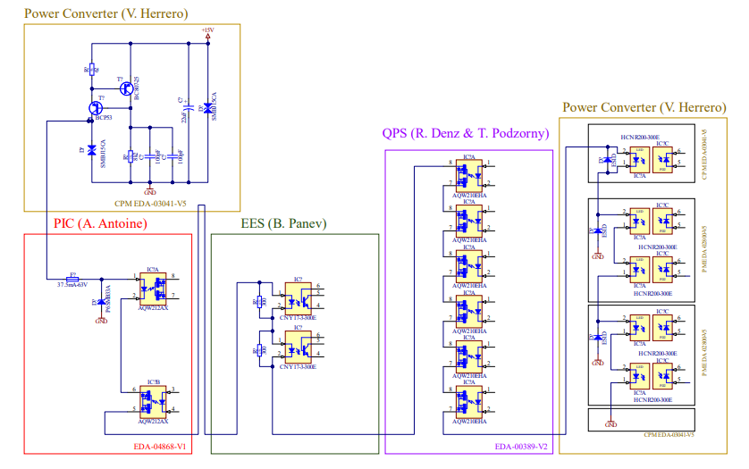
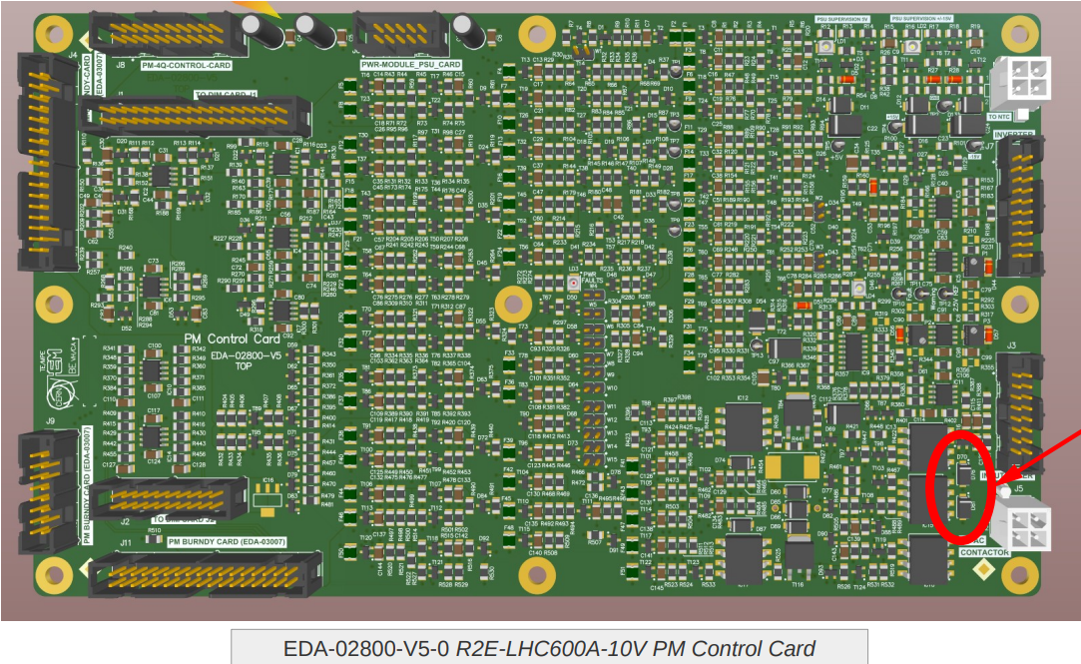
PIC Loops
R6
R6: The final layout and implementation of PIC loops remains to be confirmed for all HL-LHC converter/circuit types and requires urgent clarification for the imminent implementation in the HL-LHC IT String. The agreed solution shall be documented in an updated version of the interface specification including the new requirements and specificities of HL-LHC.
Fast Power Abort (FPA) Loop interfaces with:
Quench Protection System (QPS) to propagate the quench
Power Converters (PC) to be turned off
Energy Extraction System (EES) to be turned on
Power Interlock (PIC) informing related protection systems
Flags transmitted via 10 mA current loops
The addition of an extra optocoupler in the PIC card in the LHC and in HL-LHC (for redundancy reasons in the scope of the PICv2 deployment) further reduces the voltage available in the circuit
Several solution are being discussed, among which the use of a new 24V Voltage Supply to be submitted to radiation test
Loops are being tested in the IT-string
Fast Abort Current Chain in 600 A LHC circuit R2E-LHC600A-10V converters – Status in 2023
Presented at MCF Topical meeting #55 (link Indico) / V. Herrero

Slide 23
List of Topics, Comments and Recommendations during HL-LHC MCI Days 2023

Slide 24
List of topics presented
Subject | Speaker
Introduction to the Day and Recall of the Instrumentation Review 2020 and Panel Recommendations | Markus Zerlauth
Quench Detection Scheme and Monitoring Baseline | Jens Steckert
System Test and Commissioning of QDS Instrumentation and Monitoring | Tomasz Podzorny
Layouts for HL-LHC Quench Detection Instrumentation | Alvaro Santiago Ferrer
Power Interlock Controller Loops, System Tests and Commissioning | Alain Antoine
Cryogenic Instrumentation Scheme, System Tests and Commissioning | Marco Pezzetti
Insulation Vacuum Instrumentation Scheme, System Tests and Commissioning | Jaime Perez Espinos
Current Leads Heating System Design, System Testing and Commissioning | Giorgio D'Angelo

Slide 25
List of topics presented
Subject | Speaker
Connecting and Integration of the Instrumentation in the Magnets | Herve Prin
Connecting and Integration of the Instrumentation in the DCM | Yann Leclercq
Connection and Integration of the Instrumentation in the Cold Powering System | Christian Barth
IFS Box Interfaces and Documentation | Giorgio D'Angelo
QDS Input Patch Panels | Jens Steckert
ElQA Tests for Instrumentation | Mateusz Bednarek
Overview of the System Tests and Commissioning Plan for the HL-LHC IT String | Samer Yammine
Wrap-up Discussion (open session)

Slide 26
Comments and Findings
 | Description | System/WP | Status | Comments
C1 | A comprehensive list of functional requirements for the different types of instrumentation used was not presented during the day. Despite the baseline being well established by now, the panel considers it is useful to collect the various documents defining the functional requirements and specifications concerning instrumentation in a dedicated repository. This will allow for traceability and evaluation of their operational performance with respect to initial requirements throughout the complete project lifecycle, especially during the commissioning phase. | All | tbd
C2 | The new cryogenic line that feeds the inner triplet to the D2 magnet (QXL) is designed to operate independently from the existing QRL in the LHC. An updated strategy for the cooldown permits shall be defined considering the possibility to cool Long Straight Sections (LSS) and arcs separately. | Cryo | tbd

Slide 27
Comments and Findings
 | Description | System/WP | Status | Comments
C3 | The new concept of the Quench Detection System (QDS) input patch panel was presented during the day which deports the connections used for Electrical Quality Assurance (ElQA) tests (as an identical image of the IFS connectors) to the new HLLHC non-irradiated technical galleries UR15 and UR55. The patch panel may exhibit high voltages during circuit operations as the connectors are galvanically connected to the magnet circuits (as for many other components of the magnet powering system installed in the UR). An overall strategy for access and electrical intervention procedures must be defined for HL-LHC galleries during the different operational phases (HWC, run period, etc.) to ensure that CERN’s electrical safety standards are respected in the new HL-LHC technical galleries that for a first time will remain accessible during beam operation. | WP7 | On-going | Presented at MCF #137
C4 | An extensive list of baseline documentation was presented during the day. The panel endorses that prompt actions are taken to synchronise as soon as possible (in view of approaching IT String) the naming conventions of the signal naming between the different documentation and the various databases. | All | Okay | General instrumentation and signal layout presented at MCF #137
C5 | During the individual system tests of the quench detection system, input terminals might be shorted to allow for early individual system tests ahead of reaching nominal conditions in the magnet string. A risk of keeping the terminals shorted while in operation cannot be excluded. Protection mechanisms and/or appropriate procedures/commissioning tests should be implemented to avoid operating the different systems relying on this technique with shorted terminals. | ElQA | tbd

Slide 28
Comments and Findings
 | Description | System/WP | Status | Comments
C6 | The instrumentation wires used for HL-LHC (e.g., Axon) are from the same supplier providing the LHC wires. Nevertheless, the recommendation from the Instrumentation Review 2020 to qualify the wires to defined acceptance criteria was not fully addressed during the instrumentation day. The panel remarks that the instrumentation wires – as any other equipment connected to the magnet circuits - should be qualified in compliance with the Electrical Design Criteria (EDC) of the different magnets and cold powering systems. In addition, the halogen content in the resin of the wires should be clarified as a derogation was necessary for their use in the LHC. A complete table with the used wires should be established. | WP3 | tbd
C7 | It has been clarified that the number of temperature sensors foreseen in the DFH for the HTS to MgB2 splices in the 2 kA and 600 A corrector circuits will be revised after the full prototype test in SM18 (Cluster F) that could lead to a major reduction of sensors. The proposed strategy is encouraged by the panel and the nominal configuration should be used for a final validation test in the HL-LHC IT String test facility. | WP6A | Okay | Number of temperature sensors reduced. Final configuration to the tested in the IT-String

Slide 29
Comments and Findings
 | Description | System/WP | Status | Comments
C8 | It was stated that general-purpose cables (purchased through the CERN stores and installed by EN/EL) may be used for voltages beyond the specified voltage in the technical specifications based on the experience from the LHC and dedicated high voltage tests. The presented strategy to pre-qualify cable samples with their associated connectors to the test levels defined by the application is acceptable for the HL-LHC IT String as schedule constraints are not compatible with the long procurement delays. For the machine installation during LS3, efforts are already ongoing between IPT, CARE, EN/EL and the HL-LHC project to re-instantiate an adapted set of QA tests (mechanical, electrical, fire resistance, radiation...) for all cables procured for installation. It remains, however, the responsibility of the equipment group to ensure an appropriate selection and eventual qualification of their choice of instrumentation cables and connectors. |  | Okay | ElQA Qualification of cables and connector for IT-String presented in MCF #136
C9 | Electromagnetic Compatibility (EMC) and crosstalk issues were discussed during the day with an accent on the impact on the cryogenic instrumentation. The concerned groups shall identify (e.g., in the context of a dedicated MCF meeting) the need of additional dedicated crosstalk tests which shall be requested to String Validation Program (SVP) meetings by the end of 2023. | All | On-going | Test on-going and results to be presented at MCF
C10 | Given the challenge of integrating instrumentation wires into the HL-LHC IFS flanges and the associated capillaries and considering LHC experience, procedures for their in-situ replacements/repairs shall be established in due time. | WP3 | tbd

Slide 30
Recommendations
 | Description | System/WP | Status | Comments
R1 | A harmonization of the voltage levels and test strategies for the instrumentation cables used for circuit instrumentation should be performed. In principle cables shall not exceed any parameter listed in their technical datasheets, the voltage rating deserves particular care. Working beyond specifications may be required by some applications. However, additional qualifications may be necessary under the full responsibility of the equipment owner. | WP7 | Okay | Status presented at MCF #127. Additional qualification performed by ElQA at MCF #136
R2 | Quench detection thresholds of UQDS devices will, for a first time in the LHC, be remotely configurable by software. Baseline settings for all SC elements should be summarised in a reference document and a clear procedure to validate (e.g., MP3, use two-person check before threshold change, etc.) and implement their change shall be defined. The implementation of an envelope of allowed operational settings to increase the robustness against wrong/corrupted settings introduced by the experts shall be studied. | WP7 | On-going | Discussed at MCF #127. The configuration file exists also in a flash memory locally to the QDS unit since it needs to be always accessible even if the control network fails at CERN. Configuration file containing the thresholds and evaluation times will be in EDMS and transmitted by the experts to LSA database and the configuration is loaded from LSA to the QDS at the request of the expert.
R3 | A methodology based on the comparison of the QDS configuration with a configuration file stored in Gitlab is presented. While automatic configuration checks are strongly encouraged, such systems need to have a guaranteed availability 24/7, hence the use of operational CERN services (e.g., LSA database) should be studied for the threshold management configuration. | WP7 | On-going

Slide 31
Recommendations
 | Description | System/WP | Status | Comments
R4 | The panel was presented with a baseline quench detection strategy including symmetric quenches. Before application in the tunnel, the baseline detection schemes shall be demonstrated in stand-alone magnet tests in the upcoming tests in the SM18 facility, in particular for the novel protection scheme of D1 using busbar voltages to detect symmetric quenches. The addition of an absolute threshold over the D2 (MBRD) to mitigate the remote possibility of the fully symmetrical quench of the D2 magnet poles shall be studied. | QDS, MP3 and SM18 teams |  | To be followed within MCF
R5 | To reduce the risk of down-time of the machine due to the very limited access possibilities on top of the power converters, the 2oo3 redundancy of QDS current measurement transducers shall be consistently applied for all current measurements. | WP7 | Okay | Presented at MCF #127 This has been confirmed for the HL-LHC.
R6 | The final layout and implementation of PIC loops remains to be confirmed for all HL-LHC converter/circuit types and requires urgent clarification for the imminent implementation in the HL-LHC IT String. The agreed solution shall be documented in an updated version of the interface specification including the new requirements and specificities of HL-LHC. | WP7 | On-going | Alternatives for FPA Loop of the 600 A/200 A Circuit with R2E PC treated in MCF Topical Meetings, last #55 (link).
R7 | For LHC commissioning, He level sensors were installed in the DFBs to control the filling process at 4.5K. No details were presented on how this process will be controlled for the HL-LHC magnets (where DFBs are replaced by SC links and DFX/M). An adapted procedure shall be developed based on the HL-LHC baseline instrumentation and demonstrated during the cooldown of the IT String. | WP9 | Okay | Presented at MCF #127. LHe is not controlled in the magnets, for which is implemented the pressure control at ~1.3 bar that guarantee the liquid phase of subcooled helium. All level sensors reading will be verified via a so-called boil-off test.

Slide 32
Recommendations
 | Description | System/WP | Status | Comments
R8 | In the current baseline, the CL heater cartridges are powered with a 48 Vac isolation transformer technique with a hysteresis (bang-bang) regulation using a solid-state relay. A detailed study should be carried out on the transformer in-rush current and potential EMC effects that this configuration will generate on the AC network and adjacent accelerator equipment also considering potential benefits of increasing the voltage to 230 Vac. | WP7 | On-going | Test on-going and results to be presented at MCF
R9 | The current lead temperature is read both by TE-MPE and TE-CRG. TE-MPE uses a thermocouple and TE-CRG a platinum sensor. To increase diagnostics and root cause identification during operation, the publication of temperature information from TE-MPE equipment towards TE-CRG is recommended. In addition, the general status of the current lead heating system should be published by TE-MPE and retrieved by the cryogenics system. | WP7 | Okay | Presented at MCF #127 All data are available in CMW (and logging-NXCALS), meaning that all users who need the data can get access through CMW.
R10 | The possibility of a thermal runaway of the CL head due to malfunctioning of the current lead heating system was stated. The maximum allowable temperature of the CL head shall be defined, and a risk assessment conducted for the mentioned failure-mode to occur. Appropriate mitigation measures shall be defined and implemented in case the mechanical integrity of the lead is at risk. | WP7 | On-going | Test on-going and results to be presented at MCF

Slide 33
Recommendations
 | Description | System/WP | Status | Comments
R11 | Insulation tests using tap water may degrade the insulator quality and introduce risk on the long-term operation of the insulation. A detailed study on the impact (including long-term effects) of tests with immersion of the insulated wires in tap water, especially in case of a water penetration, must be conducted. It is recommended to obtain feedback from the wire manufacturer concerning the suitability of the insulation to water immersion. Furthermore, potential alternatives like testing in gHe shall be also studies. | WP3 | Okay | See Current Lead Heating System (CLHS) validation presented at MCF #133
R12 | The presentation for the cold powering system, and particularly the integration of instrumentation on the DFHX showed a complex array of several connectors, without any details on the mechanical support of these instrumentation cables. Integration should be completed asap as additional supports/harnesses might be required to avoid damaging the delicate connectors at the CL interface. | WP6A | Okay | Presented at MCF #127
R13 | A design of the DFHX/M splitting modules based on wire-to-wire connections has been presented for use in the IT String. Synergies and common designs with the PCB based design of the QDS input patch panel solution shall be explored and implemented for the series version | WP6A | Okay | Presented at MCF #127
R14 | The scheme for the ventilation of the local 120 A conduction-cooled current leads is not defined yet for the HL-LHC. The ancillaries should be completed in due time to be implemented and tested in the HL-LHC IT String. | WP6A | On-going | Status presented at MCF #127 Two ventilation methods to be tested in the HL-LHC IT-String

