Slide 1

PDSU-CLIQ/DQHDS interlocking via BIS concentrator
Tomasz Podzorny
On behalf of the TE-MPE and WP7
14th HL-LHC Collaboration Meeting – Genoa, Italy – 7-10 October 2024

Slide 2
Contents
Inner Triplet (IT) circuit protection in a brief
Requirements for Protection Devices Supervision Unit (PDSU)
PDSU interlocking capabilities
  QPS devices
  Circuit powering
  Beam abort
Beam interlocking and the latency budget
System design
Summary

Slide 3
Inner Triplet circuit protection
Magnet Protection
  Heater Discharge Power Supply (HDS) units – in total 48
  Coupled Losses Induced Quench (CLIQ) units – in total 6
Quench Detection Systems (QDS)
  Individual QDS systems for Q1, Q2 and Q3 – in total 3+3
  QDS system for superconducting link (SC link) – in total 1+1
  QDS system for bus-bar protection – in total 1+1
Protection Devices Supervision Unit (PDSU)
  HDS and CLIQ supervision and trigger distribution
  Ensure the machine protection
  PDSU systems for Q1, Q2 and Q3 – in total 3+3
Powering Interlock Controller (PIC)
The new protection device
The UQDS development framework and EDAQ supervision

Slide 4
Key objectives for PDSU
Activate DQHDS and CLIQ devices
  Coupling between detection (UQDS) and protection (DQHDS and CLIQ) devices
Interlock spurious triggers of protection devices
  Triggers the remaining protection of the circuit
  Triggers power abort
  Triggers beam abort via dedicated connection to Beam Interlock System (BIS)
Complement UQDS data for the detailed analysis of the events
  Voltage and current monitoring of DQHDS and CLIQ
  Complementary monitoring of triggering signals and statuses
Provide powering interlocks and health monitoring
  Provides QPS OK signal for the protection equipment
  Slow power aborts in case of unavailability of the protection equipment
  Monitoring of trigger, status and health signals

Slide 5
Interlocks and triggers of PDSU
Two categories of trigger sources
  External sources
    UQDS
    PDSU
  Internal sources
    Evaluation of current signals of HDS units
    Evaluation of current signals of CLIQ units
Powering and beam interlocking
  Interface to PIC
  Interface to BIS
  Interface to LHC supervision for Software Interlocks

Slide 6
External trigger sources
PDSU Q1 A
UQDS Q1 A
HDS Q1
UQDS Q1 B
PDSU Q1 B
16x
HDS Q1
UQDS Q2 A
HDS Q1
UQDS Q2 B
CLIQ Q1
2x
CLIQ Q1
UQDS Q3 A
PDSU Q2 A
UQDS Q3 B
PDSU Q2 B
UQDS SC A
UQDS SC B
UQDS BB A
UQDS BB B
PDSU Q3 A
PDSU Q3 B

Slide 7
Internal trigger sources
PDSU Q1 A
HDS current and voltage
  Monitored with 16 bit at 192 kHz
  Current readout from the HDS current transformer
CLIQ current and voltage
  Monitored with 20 bit at 400 kHz
  Current readout from the current transformer and dI/dt sensor
Active triggering on the current
  Variable threshold
  Digital filtering
Voltage signals used for QPS OK
PDSU re-triggers all protection units if a spurious trigger of HDS or CLIQ is detected
HDS Q1
PDSU Q1 B
16x
HDS Q1
HDS Q1
CLIQ Q1
2x
CLIQ Q1
PDSU Q2 A
PDSU Q2 B
PDSU Q3 A
PDSU Q3 B

Slide 8
Interlocking of the circuit powering
UQDS Q1 A
Current loop interlock
  Source is the Power Converter (PC)
Powering Interlock Controller (PIC)
  Interlocks powering process
  Interfaces to the Beam Interlock System (BIS)
PDSU is an active device
  Requests Fast Power Aborts (FPA)
  Interfaces via a PhotoMOS
UQDS Q1 B
PDSU Q1 A
PDSU Q1 B
UQDS Q2 A
UQDS Q2 B
PDSU Q2 A
PDSU Q2 B
UQDS Q3 A
UQDS Q3 B
PDSU Q3 A
PDSU Q3 B
UQDS SC A
UQDS SC B
PIC
UQDS BB A
UQDS BB B
PC

Slide 9
Interlocking of the beam
PDSU Q1 A
DYPG rack
A new machine protection requirement
A direct path to the BIS CIBM via the new BIS concentrator
Standard BIS signaling between PDSU and the BIS concentrator (CIBFX)
  Fail-safe RS-485 receivers with the fault detection
  Fail-safe beam permit encoding
CIBFX/CIBFIRX provide direct path to CIBM
  Redundant channels for A/B inputs
  Embedded monitoring and test modes
CIBFIRX installed in the BIS crate
  Connects to CIBM via RS-485 interface
  Removes beam permit if the respective optical user permit link is not available
PDSU Q1 B
CIBFX
PDSU Q2 A
PDSU Q2 B
PDSU Q3 A
PDSU Q3 B
Optical
A/B, monitor and test
Copper RS-485
BIS
CIBFIRX
Beam-1/2
Permit Loops
CIBM

Slide 10
The new machine protection requirement
A spurious triggering of either an HDS or a CLIQ device can lead to fast critical beam losses (> 1MJ) in the HL-LHC collimation system
  Spurious CLIQ trigger in worst scenarios requires only 5 turns (450 µs)
  Spurious HDS trigger, in the most critical case of D1, requires 40 turns (3,6 ms)
    BLM reaction time has a solid margin (3-4 times earlier)
  Spurious CLIQ trigger is the most critical fast failure case identified for HL-LHC
Timely requested beam abort is crucial
  Not possible through the standard connection (QPS-PIC-BIS)
  All protection devices require supervision
Cedric Hernalsteens has more on this topic:
  “Update on failure case studies”, 10th of October at 11:35
  “Recap. Of failure cases for round and flat optics”, 8th of October at 17:20

Slide 11
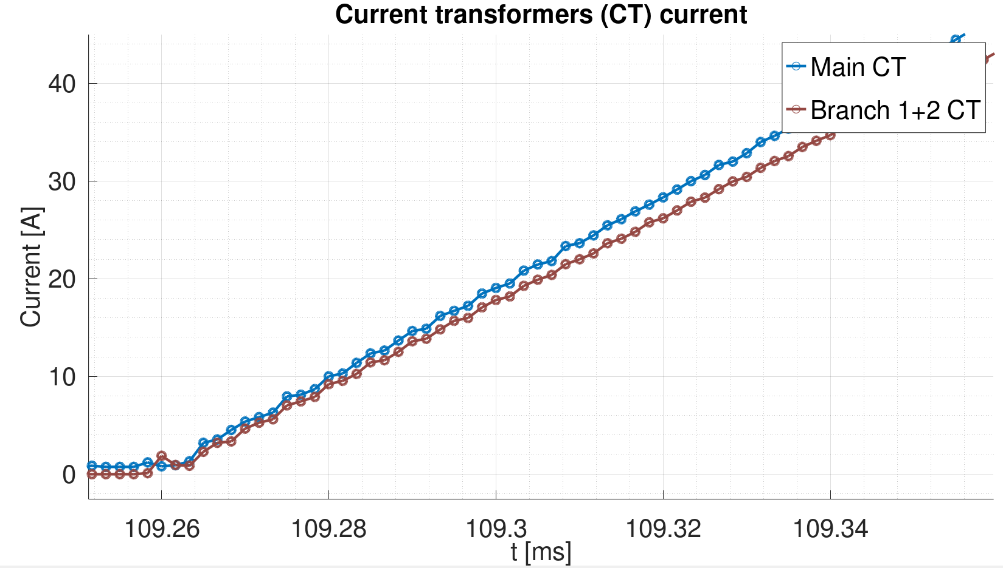
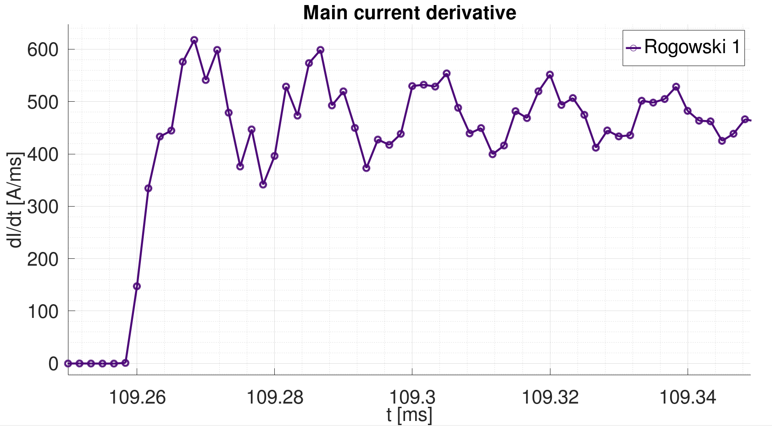
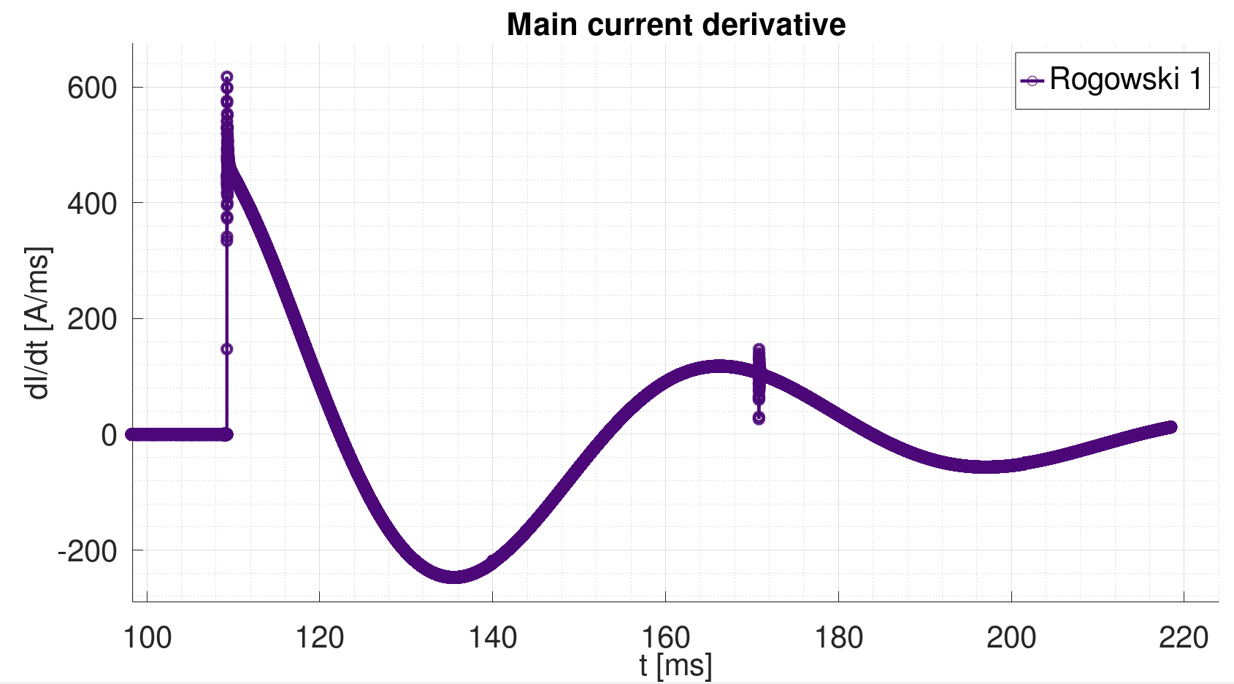
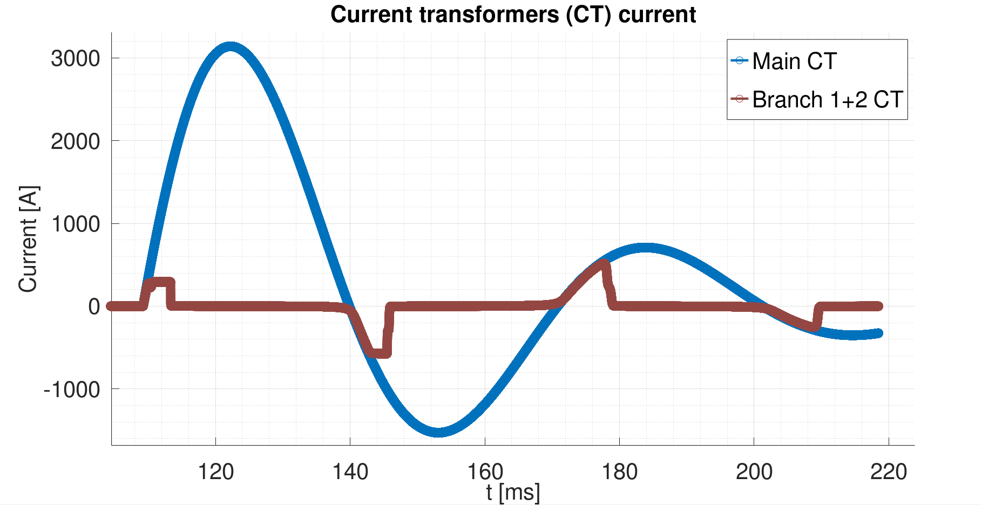
Latency budget for interlocks
Detection of spurious CLIQ trigger = 100 µs
  Detection of spurious HDS trigger < 100 µs
CIBFX to the BIS beam permit = 17 µs
  Max latency under normal conditions = 12 µs
BIS latency between P1 and P6 = 123 µs
  The longest path from R1 to R6
Beam abort sequence = 178 µs
Total time = 418 µs < 450 µs
  The target time to dump for round optics
Current transformers signals during the CLIQ discharge
Current derivative sensor signal during the CLIQ discharge
LBDS
synchronization
PDSU to BIS
Extraction
PDSU
BIS
100 µs
17 µs
123 µs
89 µs
89 µs
Beams must be dumped within 450 µs

Slide 12
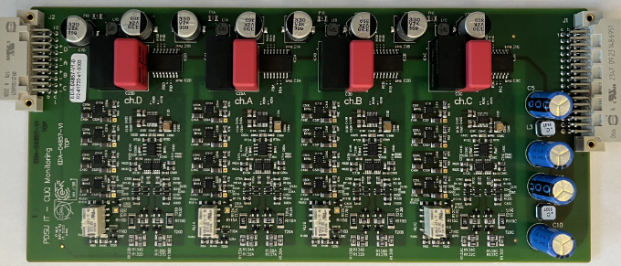
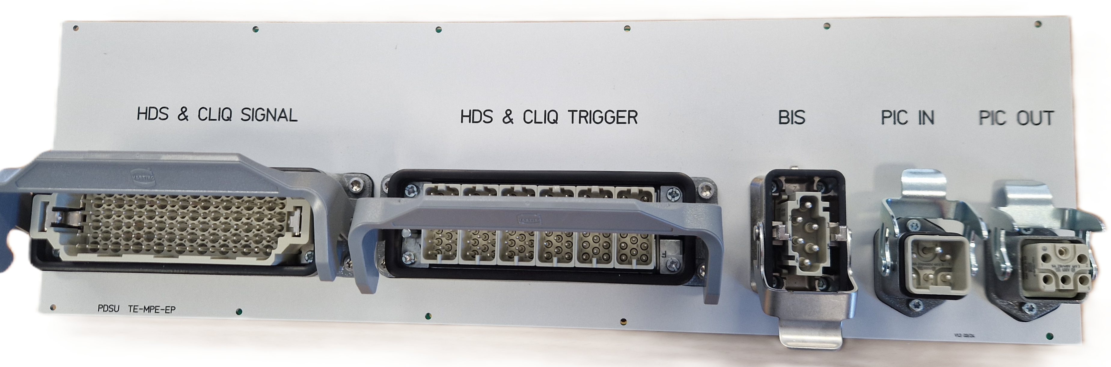
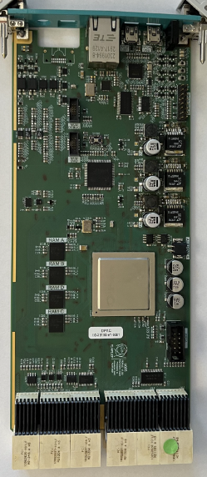
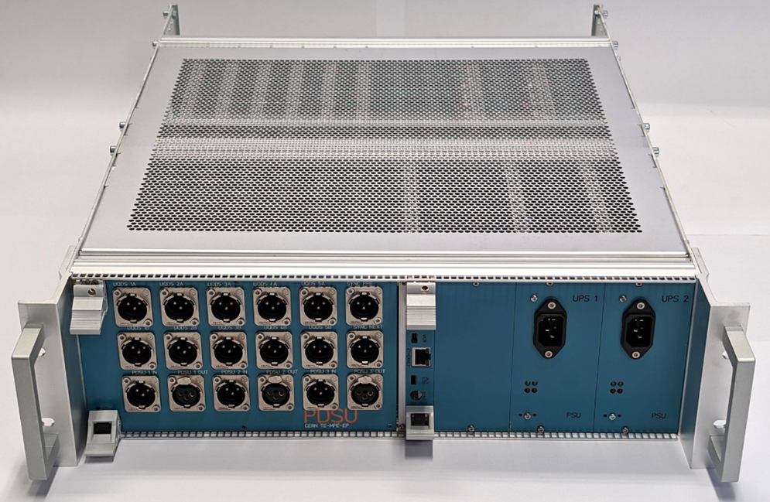
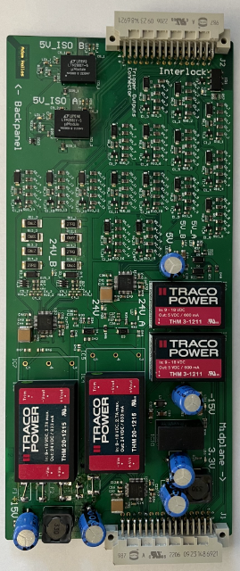
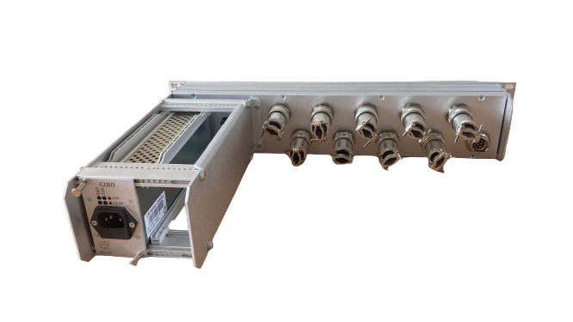
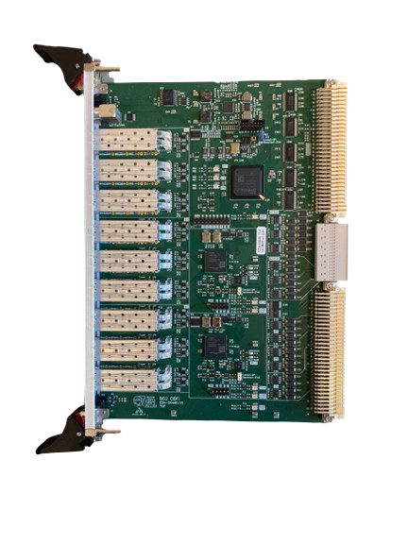
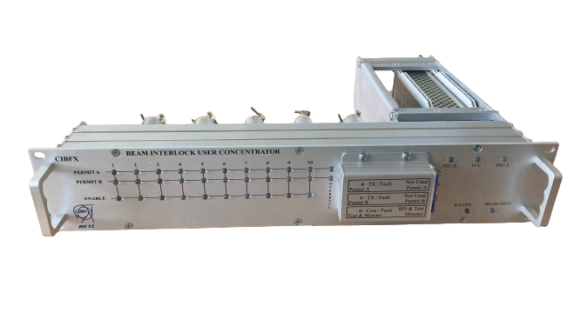
System design
PDSU
  Based on the proven UQDS ecosystem to develop machine protection systems
  Hardware to monitor HDS and CLIQ devices
  Hardware interfacing to PIC and BIS
  Ethernet-enabled data acquisition (EDAQ) enables high-definition data for event analysis and configuration management
BIS Concentrator (CIBFX/CIBFIRX)
  Standard BIS components for the beam interlock concentration for the accelerator complex
  The well-establish BIS technology to transmit beam permit with safe encoding
  Embedded supervision and isolated testing of the BIS concentrator
Lukas Felsberger has details on the reliability
  “Reliability studies on UQDS, PDSU and PDSU-BIS concentrator interface”, 10th of October at 9:50
CIBFIRX
CIBFX rear (top) / front (bottom)

Slide 13
Summary
PDSU systems are crucial to address all protection schemes associated with the Inner Triplet circuit
  Aggregation and distribution of triggers
  Powering interlocking
  Beam interlocking
Beam interlocking is the new machine protection requirement within QPS
  Close integration within QPS and BIS systems is necessary
  Tight latency budget for the entire connection
PDSU to BIS via CIBFX/CIBIFRX connection allows to fulfill requirements
  Straightforward integration within BIS system
  Maintained isolation between the systems
  Complete supervision and full test coverage

Slide 14
Thank you!
Acknowledgements:
To the collective work of TE-MPE-MI, -MP, -CB and -EP teams
For the contribution to this presentation: Antoine Colinet, Cedric Hernalsteens, Ivan Romera Ramirez, Jelena Spasic, Jens Steckert and Reiner Denz

