Slide 1
Reliability studies on uQDS, PDSU and PDSU-BIS interface for the IT protection
L. Felsberger, D. Westermann, D. Wollmann
Acknowledgements to R. Denz, C. Martin, T. Podzorny, I. Romera Ramirez, J. Steckert, J. Uythoven

Slide 2
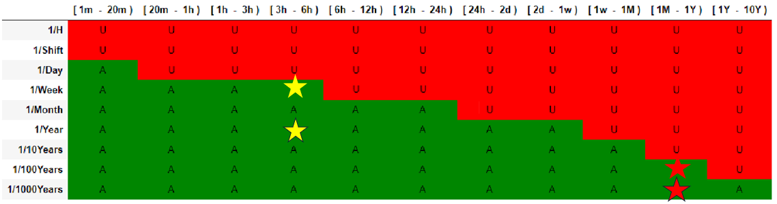
Introduction
LBDS
BIS
BISv2 reliability study
Universal Quench Detection System (uQDS):
  Detect magnet quench
  Trigger PDSU
  Trigger FPA loop, Diagnostics
Protection Device Supervision Unit (PDSU):
  (Re-)Trigger magnet protection systems
  Trigger beam dump
  Detect spurious magnet protection firing
  Trigger FPA loop, Diagnostics
Beam Interlock System (BIS):
  Transmit beam dump request
  Diagnostics
Main failure modes:
  Missed magnet protection and beam dump (target for LHC systems - 1 in 1000 years)
  Spurious magnet protection and beam dump (target for LHC - 1 in 1 year)
This presentation
PICv2 reliability study
PIC
uQDS
PDSU
Heaters + CLIQ
IT
IP
PCs
Q1,Q2,Q3,BB,SCL
IT protection systems study (CLIQ & HDS)
IT interlock panel (EPC interface)
Accelerator Risk Matrix for LHC:
→ Reliability analysis crucial

Slide 3
Reliability Analysis Methodology
  Risk identification
  and quantification
Top-Level Failure Modes, Effects and Criticality Analysis (FMECA)
Identify system, functions, associated risks and hazards and possible end-effects
Accelerator Risk Matrix
Quantify reliability requirements to mitigate risks and hazards
Top-Down reliability model
Capture system structure, redundancies, critical/non-critical parts, demand, inspection rates
Component-Level FMECA
Analyse detailed sub-system design to identify their failure probabilities for each end-effect
→ Design qualification
Feed results from Component-Level FMECA into Top-Down FTA to qualify design or require design improvements
  Risk estimation
  and mitigation

Slide 4
Top-Down Reliability Model - Quench
BIS
UR
uQDS
PDSU
Interlock loop (FPA)
PC
UQDS Q1 A
UQDS Q2 A
UQDS Q3 A
UQDS Sc link A
UQDS BB A
Heaters + CLIQ
Q1,Q2,Q3,BB,SCL
UQDS Q1 B
UQDS Q2 B
UQDS Q3 B
UQDS Sc link B
UQDS BB B
PDSU Q1 A
PDSU Q2 A
PDSU Q3 A
PIC
BIS
Beam abort requests to BIS
PDSU Q1 B
PDSU Q2 B
PDSU Q3 B
Interface Box
2x CLIQ Q1
2x CLIQ Q2
2x CLIQ Q3
Tunnel
Q1
Q2a
Q2b
Q3
USC/UJ
16 x HDS
8 x HDS
8 x HDS
16 x HDS
Courtesy of J. Spasic

Slide 5
Top-Down Reliability Model - Quench
BIS
UR
uQDS
PDSU
Interlock loop (FPA)
PC
UQDS Q1 A
UQDS Q2 A
UQDS Q3 A
UQDS Sc link A
UQDS BB A
Heaters + CLIQ
Q1,Q2,Q3,BB,SCL
UQDS Q1 B
UQDS Q2 B
UQDS Q3 B
UQDS Sc link B
UQDS BB B
Magnet quench
PDSU Q1 A
PDSU Q2 A
PDSU Q3 A
PIC
BIS
Beam abort requests to BIS
PDSU Q1 B
PDSU Q2 B
PDSU Q3 B
Interface Box
2x CLIQ Q1
2x CLIQ Q2
2x CLIQ Q3
Tunnel
Q1
Q2a
Q2b
Q3
USC/UJ
16 x HDS
8 x HDS
8 x HDS
16 x HDS
Courtesy of J. Spasic

Slide 6
Top-Down Reliability Model - Quench
BIS
UR
uQDS
PDSU
Interlock loop (FPA)
PC
UQDS Q1 A
UQDS Q2 A
UQDS Q3 A
UQDS Sc link A
UQDS BB A
Heaters + CLIQ
Q1,Q2,Q3,BB,SCL
UQDS Q1 B
UQDS Q2 B
UQDS Q3 B
UQDS Sc link B
UQDS BB B
Magnet quench
uQDS detection
PDSU Q1 A
PDSU Q2 A
PDSU Q3 A
PIC
BIS
Beam abort requests to BIS
PDSU Q1 B
PDSU Q2 B
PDSU Q3 B
Interface Box
2x CLIQ Q1
2x CLIQ Q2
2x CLIQ Q3
Tunnel
Q1
Q2a
Q2b
Q3
USC/UJ
16 x HDS
8 x HDS
8 x HDS
16 x HDS
Courtesy of J. Spasic

Slide 7
Top-Down Reliability Model - Quench
BIS
UR
uQDS
PDSU
Interlock loop (FPA)
PC
UQDS Q1 A
UQDS Q2 A
UQDS Q3 A
UQDS Sc link A
UQDS BB A
Heaters + CLIQ
Q1,Q2,Q3,BB,SCL
UQDS Q1 B
UQDS Q2 B
UQDS Q3 B
UQDS Sc link B
UQDS BB B
Magnet quench
uQDS detection
6 PDSUs triggered
PDSU Q1 A
PDSU Q2 A
PDSU Q3 A
PIC
BIS
Beam abort requests to BIS
PDSU Q1 B
PDSU Q2 B
PDSU Q3 B
Interface Box
2x CLIQ Q1
2x CLIQ Q2
2x CLIQ Q3
Tunnel
Q1
Q2a
Q2b
Q3
USC/UJ
16 x HDS
8 x HDS
8 x HDS
16 x HDS
Courtesy of J. Spasic

Slide 8
Top-Down Reliability Model - Quench
BIS
UR
uQDS
PDSU
Interlock loop (FPA)
PC
UQDS Q1 A
UQDS Q2 A
UQDS Q3 A
UQDS Sc link A
UQDS BB A
Heaters + CLIQ
Q1,Q2,Q3,BB,SCL
UQDS Q1 B
UQDS Q2 B
UQDS Q3 B
UQDS Sc link B
UQDS BB B
Magnet quench
uQDS detection
6 PDSUs triggered
Beam dump & magnet protection activated
PDSU Q1 A
PDSU Q2 A
PDSU Q3 A
PIC
BIS
Beam abort requests to BIS
PDSU Q1 B
PDSU Q2 B
PDSU Q3 B
Interface Box
2x CLIQ Q1
2x CLIQ Q2
2x CLIQ Q3
Tunnel
Q1
Q2a
Q2b
Q3
USC/UJ
16 x HDS
8 x HDS
8 x HDS
16 x HDS
Courtesy of J. Spasic

Slide 9
Top-Down Reliability Model - Quench
BIS
UR
uQDS
PDSU
Interlock loop (FPA)
PC
UQDS Q1 A
UQDS Q2 A
UQDS Q3 A
UQDS Sc link A
UQDS BB A
Heaters + CLIQ
Q1,Q2,Q3,BB,SCL
UQDS Q1 B
UQDS Q2 B
UQDS Q3 B
UQDS Sc link B
UQDS BB B
Magnet quench
uQDS detection
6 PDSUs triggered
Beam dump & magnet protection activated
PC stopped (beam dump via PIC not fast enough)
PDSU Q1 A
PDSU Q2 A
PDSU Q3 A
PIC
BIS
Beam abort requests to BIS
PDSU Q1 B
PDSU Q2 B
PDSU Q3 B
Interface Box
2x CLIQ Q1
2x CLIQ Q2
2x CLIQ Q3
Tunnel
Q1
Q2a
Q2b
Q3
USC/UJ
16 x HDS
8 x HDS
8 x HDS
16 x HDS
Courtesy of J. Spasic
Notes:
Is a design choice to have the PIC too slow – could delay the uQDS to PDSU triggering protection to allow enough time for PIC – currently not done in favour of magnet protection – and probably we would not protect magnet fast enough

Slide 10
Top-Down Reliability Model – Spurious Firing
BIS
UR
uQDS
PDSU
Interlock loop (FPA)
PC
UQDS Q1 A
UQDS Q2 A
UQDS Q3 A
UQDS Sc link A
UQDS BB A
Heaters + CLIQ
Q1,Q2,Q3,BB,SCL
UQDS Q1 B
UQDS Q2 B
UQDS Q3 B
UQDS Sc link B
UQDS BB B
Spurious CLIQ/HDS firing
PDSU Q1 A
PDSU Q2 A
PDSU Q3 A
PIC
BIS
Beam abort requests to BIS
PDSU Q1 B
PDSU Q2 B
PDSU Q3 B
Interface Box
2x CLIQ Q1
2x CLIQ Q2
2x CLIQ Q3
Tunnel
Q1
Q2a
Q2b
Q3
USC/UJ
16 x HDS
8 x HDS
8 x HDS
16 x HDS
Courtesy of J. Spasic

Slide 11
Top-Down Reliability Model – Spurious Firing
BIS
UR
uQDS
PDSU
Interlock loop (FPA)
PC
UQDS Q1 A
UQDS Q2 A
UQDS Q3 A
UQDS Sc link A
UQDS BB A
Heaters + CLIQ
Q1,Q2,Q3,BB,SCL
UQDS Q1 B
UQDS Q2 B
UQDS Q3 B
UQDS Sc link B
UQDS BB B
Spurious CLIQ/HDS firing
PDSU detects
PDSU Q1 A
PDSU Q2 A
PDSU Q3 A
PIC
BIS
Beam abort requests to BIS
PDSU Q1 B
PDSU Q2 B
PDSU Q3 B
Interface Box
2x CLIQ Q1
2x CLIQ Q2
2x CLIQ Q3
Tunnel
Q1
Q2a
Q2b
Q3
USC/UJ
16 x HDS
8 x HDS
8 x HDS
16 x HDS
Courtesy of J. Spasic

Slide 12
Top-Down Reliability Model – Spurious Firing
BIS
UR
uQDS
PDSU
Interlock loop (FPA)
PC
UQDS Q1 A
UQDS Q2 A
UQDS Q3 A
UQDS Sc link A
UQDS BB A
Heaters + CLIQ
Q1,Q2,Q3,BB,SCL
UQDS Q1 B
UQDS Q2 B
UQDS Q3 B
UQDS Sc link B
UQDS BB B
Spurious CLIQ/HDS firing
PDSU detects
PDSU A/B retriggering
Beam dump and magnet protection request
PDSU Q1 A
PDSU Q2 A
PDSU Q3 A
PIC
BIS
Beam abort requests to BIS
PDSU Q1 B
PDSU Q2 B
PDSU Q3 B
Interface Box
2x CLIQ Q1
2x CLIQ Q2
2x CLIQ Q3
Tunnel
Q1
Q2a
Q2b
Q3
USC/UJ
16 x HDS
8 x HDS
8 x HDS
16 x HDS
Courtesy of J. Spasic

Slide 13
Top-Down Reliability Model – Spurious Firing
BIS
UR
uQDS
PDSU
Interlock loop (FPA)
PC
UQDS Q1 A
UQDS Q2 A
UQDS Q3 A
UQDS Sc link A
UQDS BB A
Heaters + CLIQ
Q1,Q2,Q3,BB,SCL
UQDS Q1 B
UQDS Q2 B
UQDS Q3 B
UQDS Sc link B
UQDS BB B
Spurious CLIQ/HDS firing
PDSU detects
PDSU A/B retriggering
Beam dump and magnet protection request
PC stopped (beam dump via PIC not fast enough)
PDSU Q1 A
PDSU Q2 A
PDSU Q3 A
PIC
BIS
Beam abort requests to BIS
PDSU Q1 B
PDSU Q2 B
PDSU Q3 B
Interface Box
2x CLIQ Q1
2x CLIQ Q2
2x CLIQ Q3
Tunnel
Q1
Q2a
Q2b
Q3
USC/UJ
16 x HDS
8 x HDS
8 x HDS
16 x HDS
See also talks by C. Hernalsteens and T. Podzorny
Courtesy of J. Spasic

Slide 14
Top-Down Reliability Model – Spurious Firing
BIS
UR
uQDS
PDSU
Interlock loop (FPA)
PC
UQDS Q1 A
UQDS Q2 A
UQDS Q3 A
UQDS Sc link A
UQDS BB A
Heaters + CLIQ
Q1,Q2,Q3,BB,SCL
UQDS Q1 B
UQDS Q2 B
UQDS Q3 B
UQDS Sc link B
UQDS BB B
Spurious CLIQ/HDS firing
PDSU detects
PDSU A/B retriggering
Beam dump and magnet protection request
PDSU Q1 A
PDSU Q2 A
PDSU Q3 A
PIC
BIS
Beam abort requests to BIS
PDSU Q1 B
PDSU Q2 B
PDSU Q3 B
Interface Box
2x CLIQ Q1
2x CLIQ Q2
2x CLIQ Q3
Tunnel
Q1
Q2a
Q2b
Q3
For magnet protection, uQDS provides additional redundancy.
But beam dump via uQDS detection not fast enough!
USC/UJ
16 x HDS
8 x HDS
8 x HDS
16 x HDS
Courtesy of J. Spasic

Slide 15
Top-Down Reliability Models
Magnet Protection
Beam Dump/Spurious Firing
BIS
BIS
uQDS
PDSU
uQDS
PDSU
Heaters + CLIQ
Heaters + CLIQ
Q1,Q2,Q3,BB,SCL
Q1,Q2,Q3,BB,SCL
Magnet protection model ignores beam dump functionality (covered in spurious firing model)
Spurious firing model ignores magnet protection functionality (covered in magnet protection model)

Slide 16
uQDS & PDSU Hardware
BIS
uQDS
PDSU
Heaters + CLIQ
uQDS and PDSU share designs of hardware modules
Q1,Q2,Q3,BB,SCL
Monitoring
Channel
Monitoring
Channel
Monitoring
Channel
Monitoring
Channel
…
Passive Mid-Plane
PSU
PSU
Digital Platform (FPGA)
Triggers
I/O
Interlocks

Slide 17
uQDS & PDSU Hardware
BIS
uQDS
PDSU
Heaters + CLIQ
uQDS and PDSU share designs of hardware modules
Q1,Q2,Q3,BB,SCL
Monitoring
Channel
Monitoring
Channel
Monitoring
Channel
Monitoring
Channel
…
Passive Mid-Plane
PSU
PSU
Digital Platform (FPGA)
Triggers
I/O
Interlocks

Slide 18
uQDS & PDSU Hardware
BIS
uQDS
PDSU
Heaters + CLIQ
uQDS and PDSU share designs of hardware modules
Q1,Q2,Q3,BB,SCL
Monitoring
Channel
Monitoring
Channel
Monitoring
Channel
Monitoring
Channel
…
Passive Mid-Plane
PSU
PSU
Digital Platform (FPGA)
Triggers
I/O
Interlocks

Slide 19
uQDS & PDSU FMECA
FITS: Failures in 10^9 hours (~10^5 years)
BIS
uQDS
PDSU
HDS/CLIQ CT/IFS/interface box
20.0 FITS/channel
(to uQDS)
Heaters + CLIQ
uQDS and PDSU share designs of hardware modules
Detailed FMECA carried out for
  Analogue monitoring channels (similar between uQDS and PDSU)
  Digital Platform (identical between uQDS and PDSU)
  Approximate (pessimistic) FMECA for other modules & interfaces
Relevant failure mode types for magnet protection & beam dump
  Blind unsafe failure (detected upon commissioning or demand)
  Blind unsafe failure (detected every fill/ramp)
  Detected unsafe failure (visible in supervision)
Q1,Q2,Q3,BB,SCL
Monitoring
Channel
Monitoring
Channel
Monitoring
Channel
Monitoring
Channel
11.4 FITS per channel
…
Passive Mid-Plane
4.0 FITS
PSU
PSU
Digital Platform (FPGA)
Triggers
I/O
Interlocks
0 FITS
0 FITS
16.7 FITS
BIS concentrator
17.3 FITS/path
9.9 FITS/path
Notes:
Note that PDSU test mode overwriting normal operational mode is crucial, otherwise HDS/CLIQ won’t trigger

Slide 20
uQDS & PDSU FMECA
FITS: Failures in 10^9 hours (~10^5 years)
BIS
uQDS
PDSU
Voltage taps, IFS, patch panel
13.8 FITS/channel
(BB, SCL)
Voltage taps, IFS, patch panel
13.8 FITS/channel
(coil)
Heaters + CLIQ
uQDS and PDSU share designs of hardware modules
Detailed FMECA carried out for
  Analogue monitoring channels (similar between uQDS and PDSU)
  Digital Platform (identical between uQDS and PDSU)
  Approximate (pessimistic) FMECA for other modules & interfaces
Relevant failure mode types for magnet protection & beam dump
  Blind unsafe failure (detected upon commissioning or demand)
  Blind unsafe failure (detected every fill/ramp)
  Detected unsafe failure (visible in supervision)
Q1,Q2,Q3,BB,SCL
Monitoring
Channel
Monitoring
Channel
Monitoring
Channel
Monitoring
Channel
11.4 FITS per channel (BB & SCL)
0 FITS per channel (coils)
…
0 FITS per channel (BB & SCL)
11.4 FITS per channel (coils)
Passive Mid-Plane
4.0 FITS (BB&SCL)
4.0 FITS (coils)
Triggers
I/O
Interlocks
PSU
PSU
Digital Platform (FPGA)
9.9 FITS/path
(to PDSU)
0 FITS
0 FITS
16.7 FITS
Notes:
Double check with Jens which of the blind failures in channel can be detected during magnet ramp

Slide 21
uQDS & PDSU FMECA
FITS: Failures in 10^9 hours (~10^5 years)
BIS
uQDS
PDSU
Voltage taps, IFS, patch panel
13.8 FITS/channel
(BB, SCL)
Voltage taps, IFS, patch panel
13.8 FITS/channel
(coil)
Heaters + CLIQ
Component failure rate source is 217+ electronics reliability prediction & FMD91/2016 standard
  Values apply for indoor, stationary mission profile during useful lifetime
If end effect unclear, pessimistic choice taken
Certain end effect assignments should be validated by functional tests in hardware
  E.g. behavior under 3.3V voltage rail drift, ADC behavior under reference voltage drift
FMECA process identified parts of design that may be optimized further for QDS CONS design for main dipole magnets
  E.g. placement of additional pull up/down lines in channel
Q1,Q2,Q3,BB,SCL
Monitoring
Channel
Monitoring
Channel
Monitoring
Channel
Monitoring
Channel
11.4 FITS per channel (BB & SCL)
0 FITS per channel (coils)
…
0 FITS per channel (BB & SCL)
11.4 FITS per channel (coils)
Passive Mid-Plane
4.0 FITS (BB&SCL)
4.0 FITS (coils)
Triggers
I/O
Interlocks
PSU
PSU
Digital Platform (FPGA)
9.9 FITS/path
(to PDSU)
0 FITS
0 FITS
16.7 FITS
Notes:
Test mode PDSU – how to make sure it trggers when outside test mode

Slide 22
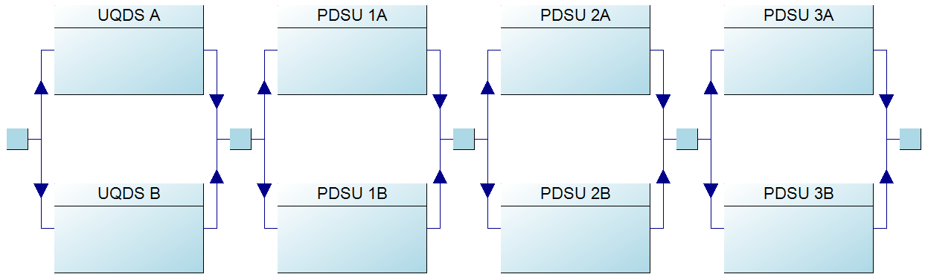
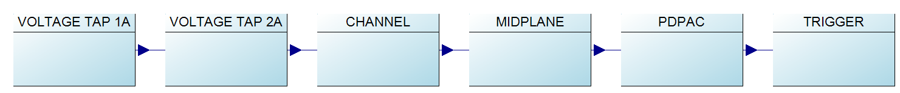
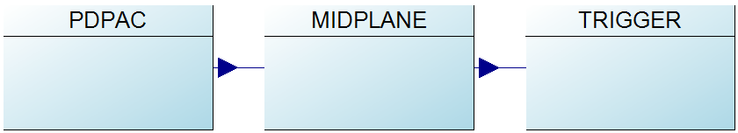
Top-Down Reliability Model – Magnet Protection
BIS
Complexity of model required making pessimistic simplifications
  Comparison with full redundancy structure confirmed that error is tolerable
Heaters & CLIQ modeled previously in IT protection systems study
uQDS
PDSU
Heaters + CLIQ
Q1,Q2,Q3,BB,SCL
UQDS
PDSU
x2
x2
x2
x6
1oo1 v 7oo8
Notes:
System is so complex that conservative simplifications were made
Series configuration of uQDS and PDSU triggers is assumed instead of respective redundancy → pessimistic
Retriggering of PDSUs omitted
Pessimistic assumptions on quench detection scenario

Slide 23
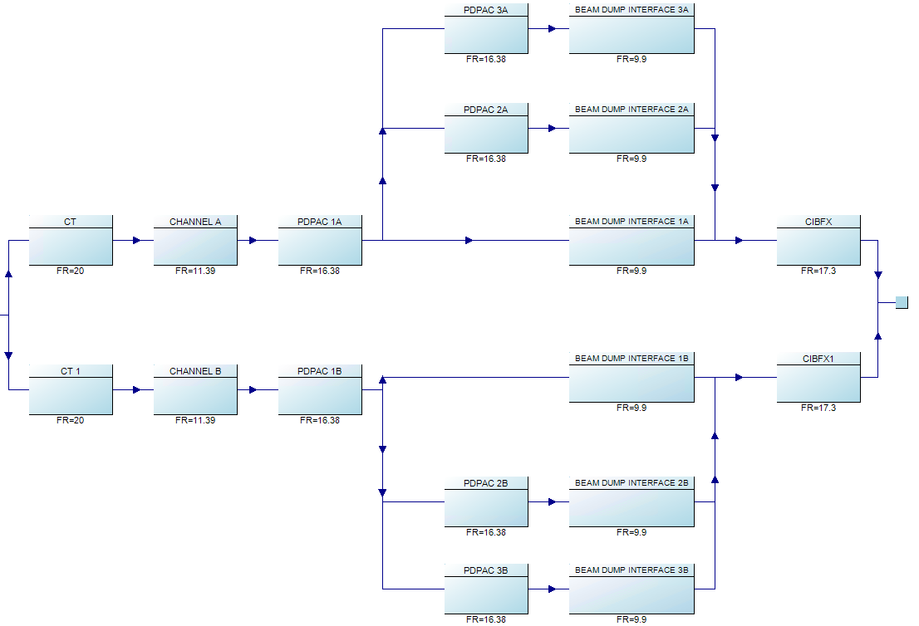
Top-Down Reliability Model – Beam Dump/Spurious Firing
BIS
uQDS
PDSU
Heaters + CLIQ
Few pessimistic simplifications required
HDS case shown, as CLIQ has additional redundancy in read-out
  Clear separation of redundant paths as PDSU retriggering does not re-trigger between paths A & B
BIS concentrator
  New CIBFX design
  Originally developed for EPC use cases
  Reliability study as part of BISv2 reliability study
Q1,Q2,Q3,BB,SCL
HDSCLIQ
BIS
Concen-trator
(retriggered) Digital Platforms
Channel
Digital Platform
Beam dump trigger
Notes:
Remove CIBF
Discuss CIBFx – started for EPC, already have separate use, little pop-up
Hier sind die trigger zwischen den digital platforms nicht ersichtlich

Slide 24
Results – Failure Rates
Repair/Inspection Policy:
Commissioning: 1 operational (op) year = 7200 hours/300 days
Ramp detection interval: 12 hours
Reaction to Supervision: 12 hours
Magnet protection: 128 instances that can have a single quench
Beam dump: 216 instances that can have a spurious trigger
Target
10 quenches every op year =
1 quench/coil every 12.8 op years
1 spurious firing per year =
1 spurious firing every 216 op years
Magnet protection
Maximum number of failures when the demand interval approaches the commissioning interval
  Magnet protection less reliable, mainly due to longer chain of systems in critical path
For both protection functions the reliability target is comfortably met.
  But under the condition of regular systematic testing
Beam dump
Notes:
Wir haben 4 IT circuits, mit jeweils 6 Magnethälften und in jeder magnethälfte haben wir 4 Coils. Das macht 464= 96. Bezüglich der Busbars nehmen wir zwischen den Hälften eines magneten 1 busbar an (3 je circuit), eine zwischen den drei magneten und eine vom ciruict weg und hin. Also insgesamt 6 pro circuit und damit insgesamt 24 stück. FÜR sc link sagten wir 2 je circuit was 8 macht. Damit haben wir 96 coils die quenchen können und busbar plus sc link macht 32. Damit kommen wir auf 128.

Slide 25
Commissioning interval Magnet protection
Repair/Inspection Policy:
Commissioning: 1 or 3 operational years
Ramp detection interval: 12 hours
Reaction to Supervision: 12 hours
Magnet protection: 128 instances that can have a single quench
Beam dump: 216 instances that can have a spurious trigger
10 quenches every op year =
1 quench/coil every 12.8 op years
With a commissioning interval of 3 years instead of 1 year, the number of failures increase
  Mainly due to the probability of blind failures accumulating that are only visible in commissioning or on demand.
    Difference smaller if demand rate is higher
With 3-year intervals, the reliability target is not met
Yearly quench test is recommended
Target
Notes:
If we can test even more during ramp – do it
Add requirements

Slide 26
System Monitoring & Testing
Magnet protection
Repair/Inspection Policy:
Commissioning: 1 operational (op) year
Ramp detection interval: 12 hours → 7200 hours
Reaction to Supervision: 12 hours → 7200 hours
Magnet protection: 128 instances that can have a single quench
Beam dump: 216 instances that can have a spurious trigger
Strong impact of less frequent/imperfect testing
  Only a small increase of about 1.1E-05, if the failures are detected and repaired after 72 hours.
  Maximum of 6.8E-01 failures if the failures are detected for the first time during yearly commissioning.
    This assumes an interlock of operation (SIS) if both critical paths lose supervision.
Monitoring & ramp testing is crucial for protection function!
  Extending coverage yields additional reliability margins
Detected problems can be fixed after fill
  Do not need to stop operations
Target
Notes:
This assumes an interlock of operation (SIS) if both critical paths lose supervision. This only becomes relevant though when the test execution/repair interval is close to 7200 hours. Without it, values would be 10% higher.

Slide 27
Conclusions & Next Steps
A reliability model for the quench protection and beam dump functions of the IT shows
  The foreseen uQDS, PDSU and BIS concentrator hardware design conforms with the reliability requirements
  This is under the condition that
    yearly commissioning tests are performed (IST) to check the integrity of the system and all interfaces
    an automated test during ramp is executed every LHC fill as part of a sequencer task to check integrity of the system
Follow-up of the study
  The uQDS/PDSU FMECA analysis results should be validated by selected HW functional tests/simulations
  Availability aspects of the system to be quantified and checked against operational data
  An analysis of critical firm- and software and configuration management should complement the hardware study
In view of the consolidation of the LHC main dipole QDS system
  The reliability model should be adapted, and pessimistic assumptions refined
  Design improvements triggered by uQDS/PDSU FMECA analysis should be implemented if possible

Slide 29
Protection System Life Cycle
  Clear and exhaustive specifications of the project
  Thorough risk and hazards analysis, definition of safety requirements
Machine Protection systems development follows defined life-cycle
Ensures that risks are mitigated
Inspired by IEC 61508 and adapted for CERN context
The scope of the uQDS & PDSU reliability analysis is to
  Identify risks and hazards and quantify requirements for their mitigation
  Qualify the detailed hardware design according to the defined requirements
  Design of the system
  Reliability analysis
  Dependability
  Availability
  Testing and validation
  Commissioning of the system
Courtesy of M. Kalinowski
  Operation and maintenance
  Experts’ advice
  Trainings
  Procedures
  Periodic testing

Slide 30
Component-Level FMECA - Introduction
Failure Modes, Effects, and Criticality Analysis (FMECA)
Purpose: identify potential failure modes of individual components within a system & quantify failure impact at system level
Id | Component | Description | failure_mode | Alpha | Component Failure Rate | Failure Mode Rate | End Effect
1.1 | C2 | ¬±10% 50V X7R SMD Multilayer Chip Ceramic Capacitor | Open | 9 | 0.357 | 0.032 | Spurious Protection
1.1 | C2 | ¬±10% 50V X7R SMD Multilayer Chip Ceramic Capacitor | Parameter change | 61 | 0.357 | 0.218 | No effect
1.1 | C2 | ¬±10% 50V X7R SMD Multilayer Chip Ceramic Capacitor | Short | 30 | 0.357 | 0.107 | Blind channel

Slide 31
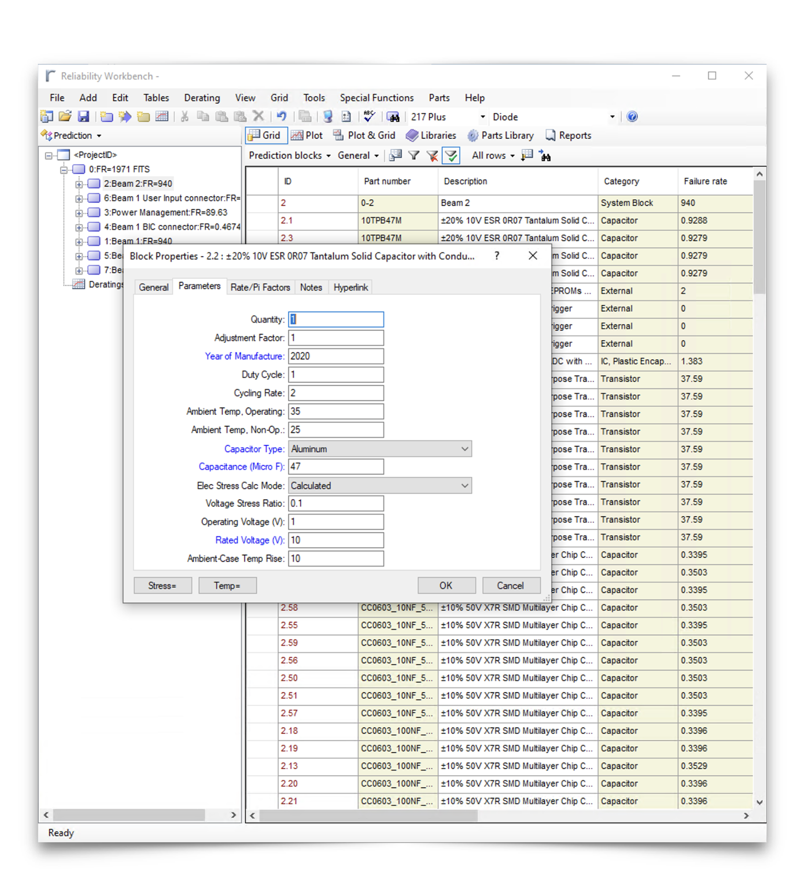
FMECA Process
Key steps
Using Bill of Materials, do a component-wise Failure Rate Prediction.
  Mainly based on 217Plus standard (2015/RIAC, but also available: Telcordia TR/SR, MIL-217, NSWC). Completed by manufacturer and test data.
  Requires definition of mission profile/environment as well as operating conditions for individual components
Identification & apportionment of component failure modes
  i.e., capacitor -> {open, param. change, short}.
  Based on handbooks (MIL-HDBK338, FMD2016).
Assigning end-effects to each failure mode of every component of the system.
  i.e., Capacitor C1: open -> no effect, short -> false dump, param. change -> blind failure.
Screenshot of Isograph Reliability Workbench (tool used for FMECA analysis)

Slide 32
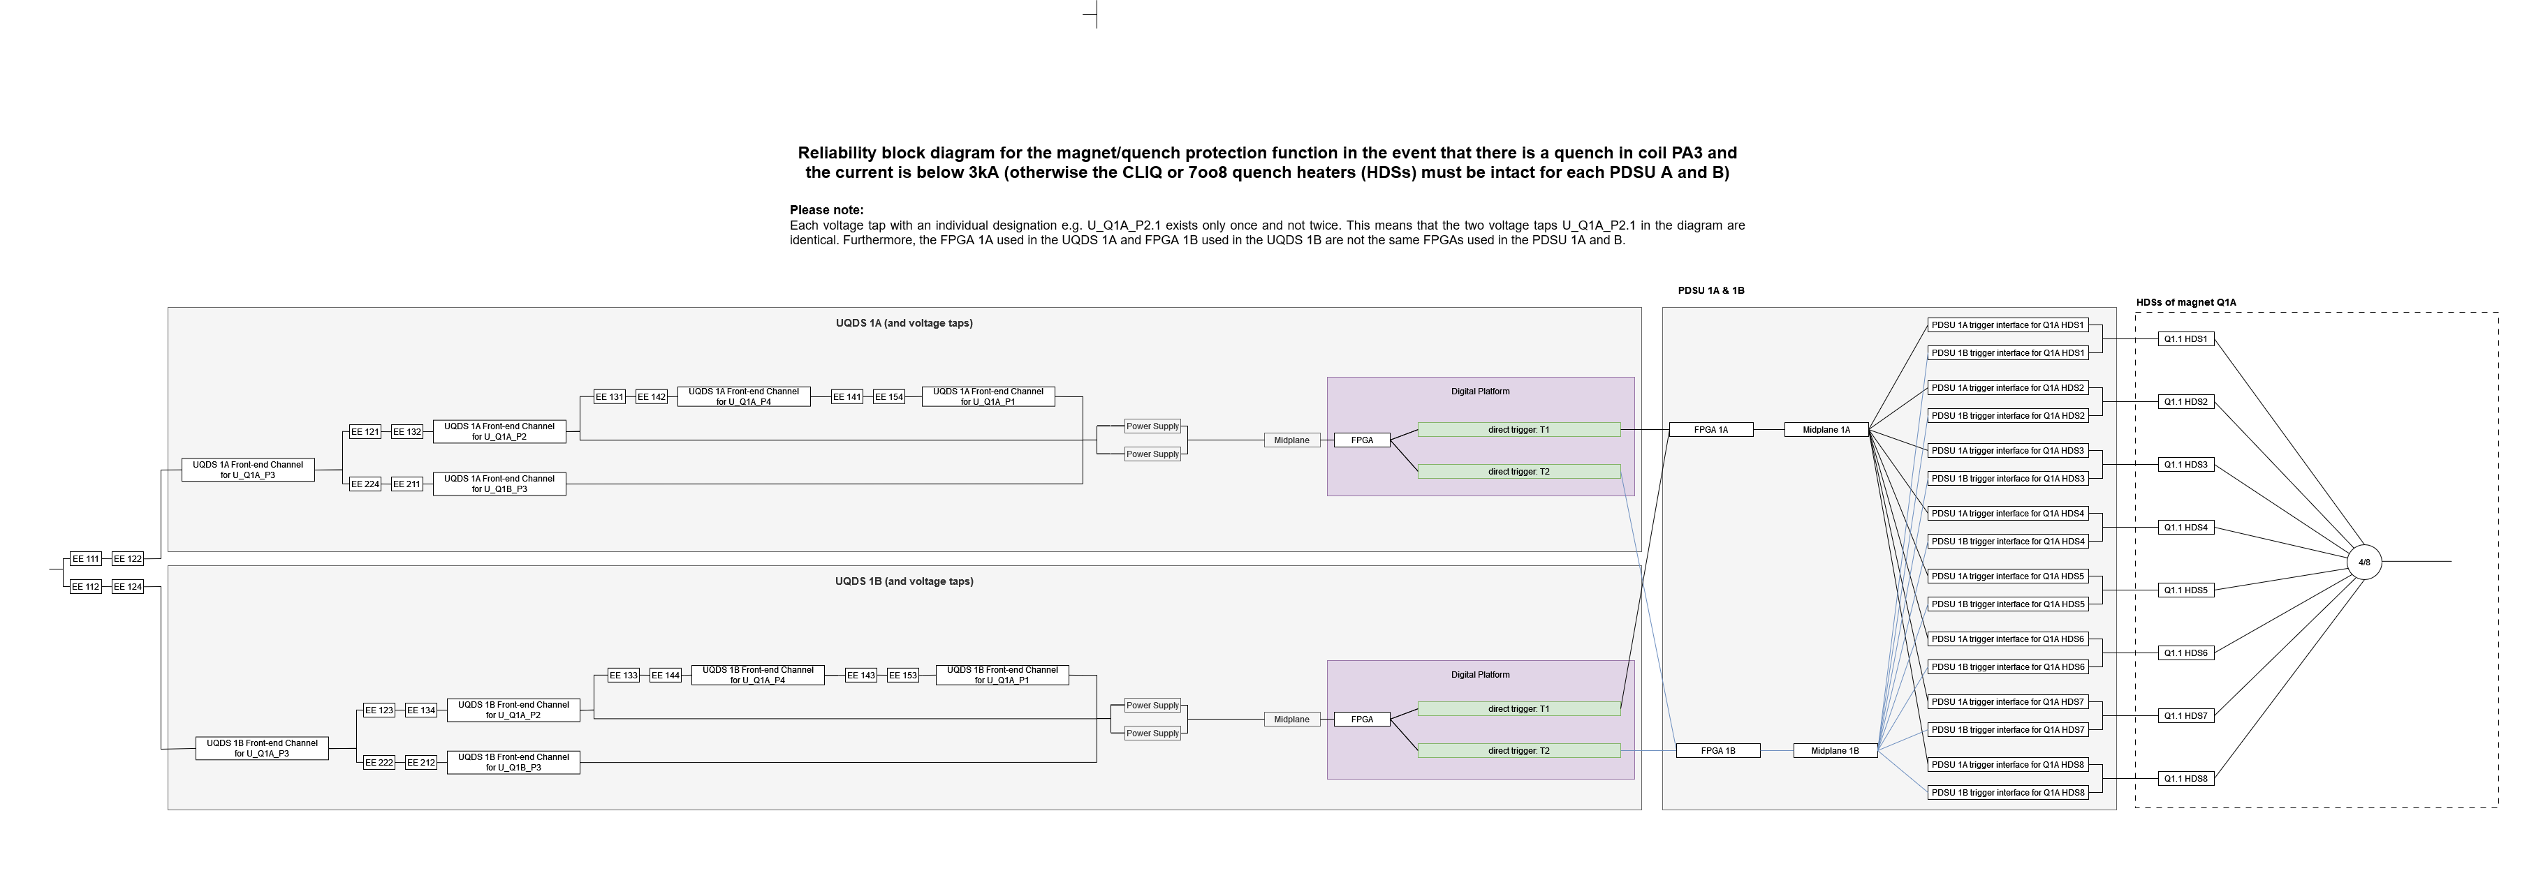
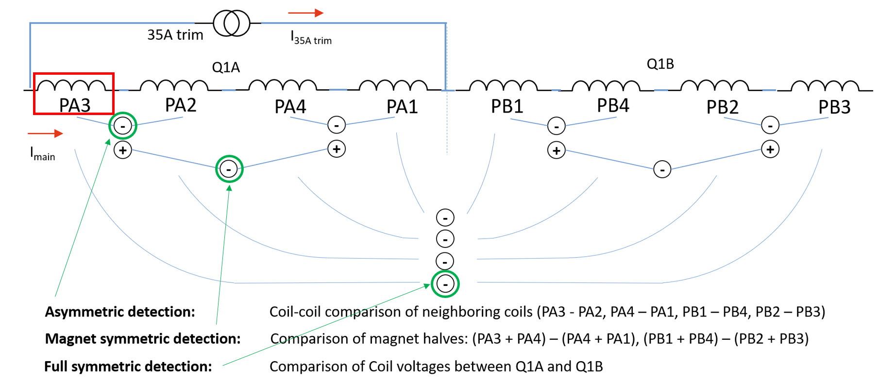
Top-Down Reliability Model – Magnet Protection
BIS
uQDS
PDSU
Quench protection strategy is inherently redundant
For single coil quench, triple redundant detection method & each of them redundant in hardware
Heaters + CLIQ
Q1,Q2,Q3,BB,SCL
Reliability model assumes single coil quench

Slide 33
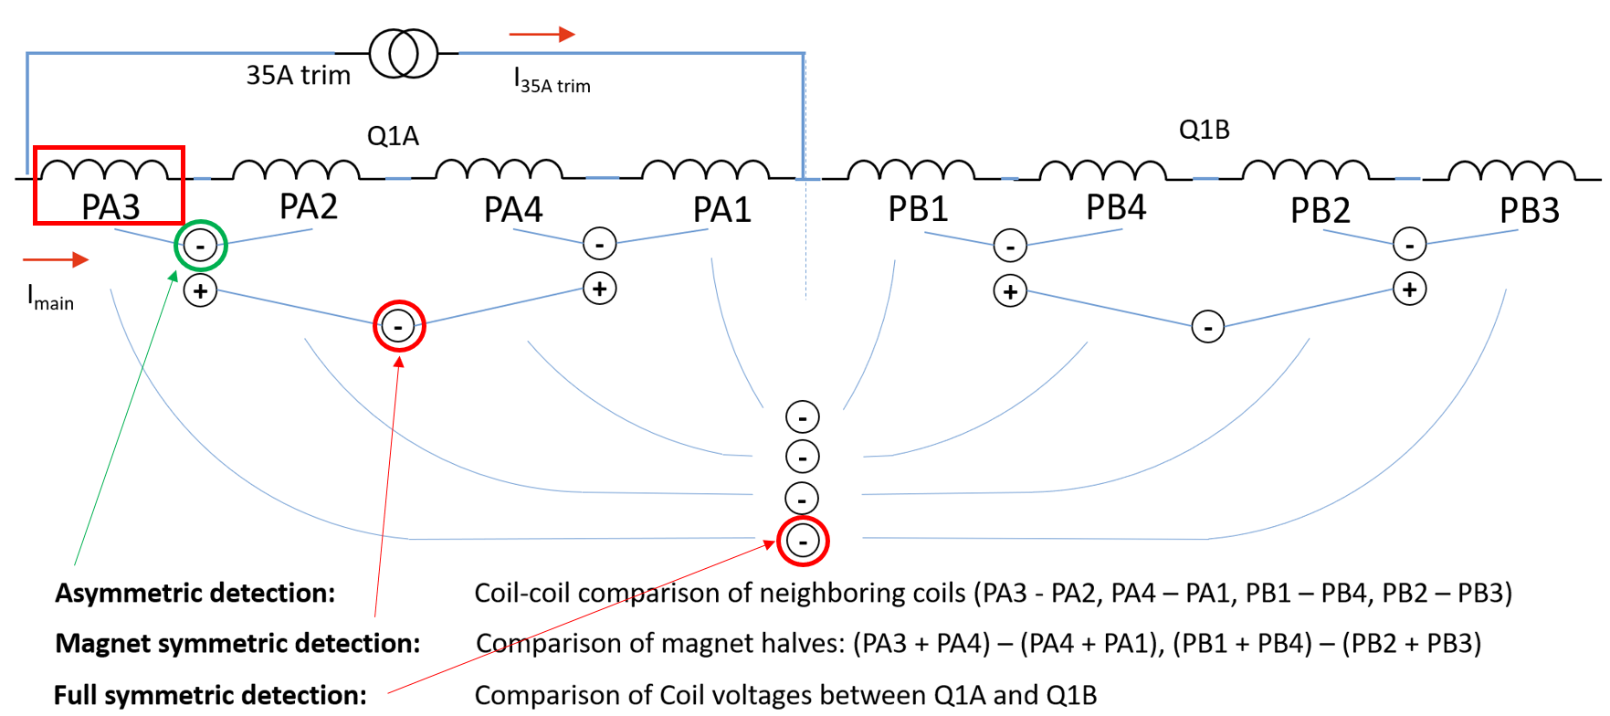
Top-Down Reliability Model – Magnet Protection
BIS
uQDS
PDSU
Quench protection strategy is inherently redundant
For single coil fault, triple redundant detection method & each of them redundant in hardware
Heaters + CLIQ
Q1,Q2,Q3,BB,SCL
Reliability model assumes single coil quench
To reflect that symmetric quenches can occur, which have reduced redundancy, two of three redundant paths are omitted.
Pessimistic scenario

Slide 34
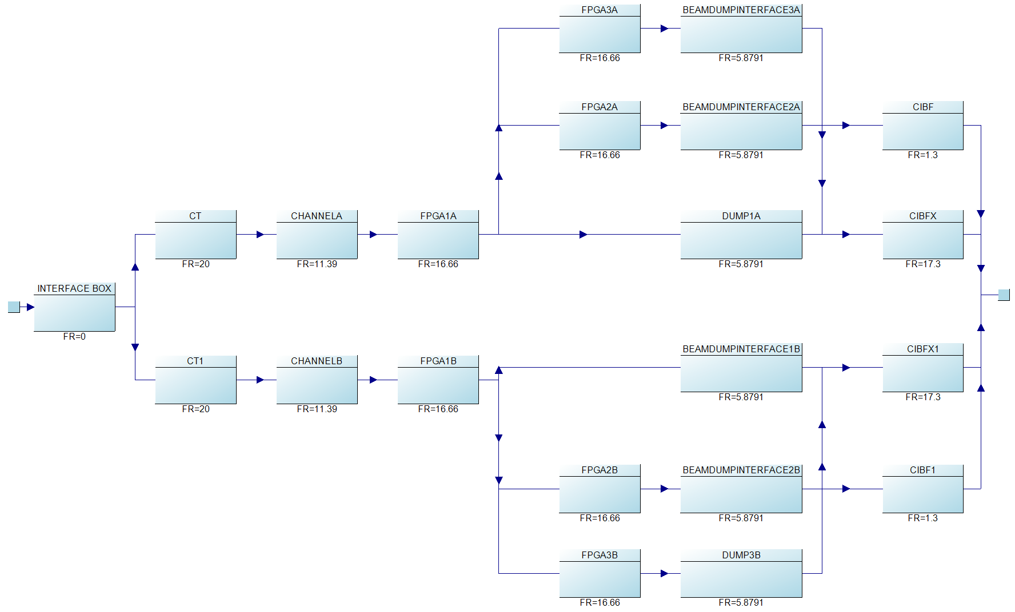
CIBFx+CIBF or only CIBFx?
Depending on the demand rate, the additional CIBF reduces the number of faults per 1000 years by 0 to 2.20E-05.
In the relevant range of 0.0046 spurious firings per year per HDS/CLIQ (1 spurious firing per year), the influence is with a difference of about 3.24E-08 to 3.24E-09 almost negligible.

Slide 35
Design qualification – Analytic Approach – Magnet Protection
An analytical approach was chosen over a simulation approach for time reasons and results are consistent
The minimal cut set method was used to consider various inspection intervals and repair actions

