Slide 1

Vacuum chambers : TAXN, TAXS
Jaime Perez Espinos, Marco Morrone
10th October 2024
14th HL-LHC Collaboration Meeting

Slide 2
Content of the presentation
Recall of scope for the TAXN & TAXS chambers
Status of TAXN chambers
Status of TAXS chambers
Conclusions
Jaime Perez Espinos, Marco Morrone | Status of TAXN and TAXS chambers

Slide 3
Scope
Originally:
  TE-VSC contributed with conceptual design, vacuum specification, qualification test and vacuum validation;
  Detailed design and procurement supposed to be an in-kind contribution from BINP (Russia).
Later:
  Decision to have it internalised at CERN ⇒ TE-VSC contribution to WP8;
  Agreement WP8-WP12 on TAXN chamber held in 2021
  Agreement WP8-WP12 on TAXS chamber, ongoing → DMR (EDMS #3102021) and new version of TE-VSC contribution to WP8 (EDMS #1820996) still under approval
Jaime Perez Espinos, Marco Morrone | Status of TAXN and TAXS chambers

Slide 4
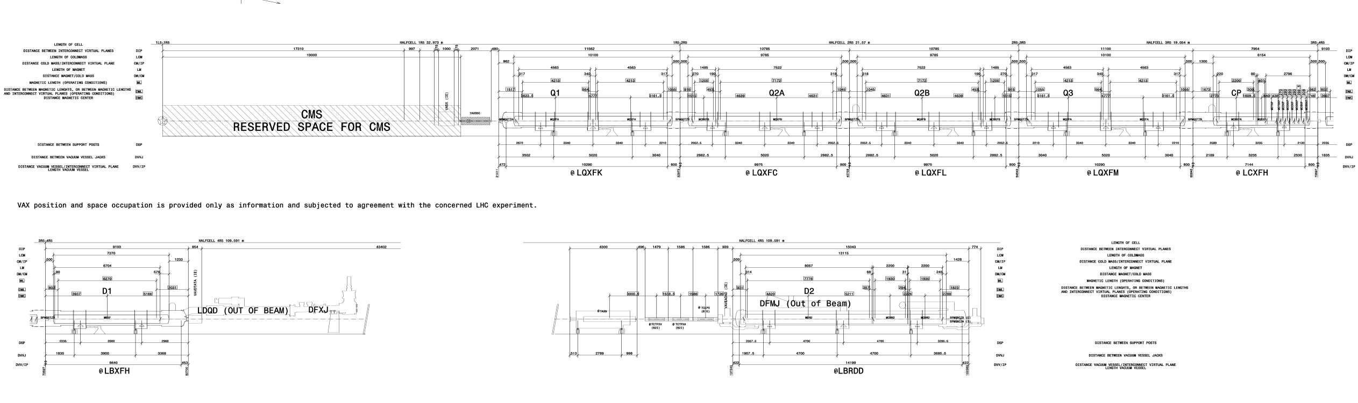
Location of the TAXN and TAXS chambers
TAXS
TAXN
TAXN chamber is to be installed about 126 m (IP flange) from the IP in point 1&5.
TAXS chamber is to be installed about 19 m (IP flange) from the IP in point 1&5.
Jaime Perez Espinos, Marco Morrone | Status of TAXN and TAXS chambers

Slide 5
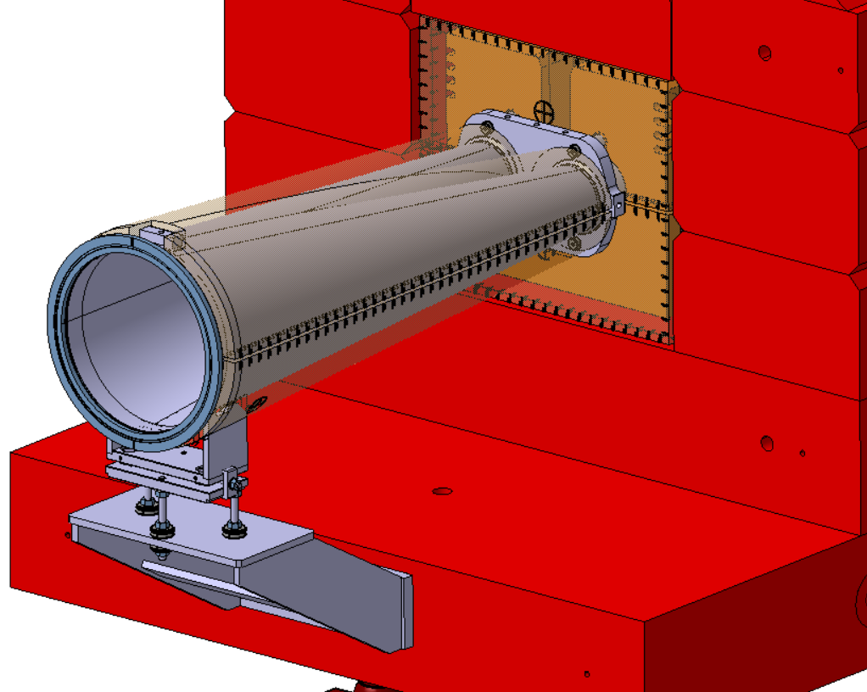
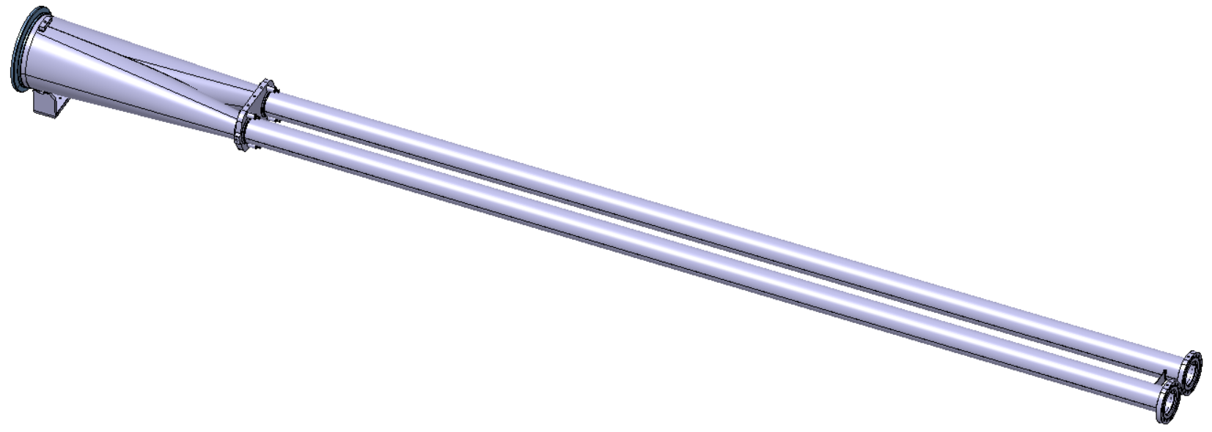
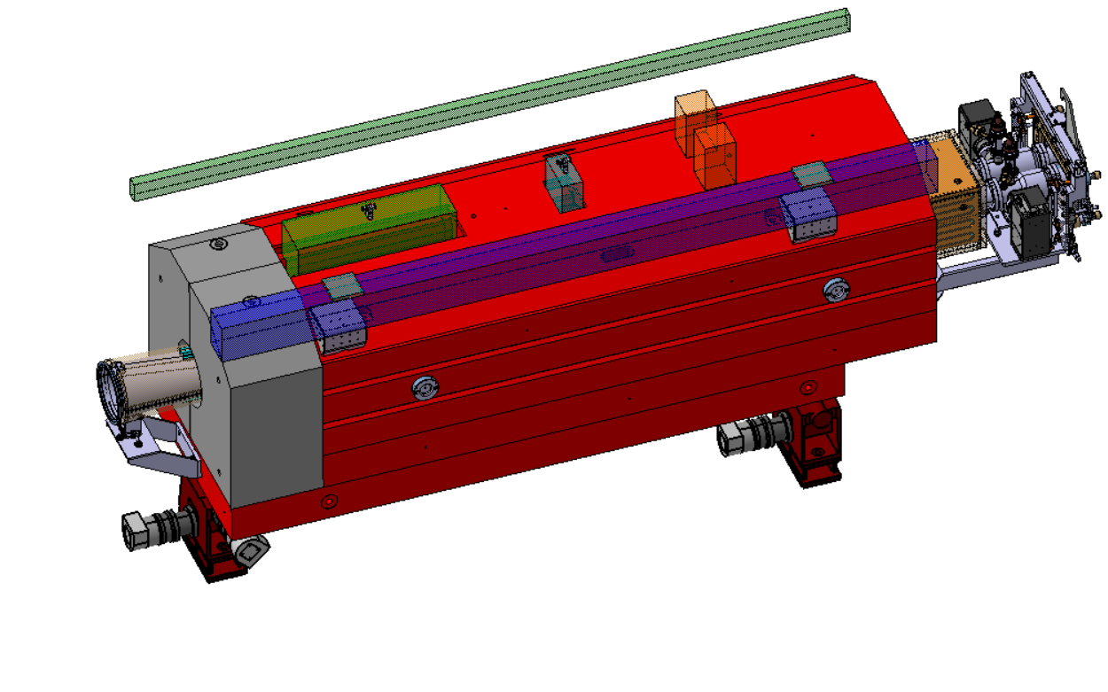
Status of the TAXN chambers
Design is finished
  Drawing reference: LHCVCTYF0001 fully approved on 18.09.2023;
  Chamber bolted to the IP face of the absorber and clamped between the two absorber halves;
  Made of stainless steel 316 LN, NEG coated and bakeable.
Production is ongoing (1 spare + 4 series chambers)
  Manufacturing strategy and post treatments report: EDMS #2997713;
  1 spare chamber produced (existing NC being addressed, to be formally reported);
  Subcomponents for rest of chambers, already produced and/or assembled.
Flange Øint 250mm
Recombination
part
Reference plate fixed
to the absorber
Integration of the bakeout jackets
and the reference plate
Non parallel tubes
4300 mm
Ø_{int} 88mm
Ø_{ext} 91mm
Flange DN100
Jaime Perez Espinos, Marco Morrone | Status of TAXN and TAXS chambers

Slide 6
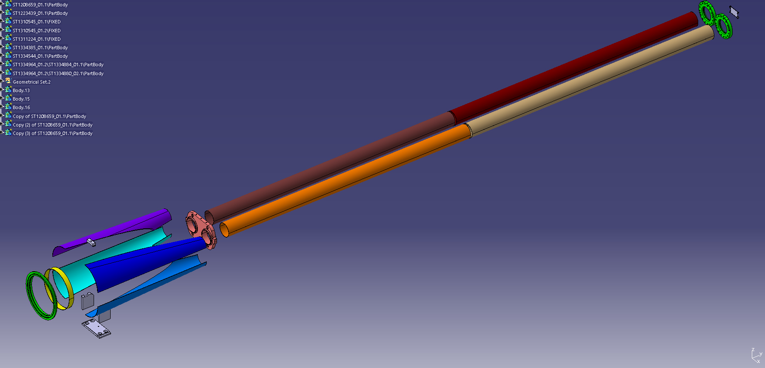
Subcomponents of TAXN chambers
1725 mm
1725 mm
1 rolled sheet composing one independent
chamber (2 chambers per leg)
Reference plate
Recombination part resulting in two cones
made of 4 pieces

Slide 7
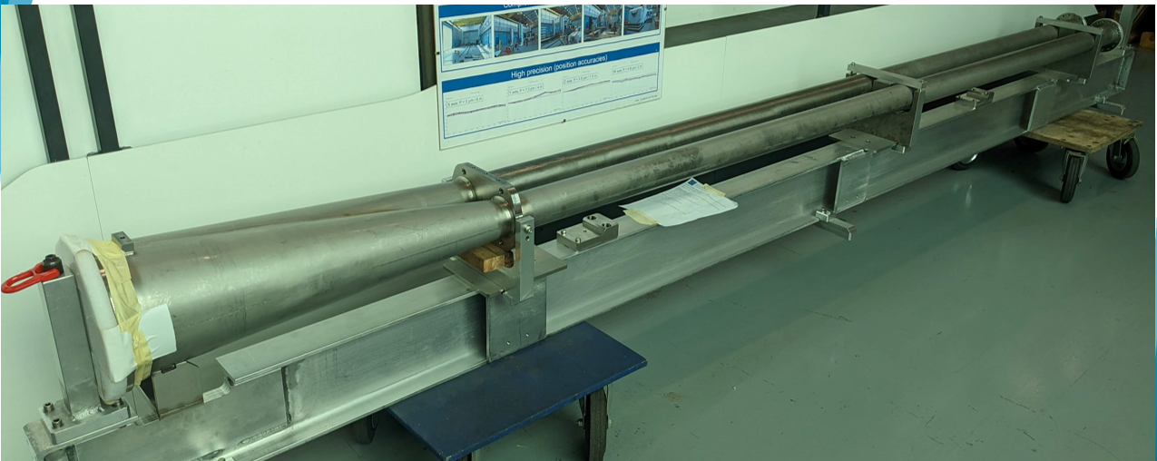
Status of TAXN chambers
1st chamber manufactured (spare): 2 NCs under discussion
…but with some problems!
Jaime Perez Espinos, Marco Morrone | Status of TAXN and TAXS chambers

Slide 8
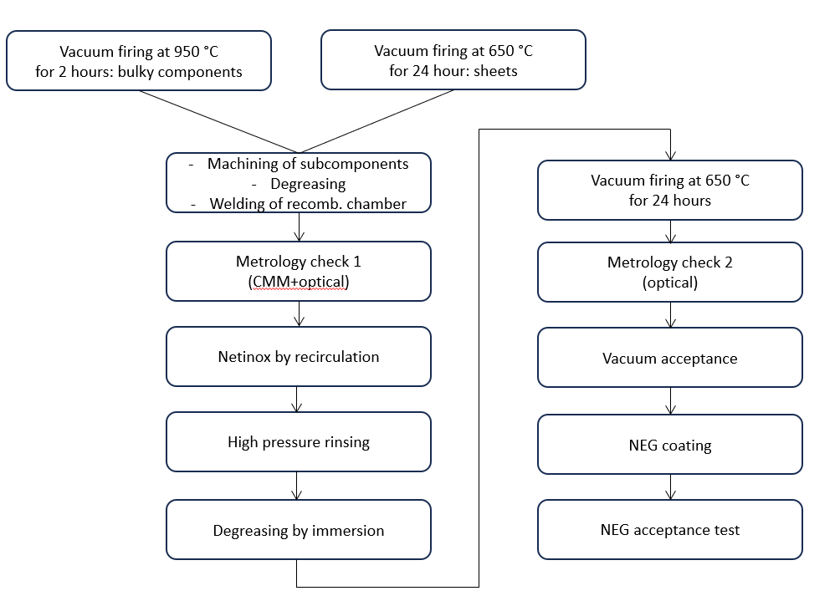

Production and verification sequence of 1st TAXN chamber
Black stains in welding regions
1
Offset from
nominal dimensions
3
Please note:
All components are degreased before any subsequent step.
Metrology NC
2
Metallized fibers
NEG NC
Marco Morrone | Status of TAXN and TAXS chambers
Jaime Perez Espinos, Marco Morrone | Status of TAXN and TAXS chambers

Slide 9
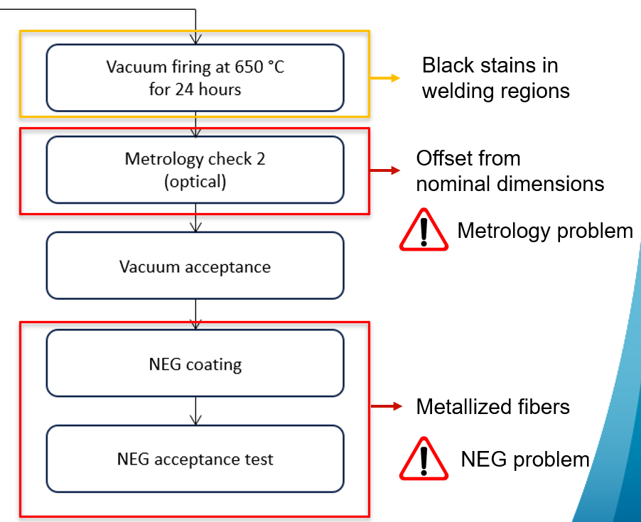
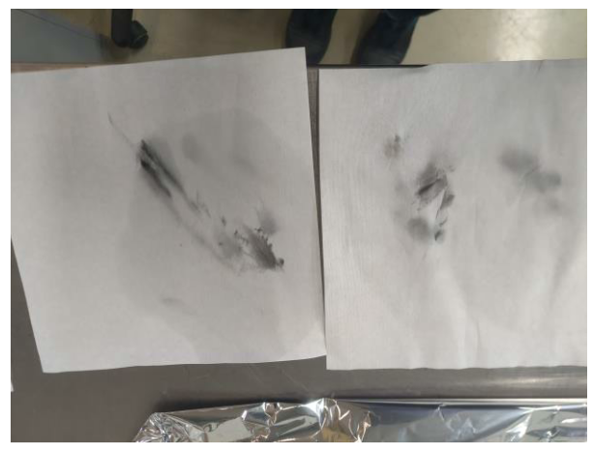
Status of the TAXN chamber
NEG NC
After vacuum firing some black stains appeared. With the intent to remove these stains some wiping tissues were used.
Some fibers got stuck on the surface of chamber. They were unnoticed and got metalized during the NEG coating.
SEM-EDS analyses proved that the fiber surface was NEG but that the core was indeed organic.
Jaime Perez Espinos, Marco Morrone | Status of TAXN and TAXS chambers

Slide 10
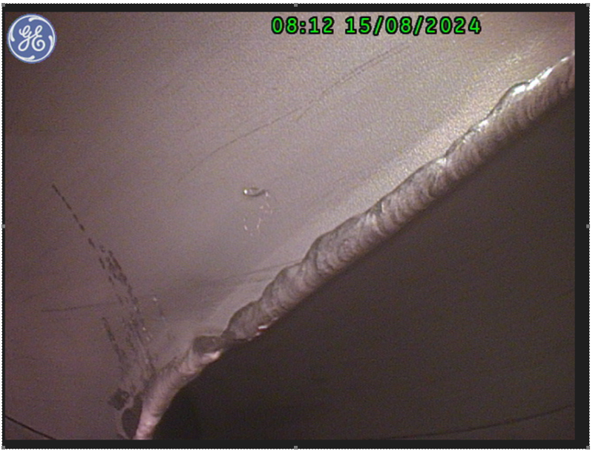
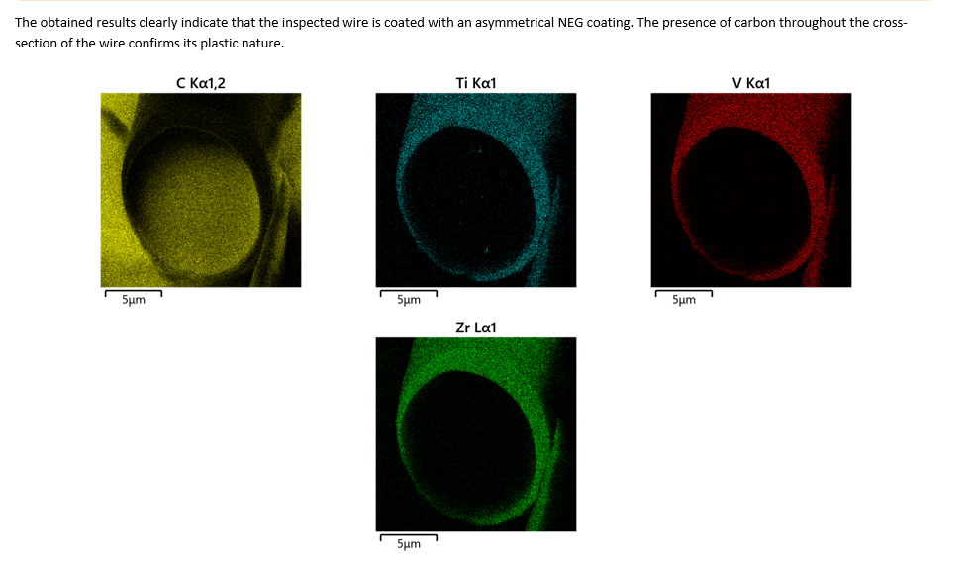
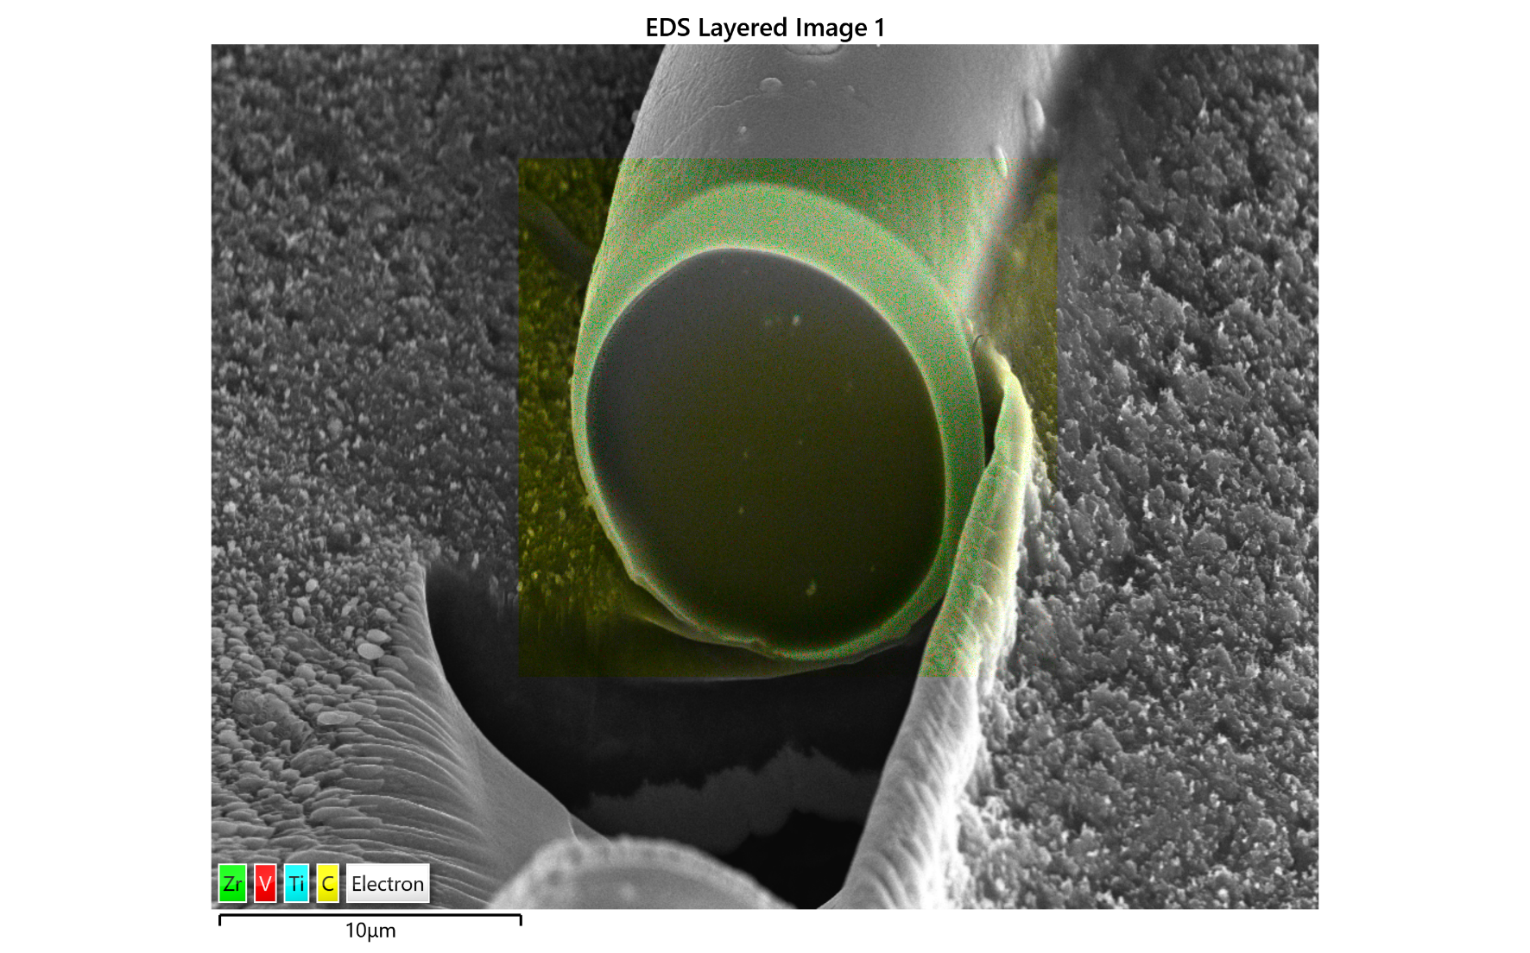
Status of the TAXN chamber
NEG NC
Many NEGGED fibers observed after the chamber was coated:
The SEM-EDS was used to analyze the surface (NEG composition) and the core (Carbon).
Jaime Perez Espinos, Marco Morrone | Status of TAXN and TAXS chambers

Slide 11
Status of the TAXN chamber
NEG NC
Action Plan to get rid of the fibers:
NEG stripping (DONE)
Vacuum firing @ 650 °C for 24 h to burn the fibers
Microscope analysis
Cleaning (with reinforced ultra-sound)
Microscope analysis
Re-NEG
HOLD POINT: continuation of action plan is linked to resolution of metrology NC and potential repair, under study by Main Workshop
Jaime Perez Espinos, Marco Morrone | Status of TAXN and TAXS chambers

Slide 12
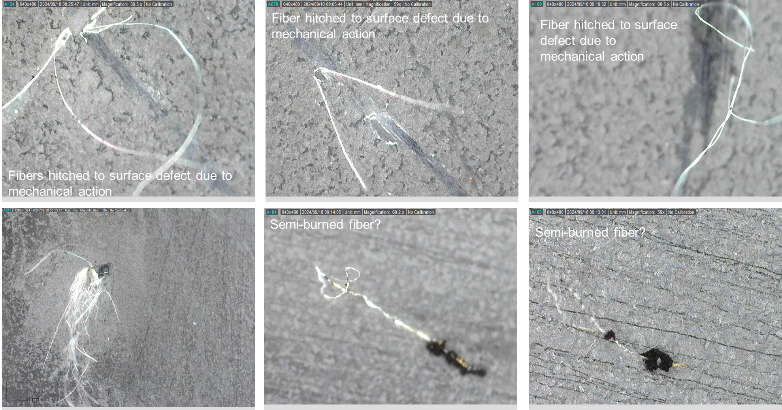
Status of the TAXN chamber
NEG NC
Inspection after stripping the NEG coating
Fiber hitched to surface defect due to mechanical action
Fibers hitched to surface defect due to mechanical action
Fibers hitched to surface defect due to mechanical action
Semi-burned fiber?

Slide 13
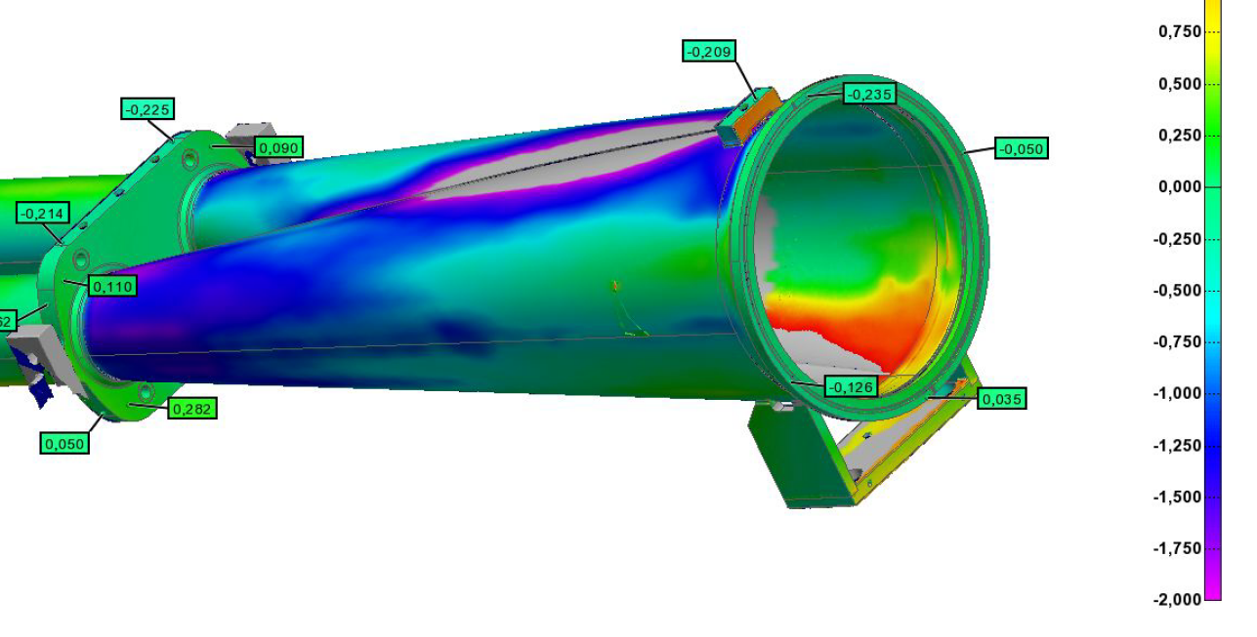
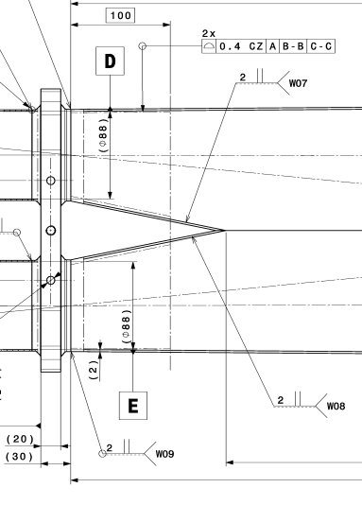
Status of the TAXN chamber
metrology NC
The metrology NC consists in a deviation (1.5-2 mm) of the recombination chamber tube diameters from a profile tolerance of 0.4 mm in the area.
Jaime Perez Espinos, Marco Morrone | Status of TAXN and TAXS chambers

Slide 14
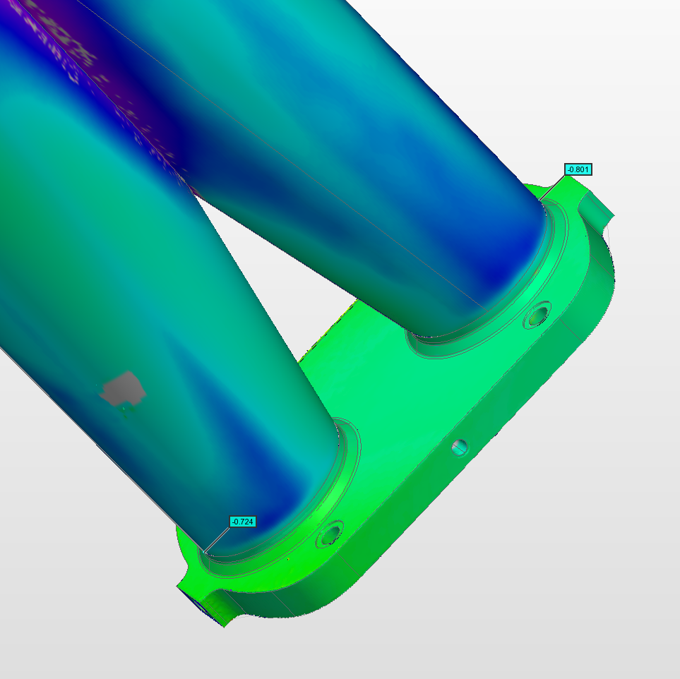
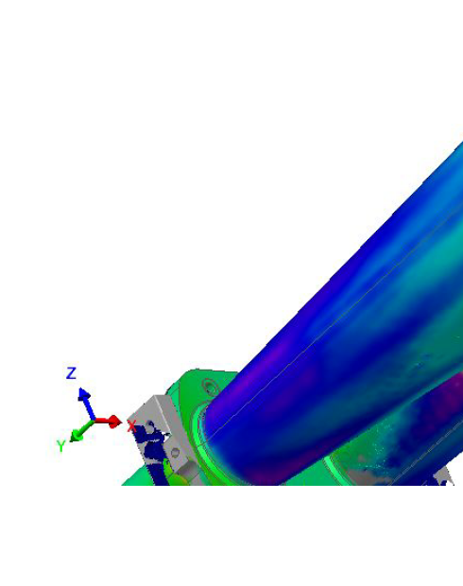
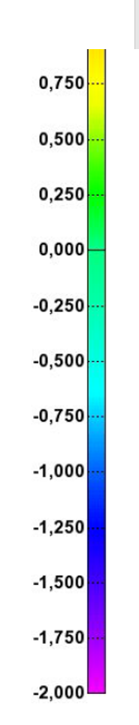
Status of the TAXN chamber
metrology NC
Further manual calliper measurements confirmed MetraScan data
Jaime Perez Espinos, Marco Morrone | Status of TAXN and TAXS chambers

Slide 15
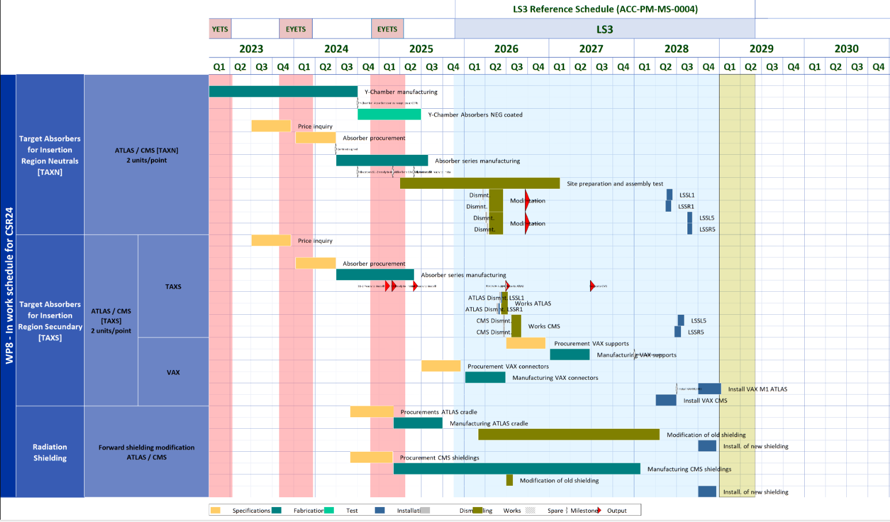
Planning for TAXN chambers
Chamber delivery by Main Workshop (after Metrology check #2)
Chamber delivery to WP8 (after NEG acceptance test)
In-machine installation periods for full TAXN
As per TE-VSC contr. to WP8 (EDMS #1820996)
Jaime Perez Espinos, Marco Morrone | Status of TAXN and TAXS chambers

Slide 16
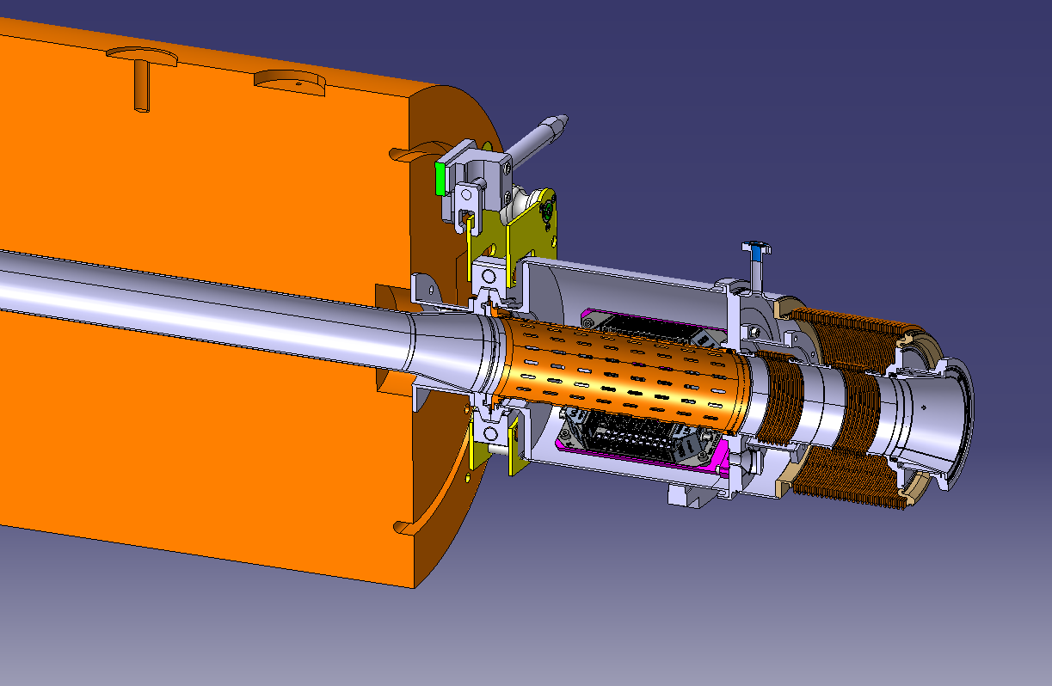
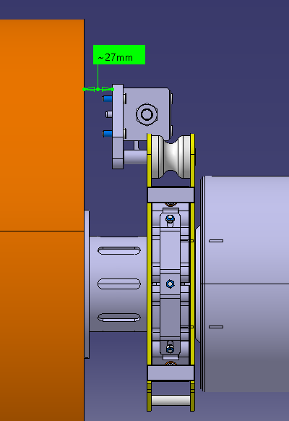
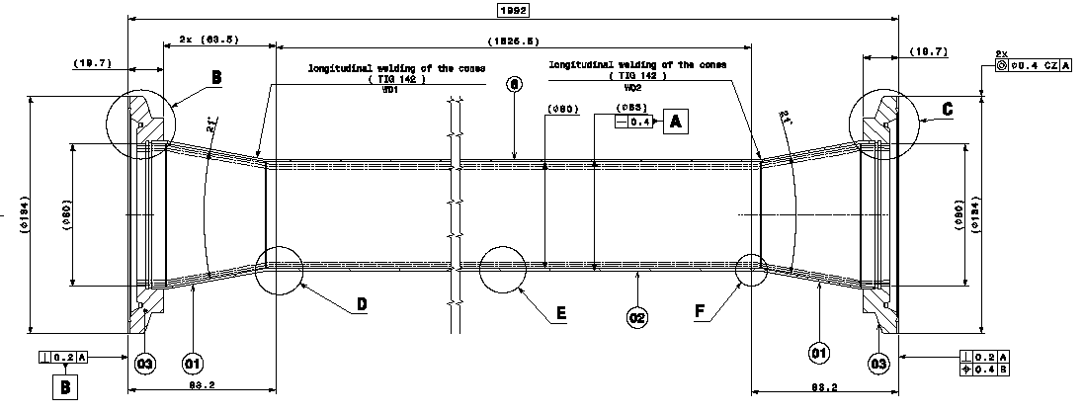
Status of the TAXS chambers
Design is finished
  Drawing references: LHCVC1SX0001 for ATLAS and LHCVC5SX0001 for CMS. To be submitted for approval once DMR and contribution document are approved;
  Chamber bolted to the non-IP face of the absorber and clamped between the two absorber halves;
  Made of a combination of stainless steels 316 LN and 316L,and coatings (aC + Cu-10 micron + Au-1 micron): non-bakeable.
JOB for production is created and agreed with Main Workshop (1 spare + 2 series chambers of each type ⇒ 6 chambers in total) ⇒ drawing approval is required
  Drawing approval is required;
  Material request is pending of signature until BC is allocated.
Integration of the TAXS chamber together with the Q1-TAXS module and the collar chain
ATLAS case: 1992 mm long
CMS case: 2071 mm long
Details in DMR (EDMS #3102021)
Jaime Perez Espinos, Marco Morrone | Status of TAXN and TAXS chambers

Slide 17
Planning for TAXS chambers
Chamber delivery by Main Workshop as per JOB agreement (TBC due to delay on signature for material request and drawing approval)
Chamber delivery to WP8 after surface treatment and vacuum acceptance test
In-machine installation periods for full TAXS
As per TE-VSC contr. to WP8 (EDMS #1820996)
Jaime Perez Espinos, Marco Morrone | Status of TAXN and TAXS chambers

Slide 18
Conclusions
1st TAX-N chamber (spare chamber) is manufactured but two NCs are reported: unwanted NEG fibers (minor) and metrology anomaly (major).
  Although the NEG was coated with good adhesion, some NEG fibers were found stuck to the internal surface of the chamber. These might detach during operation involving potential serious UFO-like problems. VSC is confident that this problem can be solved.
  A major metrology anomaly was identified at the level of the recombination part. The CERN main workshop is currently working on it with the aim to save the chamber.
TAX-S chamber design parameters have been collected.
  Design of copper coating tooling done internally.
  Technical drawings of the chambers finalised in cooperation with the main workshop.
  JOB for production is created and agreed with main workshop.
  Approval of DMR, TE-VSC contribution document to WP8 and manufacturing drawings are required before production is actually launched.
Marco Morrone | Status of TAXN and TAXS chambers

Slide 19
Thank you for your attention

Slide 20
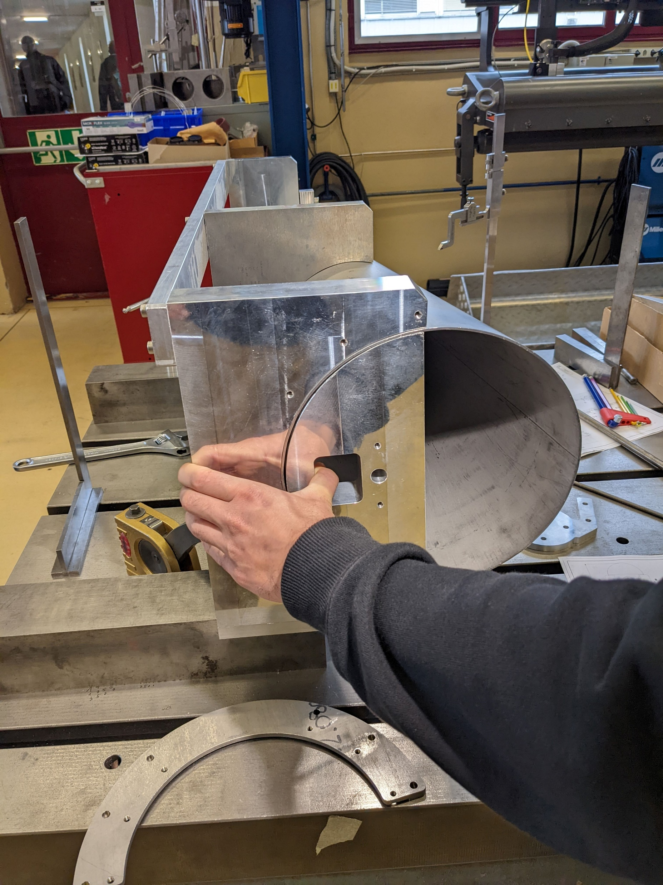
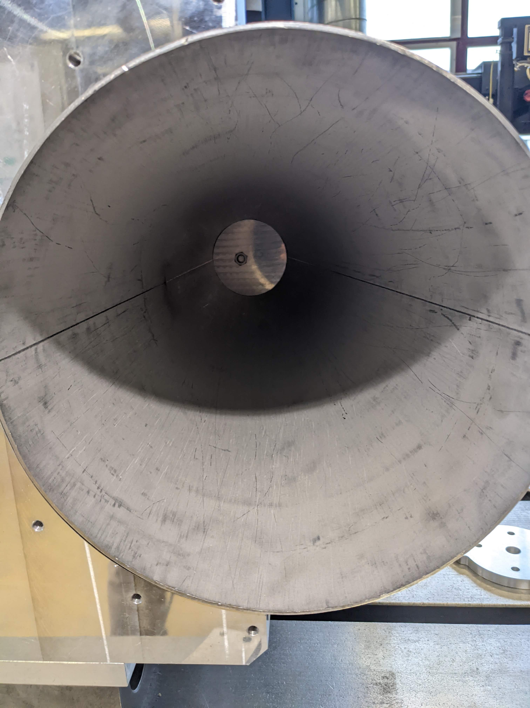
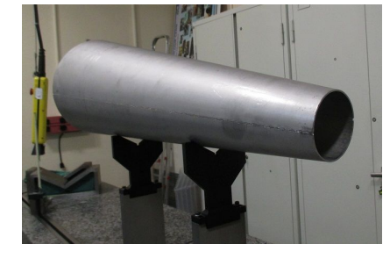
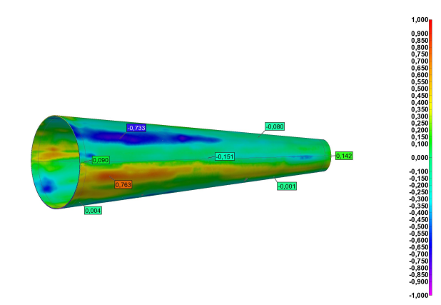
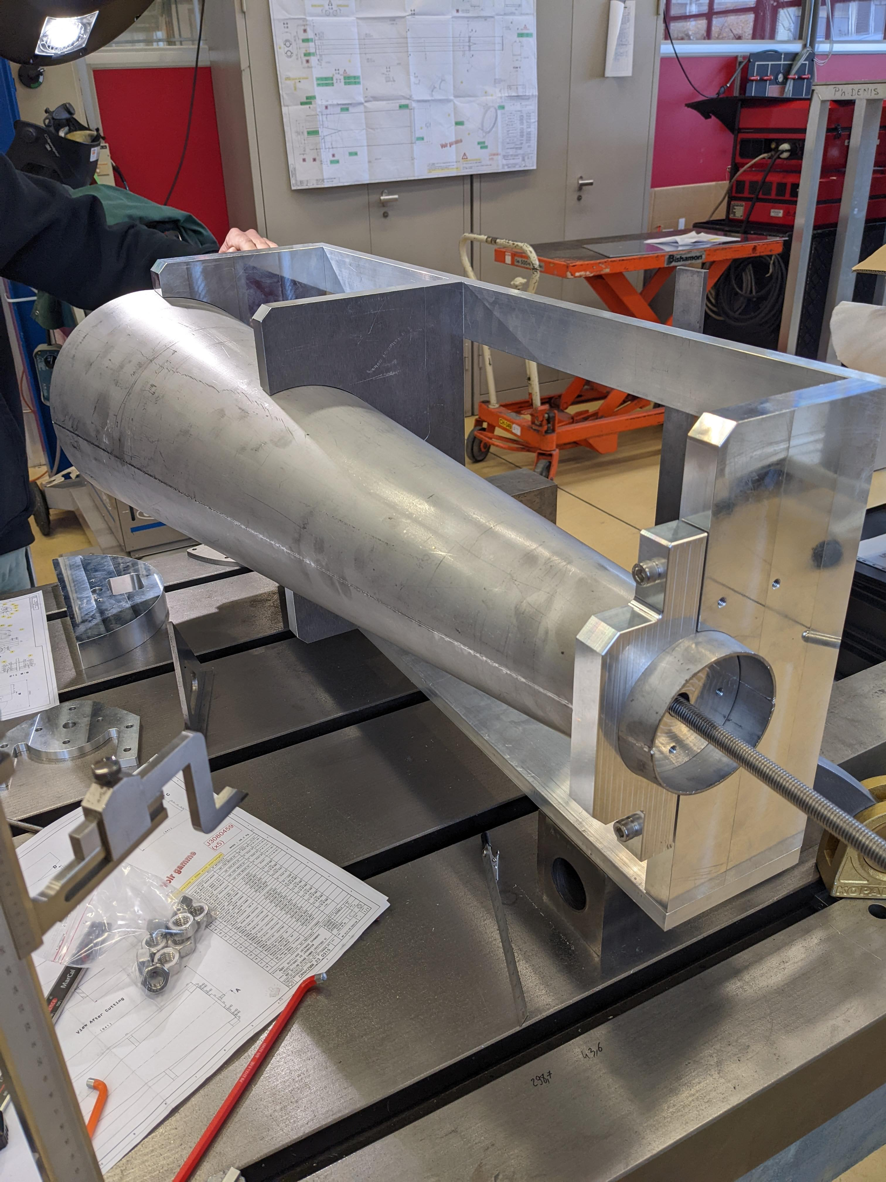
Status of the TAXN chamber
Status of the TAXN chamber
Status of the subcomponents
Half-cones (8x) formed and welded
  Shape calibrated, wire cut, and intermediate metrology checked
  Vacuum acceptance test for conical part of the first chamber ok!
Jaime Perez Espinos, Marco Morrone | Status of TAXN and TAXS chambers

Slide 21
Status of the TAXN chamber
Status of the subcomponents
Half tubes (20x) formed and welded (linear weld)
  Shape calibrated, wire cut for prototype chamber.
Jaime Perez Espinos, Marco Morrone | Status of TAXN and TAXS chambers

Slide 22
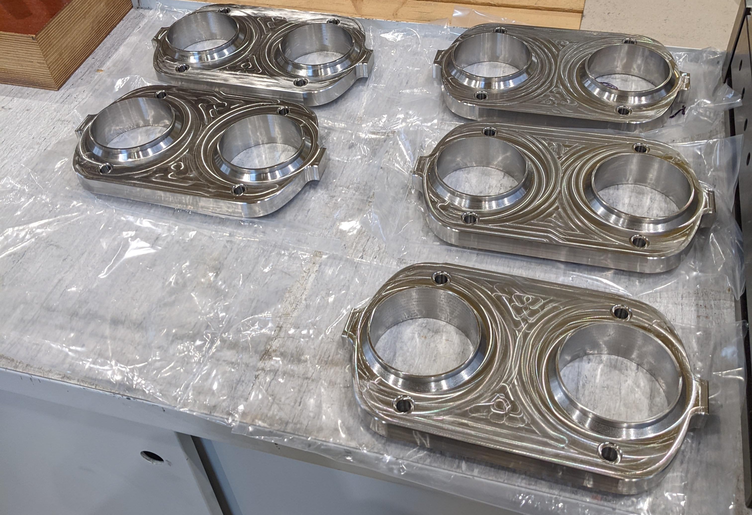
Status of the TAXN chamber
Status of the subcomponents
Other components
  Flanges & recombination reference plate machined.
  Transporting/storage beam + special beam for NEG coating ready.
All the subcomponents for the 5 chambers have been manufactured
Jaime Perez Espinos, Marco Morrone | Status of TAXN and TAXS chambers

Slide 23
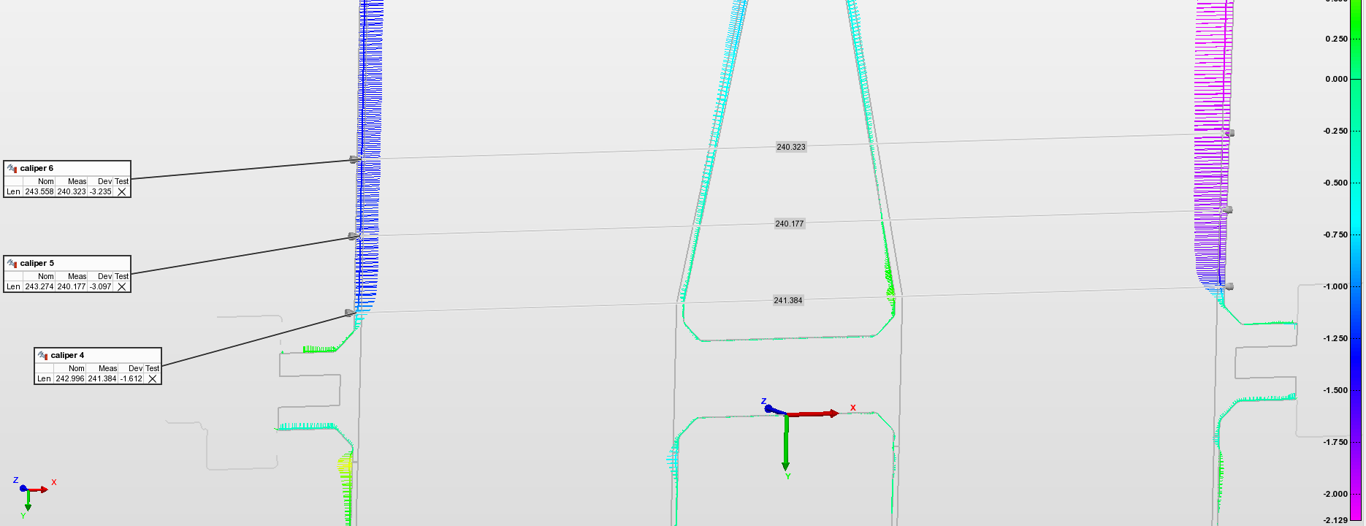
Status of the TAXN chamber
metrology NC
Courtesy of Giacomo Calchi
Manual calliper measurements at 10 mm, 30 mm, 50 mm from the flange were taken with Mike Dequidt confirming the MetraScan data.
Jaime Perez Espinos, Marco Morrone | Status of TAXN and TAXS chambers

Slide 24
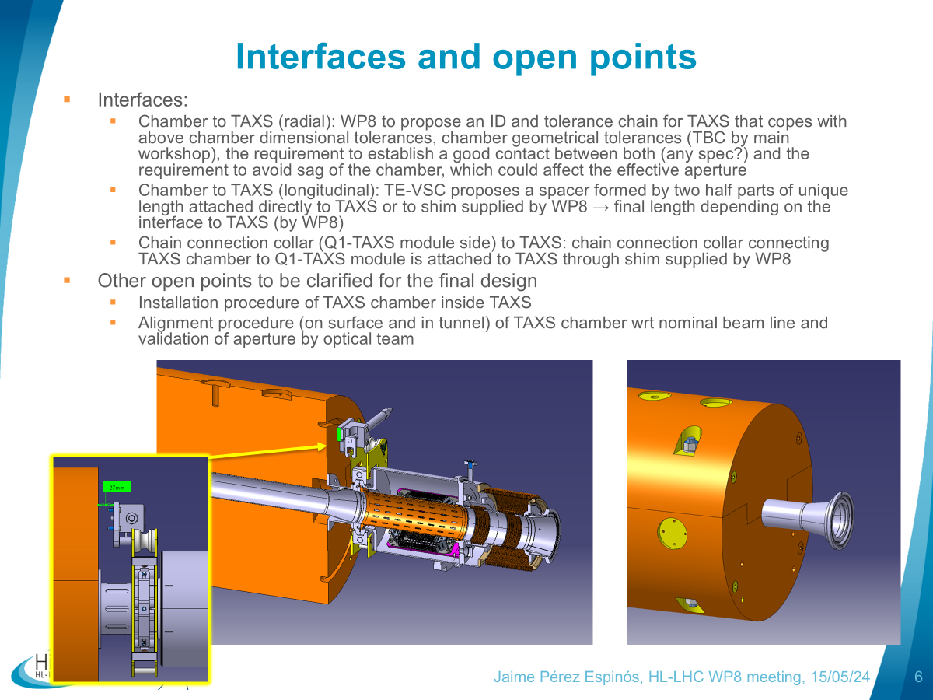
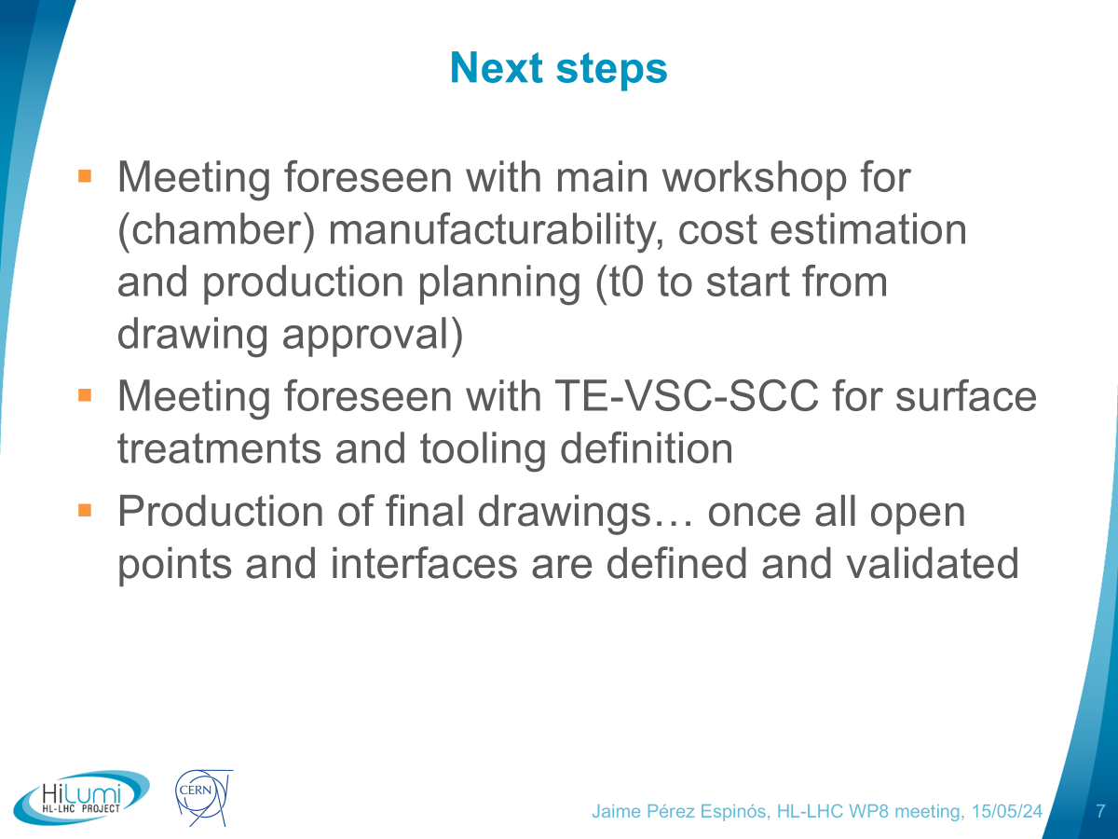
Slides from TAXS chamber contribution on 15/05/24
INDICO #1410699
Jaime Perez Espinos, Marco Morrone | Status of TAXN and TAXS chambers

